Slide 1

Impedance simulations of the HL-LHC Beam Gas Vertex beam profile monitor
Hélène Guérin, on behalf of the BGV team (B. Kolbinger, J. Storey)
Acknowledgments: C. Antuono, P. Krkotik, B. Salvant, L. Sito
62nd IWG meeting, 23/08/22

Slide 2
Outline
Introduction
  BGV principle and context
  Demonstrator instrument
Demonstrator impedance
Future instrument
  Parametric impedance study
  Future design layout
Impedance simulations
  Longitudinal impedance
  Expected power loss
  Transverse impedance
Conclusion

Slide 3
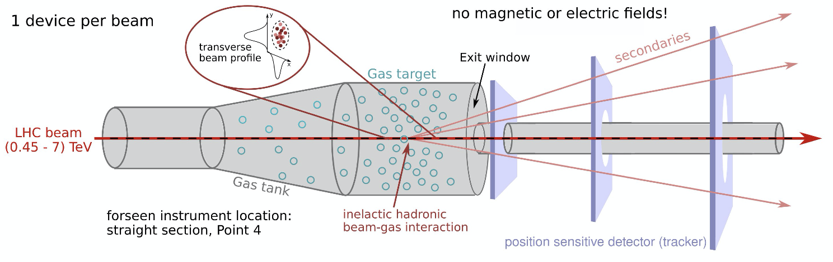
Introduction
Non-invasive transverse beam profile monitor based on the reconstruction of vertices of beam-gas inelastic hadronic interactions.
Provide continuous emittance and beam profile measurement throughout the LHC accelerator cycle (450 GeV to 7 TeV).
Consists of: a gas target, a forward tracking detector and computing resources dedicated to event reconstruction.
Transverse beam profiles inferred from density of reconstructed primary vertices of beam-gas interaction.
One instrument per beam, measuring x and y planes.

Slide 4
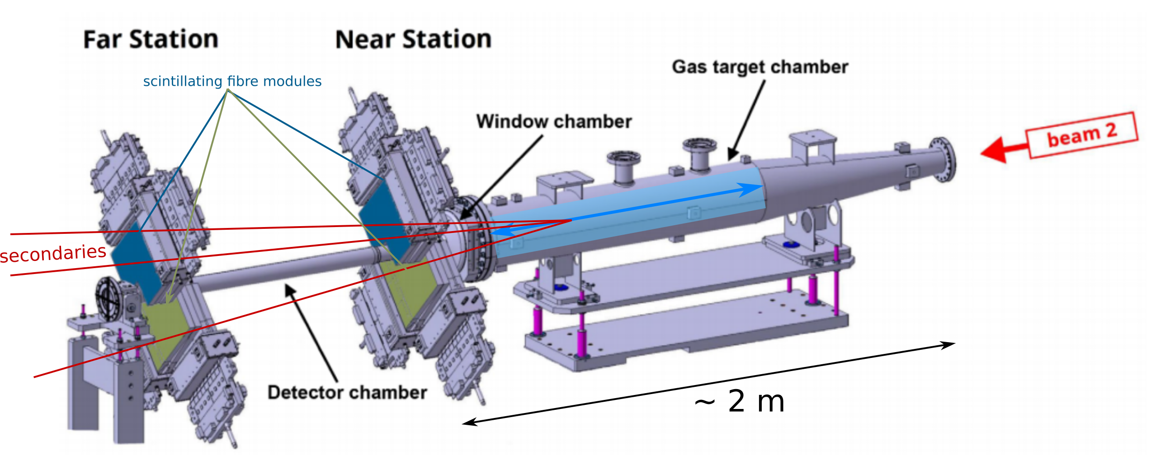
History – Demonstrator BGV
Installed, commissioned and operated in LHC Run 2 (LHC-BGV-EC-0002, PhysRevAB)
Tracking detector based on scintillating fibre stations (LHCb SciFi tracker).
Neon gas target of ~ 1.8 m length and 1.4*10⁻⁷ mbar
Proved that the method can be used for beam size measurement throughout the full LHC energy cycle.
Reconstruction of beam-gas interaction vertices not possible -> no beam profile measurement.
Future instrument in design phase for beam size and profile measurement.
-> Design report for a review in October 2022.

Slide 5
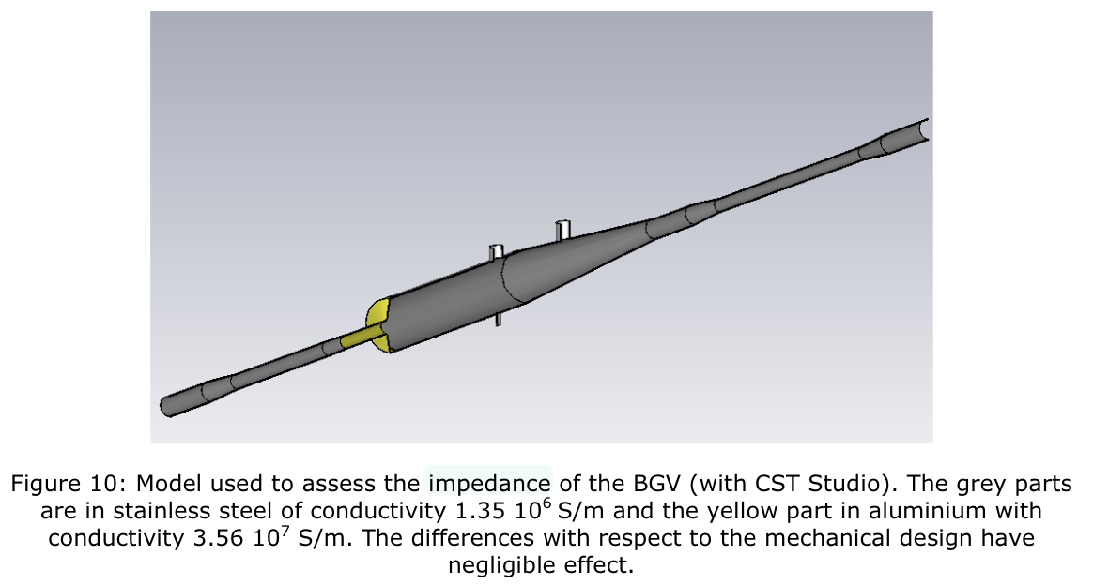
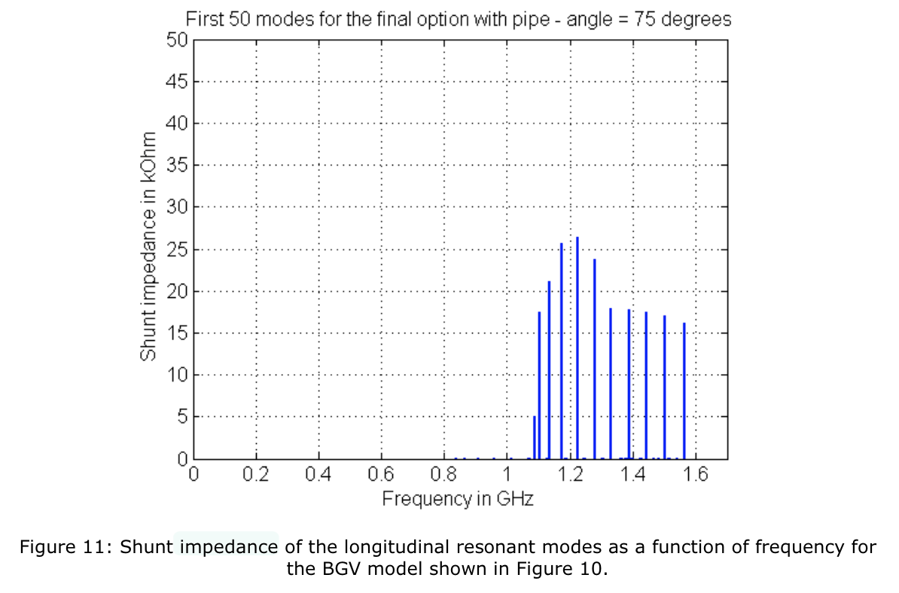
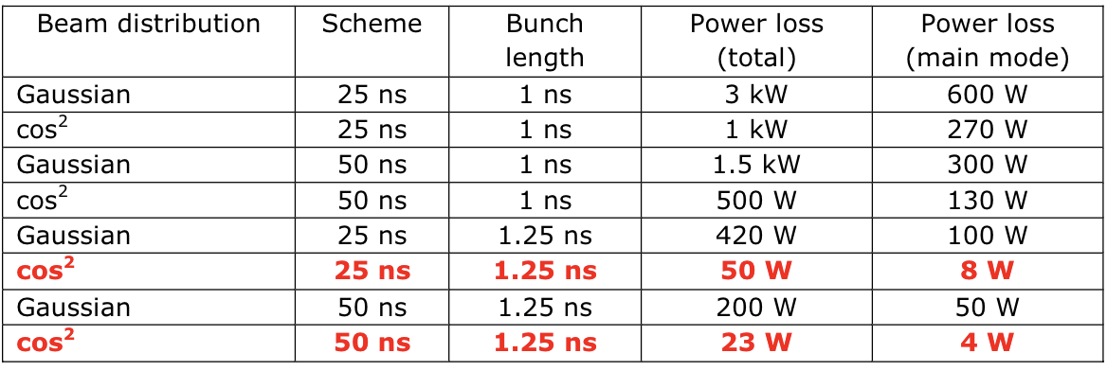
Demonstrator - Longitudinal impedance simulations
From LHC-BGV-EC-0002, simulations by Benoit Salvant
Resonant modes from ~1.1GHz, with shunt impedance up to 26kOhm
Longitudinal effective impedance: Im(Z/n) = 0.74mOhm

Slide 6
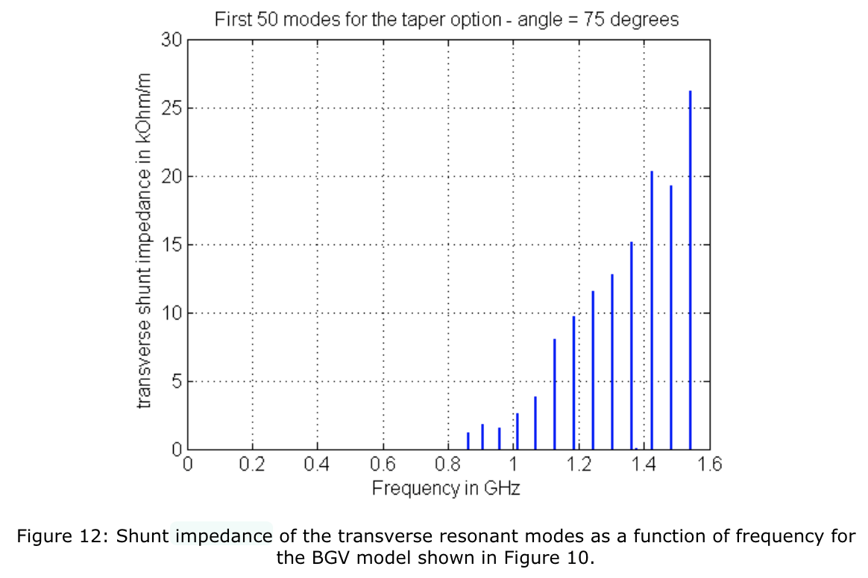
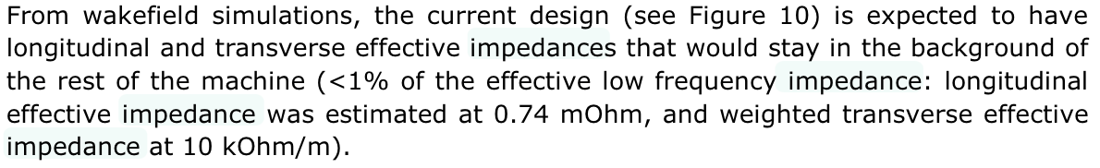
Demonstrator – Transverse impedance simulations
From LHC-BGV-EC-0002, simulations by Benoit Salvant

Slide 7
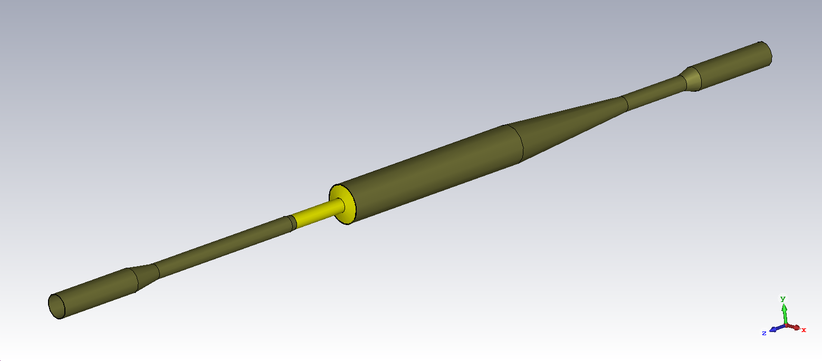
Parametric study
Main conclusions:
D is the main impact parameter: drives the R_{s} and fq of resonant modes;
Increasing L increases the number of modes but reduces their R_{s} (detunes the cavity);
Tapers can help mitigating the impact of modes to a certain extend.
L_{in}
L
L_{out}
D
Beam direction
Other constraints for the gas tank design:
Need for a thin exit window ~85deg for instrument performance;
Small aperture sections for tracker acceptance optimisation (high momentum tracks have small angle trajectories), and for pumps conductance;
Longitudinal gas pressure profile (similar parametric study): adjusted taper, tank and beam pipe lengths for a 1m long plateau and small tails (limit radiation background);
Practical considerations: minimum tank length required to place alignment modules and gas injection capillary.

Slide 8
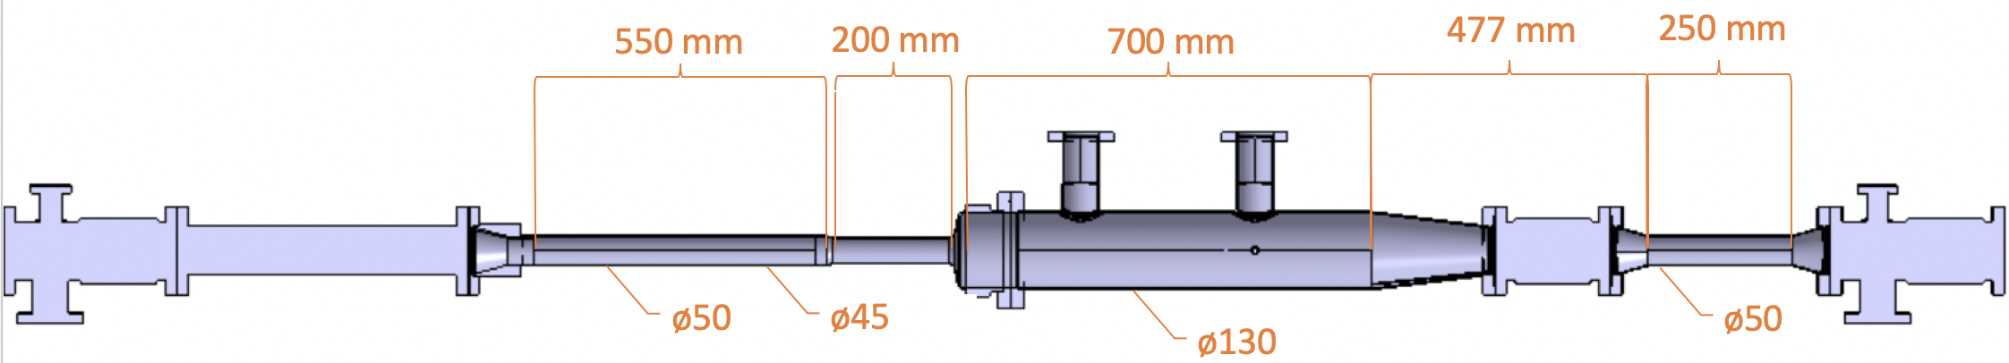
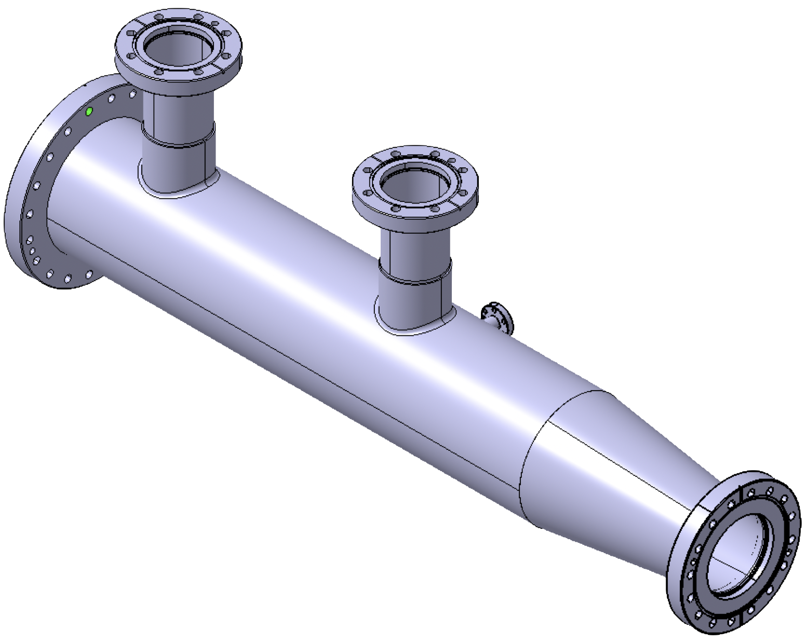
Future instrument design (Catia)
(design report October 2022)
Beam direction
Work from T. Ramos Garcia,
BI-ML

Slide 9
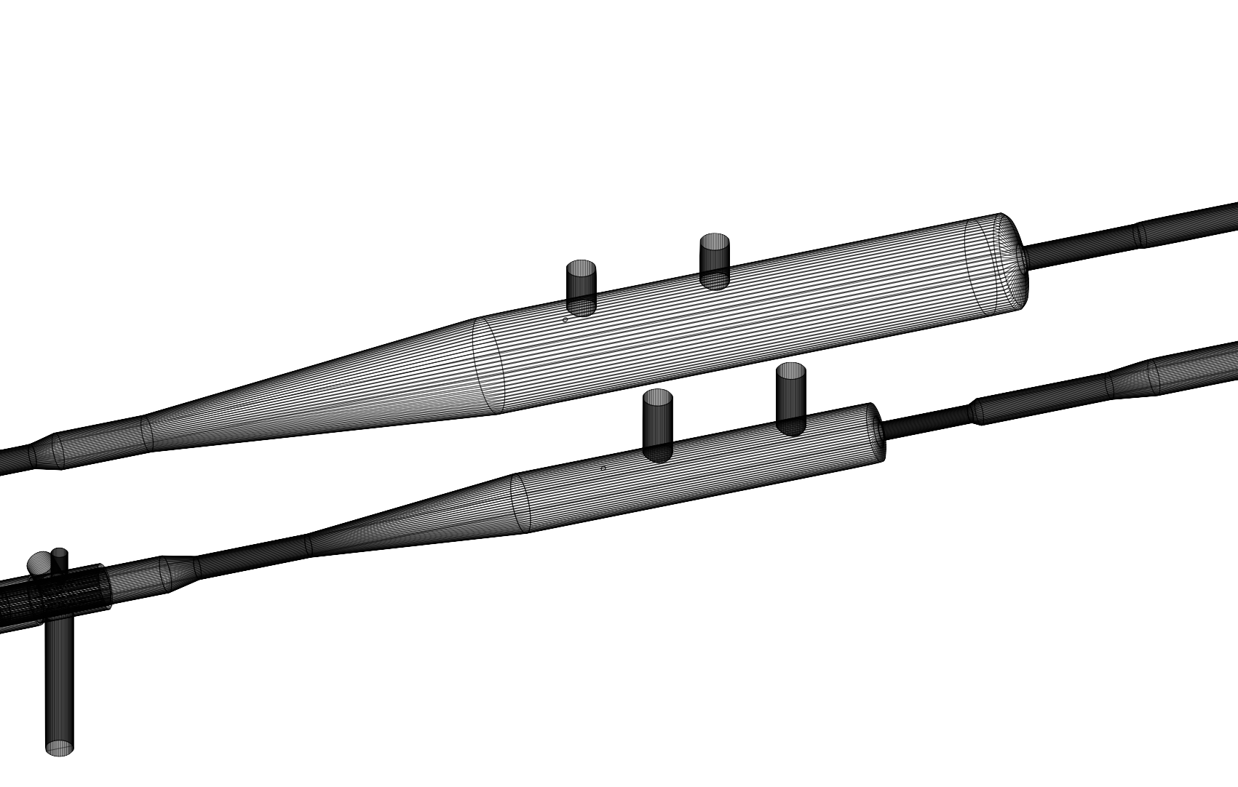
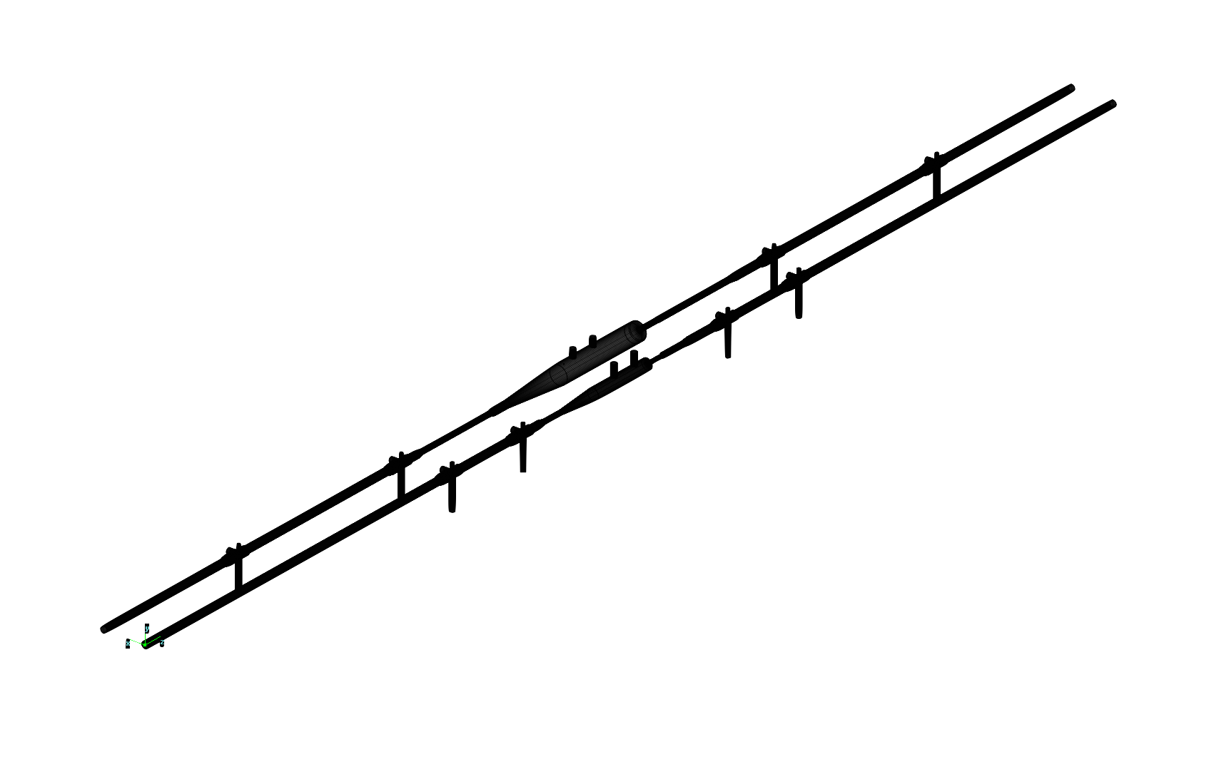
Comparison with the demonstrator tank
Much more compact instrument:
(geometry from Molflow+ simulation tool)
Demonstator
Demonstator
Future BGV
Future BGV
Main changes:
Tank diameter reduced from 212mm to 130mm inner diameter;
All chamber parts shorter (compact hybrid pixel detector tracker);
Ion pumps closer to the gas target.

Slide 10
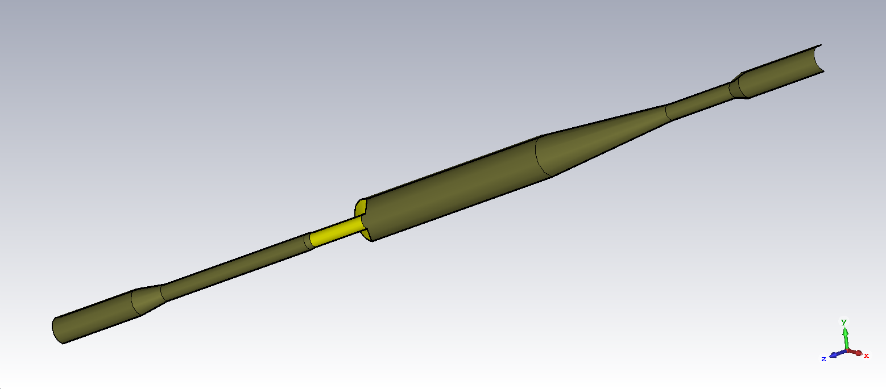
Final design simulated in CST
All parts of the structure are in stainless steel, except the exit window and beam pipe holding the detectors shown in yellow, which are in Al alloy. The entire structure will be NEG-coated.
Main simplifications compared to Catia model :
Shielded bellow on upstream taper not included (smooth taper instead)
Ports along the tank: expected to be shielded, except maybe the one of the gas injection capillary (1cm diameter)
NEG coating not considered.
Impedance of the 4 connections to ion pumps to be added.

Slide 11
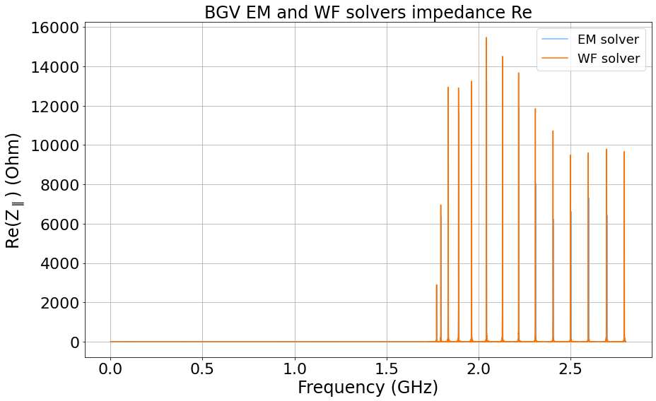
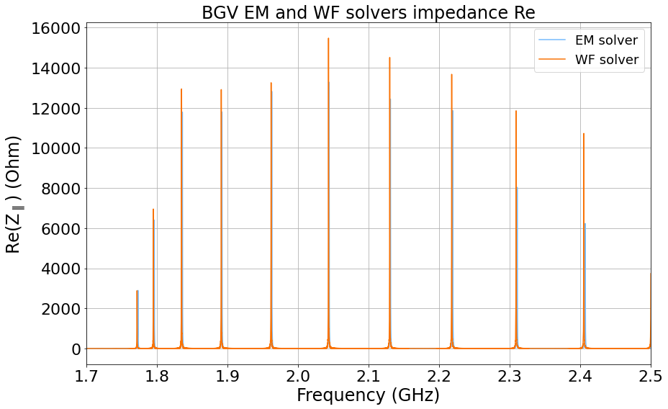
Longitudinal Impedance - Re
Good agreement between EM (resonator model) and WF solvers, just peak height discrepancy with higher values for WF solver (plots with 10e6 points)

Slide 12
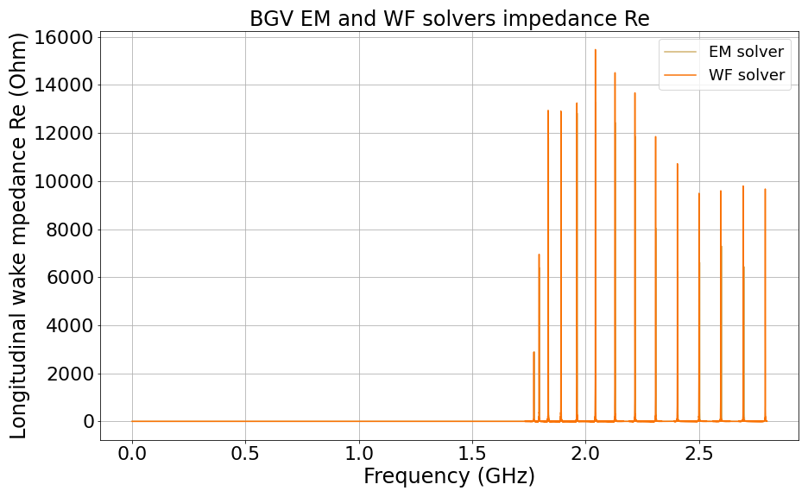
Longitudinal Impedance - Re
Demonstrator :
Similar spectrum pattern compared with the demonstrator, but shifted to higher frequencies (> 1.7 GHz) and shunt impedance values almost twice smaller (< 16 kOhm).

Slide 13
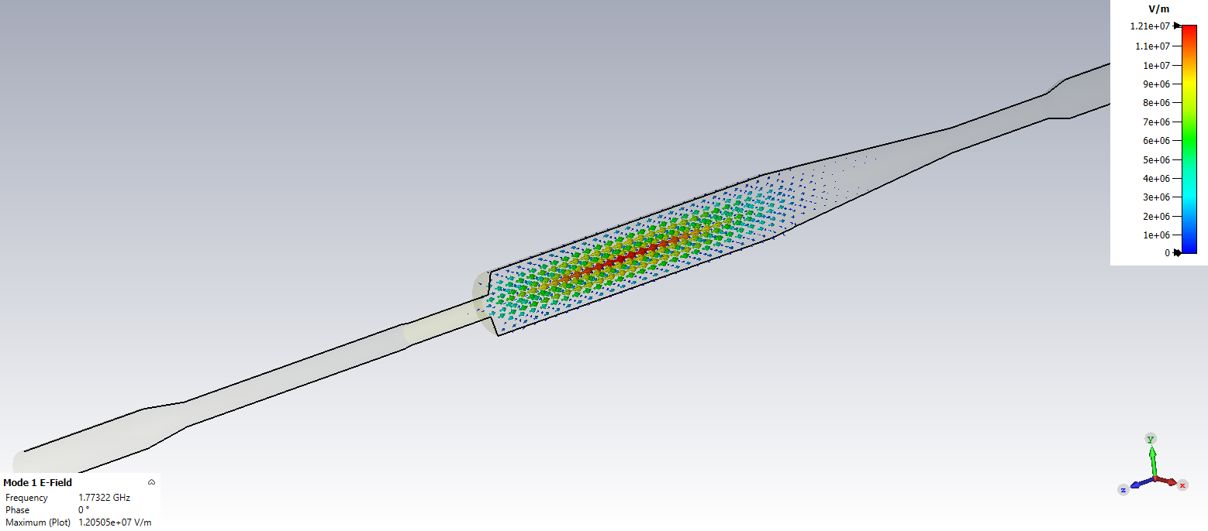
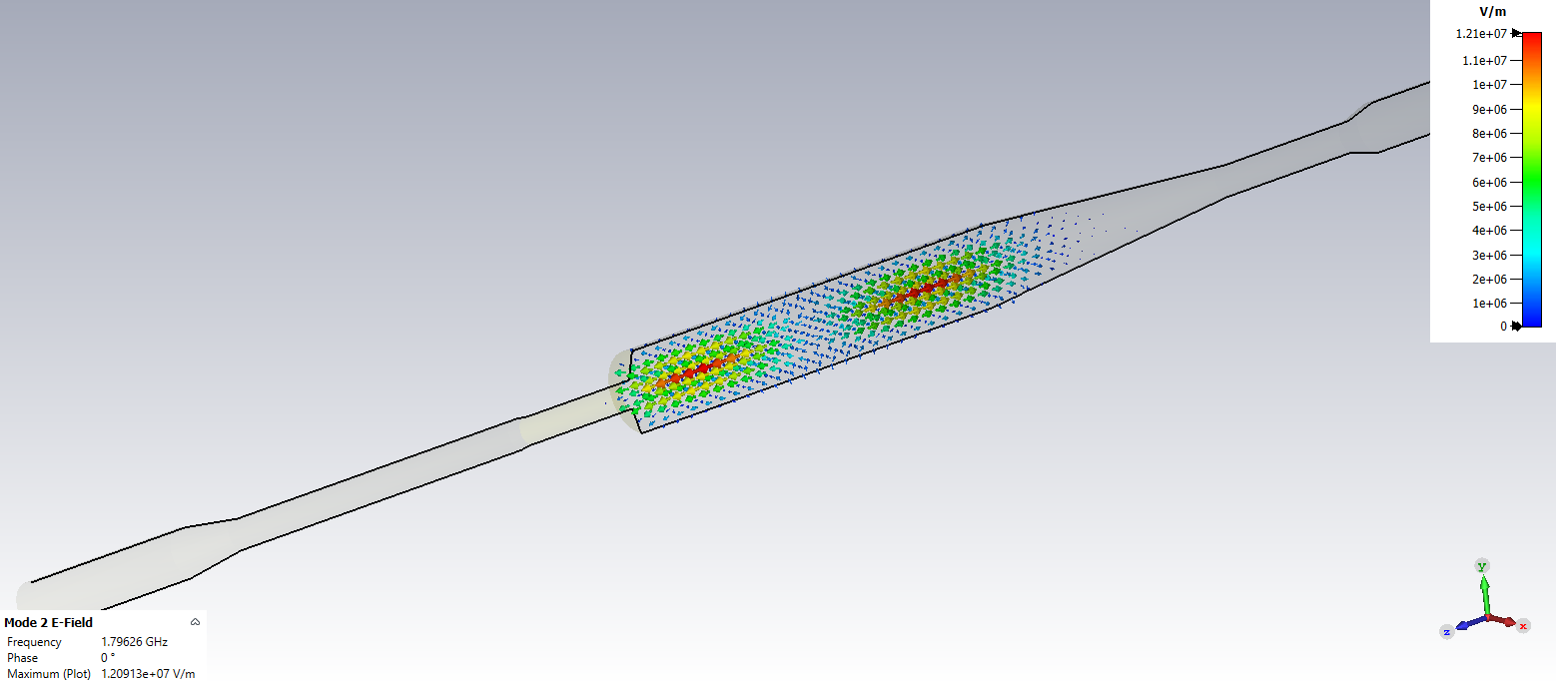
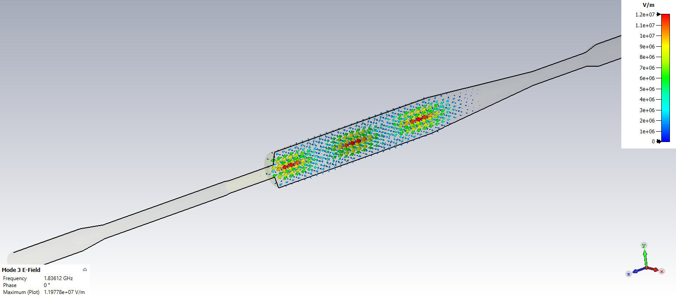
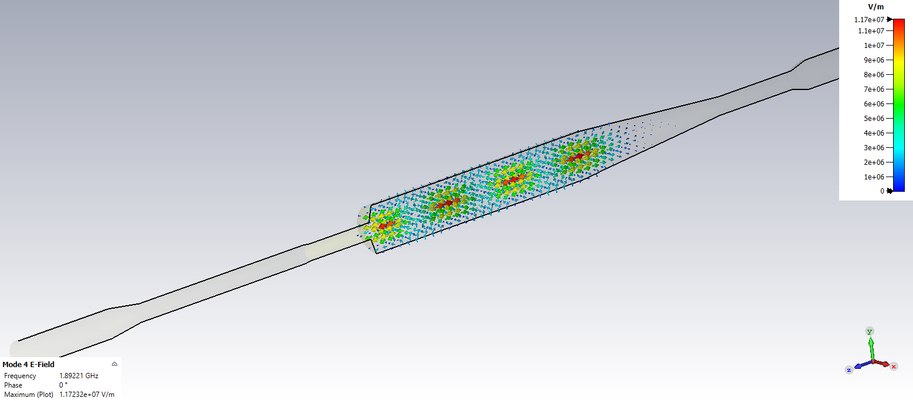
E field pattern - first resonant modes
1st mode, f = 1.77 GHz
2nd mode, f = 1.80 GHz
3rd mode, f = 1.84 GHz
4th mode, f = 1.89 GHz

Slide 14
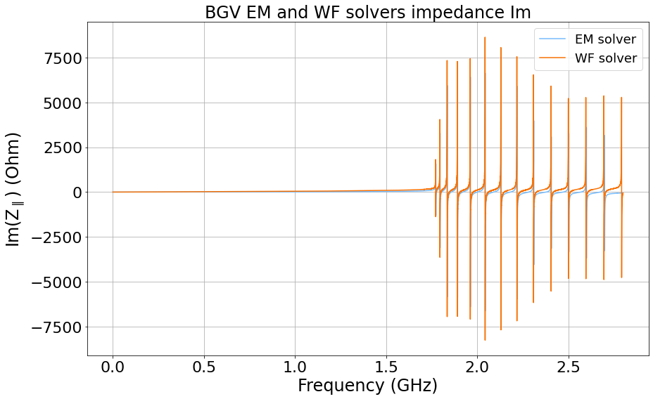
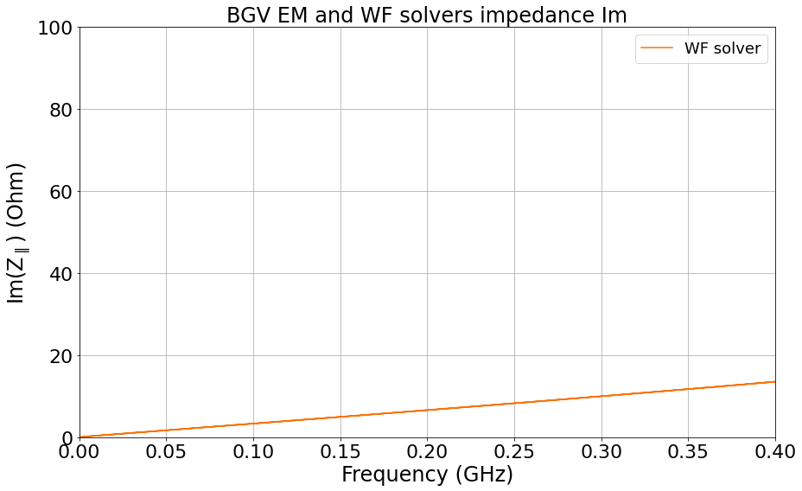
Longitudinal Impedance - Im
Im(Z/n) at low frequency, far from 1st resonance (n=f/f_{rev}= f / 11245 Hz):
Im(Z/n)=0.382 mOhm
(Demonstrator : 0.74 mOhm : almost reduced by a factor two)

Slide 15

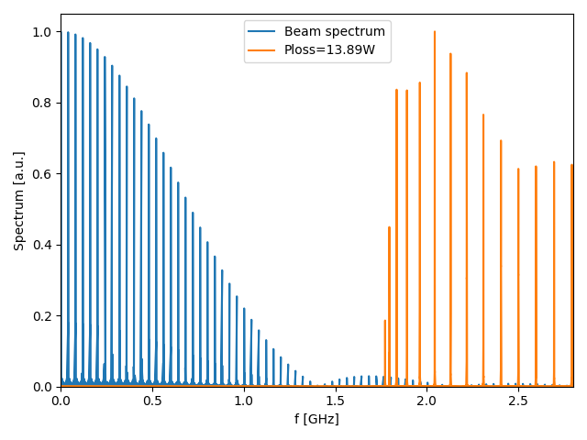
Power loss calculation
From Ohm’s law: P_{loss}=(I_{bunch}N_{bunch})²Z_{loss}, with :
  I_{bunch}=nef₀
    $$n$$: number of charges per bunch = 2.3e11 p/bunch
    $$e$$: elementary charge
    $$f_{0}=2π/ω_{0}$$: revolution frequency = 11245 Hz (HL-LHC)
    $$N_{bunch}$$: number of bunches = 2808
    Assuming equidistant spaced bunches $$Δt_{bunch}=25ns$$ of same intensity
Considering frequency range > 0 and
for $$n$$ isolated resonances
distributed at$$ω=ω_{i}$$:
Shifting the impedance spectrum
by frequencies between [-20;20] MHz,
in order to consider all possible cases of
overlap between the two spectra;
Consider P_{loss,av} and P_{loss,max}.
Beam parameters from CERN-ACC-NOTE-2022-0001
normalised beam spectrum
= f(modeled bunch shape)
Notes:
I_bunch = DC beam current
P_{\textnormal{loss}}=2I_{\textnormal{beam}}^2\sum_{i=0}^n|\Lambda(\omega_i)|^2\Re[Z_{\parallel}(\omega_i)]

Slide 16
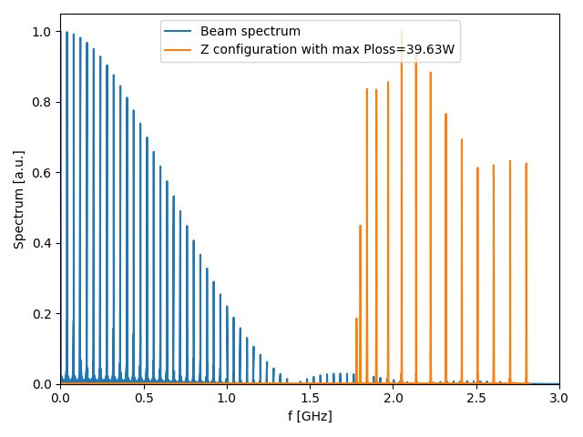
Power loss - Results overview
q-Gaussian bunch shape, P_{loss, max} = 39.63W
with Z fq shifted by 8.5MHz:
q-Gaussian bunch shape:
Raw spectrums, P_{loss} = 13.9 W
Average fq shift, P_{loss,av}= 13.9 W
Max P_{loss} configuration, P_{loss,max} = 39.6 W
Gaussian bunch shape:
Raw spectrums, P_{loss} = 11.0 W
Average fq shift, P_{loss,av} = 10.9 W
Max P_{loss} configuration, P_{loss,max} = 11.5 W
Binomial bunch shape:
Raw spectrums, P_{loss} = 7.8 W
Average fq shift, P_{loss,av} = 7.8 W
Max P_{loss} configuration, P_{loss,max} = 8.8 W
Cos² bunch shape:
Raw spectrums, P_{loss} = 10.6 W
Average fq shift, P_{loss,av} = 10.4 W
Max P_{loss} configuration, P_{loss,max} = 12.4 W
Notes:
Parabolic bunch shape:
Raw spectrums, P_{loss} = 101.8 W
Average fq shift, P_{loss,av} = 182.1 W
Max P_{loss} configuration, P_{loss,max} = 3234.3 W

Slide 17
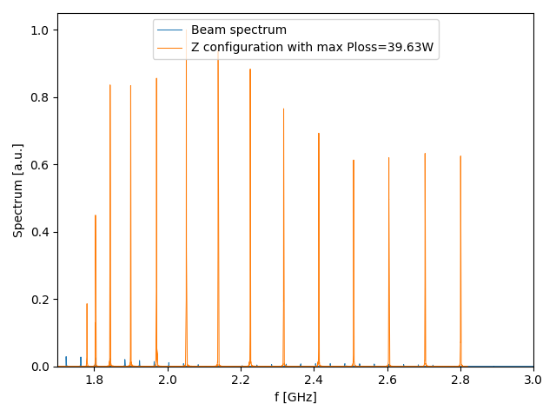
Power loss - Results overview
q-Gaussian bunch shape, P_{loss, max} = 39.6W
with Z fq shifted by 8.5MHz: 2nd, 3rd and 6th modes falling on beam harmonics
q-Gaussian bunch shape:
Raw spectrums, P_{loss} = 13.9 W
Average fq shift, P_{loss,av}= 13.9 W
Max P_{loss} configuration, P_{loss,max} = 39.6 W
Gaussian bunch shape:
Raw spectrums, P_{loss} = 11.0 W
Average fq shift, P_{loss,av} = 10.9 W
Max P_{loss} configuration, P_{loss,max} = 11.5 W
Binomial bunch shape:
Raw spectrums, P_{loss} = 7.8 W
Average fq shift, P_{loss,av} = 7.8 W
Max P_{loss} configuration, P_{loss,max} = 8.8 W
Cos² bunch shape:
Raw spectrums, P_{loss} = 10.6 W
Average fq shift, P_{loss,av} = 10.4 W
Max P_{loss} configuration, P_{loss,max} = 12.4 W
Notes:
Parabolic bunch shape:
Raw spectrums, P_{loss} = 101.8 W
Average fq shift, P_{loss,av} = 182.1 W
Max P_{loss} configuration, P_{loss,max} = 3234.3 W

Slide 18
Power loss - Comparison with demonstrator
Beam parameters demonstrator simulations (Benoit, BGV ECR):
« Power loss estimated for the BGV with foreseen post-LS1 parameters
25 ns : 2748 bunches with 1.15 1011 p/b ;
50 ns : 1374 bunches with 1.6 1011 p/b »
Red : « most likely » cos2 situation with 1.25 bunch length

Slide 19
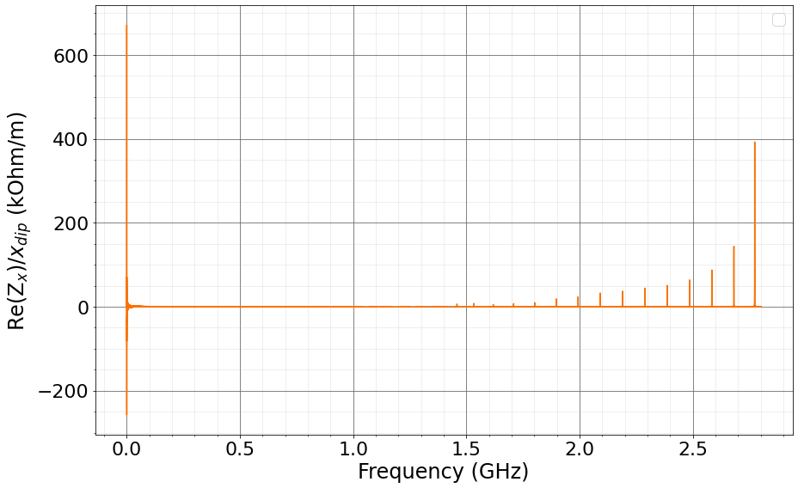
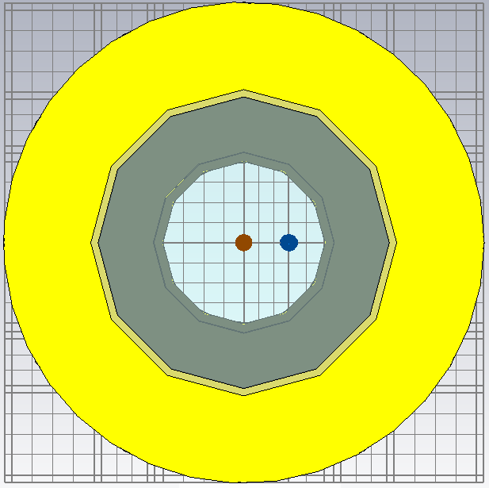
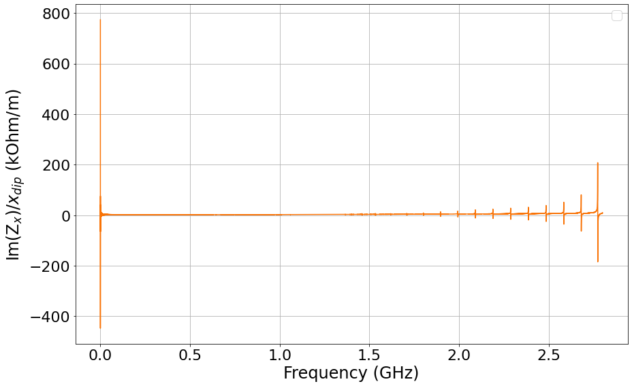
Transverse horizontal impedance – Dipolar
Beam and integration path offsets x_{dip}=x_{quad}=12.5mm (~19% tank radius, 3 mesh cells between beam and integration path)
Z_{x}(𝛚) = Z_{x}⁰(𝛚) + Z_{x}^{dip}(𝛚)x_{dip} + Z_{x}^{quad}(𝛚)x_{quad},
Beta functions at the foreseen instrument locations:
β_{x, B1-BGV}~320m
β_{x, B2-BGV}~160m
Integration
path
Beam
Notes:
Z_{x}(f)=a_{x}(f)+Z_{x}^{dip}(f)x_{dip}+Z_{x}^{quad}(f)x_{quad}
The BGV being symmetrical w.r.t to the z axis, which corresponds to the nominal beam axis, a_{x}(f)=0, and the impedance in y is expected to be identical to Z_{x}.

Slide 20
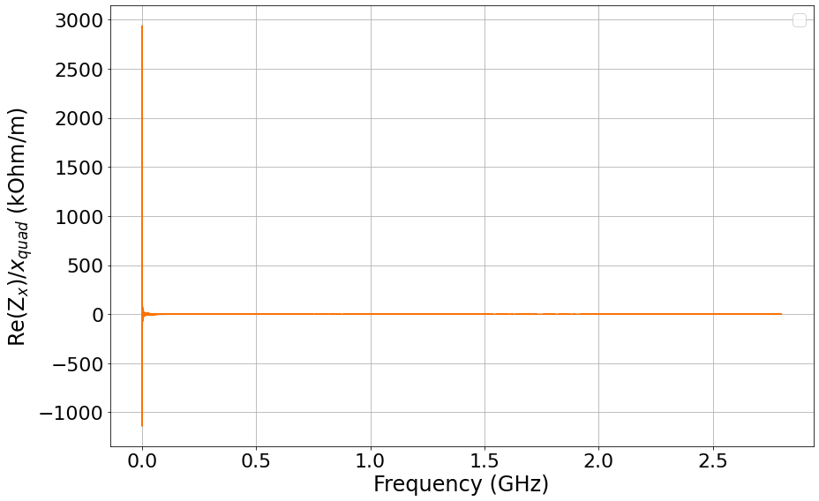
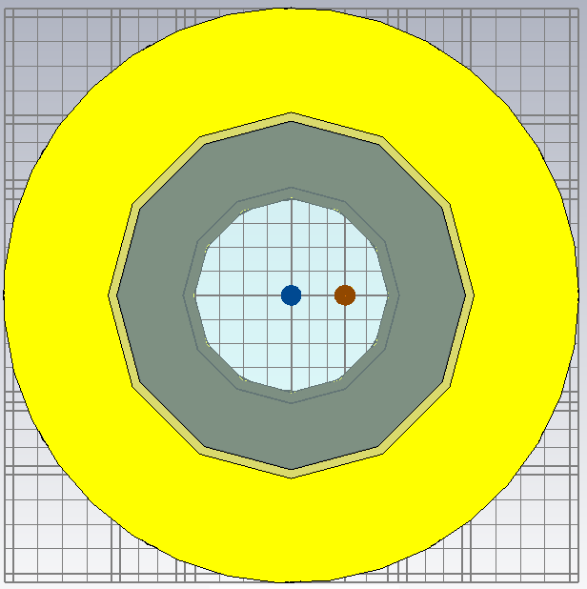
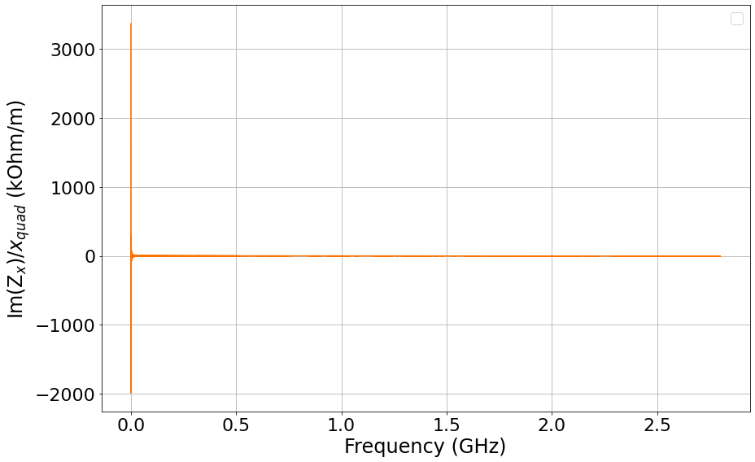
Transverse horizontal impedance – Quadrupolar
Beam and integration path offsets x_{dip}=x_{quad}=12.5mm (~19% tank radius, 3 mesh cells between beam and integration path)
Z_{x}(𝛚) = Z_{x}⁰(𝛚) + Z_{x}^{dip}(𝛚)x_{dip} + Z_{x}^{quad}(𝛚)x_{quad},
Beta functions at the foreseen instrument locations:
β_{x, B1-BGV}~320m
β_{x, B2-BGV}~160m
Integration
path
Beam
Notes:
Z_{x}(f)=a_{x}(f)+Z_{x}^{dip}(f)x_{dip}+Z_{x}^{quad}(f)x_{quad}
The BGV being symmetrical w.r.t to the z axis, which corresponds to the nominal beam axis, a_{x}(f)=0, and the impedance in y is expected to be identical to Z_{x}.

Slide 21
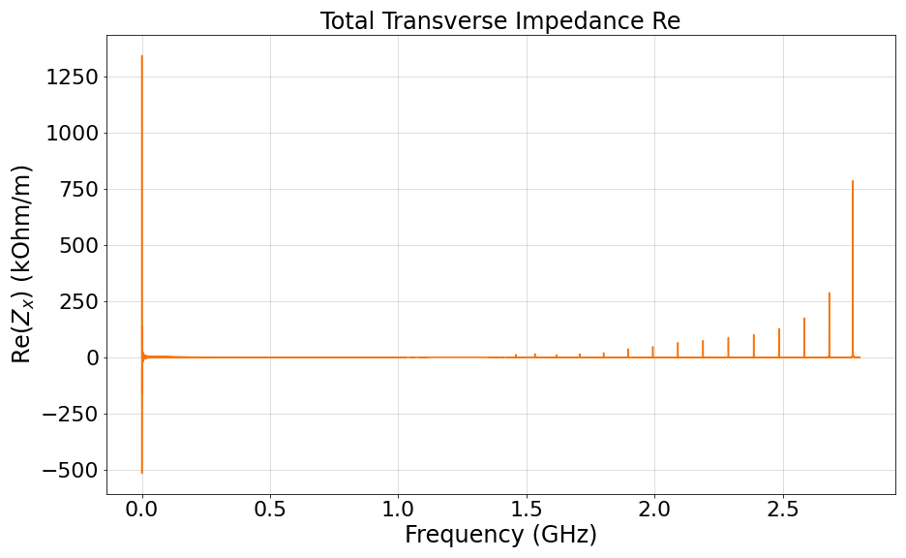
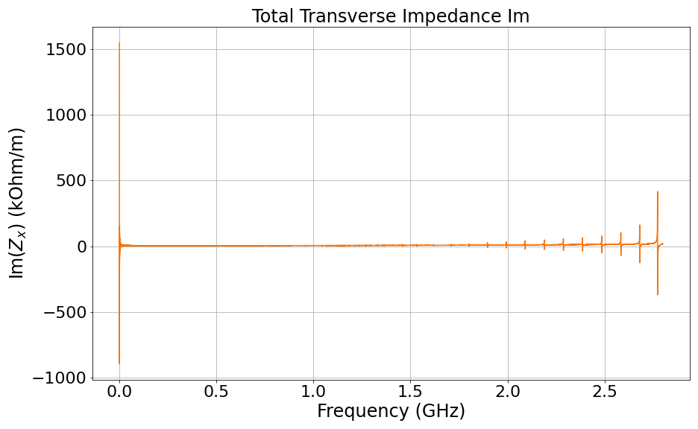
Total transverse horizontal impedance
Z_{x}(𝛚) = Z_{x}⁰(𝛚) + Z_{x}^{dip}(𝛚)x_{dip} + Z_{x}^{quad}(𝛚)x_{quad},

Slide 22
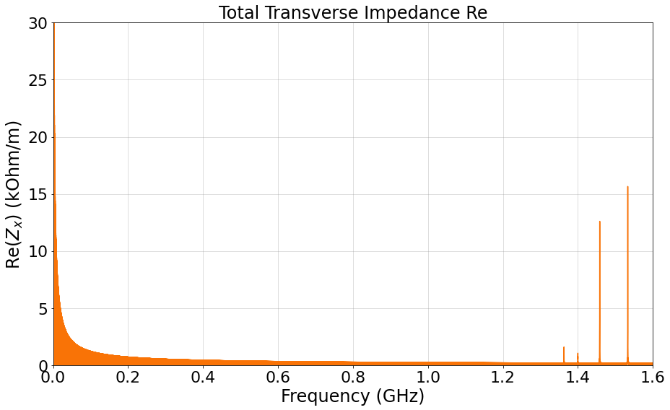
Total transverse horizontal impedance
Z_{x}(𝛚) = Z_{x}⁰(𝛚) + Z_{x}^{dip}(𝛚)x_{dip} + Z_{x}^{quad}(𝛚)x_{quad},
Resonant modes of the new structure start at higher frequencies and have shunt impedance values <16kOhm/m (vs up to 27kOhm/m for the demonstrator)

Slide 23
Summary and Outlook
According to simulations, we managed to reduce the beam coupling impedance of the future instrument, compared to the demonstrator.
BGV needs from IWG:
Do these contributions seem big for HL-LHC? Would this device be a worry for machine operation?
What information would you like to find impedancewise in the design report?
What’s next?
Results presented in IBIC conference proceeding and poster contribution: “New Gas Target Design for the HL-LHC Beam Gas Vertex Profile Monitor” (September 12-16th 2022),
And detailed in the HL-LHC BGV design report, which will be submitted ~end September 2022
Presented during instrument review October 19th 2022

Slide 24
Thank you for your attention

Slide 25
Back-up

Slide 26
Simulation method
Simulations on CST Particle Studio, using both Wake Field and Eigen Mode solvers for comparison
Between 0 and 2.8GHz
WF solver: Gaussian beam of 0.6ns width, wake length = 1km,
Particle beam parameters, wake integration method, WL, cells per WL... cf previous presentation

Slide 27
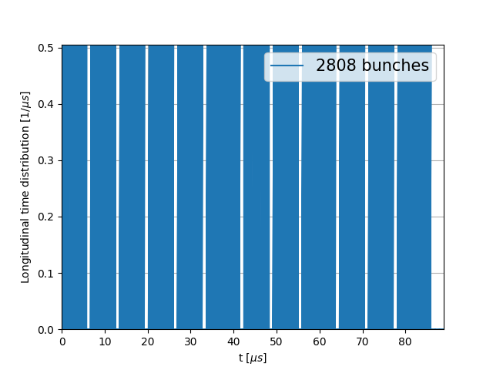
Beam parameters
Filling pattern (few lines of code provided by Leonardo/Chiara)

Slide 28
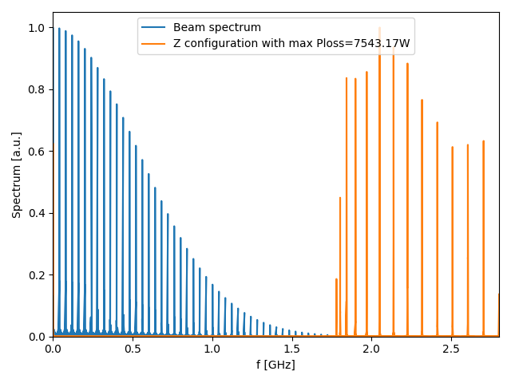
Power loss – Troubles encountered
Issues with both fq shift (high fq mode peaks being shifter to low fq -> very high Ploss values) and envelope method (dependency with the number of points of the impedance spectrum -> very high Ploss values again)
q-Gaussian bunch shape:
Raw spectrums, P_{loss} = 13.89 W
Average fq shift, P_{loss}= 429.59 W
Max P_{loss} configuration, P_{loss} = 20546 W
Beam spectrum envelope, P_{loss} = ~39 kW
Gaussian bunch shape:
Raw spectrums, P_{loss} = 10.99 W
Average fq shift, P_{loss} = (forgot)
Max P_{loss} configuration, P_{loss} = 7543 W
Beam spectrum envelope, P_{loss}= ~30 kW
Solution : use fq shift method with adding zeros at the end of the impedance spectrum.
Gaussian bunch shape, P_{loss, max} = 7543 W configuration:
Last impedance peak shifted to low frequencies (np.roll() )

Slide 29
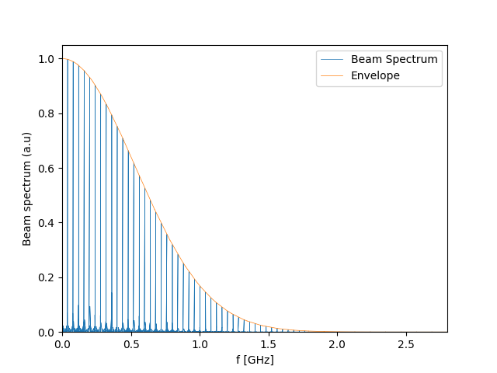
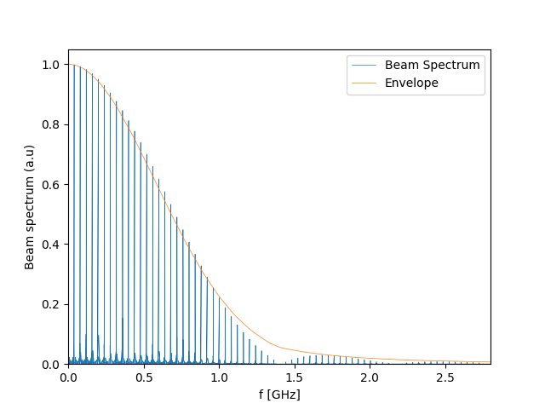
Power loss – Beam Spectrum
Gaussian shapes
Gaussian bunch shape, beam spectrum :
q-Gaussian bunch shape, beam spectrum :
Gaussian shape : f(x)=$$\frac{1}{b_{L}}…$$ -> Spectrum envelope: FT[f(x)](f)=exp(-2*(pi*f*b_{L})^2)
q-Gaussian : (cf. formula from ) with RMS ... -> No simple analytical FT formula -> hand-made envelope

Slide 30
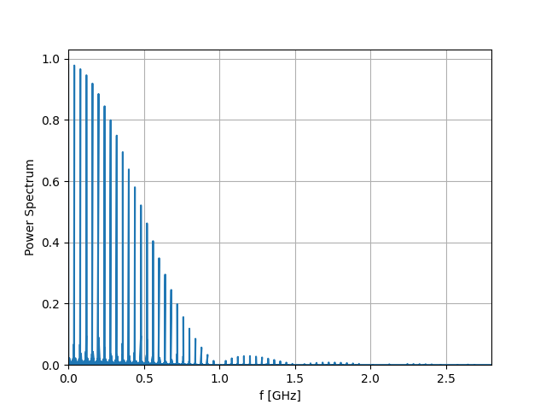
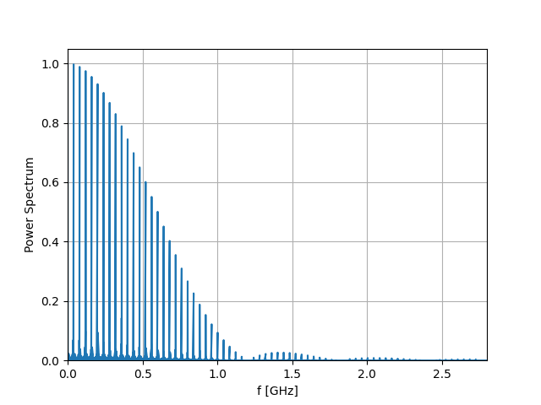
Power loss – Beam Spectrum
Binomial and Cos² bunch shapes
Binomial bunch shape, beam spectrum :
Cos² bunch shape, beam spectrum :
Calculating the Ploss of 200 configurations, randomly shifting the impedance spectrum from a value between -10 and +10 MHz from initial simulated spectrum.

Slide 31
Transverse Impedance - Theory
Assuming no coupling between the two transverse planes and neglecting terms of second order and higher:
Z_{x}(𝛚) = Z_{x}⁰(𝛚) + Z_{x}^{dip}(𝛚)x_{dip} + Z_{x}^{quad}(𝛚)x_{quad},
where x_{dip} denotes the particle beam offset along x axis, and x_{quad} the offset of the integration path.
The Z_{x}⁰ component is independent of these offset and can be observed with simulations without offsets, while the dipolar (driving) component Z_{x}^{dip} is proportional to the beam displacement, and the quadrupolar (detuning) component Z_{x}^{quad} is proportional to the integration path displacement. These displacements x_{dip} and x_{quad} must be small w.r.t the structure diameter for the linear approximation to be valid.
Sufficient resolution must be ensured in the simulation between the beam and integration path.
Since the BGV structure simulated is symmetrical w.r.t the beam axis, only the horizontal plane was considered and the vertical impedance is expected to be similar.
In the absence of beam or witness path offset, the transverse impdance was abserved to be null, which was expected thanks to the axial symmetry of the structure.
Integration
path
Integration
path
Beam
Beam

