Slide 1
CCPC-ECS (brief status)
&
A Tester for the OT FE Electronics
André Massafferri & Antonio Pellegrino
Rio de Janeiro, 15-12-2011
CCPC-ECS
  brief status
  First prototype; block diagram & Pinout
Introduction
  Why a FE Tester
  tester functionalities
Toward a new FE Tester
  design
  time scale
  open questions

Slide 2
CCPC-ECS Status
concept: generic mezzanine to connect any device to control room
PCIe, I2C, JTag, SPI → CCPC → 1Gbs Eth
R&D and mass production: CBPF-Rio
focus on TELL40:
> OnBoard implementation due vertical limitation (ATCA)
> integration discussed in last october in Marseille
PCIe, JTag (& maybe SPI) very useful
I2C not needed due intrinsical control system in ATCA
Validation board: Automatic Testing system for HW & SW
documentation: technical note & specs & Talk
> available for next Electronics meeting

Slide 3
CCPC-ECS Status (cont’d)
Software low-level on Linux:
> access registers of any Altera FPGA via PCIe OK
> load any Altera FPGA via JTag OK
> I2C control to any device (Temp,Biasing ...) OK
> SPI communication to be done
> PCIe ECS interface our next Benchmark
Low Speed protocols implemented in Cyclone IV FPGA
PCIe ←→ Cyclone IV ←→ I2C, JTag, SPI
I/O flexibility
> Firmwares (except SPI) OK
Prototypes: CCPC-ECS & Validation boards
> both in production → ready Feb/2012
> five 2nd versions → mid 2012
(Brasil, CERN, Marseille*, Lausanne, ...?)

Slide 4
First Prototype Block Diagram
nanoETX-TT Kontron
mezzanine
FPGA
Cyclone IV
RJ45
Eth 1Gbs
C
O
N
C
C
P
C
1xPCIe
8xI2C
C
O
N
D
E
V
I
C
E
IP HW
4xJTag
1xPCIe
4xSPI
IP SW
GPIO(JTag)
N x GPIO
config
flexibility
CON
1xUSB
Switch
PCIe
1xPCIe
6xPCIe
external
LVDS
VGA
adapter
CON
LVDS
1xCLK PCIe
CLK
PCIe
6xCLK PCIe
12V
monitor
POWER (5V0,3V3,1V5,1V2,1V0)

Slide 5
First Prototype Pinout
SAMTEC: QMS-078-04.25-L-D-PC4 (device)
QFS-078-04.25-L-D-PC4 (ECS)

Slide 6
Switching topic
A Test Bench for the upgraded OT FE Electronics mass production

Slide 7
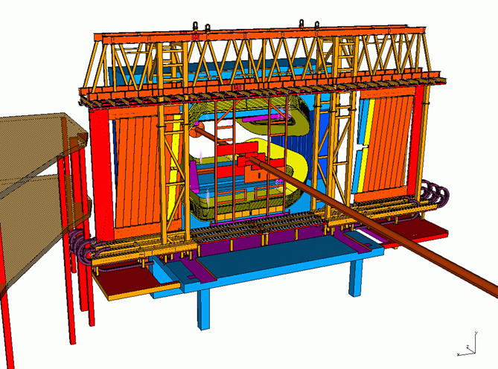
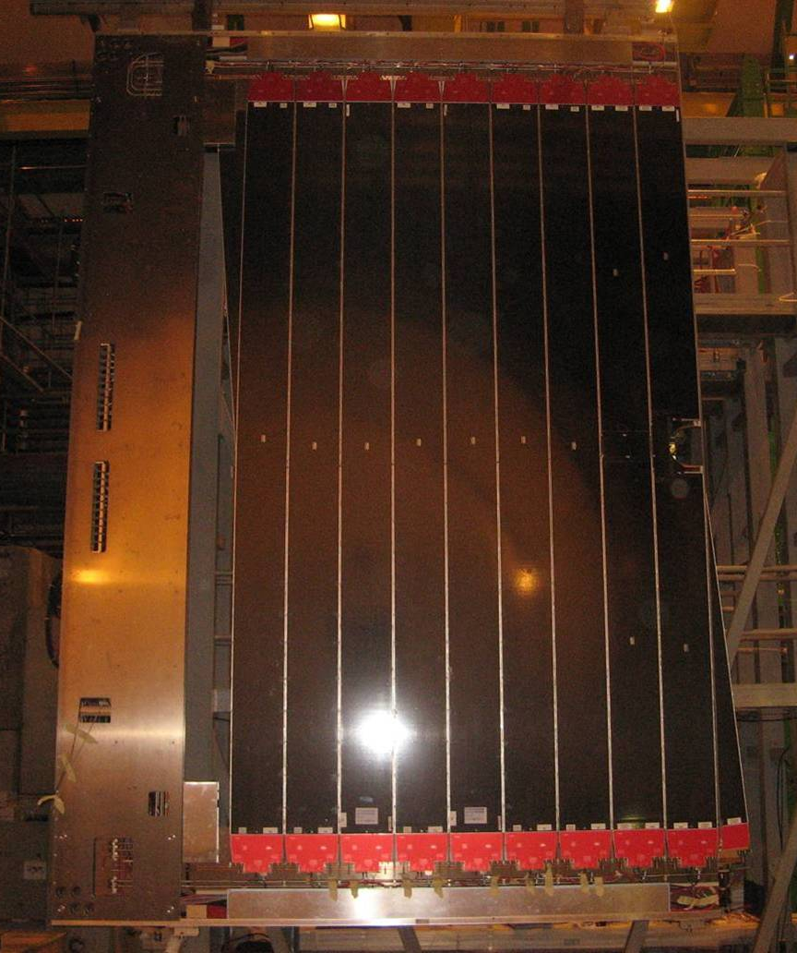
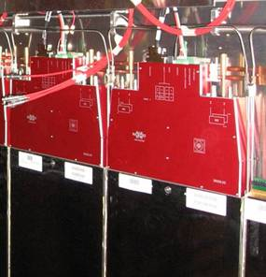
OT FEE Overview
Bridge
C-Frames
Distribution of LV,HV, ECS/TFC, etc.
Modules
straw tubes modules
2×2×9 FE Boxes

Slide 8
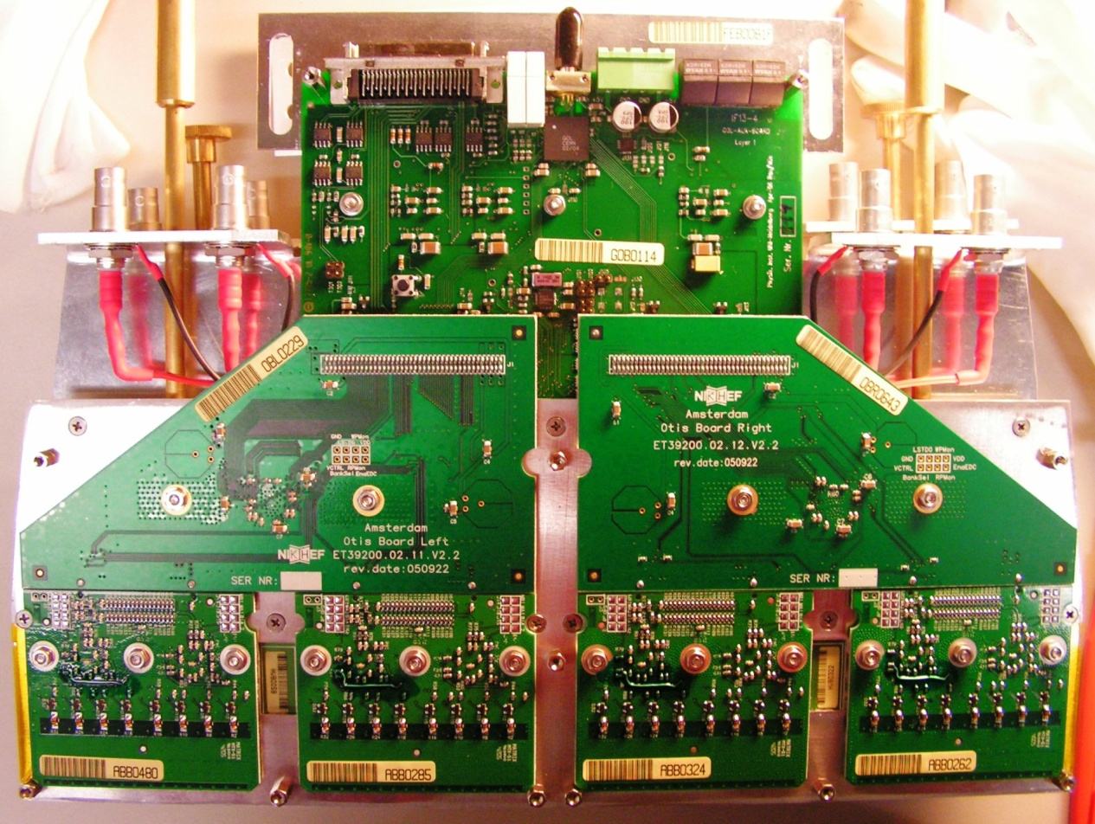
FE Electronics (the present one)
Data Fiber
TFC&ECS
Front end box (full size):
channels
4 × (32 ch) HV Boards
16 ASDBLR chips
4 OTIS TDC chips
1 GOL chip: 1.6 Gbit/s
LV
HV
GOL/AUX
MASS PRODUCTION:
500 GOL/AUX Boards
2.000 OTIS TDC Boards
4.000 ASDBLR Boards
2.000 HV Boards
OTIS
ASDBLR

Slide 9
Why a FE Tester?
A fully automatized FE Tester was mandatory given the large size of the production
MASS PRODUCTION:
500 GOL/AUX Boards
2.000 OTIS TDC Boards
4.000 ASDBLR Boards
2.000 HV Boards
Although we tested individually all boards inside a FE Box, a final global test proved invaluable:
  FE assembly defects ⇒ ~1/3 of FE Box re-assembled
  synchronicity between 4 OTIS in one FE Box could be checked
We did NOT use ODIN and Tell1, but generated TFC internally and read data asynchronously (see next slides):
  simple setup, ready ahead of time (2 extra Nikhef FTE for 1 year)
  but could not check synchronicity (Bxid, L0id, etc.)

Slide 10
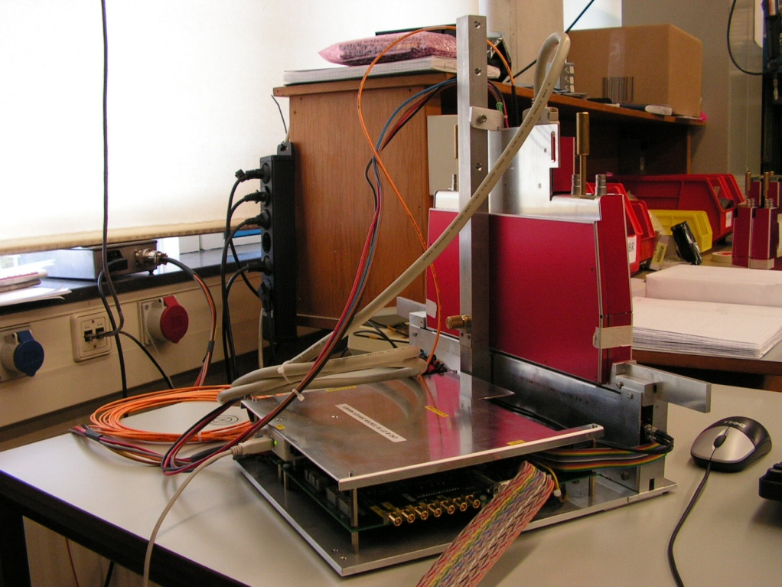
FE Test Setup
TFC + I²C
Optical Link Data
USB-2-JTAG
Atlas Slink “Gola”
FE Under Test
Altera Board
JTAG
PC Windows
PC Linux
SPI
Inj. “flipper-box”

Slide 11
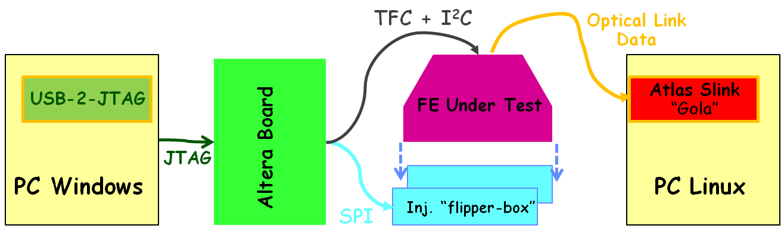
FE Tester Functions
Test of global functionality of fully assembled FE-Boxes:
  Analog input signal injection (mimicking straw-like signal)
  Internal Generation of ECS & TFC
  Data Acquisition (Fiber ⇒ Disk)
Threshold Scan
Input signal amplitude scan
ASDBLR Testpulse (hi/lo even/odd)
Input signal delay Scan
L0 delay scan
…

Slide 12
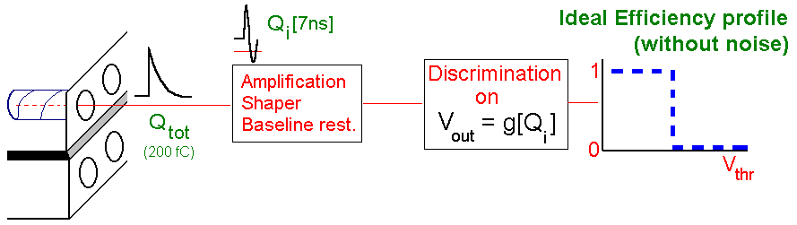
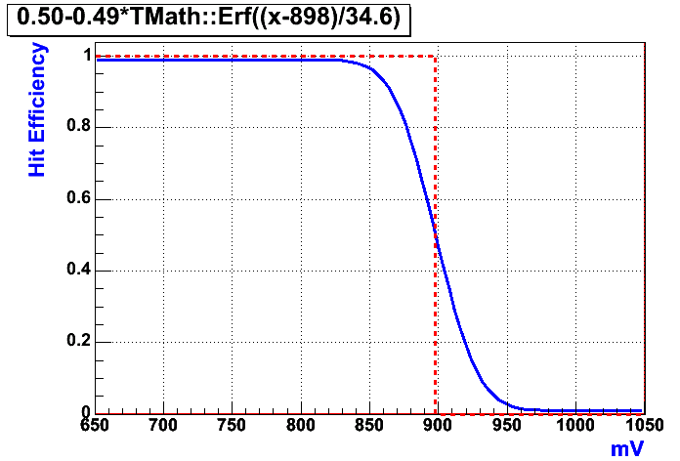
Threshold Characteristics
For a Gaussian Noise, fit efficiency curve with “Erf” and use 50% point as the best estimator

Slide 13
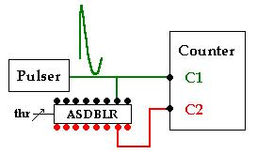
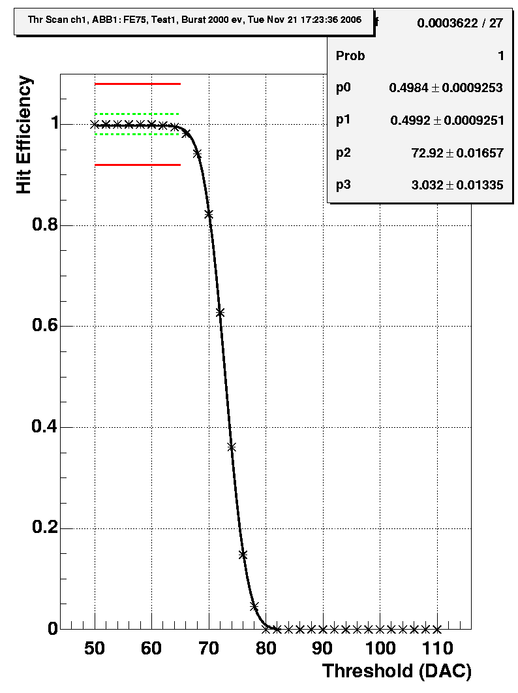
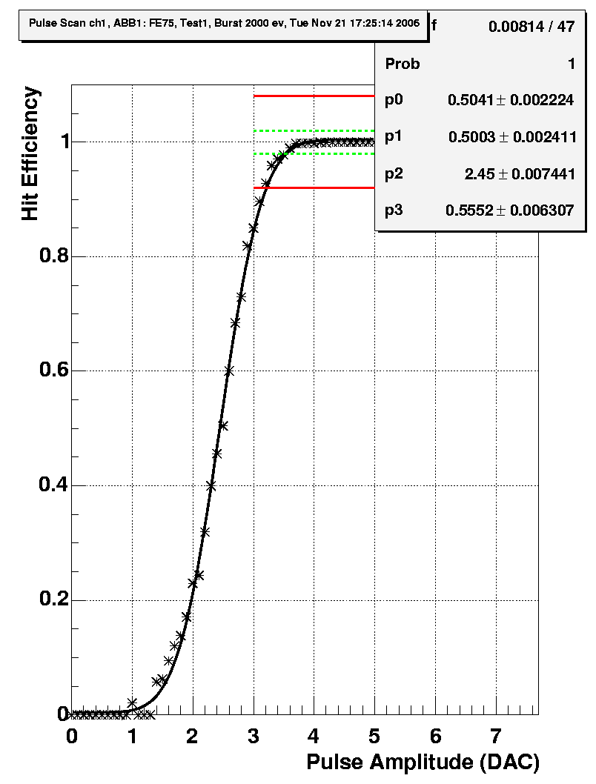
Threshold Characteristics (cont’d)
Hit Efficiency = C2 / C1
Measure hit efficiency profile for each channel, fit Erf to data and determine V_{thr}^{[50%]} and σ_{noise}
V_{thr}^{[50%]} = 77.92 DAC
σ_{noise} = 3.03 DAC
Analogously for input pulse amplitude scan
Channel-to-channel uniformity within ~50 mV!

Slide 14
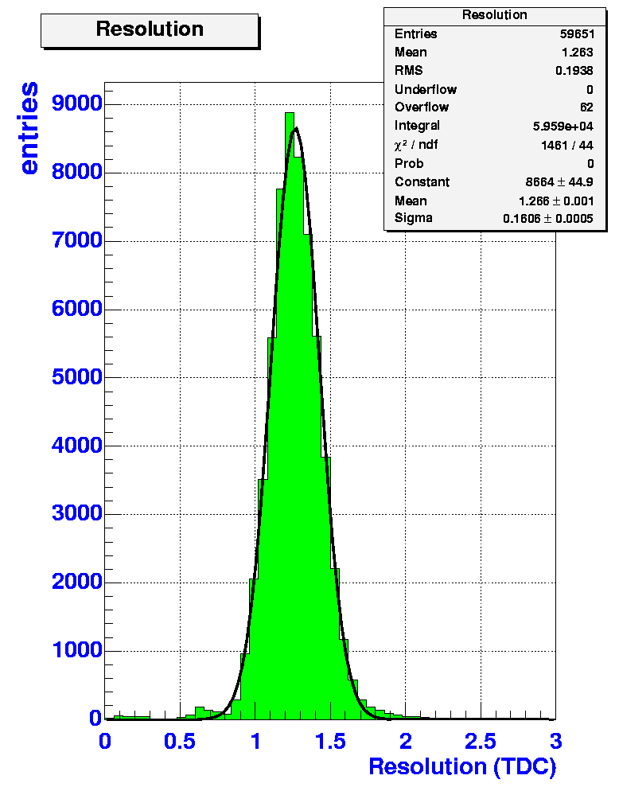
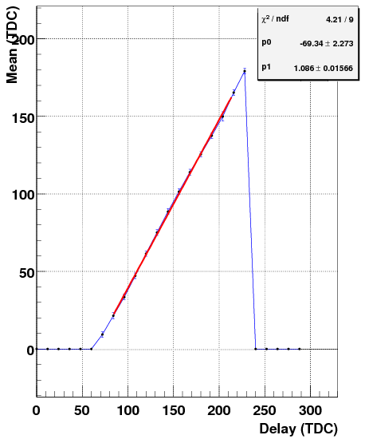
Timing Tests
Hit Delay Scan
About 1.2 TDC channels (~0.5 ns)
Includes Test-Setup resolution etc.
Fit straight line to data and reject if poor linearity (large χ²⁾

Slide 15
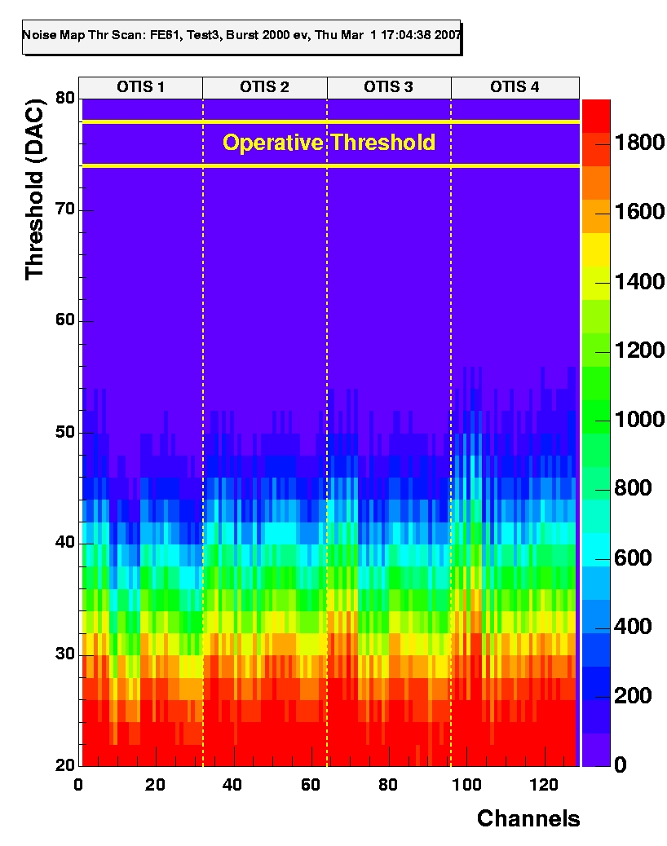
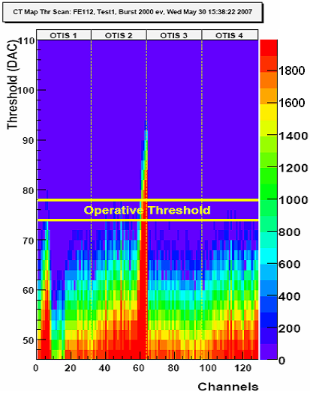
Noise Tests
OK
Noisy channels

Slide 16
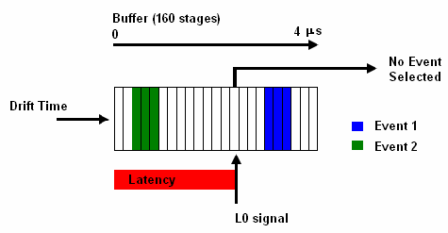
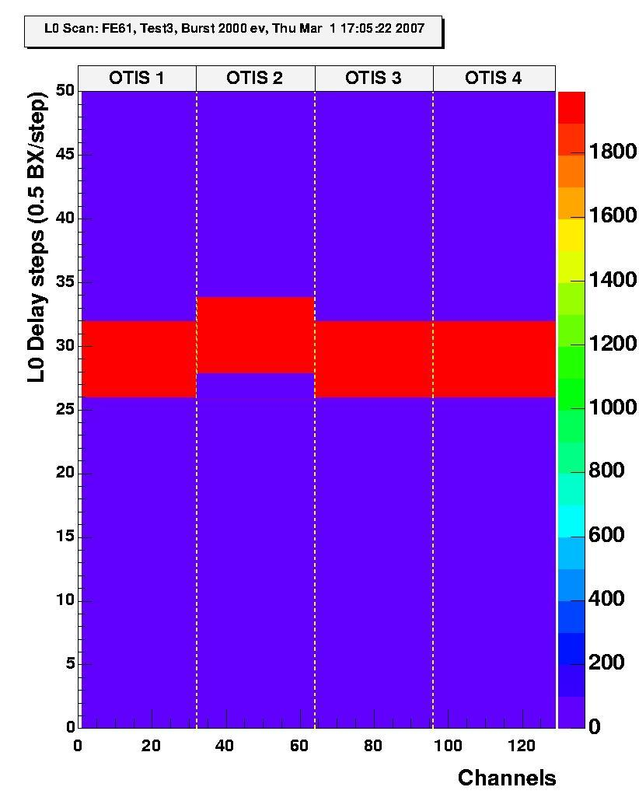
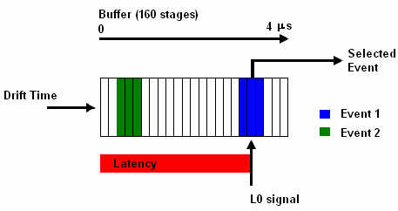
L0 Delay Checks
L0 Delay
L0 Delay

Slide 17

In summary: Test Sequence
Threshold characteristics :
Amplitude Scan with input signal ⇒ V_{thr}^{50%}, noise, cross-talk, etc.
Thr Scan with input signal ⇒ V_{thr}^{50%}, noise, cross-talk, etc.
Thr Scan with Testpulse (lo/hi) ⇒ V_{thr}^{50%}, noise, cross-talk, etc.
Noise :
  Thr Scan without input signal
Timing :
    TDC spectra of all channels
    Input delay scan over the full time range
L0 scan :
  L0 Delay Scan in steps of ½ BX
Analysis
  Control histograms automatically generated for all tests, fitting, etc.
All test results available via the Web

Slide 18
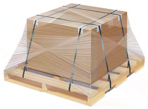
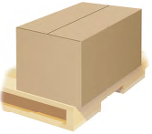
What we learned
quality of production excellent thanks to systematic and meticulous testing
should have (did not!?) tested also high data-load with random triggers
  check synchronicity (mainly Bxid)
we used up >90% of our spares (mainly in commissioning in 2009 and 2010)
  buuuut… repaired all defect FE Boxes!!
  without retaining functional FE Testers, we’d be dead by now!
  FE Tester not only important in production, for whole life cycle!
FE Box transport needs care!?
  Not much use testing, if lousy transport after test!?
  corollary: needs FE Tester also at CERN
GOOD!
NOT GOOD!

Slide 19
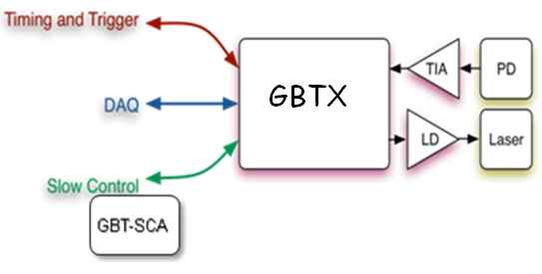
Goal of the project
What tester do we need for the upgraded OT FE?
a tester who can receive the GBTx data
a tester using GBT/GBT-SCA for TFC/ECS
a tester capable of writing “raw” data to disk
  Real time? What bandwidth? Well, let’s say at least “bursts” of O(10,000) consecutive events (a “step” in a threshold/delay scan!)
  histogramming in FPGA? Yes, please!
  data analysis in FPGA? No, thanks!
a tester who can be itself controlled via TCP/IP GbE
  mainly to configure a “step” run (e.g. 33 threshold steps of 10k evts)
  extra controls needed (e.g. SPI) ? Probably not…
When do we need it?
Basic blocks 2nd half next year, 1st prototype in 2013, 3 instances by 2014
CBPF/Nikhef cooperation (aimed at OT), support by Marseille & LHCb Online
Question: commonalities with other test benches??

Slide 20
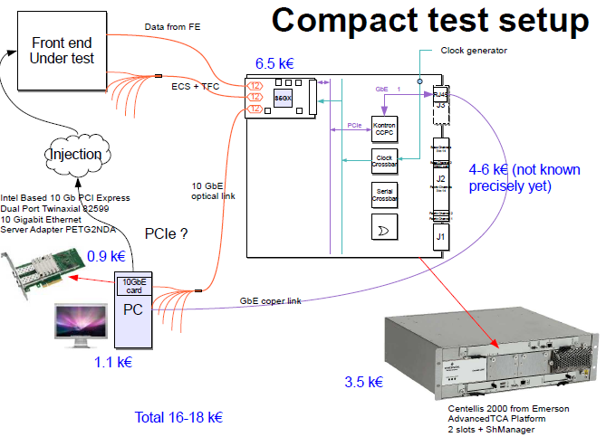
The Perfect Answer!
Based on proposal by J-P Cachemiche & A. Massafferri
Data from FE
TFC/ECS
Data to PC

Slide 21
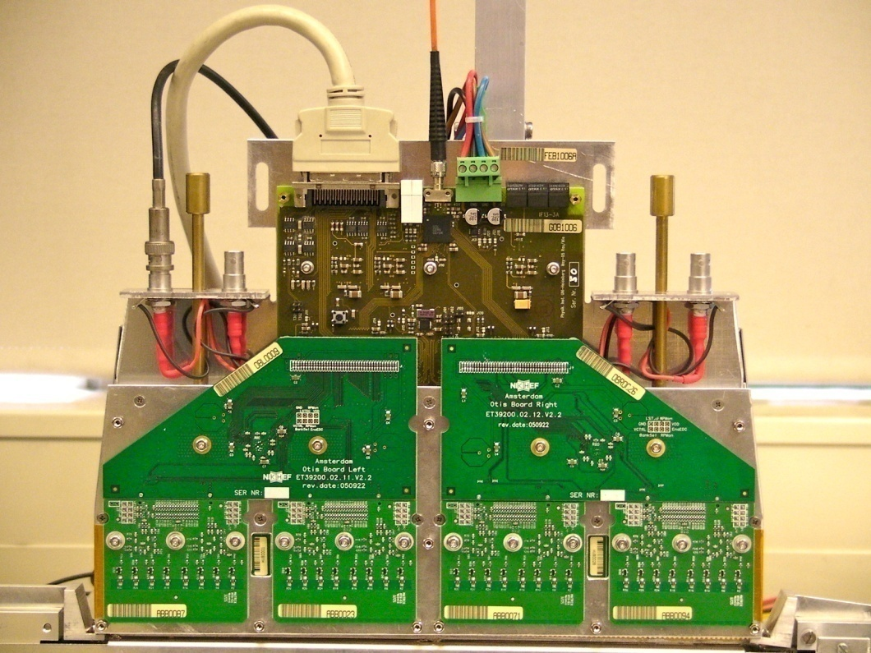
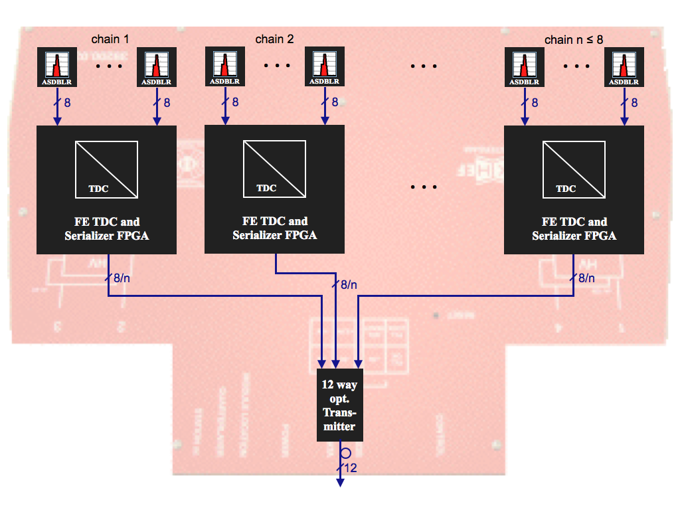
Overview of OT 40MHz Upgrade
We have 432 of these objects (FE Boxes in OT)
  36 per C-Frame (12 C-Frames)
GOL/AUX Board (and ASIC) needs replacement
Fiber
(12-fib. Ribbon)
OTIS Boards (and ASIC) need replacement
(2 fibers)
Control
LV
cable
HV and ASDBLR Boards may remain unchanged
HV
cable
So, Tester physical interfaces to/from FE Box are:
  12-fibers ribbon (data: 4 or 8 GBTx)
  2 fibers (bi-directional TFC/ECS)

Slide 22
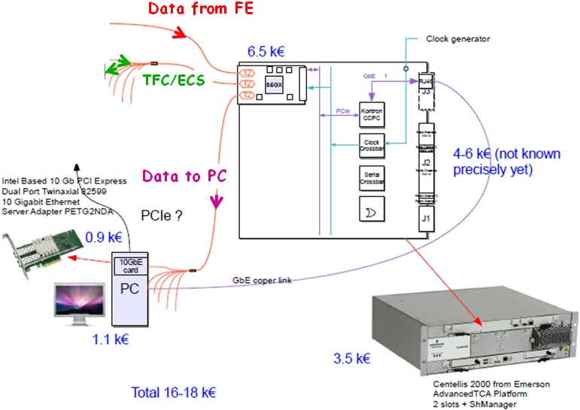
Modified FE Test Bench
TFC + I²C
Optical Link Data
USB-2-JTAG
Atlas Slink “Gola”
FE Under Test
Altera Board
JTAG
PC Windows
PC Linux
SPI
Inj. “flipper-box”
Injector can be re-used

Slide 23
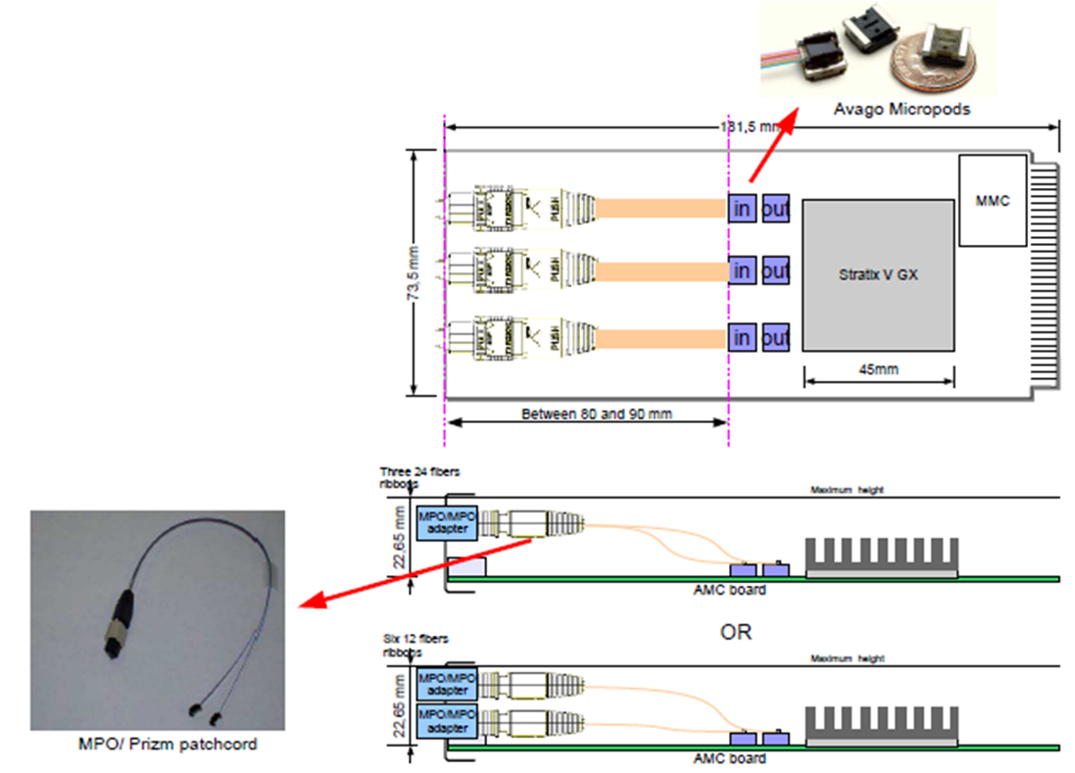
Optical Interfaces
Use input/output configurability of the 3×12 optical links to/from Stratix V
12× Data from FE
Snap 12
12× Data out to PC
Snap 12
6× bidirectional TFC/ECS
Snap 12
Snap 12

Slide 24
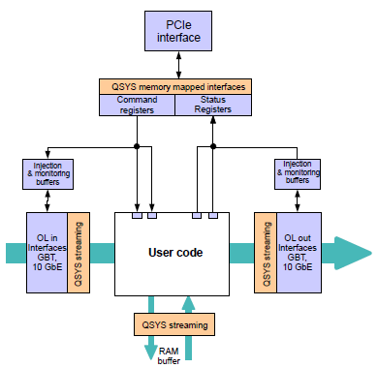
FPGA Firmware interfaces
E.g. for data from Front-End:
This part of User code (and FE injector control?) by us (CBPF + Nikhef)
However needs clarification:
will there be a TFC/ECS firmware fitting in the same Stratix V?
capable of working (e.g. STEP runs) without external hardware?
will there be basic software (C API? PVSS?) to drive the TFC/ECS?
When? Who?
  CBPF student at CERN (L. Lessa) could help ⇒ OT pilot test-case ?
I/O configure
Raw bank fmt
Burst buffering
histogramming
TFC/ECS ?
GBT in
10 GbE out

Slide 25
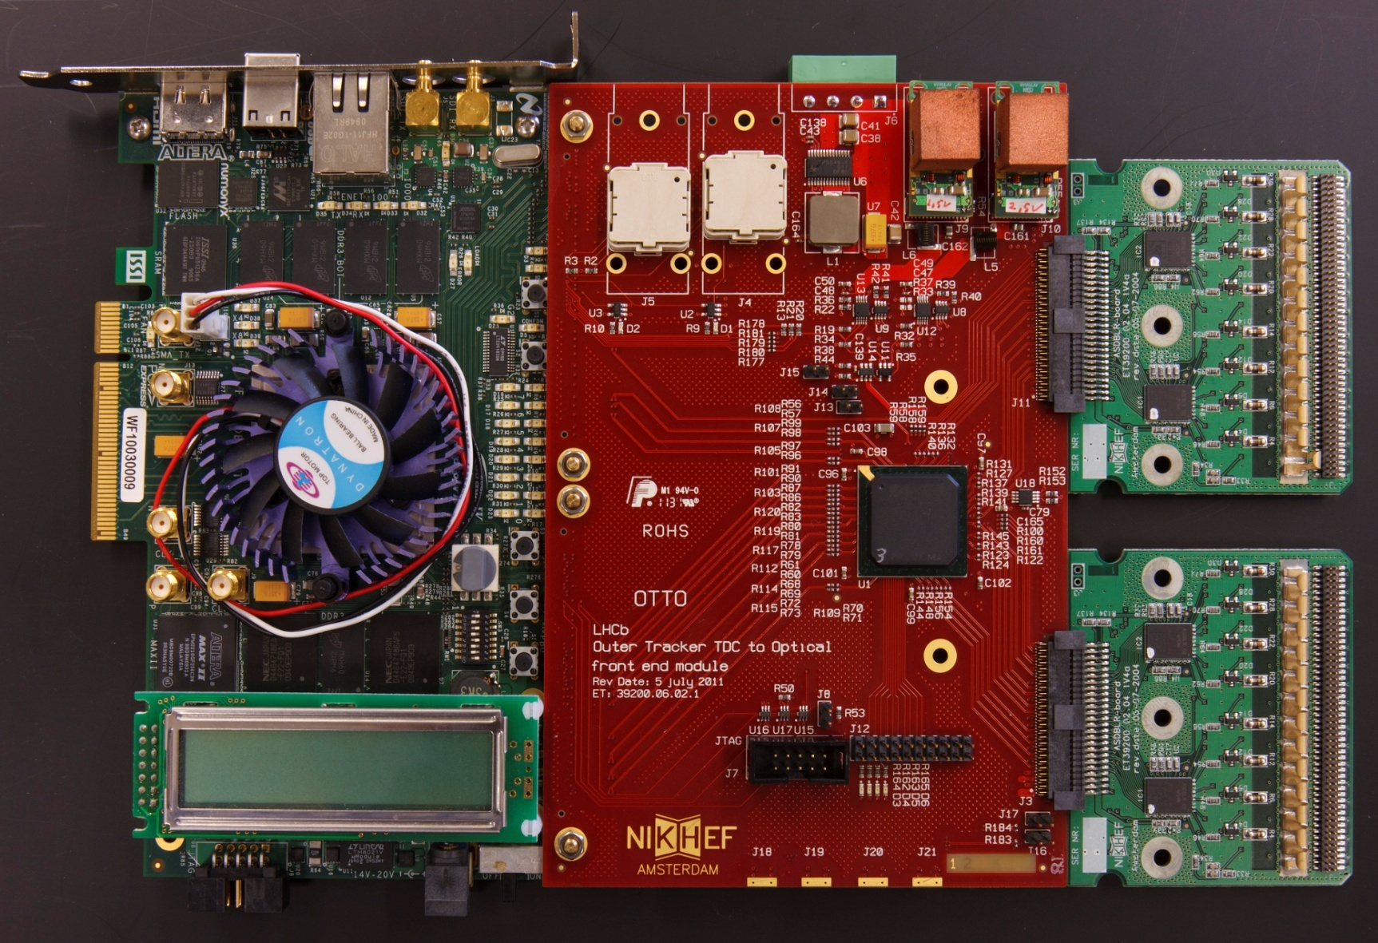
Where we are now
ASDBLRs
Stratix IV (readout and GBT emulator)

Slide 26
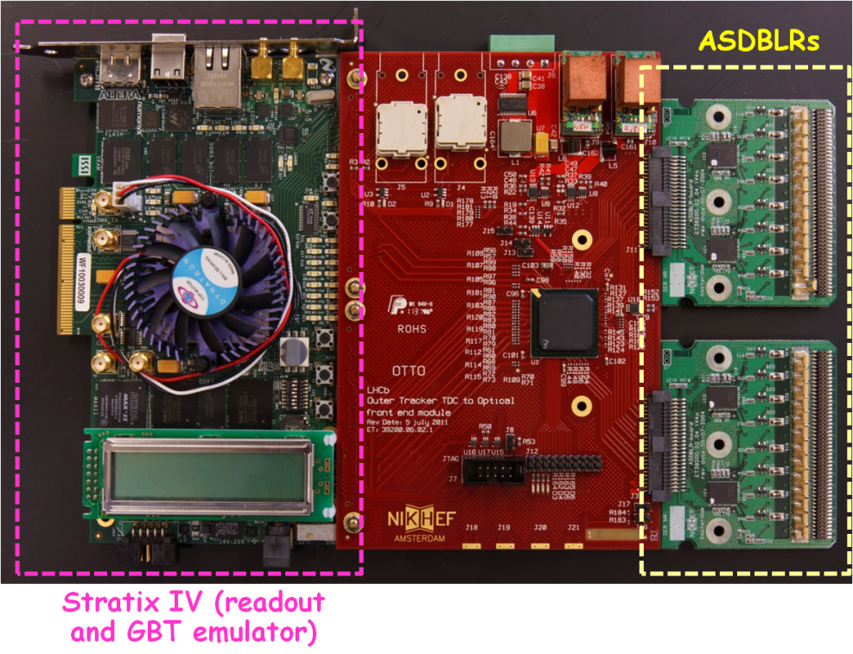
How do we read & control?
At present testing through:
ASDBLR connected to Actel TDC
all data and control lines from/to Actel via HSMC connector to Stratix IV
Actel registers (I2C) controlled by Stratix IV via 1GbE
    UDP Nikhef-made + encoding/decoding software on Linux
all data read by Stratix IV via 1GbE (UDP Nikhef-made)
Ok for a while, until 1st prototype Actel TDC service board debugged, then FE test bench needed
When do we need it?
Basic blocks 2nd half next year, 1st prototype in 2013, 3 instances by 2014
CBPF/Nikhef cooperation (aimed at OT), support by Marseille & LHCb Online
Question: commonalities with other test benches??

