Slide 1

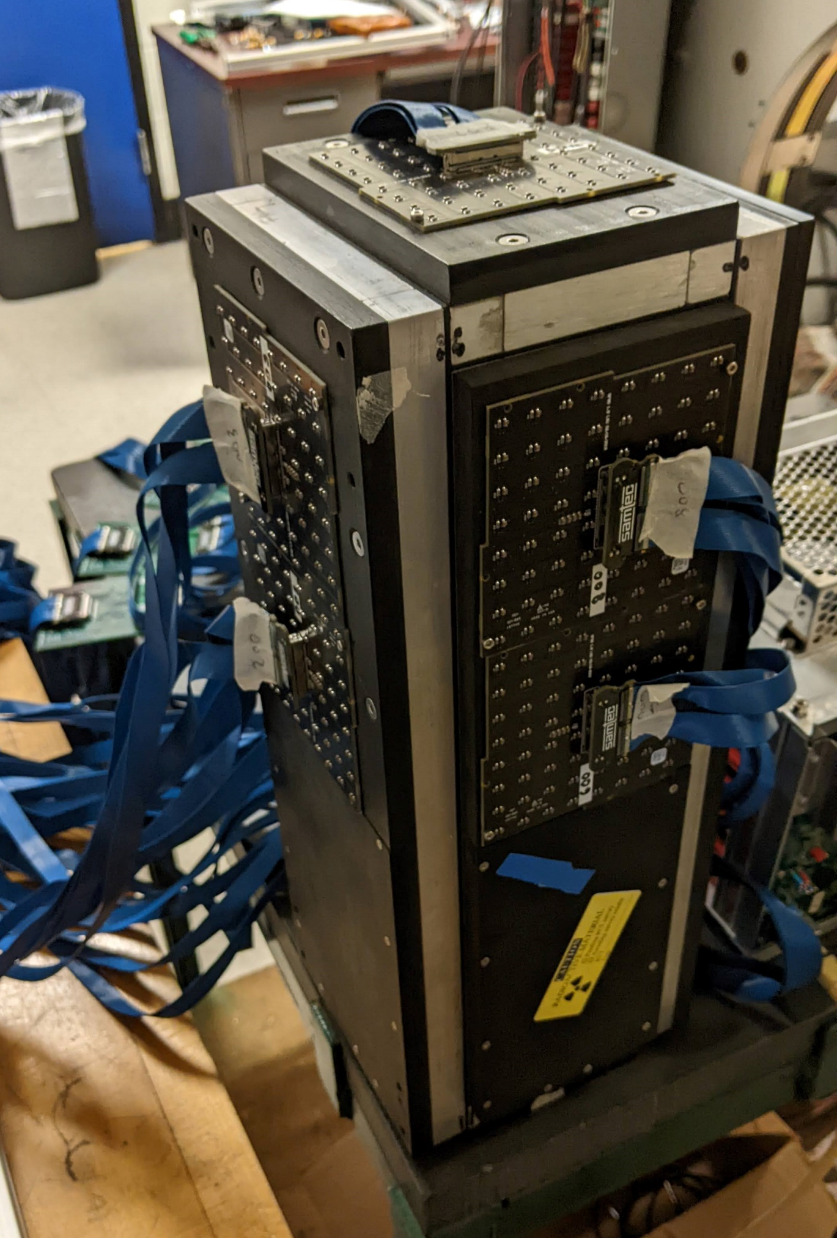

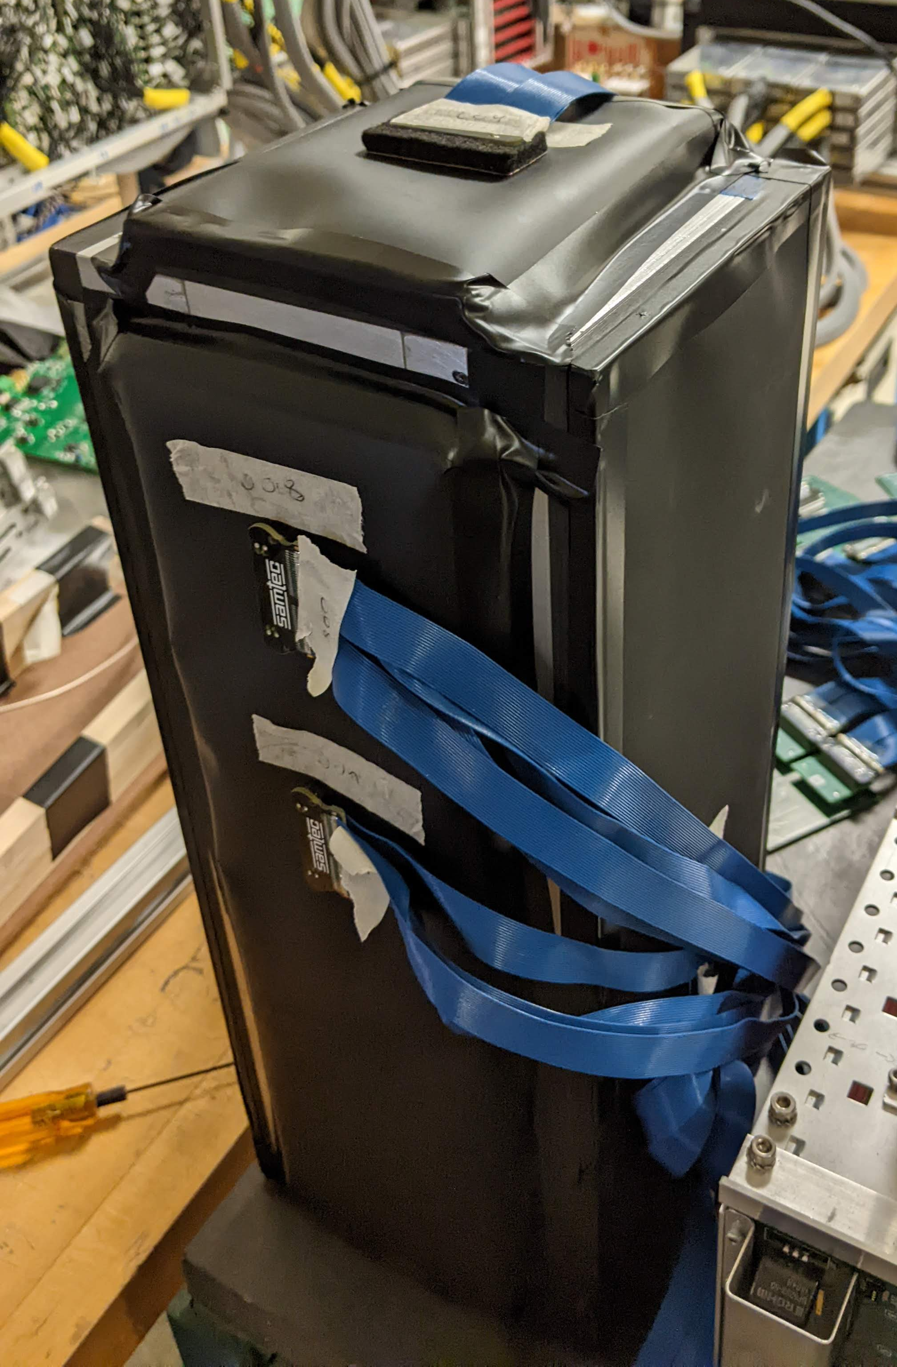
Light Barrier Test Analysis
Michael Reh
15 Aug 2022
University of Colorado Boulder
Michael.Reh@colorado.edu

Slide 2
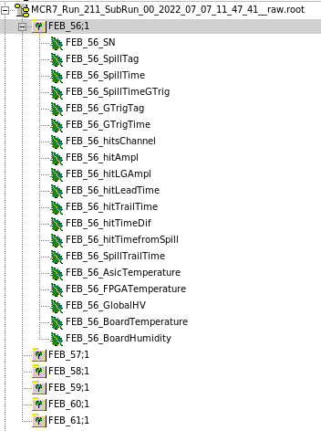
Looking at the Data
Data comes pre-packaged in .daq files
  Consist of data packets for individual hits
  No ADC waveform vs time
  We receive pre-packaged info from hits like hit timing, signal amplitude, channel number, etc.

Slide 3
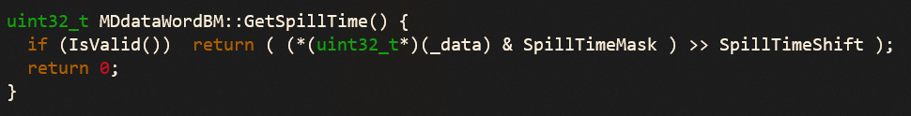
Data Overload
Data comes in 32-bit chunks that is bit-manipulated to extract relevant information in the unpacking procedure, e.g.
For the runs with no light barrier, the data stream cannot keep up with the input, and so some of the bits get missed, leading to data corruption
All of the runs with no light barrier can have some of their data unpacked, but all eventually seg fault when the stream gets to a bad read
From the bit I was able to unpack, there appears to be at least an order of magnitude more hits in these runs than those with some light barrier

Slide 4
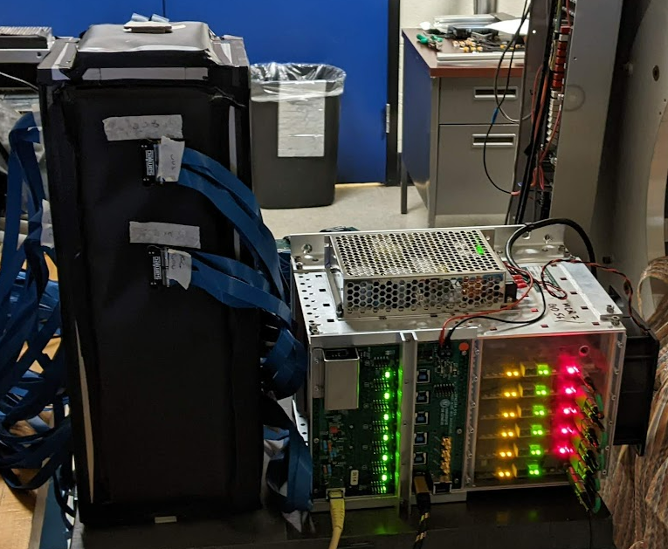
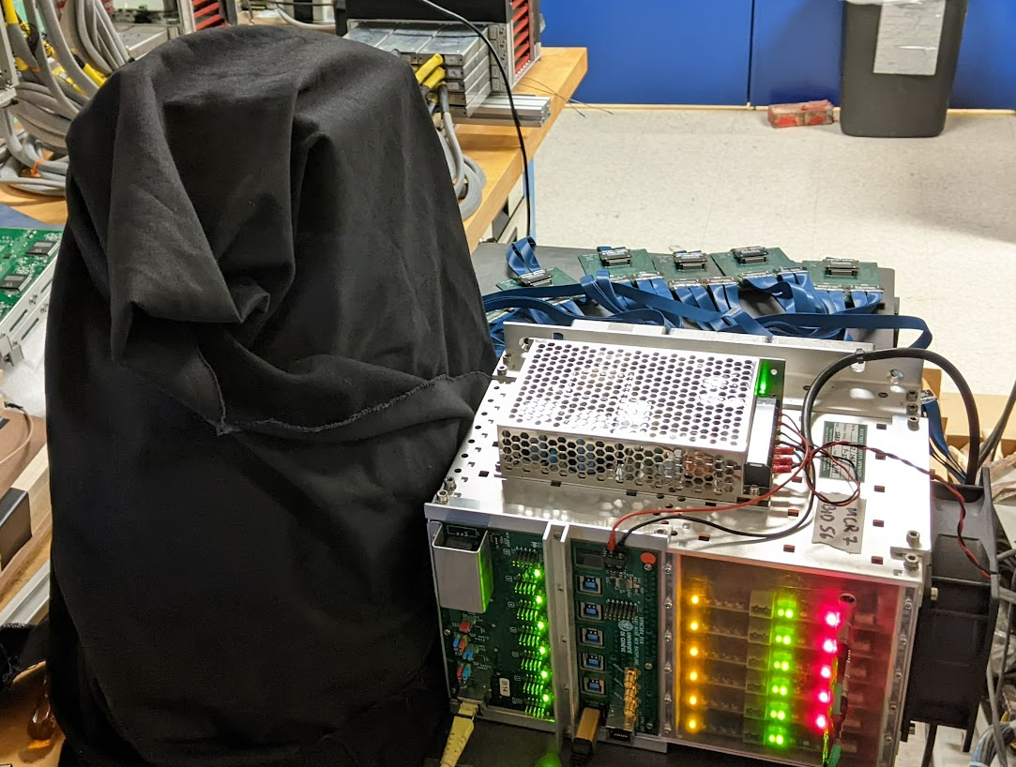
Other Baselines
Since we do not have a baseline with no light barrier to compare against, we tried something different at Penn
  Collected data with both light barriers applied to the detector
  Hope that combination of the CU polyester sheet and UPenn black sheet will provide a baseline that is at least as strong of a shield as either of the individuals
    If the individual light shields are comparable to using both, that is a positive sign
CU Polyester Light Barrier
UPenn “Black Sheet”

Slide 5
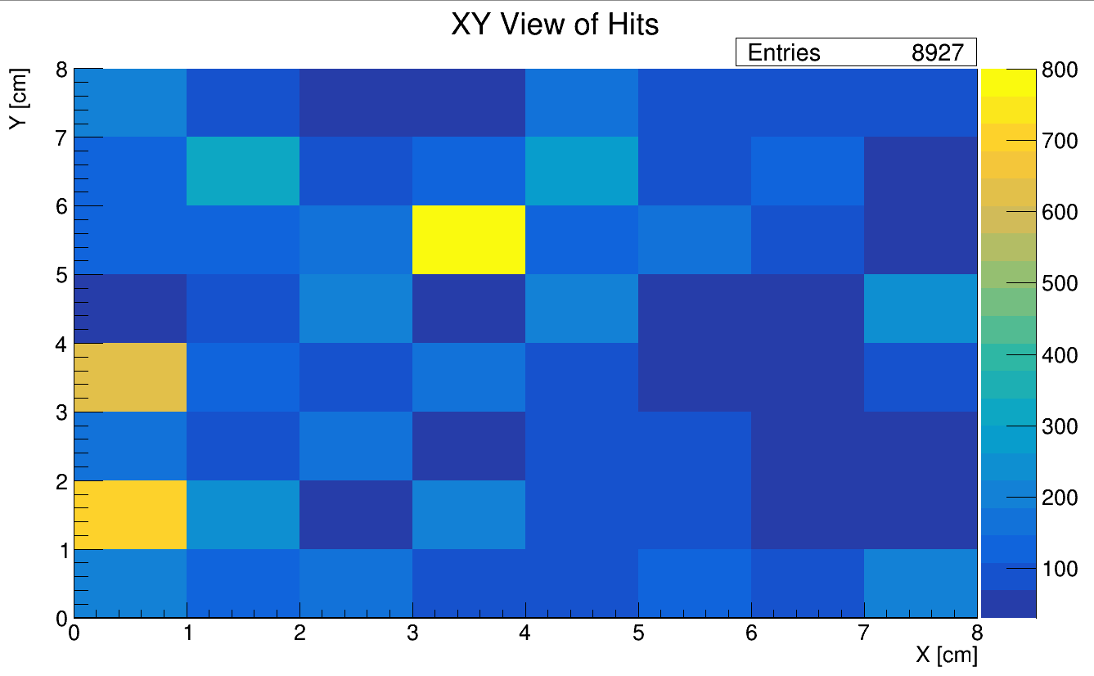
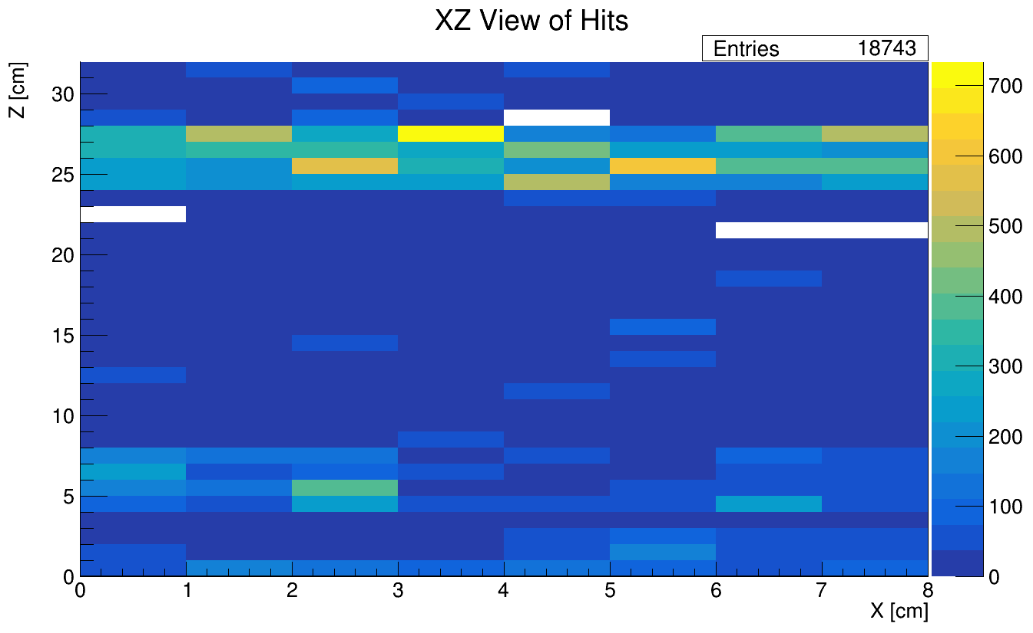
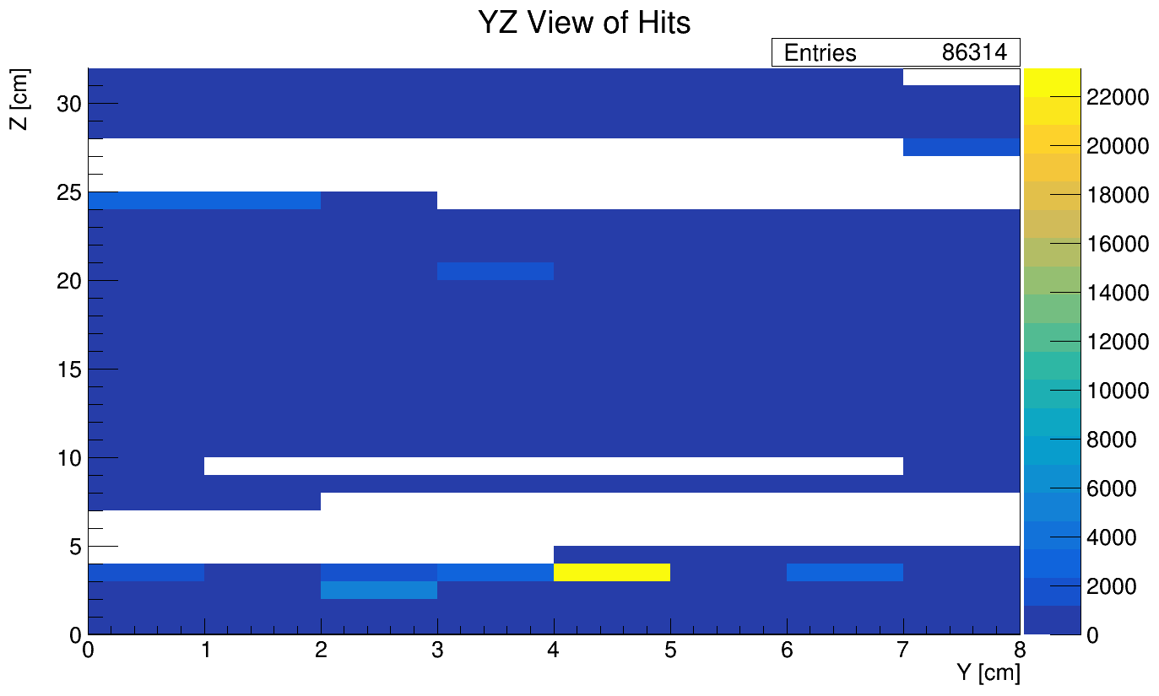
Original Hit Count Plots
“Hits” defined in DAQ, presumably by the ADC waveform increasing beyond some threshold

Slide 6
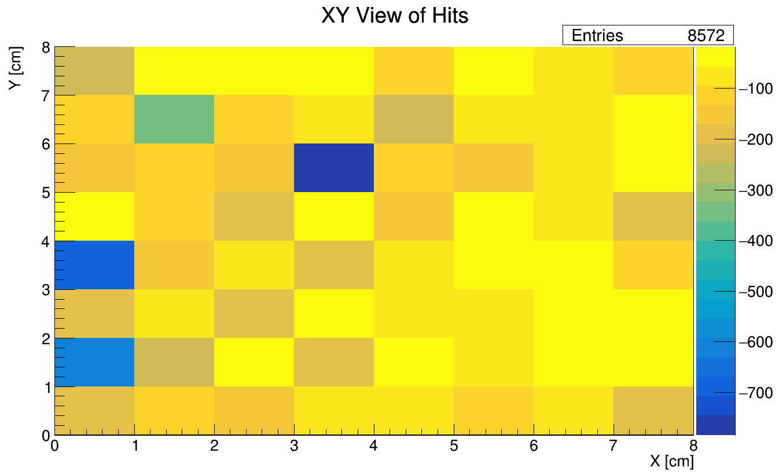
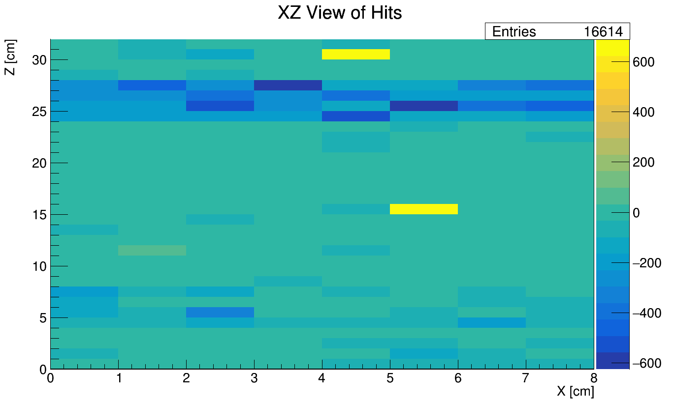
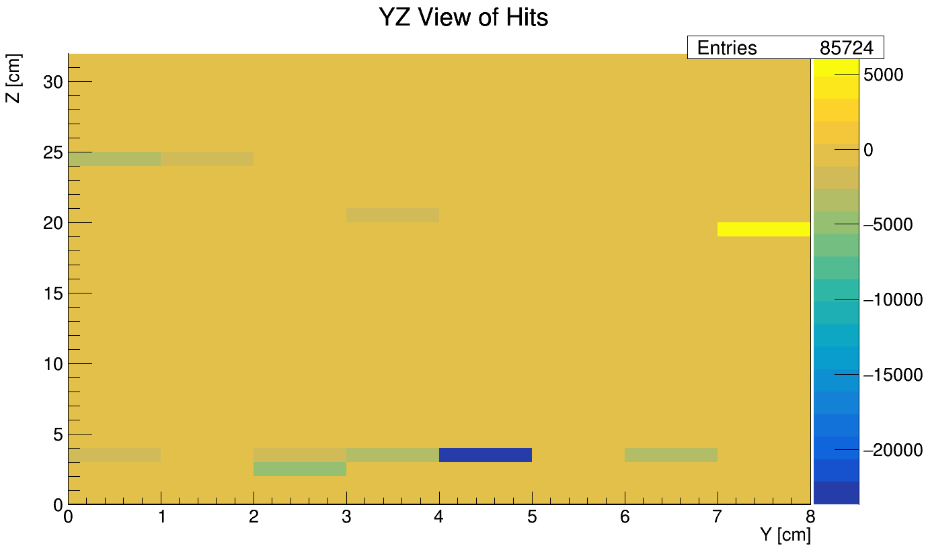
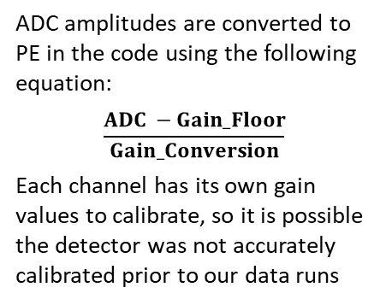
Trying to Use PE Counts
ADC amplitudes are converted to PE in the code using the following equation:
$$\frac{ADC −Gain_Floor}{Gain_Conversion}$$
Each channel has its own gain values to calibrate, so it is possible the detector was not accurately calibrated prior to our data runs
Negative PE counts

Slide 7
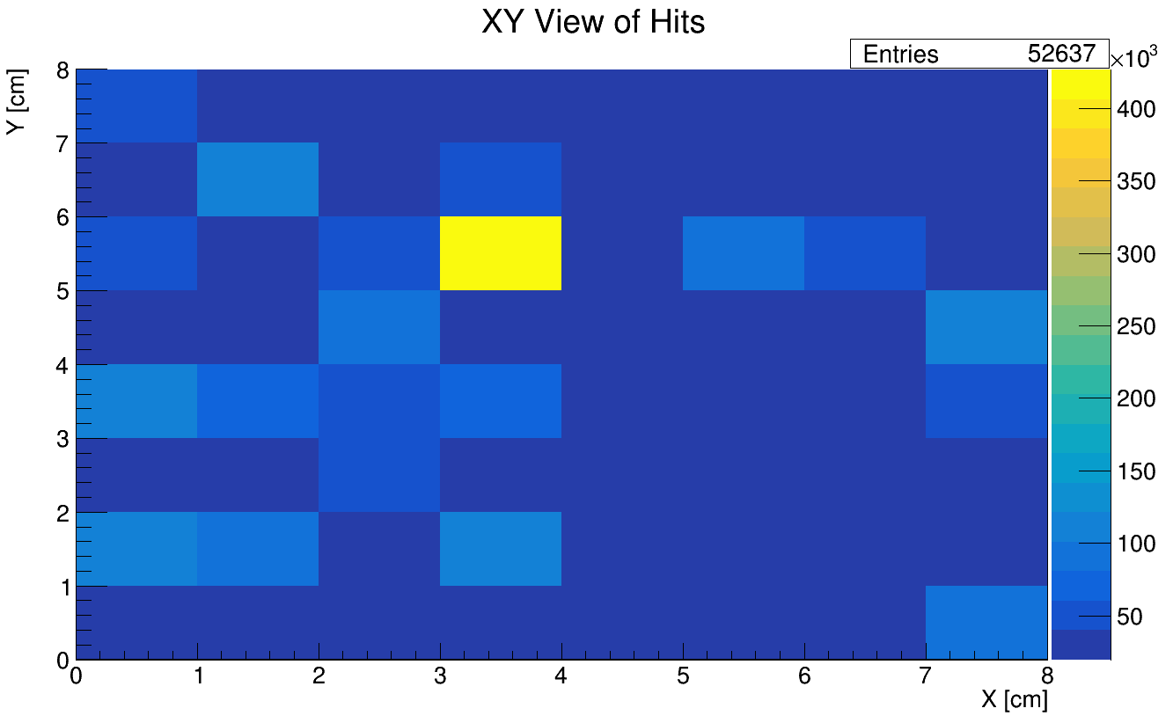
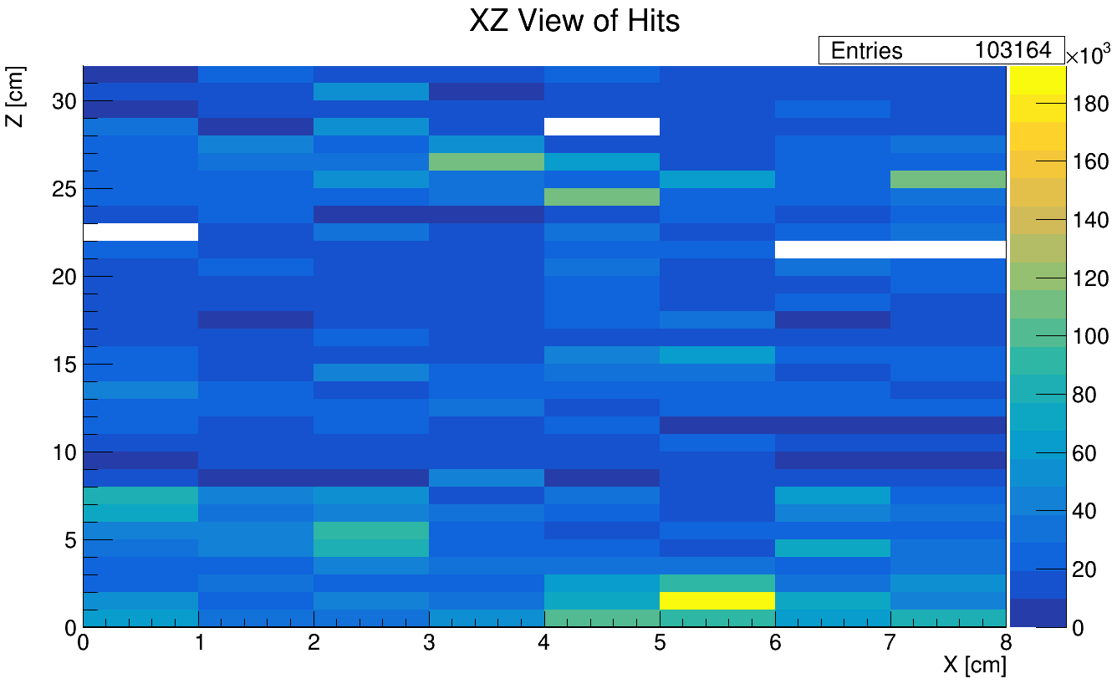
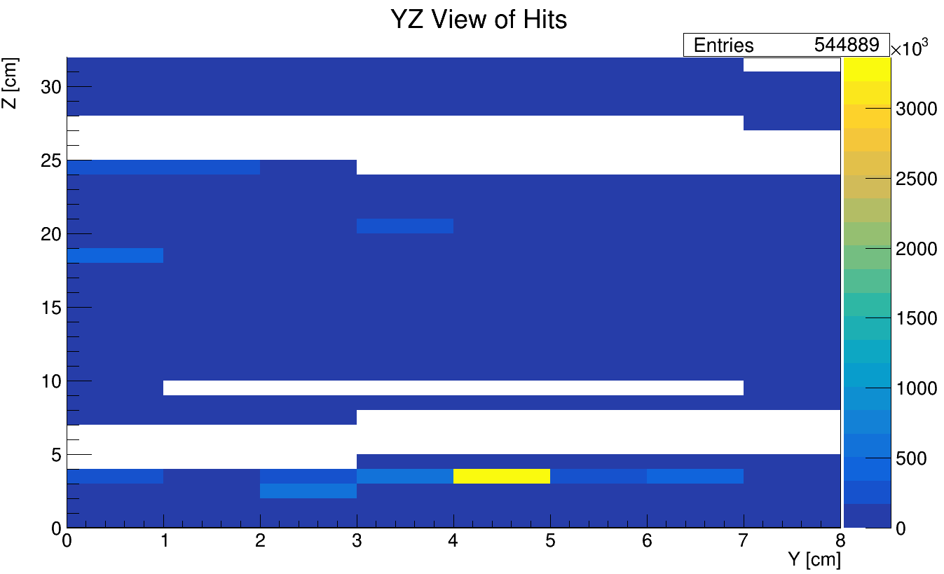
New Plan: Look at ADC
Instead of filling with 1 for each hit, now fill using the ADC peak value for each hit

Slide 8
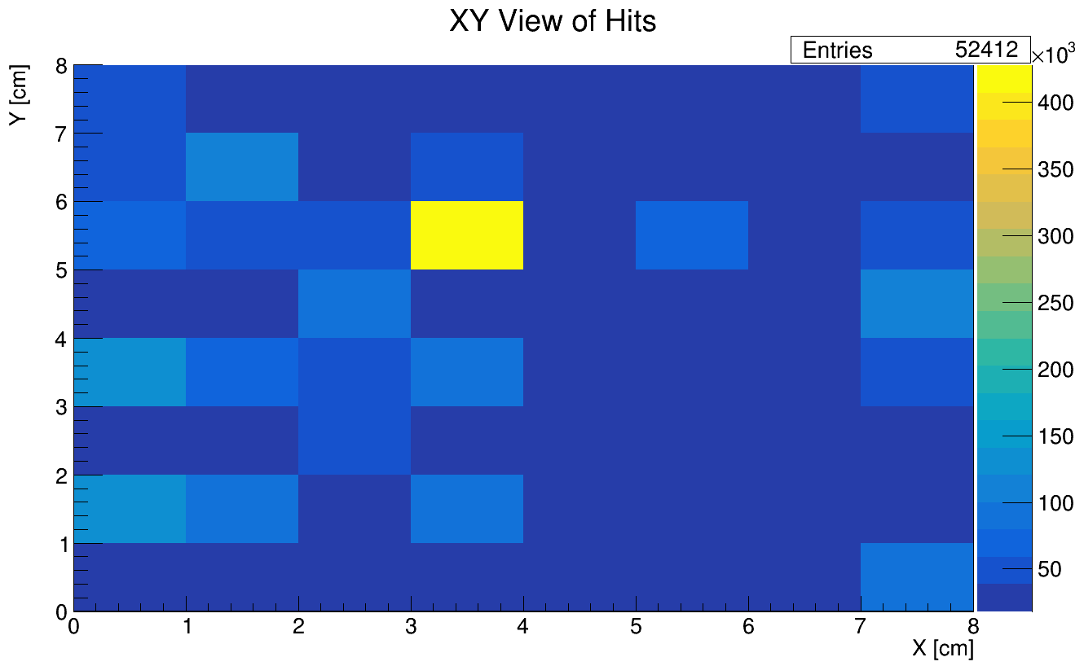
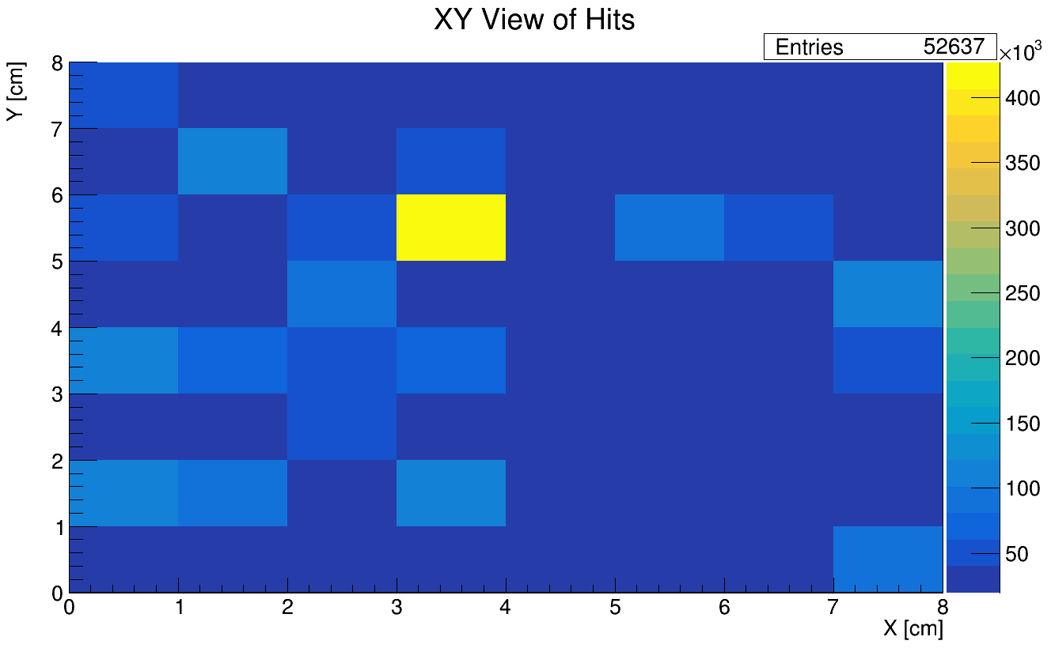
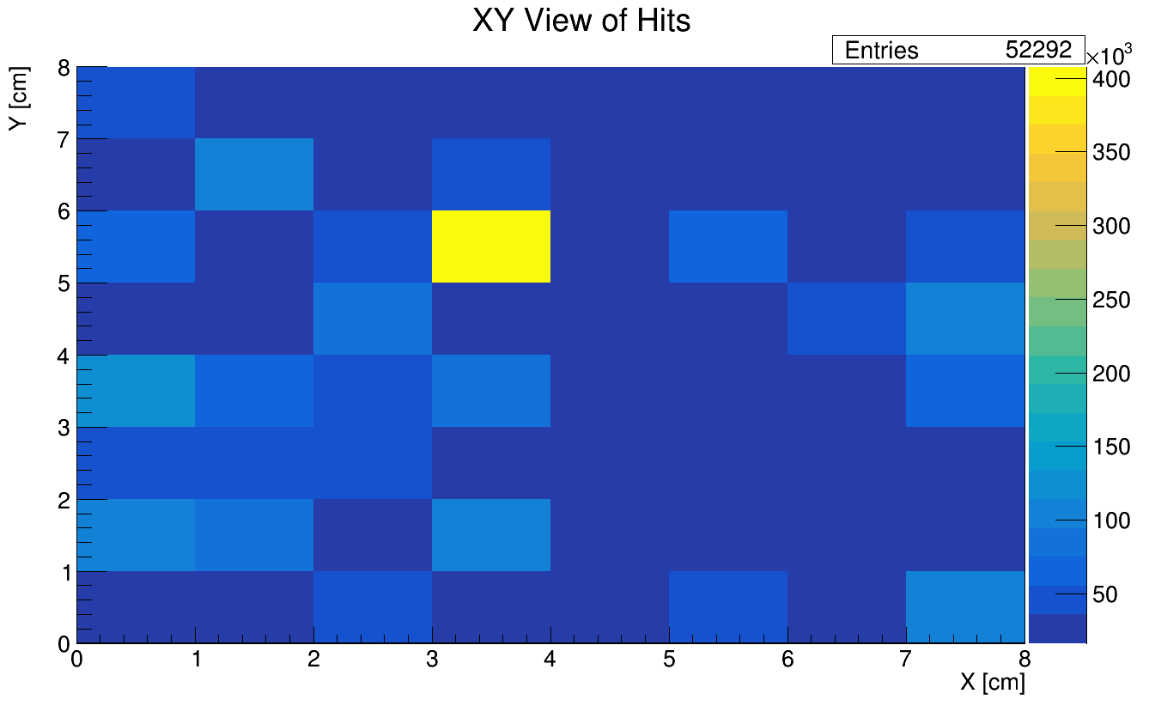
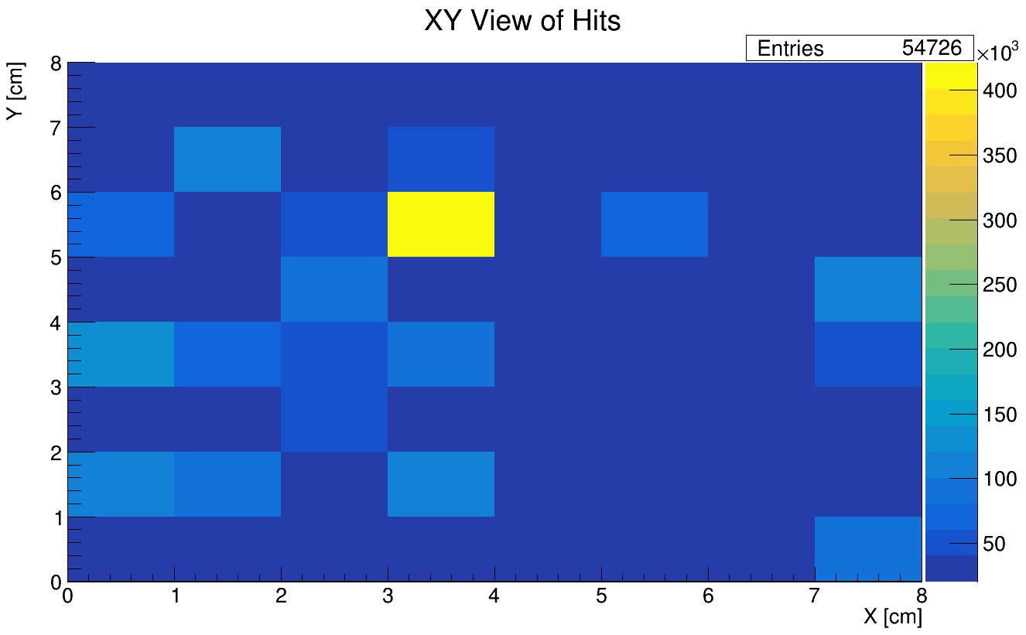
XY ADC Counts: Lights On Trials
CU LB, No Felt
CU LB + UPenn Black Sheet
CU LB with Felt
UPenn Black Sheet only

Slide 9
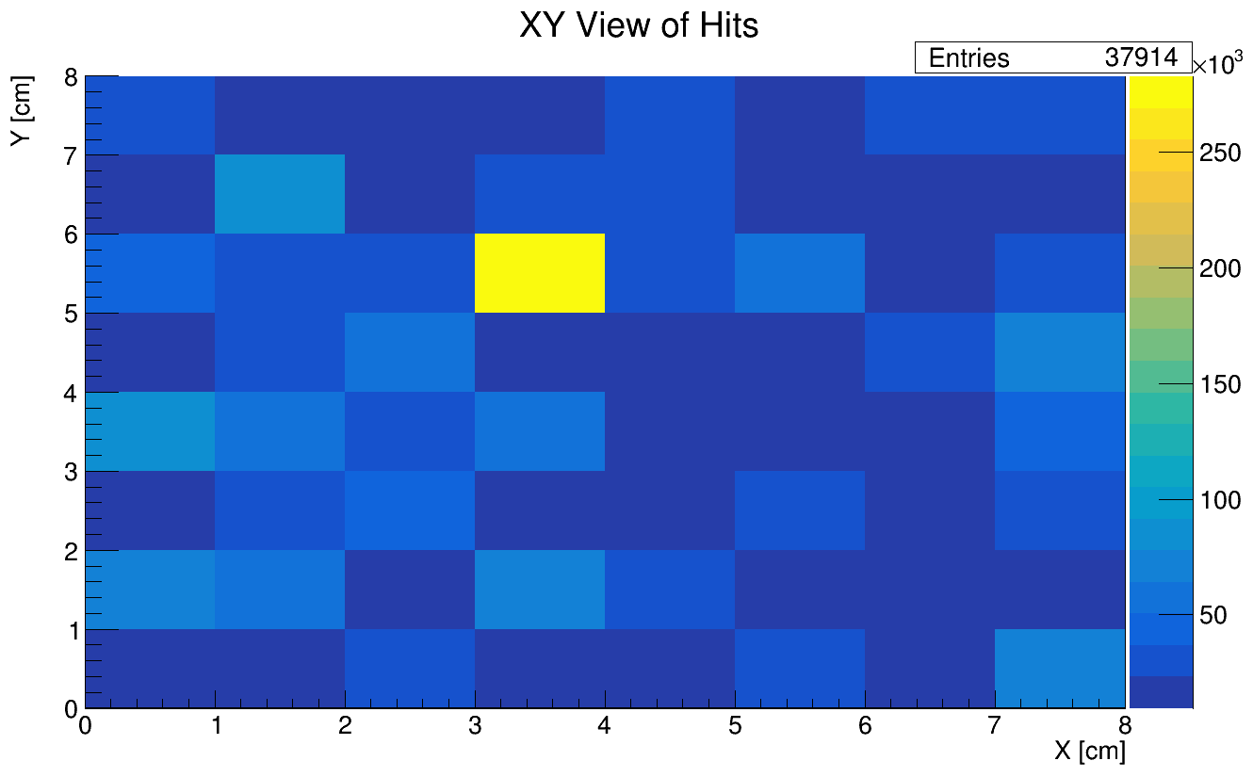
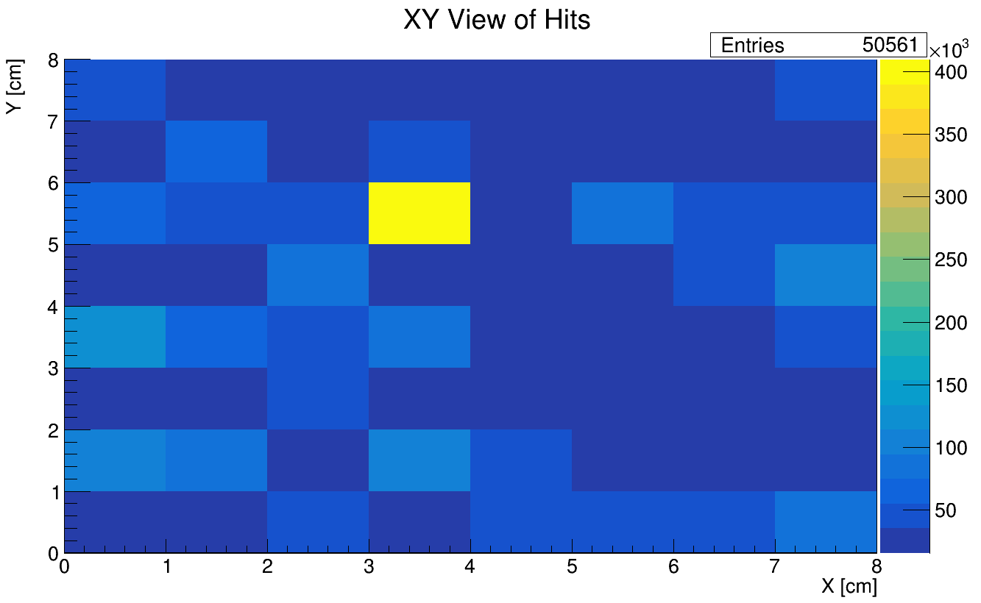
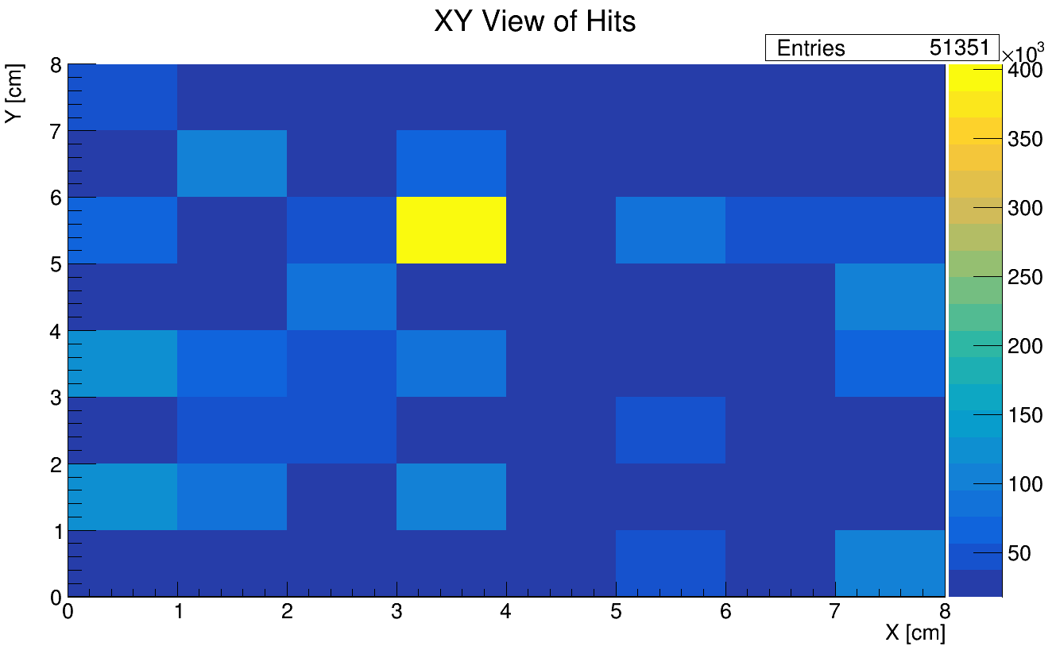
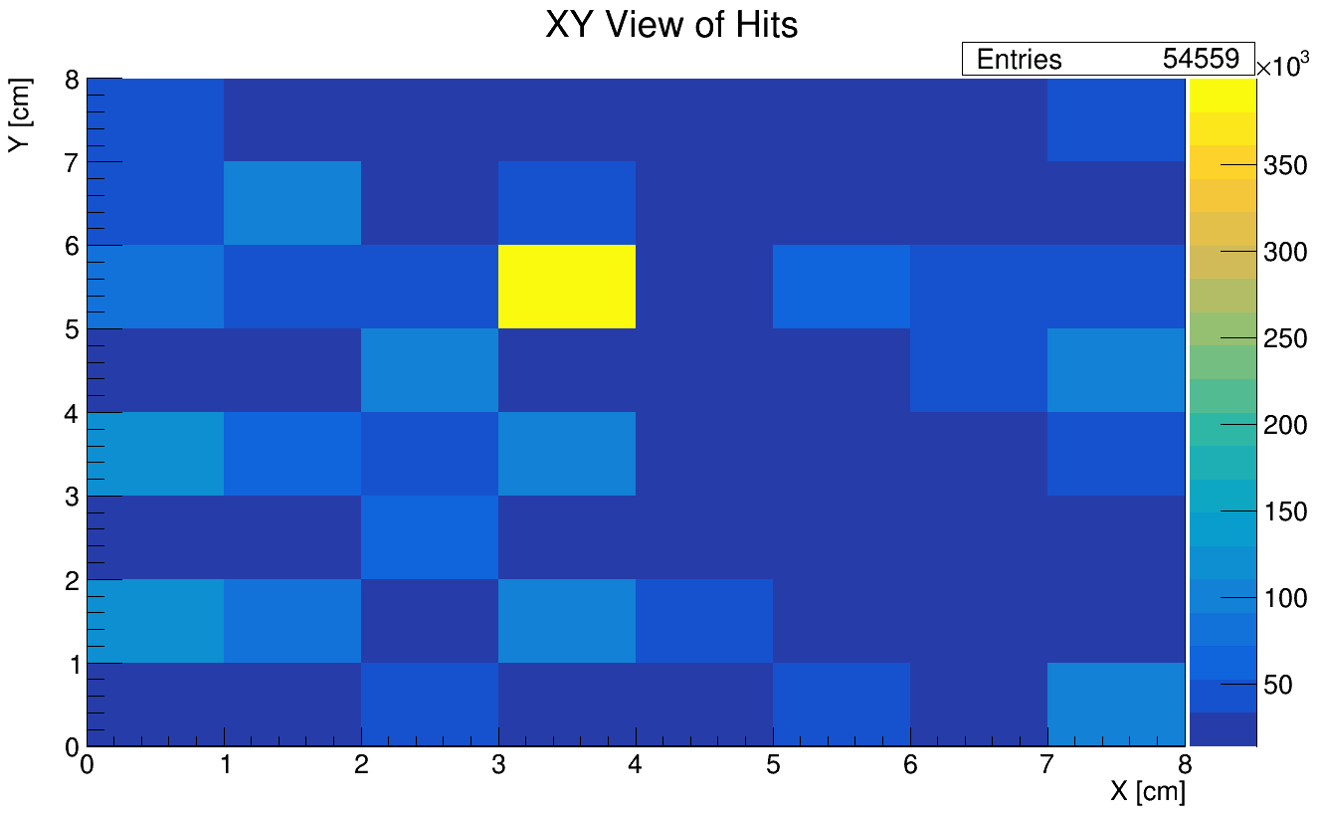
XY ADC Counts: Lights Off Trials
2/6 Sub-runs got corrupted, so only has ~2/3 of normal data
CU LB, No Felt
CU LB + UPenn Black Sheet
CU LB with Felt
UPenn Black Sheet only

Slide 10
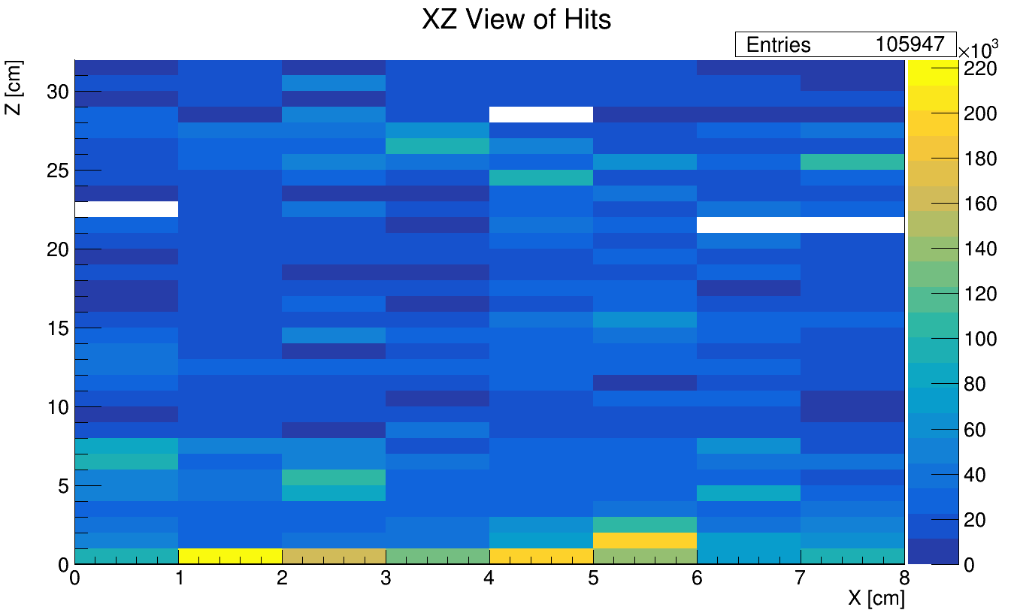
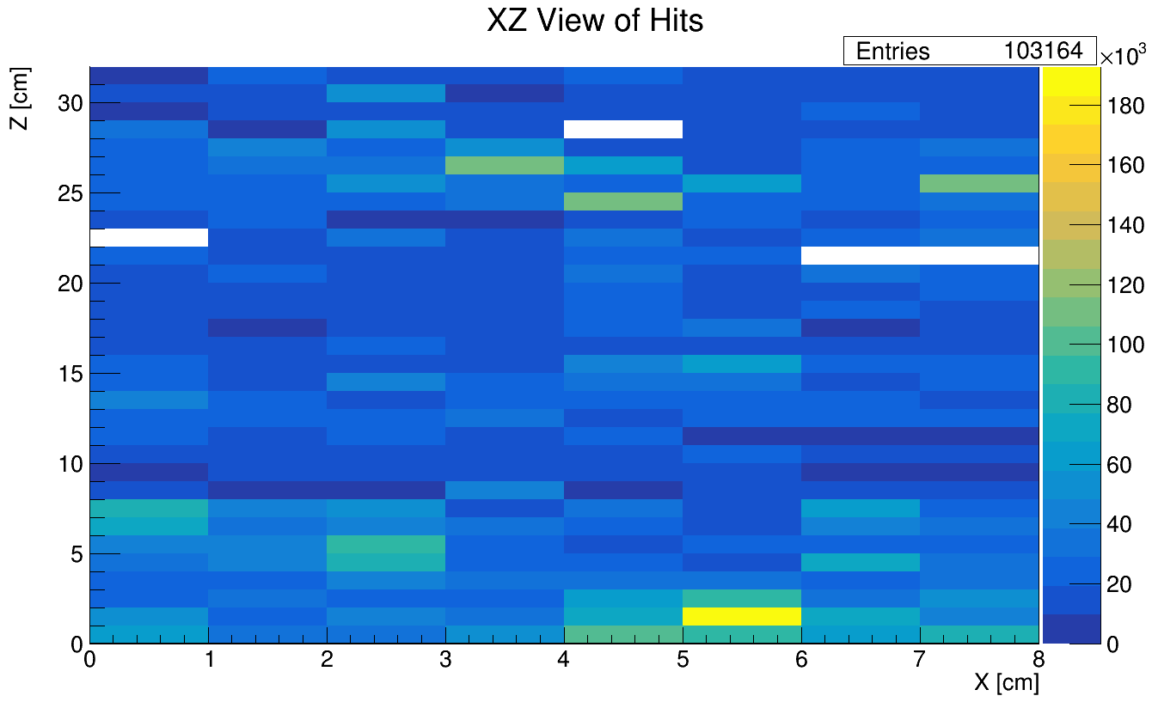
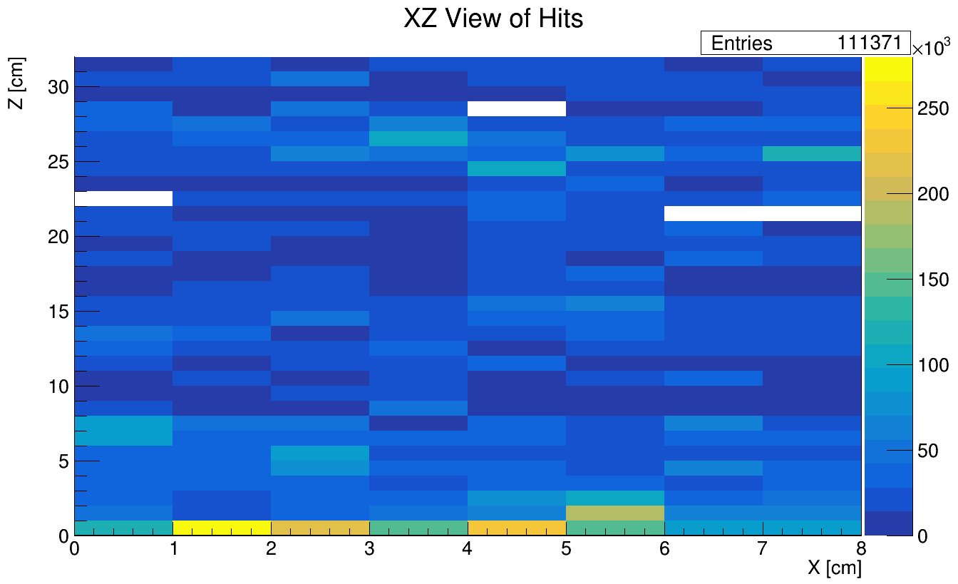
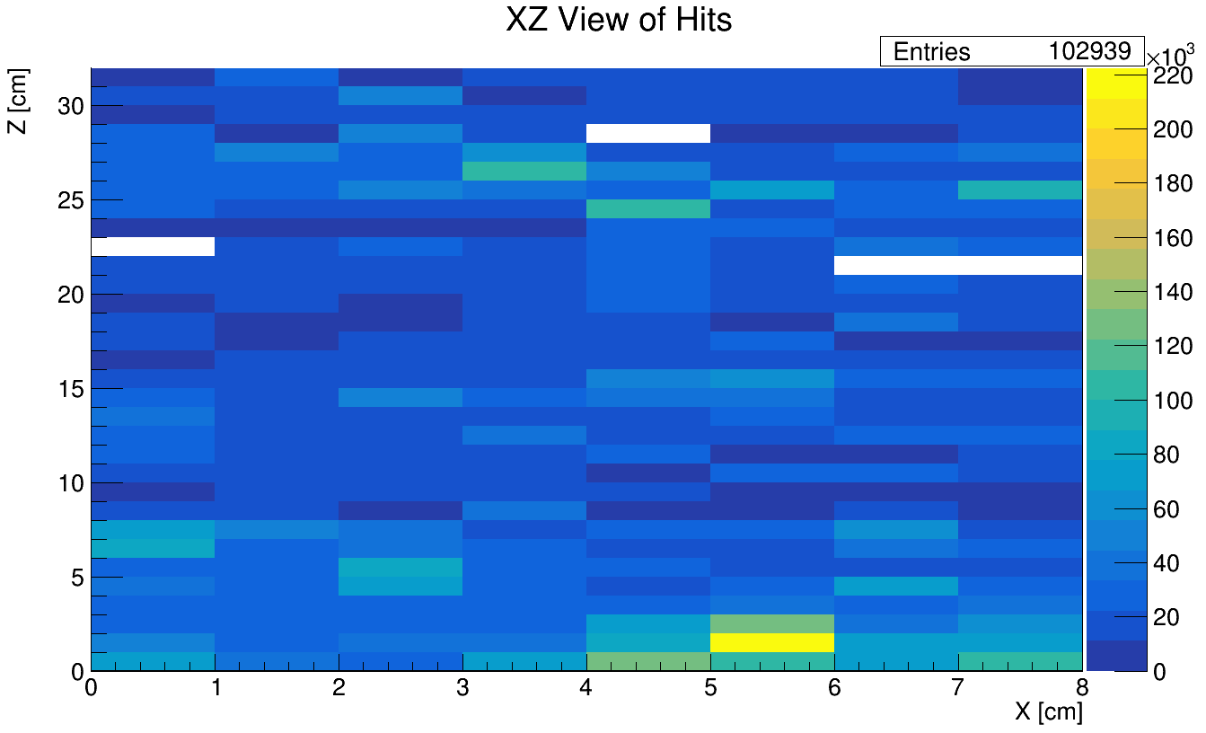
XZ ADC Counts: Lights On Trials
CU LB, No Felt
CU LB + UPenn Black Sheet
What’s going on here?
CU LB with Felt
Light leak on LB edge?
UPenn Black Sheet only

Slide 11
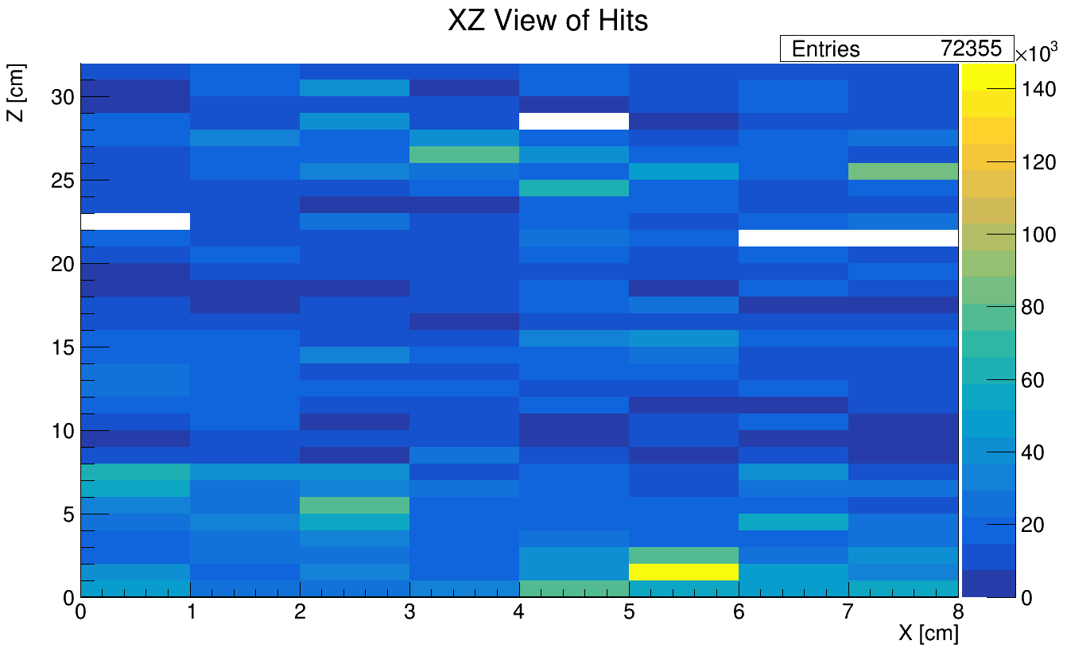
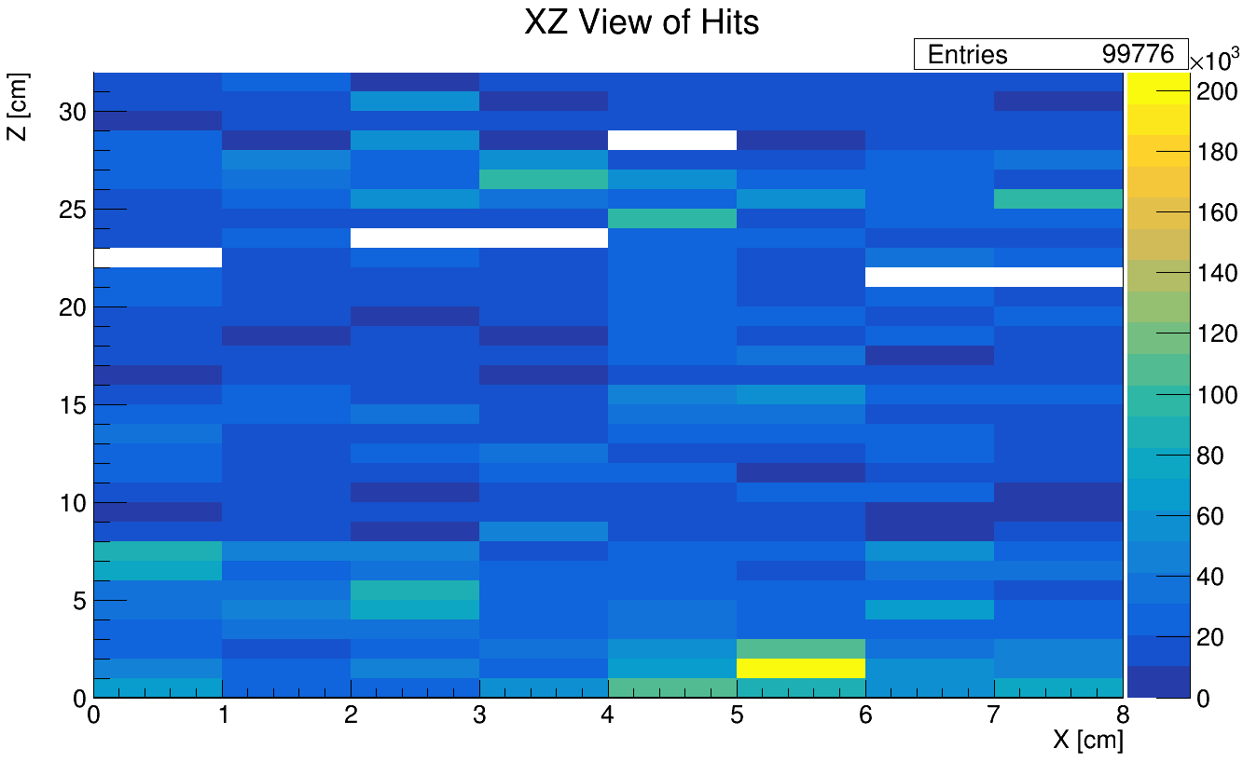
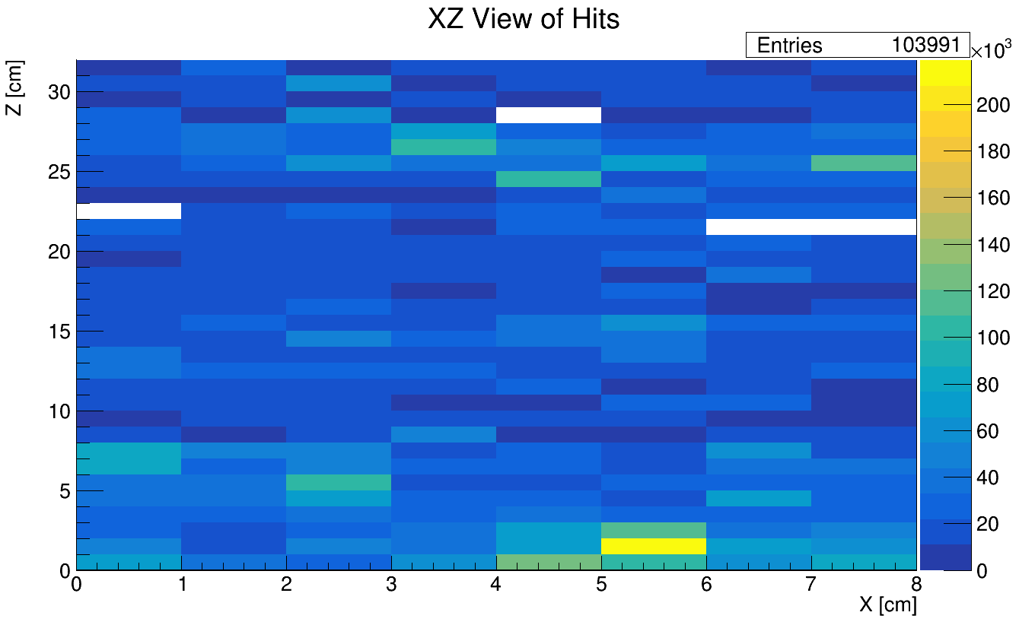
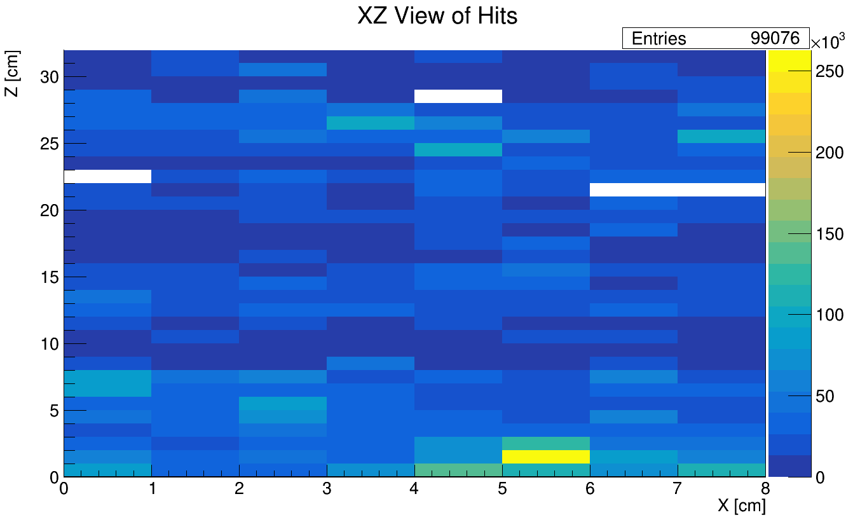
XZ ADC Counts: Lights Off Trials
2/6 Sub-runs got corrupted, so only has ~2/3 of normal data
CU LB, No Felt
CU LB + UPenn Black Sheet
CU LB with Felt
UPenn Black Sheet only

Slide 12
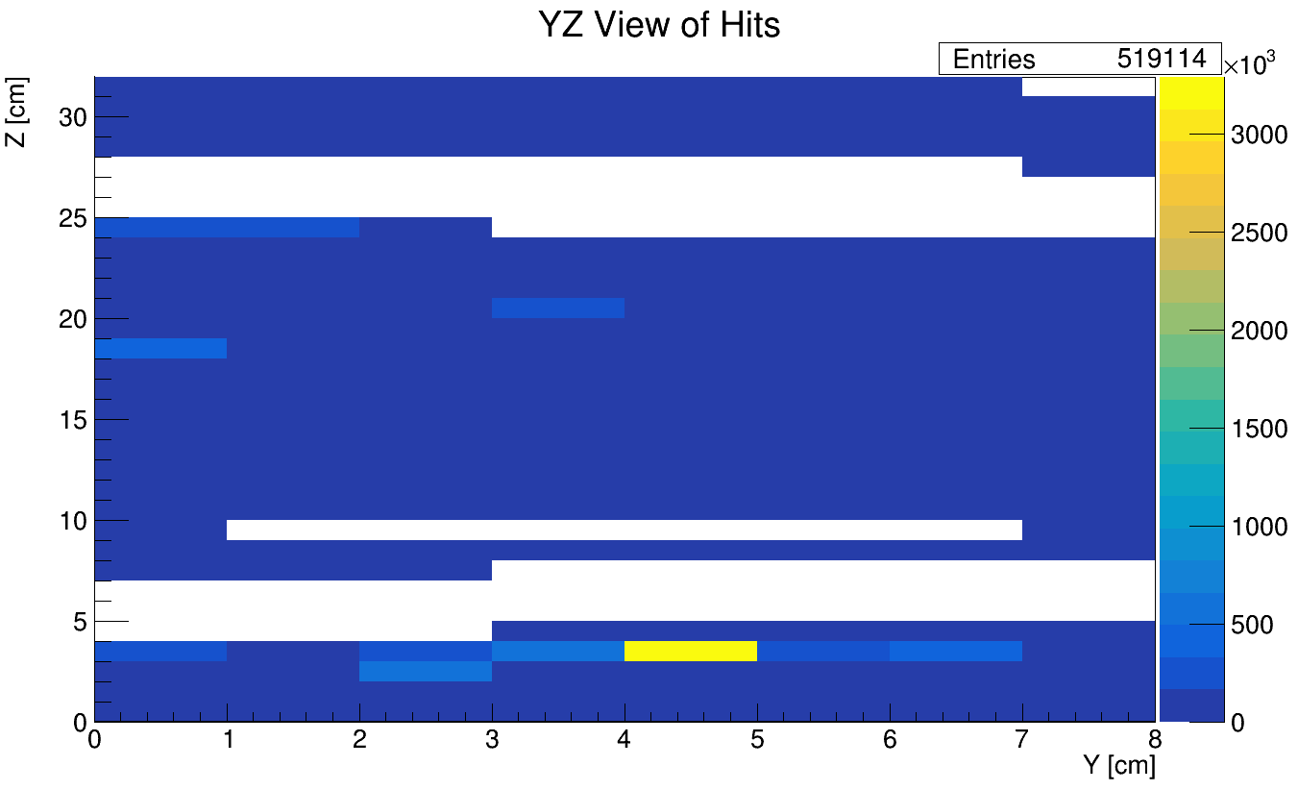
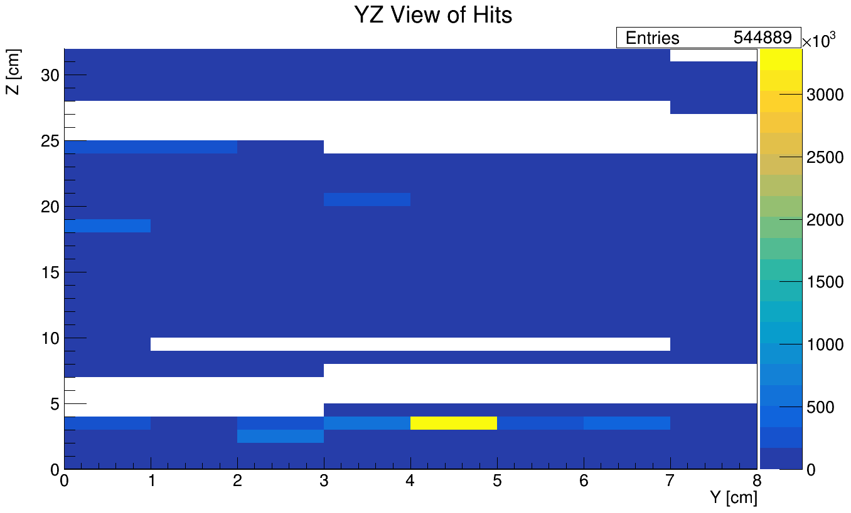
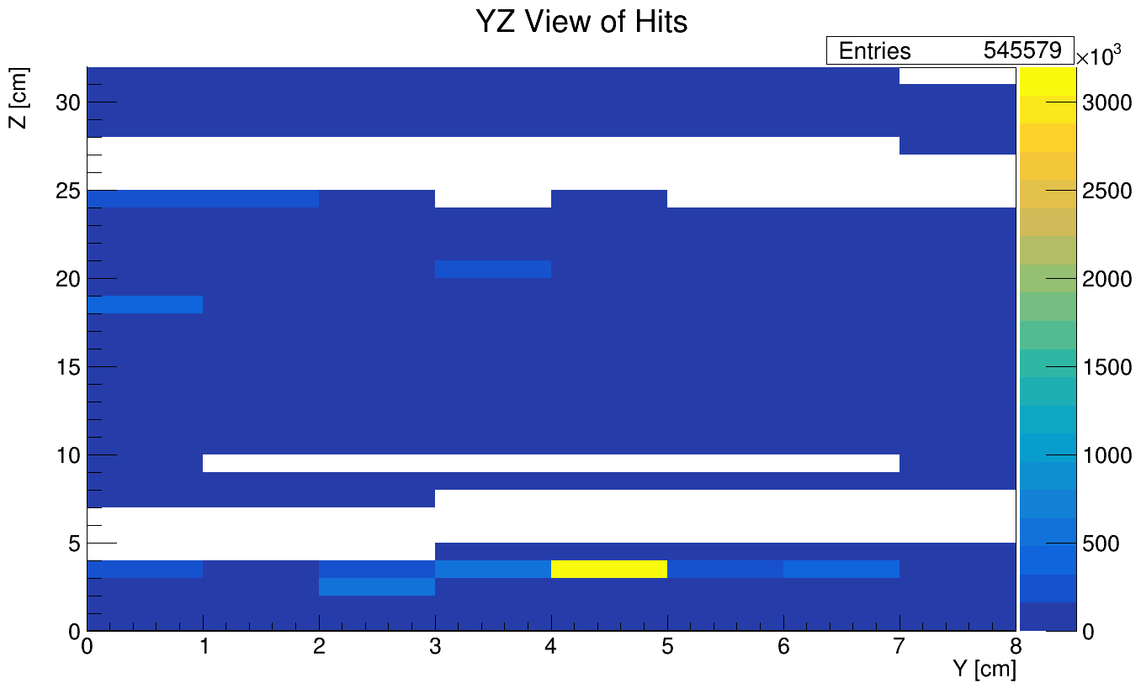
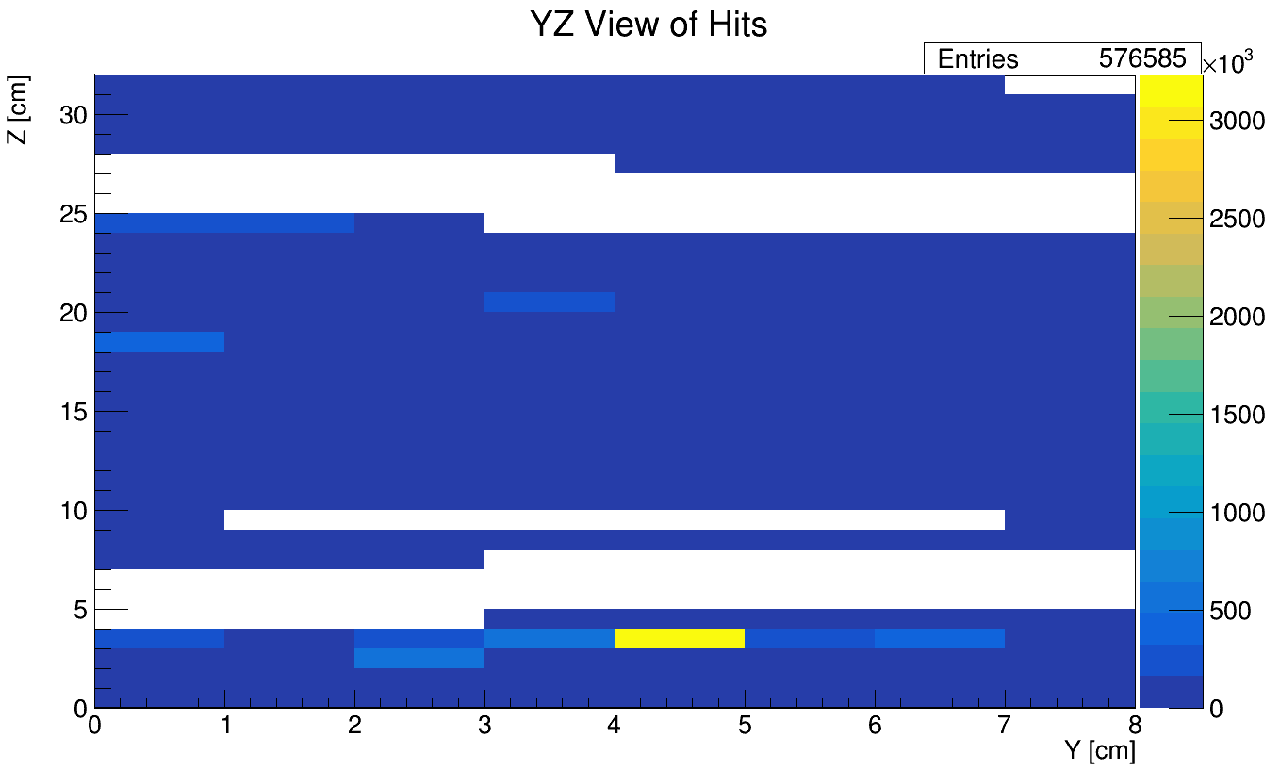
YZ ADC Counts: Lights On Trials
CU LB, No Felt
CU LB + UPenn Black Sheet
CU LB with Felt
UPenn Black Sheet only

Slide 13
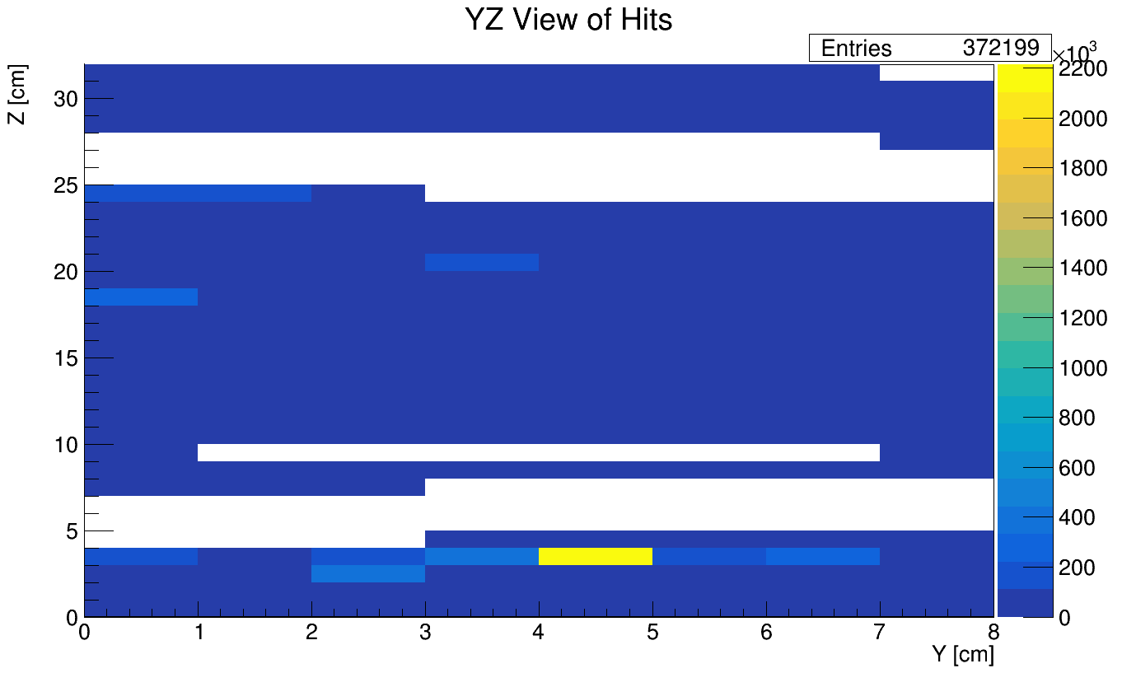
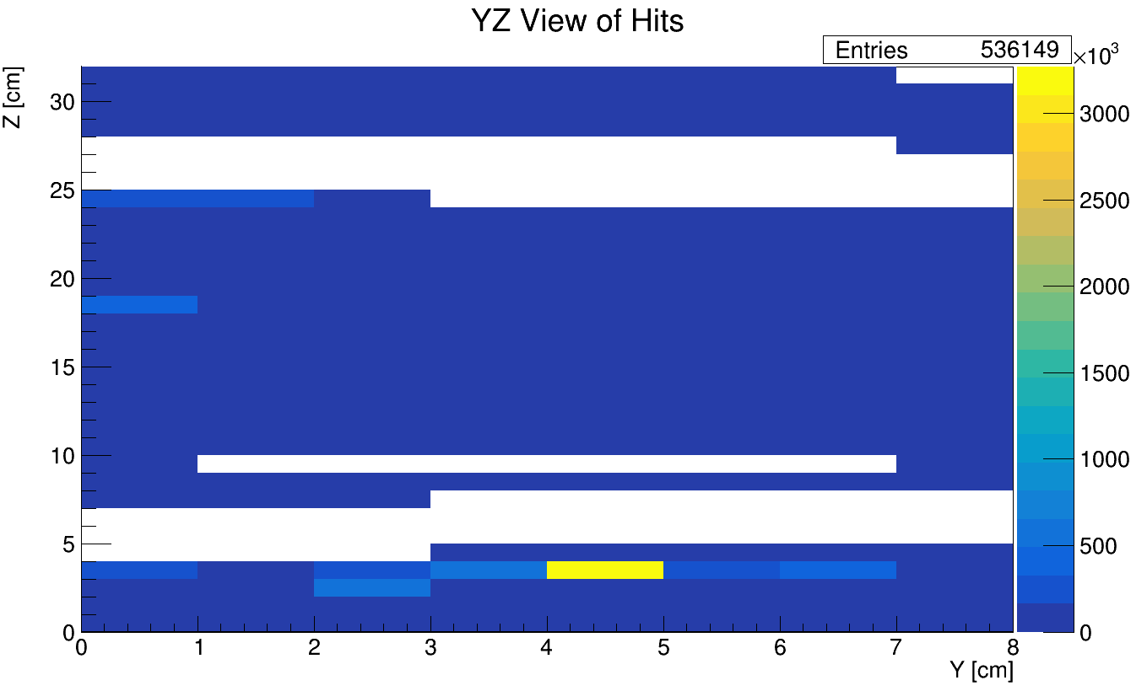

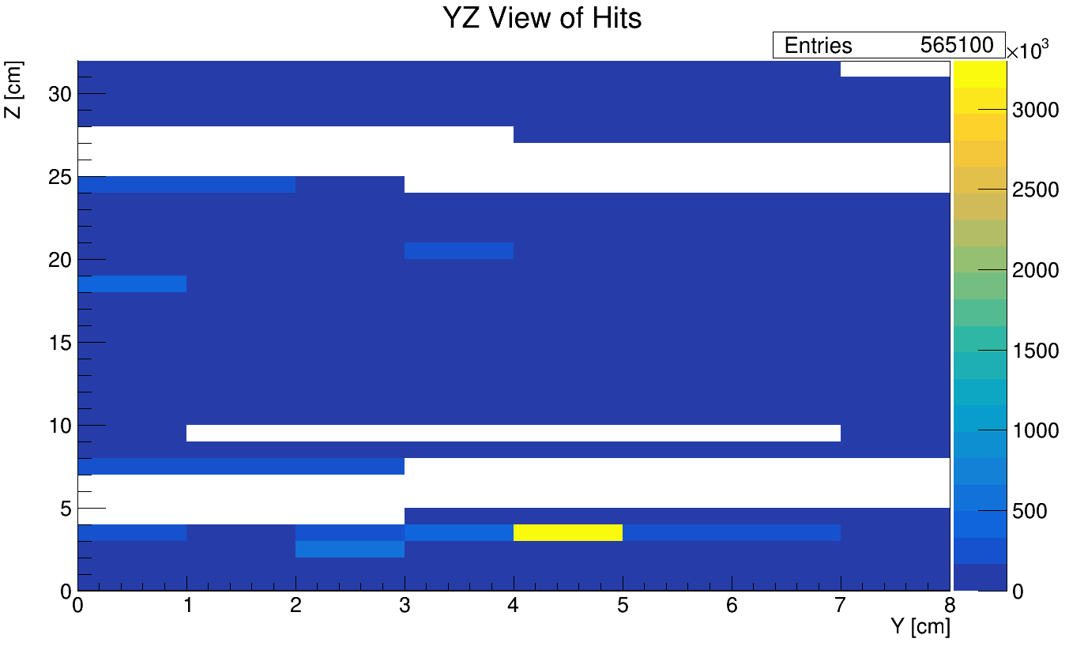
YZ ADC Counts: Lights Off Trials
2/6 Sub-runs got corrupted, so only has ~2/3 of normal data
CU LB, No Felt
CU LB + UPenn Black Sheet
CU LB with Felt
UPenn Black Sheet only

Slide 14
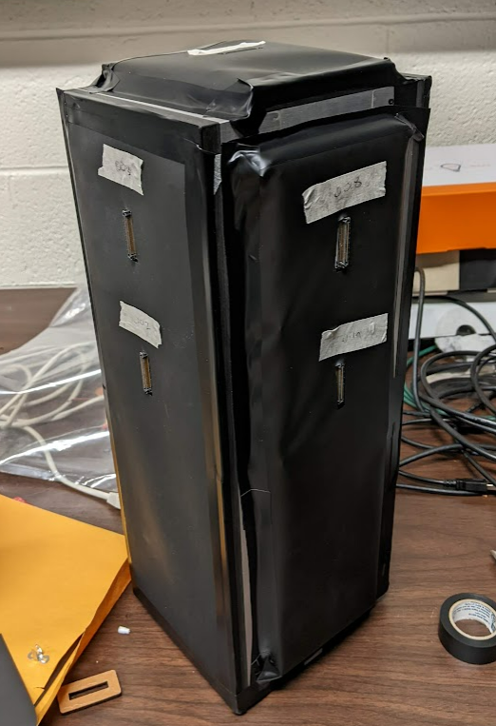

Light Leak?
Significantly enhanced signal in XZ edge channels; only appears when lab lights are on
Possible that the electrical tape seal was imperfect for one of the edges, allowing some light leak.
  Polyester did puff out on some of the faces, and attaching was difficult
If we consider this as a light leak, others should be easily identifiable!
?

Slide 15
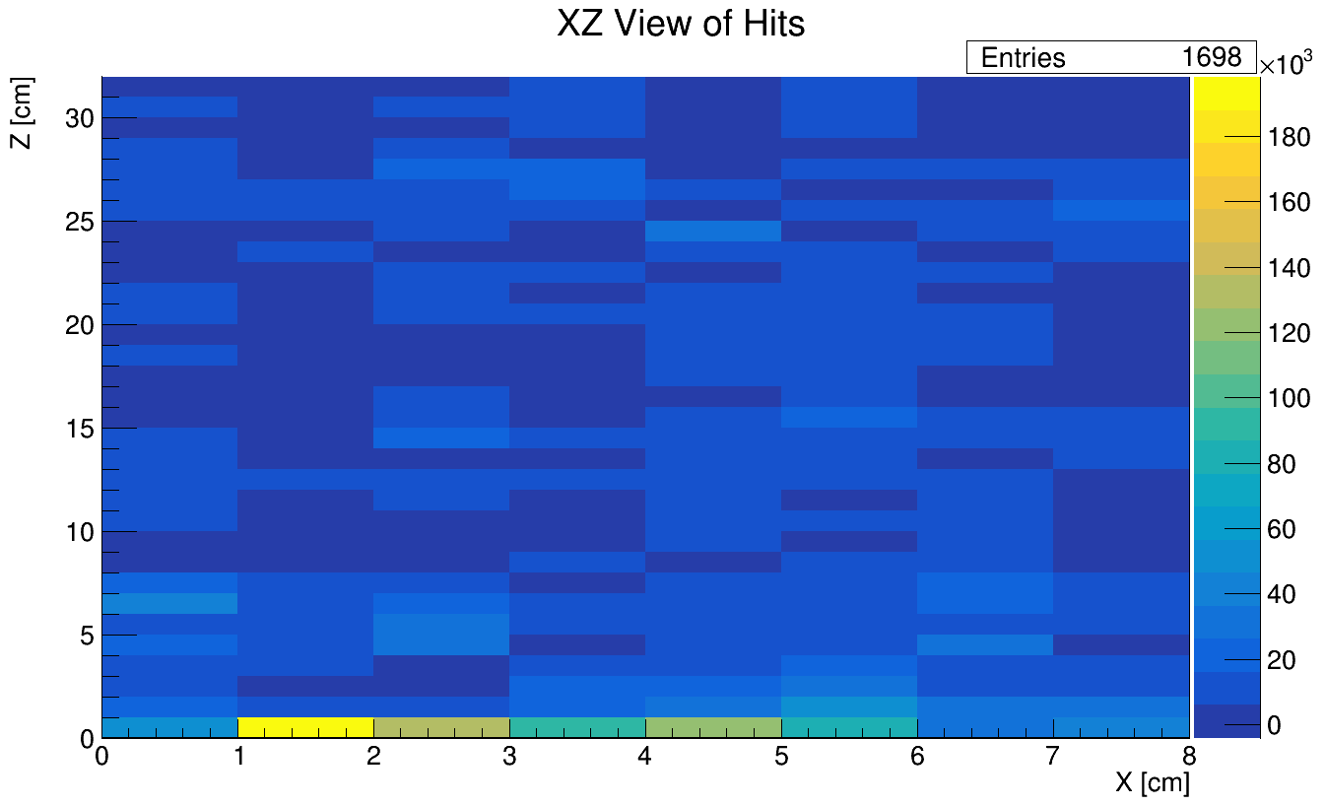
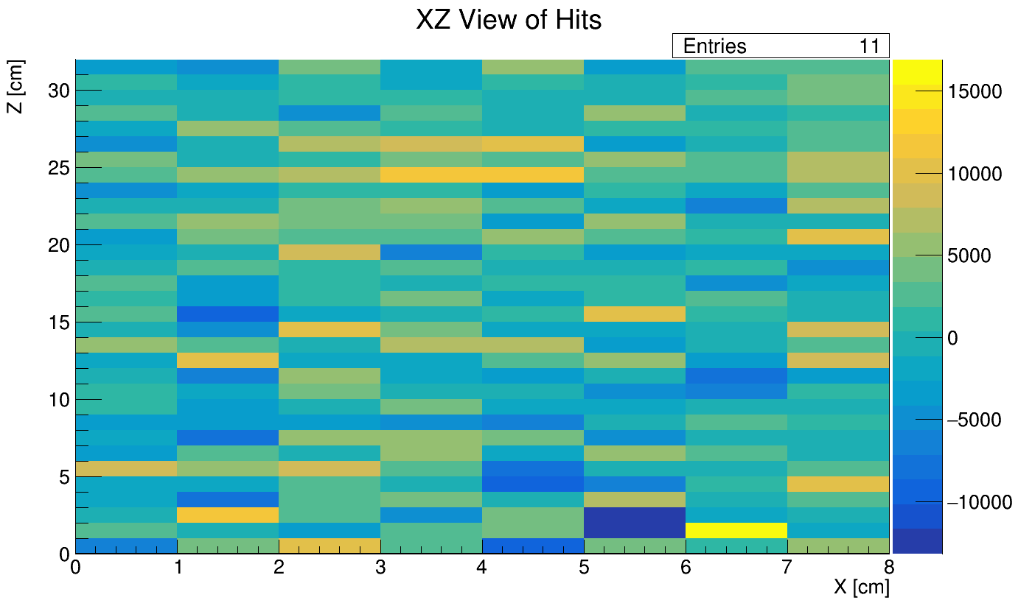
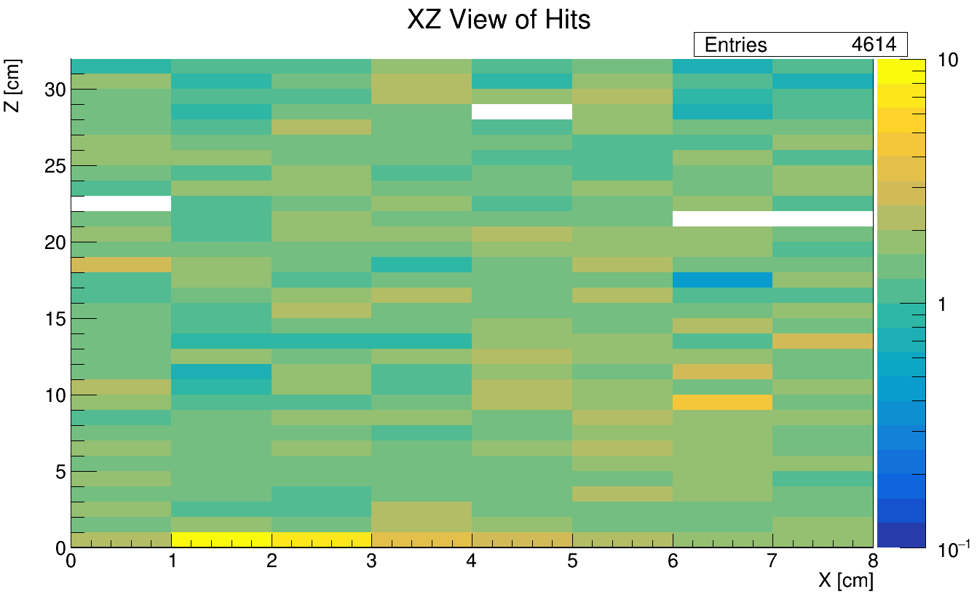
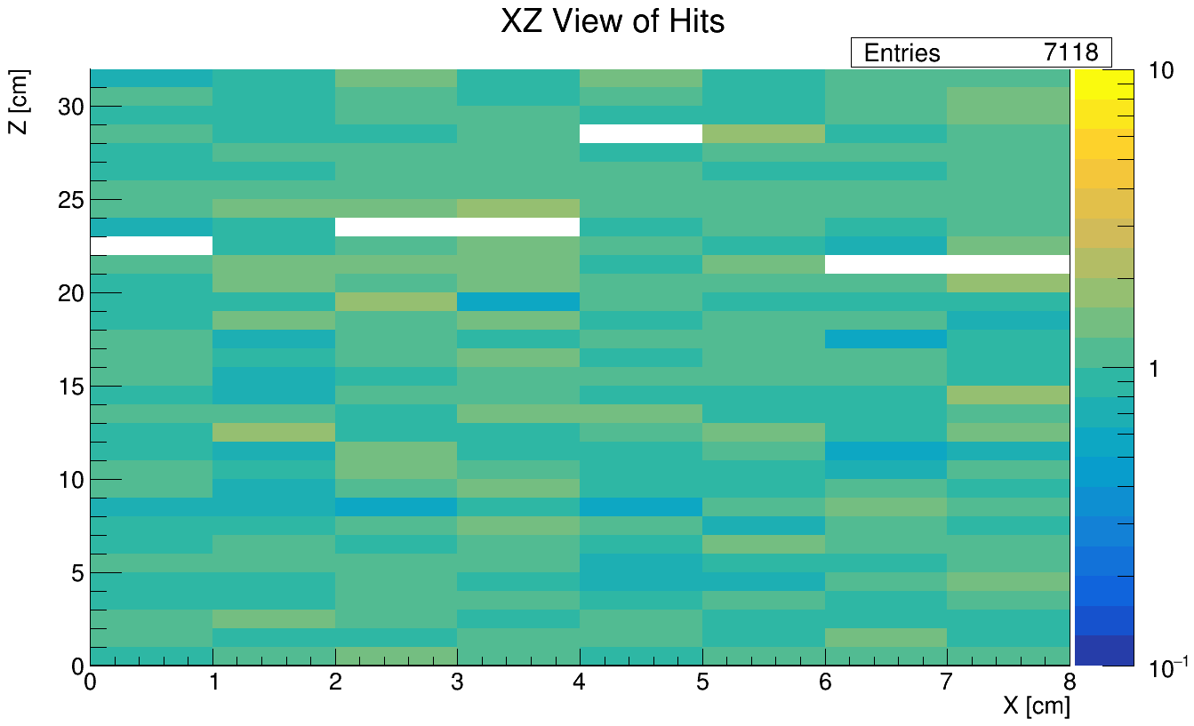




Light Leak?
Normal Diffs $≲{10}^{4}$
Leak Diff $\sim {10}^{5}$
CU LB, No Felt; Lights ON – OFF diff
CU LB + UPenn Black Sheet;
Lights ON – OFF diff
Normal Ratios $\sim 1$
Leak Ratio $\sim 10$x
CU LB, no Felt; Lights ON / OFF ratio
CU LB + UPenn Black Sheet;
Lights ON / OFF ratio

Slide 16
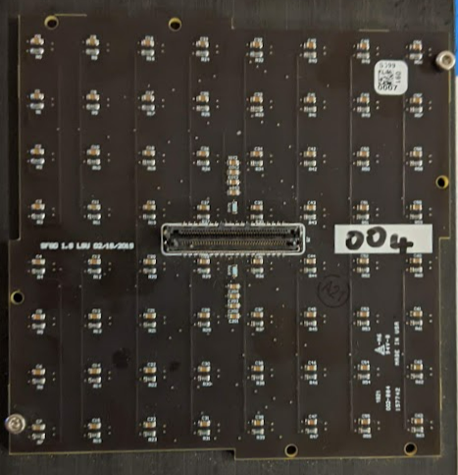
Effect of the Felt Rings
If we reference the edge leak as a standard, there is nothing on this scale near SAMTEC connection site
Would see some enhanced signal in the central MPPCs for no felt runs with lights on
CU LB, No Felt, lights on
Look at central 4x4 since the orientation of the connector is ambiguous
CU LB with Felt, lights on

Slide 17
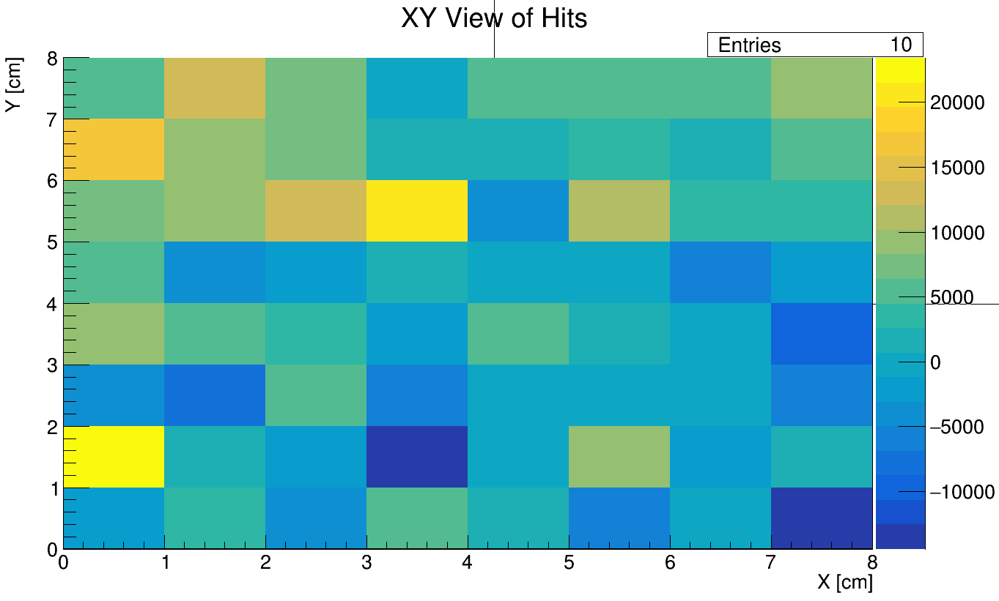
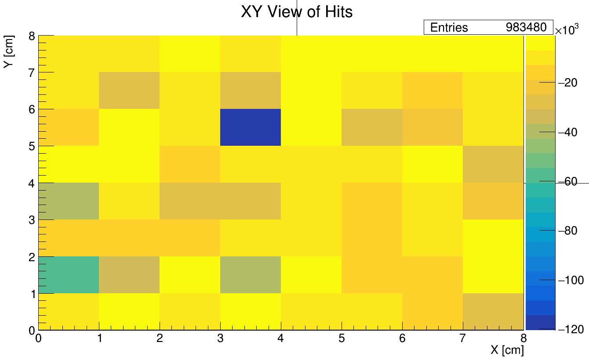
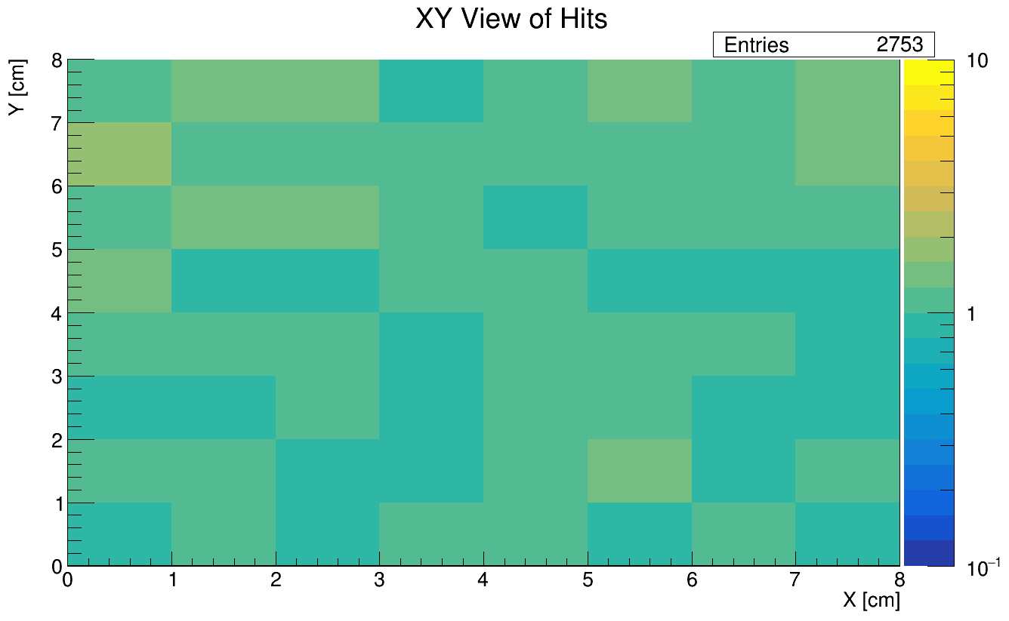
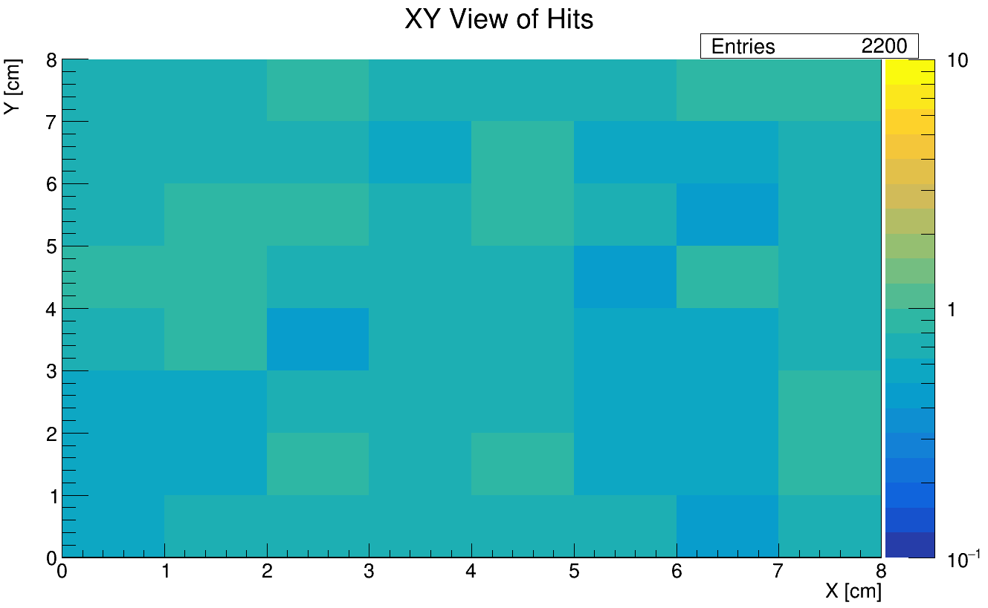
Effect of the Felt Rings – XY
** Expected 2/3 shortage due to corrupted data runs
CU LB, Lights on;
No felt – with felt diff
CU LB, Lights off;
No felt – with felt diff
** Expected 2/3 shortage due to corrupted data runs
CU LB, Lights on;
No felt / with felt ratio
CU LB, Lights off;
No felt / with felt ratio

Slide 18
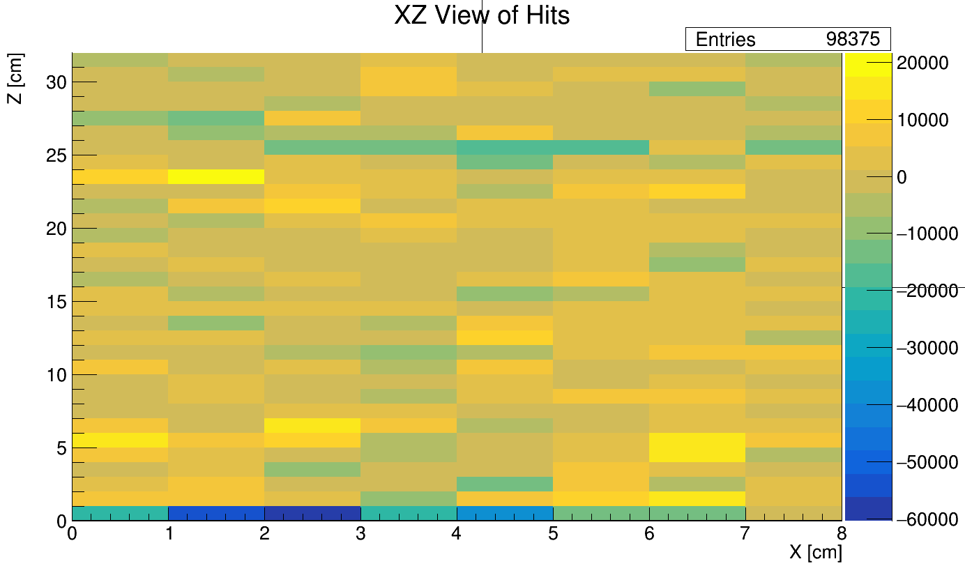



* NOTE: If outlier channels were true leaks, we would expect a discrepancy between the lights on and lights off trials
Effect of the Felt Rings – XZ
** Expected 2/3 shortage due to corrupted data runs
CU LB, Lights on;
No felt – with felt diff
CU LB, Lights off;
No felt – with felt diff
Same hot channels with lights on and off
(channels went cold for some of the later runs)
** Expected 2/3 shortage due to corrupted data runs
CU LB, Lights on;
No felt / with felt ratio
CU LB, Lights off;
No felt / with felt ratio

Slide 19




* NOTE: If outlier channels were true leaks, we would expect a discrepancy between the lights on and lights off trials
Effect of the Felt Rings – YZ
** Expected 2/3 shortage due to corrupted data runs
CU LB, Lights on;
No felt – with felt diff
CU LB, Lights off;
No felt – with felt diff
** Expected 2/3 shortage due to corrupted data runs
CU LB, Lights on;
No felt / with felt ratio
CU LB, Lights off;
No felt / with felt ratio

Slide 20

Conclusions
There is no light leak near the SAMTEC connectors on the scale of the light barrier edge leak
  The felt rings around the connectors may not be necessary
A light leak was visible near the edge of one polyester sheet
  Characterized by significantly amplified ADC signal ($\sim$10x higher) that only appears in runs with the lab lights on
  Will have to be more careful when installing the light barrier
    Ensure it lies (mostly) flat
    Ensure no light gaps at the edges
Overall, the CU light barrier functions at least as well as the black sheet used for the US-Japan prototype at UPenn

Slide 21
Backup

Slide 22
Test Configurations
10 Test Configurations:
Run # | Room Lights | Polyester Sheet | Felt Rings | Penn Light Barrier
202 (206) | On (Off) | Off | Off | Off
211 (212) | On (Off) | On | Off | Off
215 (216) | On (Off) | On | Off | On
219 (220) | On (Off) | On | On | Off
221 (223) | On (Off) | Off | Off | On
No Light Barrier
Polyester Only
Polyester + Black Sheet
Polyester + Felt
Black Sheet Only
** Room lights off ≠ completely dark in the room.
Some light from computer monitors (needed to be on to check for data collection errors) and from readout crates **

Slide 23




CU LB vs Upenn Black Sheet – XY
** Expected 2/3 shortage due to corrupted data runs
CU LB, Lights on;
No felt – with felt diff
CU LB, Lights off;
No felt – with felt diff
** Expected 2/3 shortage due to corrupted data runs
Lights on; CU LB / Black Sheet ratio
Lights off; CU LB / Black Sheet ratio

Slide 24




CU LB vs Upenn Black Sheet – XZ
** Expected 2/3 shortage due to corrupted data runs
CU LB, Lights on;
No felt – with felt diff
CU LB, Lights off;
No felt – with felt diff
Cooled off channels
** Expected 2/3 shortage due to corrupted data runs
Light Leak
Lights on; CU LB / Black Sheet ratio
Lights off; CU LB / Black Sheet ratio

Slide 25




CU LB vs Upenn Black Sheet – YZ
** Expected 2/3 shortage due to corrupted data runs
CU LB, Lights on;
No felt – with felt diff
CU LB, Lights off;
No felt – with felt diff
** Expected 2/3 shortage due to corrupted data runs
Lights on; CU LB / Black Sheet ratio
Lights off; CU LB / Black Sheet ratio

