Slide 1
Installing the foam and closing the SFGD box
L. Bartoszek
BARTOSZEK ENGINEERING
8/14/22

Slide 2
Foam assembly proposal
I have a few proposed tools to allow the large foam pieces to be glued to the sides of the box
I have four new glues to test for the foam assembly
  First glue tested was not strong enough
I have the report on the measurement of the foam and have calculated the force required to compress the foam by the expected amounts

Slide 3
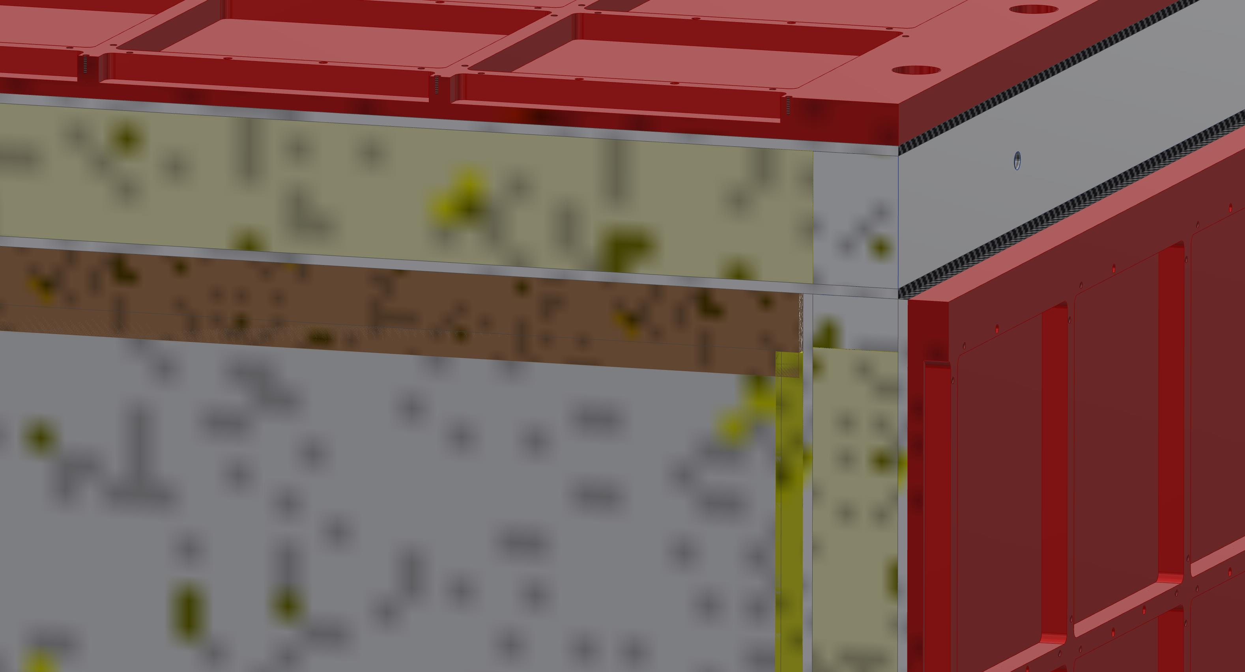
Vertical plane section view looking downstream
DIVINYCELL
TOP PLATE FOAM
CUBES
The top foam is .75 inches thick and is compressed by 5.9 mm
The BR foam is compressed by 1.28 mm

Slide 4
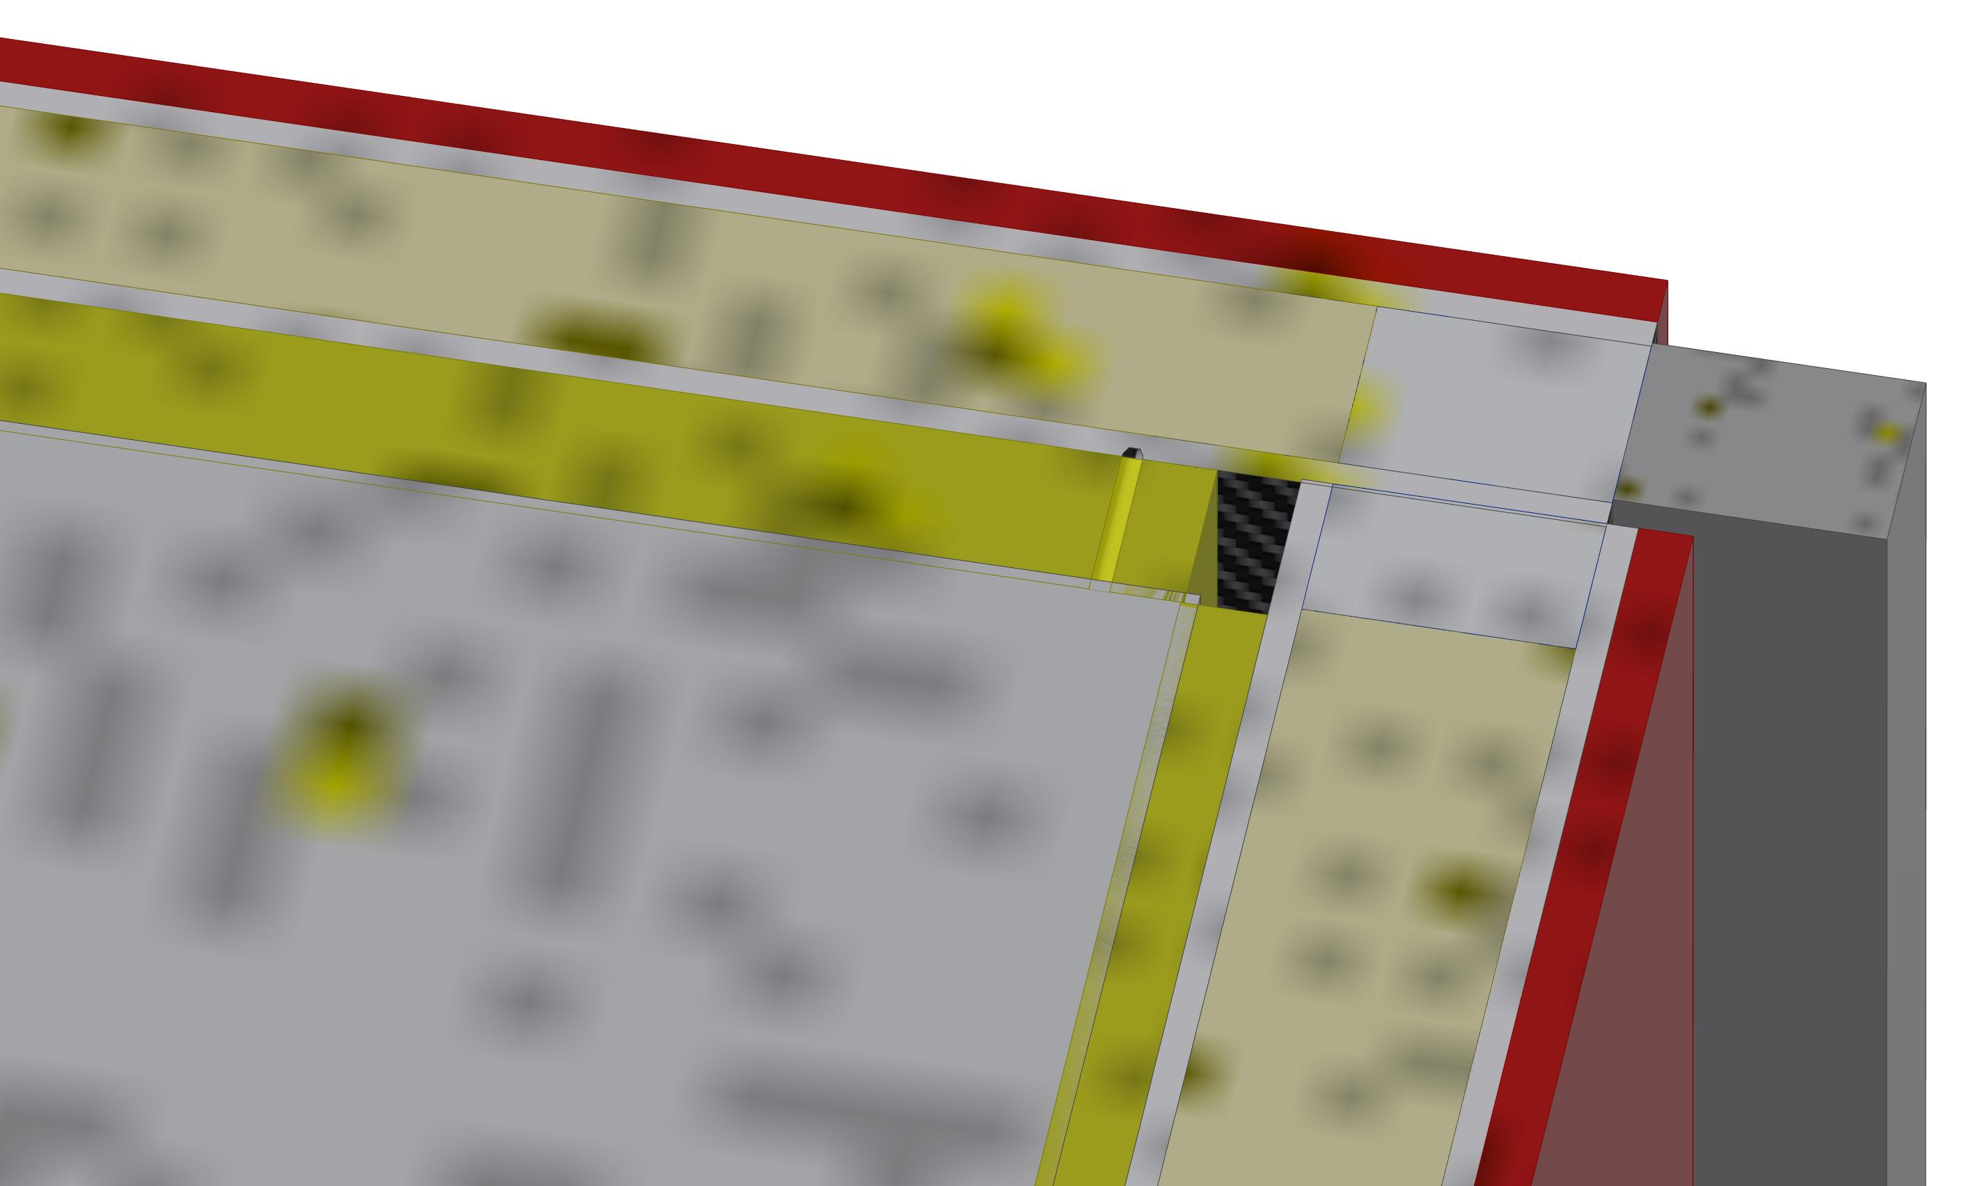
Horizontal plane section view showing the DS and BR intersection
The DS foam is compressed by .93 mm

Slide 5
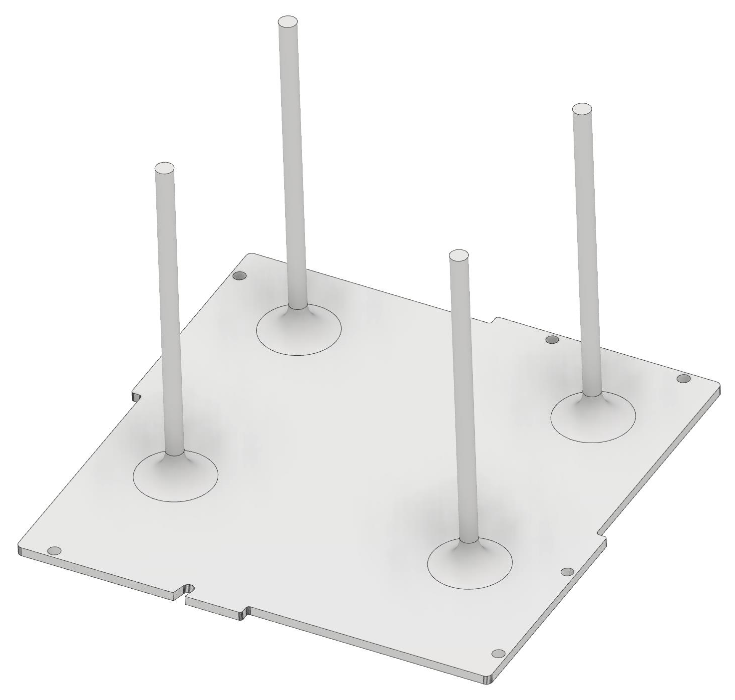
MPPC-like 3D printed tool to locate foam on the top plate
The beam right tool is similar, but the legs are shorter because the plate and foam are thinner.
This tool is held on by the same M2 bolts that hold the MPPC boards on.

Slide 6
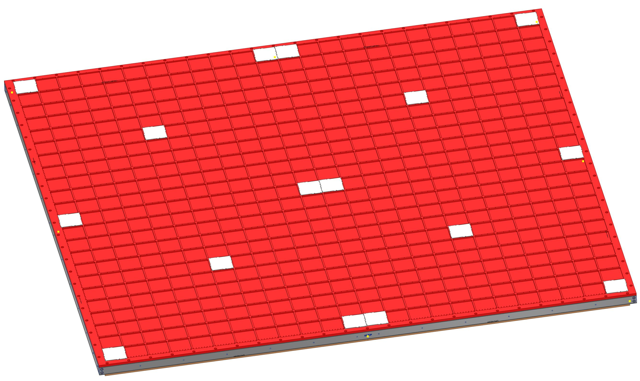
Possible distribution of guides on the top plate
There will be four pieces of .75 inch foam to attach to the top plate
12 strips, 2 MPPCs wide might be much easier to handle with less stretching.

Slide 7
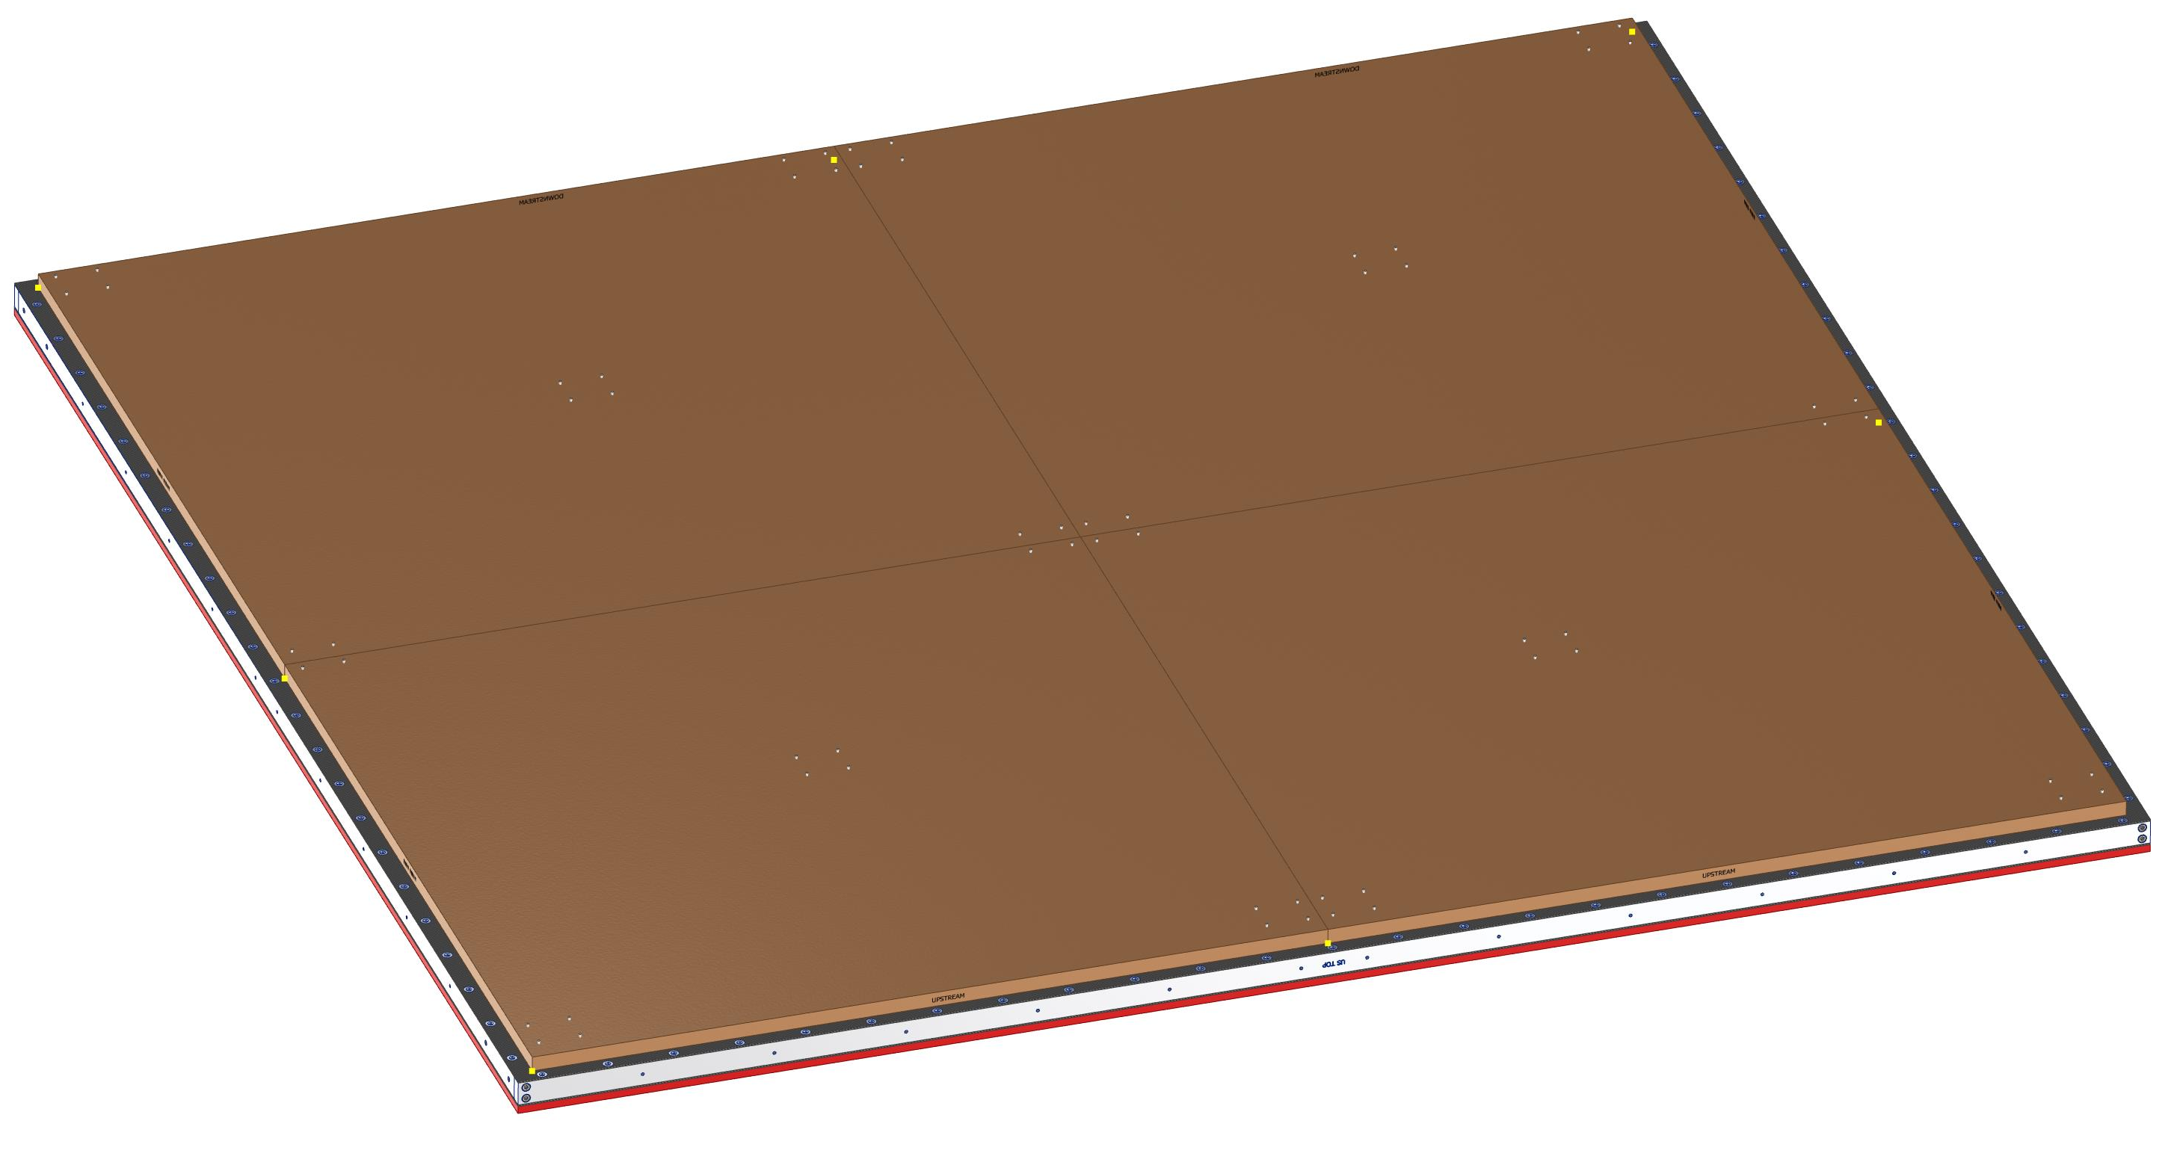
View of the foam side of the Top Plate with tools poking through
You can see the dividing lines between the foam pieces.

Slide 8
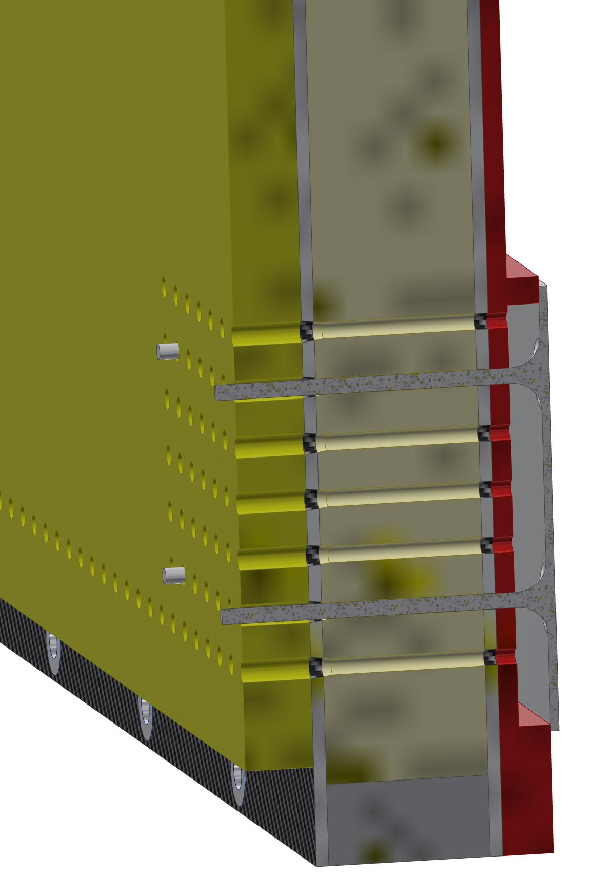
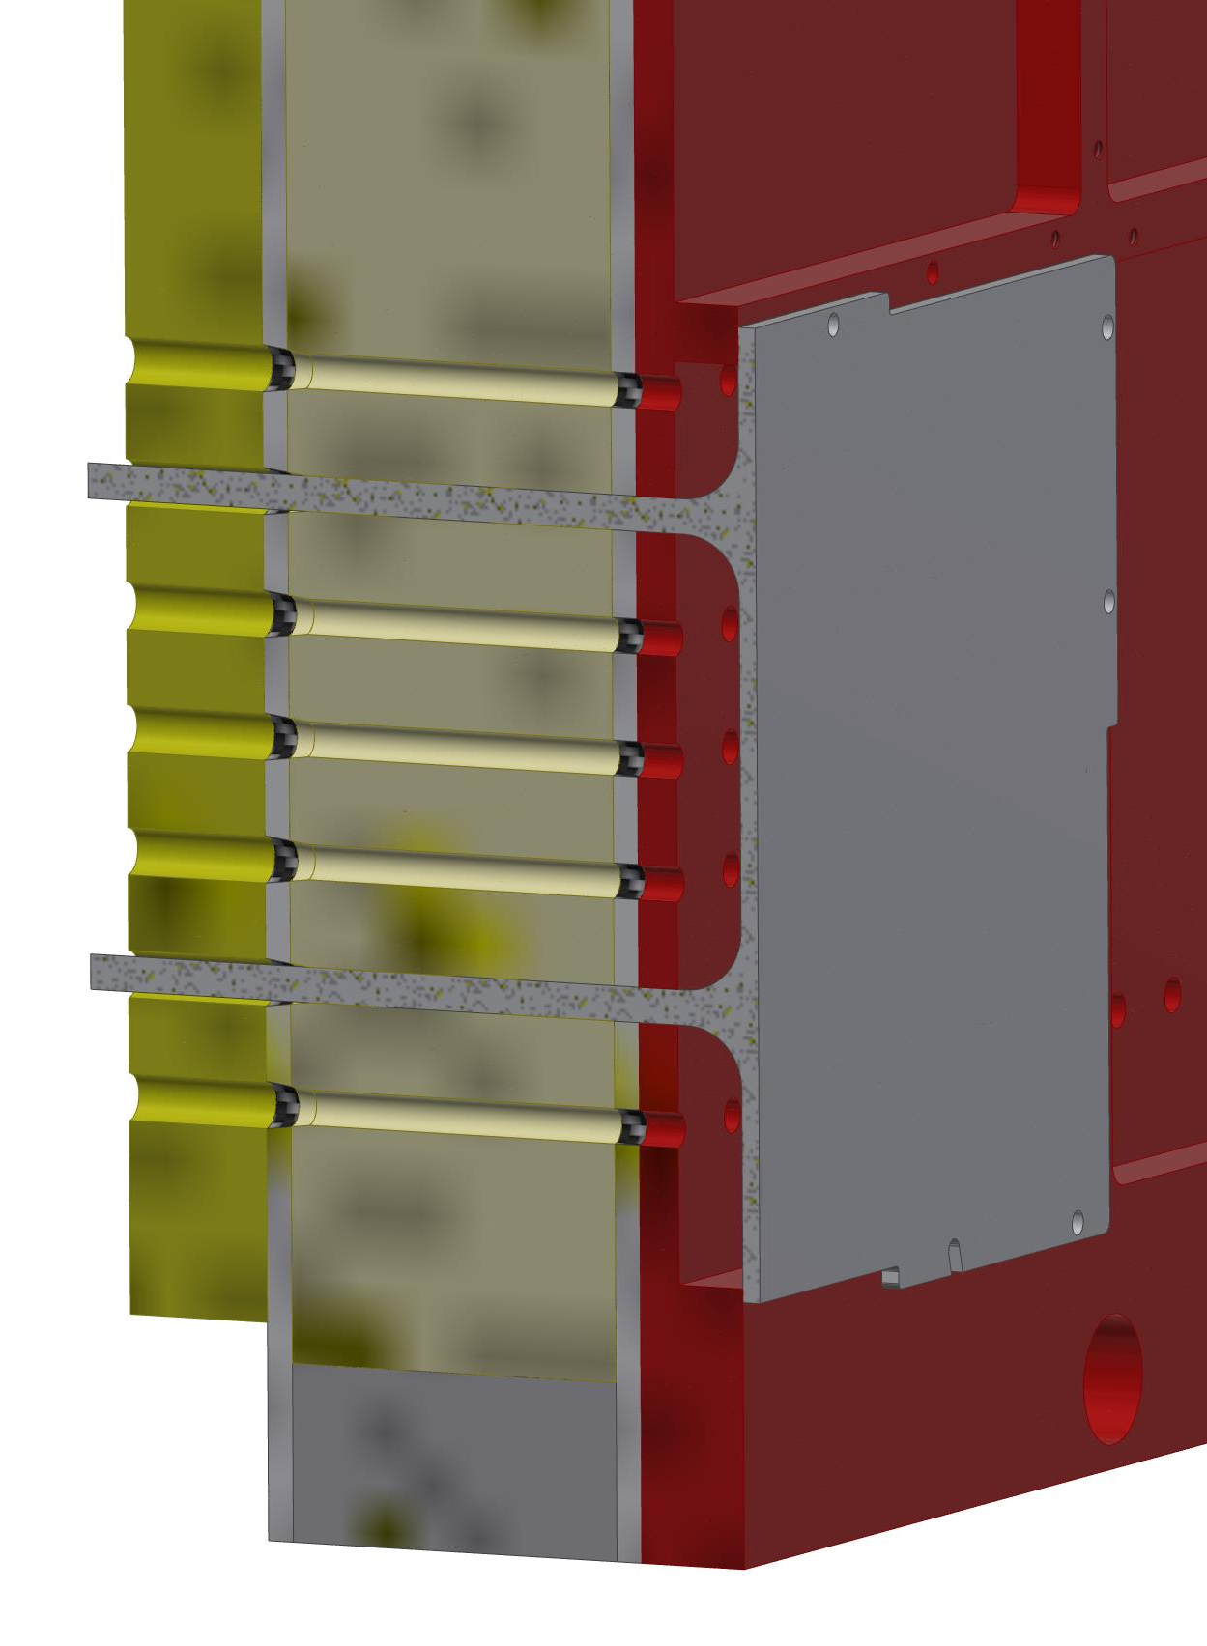
Two section views of the foam locating guide tool

Slide 9
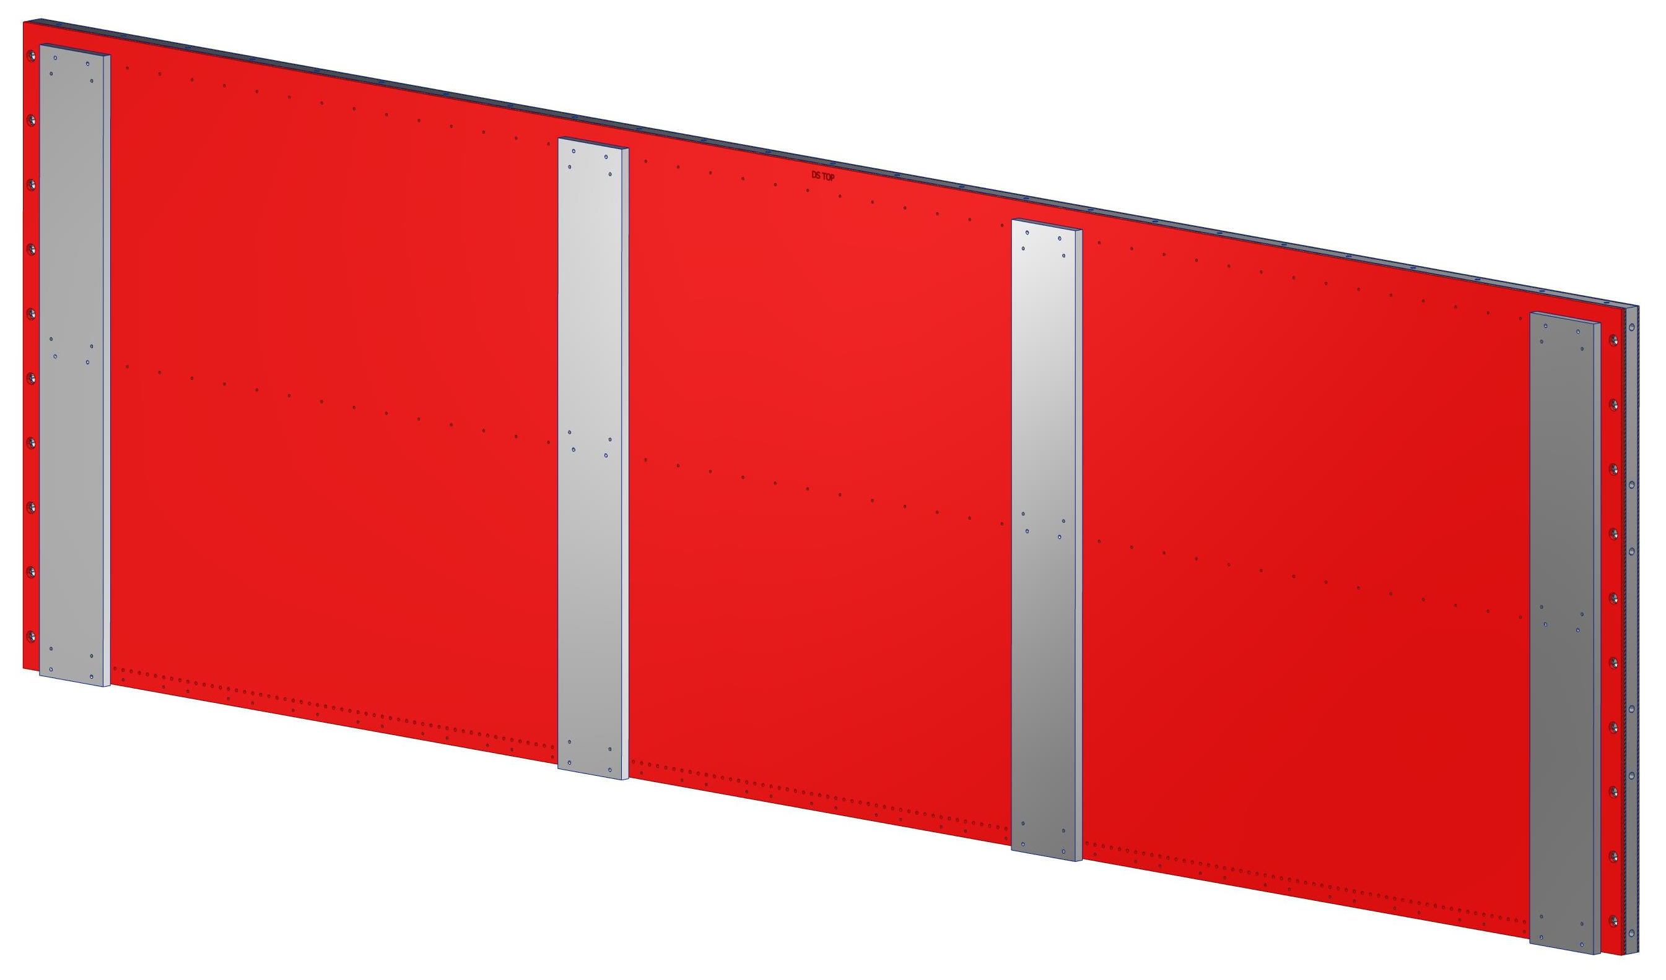
A different style of tool is needed for the DS plate
There will be two sheets of foam to attach to the DS plate

Slide 10
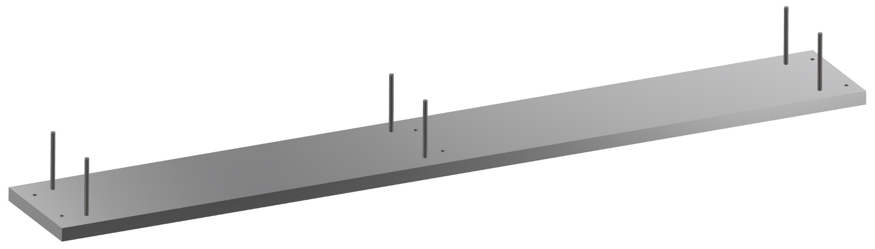
Foam guide tool that works wherever there are calibration modules
This tool is made from a plate of aluminum and six stainless M3 dowel pins 50 mm long. The dowels are press fit into the plate. The screw holes that hold it on match those for the calibration modules.
I made the plate thickness >3X the diameter of the pins to ensure they would be stable and perpendicular to the plate.

Slide 11
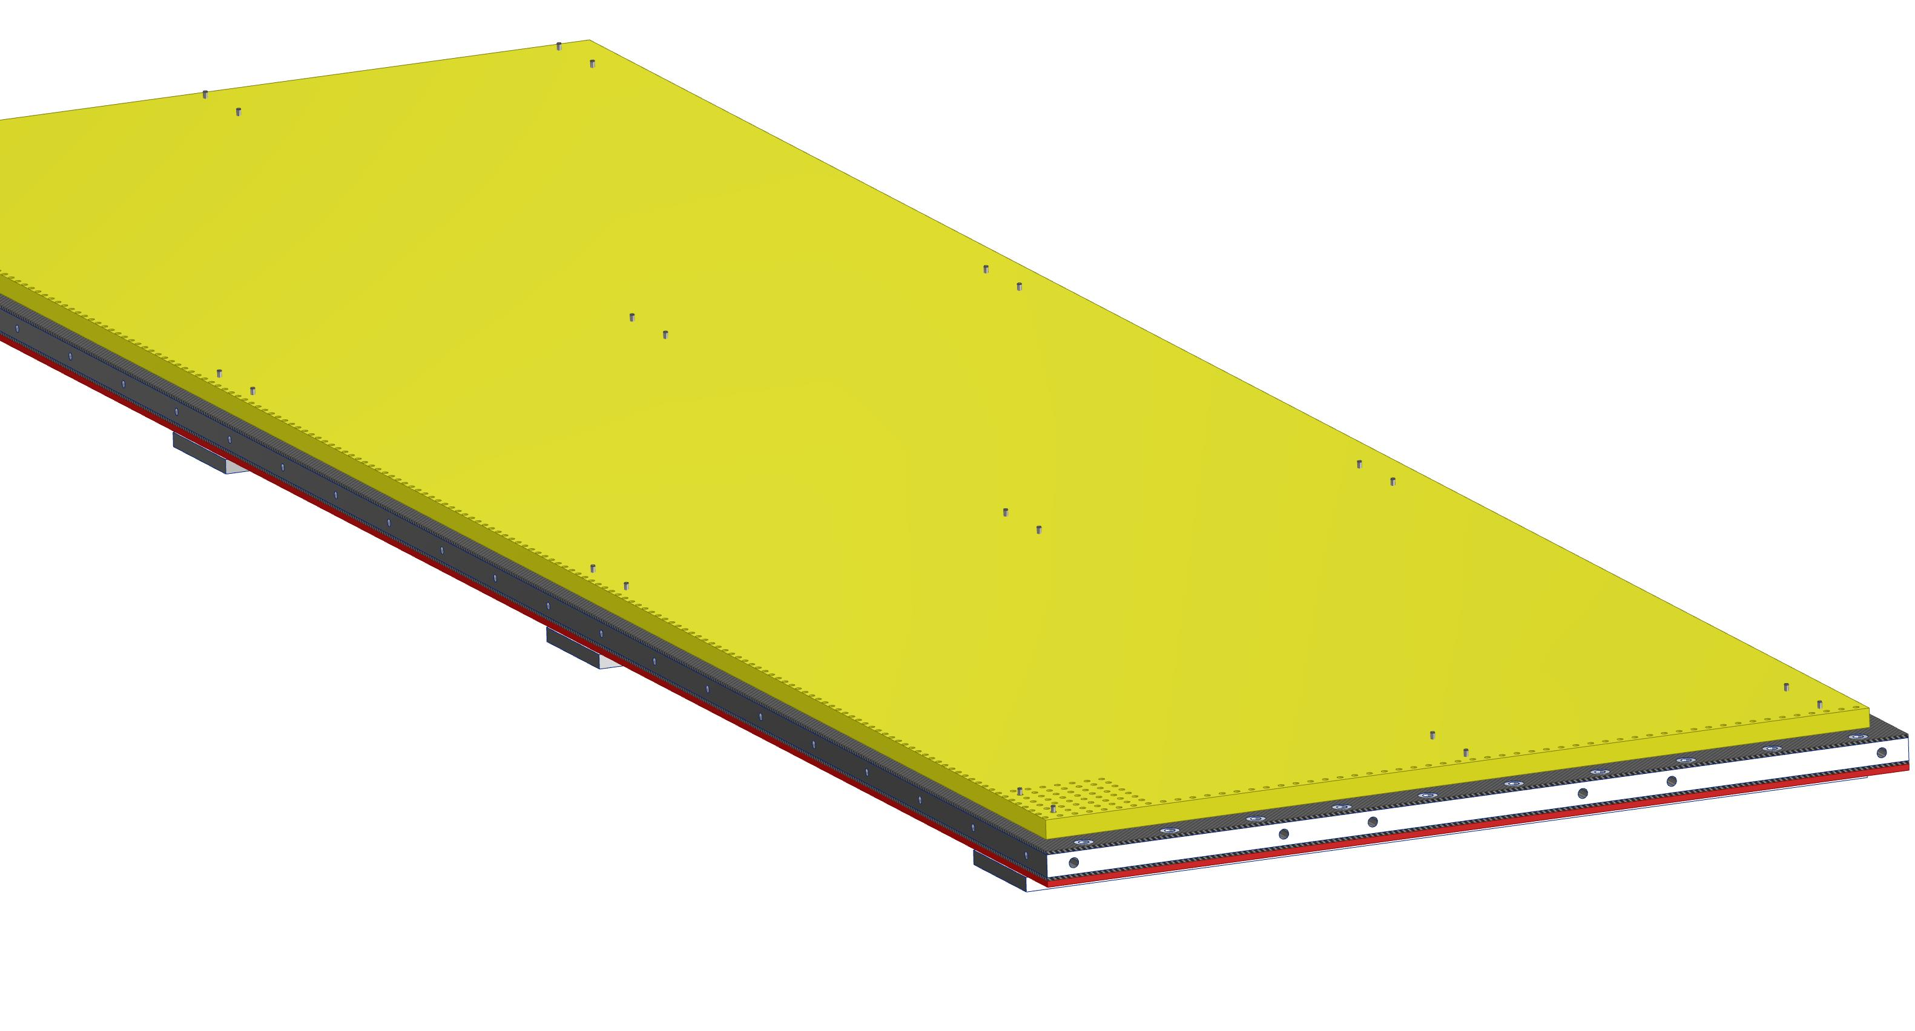
Foam-side view of the DS plate with tools poking through
The foam hasn’t been divided here yet, but it is made of two pieces.

Slide 12
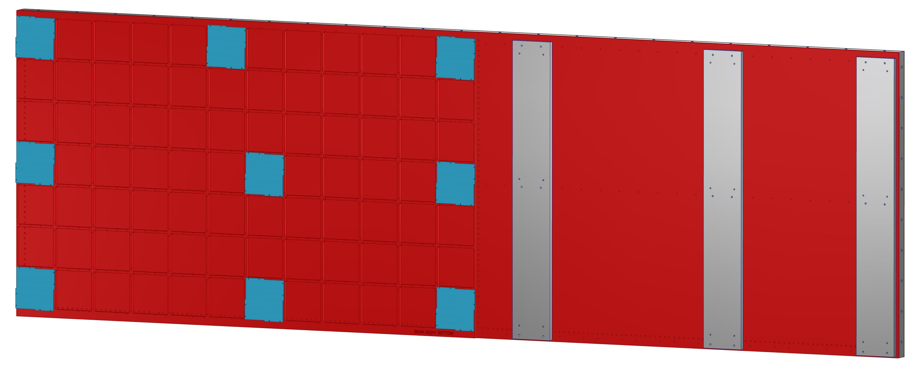
Distribution of tools on BR foam gluing
Beam right has both MPPCs and calibration modules, so it needs two different tools.
This one also has two pieces of foam to glue on.

Slide 13
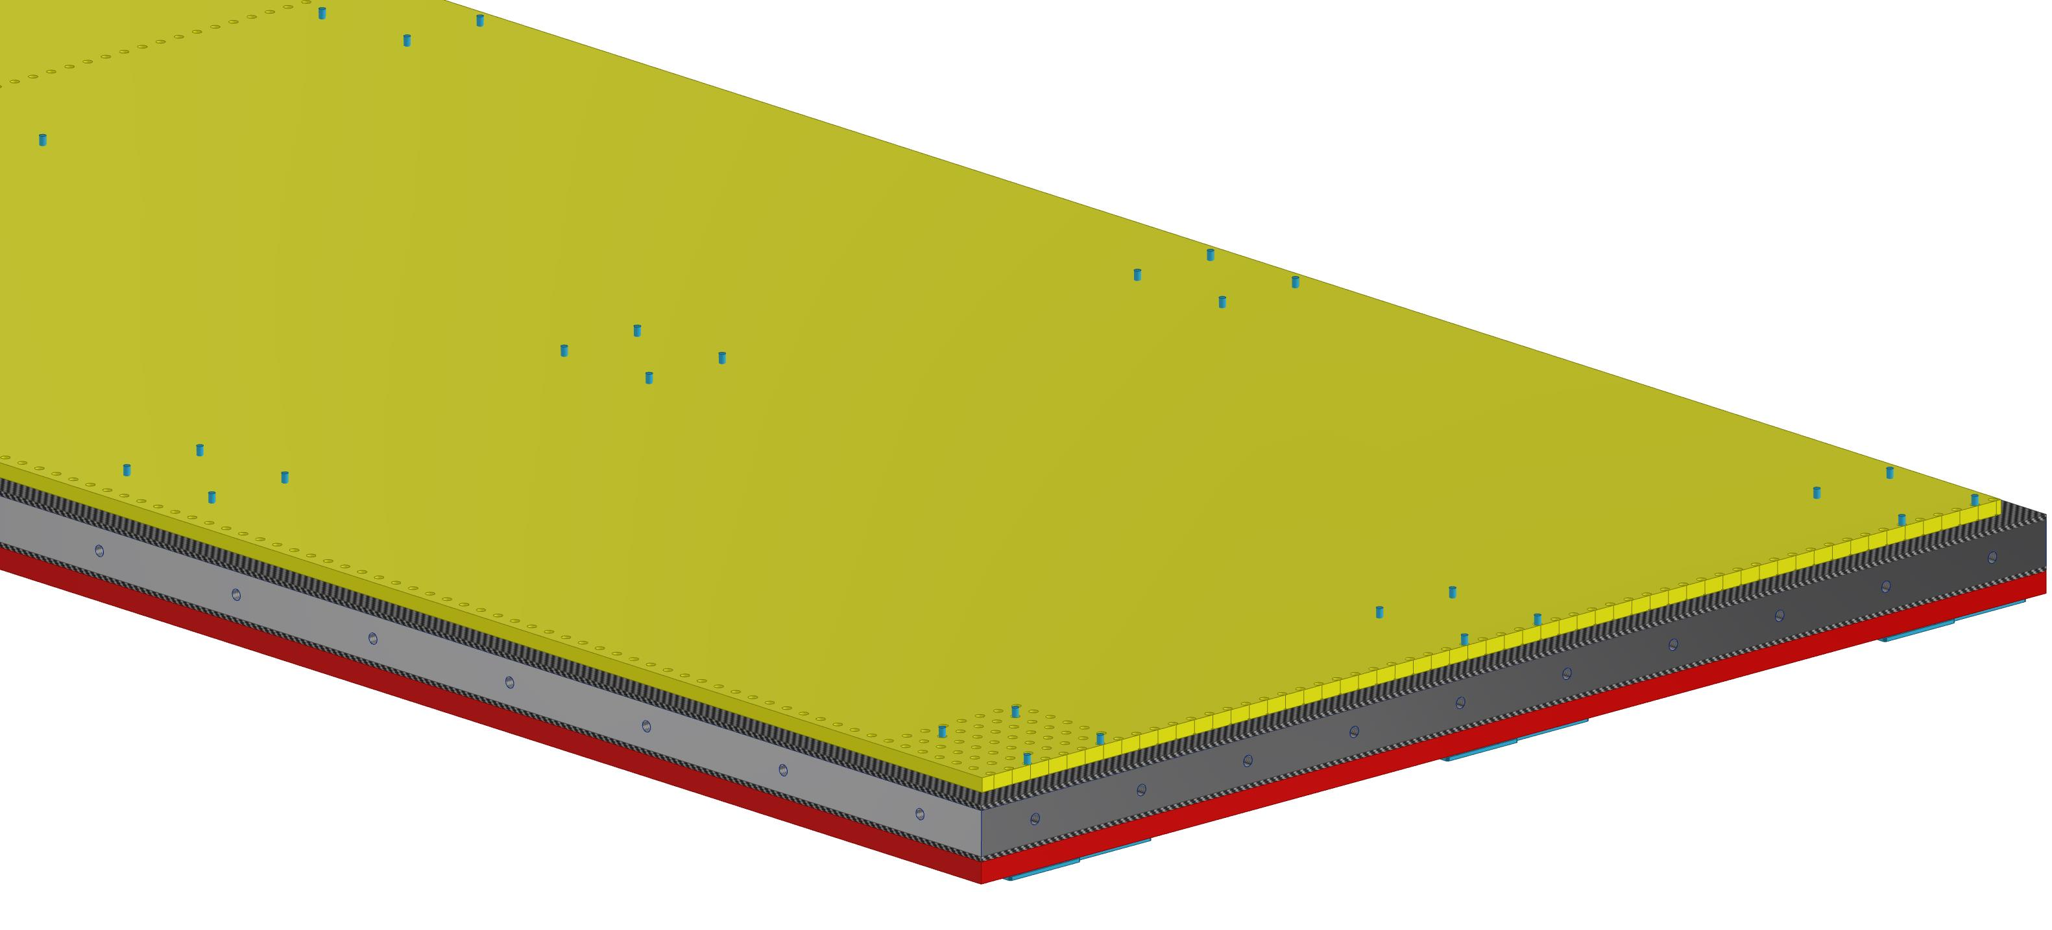
View from the foam side of the Beam Right plate with tools poking through
The foam hasn’t been divided here yet, but it is made of two pieces.

Slide 14
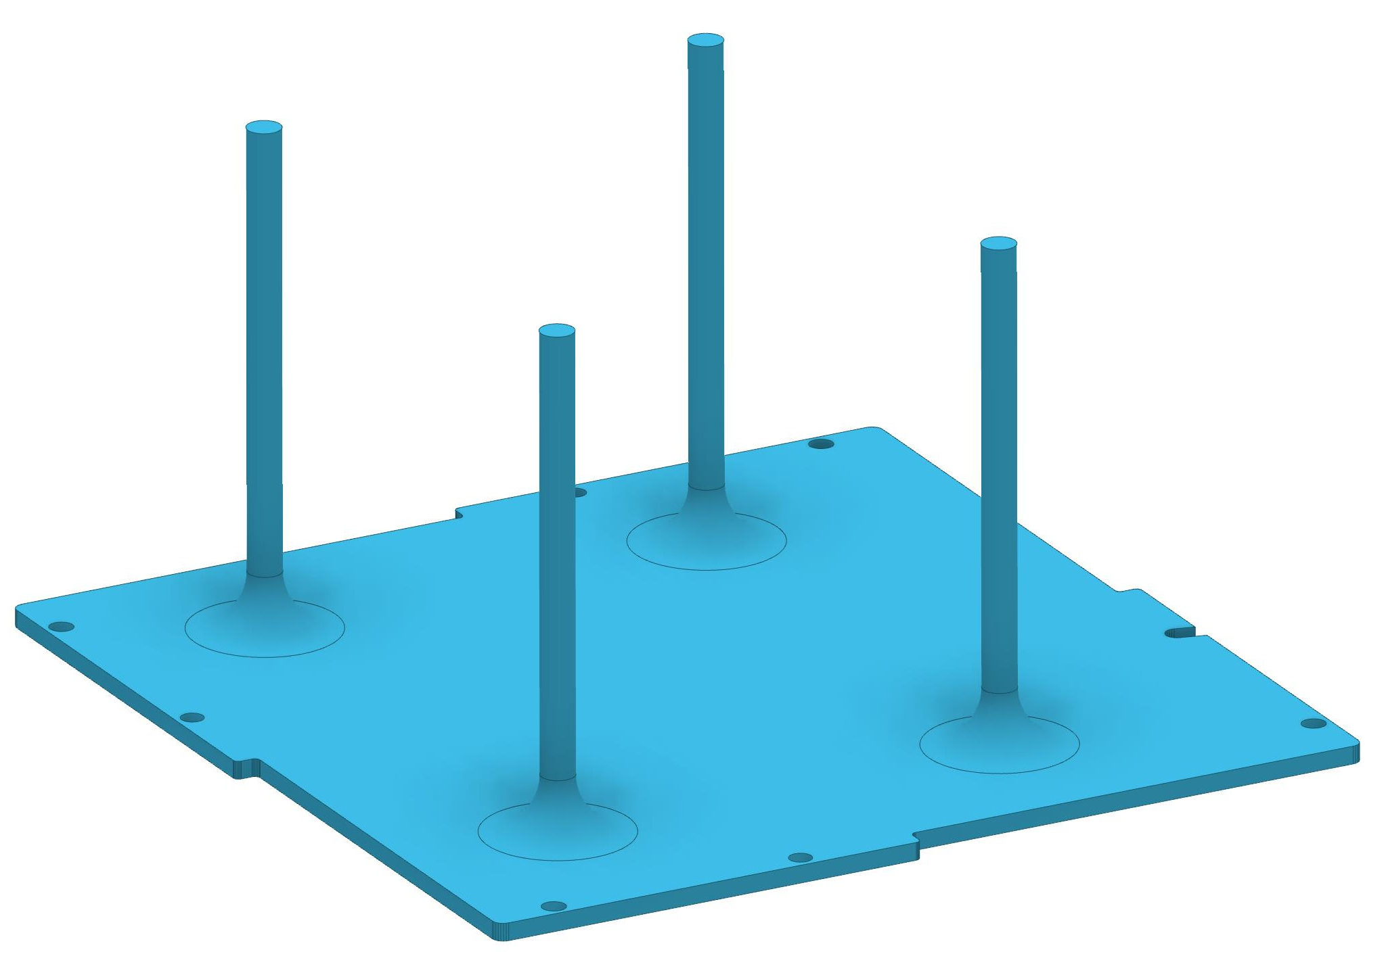
MPPC-like 3D printed tool to locate foam on the BR plate
I will ask my son-in-law to print these to see how strong they are.

Slide 15
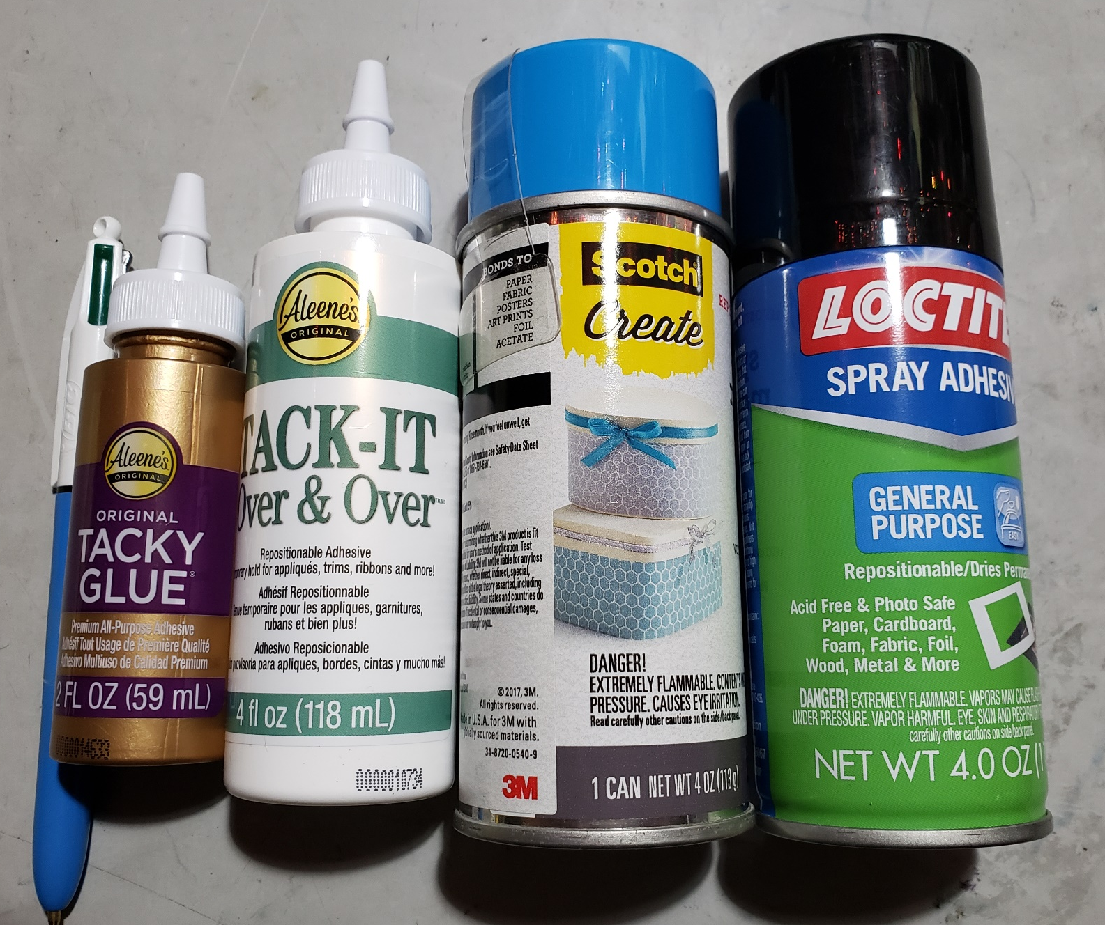
Proposed glue for foam
I purchased these glues before I went on vacation. When I get back I will test the foam samples with the carbon fiber plates I bought. I want to see if the bond strength is sufficient, if they are repositionable, and what the general application is like. In particular, I want to see if there is any possibility of plugging fiber holes.
I am favoring aerosol adhesive, unless there is a reason to avoid them.

Slide 16

I have received the report from the foam measurement company. They tested three different thickness samples, three times in series. Graphs of the results follow.

Slide 17
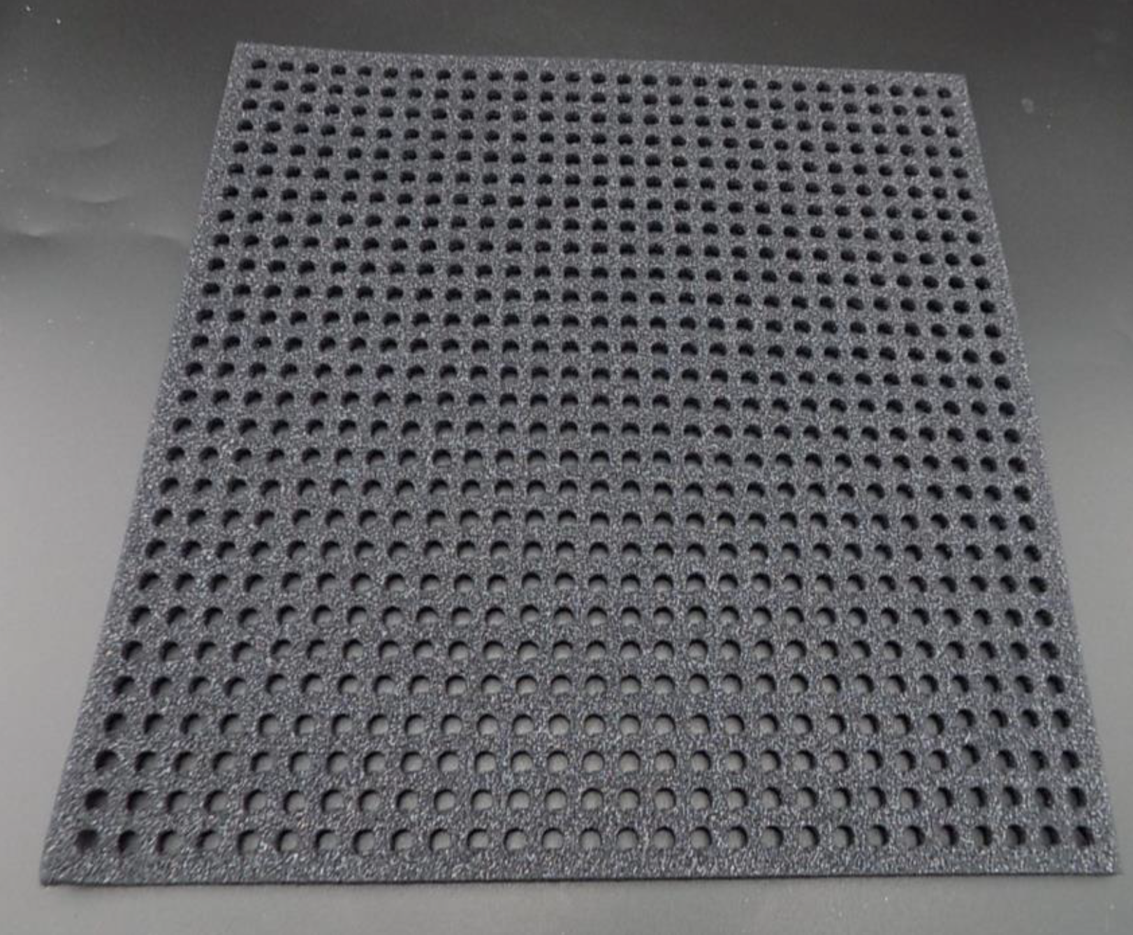
Photo of .25 inch thick X 30 cm X 30 cm piece of foam with .25 inch dia. holes

Slide 18
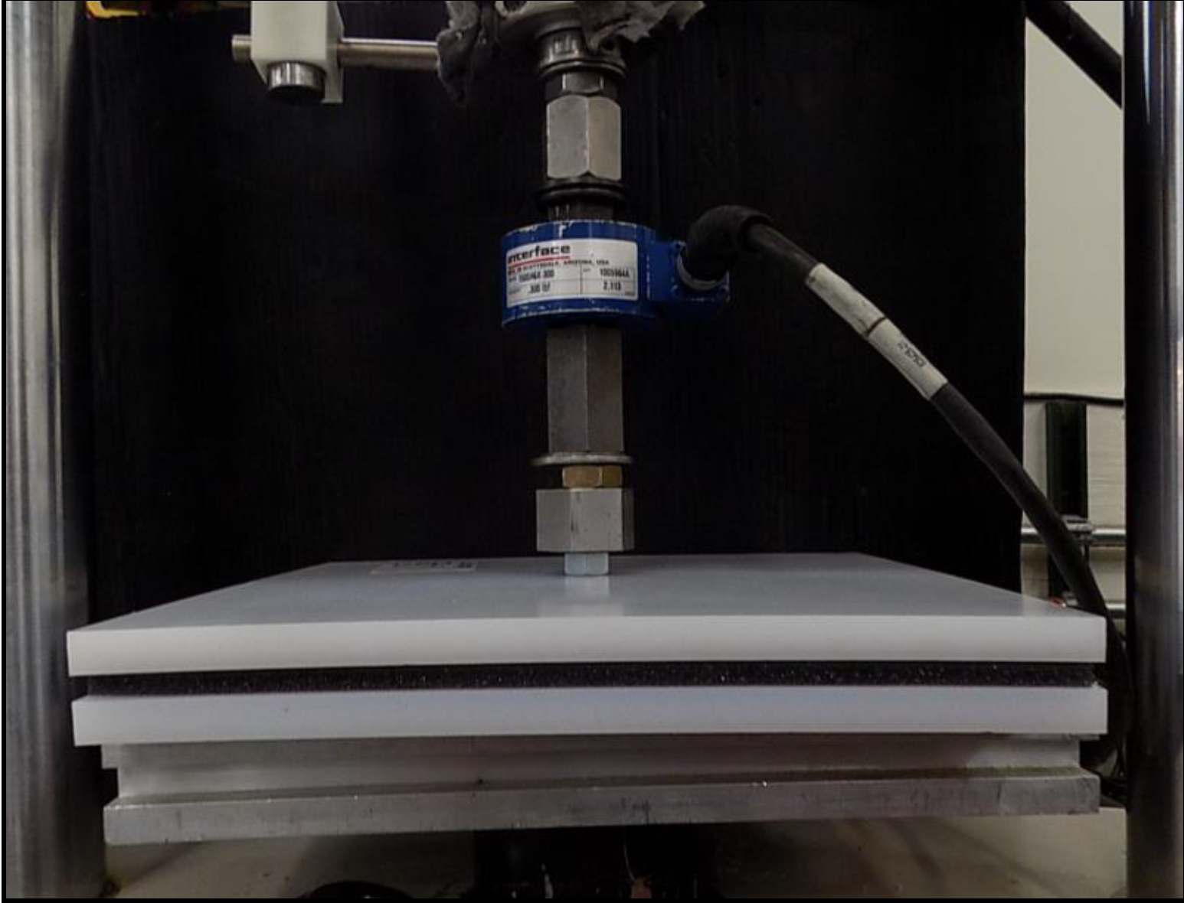
Photo of test setup to measure 30 cm X 30 cm pieces of foam

Slide 19
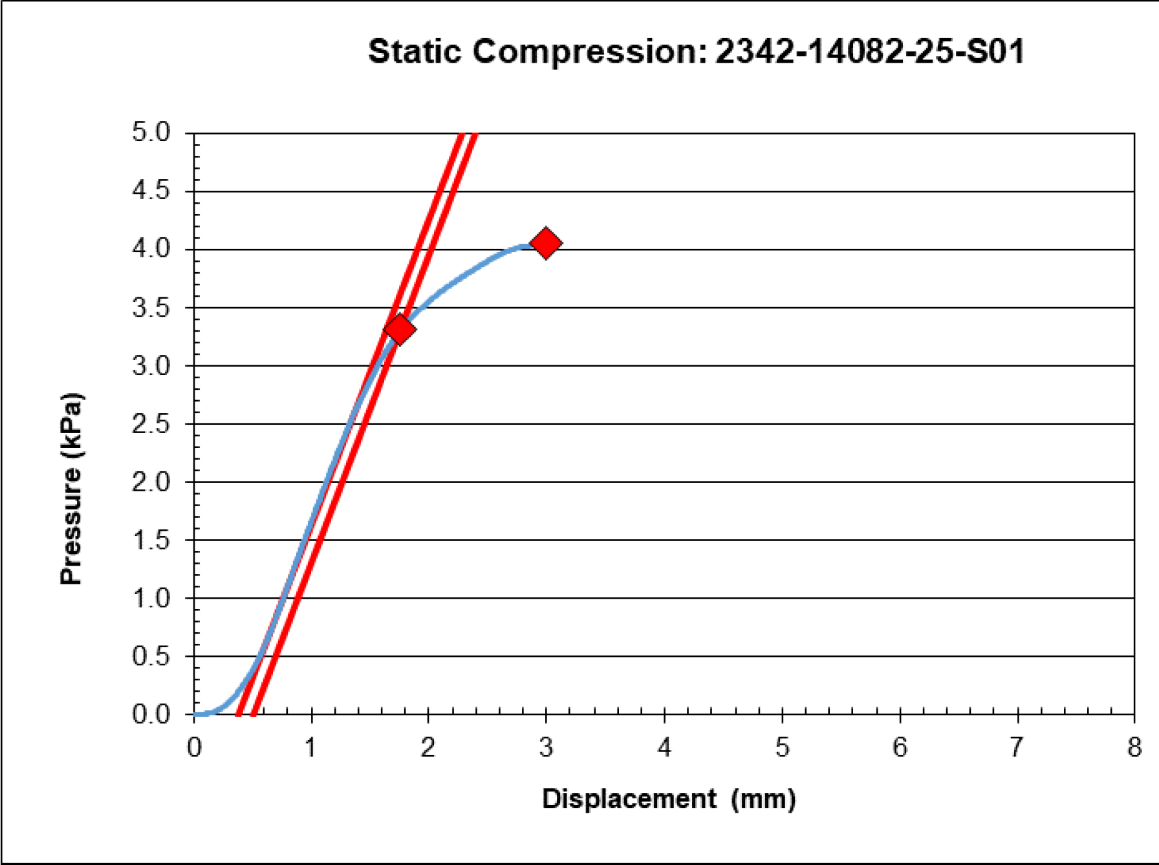
First test result for the .25 inch thick foam

Slide 20
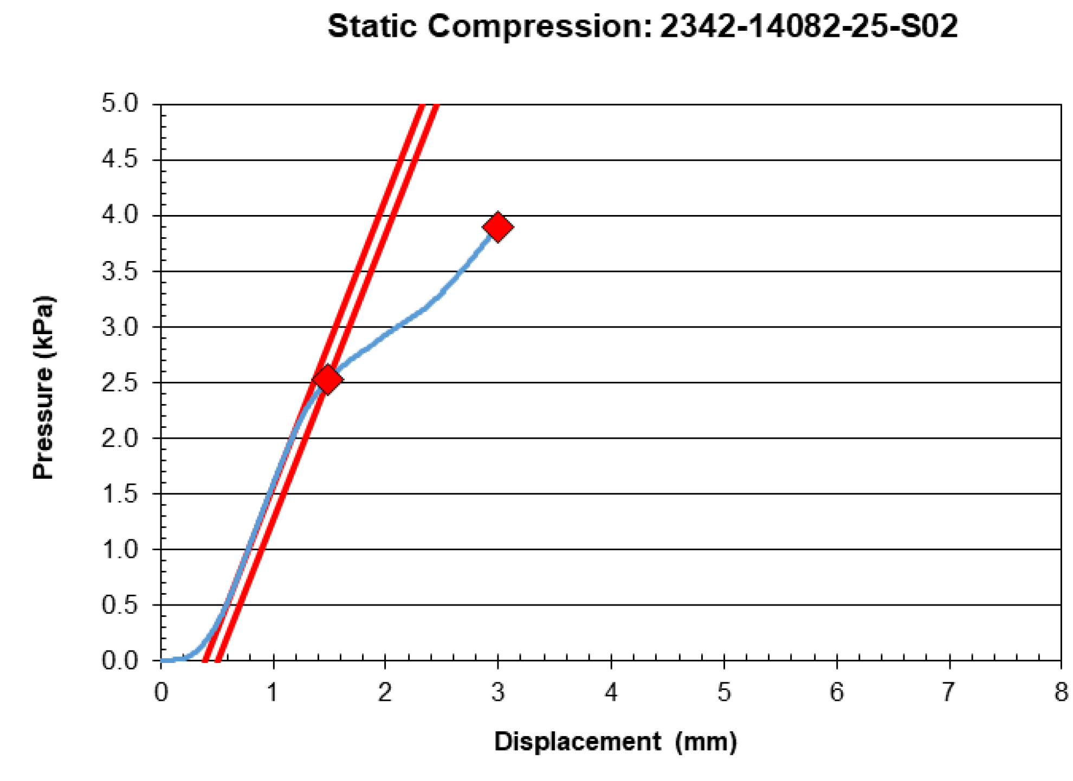
Second test result for .25 inch thick foam

Slide 21
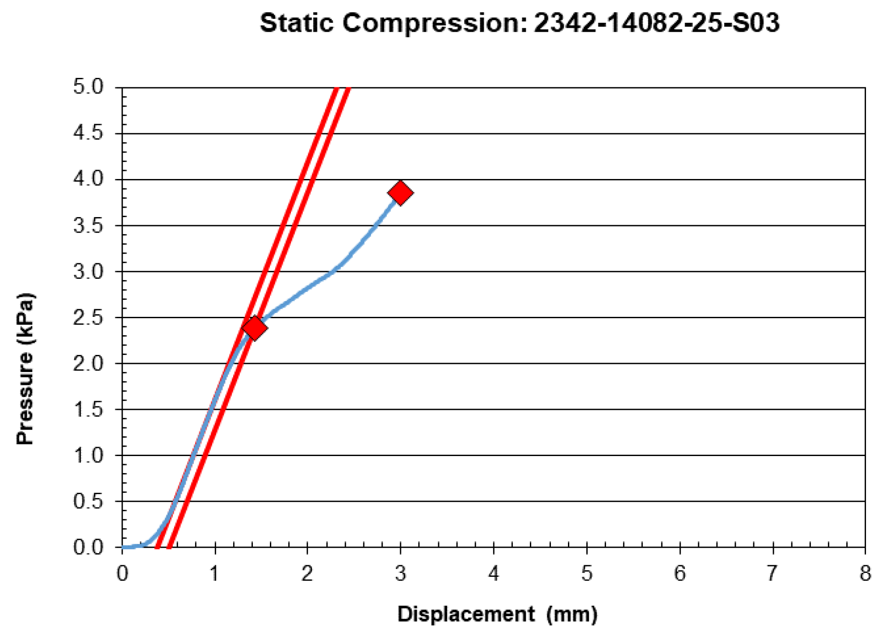
Third test result for .25 inch thick foam

Slide 22
Conclusions from multiple tests
The foam looks the stiffest the fist time it is tested
Successive tests taken at least one minute apart show that the foam is weaker after the first compression
  There is very little difference between the 2nd and 3rd tests
  I used the first test compression pressure in my load calculations because when we close the box it will look like a first compression of the foam

Slide 23
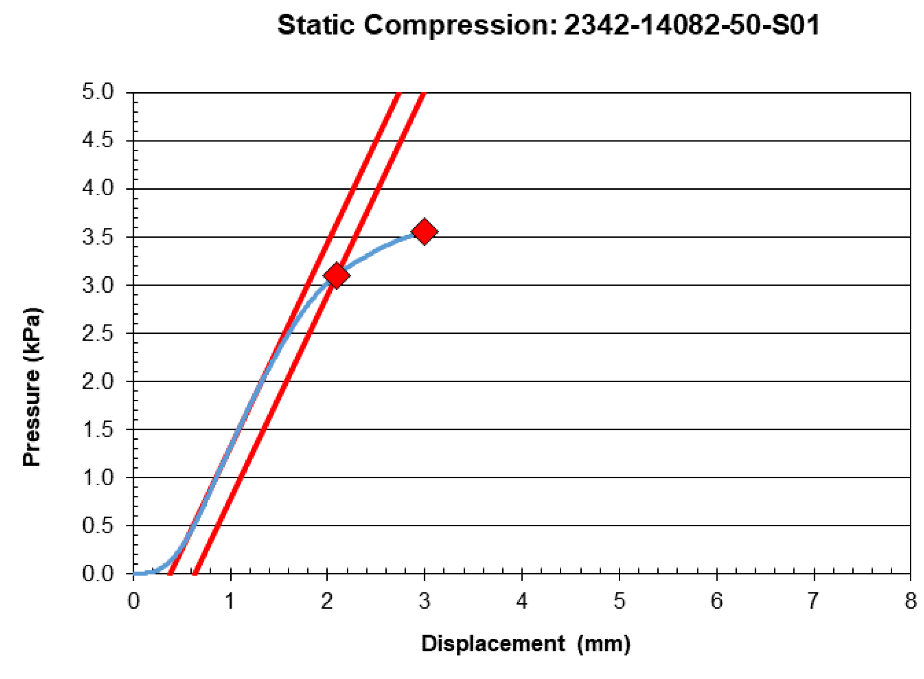
First test results for .50 inch thick foam

Slide 24
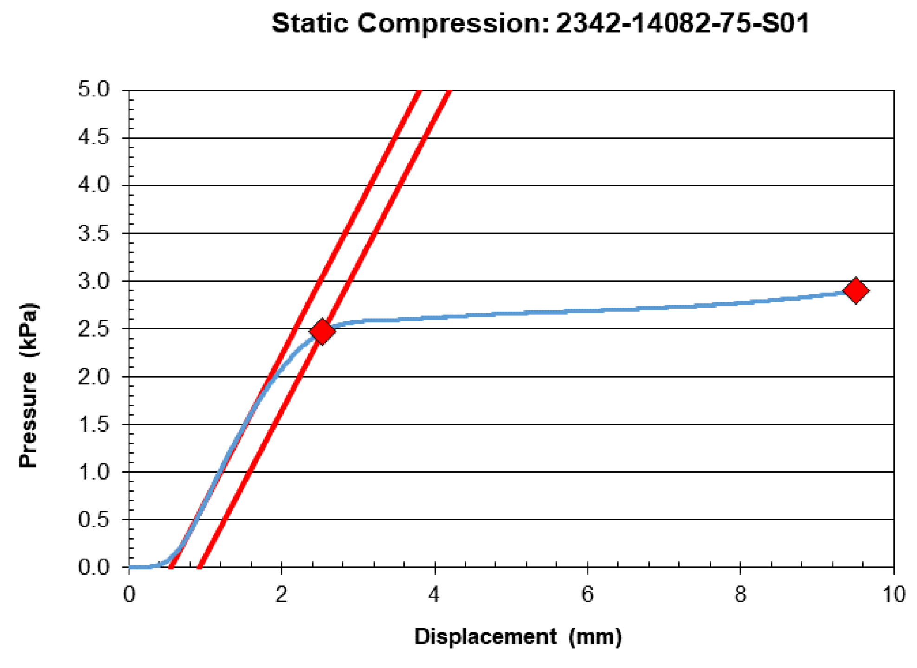
First test result for .75 inch thick foam

Slide 25
Force calculation for the top plate
The top foam is .75 inches thick and is expected to deflect by 5.9 mm
  The force required to compress the top plate foam to that deflection is about 10.16 kN, or 2,285 lbs
    This sounds like a lot, but the weight of the top plate causes the first ~1mm of deflection
  The 96 M6 bolts that pull the top plate down can exert 374 kN of force, much more than the 10.16 kN required
  Deflection of the bottom plate and the uneven distribution of the deflection are ignored in this calculation. The assumption is that the entire piece of foam deflects by ~6mm.

Slide 26
Force calculation for the DS plate
The downstream foam is .50 inches thick and is expected to deflect by .93 mm
  The force required to deflect this foam by that much is 1.36 kN
  There are 20 M6 bolts, 10 on each end, pulling this plate into the assembly, which can exert 78 kN of force, 78 kN >> 1.36 kN required
  See next slide for subtlety of assembly

Slide 27
Force Calculation for the BR plate
The beam right foam is .25 inches thick and expected to deflect by 1.3 mm
  The force required is 2.69 kN, 605 lbs
  This is not a large force. 1.4 M6 bolts can apply this.
There are no bolts perpendicular to this plate that are able to pull the plate into the assembly
  All of the bolts are in the plane of the plate
Some form of clamping will be required to pull this plate into place
The Beam Right and Downstream plates may need to be assembled simultaneously because 10 of the bolts that pull the DS plate in are in the BR plate

Slide 28
Comments on Box Assembly
The reason we had the foam tested is because our Russian colleagues knew that they had no mechanism in the assembly platform to force the Beam Right or Downstream Plates into place if the foam required a large compression force
I selected the weakest foam I found and its compression numbers are reasonable
Even so, additional clamping will be needed to close the corner between the BR and DS plates

Slide 29
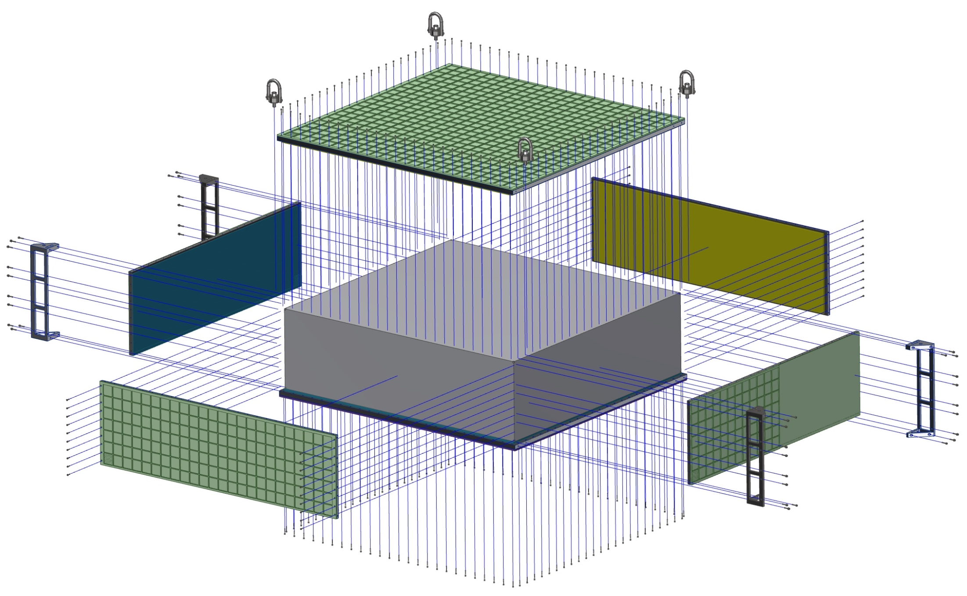
Exploded view showing the directions that bolts fasten the box plates
DS plate
BR plate
M8 bolts for the corner brackets do not fasten the BR and BL plates to the US and DS plates.

Slide 30
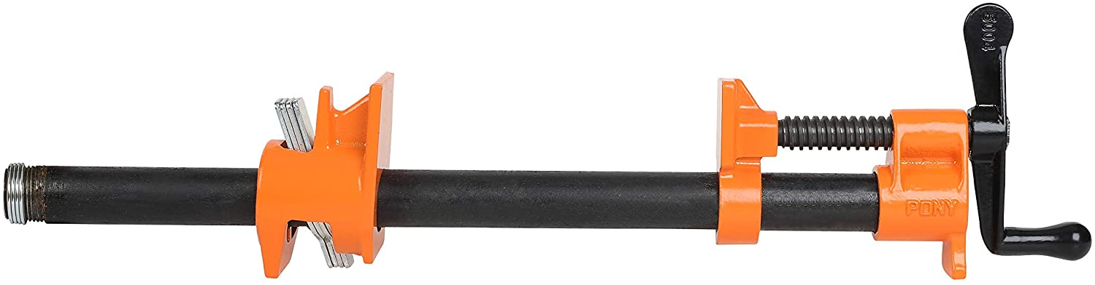
Example of a pipe clamp that could be applied to the box to compress the BR and DS foam
The advantage of this style of clamp is that it can be made as long as necessary by lengthening the pipe connecting the two end pieces.

Slide 31
Conclusion
I have manufacturing drawings for all of the foam pieces required
We have a quote from the Foam Factory, and a demonstration that they can cut large arrays of holes
I am about to test more glues
I have designed several fixtures to position foam pieces during gluing
  Who will get these fixtures made? Who will pay?
I have identified a subtlety with closing the box that will require some additional clamping
We need to get feedback from our Russian colleagues

