Slide 1
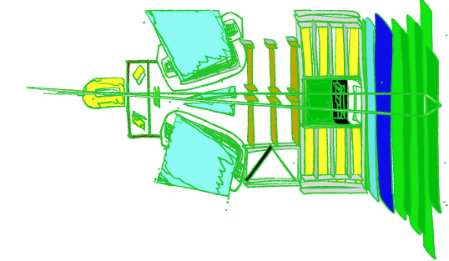


Front-End electronics
Christophe Beigbeder CNRS / IJCLab (Orsay, France),
  on behalf of the Electronic Calorimeter groups
LHCb ECAL Upgrade II workshop. Orsay Dec 13th 2022

Slide 2
Outlook
Present design
Proposed Architecture for upgrades 1b and 2
Project organisation
Conclusion

Slide 3
Present Electronics Overview
8 + 2 Racks (ECAL,HCAL),18 Crates are situated on the calorimeter platform
  Above and close to the detector : 10 kRad foreseen for the Run 3
Commercial 9U crate. 3 max per rack, equipped with heat exchanger (water) and turbine on the top.
Power supplies : specially developed by Wiener for the LHC projects . Radiation tolerant.
  There are modules for low voltages on each crate.
  In the bottom of the rack , RCM 380 to 48 V distributed to the Marathon Module
  ~15 years old. Spares from dismounted sub-detectors (PS/SPD)
Crate houses ~16 Febs, one Crate Controller and for some of them cards for the Led calibration system
  4 Slots potentially available for extra Febs to fully populate the crate
The backplane powers and interconnects the boards for both slow control and signals coming from or going to other crates/racks to produce the trigger elements
The Feb receives the 32 input signals via ~ 15 / 20 meter long cables from the HCAL and ECAL
The system with 5 Fe boards and a dedicated firmware is also used for the Plume luminometer

Slide 4
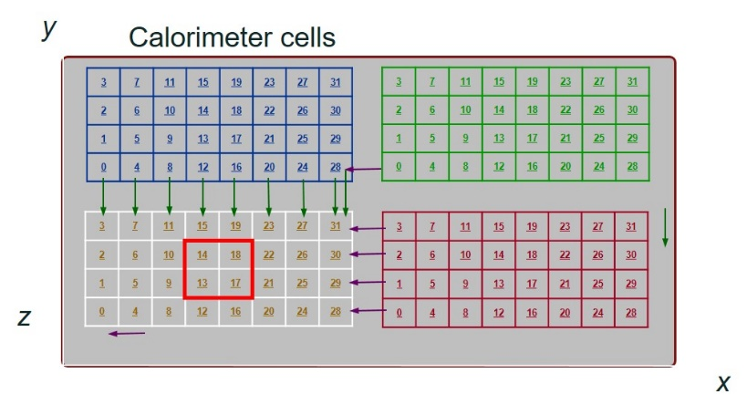
Present Electronics Overview
The Feb perform @ 40 MHz the energy measurement and a pre-processing for the trigger with the following :
  The shaping and the integration of the analog signal -> ICECAL chip.
  The 12 bit conversion thanks to a commercial ADC.
  The processing of the signal in MICROCHIP (ACTEL) FPGAs
    The pedestal subtraction and low frequency noise cancellation
    The trigger primitives
    The event formatting
The Feb transmits and receives Fe/trigger data from its left and up side neighbours via the backplane (@40 MHz) and Cat5 cables (@280 MHz) for 280 In/Out bits per board
Each board calculates the Energy of each of the 32 clusters (ET) then extract the cluster with the Highest Energy and its corresponding address, the Total Energy per board and determine the Multiplicity, how many channels are above a defined threshold.
The trigger algorithm needs to concentrate all the data in a single chip to process the 45 X 10 bits. Actel - Igloo2- MG2L150 -1152 pins
The Feb transmits Fe data (energy/channel) together with the trigger elements and the reduced BXID to the DAQ after serialization by GBT (112 bits@40 MHz) and 4 links to the PCI 40
~ 300 Fe boards and 25 Crate Controlers was produced

Slide 5
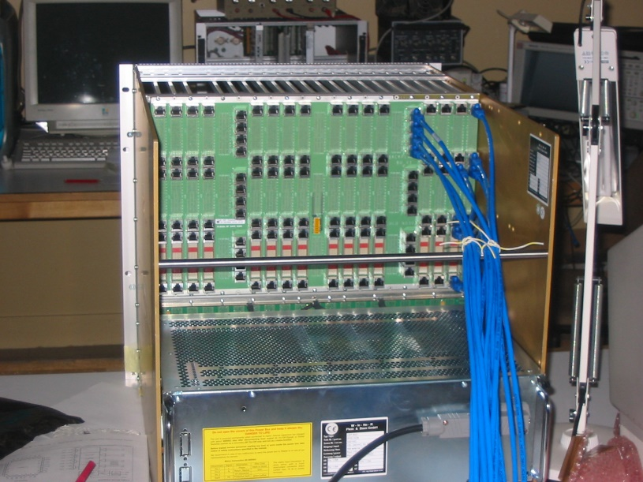
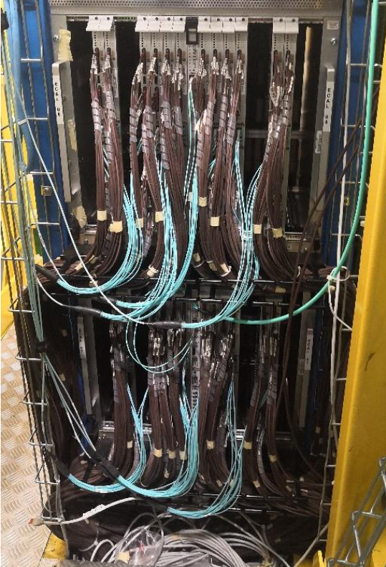
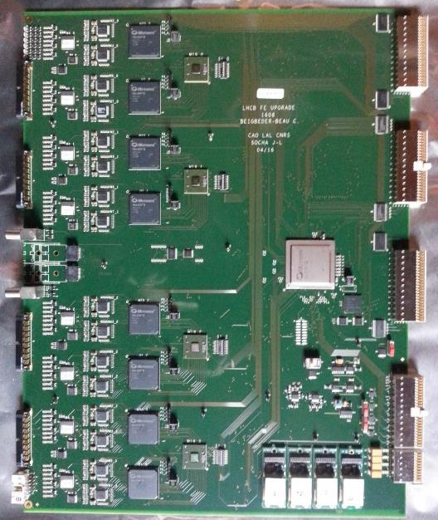
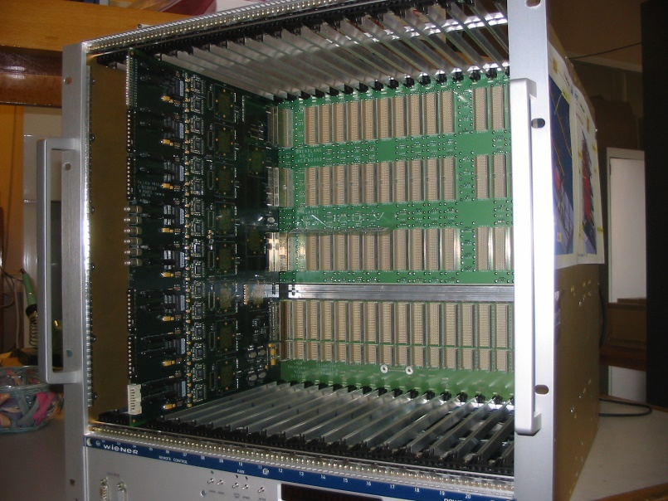
Electronics for the upgrade1b&2

Slide 6
Electronics for the upgrade1b&2
  Start discussion beginning of 2021
  One meeting @ CERN during LHCb week
  three calorimeter brainstorming meetings
https://indico.cern.ch/event/982989/
  https://indico.cern.ch/event/968608/
  LHCB Upgrade2 electronics kick off meeting by Ken @ CERN
  LHCb Upgrade2 electronics workshop in June 2022
  Since mid 2022 : Regular monthly meeting on chip design and reporting during Calorimeter meeting and LHCb week

Slide 7


Electronics for the upgrade1b&2
Current participants : 6 Labs , 2 are not members of the LHCb collaboration
IJCLab, Orsay (contact : Christophe Beigbeder).
ICCUB, Barcelona (contact : Edu Picatoste).
LPC Clermont-Ferrand (contact : Samuel Manen).
IFIC, Valencia (contact : José Mazorra de Cos).
IP2I, Lyon (contact : Hervé Mathez).
LPC Caen (contact : Laurent Leterrier)
Funding :
  IN2P3 R&T (50 K€ granted), 3yrs (1st prototype).
  R&D&I Complementary Plans of the Spanish Government. European Union–NextGenerationEU (granted at ICCUB, requested at IFIC).

Slide 8
Electronics for the upgrade1b&2
Key parameters
  Produce time measurement in the range of ~ 20ps (signal dynamic dependant)
  Number of channels: ~30000 (double side readout)
  Trigger less architecture
  Occupancy: Time measurement on a signal over a threshold for a targeted occupancy of 10% in average.
  Dynamic range : 50 Mev-100 Gev of transverse energy for Energy measurement and 50 Mev- 5 Gev for the timing
  Energy measurement on 12 Bits every 25ns (no zero suppress)
Constraints and consequences
    Total dose: ~100 Mrad in the hottest region.
    40 KRad on the platform for for 300 fb⁻¹ offer the opportunity to use a large choice of components or Asic technologies
      FPGA : Microchip or Xilinx
      Use of commercial components possible after radiation hardness qualifications.
      Less material and electronics on the detector
    We have to stick to the production of the CERN components :
      ~ 2 steps for the developments according to the LHC schedule

Slide 9
Electronics for the upgrade1b&2
Chosen architecture
Energy
ASIC
ADC
Digital Back-End
Detector cells
Optical Link
FPGA
GBT
?
50Ω
I
?
12-20m cable
PMT
Time
ASIC
opamp
Front End Board
Two separate processing paths with dedicated Asics in the same techno 65 nm :
  Energy path close to the current ICECAL scheme (mostly analog processing)
  Timing path based on a waveform TDC.
  For dynamic range compatibilities, cable attenuation, Signal range Gain , noise, BW requirements:
    Amplification and shaping either at the PM level or on the FEB
    Opamp stage + dedicated passive attenuator for each ASIC could provide the optimal signal conditioning ( see Edu’s talk)

Slide 10
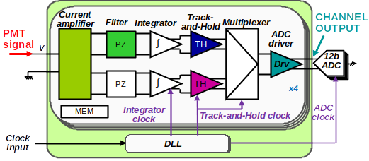
Electronics for the upgrade1b&2
Energy path based on the evolution of the ICECAL chip
New design but keeping the same principles and functionalities of the ICECAL
  Dual gain to cover the large dynamic range
  Integrating the 12 bits ADC is under consideration
    See next talks on “ICECAL II ” by Jose

Slide 11
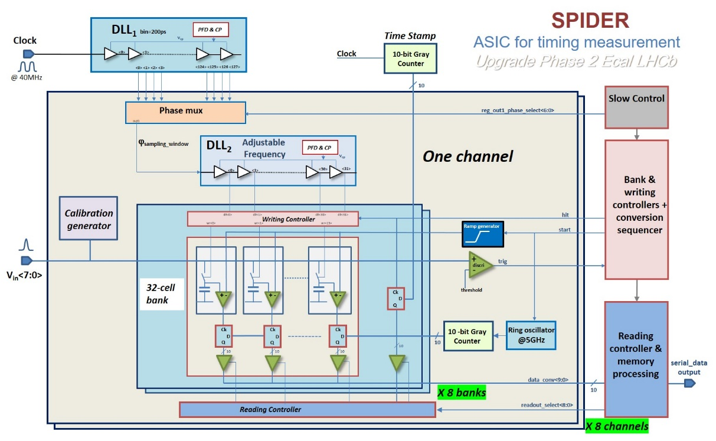
Electronics for the upgrade1b&2
Timing path based on the SPIDER chip
TDC : analog memories based on switched capacitor arrays (SCA)
  50-400 ps binning. 3 ps resolution for ~1ns rise time at the optimum amplitude.
  Pipelined architecture to reduce dead time and match the average occupancy
  Adjusted window of interest to reduce readout latency and techno size constraints.
      See next talks on SPIDER by Philippe and requirements for precise time measurement by Dominique

Slide 12
Electronics for the upgrade1b&2
The Front end processing part
  Use the radiation tolerant Microchip PolarFire chip, tested up to 400 kRad
  Receives the energy information from the 12 bit ADC as it’s presently done
  Process the charge information keeping the same as actual
    Pedestal subtraction and low frequencies noise cancellation
  Receives the timing information by serial links, for each of the channels
  Process the timing information
    DE serialized the data streams: samples and coarse counter (reduced BXID)
    Extract the time thanks to an embedded digital CFD
  Associate the charge to the time by comparing the FPGA BXID counter and the reduced BXID coming with the SPIDER data (derandomizer )
=> Is the actual system with links between cards and crate still needed : to keep, to ameliorate ...
  For timing correction for adjacent towers
  For Trigger primitives
  For any pre processing, using the FPGAs
  = > This has a real Impact on the design of the whole system

Slide 13
Electronics for the upgrade1b&2
      Steps for the electronic upgrades : RUN 4 (2029)
        Inner part : Channels are in “ Inner crates” not mixed with middle and outer part of the detector and could be housed in the same crate with non replaced Inner channels .
          ~3500 single side readout in place of the ~1000 , ~2500 channels / 80 boards .
          ~ 110 Fe boards mechanically identical to the actual ones with 32 channels inputs for connectivity reasons, housed in ~ 7 crates (5 coming from PD/SPD)
          CC- Crates – Power supplies – Cooling should be kept as the rest of the electronics
          Cables : may use of the existing one
          Use of the CERN new components, already available for evaluation
              lpGBT (10 Gbits) . Optical drivers
              PCIe 400 version1 (see Julien’s talk)
              The 2 systems has to be compatible
                PCIe400 – Crate controller
                Data format : New Calo firmware for the PCIe 400
        Feb design closed to the existing one in term of architecture and integration
        Run two systems : latency , data format
        Planning is quite aggressive specially for the Asic developments and production
        => Option of upgrading the electronics like it is done for the run5 has to be studied (other scenario)

Slide 14
Electronics for the upgrade1b&2
      Steps for the electronic upgrades : RUN 5 (2035)
          A complete redesign of the system
            ~15000 double readout channels including the Inner part
            ~ 32 000 cables => Make sure it’s possible otherwise we have to change the complete philosophy of our design
            472 Feb (64 channels) and 30 Crates
            Extension of the platform necessary
            New crates
              New backplane with connectivity for the analog signals coming by the rear side of the crate ; possible signal interconnections between crates
              New power distribution backplane
            New power supplies : active participation with CERN already welcomed
            New DAQ and new crate controller
        Feb design is based on the RUN 4 developments even if the topology is completely changed
        Asic production and schedule looks ok ( large gap between run4-run5)
        Schedule for Run5 looks more “comfortable” than for Run 4

Slide 15
Project schedule and organization
ASICs : Technical organization is ready for the two developments
  All the WP are covered for the two chips
    IN2P3 labs for the timing
    Spanish labs for the energy
      No problems for sharing part of the design between labs
      Possible integration of the chips in a single one
  Confidentiality rules concerning certain parts of the design has been fixed
  Asic for timing
    End 2023 : first prototype with 2 channels
    mid 2025 : second prototype with the definitive pinout
    Mid 2027 : Production for the 3500 channels ie ~450 chips
    End 2031 : Production of the latest version :
  Asic for Energy
    ~ Same schedule than the ASIC for the timing.
Test bench : develop together with LPC based on the Sampic test bench
Test bench for ICECAL will be similar to the present one in Barcelona
Test beam : dedicated board with Microsemi FPGA and version 1 of the SPIDER

Slide 16
Project schedule and organization
Fe board for Run 4
  Can start already with the present manpower at IJCLab and LPC
        Start implementing all CERN components LpGBT - Optical Drivers
        First version on 2025 following the Asic developments to be ready for 2028
          fabrication Installation and commissionning in 2028
      Fe boards for Run 5
        Production for ~ 400 boards and commissionning takes several years based on our experience on the development of the electronics for Run 1-3 and needs manpower
        Discussions has not already started on :
          Crate controller
          Backplanes
          Cables and connectors studies
          Power supplies
          Crates- Racks
          Cooling
        Part of it was the CERN responsibilities specially for Run1. What can we expect from CERN now
        => Manpower is missing on all this topics regarding the possible involvement of the labs already in the project. Labs has to integrate to the project as soon as possible

Slide 17
Conclusion
The architecture of the electronics is almost defined and Asics developments have already started
Still on–going studies and questions concerning the very Front-end, PMT base and signal distribution to the two ASICs, single or dual gain ....
The time resolution is mainly dominated by the Detector performance (dynamic, rising time, noise )
The schedule is quite tight for the Run 4 specially for the Asics developments and consequently for the boards
The different scenarios for Run4 need to be evaluated carefully
Open the collaboration to other labs is absolutely necessary to face all the developments needed specially for Run 5

