Slide 1
PMTs Photon detectors and cables
E. Picatoste
ECAL Upgrade II Workshop at ICJLab (Orsay)
13/12/2022

Slide 2
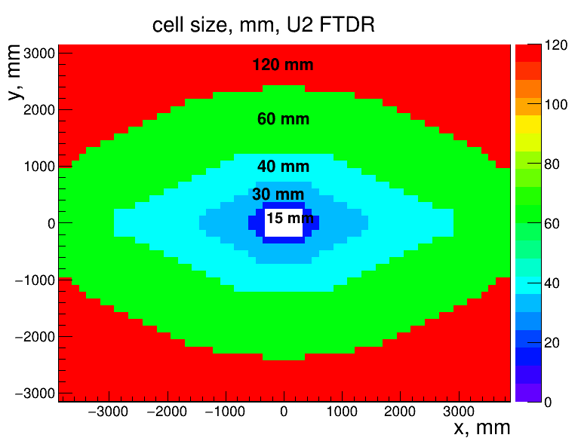
PMTs for the Calorimeter Upgrade II
Different detector zones, different needs (gain, ageing, geometry)
  Inner part:
    High doses
    2 channel technologies: SPACAL-W, SPACAL-Pb
  Outer zone
    Shashlik technology
    Somehow more relaxed requirements due to lower radiation doses
Stringent geometry in the innermost zone (15mm)
Ageing is an important limit
  Needs of high number of photoelectrons → maximum amount of integrated charge before degrading the device characteristics
  Total integrated charge ≥ 10³ C (to be confirmed/evaluated for MCD)
Gain values expected from ageing
Cell size case | Channel technology | High G (Imax lim.) | Low G (Imax lim.)
15 mm | SPACAL W | 4k | 1k
30 mm | SPACAL Pb | 4k | 500
40, 60, 120 mm | Shashlik | 100k | 11k

Slide 3
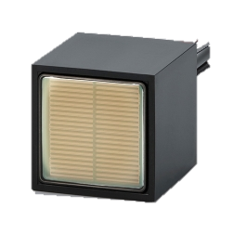
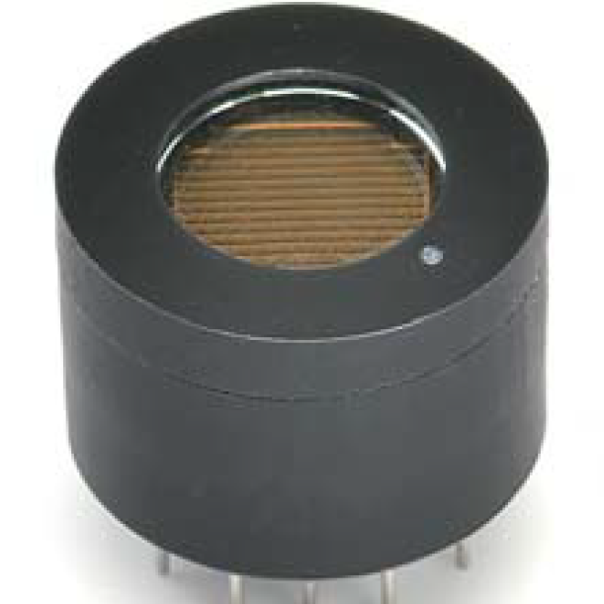
PMT Measurements
PMT: R11187
PMT: R14755U-100
PMTs?
  R11187 (TILECAL), R14755U-100, R7600U-20 (MCD), FEU115M,…
Perform measurements to check PMT characteristics at detector expected gains
  Time resolution ~20 ps
  Energy resolution
  Signal linearity
Other measurements
  Ageing
  Radiation hardness
TILECAL
Good timing
Lower gain (8 dynodes)
Lower gain (6 dynodes)
Good timing
Smaller but still 1-2 mm large

Slide 4
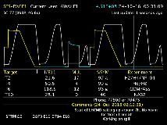
PMT Laboratory Setup
Light tight box
HV Power Supply
Optical Beam
Attenuator
PMT
HV
Collimator
Diffuser
Single Mode Fiber
Output
Picosecond pulsed Diode Laser
Power Supply (0-5V)
Wavecatcher 8ch
Laser trigger
Control + data

Slide 5
PMT Measurements at the Laboratory
First good results on time resolution, BUT
Gain at laboratory using statistics and pulsed light method is not well understood
  Need to use same Nphe and PMT bias voltage (HV) as test beam for comparison
    Higher Nphe reduce time resolution!
Try 1-Phe method
  Use PACTA transimpedance amplifier (from CTA) to amplify PMT signal
  Analyze data with double Gaussian fit or Bellamy function (E.H. Bellamy et al.INucl. Instr. and Meth. inPhys . Res. A 339 (1994) 468-476)
  Estimate N_{phe} from the measured (1-Phe) gain?

Slide 6
PMT Laboratory Setup 1-Phe
Light tight box
HV Power Supply
Optical Beam
Attenuator
PMT
HV
Collimator
Diffuser
PACTA
LV Power Supply
Single Mode Fiber
Diff
Output
Picosecond pulsed Diode Laser
Power Supply (0-5V)
Wavecatcher 8ch
Laser trigger
Control + data

Slide 7
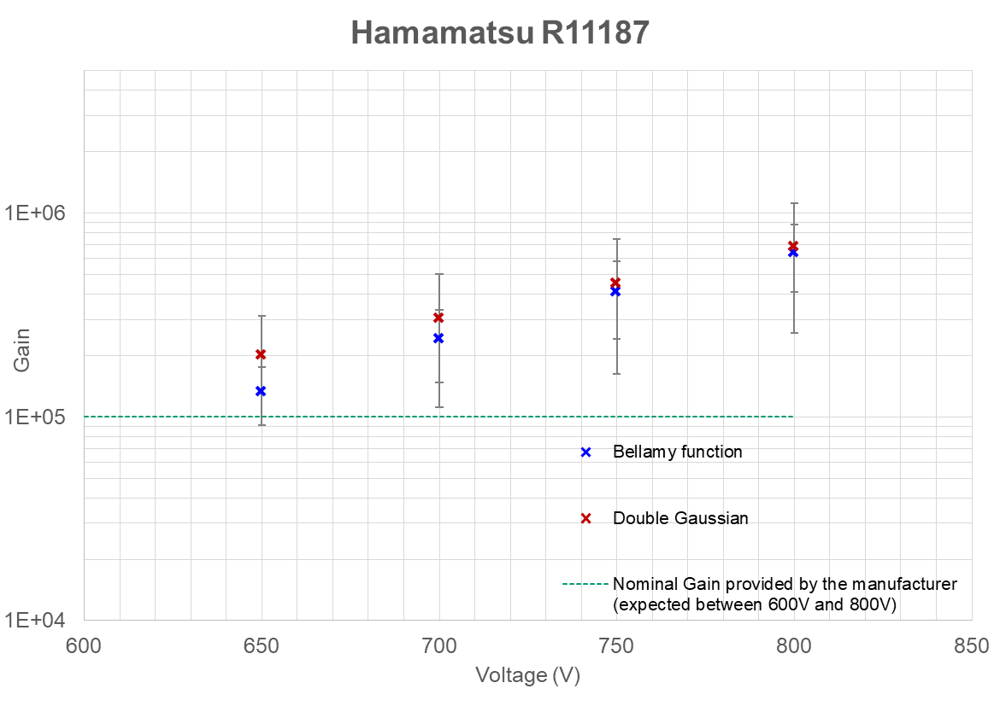
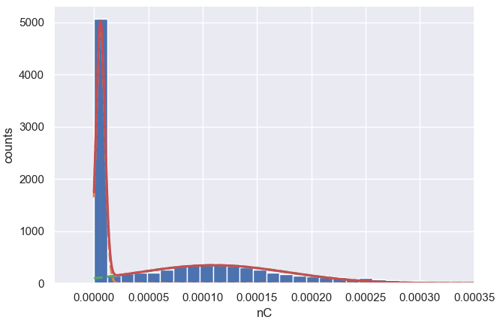
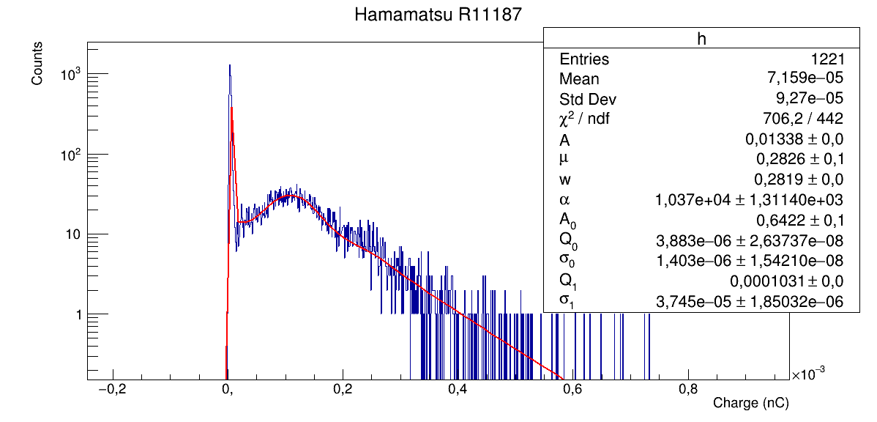
PMT Measurements: 1-Phe Gain
PMT R11187 – 800 V (HV)
(TILECAL)

Slide 8
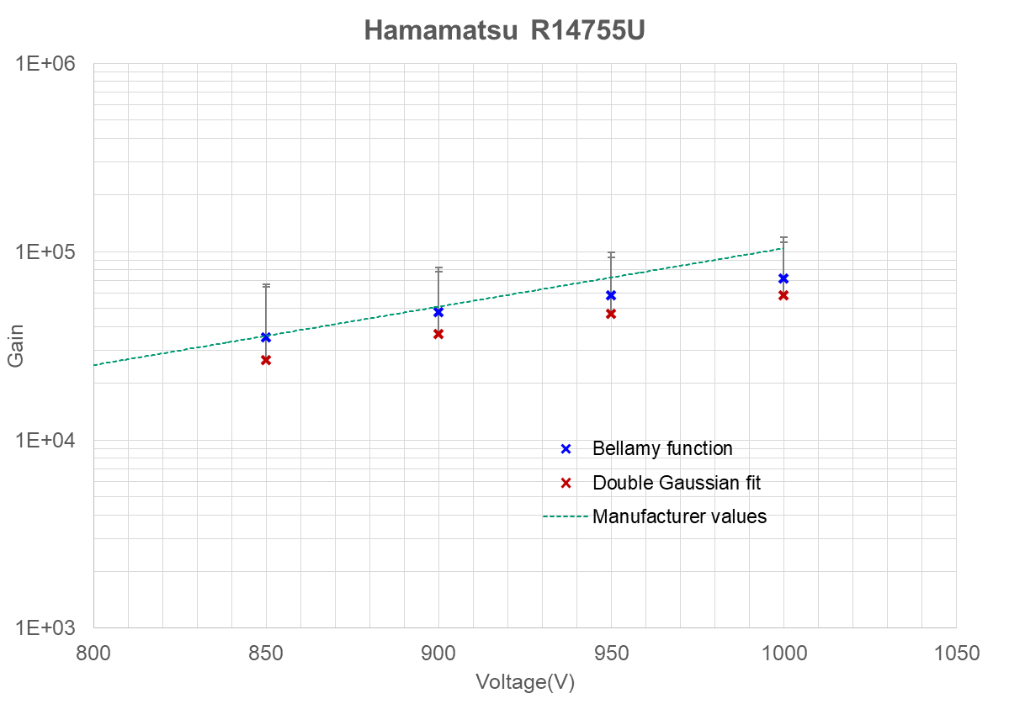
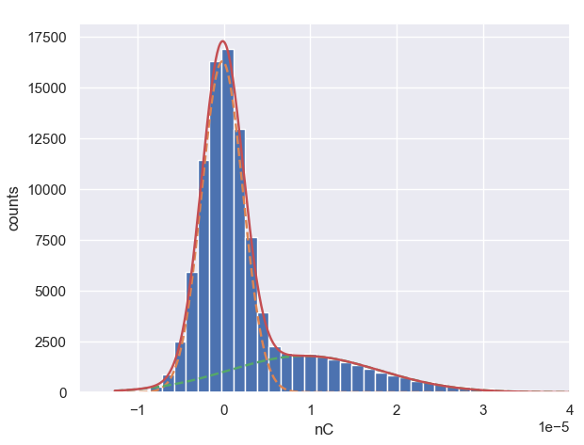
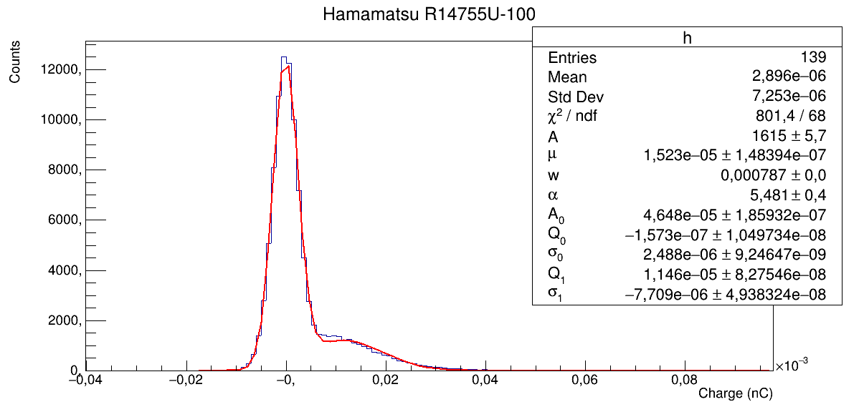
PMT Measurements: 1-Phe Gain
PMT R14755U – 1000V (HV)
(round)

Slide 9
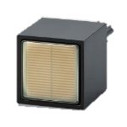

PMT Linearity Measurements at SPS Test Beam (2022)
$NL=\frac{R_{max}}{R_{min}}$, where $R=\frac{<Ampl>}{E_{beam}}$
R11187 (Tilecal)
  Max/Min response ~1% in the 20-100 GeV range
  8 dynodes, tapered board to help against space-charge effects
  More linear than Round MCD
R14755U-100 (Round MCD)
  Max/Min response significantly worse than Tilecal
    10-30% in the 20-100 GeV range at the useful HVs
  Max/Min response ~2.5% even in the 20-40 GeV range at reasonable voltages.
  6 dynodes
  R&D needed
    Tapered board?
    Transistorized base?
    Asking some more dynodes?
Tilecal
Loris Martinazzoli

Slide 10
PMT Linearity Measurements at SPS Test Beam (2022)
$NL=\frac{R_{max}}{R_{min}}$, where $R=\frac{<Ampl>}{E_{beam}}$
R11187 (Tilecal)
  Max/Min response ~1% in the 20-100 GeV range
  8 dynodes, tapered board to help against space-charge effects
  More linear than Round MCD
R14755U-100 (Round MCD)
  Max/Min response significantly worse than Tilecal
    10-30% in the 20-100 GeV range at the useful HVs
  Max/Min response ~2.5% even in the 20-40 GeV range at reasonable voltages.
  6 dynodes
  R&D needed
    Tapered board?
    Transistorized base?
    Asking some more dynodes?
Round
Loris Martinazzoli

Slide 11
PMT Linearity Measurements at SPS Test Beam (2022)
Round PMT ampliudes Vs. HV Vs. E
Round PMT non-linearity causes?
PMT DC output current should be lower than 1/100 the voltage divider current (I_{bias})
  I_{bias} = 30-100µA
Estimate PMT I_{out,DC} from
  Amplitudes
  Rates: 10kHz to ~200Hz (at different E)
I_{out,DC} ≥ I_{bias}/100 for V_{bias} ≥ 600V
Plan:
  Reduce base resistors (2MΩ to 470kΩ or lower)
  Test transistorized base
Loris Martinazzoli

Slide 12
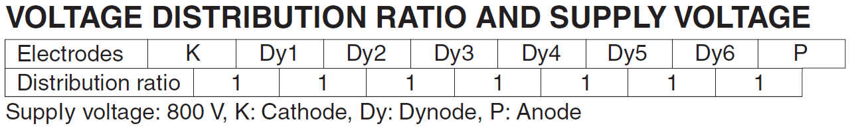
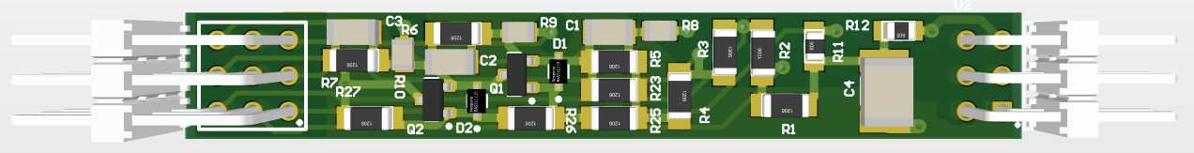
PMT Linearity Measurements at SPS Test Beam (2022)
Round PMT non-linearity causes?
PMT DC output current should be lower than 1/100 the voltage divider current (I_{bias})
  I_{bias} = 30-100µA
Estimate PMT I_{out,DC} from
  Amplitudes
  Rates: 10kHz to ~200Hz (at different E)
I_{out,DC} ≥ I_{bias}/100 for V_{bias} ≥ 600V
Plan:
  Reduce base resistors (2MΩ to 470M or lower)
  Test transistorized base
Only if resistive divider
Only if transistorized divider

Slide 13
PMT Signal Conditioning
Photodetectors readout solution follows the same scheme as in current ECAL:
  Minimal light transport with PMT sensors near modules,
  All electronics in crates on top of the detector (reduced radiation),
  Connection via analog link (coaxial) ~12m long (up to 20m considered).
ASIC/chipset in TSMC 65nm with separate energy and timing processing paths
Front-End ASIC
Energy
ASIC
ADC
Digital Back-End
Detector cells
Optical Link
FPGA
GBT
?
50Ω
I
?
12-20m cable
PMT
Time
ASIC
opamp
Front End Board
Amplifier + Shaper circuit included on the PMT base or FEB under consideration
  To compensate cable attenuation, improve SNR, if necessary, and reduce spill-over effort
  To act as a buffer to help split the signal between paths
  Different ASIC requirements (signal range, gain, noise, BW): add dedicated passive attenuator for each path.
  If at FEB, use differential outputs to ASICs

Slide 14
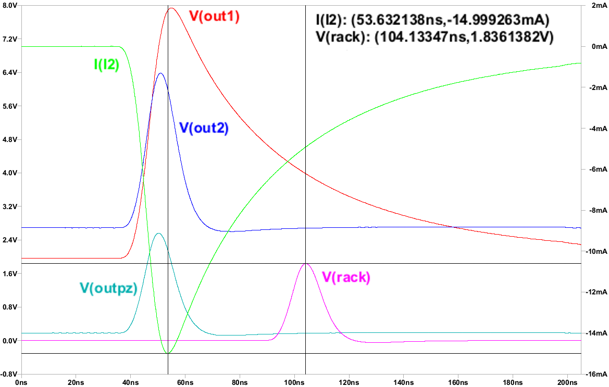
PMT signal Conditioning: Opamp Circuit
Two stage OpAmp based circuit on PMT divider:
  Transimpedance amplifier(OPA847) boost SNR.
  PZ cancellation network reduce pulse width.
  High slew rate coaxial cable driver(OPA695).
Radiation damage limits available commercial components:
  design dedicated ASIC or integrate in front-end board.
Board designed and produced, now under test.

Slide 15
Summary
Different detector zones, different needs (gain, ageing)
Main PMTs under study: R11187 (Tilecal) and R14755U-100 (round)
PMT tests
  Laboratory: gain, linearity, time resolution
    Gain has been measured with 1-Phe method with reasonable results
    Need to define a method to define the N_{phe} to be able to compare results
  TB: energy resolution, time resolution, linearity, gain
    Energy and time resolution routinely measured at TB
    Linearity problems with R14755U-100 → review PMT base
  Other: ageing, radiation hardness
PMT signal conditioning is considered with operational amplifier-based circuit
  To compensate cable attenuation, improve SNR and reduce spill-over effort
  To act as a buffer to help split the signal between paths

Slide 16
Thank you for your attention!

Slide 17
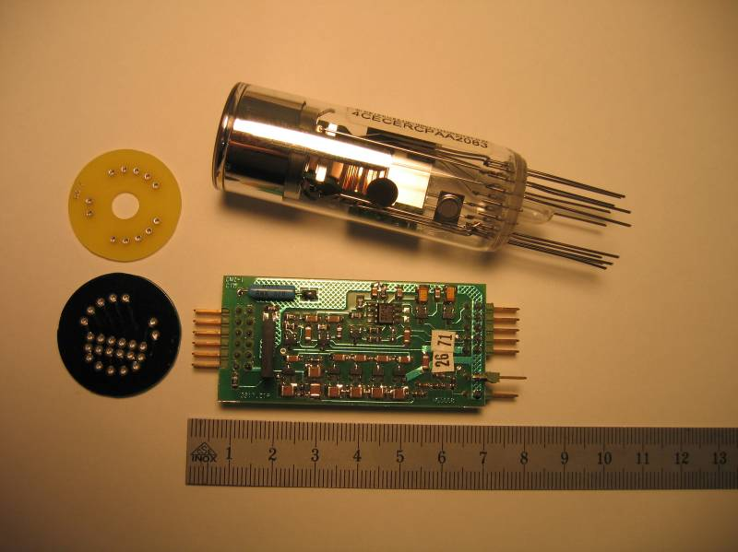
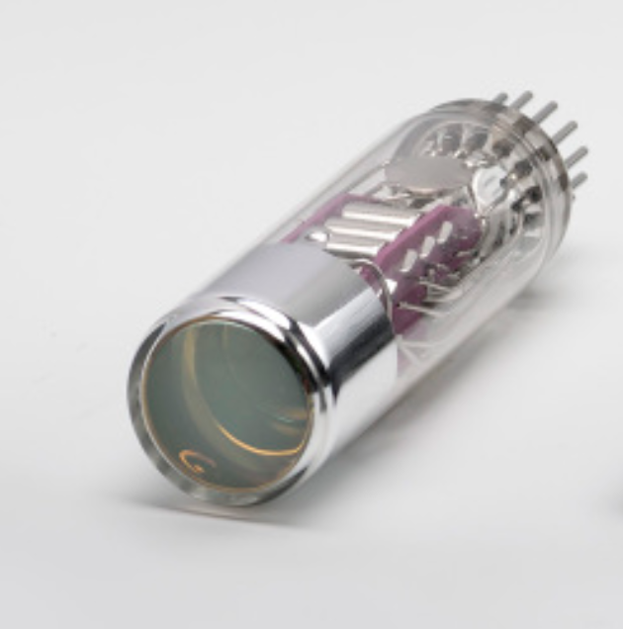
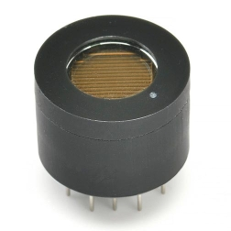
PMT characteristics summary
PMT | Ø outer (mm) | Ø Eff area (mm) | Photo cathode ⁽¹⁾ | λ range (nm) | λ peak (nm) | <QE> PMT*GFAG (%) | Gain ~800V | Dynodes | Dark Current ~800V (nA) | t rise (ns) | T.T.S. (ns) | Price (€)
R14755U-100 | 16 | 8 | SBA | 300-650 | 400 | 9.5 | 2.5 x 10⁴ | 6 | 0.1 | 0.4 | ? | 798
R11187 (TILECAL) | 25.7x25.7 | 18x18 | BI | 300-650 | 420 |  | 1.0 x 10⁵ | 8 | 0.25 | 1.5 | ?
R7600U-20 (MCD 2020) | 30x30 | 18x18 | ERMA | 300-920 | 530 | 15.3 | 1.0 x 10⁶ | 10 | 20 | 1.6 | 0.35 | 1750
R12421 (2018) | 13.5 | 10 | EGBI | 300-700 | 420 | 10 | 2.0 x 10⁶ | 10 | 1 | 1.2 | 1.4
R7899-20 (ECAL) | 25 | 22 | BI | 300-650 |  | 10.3 | 2.0 x 10⁶ | 10 | 2 | 1.6 | 0.6
(1) SBA: Super bialkali, BI: bialkali, ERMA: Extended red multialkali, EGBI: Extended green bialkali
PMT: R11187,
R7600U-100
PMT: R7899-20
PMT: R14755U-100
PMT: R12421

Slide 18
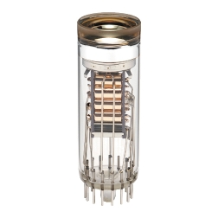
PMTs being studied
PMT: R7899-20
PMT: 7600U-20
PMT: R11187
PMT: R14755U-100
MCD 2020
Good timing
Relatively high gain (10 dynodes)
TILECAL
Good timing
Lower gain (8 dynodes)
Lower gain (6 dynodes)
Good timing
Smaller but still 1-2 mm large
Used on ECAL/HCAL runs ½
Low timing uniformity over photocathode
10 dynodes

Slide 19
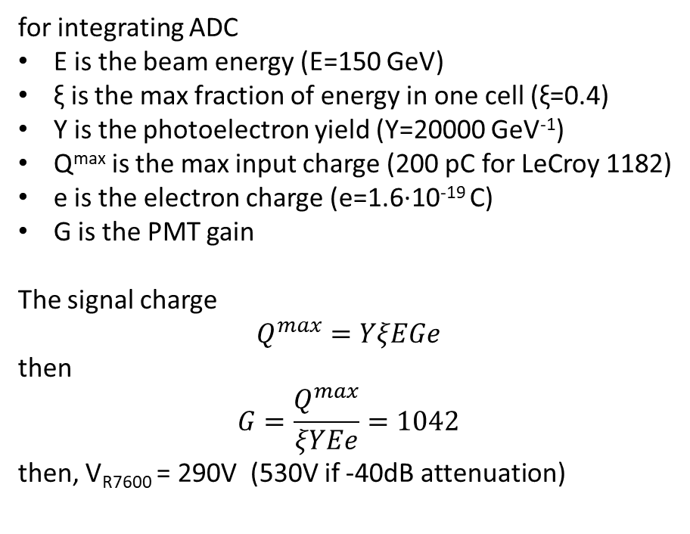
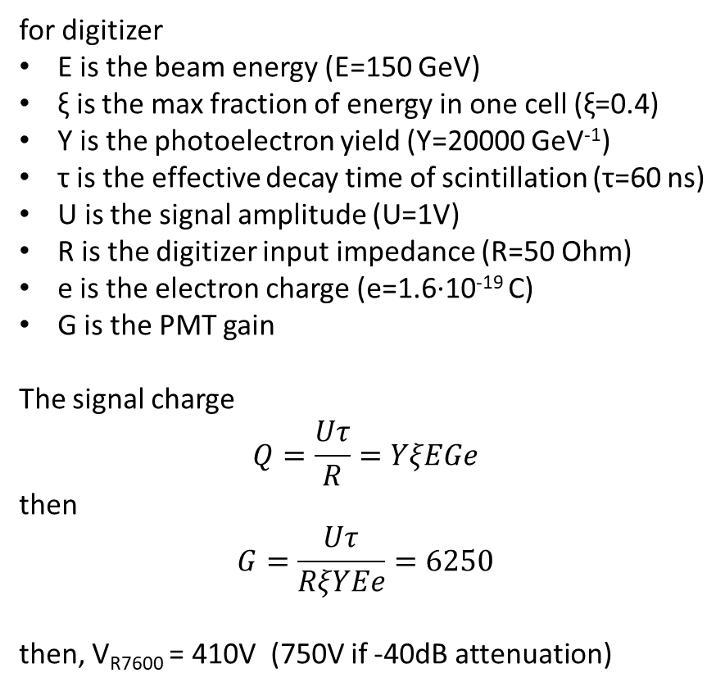
PMT gain calculation for test beam at CERN
for digitizer
E is the beam energy (E=150 GeV)
ξ is the max fraction of energy in one cell (ξ=0.4)
Y is the photoelectron yield (Y=20000 GeV⁻¹)
τ is the effective decay time of scintillation (τ=60 ns)
U is the signal amplitude (U=1V)
R is the digitizer input impedance (R=50 Ohm)
e is the electron charge (e=1.6·10⁻¹⁹ C)
G is the PMT gain
The signal charge
$$Q=\frac{Uτ}{R}=YξEGe$$
then
$$G=\frac{Uτ}{RξYEe}=6250$$
then, V_{R7600} = 410V (750V if -40dB attenuation)
u < 1 V
τ = 60 ns
for integrating ADC
E is the beam energy (E=150 GeV)
ξ is the max fraction of energy in one cell (ξ=0.4)
Y is the photoelectron yield (Y=20000 GeV⁻¹)
Q^{max} is the max input charge (200 pC for LeCroy 1182)
e is the electron charge (e=1.6·10⁻¹⁹ C)
G is the PMT gain
The signal charge
$$Q^{max}=YξEGe$$
then
$$G=\frac{Q^{max}}{ξYEe}=1042$$
then, V_{R7600} = 290V (530V if -40dB attenuation)

Slide 20
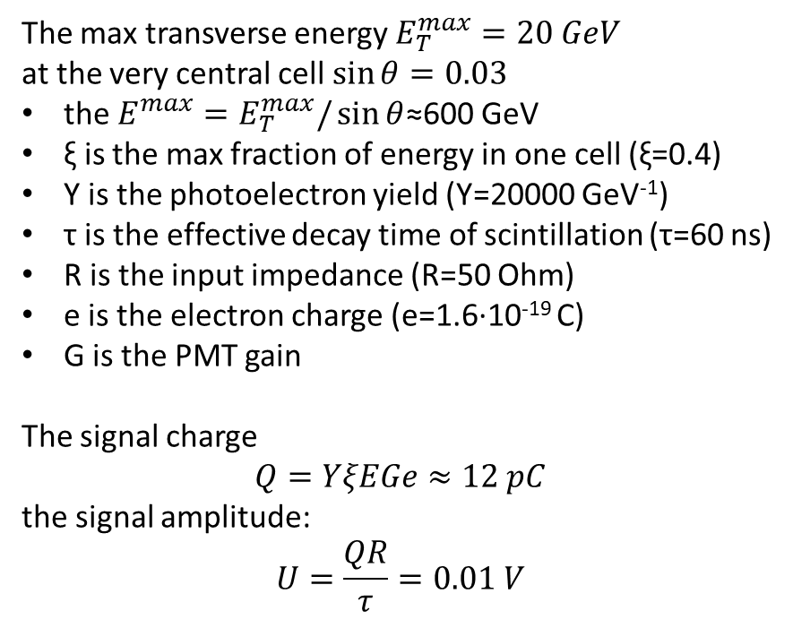
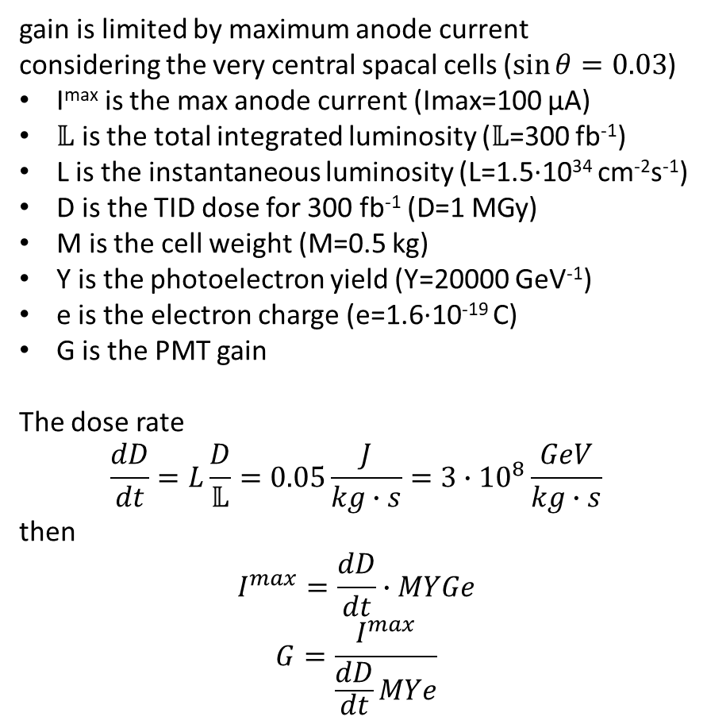
PMT gain calculation for the LHCb operation
gain is limited by maximum anode current
considering the very central spacal cells ($\sin{θ}=0.03$)
I^{max} is the max anode current (Imax=100 μA)
$𝕃$ is the total integrated luminosity ($𝕃$=300 fb⁻¹)
L is the instantaneous luminosity (L=1.5·10³⁴ cm⁻²s⁻¹)
D is the TID dose for 300 fb⁻¹ (D=1 MGy)
M is the cell weight (M=0.5 kg)
Y is the photoelectron yield (Y=20000 GeV⁻¹)
e is the electron charge (e=1.6·10⁻¹⁹ C)
G is the PMT gain
The dose rate
$$\frac{dD}{dt}=L\frac{D}{𝕃}=0.05\frac{J}{kg∙s}=3∙{10}^{8}\frac{GeV}{kg∙s}$$
then
$$I^{max}=\frac{dD}{dt}∙MYGe$$
$$G=\frac{I^{max}}{\frac{dD}{dt}MYe}$$
The max transverse energy $E_{T}^{max}=20 GeV$
at the very central cell $\sin{θ}=0.03$
the $E^{max}=E_{T}^{max}/\sin{θ}$≈600 GeV
ξ is the max fraction of energy in one cell (ξ=0.4)
Y is the photoelectron yield (Y=20000 GeV⁻¹)
τ is the effective decay time of scintillation (τ=60 ns)
R is the input impedance (R=50 Ohm)
e is the electron charge (e=1.6·10⁻¹⁹ C)
G is the PMT gain
The signal charge
$$Q=YξEGe≈12 pC$$
the signal amplitude:
$$U=\frac{QR}{τ}=0.01 V$$
Then, within the Spacal section, the PMT gain should scale proportionally to sinθ.
i.e. G=156*sinθ/0.03

Slide 21
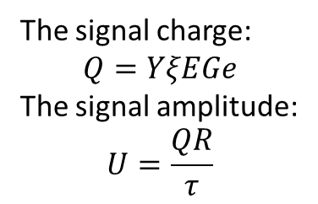
The Upgrade-2 FTDR configuration: gain limited by ageing
PMT gain limited by I^{max}
Lumi=1.5·10³⁴ cm⁻²s⁻¹.
SPACAL light yield (zone 15mm and 30mm): 20 ph.el/MeV
Shashlik light yield: 3 ph.el./MeV
cell size (mm) | G_{PMT} channel | G_{PMT} REAR | G_{PMT} FRONT
15 | 568 | 812 | 1894
30 | 381 | 544 | 1270
40 | 8210 | 11729 | 27367
60 | 21868 | 31240 | 72893
120 | 21367 | 30524 | 71223
GAIN
The signal charge:
$$Q=YξEGe$$
The signal amplitude:
$$U=\frac{QR}{τ}$$
cell size(mm) | Y (phe/GeV) | ξ | Emax (GeV) | τ (ns)
15 | 20000 | 0.4 | 698.4 | 60
30 | 20000 | 0.4 | 453.1 | 4
40 | 3000 | 0.4 | 291.5 | 10
60 | 3000 | 1 | 140.8 | 10
120 | 3000 | 1 | 63.2 | 10
cell size (mm) | U (V) channel | U (V) REAR | U(V) FRONT
15 | 0.42 | 0.60 | 1.41
30 | 2.76 | 3.95 | 9.21
40 | 2.30 | 3.28 | 7.66
60 | 7.39 | 10.56 | 24.63
120 | 3.24 | 4.63 | 10.80
Max signal
Maximum signal amplitudes are orientative
  If too high, the gain of the PMT can be lowered
  and PMT lifetime extended
LSB is calculated dividint maximum signals by the
minimum ADC step (4096 for 12 bit)
LSB in Calo I is 4.9·10⁻⁴ V
  and noise is about 1-2 LSB
cell size (mm) | LSB (V) channel | LSB (V) REAR | LSB (V) FRONT
15 | 1.03x10⁻⁴ | 1.48x10⁻⁴ | 3.44x10⁻⁴
30 | 6.75x10⁻⁴ | 9.64x10⁻⁴ | 2.25x10⁻³
40 | 5.61x10⁻⁴ | 8.01x10⁻⁴ | 1.87x10⁻³
60 | 1.80x10⁻³ | 2.58x10⁻³ | 6.01x10⁻³
120 | 7.91x10⁻⁴ | 1.13x10⁻³ | 2.64x10⁻³
LSB

Slide 22
W/Poly - Pulse shape
Studied the average pulse at 60 GeV
  R14755U pulses are shorter than TileCal’s with faster rise and decay time
    Better containment within the bunch crossing
  Average pulse shape affected by the readout configuration
    Slower pulse in single side readout due to the light reflected by the mirror in front
    Studies ongoing with Monte Carlo simulations
PRELIMINARY
Single side readout | Rise time (10-90%) [ns]
R11187 (TILECAL) | 3.6
R14755U-100 (round) | 1.8
PRELIMINARY

Slide 23
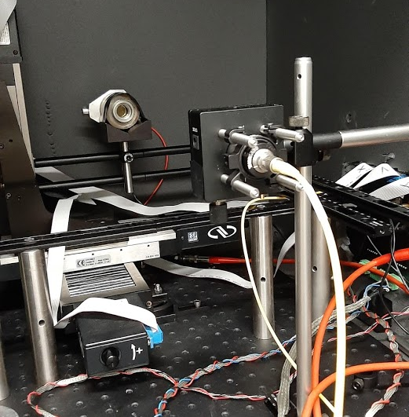


Transient time measurements
Objective: study the transient time uniformity over the photocathode of R7600U-20
Measurements:
  PMT signal output amplitude
  Transient time: time between laser trigger and PMT output pulse
  Transient time spread: standard deviation at a given photocathode position
PMTs:
  R7600U-20: ZF0002, TS0340
  ECAL R7899-20
EXPERIMENTAL SETUP
PMT: R11187
PMT
Collimator
Laser
Grid of points, (laser)
12x12 matrix, 1.5mm separation
500 waveforms per point
Bias voltage = 800V
‘Cardboard’ collimator

Slide 24
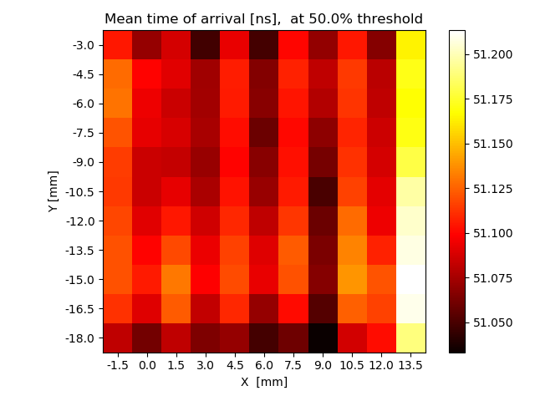
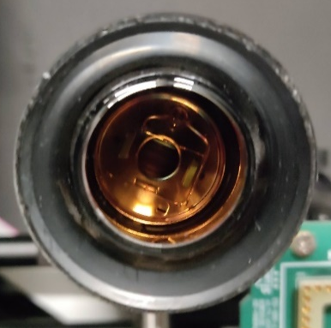


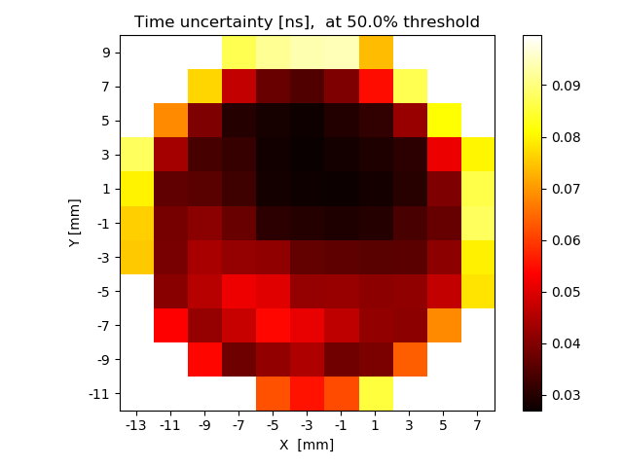
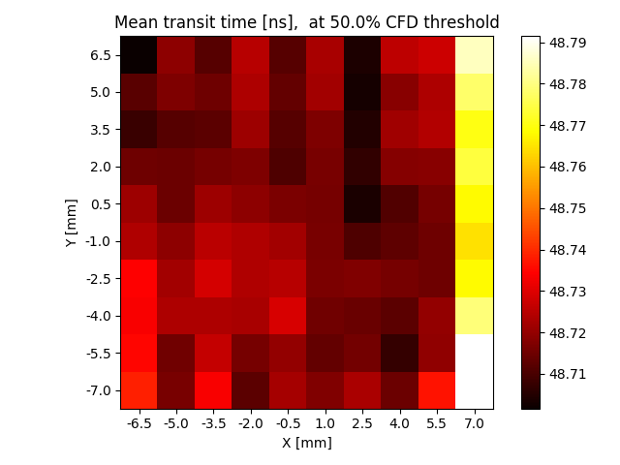

Light readout: PMTs time resolution and TTS uniformity
  Non uniformity may increase the time resolution
  The use of light guides would reduce the uniformity requirement
  Scan over photocathode with laser light
  Arrival time uniformity over R7600U-20
  CFD 0.5 → total std = 41 ps
PMT: R7899-20
PMT: R7600U-20 or R11187
PMT
Collimator
Laser
Grid of points, (laser)
Grid of points, (laser)
  Arrival time uniformity over R7899-20
  CFD 0.5 → total std = 1.36 ns
  Arrival time uniformity over R11187
  CFD 0.5 → total std = 32 ps

Slide 25
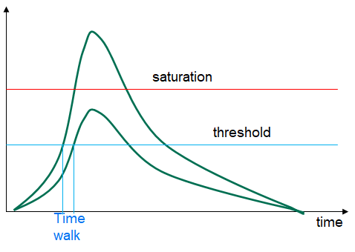
Timing and amplifier at PMT base
20 ps time resolution is mandatory to distinguish interactions → maintain physics performance.
Time path self-trigger threshold could be set for 5GeV depositions in channel.
  Testbeam 2020 results assure 20 ps time resolution above 5GeV of beam energy (E_{T} = 2GeV).
  Time measurement for 2x2 cluster or each channel, depending on occupancy.
Theoretically, time jitter above time resolution for smaller signals.
  Assume
    Dynamic Range=1V, for E_{T,max} = 40GeV and E_{T,max} = 2GeV → min signal 50mV ;
    Rise time (10%-90%) of SPACAL GFAG and MCD: 5ns ;
    noise = 1mV,
  therefore → jitter = noise/slope = 1mV/(50mV/5ns) = 100ps rms
Can we increase the Slope by a factor 5 to achieve 20ps?
  reduce scintillator rising time?
  increase gain, but then pulse saturates at SCA so no CFD correction.
    external time walk correction using energy path measurement?
    external baseline correction with initial SCA samples/event
Alternative to measure time with MCP-PMT layer.
  Sampling rate specification would increase by some factor.
  Sample pattern for digitization may change wrt module PMTs.

