Slide 1
(PS/SPD) HV System
ECAL Upgrade II Workshop
Orsay
12-14 December 2022

Slide 2
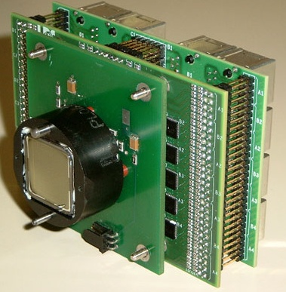
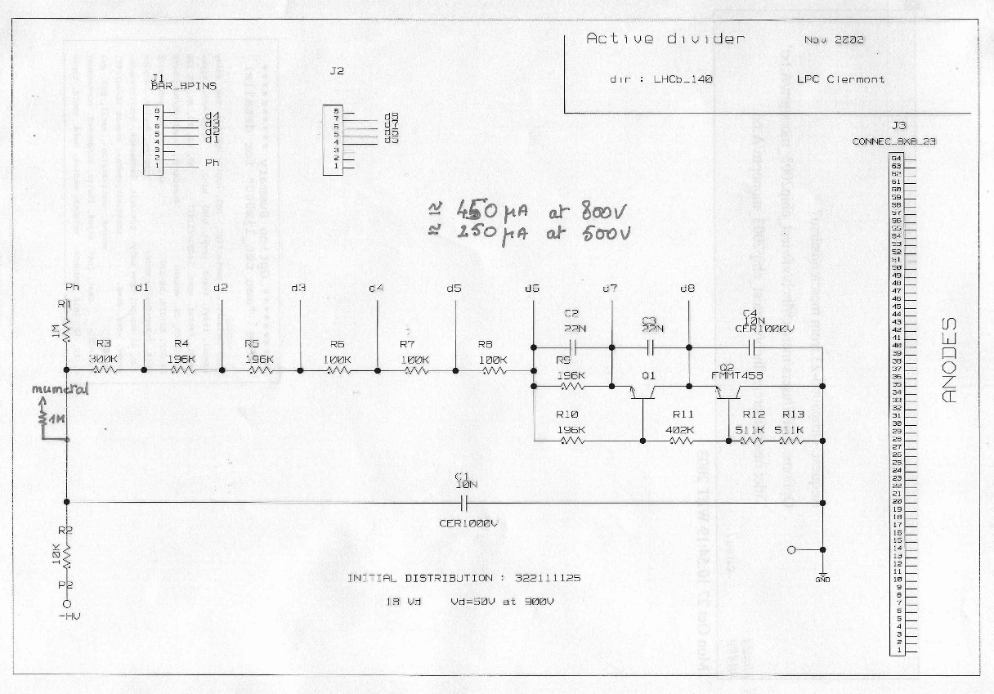
PS/SPD MaPMT
As a reminder:
  MaPMT (64-channels) located on top and bottom of the detector inside VFE boxes
    200 MaPMT for PS and SPD
  Multistage board:
    PMT base, ASIC (analog part), connectors (signal, clock, LV, HV and temperature probes)
    An active (transistor) base was chosen: the same for PS and SPD
    Compact circuit few components
      1 resistor and 2 transistors (2 last stages) tested in radiations
    Simplicity
    HV between 500V to 900V
https://indico.cern.ch/event/410616/contributions/1867406/attachments/832022/1151064/MAPMThighcurrentbase.pdf
https://indico.cern.ch/event/416146/contributions/1000561/subcontributions/80539/attachments/854825/1193198/page1.jpg
PS VFE board
Transistor base schematic: M. Crouau

Slide 3
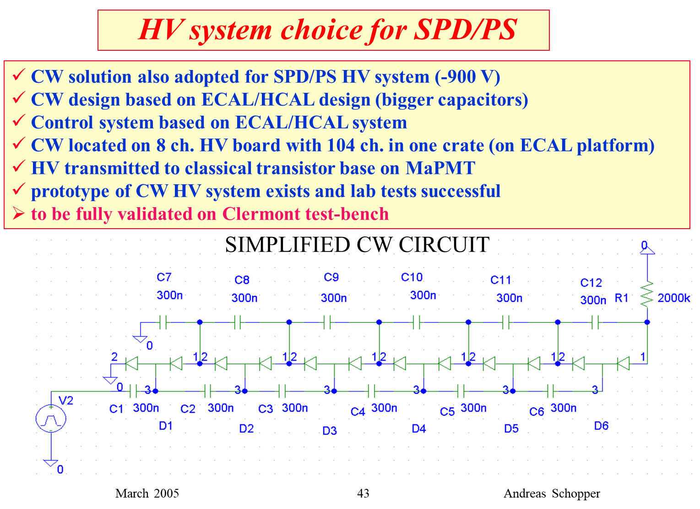
Overview of HV system for PS/SPD
LHCb Plenary meeting 11/3/2005
CW Designed made by Yuri Gilitsky (IHEP)
Control signal distribution board derived from ECAL/HCAL HV control board by Anatoli Konoplyannikov
Yuri Guz has the final design
https://indico.cern.ch/event/421794/contributions/1023953/attachments/885514/1245087/calo_plenary_05_03.ppt

Slide 4
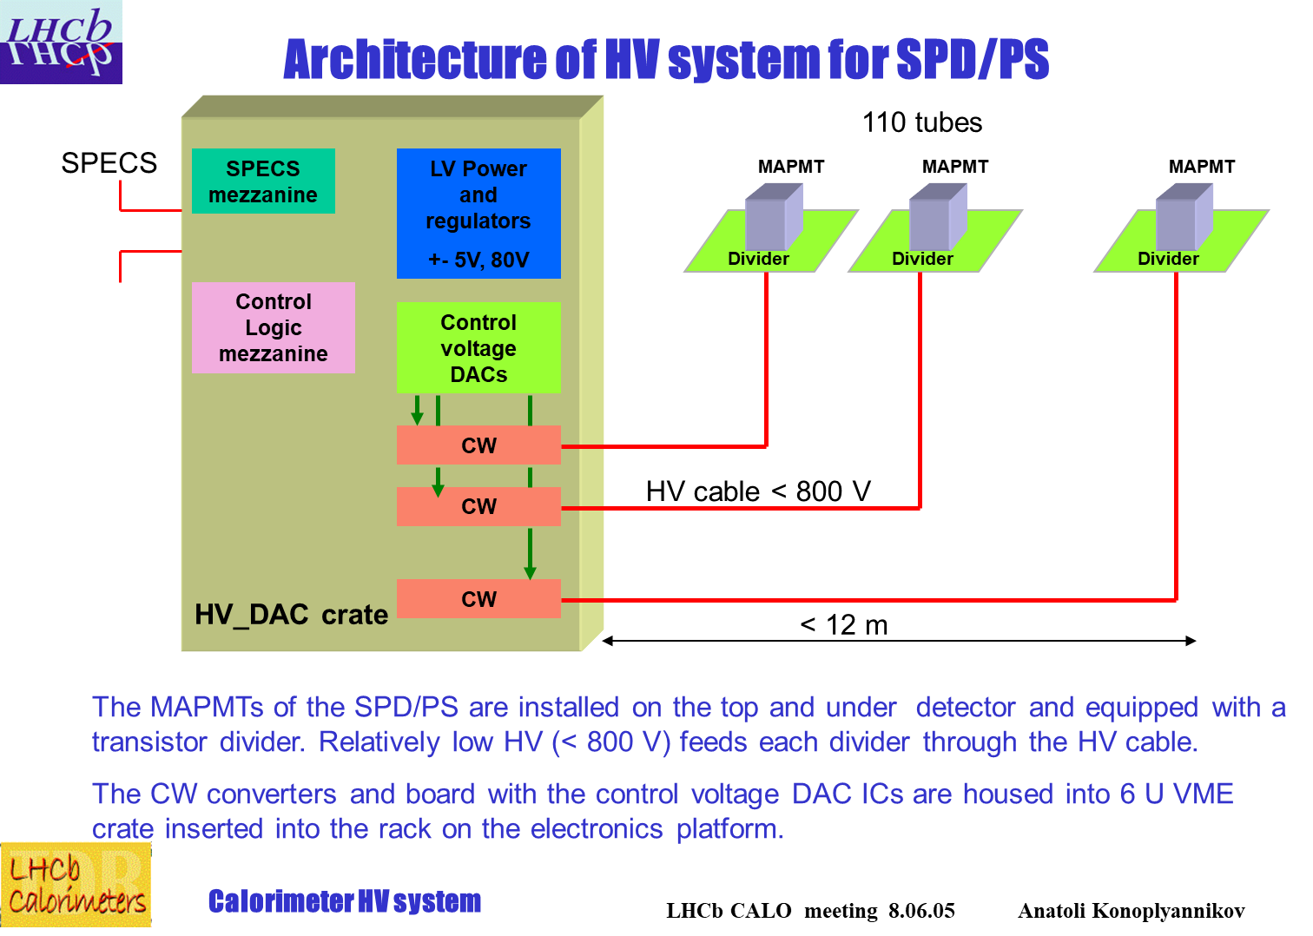
Overview of HV system for PS/SPD
LHCb CALO meeting 08/06/2005
Anatoli
ECAL platform
Details:
https://indico.cern.ch/event/423632/contributions/1907431/subcontributions/171127/attachments/895616/1261810/hvSPD_PS.ppt
~12 – 22 m

Slide 5
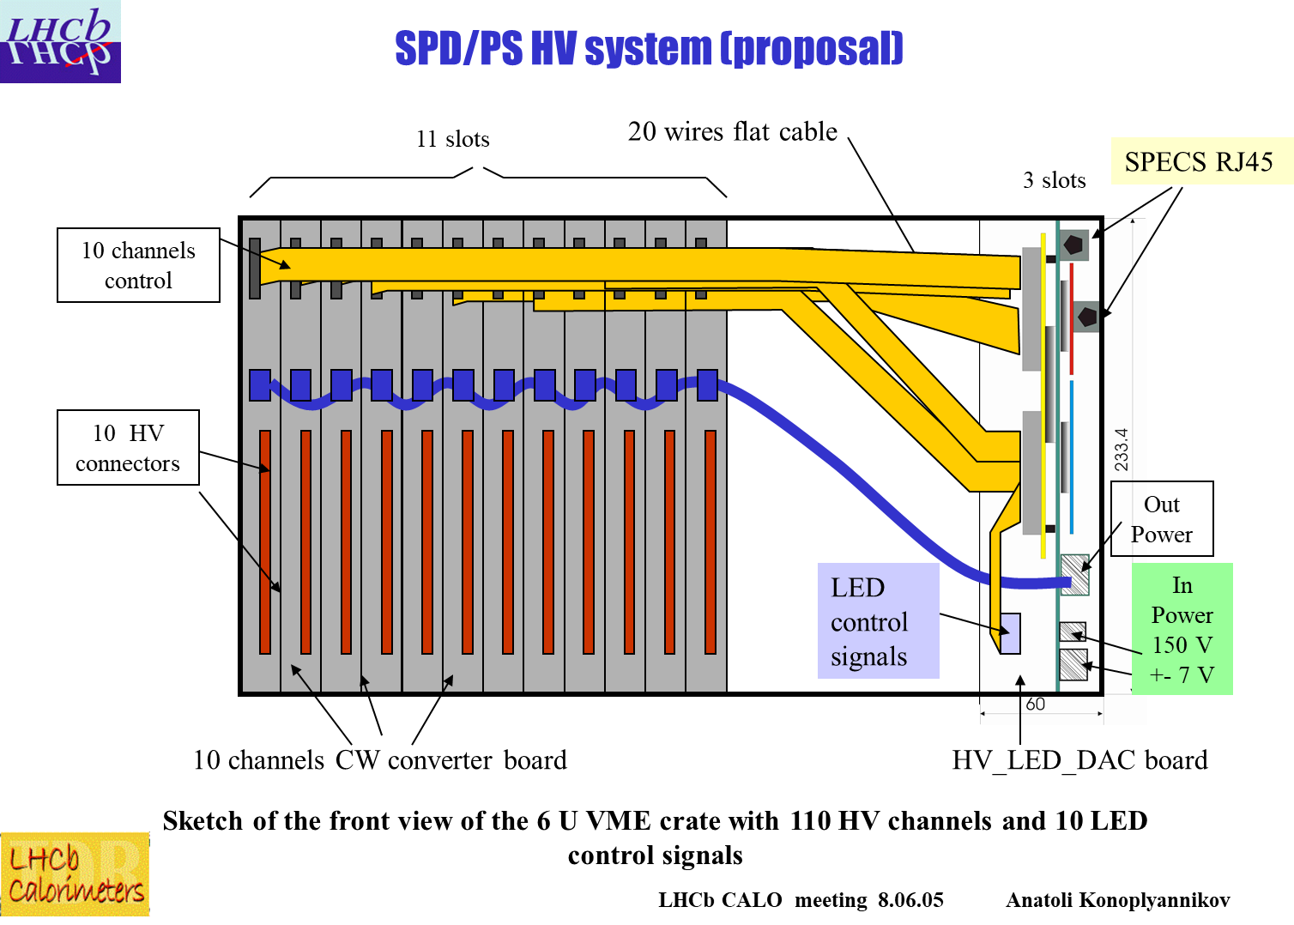
Overview of HV system for PS/SPD
LHCb CALO meeting 08/06/2005
Anatoli

Slide 6
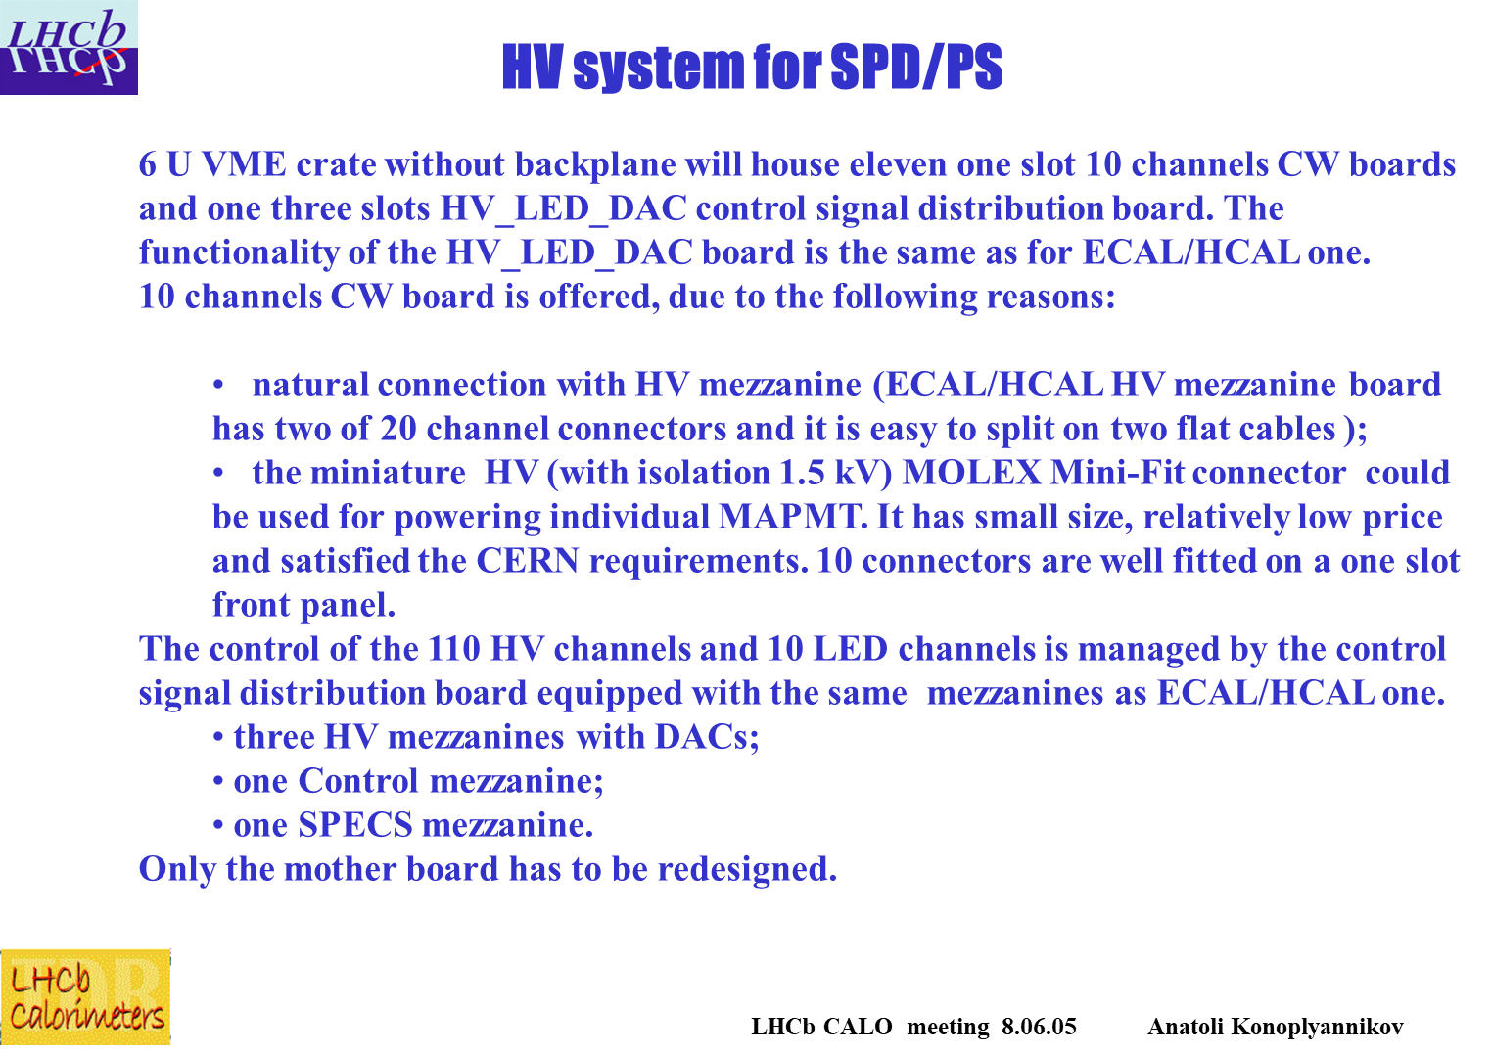
Overview of HV system for PS/SPD
From PP Agilent:150V -18V
Final design
Maraton L3B01 (11) :+-7volts
<700V
30 meters
Cablesx15
TK24-U

Slide 7
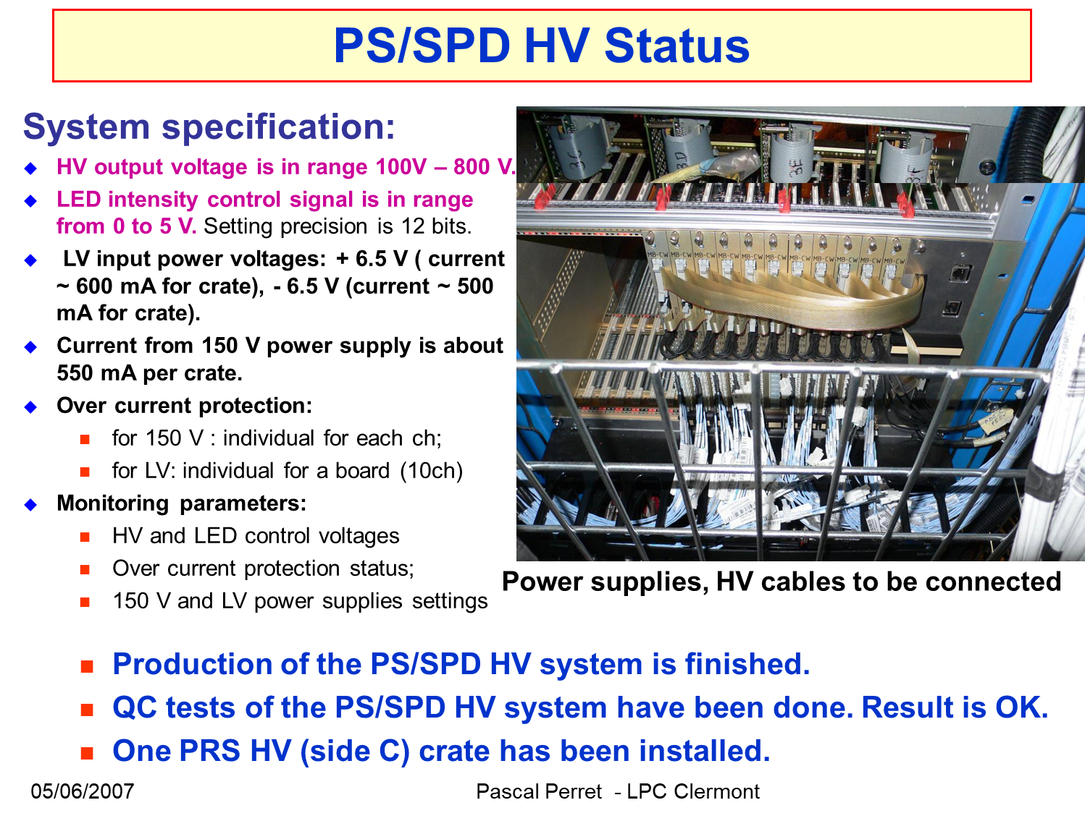
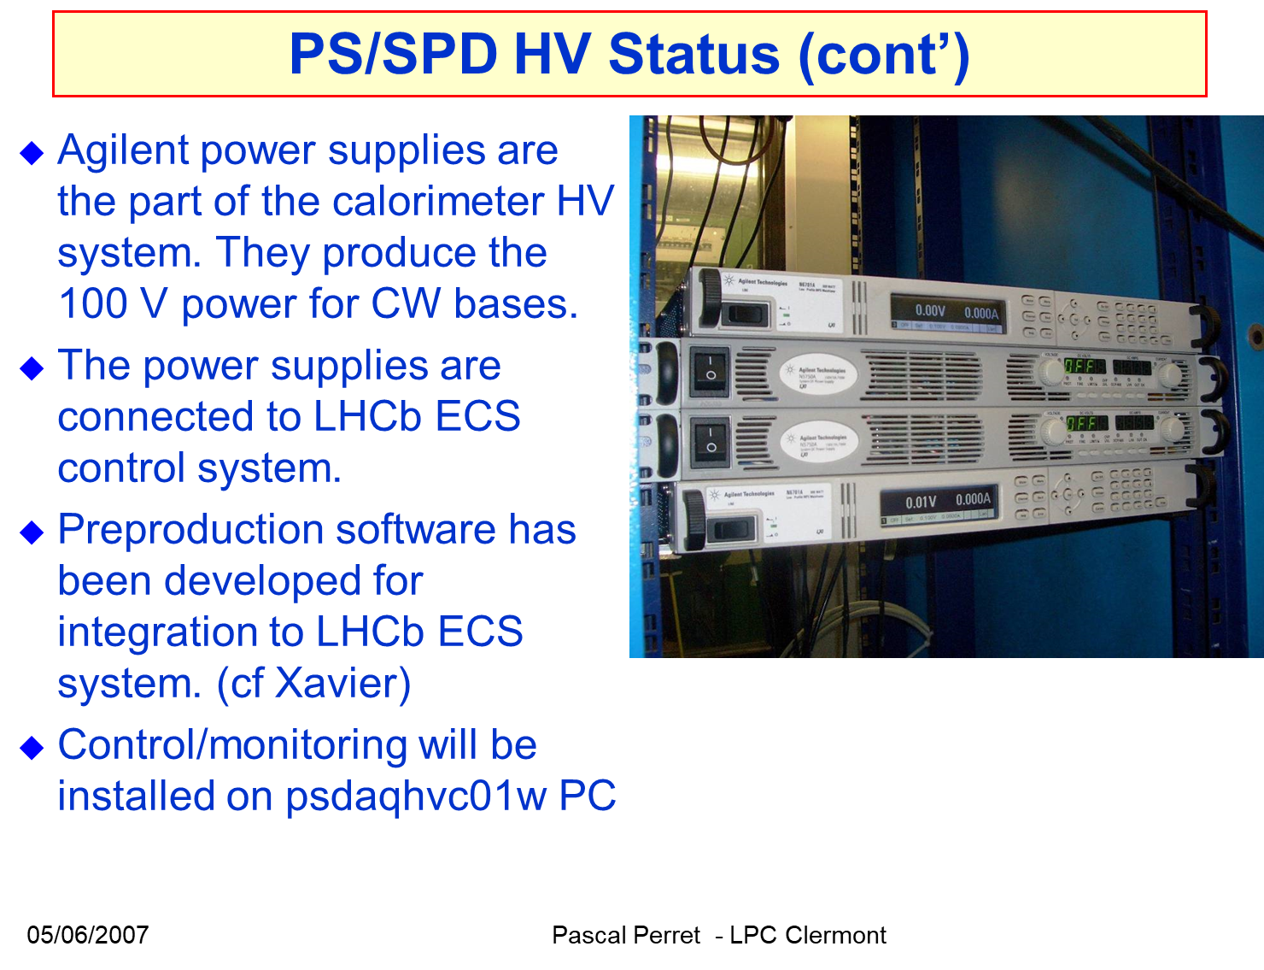
Overview of HV system for PS/SPD
LHCb CALO meeting 05/06/2007
https://indico.cern.ch/event/16379/contributions/242632/attachments/194859/273339/PS-SPD_PP-070605c.pdf

Slide 8
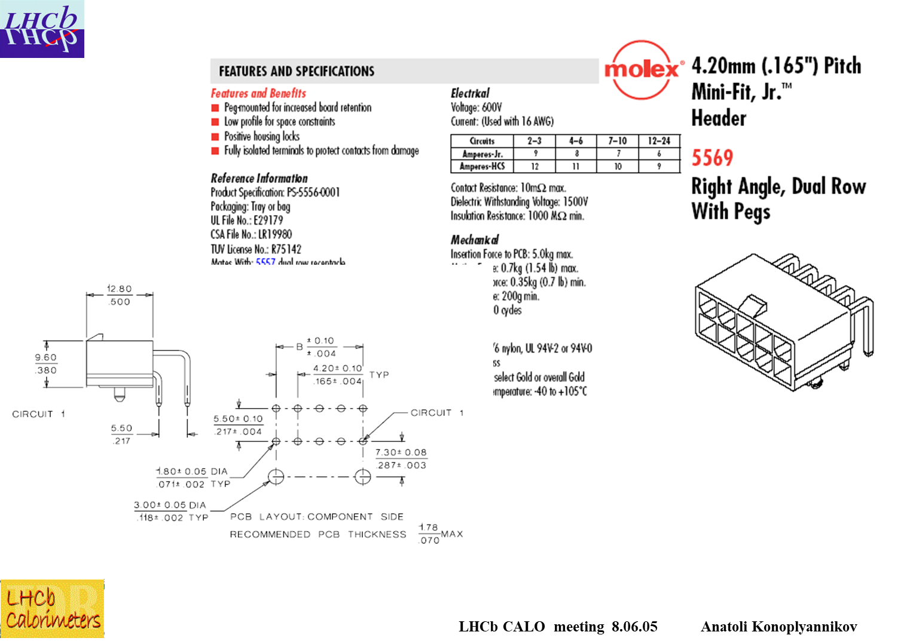
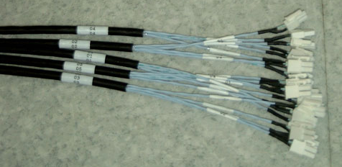
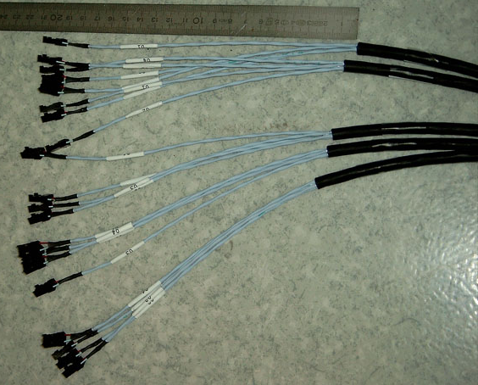
Overview of HV system for PS/SPD
Connectors HV boards
Cables
Draka-Fileca TK24-U 4845-0001A F 4811P002
Final one?
Diameter: 7.2 mm
Connectors:
Antelec FA-S1-03 Molex 3901-2025

Slide 9
HV system for ECAL
  A similar system could be used to provide HV to ECAL PMT
    It was very robust: 1 single channel broken
  The main challenge is the number of channels and to find a place for its location
    PS/SPD HV system:
      6U board, 10 channels/board + control system, 1 crate/side hosting 11 boards + control system + LED
      Power supplies: 7V from a Maraton shared with LED system + 100V from Agilent PS in the barracks
    We could have ~18-20 channels/board (given by the connector dimensions) if connections with the control board is on the backplane. A 9U board could be used if more convenient?
    Few numbers for 30208 channels:
      If 20 boards/crate and 20 channels/board ⇒ 38 crates/side (42 for 18 channels)!
        + xx Maraton
      3776 cables (with 4 cables in one) per side to distribute HV to PMT
  How to reduce the size of the system:?
    Could we use part of the current CW HV system for shashlik modules (or a fraction)?
    Could we deal with a common HV for few channels to reduce the size of the system?
  A lot to be studied!

