Slide 1

Practical informations for the ECAL Upgrade 2 Workshop
Patrick Robbe, IJCLab Orsay, 12 Dec 2022

Slide 2
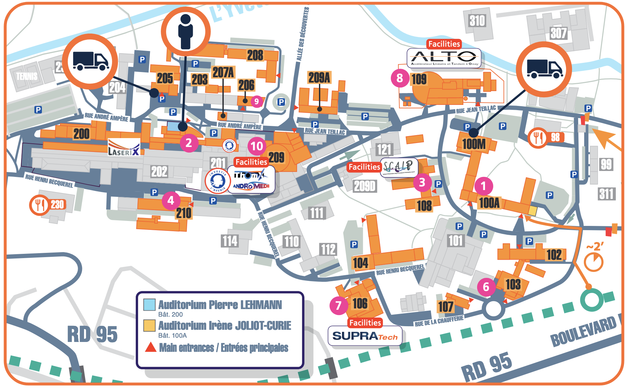
Meeting rooms
Monday
Tuesday
Auditorium Pierre LEHMANN
Wednesday
Auditorium Irène JOLIOT-CURIE
RER B

Slide 3
Coffee breaks
Monday and Tuesday, in the cafeteria next to the auditorium in building 200
Wednesday, also next to the auditorium in building 100

Slide 4
Lunches
Monday, Tuesday: In the campus cantine (CESFO), at 13:15: we can go all together after the morning sessions.
One ticket = 1 starter, 1 hot dish, 1 desert, 1 drink
Wednesday, lunch boxes after the end of the meeting in a room close to the auditorium in building 100

Slide 5
Wifi
EDUROAM
Or IJCLAB-Public network (with registration on portal)
The cafeteria can be used during all day
If you need an office to work or meet, please tell me

Slide 6
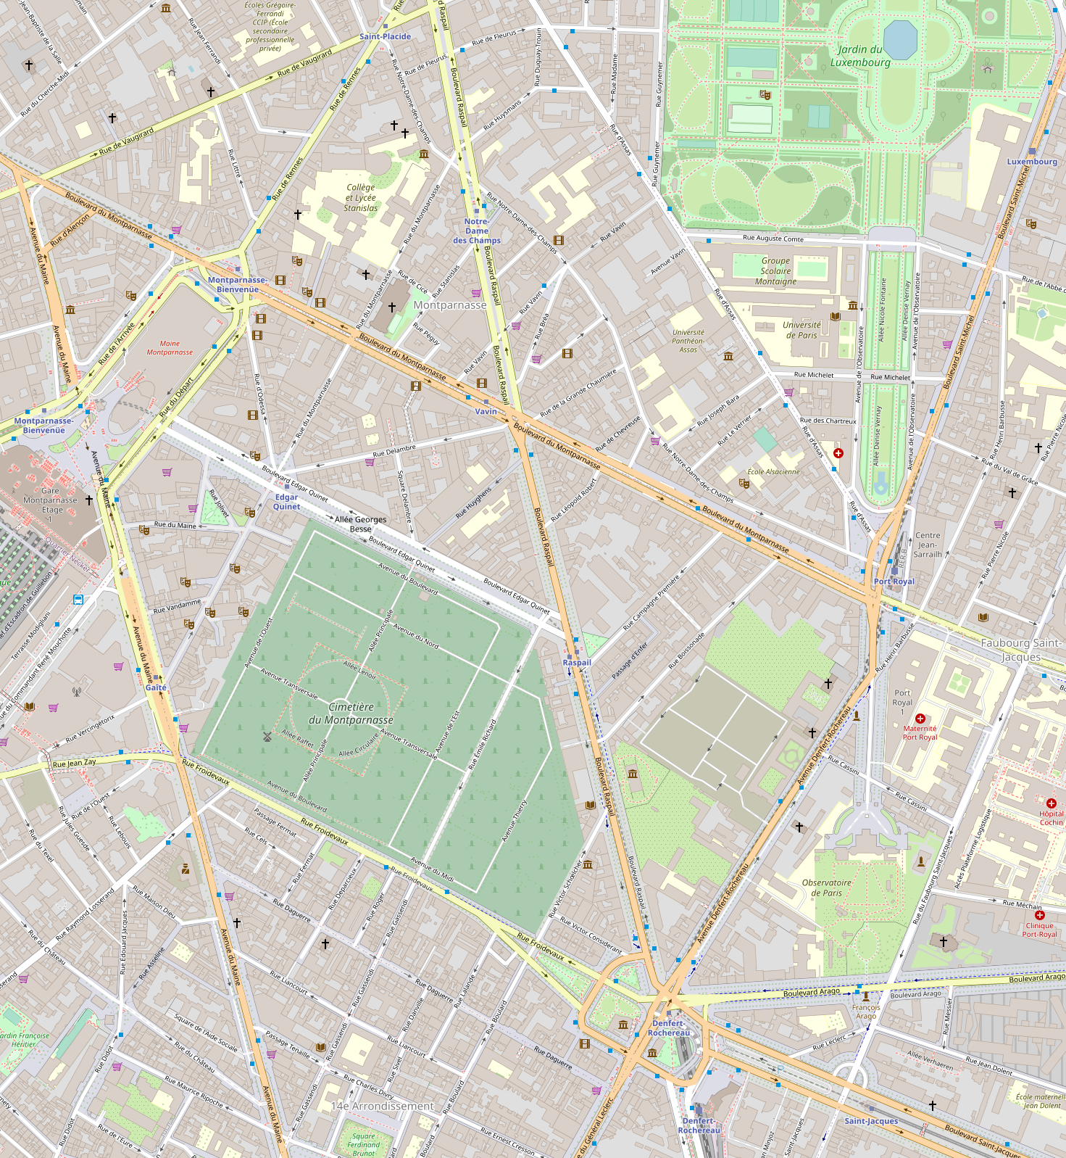
Workshop dinner
Restaurant ‘La Coupole’, 102 boulevard du Montparnasse, Paris 14
19:30 on Tuesday 13 Dec
From Orsay (~30 min):
  RER B to Denfert-Rochereau + Subway line 4 direction ‘Porte de Clignancourt’ to Vavin
  RER B to Port-Royal and 750 m walk on ‘boulevard Montparnasse’
Vavin
Restaurant
Port-Royal
Denfert-Rochereau

Slide 7
Misc.
No RER B between Gare du Nord and Roissy-Charles de Gaulle airport after 22:45 every day
Wednesday evening: football game with probably a lot of people on the streets in Paris
ENJOY THE WORKSHOP !

Slide 8
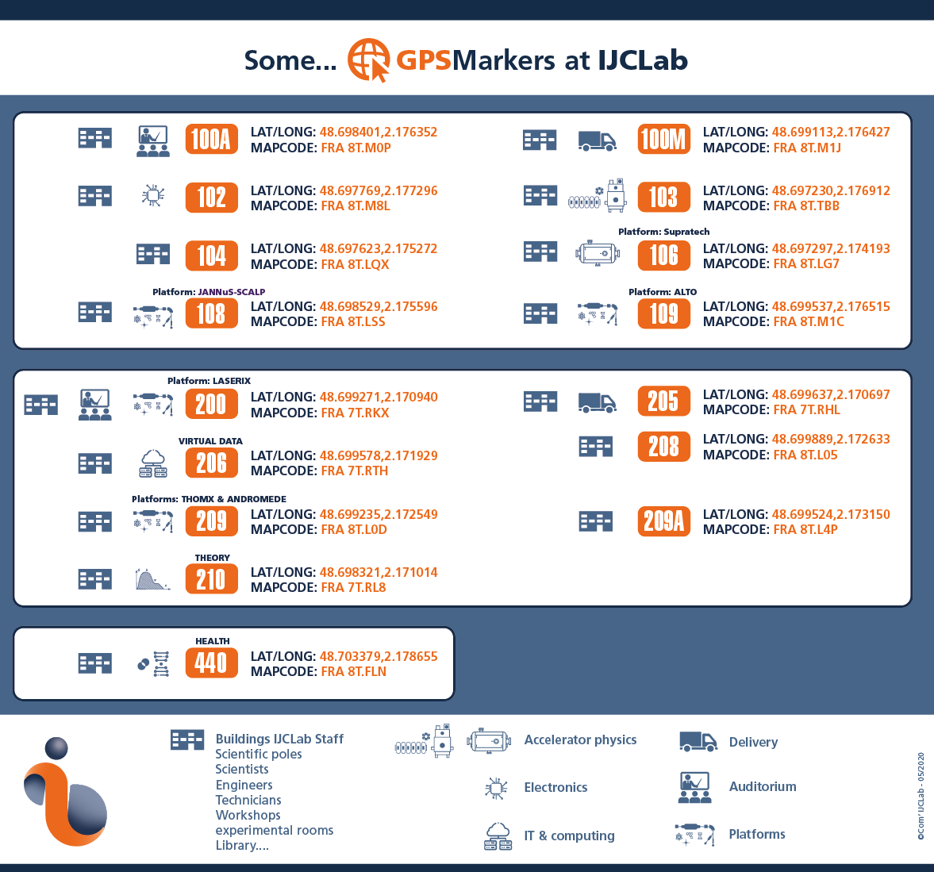
IJCLab buildings coordinates

