Slide 1




North Area Consolidation
De-cabling Working Group
Meeting #12
21st September 2022
Michael JECKEL
on behalf of NA-CONS
BEAMS
DEPARTMENT

Slide 2
Content
List of actions
Planning
Lock out of EHN2 & BA82 (see Marcin’s talk)
Status DEC (Demande d’Enlèvement de Câbles) (Enguerrand’s and Francesco’s Talk)
Identification of cables in TT81-85 (see Enguerrand’s Talk)
Documents to be adapted to EHN2
Deadline for final DECs

Slide 3
List of actions from previous meetings
Action No. | Description | Responsible | Status
1 | ECR to remove SPS INTERCOM & PAGE 1 TV systems in the NA | I. Kozsar | In progress
2 | Collect DECs from different groups | M. Jeckel | In progress
3 | Prepare list of systems together with corresponding electrical circuits that need to remain operational | S. Levorato | In progress
4 | Prepare list of systems together with corresponding electrical circuits that need to remain operational | M. Szewczyk | In progress
5 | Prepare list of systems together with corresponding electrical circuits that need to remain operational | T. Barbe
6 | Prepare list of systems together with corresponding electrical circuits that need to remain operational | J. Ramos
7 (New) | Prepare list of systems together with corresponding electrical circuits that need to remain operational | F. Juban
8 (New) | Investigate on Liquid Krypton control cables from ECN3 | F. Duval
9 (New) | Investigate on SPS-EPO DATAPLEX | Y. Gaillard
10 (New) | Investigate on power needs for the gas system (BG82) | D. Jaillet

Slide 4
List of recommendations from HSE unit following EHN1 de-cabling incidents
Recommendations follow the S-T-O-P principle.
S = substitution (elimination of danger), T = technical measure, O = organizational measure, P = measure relating to people
Nature of the action.
I = Immediate action, A = Action with agreed deadline (date), SR = Strong Recommendation, R = Recommendation
List of Actions sorted by the priority.

Slide 5
List of recommendations from HSE unit following EHN1 de-cabling incidents
Recommendations follow the S-T-O-P principle.
S = substitution (elimination of danger), T = technical measure, O = organizational measure, P = measure relating to people
Nature of the action.
I = Immediate action, A = Action with agreed deadline (date), SR = Strong Recommendation, R = Recommendation
List of Actions sorted by the priority.

Slide 6
List of recommendations from HSE unit following EHN1 de-cabling incidents
Recommendations follow the S-T-O-P principle.
S = substitution (elimination of danger), T = technical measure, O = organizational measure, P = measure relating to people
Nature of the action.
I = Immediate action, A = Action with agreed deadline (date), SR = Strong Recommendation, R = Recommendation
List of Actions sorted by the priority.

Slide 7
Questions ?

Slide 8
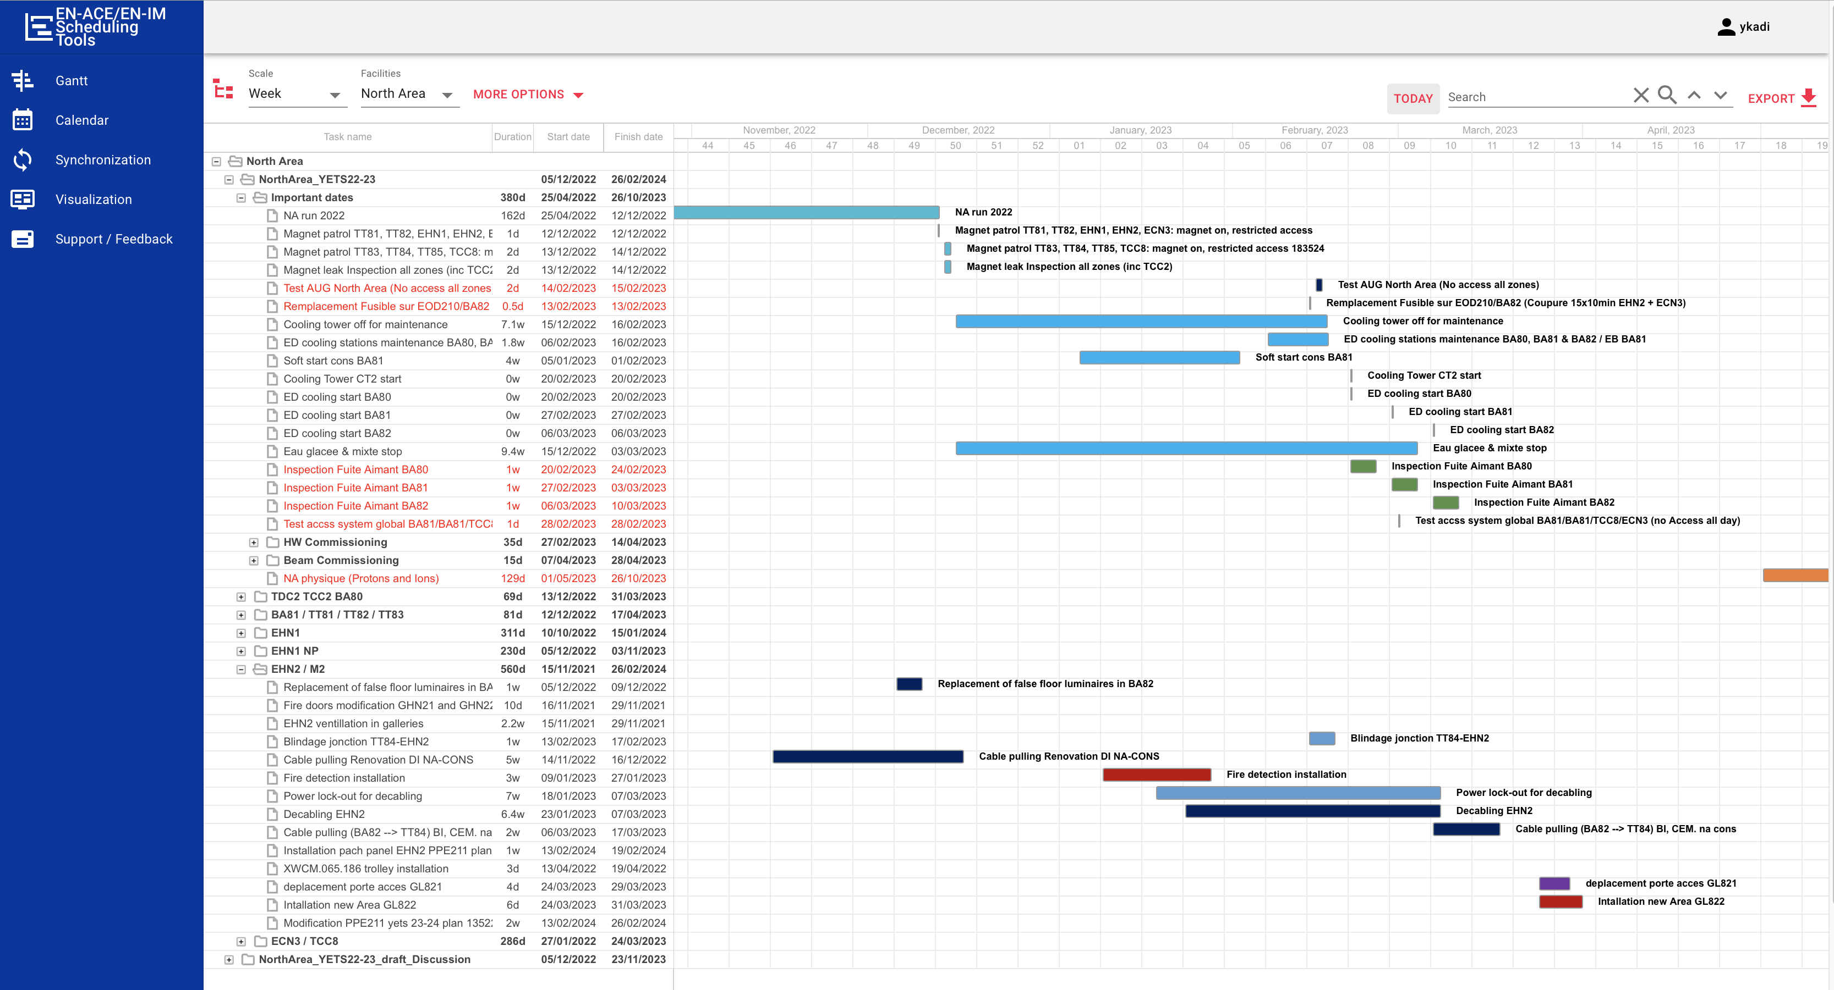
Planning
Time window: 23.01.2023 – 10.03.2023 (6 weeks)
https://oss-coordination.web.cern.ch/gantt/latest

Slide 9
Important Dates
Wed. 15.11.22 End of beam in EHN2 & ECN3
15.11. – 18.11. Magnet inspection with RP
@ EHN2, ECN3, TT83-85, TDC8 & 85 NO TCC8
18.11.22 – 29.03.23 Lock-out of EPC in BA82
30.03.23 ?? Test alim. EPC BA82
16.01.23 - 10.03.23 Time window for de-cabling BA82
Lock-out of EHN2 & BA82
01.05.23 Physics in EHN2

Slide 10
Deadline for final DECs
The final DEC is to certify, by the group link person, that the cable is disconnected and labeled with purple and the other dedicated colour tape of the different systems,
on both ends of the cable.
Deadline: 31st of October 2022 17h30

Slide 11
Questions ?

Slide 12

Dankeschön !

