Slide 1






Project North Area Consolidation
DECs status: EHN2 / BA82 / BX82 / BG82
Enguerrand DUMONT
Francesco DEVITO
BE-EA-PR
September 21th 2022

Slide 2
Summary
Sharepoint presentation :
  What is Sharepoint and what is its purpose ?
  Sharepoint organization EHN2 / BA82 / BX82 / BG82
    GESMAR : Obtaining Cables Information
  SharePoint : Cables Composition of tables
  SharePoint : Summary
  SharePoint : Cables list to Pre-DEC
  Pre-DEC to DEC (Identification In Place)
  Colour code of different systems
  DEC Status (Demande d’Enlèvement de Câbles)
  Orphan Cable List
Actions for connected cables between EHN2 and TT84
Preparations for the next decabling campaign
  Area concerned from TT81 to TT85
  Sharepoint : Folder organization TT81-TT85

Slide 3

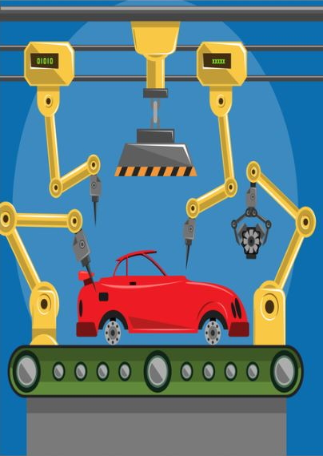




What is SharePoint and what is its purpose ?
Facilitate communication of cable information

Slide 4
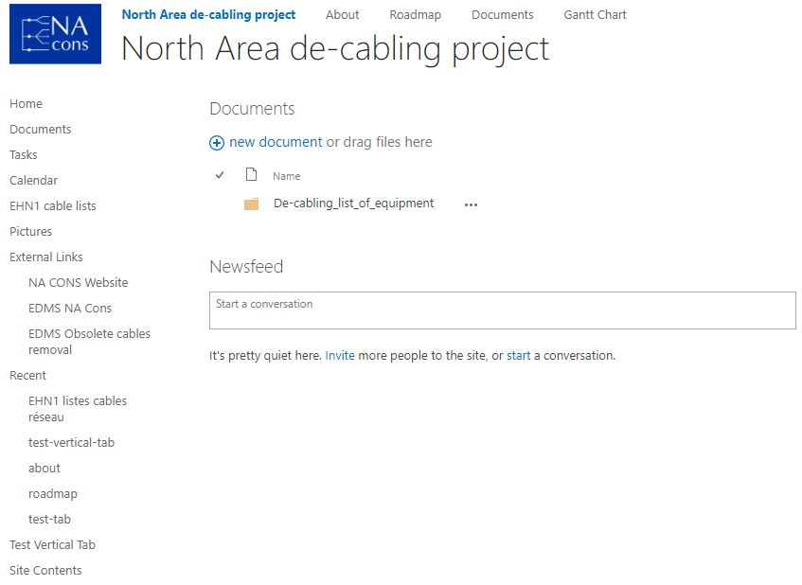

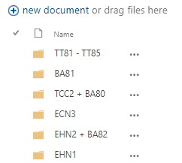
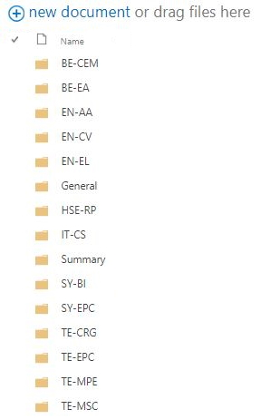




SharePoint : Folder organization
EHN2 / BA82 / BX82 / BG82
SharePoint link
http://https//espace.cern.ch/NA-de-cabling-project/_layouts/15/start.aspx#/Shared%20Documents/Forms/AllItems.aspx

Slide 5

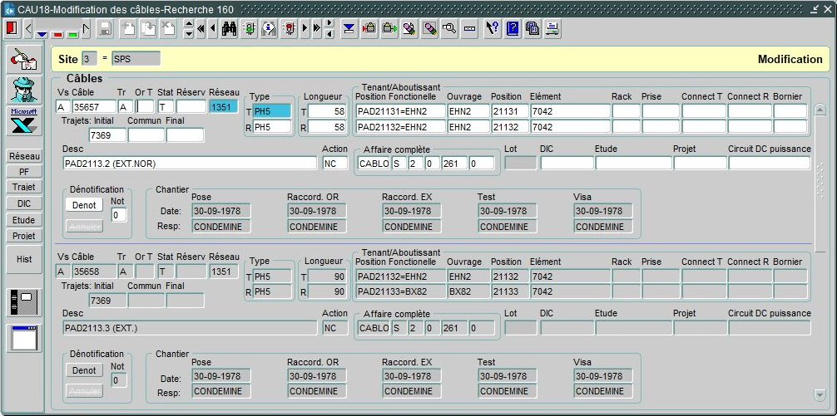
GESMAR : Obtaining Cables Information

Slide 6

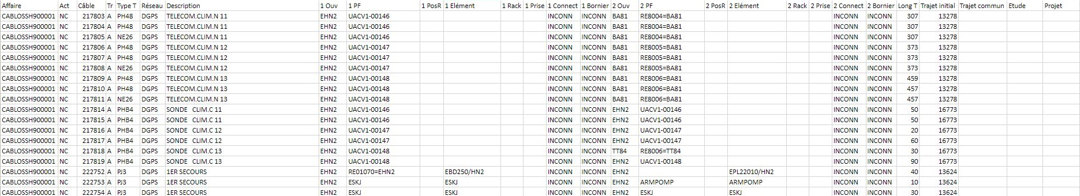
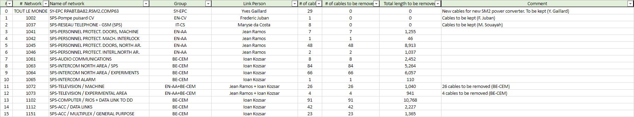
SharePoint : Cables Composition of tables

Slide 7
SharePoint : Folder organization
SharePoint link
http://https//espace.cern.ch/NA-de-cabling-project/_layouts/15/start.aspx#/Shared%20Documents/Forms/AllItems.aspx

Slide 8
SharePoint : Summary

Slide 9
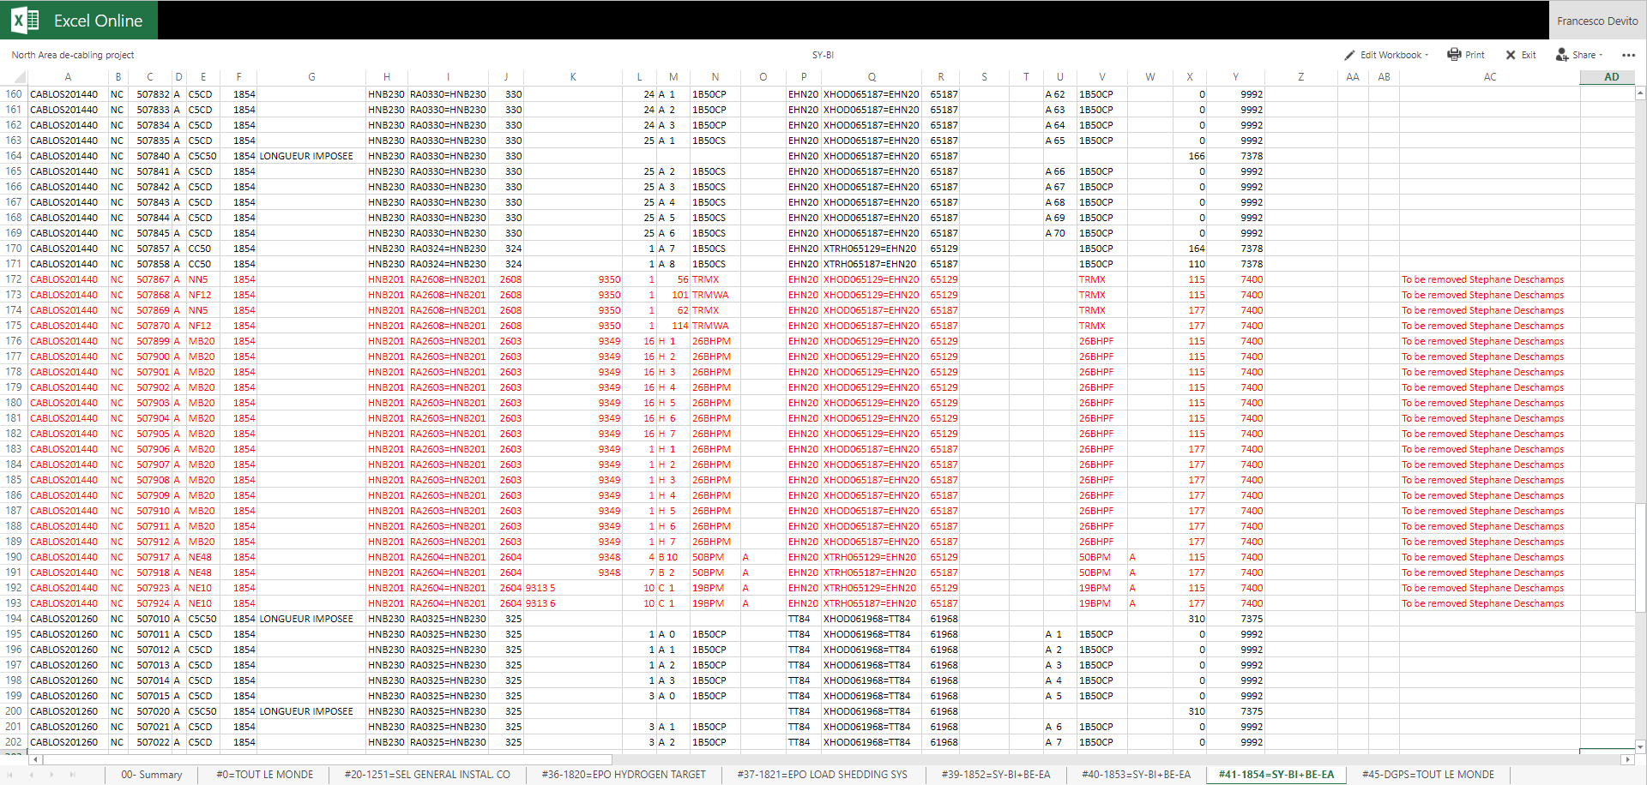
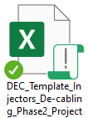
SharePoint: Cables list to Pre-DEC
DEC
Template
To be moved to..

Slide 10
DEC Template (Demande d’Enlèvement de Câbles)

Slide 11
Pre-DEC to DEC (Identification In Place)
ID Filled up Needed

Slide 12
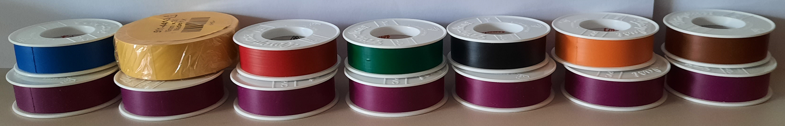
Colour code of different systems
CERN store: 04.94.30.344.5

Slide 13
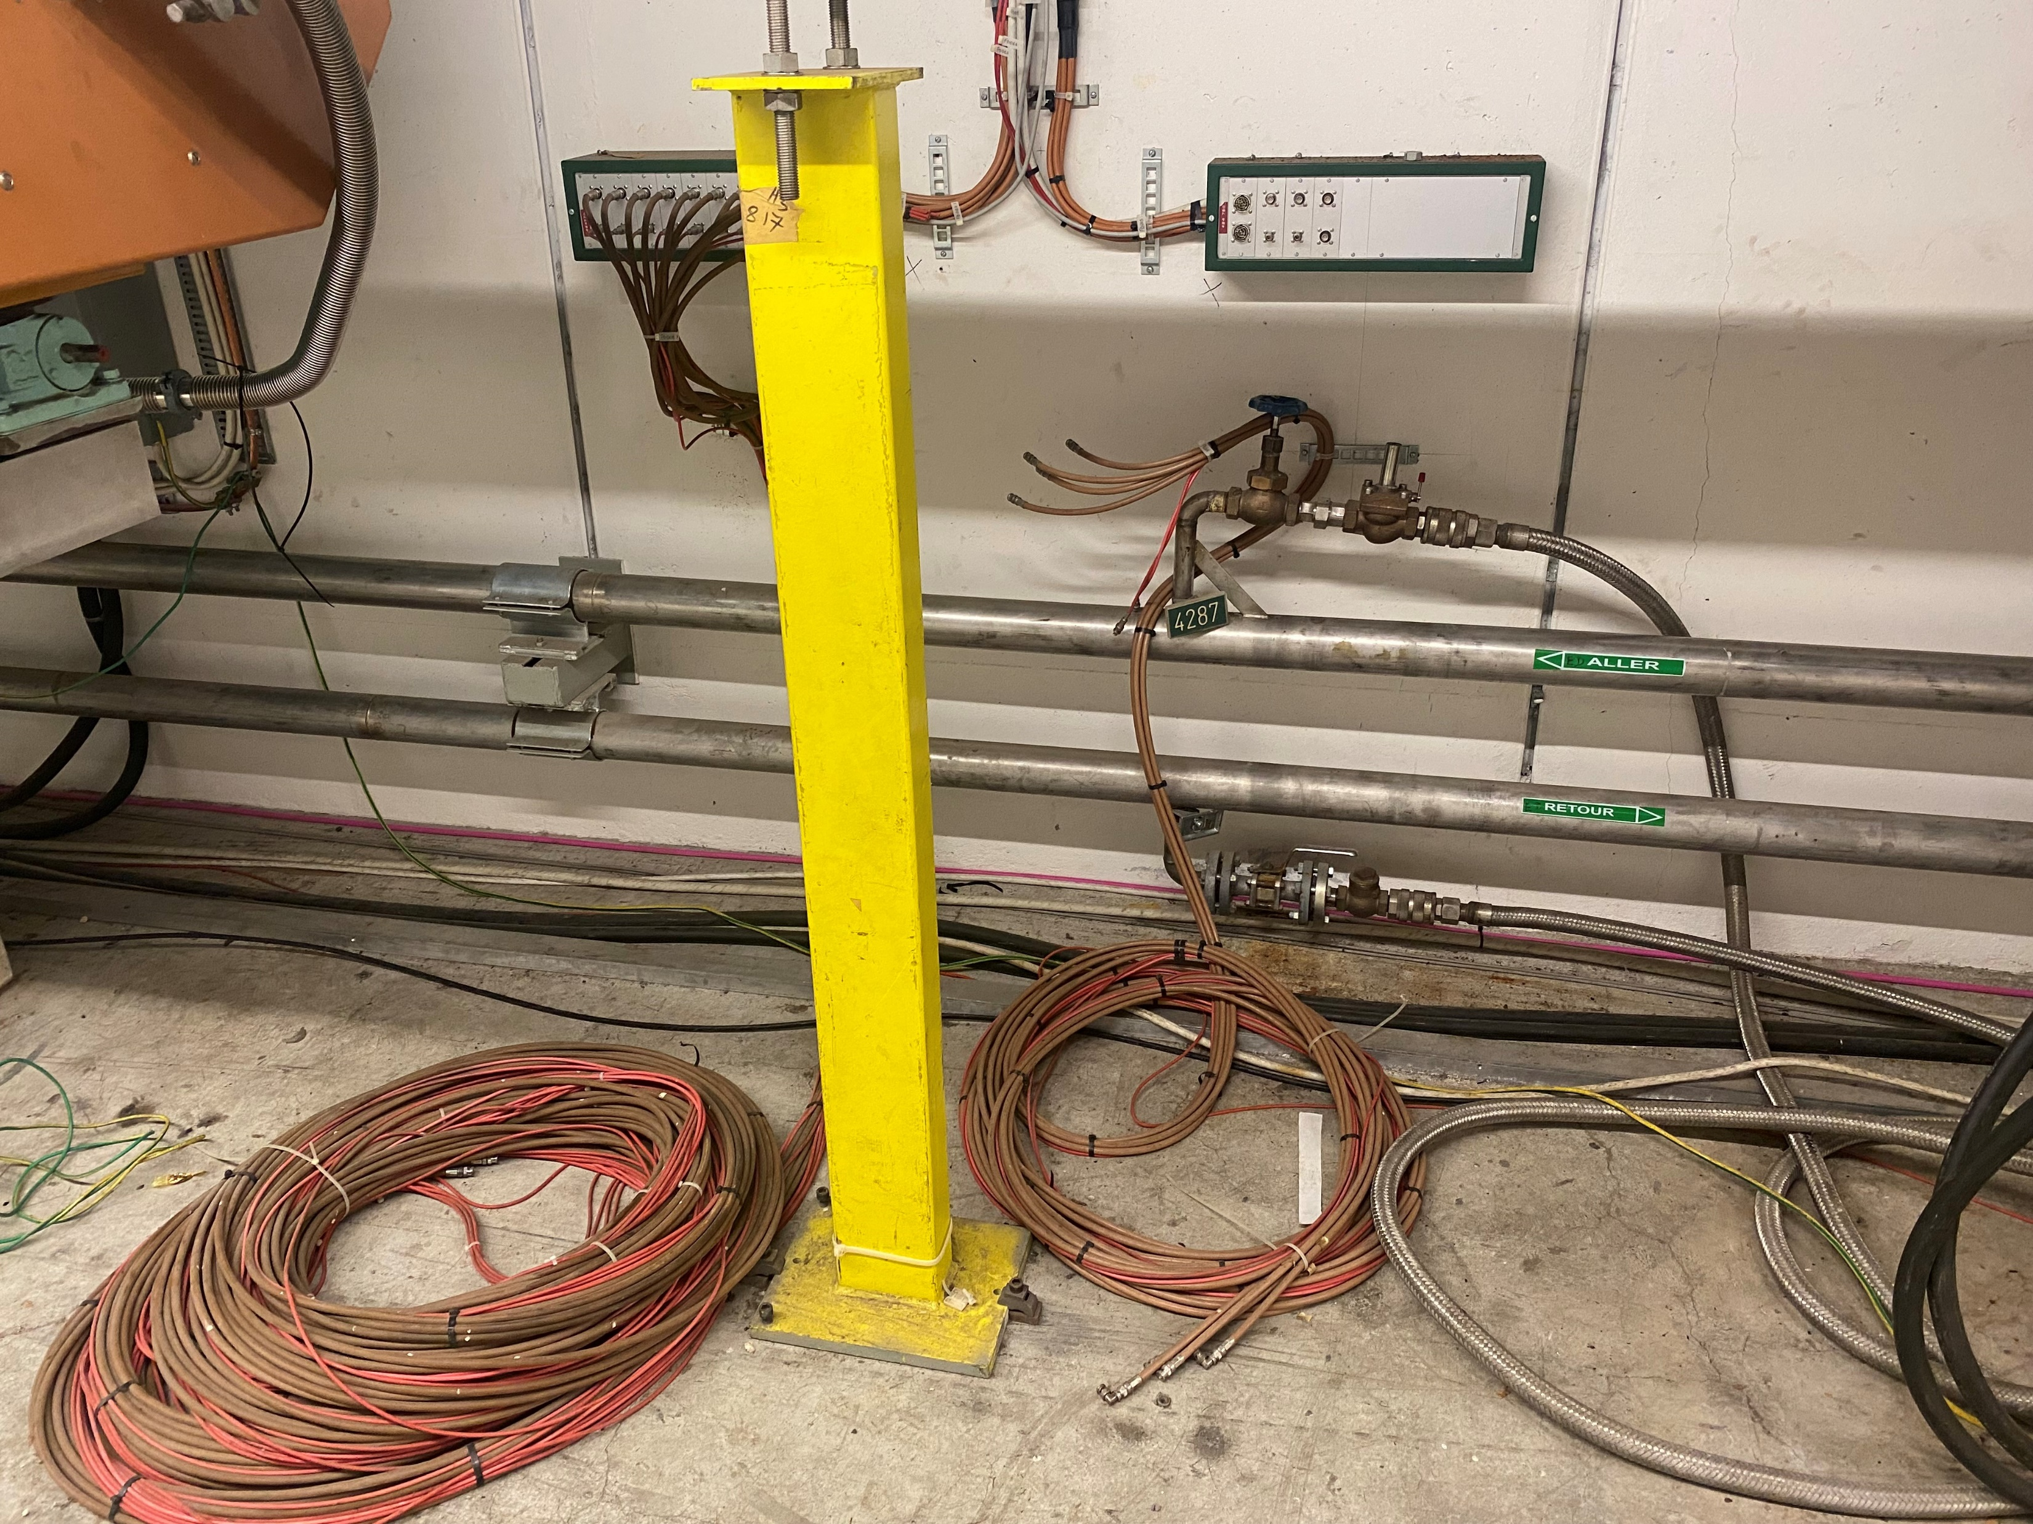
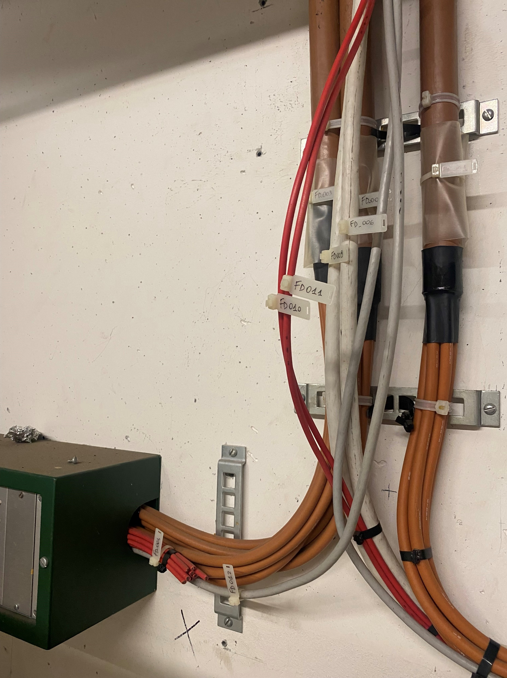
Orphan Cable List
Obsolete Boxes
No Reference
Orphan Cable List

Slide 14
DEC Status (Demande d’Enlèvement de Câbles)
N° | Group | Group name | Link Person | Cable list | Pre-DEC | DEC - approved on EDMS | # of cables | Length [km]
1 | BE-CEM | Controls Infrastructure | Ioan Kozsar | Done | Done | Not started | 350 | 30.916
2 | BE-CEM | BIDs (targets, dumps, etc.) | Ioan Kozsar & J. Lendaro | Not concerned | Not concerned | Not concerned | 0 | 0.000
3 | BE-CSS | Controls Software & Services | Ioan Kozsar | Not concerned | Not concerned | Not concerned | 0 | 0.000
4 | BE-EA | Experimental Areas | Francesco Devito | To be Confirmed | Not started | Not started | 570? | 31.452
5 | BE-ICS | Industrial Control Systems | >>EN/AA | Not concerned | Not concerned | Not concerned | 0 | 0.000
6 | EN-AA | Access & Alarms | Jean Ramos | Done | Missing | Not started | 200 | 18.228
7 | EN-CV | Cooling & Ventilation | Frederic Juban | Waiting Info | Not started | Not started | 4? | ?
8 | EN-EL | Electrical Engineering | Marcin Szewczyk | Done | Done | Not started | 24 | 1.100
9 | EN-HE | Handling Engineering | Sylvain Fumey | Not concerned | Not concerned | Not concerned | 0 | 0.000
10 | HSE-RP | Radiation Protection | Guillaume Michet | Done | Done | Not started | 11 | 4.352
11 | IT-CS | Communication Systems | Maryse da Costa | Not concerned | Not concerned | Not concerned | 0 | 0.000
12 | SY-BI | Beam Instrumentation | Stephane Deschamps | Done | Done | Not started | 170 | 21.596
13 | SY-EPC | Electrical Power Converters | Yves Gaillard | Done | Done | Not started | 205 | 23.552
14 | SY-STI | Sources, Targets and Interactions | Ioan Kozsar & J. Lendaro | Not concerned | Not concerned | Not concerned | 0 | 0.000
15 | TE-CRG | Cryogenics | Thomas Barbe | Not concerned | Not concerned | Not concerned | 0 | 0.000
16 | TE-MPE | Machine Protection | Mathieu Favre | Not concerned | Not concerned | Not concerned | 0 | 0.000
17 | TE-MSC | Magnets, Superconductors and Cryostats | Philip Schwarz | Done | Done | Not started | 68 | 4.754
18 | TE-VSC | Vacuum, Surfaces and Coatings | Abel Gutierrez | Not concerned | Not concerned | Not concerned | 0 | 0.000
19 | EP-Users | COMPASS | Stefano Levorato & F. Devito | Waiting Confirm | In progress | Not started | 367 | 28.864
20 | BE-EA | ORPHAN CABLES | Francesco Devito | Waiting Confirm | In progress | Not started | 40 | 9.639
 |  |  |  |  |  | Total: | 2005 | 174.453

Slide 15
Orphan Cable List
Obsolete Boxes
No Reference
Orphan Cable List

Slide 16
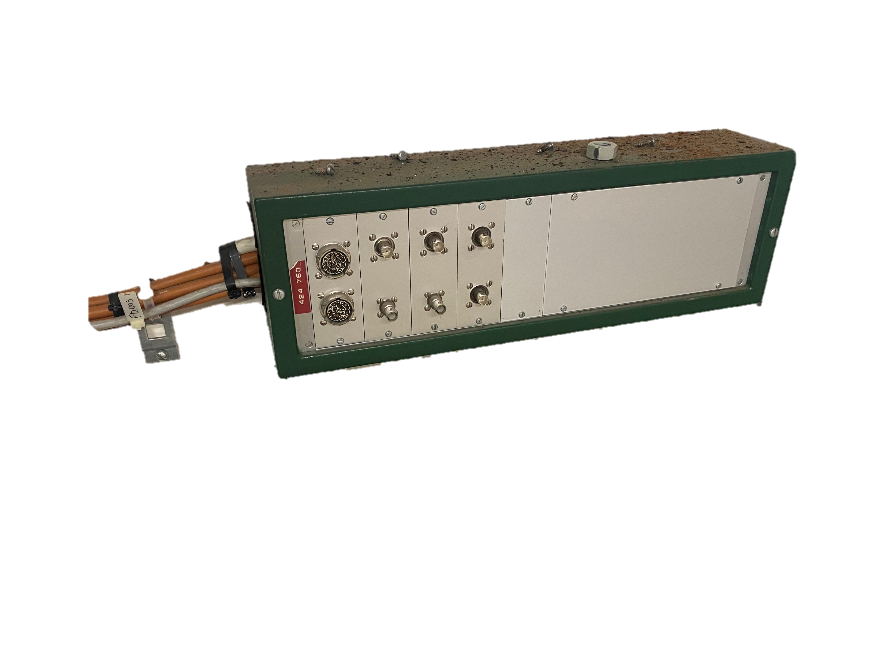
Orphan Cable List
Moved to SY-BI DEC (1853: SY-BI + BE-EA)
Added Complementary information
Filtering by GESMAR

Slide 17
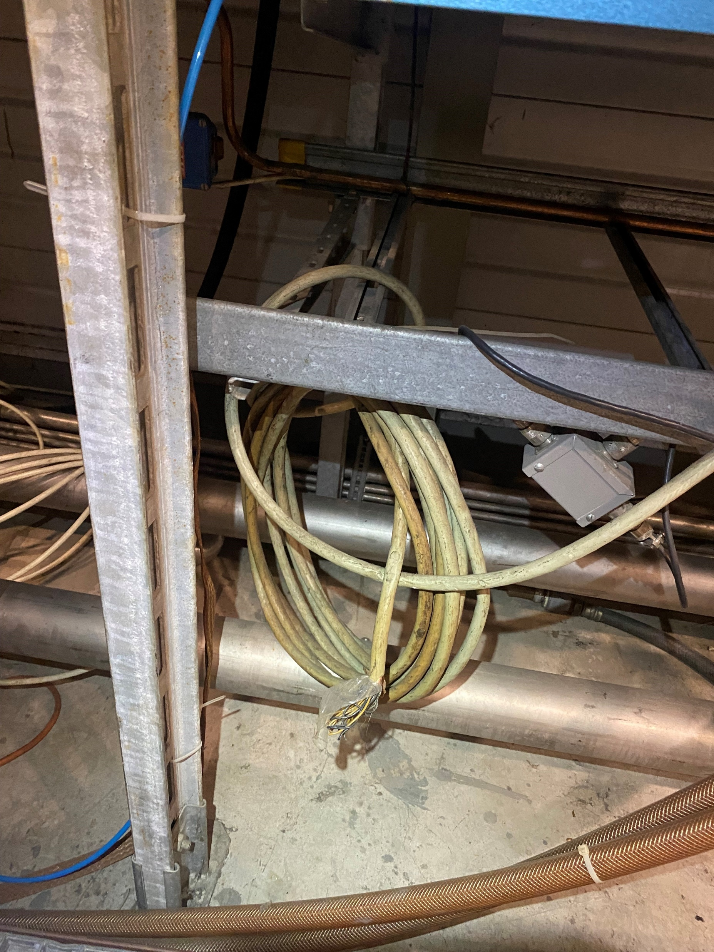
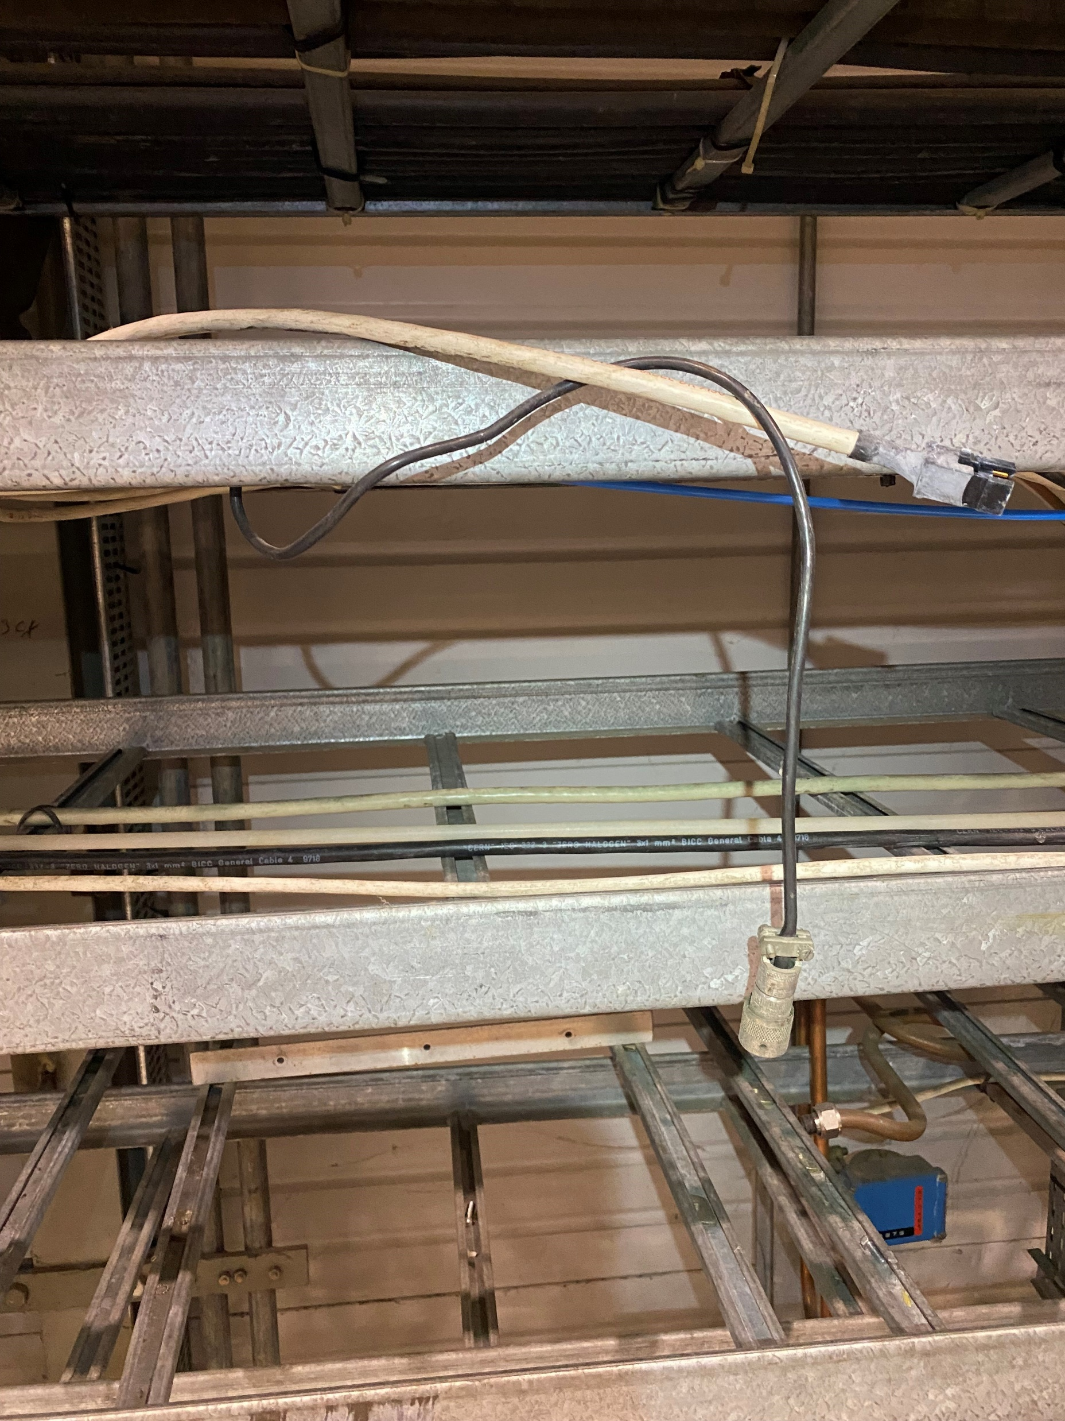
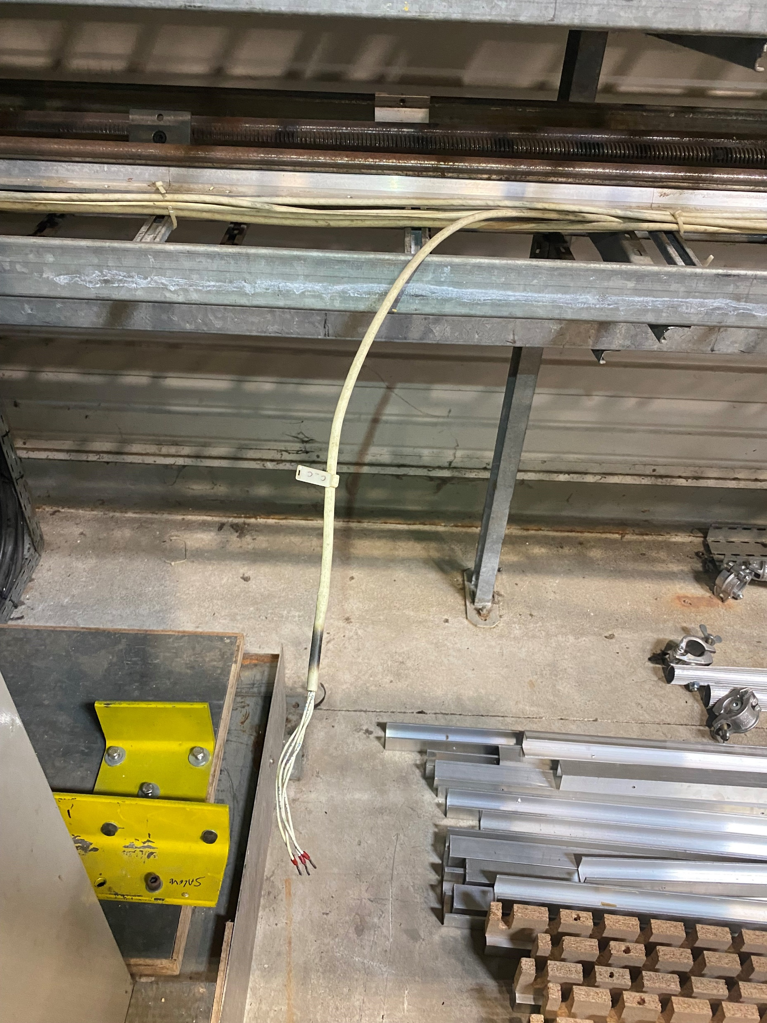
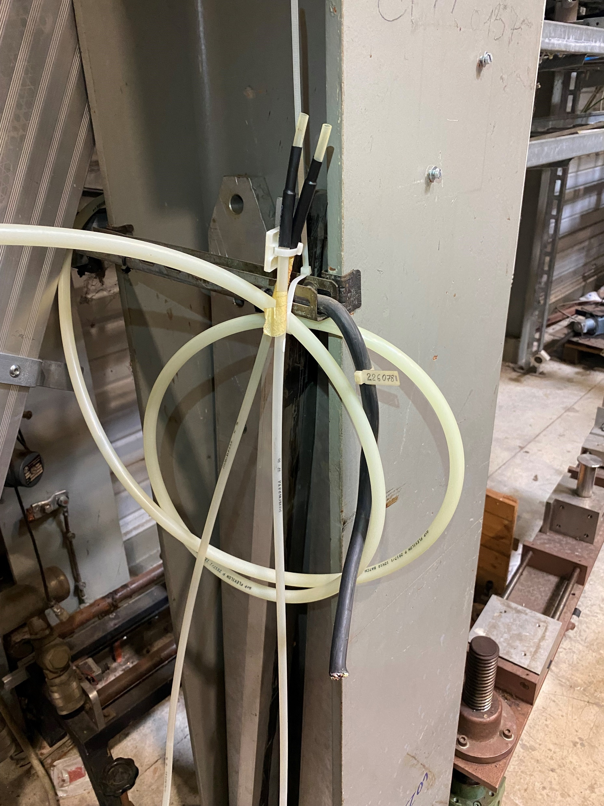
Orphan Cable List

Slide 18
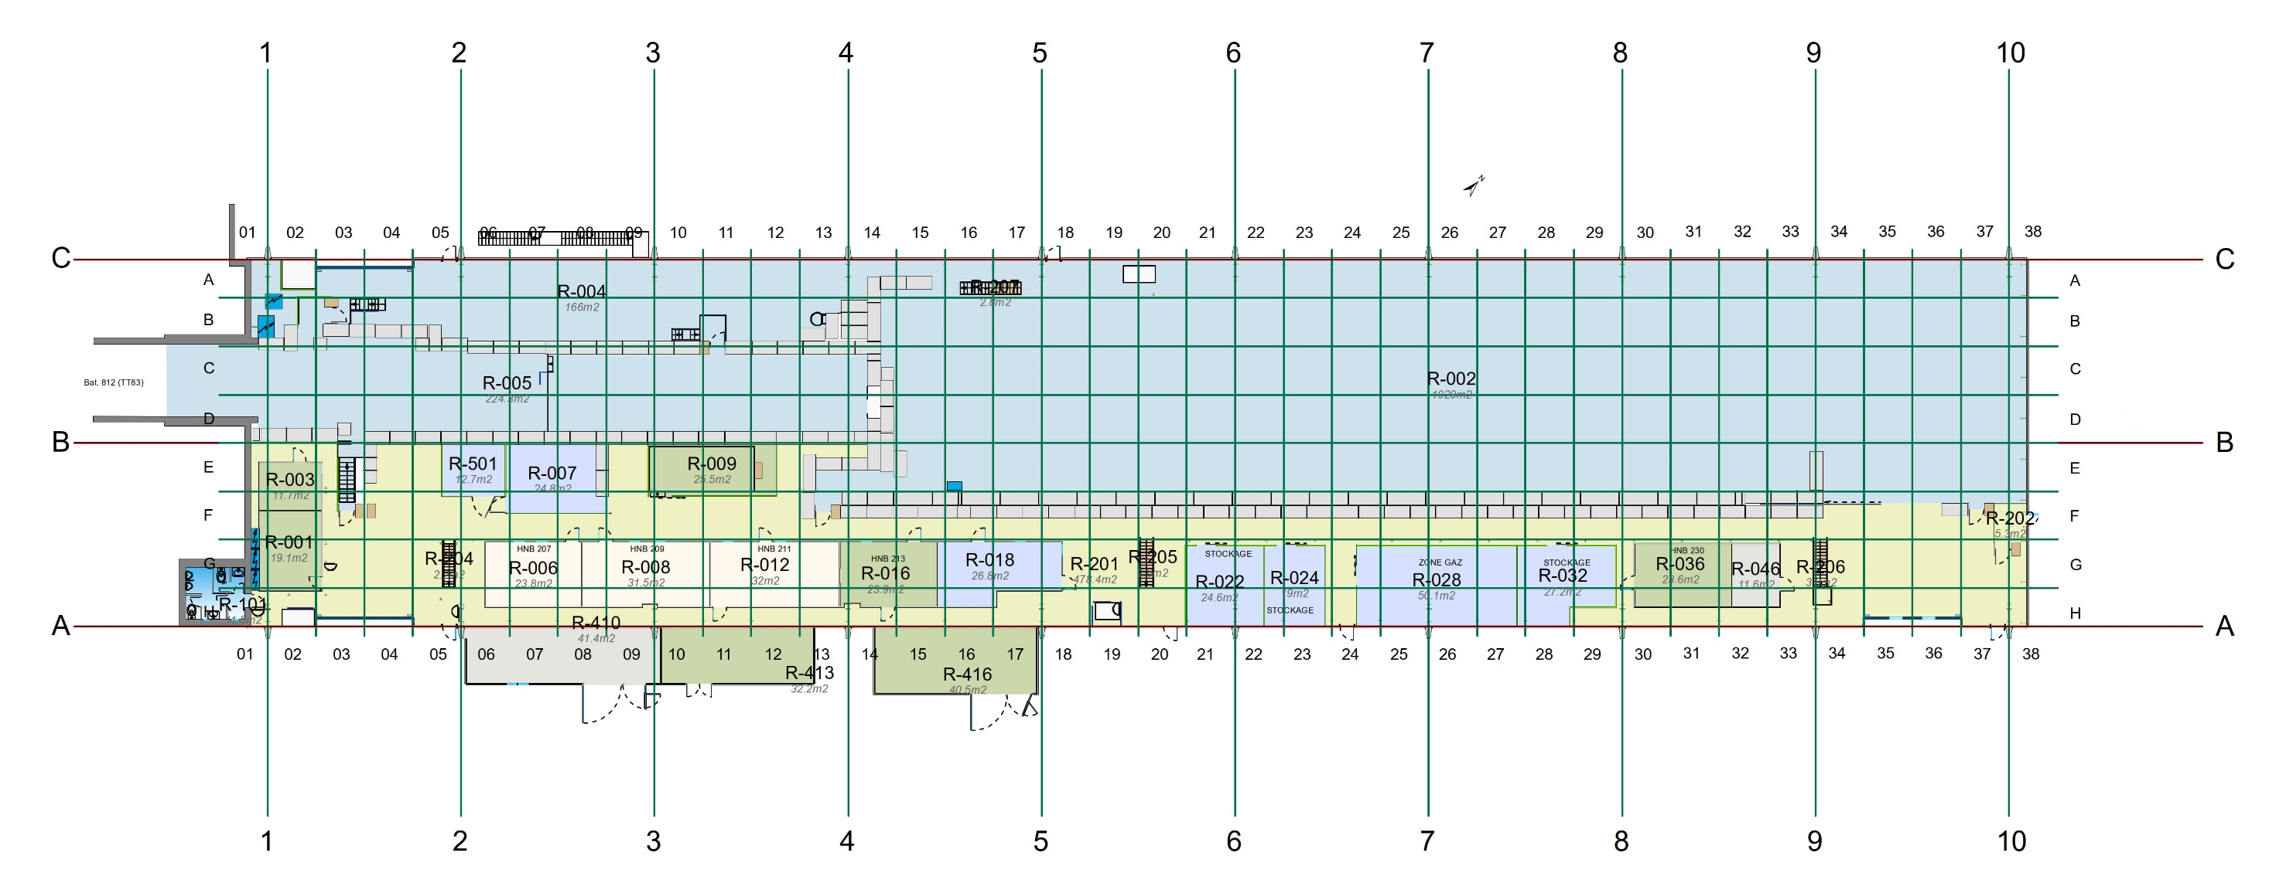
EHN2: Coordinates

Slide 19
Brief: List of actions
1 | Cable marking on the EHN2 & BA82 list (on SharePoint) | √
2 | To move Cables from the Cable List to DEC Template | √
3 | Proceed with identification in place
4 | FIND, DISCONNECT, PURPLE LABEL (and user color code label)
5 | Confirm DEC to be approved on EDMS

Slide 20
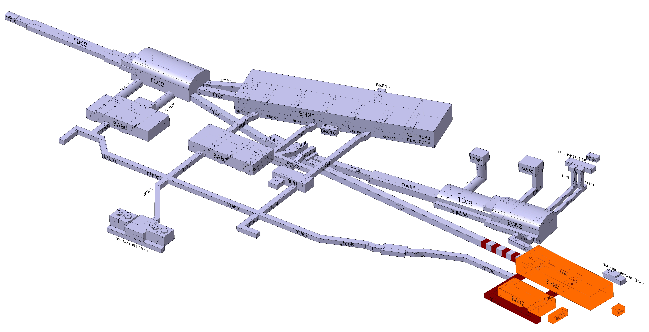
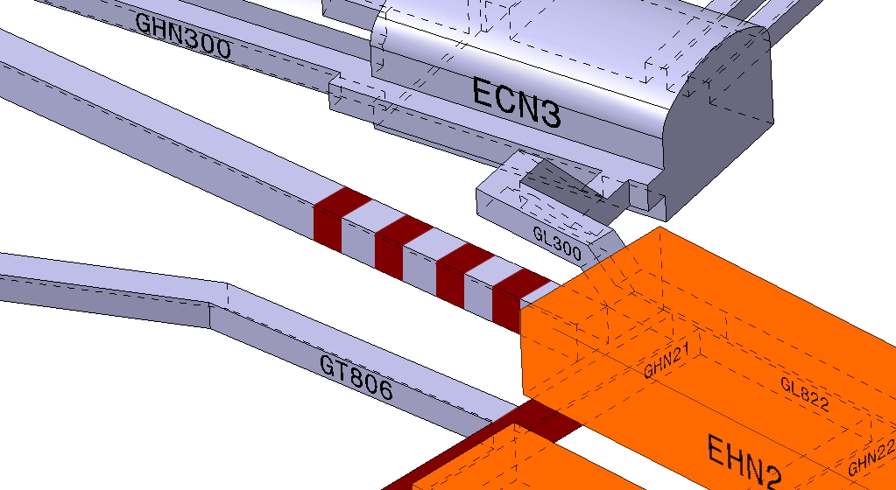
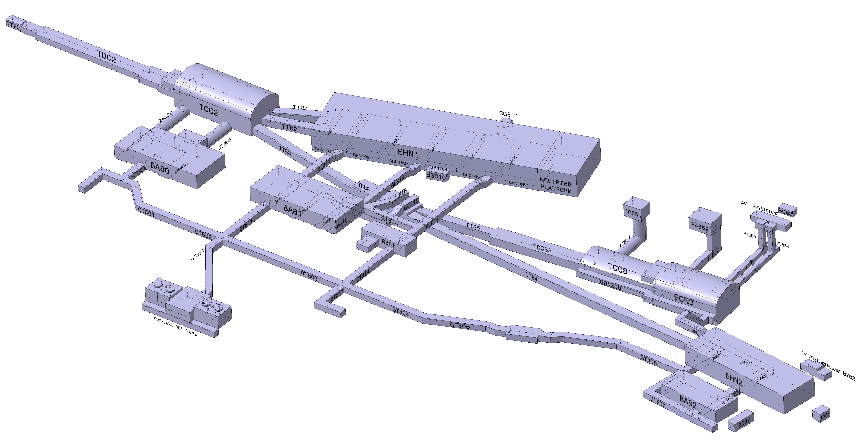
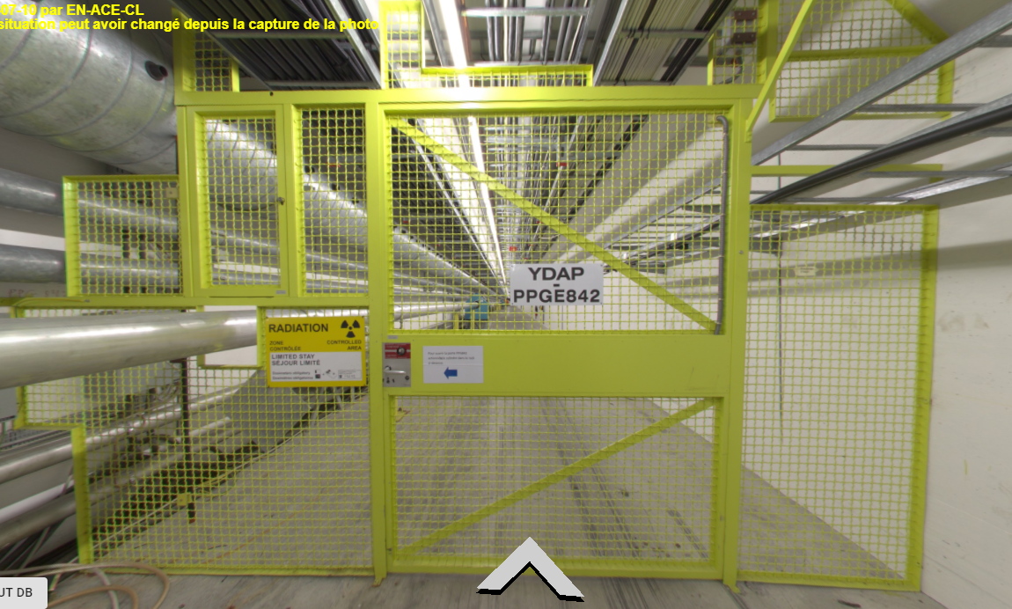
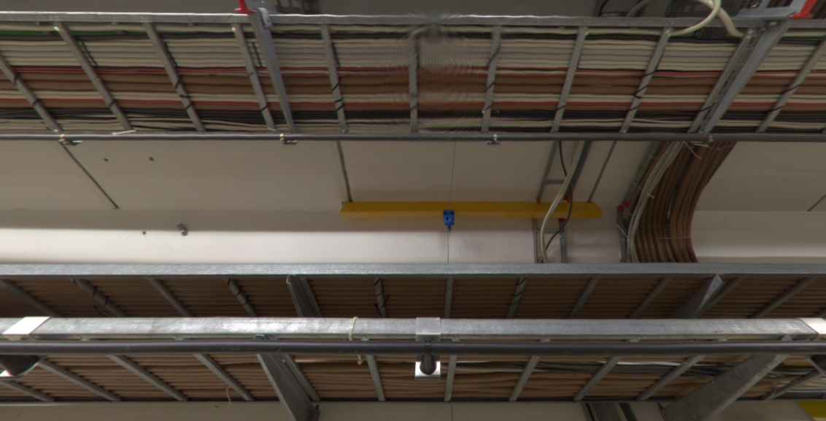
Cables connected between EHN2 and TT84

Slide 21
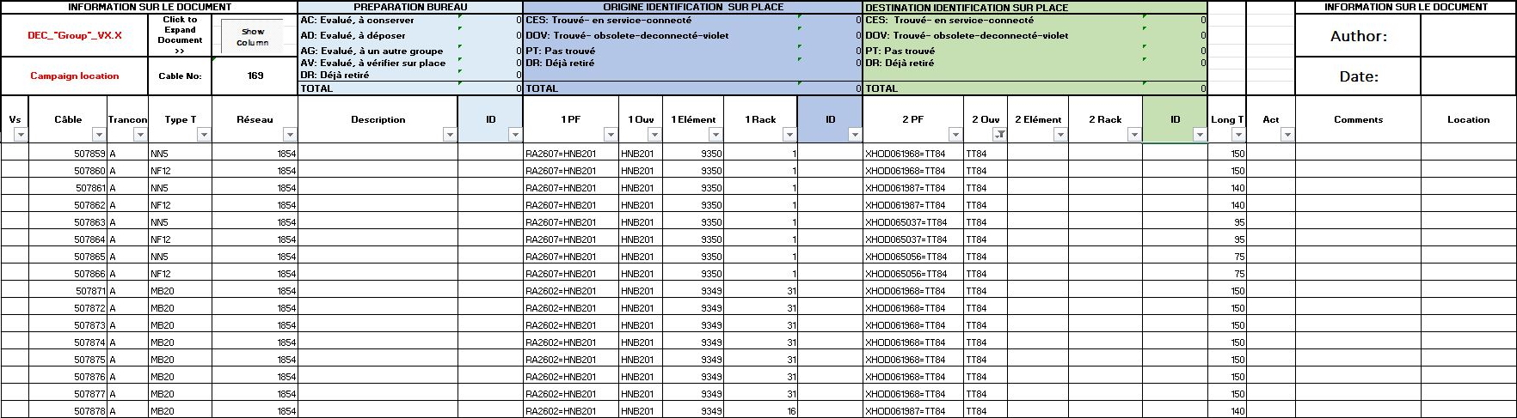
Cables connected between EHN2 and TT84
56 câbles found

Slide 22

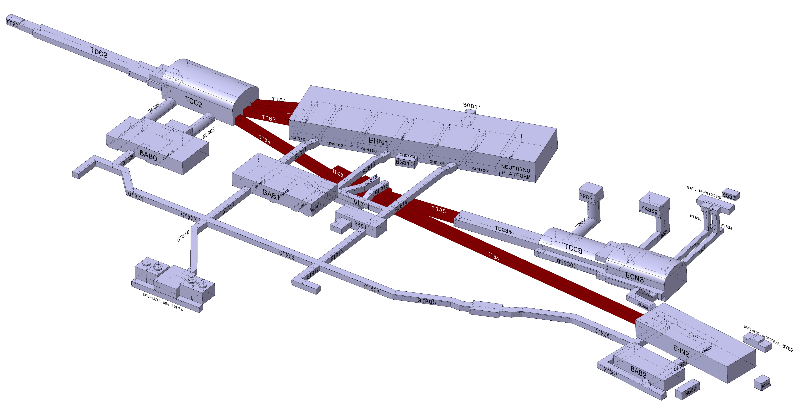
Preparations for the next décabling campaign
Area concerned from TT81 to TT85

Slide 23



Sharepoint : Folder organization TT81-TT85

Slide 24


Thanks you for your attention

