Slide 1
Requirements for surface treatment of
Q5 beam screens
G. Iadarola for e-cloud team

Slide 2
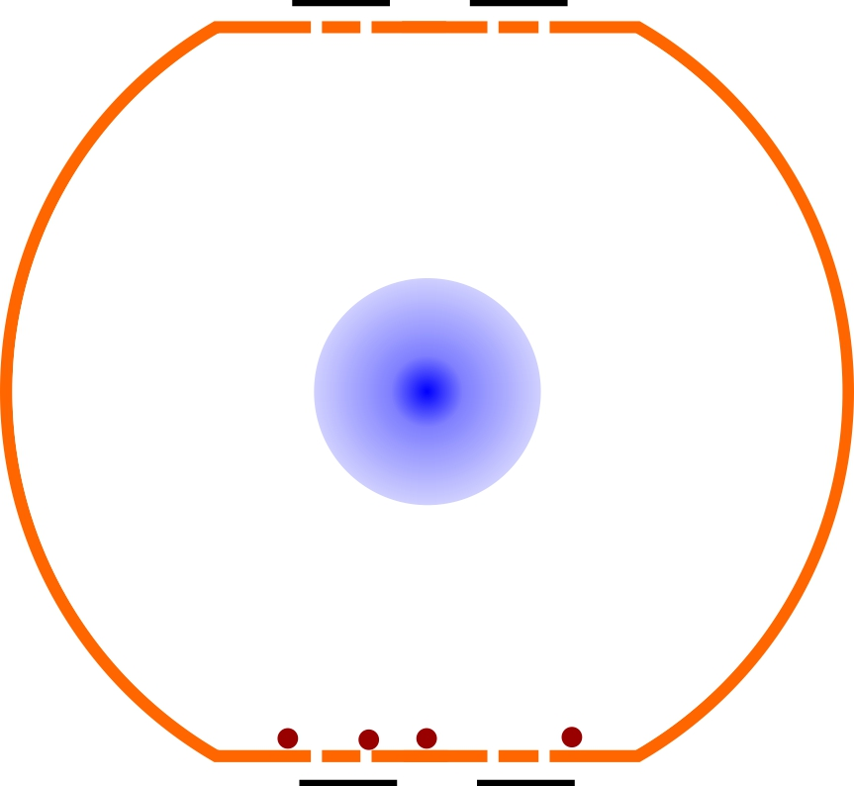
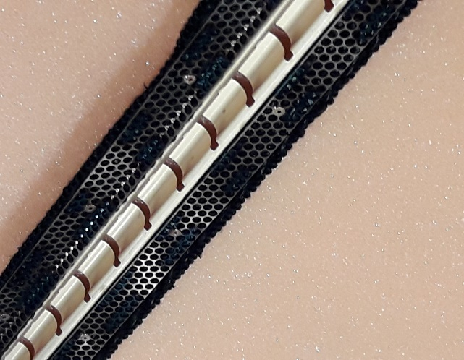
Surface treatment in the presence of cryosorbers
The TE-VSC team is considering special procedures to reduce the Secondary Electron Yeld (SEY) of the beam screens for the Q5 magnets in IR1 and IR5:
The "conventional" in-situ amourphous carbon coating as foreseen for the inner triplets is not applicable due to the presence of cryosorbers
Cryosorbers
See presentation by M. Himmerlich at TCC meeting, 7 July 2022

Slide 3
Surface treatment in the presence of cryosorbers
The surface team is considering the possibility of treating only a fraction of the surface, in particular avoiding the flat parts of the beam screens, where the pumping slots and the cryosorbers are located
No treatment
Cryosorbers
See presentation by M. Himmerlich at TCC meeting, 7 July 2022

Slide 4
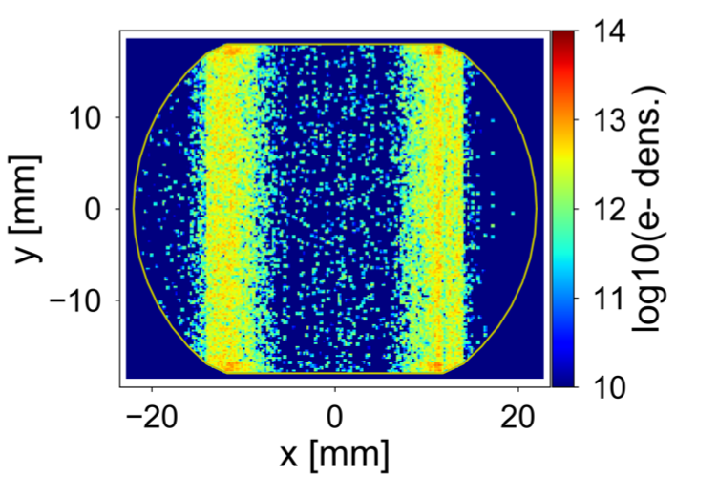
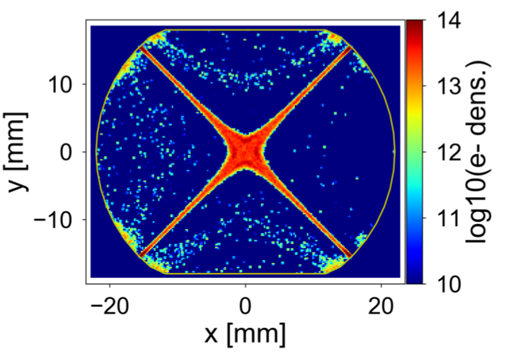
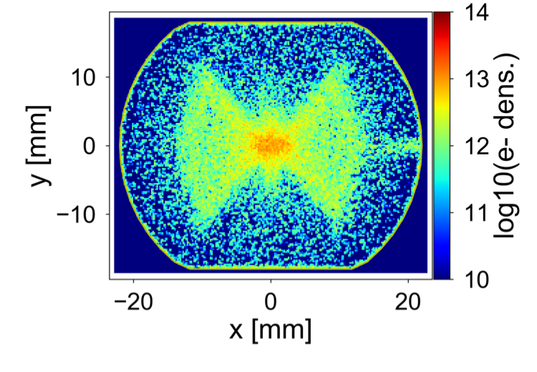
Electron distributions
Electrons impacting on the flat parts of the beam screens are present in dipole and drift regions but not in quadrupole regions:
In the quadrupole region the e-cloud can be fully suppressed without treating the flat part of the beam screens
Dipole
Quadrupole
No coating
Drift
See presentation by M. Himmerlich at TCC meeting, 7 July 2022

Slide 5

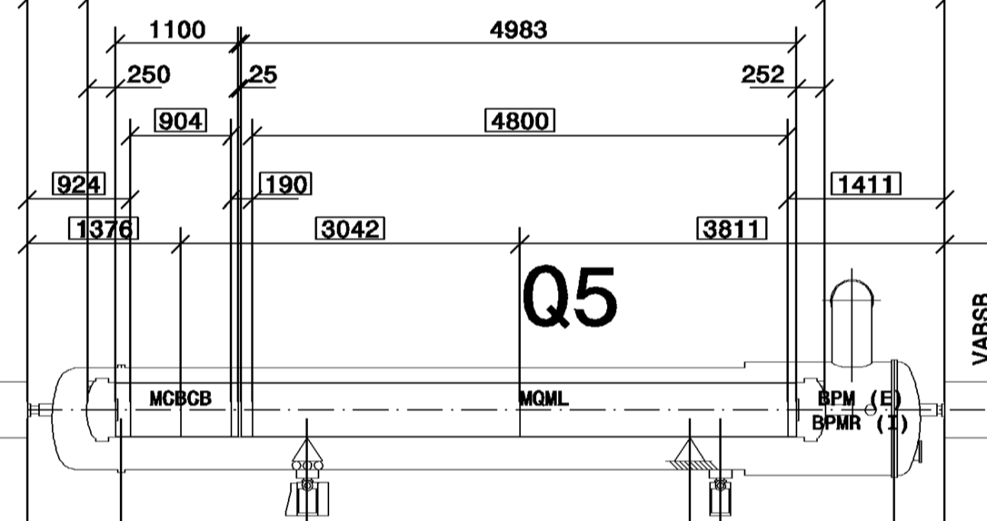
Magnetic configuration
Within the Q5 cryostats:
60% of the length is occupied by the MQML quadrupole
11% of the length is occupied by a dipole corrector
29% of the length is drift region
Due to magnetic trapping, e-cloud is much stronger in the quadrupole that in the other regions
More than 92% of the electrons are located in the quadrupole (where they are concentrated very close to the beam)
It is reasonable to suppress the e-cloud only in the qudrupole area → no need to treat the flat parts of the beam screen

Slide 6
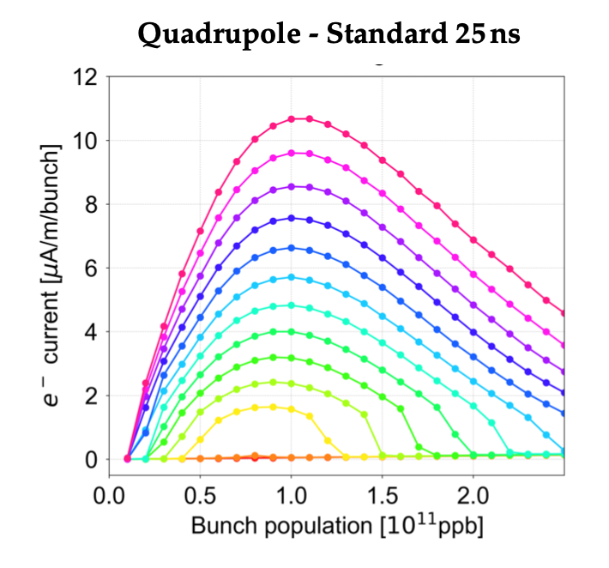
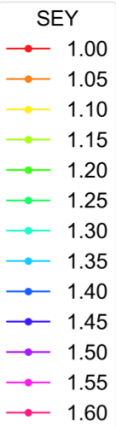
SEY requirements
SEY_{max} < 1.05 guarantees full suppression for all intensities
SEY_{max} < 1.10 gives full suppression for bunch intensities larger than 1.2e11 p/bunch (HL-LHC intensity range in stable beams) → can be considered acceptable

Slide 7
Conditioning requirements
Surface treatement could be optimized (e.g. in order to reduce dust production) by targeting an intermediate SEY value after treatment and achieving the target value with beam-induced conditioning
Possible scenario discussed with the surface team:
  SEY_{max} < 1.5 after treatment
  Target SEY (see previous slide) achieved after accumulating a dose 5×10⁻⁴ C/mm²
  The treatment should guarantee that the target SEY is within reach also in case of surface modification due to CuO formation (as observed in the LHC arcs) → to be validated with dedicated lab tests
Conditioning of this surface would happen "transparently" during scrubbing run at 450 GeV after a LS (needed for arcs and newly installed devices)
  Doses accumulated during a typical scrubbing run are larger than 10⁻³ C/mm²
  Expected no impact on scrubbing efficiency (β functions at Q5 small at 450 GeV, → negligible impact on stability and beam quality preservation)

Slide 8
Summary
It is possible to limit the e-cloud suppression only for the quadrupole region
  allows avoiding treating the flat parts of the beam screens
Target SEY value: SEY_{max} < 1.10
  Gives full suppression for bunch intensities larger than 1.2e11 p/bunch (HL-LHC intensity range)
If necessary, an intermediate SEY value after treatment can be considerent, provided that the target value can be achieved with beam-induced conditioning within a typical scrubbing run
  The treatment should guarantee that the target SEY is within reach also in case of surface modification due to CuO formation (as observed in the LHC arcs) → to be validated with dedicated lab tests

Slide 9
Thanks for your attention!

Slide 10
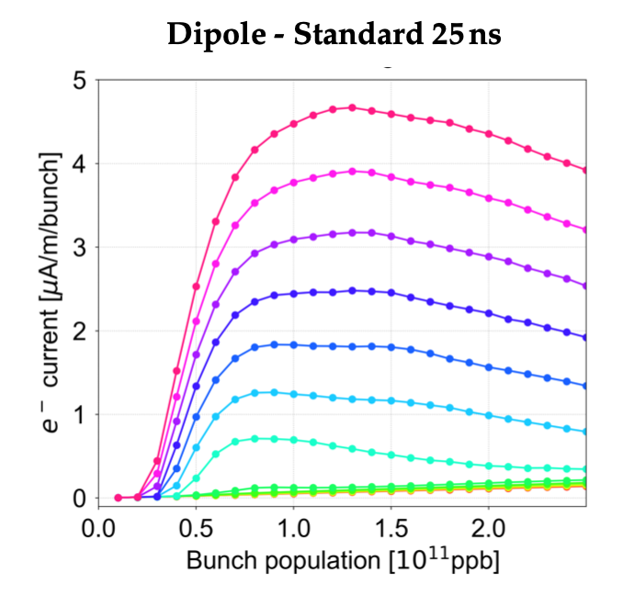
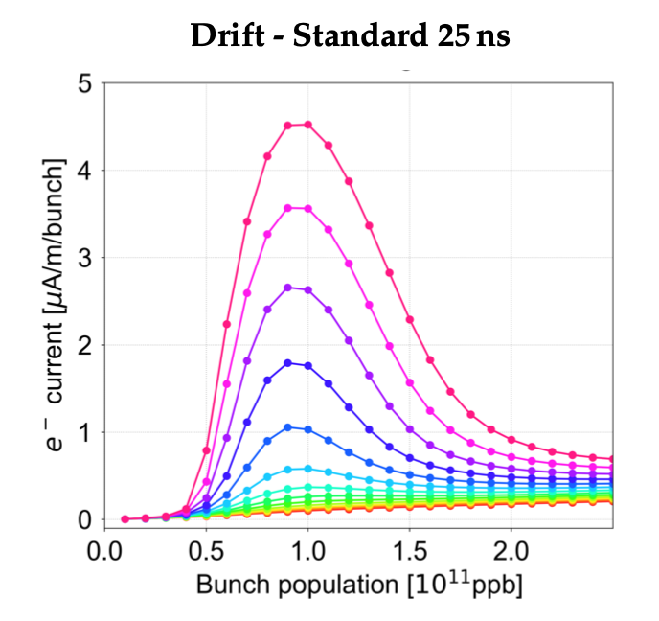
Outlook for HL-LHC – effect Q5

