Slide 1


Update on interaction region magnet tests
E. Todesco, B. Yahia, S. Feher, G. Ambrosio, G. Apollinari, S. Izquierdo Bermudez, S. Ferradas Troitino, J. C. Perez, F. Toral, et many al.
22 August 2022, WP2 meeting

Slide 2
CONTENTS
May-June: endurance test of MQXFA05 (presented at TCC)
July: test of MQXFA10
June: test of MCBXFBP2c (presented at TCC)
July: test of MCBRD01
July test of MCBRDP4

Slide 3
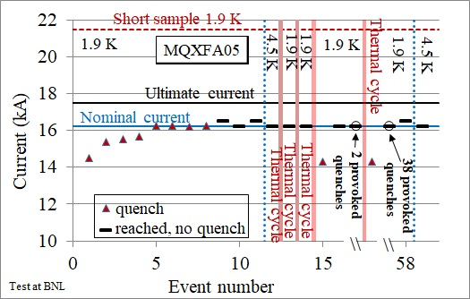
MQXFA05 endurance test
Endurance test anticipated to vertical position for two reasons
  Have an early indication about long term behaviour after the issues seen in 11 T series magnets and in FNAL 14 T short model (MDPTC1)
  Decouple the magnet from the cold mass – so having a test that does not include the SS shell welding
Endurance test of MQXFA05 (B. Yahia and the AUP collaboration)

Slide 4
MQXFA05 endurance test
First three thermal cycles done in 2021
  Already at that time I asked for one additional thermal cycle
Two additional cycles done in April-May 2022
  With an addition of provoked quenches at nominal current to get a total of 50 quenches
Endurance test of MQXFA05 (B. Yahia and the AUP collaboration)

Slide 5
MQXFA05 endurance test
After all this, nominal plus 300 A reached at 1.9 K, nominal at 4.5 K, no quenches
  This is the best result we could expect
Note that LARP magnets never showed signs of magnet degradation with successive thermal cycles, but we never had a dedicated test in these controlled conditions
Endurance test of MQXFA05 (B. Yahia and the AUP collaboration)

Slide 6
MQXFA05 endurance test
There were two quenches on thermal cycle 4 and 5 at 14.3 kA
  There are indications that these are not training quenches since we see a recovery in the voltage signal – analysis and discussion is ongoing
Endurance test of MQXFA05 (B. Yahia and the AUP collaboration)

Slide 7
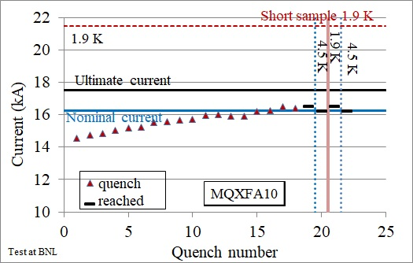
MQXFA10
Brief reminder:
  MQXFA03, MQXFA04, MQXFA05, MQXFA06 reached requirements in vertical test
  MQXFA07 and MQXFA08 did not reach requirements – analysis ongoing, with significant results for MQXFA07 - not reported here
  MQXFA09 had an issue during assembly and corrective actions will be done at the end of the production
MQXFA10 has been tested in July and reached performance
  Rather long training, but perfect memory and margin at 4.5 K
Endurance test of MQXFA10 (B. Yahia and the AUP collaboration)

Slide 8
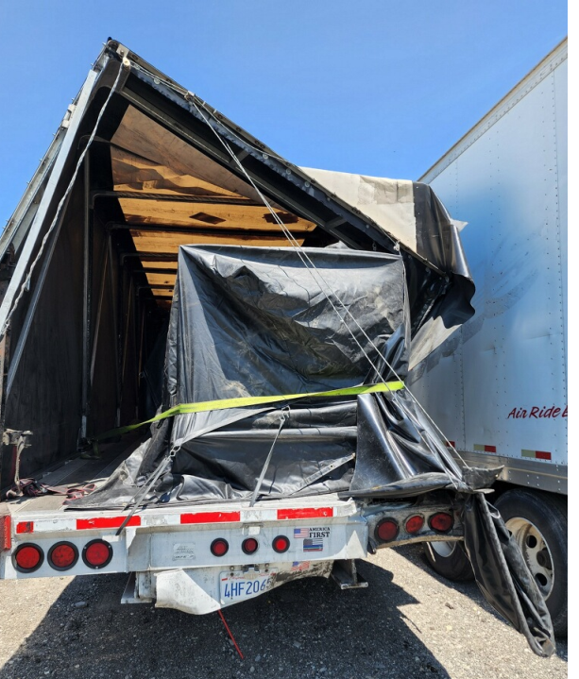
NEXT MQXFAs
MQXFA11 truck had an accident during transport between S. Francisco and Long Island
  Nobody got injured
  Large acceleration well beyond spec (5 to 10 g measured, 2 g specified)
  No visible damage (on the magnet)
  It will be tested in BNL in September
MQXFA08b is being assembled in BNL
  The limiting coil is replaced with a new one
  It will be tested after MQXFA11, in November
  This will probably be the last magnet tested in BNL in 2022
First cold mass (MQXFA03 and MQXFA04) being cryostated, test in fall
Second cold mass (MQXFA05 and MQXFA06) assembly is starting

Slide 9
CONTENTS
May-June: endurance test of MQXFA05 (presented at TCC)
July: test of MQXFA10
June: test of MCBXFBP2c (presented at TCC)
July: test of MCBRD01
July test of MCBRDP4

Slide 10
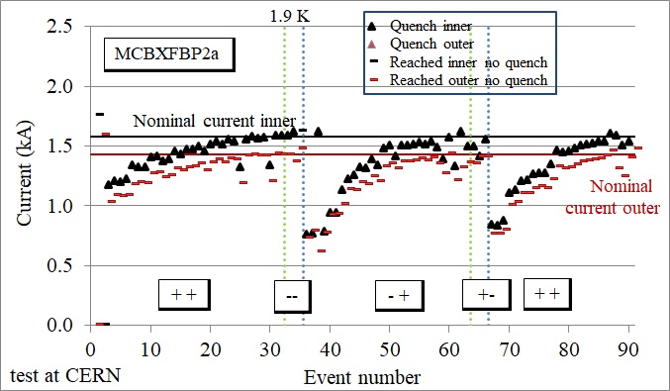
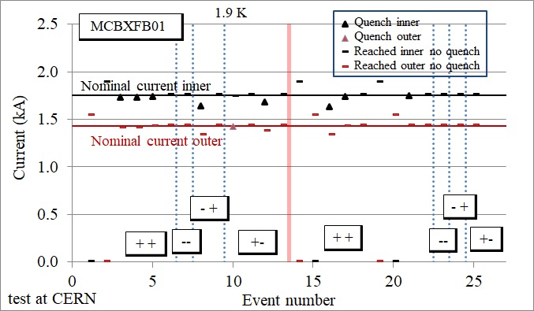
MCBXFBP2c test
The first two MCBXFB prototype had a performance limitation that required training when changing the sign torque
  This issue was cured by a design iteration on inner dipole coils, implemented on MCBXFB01
  All these magnets had coils/components manufactured at CIEMAT and magnet assembly at CERN
Elytt started coil manufacturing in 2022, we decided to retrofit the MCBXFBP2 with the inner coils from Elytt – two aims:
  Validate the coil production line
  Verify the reproducibility of the design change on a second magnet
Test of MCBXFBP2 and 01 (S. Ferradas, J. C. Perez, F. Toral and the CIEMAT collaboration)

Slide 11
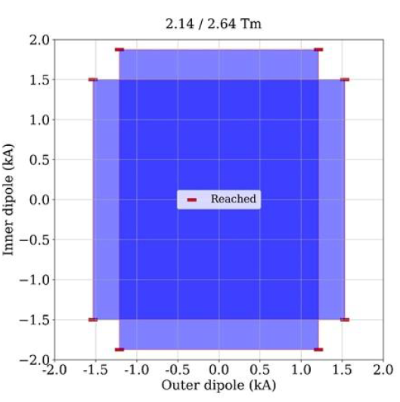
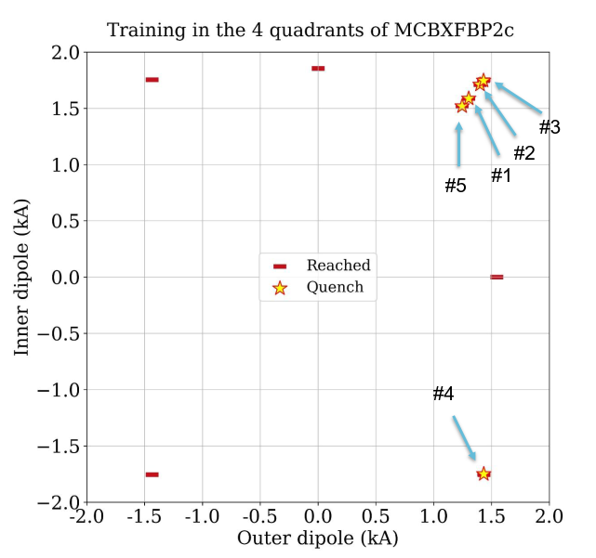
MCBXFBP2c test
Elytt coils were assembled in a inner dipole, and assembled with the «old» outer dipole of MCBXFBP2a/b
  New name is MCBXFBP2c
Test started in May 2022, magnet reached operation at 7.5 TeV with few quenches on first powering
After thermal cycle, the whole region required for operation at 7.5 TeV was reached without quenches
Test of MCBXFBP2c (S. Ferradas, J. C. Perez, F. Toral and the CIEMAT collaboration)

Slide 12
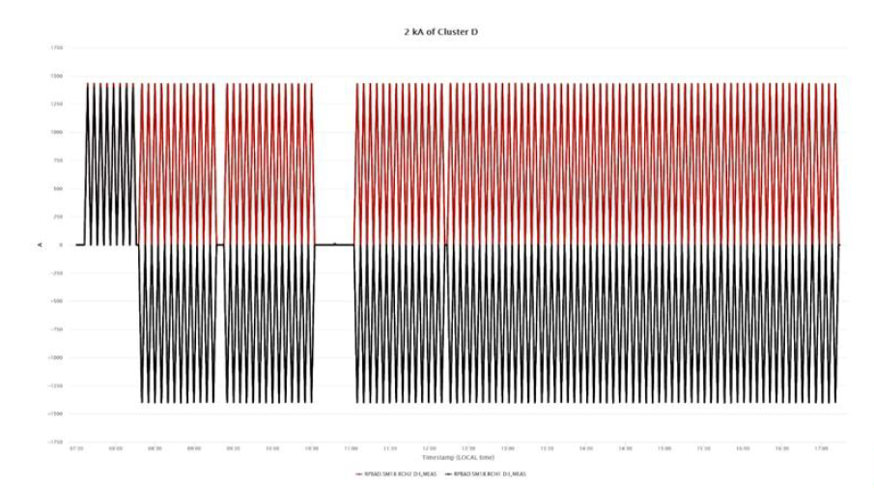
MCBXFBP2c test
It has been decided also to perform a preliminary endurance test, with hundreds cycles and changing the torque
Test at nominal current, i.e. operation at 7 TeV
Total of 232 ramps, with two sign changes – no quenches
MCBXFB02 (first magnet fully done in Elytt) to be tested in November
MCBXFAP1 (prototype long magnet) to be tested in November

Slide 13
CONTENTS
May-June: endurance test of MQXFA05 (presented at TCC)
July: test of MQXFA10
June: test of MCBXFBP2c (presented at TCC)
July: test of MCBRD01
July test of MCBRDP4

Slide 14
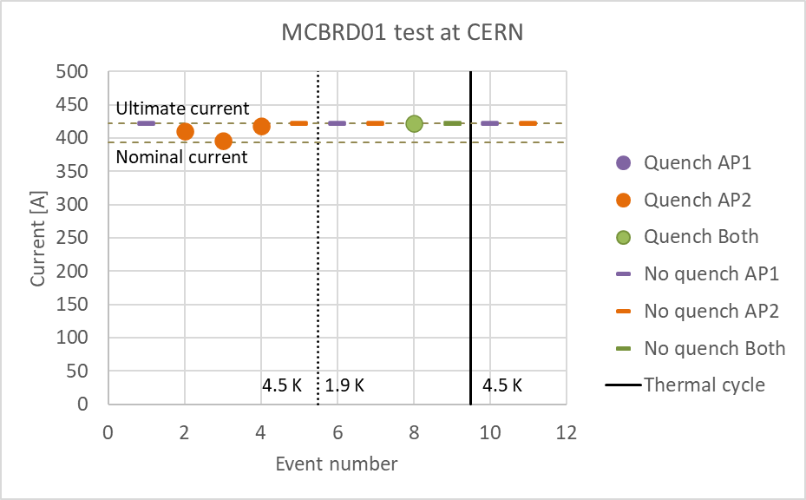
MCBRD magnets
MCBRD01 (first series magnet from China) tested at CERN
  In China: Individual coils were trained, long training (in IHEP)– assembled magnet reached ultimate at 4.5 K, but some retraining around nominal observed (in IMP)
  Both apertures reached ultimate at 1.9 K, satisfying retraining requirements
  Weakness in coil insulation to be assessed
Test of MCBRD01 at CERN (A. Foussat, G. Willering, F. Mangiarotti and the IHEP collaboration)

Slide 15
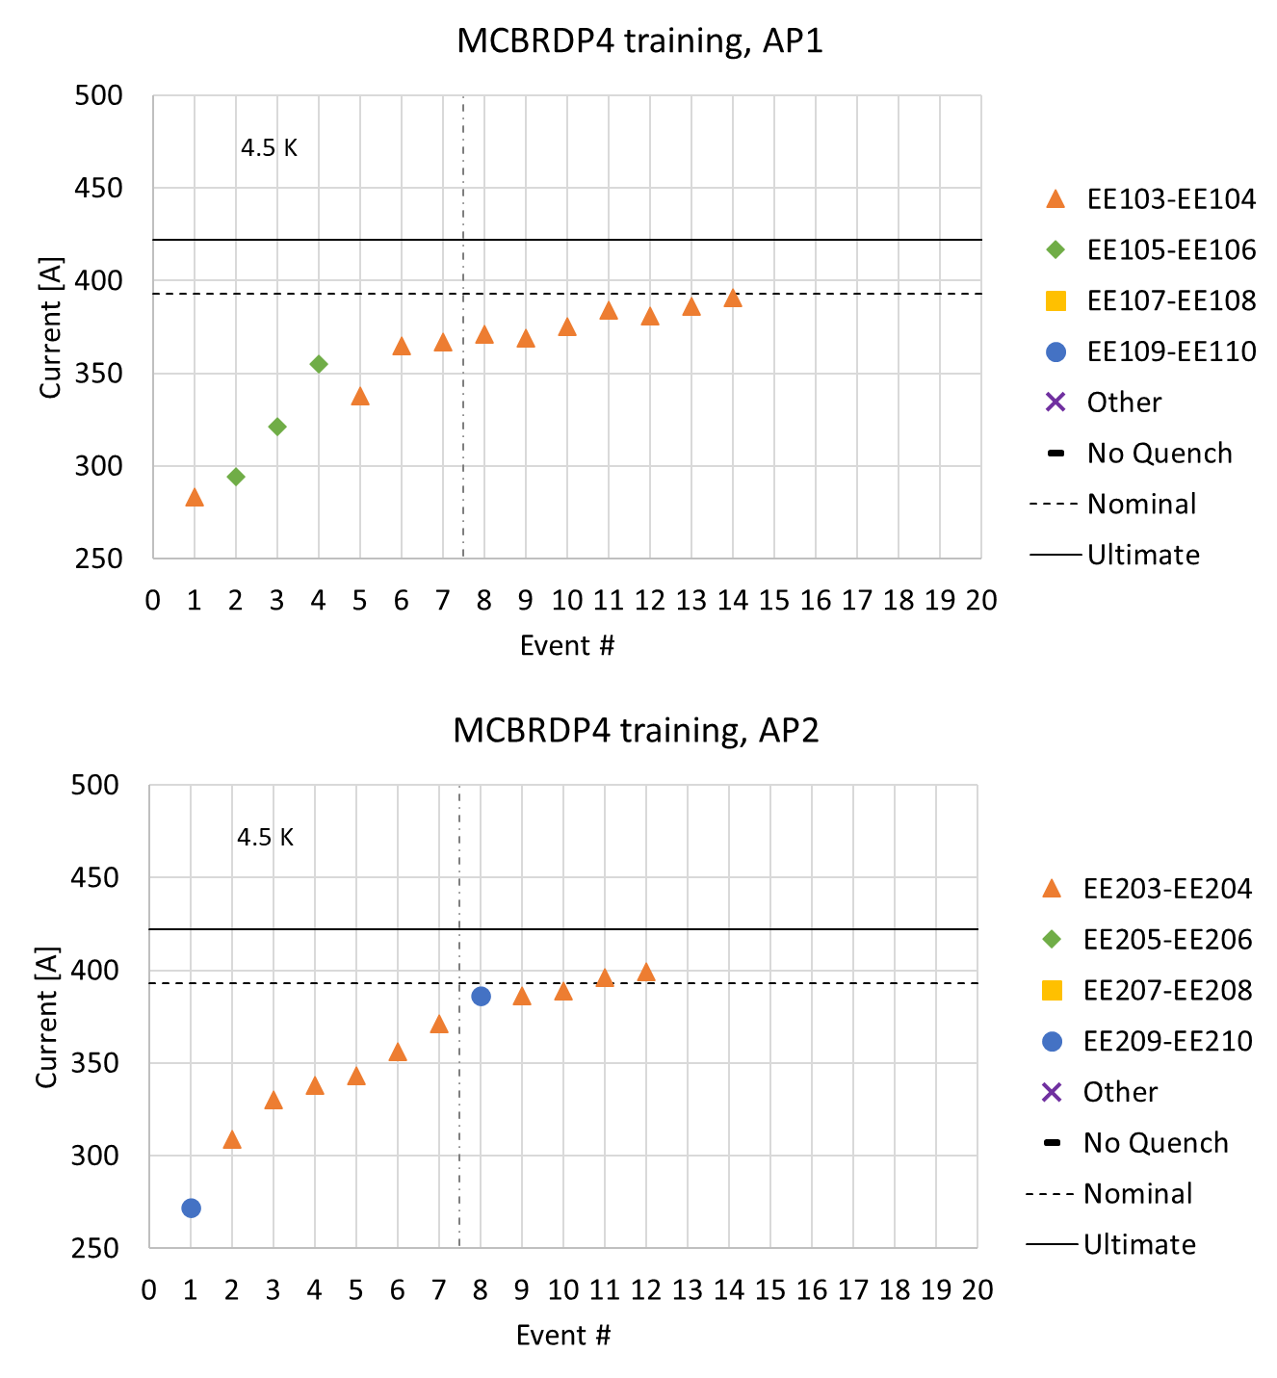
MCBRD magnets
MCBRDP4 (third prototype done in CERN, 927) tested at CERN
  Training done at 4.5 K to better assess the test conditions in China
  Nominal reached with about 15 quenches
  At 1.9 K both apertures went to ultimate current without any further training
Test of MCBRDP4 at CERN (A. Foussat, G. Willering, F. Mangiarotti, and 927 team)

