Slide 1


Ultra-sensitive Rn detection and its suppression
Ivan Štekl
Institute of Experimental and Applied Physics
Czech Technical University in Prague
IEAP CTU was found in 2002 as a scientific and educational institute of the CTU in Prague, focusing on a research in the field of particle and subatomic physics performed in an international experiments
105 people (38 from abroad)
1) Brief introduction of IEAP CTU (main research topics)
2) Why we need to suppress Rn caused background?
3) Rn detection (ultra-low concentrations)
4) Rn suppression
5) Rn in education
Notes:
1

Slide 2
Main research subjects in IEAP CTU:
CERN – experiments ATLAS (ATLAS TPX – radiation field measurement, luminosity monitoring, theory, data processing), MoEDAL, AFP, ISOLDE (nuclear physics at CERN)
Neutrino physics – 2νEC/EC decay of ¹⁰⁶Cd (experiment TGV – necessity to upgrade), experiment COBRA (close to end), detection of 0ν and 2νββ decay of ⁸²Se (experiment SuperNEMO), experiment LEGEND (USA/Germany – 0νββ decay of ⁷⁶Ge); detection of atmospheric neutrinos in experiments KM3NeT and Baikal-GVD); detection of reactor antineutrinos
Detection of dark matter – experiment PICO in SNOLAB (Canada), detection of neutralino
Detection of high-energy cosmic rays – detection of radiation from universe (8 Timepix detectors on ISS, NASA; Timepix detector on Proba-V and RISESAT satellites; small unit VZLUSat), new projects with ESA (HardPix on-board GOMX-5 Cubesat mission, 12U, 20 kg. Launch 2023; 2x HardPix outside Lunar Gateway as part of ESA ERSA. Launch 2024).
Structure of atomic nuclei and nuclear reactions – fission, radioactive nuclei decay, super heavy nuclei, astrophysical reactions
Applications – pixel and strip detectors, imaging (X-rays and neutrons), biomedicine, hadron therapy, study of material…..
All our activities are based on international cooperation

Slide 3
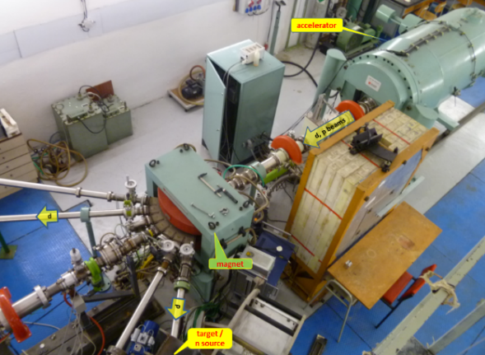
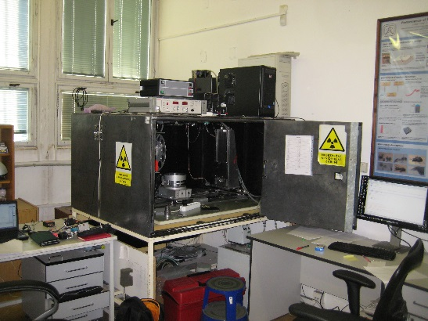
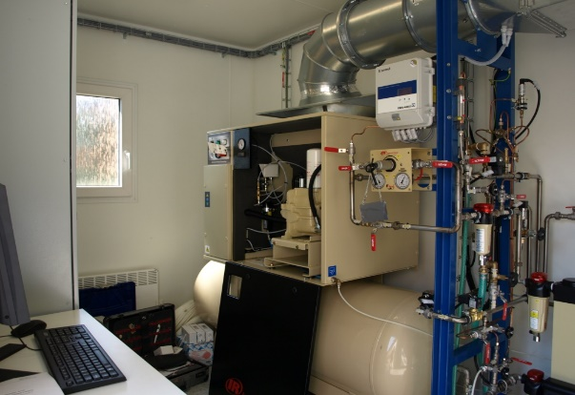
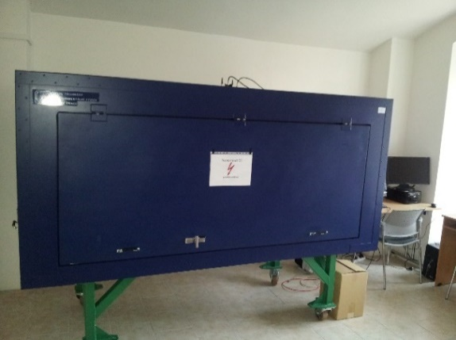
Research infrastructure of IEAP CTU
Van de Graaff accelerator
Underground laboratory LSM in Modane, France
Small underground laboratory in Prague in a nuclear shelter
2 electron microscopes
Laboratory for high-resolution X-ray radiography, 3D X-ray tomography and neutronography in IEAP,
Specialized laboratory for experimental imaging – common laboratory of IEAP and 3rd faculty of medicine of CU
Radon laboratory (ultrasensitive measurement, radon-free chambers) – common laboratory of IEAP and the National Radiation Protection Institute;
Tunable electron source and equipment for scintillators measurements – common laboratory of IEAP and the NUVIA company.

Slide 4
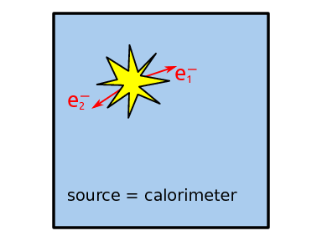
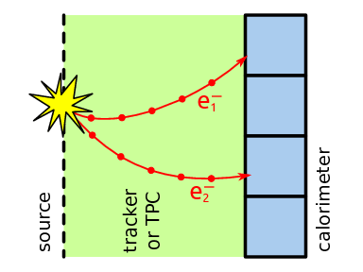
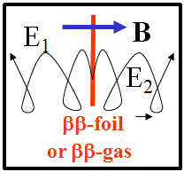
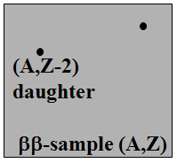
Experimental techniques to observe ββ-decay (no method is perfect)
Geochemical &
Radiochemical
Calorimetric
Tracking + Calorimetric
TPC
ββ-daughter rate
E₁+E₂ spectrum
E₁, E₂, θ
E₁, E₂
Precise ββ-observation, Any ββ-source can be measured (test nuclear models), Potentially zero-background, Test of ββ0ν mechanisms
Energy resolution, High (~ 100%) efficiency
Formula of experimental sensitivity
N_{A} : Avogadro number
M : source mass
ε : efficiency
m_{mol} : molar mass
t : time of measurement
a : Isotope abundance
N_{BGR} : background rate
ΔE : energy resolution

Slide 5
Ultra low background experiments (neutrino physics, DM)
SuperNEMO: measurement of double beta decay in the LSM underground laboratory in Modane, France (4 800 m w.e.) – cooperation of institutions (France, UK, Czechia, Slovakia, Russia, Ukraine, JINR)
DEMONSTRATOR = 1 module (7 kg of ⁸²Se)
The goal is to reach a zero background level in the region of interest
of 0νββ.
Demonstrator sensitivity for 0νββ:
T_{1/2} > 5.9 x10²⁴ y (90% C.L.) and ⟨m⟩ < 0.2 - 0.55 eV
Calorimeter (712 Optical Modules, plastic scintillator, PMT) is ready. Tracking detector (2034 cells running in Geiger mode and filled with a gas mixture (95% He, 4% ethanol, 1% Ar) is ready. A coil producing a 25 G magnetic field is installed.
We need gamma and neutron shielding. Data taking.

Slide 6
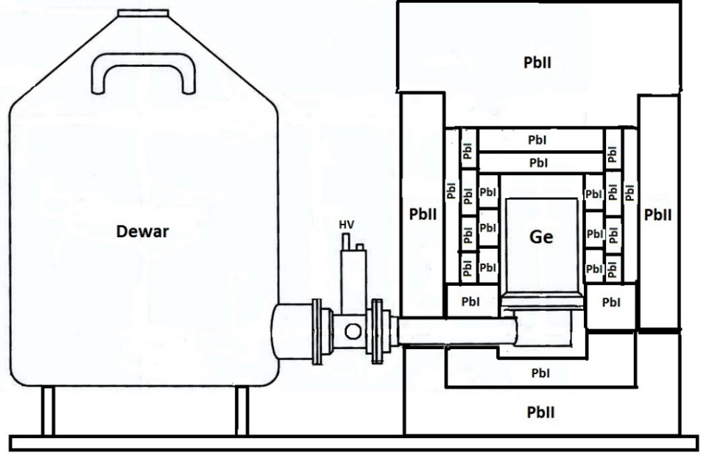
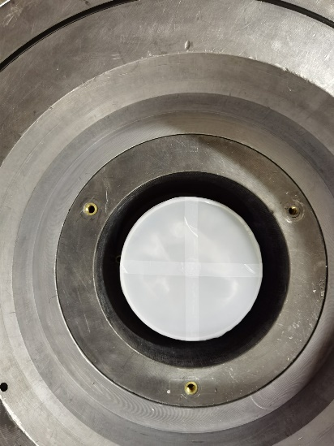
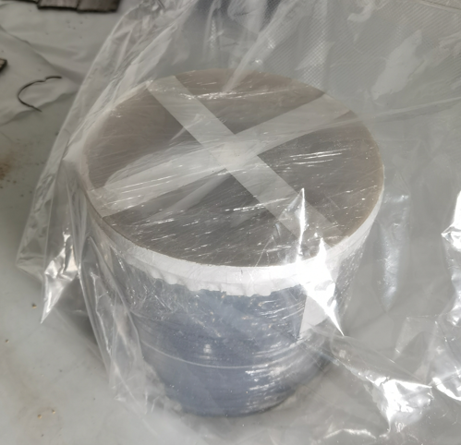
Search for ββ decay on excited levels of ⁸²Se with the OBELIX spectrometer and the influence of radon background
Why we need to suppress Rn caused background?
OBELIX is a unique ultra-large volume HPGe spectrometer
Volume is 600 cm³, Mass is 3.2 kg
Relative detection efficiency is 160% and energy resolution is 2.2 keV @ 1332 keV
Record ultra-low radioactive background level due to specially constructed individual multilayer passive shield
Location: LSM (Modane, France, 4800 m.w.e.)
A source in Marinelli vessel with 6 kg of ⁸²Se was installed on OBELIX (October of 2021) for long-term measurements in order to search for double beta decay into excited states of the daughter nucleus ⁸²Kr, which have not yet been observed by anyone.

Slide 7
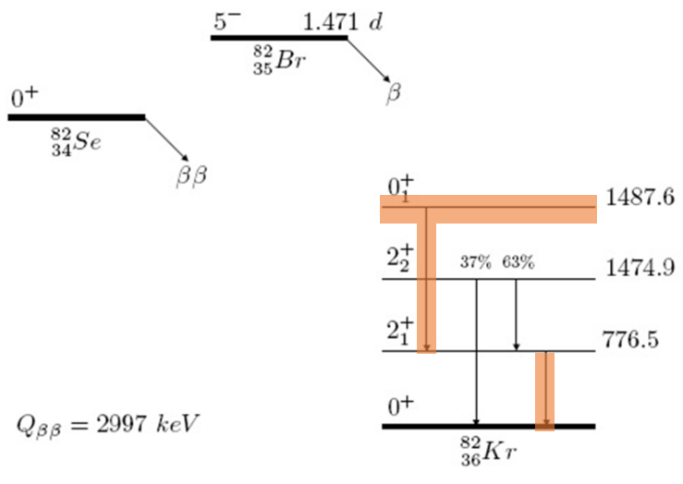
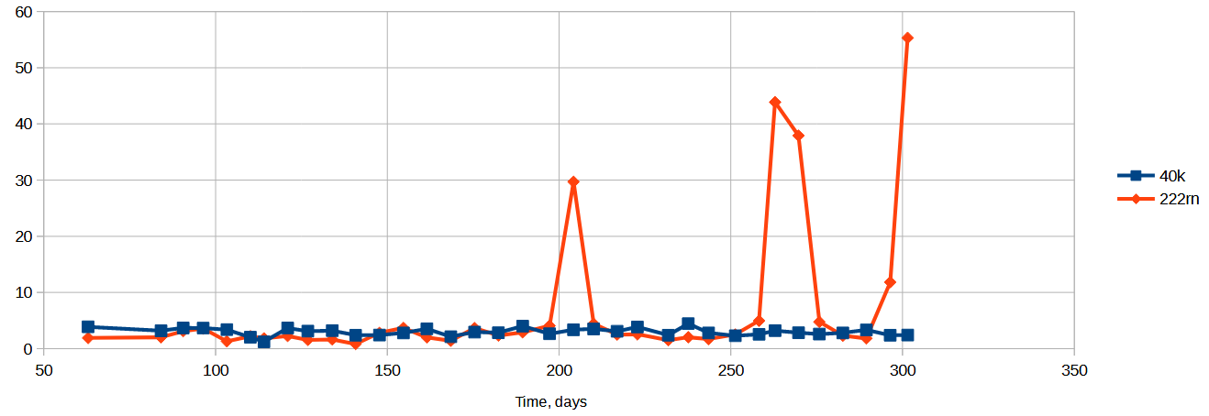
Theoretical expectations of transition to 0⁺₁ exited state are at the level of T_{1/2} ~ 5-7.5 x 10²² y (A. Barabash, F. Šimkovic).
After 10 months of exposure, OBELIX has achieved this level of sensitivity!
Look at radon peaks (the sum of the 351 keV, ²¹⁴Pb, and 609 keV, ²¹⁴Bi, lines from the ²²²Rn) we observe anomalous spikes.
The reason is unknown (open shielding, stop clean air flushing???), but it cost us a month of exposure, which we had to reject.

Slide 8
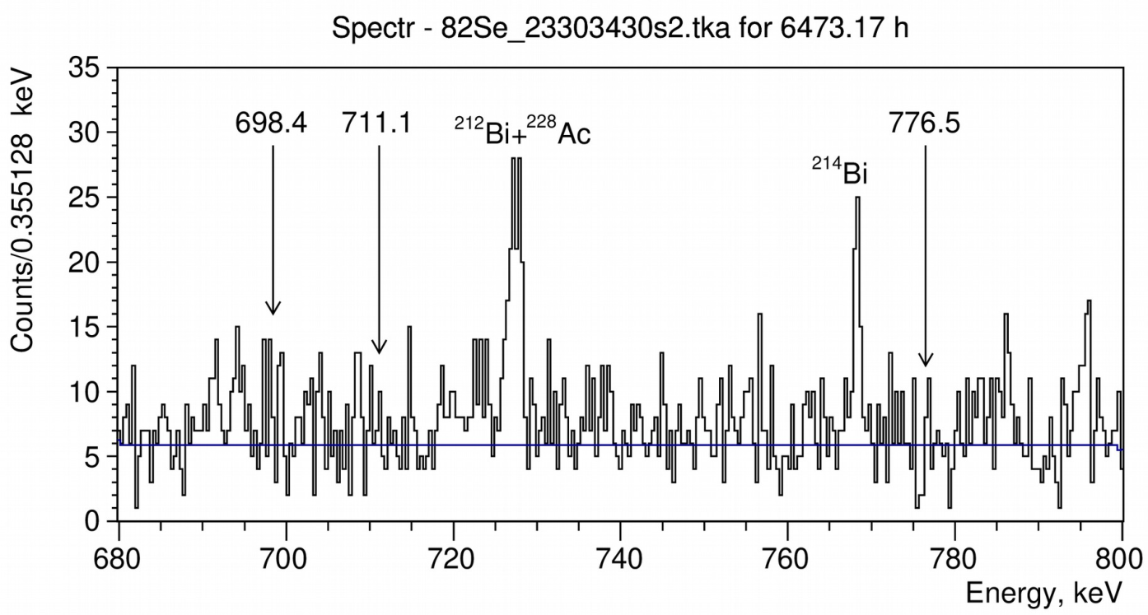
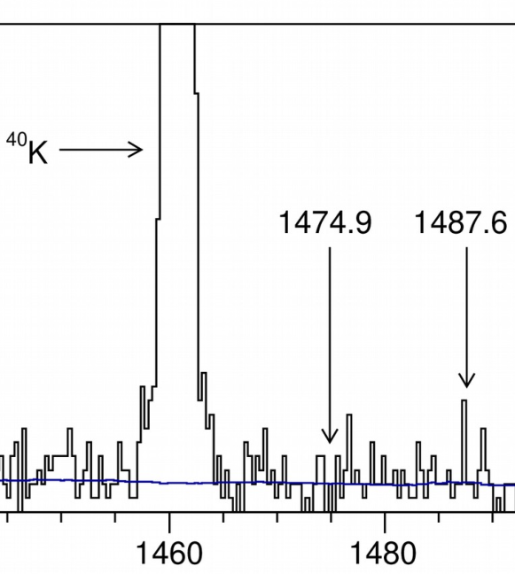
Current results
No effect was observed in 12 months of measurement
We reached sensitivity level T_{1/2} ~ 5 х 10²² y (see the table below).
Measurements are in progress to reach T_{1/2} ~ 10²³ y…
Level | Gammas with efficiencies | Limit Т_{1/2} (90% CL), 10²² y
 |  | present | MPI | [1]
2⁺₁ (776.5 keV) | 776.5 (2.416%) | 5.89 | 1.19 | 1.3
2⁺₂ (1474.9 keV) | 776.5 (1.341%)+1474.9 (0.756%) | 4.53 | 1.02 | 1.0
0⁺₁ (1487.6 keV) | 711.1 (2.129%) | 2.39 | 0.95
 | 776.5 (2.076%) | 5.06 | 1.10
 | 711.1 (2.129%) + 776.5 (2.076%) | 4.29 | 1.38 | 3.4
[1] J. W. Beeman et al., Eur. Phys. J. 75 (2015) 591.

Slide 9
Long-term studies of rare processes continue on the OBELIX
The sensitivity level of T_{1/2} ~ 5 х 10²² y for the double decay of ⁸²Se into excited levels has been reached on the OBELIX spectrometer.
Within 2 years of additional measurements, it is planned to reach the level of T_{1/2} ~ 10²³ y.
Radon is a serious problem, so protection and control is essential.
Main sources of the radon:
• Diffusion of the Rn from outside the detector
• Rn emanation of materials inside the detector.
What is needed:
• Rn detectors sensitive to ~0.1 mBq/m³ – Rn detector
• Isolation of the detectors using thin foils, glue... with low radon diffusion coefficient - Rn diffusion apparatus
• Emanation measurements of parts inside the detector - Rn emanation apparatus

Slide 11
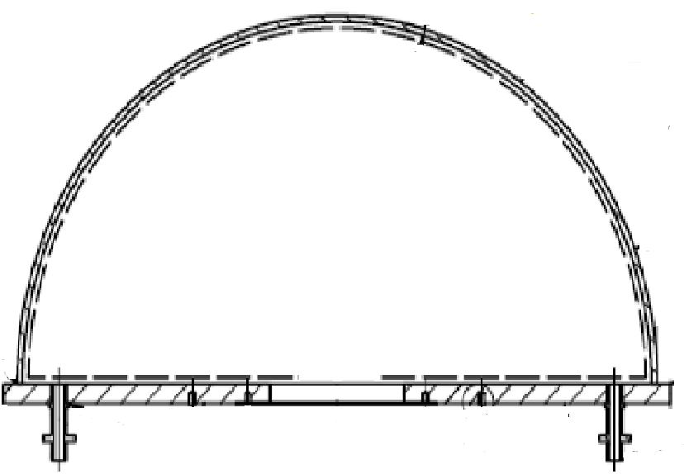
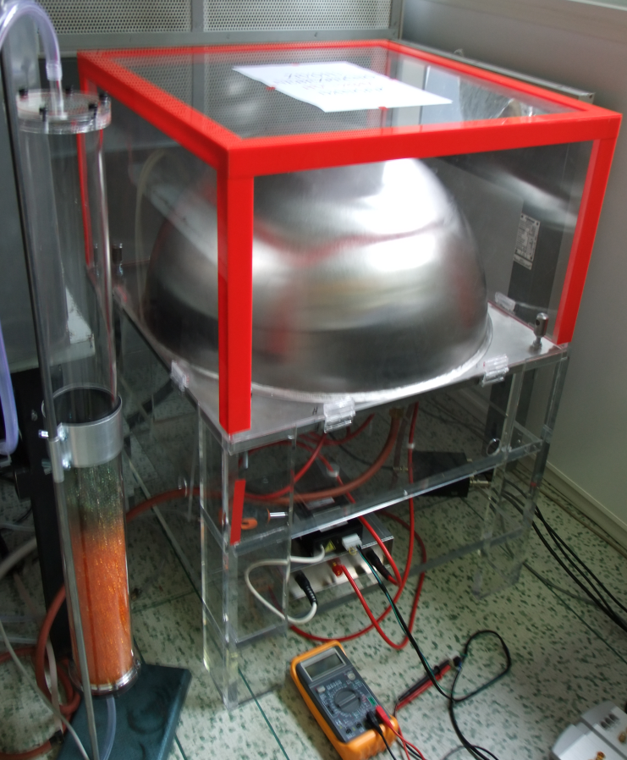
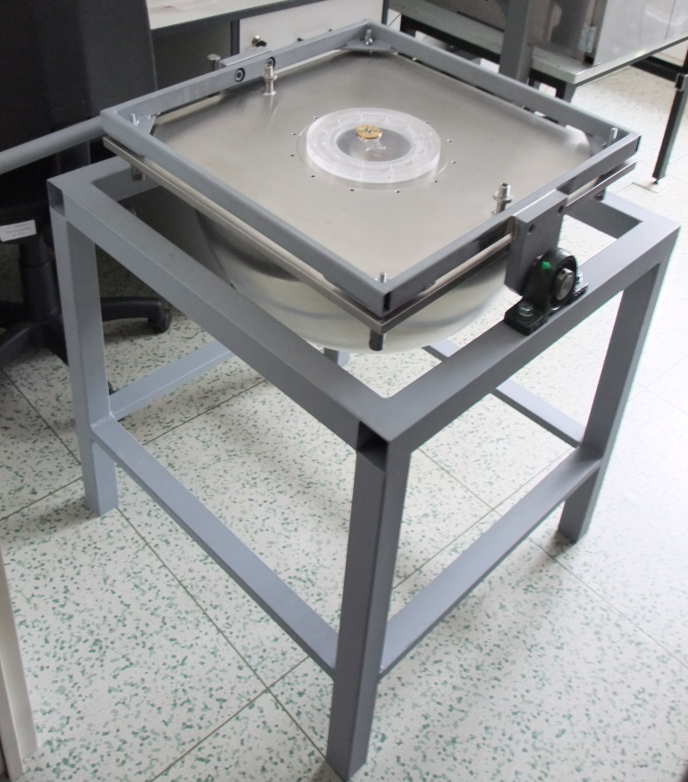
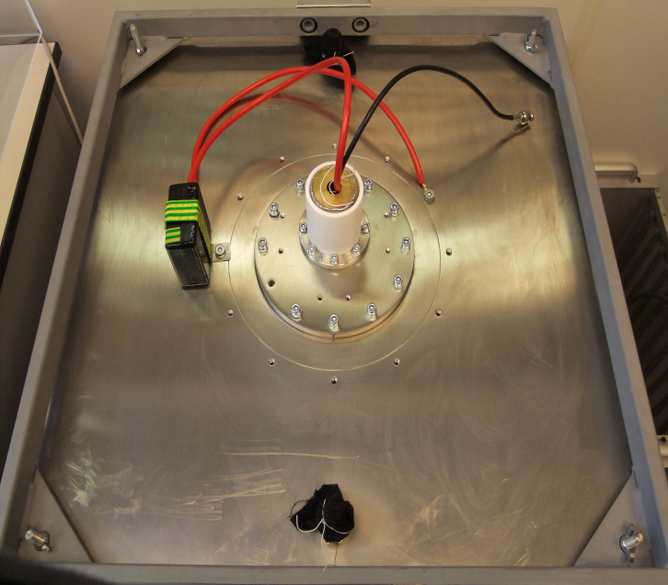
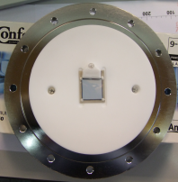
Rn detection (ultra-low concentrations)
hemisphere stainless steel, volume = 50L
Electrostatic collection, PIN diode.
Results
HV = 12 kV, efficiency ~ 25%
Measurement of background
Remark
1 mBq/m³ means 86 decays of Rn in m³ per day
[+HV 25kV]
PIN diode

Slide 12
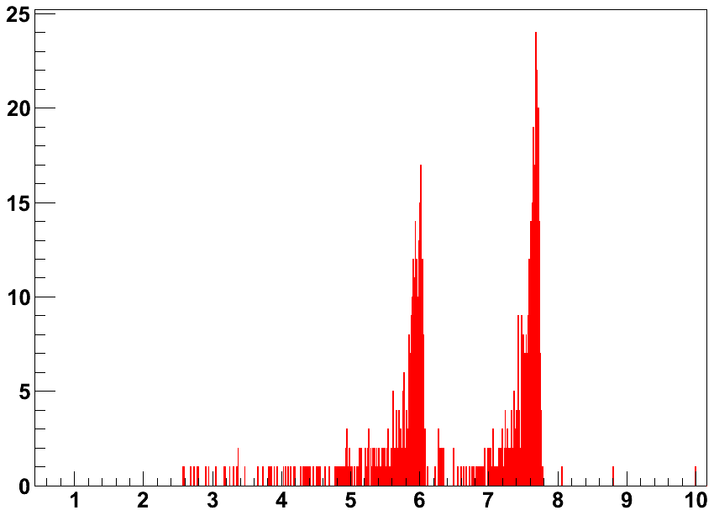
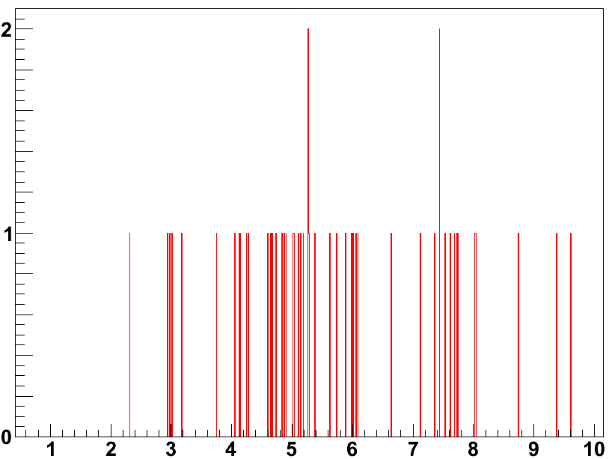
Energy spectrum measured at the beginning of background measurement (5 Bq/m³)
²¹⁸Po
²¹⁴Po
Time of measurement [day] | Sensitivity [mBq/m³]
1 | 11
7 | 3.5
30 | 1.6
75 | 1
Events[per day]
Energy[MeV]
Events[per day]
Background after 2 months is 11±1 events/day in the ROI (6.2-7.8 MeV, ²¹⁴Po)
Energy[MeV]

Slide 13
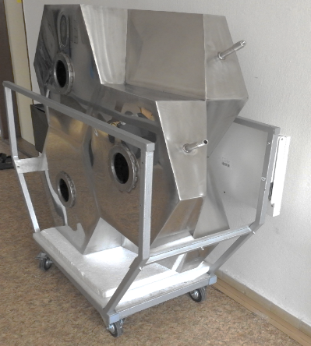
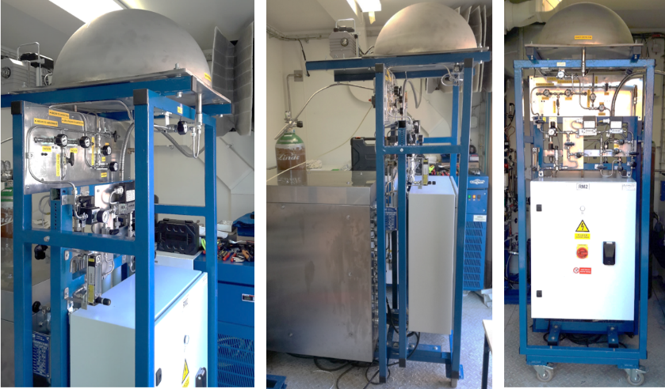
Honeycomb Rn detector (Volume 300 L = 6 ×50 L )
HV (-7 kV) – noise at 150 keV, Efficiency of ̴ 33%
Stainless steel thickness - 2 mm
Background of construction materials: ²²⁶Ra < 0.1 Bq/kg
Software, simultaneously data analysis (6 detectors)
Expected sensitivity of the Radon detector ~ mBq/m³
Radon concentration line
Adsorbent – active charcoal K48
Adjustable temperature of adsorbent – cooling up to - 180 ℃
Disadsorbtion of Rn from adsorbent – heating up to +135 ℃
Expected sensitivity ~ 10 μBq/m³

Slide 14
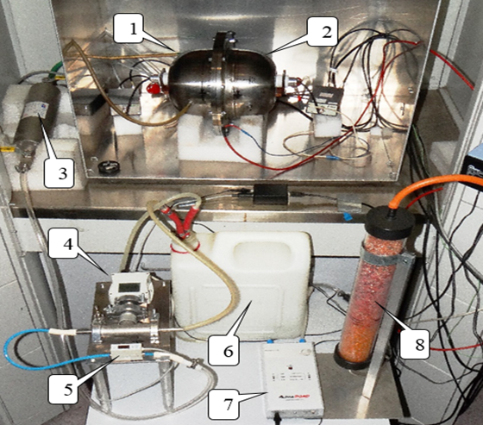
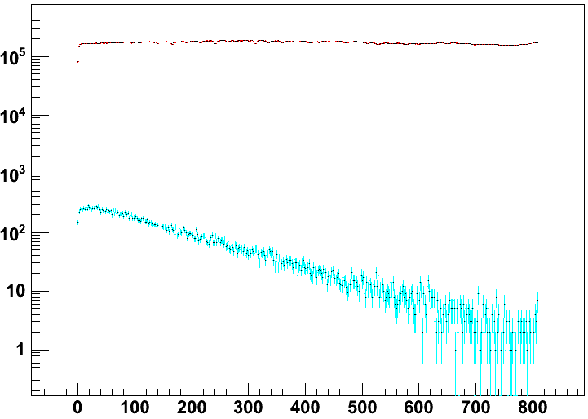
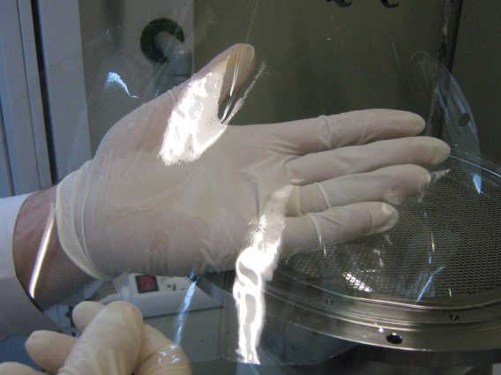
Radon diffusion apparatus
2 hemispheres separated by tested material foil (left hemisphere with high Rn activity, 38 kBq/m³; Rn penetrates into right hemisphere)
1/2 - Left/right vessel; 3 - Radon source; 4 - Sensors of temperature, humidity, and pressure; 5 - Flow-meter; 6 - Air buffer; 7 - Air pump, 0.34 L /min; 8 - Air dryer
Measurement of Rn diffusion through 50 µm NYLON film
Rn suppression factor C1/C2 > 76 500; Diffusion coefficient D =4.7·10⁻¹⁶ m²s⁻¹

Slide 15
Summary of results for different materials (foils) for the SuperNEMO detector from the radon-tightness point of view.
Foils | Thickness [µm] | C1/C2 | C₁/C₂ normalized to 15 µm | Diffusion coefficient D [10⁻¹² m²s⁻¹] | Diff. length L [µm]
HDPE (2 layers) | 2×144 | 3.5 | 1.1 | 19 | 3 000
TROPAC III | 102 | > 8 300 | > 600 | < 0.0043 | < 46
TROPAC junction | 102 | > 6 300 | > 500 | < 0.0051 | < 50
Bovlon film | 0.015 | 4.0 | 4.0 | 0.84 | 633
Mylar (2 layers) | 2×20 | > 9 100 | > 2 300 | < 0.0012 | < 24
Mylar junction | 20 | 110 | 85 | 0.030 | 120
EVOH (2 layers) | 2×15 | > 31 000 | > 8 900 | < 0.00035 | < 13
EVOH + PE | 125 | 165 | 20 | 0.013 | 254
Nylon | 50 | 76 500 | 6 380 | 0.00047 | 15
PET | 1 000 | > 41 136 | > 35 | < 0.076 | < 190

Slide 16
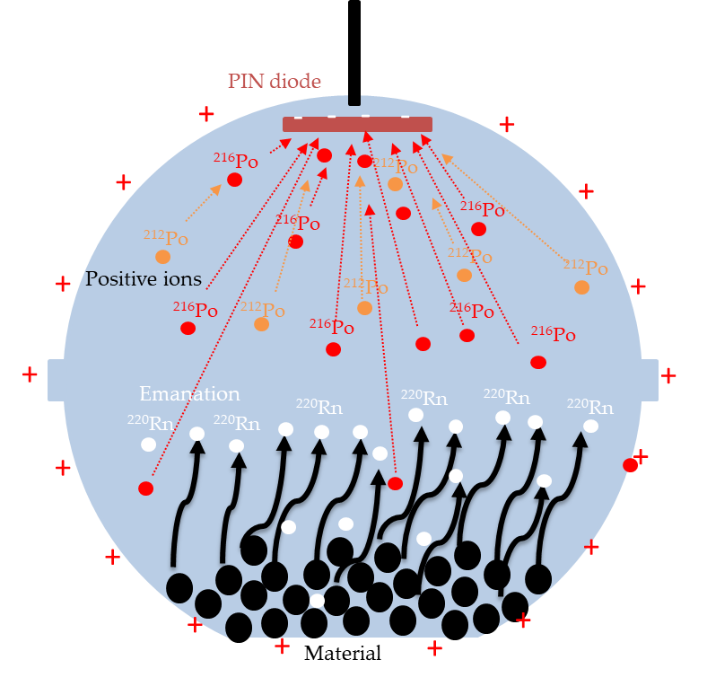
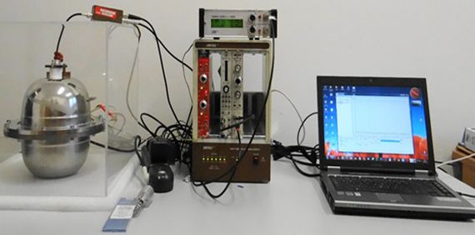
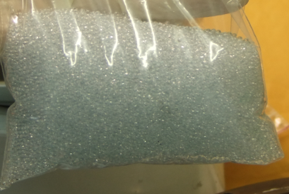
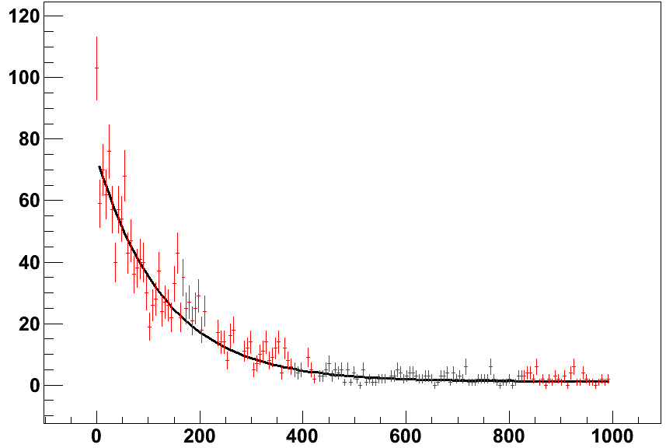
Apparatus for measurement of Rn emanation
Measurements of Rn emanation from glass pellets
Rn from glass pellets < 1.3 x 10⁻⁹ Bq/kg/s
Events per[6h]
Time[h]

Slide 17
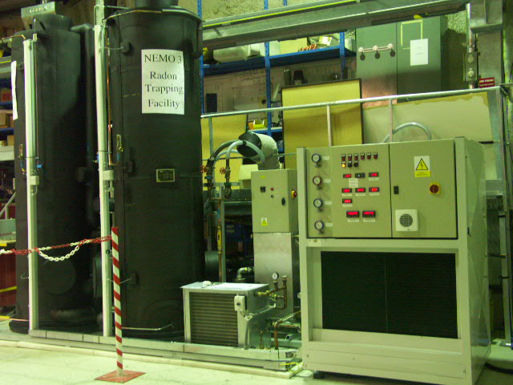
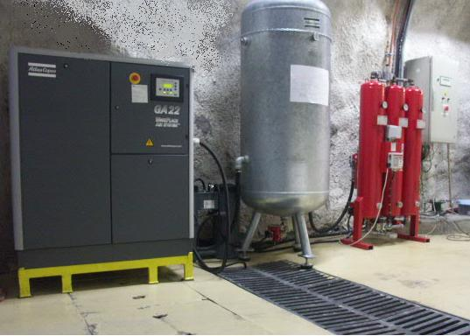
Suppression of Rn from air
Radon trapping on charcoal => Radon decays during trapping
reduction factor 100 => „retention time“ T = 606 hours (~ 25 days)
T (hours) = K (m³/kg) * m (kg) / f (m³/hour)
T – retention time of Radon in charcoal; m – mass of charcoal
f – flux of gas
K – depends on charcoal type, temperature, pressure (J. Busto, CPPM):
t (°C) 20 0 -30 -40 -50 -60
K(m³/kg) 4 12 53 78 152 272
A(222Rn) in LSM ~ 10-20 Bq/m³
Antiradon setup: 500 kg charcoal @ -50ºC, 7 bars
Activity: A(²²²Rn) < 10 mBq/m³ !!! Flux: 150 m³/h (produced by ATEKO company, Czech Republic)

Slide 18
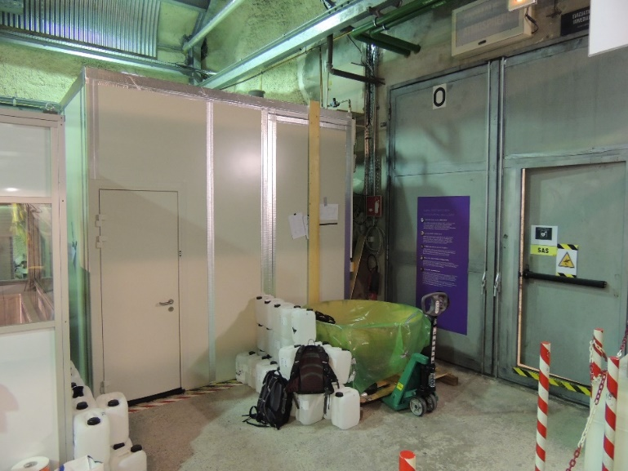
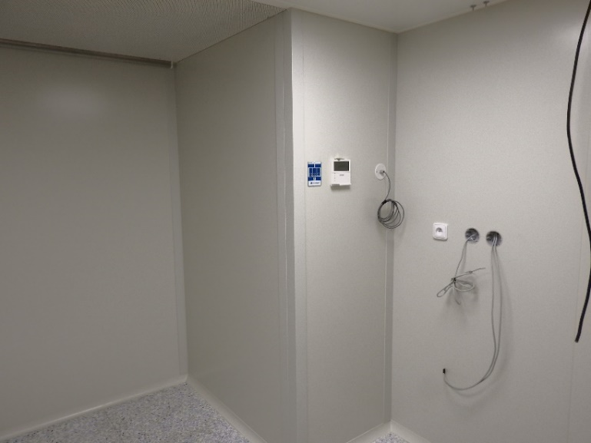
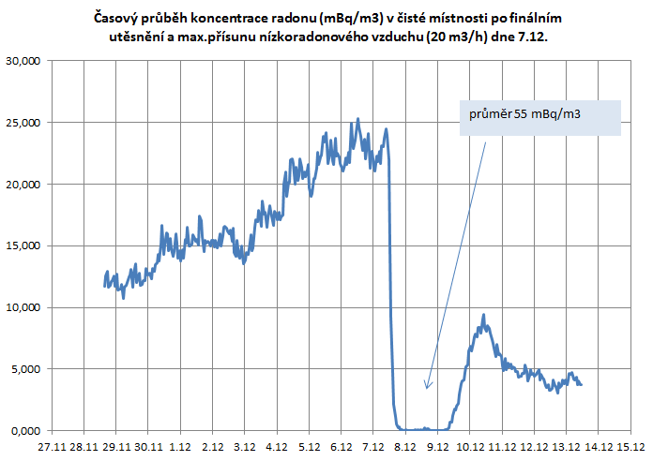
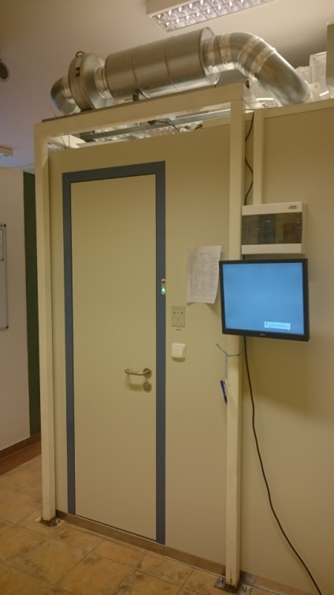
Clean rooms in SURO and LSM (ISO 5, zero-dose environment)
- Anti-radon system and clean room (ISO 5) is installed in SURO and in LSM
- Suppression of all types of radioactivity (including Radon) for biological studies, preparation of detectors, enriched foils…..

Slide 19
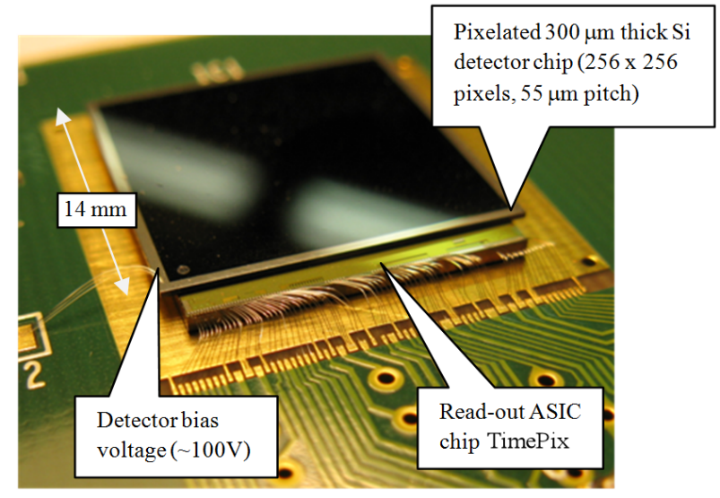
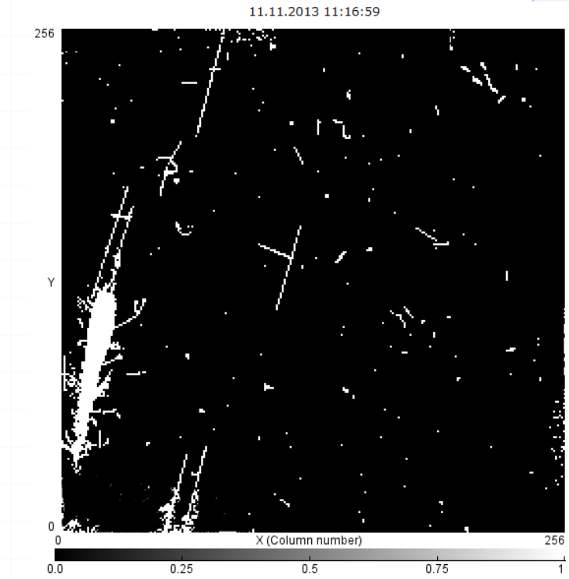
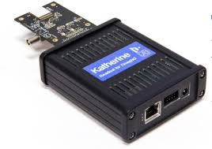
Medipix/Timepix collaboration (headed by M. Campbell, CERN):
e.g. Timepix3
Each pixel can be configured to operate in different mode independently to other pixels
Measuring Energy (TOT, dead time per pixel 475 ns) and Time-stamping (TOA, 1.56 ns) simultaneously
Readout modes: a) Frame-based mode (max~1300 fps); b) Data-driven mode (~40Mhits/s), dead time per pixel min. 475ns
Output data: up to 8 serial lines, 640MHz => max. data rate= 5.12 Gbps

Slide 20
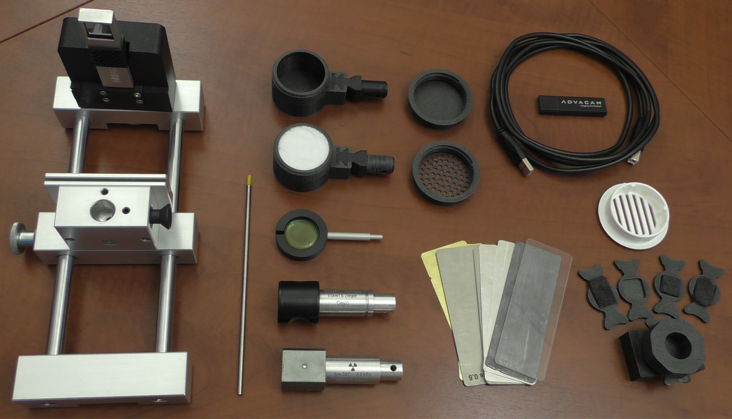
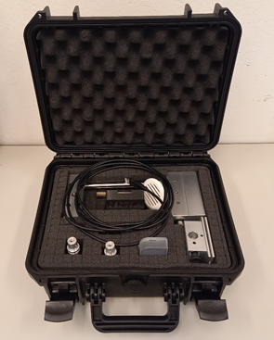
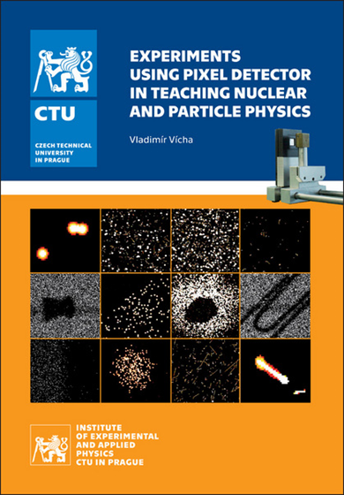
SESTRA - School Education Set with Timepix for Radiation Analysis
Uranium Glass (𝛼, 𝛽 and 𝛾 source)
Mounting Rails
Source Holder
Camera Holder
Aluminium, Stainless, Copper, Brass
and Lead Shielding Plates
Radiography Adapter Head
+Samples with Hidden Patterns
Vacuum Cleaner Grate Adapter
USB Cable
Book of detailed guidelines
“Experiments Using Pixel Detector in
Teaching Nuclear and Particle Physics”
Particle Camera MiniPixEDU
(Timepix detector, calibrated)
Control Software
Pixelman Simple preview & Pixet basic
(acquisition, online visualisation, etc.,)
Alfa source
(241Am, 𝛼 and 𝛾 source, 9.5 kBq)
Gamma source
(241Am, 𝛾 source, 300 kBq, optional)
Potassium Salt
(𝛽 and 𝛾 source)
Thoriated Tungsten Electrode
(𝛼, 𝛽 and 𝛾 source)

Slide 21
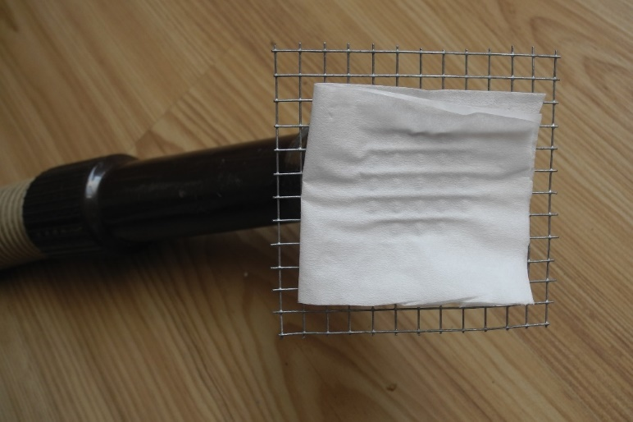
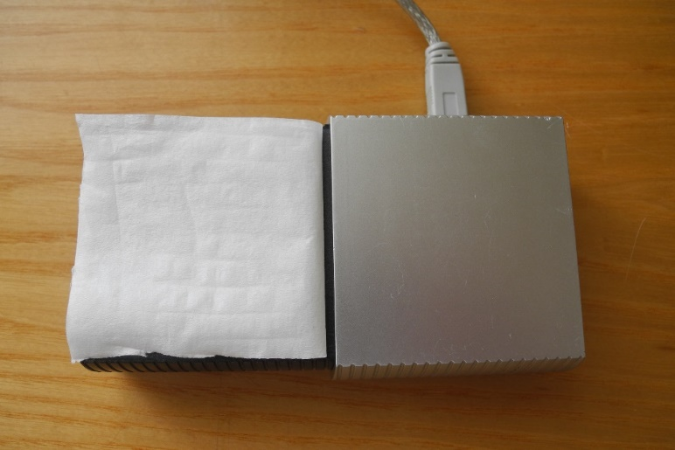
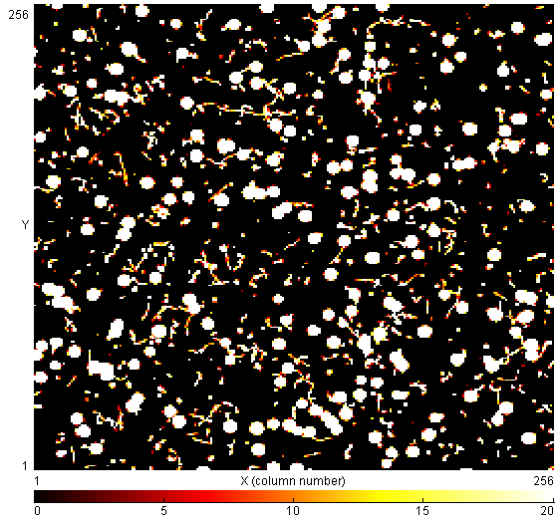
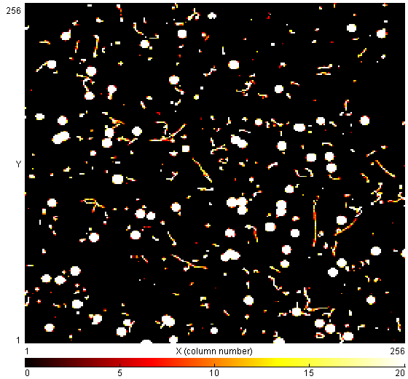
Demonstration OF background radioactivity caused by radon
Visualizations of the Rn caused radioactivity of the paper tissue used as an air filter at home. The filtering took 5 minutes and exposure time was 10 minutes in both cases.
Not-ventilated (left) room
Ventilated (right) room

Slide 22
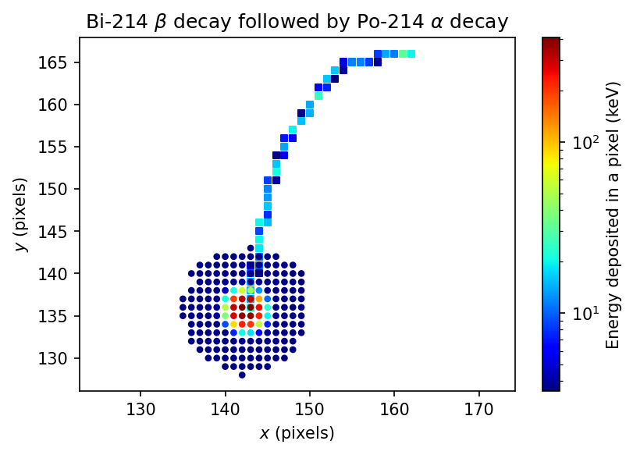
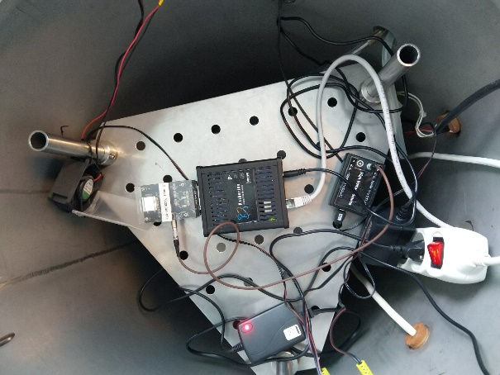
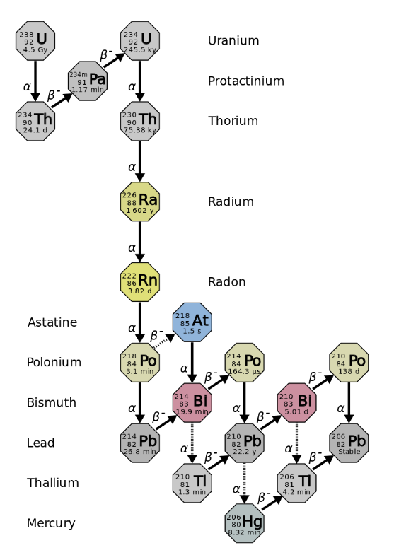

Measurement of half-life time of Po-214 (also Po-212) with high precision using TPX3 detector (student J. Jelínek)
Measurement was done in SURO, Timepix3 into barrel with high activity of Rn-222 (units to tens of MBq m⁻³) for 140 hours
Daughter nuclei attach to Timepix3 surface and subsequent decays were observed
The overal result of measurements is:
$T_{1/2}=163,565±0,034(\text{stat})±0,022(\text{syst})$ µs
Other recent experimental values:
$T_{1/2}=163,58±0,29(\text{stat})±0,10(\text{syst})$ µs (Bellini et al., 2013)
$T_{1/2}=163,47±0,03$ µs (Alexeyev et al., 2020) – no proper error
discussion
Spatial resolution of Timepix3 allowed to collect large data set (order of 10⁷ events) in short time (approx. 6 days) while maintaining reasonable signal to noise ratio.

Slide 23
Millennium Institute for Subatomic Physics at the High Energy Frontier, SAPHIR is based on the similar way and it looks that you are going on proper way in science:
Instrumentation R&D
International cooperation based on reciprocity
Precisely defined responsibility of your team in the collaborative research
Support of local research infrastructure
Strong theoretical team.
Posssible areas of cooperation:
Detector technologies (scintillating detectors, strip, pixel…)
Deep underground laboratories (ANDES – technologies of ultra-low background)
Space (payloads based on pixel detectors, Chile has ambitious program to space)
Detection of radiation (HPGe spectroscopy)

Slide 24
Thank you for your attention

Slide 25


Radon
There are three decay “chains” that occur in nature:
the uranium series, beginning with ²³⁸U,
the thorium series, which originates with ²³²Th,
the actinium series, which originates with ²³⁵ U.
  Radon
  Inert noble gas,
  belongs to the ²³⁸U chain (present in any material),
  high diffusion and permeability
  wide range of energy of emitted radiation (with the daughters),
  surface contaminations with radon daughters (heavy metals),
  broken equilibrium in the chain at ²¹⁰Pb level.
Radon ²²²Rn and its daughters form one of the most dangerous source of background in many experiments
²³⁸U radium series
²³²Th - thorium
Different experimental results of radon decay progenies charge obtained by different authors

Slide 26




Detector “Obelix” (JINR/IEAP CTU/LSM)
P type coaxial HPGe detector (U-type ultra low background cryostat
located at LSM (4800 m w.e.)
Sensitive volume 600 cm³ Efficiency 162%
Energy resolution ~1.2 keV at 122 keV (⁵⁷Co), ~2 keV at 1332 keV (⁶⁰Co)
12 cm of arch. Pb, 20 cm of low active Pb, Radon free air
Process | T_{1/2} [years]
2ν2β⁻ decay to 0⁺₁ [1130 keV]
2ν2β⁻ decay to 2⁺₁ [540 keV]
Mass of ¹⁰⁰Mo – 2517,15 g
Total measurement time – 2288 h
¹⁰⁰Mo
¹⁰⁰Mo
The price of such detector is
250 kEUROs => you need
international cooperation

Slide 27




Laboratoire Souterrain de Modane
Road tunnel Fréjus (France – Italy border)
Depth of ~ 4800 m.w.e. (muon suppression factor ~ 10⁶)
Muon flux: 4 x 10⁻⁵ μ.m⁻².s⁻¹
Neutron flux: 4 x 10⁻² n.m⁻².s⁻¹(fast);
1.6 x 10⁻² n.m⁻².s⁻¹ (thermal)
Radon: 15 Bq.m⁻³
Main hall
HPGe room 1

Slide 28

Flight Amsterodam – Santiago, 5. - 6. 12. 2021
Measurement by pixel detector during flight (only during take-off it was impossible)
a) 1st local maximum: appr. 80 minutes after take-off (11 p.m.)
b) 7 hours flux is relatively stable
c) After 600 minutes of flight (8:30 a.m.) flux is increasing.
The second maximum is in time 730-780 minutes of flight
(10 a.m.- 10:50 a.m.)
d) Landing is clearly visible

Slide 29




Detection of muons during flight:
In vertical position: total number 674 (1 per 45s)
In horizontal position: total number 169 (1/170s)
Measurements during landing (last 36 minutes) – decreasing of flux is clearly visible
Time before landing = 18 minutes
Time before landing = 36 minutes
Time before landing = 3 minutes

Slide 30




Experiments in high radiation environment: i) activities in space, ii) LHC (MoEDAL, ATLAS-TPX)
International Space Station
In orbit since 3Q 2012
380 km
5 Timepix-Lite detectors placed on ISS since 2012 (collaboration with NASA and the University of Houston).
USB-Lite interface developed at IEAP.
ESA Proba V satellite
Launched 7th May 2013
820 km
SATRAM module with Timepix detector onboard ESA satellite Proba-V.
Characterization of space radiation at LEO. TPX in open space.
Developed by IEAP and BD Sensors.

Slide 31





VZLUSAT-1
Launch 2017
500 km
Timepix detector as part of miniature X-ray telescope onboard VZLUSAT-1 cubesat since 2017.
The first Czech satellite since 1996.
RISESAT satellite
Launch 2019
500 km
Japanese microsatellite RISESAT (Rapid International Scientific Experiment Satellite); dimensions 50x50x50 cm, weight ~50 kg
Development led by Tohoku University and Hokkaido University

Slide 32



Data Acquisition Control Software
PIXELMAN – IEAP CTU
Acquisition and control tool for Medipix & Timepix detectors
PIXET - ADVACAM
Acquisition and control tool for Timepix & Timepix 3 detector
J-PIX – IEAP CTU
Acquisition and control tool for Timepix 3 detector currently under development fully designed in Java to be multi-platform
Typical response of Timepix device to natural background radiation:
Clearly recognizable tracks
and traces of
- X-rays
- electrons
- alpha particles
- muon
- electron-positron pair, … .

