Slide 1





Charged Dark Matter and the H0 tension ?
Philippe Brax
Institut de Physique Théorique
Université Paris-Saclay
Collaboration with J. Beltran-Jimenez and D. Bettoni (Salamanca)
2004.13677 2007.11029
2103.03627

Slide 2
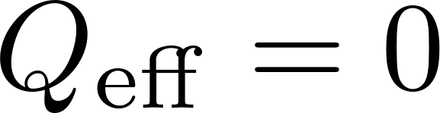
Non-linear effects in non-linear electromagnetism:
A heuristic classical reasoning: if electromagnetism is non-linear then point-like particles belong to their screening radius:
Screening radius
Effectively point-like particle decouple from the U(1) field! Only macroscopic configurations will feel effects.
We will concentrate on non-linear theories with a single charged dark matter particle.

Slide 3
Charged dark matter?
Dark matter, typically fermions, could be charged under a new U(1).
Before acquiring a mass, must be careful about the anomaly condition. Not all charges allowed.
At low energy, once dark matter acquires a mass, both particles and anti-particles of opposite charges may be present.
Standard scenario: freeze out and suppressed particle-antiparticle annihilation. See: http://arxiv.org/abs/0810.5126
Here we will require an unknown period of dark matter genesis where only one type of charge remains.

Slide 4
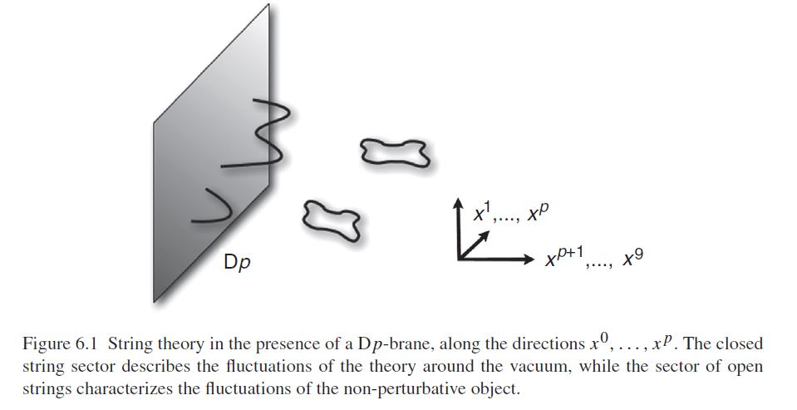
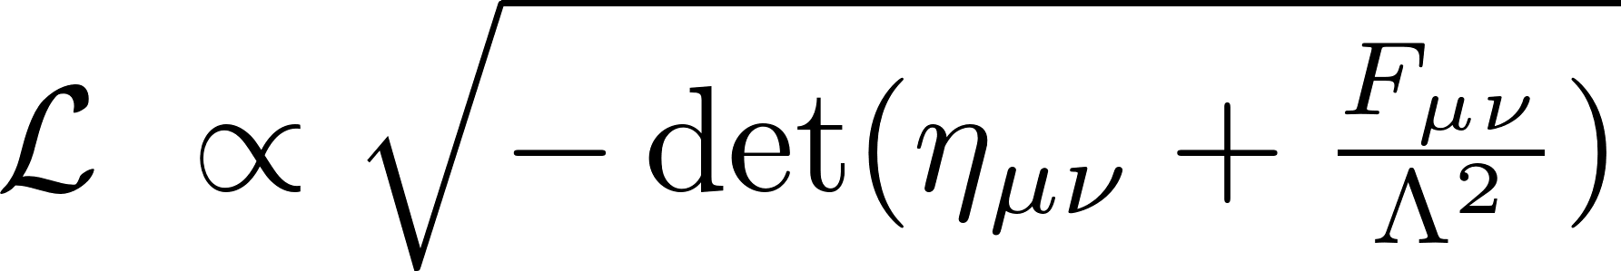
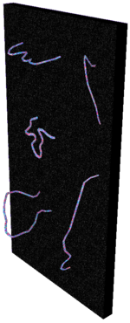
Non-linear effects?
One brane could carry a U(1) gauge field.
Dark matter could live on this brane and be charged
We will be agnostic about the origin of the models in the following: effective field theory approach
Born-Infeld theory
Screening of elementary charges guarantees a finite energy configuration
Another brane could carry the baryons

Slide 5

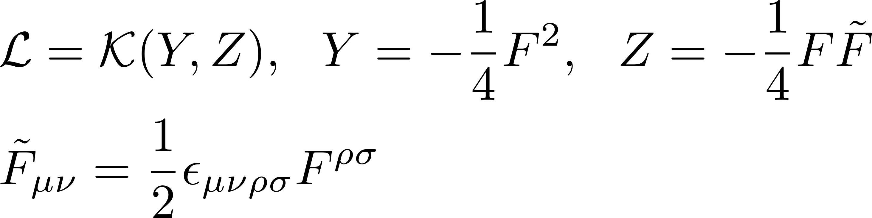
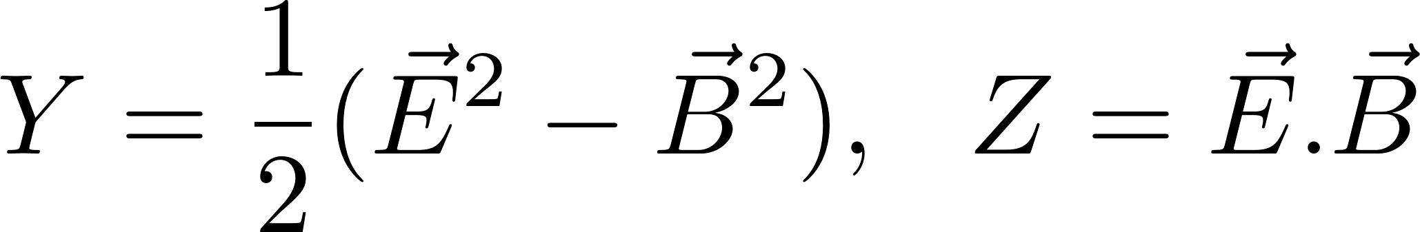
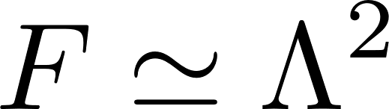
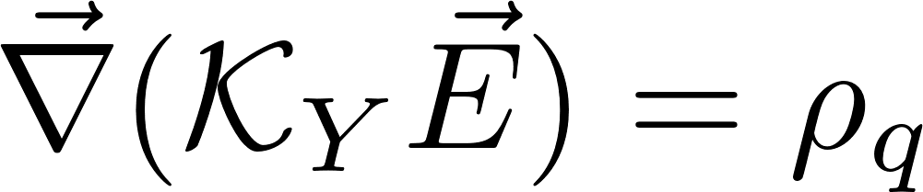
Non-linear Electrodynamics: an effective approach
Maxwell
Non-linear terms in powers of Y and Z suppressed by scale Λ. Non-linear regime when powers of Y and Z dominate over the linear term in Y.
Coulomb’s law
Non-linear effect similar to K-mouflage for scalars
Electric charge

Slide 6
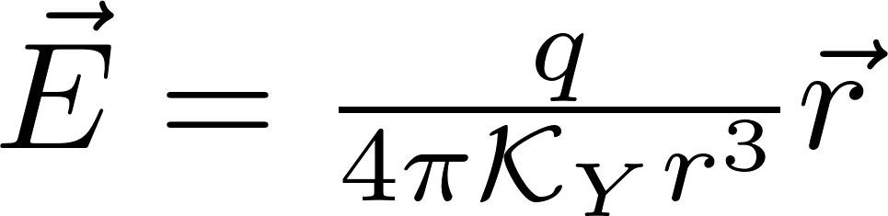
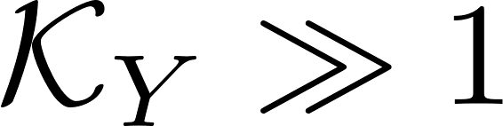
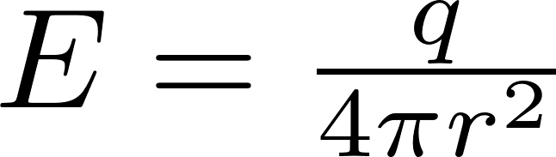
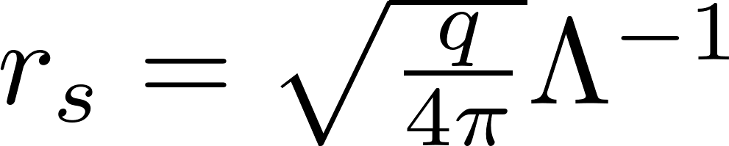
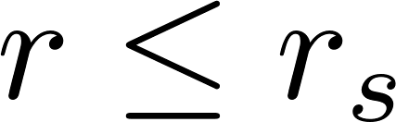
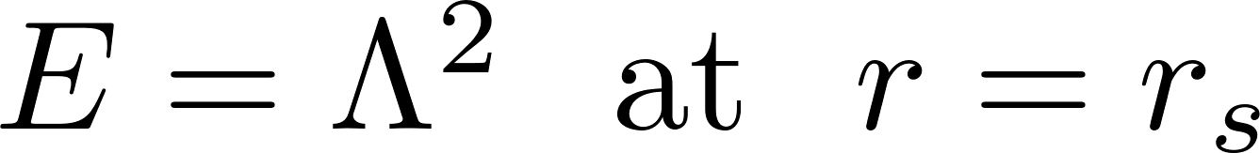
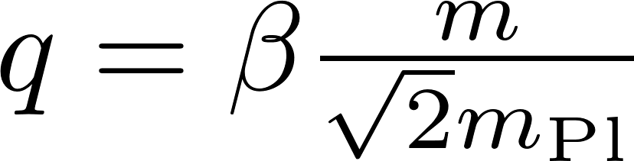
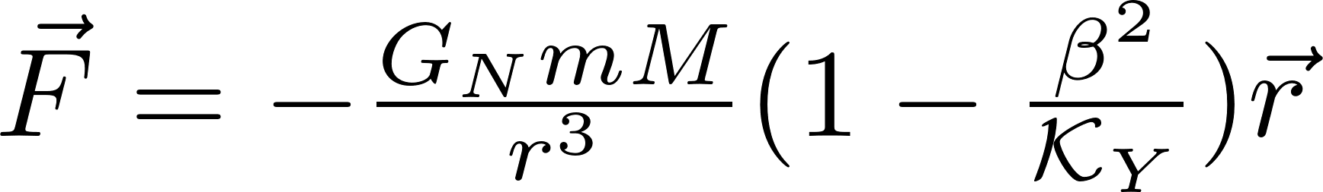
Screening when
Point charges:
unscreened
screened
Screening radius
If only one charged species, charge is proportional to mass:
Repulsive force
Reduction of Newton’s constant

Slide 7
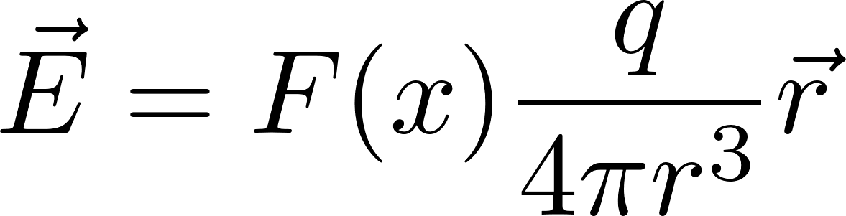
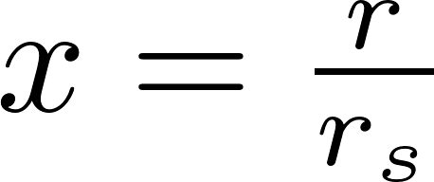
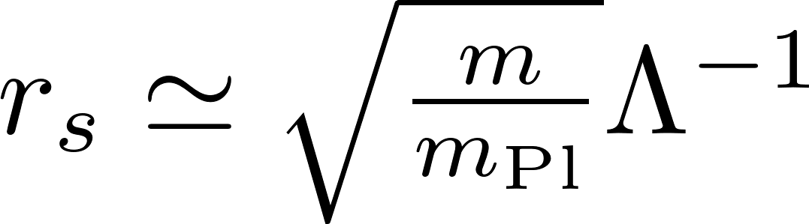
The screening function:
The screening radius goes like the square root of the mass!

Slide 8
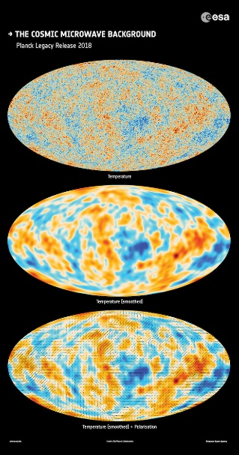
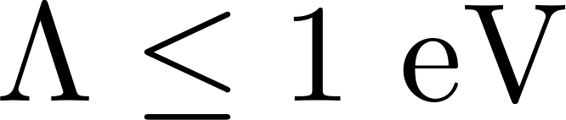
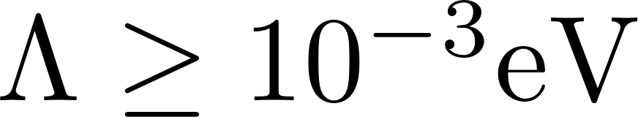
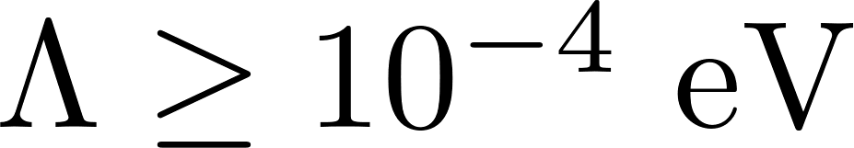
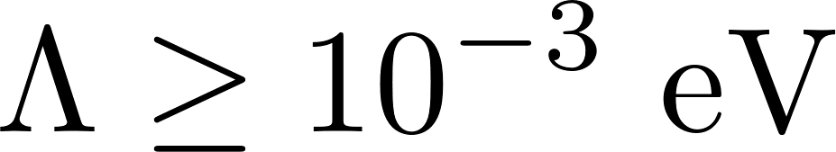
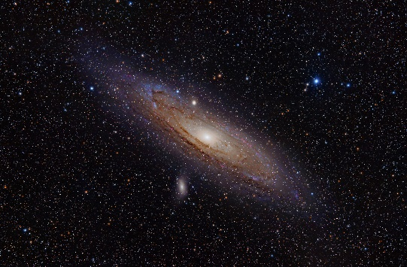

Some scales:
Energy at matter-radiation equality
All the horizon at least till last scattering should be screened:
The screening radius of the horizon now should be smaller than the horizon:
Dark energy scale
Clusters should be unscreened:
Galaxies should be unscreened:
Effects on late Universe only:

Slide 9
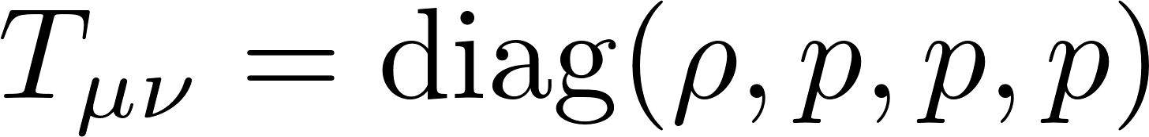
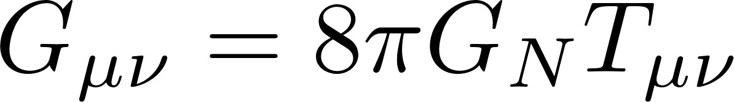

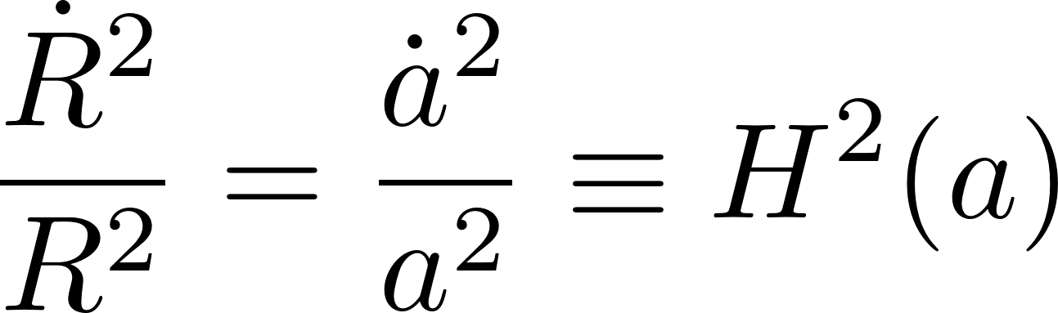
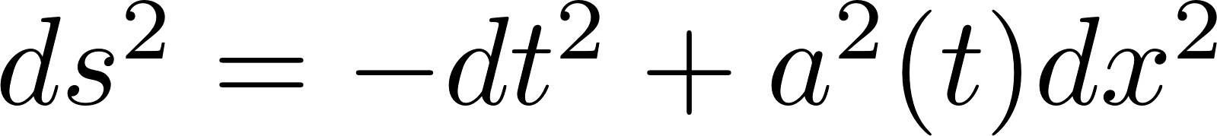
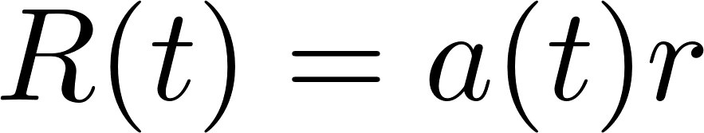
How to do cosmology with screened radiation?
Photons:
Described by a relativistic fluid
The cosmological principle allows one to describe the evolution of the Universe as the dynamics of co-moving shells:
Eulerian (R(t),t) description of evolving shells
(r,t) Lagrangian description foliated by the initial radii of the shells

Slide 10
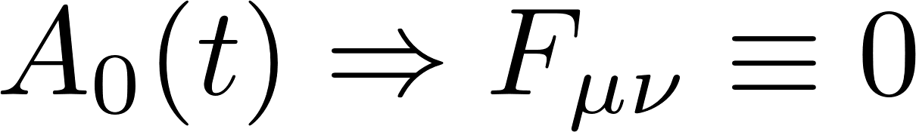
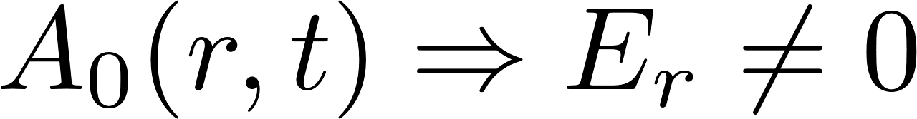
Screened difficulties:
Field description:
Cosmological principle
Screening breaks homogeneity
Fluid description:
Inhomogeneous models? Lemaitre!
Inhomogeneous density and pressure? How to model it?

Slide 11
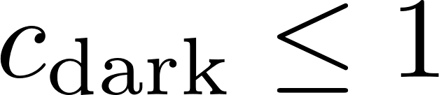
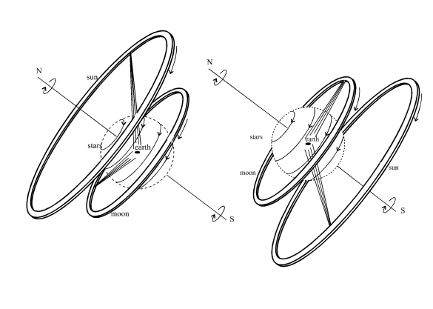
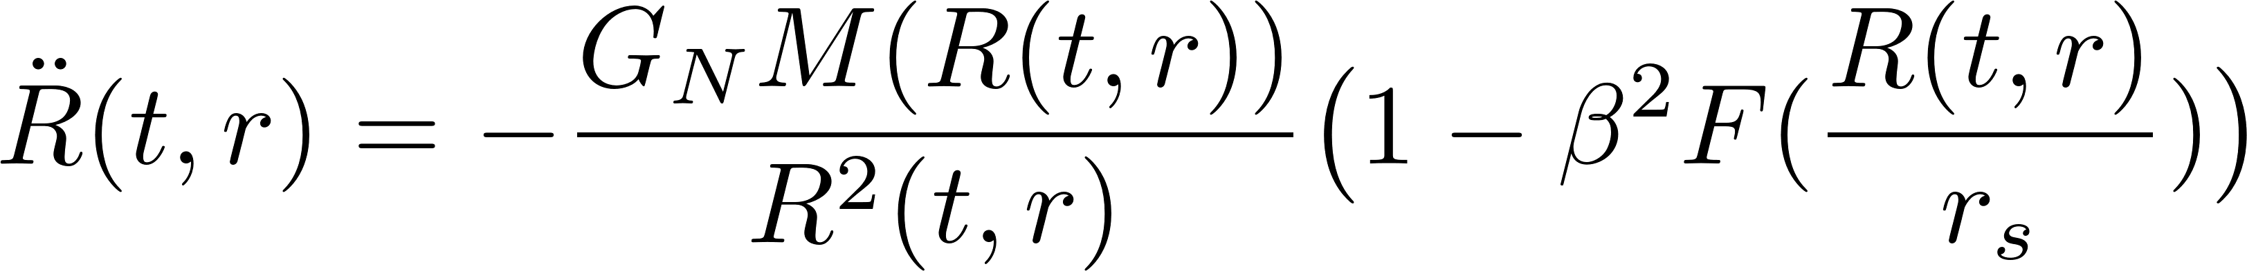
Newtonian Cosmology
Restrict our description of the Universe to the horizon (domain of influence of the dark U(1)) as speed of light c=1 when unscreened (early in the Universe).
Initially foliate the Universe in shells of radius r inside the horizon.
For scalars, K-mouflage involves a plus sign! More gravity… similar type of modification…
Newton’s law
Dark repulsion

Slide 12
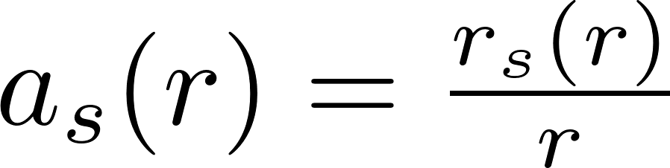
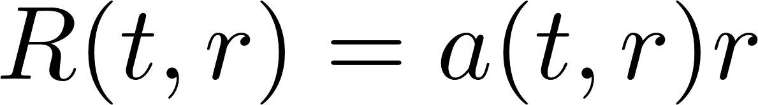
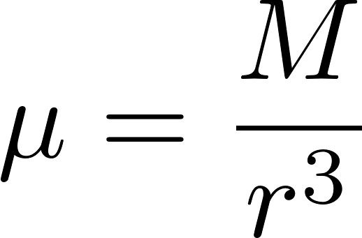
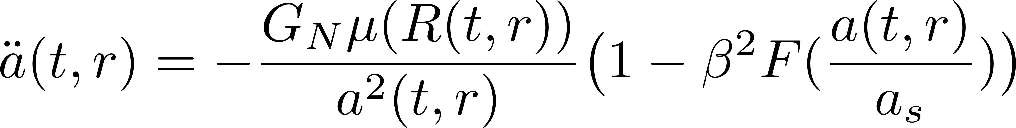
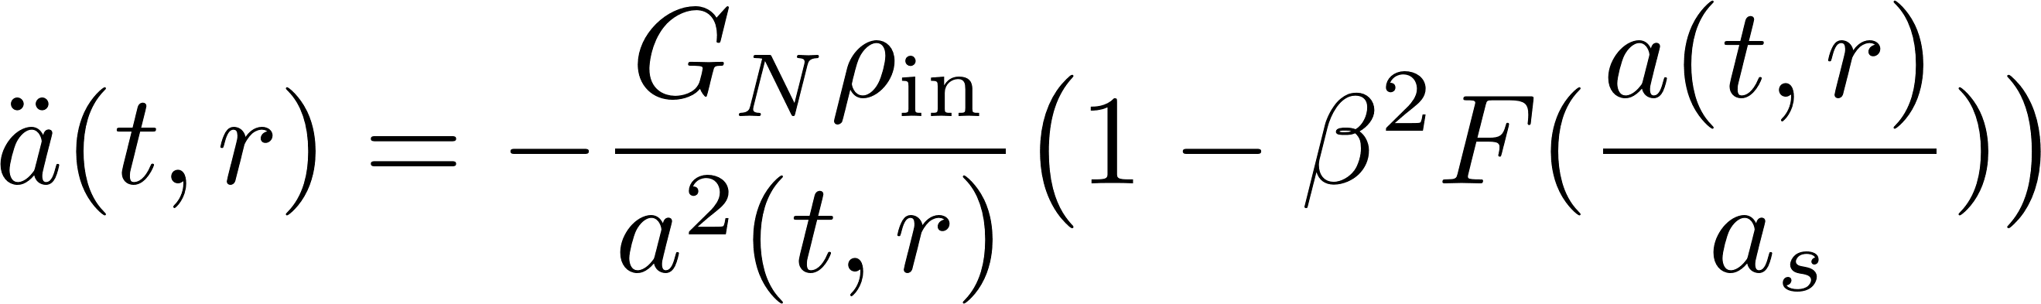
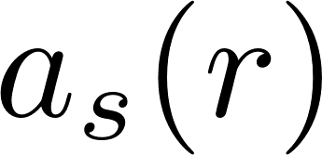
Breaking the co-moving evolution
Breaking of co-moving evolution
Locally we can always define the scale factor of each shell:
No shell crossing
Explicit dependence on the scale factor when a shell exits its screening radius

Slide 13
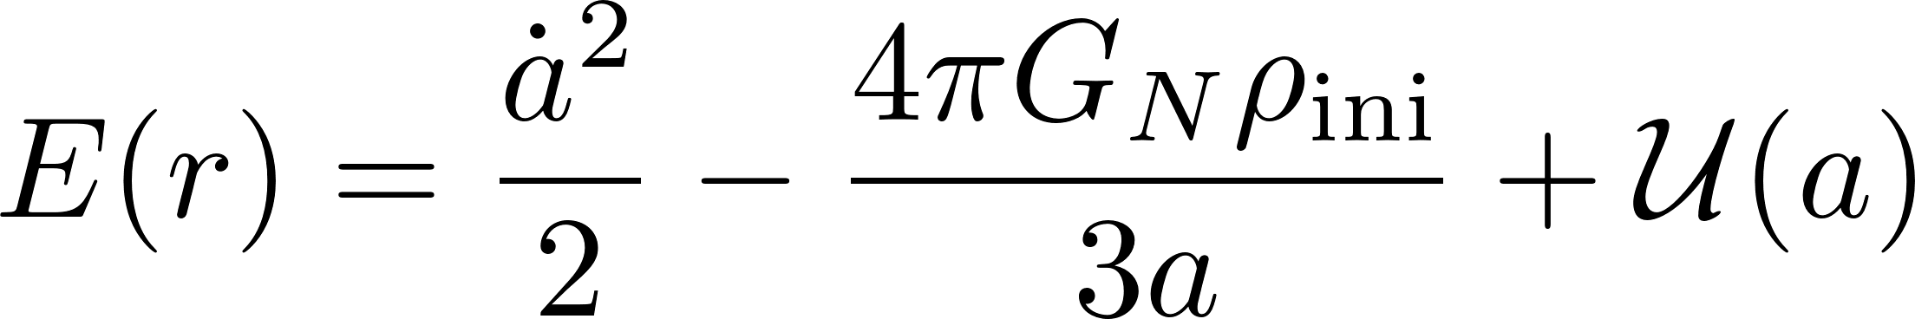
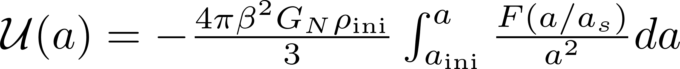
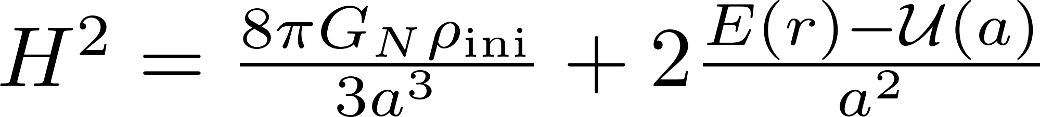
Curvature and pressure
When mass is conserved, can integrate to get Friedmann’s equation:
Early Universe curvature
Acts like an effective curvature term or “pressure”…
Looks like Tolman-Bondi-Lemaitre… not quite!

Slide 14
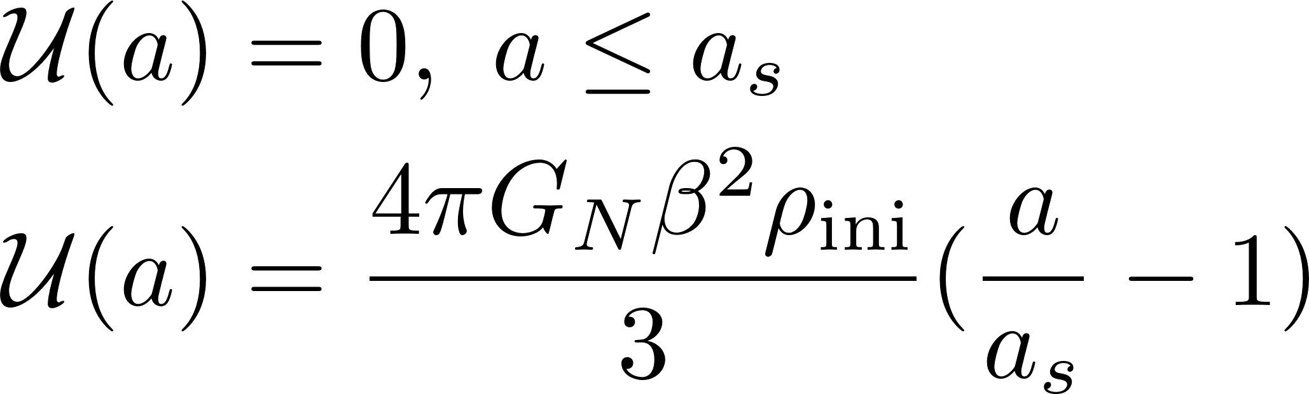
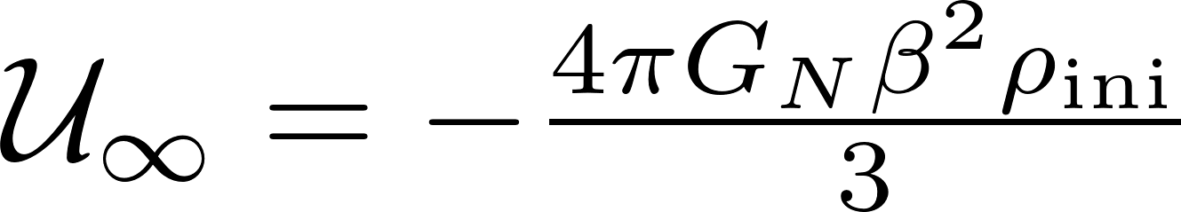
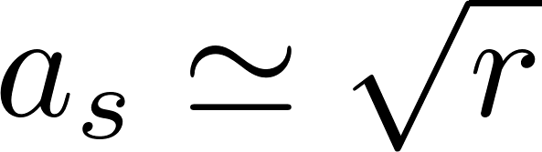
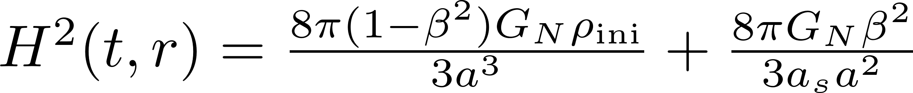
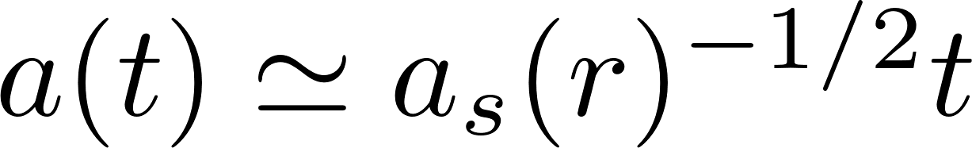
Curvature and pressure
Shells with small r exit their screening radius earlier.
For a sharp screening function:
For shells outside their screening radius:
Asymptotic negative curvature
Repulsive effect

Slide 15
Dynamics of DM shells:
From yellow to Green: smaller and smaller initial radius r
When the different shell exit their screening radii (the innermost shells first), the evolution is not co-moving anymore. The inner shells catch the outer ones, resulting in a “compression” zone before relaxing a ending again co-movingly in a negatively curved Universe.
The initial co-moving evolutions breaks up as (green) inner shell exit their screening radii and feel the repulsive effect of the dark electric force. Eventually the curvature dominated phase starts whilst the transient regions sees a faster evolution of the innermost shells.

Slide 16
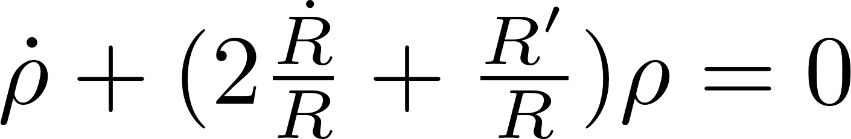


Equivalence with Lemaitre models (1933)
Absent in TLB models
Two fluid models:
dust and fluid with pressure
The line element is:
A=0 if no pressure
Conservation of matter:
Electric pressure
Einstein equations:

Slide 17



The H0 tension?
Toy model: only DM and no shell crossing.
???
We have seen that inner shells have a faster evolution than outer shells.
The Hubble rate deduced at last scattering not influenced by dark U(1) (screening)
At small redshift, closer objects from an observer have a larger expansion rate.
Close objects have different Hubble rates on different shells
Close objects
observer

Slide 18



The H0 tension?
10% effect for a coupling of order one and a cut-off scale:
No discrepancy on BAO scale

Slide 19


Anisotropy
When the observer is not at the centre of the shells, there is an anisotropic effect:
Unity for comoving motion

Slide 20
Time to conclude!
Dark repulsion could have interesting effects at late time whilst preserving early time cosmology: a window on the H0 tension?
Need to compare to data for Born-Infeld, best motivated model.
How do structure form in these scenarios (spherical collapse…) ?
N-body simulation should help!
More funny properties (vanishing susceptibilities…)

Slide 21
Adding baryons:
The presence of baryons “induces” shell crossing of DM for models with no shell crossing at the
DM level.
No shell crossing for baryons here.
The Hubble rate of baryonic shells follows the trend of DM, i.e. outer shells lag behind.
DM “pushed away” compared to baryons. Could leave DM depleted regions.

Slide 22


Dark matter and baryon shells in a DBI model.
You can see the fact that the dark matter shells cross!
And the mass within each shell is not constant.

Slide 23
Adding Dark Energy:
Before complete dominance by DE, the inner shells still have a larger Hubble rate.
The inner shell baryons have a large Hubble rate when the Universe is not completely DE dominated.

Slide 24



Possible astrophysics effects:
If distribution of matter reconstructed from Newton’s law and Newton’s potential, then unaccounted for repulsion implies at least two possible effects:
An increase of the velocity dispersion due to the repulsive effect of the dark repulsion?
Possible large scale flows of galaxies pushed away by the dark repulsion ?

