Slide 1

MD7203: New IR7 optics for improved cleaning and impedance
B. Lindström on behalf of R. Bruce, X. Buffat, R. de Maria,
L. Giacomel, N. Mounet, S. Redaelli
Thanks to: D. Mirarchi, S. Fartoukh, M. Solfaroli, R. Tomás,
J. Wenninger
4th October 2022 – restricted Machine Protection Panel

Slide 2
Introduction and Motivation
HL-LHC beam intensity and brightness produces significant challenges:
  Beam losses in IR7 DS could cause quenches
  Impedance can cause instabilities
Beam losses:
  Initial plan to mitigate them using TCLDs installed between two 11T dipoles
  11T dipole availability for HL-LHC is uncertain and a backup strategy must be devised
Impedance:
  Low-impedance collimators are introduced in stages (LS2, LS3), but these are not enough and relaxed collimator settings were requested by WP2
  Further reduction of impedance helps ensure beam stability
  Impedance reduction could also allow for tighter settings

Slide 3
New IR7 optics¹ and collimator setup²
Increase collimator beta functions
  Larger normalized kicks on scattered particles → larger probability of absorbing them in TCS / TCLAs
  Larger physical gaps → lower impedance
Increase single pass dispersion at TCS / TCLAs
  Increased through optics rematch and orbit bump
  Off-momentum particles outscattered from TCP are more likely to be intercepted by collimators before reaching the DS
Asymmetric TCLA settings
  Improves cleaning performance
  Gap kept constant – one jaw moves closer and catches dispersive losses
  Successfully used on TCPs operationally in 2018 ion run
Single-sided jaw collimators
  Retract one jaw of selected collimator(s) to reduce impedance further ³
1: R. Bruce et al, https://doi.org/10.18429/JACoW-IPAC2021-MOPAB006
2: B. Lindstrom et al, https://doi.org/10.18429/JACoW-IPAC2022-TUPOTK062
3: D. Kodjaandreev, http://cds.cern.ch/record/2690267

Slide 4
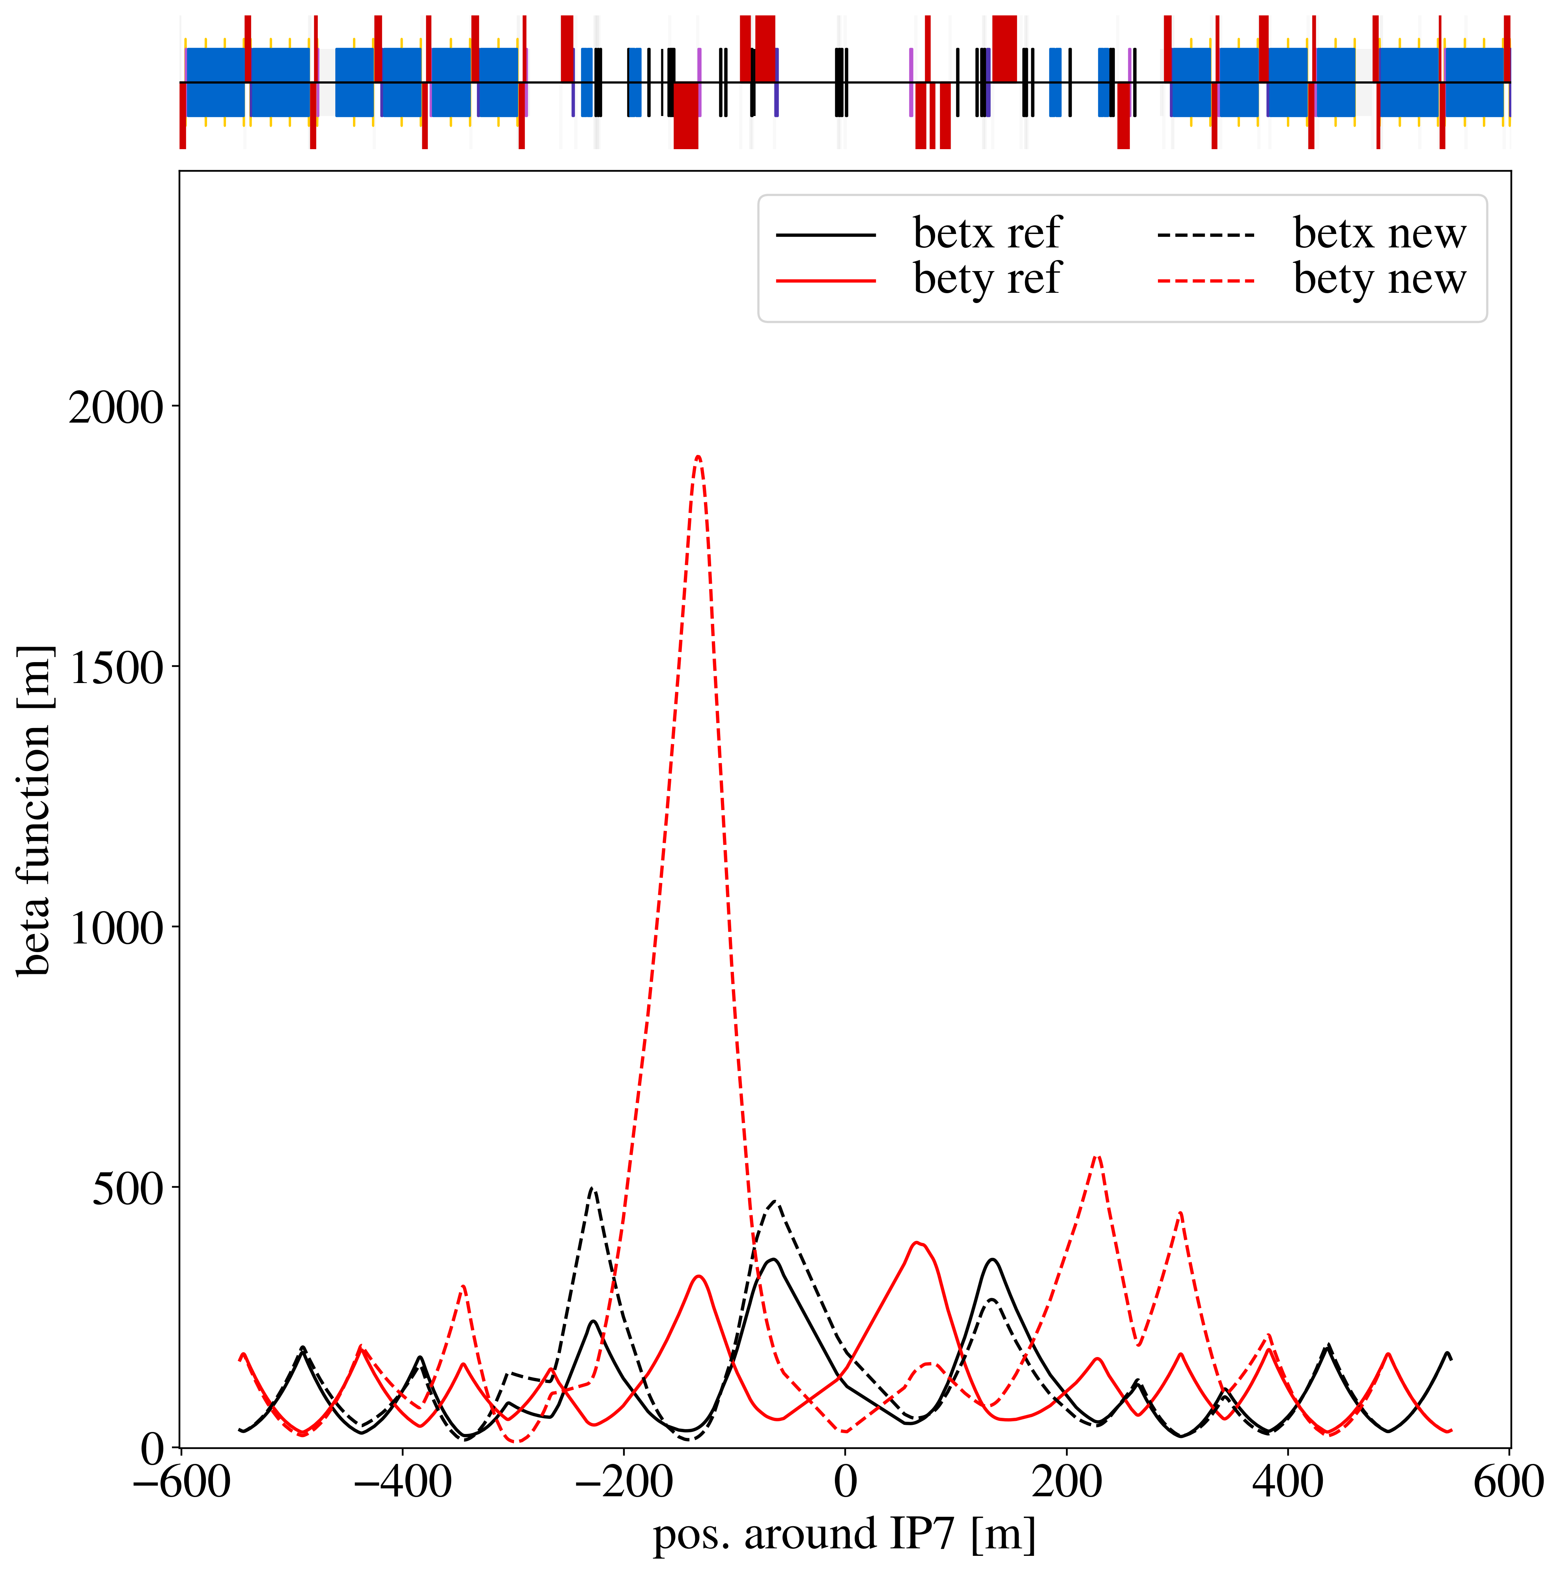
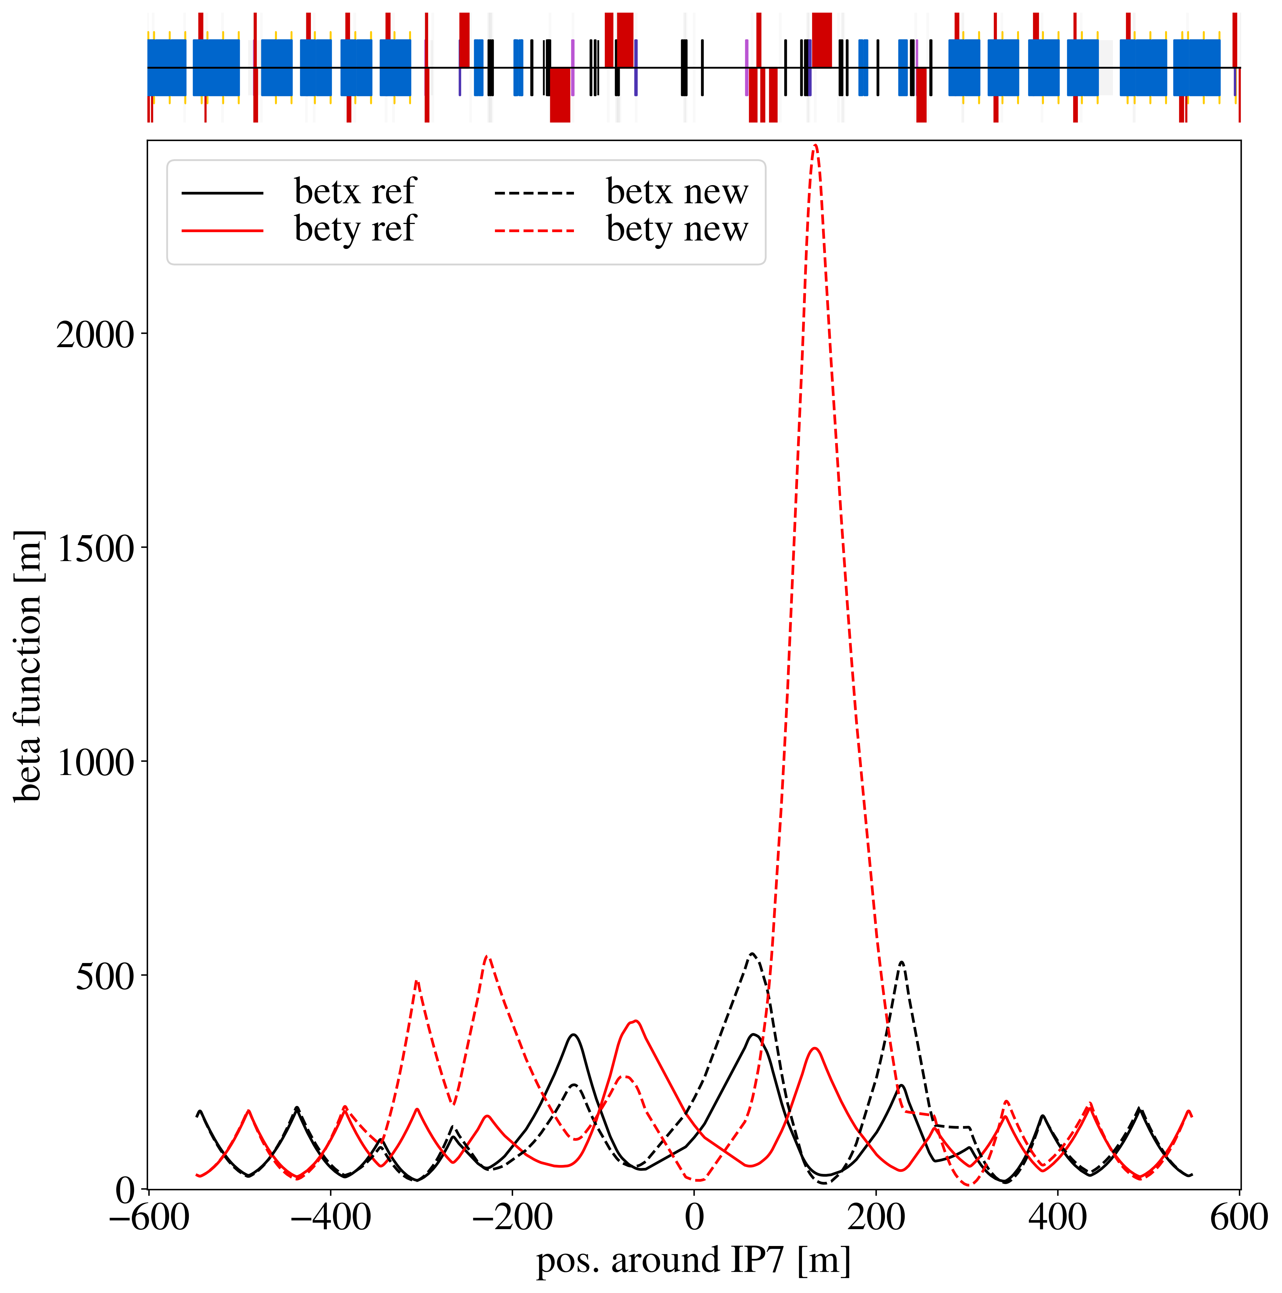
Beta functions

Slide 5
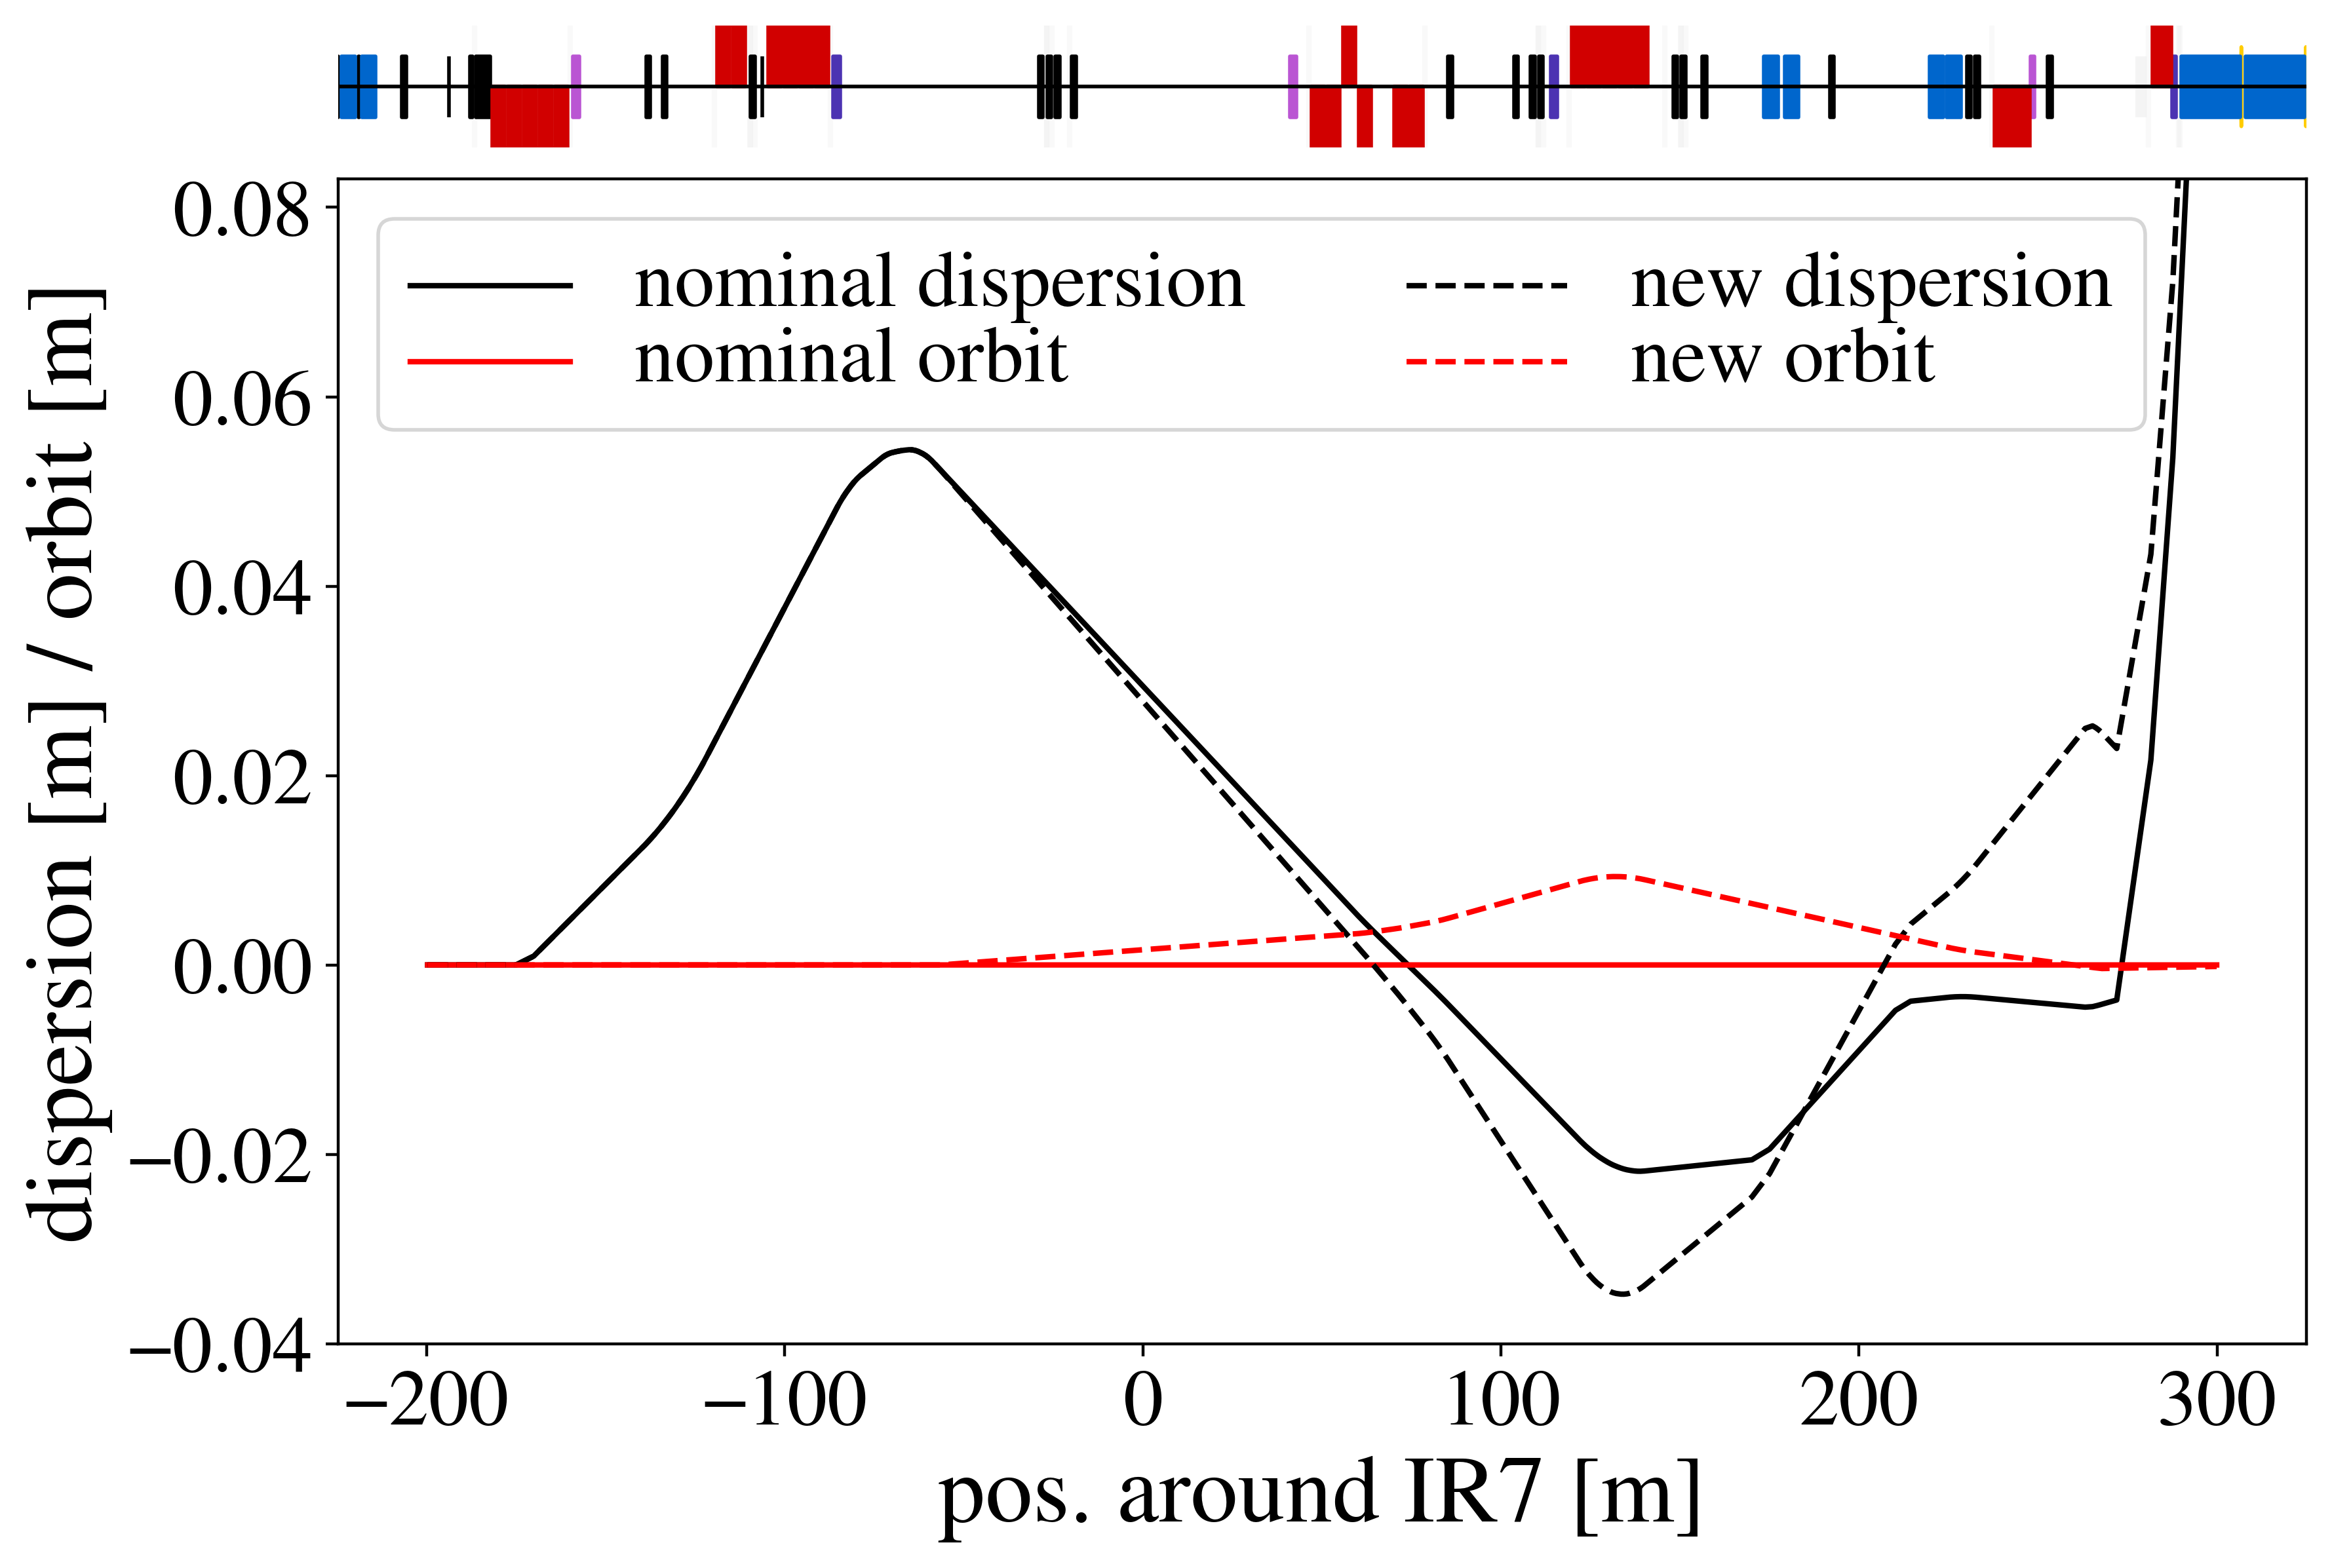
Dispersion
The two large kicks per bump are at locations of small dispersion (0.1-0.2 m), so it should be Ok for the length change of the orbits – Jörg
mcbwh.4l7.b1: 34 % of max
mcbch.7r7.b1: 50 % of max
mcbch.9r7.b1: -3.7 % of max

Slide 6
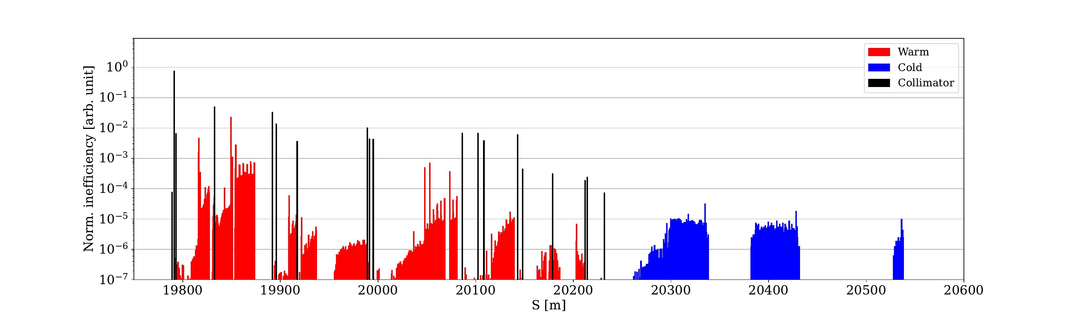
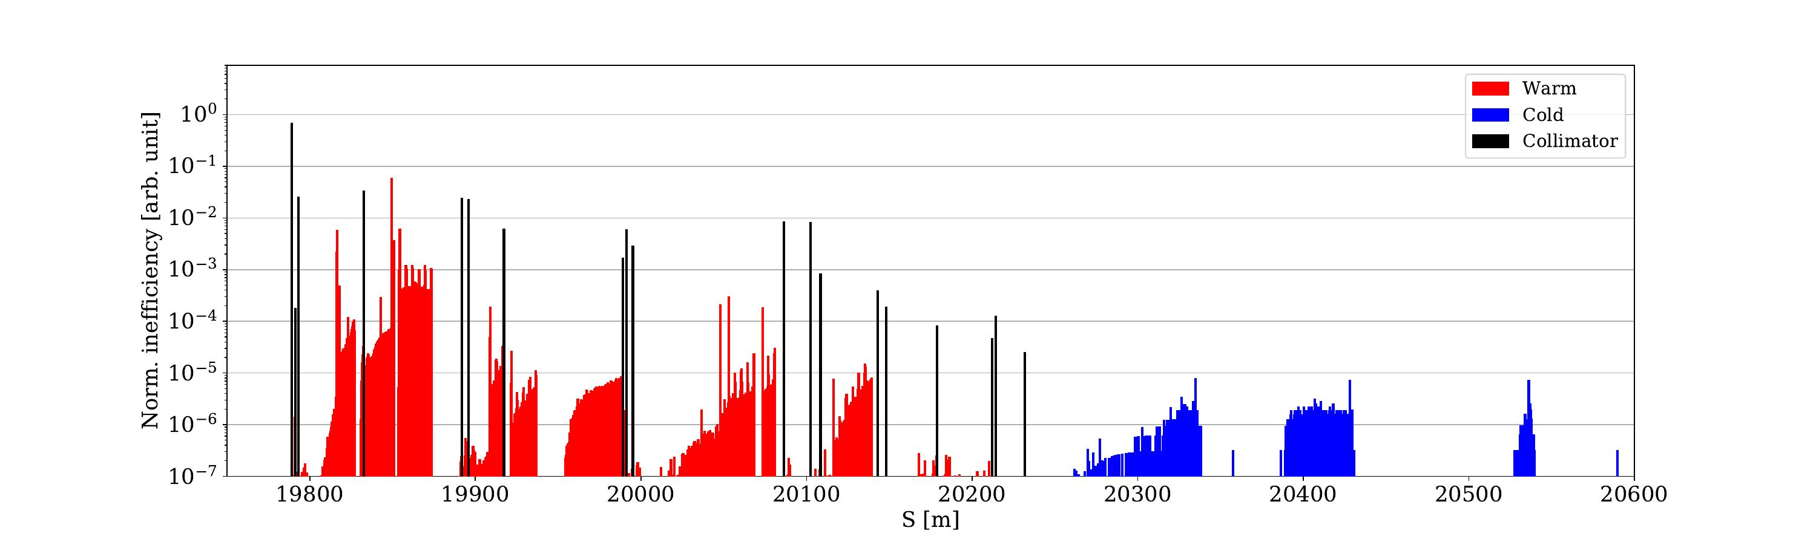
Loss map comparison (runIV – 20 cm, relaxed)
nominal
rematched optics + orbitBump + offset TCLA

Slide 7
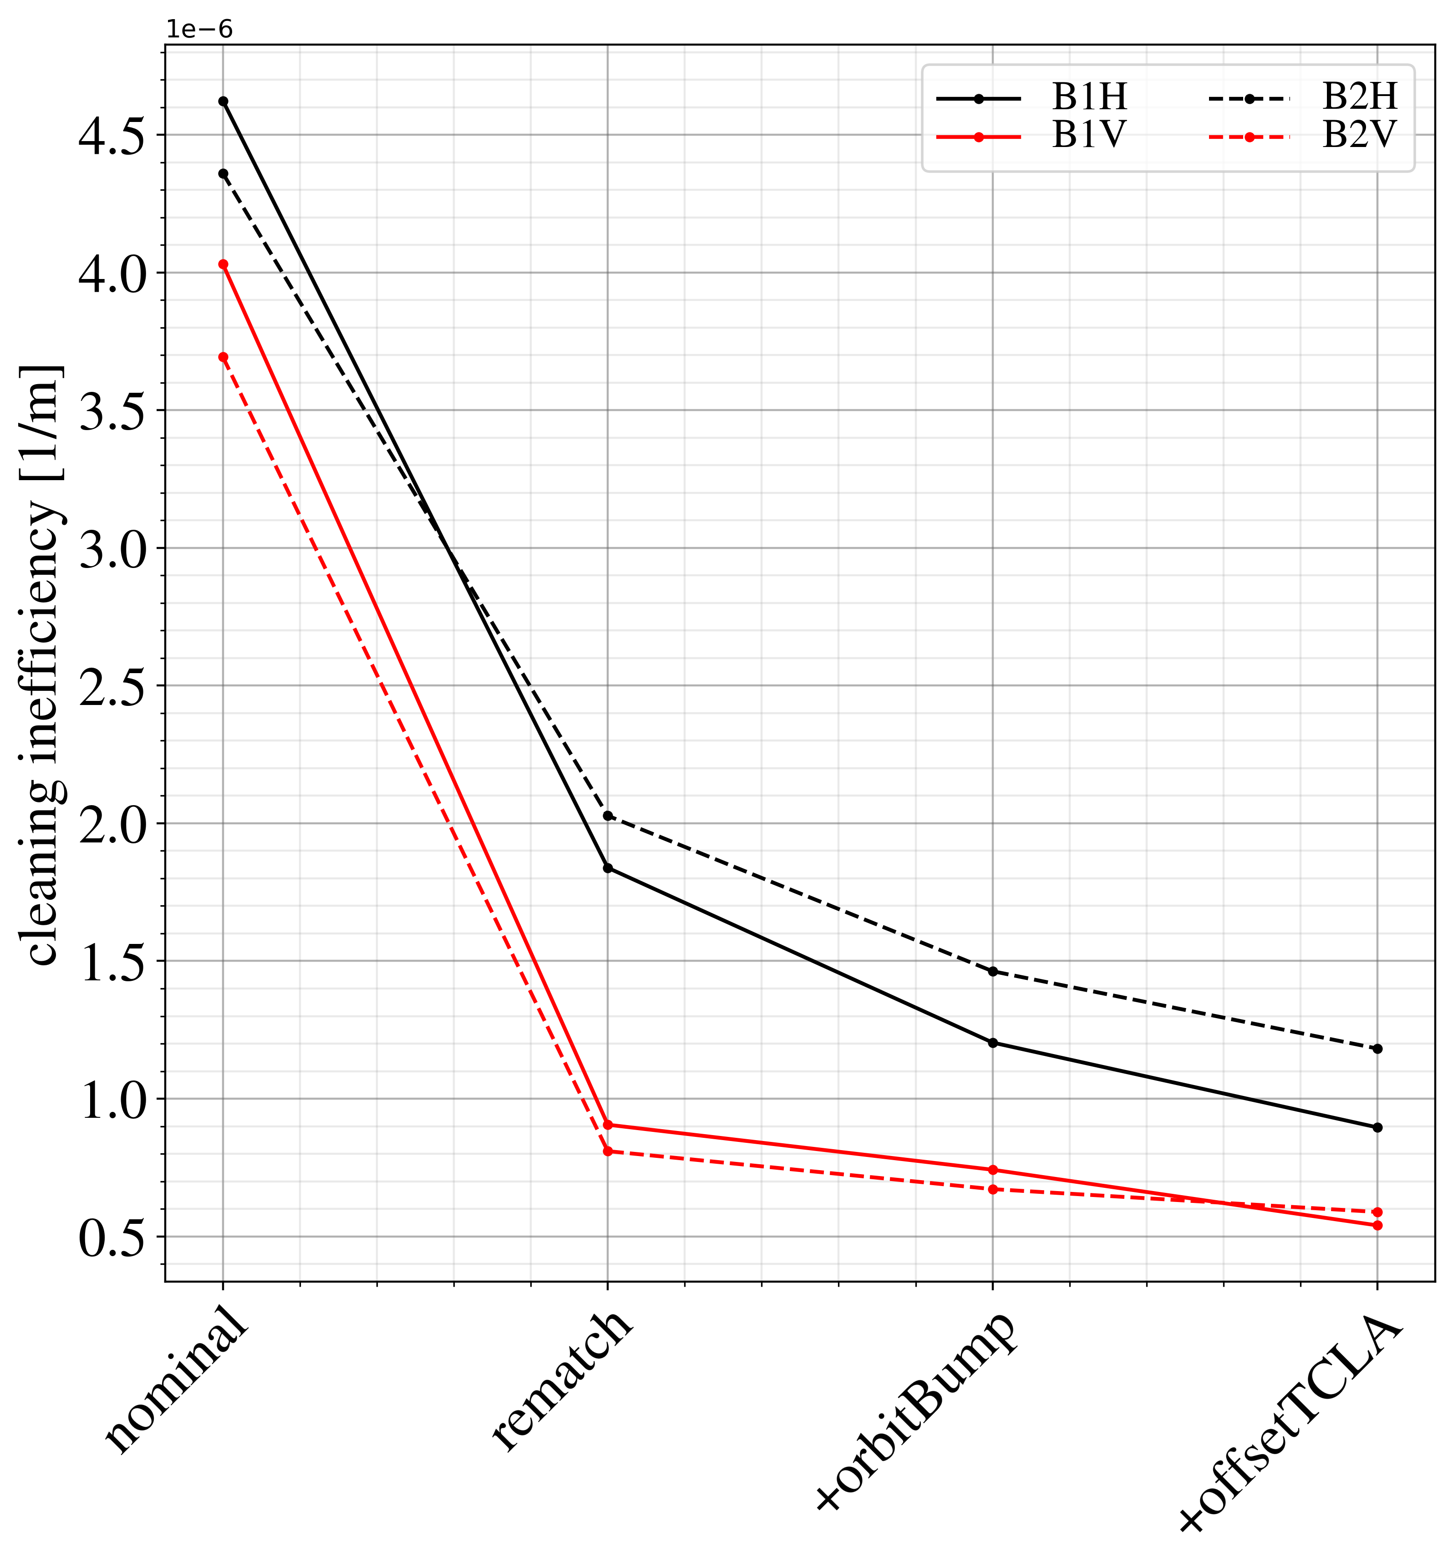
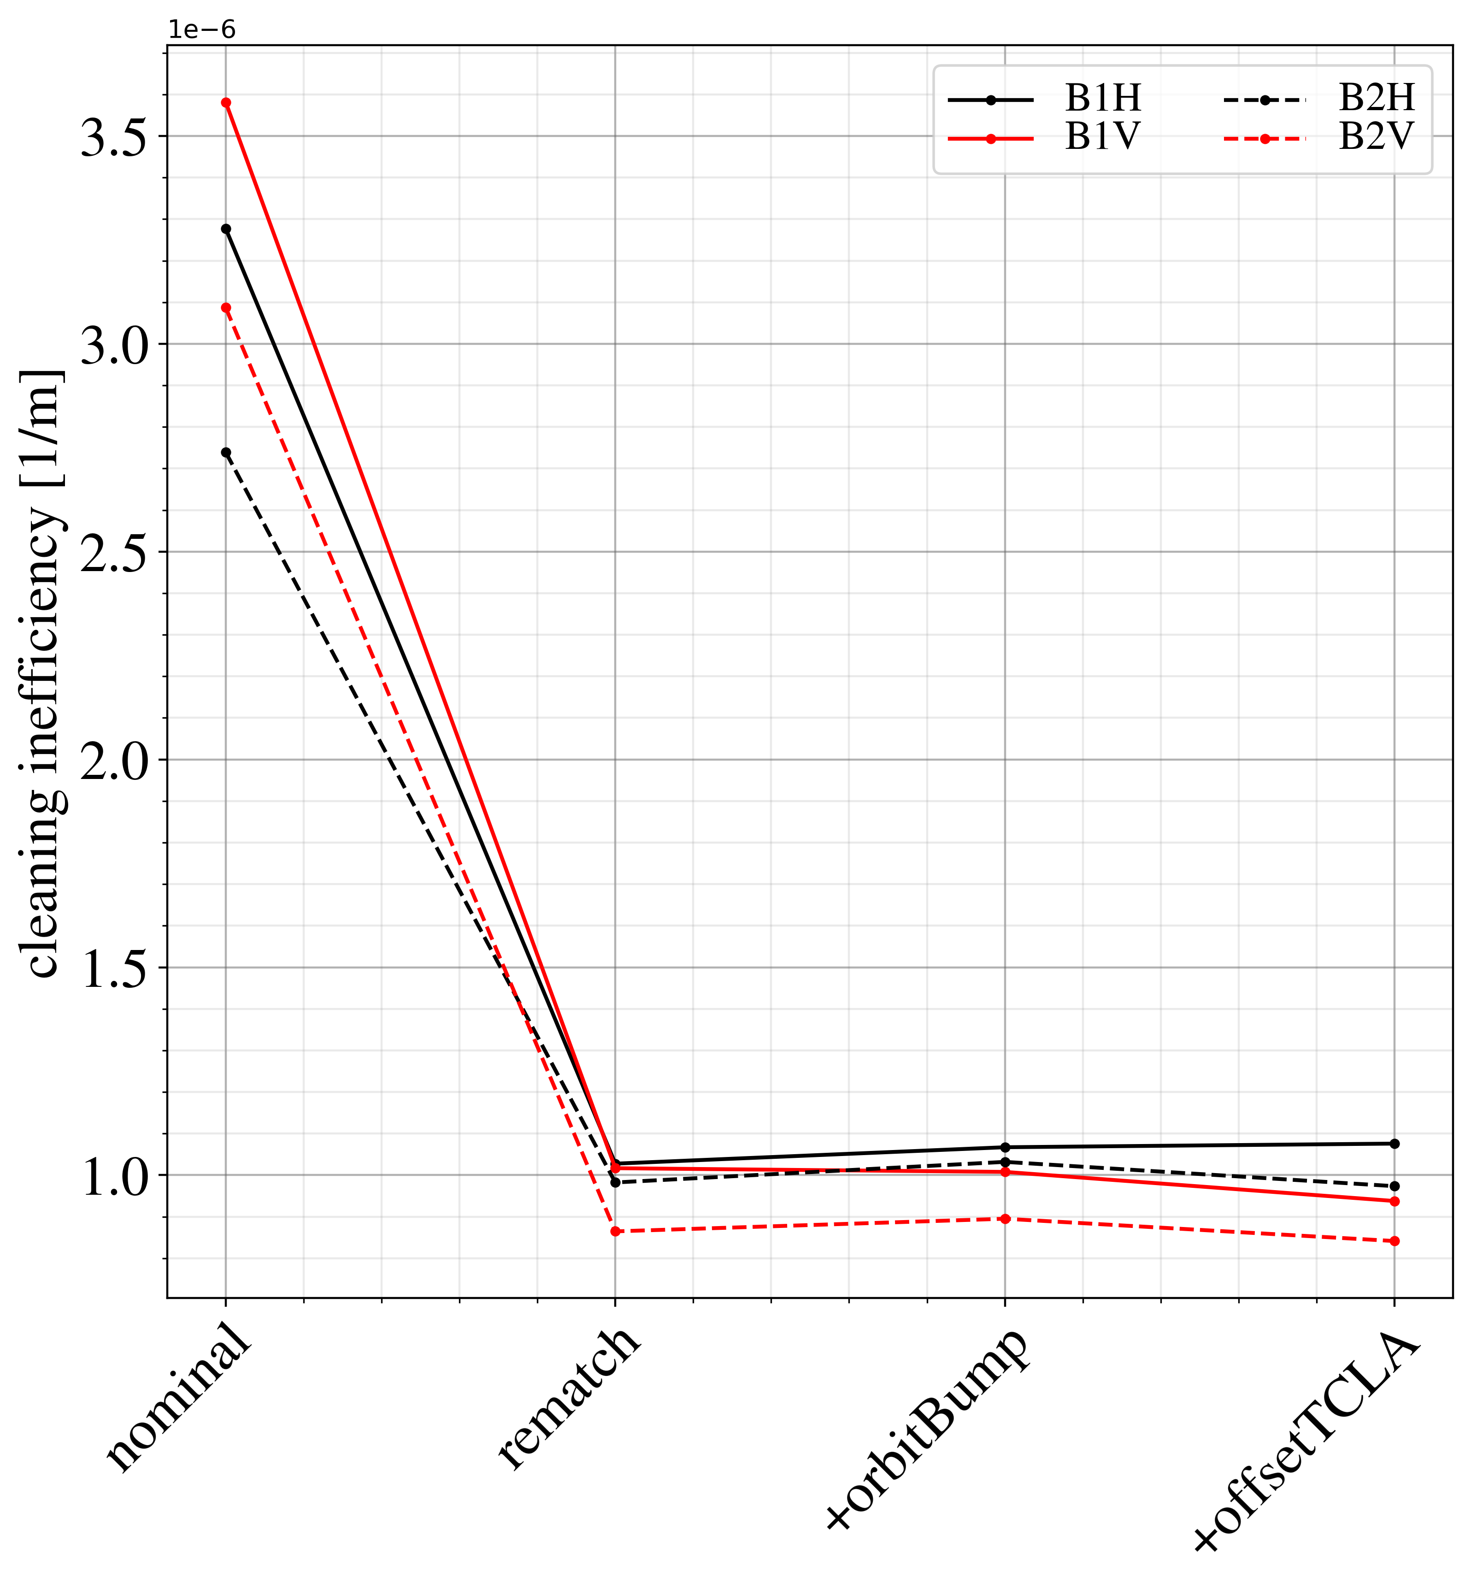
Loss map comparison (runIV)
Significant reduction, up to 80 %, in the three main DS clusters
DS1
DS2

Slide 8
MD plan
Fill 1:
  Set up and correct new IR7 optics at FT
  6 hours
  Only pilots – no impedance measurements possible
Fill 2:
  Detailed measurements of cleaning performance and impedance
  8 hours
  2-3 days after Fill 1
Impedance measurements:
  Use ADT to kick one nominal and one pilot bunch to see tune shift
  Lower octupole current until instability is observed as EOF
Loss maps:
  Horizontal and vertical loss maps
  Use ADT to blow-up a pilot bunch completely
Machine protection:
  Setup beam (< 3e11 protons)
  Mask IR7 collimator limits and BPMs, collimators to be moved to new settings
  Optics will be changed

Slide 9
Machine Protection related concerns
Aperture in IR7:
  Nominal: ~41 σ for both beams
  Rematched optics: 21.2 σ in MQWA.C5L7.B1 / 18.5 σ in MQWA.C5R7.B2
  Rematched optics+orbit bump: 21.2 σ in MQWA.C5L7.B1 / 17.6 σ in MQWA.E4L7.B2
Collimator movement:
  All IR7 collimators need to be moved during optics rematch.
    Move out to expected positions plus margin prior to optics change
    Check alignment and then move collimators to nominal gaps
  TCLA to be offset with a fixed gap. Offset is in the same direction as the orbit perturbation caused by asynch dumps, and remains in the shadow of the TCS.
MQW higher order modes:
  MQWA has large b3 and causes optics changes with the orbit bump, although these are ”insignificant” (see next slide for numbers)

Slide 10
MQWA errors with 9.3 mm bump:
(1) nominal optics (2) rematched (3) rematched + orbit bump
(1)
deltaQ1: +0.0000225
deltaQ2: -0.000019874
deltaDQ1: -0.108400794
deltaDQ2: -0.015907795
betabeatX: 1.0002538
betabeatY: 1.0001194
deltaX: +2.06106818233494e-05
deltaY: +1.50795259224515e-05
(2)
deltaQ1: +0.000024267
deltaQ2: -0.000014737
deltaDQ1: +0.127441728
deltaDQ2: -0.022560443
betabeatX: 1.0004135
betabeatY: 1.0002283
deltaX: +2.8712788989093e-05
deltaY: +2.7672176230855e-05
(3)
deltaQ1: +0.001703098
deltaQ2: -0.00019679
deltaDQ1: +0.227847012
deltaDQ2: -0.043988004
betabeatX: 1.0124906
betabeatY: 1.003714
deltaX: -6.6821e-5
deltaY: +9.81098661950715e-05

Slide 11
First fill (optics setup) – 6 hours
Inject b1/b2, 3 pilots per beam, non-colliding
Normal ramp to 6.8 TeV, xing bump, remain at FT
New IR7 optics:
  Drive collimator to more open settings
  Deploy optics change
  Check consistency of new optics / corrections
  Check collimator alignment using BPMs (or BLMs when no BPMs), adjust if necessary
  Drive collimators to final settings (manually)
  Measure global aperture
Orbit bump:
  Open collimator gaps symmetrically to accomodate for bump
  Apply horizontal 9.3 mm bump
  Measure global aperture (in case of time)
  Loss maps if any beam remains

Slide 12
Second fill (measurements) – 8 hours
Inject b1/b2, 1 nominal + 20 pilots, non-colliding
Nominal ramp to 6.8 TeV and remain at FT
Measure tune-shift using ADT
New IR7 optics:
  Same procedure as fill 1
  Measure tune shift
  H/V loss maps, two per plane per beam
Asymmetric TCLAs:
  Move final two TCLAs in b1/b2 +3 sigma
  H/V loss maps, two per plane per beam
Orbit bump:
  Same procedure as fill 1
  H/V loss maps, two per plane per beam
Single-sided jaws:
  Retract one jaw completely of old IR7 collimators
  Measure tune shift
  H/V loss maps
  Decrease octupole current until instability occurs

Slide 13
Thanks for listening and to everyone involved!
R. Bruce, X. Buffat, R. de Maria, S. Fartoukh,
L. Giacomel, B. Lindström, D. Mirarchi, N. Mounet,
S. Redaelli, M. Solfaroli, R. Tomás, J. Wenninger

Slide 14
First fill (optics setup) – 6 hours
B1/B2 1 to 3 pilots
nominal ramp to FT
(0): loss maps
Drive collimators to open settings compatible with new optics + margin
Change to new IR7 optics
Check and correct optics
Check collimator alignment using BPMs (use BLMs when BPMs are not available), drive to nominal sigma gaps in new optics
(1): loss maps
(1): aperture measurement
Drive collimators to open settings compatible with orbit bump, with margin
Apply horizontal orbit bump of 9.3 mm
(2): aperture measurement (in case of time)
(2): loss maps if beam remains

Slide 15
Second fill (measurements) – 8 hours
B1/B2 20 pilots + 1 nominal (<3e11 protons total)
nominal ramp to FT
(0): impedance measurement + loss maps
Drive collimators to settings found in Fill 1
Change to new IR7 optics
Check consistency of new optics
(1): impedance measurements + loss maps
Move last two TCLAs B1/B2 by three sigma – constant gap
(2): loss maps
Open secondary collimators to accomodate for orbit bump
Apply orbit bump, 9.3 mm, and drive collimators to nominal settings (with the bump)
(3): loss maps
Retract one jaw for TCP.B and old TCSG collimators
(4): impedance measurements + loss maps
Decrease octupole current until instability occurs

Slide 16
MD7203 – plan to test mitigation strategies already in RunIII
Relative loss reduction in first DS cluster (avg) compared to reference scenario
scenario | B1H | B1V | B2H | B2V | impedance | tune shift
(0): reference | 1 | 1 | 1 | 1 | 1 | ref
(1): optics rematch | 0.56 | 0.48 | 0.70 | 0.44 | 0.9 | 1.2e-4*
(2): orbit bump + (1) | 0.35 | 0.39 | 0.47 | 0.41 | -- | --
(3): offset TCLA + (2) | 0.23 | 0.31 | 0.32 | 0.32 | -- | --
(4): single-sided jaws + (1) | 0.84 | 0.56 |  |  | 0.8 | 2.4e-4*
(3) is for maximizing cleaning performance
(4) is for maximizing impedance gain
* tune shift in x, in y it is about half

Slide 17
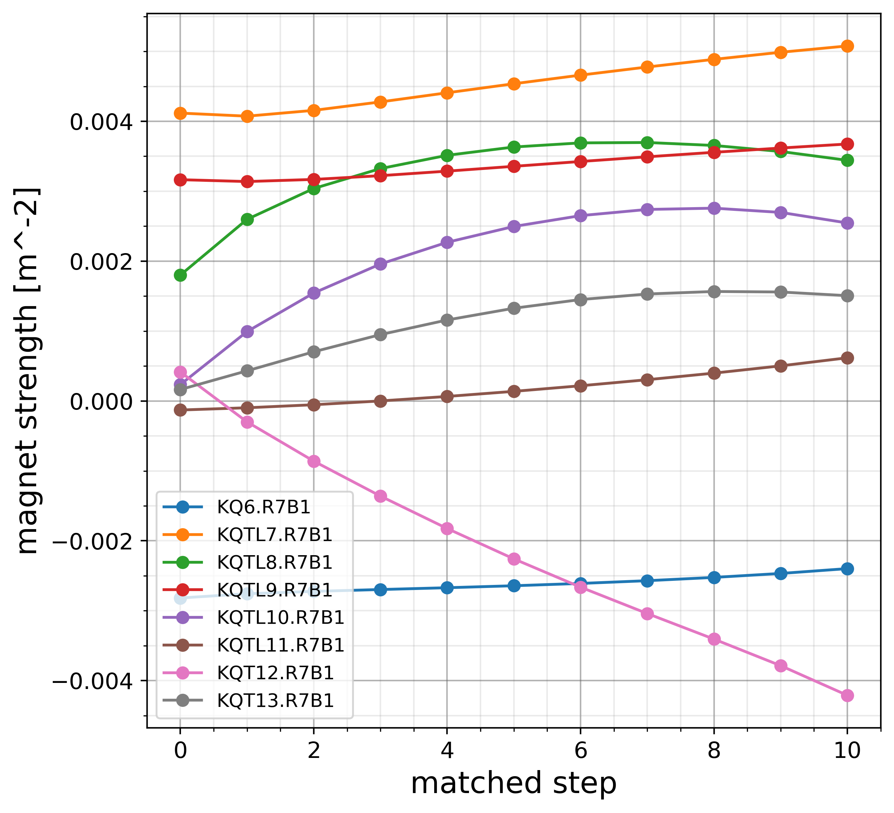
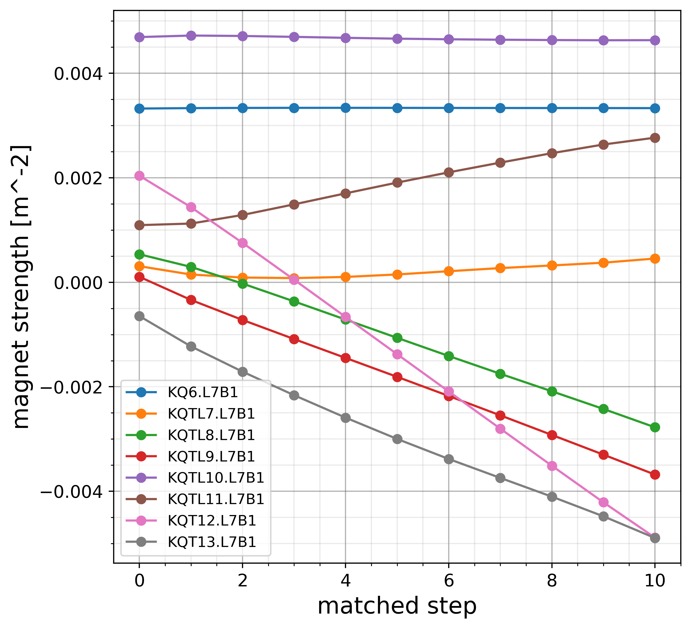
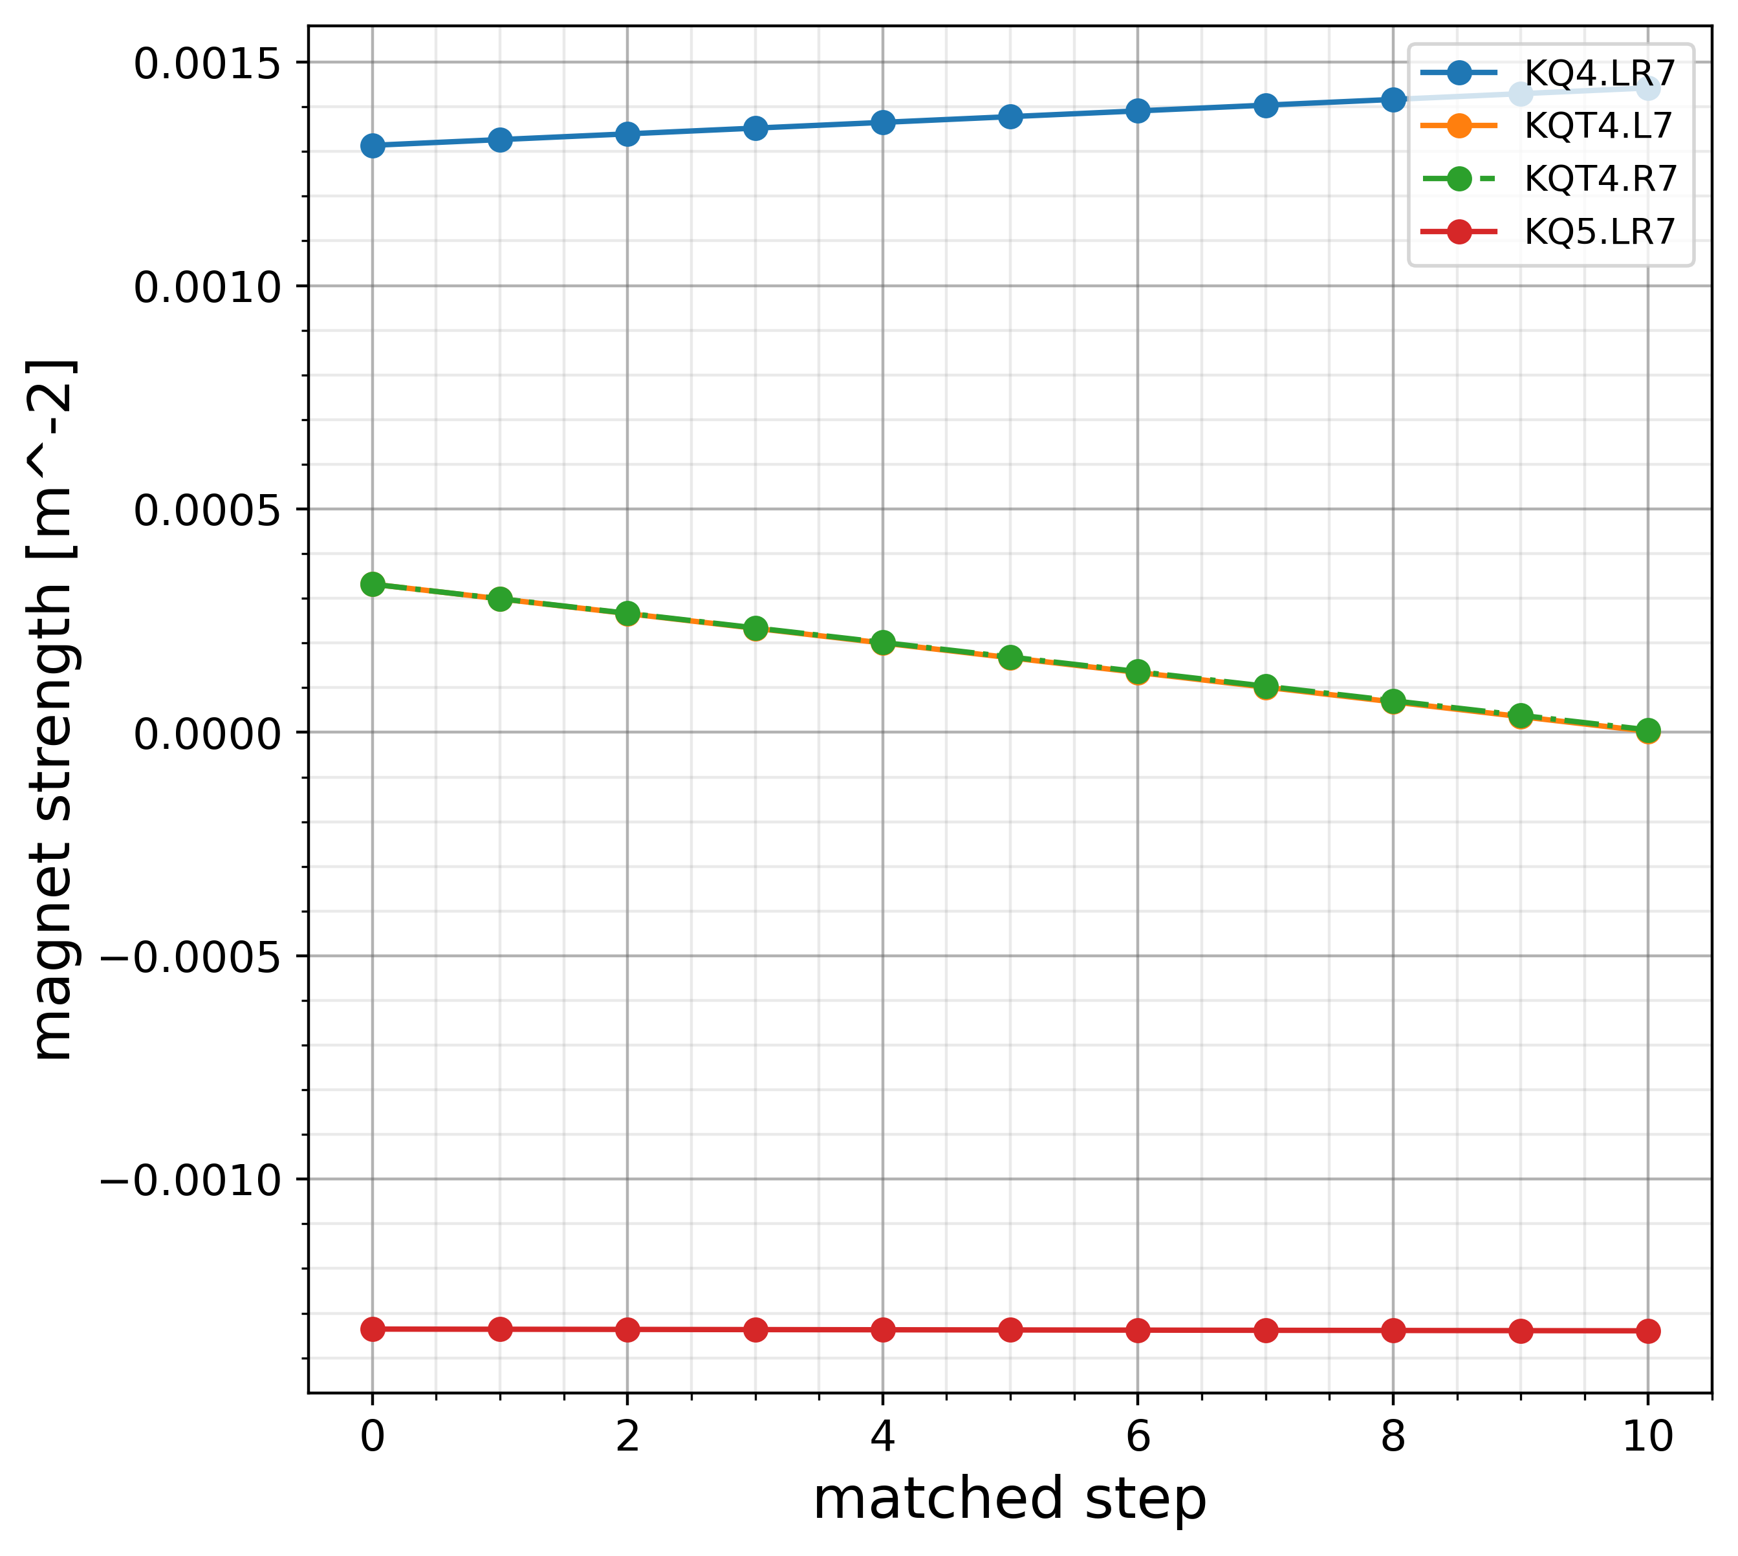
Optics transition

Slide 18
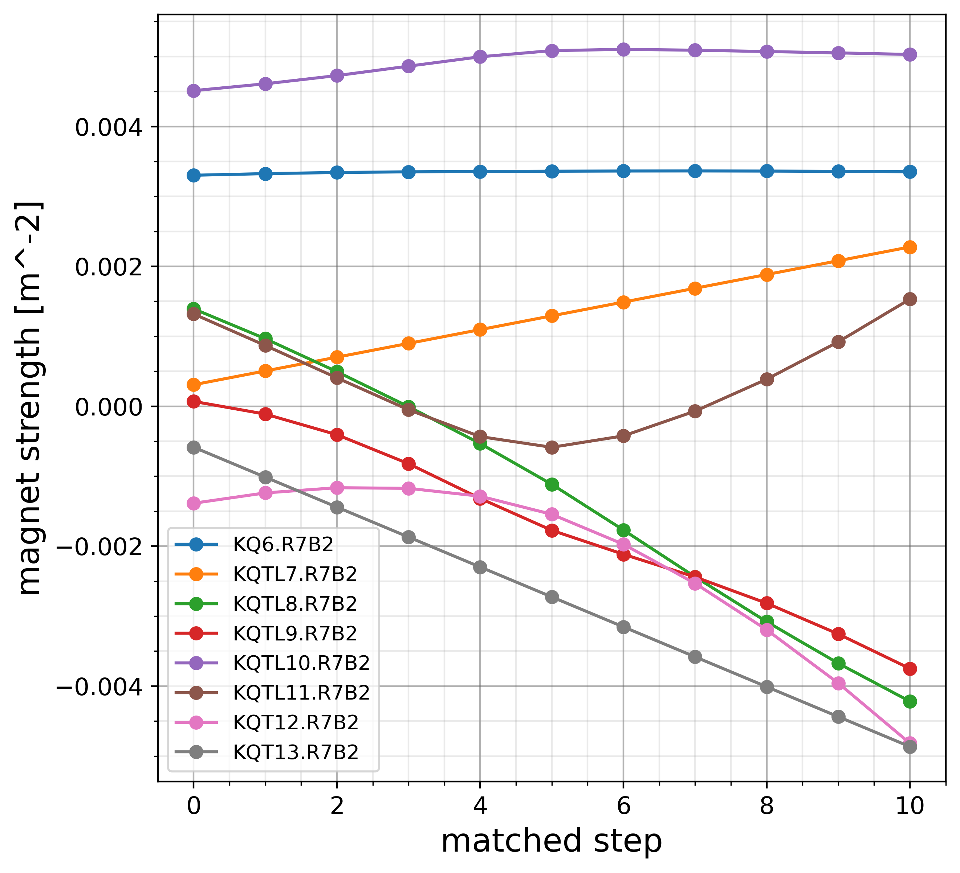
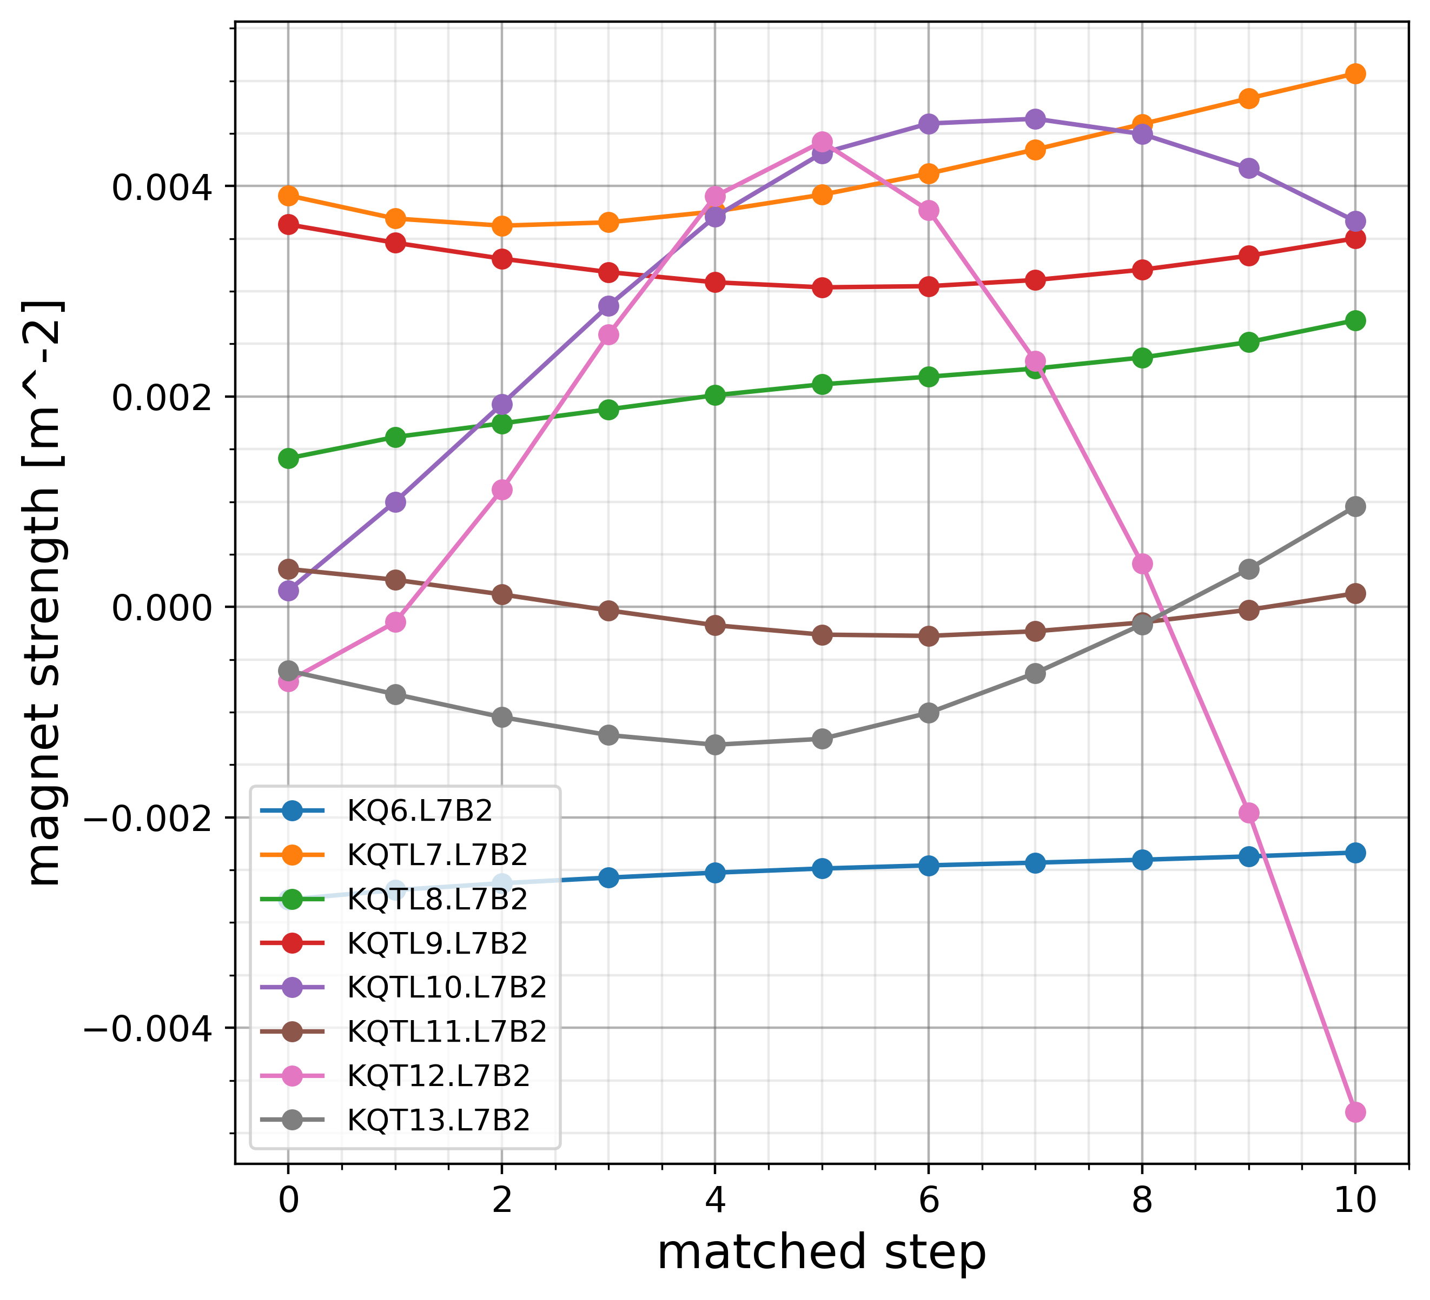
Optics transition

Slide 19
MQ currents
Magnet | Limit | Optics 1 | Optics 2
KQT13.R7B1 | 550 | 152 | 23
KQT12.R7B1 | 550 | -426 | -479
KQTL11.R7B1 | 550 | 60 | 56
KQTL10.R7B1 | 550 | 245 | 253
KQTL9.R7B1 | 500 | 354 | 369
KQTL8.R7B1 | 550 | 332 | 331
KQTL7.R7B1 | 550 | 489 | 497
KQ6.R7B1 | 400 | -218 | -230
KQ6.L7B1 | 400 | 304 | 303
KQTL7.L7B1 | 550 | 44 | -13
KQTL8.L7B1 | 200 | -267 | 191
KQTL9.L7B1 | 300 | -355 | -287
KQTL10.L7B1 | 500 | 446 | 477
KQTL11.L7B1 | 300 | 266 | 286
KQT12.L7B1 | 550 | -494 | -530
KQT13.L7B1 | 550 | -495 | -528
Magnet | Limit | Optics 1
KQT13.R7B2 | 550 | -492
KQT12.R7B2 | 550 | -488
KQTL11.R7B2 | 550 | 148
KQTL10.R7B2 | 550 | 485
KQTL9.R7B2 | 500 | -361
KQTL8.R7B2 | 500 | -407
KQTL7.R7B2 | 550 | 219
KQ6.R7B2 | 400 | 306
KQ6.L7B2 | 400 | -213
KQTL7.L7B2 | 550 | 489
KQTL8.L7B2 | 300 | 263
KQTL9.L7B2 | 380 | 338
KQTL10.L7B2 | 500 | 353
KQTL11.L7B2 | 300 | 12
KQT12.L7B2 | 550 | -486
KQT13.L7B2 | 550 | 97
Magnet | Limit | Optics 1
KQ4.LR7 | 710 | 706
KQT4.L7 | 600 | 1
KQT4.R7 | 600 | 3
KQ5.LR7 | 710 | -656

Slide 20
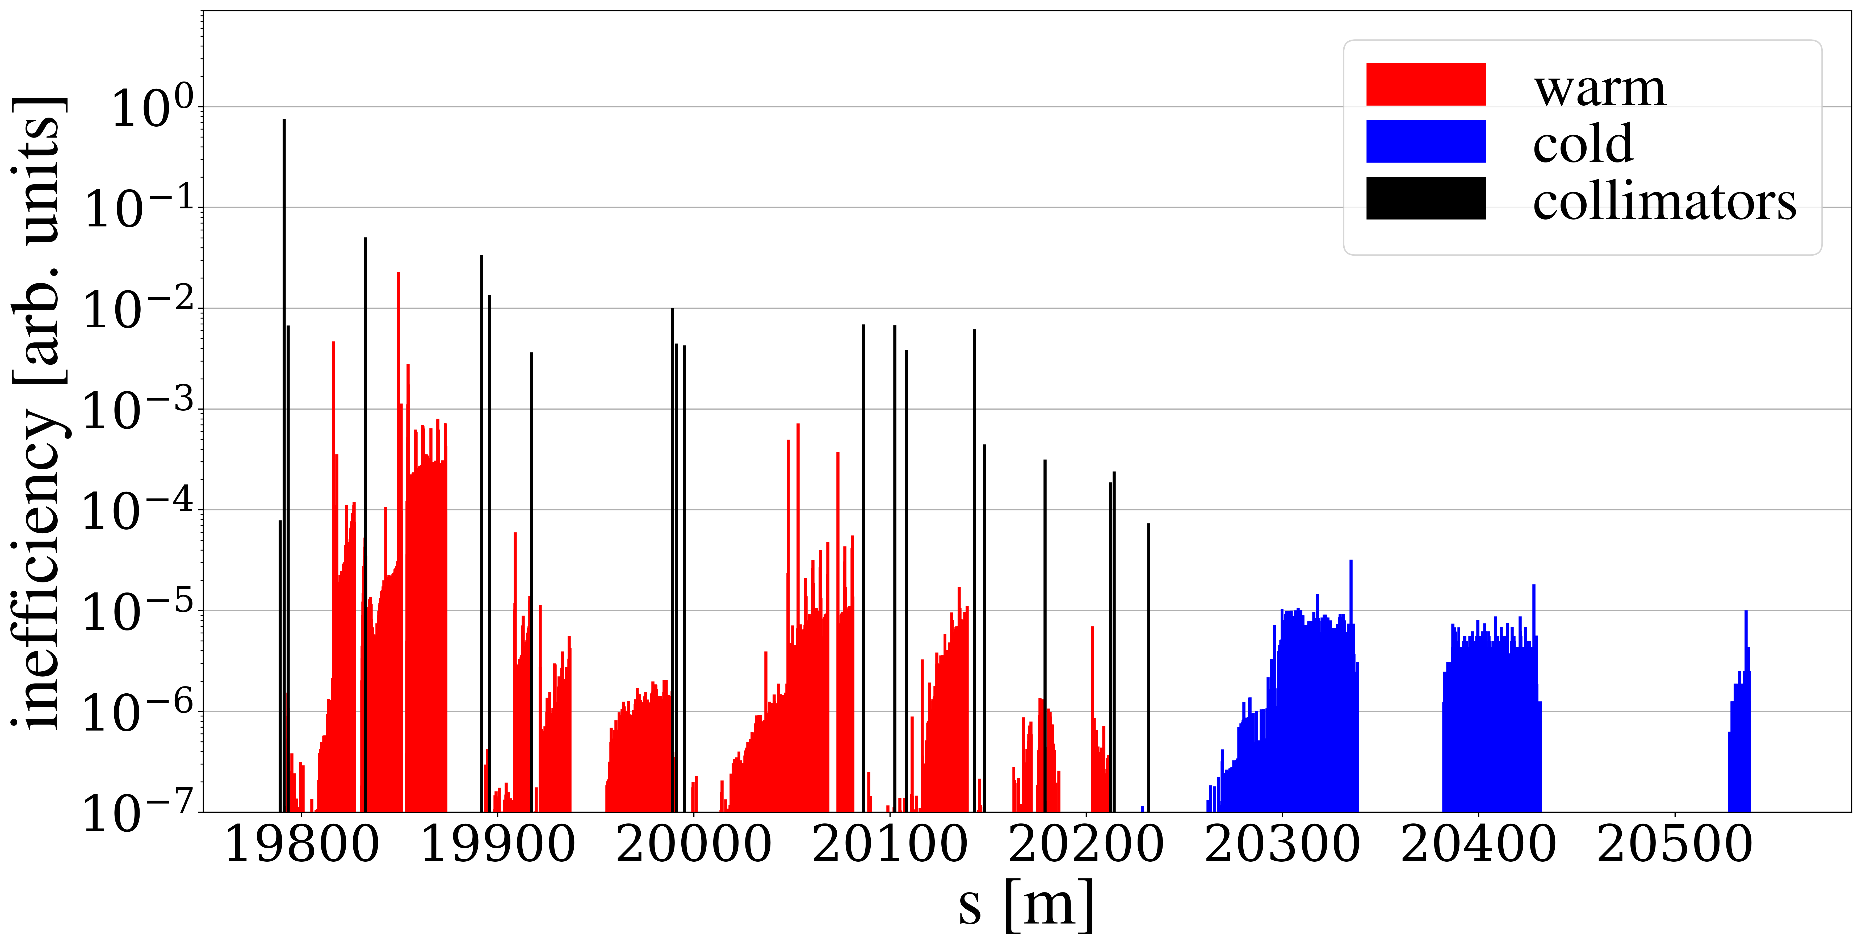
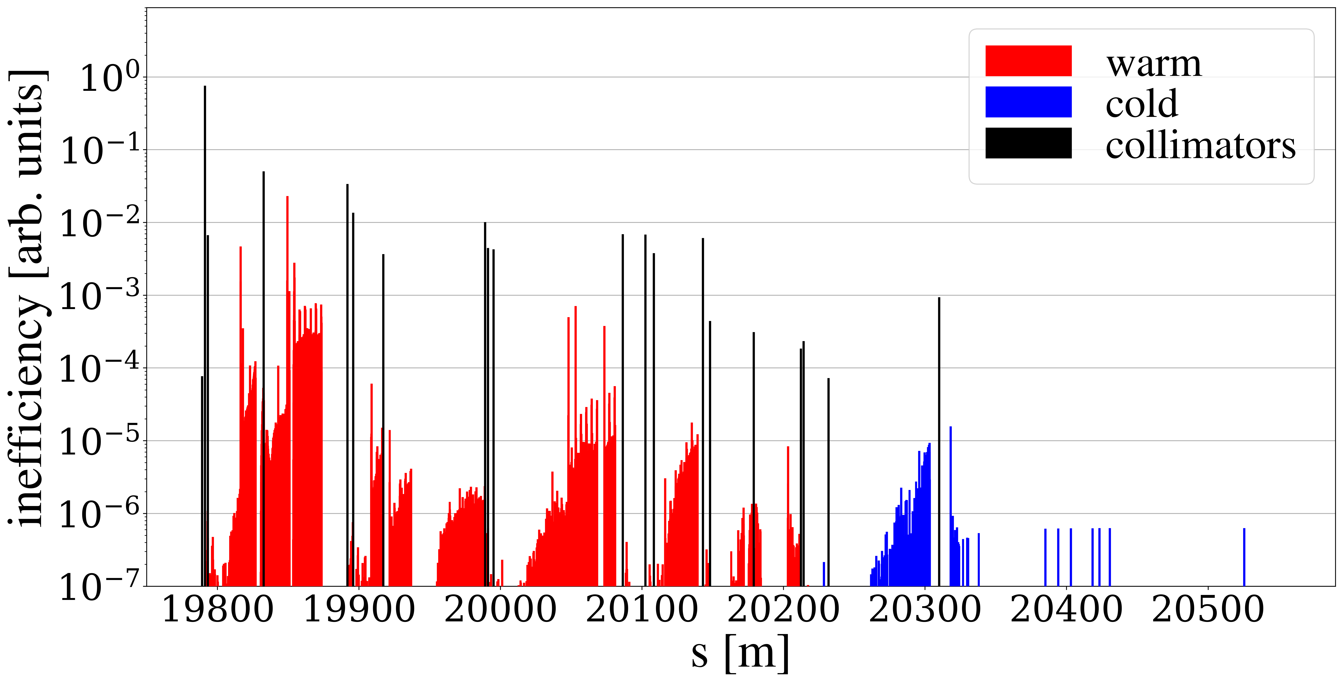
TCLD in IR7 dispersion suppressor
TCP
Planned for RunIII to mitigate quench risk in DS
Replace one main dipole with two short 11T dipoles
Production of 11T dipoles delayed – availability for HL-LHC is uncertain
For ions, DS losses will be mitigated using crystal collimators
Quench tests needed to conclusively determine necessity of TCLD or other mitigations, for proton operation
TCLD

Slide 21
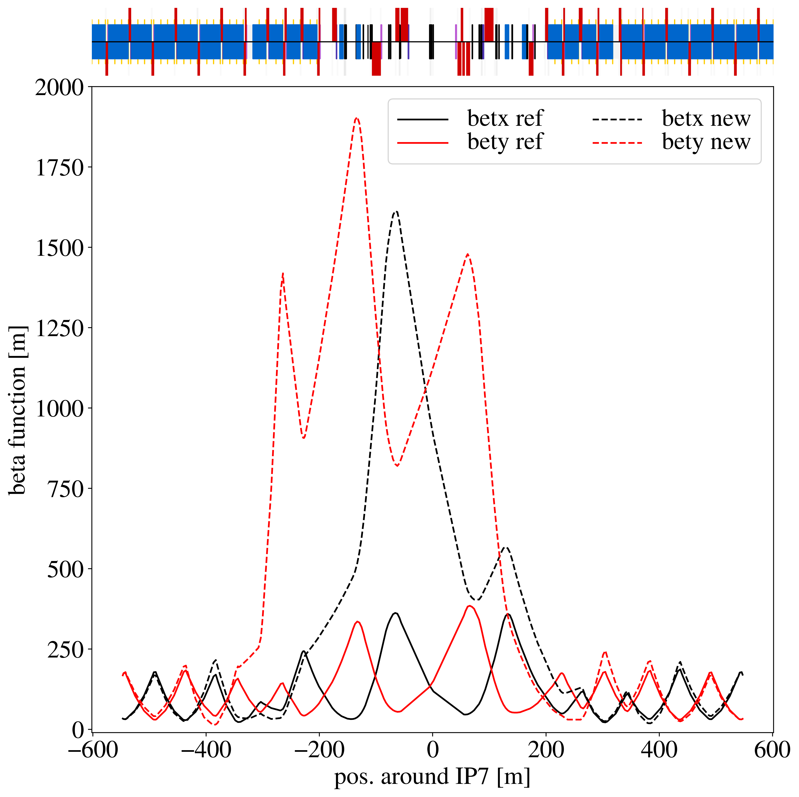
Outlook – towards better optics
Skip the phase advance restriction (S. Fartoukh, R. de Maria)
Impedance goals:
  Large beta functions at all collimators
Cleaning performance goals:
  Optimized phase advances between collimators
  Large TCP (and possibly TCS) beta functions
  Large single pass dispersion from TCP to TCS / TCLA
  Small beta functions at TCLA (and possibly TCS)
One possibility focused on impedance – up to 70 % improvement in IR7 collimators according to scaling formula

Slide 22
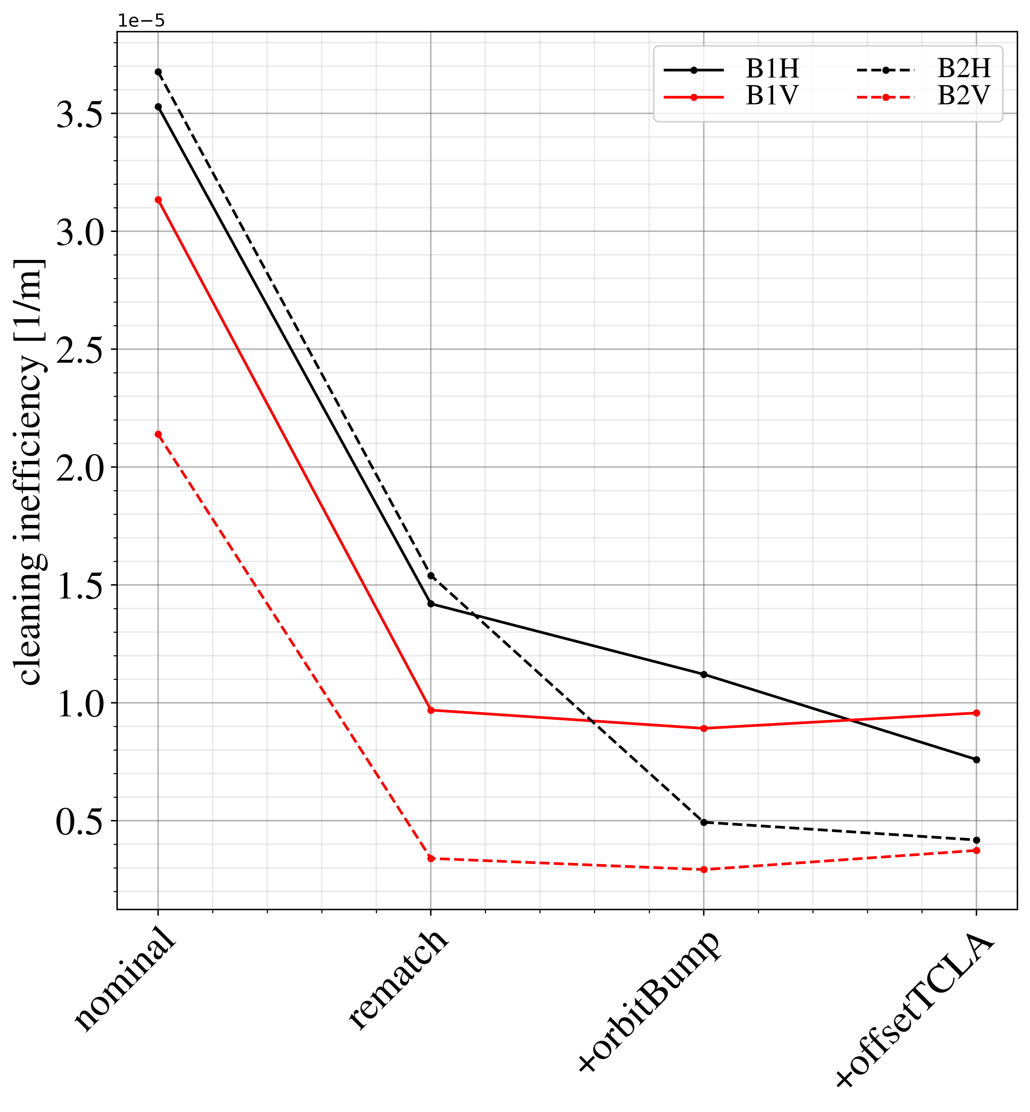
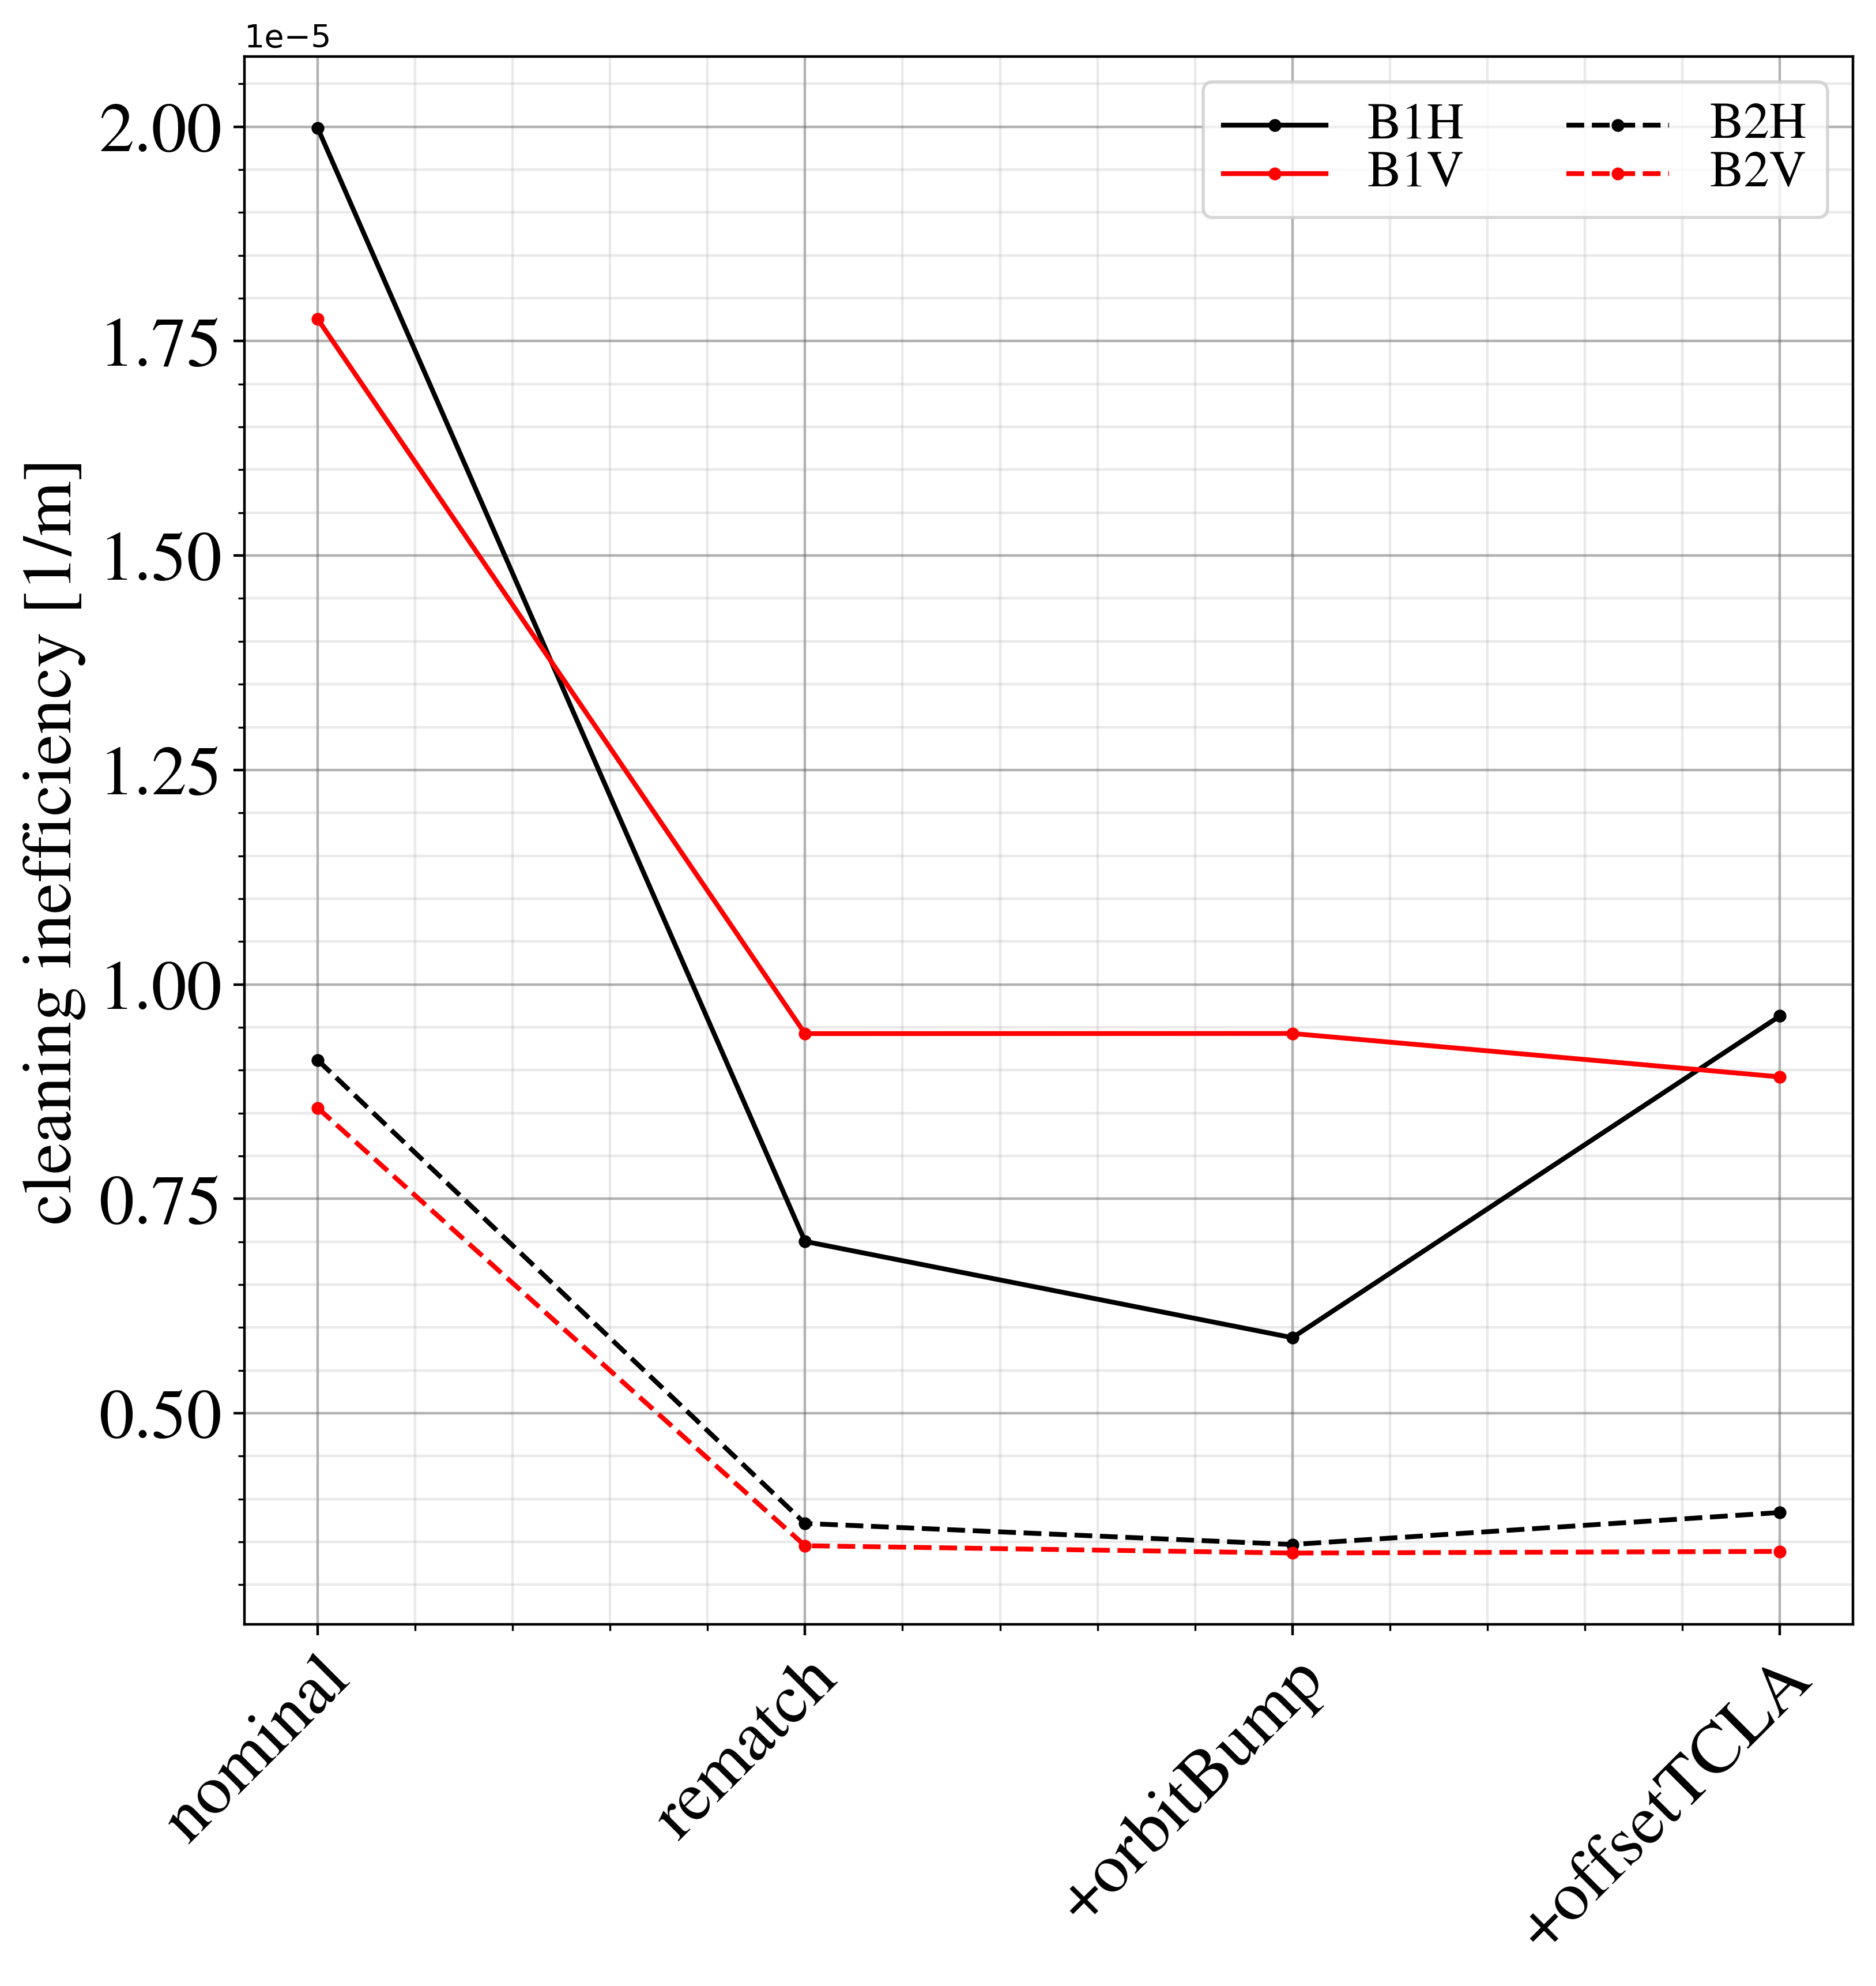
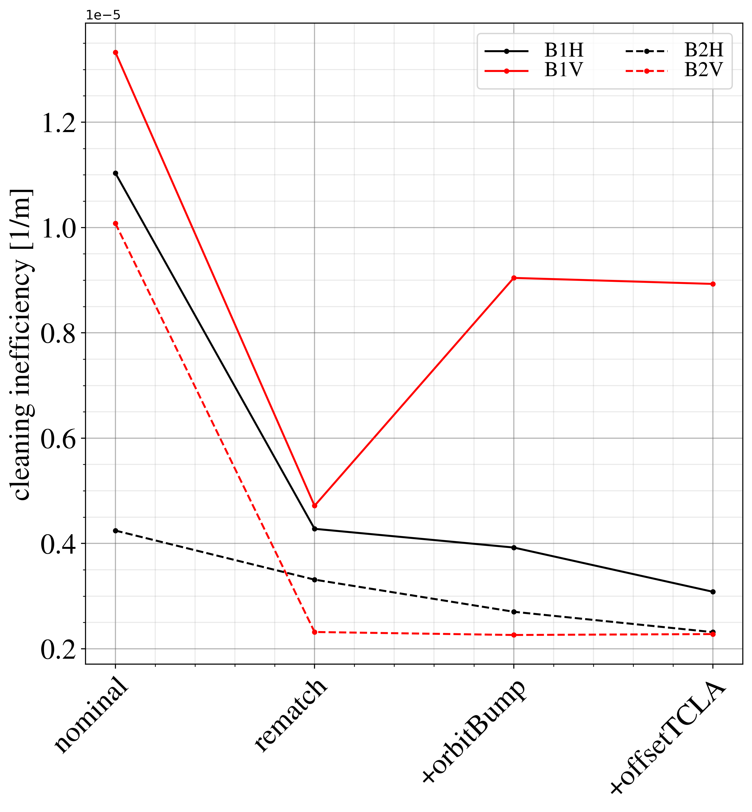
Peak losses in DS clusters
DS1
DS2
DS3

Slide 23
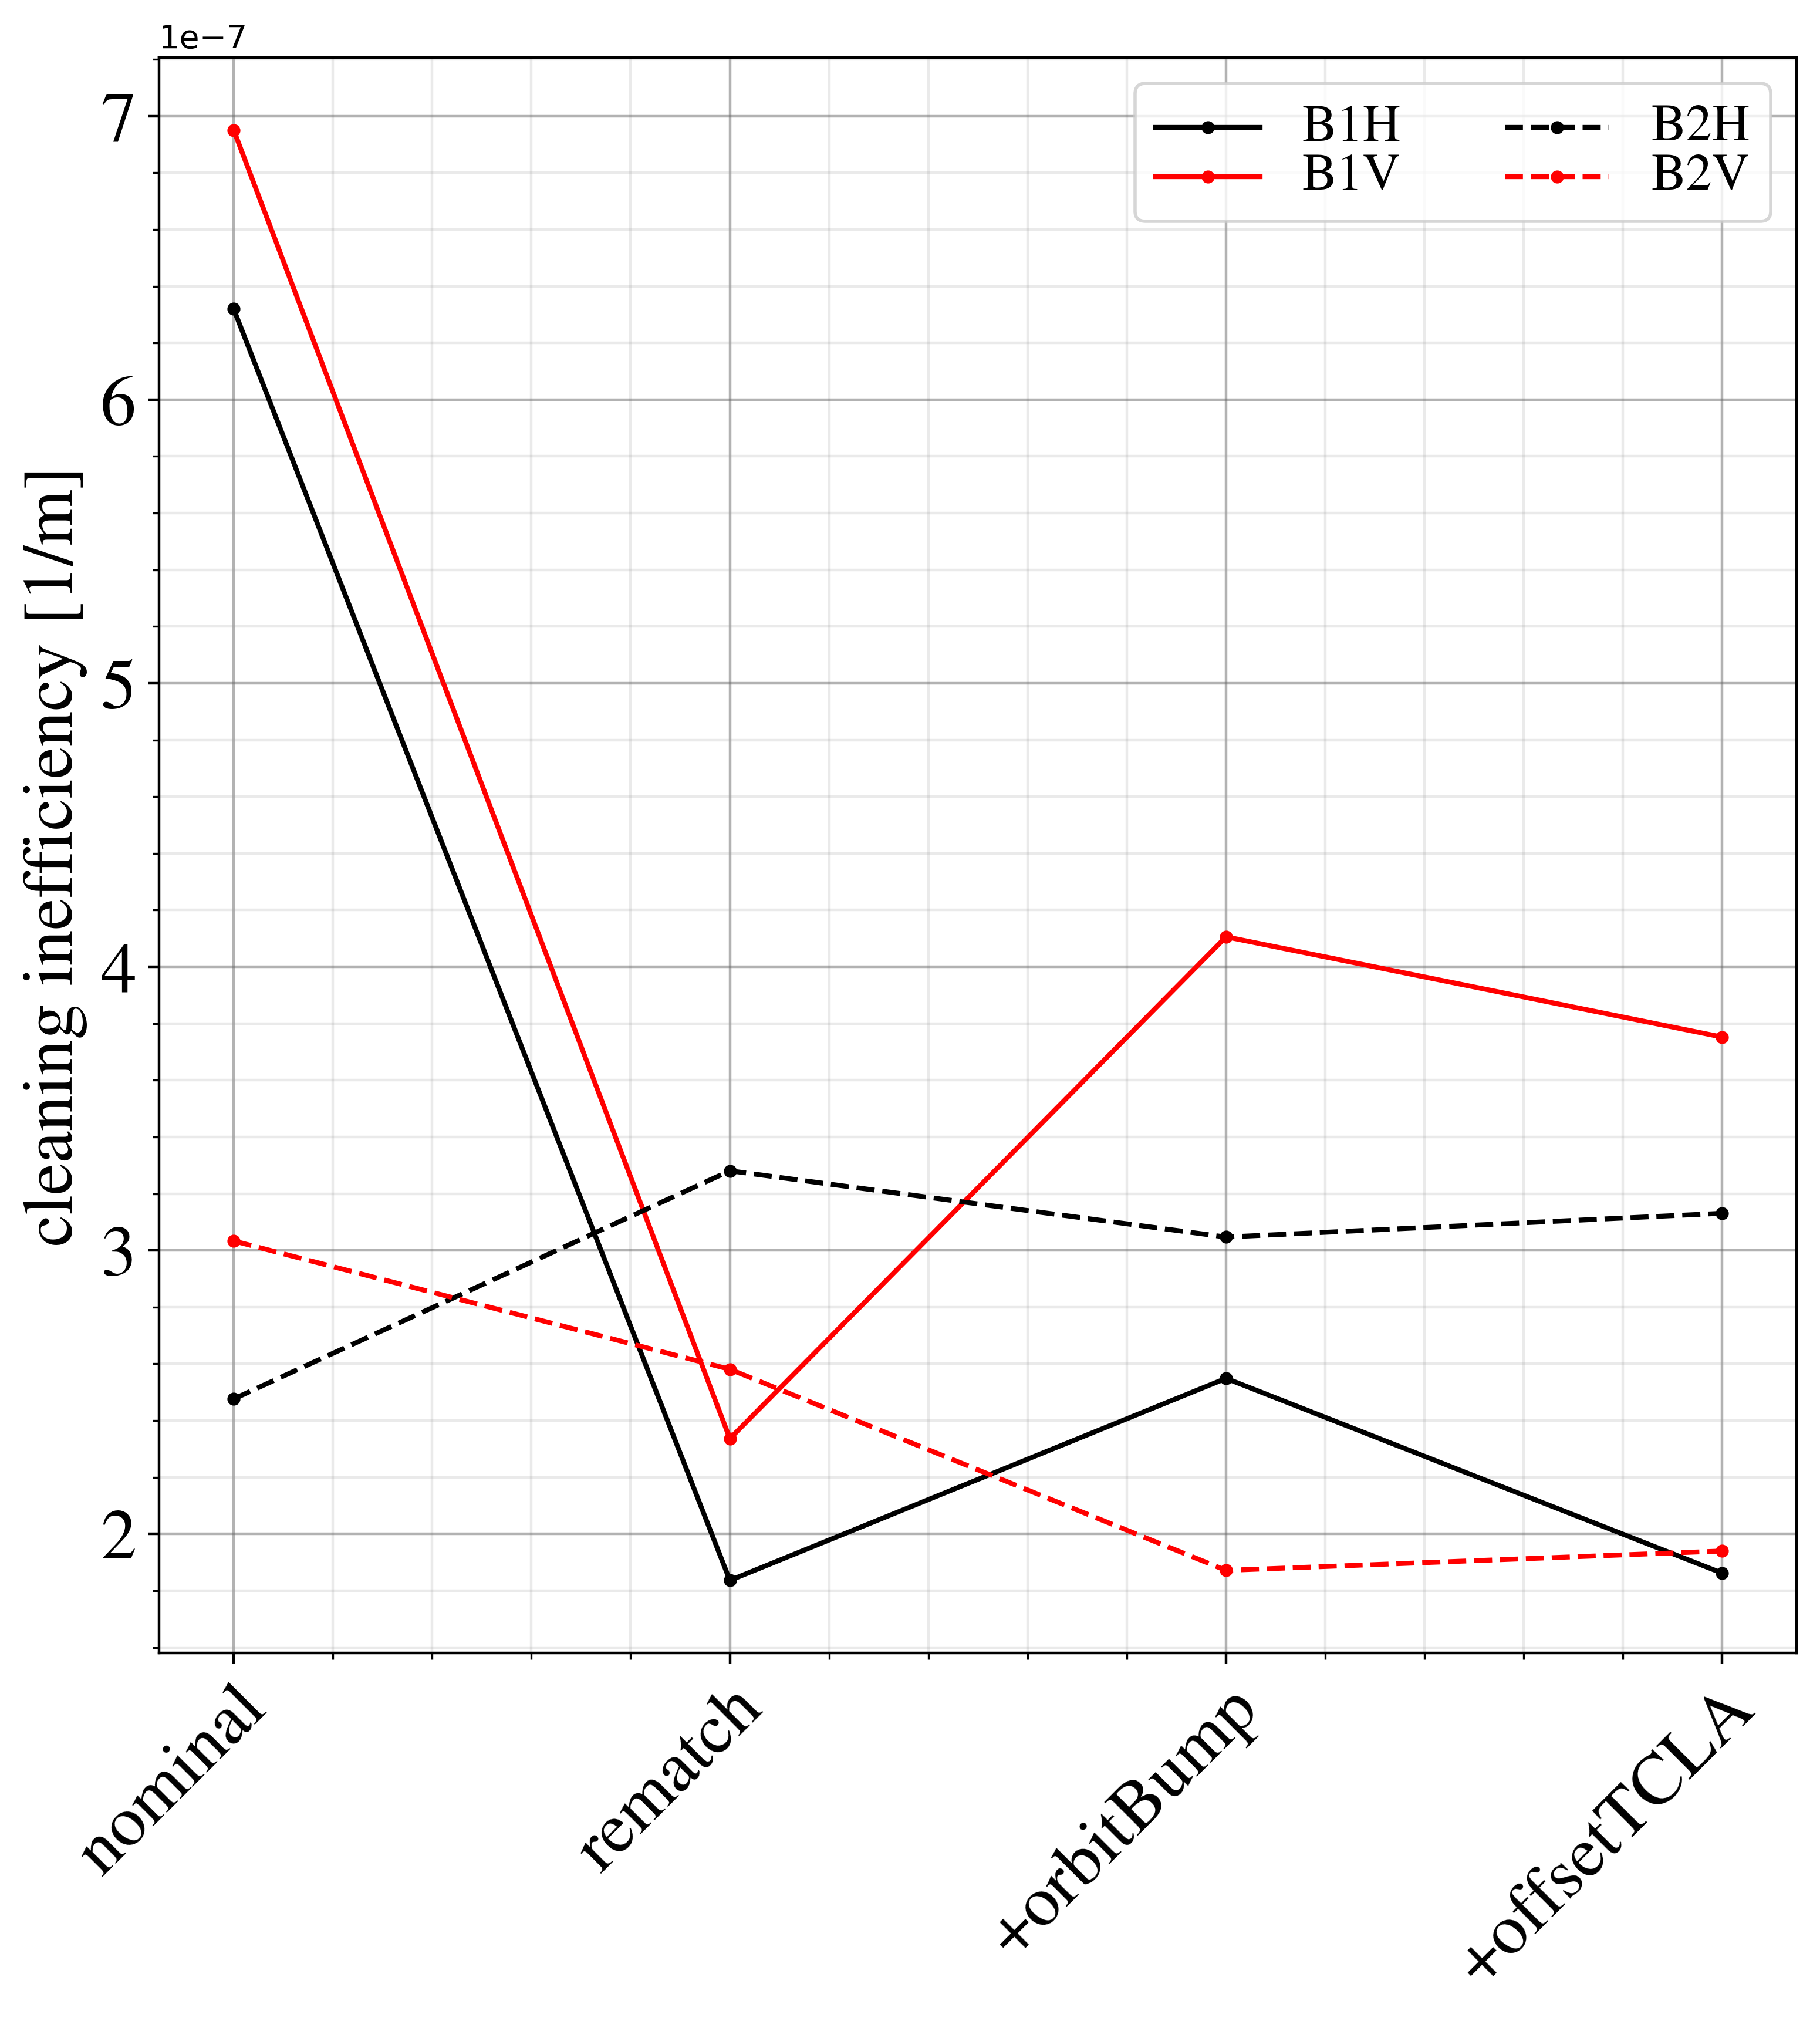
Average losses in DS clusters
DS1
DS2
DS3

Slide 24
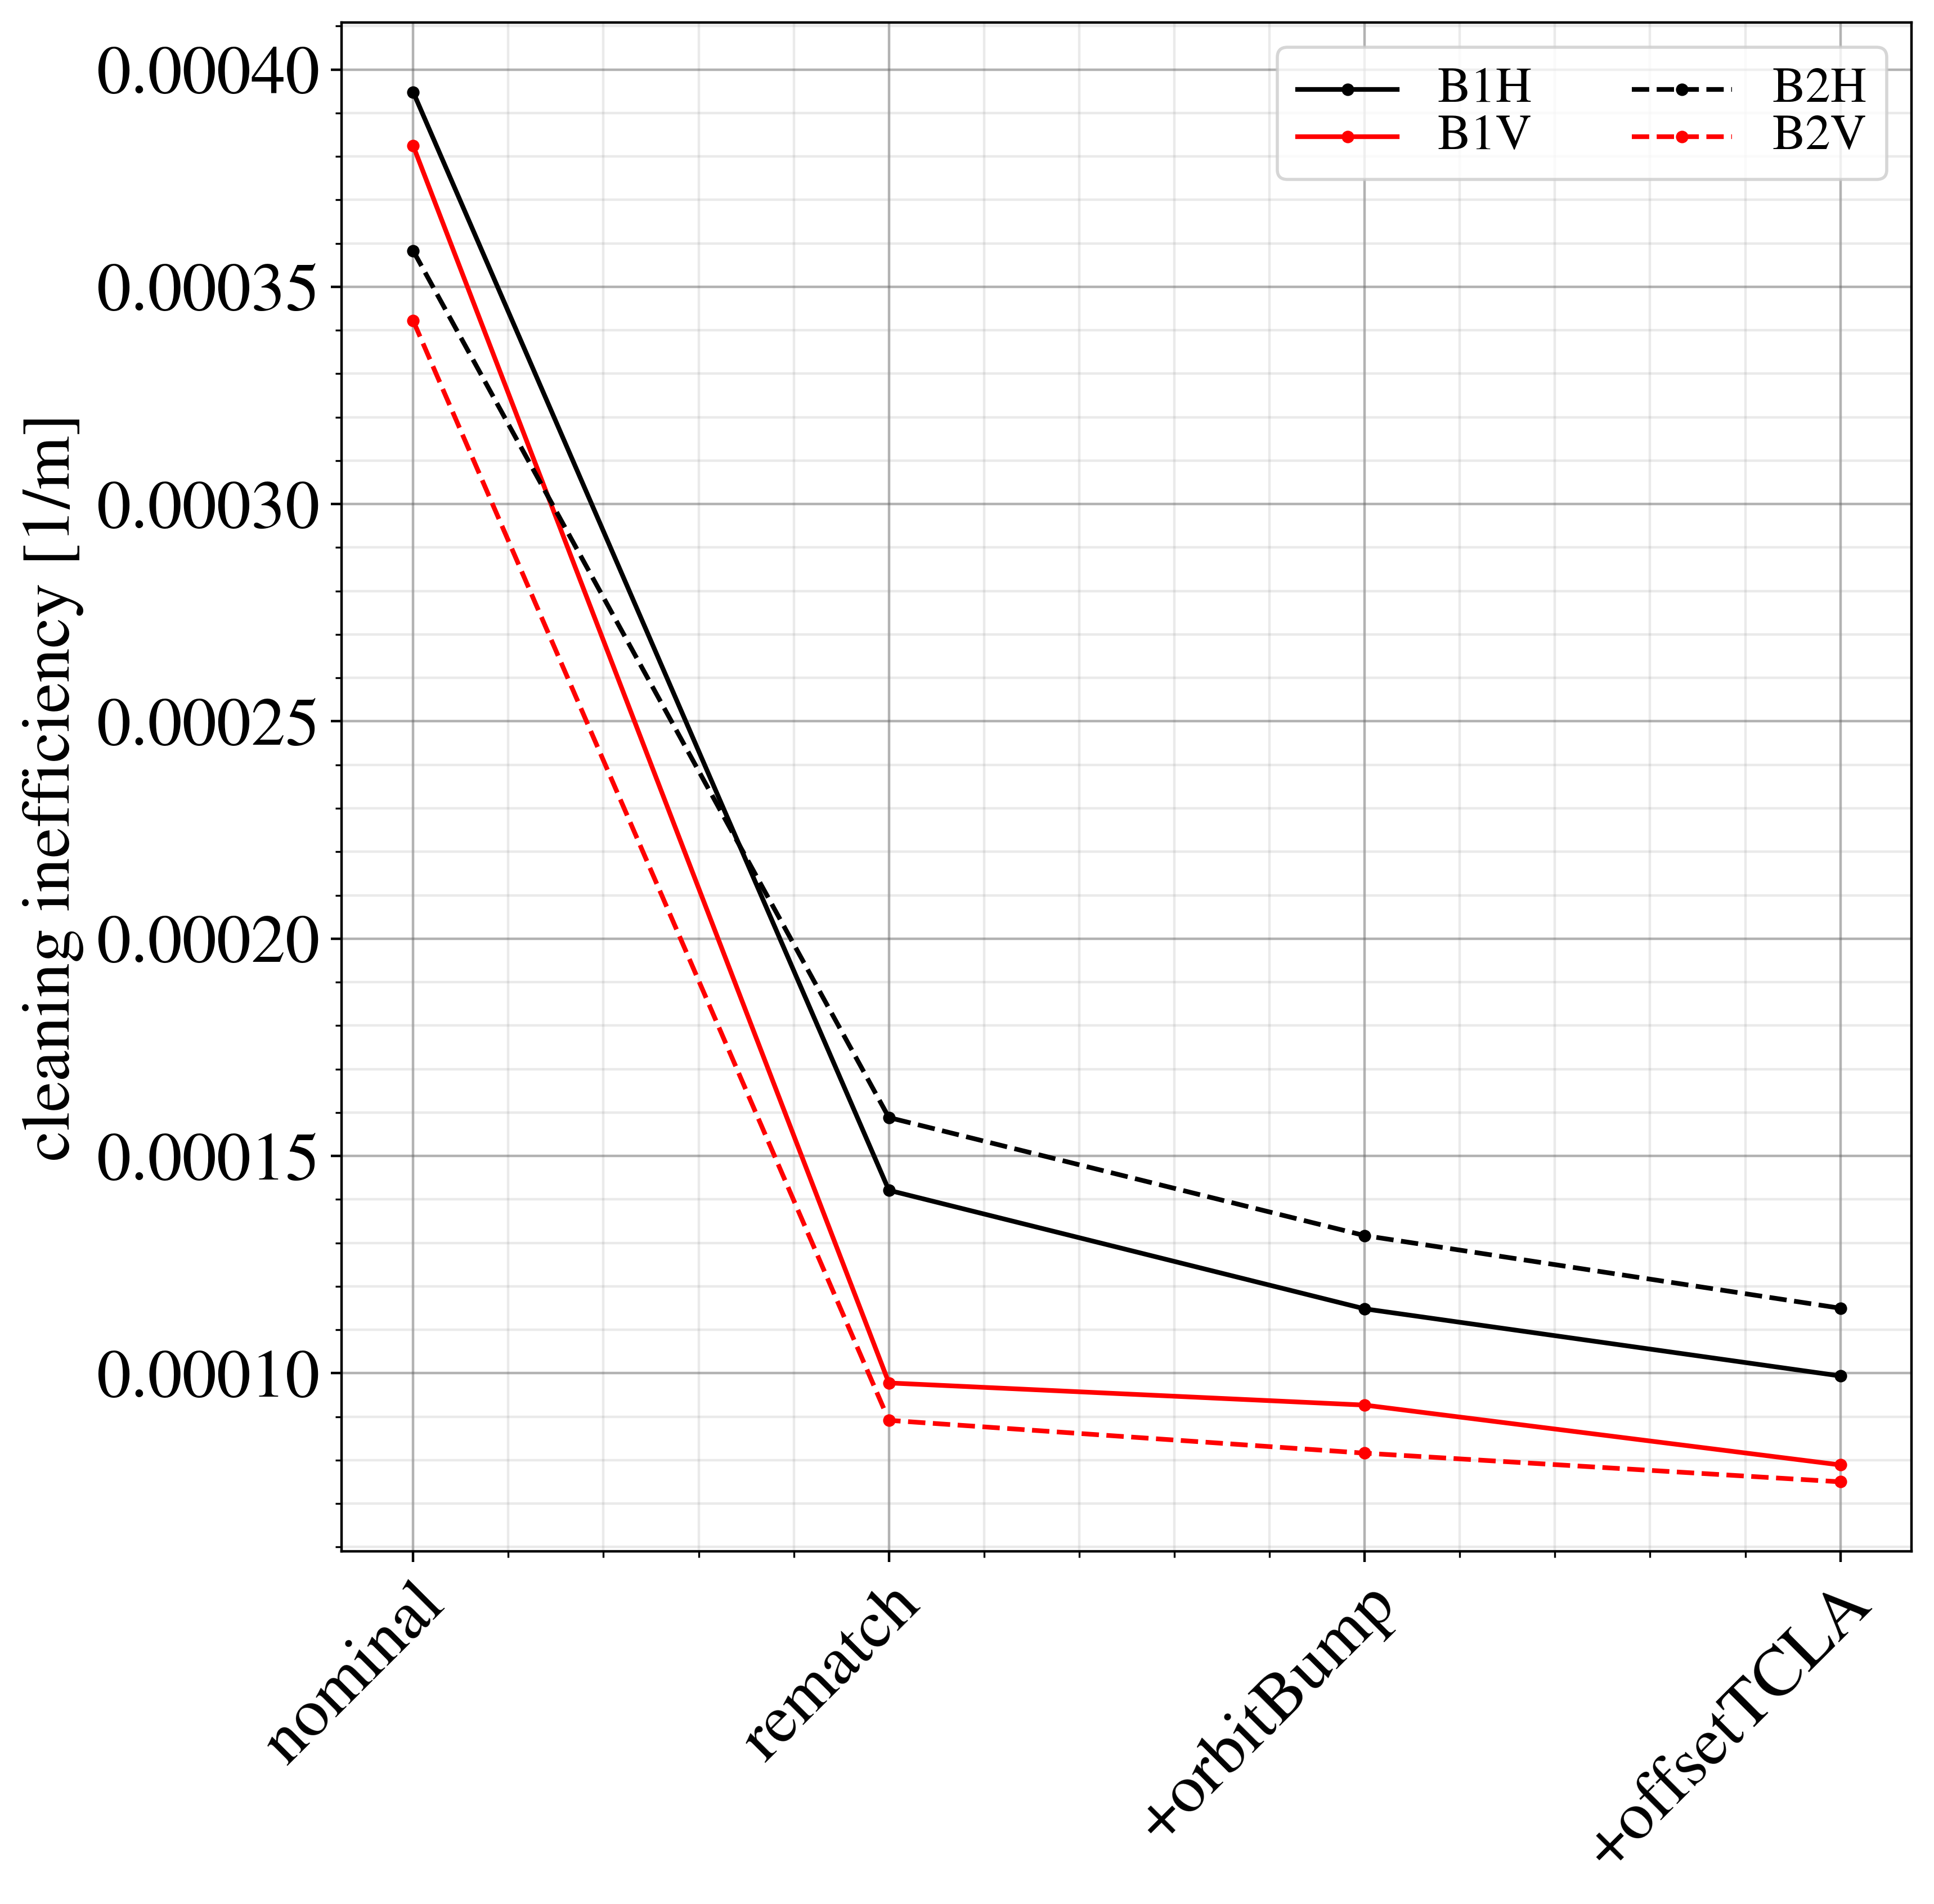
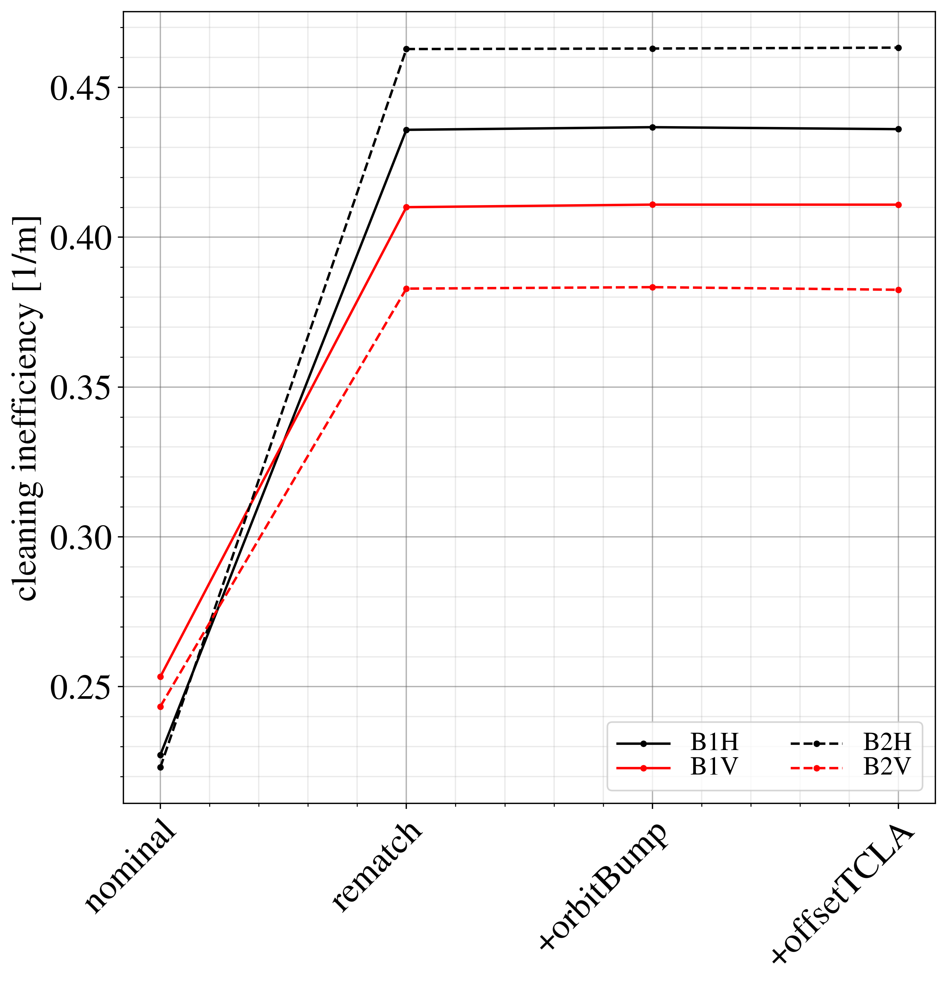
-
DS total
Global cleaning inefficiency

Slide 25
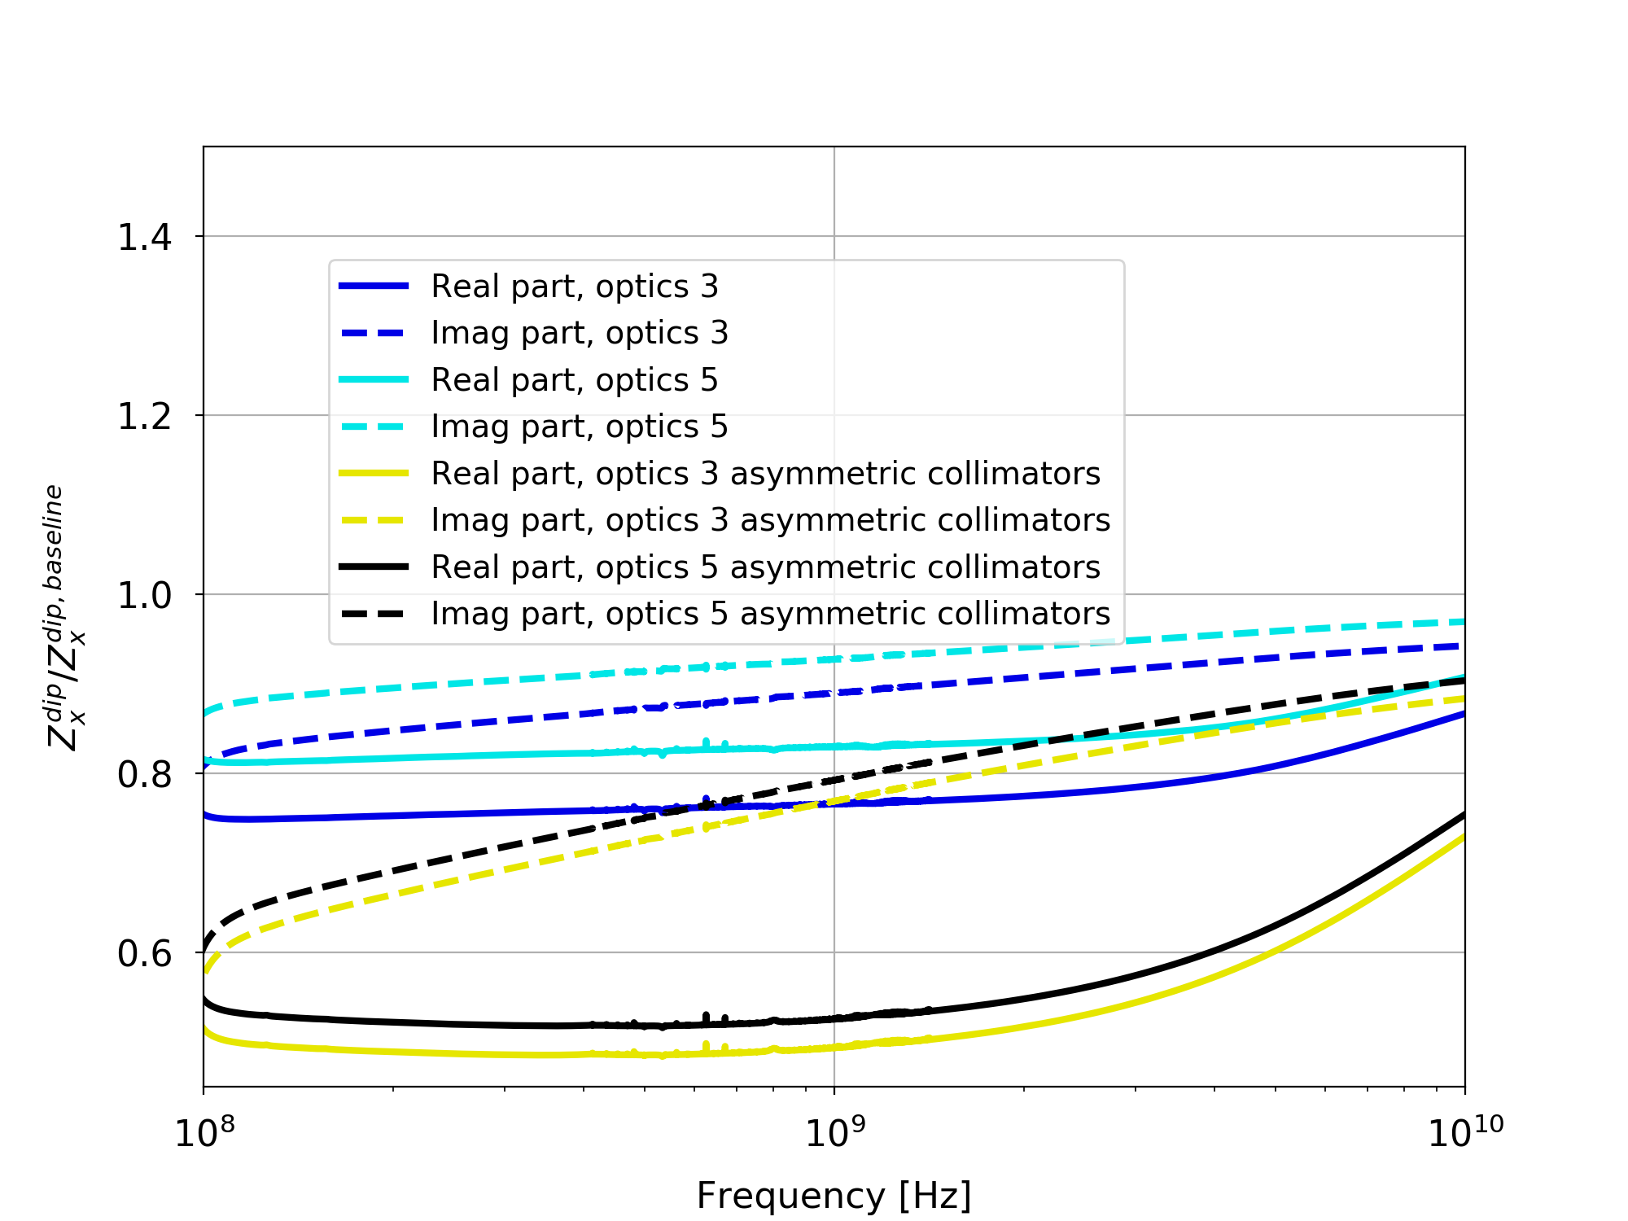
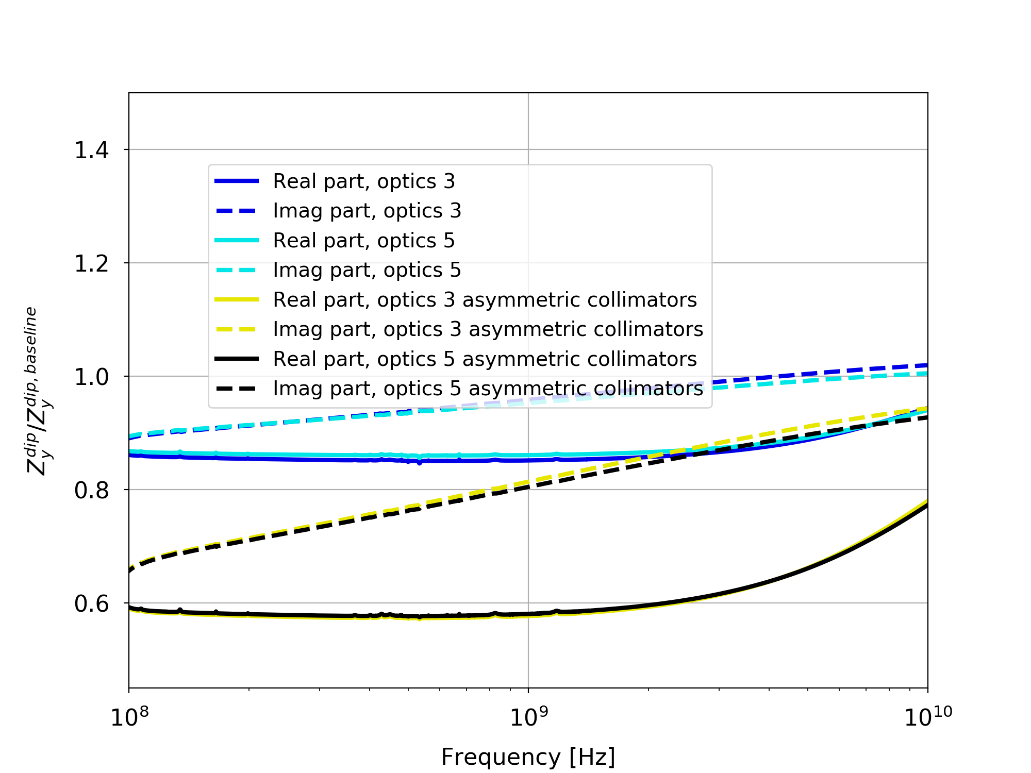
Impedance
Impedance reduction, with/without asymmetric settings
Optics 5 is the one proposed for the MD
horizontal
vertical
L. Giacomel

Slide 26
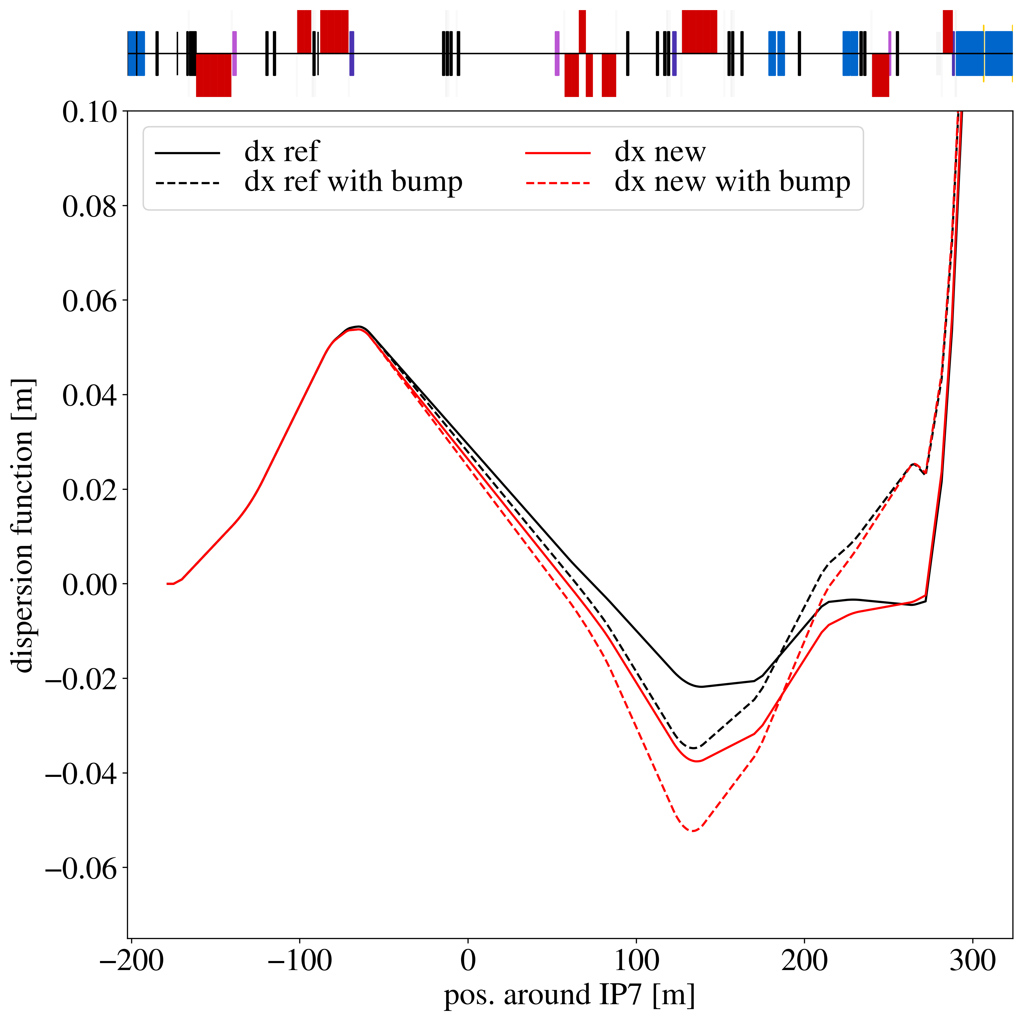
Single pass dispersion

Slide 27
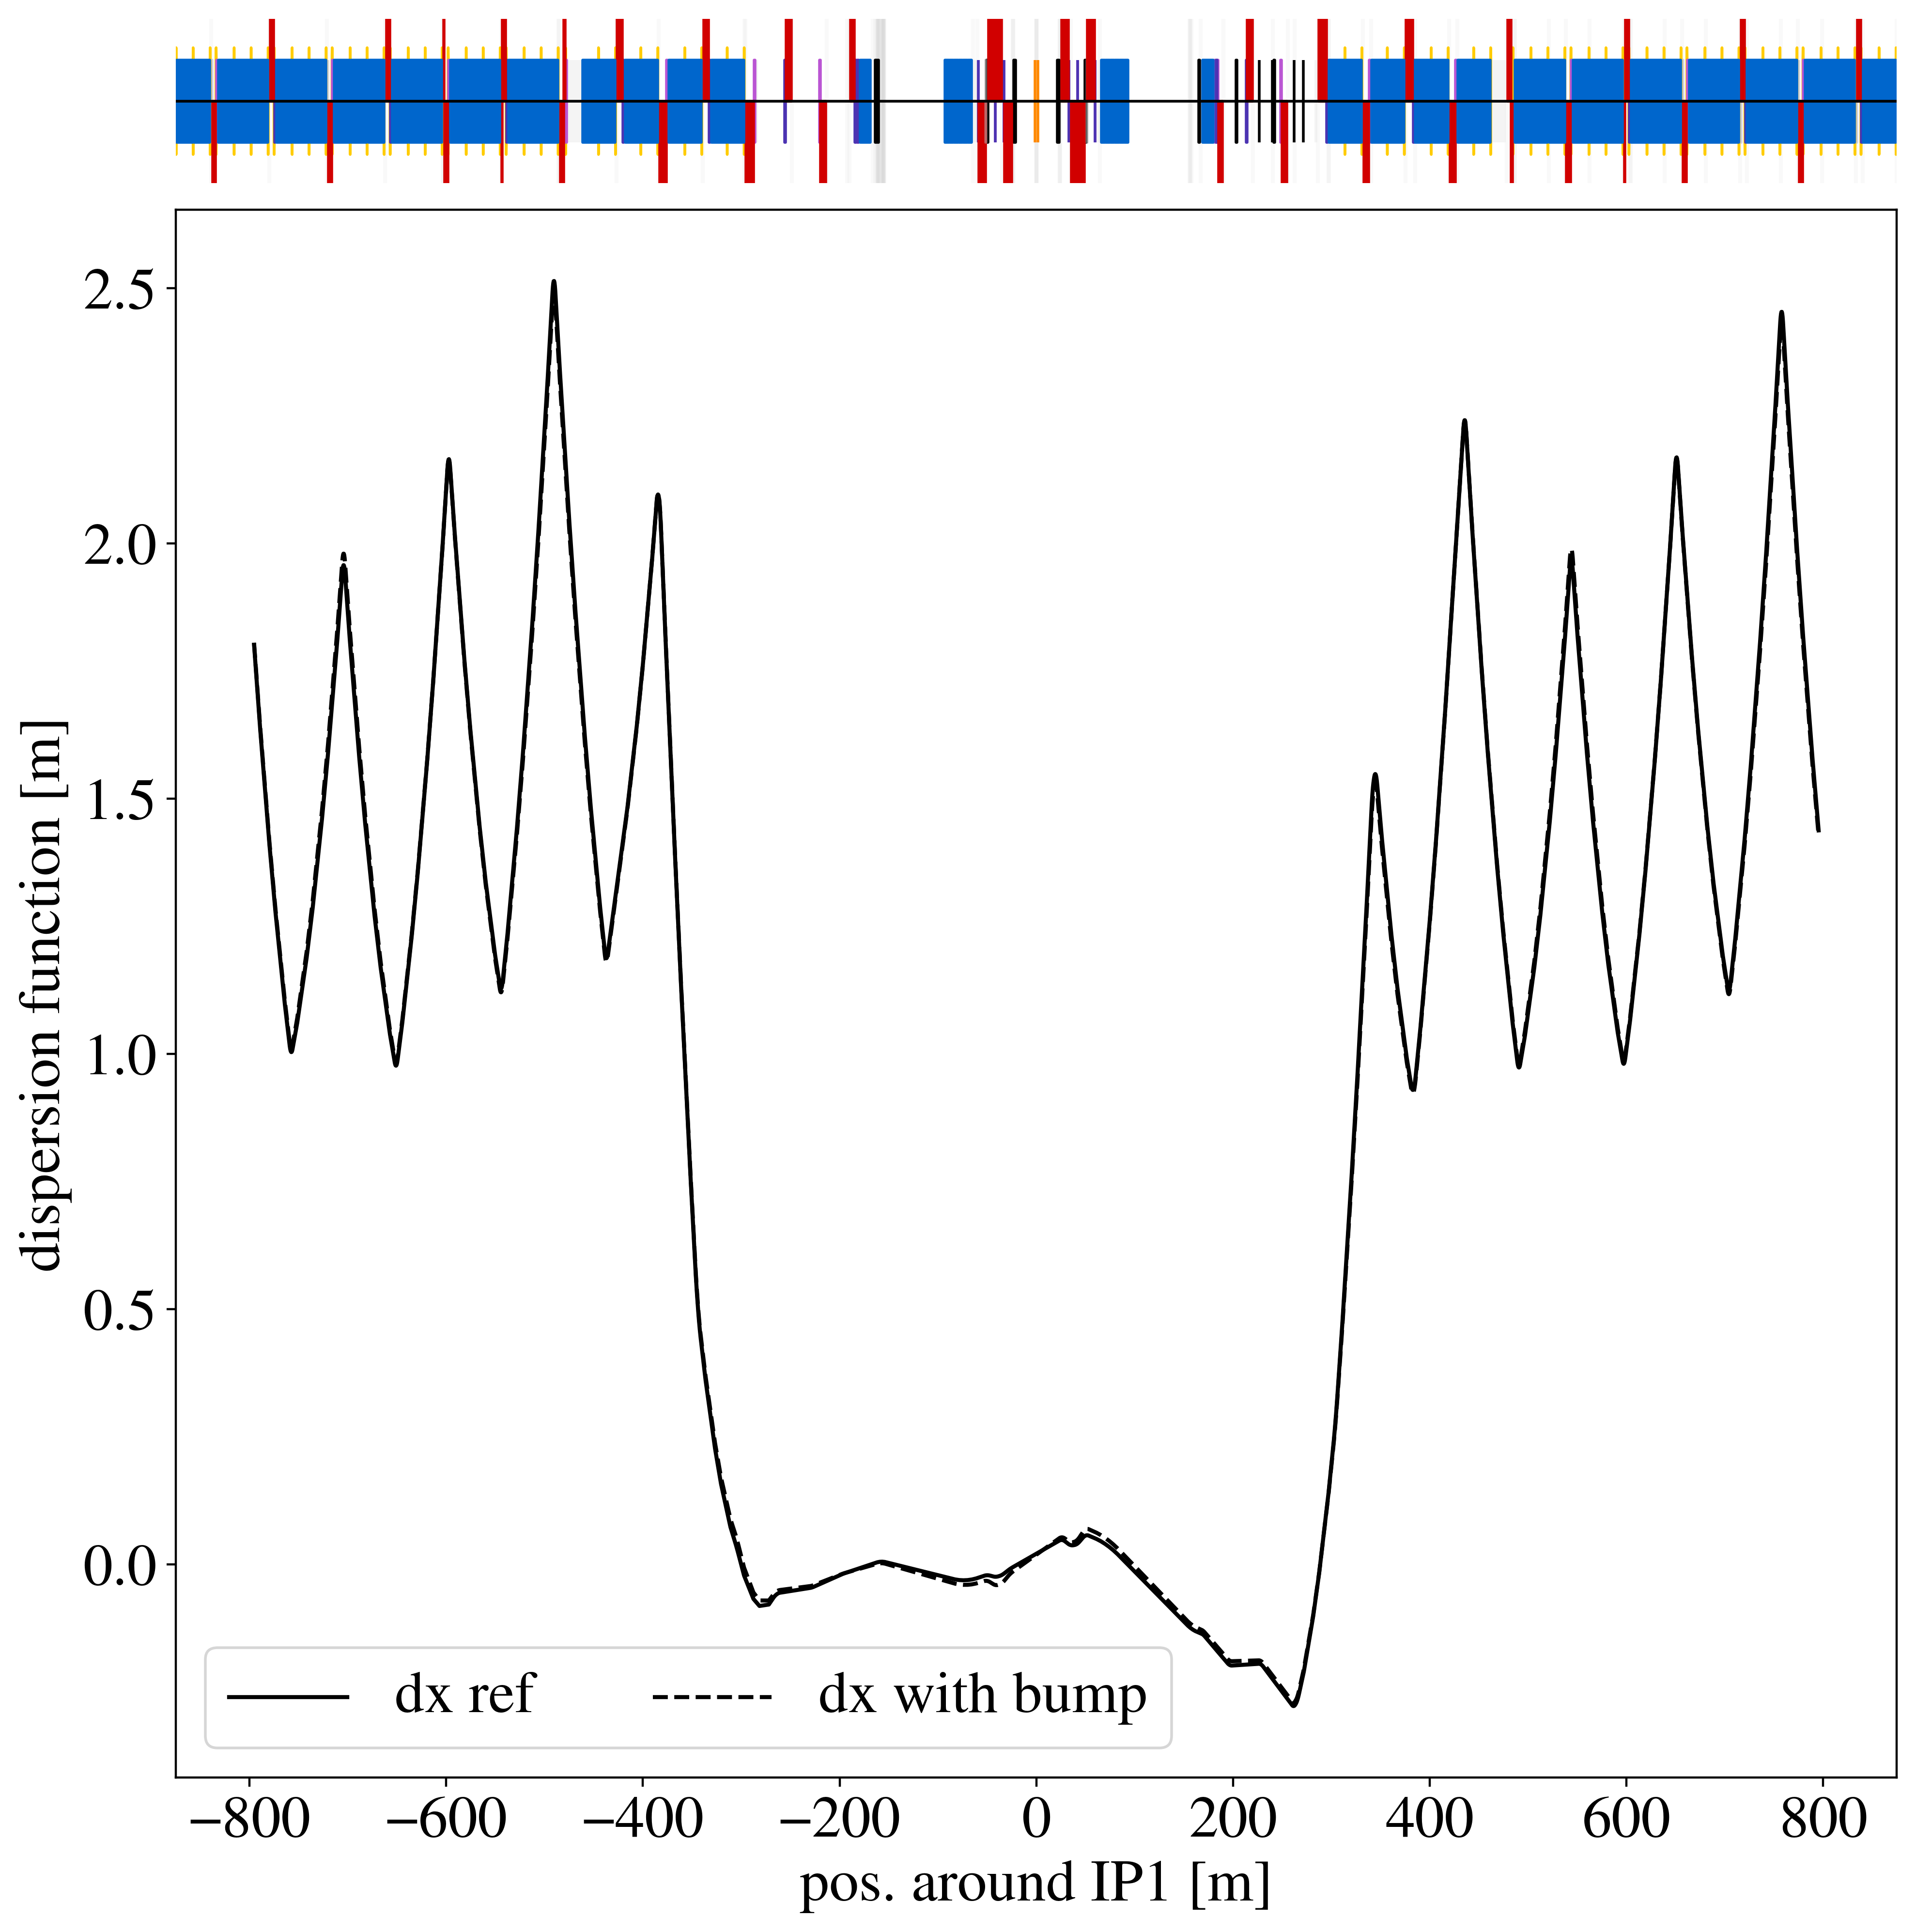
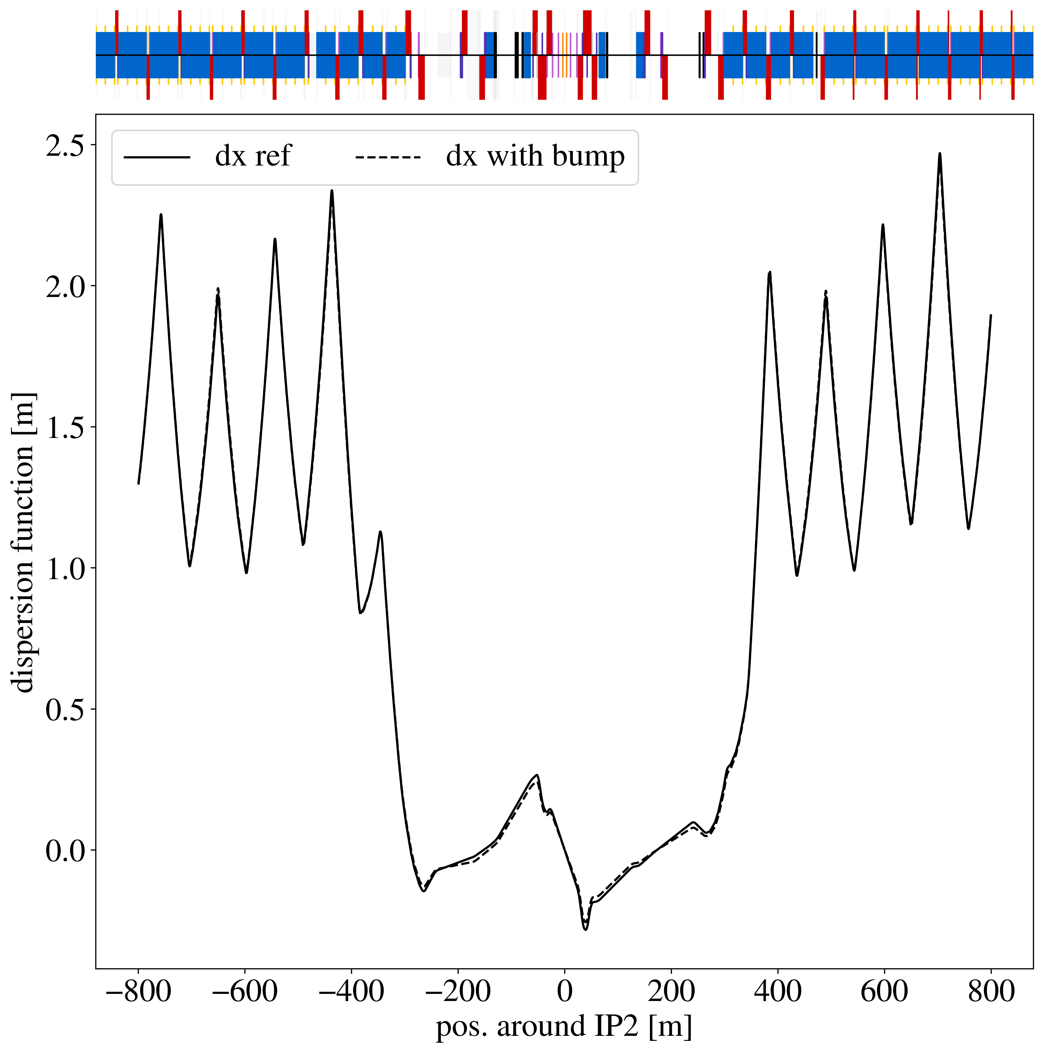
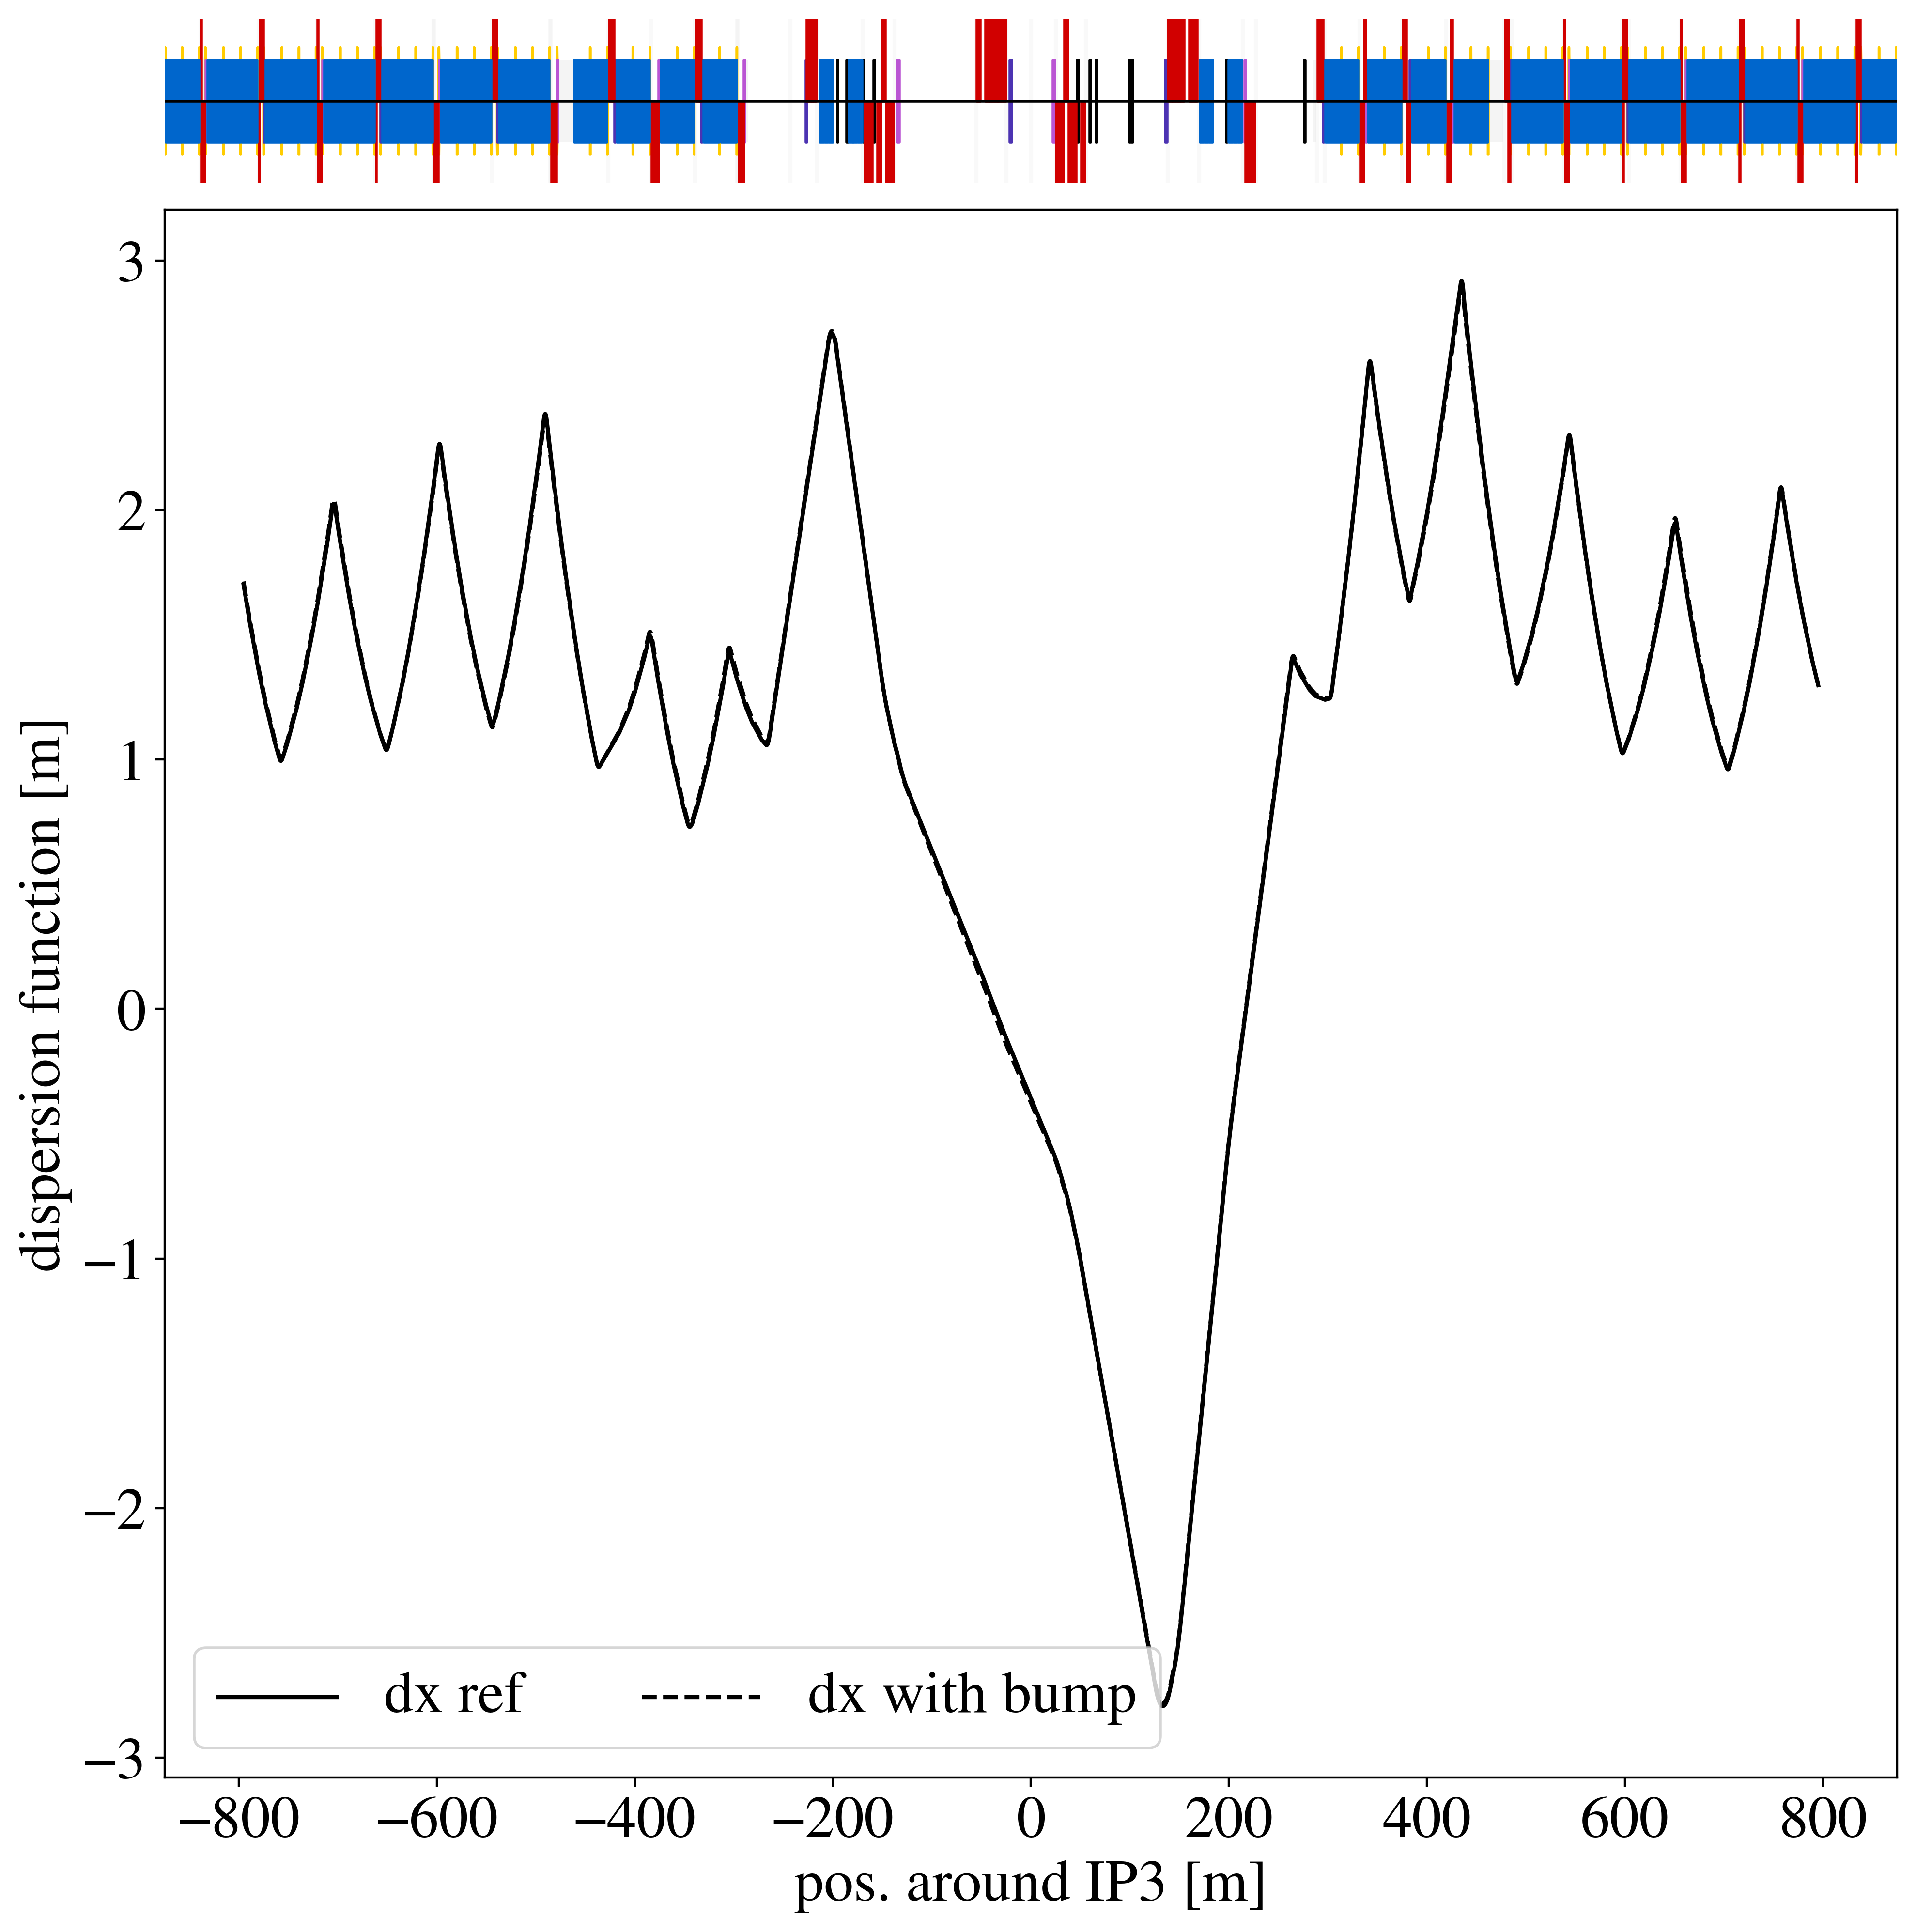
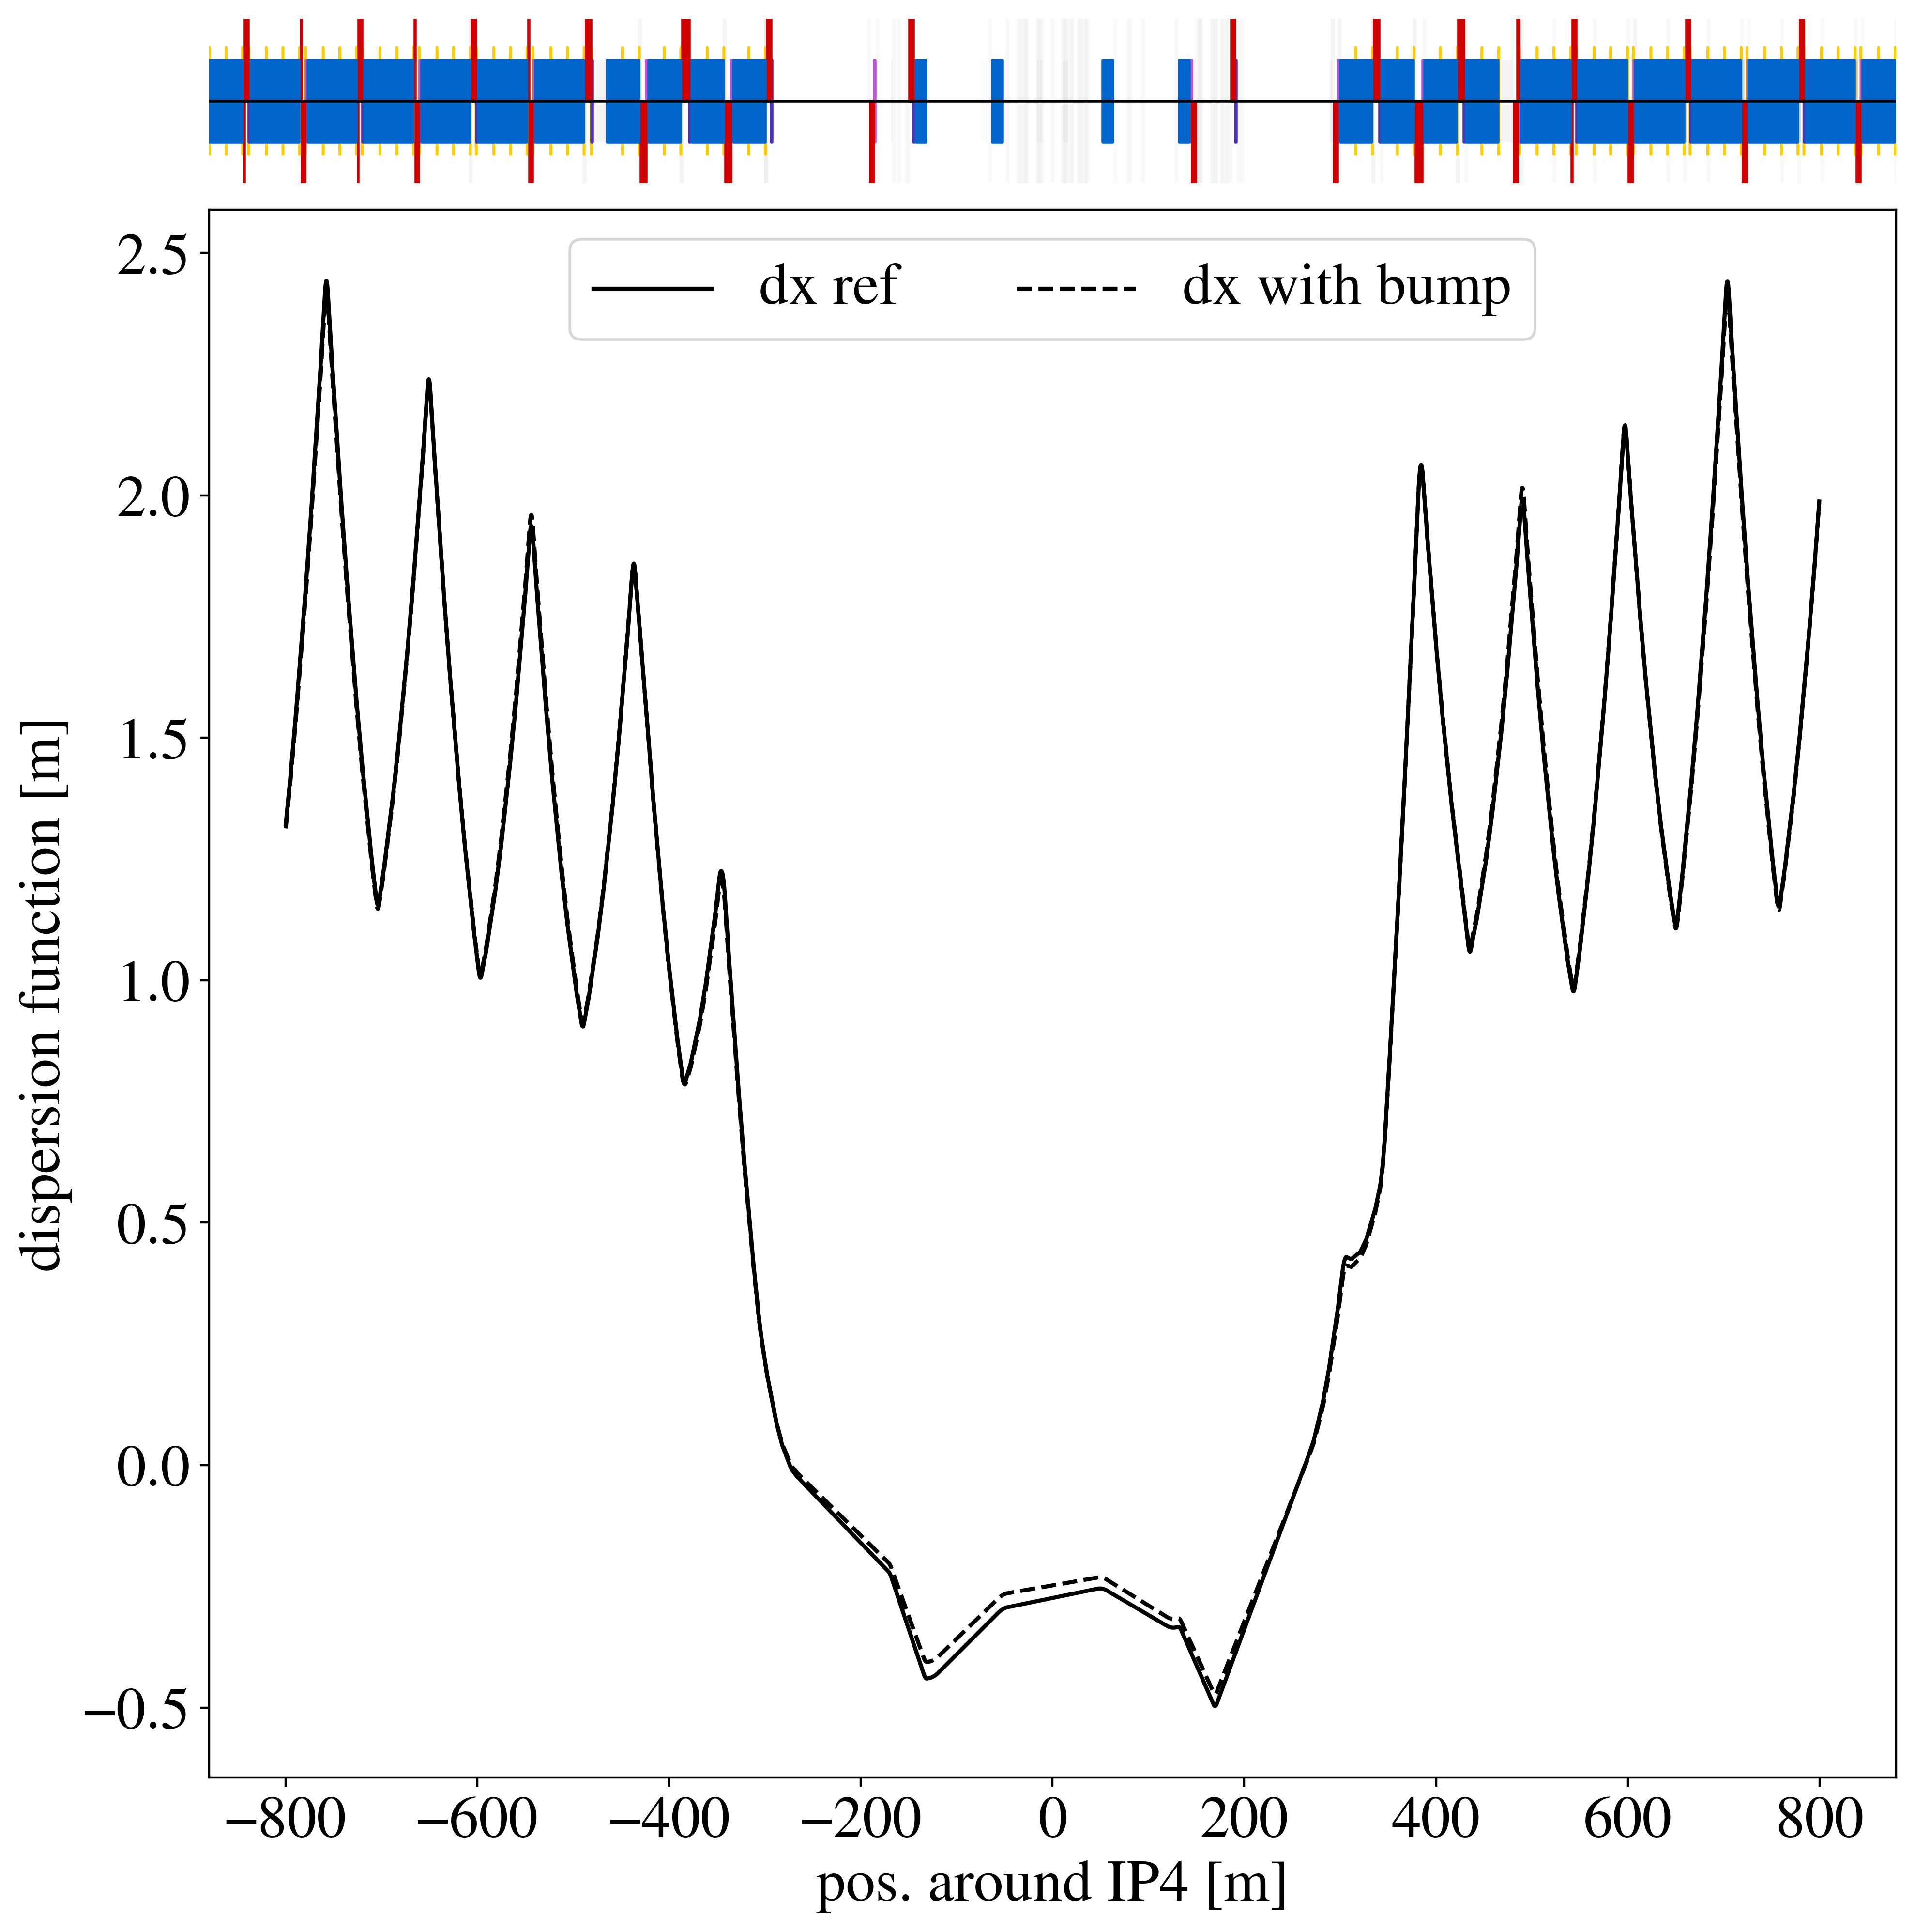
Orbit Bump – Global Dispersion

Slide 28
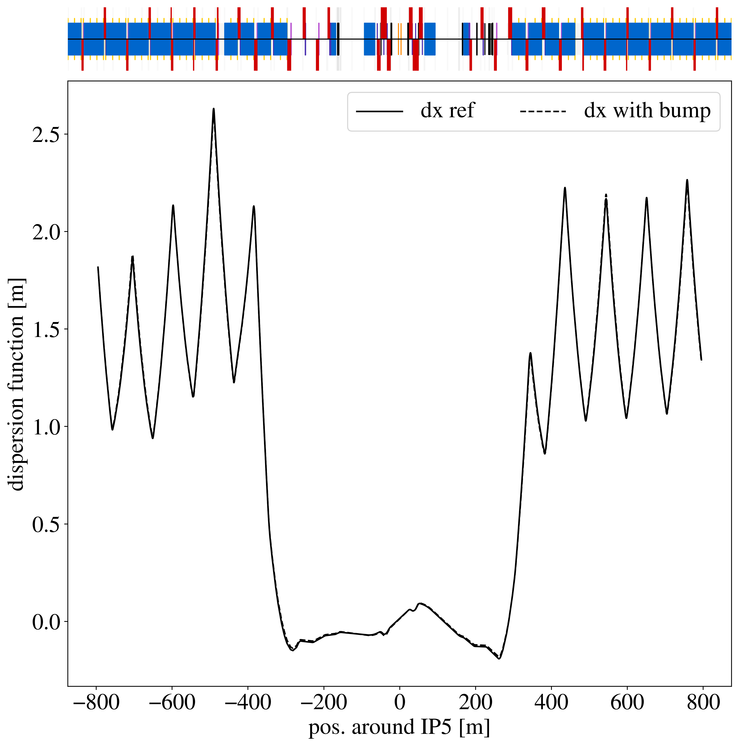
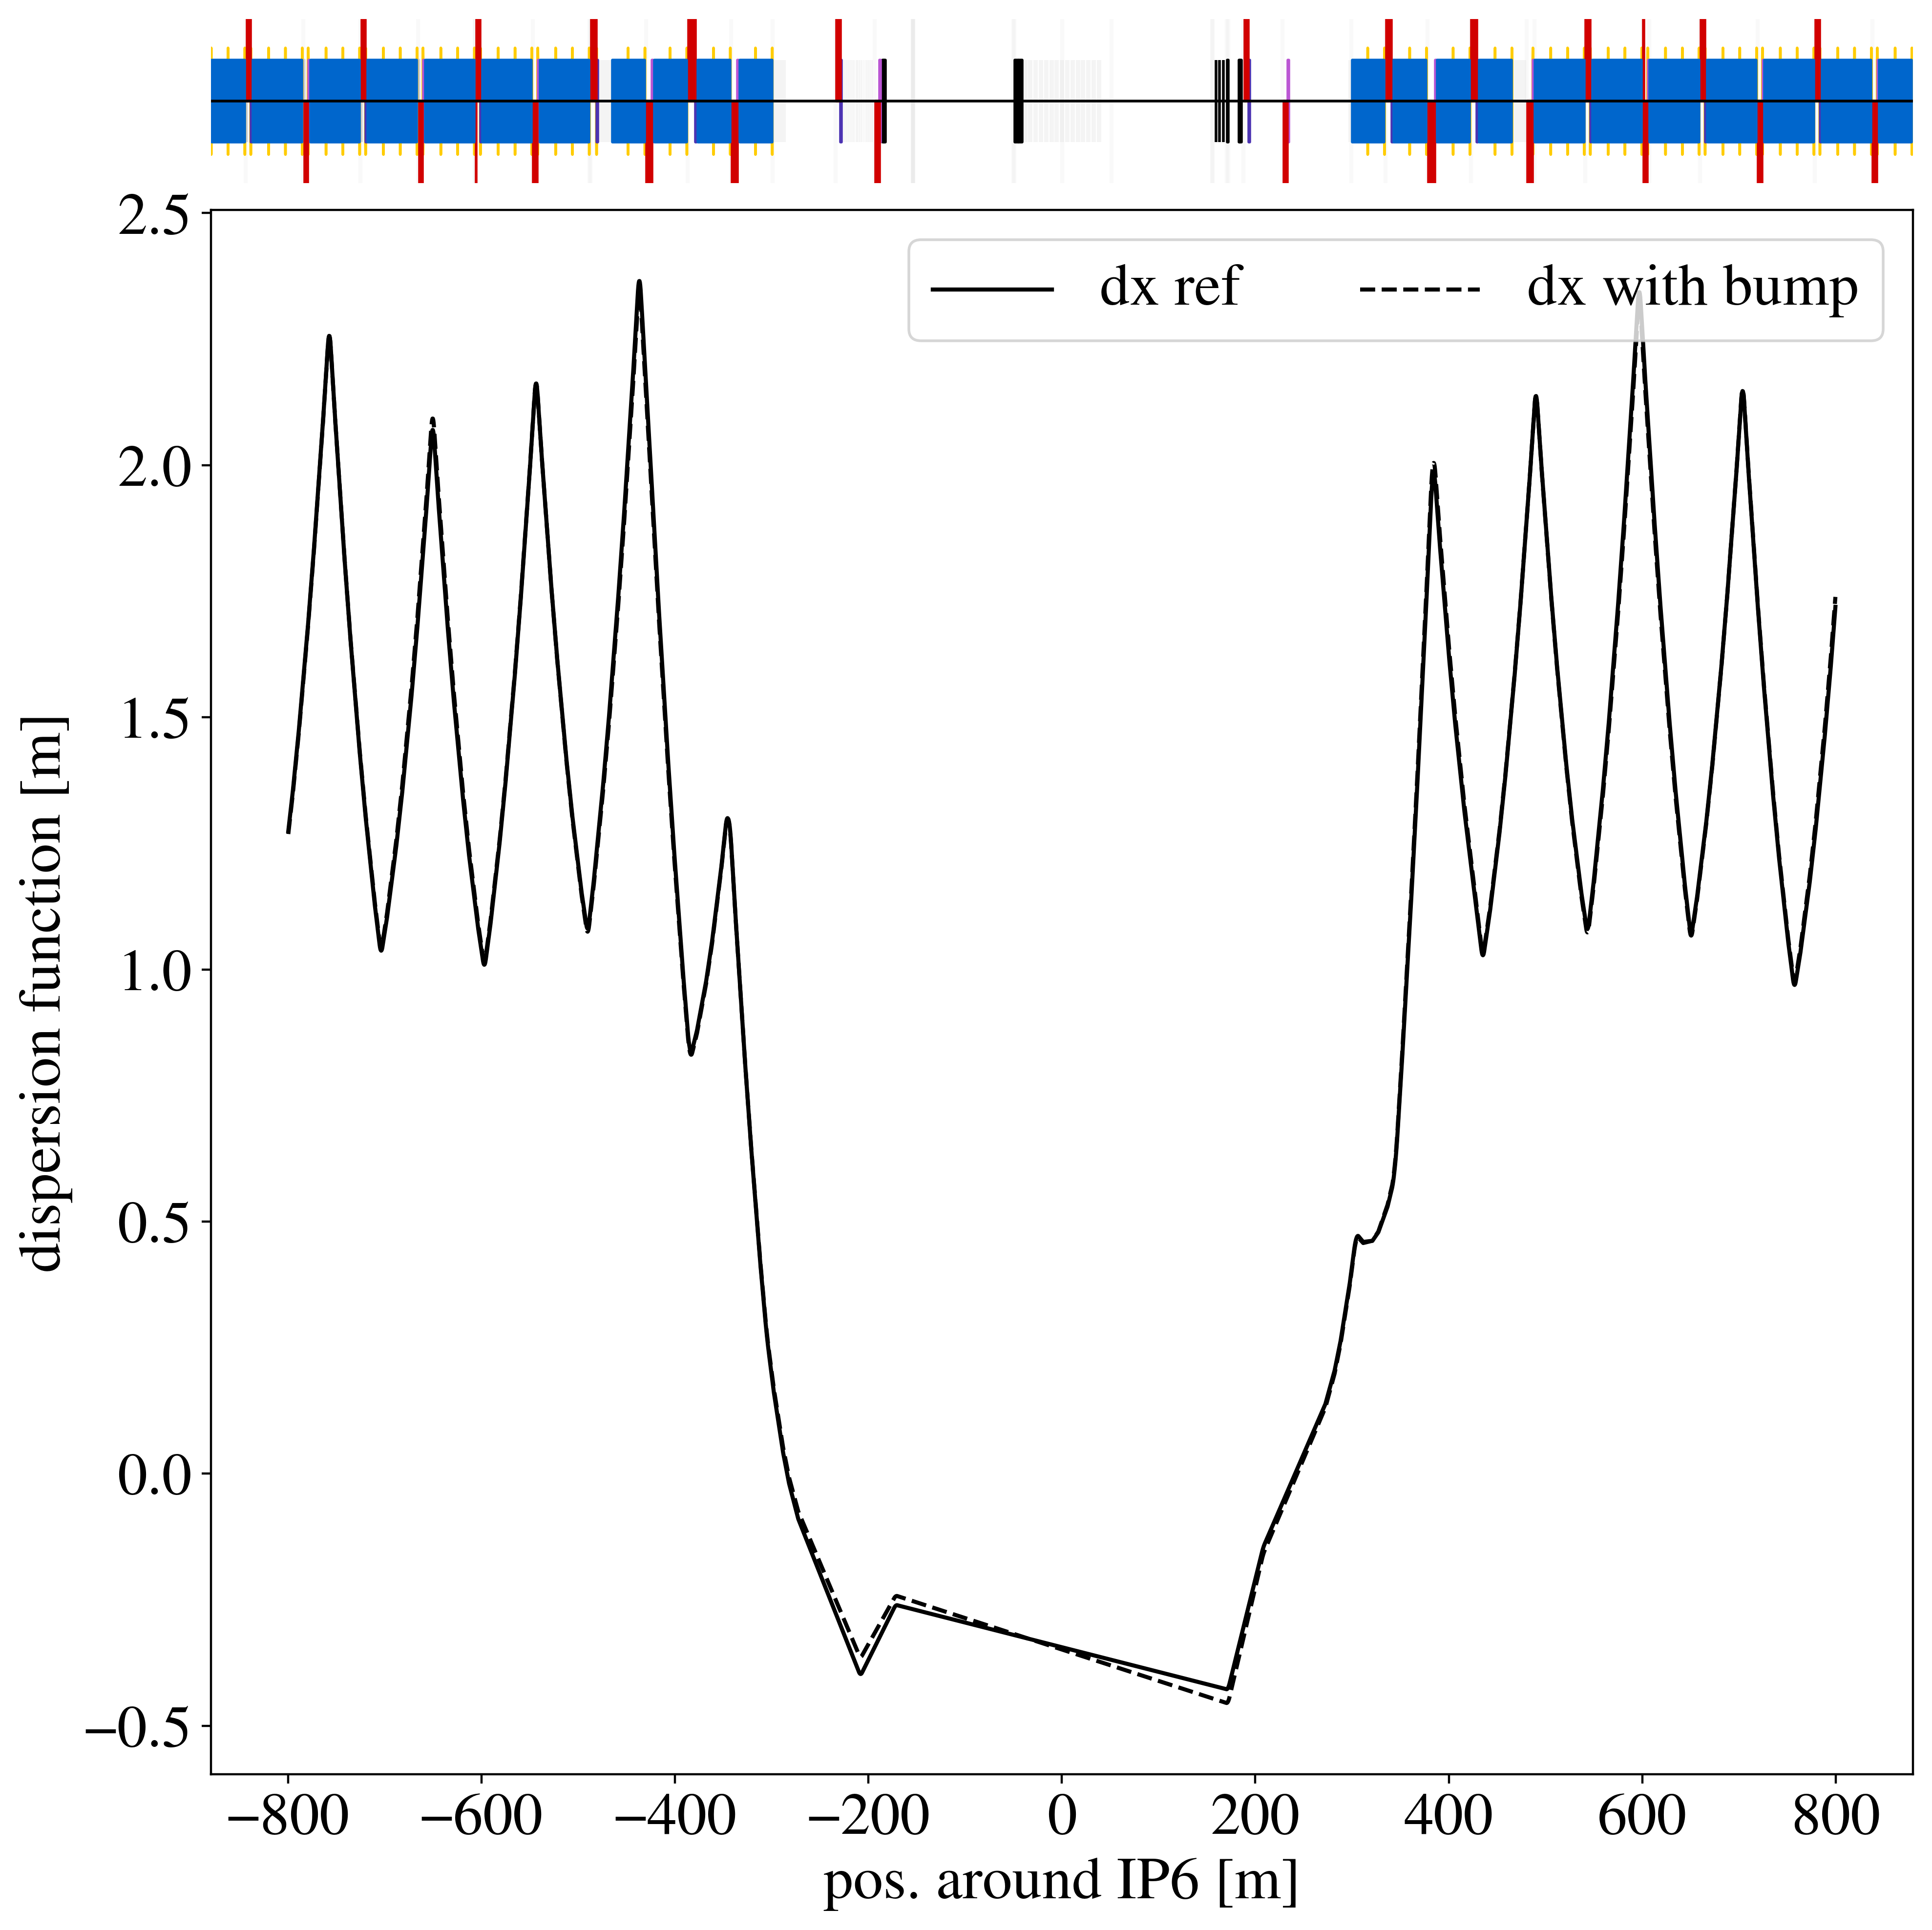
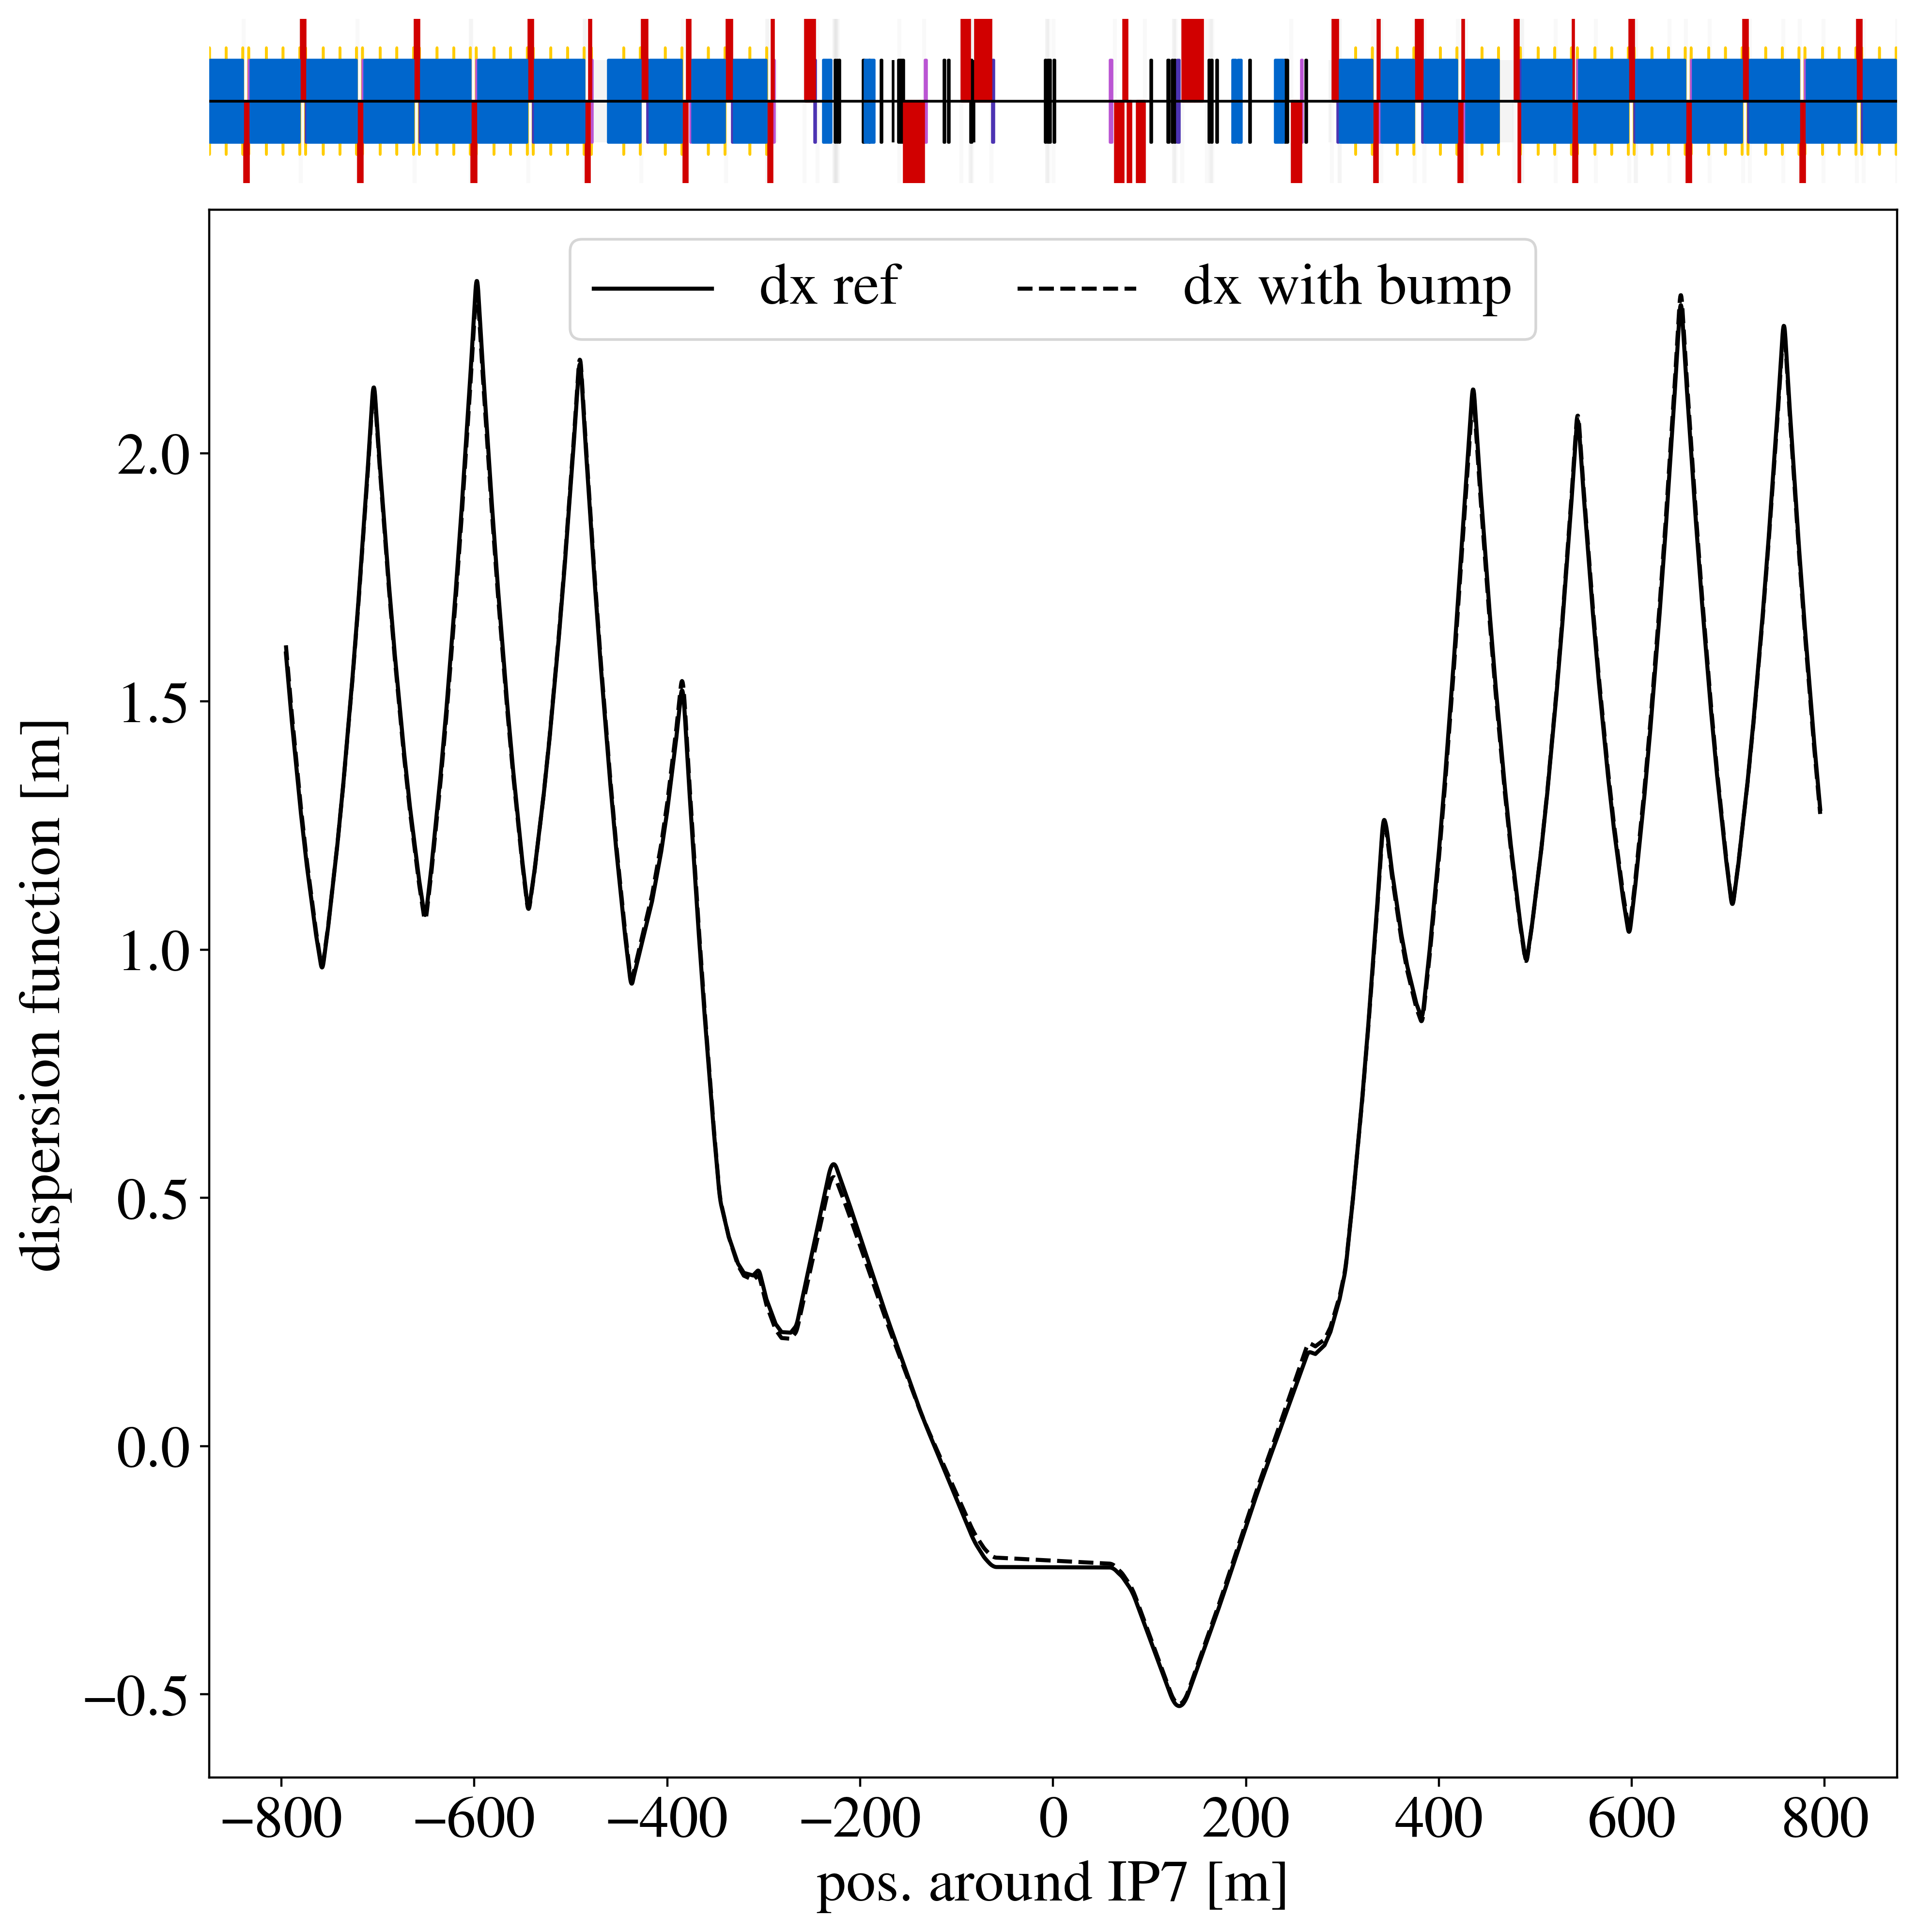
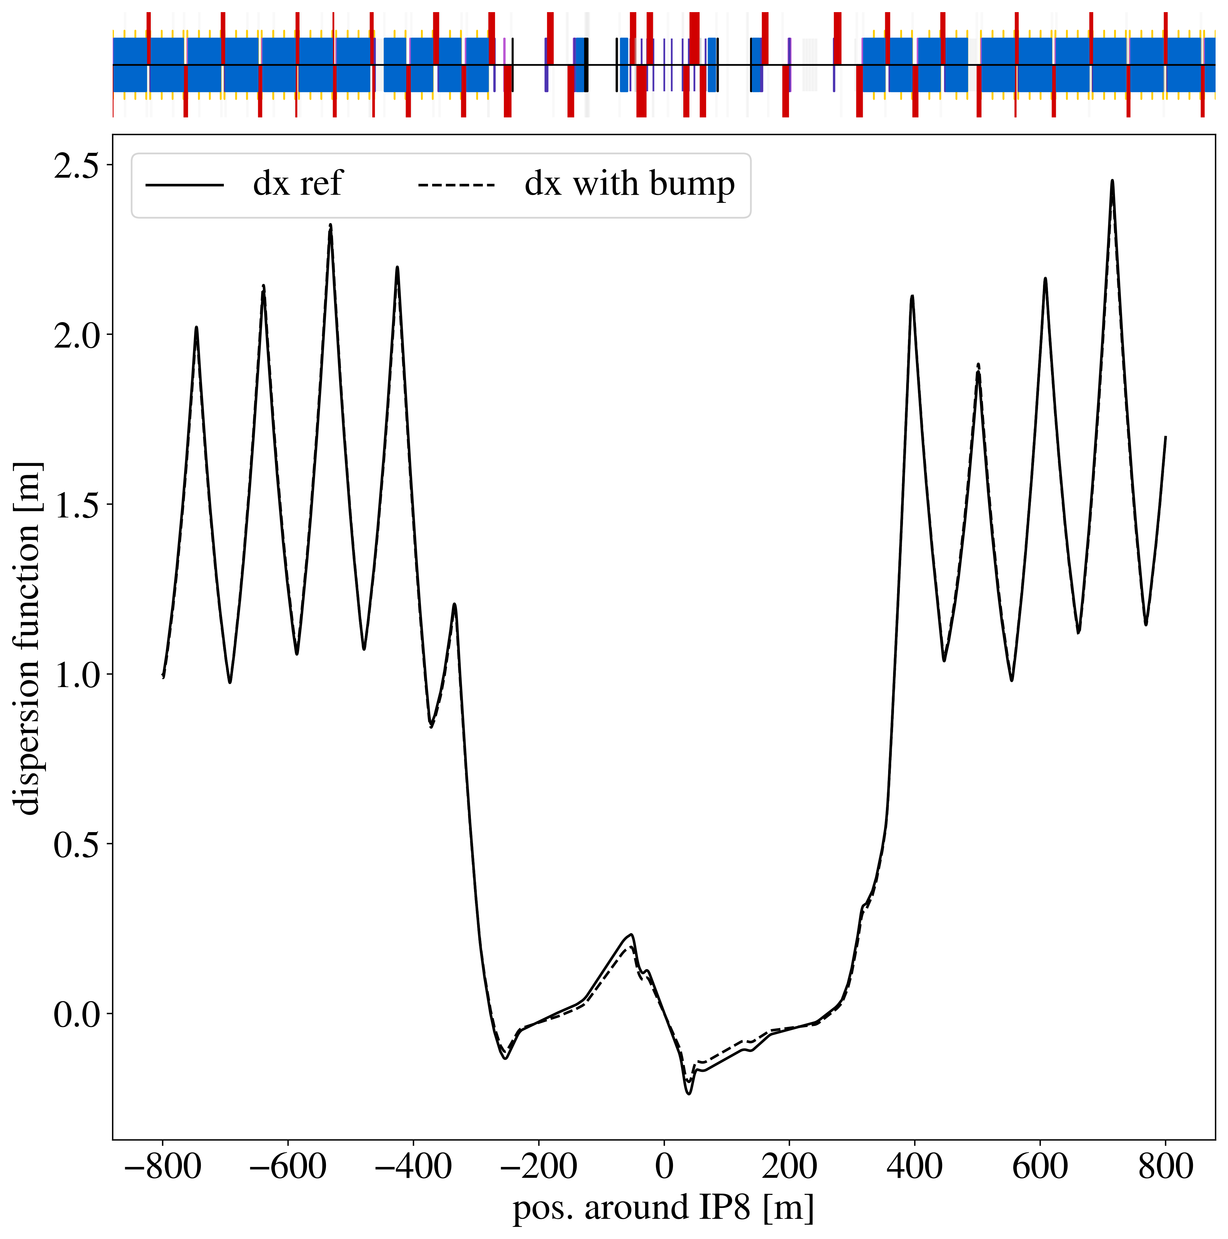
Orbit Bump – Global Dispersion

Slide 29
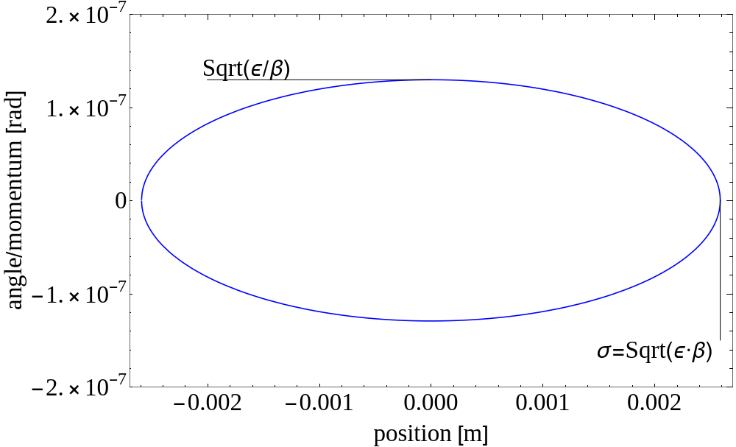


Beam sensitivity to perturbations
Constant area: $π⋅ε$

Slide 30
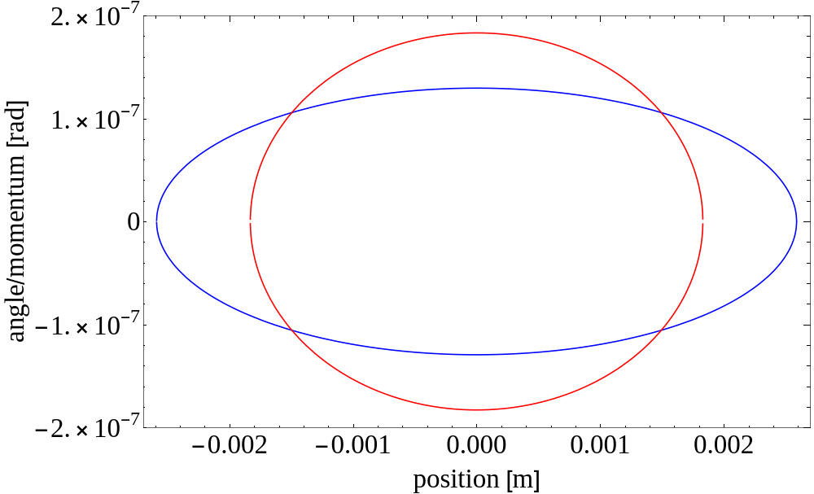
Beam sensitivity to perturbations
Ellipse at location with smaller beta function, area is the same

Slide 31
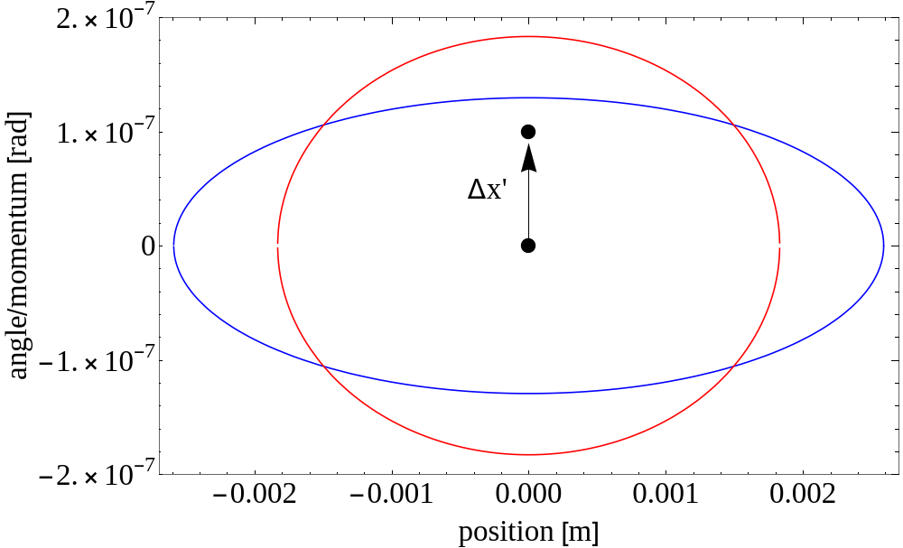
Beam sensitivity to perturbations
A particle receives a kick

Slide 32
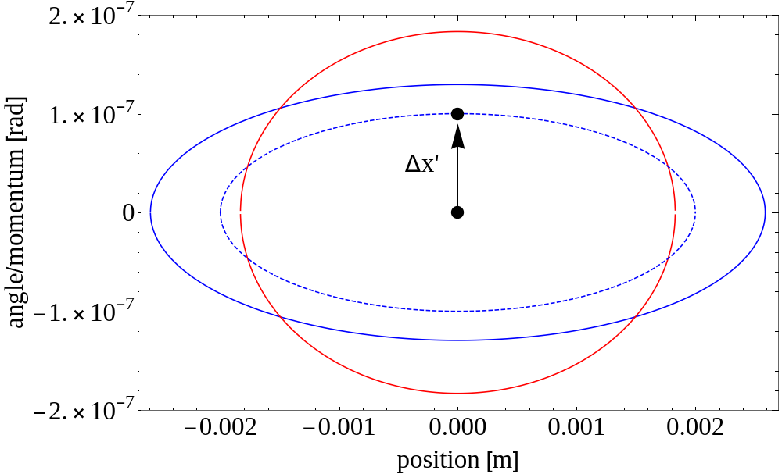
Beam sensitivity to perturbations
Particle traces out ellipse in phase space

Slide 33
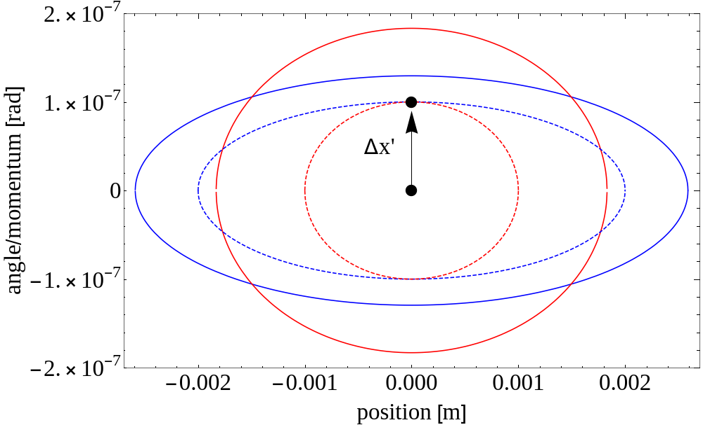
Beam sensitivity to perturbations
Particle at other location traces out different ellipse

Slide 34
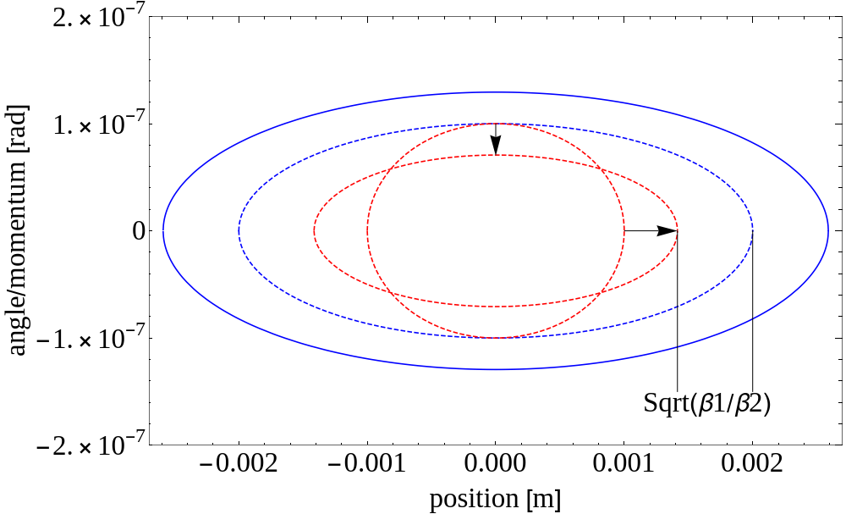
Beam sensitivity to perturbations
Observe Red particle at Blue location, transforms the ellipse
Amplitude of particle kicked at Red location smaller than particle kicked at Blue location. This is because of the beta function

Slide 35
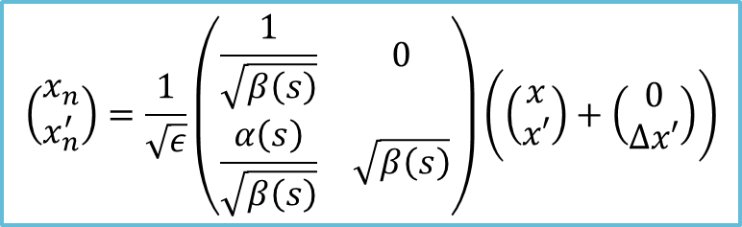
Beam sensitivity to perturbations
Observe Red particle at Blue location, transforms the ellipse
Amplitude of particle kicked at Red location smaller than particle kicked at Blue location. This is because of the beta function
$$\left(\begin{matrix}x_{n} \\ x_{n}^{′}\end{matrix}\right)=\frac{1}{\sqrt{ε}}\left(\begin{matrix}\frac{1}{\sqrt{β\left(s\right)}} & 0 \\ \frac{α\left(s\right)}{\sqrt{β\left(s\right)}} & \sqrt{β\left(s\right)}\end{matrix}\right)\left(\left(\begin{matrix}x \\ x′\end{matrix}\right)+\left(\begin{matrix}0 \\ Δx′\end{matrix}\right)\right)$$

Slide 36
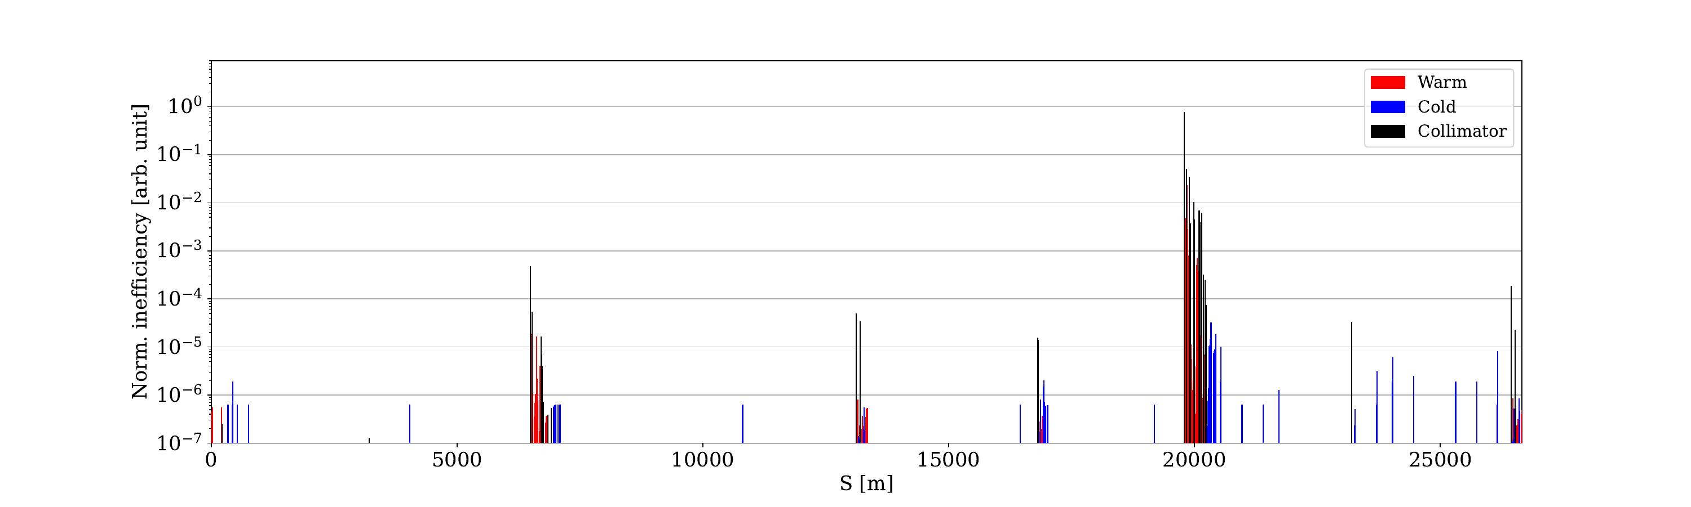
B1H – 20 cm – relaxed settings – no TCLD (ref)

Slide 37
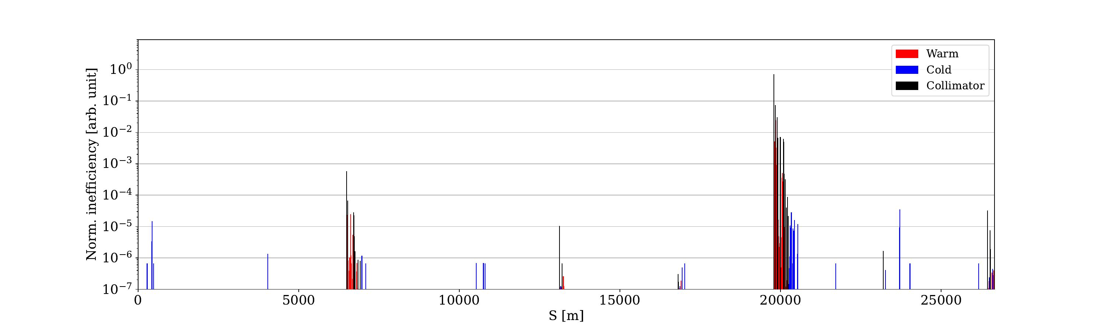
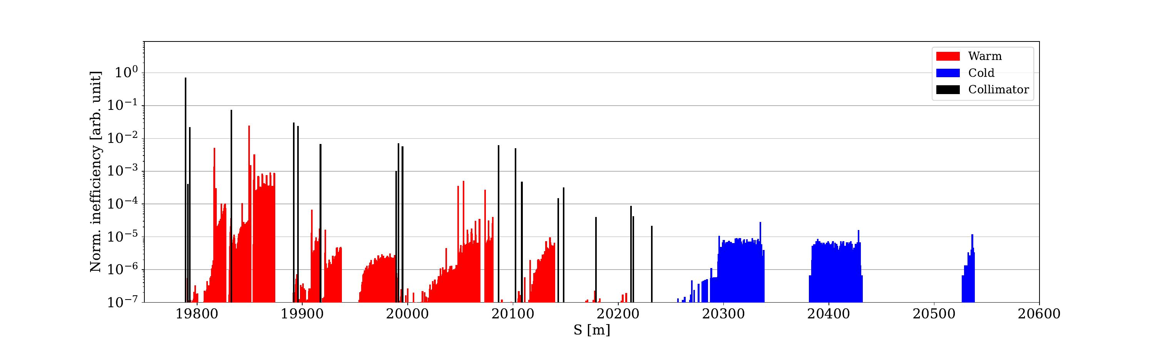
B1V – 20 cm – relaxed settings – no TCLD (ref)

Slide 38
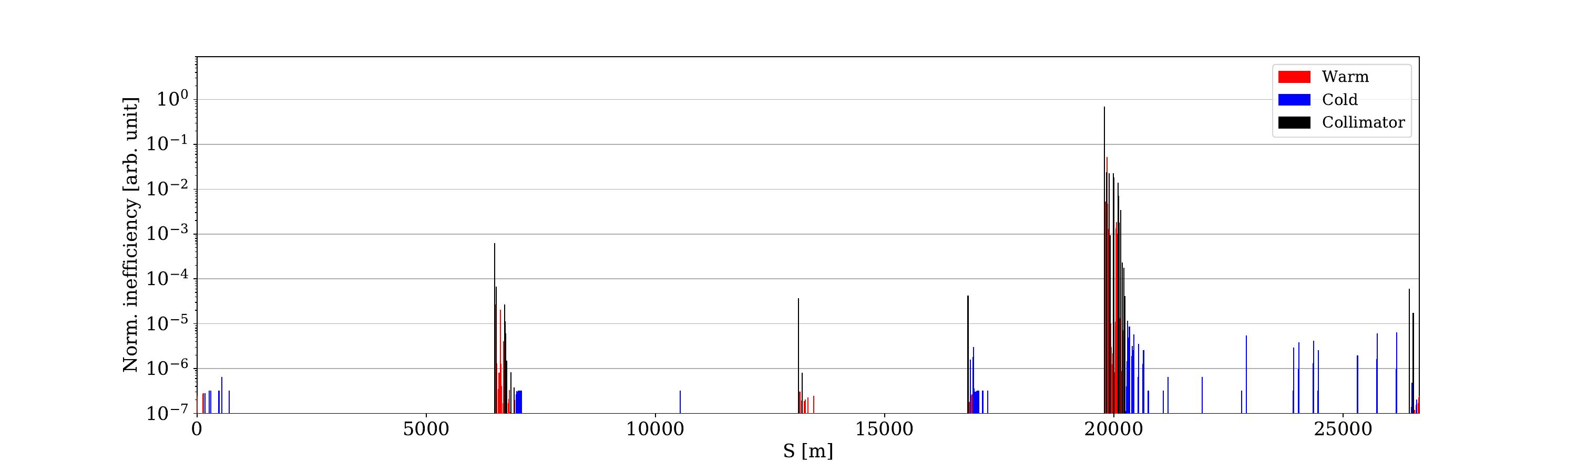
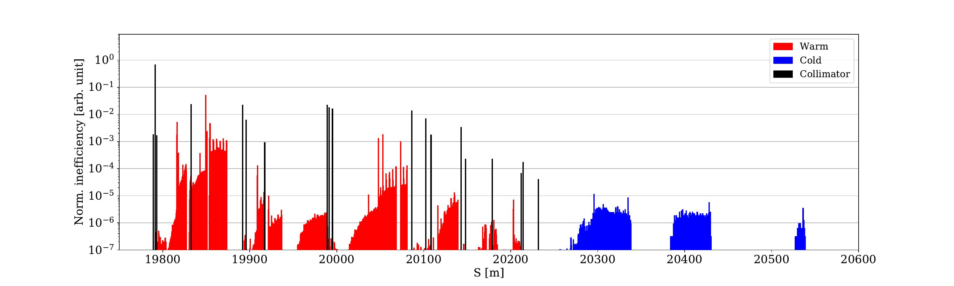
B1H – rematch

Slide 39
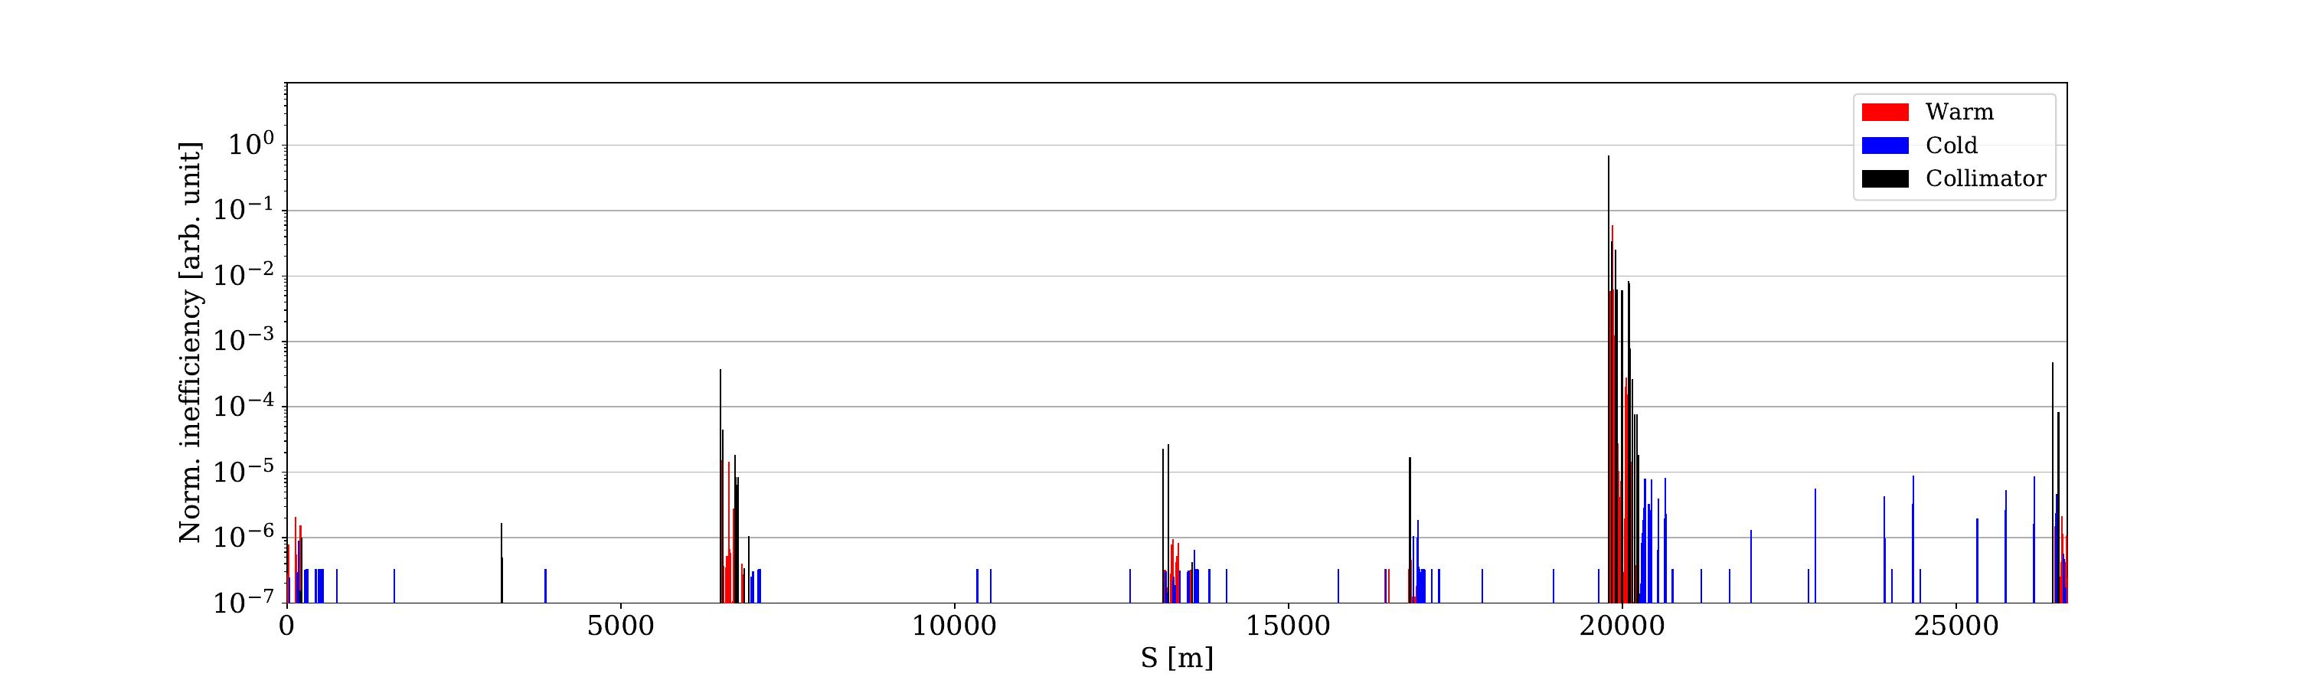
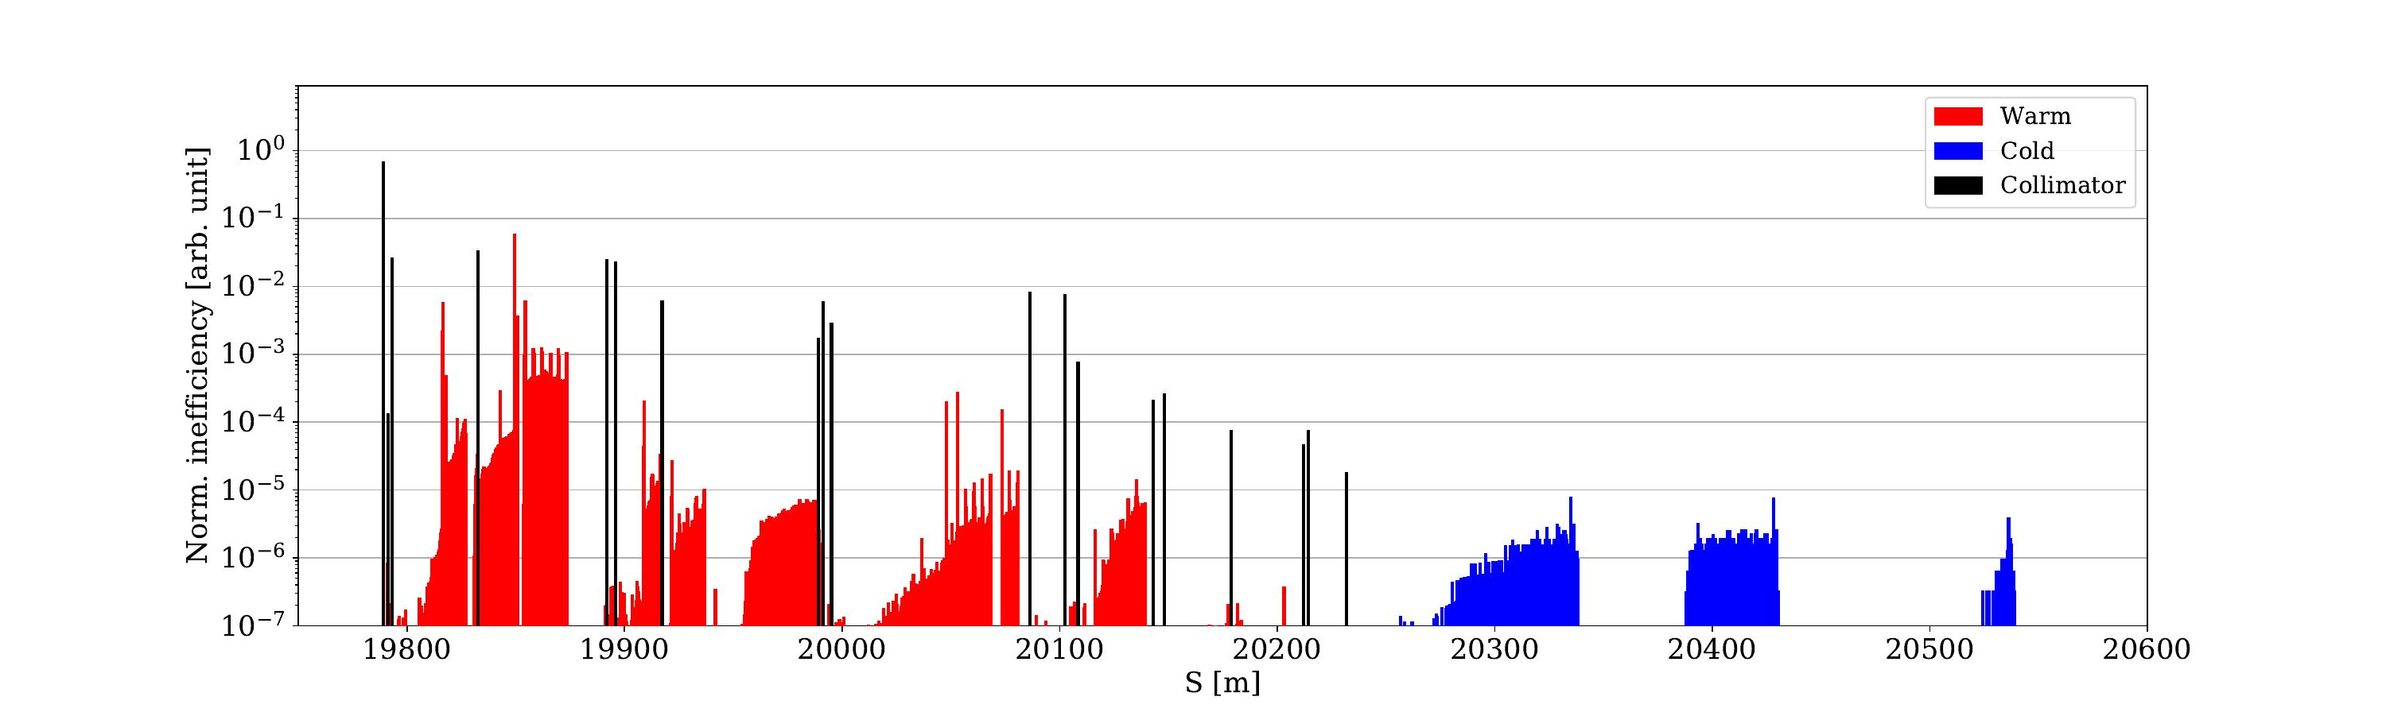
B1V – rematch

Slide 40
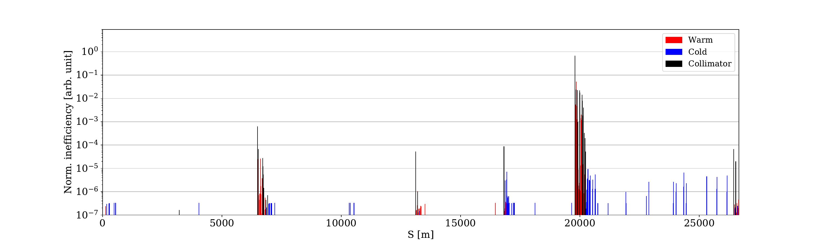

B1H – rematch + orbit bump

Slide 41

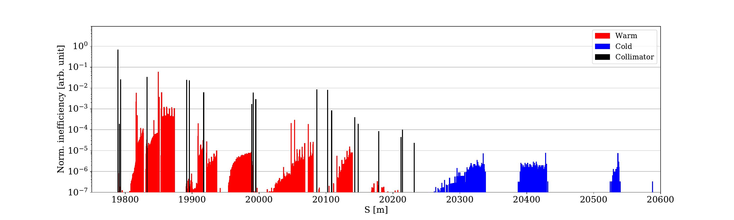
B1V – rematch + orbit bump

Slide 42
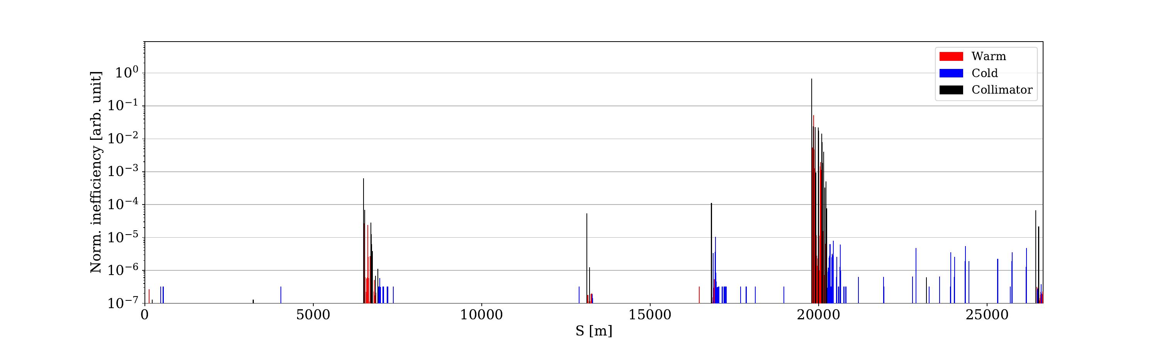

B1H – rematch + orbit bump + TCLA offset 3 sigma

Slide 43

B1V – rematch + orbit bump + TCLA offset 3 sigma

Slide 44


B2H – 20 cm – relaxed settings – no TCLD (ref)

Slide 45


B2V – 20 cm – relaxed settings – no TCLD (ref)

Slide 46


B2H – rematch

Slide 47


B2V – rematch

Slide 48


B2H – rematch + orbit bump

Slide 49


B2V – rematch + orbit bump

Slide 50


B2H – rematch + orbit bump + TCLA offset 3 sigma

Slide 51


B2V – rematch + orbit bump + TCLA offset 3 sigma

