Slide 1
Exploratory benchmarking with rootreadspeed
David Poulton, Enrico Guiraud

Slide 2
Table of contents
rootreadspeed
Benchmarking setup
Results and thoughts
More things to do
Takeaways

Slide 3
I only had a few weeks
Disclaimer: Very possible you may have questions for graphs that I don’t have satisfying answers to…

Slide 4
rootreadspeed

Slide 5
Runtime of an analysis
Various factors affect runtime
  Reading data
    From network (XRootD)
    Locally (SSD, HDD, etc)
  Data decompression
    Depends on algorithm
    Can be CPU intensive
  Analysis logic/using the data
    Generally most CPU intensive
    Usually easily parallelised
Where is the bottleneck?
EOS
Bottlenecked by EOS load + network
SSD/HDD
Network
Bottlenecked by local network
Bottlenecked by storage speed
Decompression
Bottlenecked by algorithm + CPU
Results!
Processing / analysis
Bottlenecked by CPU

Slide 6
Identifying bottlenecks
rootreadspeed gives some direct insight into the first two segments
  Reading data
  Data decompression
Indirect insight into the analysis segment
EOS
SSD/HDD
Network
Decompression
Results!
Processing / analysis

Slide 7
Introducing rootreadspeed
The tool gives us a variety of metrics to use, most importantly:
  Real time
  CPU time
  Effective throughputs
We can apply some basic rules to identify the bottlenecks…
  A = analysis runtime, N = threads, T_{R} = real time, T_{C} = CPU time.
    T_{C}/N ≪ T_{R} → Data storage is bottleneck
    T_{C}/T_{R} ≈ N → CPU is bottleneck (decompression)
      Both can be impacted by compression algorithm!
    T_{R} ≪ A → Analysis code is bottleneck
rootreadspeed
--files GluGluToHToTauTau.root TTbar.root
--trees Events
--all-branches
--threads 12
--tasks-per-worker 12
Running with 8 threads even though 12 were requested.
Total number of tasks: 56
Thread pool size: 8
Real time to setup MT run: 0.234943 s
CPU time to setup MT run: 0.23 s
Real time: 19.7102 s
CPU time: 148.76 s
Uncompressed data read: 6808718253 bytes
Compressed data read: 3725364571 bytes
Uncompressed throughput: 329.439 MB/s
41.1799 MB/s/thread for 8 threads
Compressed throughput: 180.251 MB/s
22.5314 MB/s/thread for 8 threads
CPU Efficiency: 94.0%
Reading data is likely CPU bound (decompression).
For details run with the --help command.

Slide 8
Benchmarking setup

Slide 9
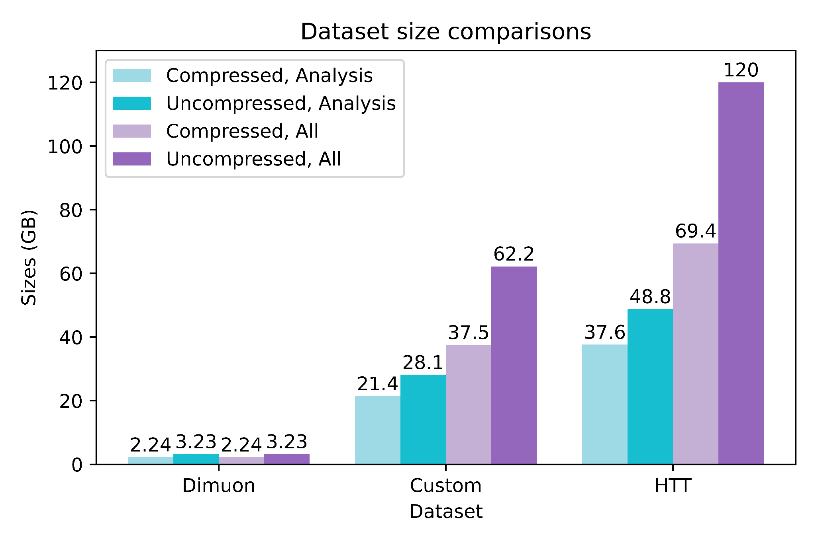
Benchmarking setup
Three datasets were used for benchmarking
  Higgs->TauTau (9 files, ~70GB)
  Dimuon (1 file, ~2.2GB)
  Custom (3 files, ~27GB)
  All files compressed with ZLib level 1
  Specific list of branches read
  Data is on eospublic for XRootD tests
Tests were repeated 2-5 times, time (and sanity) permitting
Varied on the number of cores, speed of storage/network, amount and type of data read, etc.
Good to confirm - the branches you read can have a big difference!

Slide 10
Results and thoughts

Slide 11
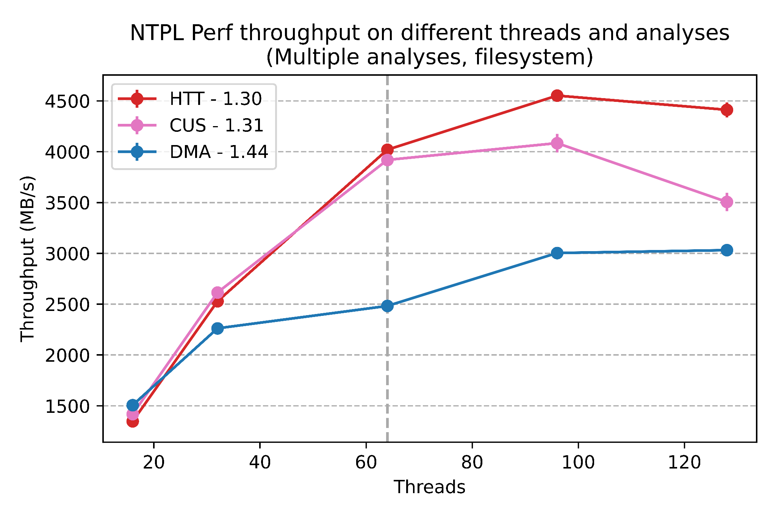
More threads usually = better
Threads tend to provide a linear speed up at first
Too many threads eventually starts to degrade performance
Parallelizability limited by file clusters (DMA plateau)

Slide 12
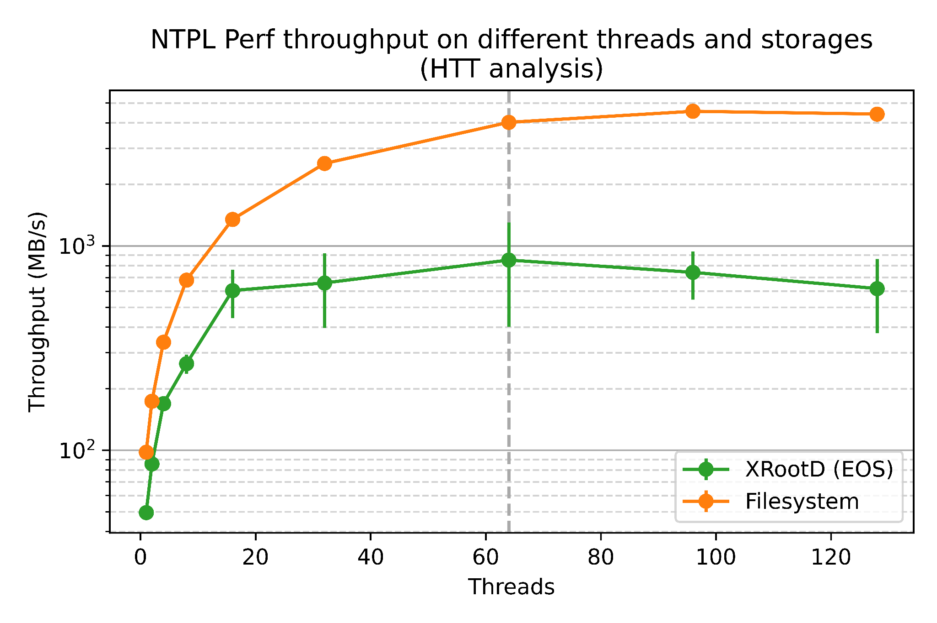
Networks have a weakest link
At some point you run at the mercy of network and shared services
Linear growth and then plateau at 32/64 threads with huge variance
Might confound benchmarking when relying on EOS files
With low threads we’re neither CPU nor I/O bound
Notes:
Re-cluster dataset with fewer clusters to see if it reduces the network latency.
Compare EOS and /eos/.

Slide 13
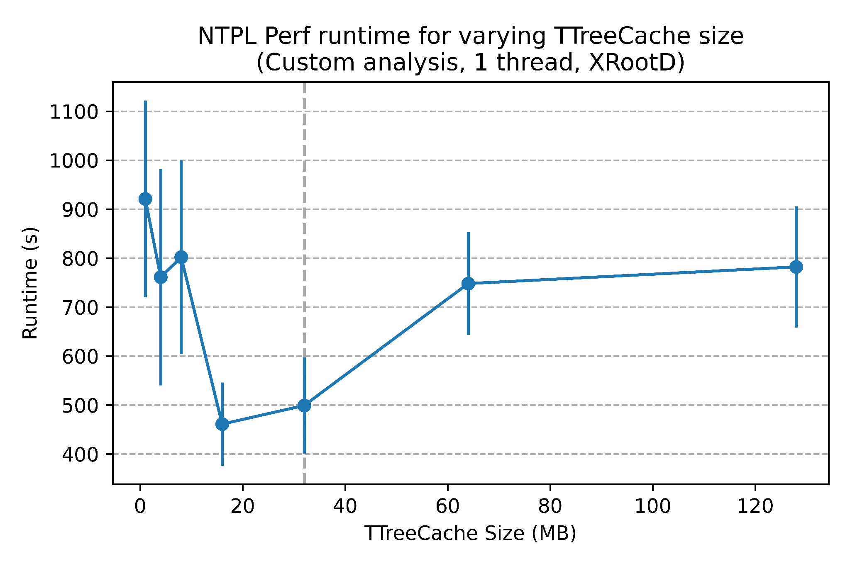
Cache size and latency amortization
Too small cache size created excessive requests and overhead?
Too large cache size lead to delays between network bursts?
Moderate cache size amortized CPU time well?
Notes:
Re-cluster dataset with fewer clusters to see if it reduces the network latency.
Compare EOS and /eos/.

Slide 14
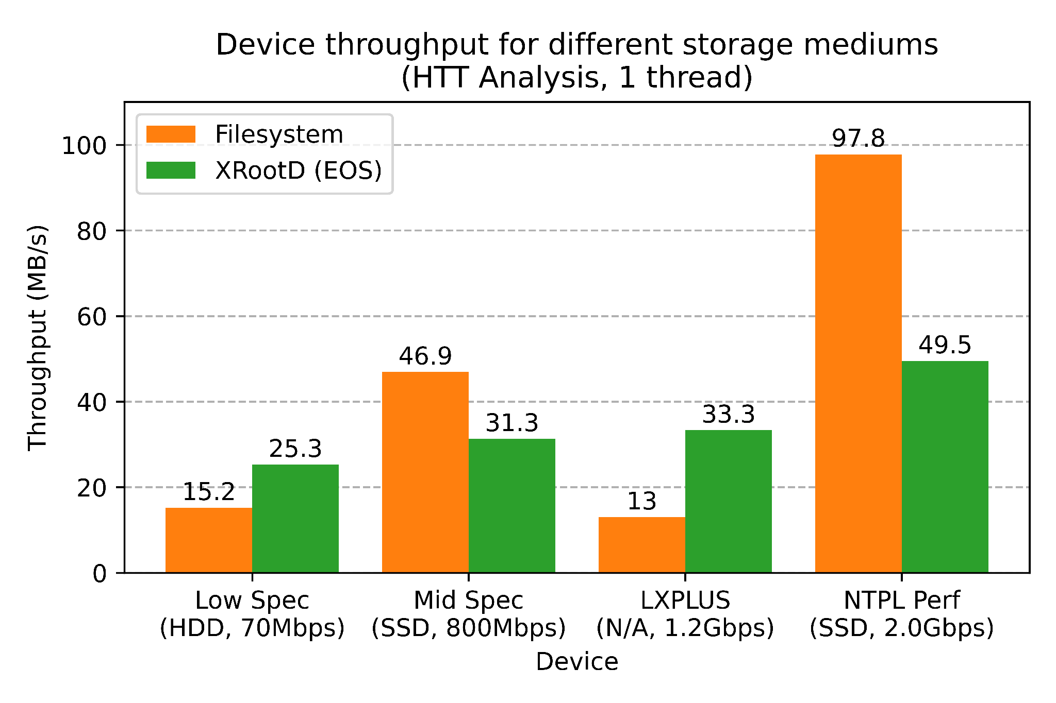
Filesystem vs XRootD (EOS)
Network isn’t always slower
Safe to assume an SSD will give best throughput
Accessing an EOS file on LXPLUS is better through XRootD than /eos/

Slide 15
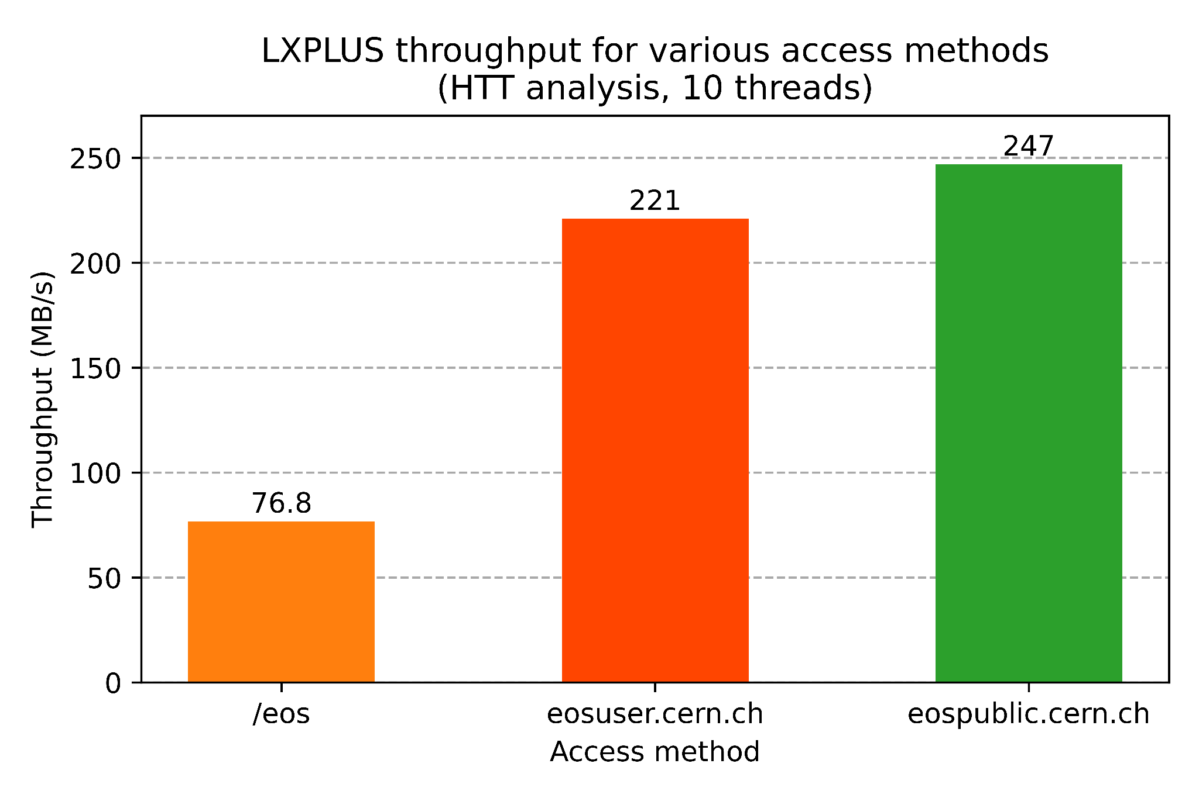
LXPLUS eos access
Direct access through /eos is worst (by far)
Accessing eospublic files is best if possible
Otherwise put files in CERNBox and access through eosuser.cern.ch

Slide 16
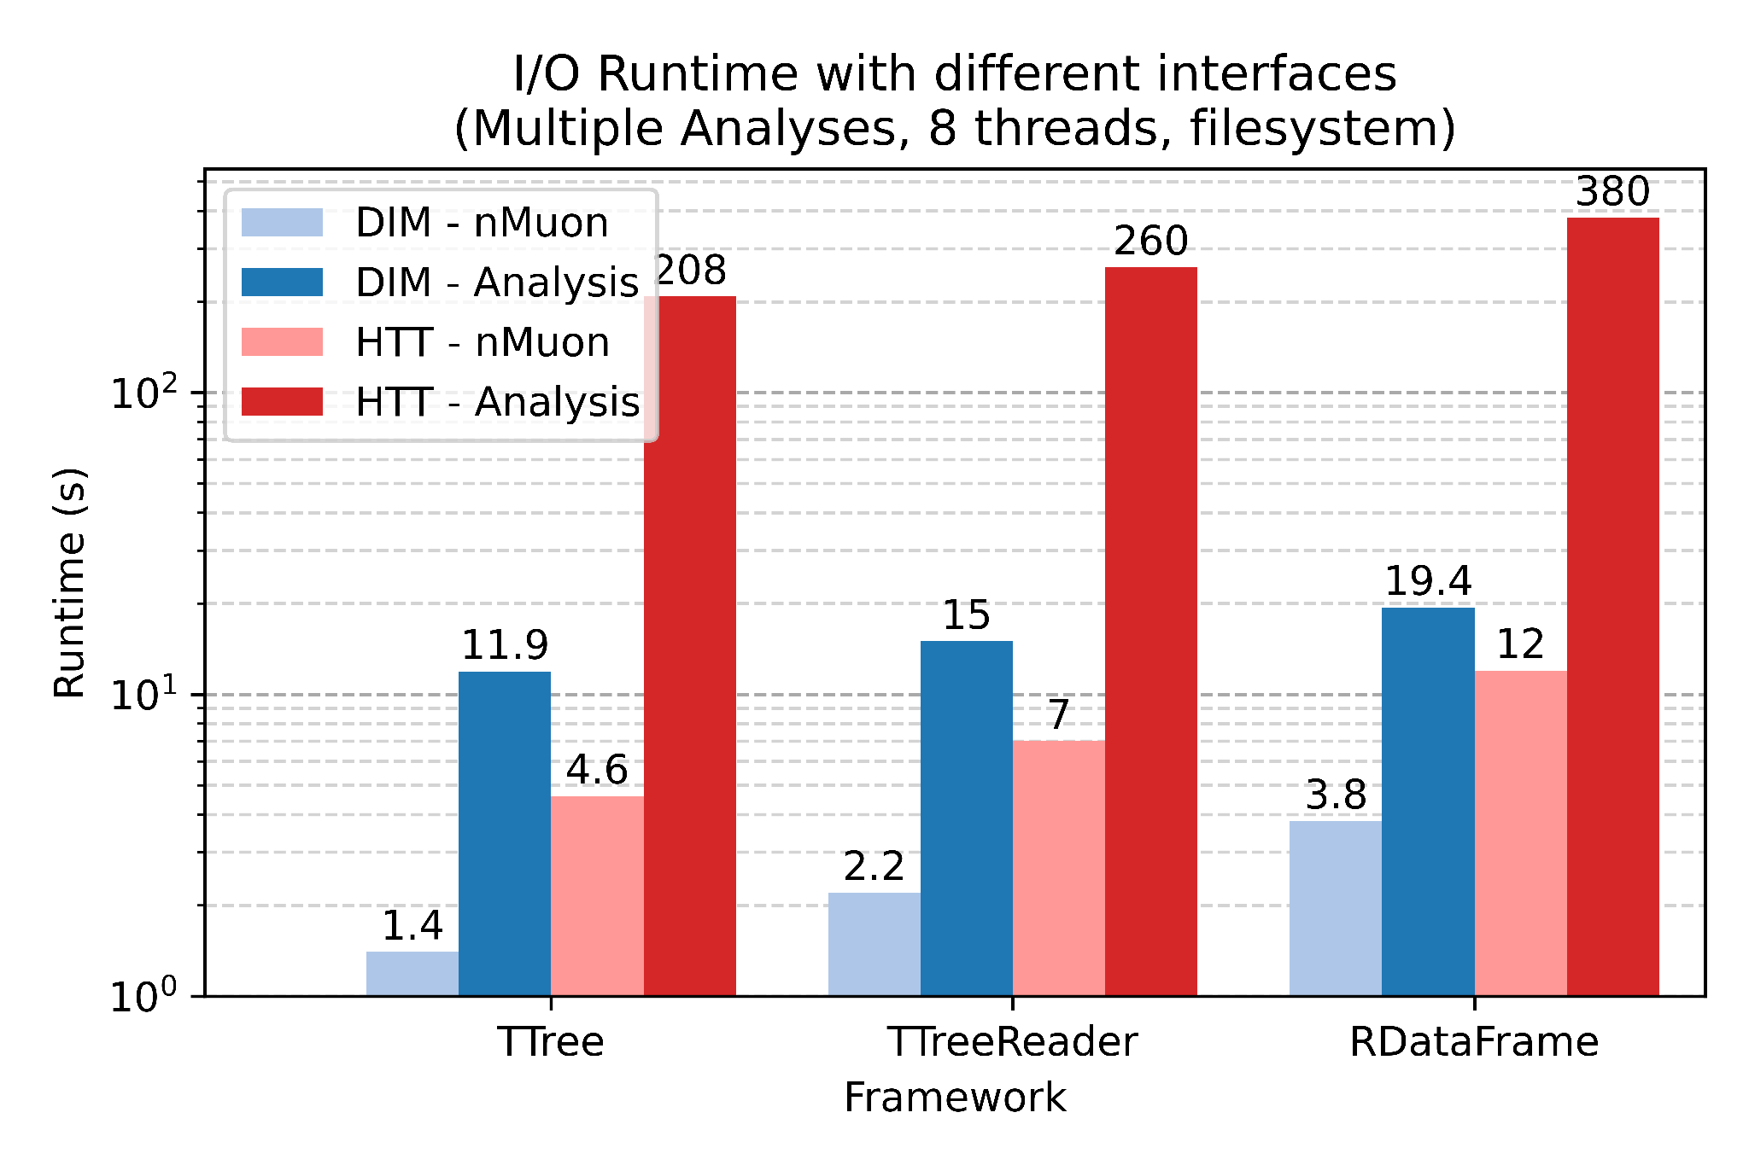
Interfaces add overhead
Most interested in the difference across same colour
Nice interfaces come at a cost
Each layer of abstraction adds ~30% I/O time

Slide 17
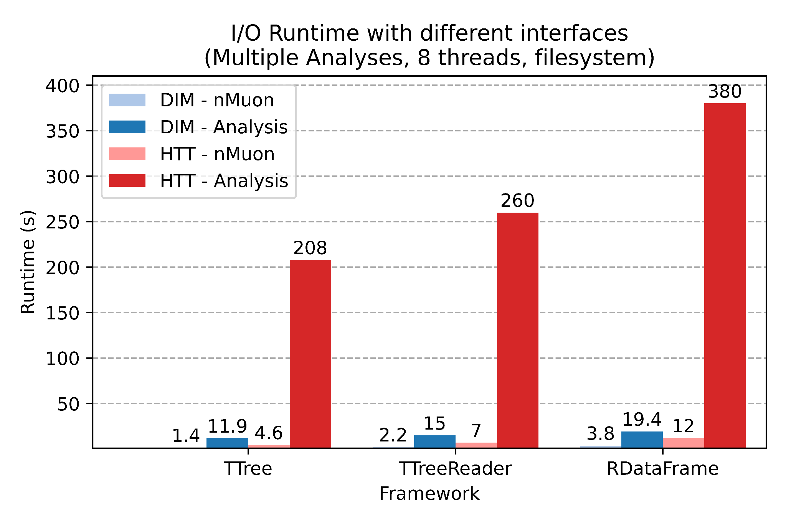
Interfaces add overhead (Cont)
Raw I/O isn’t a realistic situation, usually CPU intensive analysis code to mitigate overhead
…but more CPU work generally involves reading more data

Slide 18
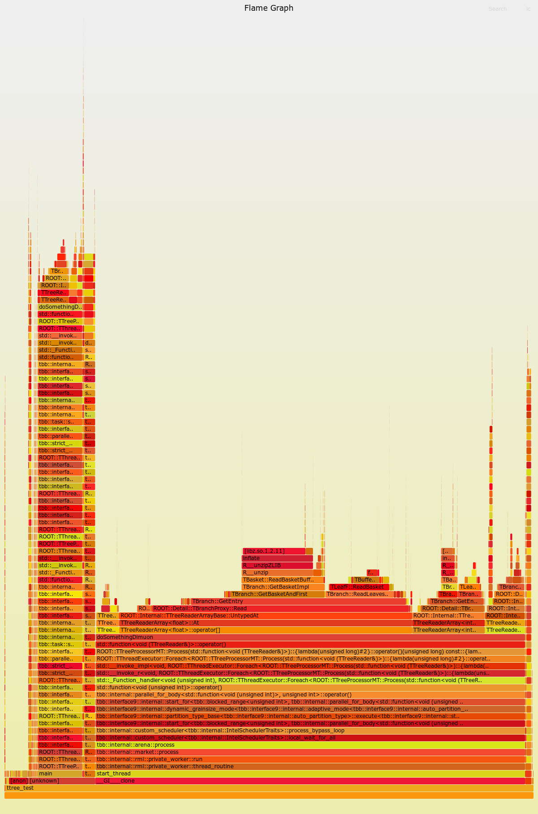
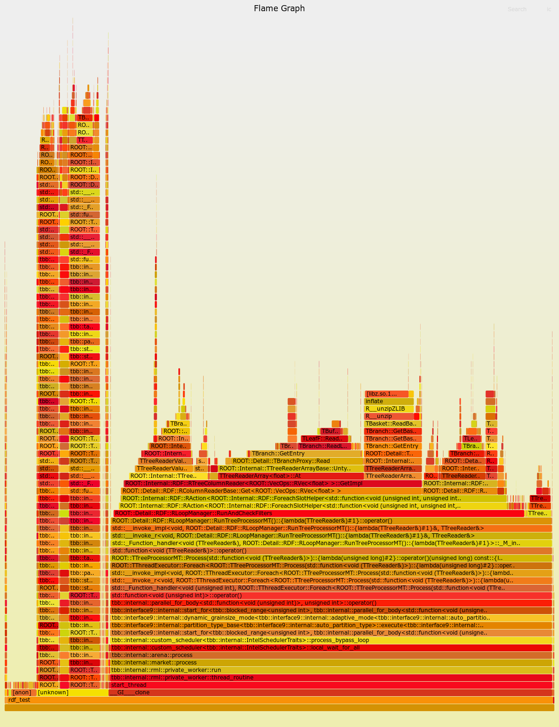
Interfaces add overhead (Cont)
Interface overhead seems to come from many small places
No clear optimizeable regions, just the costs of many features adding up
TTreeReader
RDataFrame

Slide 19
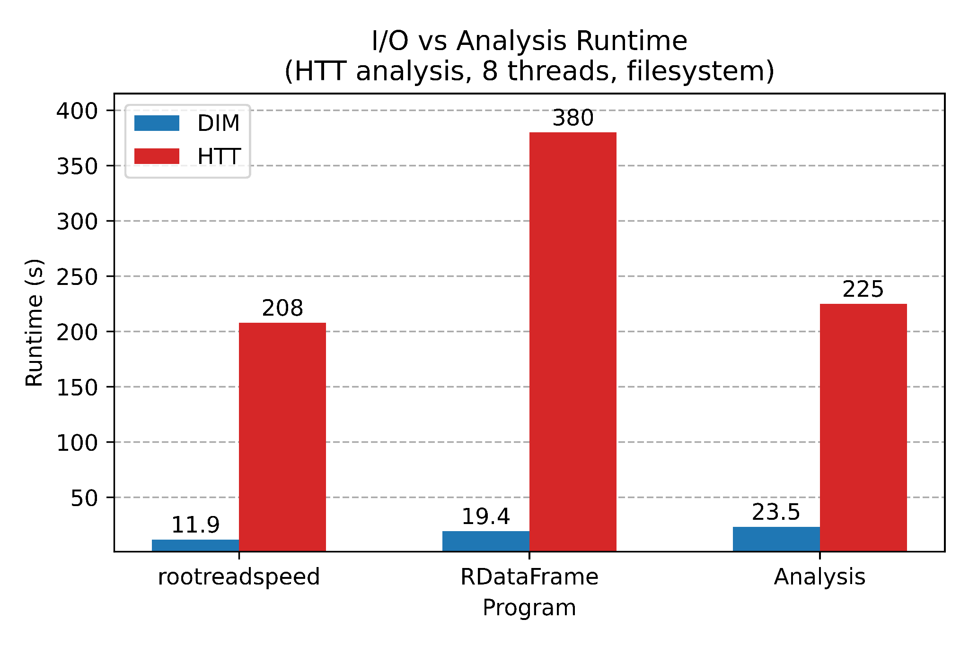
Reading all data can be misleading
rootreadspeed should be a base benchmark of runtime
Analyses will filter events and read less data
How do we make this a fair comparison?
Just reading data

Slide 20
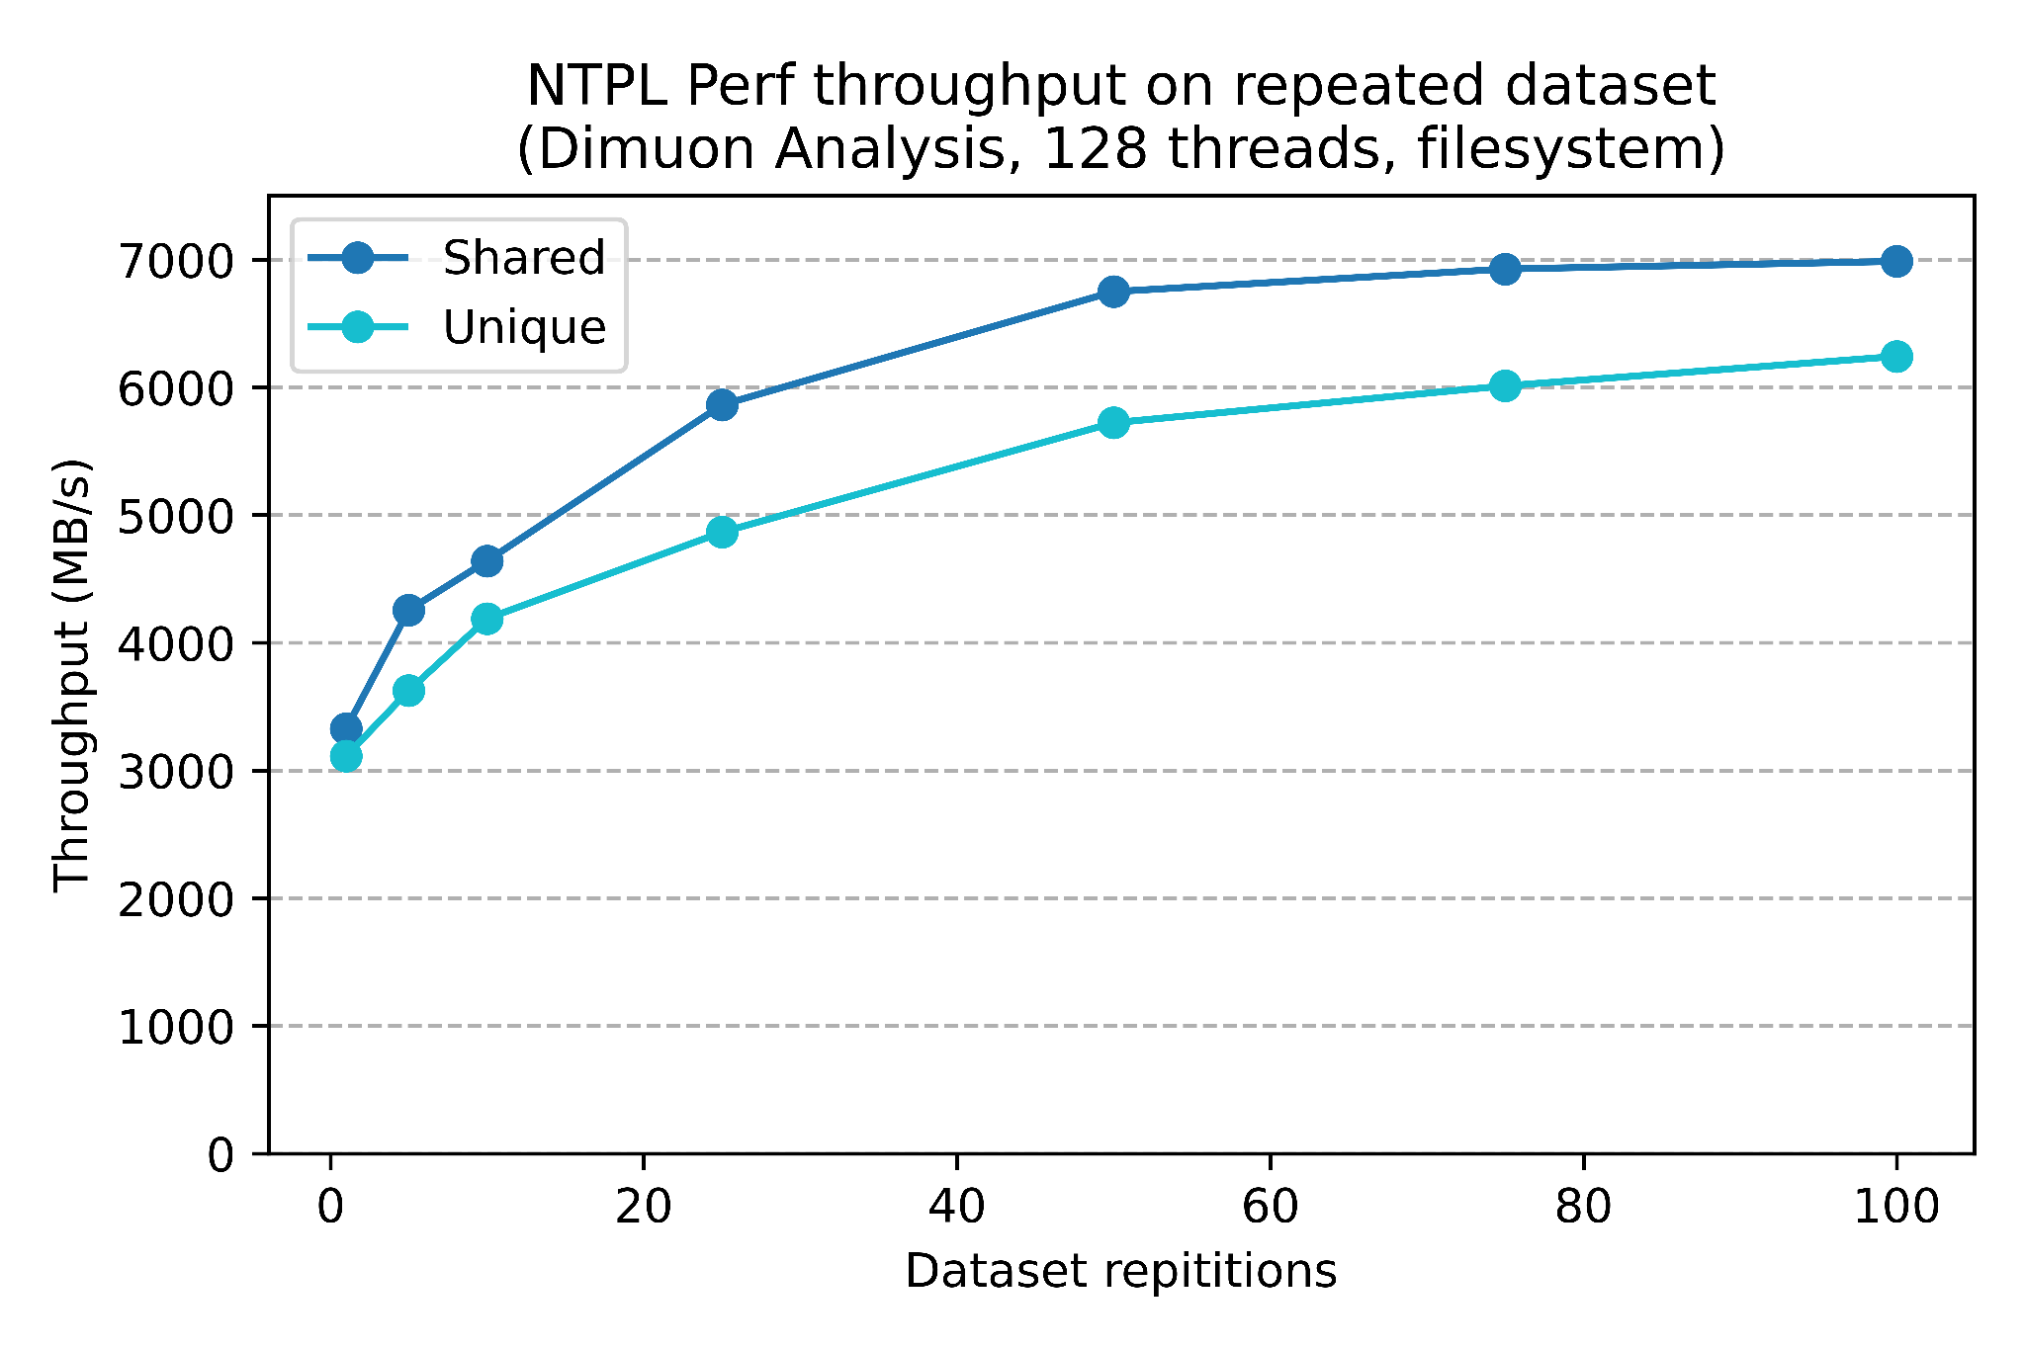
Duplicating datasets increases throughput
Shared = exact same file
Unique = copy of file (cp, not symlink)
Repeating on the same file → higher throughput
Maybe memory related? NTPL Perf has 130GiB RAM ≈ 60 x 2.2GB

Slide 21
More things to do

Slide 22
The relentless march of progress
Some more benchmarking that could be done:
Testing TTreeCache more robustly for handle network variance
+ TTreeCache effect on different network speeds, CPUs etc
Benchmarking different compression algorithms
Another rootreadspeed nice-to-have would be raw readspeed - ie. excluding decompression time. Suggestions on how to accomplish this are welcome.

Slide 23
Takeaways

Slide 24
Takeaways
What we got from all of this:
The rootreadspeed benchmarking tool
  PR in review
A page of results for expected throughputs
  Old version
  New version (WIP)
Several graphs of varying perplexity

Slide 25
Thank you! (:

Slide 26
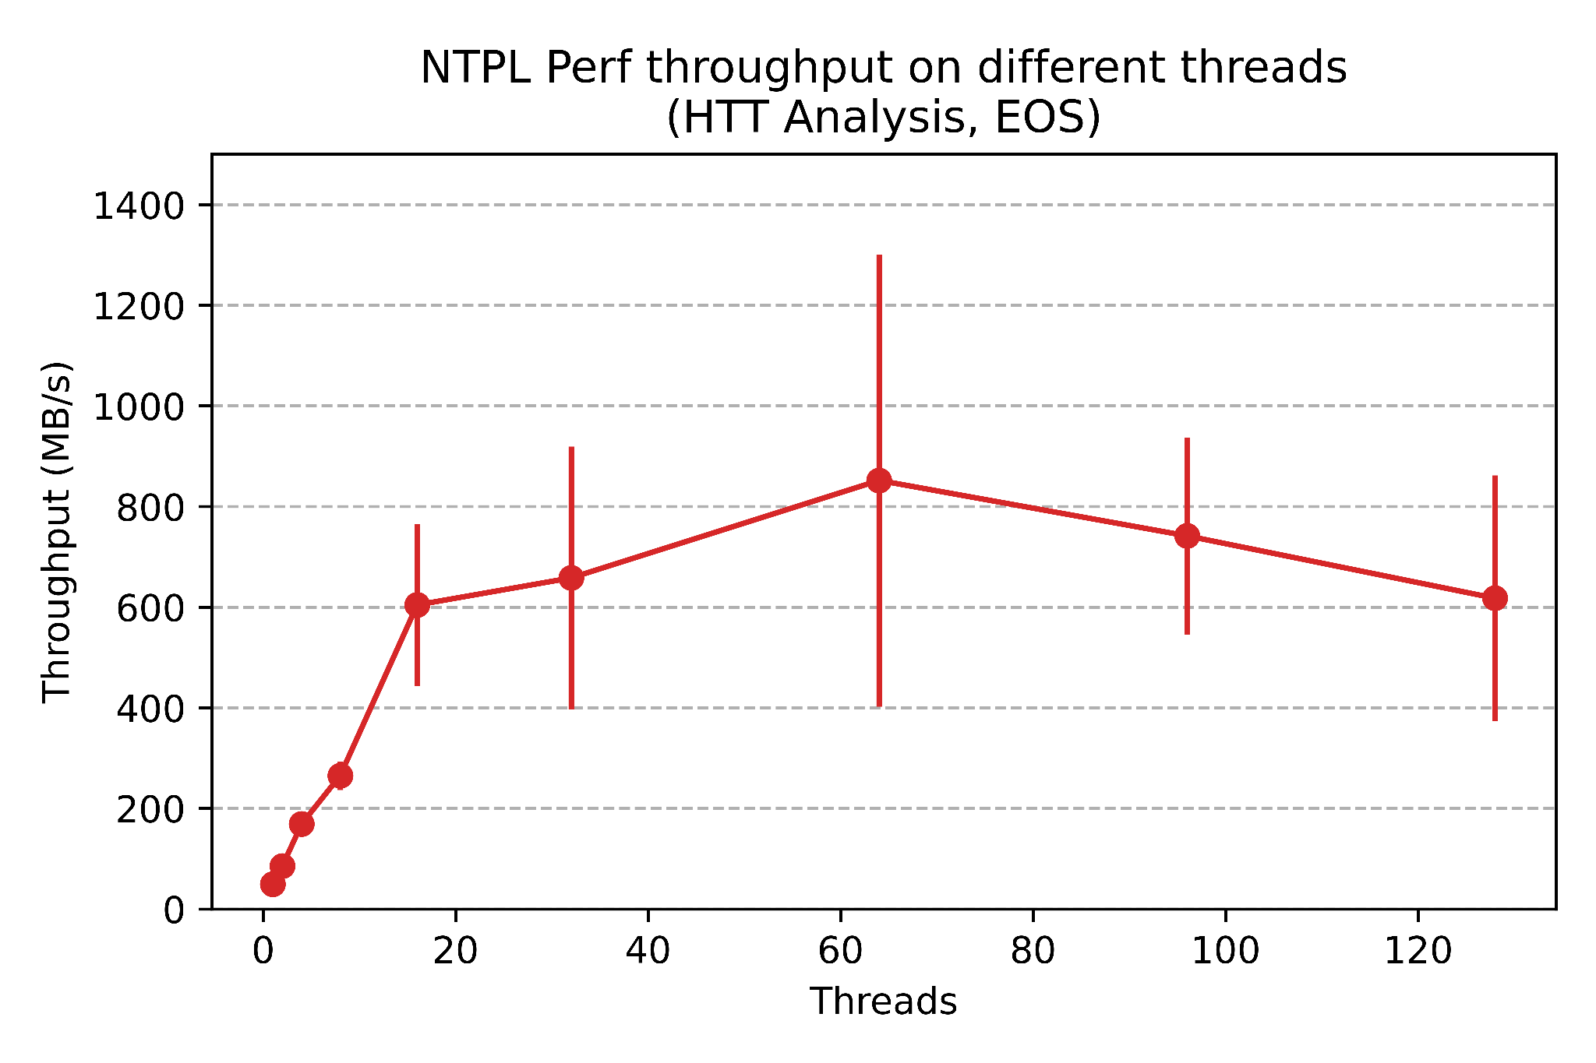
Network limits

Slide 27
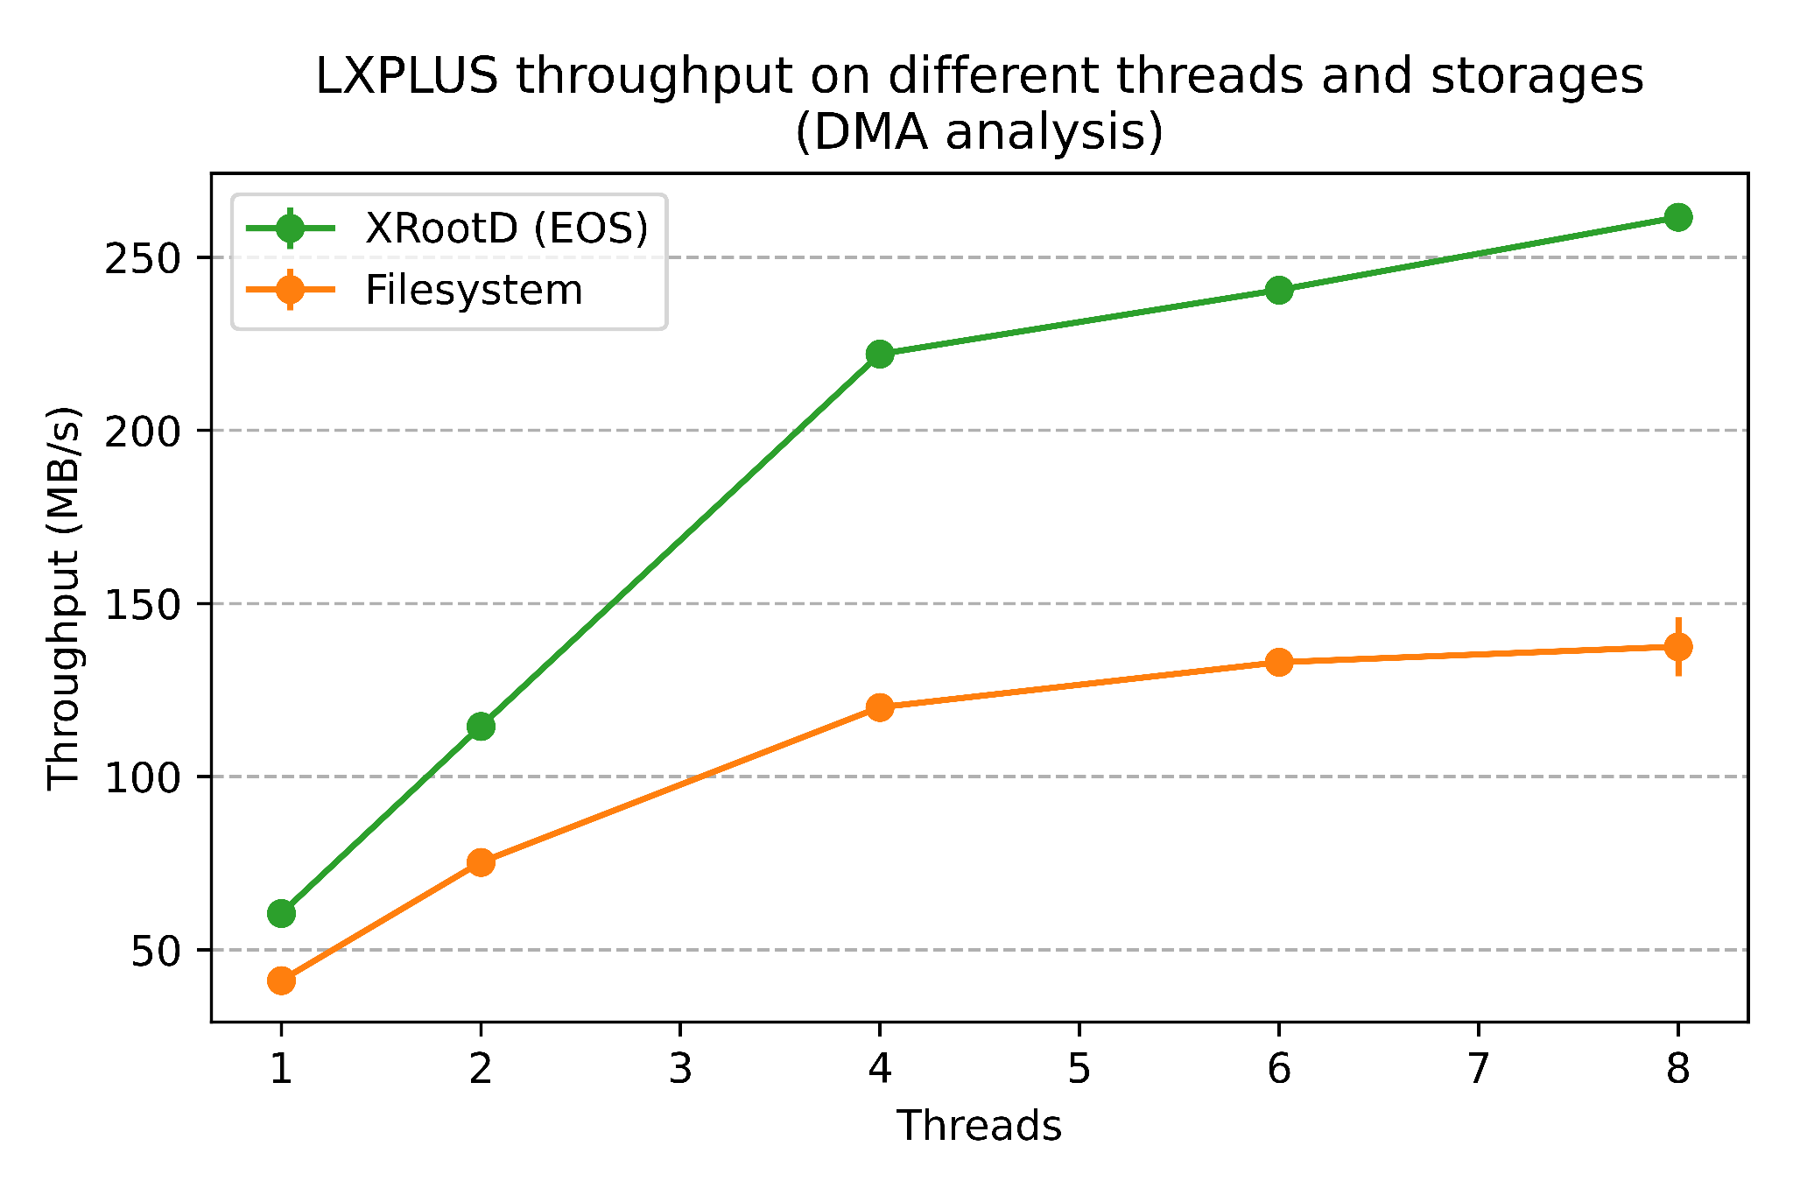
LXPLUS /eos/ vs XRootD

