Slide 1

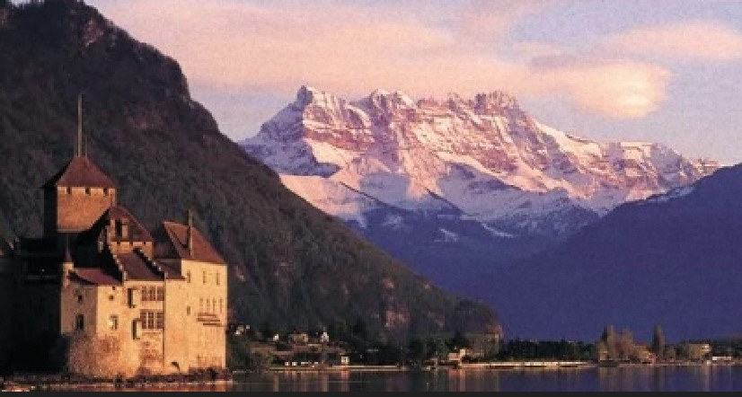
WELCOME TO COOL’23
WELCOME TO MONTREUX

Slide 2

14th edition of the bi-annual meeting
First held here in Montreux in 1993
First in-person meeting since 2019 (BINP, Novosibirsk)
47 registered participants
  Unfortunately, we had several last-minute cancellations
  The present geo-political and economic situation has made the organisation of this workshop very challenging
  28 oral presentations
  19 posters – best poster prizes
  Dieter Möhl Awards
  Guest speaker for the Closing Session on Friday

Slide 3
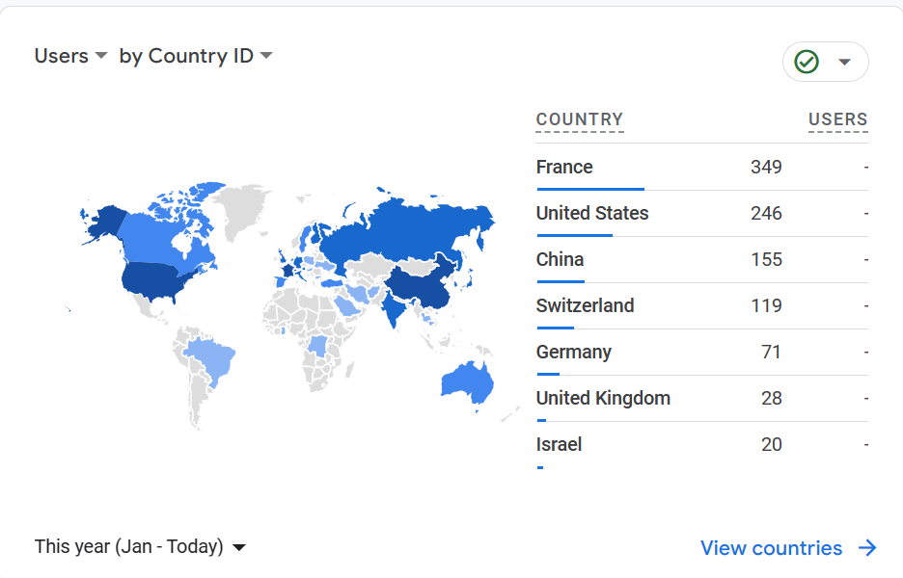

Slide 4
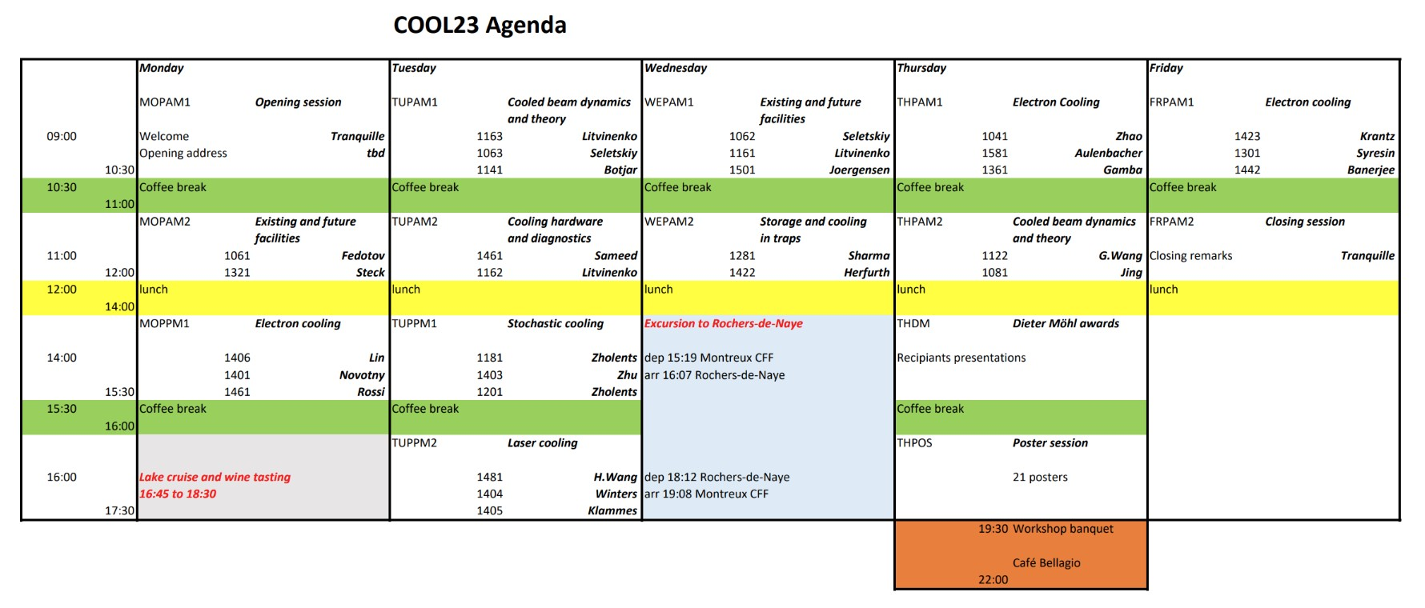
SOME TWEEKS WILL NEED TO BE MADE TO THE ABOVE SCHEDULE

Slide 5
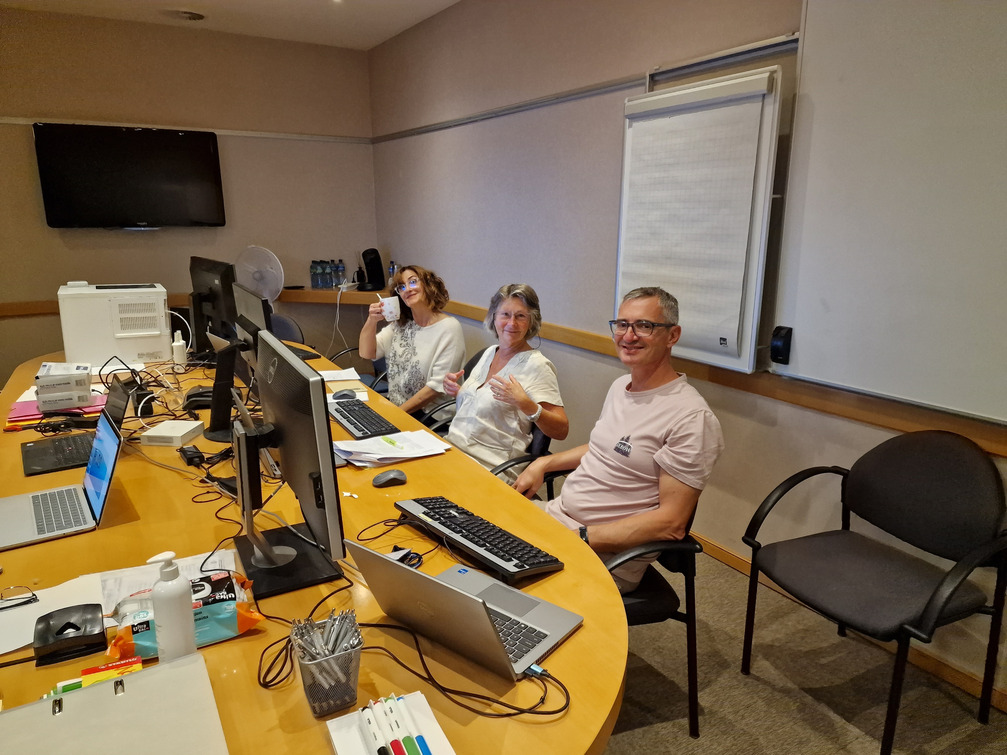
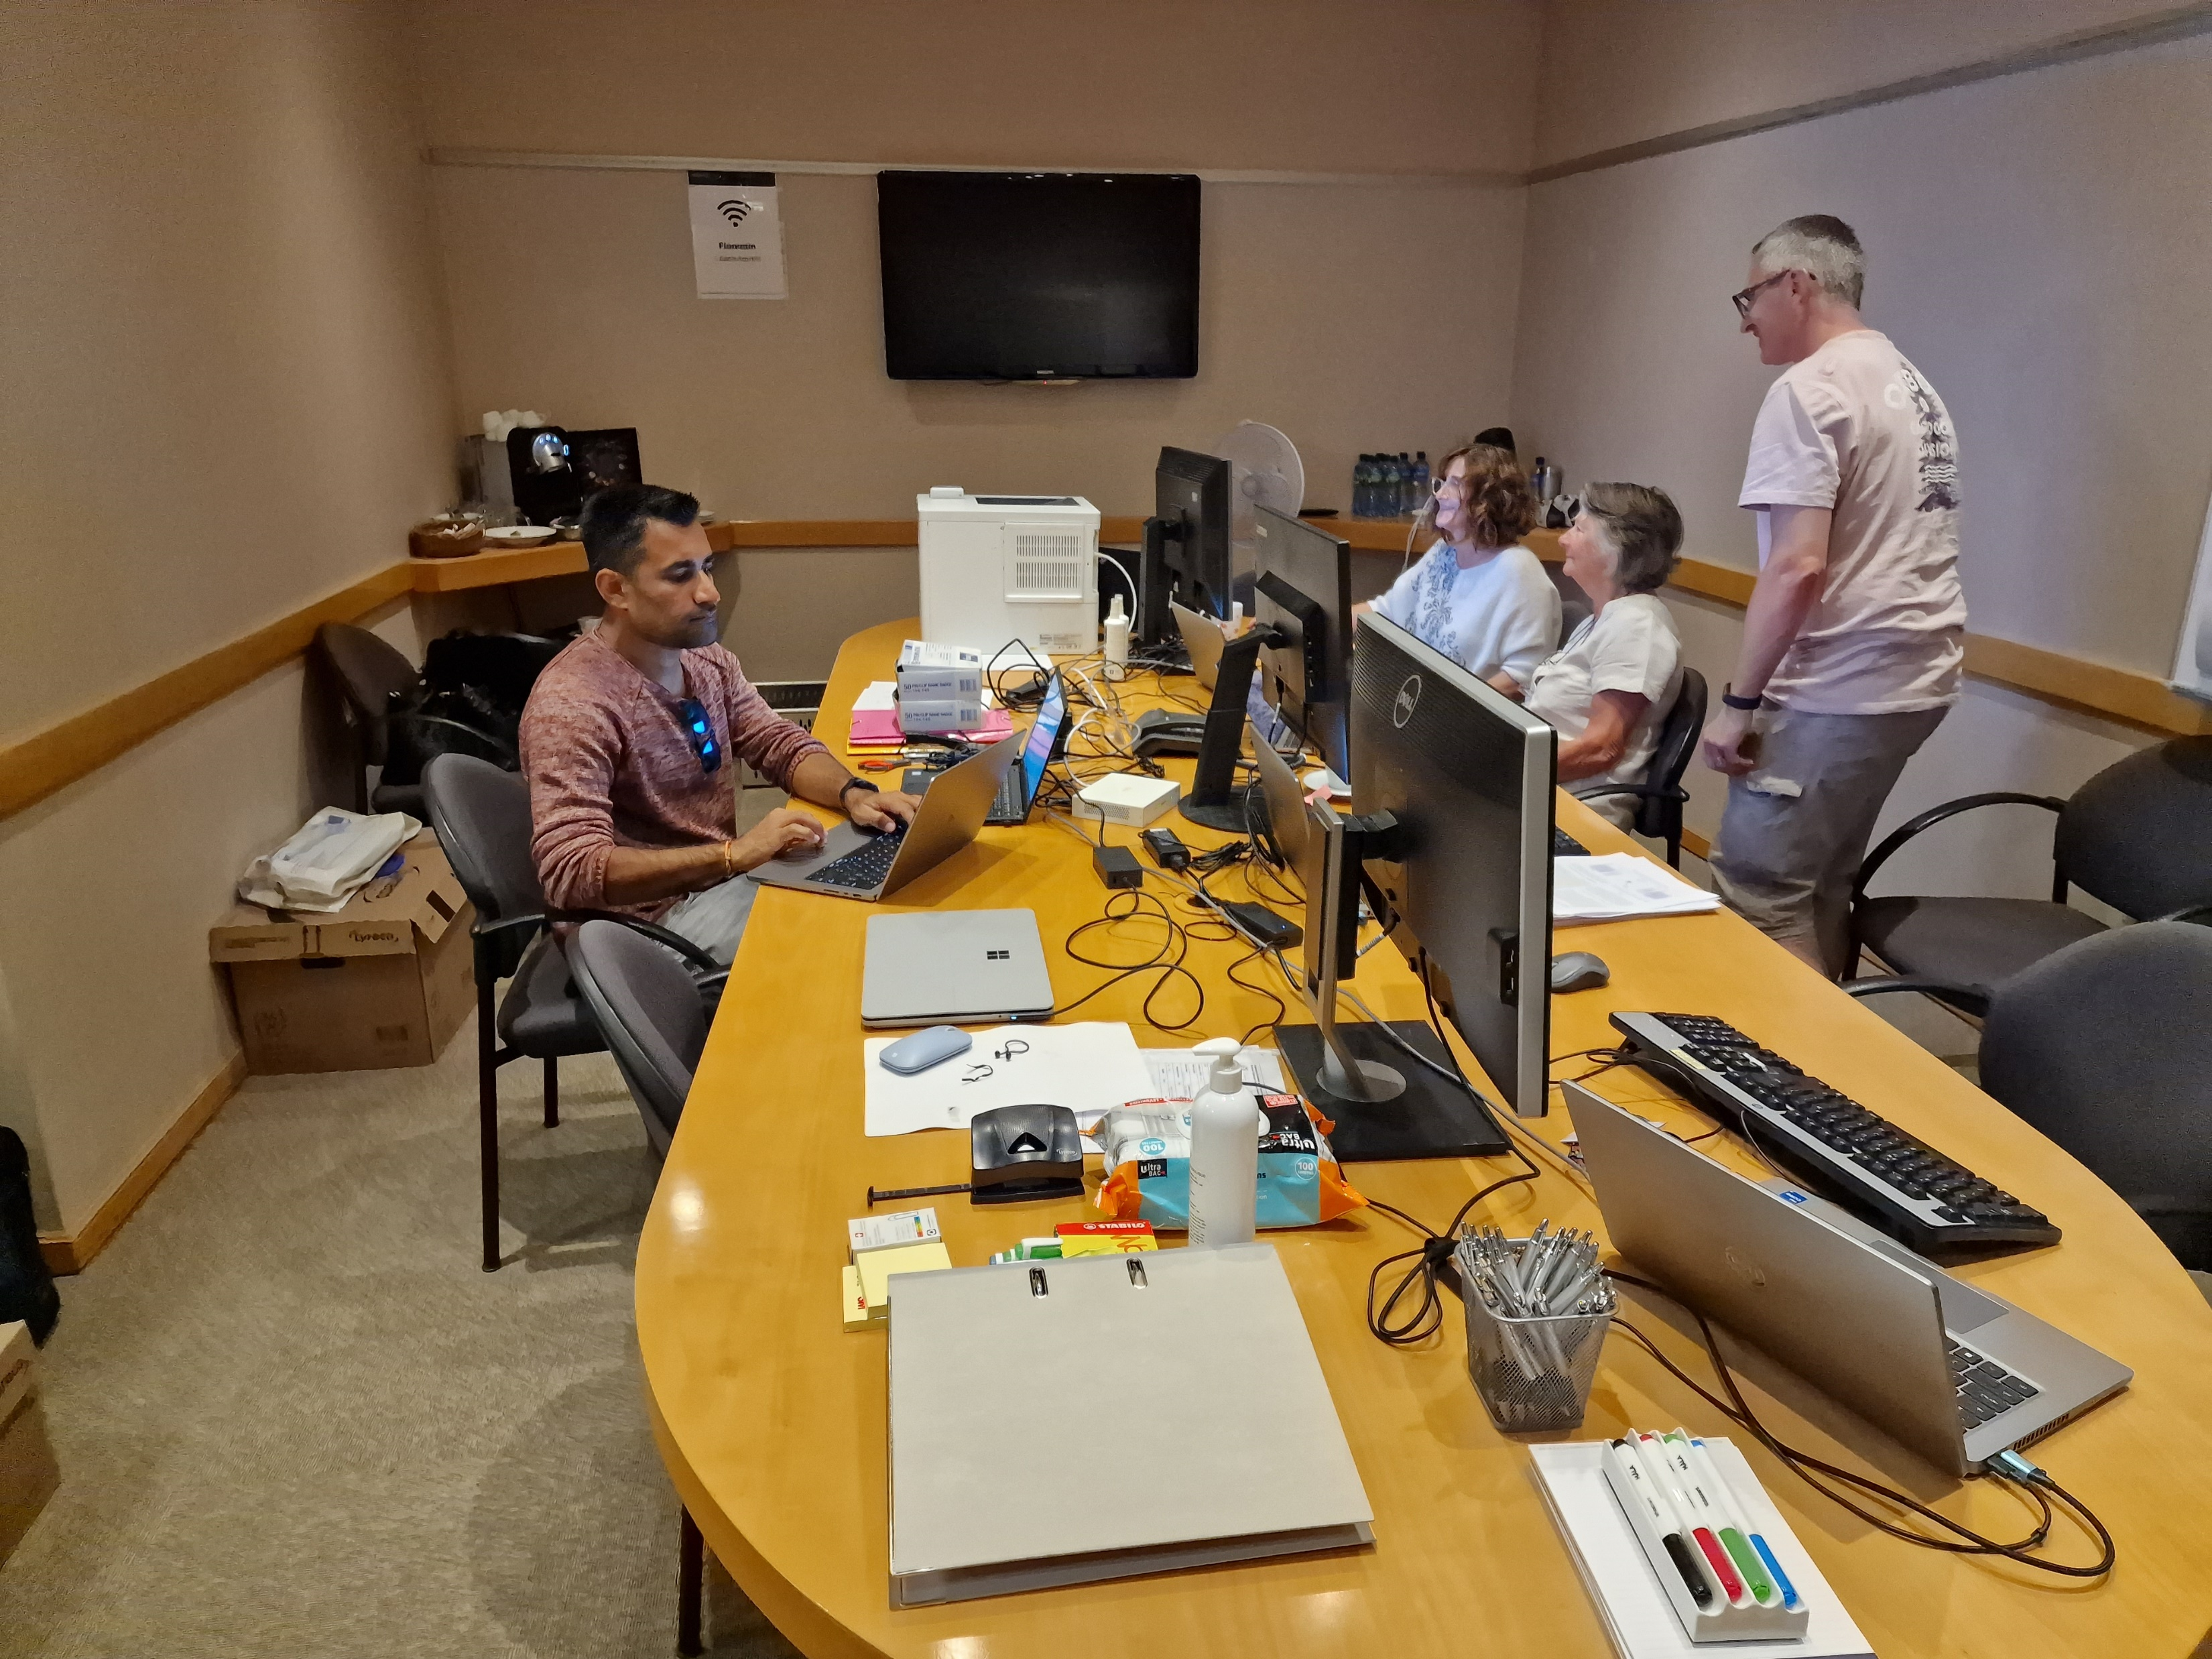
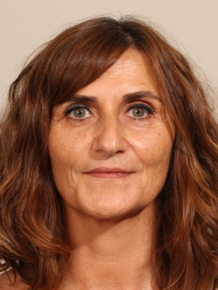
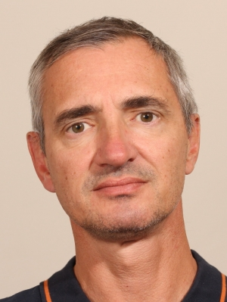
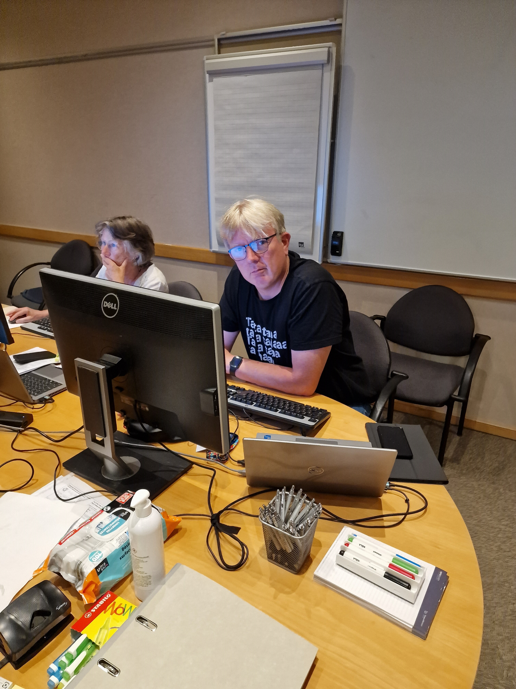
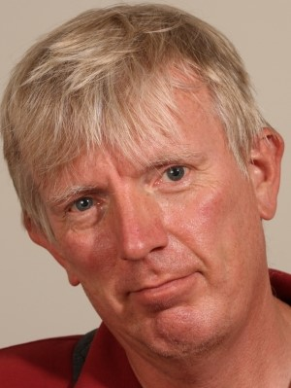
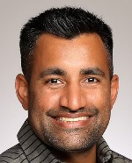
Meet the team
Christine
JACoW editor
Madeleine
Alexandre
Lars
Gunn

Slide 6
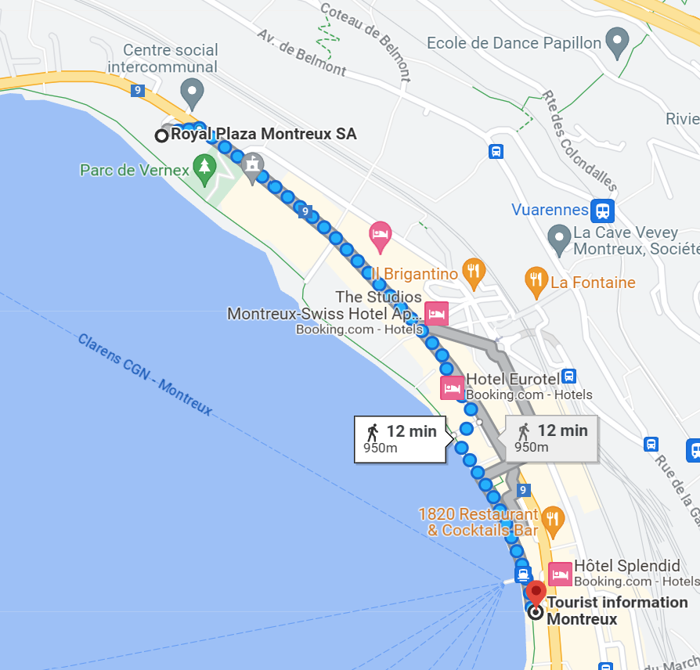
The Montreux tourist office is happy to help you with any excursion plans that you may have.
The office can be found opposite
the CGN boat jetty.

Slide 7
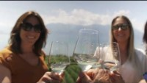

Slide 8
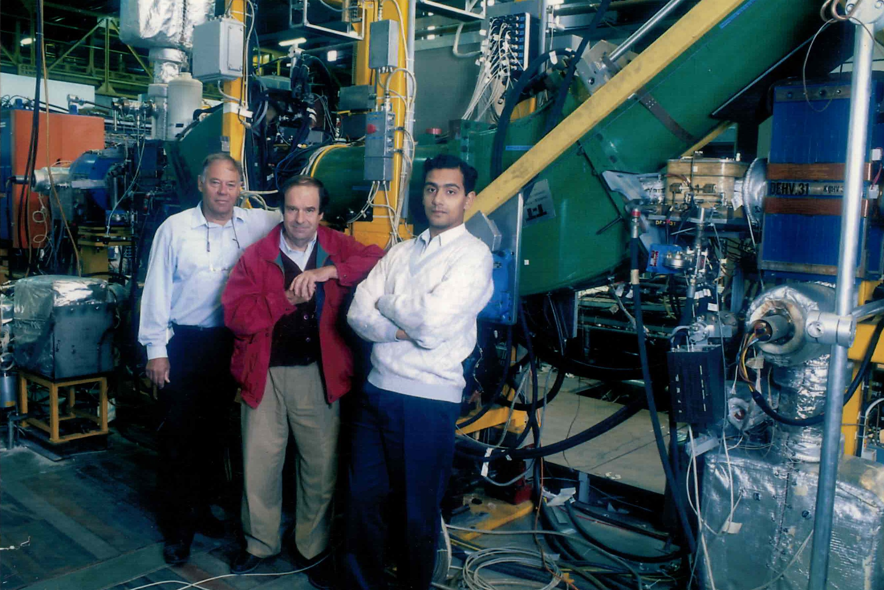
This workshop is dedicated to the memory of my two former “Eteam” colleagues:
Jacques BOSSER († 2023)
Rudy LEY († 2019)

