Slide 1

Accelerator Physics Requirements for Electron Cooler at the EIC Injection Energy
Alexei Fedotov, Dmitry Kayran, Sergei Seletskiy
Collider-Accelerator Department
Brookhaven National Laboratory

Slide 2
Outline
Electron Ion Collider (EIC) cooling requirements
EIC cooling methods and coolers
High-energy cooling in EIC
Precooling at the EIC injection energy
Precooler design parameters
Precooler challenges
Summary

Slide 3
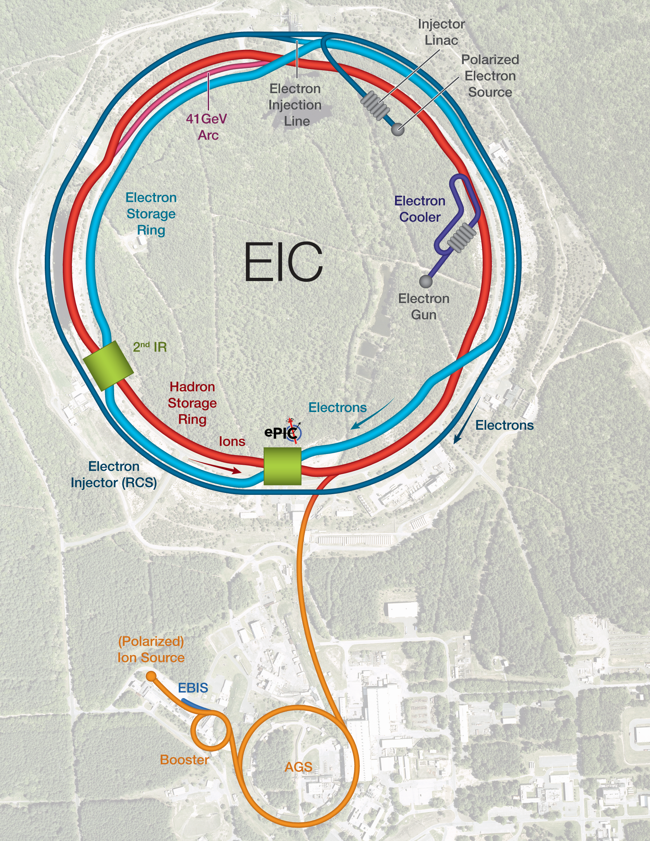
EIC Introduction
Design is based on existing RHIC complex​
  RHIC accelerator chain will provide EIC hadrons​
High luminosity interaction region(s) ​
  L = 10³⁴cm⁻²s⁻¹​
Hadron Storage Ring (HSR: RHIC Rings) 40-275 GeV​
  Supplied by AGS and Booster Injectors​
  Hadron cooling
Electron Storage Ring (ESR) 5–18 GeV ​
  Need to inject polarized bunches every second​
Rapid Cycling Synchrotron (RCS)​
  Designed to supply polarized bunches to the ESR every second​
  Polarized e-source and pre-injector
E_{cm} = 20 GeV -141 GeV
High luminosity goal: L = 10³⁴cm⁻²s⁻¹

Slide 4
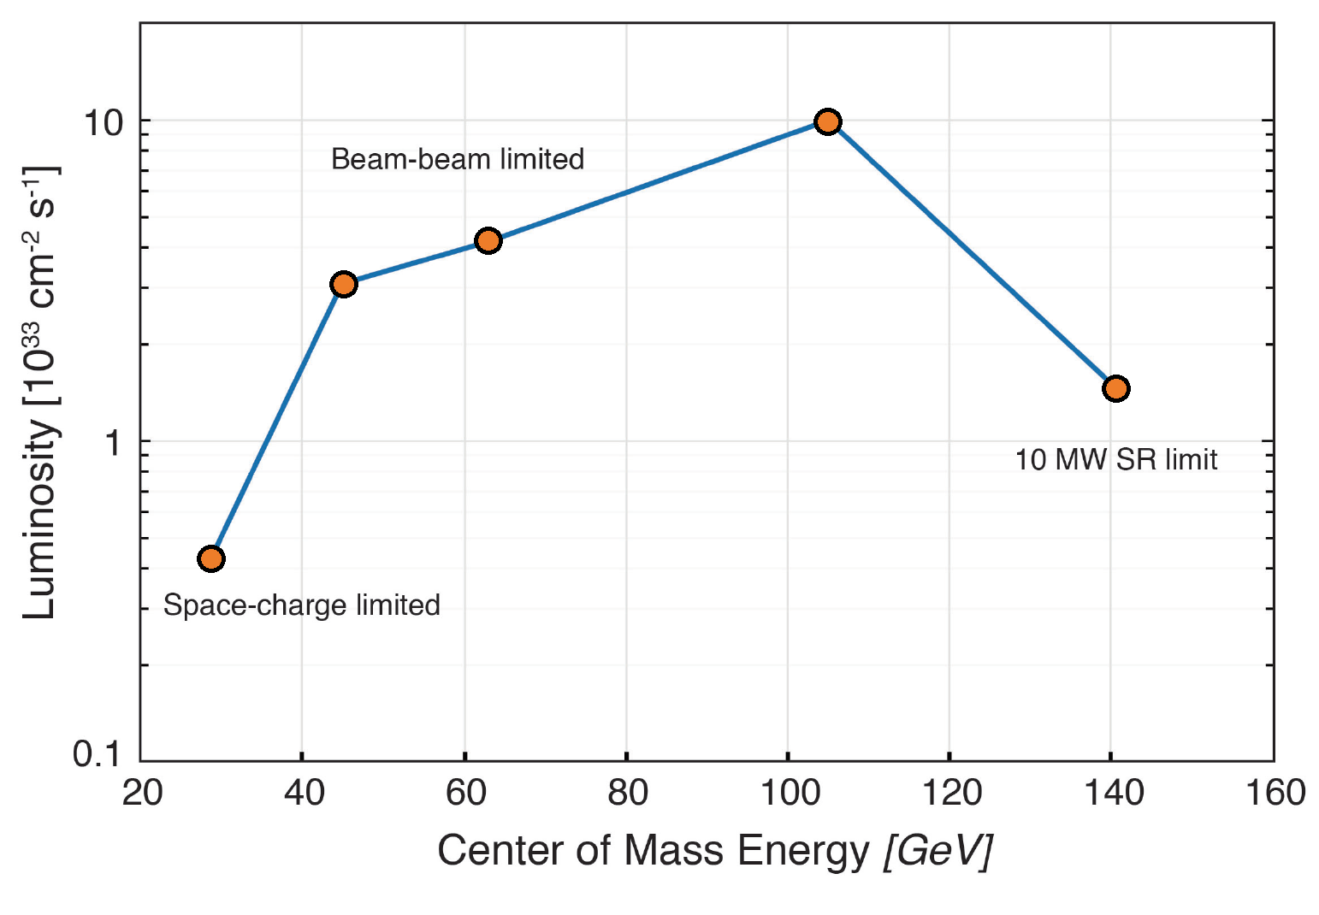
High Luminosity and Hadron Cooling
The luminosity in the EIC strongly benefits from cooling of hadrons transverse and longitudinal beam emittances.
At collision energies, IBS longitudinal and transverse(h) growth time is 2-3 hours. Beam-beam growth time(v) is > 5 hours. The cooling time shall be equal to or less than the diffusion growth time.
With Hadron Cooling:
  EIC design luminosity
  L = 1·10³⁴cm⁻²s⁻¹ at E_{cm}=105 GeV can be achieved & full range of EIC physics exploited.
Integrated luminosity with cooling is 10 x larger than without cooling.​

Slide 5
Hadron cooling requirements for EIC
High-energy cooling of protons (275, 100 GeV):
At EIC proton collision energies of 41, 100 and 275 GeV, cooling should counteract longitudinal and transverse emittance growth and maintain close to initial beam emittances.
Low-energy Cooling:
Precooling of protons at injection energy (24 GeV):
The goal of cooling at injection energy of protons (Precooling) is to obtain initial proton parameters by cooling vertical emittance to 0.3-0.5 um (rms normalized). This requires 13 MeV electron accelerator.
Cooling protons at low collision energy (41 GeV):
13 MeV electron cooler (Precooler) can be extended to 22 MeV, which would provide required cooling for protons at collision energy of 41GeV.
5

Slide 6
Cooling methods for EIC
Electron Cooling (13MeV):
Precooling of protons at injection energy of 24 GeV to reduce vertical emittance to 0.3 um (rms, normalized).
Electron Cooling (22MeV):
Cooling of protons at collision energy of 41 GeV.
Coherent Electron Cooling, CeC (55, 150MeV):
High-energy cooling of protons at collision energies of 100, 275 GeV.
Electron Cooling (55, 150MeV):
High-energy cooling of protons. Considered as a backup for CeC method.

Slide 7
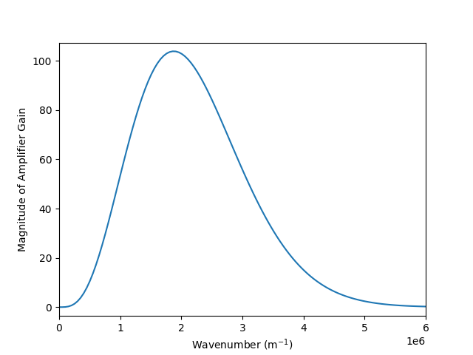
High energy cooling based on CeC
Similar to stochastic cooling, tiny fluctuations in the hadron beam distribution are detected, amplified and fed back to the hadrons by electron beam, reducing emittance of the hadron beam.
High bandwidth (small slice size)
Detector (Modulator), amplifier and feedback (kicker)
E<E₀
H⁺
Modulator
E>E₀
Kicker
R₅₆
R₅₆
R₅₆
e⁻
For high-energy protons, a large bandwidth (tens of THz) is required:
➔ Using an electron beam to pickup fluctuations, to amplify and to kick back.
EIC CDR baseline Amplification method: micro-bunched amplifier.

Slide 8
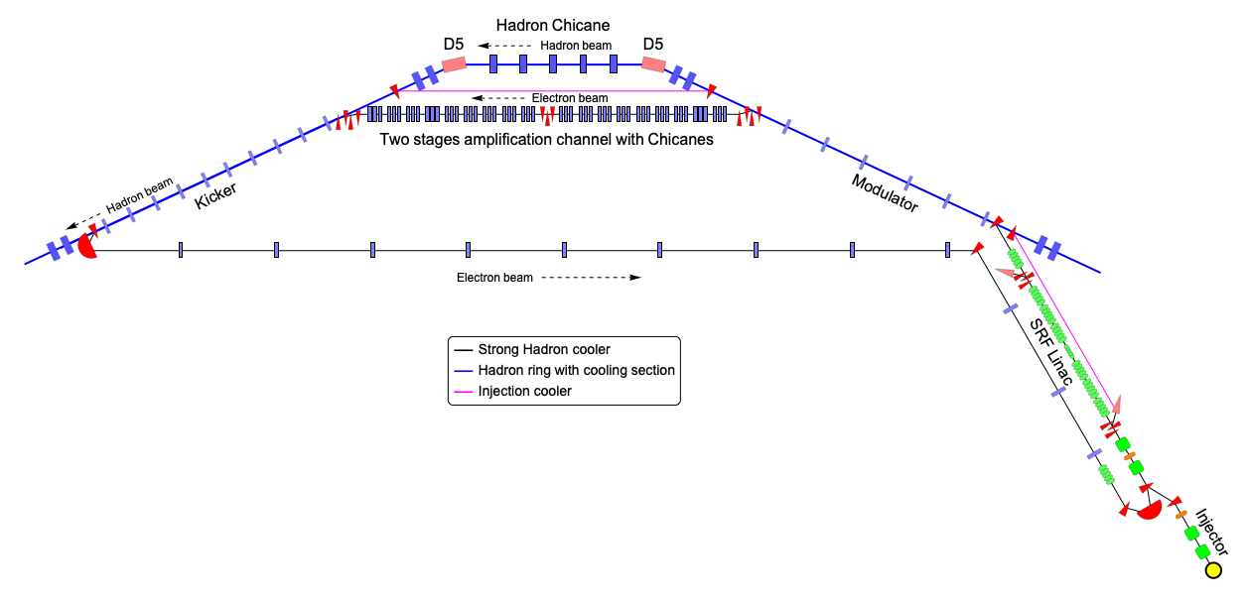
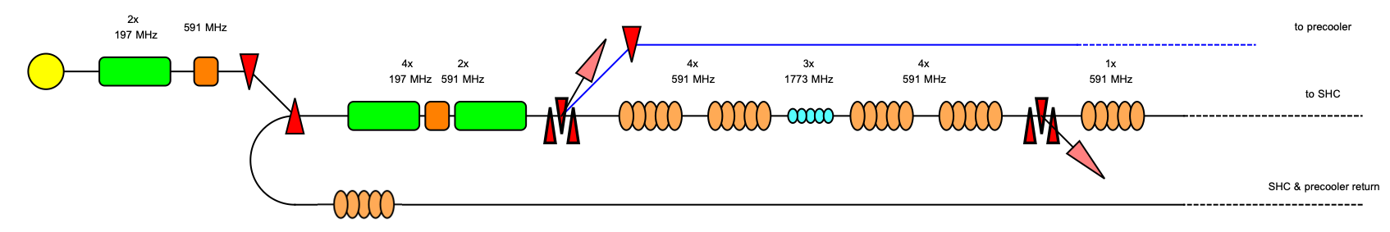
EIC High Energy-CeC/Precooler facility layout
COOL’23 presentation:
K. Dietrick et al.
EIC High-Energy CeC-based cooler (Strong Hadron Cooling, SHC) design:
E. Wang et al., “The accelerator design progress for EIC strong hadron cooling”, IPAC21 (2021).
W. Bergan et al., “Design of the MBEC Cooler for the EIC”, IPAC21 (2021).
C. Gulliford et al., “Design and optimization of an ERL for cooling EIC hadron beams”, IPAC23 (2023).
Precooler bypass
Precooler (13MeV) bypass
Gun
13MeV
4x
1773 MHz
High-energy Cooler (150MeV)

Slide 9
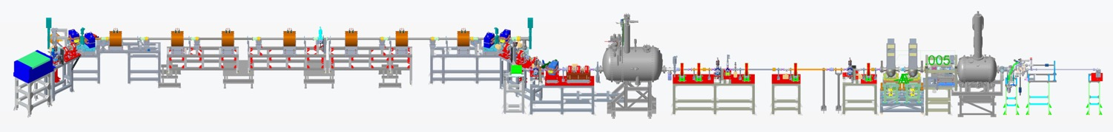
CeC-X: Proof of Principle experiment
COOL’23 talks:
V. Litvinenko et al.
Y. Jing et al.
G. Wang et al.
At BNL, efforts are underway to demonstrate CeC experimentally.
4-cell PCA
Kicker
Modulator
2014-17: Built and commissioned electron accelerator.
2018: Experiments with FEL-based CeC.
2019: Built and commissioned PCA-based system.
2020-23: Experiments towards PCA-amplified CeC.

Slide 10

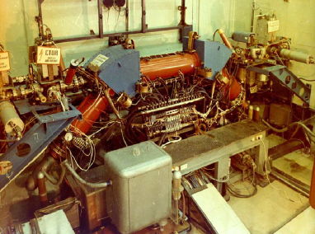
Electron Cooling
The method of electron cooling was presented by G.I. Budker (Novosibirsk) in Saclay, 1966.
First experimental
demonstration of electron cooling at NAP-M storage ring (Novosibirsk, 1974).
Electron Cooling is a well-established technique with almost 50 years of experimental experience.
High Voltage DC coolers: (1974-): all DC electrostatic accelerators; all use magnetic field to confine electron beam (magnetized cooling). FNAL Recycler cooler: Pelletron electrostatic generator (4MeV electrons), transport of electron beam without continuous magnetic field.
RF acceleration (High Energy approach): BNL LEReC electron cooler (2019-21): First RF-linac based electron cooler (approach is directly extendable to higher energies). LEReC does not use any magnetization of electrons. LEReC was successfully used for RHIC operations in 2020-21 to cool ion bunches directly at collision energy.
3

Slide 11
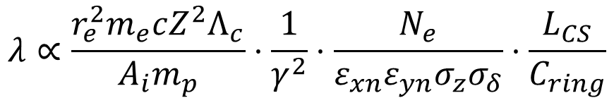
Electron Cooling at high energy
$$λ∝\frac{r_{e}^{2}m_{e}cZ^{2}Λ_{c}}{A_{i}m_{p}}⋅\frac{1}{γ^{2}}⋅\frac{N_{e}}{ε_{xn}ε_{yn}{σ_{z}σ}_{δ}}⋅\frac{L_{CS}}{C_{ring}}$$
Cooling rate
Reduction in a cooling rate with energy can be compensated by:
  Increasing the 6-D phase space density of the electron bunch
  Increasing the length of the cooling section
  Precooling an ion bunch, because ions with a small velocity spread are cooled faster
What is needed is to design accelerator which can provide electron beam parameters required for cooling.
Several approaches to electron accelerator were considered.

Slide 12
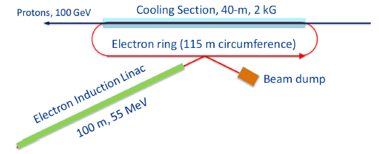
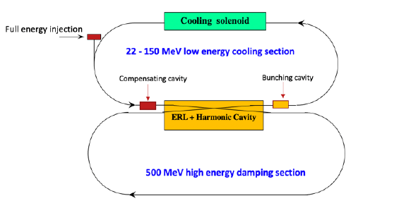
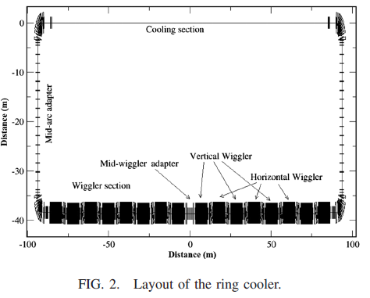
High-energy cooling for EIC
Several approaches based on conventional electron cooling, as alternative to Coherent Electron Cooling (which is present baseline for EIC Strong Hadron Cooling), were considered:
Induction Linac based Ring cooler (FNAL):
V. Lebedev, S. Nagaitsev et al.,”CDR: A ring-based electron cooling for EIC”, JINST 16 T01003 (2021).
2. Dual-ring electron accelerator (JLAB):
B. Dhital et al., “Beam dynamics study in a dual energy storage ring for ion beam cooling”, Proc. IPAC21, TUXA07 (2021).
3. ERL-based Circulator Ring (JLAB):
S. Benson et al., ERL19, LINAC20 presentations
4. Storage Ring electron cooler (BNL):
H. Zhao, J. Kewisch et al., “Ring-based electron cooler for high energy beam cooling”, PRAB 24, 043501 (2021)
COOL’23 talk: F. Lin et al.

Slide 13
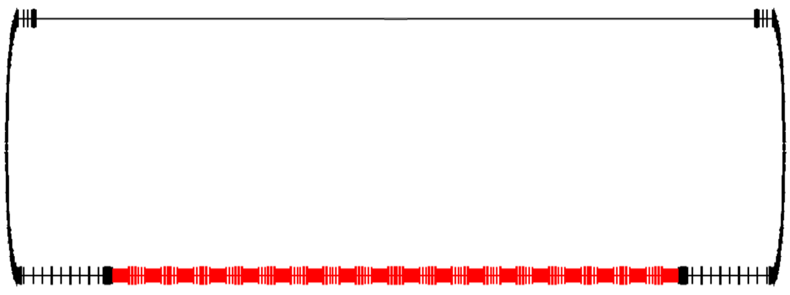
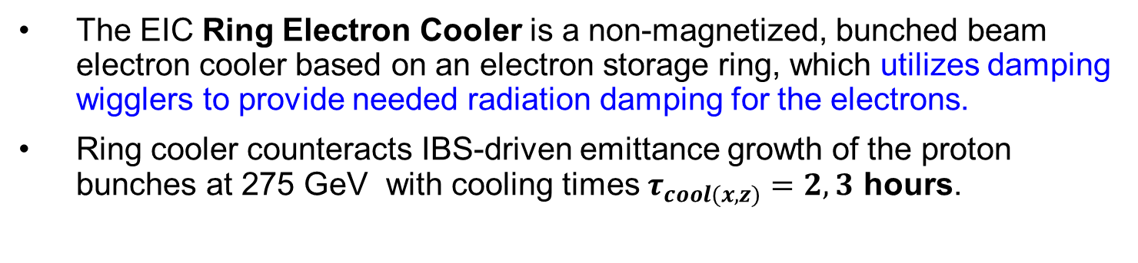
EIC Ring Electron Cooler
COOL’23 talk:
S. Seletskiy et al.
The EIC Ring Electron Cooler is a non-magnetized, bunched beam electron cooler based on an electron storage ring, which utilizes damping wigglers to provide needed radiation damping for the electrons.
Ring cooler counteracts IBS-driven emittance growth of the proton bunches at 275 GeV with cooling times $τ_{cool(x,z)}=2, 3$ hours.
p
Cooling section
p
p
e
No continuous solenoidal field in the cooling section
Electron bunches, not a DC beam
150 MeV Electron Cooler
Wiggler section

Slide 14
EIC cooling requirements for Precooler
Goal of precooling at injection energy of protons is to obtain required small vertical emittance of protons.
14

Slide 15
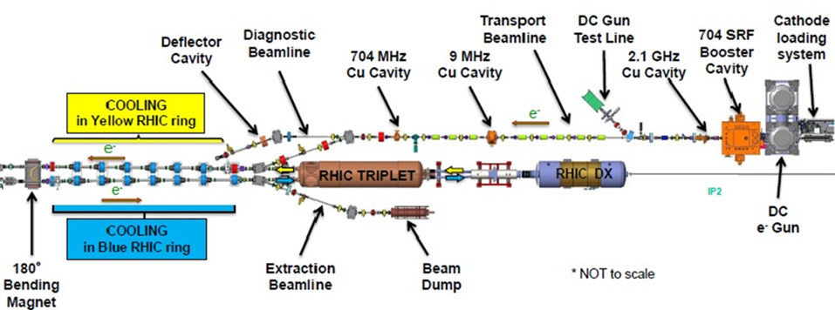
LEReC electron cooler
LEReC was designed
to operate at energies up to 2.6 MeV*.
*A. Fedotov et al., in Proc. NAPAC’16, Chicago, IL, USA, Oct. 2016, pp. 867-869.
LEReC is fully operational electron cooler which:
  utilizes RF-accelerated electron bunches
  uses non-magnetized electron beam (there is no magnetization at the cathode and there is no continuous solenoidal field in the cooling section)
LEReC approach was chosen for the EIC Precooler (13 MeV electron energy).
15

Slide 16





13 MeV Precooler combined with 150 MeV HEC-CeC
HSR SC Magnets
Cooling Section 2 ~60m
(HEC-CeC Kicker)
Cooling Section 1 ~60m
(HEC-CeC Modulator)
HSR SC Chicane
HSR SC Magnets
HSR SC Magnets
Electron beam direction
Precooler 13 MeV
U- turn
HEC 150 MeV
Electron beam direction
HEC-CeC/Precooler Shared Returning loop
IP2
Zoom in
SHC only transport
HSR
Hor. dipoles
Precooler 13 MeV
300 kW
Beam dump
197MHz RF
DC Gun
Vertical dipoles
Solenoids
197MHz cavities
Quadrupoles
197MHz SRF
591 MHz cavities
DC Gun
μ- shielding
HEC 150MeV
U-turn
4 Hor. comp dipoles might be needed

Slide 17
Cooler parameters for protons at 23.8 GeV
 | electrons | protons
gamma | 25.4 | 25.4
RHIC RF frequency, MHz | 197 | 24.6
Cooling section length, m | 120 | 120
Cooling sections beta function, m | 200 | 200
Hadrons Dx, Dx’, m, rad |  | <0.5, <0.04
Charge per bunch, nC | 4 | 45
Electrons kinetic energy, MeV | 12.5
Electron average current, mA | 98
Normalized emittance, rms, um | 1.5 | 2
rms bunch length, cm | 5 | 70
rms dp/p | 5e-4 | 6e-4
rms angles in cooling section, urad | 20* | 20
*Required rms angular spread of electrons is about factor of 5 smaller than in LEReC.

Slide 18
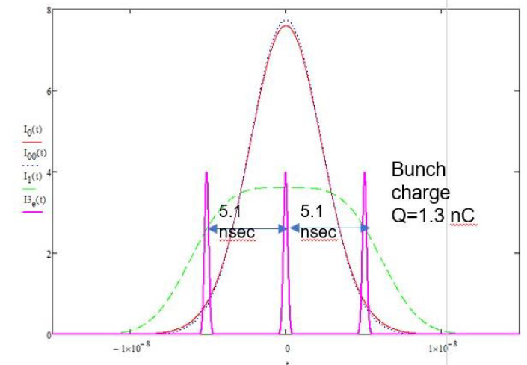
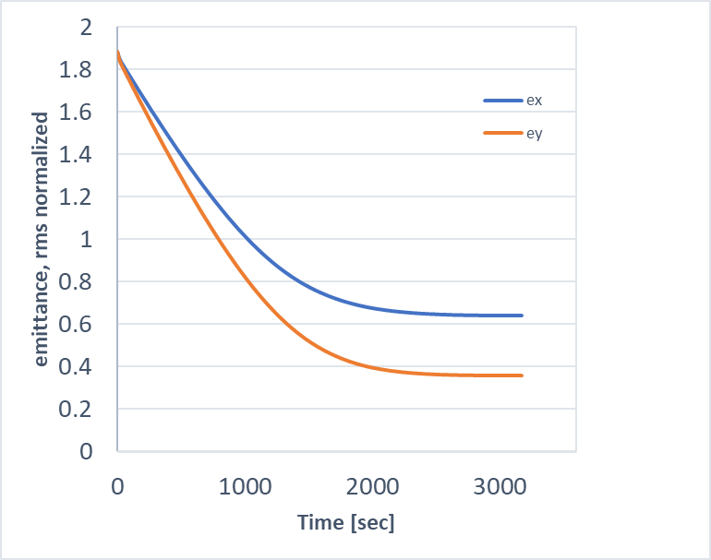
Cooling simulations
Proton bunch with
single RF harmonic
Total electron charge per ion bunch: Q_{total}=4nC
Average current of electrons: I_{av}=98mA
Electrons rms angles in the cooling section: 20urad
Effective cooling section length: 120 meters
Proton bunch with double RF harmonic
Peak current, A
Electron bunches
(Q=1.3nC)
t [nsec]
Fig. Electron beam time structure (3 electron bunches per single bunch of protons).
2nd harmonic RF alleviates space-charge effects reducing peak current of protons to about 3A (space charge tune shifts after cooling ΔQ_{sc,x,y}=0.06, 0.1), allowing vertical emittance to be cooled without introducing additional heating of horizontal emittance.
One can accelerate such cooled beams
with 1:2 or 1:1 (round) emittance ratio to top energy, at which horizontal emittance can be increased as needed.
Fig. Cooling of protons at γ=25, with decoupled transverse motion (IBS+Cooling only).
18

Slide 19
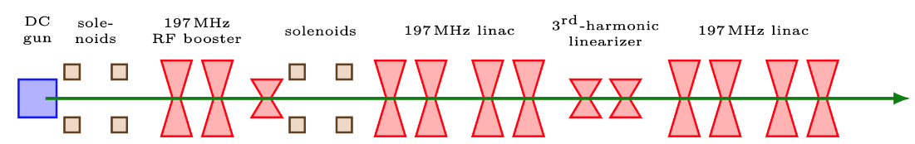
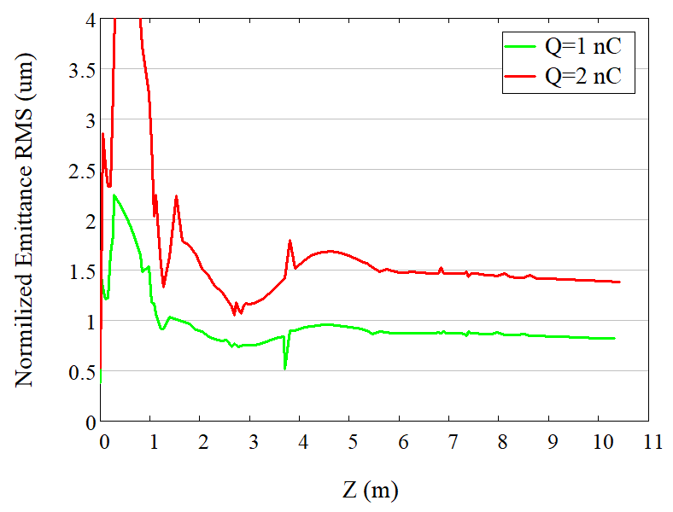
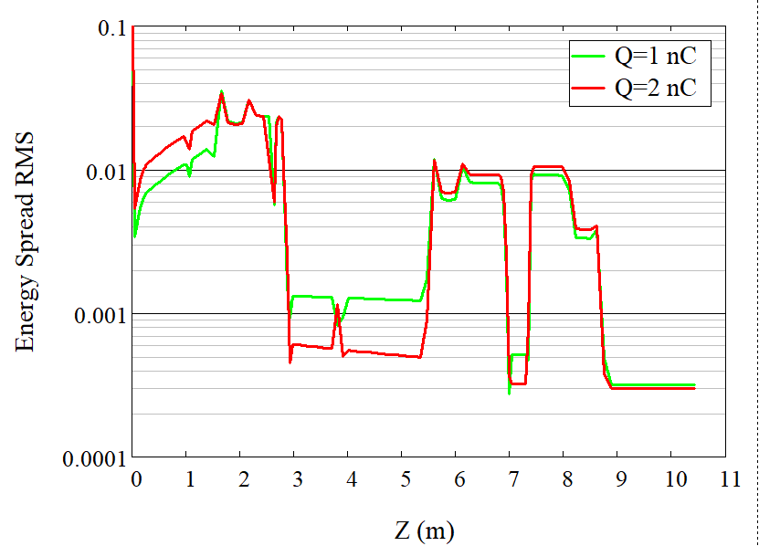
Beam dynamics simulation
13 MeV
Final energy
3 MeV
Achievable beam quality at the linac exit for bunch charge of 1-2 nC:
Energy spread < 3e-4
Normalized emittance <1.5um
Simulations show that required electron beam parameters at 13 MeV can be achieved. Such electron beam parameters should be preserved through very long electron beam transport and through the cooling sections.
Designed beta-function in cooling section 200 m, angular spread from emittance <17 urad (for 2nC bunches)

Slide 20
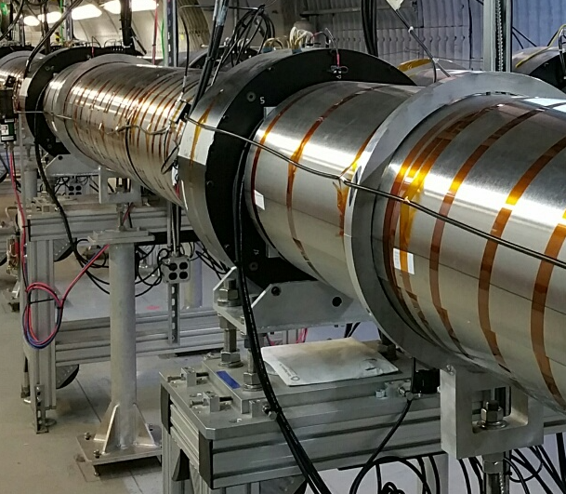

Cooling sections requirements
The design of the cooling section will closely follow the LEReC approach *.
To maintain the transverse angle deviation of the electron beam trajectory < 20 μrad, the integral of residual transverse magnetic field between correctors in the cooling region must be kept below 1 μTm.
Shielding of the residual magnetic field to such level can be achieved using concentric cylindrical layers of high-permeability alloy in the cooling sections**.
Some cooling section space will be taken up by short weak solenoids, which control the angular spread of the electron beam due to its space charge.
Picture: LEReC cooling sections.
μ-shielding
μ-shielding
μ-shielding
μ-shielding
μ-shielding
10 m
10 m
10 m
merging/matching section
merging/matching section
Weak solenoids
BPMs and correctors
20
[*] A. Fedotov et al., in Proc. NAPAC’16, Chicago, IL, USA, Oct. 2016, pp. 867-869.
[**] S. Seletskiy et al., in Proc. NAPAC’16, Chicago, IL, USA, Oct. 2016, pp. 1030-1032.

Slide 21
Electron angles in cooling sections
Design of cooling sections and optimization of electron beam dynamics are being developed to minimize various contributions to electron angles in cooling sections.
Largest contributions to electrons angles are:
- Electron beam emittance
- Electron beam space charge
- Focusing from proton beam
- Remnant magnetic fields
For electron bunches with about 2nC charge per bunch (highest planned electron intensities), several solutions were developed to keep total rms electron angular budget in cooling sections around 20-30urad.
We are now looking into optimization with lower intensity bunches, 1.3-1.4nC per bunch.
21

Slide 22
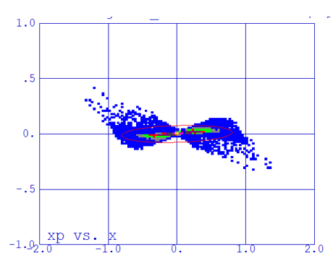
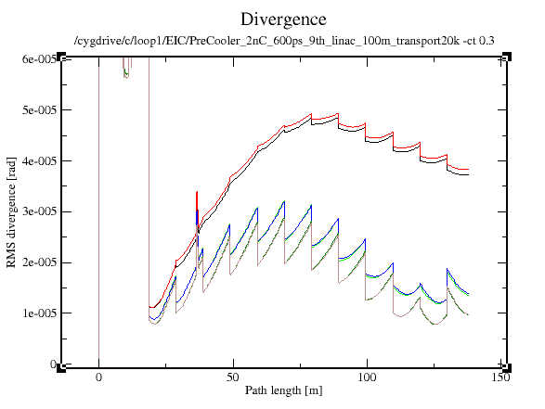
Evolution of electron angles in cooling section
Electron bunch charge of 2nC
Initial pulse duration 600 ps
Q_90% =1.8 nC (90% of the beam)
Average divergence is around 20urad
For non-uniform electron distribution,
space charge leads to tails of the distribution
with large velocity spread. These particles
do not contribute to cooling process and can
be neglected for an estimate of effective portion of the beam participating in cooling.
Simulations of electron beam divergence (including space charge) through long cooling section.
Phase space
Divergence
100% of the beam
90% of the beam
70% of the beam
22
Path length [m]

Slide 23
Precooler challenges
Designing of 13MeV electron cooler to cool protons at 24 GeV is very challenging.
Such a cooler requires:
Achieving required electron beam parameters from injector
Beam transport of electron bunches without significant degradation of beam emittance and energy spread at low energy (requires control of space charge and RF gymnastics)
Achieving very small angular spread in cooling sections
Operation of electron accelerator at high current
Integration of 13MeV electron cooler with high-energy (150MeV) cooler based on CeC approach adds additional constraints:
Limited space available for effective cooling
- Additional merges and optics matching sections (due to split into two separate cooling sections)
Finding proper solutions for mu-metal shielding of cooling sections with numerous magnetic elements needed for CeC-based cooler
- Linac SRF frequency should cover operation at low and high energy
23

Slide 24
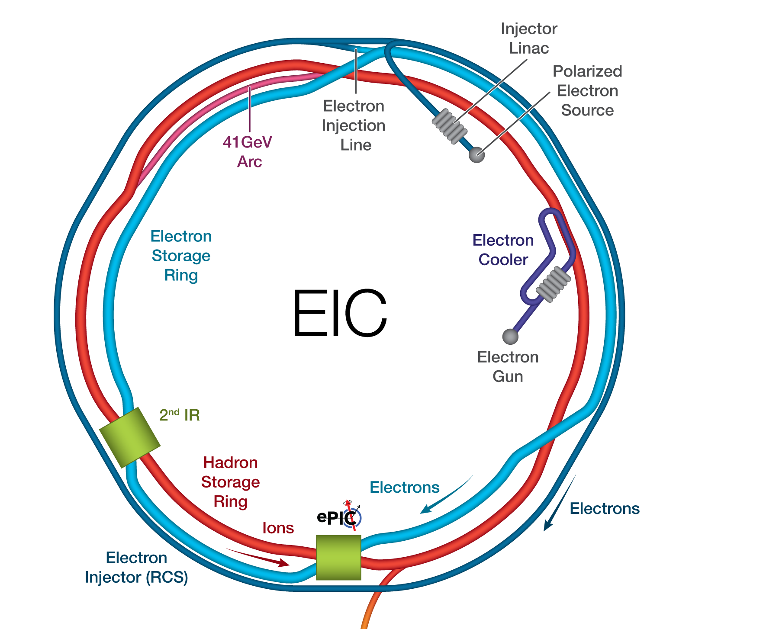
Summary
The luminosity in the EIC benefits strongly from hadron cooling.
LEReC-type RF-based electron cooler is being developed to provide cooling of protons at injection energy of 24GeV. Such a Precooler requires 13MeV electron accelerator.
Obtaining small angular spread of electrons (about factor of 5 smaller than in LEReC) in cooling sections is very challenging, especially with many additional constraints.
Precooler accelerator can be extended to 22MeV to provide cooling of protons at a store energy of 41GeV.
Optimization of Precooler parameters and its integration with the high-energy EIC coolers is in progress.

Slide 25
Acknowledgement
Design of Electron Cooler for EIC injection energy of protons greatly benefits from help and expertise of many people from Brookhaven and Jefferson Lab EIC teams and BNL’s Collider-Accelerator Department Beam Cooling Group.
Special thanks to Erdong Wang and Sergei Nagaitsev for many useful discussions and help.
Work supported by the U.S. Department of Energy.
Thank you!

