Slide 1



Perspective of a Dual Energy Storage Ring Cooler for Hadron Beam Cooling *
Fanglei Lin⁴
on behalf of S. Benson, Ya.S. Derbenev¹, D. Douglas¹, B. Dhital³, J. Guo¹, A. Hutton¹, G. Krafft^{1,2}, V. Morozov⁴, H. Zhang¹, Y. Zhang¹,
COOL 2023, Montreux, Switzerland, Oct 8-13, 2023
¹ Thomas Jefferson National Accelerator Facility, Newport News, VA, USA
² Center for Accelerator Science, Old Dominion University, Norfolk, VA, USA
³ Brookhaven National Laboratory, Upton, NY, USA
⁴ Oak Ridge National Laboratory, Oak Ridge, TN, USA
* Work supported by U.S. DOE NP funding

Slide 2
Outline
Introduction and Motivation
A dual energy electron storage ring cooler
  Concept
  Design
  Beam dynamics
  Cooling performance
Summary

Slide 3
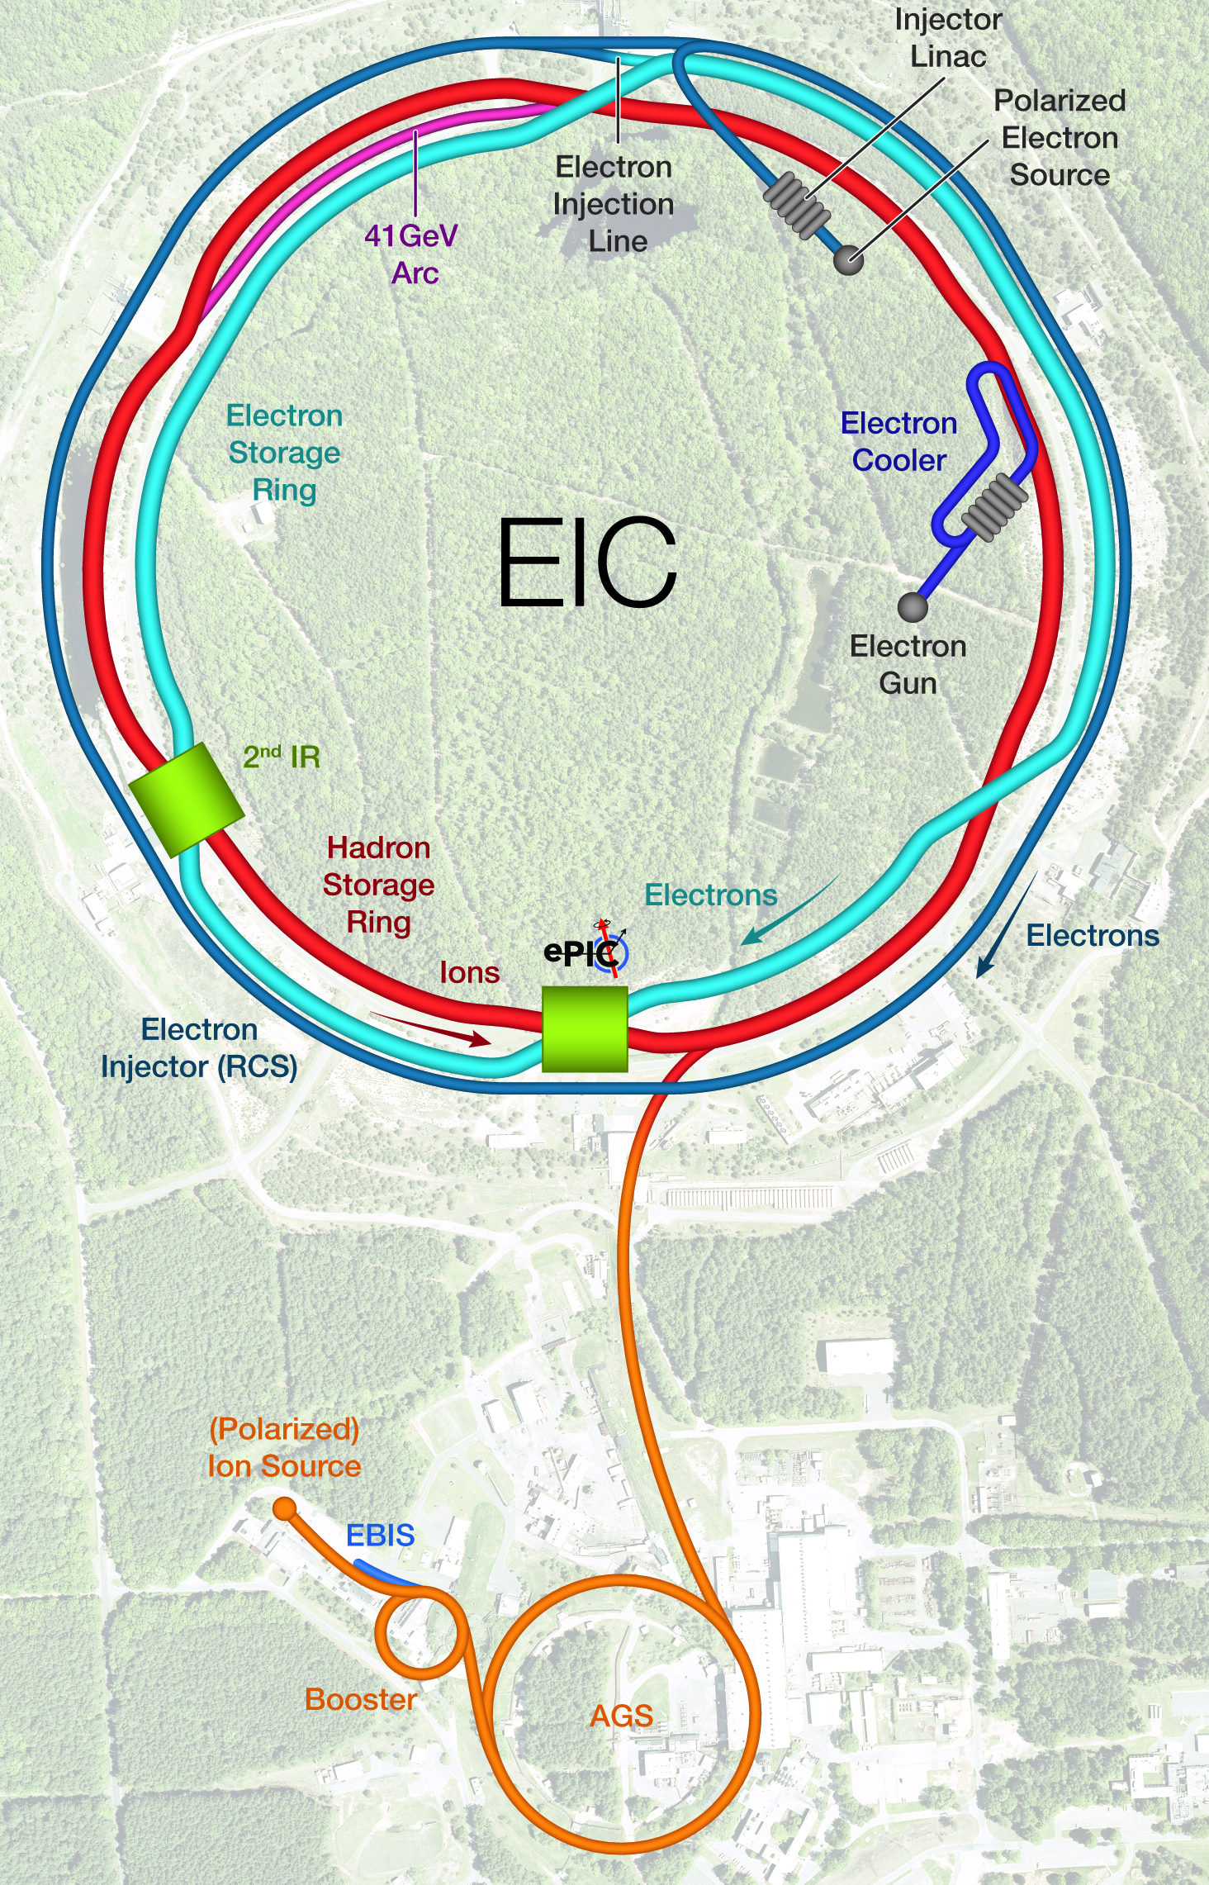
US EIC for QCD Frontier
Electron Ion Collider (EIC) will be built at BNL, based on the existing RHIC, Jefferson Lab is a partner lab
Goals
  High luminosity: L=(0.1-1)x10³⁴ cm⁻² s⁻¹ ➔ 10-100 fb⁻¹ integrated luminosity
  Collisions of highly polarized +/-70% e, p and light ion beams with flexible spin patterns
  Large ranges of center of mass energies: E_{cm}=(20-140) GeV and ion species: protons–Uranium
  Ensure accommodation of two IRs
  Large detector acceptance and good background conditions
Hadron storage ring 40-275 GeV (existing)
  1160 bunches, large beam current (up to 1 A) , strong hadron cooling (coherent electron cooling)
Electron storage ring (2.5–18 GeV (new))
  1160 bunches, large beam current (up to 2.5 A) ➔ maximum 10 MW S.R. power, SRF cavities
Electron rapid cycling synchrotron (new)
  2x28 nC bunches, 1 Hz cycle time, spin transparent for high polarization
High luminosity interaction region(s) (new)
  L = 10³⁴cm⁻²s⁻¹ with superconducting magnets
  25 mrad crossing angle for the primary detector with crab cavities
  Spin rotators (longitudinal electron spin)
  Forward hadron instrumentation for tagging
RHIC at BNL
RHIC at BNL
EIC design report

Slide 4
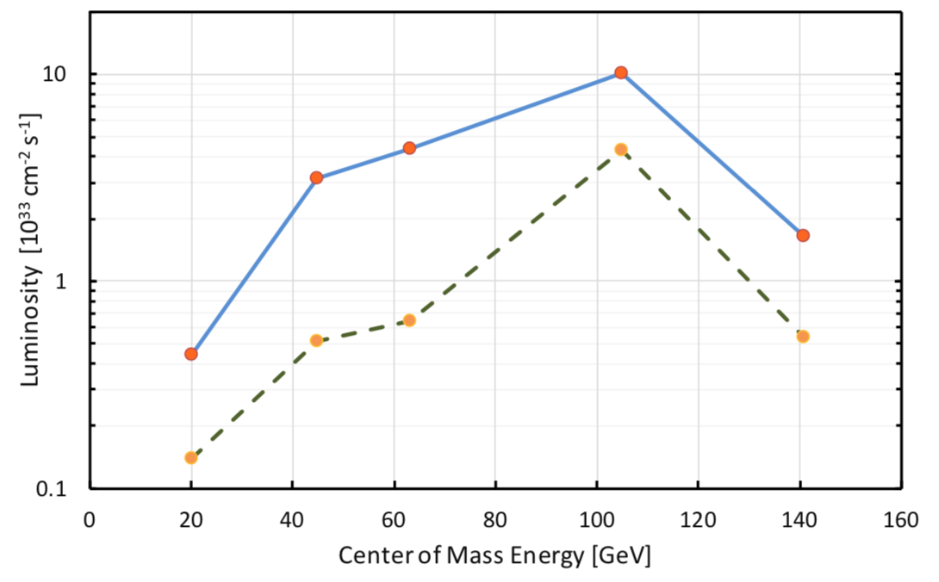
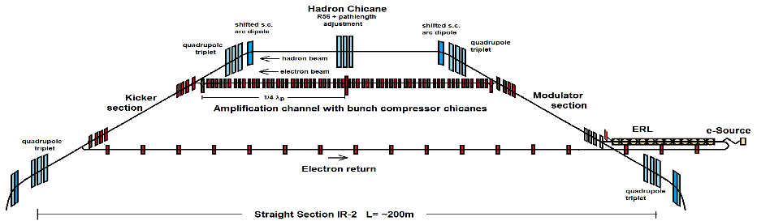
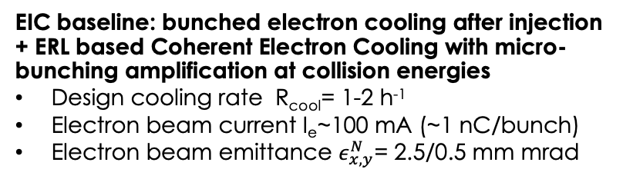
High Luminosity EIC through Strong Hadron Cooling
with SHC
For 104.9 GeV CM energy |  | Proton | Electron
Energy | GeV | 275 | 10
Bunch current / intensity | A / 10¹⁰ | 1 / 6.9 | 2.5 / 17.2
RMS norm. emit. h / v | µm | 3.3 / 0.3 | 391 / 26
RMS bunch length | cm | 6 | 0.7
RMS long. emittance | eV.s | 0.036 | -
IBS growth time long. / h | h | 2.9 / 2 | -
Beta functions at IP | cm | 80 / 7.2 | 45 / 5.6
Luminosity per IP | cm⁻²sec⁻¹ | 1 x 10³⁴
w/o SHC
Unprecedented colliding proton/ion beams: many bunches, large beam currents, small transverse emittance, flat beam, short bunches, and large beam-beam parameters
Particularly, short longitudinal and transverse IBS time ➔ unacceptable emittance growth over one typical beam store time (>8 hours) ➔ significant decay of instant luminosity
Strong cooling of hadron beam is required to mitigate IBS and other effects to reduce emittance (cooling before collision) and to preserve emittance (continuous cooling during collision)
EIC baseline: bunched electron cooling after injection + ERL based Coherent Electron Cooling with micro-bunching amplification at collision energies
Design cooling rate R_{cool}= 1-2 h⁻¹
Electron beam current I_{e}~100 mA (~1 nC/bunch)
Electron beam emittance $ε_{x,y}^{N}$= 2.5/0.5 mm mrad
EIC design report

Slide 5
Other Alternatives ?
Must work with an intense bunched proton beam in the EIC: 10 to 30 nC per bunch up to1 Ampere average current
This presentation describes one possible alternative cooling scheme: a dual energy electron storage ring cooler
  Focusing on discussion of design, beam dynamics and cooling performance

Slide 6
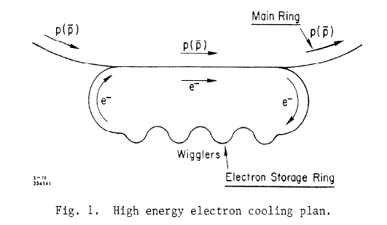
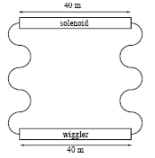
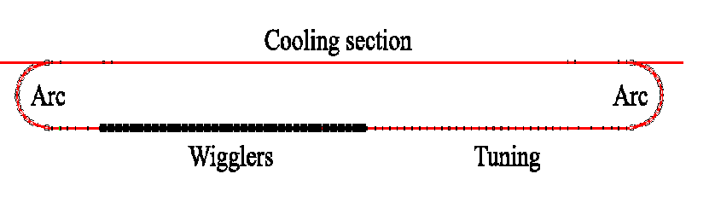
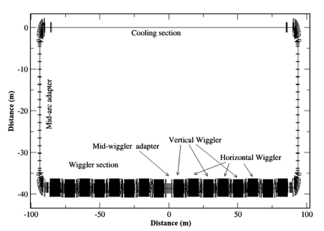
Electron Storage Ring Based Cooler
Electron storage ring has been considered as a cooler since the late 1970s. However, none has been built up to now.
D. Cline, et. al., SLAC-PUB-2278, Mar 1979
A. Burov, S. Derbenev, et. al., FERMILAB-TM-2058, 1998
M. Gentner, S. Derbenev, et. al., Nuc. Inst. Meth. Res. A, 424, 277-295, 1999
For RHIC
For HERA
Cooling Solenoid
Low cooling energies
SRFs
High damping energy
Wigglers
F. Lin, et. al, IPAC2016, Busan, Korea (2016)
H. Zhao, et. al, PRAB 24, 043501 (2021)

Slide 7
Requirements
EIC proton beam energy: 41 – 275 GeV
Required cooling electron beam energy: 22 – 150 MeV
  Typical electron IBS effect is very strong -> very short IBS times ~ tens of milli-seconds
  Typical synchrotron radiation damping is very weak -> long damping time, seconds up to minutes
  Unbalanced IBS and radiation damping can be mitigated through higher electron energies and/or damping wigglers
  Beam-beam scattering effect from ion beams can be problematic with certain beam parameters

Slide 8

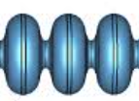
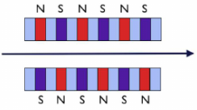
Concept of a Dual Energy Storage Ring Cooler
Solve the ion cooling and the heat removal (radiation) problems separately
Full energy injection
Ion beams in accelerators
Cooling channel
22 - 150 MeV in the cooling section
SRFs
compensating and bunching cavities
155 MeV in the damping section
Wigglers
F. Lin et.al, IPAC2016, Busan, Korea
Original Idea: use wigglers in the damping ring to enhance the damping

Slide 9
Concept of a Dual Energy Storage Ring Cooler
Solve the ion cooling and the heat removal (radiation) problems separately
Full energy injection
Ion beams in accelerators
Cooling channel
22 - 150 MeV in the cooling section
SRFs
compensating and bunching cavities
500 MeV in the damping section
Explored Idea: increase the beam energy in the damping ring to enhance the damping

Slide 10
Comments on this Concept
The essential of this concept is “dual energy”: lower energy cooling section and higher energy damping section
The technical approaches can be different in details. For example:
  Cooling section
    Magnetized cooling
    Non-magnetized cooling
  Energy exchange between the two sections with SRF cavities
    Conventional single axis ERL SRF cavities
    Twin axes cavities
  Damping mechanisms
    Wigglers
    High energy
    Combination of wigglers and high energy

Slide 11
Study of the Dual Energy Storage Ring Cooler
With the following assumptions in the design
  Magnetized cooling
  High energy in the damping section, without wigglers
These assumptions were optimal for the proton beam parameters we were considering. They were chosen after carefully considering various potential cooling scenarios.

Slide 12



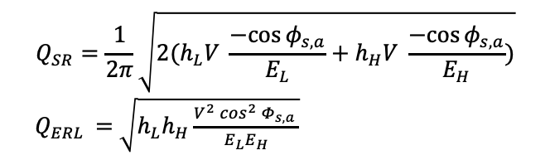
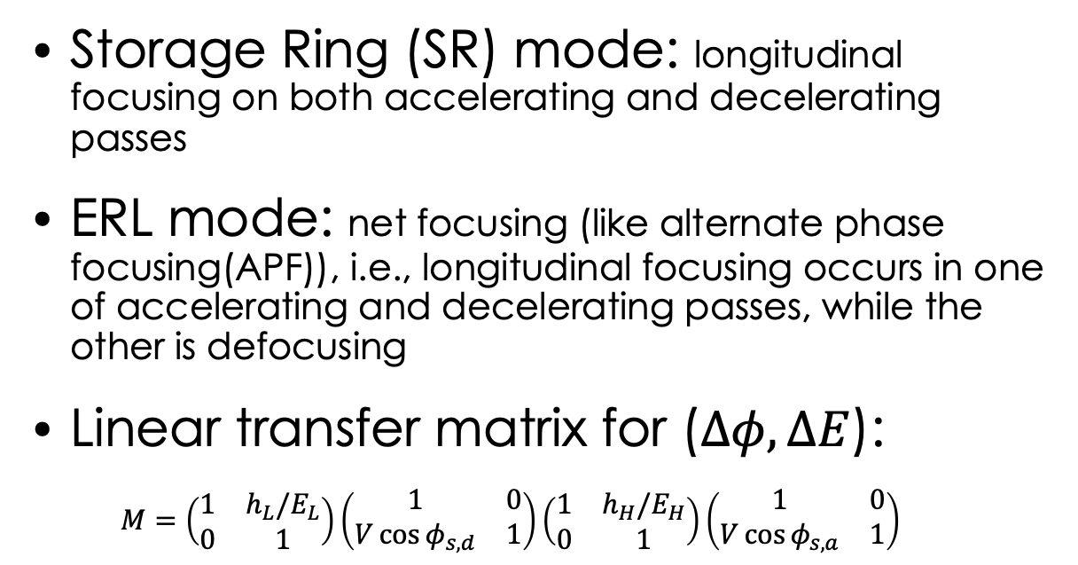



Longitudinal Stable Modes
Storage Ring (SR) mode: longitudinal focusing on both accelerating and decelerating passes
ERL mode: net focusing (like alternate phase focusing(APF)), i.e., longitudinal focusing occurs in one of accelerating and decelerating passes, while the other is defocusing
Linear transfer matrix for ($∆φ,∆E$):
$M=\left(\begin{matrix}1 & h_{L}/E_{L} \\ 0 & 1\end{matrix}\right)\left(\begin{matrix}1 & 0 \\ V\cos{φ_{s,d}} & 1\end{matrix}\right)\left(\begin{matrix}1 & h_{H}/E_{H} \\ 0 & 1\end{matrix}\right)\left(\begin{matrix}1 & 0 \\ V\cos{φ_{s,a}} & 1\end{matrix}\right)$
ERL mode
$$φ_{s,a}$$
$$φ_{s,d}=π+φ_{s,a}$$
$$φ_{s,d}$$
$$φ_{s,d}$$
SR mode
$$φ_{s,d}=π+(π−φ_{s,a})$$
 | SR mode | ERL mode
Qs from formula | 0.03448 | 0.001627
Qs from simulation | 0.03415 | 0.001631
Difference in % | 0.9 | 0.2
$$Q_{SR}=\frac{1}{2π}\sqrt{2(h_{L}V \frac{−cos{φ_{s,a}}}{E_{L}}+h_{H}V \frac{−cos{φ_{s,a}}}{E_{H}})}$$
$Q_{ERL}$ = $\sqrt{h_{L}h_{H}\frac{V^{2}\cos^{2}{Φ_{s,a} }}{E_{L}E_{H}}}$
Here $h_{L,H}=\frac{2πf_{0}L_{L,H}η_{L,H}}{β_{H}^{3}c}$

Slide 13
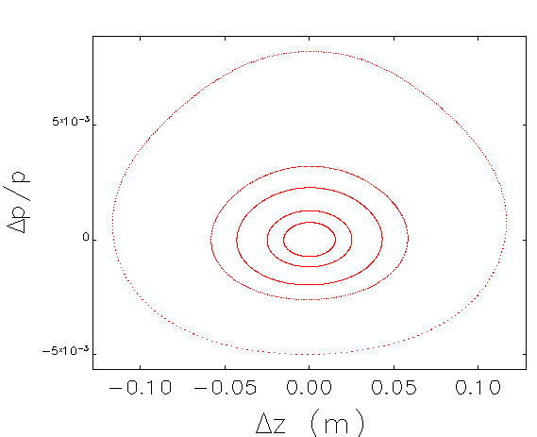
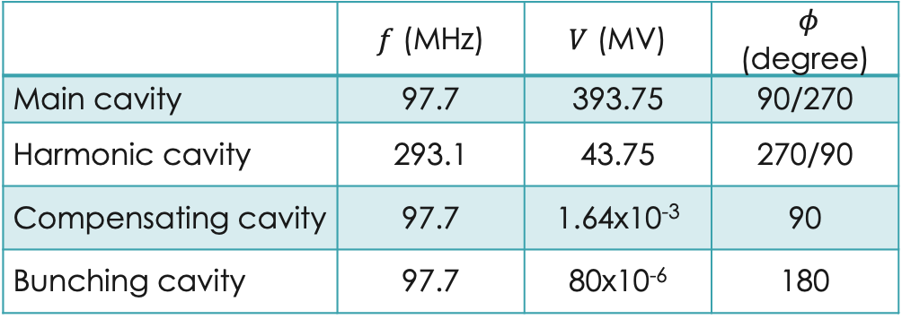
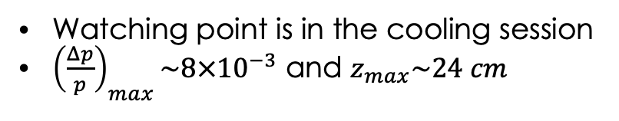
Longitudinal Phase Space w/ Main Cavity $f=97.7$ MHz
 | $f$ (MHz) | $V$ (MV) | $φ$ (degree)
Main cavity | 97.7 | 393.75 | 90/270
Harmonic cavity | 293.1 | 43.75 | 270/90
Compensating cavity | 97.7 | 1.64x10⁻³ | 90
Bunching cavity | 97.7 | 80x10⁻⁶ | 180
5 x 10⁻³
0
-5 x 10⁻³
Watching point is in the cooling session
${\left(\frac{Δp}{p}\right)}_{max}\sim 8×{10}^{−3}$ and $z_{max}\sim 24 cm$

Slide 14
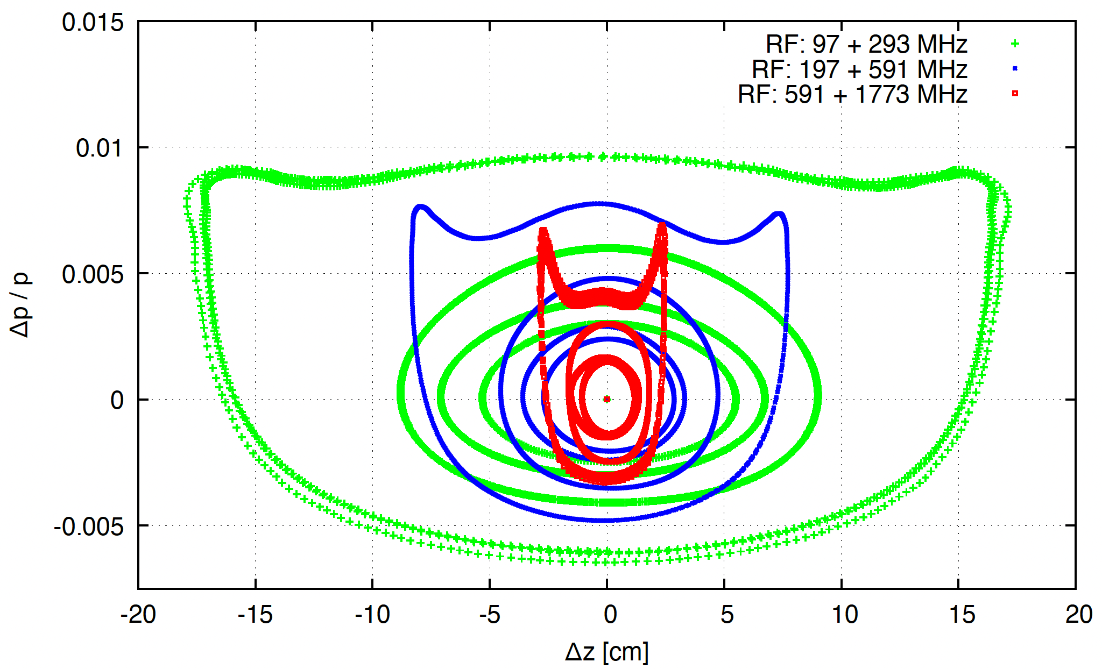
Longitudinal Phase Space w/ Various Main Cavity Frequencies
The lower RF frequency, the larger longitudinal phase space volume => longer bunch length
* We note that the low frequency cavities will be costly to build, especially for cavities with frequency < 300 MHz.

Slide 15
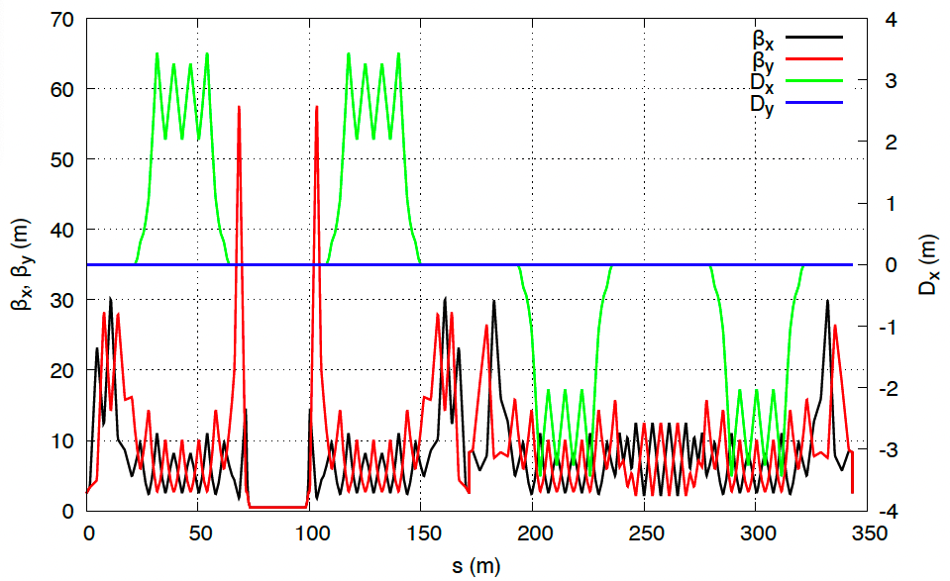
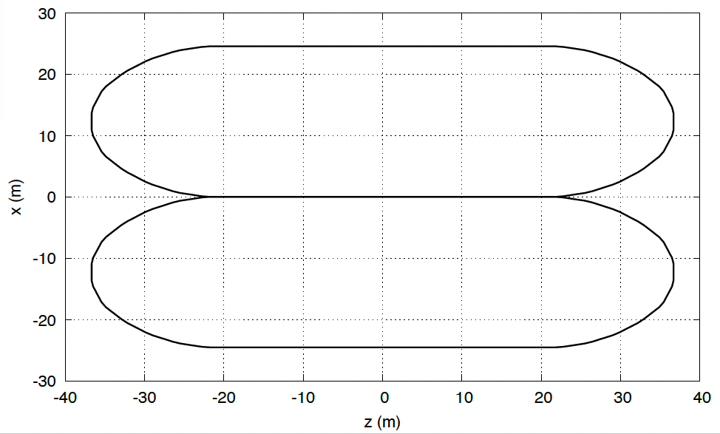
Preliminary Lattice Design
The length of cooling section can be adjusted to meet the requirement.
We realize that arcs with small M₅₆~71cm are preferred
Two sections can be vertically stacked to reduce the footprint and don’t have to be the same sizes

Slide 16
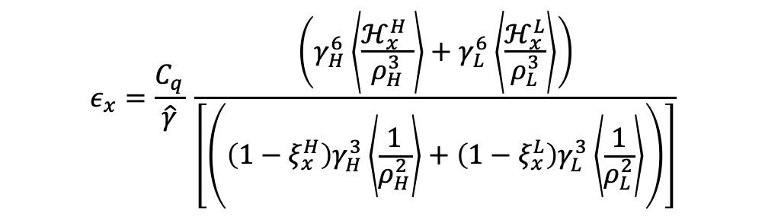
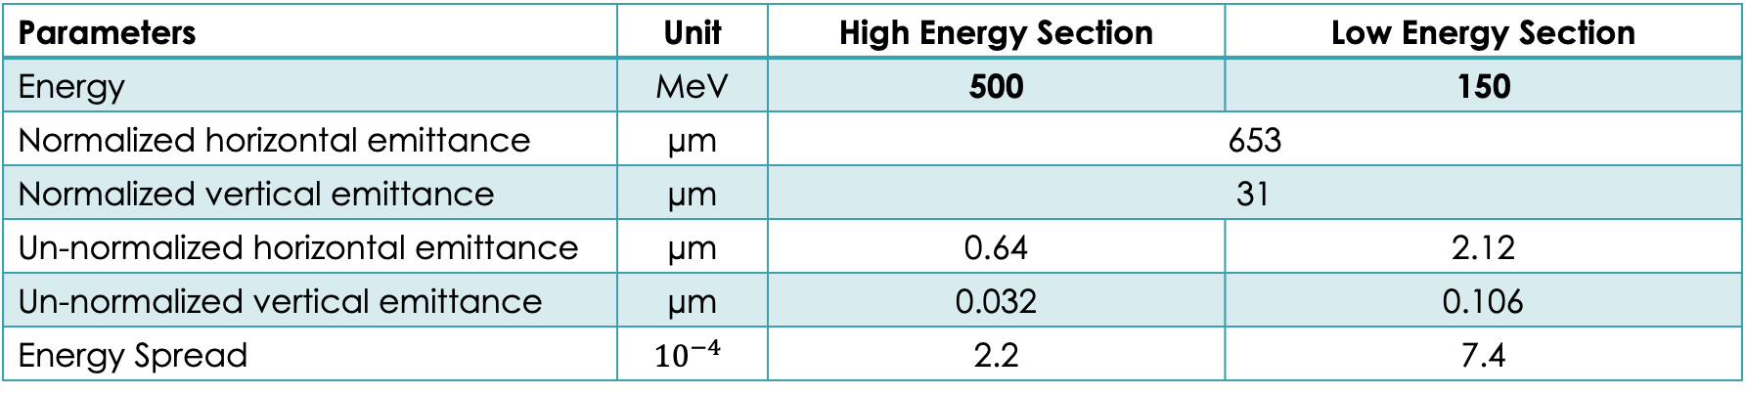
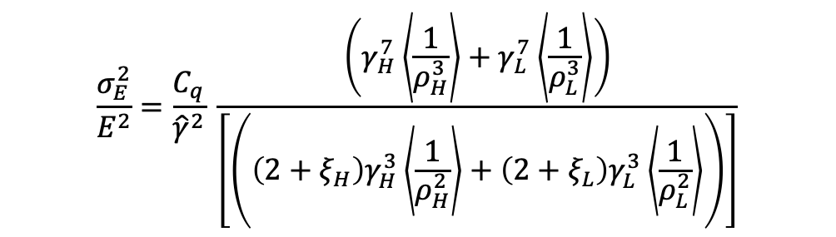
Electron Equilibrium Emittance and Energy Spread
$$ε_{x}=\frac{C_{q}}{\hat{γ}} \frac{\left(γ_{H}^{6}\left\langle \frac{ℋ_{x}^{H} }{ρ_{H}^{3}}\right\rangle +γ_{L}^{6}\left\langle \frac{ℋ_{x}^{L}}{ρ_{L}^{3}}\right\rangle \right)}{\left[\left(\left(1−ξ_{x}^{H}\right)γ_{H}^{3}\left\langle \frac{1}{ρ_{H}^{2}}\right\rangle +\left(1−ξ_{x}^{L}\right)γ_{L}^{3}\left\langle \frac{1}{ρ_{L}^{2}}\right\rangle \right)\right]}$$
$$\frac{σ_{E}^{2}}{E^{2}}=\frac{C_{q}}{{\hat{γ}}^{2}} \frac{\left(γ_{H}^{7}\left\langle \frac{1}{ρ_{H}^{3}}\right\rangle +γ_{L}^{7}\left\langle \frac{1}{ρ_{L}^{3}}\right\rangle \right)}{\left[\left(\left(2+ξ_{H}\right)γ_{H}^{3}\left\langle \frac{1}{ρ_{H}^{2}}\right\rangle +\left(2+ξ_{L}\right)γ_{L}^{3}\left\langle \frac{1}{ρ_{L}^{2}}\right\rangle \right)\right]}$$
Parameters | Unit | High Energy Section | Low Energy Section
Energy | MeV | 500 | 150
Normalized horizontal emittance | µm | 653 | 622
Normalized vertical emittance | µm | 31 | 31.1
Un-normalized horizontal emittance | µm | 0.64 | 2.12
Un-normalized vertical emittance | µm | 0.032 | 0.106
Energy Spread | $${10}^{−4}$$ | 2.2 | 7.4

Slide 17


Electron Damping Times and Inter Beam Scattering Times
Damping time(s):
$$\frac{t_{rev,tot}}{τ_{rad,tot}}=\frac{t_{rev,L}}{τ_{rad,L}}+\frac{t_{rev,H}}{τ_{rad,H}}$$
IBS time(s)*:
$$\frac{t_{rev,tot}}{τ_{IBS,tot}}=\frac{t_{rev,L}}{τ_{IBS,L}}+\frac{t_{rev,H}}{τ_{IBS,H}}$$
* Used the code elegant, based on the Bjorken-Mtingwa formula
Parameters | unit | Dual Energy Storage Ring Cooler (E_{high}=500 MeV, E_{low}=150MeV)
Horizontal damping time vs. IBS time | s | 3.20 vs. 5
Vertical damping time vs. IBS time | s | 0.69 vs. 12328.33
Longitudinal damping time vs. IBS time | s | 0.25 vs. 0.44
The cooling electron beam has shorter damping times than IBS times

Slide 18
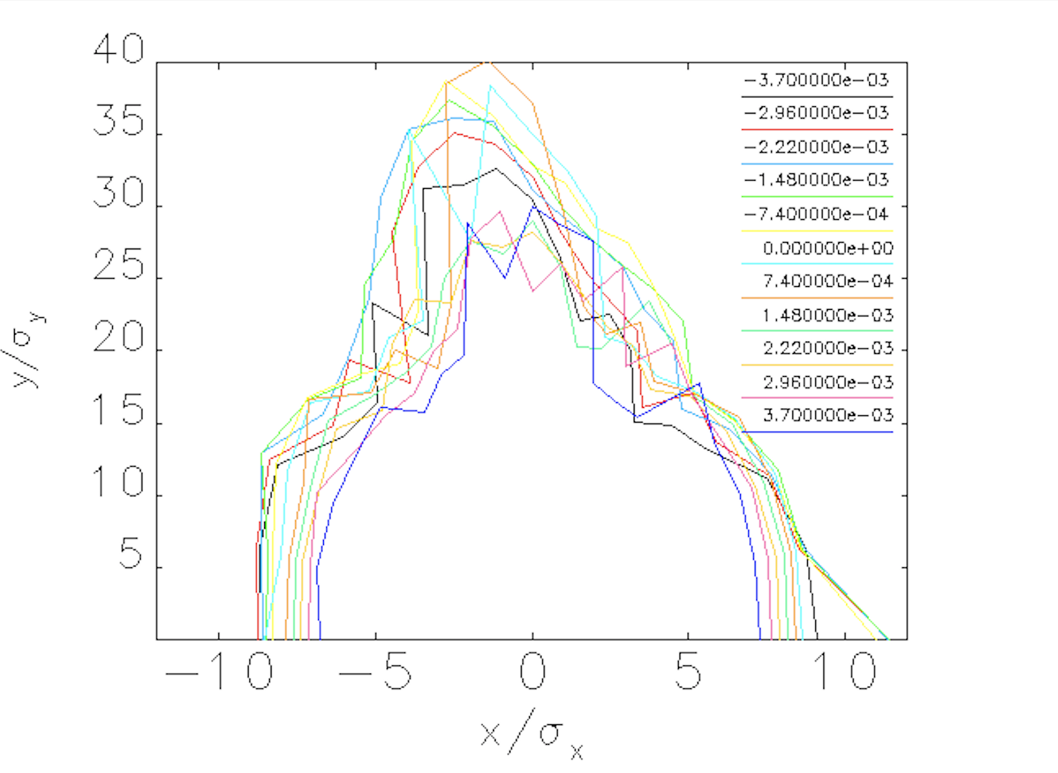


Dynamic Aperture (DA) in the Bare Lattice
$$35σ_{y}$$
$$±8σ_{x}$$

Slide 19
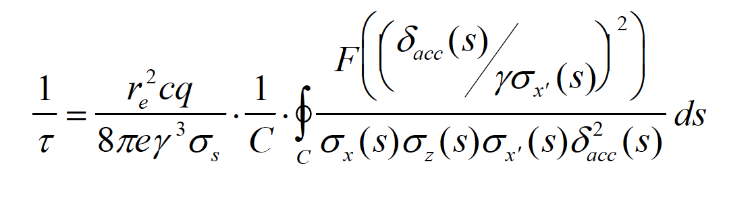
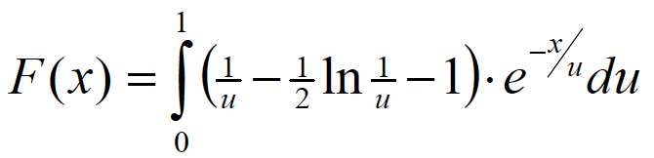
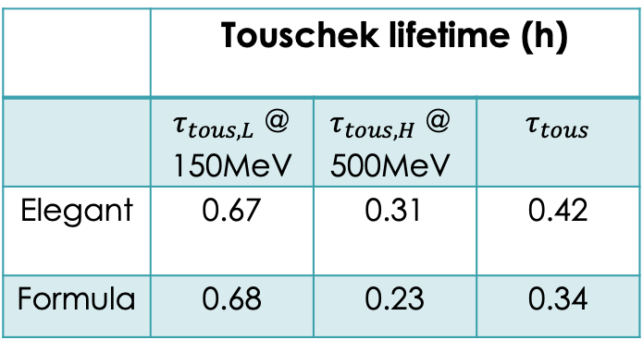
Momentum Aperture (MA) and Touschek Lifetime
 | Touschek lifetime (h)
 | $τ_{tous,L}$ @ 150MeV | $$τ_{tous,H}\text{ @ }\text{50}\text{0}\text{MeV}$$ | $$τ_{tous}$$
Elegant | 0.67 | 0.31 | 0.42
Formula | 0.68 | 0.23 | 0.34
High energy ring momentum acceptance is reduced by a factor of the energy ratio of low to high energy rings

Slide 20
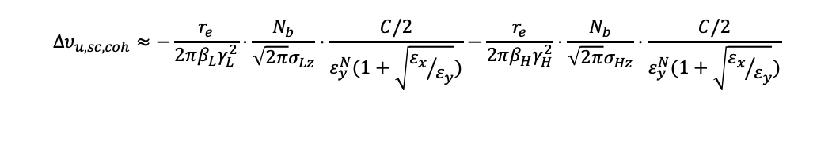
Space Charge Effect
$$Δυ_{u,sc,coh}≈−\frac{r_{e}}{2πβ_{L}γ_{L}^{2}}⋅\frac{N_{b}}{\sqrt{2π}σ_{Lz}}⋅\frac{C/2}{ε_{y}^{N}(1+\sqrt{{ε_{x}}/{ε_{y}}})}−\frac{r_{e}}{2πβ_{H}γ_{H}^{2}}⋅\frac{N_{b}}{\sqrt{2π}σ_{Hz}}⋅\frac{C/2}{ε_{y}^{N}(1+\sqrt{{ε_{x}}/{ε_{y}}})}$$
For cooling 275 GeV protons
For cooling 100 GeV protons
 | Low energy | High energy | Low energy | High energy
energy (MeV) | 150 | 500 | 55 | 500
beta | 0.999994179 | 0.999999478 | 0.999956839 | 0.999999478
gamma | 293 | 978 | 108 | 978
circumference (m) | 171.7 | 171.7 |  | 171.7
r_e (m) | 2.82e-15
N_b | 6.90E+10 | 6.90E+10
rms bunch length (cm) | 2.5
normalized horizontal emittance (um) | 653
normalized vertical emittance (um) | 31 |  |  | 33.5
epsilon_x/epsilon_y | 18 | 18
Laslett tune shift (separate rings) | 0.00562 | 0.000504 | 0.0417 | 0.000504
Laslett tune shift (whole ring) | 0.00612 |  | 0.0422
Space-charge induced Laslett tune shift of the electron beam is acceptable for cooling the ion beam with energies of 100 and 275 GeV

Slide 21
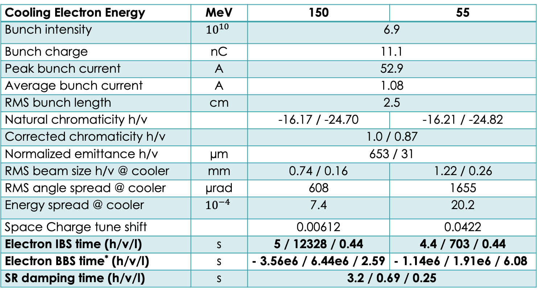
Electron Parameters for Cooling
Cooling Electron Energy | MeV | 150 | 55
Bunch intensity | $${10}^{10}$$ | 6.9
Bunch charge | nC | 11.1
Peak bunch current | A | 52.9
Average bunch current | A | 1.08
RMS bunch length | cm | 2.5
Natural chromaticity h/v |  | -16.17 / -24.70 | -16.21 / -24.82
Corrected chromaticity h/v |  | 1.0 / 0.87
Normalized emittance h/v | µm | 653 / 31
RMS beam size h/v @ cooler | mm | 0.74 / 0.16 | 1.22 / 0.26
RMS angle spread @ cooler | µrad | 608 | 1655
Energy spread @ cooler | $${10}^{−4}$$ | 7.4 | 20.2
Space Charge tune shift |  | 0.00612 | 0.0422
Electron IBS time (h/v/l) | s | 5 / 12328 / 0.44 | 4.4 / 703 / 0.44
Electron BBS time* (h/v/l) | s | - 3.56e6 / 6.44e6 / 2.59 | - 1.14e6 / 1.91e6 / 6.08
SR damping time (h/v/l) | s | 3.2 / 0.69 / 0.25
* BBS: Beam-beam scattering from ion beams, calculated using the code getrad7 developed by H. Zhao

Slide 22
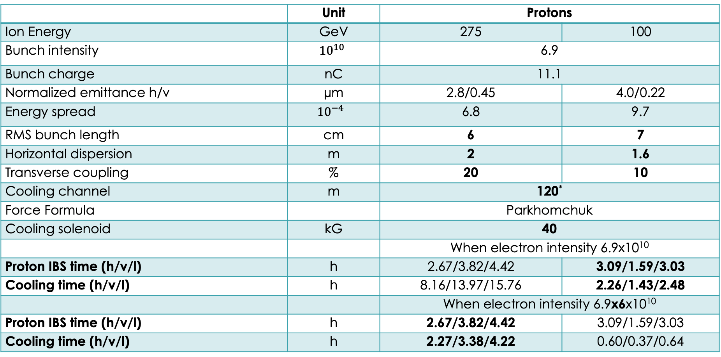
Cooling Performance
Calculated using the code JSPEC, H. Zhang
 | Unit | Protons
Ion Energy | GeV | 275 | 100
Bunch intensity | $${10}^{10}$$ | 6.9
Bunch charge | nC | 11.1
Normalized emittance h/v | µm | 2.8/0.45 | 4.0/0.22
Energy spread | $${10}^{−4}$$ | 6.8 | 9.7
RMS bunch length | cm | 6 | 7
Horizontal dispersion | m | 2 | 1.6
Transverse coupling | % | 20 | 10
Cooling channel | m | 120*
Force Formula |  | Parkhomchuk
Cooling solenoid | kG | 40
 |  | When electron intensity 6.9x10¹⁰
Proton IBS time (h/v/l) | h | 2.67/3.82/4.42 | 3.09/1.59/3.03
Cooling time (h/v/l) | h | 8.16/13.97/15.76 | 2.26/1.43/2.48
 |  | When electron intensity 6.9x6x10¹⁰
Proton IBS time (h/v/l) | h | 2.67/3.82/4.42 | 3.09/1.59/3.03
Cooling time (h/v/l) | h | 2.27/3.38/4.22 | 0.60/0.37/0.64
* Notice that the length of cooling channel 120 m available in the EIC

Slide 23
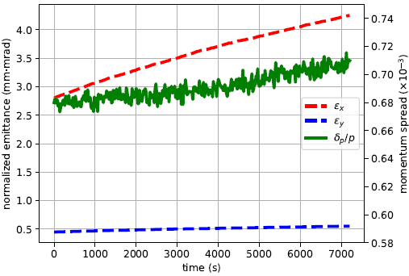
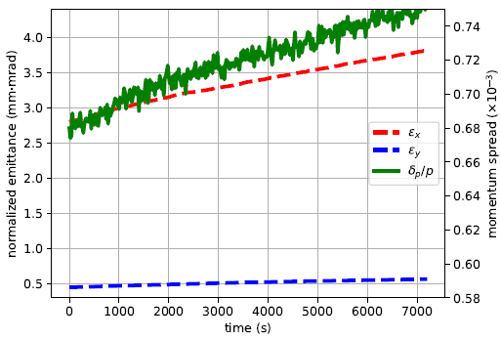
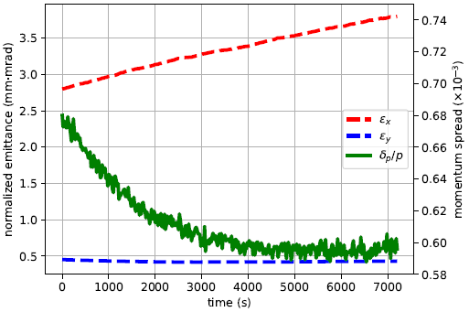
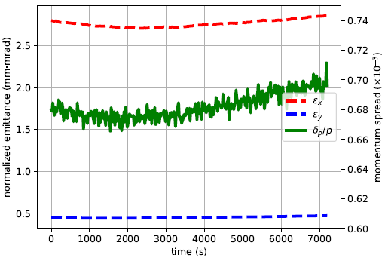
Cooling Performances for Protons @ 275 GeV
Electron intensity 6.9E10, Proton D_{x,y} =0
Electron intensity 6.9E10, Proton D_{x} =2.0 m and D_{y}=0
No cooling
Electron intensity 6.9*6E10, Proton D_{x,y} =0
Electron intensity 6.9*6E10, Proton D_{x} =2.0 m, D_{y}=0

Slide 24
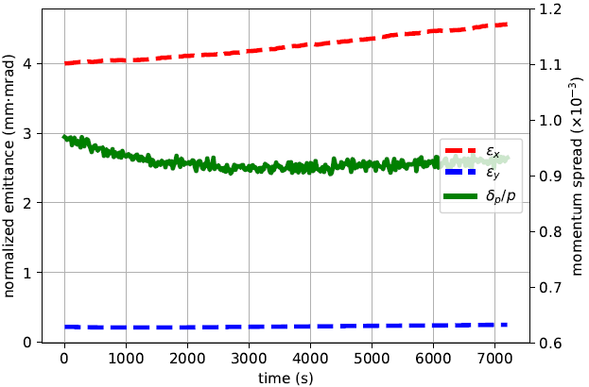
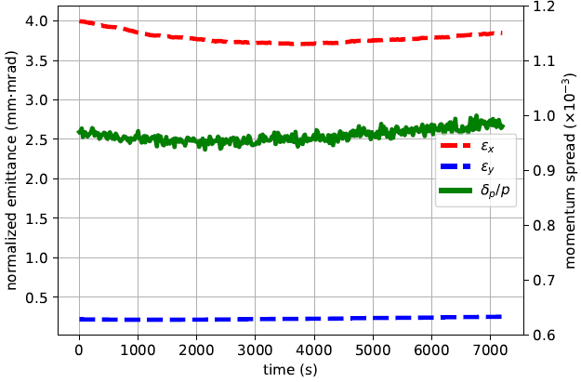
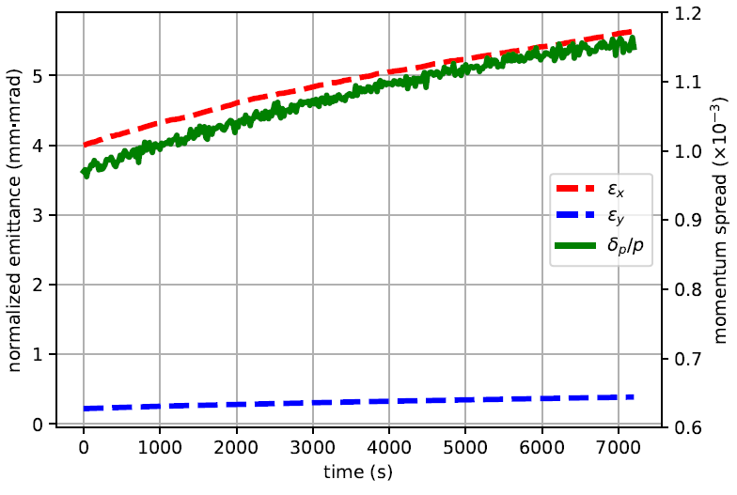
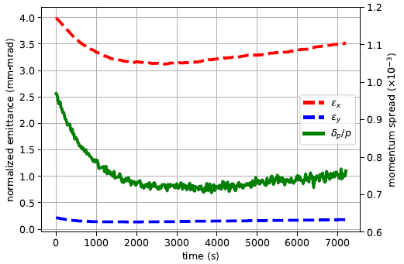
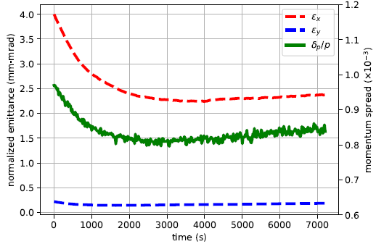
Cooling Performances for Protons @ 100 GeV
Electron intensity 6.9E10, Proton D_{x,y} =0
Electron intensity 6.9E10, Proton D_{x} =2.0 m and D_{y}=0
No cooling
Electron intensity 6.9*6E10, Proton D_{x,y} =0
Electron intensity 6.9*6E10, Proton D_{x} =2.0 m, D_{y}=0

Slide 25
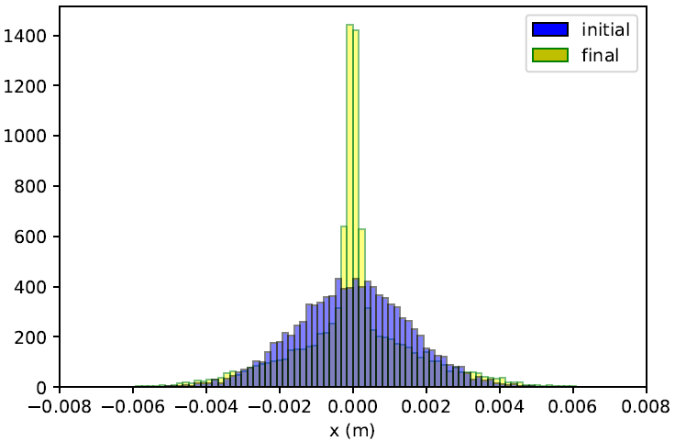
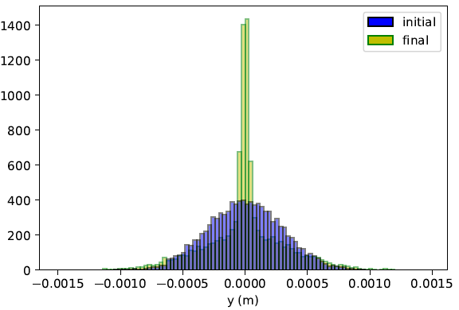

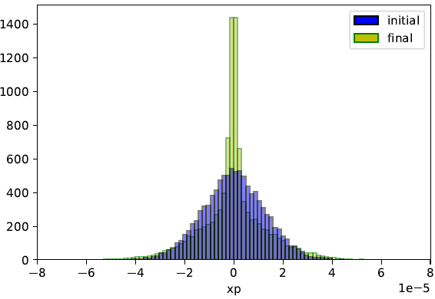
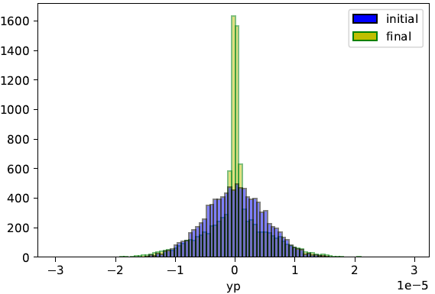
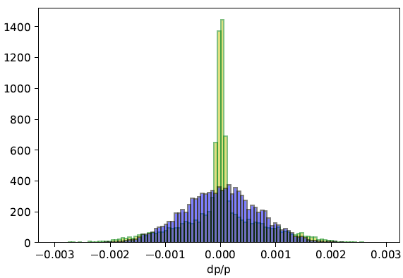
Proton Beam Distributions before and after Cooling @ 275 GeV with Electron Intensity 6*6.9e10

Slide 26
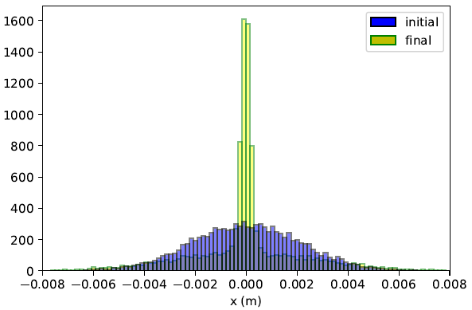
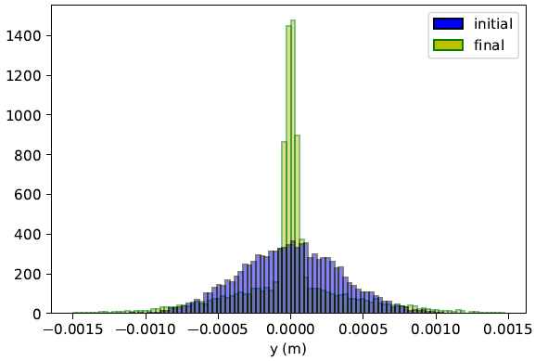
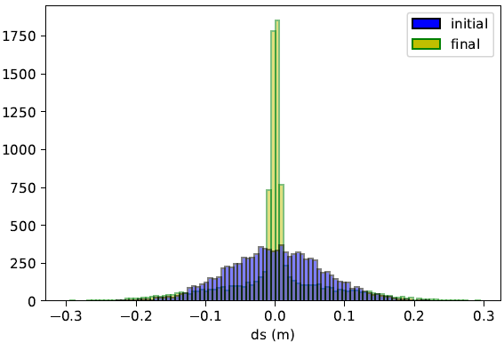
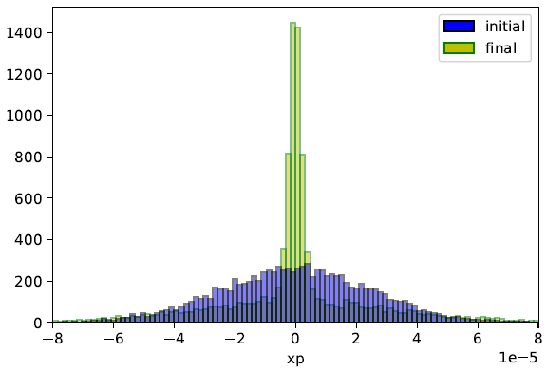

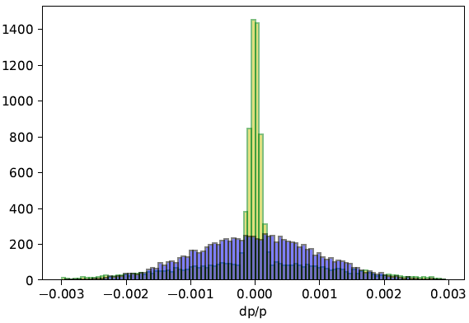
Proton Beam Distributions before and after Cooling @ 100 GeV with Electron Intensity 6.9e10

Slide 27
Summary
Design and study of beam dynamics are carried out for a proposed dual energy electron storage ring cooler.
Cooling performance using the EIC ion beam parameters is evaluated and results are promising.
Optimization of the design can be further pursued to improve the cooling performance.

Slide 28
Publications
F. Lin, et.al., “Storage-Ring Electron Cooler for Relativistic Ion Beams”, IPAC’16.
B. Dhital, et al., “Two-Energy Storage-Ring Electron Cooler for Relativistic Ion Beams”, NAPAC19, TUPLM13.
B. Dhital, et al., “Equilibria and Synchrotron Stability in Two Energy Storage Rings”, IPAC19, MOPGW104.
B. Dhital, et al., “Estimates of Damped Equilibrium Energy Spread and Emittance in a Dual Energy Storage Ring”, IPAC21, MOPAB240.
B. Dhital, et al., “Beam Dynamics Study in a Dual Energy Storage Ring for Ion Beam Cooling”, IPAC21, TUXA07.
B. Dhital, et al., "Dual Energy Storage Ring and Possible Applications", AccApp’21.
B. Dhital, et al., “Cooling Performance in a Dual Energy Storage Ring Cooler”, IPAC22, MOPOTK047.
B. Dhital, et al., “Dual Energy Storage Ring Electron Cooler for Ion Beam Cooling,” PRAB under revision.
H. Zhang, et al., “Latest Updates on JESPEC – an IBS and Electron Cooling Simulation Program”, IPAC’23
H. Zhang, et al., “JSPEC: a Program for IBS and Electron Cooling Simulation”, COOL23

Slide 29
Thank you for your attention !
Danke!
Merci!
Grazie!

Slide 30
Back Up

Slide 31
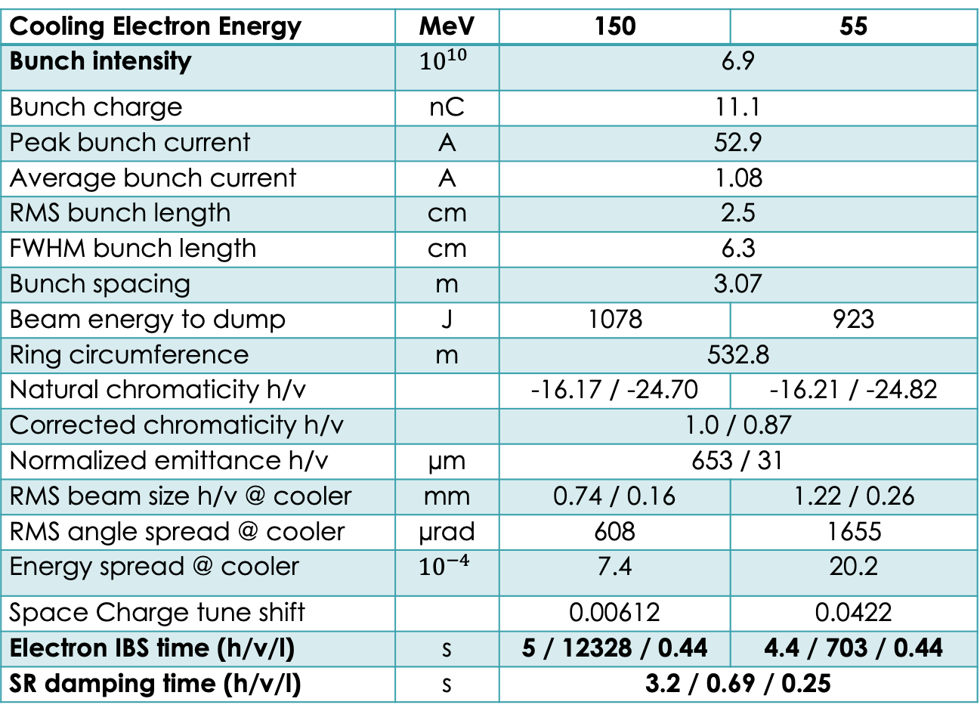
Electron Parameters for Cooling
Cooling Electron Energy | MeV | 150 | 55
Bunch intensity | $${10}^{10}$$ | 6.9
Bunch charge | nC | 11.1
Peak bunch current | A | 52.9
Average bunch current | A | 1.08
RMS bunch length | cm | 2.5
FWHM bunch length | cm | 6.3
Bunch spacing | m | 3.07
Beam energy to dump | J | 1078 | 923
Ring circumference | m | 532.8
Natural chromaticity h/v |  | -16.17 / -24.70 | -16.21 / -24.82
Corrected chromaticity h/v |  | 1.0 / 0.87
Normalized emittance h/v | µm | 653 / 31
RMS beam size h/v @ cooler | mm | 0.74 / 0.16 | 1.22 / 0.26
RMS angle spread @ cooler | µrad | 608 | 1655
Energy spread @ cooler | $${10}^{−4}$$ | 7.4 | 20.2
Space Charge tune shift |  | 0.00612 | 0.0422
Electron IBS time (h/v/l) | s | 5 / 12328 / 0.44 | 4.4 / 703 / 0.44
SR damping time (h/v/l) | s | 3.2 / 0.69 / 0.25

Slide 32
Heating from ion beam*
Energy (MeV) | Beta function (m) | Ion beta func. (m) | Ion dispersion (m) | Heating h/v/l (s)
150 | 0.25 | 100 | 0 | - 2.61e6 / 5.32e6/ 2.15
150 | 0.25 | 100 | 2 | - 5.32e6 / 9.64e6 / 3.88
150 | 0.25 | 60 | 0 | - 1.98e6 / 3.6e6 / 1.45
150 | 0.25 | 60 | 2 | - 3.56e6 / 6.44e6 / 2.59
55 | 0.09 | 100 | 0 | -1.13e6 / 1.87e6 / 6.02
55 | 0.09 | 100 | 2 | -1.56e6 / 2.62e6 / 8.35
55 | 0.09 | 60 | 0 | - 6.67e6 / 1.11e6 / 3.58
55 | 0.09 | 60 | 2 | - 1.14e6 / 1.91e6 / 6.08
- cooling in horizontal direction
* Calculated using the code getrad7, H. Zhao

Slide 33
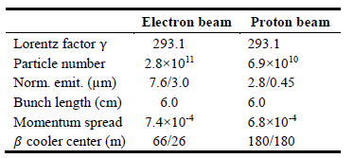
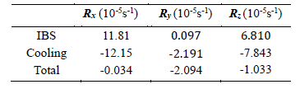
Non-magnetized cooling
- Introduce electron beam and ion beam dispersion

