Slide 1


SPECIFICATIONS AND STATUS OF THE NEW ELECTRON COOLER FOR THE CERN ANTIPROTON DECELERATOR (AD)
A. Rossi, C. Accettura, W. Andreazza, A. Bollazzi, C. Castro Sequeiro, J. Cenede, N. Chritin, Y. Coutron, D. Gamba, L. Joergensen, C. Machado, O. Marqversen, L. Ponce,
J. A. Ferreira Somoza, Y. Thurel, A. Frassier, G. Khatri, A. Pikin, M. Sameed,
A. Sinturel, T. Todorcevic, G. Tranquille, L. von Freeden
COOL23, 8th - 13th October 2023

Slide 2
Outline
Context: the AD complex and cycle
New electron cooler specifications
Design details and timeline
A. Rossi et al. COOL23, 8th - 13th October 2023

Slide 3
AD (Antiproton Decelerator) &
ELENA (Extra Low ENergy Antiproton ring)
~1.5 10¹³ protons (26 GeV) on target
~3.5 10⁷ antiprotons captured in AD
Deceleration to the lowest energy:
    → 5.3 MeV (AD)
    → 100 keV (ELENA)
Antiprotons extracted per cycle:
    1 bunch ~3x10⁷ (AD)
    4 bunches of ~6x10⁶ p-bars (ELENA)
Cycle lengths:
    ~100 s (AD)
    ~15 s (ELENA)
Beam cooling
    Stochastic → 3.57 and 2.0 GeV/c
    Electron (AD) → 300 and 100 MeV/c
    Electron (ELENA) → 35 and 13.7 MeV/c
Main purpose of the facility is to provide 100 keV pbar beams to (trap) experiments!
Sketch of the AD (circumference 182 m)
ELENA (circumference 30.4 m)
AD/ELENA experiments
Courtesy of Davide Gamba
Notes:
Protons coming from the SPS (Super Proton Synchrotron): about 10^13 protons of momentum 26 GeV/c to produce 5×10^7 antiprotons per minute, by collision on a Iridium target.

Slide 4
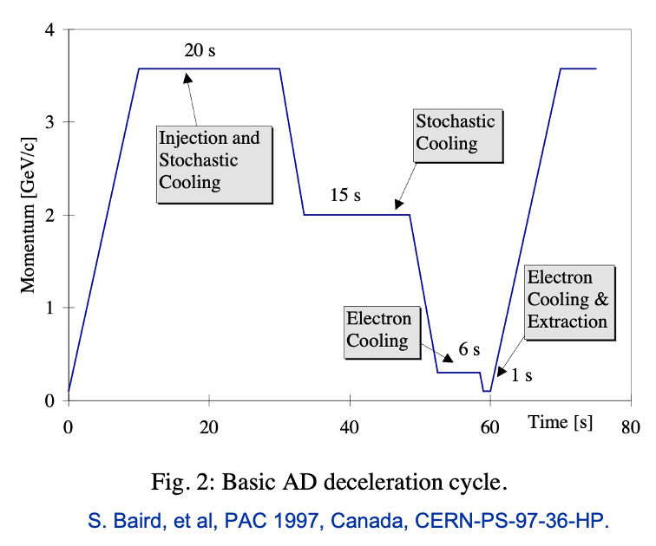
AD cycle and motivation for a new electron cooler
    Figures of merit
    Captured intensity (linked to target + DI + s-cooling performance)
    Transmission along the cycle (linked to optics control and s-/e-cooling performance)
    Cycle length (mainly driven by s-/e-cooling performance, and tollerated losses…)
    Number of cycles for physics (affected by systems - inc. e-cooling - reliability)
    Motivations for a new e-Cooler
    Improve e-Cooler reliability
    Reduce cycle length by 20%
    Reduce beam losses
}
not only with
e-cooler
Courtesy of Davide Gamba
Notes:
Radio frequency (RF) systems decelerate and bunch the cooled antiprotons at 3.5 GeV/c.

Slide 5
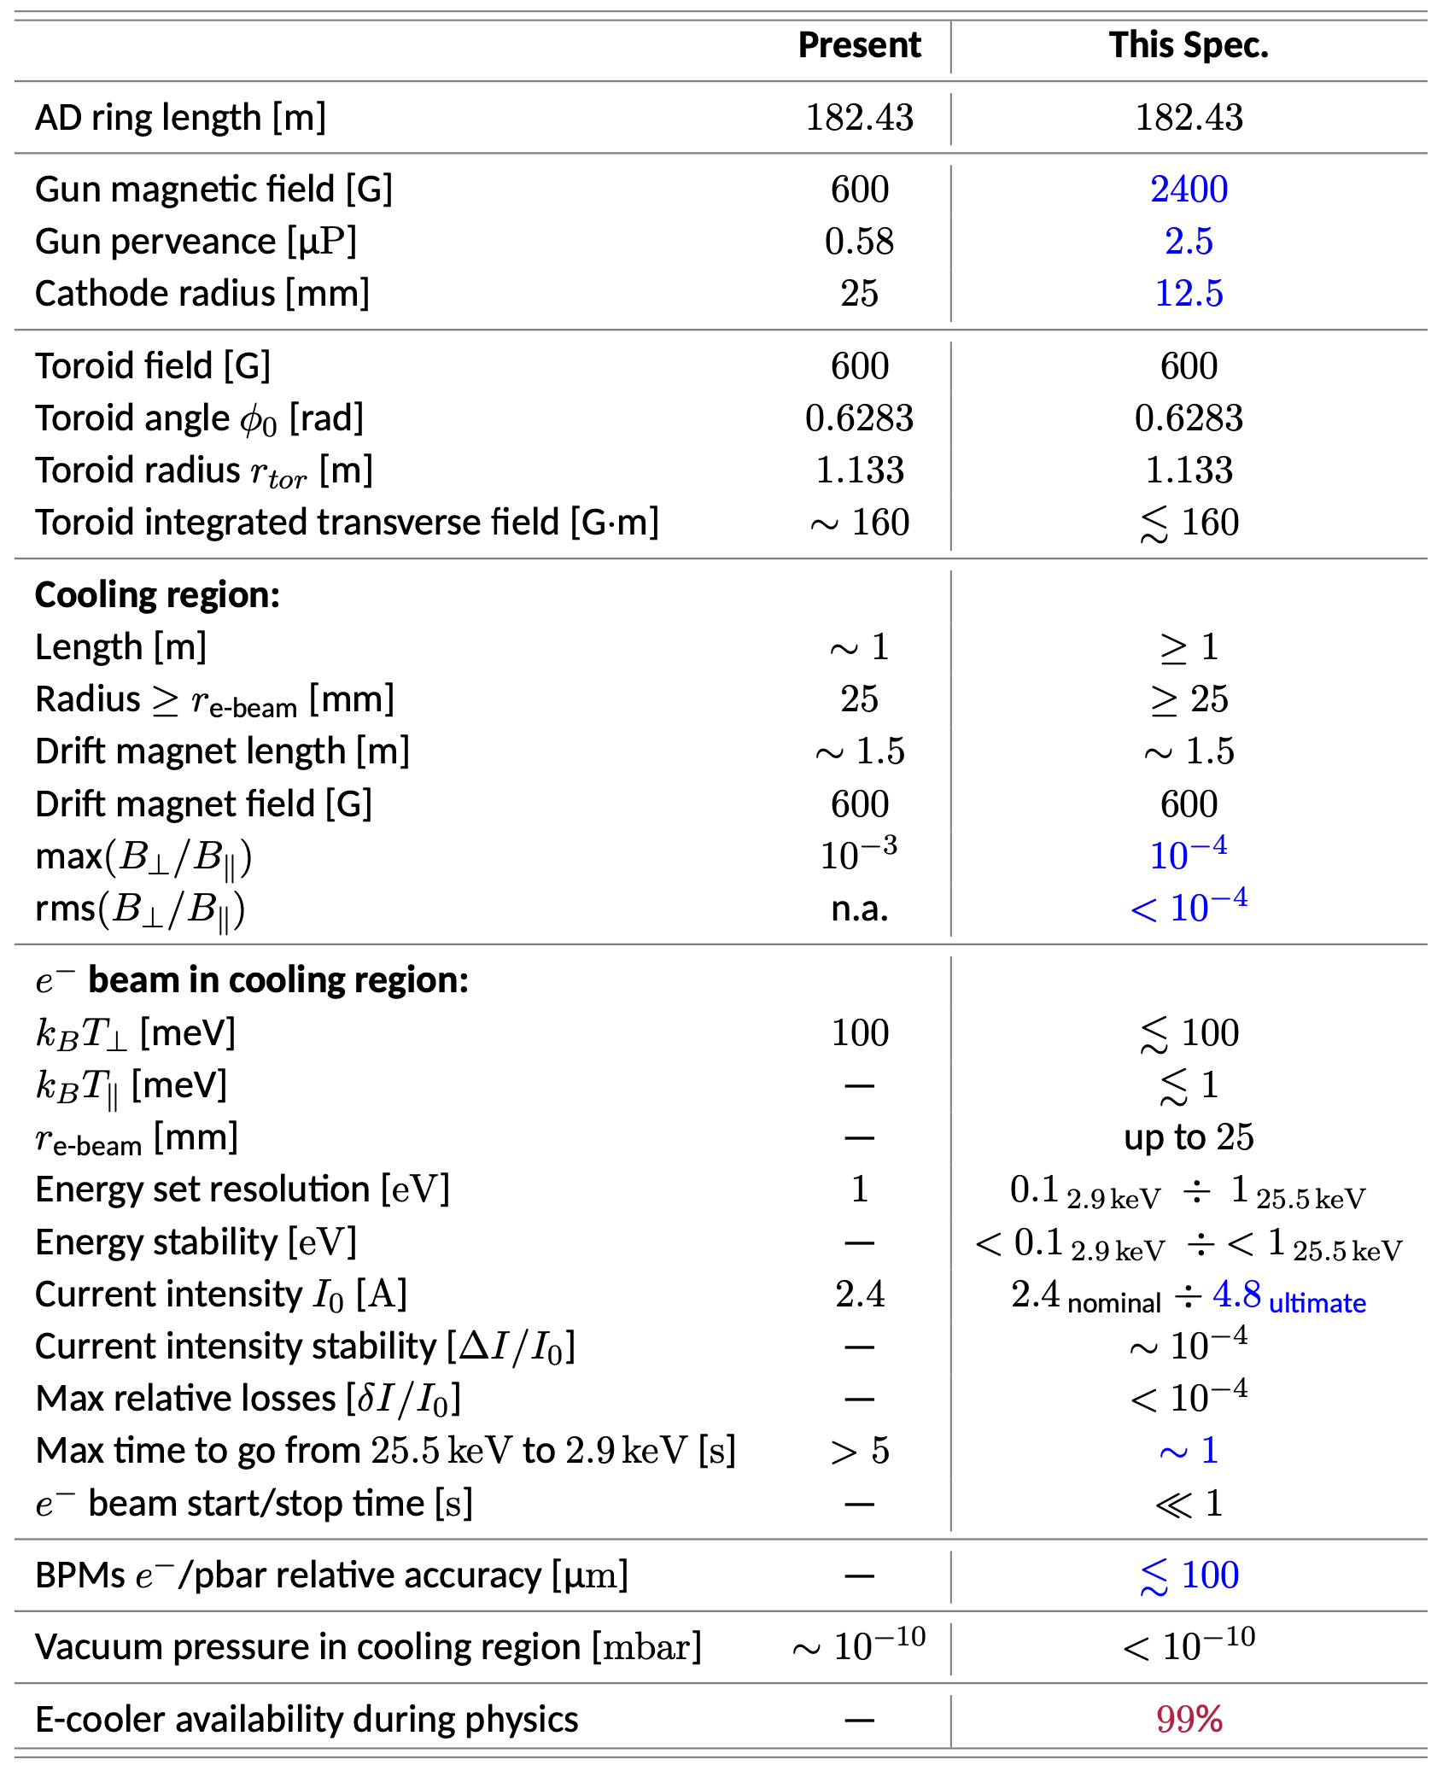
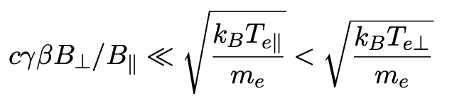
e-Cooler specifications
}
Expansion of the e⁻ beam by a factor of 2 to reduce transverse energy
CERN EDMS doc. AD-LNT-ES-0001
}
More stringent to limit e⁻ beam heating in the cooling region
}
Might be limited by space charge and other effects
}
Possible via the gun grid
Determines the choice of components/spares
Notes:
Cooling time increase with angular (depends on transverse e- velocity spread) and momentum (depends on longitudinal e- velocity spread) difference between e- and pbar

Slide 6
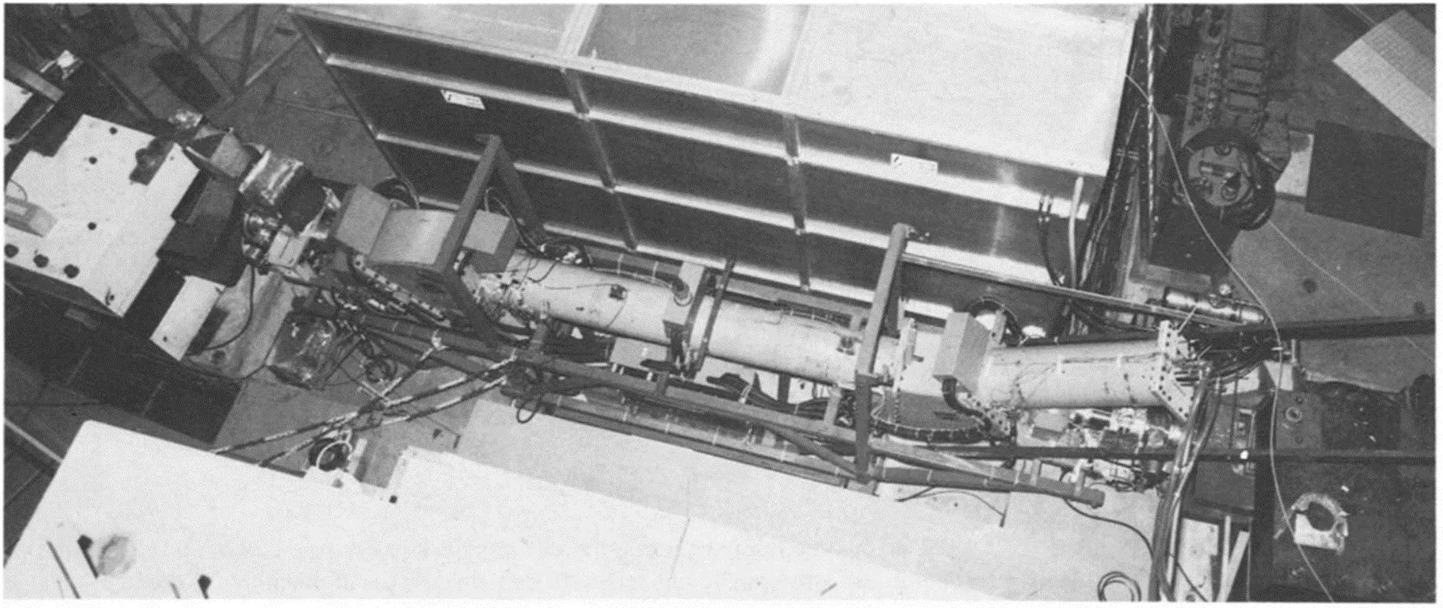
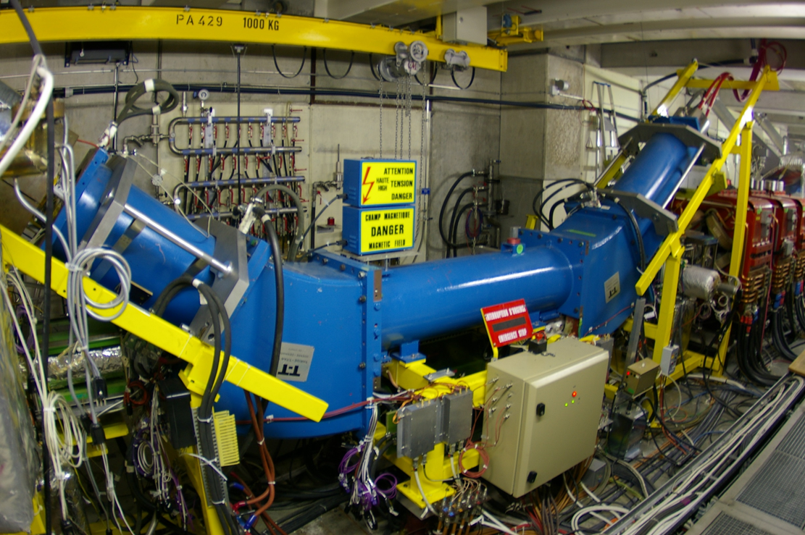
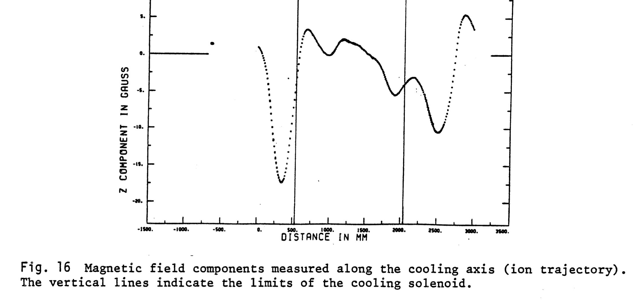
Current e-Cooler
Low Energy Antiproton Ring (1982-1997)
Antiproton Decelerator Ring (2000-today)
A. Wolf, L. Hütten and H. Poth,
Magnetic field measurements for the electron cooling device for LEAR,
EP Internal Report 84-01
Courtesy of Gerard Tranquille

Slide 7
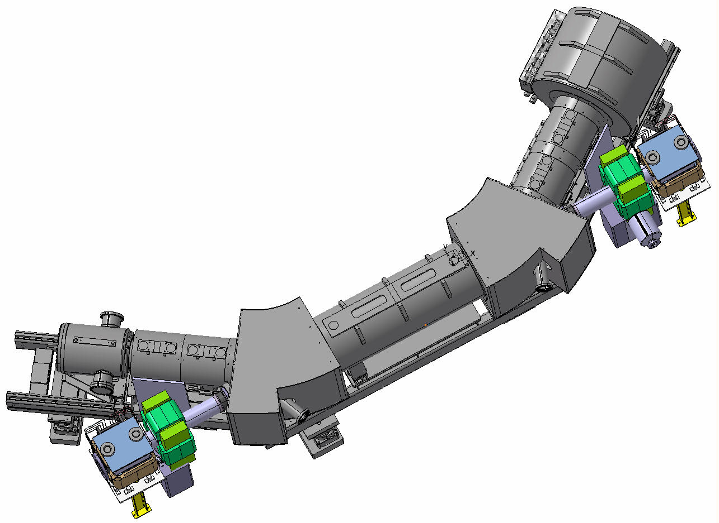
Courtesy of Nicolas Chritin & William Andreazza

Slide 8
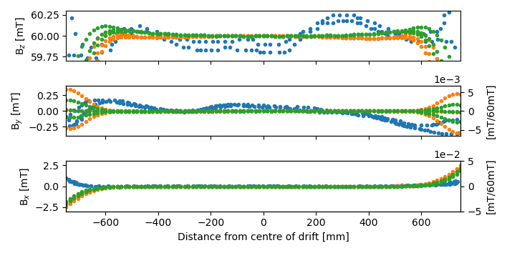
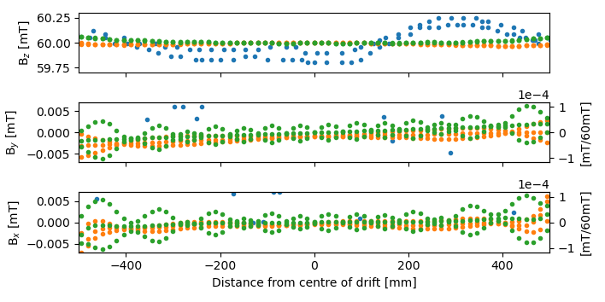
Comparison of the current e-cooler drift to design
”perfect” / measured magnets
Bz in direction of e− motion
By ⊥ bending plane
Bx || bending plane
↖︎ 28 mm
on axis
↘︎ ︎28 mm
1984 – scaled from Wolf et al.’s measurements
Complete solenoid
Pancake solenoid
Courtesy of Luke von Freeden

Slide 9
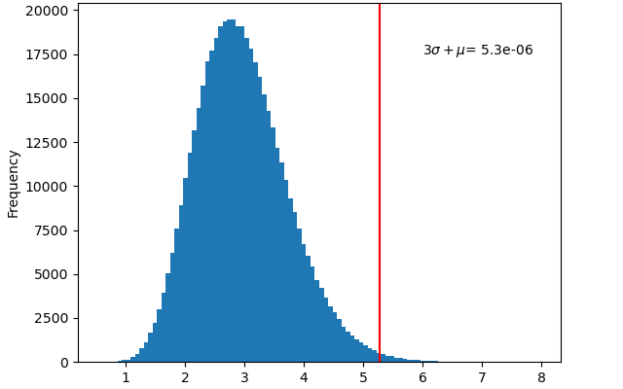
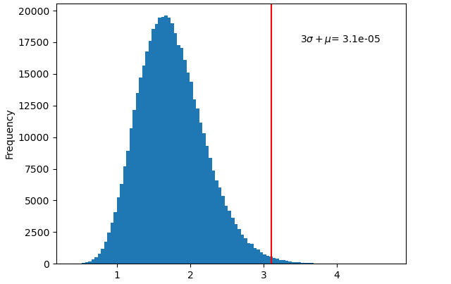
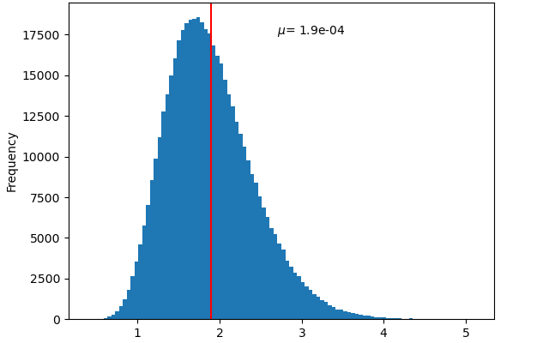
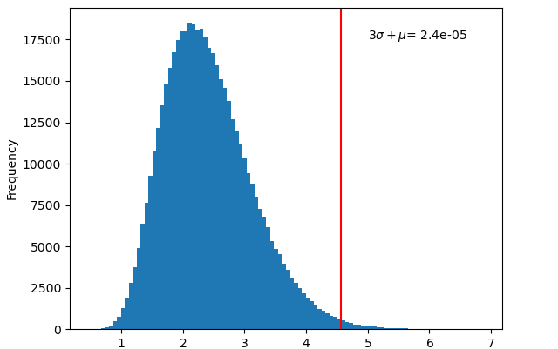
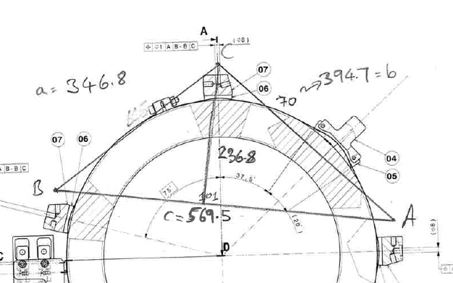
Comparison complete vs. pancake drift solenoid
5.3x10⁻⁶
Complete
Pancake
3.1x10⁻⁵
Fied error due to powering
tolerances
resolution 3σ = 5PPM and ripple µ = 1m
Fied error due to powering
long term stability
resolution 3σ = 1000PPM,
nom = 75%
x10⁻⁵
1.9x10⁻⁴
2.4x10⁻⁵
3 pt supports positioning
toleance
3σ = 200µm
3 pt supports positioning
long term stabitly
3σ = 20µm
x10⁻⁴
x10⁻⁵
Courtesy of Luke von Freeden

Slide 10
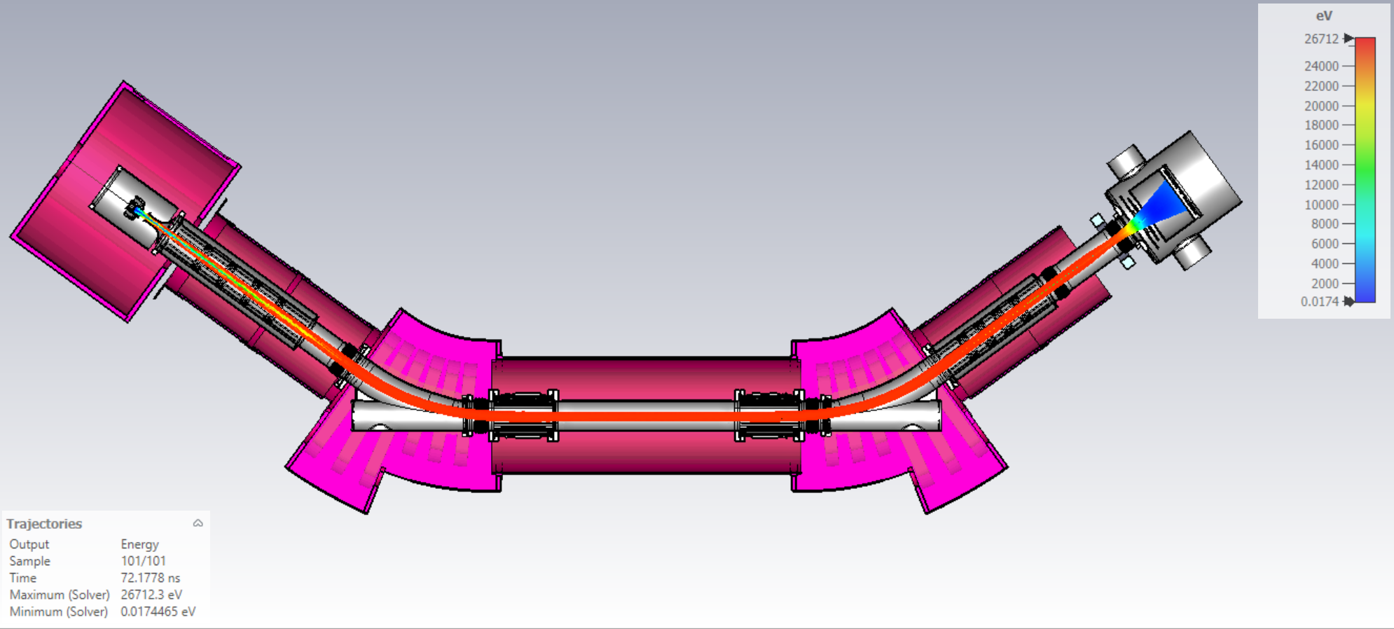
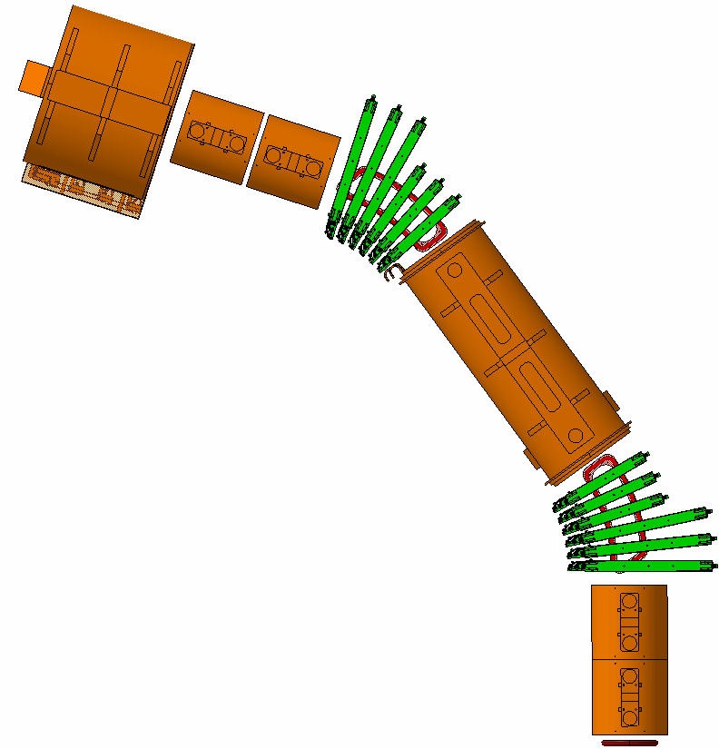


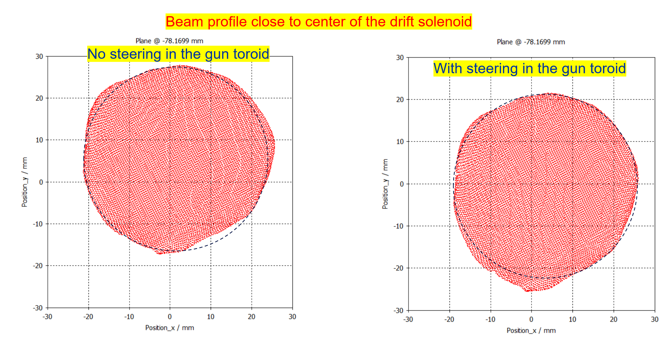
Electron transport simulation to validate design
Courtesy of Gunn Khatri

Slide 11
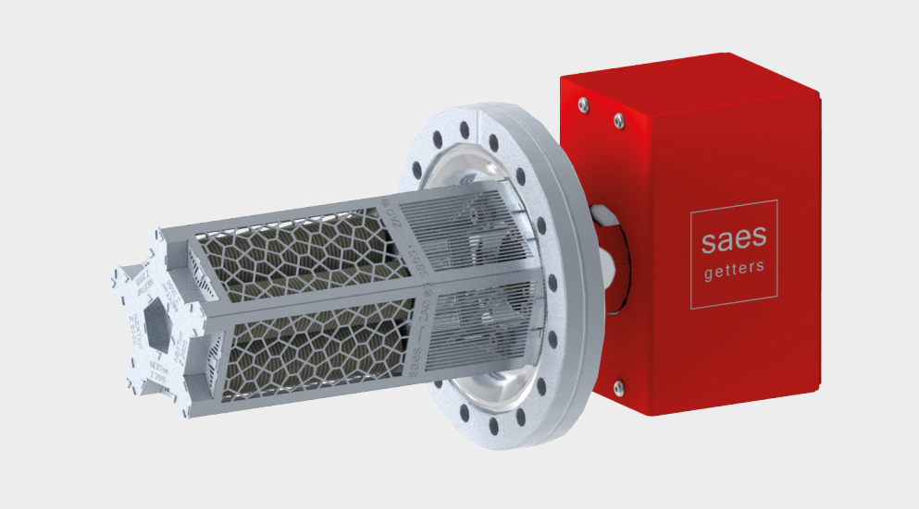
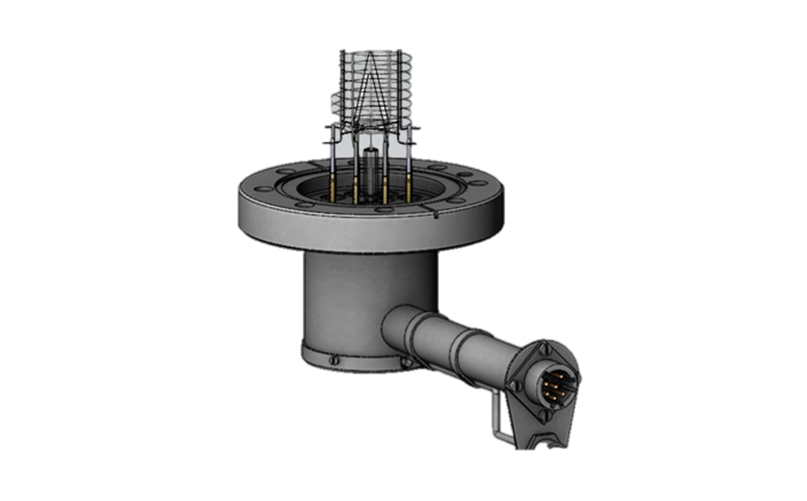
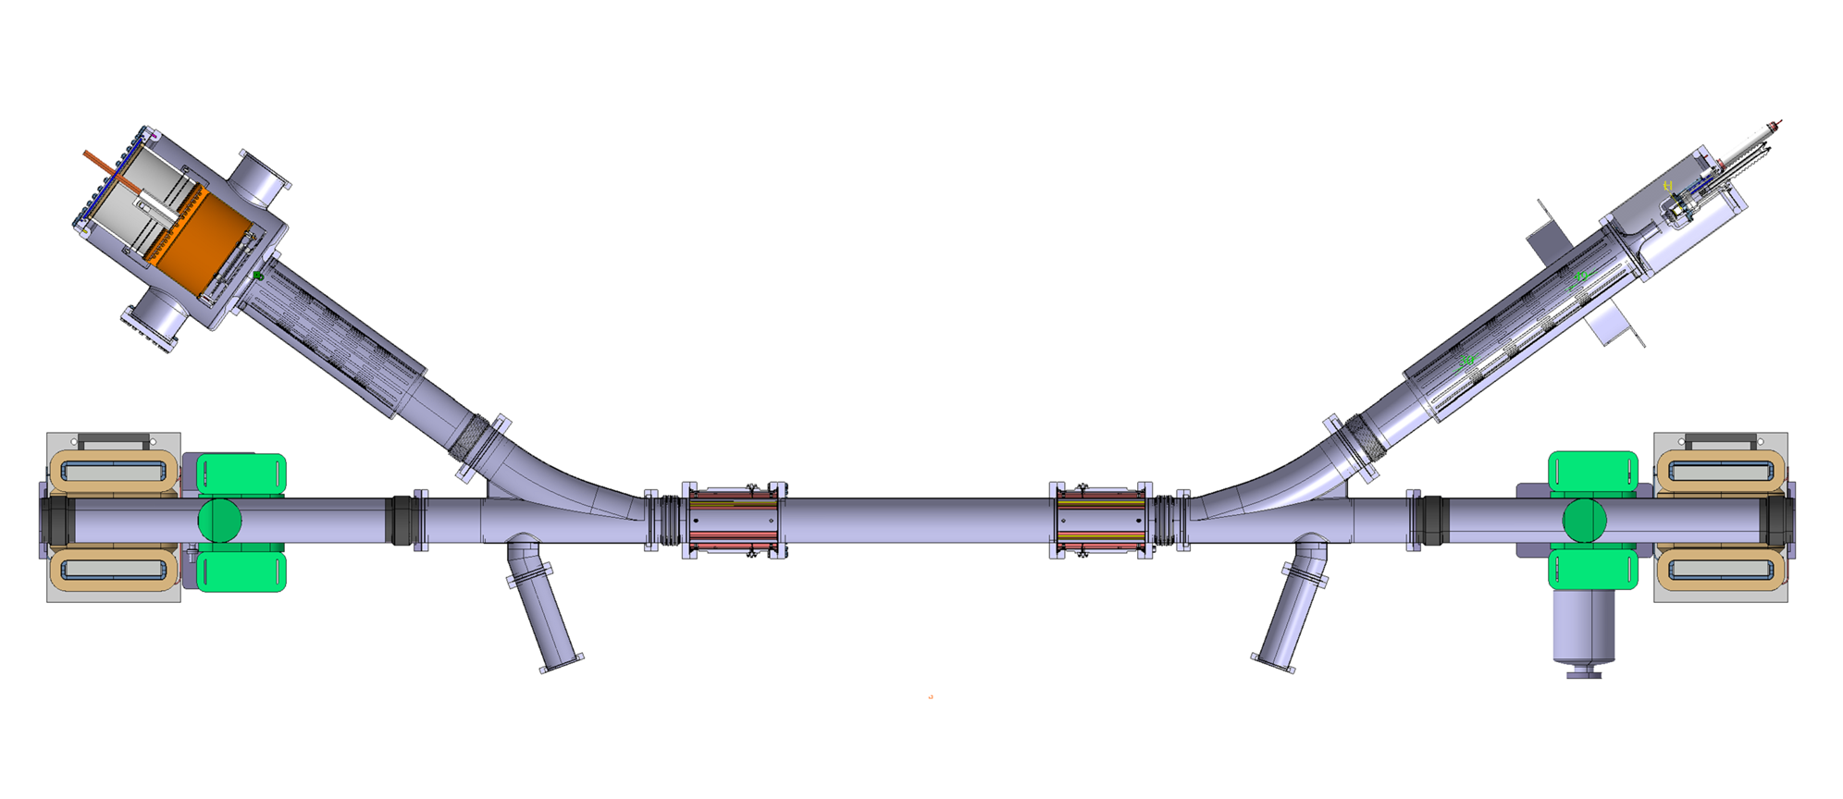
Vacuum
Collector
NexTorr pump
Gun
Similar design to ELENA e-cooler
Extensive use of NEG-strips and coating
NEG strips
NEG strips
NEG coating
NEG coating
NEG coating
No clearing electrode
DN200
NexTorr pumps
Courtesy of Cristina Castro Sequeiro, Jose A. Ferreira Somoza, Alexandre Sinturel

Slide 12
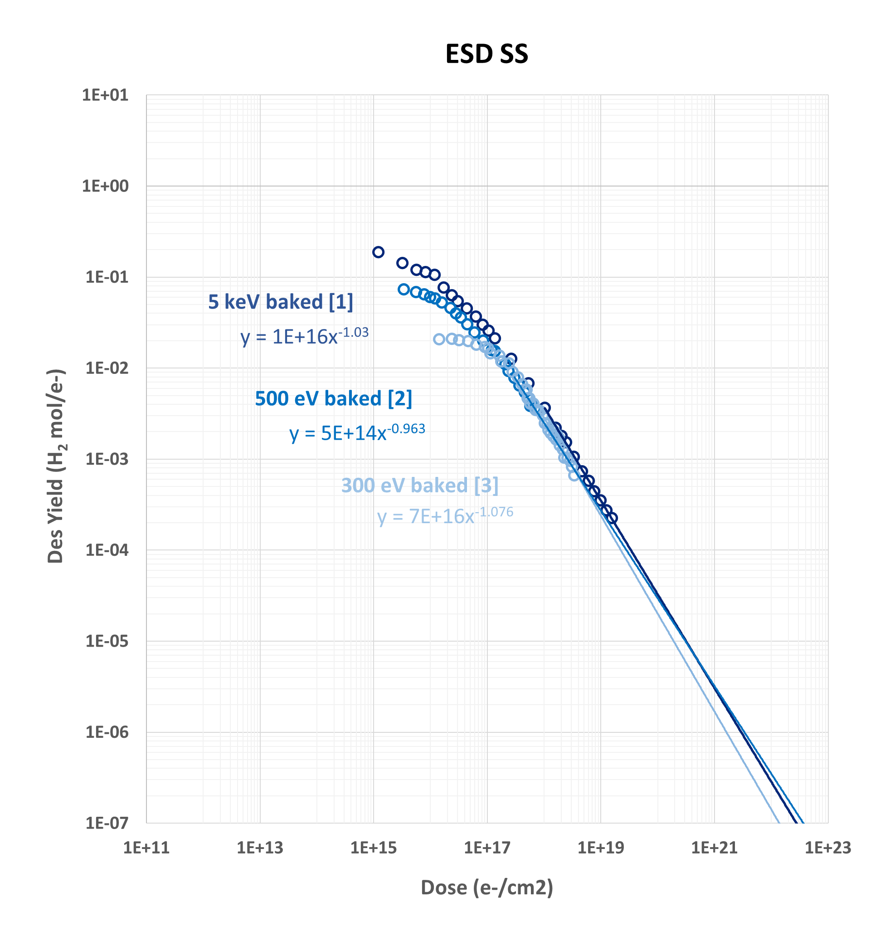
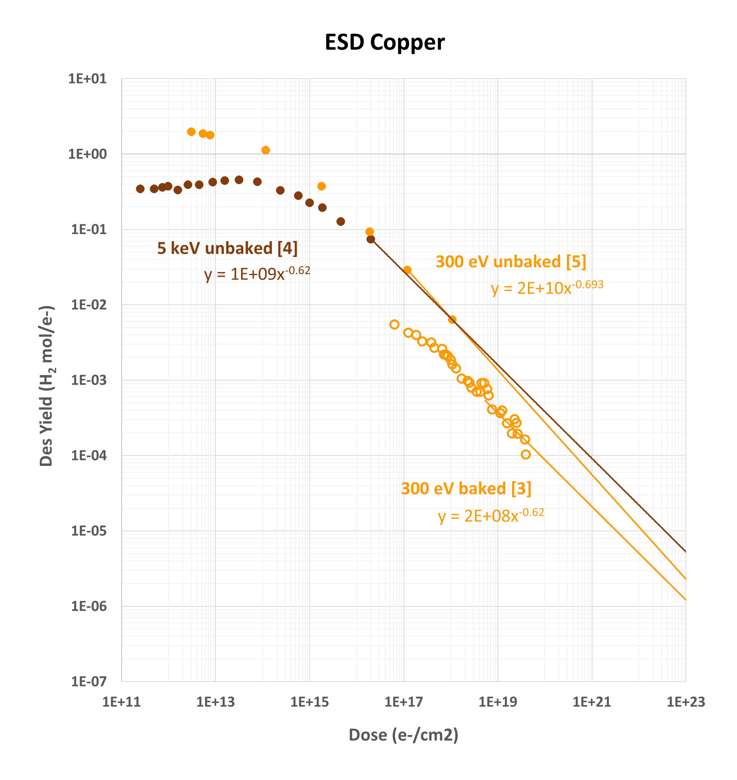
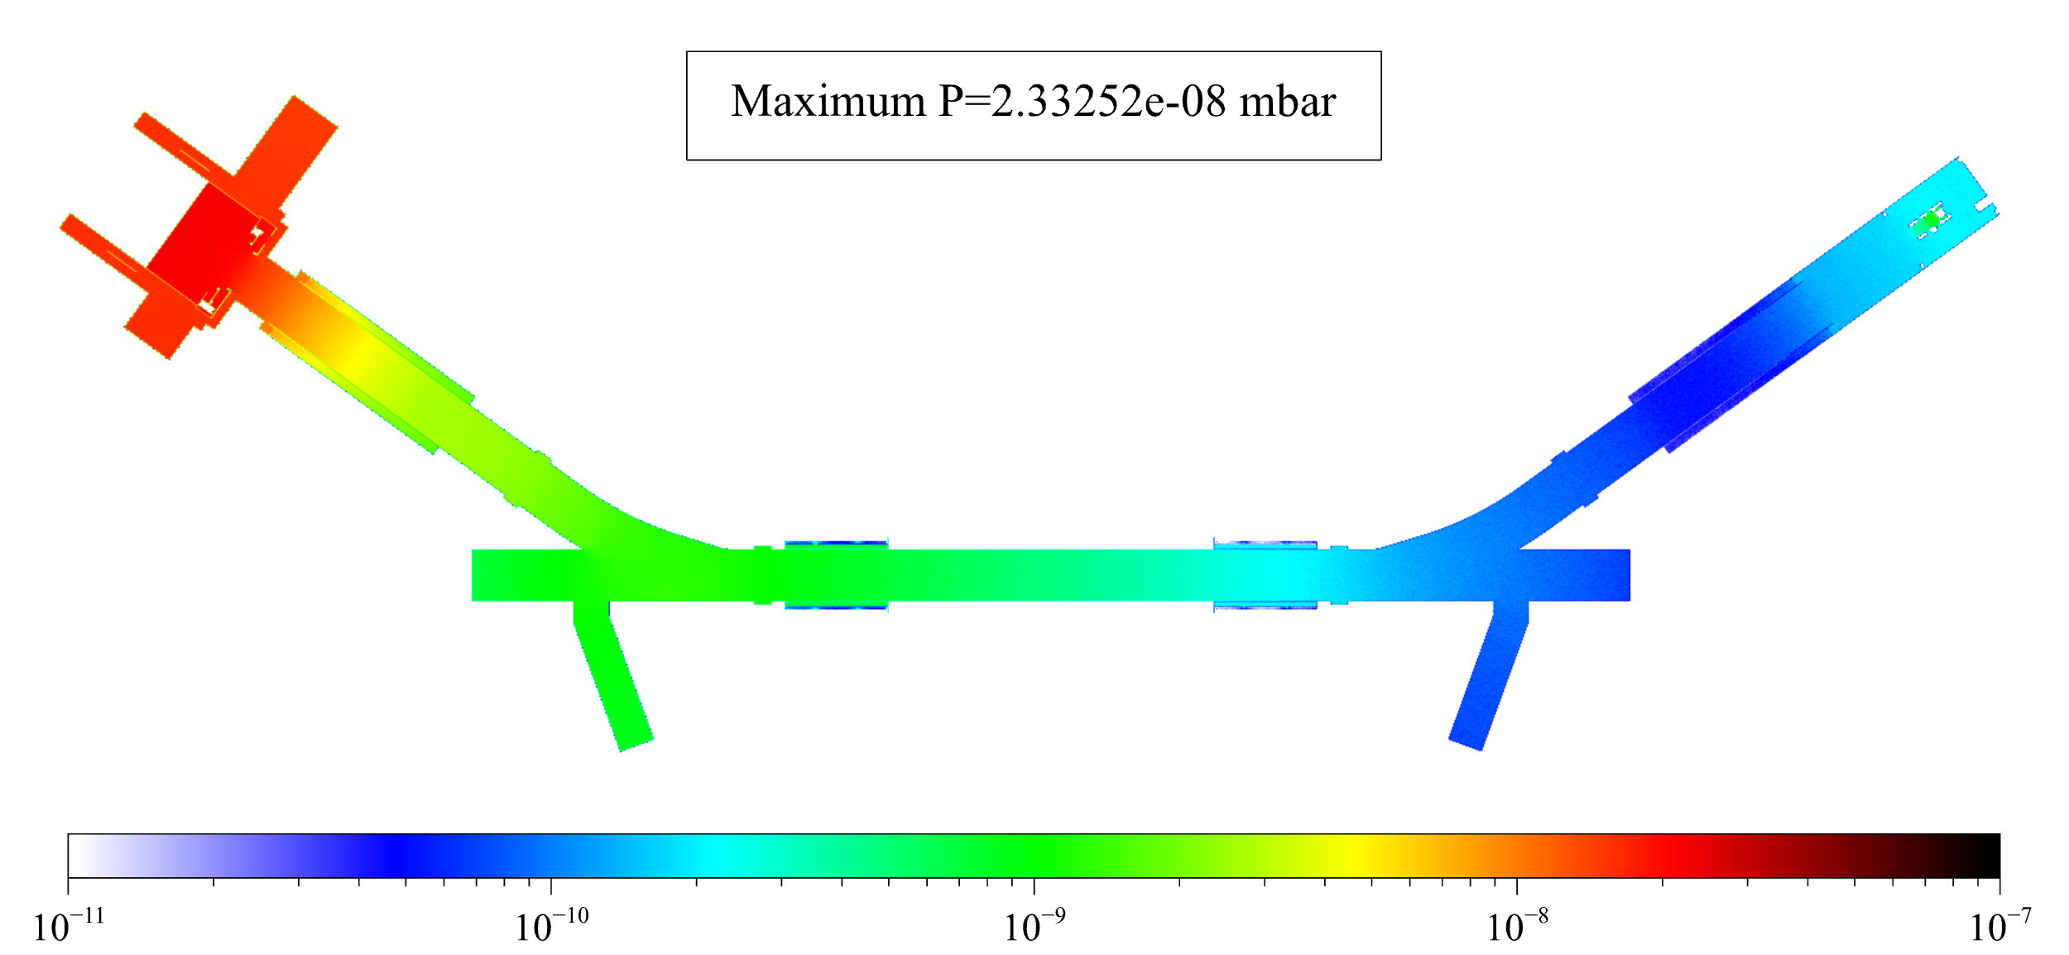
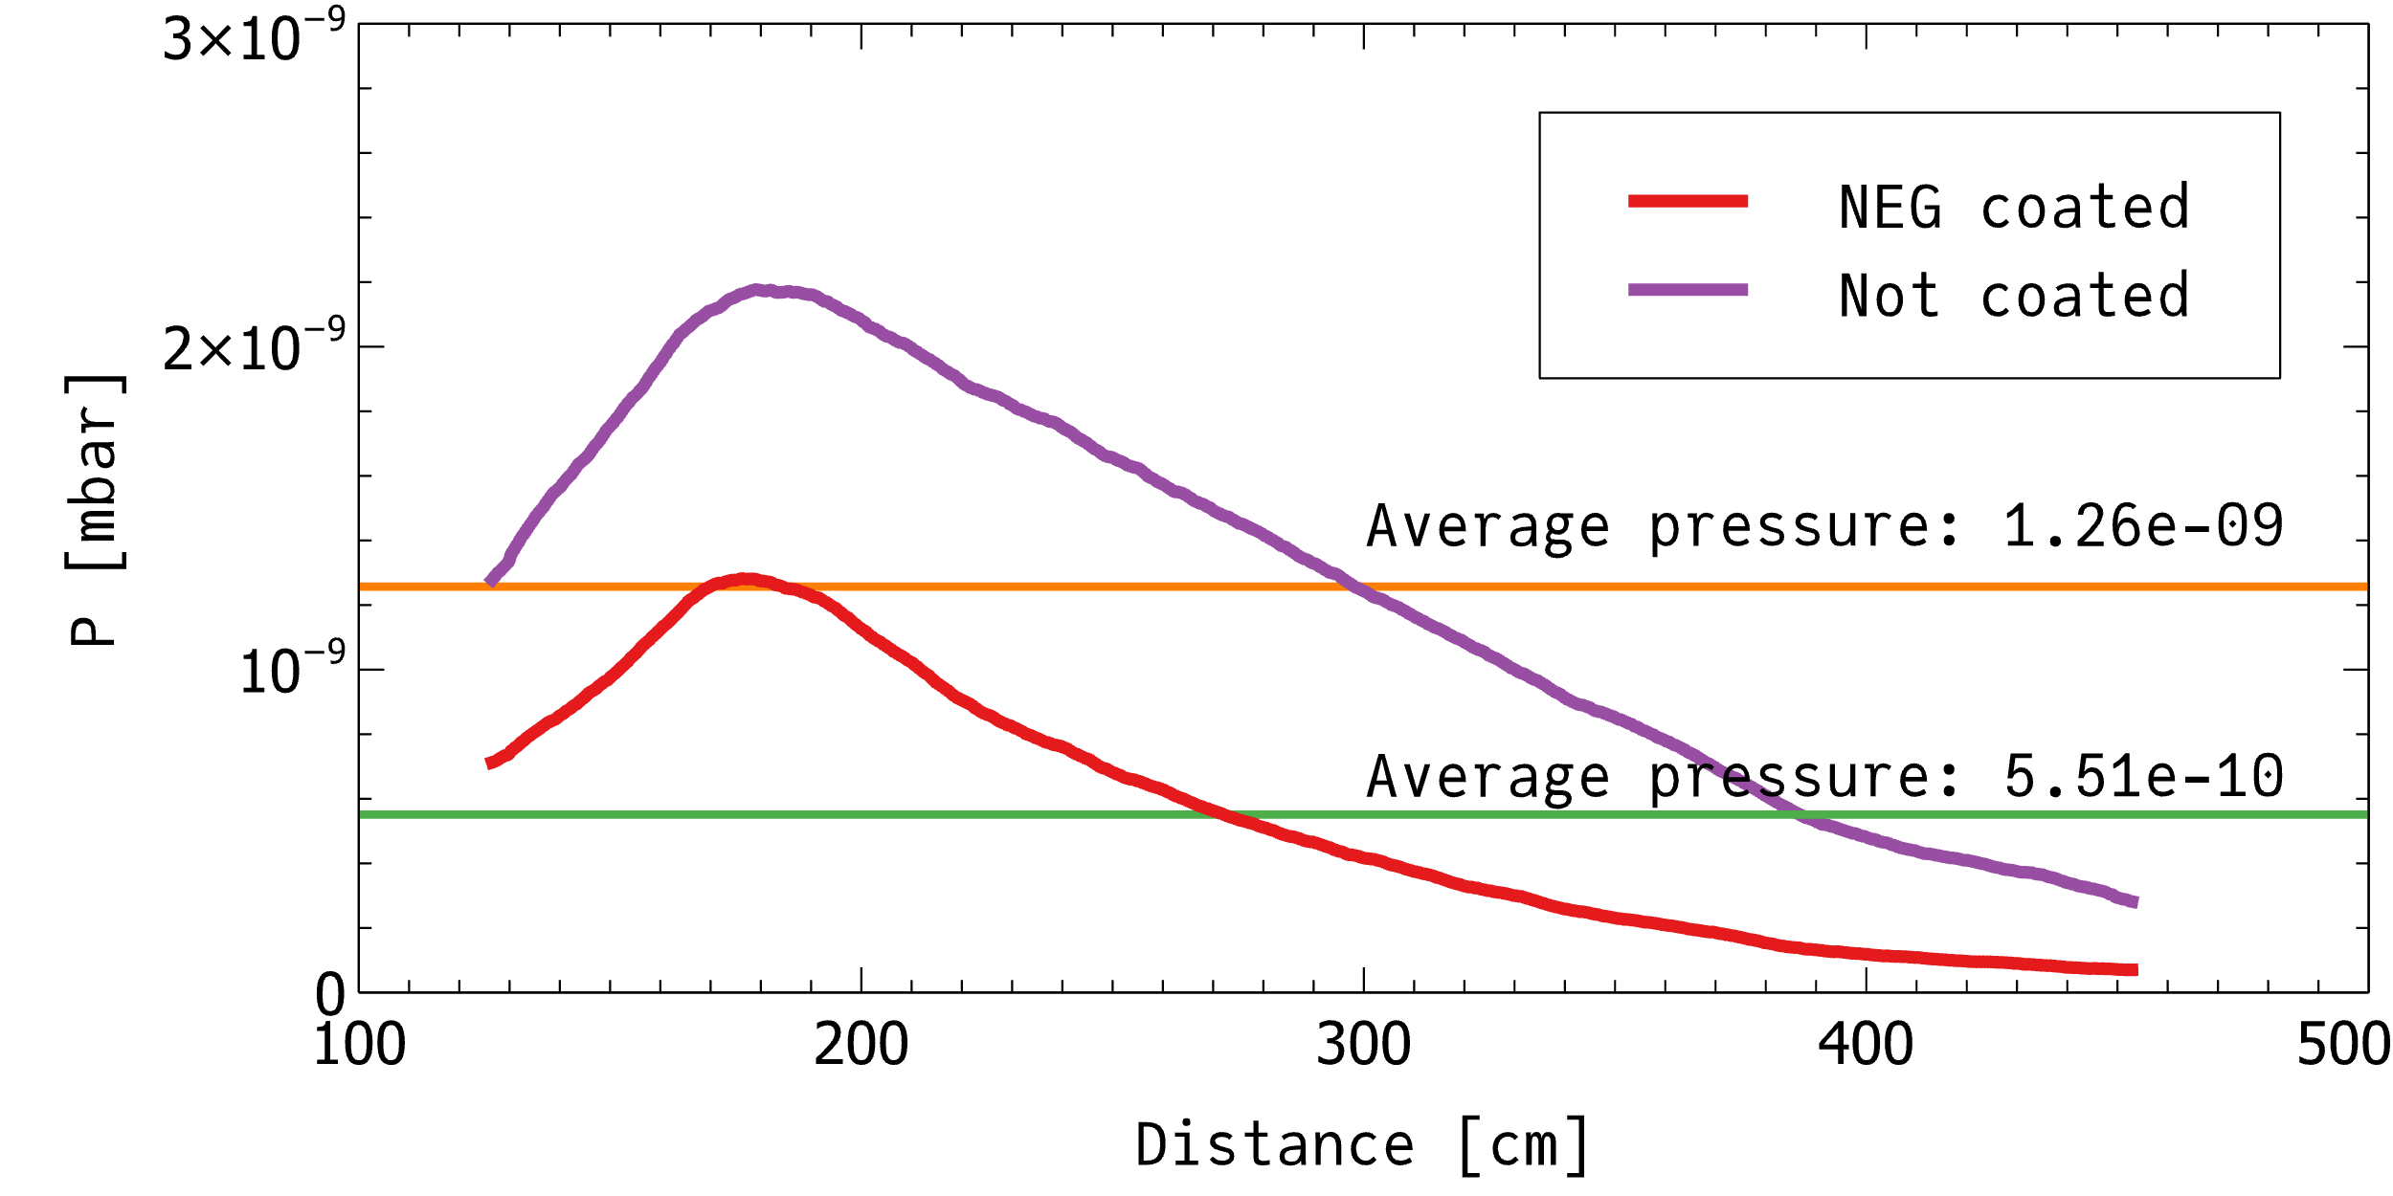
Results
Gas loads from gun and collector after ≈ 1 day operation
Courtesy of Cristina Castro Sequeiro, Jose A. Ferreira Somoza, Alexandre Sinturel

Slide 13
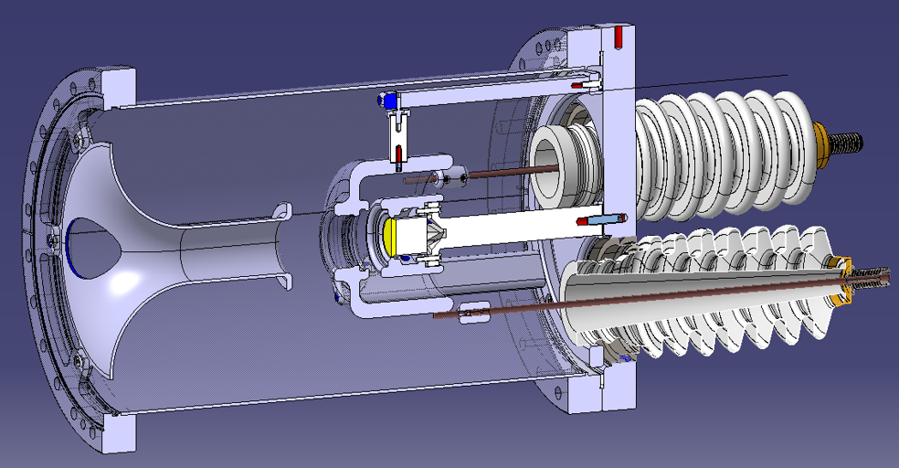
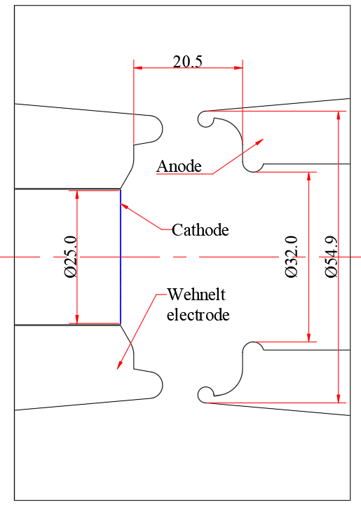
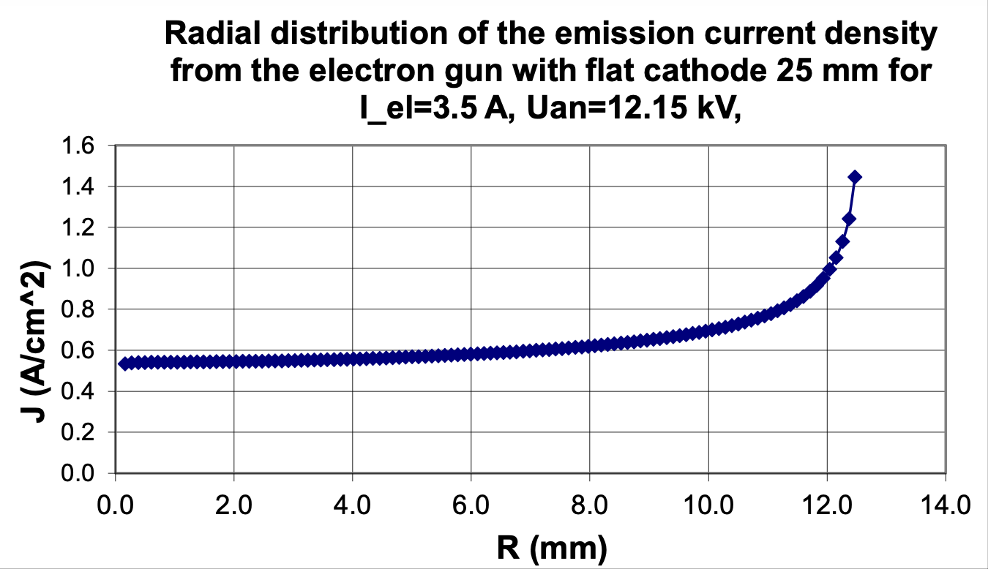
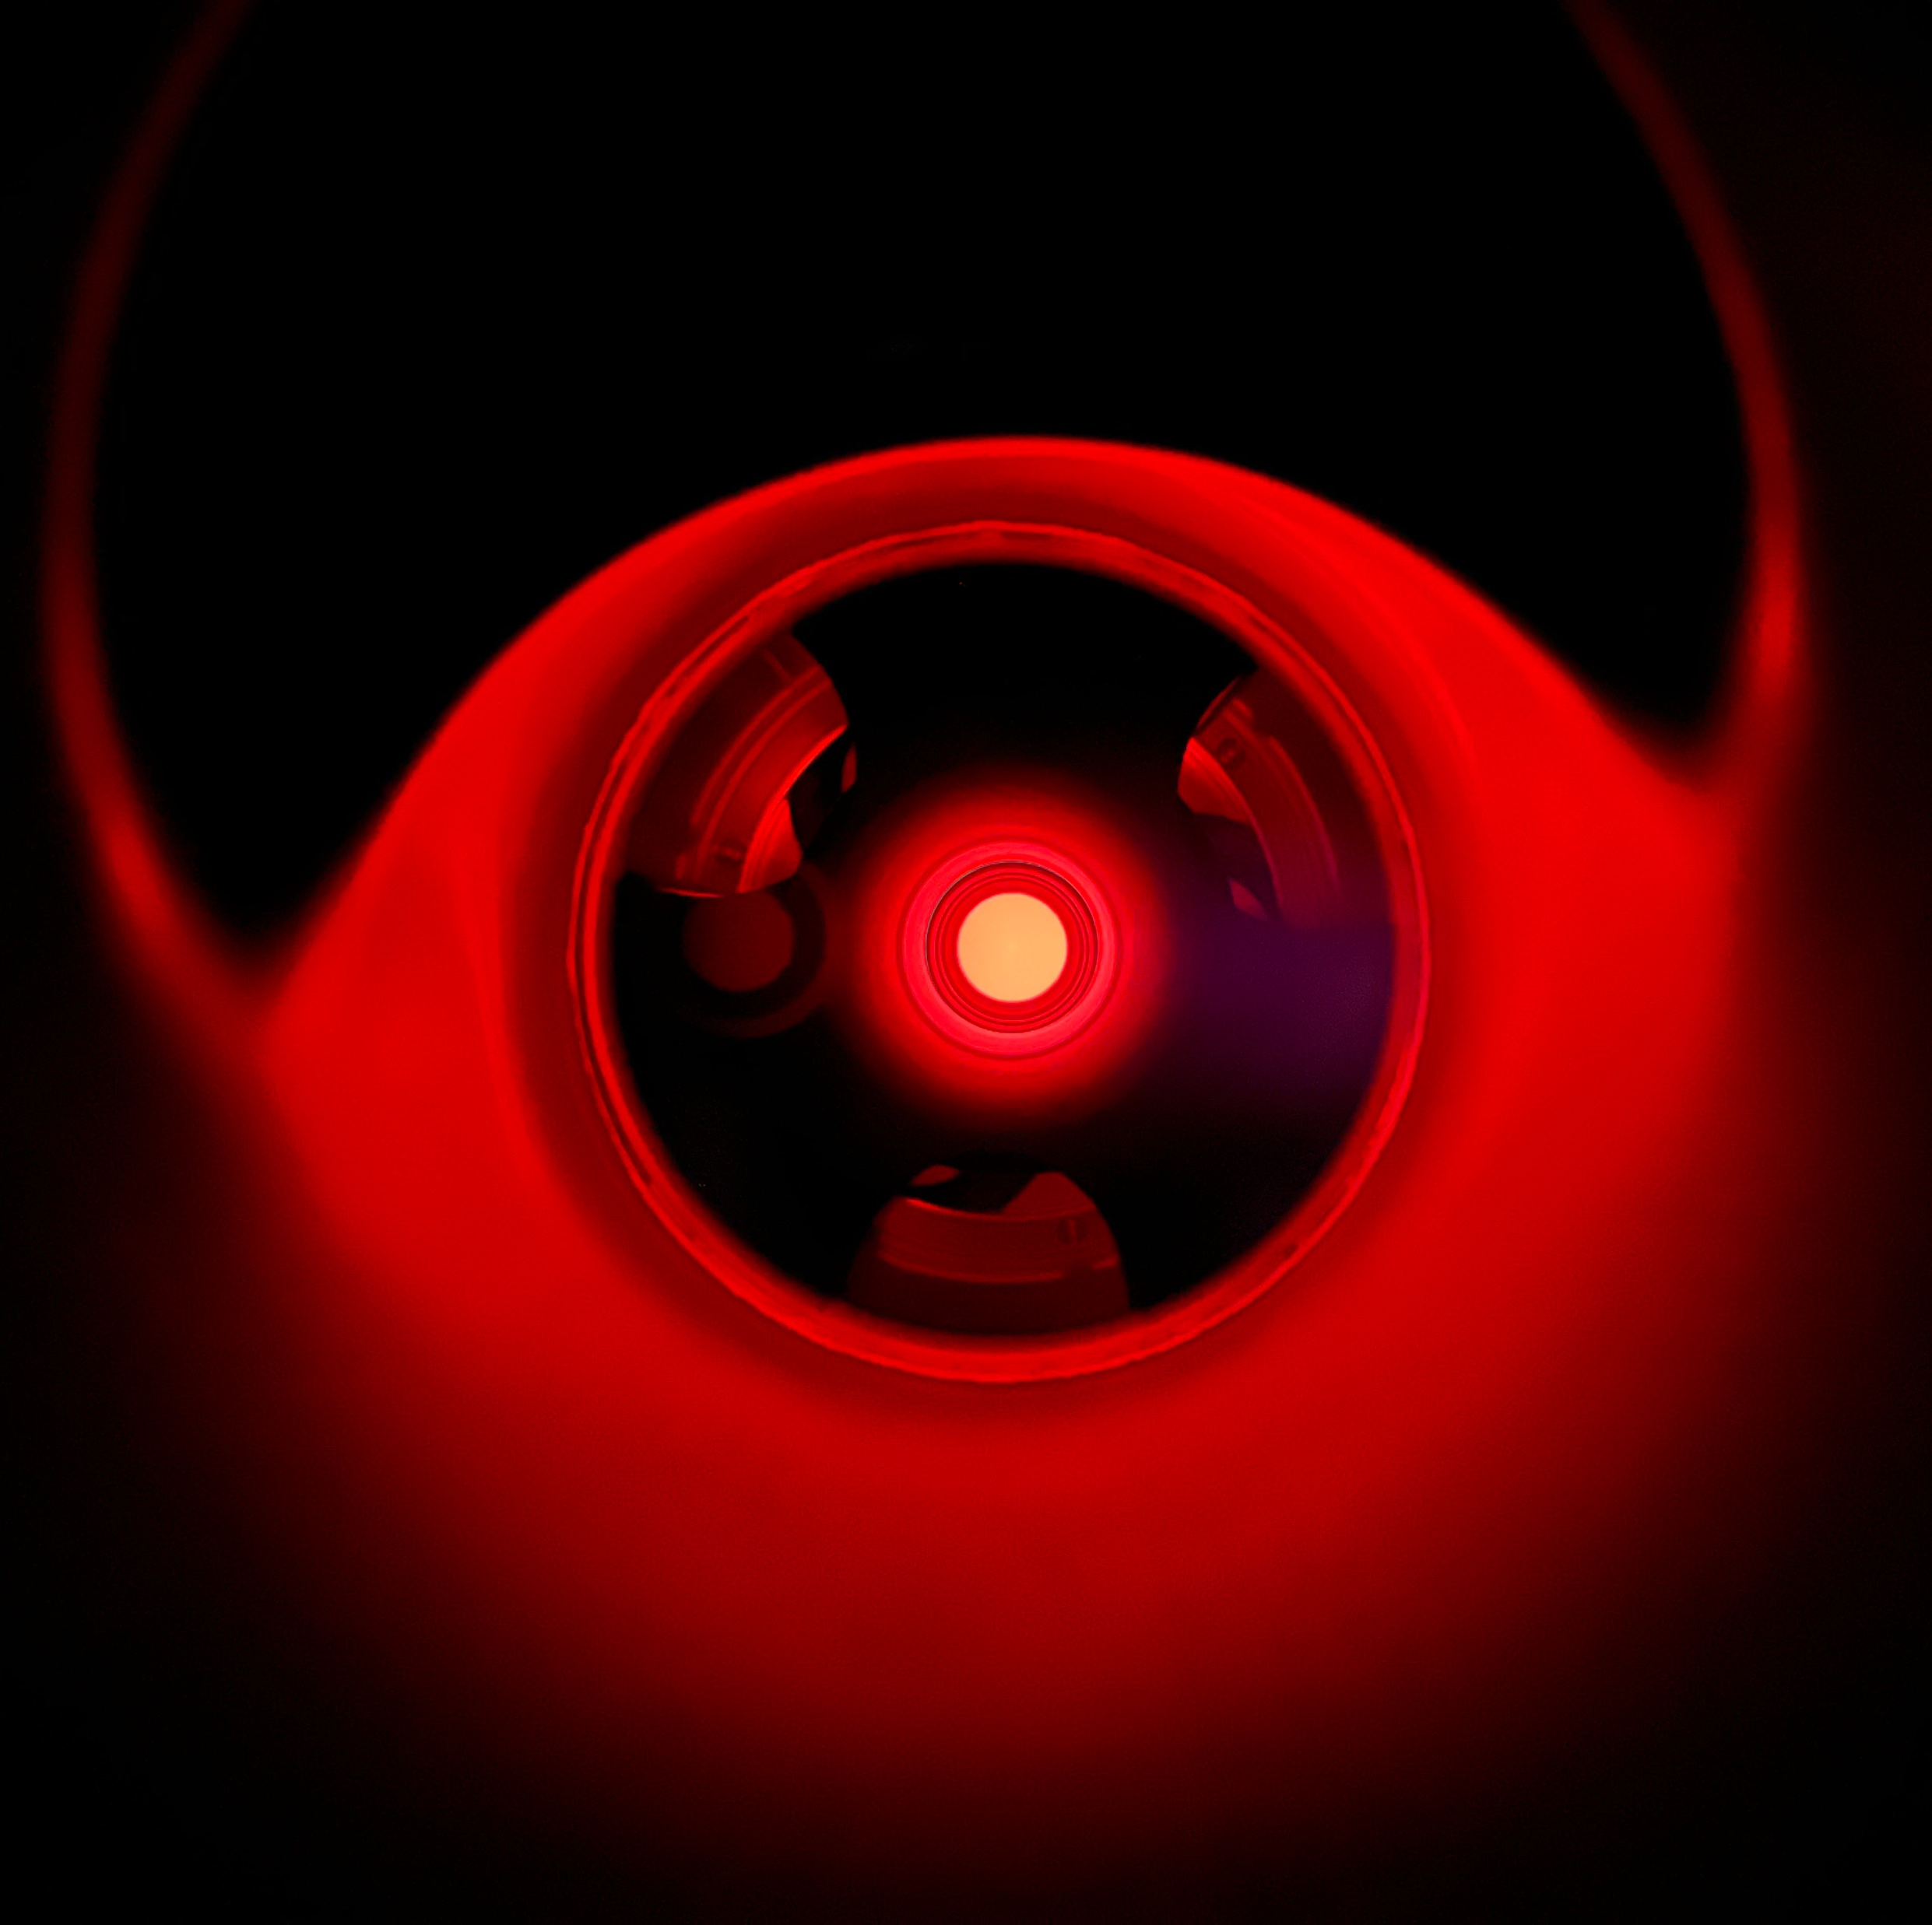
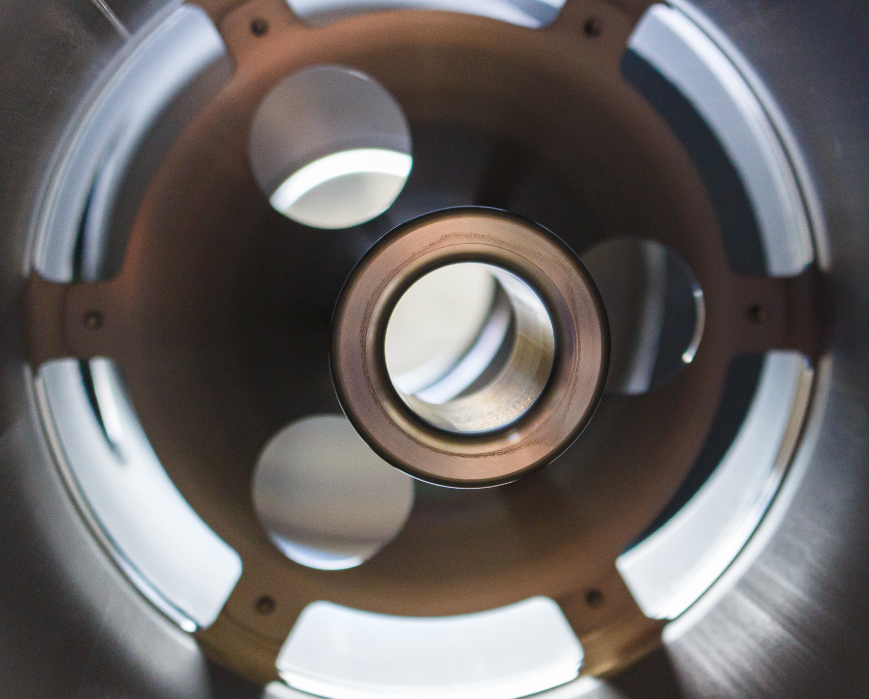
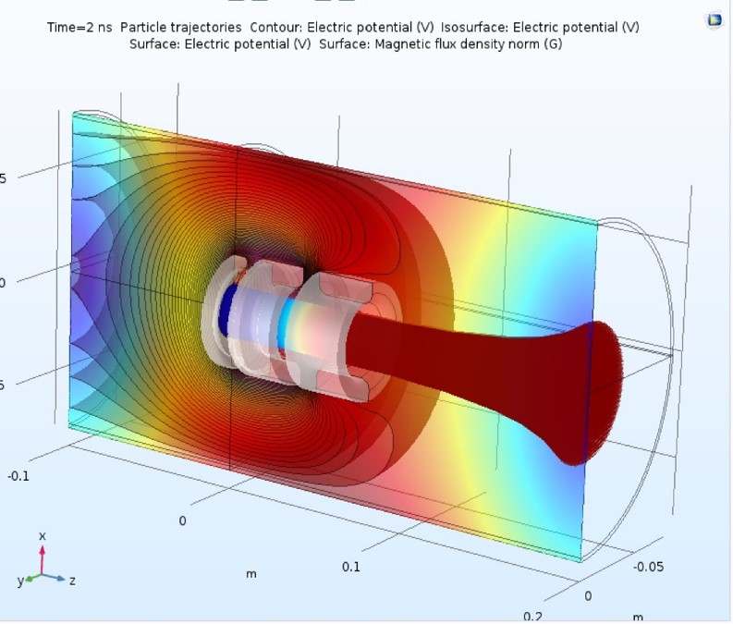
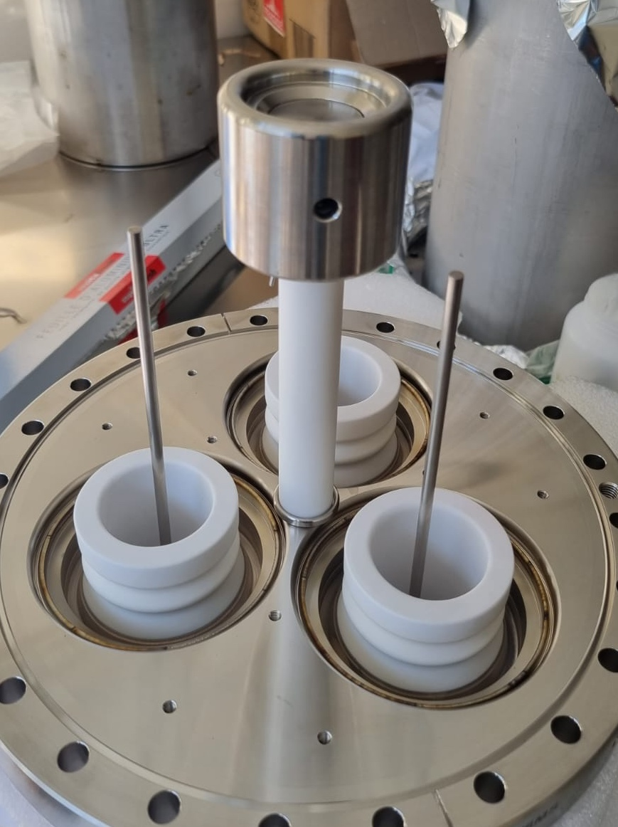
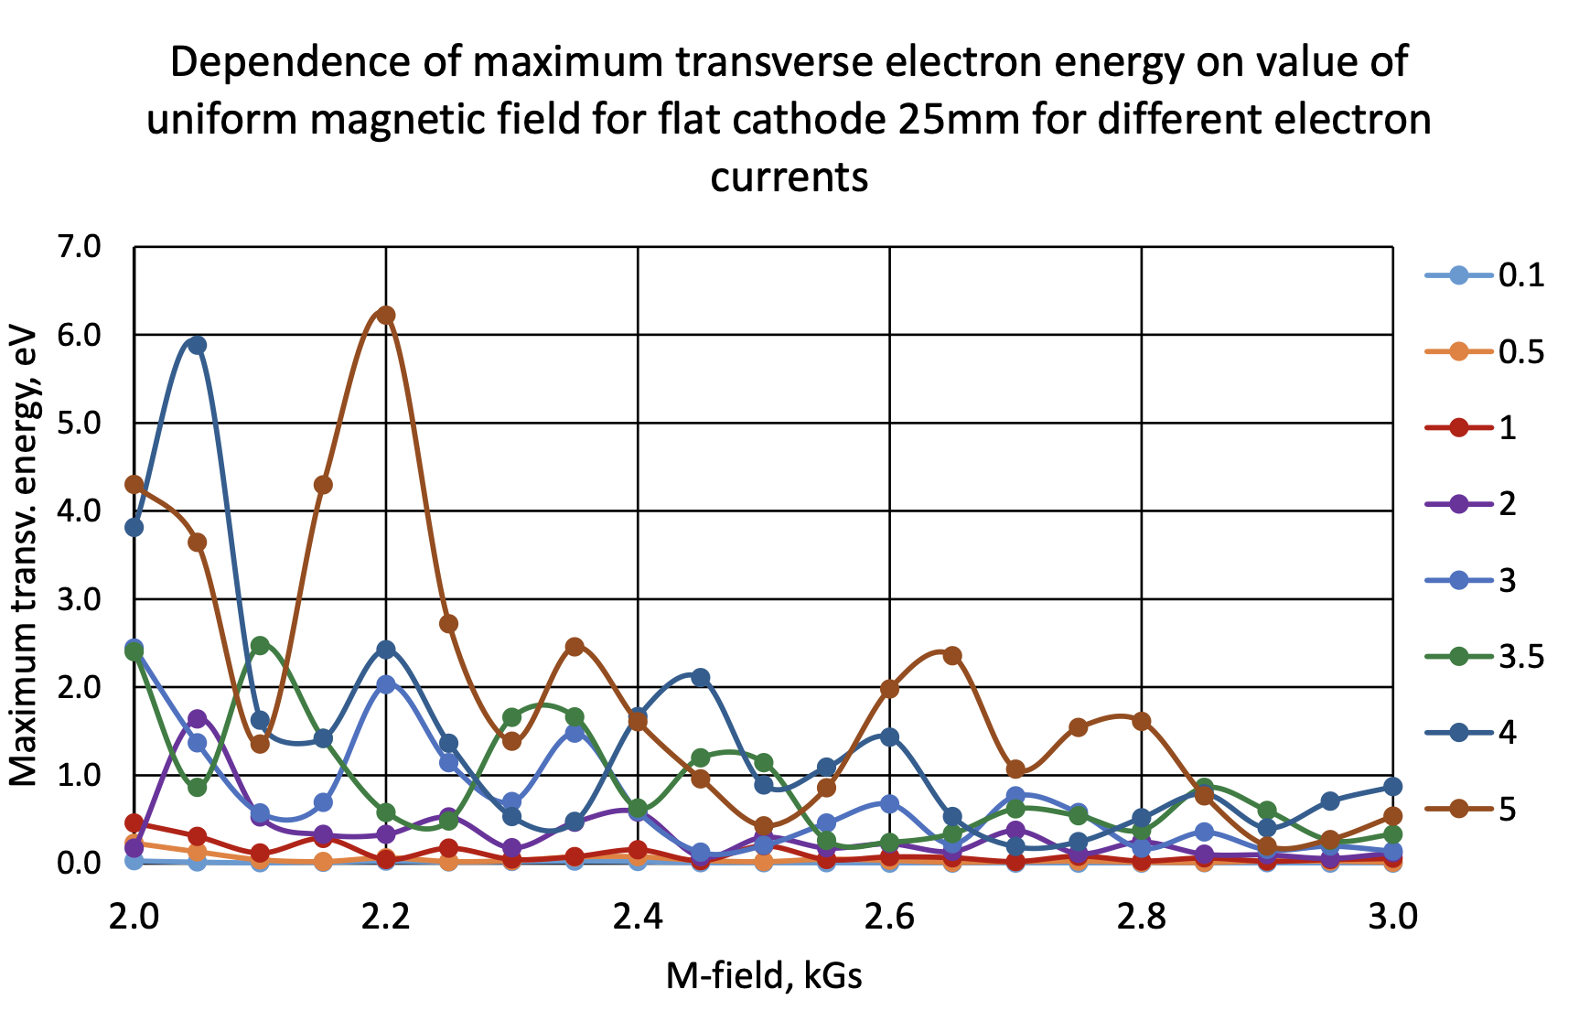
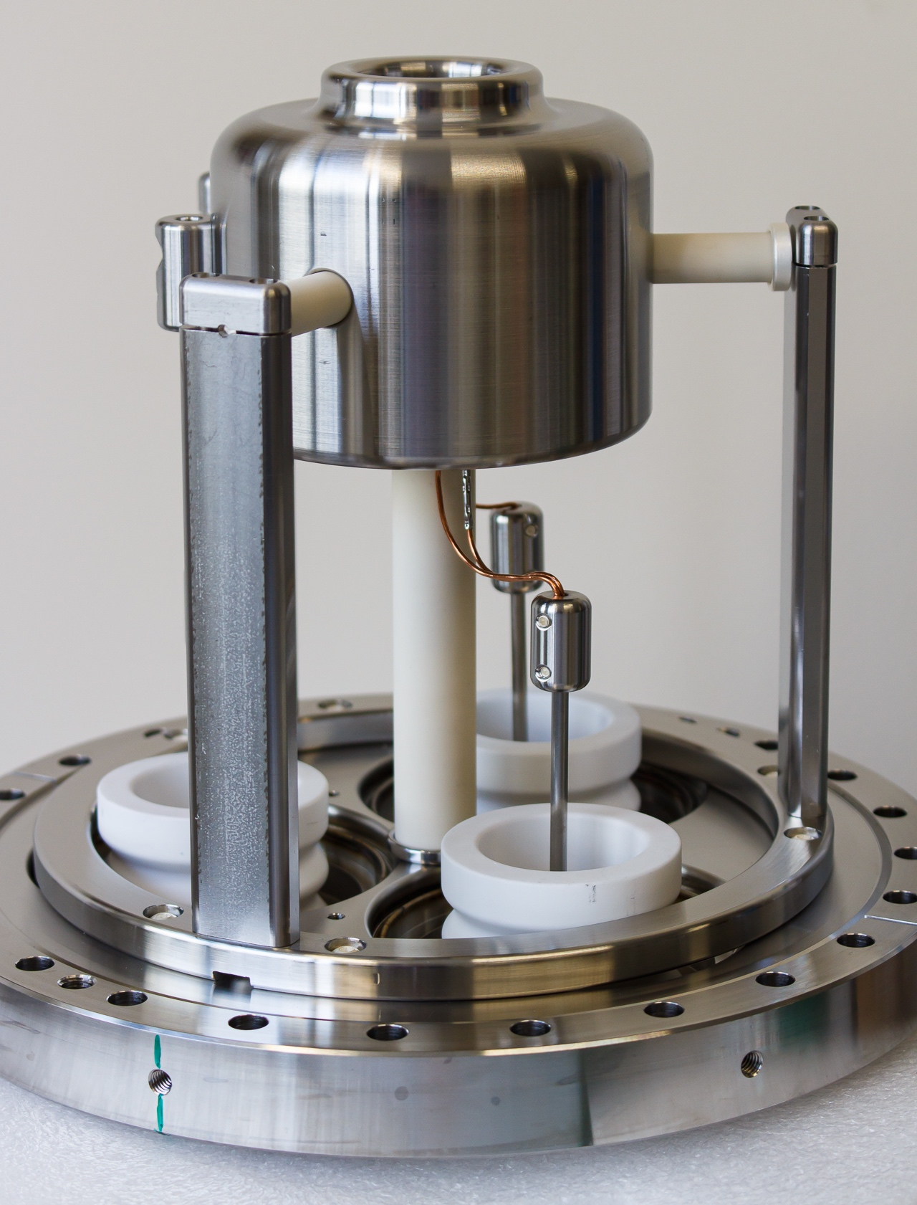
Gun – prototype
Anode – Grid – Cathode
Courtesy of Jean Cenede
Courtesy of Alexandre Pikin
Courtesy of Gerard Tranquille
Photos by
Giulio Stancari

Slide 14
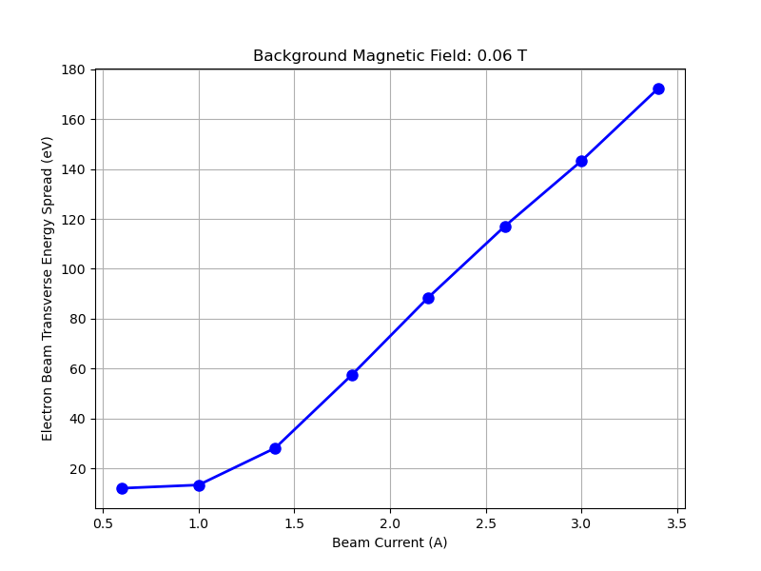
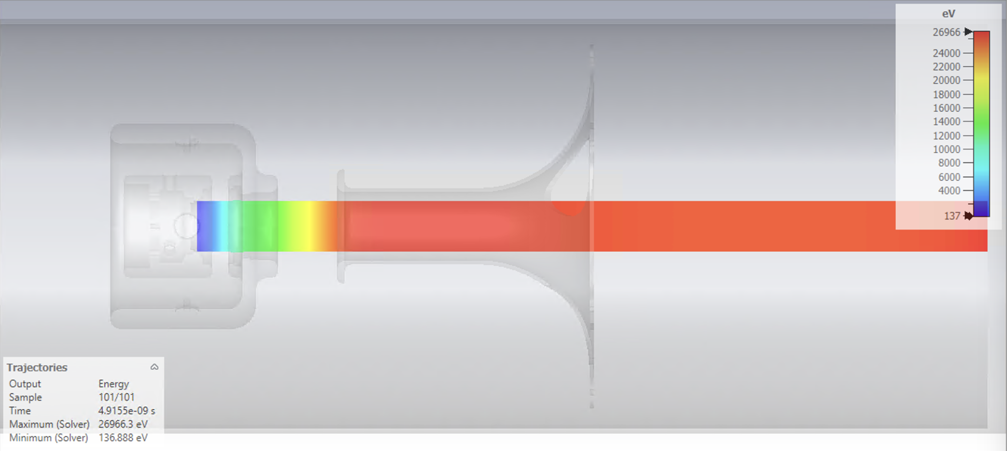
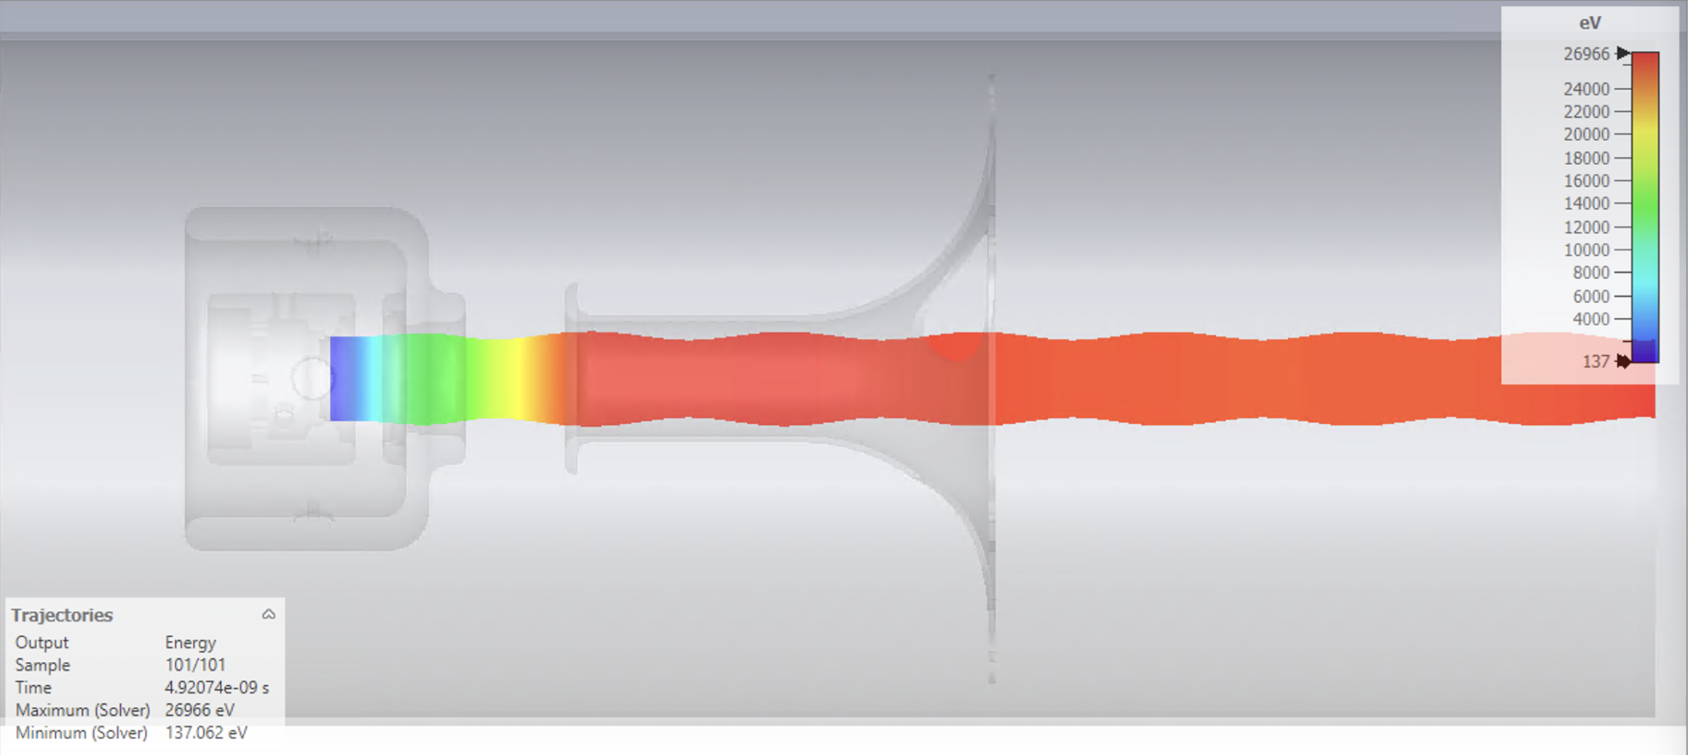
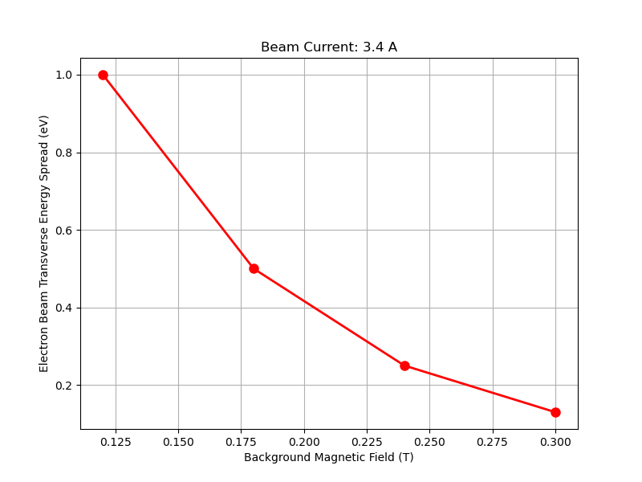
Gun CST simulations
Courtesy of Sameed Muhammed

Slide 15
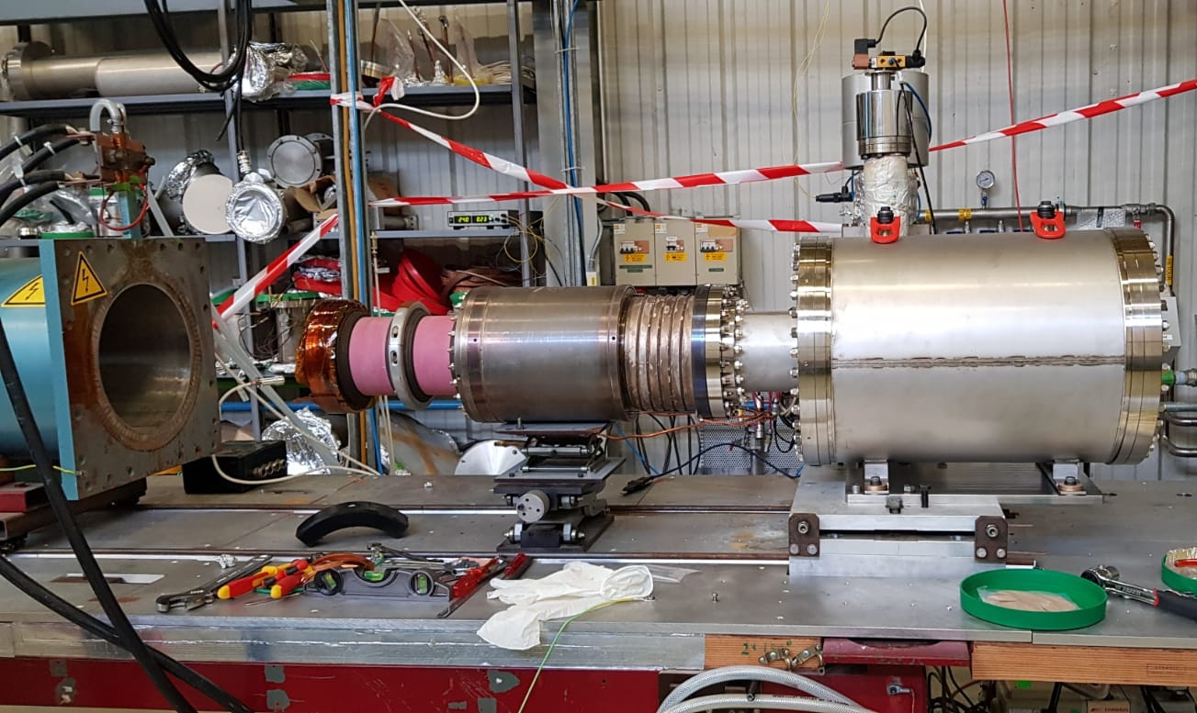
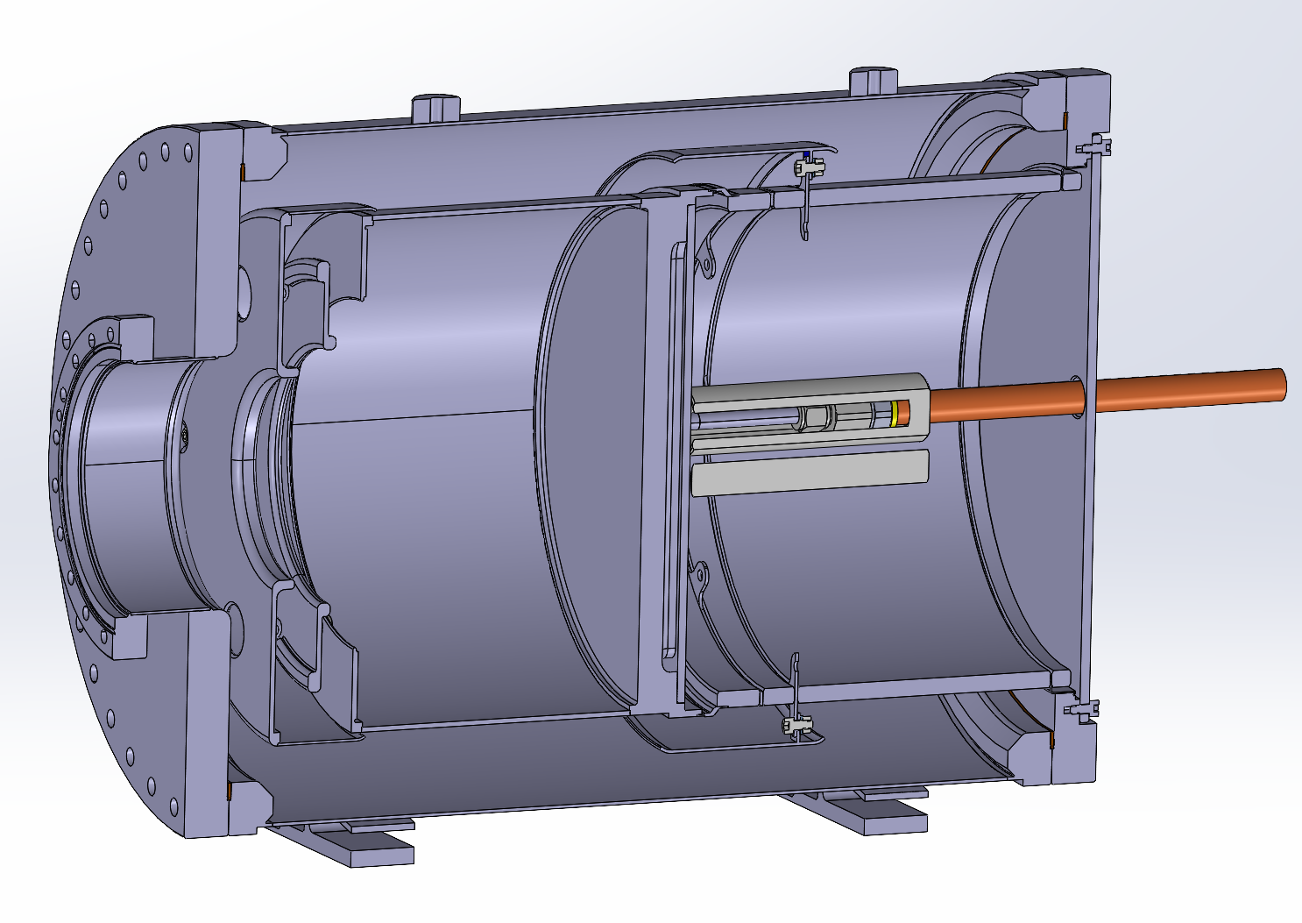
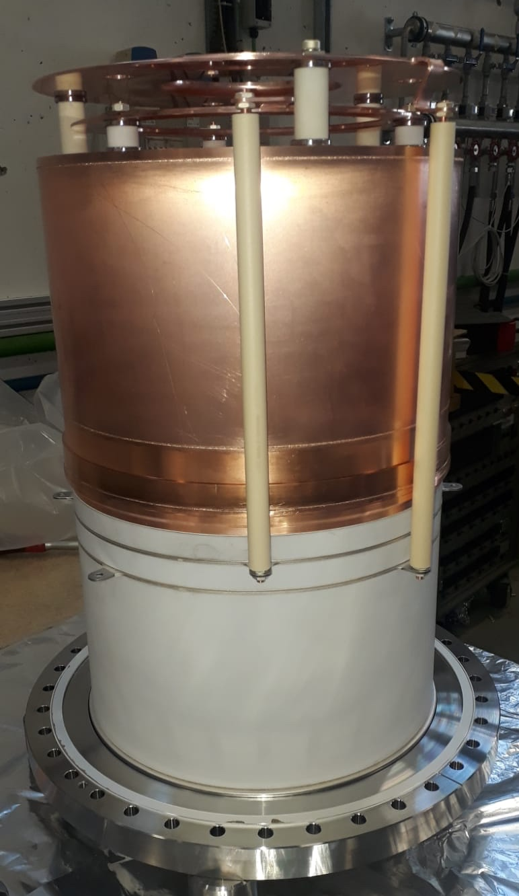
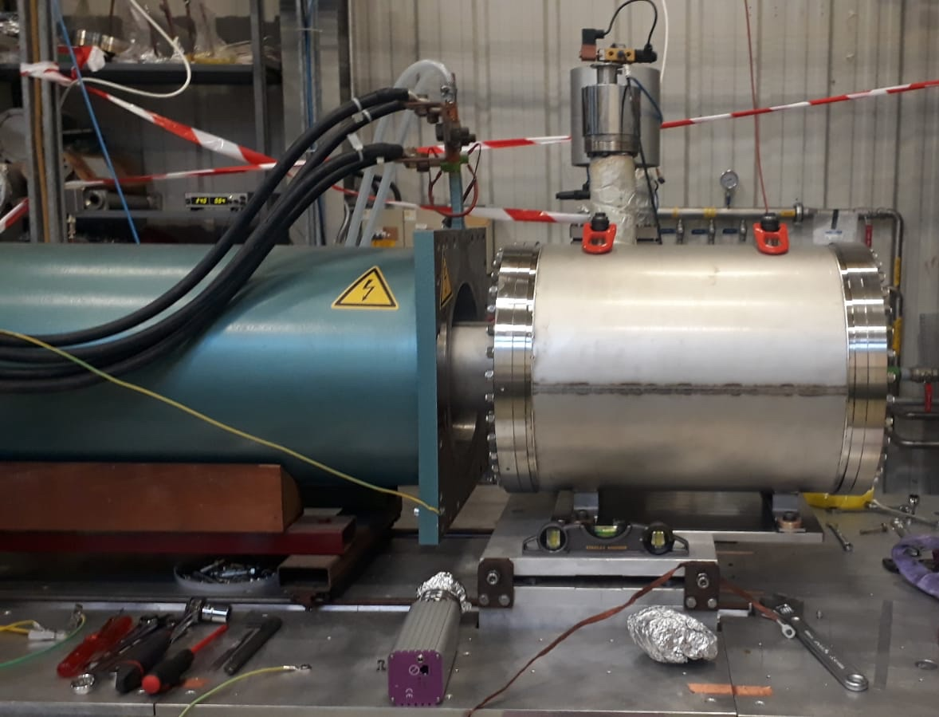
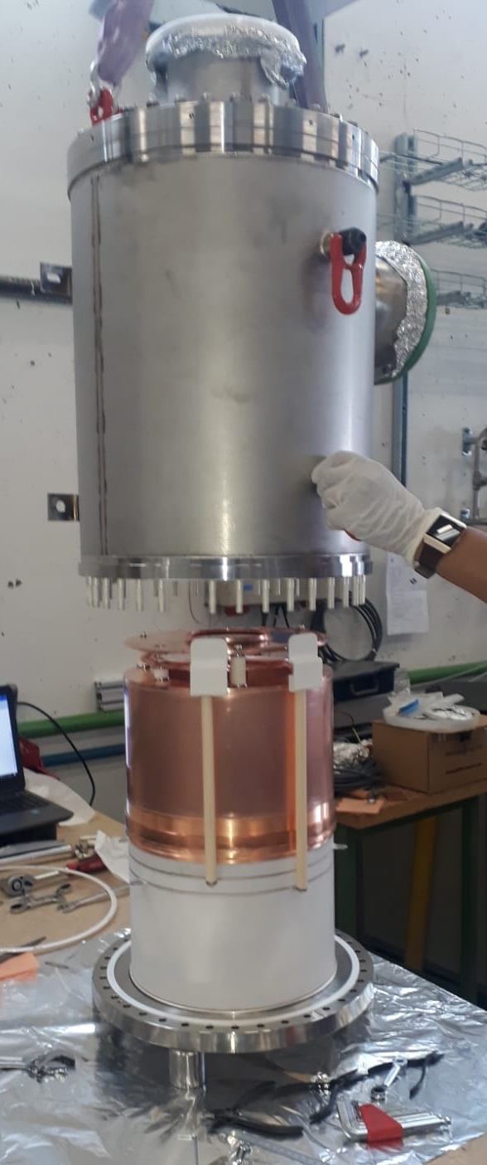
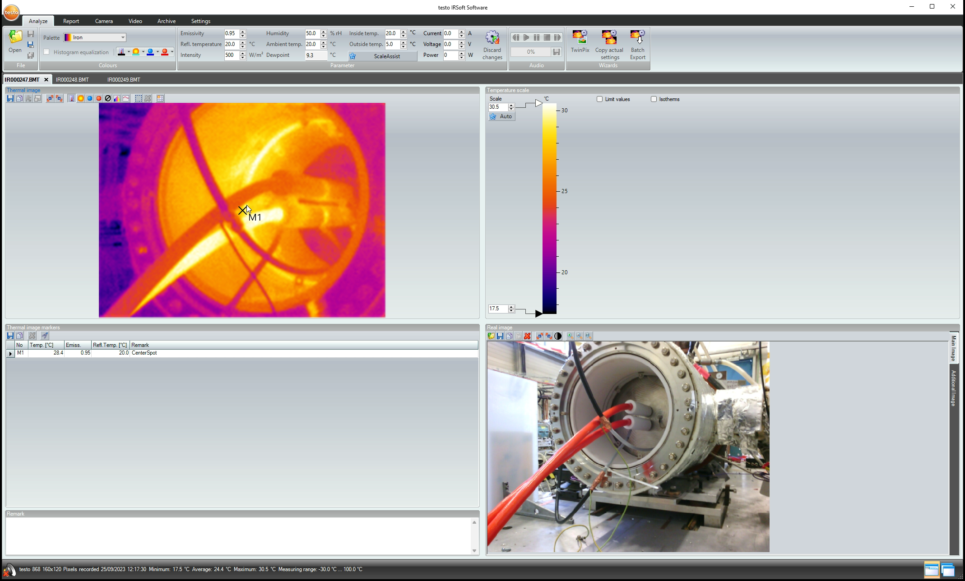
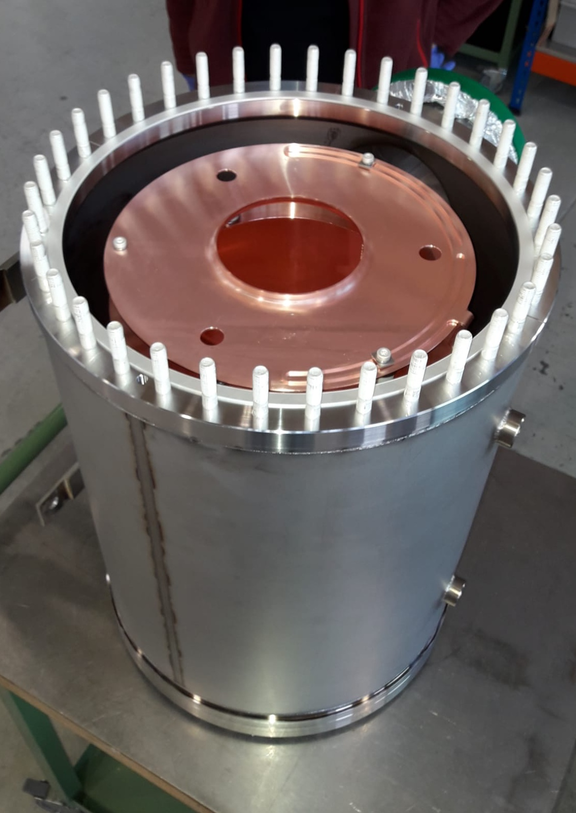
Collector
Courtesy of Jean Cenede & Yannick Coutron
Courtesy of Alexandre Frassier, Jean Cenede, Gunn Khatri

Slide 16
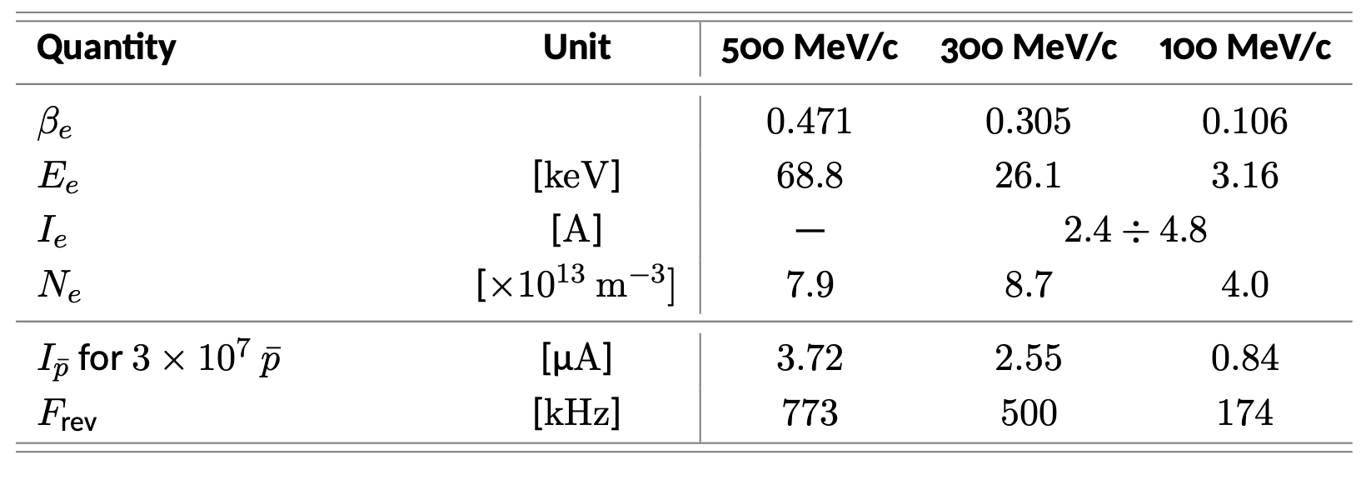
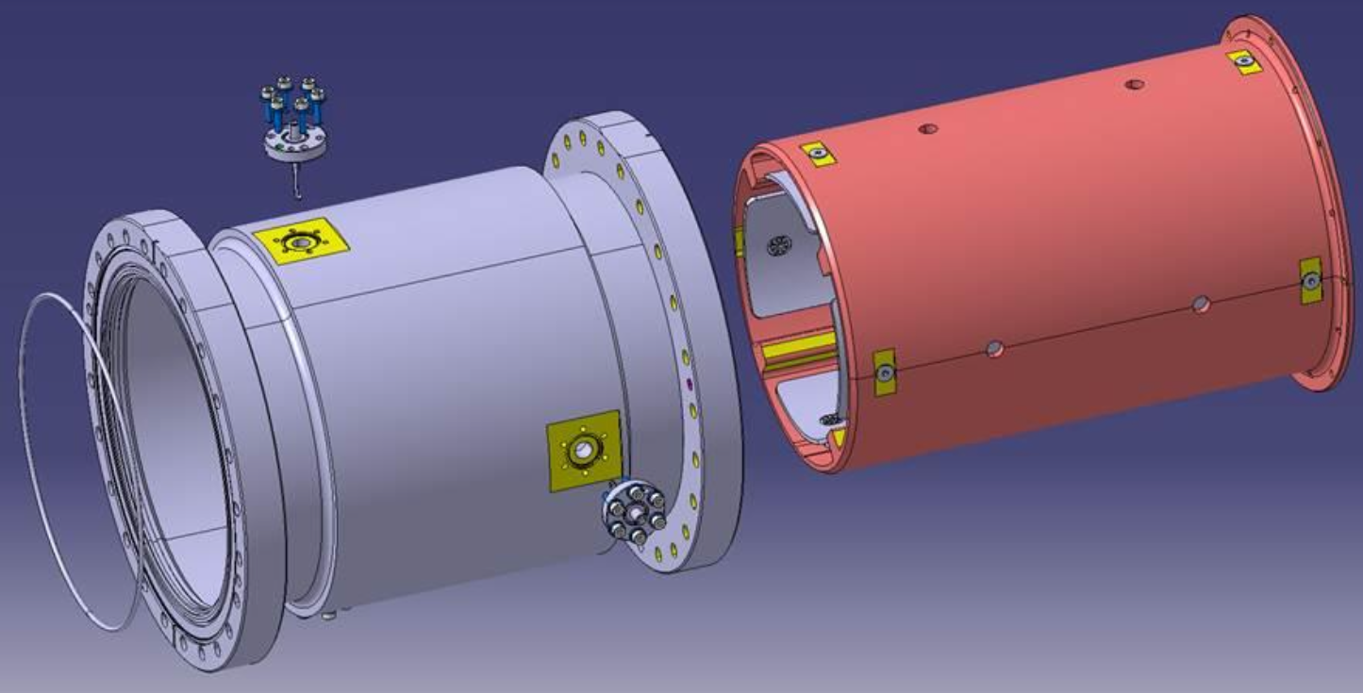
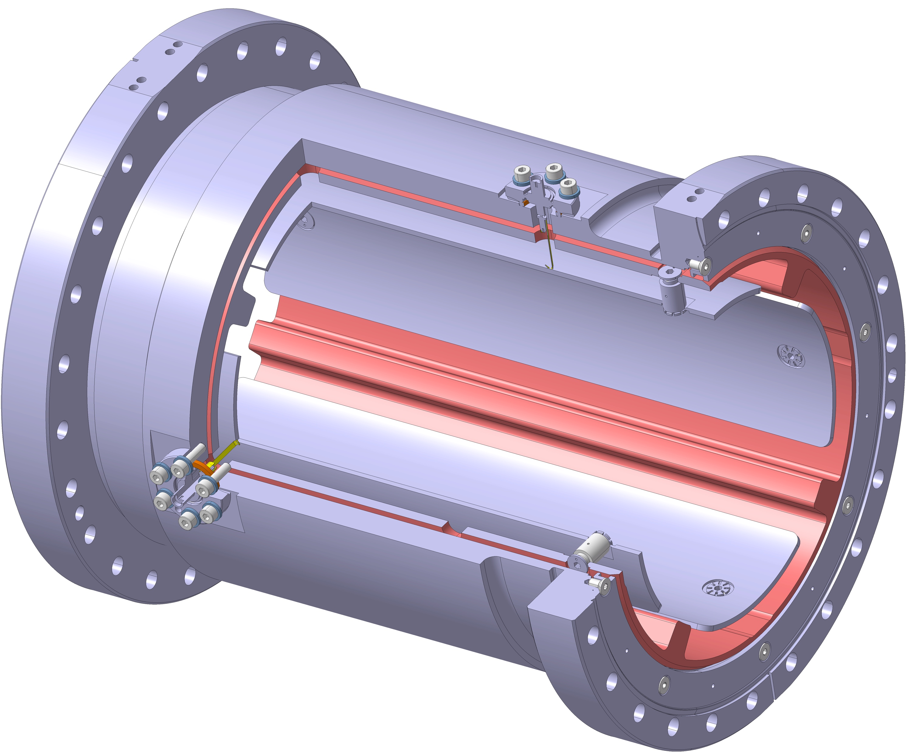
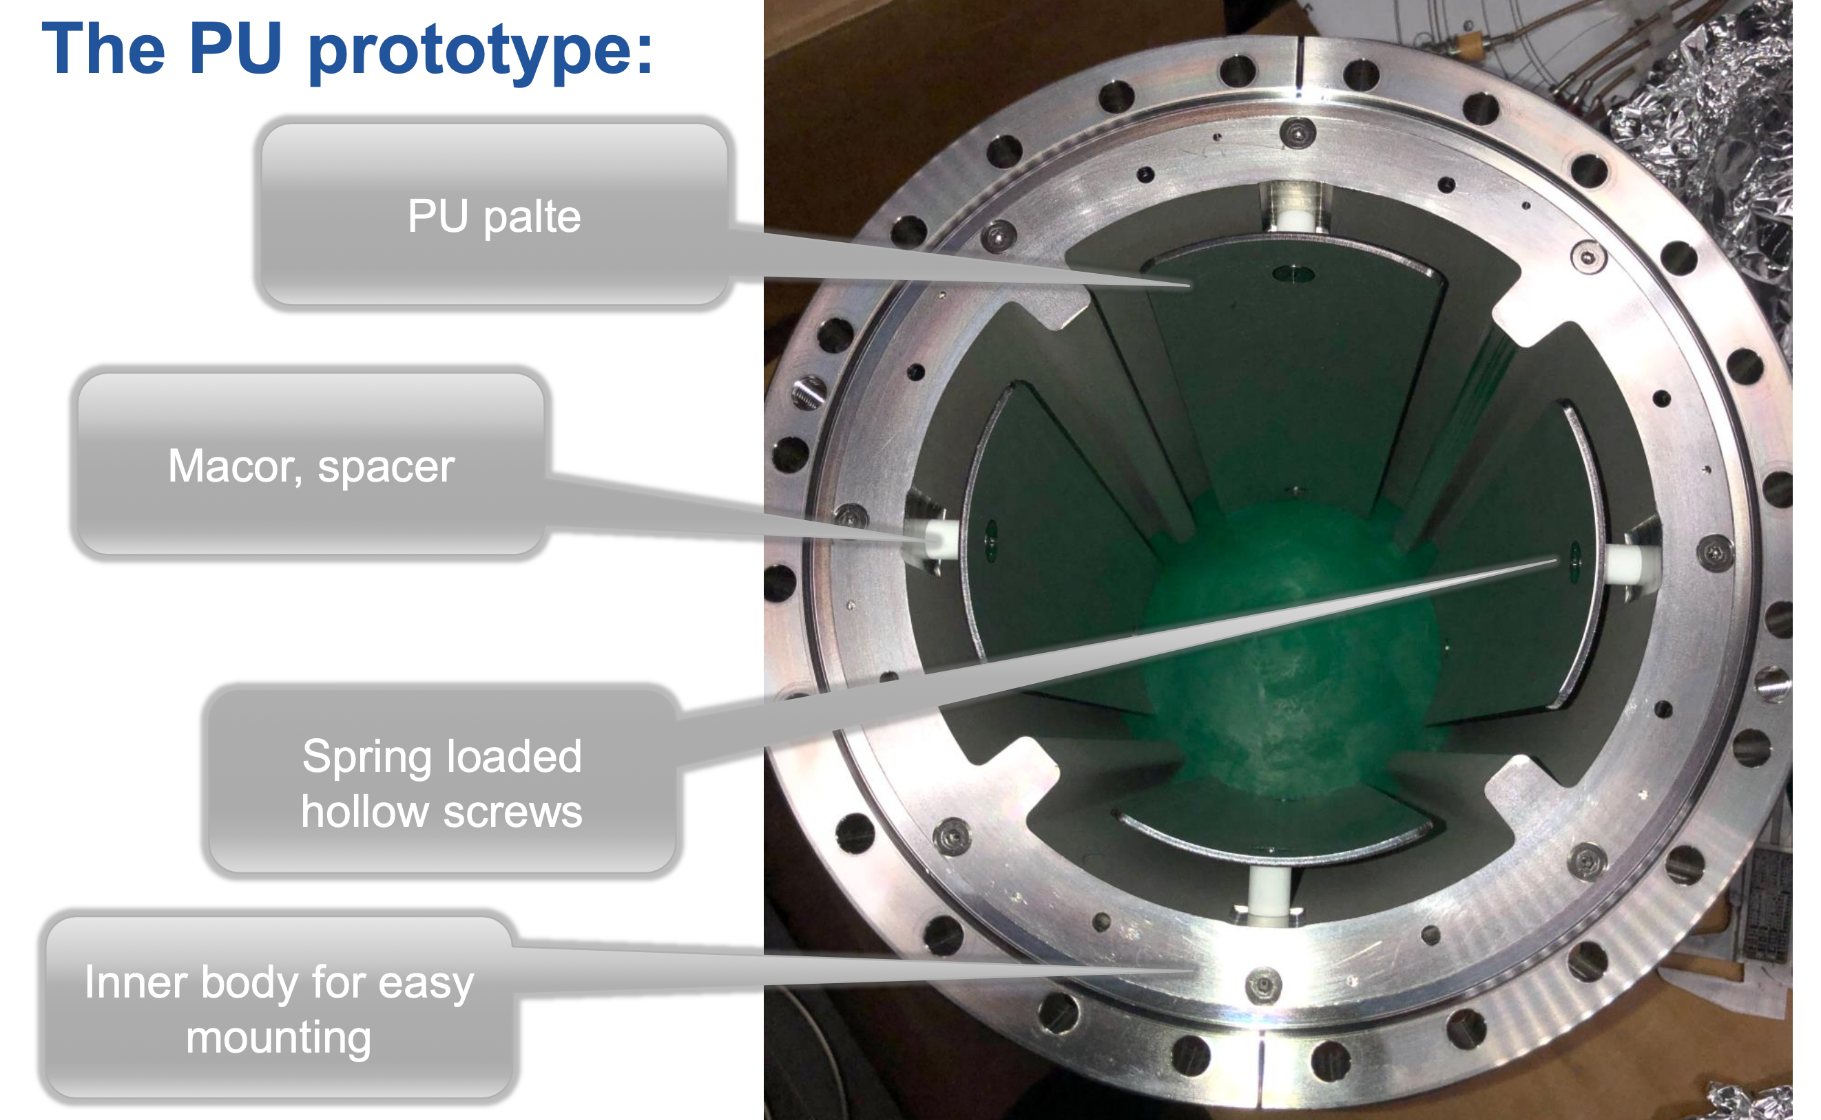
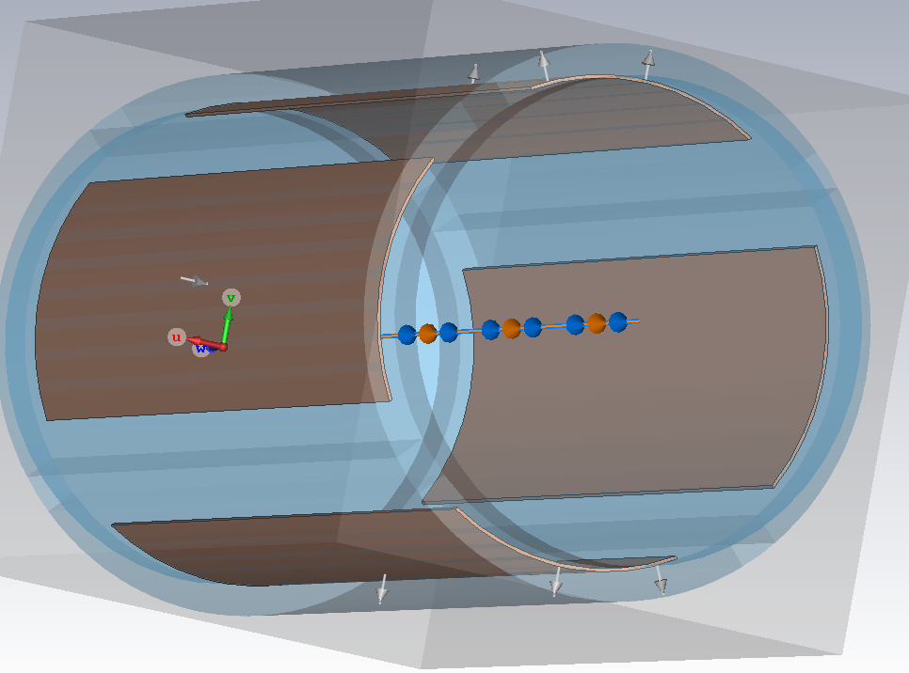
BPM
Estimated resolution 90 µm
Courtesy of Ole Marqversen, Frank Guillot-Vignot, Nicolas Chritin

Slide 17
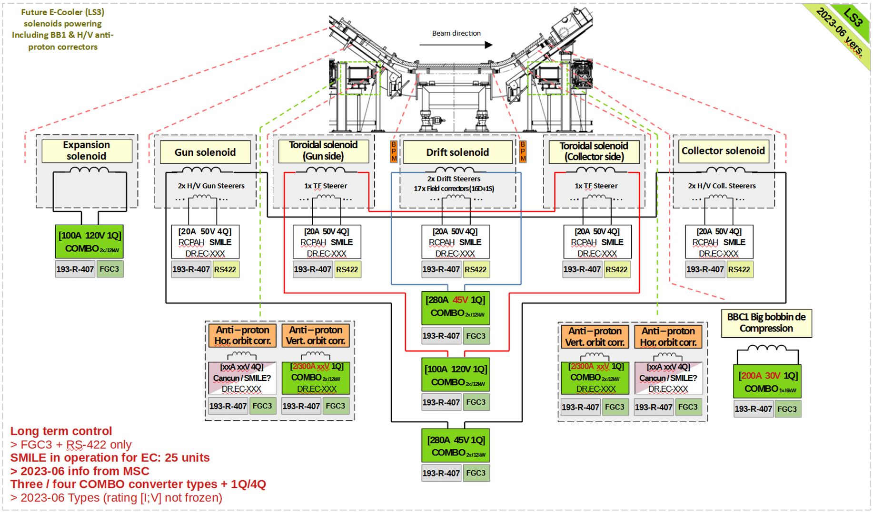
Magnet powering
Courtesy of Yves Thurel, Alessio Bollazzi, Christophe Machado, Todor Todorcevic

Slide 18
Test strategy
Components test separately in labs:
  Magnets tested individually for acceptance and to tune correctors, plus as an ensamble to measure steering magnets strength and prepare for operations.
  Gun and collector tested individually, with magnets equivalent to those for the final electron cooler. Possibility of measurements of the e⁻ beam transverse profile after expansion planned but not yet implemented
  Vacuum chambers tested individually
  Powering system tested individually
Commissioning after installation foreseen to fine tune
A. Rossi et al. COOL23, 8th - 13th October 2023

Slide 19

Rough planning
A. Rossi et al. COOL23, 8th - 13th October 2023

Slide 20
Conclusions
Functional (and engineering) specifications of the new AD electron cooler have been presented
  The new device aims at improving the current performance with a better magnetic field quality, electron beam magnetic expansion, better measurements of the beams relative position, faster switching of the electron beam on/off
The design is being finalised
  The magnetic design has evolved to complete solenoids (apart from the bends), few details to be looked at
  Gun and collectors prototypes are being tested
  Powering has been defined
  Vacuum design is ~completed
  Individual component testing
Installation foreseen for 2026 and operation in 2027
A. Rossi et al. COOL23, 8th - 13th October 2023

Slide 21
Thank you
A. Rossi et al. COOL23, 8th - 13th October 2023

Slide 22

Main subsystems/components – cartoon
Gun & Collector SY-BI
Magnets TE-MSC
Vacuum System TE-VSC
BPM SY-BI
Support and shielding
Powering (LV & HV) SY-EPC
Ancillaries
Expansion gun solenoid
Gun and collector arm solenoids
+ H/V steerers
Collector squeeze coil
Gun
Collector
Toroid
BPMs
Toroid
.
H/V Orbit Corrector
H/V Orbit Corrector
V steer
Drift & H/V steer
V steer
Support structure
Magnet powering
HV powering
A. Rossi – AD-CONS e-Cooler Procurement Readiness Review

