Slide 1












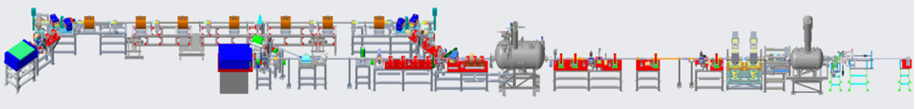
Observation of the Ion Imprint in CeC Electron Beam
Vladimir N. Litvinenko for the CeC operation group:
Yichao Jing, Jun Ma, Irina Petrushina, Igor Pinayev, Kai Shih, Gang Wang, Yuan Wu and Jean C. Brutus
Brookhaven National Laboratory and Stony Brook University
COOL’23 Workshop, Montreux, Switzerland – October 10, 2023

Slide 2
Results belong to all people contributed to CeC project – never can get all your pictures …

Slide 3
Content
Main processes in Coherent electron Cooling (CeC)
Process of the hadron imprint into electron beam
Theory of the imprint process
Simulation of the imprint process
First (unsuccessful) attempt to observe the imprint
Experimental observation of the imprint
Conclusions and discussions

Slide 4
Coherent electron Cooling
All CeC systems are based on the identical principles:
  Hadrons create density modulation (imprint) in the co-propagating electron beam
  Density modulation is amplified using broad-band microbunching instability
  Time-of-flight dependence on the hadron’s energy results in energy correction and in the longitudinal cooling. Transverse cooling is enforced by coupling to the longitudinal degree of freedom.

Slide 5
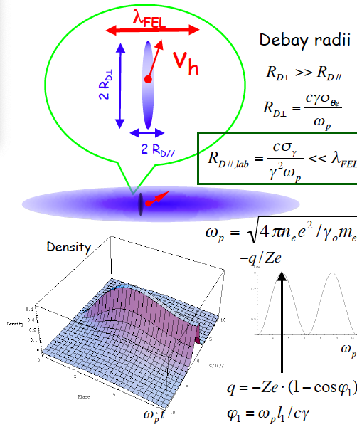
Simple models of the imprint: Debye shielding in infinite cold plasma (e-beam) and estimates
+Ze
Equations for reaction of cold infinite plasma on sudden appearance of a heavy positively charged ion (with Ze charge) can be solved analytically
Solution is simple: total screening charge oscillates with plasma frequency and peaks at 2Ze. The density is infinite at the location of the ion!
Handwaving arguments can say that for e-beam with velocity spread, size of the electron imprint has typical size of R_{D}~ σ_{v} /ω_{p}
For ultra relativistic beams, where σ_{vt} >> σ_{v//}, it implies that the imprint has a shape of a pancake large in transverse direction R_{t} >> R//

Slide 6
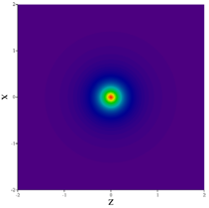

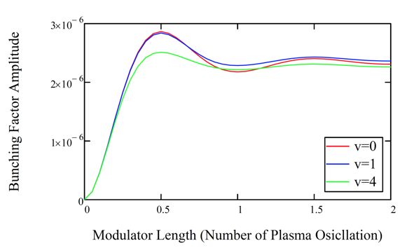
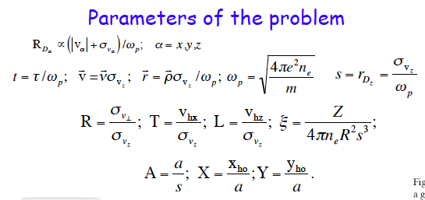
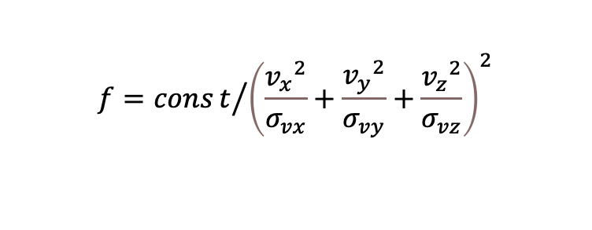
Solution for infinite beam with κ-2 distribution of velocities
G. Wang and M. Blaskiewicz, Phys Rev E 78, 026413 (2008)
$$f=const/{{\left(\frac{{v_{x}}^{2}}{σ_{vx}}+\frac{{v_{y}}^{2}}{σ_{vy}}+\frac{{v_{z}}^{2}}{σ_{vz}}\right)}^{2}}$$
CeC PoP: b=1.73E-6

Slide 7
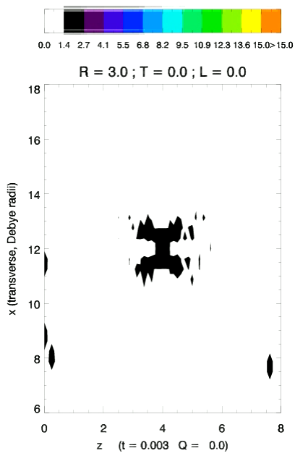
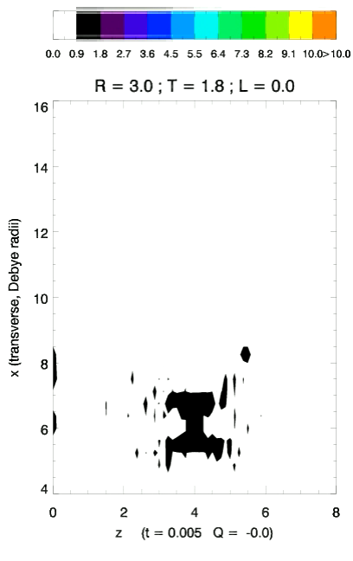

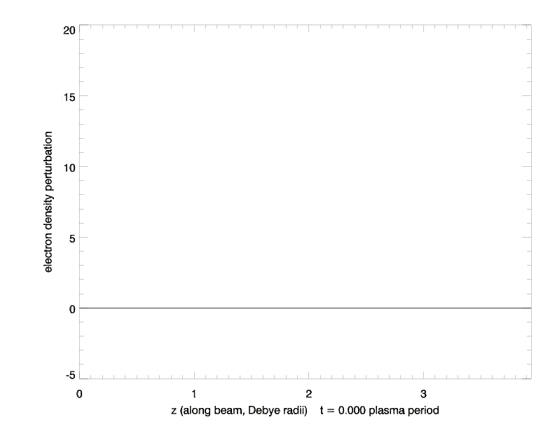
Numerical simulations: VOPAL, Tech X

Slide 8
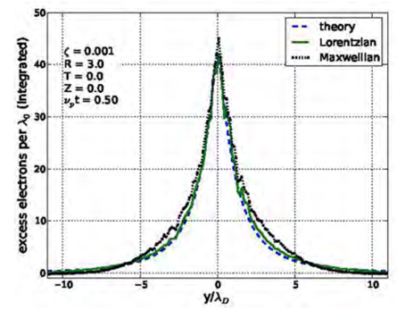
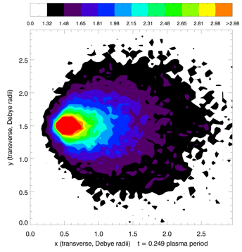
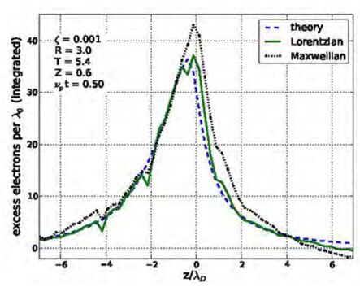
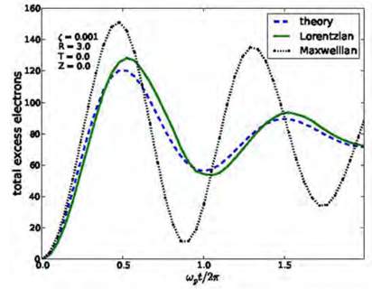
Simulations of modulator: infinite uniform beam
Simulation of the CeC modulator agree well with the analytical results.
© Tech-X

Slide 9
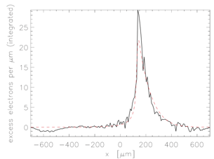
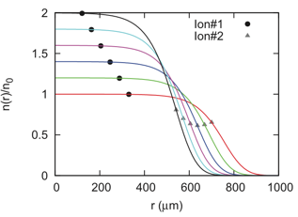
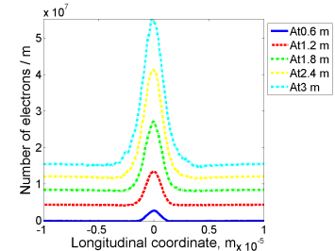

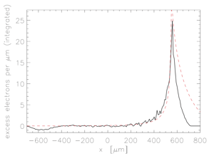
3D modulator simulation with finite beam...
© Tec-X VOPRAL
SBU/ SPACE code
stationary
moving
stationary (left) and moving (right) ion
Solving Vlasov equations
Dynamics of shielding of a moving charged particle in a confined electron plasma, A. Elizarov and V. Litvinenko, Phys. Rev. ST Accel. Beams 18, 044001.

Slide 10
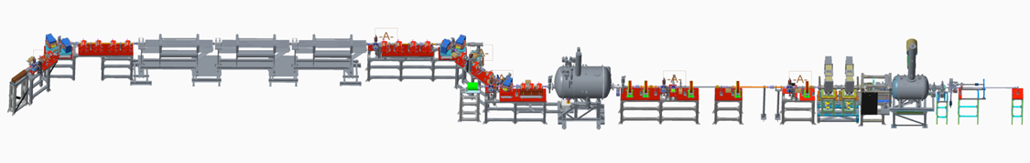
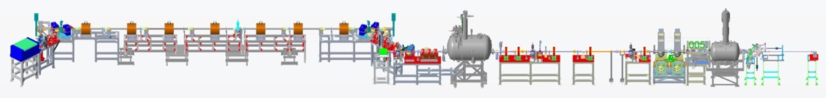
CeC X at RHIC
2014-2017: built cryogenic system, SRF accelerator and FEL for CeC experiment
2018: started experiment with the FEL-based CeC. It was not completed: 28 mm aperture of the helical wigglers was insufficient for RHIC with 3.85 GeV/u Au ion beams
We discovered microbunching Plasma Cascade Instability - new type of instability in linear accelerators. Developed design of Plasma Cascade Amplifier (PCA) for CeC
In 2019-2020 a PCA-based CeC with seven solenoids and vacuum pipe with 75 mm aperture was built and commissioned.
During Run 20, we demonstrated high gain Plasma Cascade Amplifier (PCA) and observed presence of ion imprint in the electron beam
New time-resolved diagnostics beamline was built and commissioned.
Now we are focusing on demonstrating longitudinal CeC cooling.
High gain 10 THz FEL (2018)
RHIC ion beam
CeC SRF accelerator
Unchanged
Kicker
4-cell PCA
Modulator
RHIC ion beam
The CeC Plasma Cascade Amplifier has a bandwidth of 15 THz >2,000x of the RHIC stochastic cooler

Slide 11
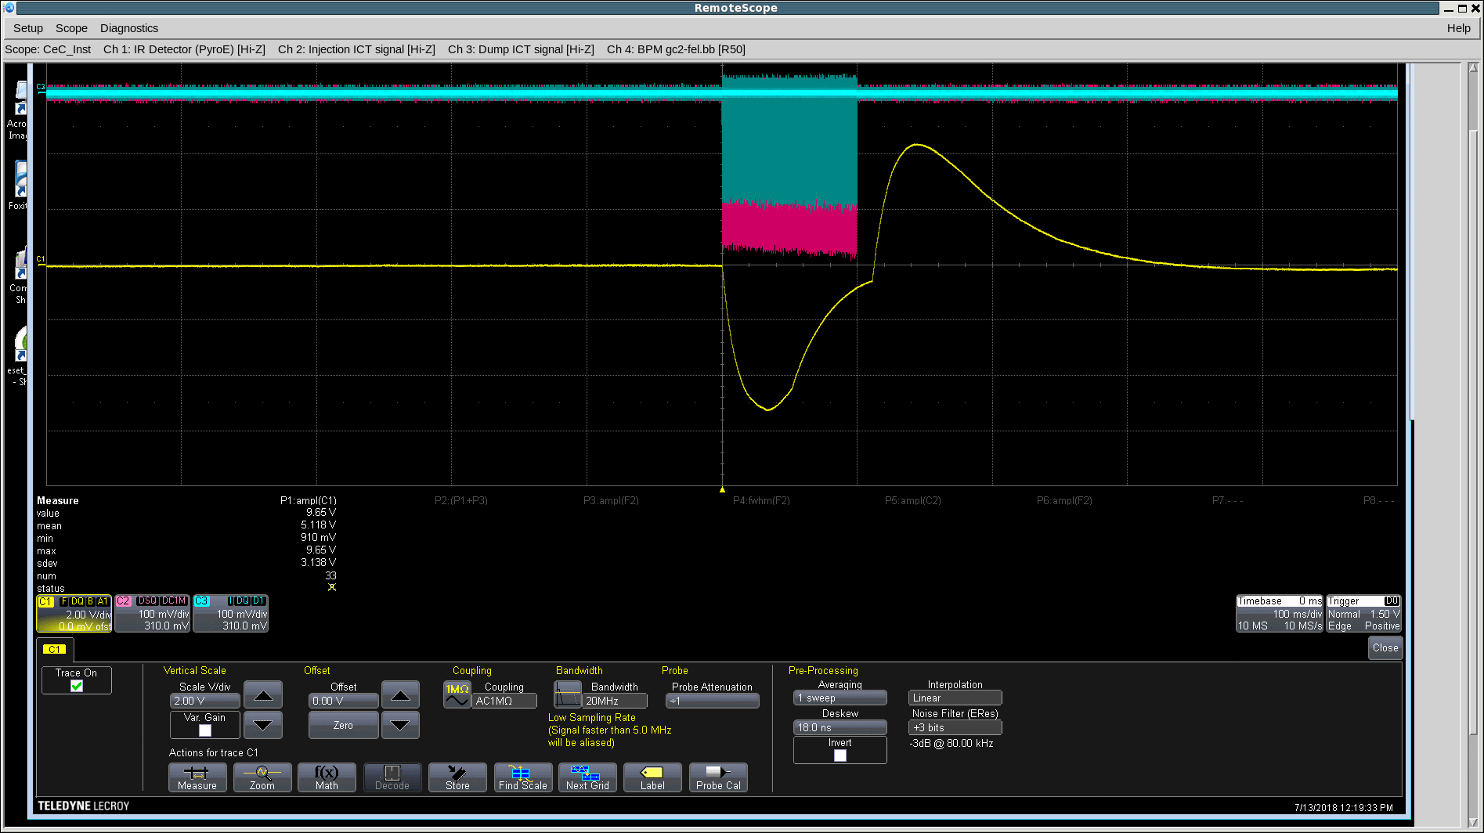
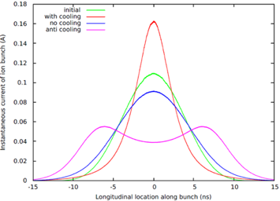
Attempt to test FEL-based CeC
High gain 10 THz FEL (2018)
RHIC ion beam
CeC SRF accelerator
FEL lasing pulse at 31 μm: April 2018
Parameter | Design | Status | Comment
Species in RHIC | Au⁺⁷⁹, 40 GeV/u | Au⁺⁷⁹ 26.5 GeV/u | ✔ to match e-beam
Electron energy | 21.95 MeV | 14.56 MeV | Linac’s quench limit
Charge per electron bunch | 0.5-5 nC | 0.1- 10.7 nC | ✔
Peak current | 100 A | 50 -100A | ✔
Bunch duration, psec | 10-50 | 12 | ✔
Normalized beam emittance | < 5 mm mrad | 0.15 – 5 mm mrad | ✔
Energy spread, RMS | 0.1% | Core <0.1% | ✔
FEL wavelength | 13 μm | 31 μm | ✔ with new IR diagnostics
Repetition rate | 78.17 kHz | 78.17 kHz | ✔
CW beam | 80-400 μΑ | 150 μΑ | ✔
Electron bunch
train
IR detector
signal
Predicted evolution of ion bunch profile in 40 minutes

Slide 12
Overlapping and separating electron and 26.5 GeV/ion bunches
We developed beam-based alignment technique for nearly perfect overlap of overlap electron and ion beams by aligning their trajectories in common section
CeC accelerator generates and accelerates electron bunches with frequency of 78 kHz in CW mode (or trains of electron bunches with this frequency).
This frequency is equal to revolution frequency of 26.5 GeV/u ion bunched in RHIC and CeC LLRF system locks locking the CeC RF system with RHIC RF system
We typically used six or twelve equally spaced ion bunches circulating in RHIC, but only one bunch can overlap with electrons at 78 kHz – interacting bunch. The other bunches serve as witness bunches for comparison.
The CeC LLRF system controls of the relative phase of two RF systems and allows us to overlap very short (~30 psec) electron bunch with the center of selected ion bunch with accuracy much better than ion bunches duration (~ 10 nsec RMS) – see top picture on the right
We can establish the overlap (interaction On) or change separation it by tents of nsec to completely separate the bunches in time (interaction OFF) – see middle picture on the right
Imprint from ion beam will result in increased power radiated by electron beam when interaction is ON
To verify overlap both in time and space, we would intentionally induce a lot of noise in e-beam to observe heating of the interacting ion bunch

Slide 13
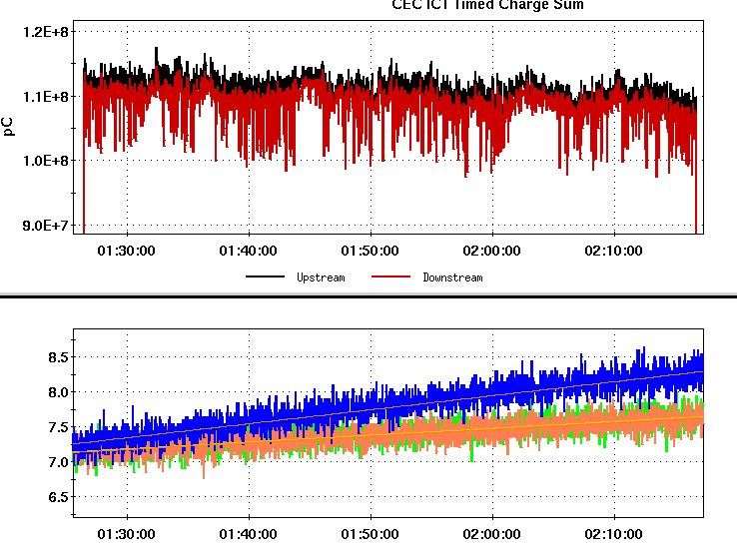
Puzzle of the CeC Run 18
Search for ion’s imprint in electron beam
and matching beam’s relativistic factors was
the first important step in CeC experiment
Interaction of ion bunch synchronized was in agreement with the measured FEL-amplified noise level
I, μA
e-beam current in μA
+/- 3 σ
120
Note Log scale
Measured
110
100
90
FWHM ion bunch length, nsec
Interacting bunch
Expected
Witness bunches
1.0
Energy detuning, %
Bottom plot: evolution of the bunch lengths for interacting (blue trace) and witness (non-interacting) bunches (orange and green traces)
Expected and measured relative change in the FEL signal with overlapping and separated beams. Measurements RMS error is 2%.
We ran out of time to demonstrate the FEL-based CeC during Run 18 with RHIC.
FEL-based CeC concept remains valid and is waiting for experimental demonstration.
Notes:
Proving expectations wrong is one of important roles played by experiment

Slide 14
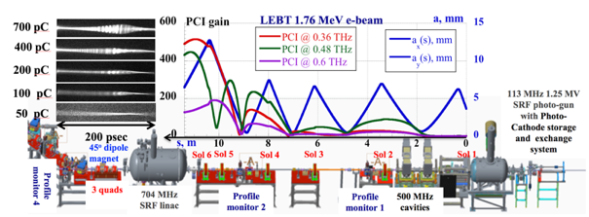
Solving the Puzzle
RHIC cryo system extended operation for LEReC mid-September 2019 and we used it to find the culprit:
THz noise in the electron beam (300-fold above the shot noise!) dwarfing the ion beam imprint.
This was not a failure of the FEL-based CeC concept, but unexpected excessive noise in the beam
(a)
Uncompressed bunch:
simulations and experiment in Sept 2018
Compressed beam simulation in CeC accelerator using Impact-T code @ NERSC
Blue line – Run 18 lattice
Red line – new lattice with suppressed PCI
20-X compression
We showed in simulations that we can control noise level in the electron beam and confirmed this in the experiment
during a short run in Summer 2019
(a) Measured time profiles of 1.75 MeV electron bunches with 0.45 nC to 0.7 nC; (b) Seven measured overlapping spectra and PCI spectrum simulated by SPACE (slightly elevated yellow line); (c) Clip shows a 30-psec fragment of seven measured relative density modulations.

Slide 15
Run 19: control of the noise in electron beam
Run 18 lattice and beam: 0.6 nC per bunch
Large signal of 2,500 V/A ~ 250-fold above base line. Can be seen both on scope and measured easily
1.5 nC, 75 A peak current
Cooling
We demonstrated that with 75 A peak current we can reduce beam noise to acceptable level. It could be as low as 6-10 times above the baseline

Slide 16
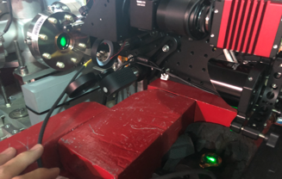
The e-beam noise level
✔
e-beam
IR port and diagnostic
In Run 19 we established technique for the e-beam noise measuring
  The THz noise in the e-beam results far-IR radiation from dipole magnet, whose power is measured by the Gentec broad-band IR detector connected to a lock-in amplifier synchronized with pulsing electron beam.
  IR radiation from the bending magnet is periodically blocked, (modulation-demodulation technique) to eliminate effect of X-rays from dumped beam on the IR detector
The baseline power level (e.g. power from the Poisson shot noise) was measured using long low charge (~300 pC) beam propagating in relaxed low-beam transport lattice. Measurements were in good agreement with simulation.
All measurements normalizes by average beam current
The IR power generated by electron beam with 1.5 nC per bunch and the nominal compression was compared with the base line IR power level
Piezo IR port and diagnostic
Summary of results
Measured ratio κ_{stat} of the noise power in the electron beam to the Poisson noise limit is more than 2 and less then 12
Beam noise satisfies requirements for cooling : κ_{stat} < 100

Slide 17
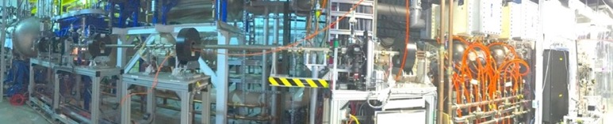
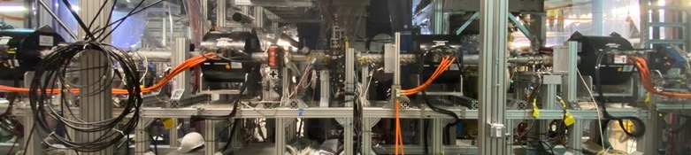
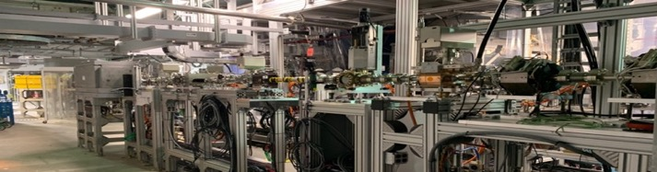

Progress with CeC
We developed complete theory and simulations of CeC with micro-bunching Plasma-Cascade Amplifier (PCA)
We replaced the FEL-based CeC to completely new PCA-based CeC system
We commissioned PCA-based CeC system and and demonstrated Plasma-Cascade Amplification experimentally (previous talk)
We also built and commissioned diagnostics beam-line for time-resolved measurements of e-beam parameters
We also improved our IR diagnostics
CeC X accelerator
CeC with plasma-cascade microbunching amplifier
Time-resolved diagnostic beamline
PCA-based CeC
CeC accelerator
Time-resolved diagnostics

Slide 18
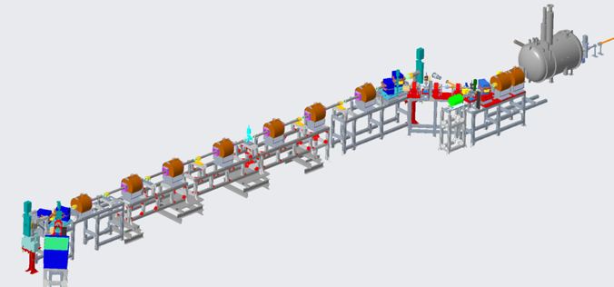
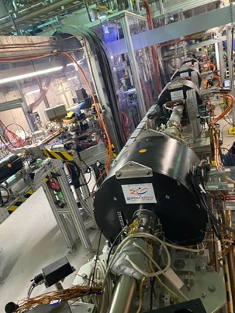
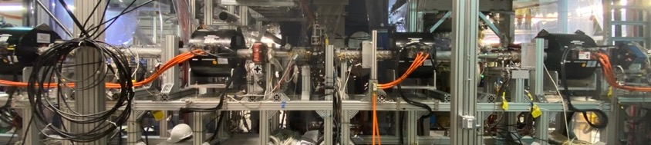
PCA was installed into CeC system in 2019-2020
Accurate alignment of the electron beam trajectory is critically important for operation of the PCA-based CeC.
First, we aligned ion beam with centers of two quadrupoles in the CeC section
Second, we accurately measured both location and the angle of the solenoid’s axes using ion beam and RHIC BPM – this is a novel method that we developed. Solenoids then were aligned with best accuracy the survey group can provide
Third, we aligned electron beam with axes of solenoids
This is a new technique we developed to guarantee overlapping of electron and ion beams as well providing straight trajectory for electron beam
RHIC beam
CeC section
using Plasma-Cascade Amplifier

Slide 19
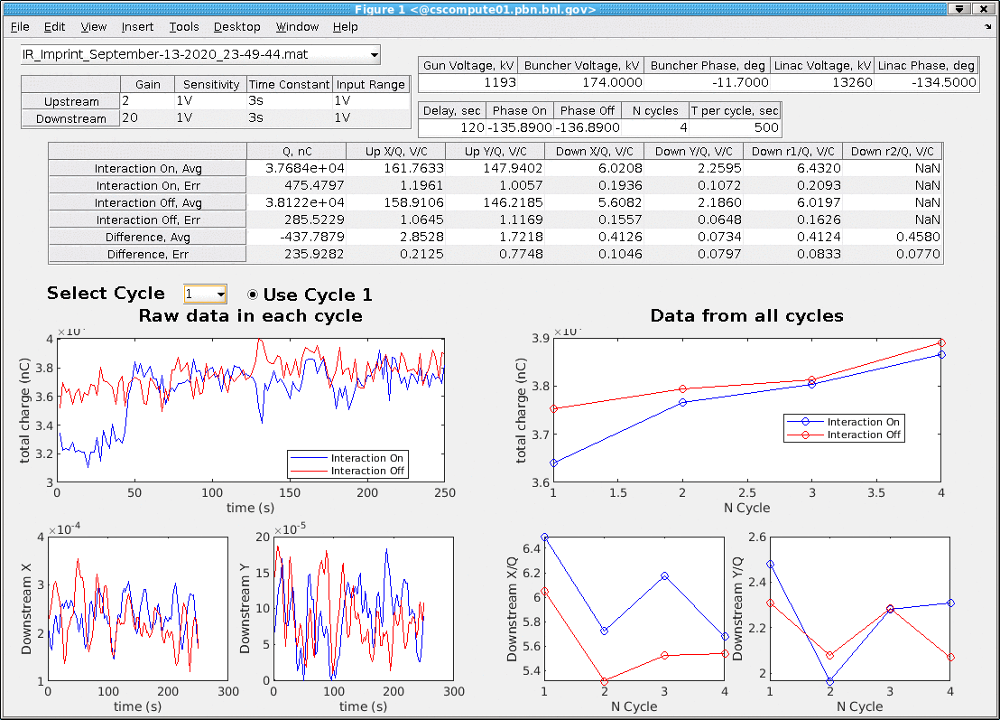
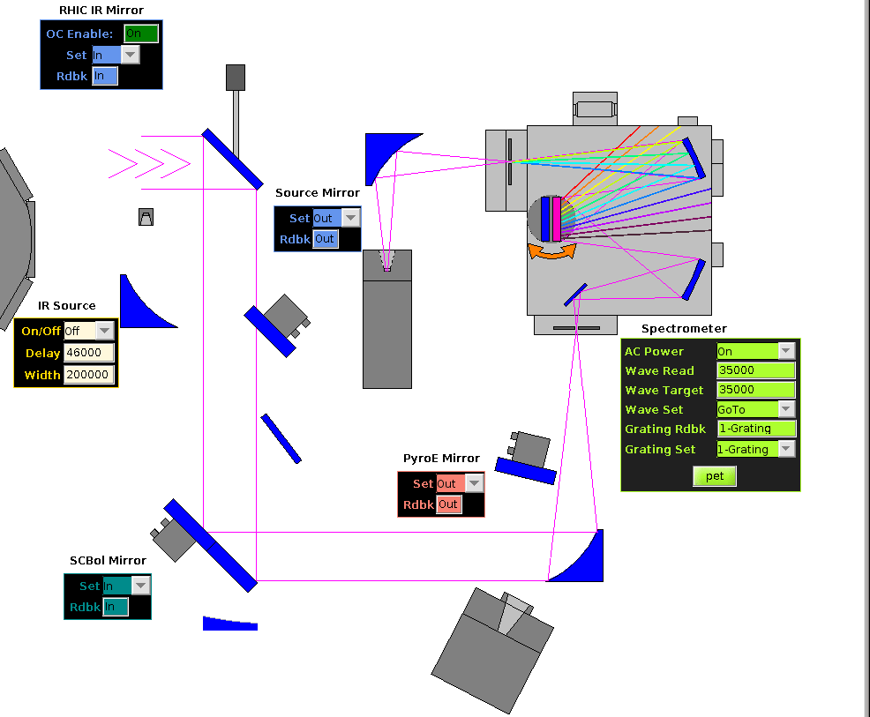
The Ion Imprint studies: Run 20
We used high-gain PCA lattice to boost radiation at 35 μm at the level detectable by IR detectors after the spectrometer. The IR signal was then measure by lock-in amplifier with two outputs (X – in-phase, Y- out-of-phase). Without the PCA boost, signal was too low to detect reliably.
We used high-order modulation-demodulation (MDM) technique to detect the imprint. MDM was accomplished by overlapping and separating electron and ion bunches in time: interaction ON/ interaction OFF
We observed clear presence of the ion imprint in the electron beam resulting in increase of the e-beam radiation at 35 μm with average imprint of
Typical “good” measurement: 4 cycles with 500 measurements each
Downstream IR diagnostics
10 m from the radiation point
Upstream
Downstream

Slide 20
Summary of the imprint measurement results
✔
Weighted average
Correlations
r =1.5±0.2
Downstream

Slide 21
Presence of ion imprint in electron beam radiation
Corrected data
Each point represents a scan (typically with 4 cycles)
Raw data

Slide 22
Probabilities
Probability that average measured imprint above zero, is 99% with raw data and and 99.8% for corrected data. There is 0.2% probability that we miss the imprint
The most probable value of observed imprint:
Imprint: Raw data
Imprint: corrected by the upstream data
Average imprint, %
Average imprint, %

Slide 23
Conclusions
The process of demonstrating presence of ion imprint in electron beam was challenged by many obstacles, which we managed to overcome.
We were unpleasantly surprised by huge amount of noise in electron beam which was present in electron beam from CeC linac in spite of rosy predictions from simulation codes (Parmela, Astra, Elegant, Impact-T…) . Title of PhD thesis of Irina Petrushina is a very good summary of the shock we experienced: “The Chilling Recount of an Unexpected Discovery: First Observations of the Plasma-Cascade Instability in the Coherent Electron Cooling Experiment”
We solve the puzzle by developing novel theory of plasma-cascade instability and demonstrating it both experimentally and in simulations.
Next, we learned how to control noise in the electron beam how generate electron beam with necessary quality for the CeC experiment and how to use it when it is needed
After a very long learning process we managed to observe ion imprint experimentally. We also learned that this measurement is relatively complicated to be used for matching relativistic factors of two beams. We found a more reliable and relatively fast method to match beam’s relativistic factors

Slide 24
Thank you for attention

