Slide 1


Studies of ion beam heating in LEReC
S. Seletskiy, A. Fedotov, D. Kayran
International Workshop on Beam Cooling and Related Topics
8th – 13th October 2023
TUPAM1R2

Slide 2
Outline
Introduction: Low Energy RHIC electron Cooler (LEReC)
Electron-ion heating (e-i heating) in LEReC
Measurement technique
Results of the experiment
Possible explanations
Summary

Slide 3
Introduction to LEReC
LEReC was designed to cool colliding gold ions $@ γ=4.9$and $@ γ=4.1$ and was successfully operated in 2020-2021 low energy RHIC run routinely providing a substantial luminosity increase.
In LEReC e-bunches are produced at the photo-cathode illuminated by a green 704 MHz laser modulated with the 9 MHz frequency to match the frequency of RHIC ion bunches.
The Electrons are accelerated to 375 keV in the DC gun followed by a 704 MHz SRF cavity bringing the beam energy to either 1.6 or 2. MeV.
Next, the e-beam is transported to the cooling section (CS) in the “Yellow” RHIC ring and to the cooling section in the “Blue” RHIC ring.
Finally, the electron beam is extracted at the exit of the blue CS through the extraction dogleg and sent to the beam dump.

Slide 4
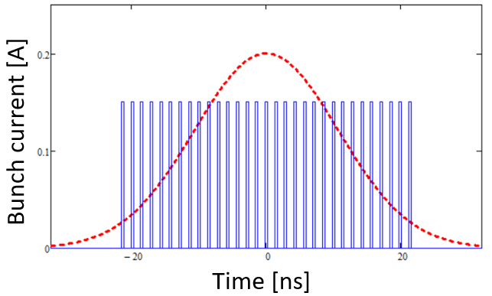
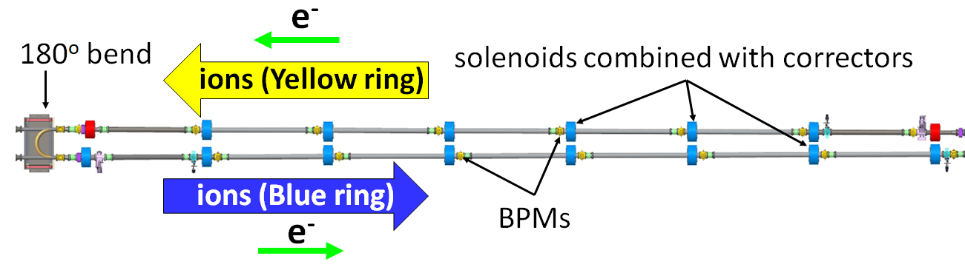
Unique features of LEReC
Au
e
LEReC is a RF-based (“bunched”) electron cooler
(we used 30-36 e-bunches per i-bunch)
LEReC is using neither an e-beam magnetization
nor a continuous solenoidal field in the cooling section.
LEReC utilizes the same electron beam for cooling ions in two consecutive cooling sections in both rings of the collider
LEReC is applied directly to the ions in the collider at top energy
LEReC-related publications:
S. Seletskiy et al., PRAB 21, 111004 (2019)
A. Fedotov et al., PRL 124, 084801 (2020)
D. Kayran et al., PRAB 23, 021003 (2020)
X. Gu et al., PRAB 23, 013401 (2020)
H. Zhao et al., PRAB 23, 074201 (2020)
S. Seletskiy et al., PRAB 23, 110101 (2020)
S. Seletskiy, A. Fedotov, D. Kayran, PRAB 26, 024401 (2023)

Slide 5
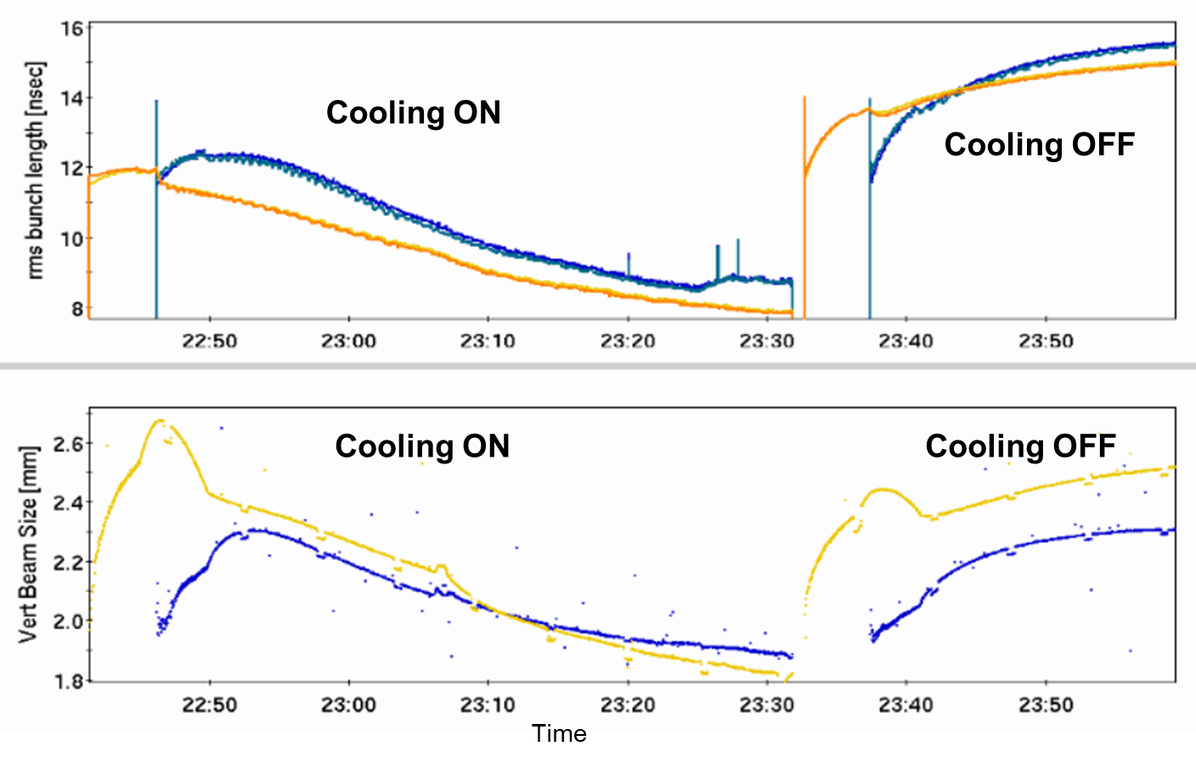
LEReC operational experience
Electron cooling effectively counteracted emittance and bunch length growth due to the Intra-beam scattering. In addition, transverse cooling was optimized to further reduce the ion beam sizes.
Operational electron current, based on optimization between cooling and other effects, was: 15-20 mA (for Au ions at 4.6 GeV/n in 2020) and 8-20 mA (for Au ions at 3.85 GeV/n in 2021).

Slide 6
Challenges during RHIC operations
Loss on recombination: Without continuous longitudinal magnetic field in the cooling section and small temperatures of electron beam, loss of ions due to radiative recombination was noticeable (in typical low-energy coolers magnetic field allows to suppress recombination loss with large transverse temperatures). This could partially be mitigated by introducing a small average velocity offset between electrons and ions.
Lifetime of ions: ions lifetime suffered due to the presence of electron beam, this was especially true for working point close to an integer. This was the dominant limiting factor requiring operation at reduced electron currents - strongest cooling did not necessarily lead to highest luminosity.
Additional diffusion mechanism from electrons: There was an additional growth of transverse beam size of ions caused by electrons (which we called “heating”). Such a heating was counteracted by cooling and was not a limiting factor for performance.

Slide 7
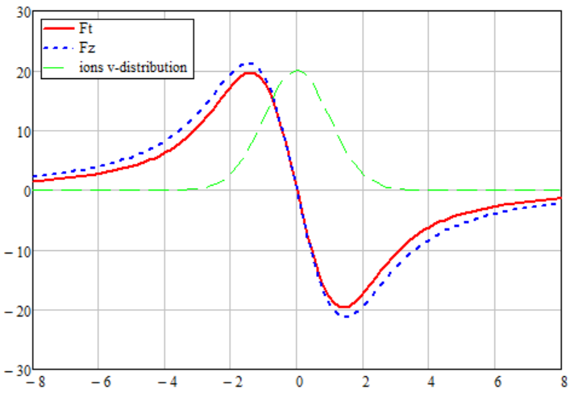
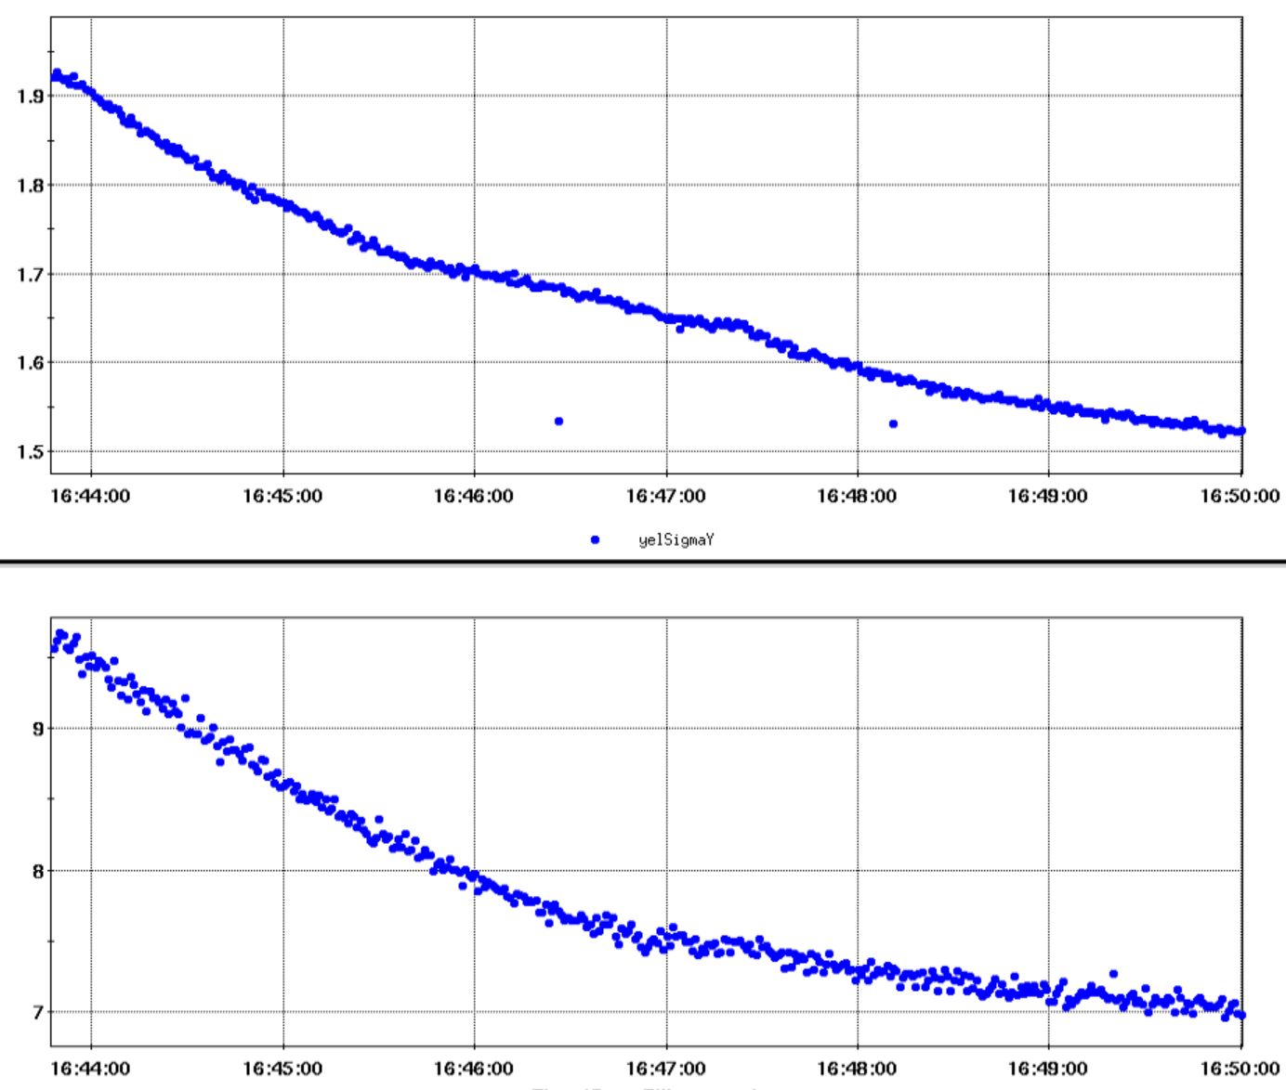
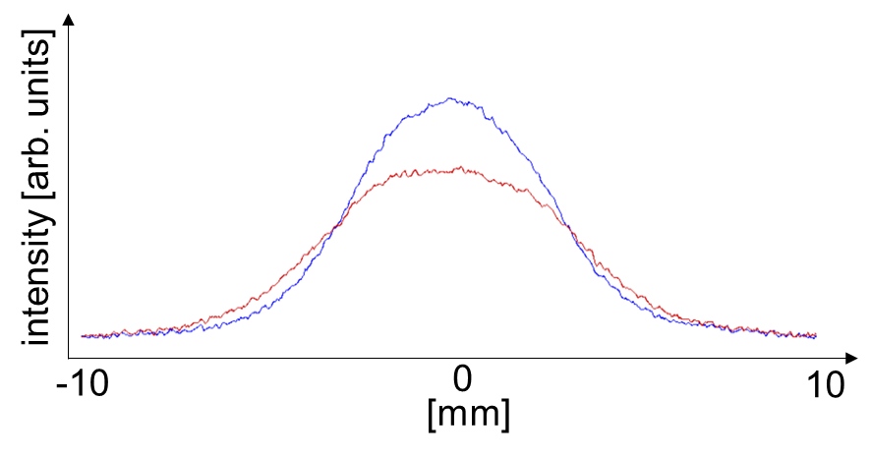
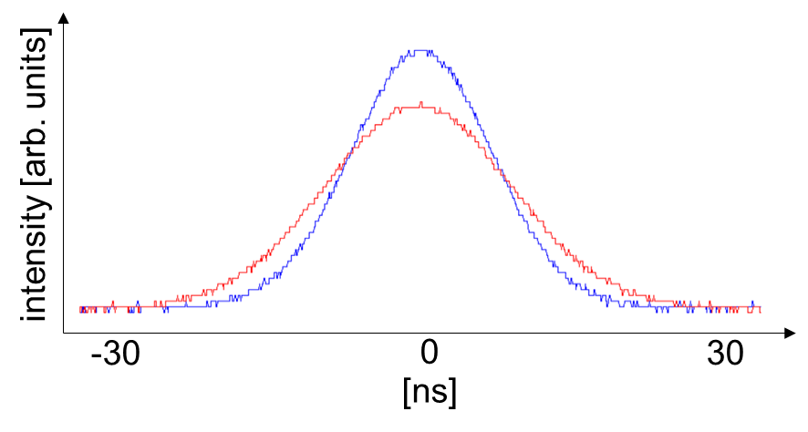

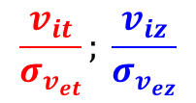
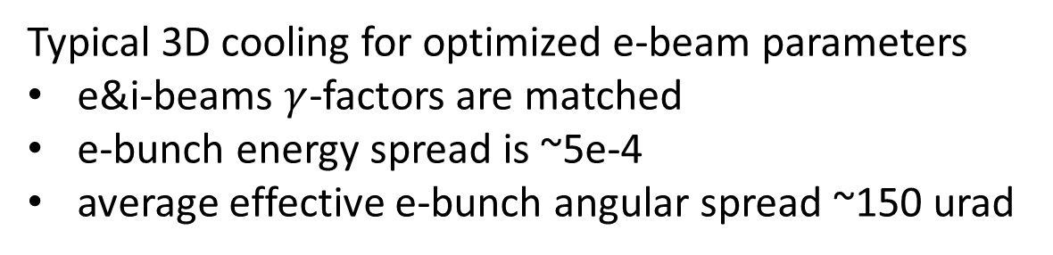

Cooling in LEReC
Typical 3D cooling for optimized e-beam parameters
e&i-beams $γ$-factors are matched
e-bunch energy spread is ~5e-4
average effective e-bunch angular spread ~150 urad
Friction force [eV/m]
$$\frac{v_{it}}{σ_{v_{et}}}; \frac{v_{iz}}{σ_{v_{ez}}}$$
$σ_{y}$ [mm]
$σ_{z}$ [ns]
Time

Slide 8
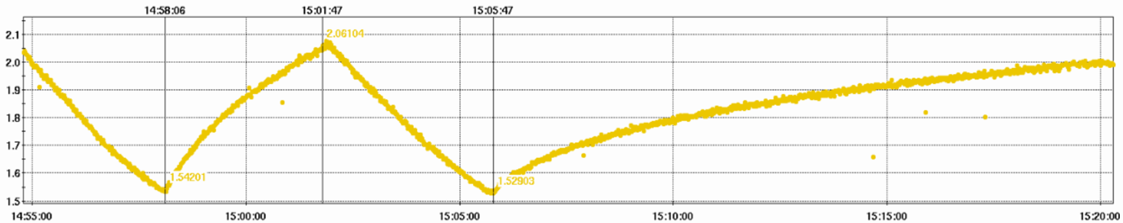
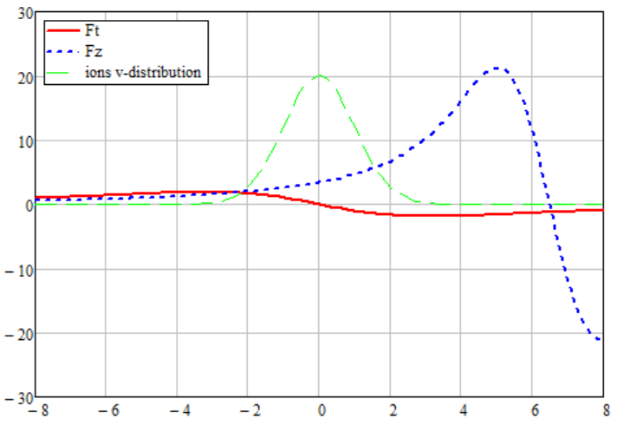



Electron-ion heating
In the presence of e-beam and with the “zeroed” cooling we observe a much faster growth of the transverse size of the i-bunch than the IBS driven size growth.
We call this additional growth of the emittance “the electron-ion heating”
IBS + e-i heating
IBS
pre-cooling
pre-cooling
Vertical bunch size [mm]
e-beam is turned off
Time
E-beam is 5 kV ($μ_{iz}≈6.3σ_{v_{ez}}$) off energy
E-beam is on energy
Here we suppress the cooling while keeping the electron beam in the CS by detuning the electron beam energy by a few kV
Friction force [eV/m]
Friction force [eV/m]
$$v_{it}/σ_{v_{et}};v_{iz}/σ_{v_{ez}}$$
$$v_{it}/σ_{v_{et}};v_{iz}/σ_{v_{ez}}$$

Slide 9
Measurement procedure
We perform the studies with the low intensity ion bunches in one ring only
We always precool the i-bunches to approximately the same transverse and longitudinal size
Next, we “switch off” the cooling by detuning the e-beam energy by 5-6 kV
In a heating measurement for given parameters we record the evolution of the ion bunches transverse and longitudinal sizes and the intensity of the ion bunches
Measurement-to-measurement we vary the charge of electron bunches, and/or the settings of the cooling section solenoids.
For each electron bunch charge used in the heating measurements we fully characterize the longitudinal and the transverse phase space of the electron bunch at the entrance to the cooling section in dedicated measurements.
We perform several control measurements of the IBS-driven size growth of the i-bunches throughout each shift. The i-bunch parameters in these measurements cover the whole parameters’ range used in the heating measurements

Slide 10
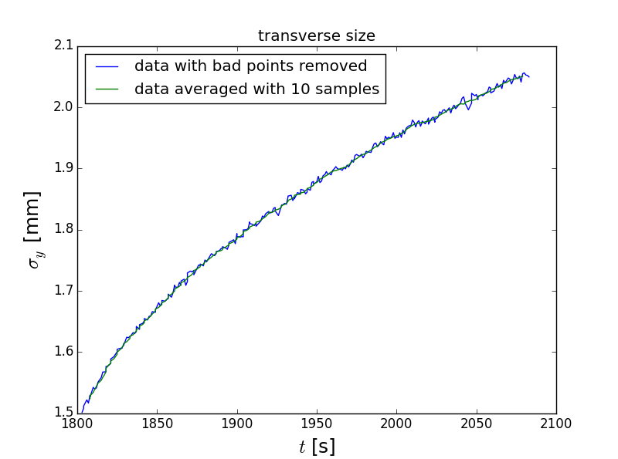
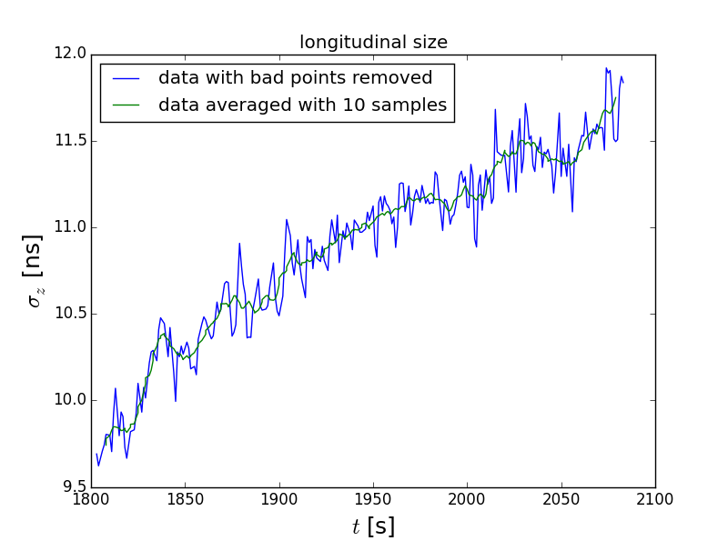
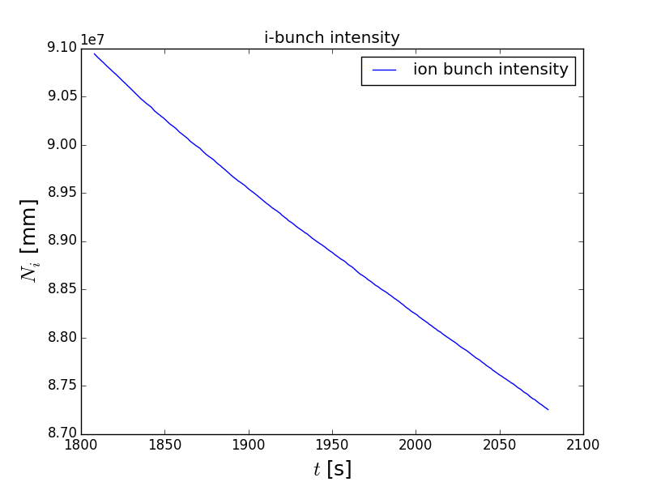
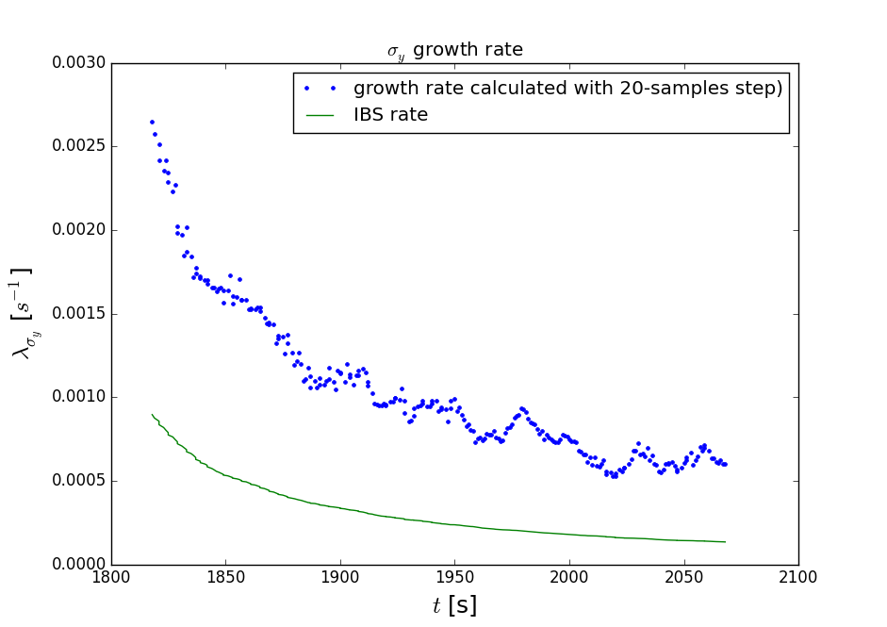
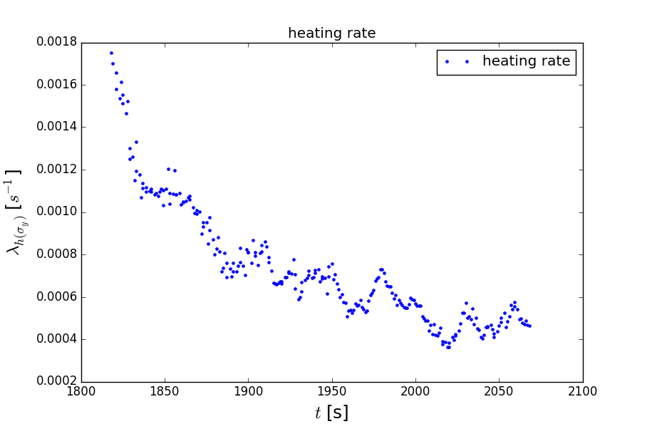
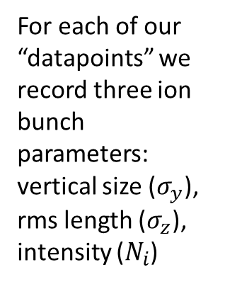
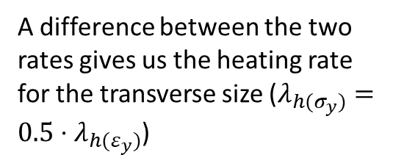
Example of data processing
For each of our “datapoints” we record three ion bunch parameters: vertical size ($σ_{y}$), rms length ($σ_{z}$), intensity ($N_{i}$)
From the bunch size measurement, we calculate the evolution of the overall growth rate of $σ_{y}$
From the measured i-bunch parameters and from dedicated measurements of the IBS-driven size growth of the i-bunches we deduce the IBS growth rate
A difference between the two rates gives us the heating rate for the transverse size ($λ_{h(σ_{y})}=0.5⋅λ_{h(ε_{y})}$)

Slide 11

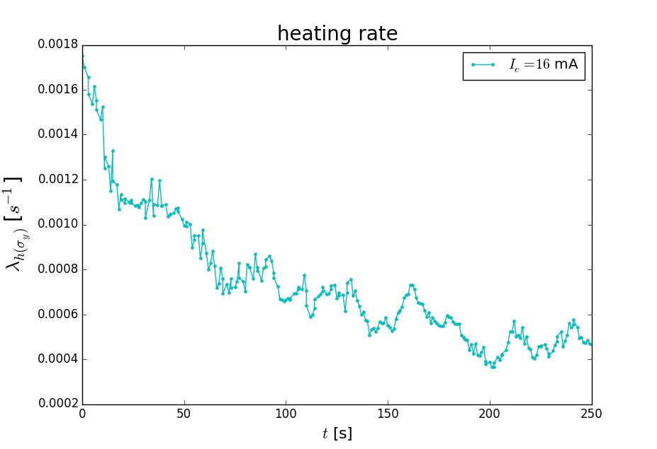
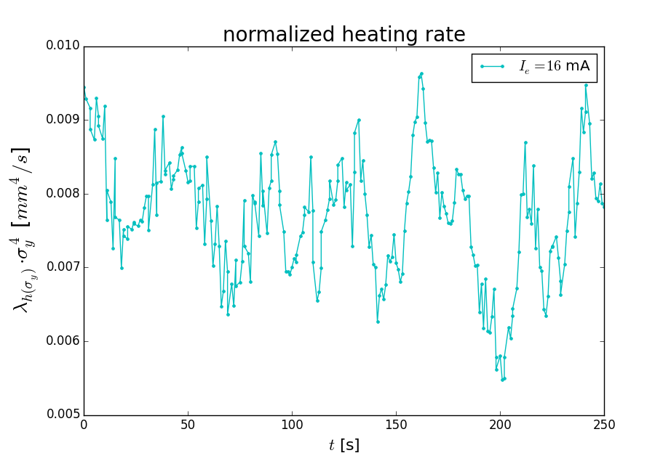
Heating process invariant
We found that in every measurement:

Slide 12
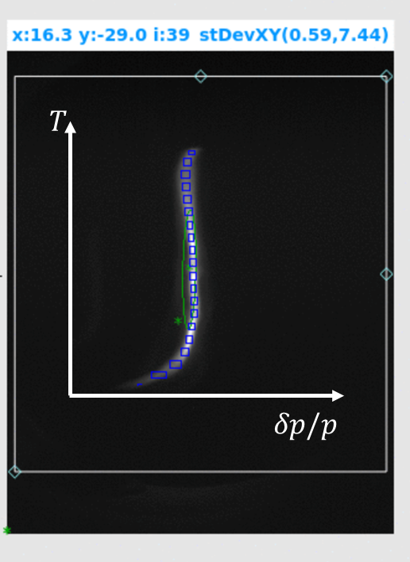
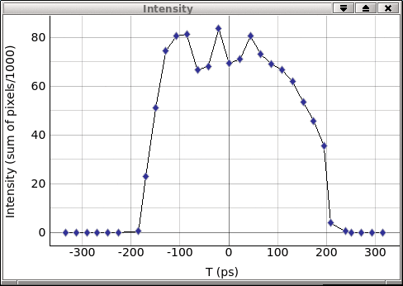
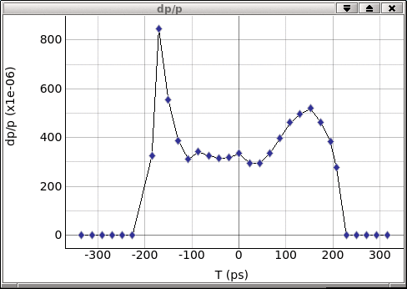
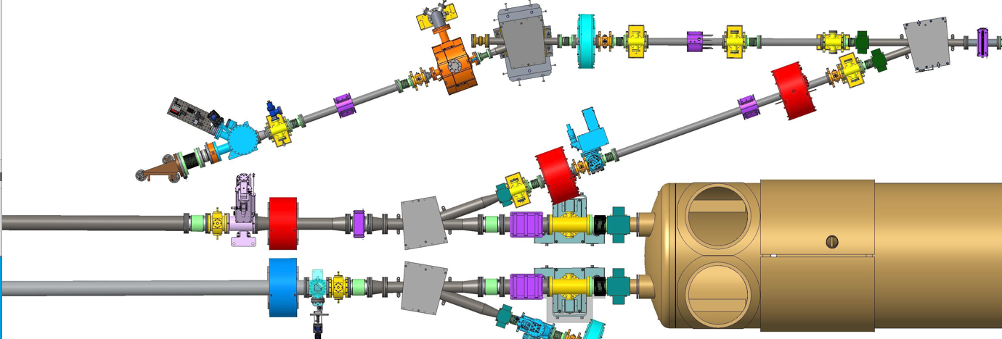
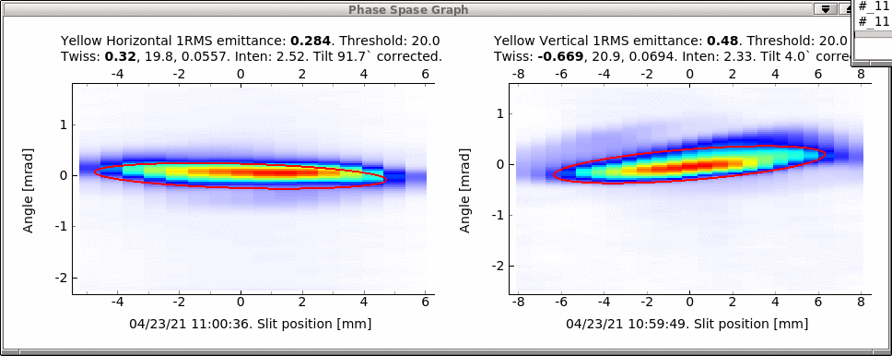
Typical e-bunch measurement
During every shift dedicated to heating studies the measurements of e-bunch parameters for all charges used in the experiment were performed.
50 pC bunch (⬄ 16 mA CW current) measurements are shown
RF diagnostic beamline
(bend + deflecting cavity)
Emittance measurement station (moving slit)

Slide 13
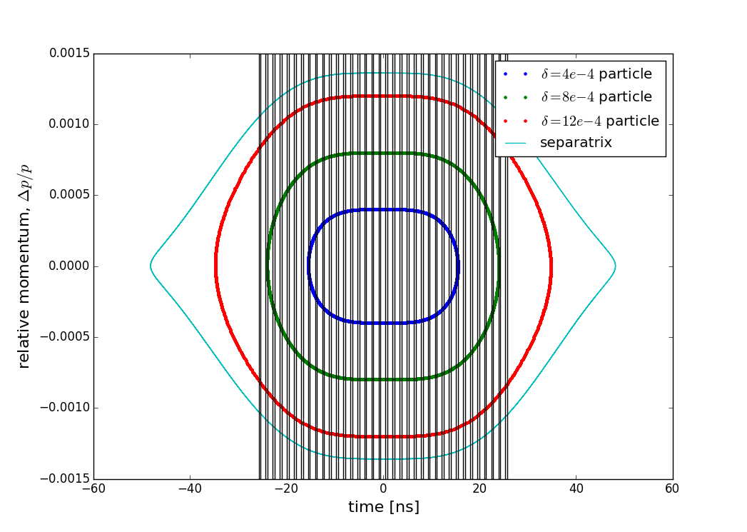
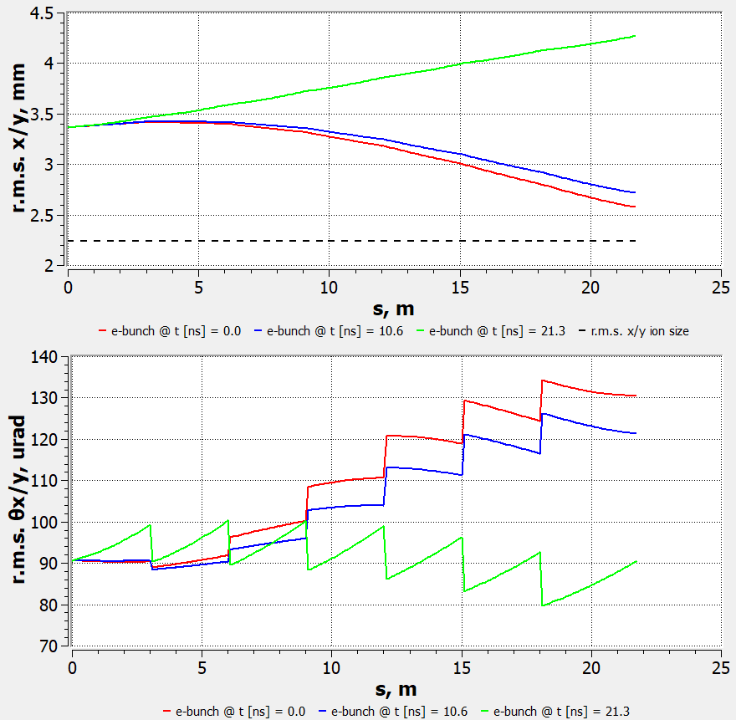
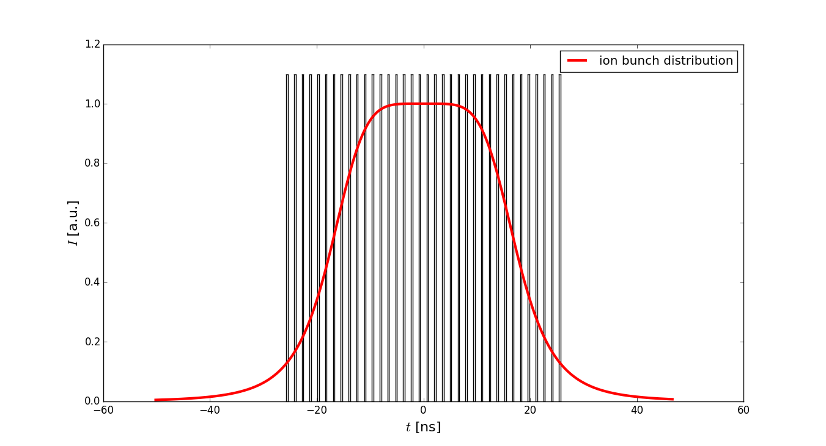
Ion-electron focusing
Ion-electron focusing is an important effect
We accounted for it by simulating the evolution of the e-bunch with the measured parameters through the cooling section.
Measurements and simulations provided us with the average bunch density in the CS for each experimental setup
In dedicated heating studies we worked both with the flat and parabolic RHIC RF bucket
The ion bunches’ intensity was intentionally kept much lower than the operational intensity

Slide 14
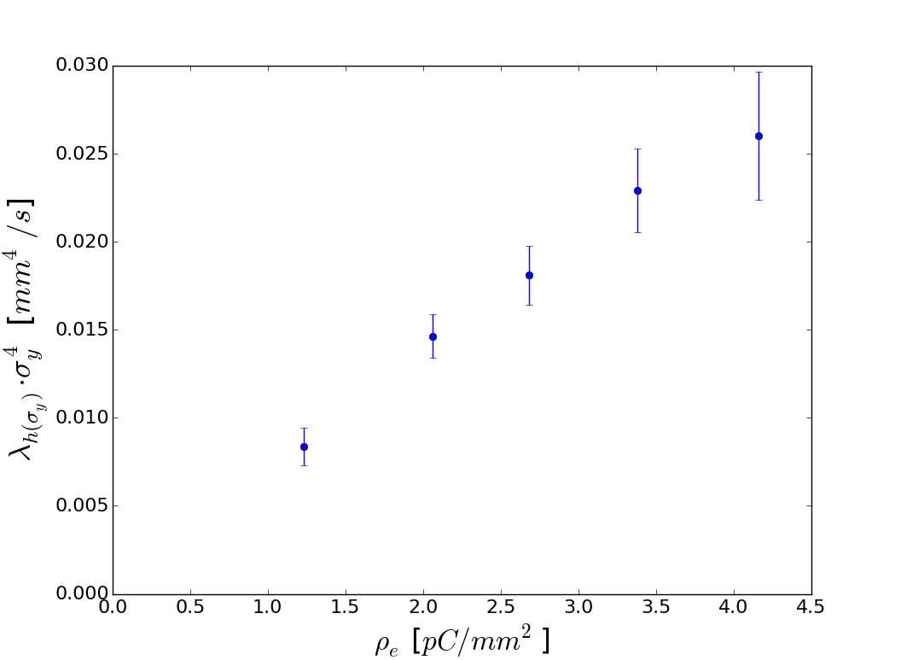
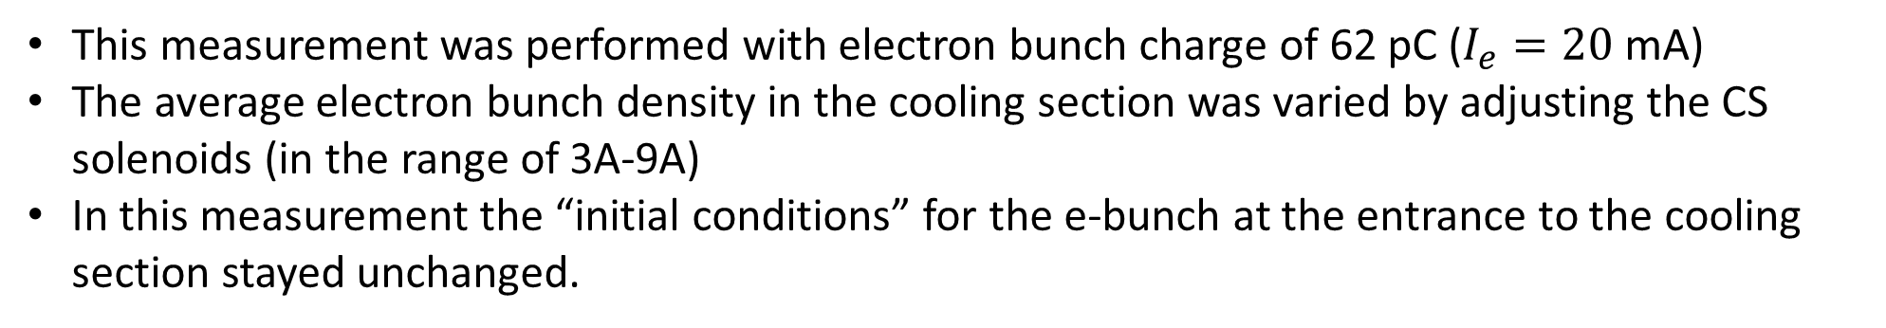
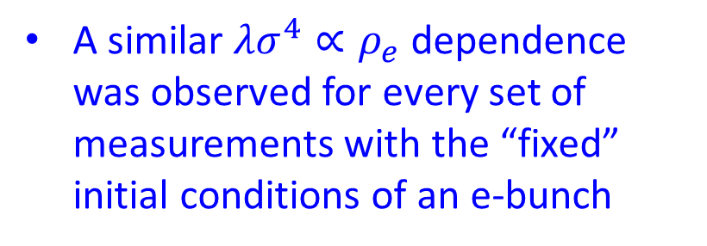
Typical measurement result for a constant e-beam current
This measurement was performed with electron bunch charge of 62 pC ($I_{e}=20$ mA)
The average electron bunch density in the cooling section was varied by adjusting the CS solenoids (in the range of 3A-9A)
In this measurement the “initial conditions” for the e-bunch at the entrance to the cooling section stayed unchanged.
A similar $λσ^{4}∝ρ_{e}$ dependence was observed for every set of measurements with the “fixed” initial conditions of an e-bunch

Slide 15
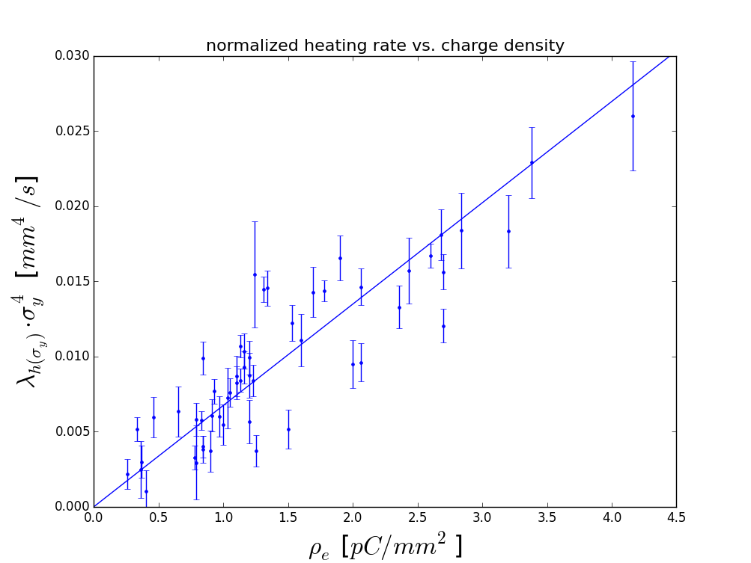
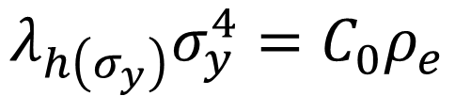
Combining all datapoints
We observed a linear dependence of the heating rate on the electron bunch density
$$λ_{h\left(σ_{y}\right)}σ_{y}^{4}=C_{0}ρ_{e}$$

Slide 16
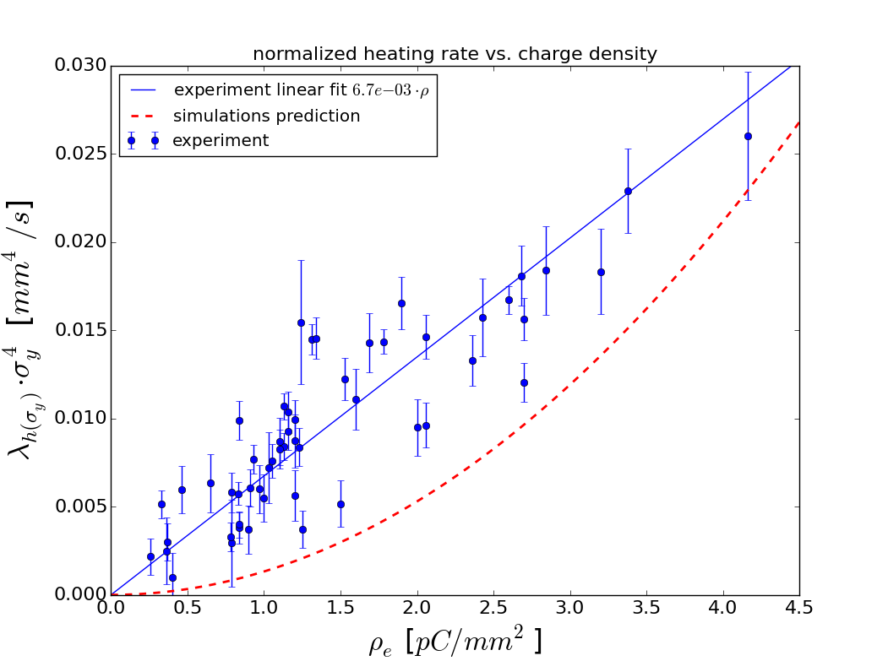
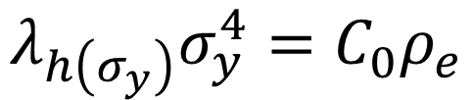
Comparison to models
We applied several theories to the observed data, but none of them predict experimentally observed dependence:
$$λ_{h\left(σ_{y}\right)}σ_{y}^{4}=C_{0}ρ_{e}$$
A simple “random walk model” with either dipole or focusing kicks.
In a more sophisticated model the focusing kicks from the space charge of e-bunches drive synchro-betatron resonances and the heating effect occurs due to the longitudinal IBS continuously “dragging” individual ions through the resonance conditions.
The red dashed line shows the model’s prediction for the heating rate on the average e-beam density. The simulations are based on a one-turn map and a thin lens treatment of the electron-ion interaction, and include the cooling force, intra-beam scattering, ion-electron focusing and electron-ion focusing kick.

Slide 17
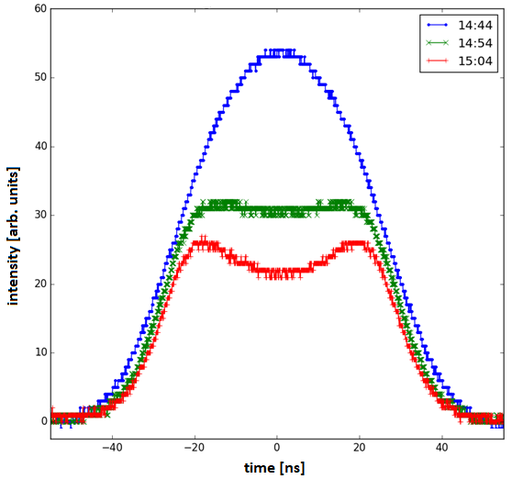
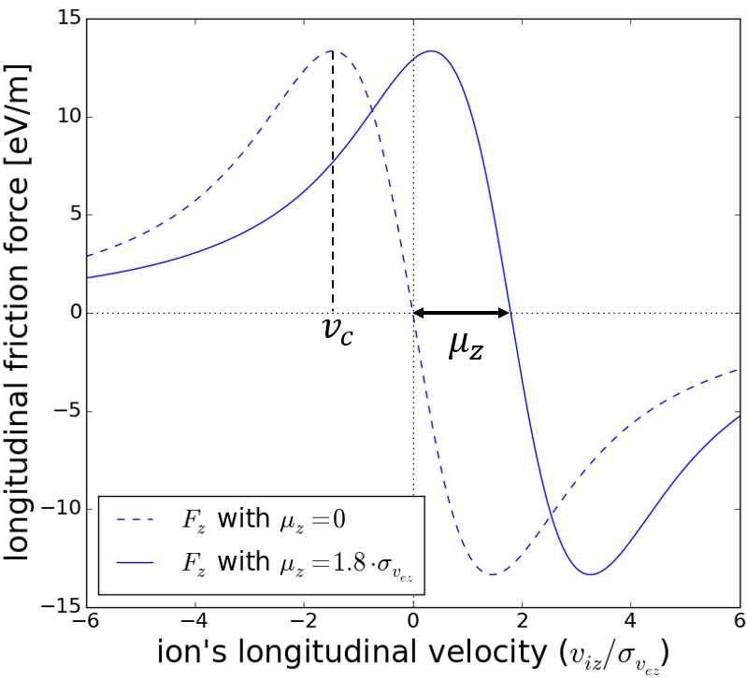
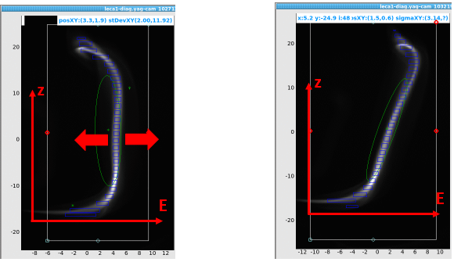
Can energy offset cause transverse heating?
An offset in electron beam energy excites the longitudinal motion of the ions
This excitation can be partially redistributed to transverse direction through coupling
To check whether we “create” transverse heating by offsetting beam energy we performed measurements with chirped e-bunch.
offset
chirp
S. Seletskiy, A. Fedotov, and D. Kayran, Experimental studies of circular attractors in the first rf-based electron cooler, Phys. Rev. Accel. Beams 26, 024401 (2023).
We compared the heating measured for the e-beam with energy offset and the beam with the chirp, large enough to produce a similar cooling force suppression

Slide 18
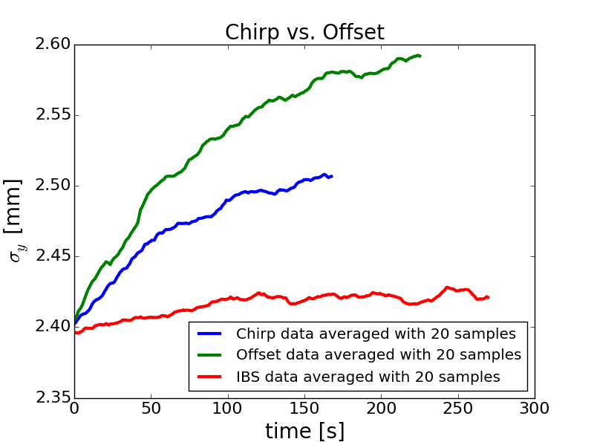
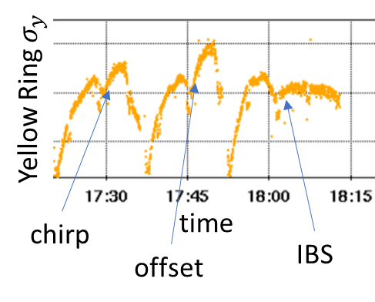
Chirp vs. offset
The offset-driven size growth rate is ~1.5 times larger than the chirp-driven one.
The energy offset is partially responsible for the observed heating

Slide 19
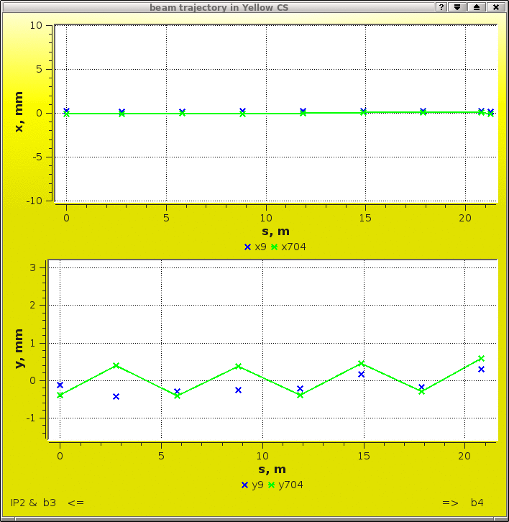
Next steps
Continue the studies with a chirped e-bunch
  Perform measurements with several bunch charges and various bunch densities
Study the heating effect “switching off” the cooling by introducing additional angles
  One of the possibilities is to create a zig-zag electron trajectory in the cooling section
x 704 MHz BPMs “see” the e-beam only
x 9 MHz BPMs see both beams

Slide 20
Summary
In presence of electron beam in the cooling section of the RHIC electron cooler (and in the absence of cooling) we observe a noticeable transverse heating of the ion bunches - a much faster growth of the transverse size of the i-bunch than the IBS driven size growth.
The optimized electron cooling overcomes both the heating and the IBS. The e-i heating was not a limiting factor for RHIC operations with the cooler.
Dedicated studies of the electron-ion heating showed that the heating rate grows linearly with the average density of electron bunches.
It was found that the extra-heating “created” by energy-offset is a substantial part of the overall emittance growth.
Further studies are planned.

Slide 21
Acknowledgements
We would like to thank our colleagues for their help in devising and carrying out the measurements and for numerous fruitful discussions:
He Zhao, Michiko Minty, Andrei Sukhanov, Jorg Kewisch,
Michael Blaskiewicz, Peter Thieberger, Xiaofeng Gu,
Wolfram Fischer, Vincent Schoefer

Slide 22
Backup slides

Slide 23
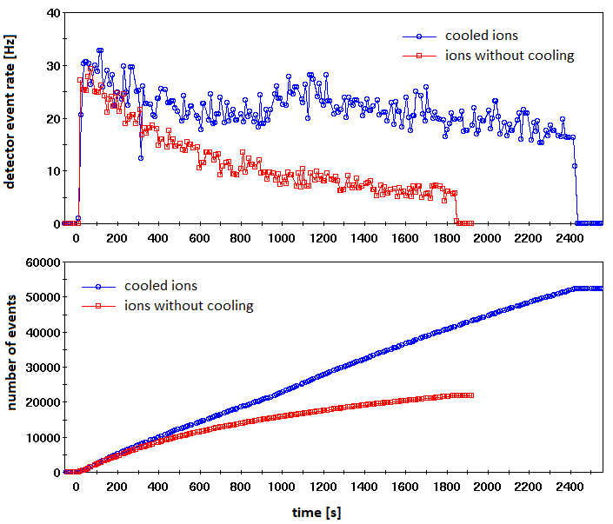
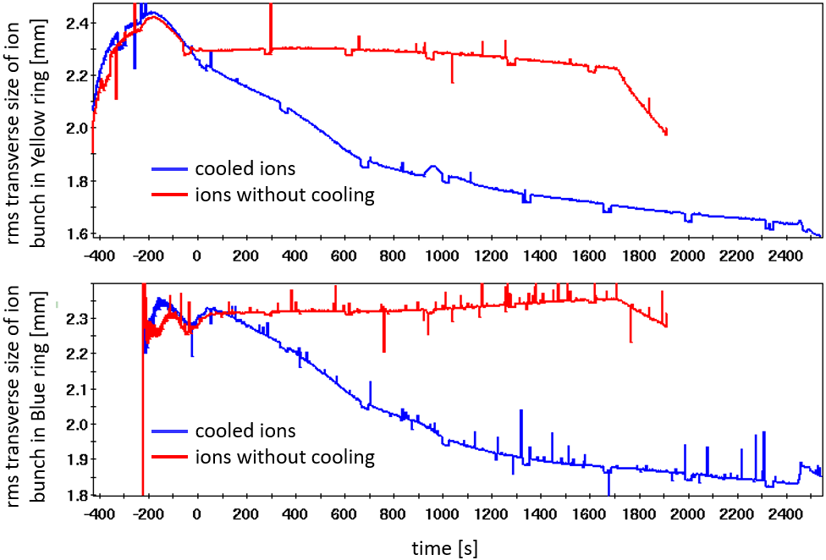
Operational cooling and gain in luminosity
An example of operational cooling in both RHIC rings during one store (compared to the store without cooling)
Integrated luminosity was increased by a factor of ~2
example from 2020 run

Slide 24
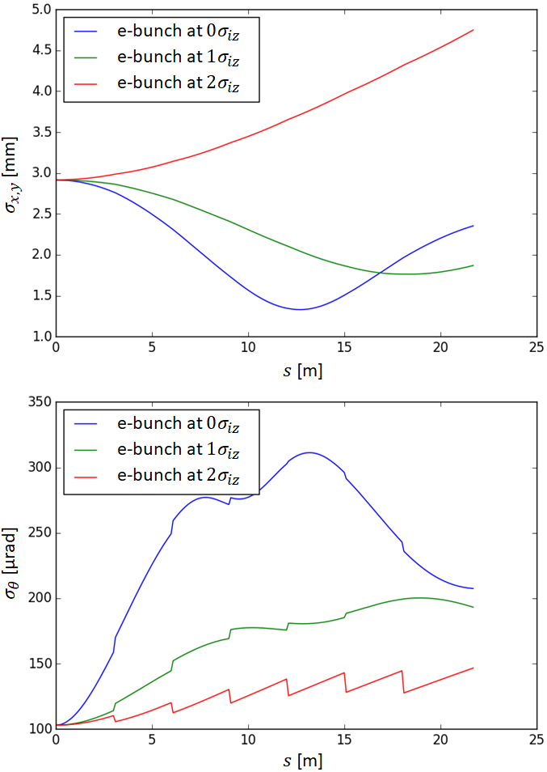
Ion–electron focusing in LEReC cooling section
LEReC is a non-magnetized cooler
Both the self space charge (SC) and the ion SC strongly affect transverse beam dynamics of e-bunches
There are 36 short e-bunches overlapped with a single long i-bunch. Each e-bunch sees an individual SC focusing from the ions.
We characterize the e-beam by the transverse angular spread averaged over the length of the cooling section and over 36 bunches and by the transverse size averaged over the CS length and over all the 36 bunches in the macrobunch.

Slide 25
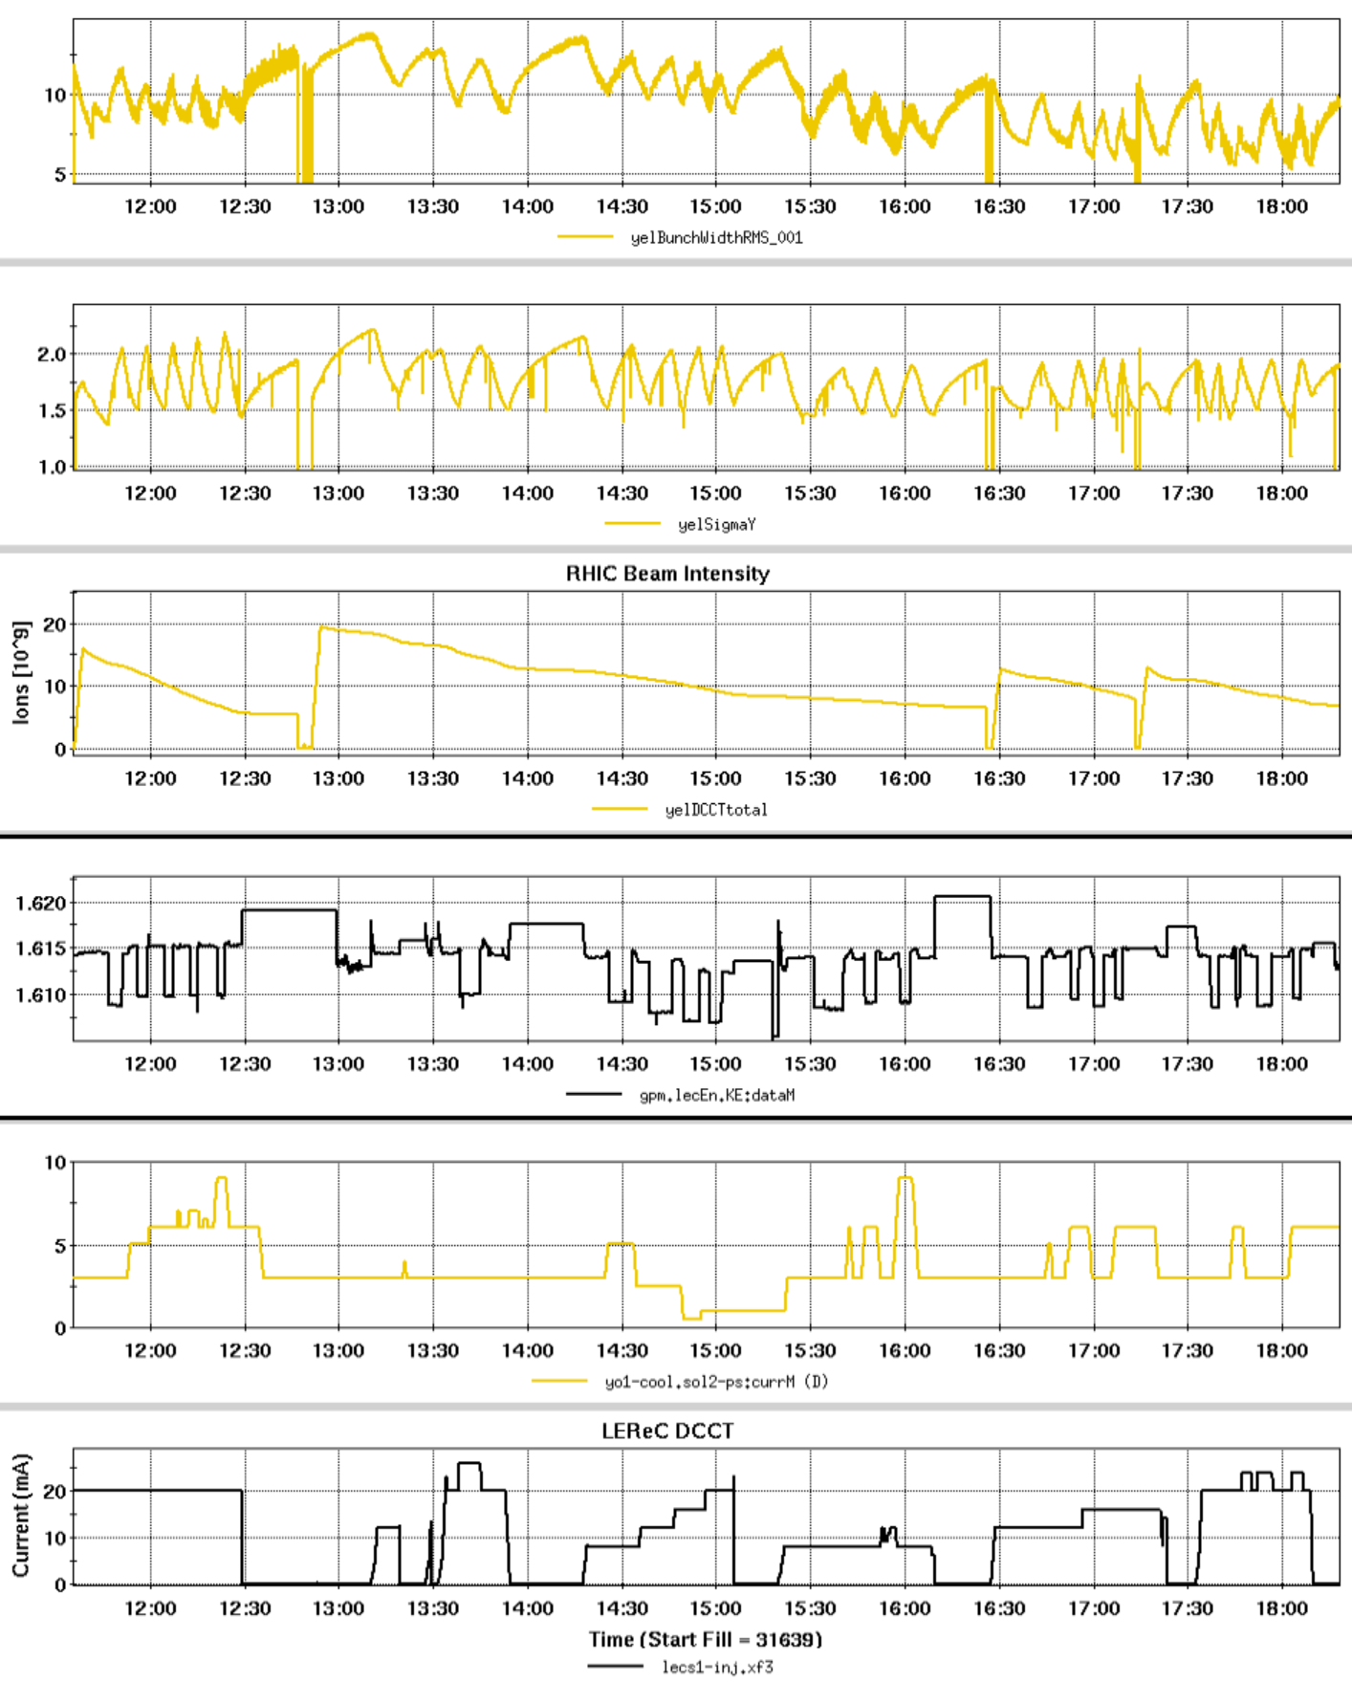
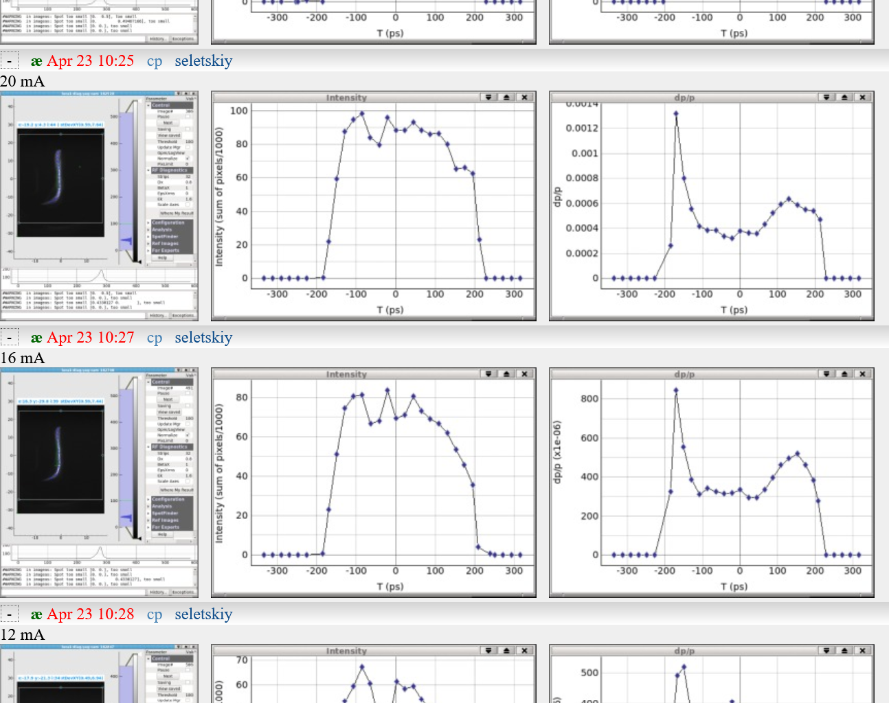
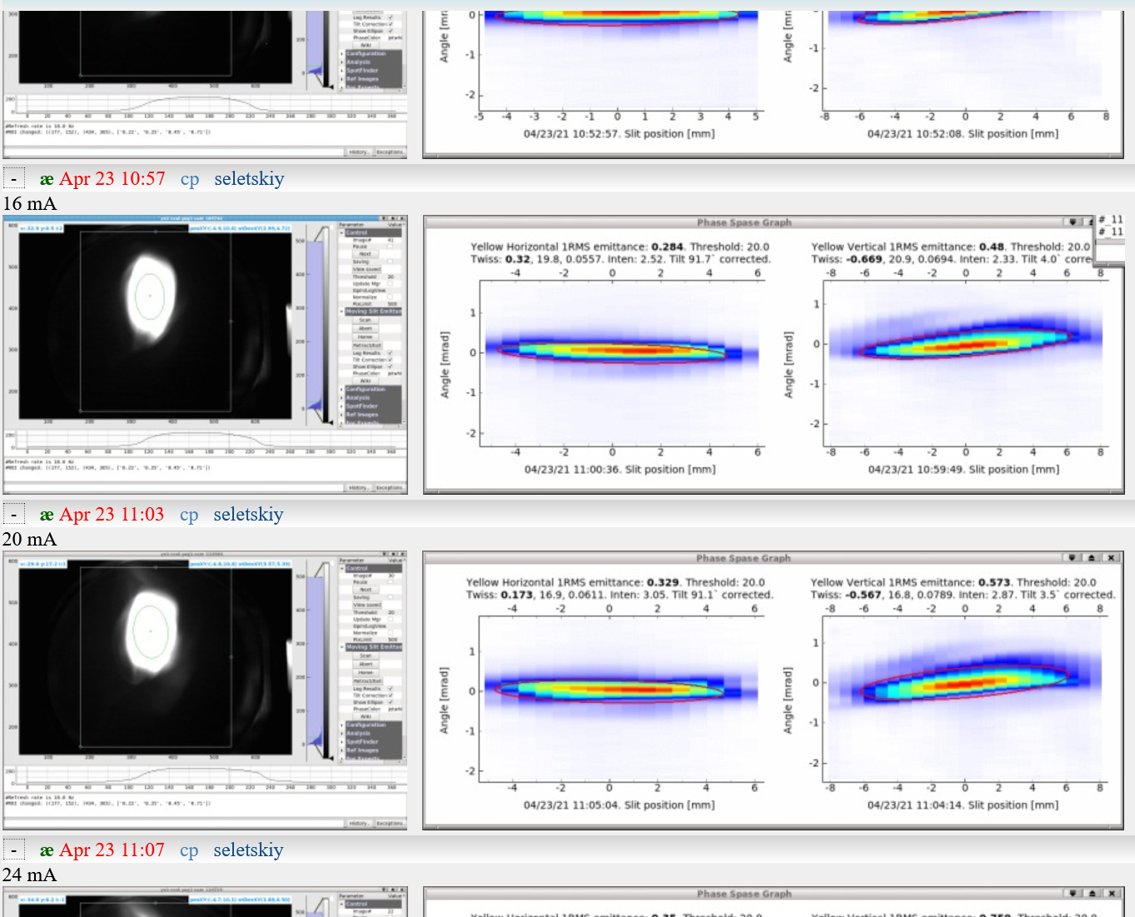
A typical shift
A record of LEReC settings and the measured i-bunch parameters during heating studies
Measuring the longitudinal and transverse phase spaces of the e-bunch for various bunch charges

Slide 26
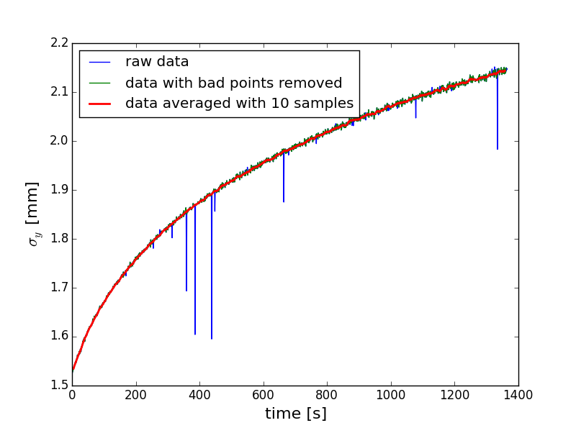
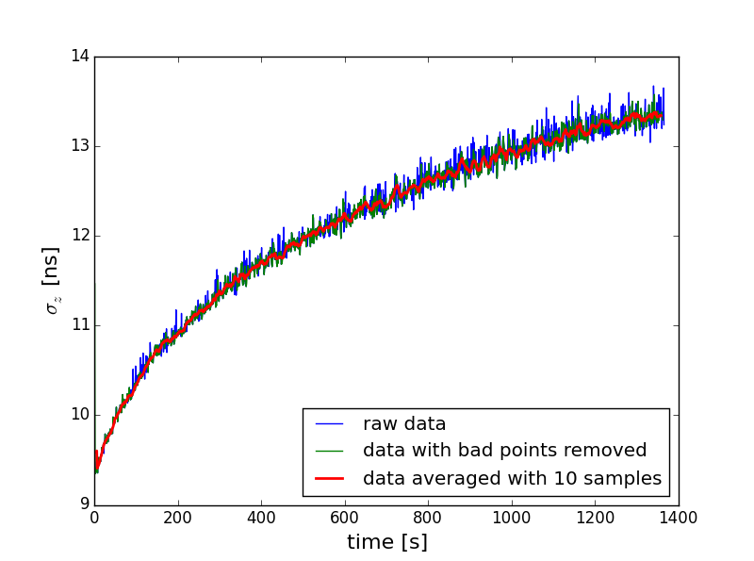
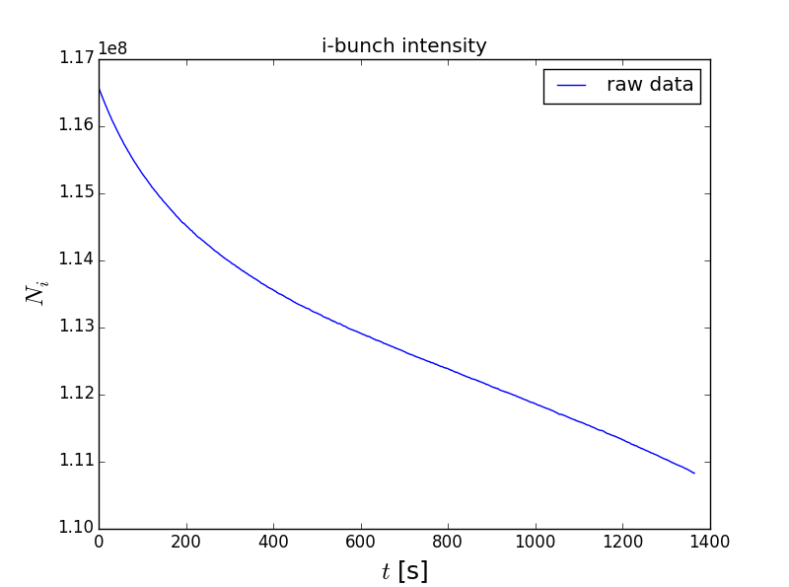




Fitting IBS-driven growth rate
Dedicated IBS measurements were taken each shift. The fitting was performed for each measurement. The results were consistent shift-to-shift and measurement-to-measurement.
We were looking for the fitting formula of the form: $λ_{IBS(σ_{y})}=C⋅\frac{N_{i}}{σ_{z}σ_{y}^{p}}$
Measurement example for flat RF bucket
$$λ_{IBS}=1∙{10}^{−9}\frac{N_{i}}{σ_{z}{σ_{y}}^{6}}$$
For the parabolic RF bucket (the same date):
$$λ_{IBS}=6∙{10}^{−10}\frac{N_{i}}{σ_{z}{σ_{y}}^{5}}$$

Slide 27

Experiment - simulations comparison

