Slide 1

STOCHASTIC COOLING OF ELECTRONS AND POSITRONS WITH EUV LIGHT
Alexander Zholents
Argonne National Laboratory
COOL 2023 conference, Montreux, Switzerland, October 10, 2023
Notes:
The amplifier plays a significant role in stochastic cooling. However, selection of broadband optical amplifiers is very limited impacting application of optical stochastic cooling. I will show that fast cooling of electrons/positrons can be achieved without the amplifier by a slight modification of a stochastic cooling method.

Slide 2

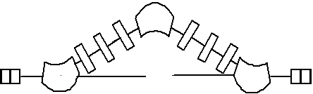
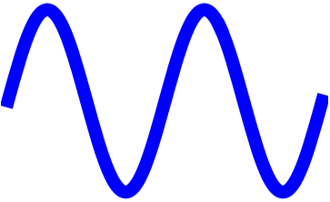
OSC in traditional approach
Delay adjustment using bypass
e⁻
Light signal is produced in undulator
Light signal amplifier
Amplified light signal is used in undulator to correct the offset
Limitations
Amplifiers are available only for several IR wavelengths
Amplifier and refractive lenses limit bandwidth of the system
A. Mikhailichenko, M. Zolotorev, “Optical Stochastic Cooling”, PRL, 71, 1993.
M. Zolotorev, A. Zholents, “Transient-time method of optical stochastic cooling”, PRE, V.50, 1994
J. Jarvis, V. Lebedev, et al., “Experimental demonstration of optical stochastic cooling”, Nature, 2022.

Slide 3


New approach: cooling with EUV light
Wiggler
Wiggler
No amplifier
Reflective optics
100% relative bandwidth
Use multiple light sources within one setup
Use light in extreme ultraviolet part of spectrum; bandwidth
Δf = 7.5 PHz

Slide 4
Basics of stochastic cooling: measure, correct, randomize
1. Measure
Simon van der Meer
beam slice length
2. Correct
Δz
Energy
Position inside the beam
e⁻
4. Repeat
3. Randomize

Slide 5
New approach: delayed correction
The lattice arrangement produces (–I) transport
1
2
3
4
Illustration on the left shows use of four light sources within one setup
e⁻
Correct
Correct
Correct
Correct
1
2
3
4
Measure, randomize
Measure, randomize
Measure, randomize
Measure, randomize
This mirror arrangement produces (–I) transport in the geometrical optics, i.e.
(
-1 0
)
M =
0 -1
d
2d
d
f = d

Slide 6
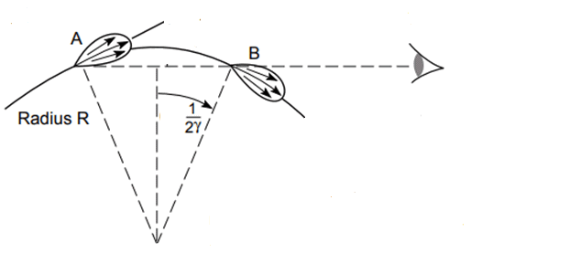
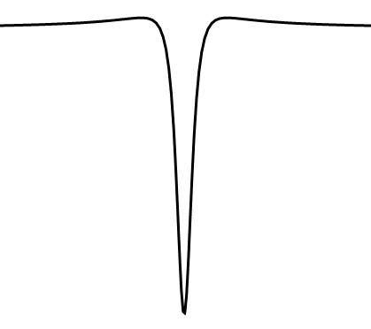
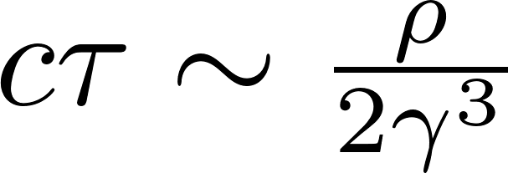
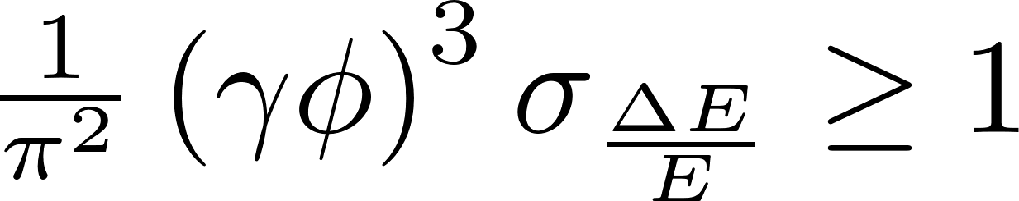
Bending magnet
Far field observer
e⁻
Condition of randomization
ρ
Bending angle
Energy spread
E_{x}
Pulse width ~ 6 nm

Slide 7
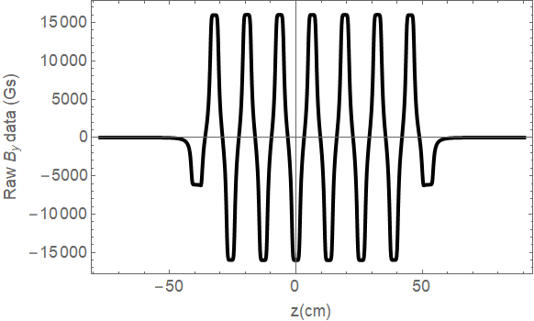
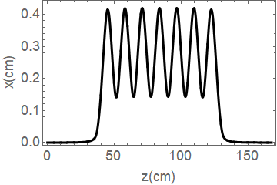

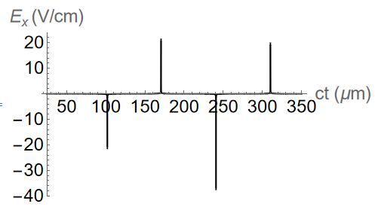
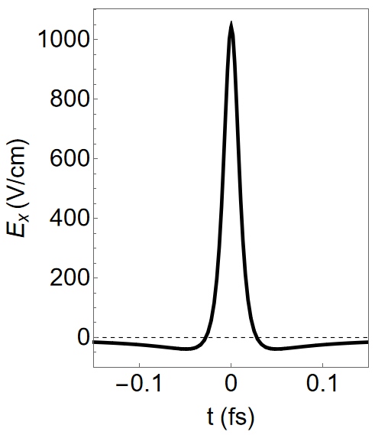
Wiggler magnet
Field^{*)}
Period 12.9 cm -> 10.9 cm
Trajectory
By (kGs)
-15 -10 -5 0 5 10 15
Collect radiation from each pole
*) Designed by Maofei Qian (ANL)
Radiation field seen by an observer
Peaks are shown incorrectly due to plot resolution
Zoom on a single pulse

Slide 8
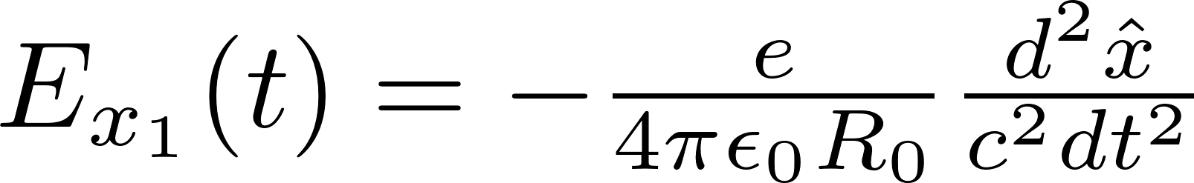

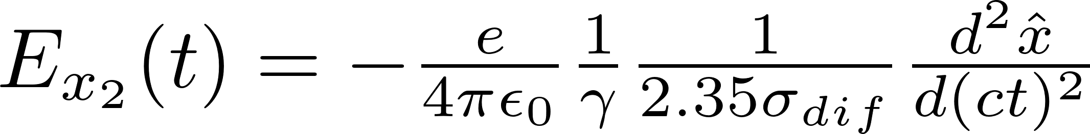
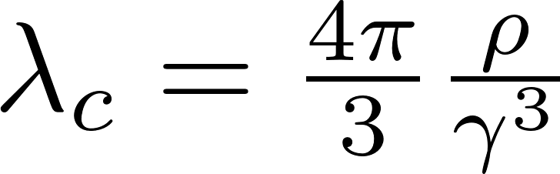
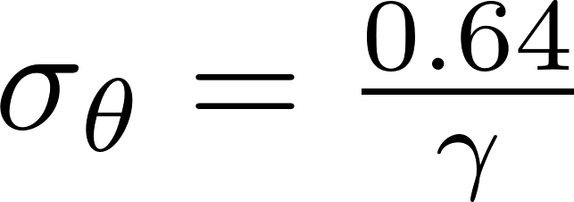
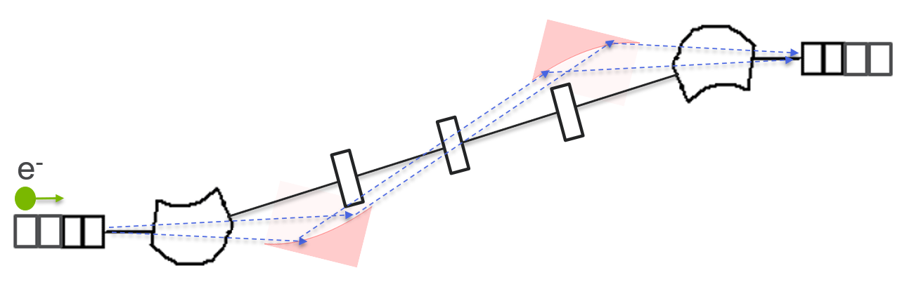
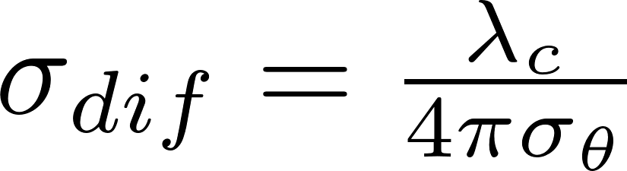
Field calculation
^{*)}
The field produced by one electron and seen by the observer at a distance R₀ >> wiggler length
is the apparent trajectory of the electron
t is the time in the observer's frame
The transported field to the second wiggler
critical radiation wavelength
radiation divergence at a critical radiation wavelength
rms size of focused light
*) The Feynman Lectures on Physics (Addison-Wesley, New York, 1963), Vol. 1, Chapter 28
Notes:
Feynman: we distinguish between \tau, the time in the frame of the electron (the emitter time) and t, the time in the observer’s frame (the observer time); x(\tau) is the true path of the electron, and \hat{x}(t) is the apparent path of the electron.

Slide 9
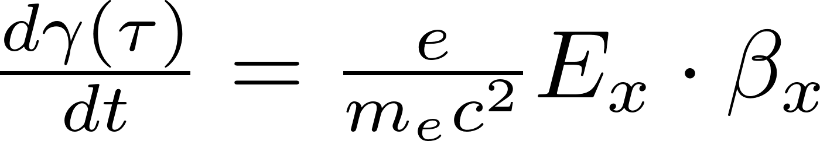
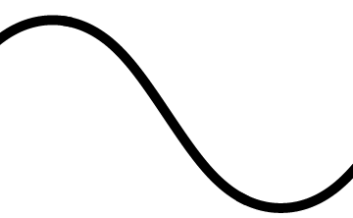
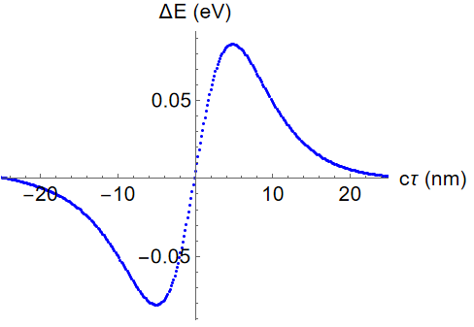
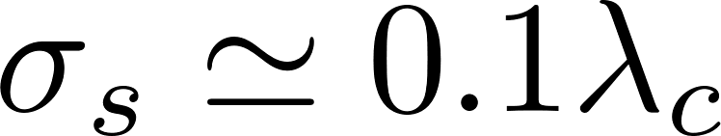

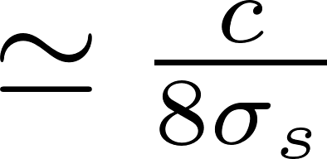
correction “kick” for Energy offset
E_{x}
β_{x}
arrival time delay τ
a fragment
Bandwidth
= 7.5 PHz
Warning!
The delay pathlength must be controlled with an unprecedented accuracy of a few nm
Energy gain/loss as a function of electron arrival time delay in interaction with a radiation pulse from a single pole

Slide 10
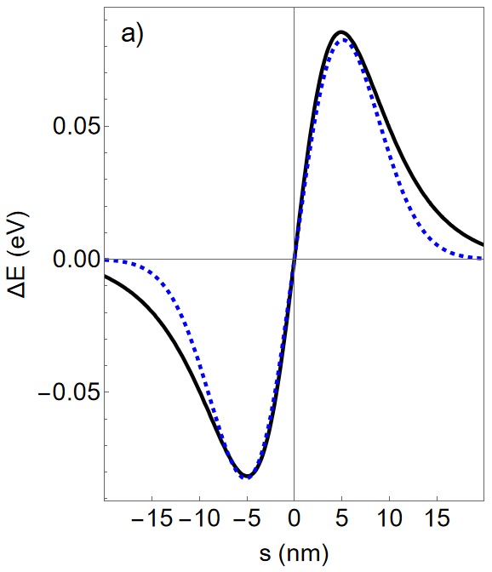

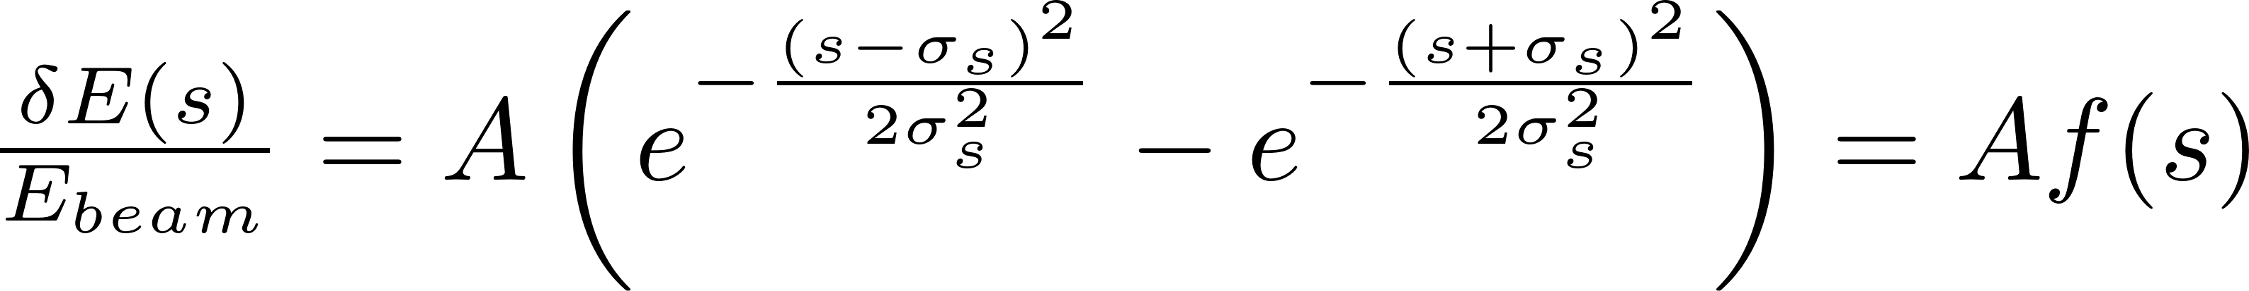
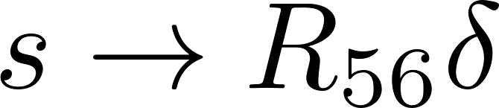
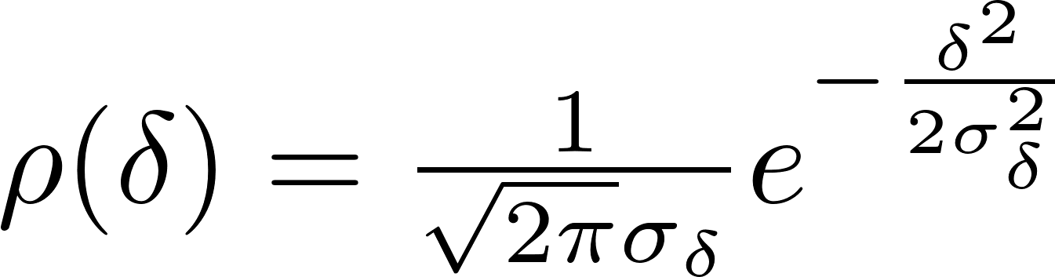
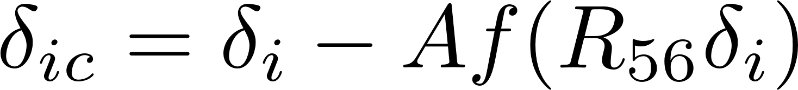
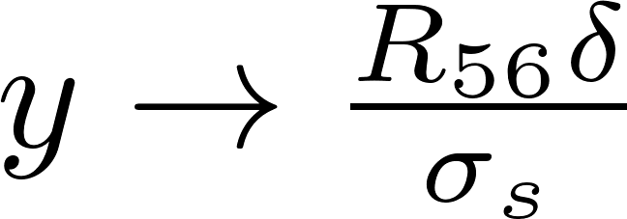
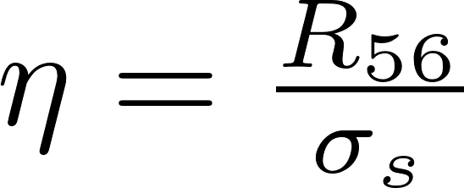
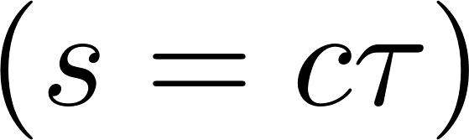
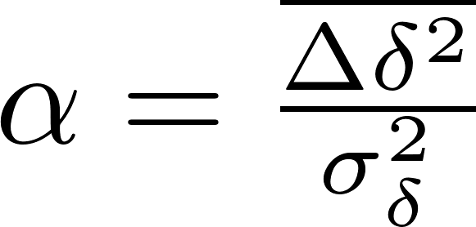
Theory
Fit energy “kick” by the function
Theory
Fit
Consider delay that is only due to energy offset
Assume Gaussian energy distribution
number of particles in the slice
cooling
heating
Cooling rate:

Slide 11
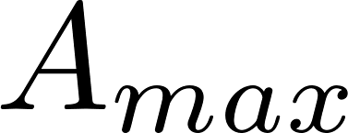
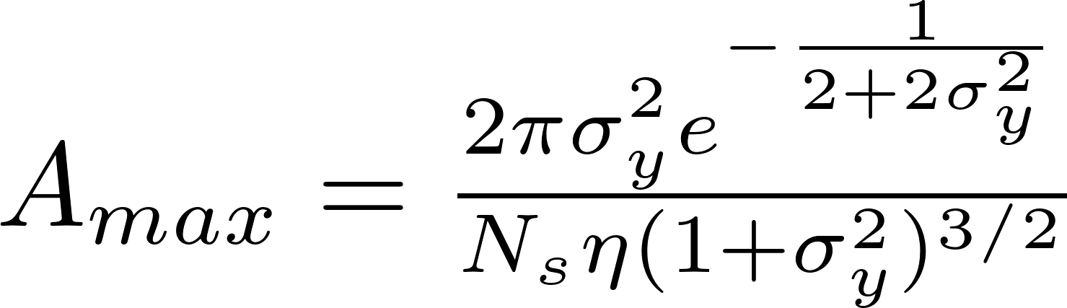
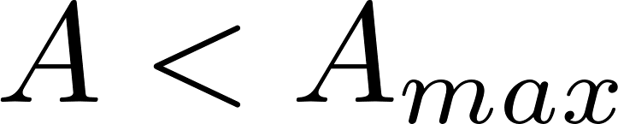
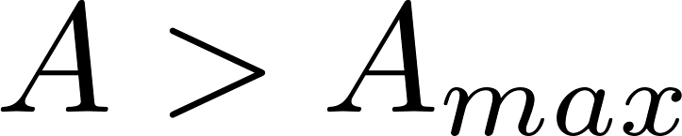
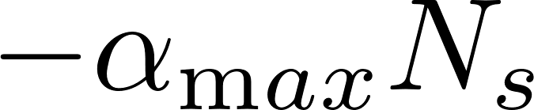
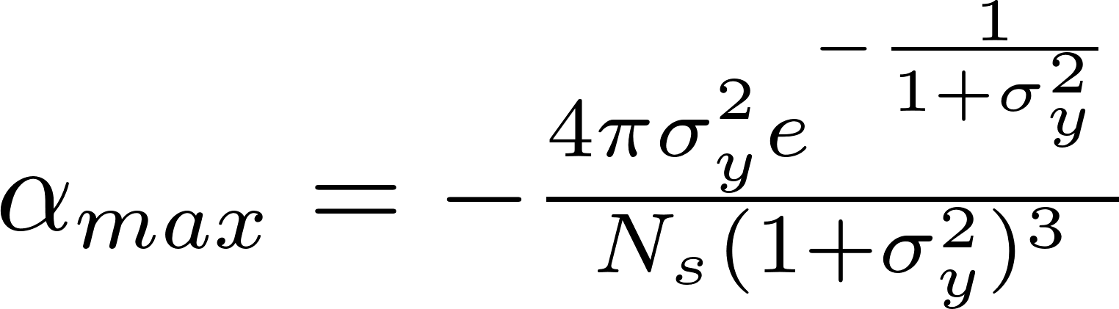
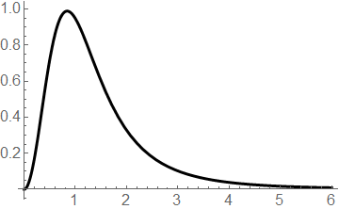
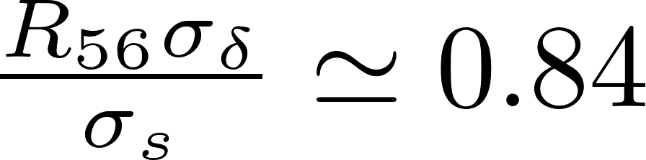
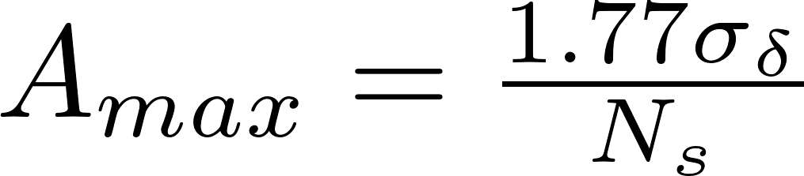
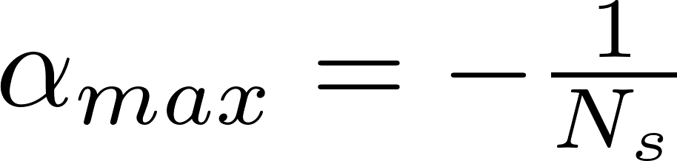
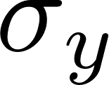
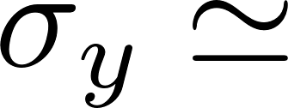
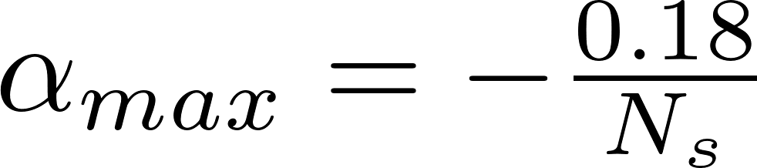
Theory cont’d
Find optimal
when cooling rate is at a maximum
insufficient cooling
heating dominates cooling
Maximum decrement
Optimal R₅₆ can be found from
0.84
In Zolotorev, Zholents paper

Slide 12
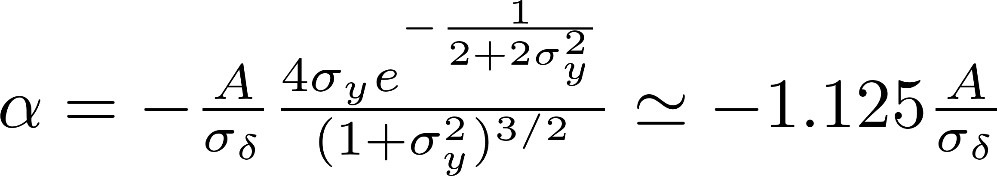
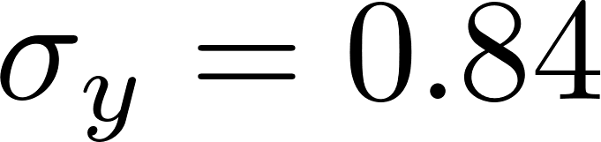
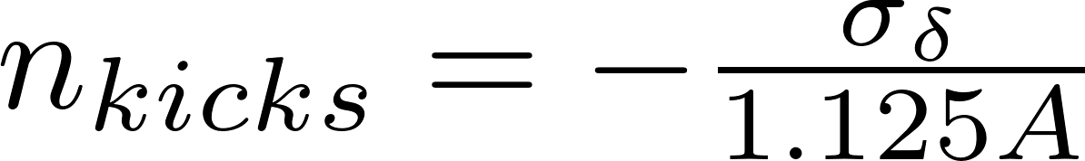
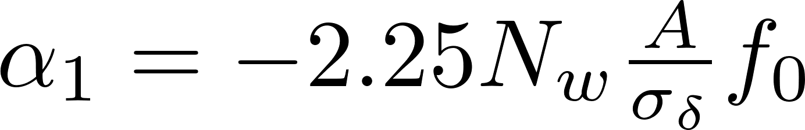

Theory cont’d
Cooling rate in case of “insufficient cooling” (when correction kicks are too weak)
A straightforward interpretation.
Damping time is defined by a number of the kicks needed to zero the energy spread
Therefore, cooling decrement in the ring with one cooling section employing the wiggler with N_{w} periods is
is the revolution frequency
Notes:
Curse or blessing

Slide 13
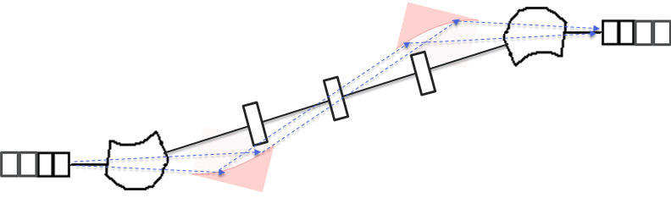
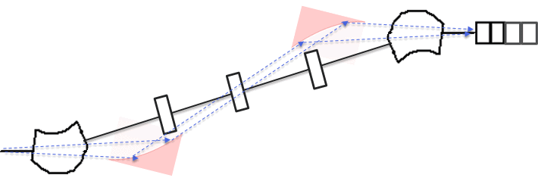
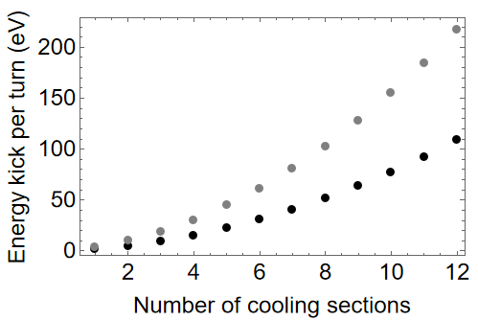

Cascade-amplified EUV stochastic cooling
1
2
3
4
When N_{c} cooling sections is used back-to-back, the cooling rate is growing NOT as N_{c}, but as
Energy kick from one magnet
Optimal slippage
wiggler with 20 period
wiggler with 10 period
Notes:
Time domain multi period wiggler cleaned 082023
OSCinUVCoolingEstimate

Slide 14




Transverse slicing^{*)}
Much simpler when operating at short wavelength
2 μm
rms vertical beam size
rms horizontal beam size
Actual number of electrons in the slice
N_{s} is the number of electrons in the longitudinal slice
It cannot help to reduce the damping time.
It only makes “insufficient cooling” even more “insufficient.
*) Zolotorev, Zholents, “Transient-time method of optical stochastic cooling”, PRE, V.50, N4, p.3087, 1994
Notes:
Curse or blessing

Slide 15




light and electron beam transport
Image light source (and electron beam) from the upstream wiggler to the downstream wiggler
-unit transport matrix for e-beam (almost)
Parabolic mirror with the focal length f = 4091.5 mm
d=4091.5 mm
e⁻ trajectory uses 4 bends
light trajectory uses 2 mirrors^{*)}
Zoom
x (mm)
0 1 2 3
equal time-of-flight
0.6 m
8027 mm
3.087°
d=4091.5 mm
2°
17 mm
y (mm)
-20 -10 0 10 20
-432.3 mm
bend magnet
*) a path length of the light is longer by a factor c/v
100 nm Al coating,
92.5% reflectivity,
range 0.5-100 eV
-I light ray’s transport matrix (almost)
Beam energy = 147 MeV
Critical photon energy 23.7 eV
Curtesy
L. Rebuffi and X. Shi
Wiggler period= 12.9 cm
Number of periods = 10

Slide 16


Imaging of a single electron radiation from the center of the upstream Wiggler to the downstream wiggler
SRW calculations.
Curtesy L. Rebuffi and X. Shi
At source (the center of the upstream wiggler)
Radiation intensity
Phase
Phase horizontal cut
Phase vertical cut
Phase
Radiation
Phase
Radiation
-400 -200 0 200 400
-400 -200 0 200 400
-3 -2 –1 0, 1, 2 (rad)
-3 -2 –1 0, 1, 2 (rad)
Upstream wiggler
-400 -200 0 200 400 (μm)
-400 -200 0 200 400 (μm)
-400 -200 0 200 400 (μm)
-400 -200 0 200 400 (μm)
At focus (the center of the downstream wiggler)
Radiation intensity
Phase
Phase
Radiation
Phase
Radiation
Downstream wiggler
-400 -200 0 200 400 (μm)
-400 -200 0 200 400
-3 -2 –1 0, 1, 2 (rad)
-3 -2 –1 0, 1, 2 (rad)
-400 -200 0 200 400 (μm)
-400 -200 0 200 400 (μm)
-400 -200 0 200 400 (μm)
-400 -200 0 200 400 (μm)

Slide 17


Light propagation Studies cont’d
Intensity and phase at shifted longitudinally (-105 mm) and shifted vertically by 0.1 mm
At source in the upstream wiggler (- 105 mm shifted)
Radiation intensity
Phase
Phase horizontal cut
Phase vertical cut
Phase
Radiation
Phase
Radiation
0.1 mm
0.1 mm
Upstream wiggler
-400 -200 0 200 400
-3 -2 –1 0, 1, 2 (rad)
-3 -2 –1 0, 1, 2 (rad)
-400 -200 0 200 400
-400 -200 0 200 400 (μm)
-400 -200 0 200 400 (μm)
-400 -200 0 200 400 (μm)
-400 -200 0 200 400 (μm)
At focus in the downstream wiggler (- 105 mm shifted)
Radiation intensity
Phase
Phase horizontal cut
Phase vertical cut
- 0.1 mm
Phase
Radiation
- 0.1 mm
Downstream wiggler
-400 -200 0 200 400
-3 -2 –1 0, 1, 2 (rad)
-3 -2 –1 0, 1, 2 (rad)
-400 -200 0 200 400
-400 -200 0 200 400 (μm)
-400 -200 0 200 400 (μm)
-400 -200 0 200 400 (μm)
-400 -200 0 200 400 (μm)

Slide 18



Beam optics of Cooling section
Dogleg-like lattice, two positive bends are followed by two negative bends, π phase advance between bends. Small trim magnets produce dispersion bump to control R₅₆ (not visible at this scale).
Defocusing quad
-I matrix
-I matrix
-I matrix
Focusing quad
wiggler
+B
+B
-B
-B
wiggler
Bending magnet
Trim1
Trim2
Trim magnet
Beta functions (m)
Dispersion function (m)
Distance along electron beam trajectory (m)

Slide 19


correction of second order time-of-flight aberrations
Use four sextupole “families”
+
-
dispersion
Betatron phase advance between sextupoles in the pair: φ_{x}= 2π, φ_{y}= π.
This allows to cancel aberrations using pairs of sextupoles with the opposite signs of the field.
Hamiltonian:

Slide 20
Possible Applications of XUV cooling
1. Produce a beam of relativistic positronium atoms:
  obtain ultra-cold electrons in one ring
  obtain ultra-cold positrons in another similar ring
  merge electrons and positrons in a common long straight section
  obtain positroniums
2. Produce a beam of antihydrogen atoms:
  obtain ultra-cold positrons in one ring
  obtain antiprotons in another ring
  merge antiprotons and positrons in a common long straight section for positron cooling of antiprotons
  obtain antiprotons
3. Prepare “cold” electrons for an electron cooling of ions and protons in the Electron Ion Collider *)
*) Tomorrow, Sergei Seletski will discuss the alternative (main) approach of using the electron storage ring with many wigglers for a strong radiation cooling of electrons

Slide 21

Storage ring design FOR EIC project
Circumference =447.2 m
12 cooling sections
180m reserved for ion cooling
Beta functions (m)
Dispersion function (m)
arcs
Distance along electron beam trajectory (m)

Slide 22

Storage ring design (2)
Twiss functions in the middle of the cooling straight^{*)}
Beta_x = 160 m
Beta_y = 110 m
Dispersion = 0.66 m
Beta functions (m)
*) This set has been chosen by Sergei Seletski for electron cooling of protons
Dispersion function (m)
Distance along electron beam trajectory (m)

Slide 23


Cooling rate and IBS growth rate
Use wiggler with period of 12.9 cm, peak field of 1.6 T, and 10 periods
Consider 1 cascade with 6 cooling sections (total length ~ 100 m)
Average energy correction (“kick”) per orbit turn due to cooling is 30 eV
“Slice” length ~ 0.13 fs (7.5 PHz bandwidth)
Number of electrons in the “longitudinal slice”:
Diffraction size 2 μm
Number of electrons in the “slice” after transverse slicing:
Estimated cooling rate is 101 sec⁻¹
Maxwell’s demon is realized (almost)
Estimated intrabeam scattering growth rate is 39 sec⁻¹

Slide 24

Cooling rate and IBS growth rate (2)
Stochastic cooling in XUV without the amplifier
Beam parameters used for cooling and IBS calculations^{*)}
cascade with:
6
12 cooling sections
 | eRHIC/p | Cooler ring/e | Unit
Energy | 270 GeV | 147 MeV
Energy spread | 6 E-4 | 1.3 E-3
Hor. emittance | 11.3 | 12 | nm
Ver. emittance | 1.0 | 6.5 | nm
Rms bunch lenth | 6 | 14.5 | cm
Bunch intensity | 6.9 E10 | 1.9 E11
Peak current | 23 | 27 | A
b)
8
10
Cooling decrement (sec⁻¹)
IBS increment (sec⁻¹)
a)
IBS
*) provided by S. Seletski
Relative energy spread
current design
equilibrium relative energy spread with 6 cooling sections in cascade is 7x10⁻⁴
b) equilibrium relative energy spread with 8 cooling sections in cascade is 4.5 x10⁻⁴

Slide 25
Conclusion
Key Takeaways
Stochastic cooling of electrons and positrons in XUV is feasible, in principle.
It provides a viable alternative to radiation cooling of electrons for electron cooling in EIC project. Design shows a good margin in cooling capacity above the required performance.
However, achieving an order of a magnitude better stability of the pathlength through cooling section(s) than it was demonstrated in OSC experiment at IOTA is questionable.

Slide 26
Back up slides

Slide 27


current idea for cooling the cooler of hadrons
eRHIC
Ion/proton ring, 3.8 km
hadrons
e⁻
12
Electron damping ring, 319 m, 147 MeV
OSC module
Number of ion/proton bunches = 1320
Ion/proton bunch rep. rate = 103 MHz
Proton beam average current = 1 A
Number of electron bunches = 1321
Electron bunch rep. rate = 1.24 GHz
Electron beam average current = 1.9 A
Each electron bunch makes 12 orbit turns in the damping ring between two subsequent interactions with ion/proton bunch!

Slide 28





Scaling with energy
Consider the case when the peak magnetic field in the wiggler and relative beam energy spread in the ring are independent of beam energy.
Since
then
Cooling rate
Intrabeam scattering growth rate
Compare to a wiggler dominated storage ring (under the same condition of a fixed wiggler’s peak magnetic field)
Cooling rate

Slide 29

Beam optics of Cooling section
Dispersion due to trim magnets. Note 10 times smaller scale for the dispersion.
+B
Trim1
+B
-B
Trim2
-B
chicane

