Slide 1


Development of stochastic cooling components for HIAF Spectrometer-Ring
Guangyu Zhu, Junxia Wu, Ze Du, Jia Yin, Liyao Ma
IMP, Lanzhou, China
Beam feedback and machine protection group

Slide 2
Outlines
Development of stochastic cooling components for HIAF Spectrometer-Ring (High Intensity heavy-ion Accelerator Facility)
  Motivation for stochastic cooling on the SRing requirements by physics
  SRing pickup/kicker optimization and test with beam on CSRm
  Notch filter evaluation for SRing stochastic cooling
  Broadband phase shifter development for stochastic cooling

Slide 3
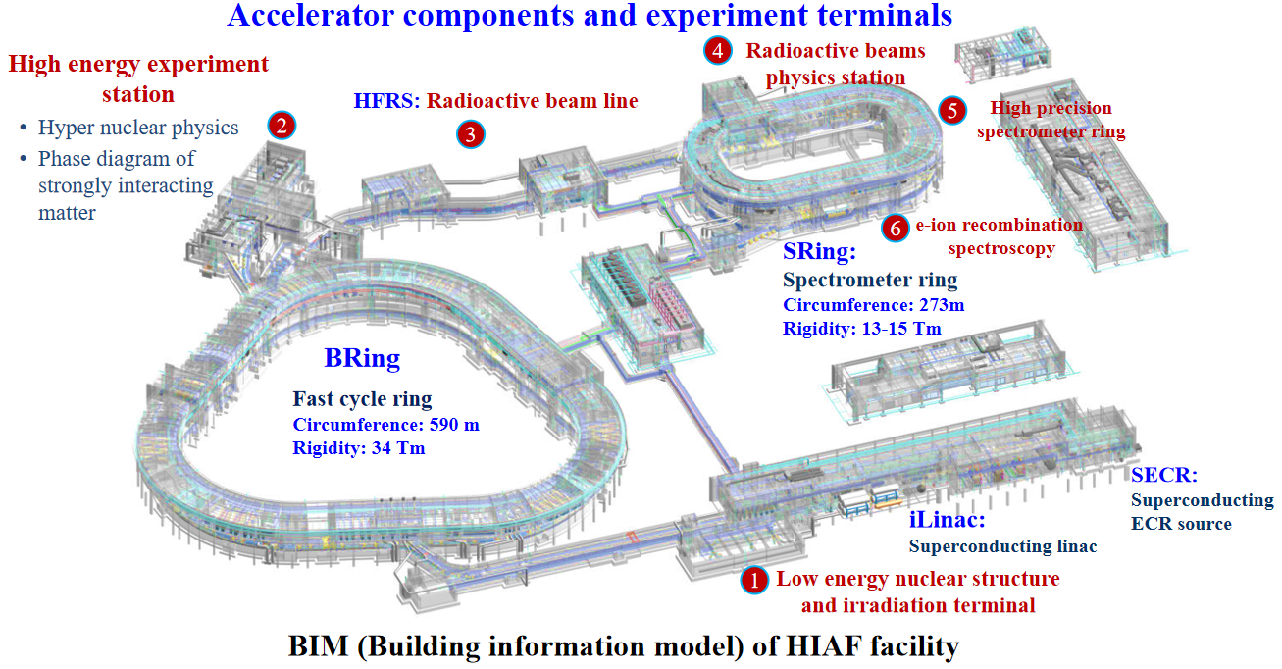
Layout of HIAF
Mass measurements of short-lived exotic nuclei, Rare Isotope Beam (RIBs) experiments, the internal target experiments.
Notes:
This is the layout of HIAF. Stochastic cooling will be built on Sring.

Slide 4
Cooling operation on the S-Ring
after injection
after bunch rotation
after compression
BRing
after the target
HFRS
SRing
Δp/p
Δp/p
Δp/p
Δp/p
±0.36%
±2.0%
±1.5%
±0.4%
L
L
L
L
extraction
injection
0.26 μs
0.26 μs
0.26 μs
1.10 μs
Δp/p ε_{x}/ε_{y} 3σ
total cooling time < 2.3 s
precooling
Electron-Cooling
SRing
Stochastic Cooling
SRing
Δ p/p: ±0.025% → ± 0.001%
ε_{x}/ ε_{y}: 5 π mm·mrad → 0.1 π mm·mrad
Δ p/p: ±0.40% → ±0.025 %
ε_{x}: 120 π mm·mrad → 5 π mm·mrad
ε_{y}: 40 π mm·mrad → 5 π mm·mrad
electron cooling
cooling time<1.0 s
cooling time<1.2 s
Stochastic cooling will be performed to reduce the emittance to less than 5 pi mm.mrad, and Dp/p of 4.0e-3 to 2.5e-4 within 1.2 s for these RI beams.
Notes:
The RI beams from HFRS after the production target will have large momentum spread of ±1.5×10⁻² (2σ). If stochastic cooling is used for such kind beams, the cooling frequency should be small to have large acceptance. However bunch rotation is proposed to decrease the momentum spread to ±4.0×10⁻³ (2σ) at first. Then stochastic cooling will be performed to reduce the emittance to less than 5 p mm.mrad, and Dp/p of 4.0e-3 to 2.5e-4 within 1 s for these RI beams. After the stochastic pre-cooling, the subsequent electron cooling will further cool down the emittance and Dp/p within 1 s to get extremely well-cooled beams.

Slide 5
Motivation for stochastic cooling on the S-ring; requirements by physics
Precooling of the radio isotope beams
Beam energy: 400 MeV/u-740 MeV/u (β: 0.71-0.83)
Number of particles: <1.0e5
Mass number: 100-200
Atomic number: 40-80
Lifetime: seconds
Before cooling: εH=200 π mm mrad, εV=40 π mm mrad,
Δp/p=±4.0e-3 (±3σ)
After cooling: εH,V=6.25 π mm mrad, Δp/p=±3.6e-4 (±3σ)
εH,V=1.25 π mm mrad, Δp/p=±6.0e-5 (1 σ)
Cooling time < 1.2 s
Notes:
For the nuclear physics, St cooling will be used to provide a fast precooling technique for radioactive fragment beams with a large phase space, which is very similar to CSRe. For the energy range, they changed from the energy range of 0.8-0.85 to below 400 MeV/u now. For our design, we consider all those energies, from 400 MeV/u to 800 MeV/u. …….

Slide 6
Comparison of TOF and notch filter momentum acceptance at 400 MeV/u (beta = 0.71)
For the beam energy below 400 MeV/u, 1-2 GHz can not be used, the cooling frequency should be below 1.2 GHz
SRing operating bandwidth: 0.6-1.2 GHz
Notes:
But for the low energy beam, for 400 MeV/u, the acceptance of tof cooling is smaller than the beam momentum spread if the cooling bandwidth is 1-2 GHz. So we changed to 0.6-1.2 GHz where the beam spread fits inside the acceptance of the TOF cooling system

Slide 7
Outlines
Development of stochastic cooling components for HIAF Spectrometer-Ring (High Intensity heavy-ion Accelerator Facility)
  Motivation for stochastic cooling on the SRing requirements by physics
  SRing pickup/kicker optimization and test with beam on CSRm
  Notch filter evaluation for SRing stochastic cooling
  Broadband phase shifter development for stochastic cooling

Slide 8
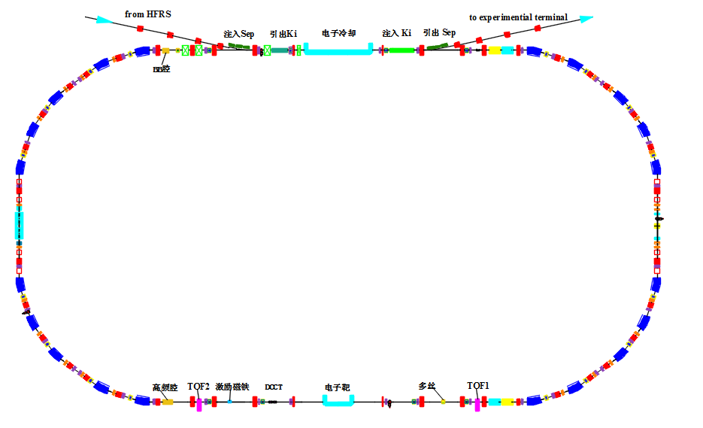
Layout of the PU and kicker of SRing stochastic cooling
From HFRS(HIAF Fragmentation Separator)
2m+2m
Electron cooler
PU1
PU2
Circumference：277.3 m
H cooling
V cooling
combiner
L cooling
μ _{pu-k H} | μ _{pu-k V}
451.9° | 266.4°
kicker
Electron target
2m+2m
Notes:
This is the layout of the Sring stochastic cooling. Not like CSRe stochastic cooling, this time space is reserved in advance for SRing stochastic cooling, 4 m for pickups and 4 m for the kickers. All of them are in straight sections without dispersion. This can prevent the coupling between the phase subspaces, especially the transverse heating due to the longitudinal kicks. It is planned to have 2 pickup tanks and 2 kicker tanks which can perform both transverse and longitudinal cooling. The betatron advances from pickup to kicker are almost 90 degree for both horizontal and vertical cooling.

Slide 9
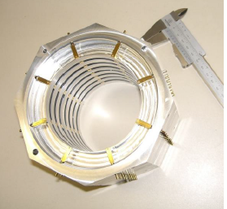
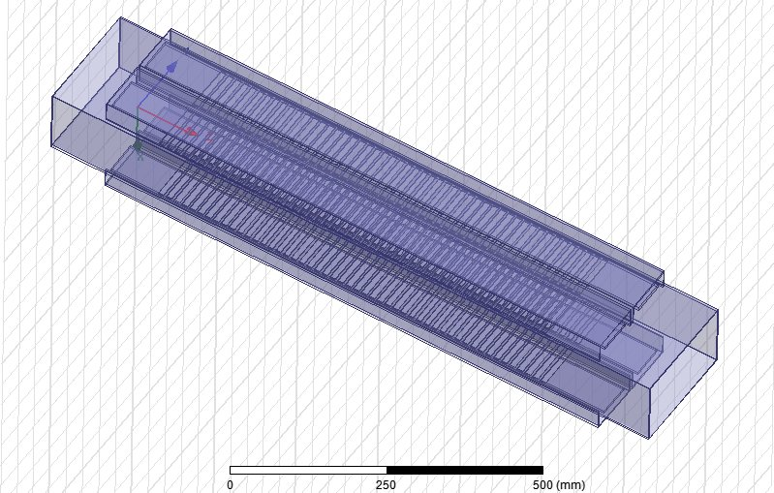
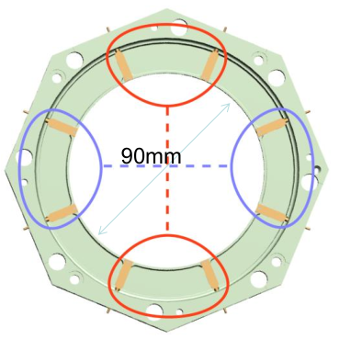
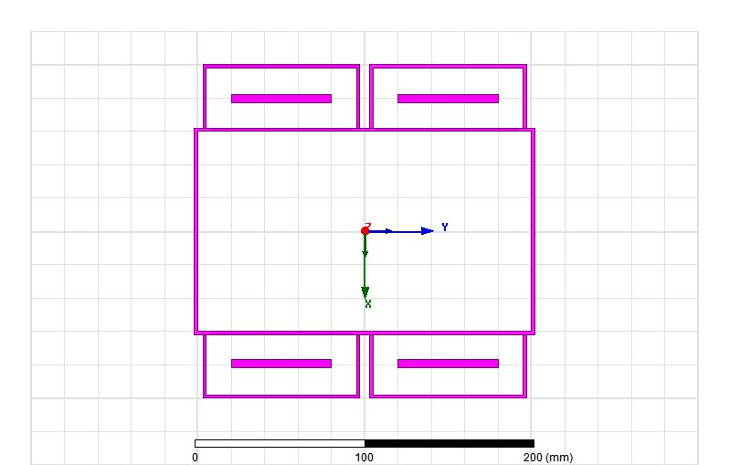
Pickup/kicker structure considered
Slot-ring structure: standing wave
Used in FAIR HESR stochastic cooling
Faltin structure: travelling wave
(beta =0.71)
Pickup for SRing
Kicker for SRing
Proposed by Rolf and Lars
Aperture

Slide 10

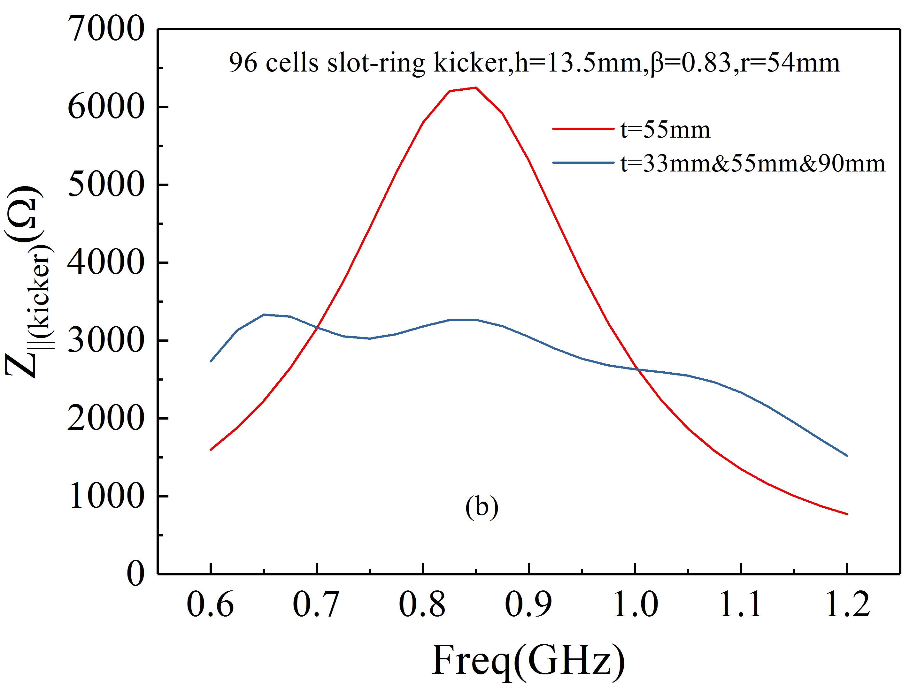
Slot-ring as pickup for SRing
Simulation：HFSS
Longitudinal shunt impedance
A power of 1 W is input into the kicker and the accelerating voltage is determined by integrating the electric field along a particle trajectory above the slots
Pipe diameter = 200 mm, beta = 0.71

Slide 11
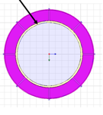
Slot-ring as pickup for SRing
Without ceramic pipe
Pipe diameter D = 118 mm
Pipe diameter D = 200 mm
ceramic pipe inside slot-ring
With ceramic pipe (8 mm thickness)
D = 118 mm
D = 200 mm

Slide 12
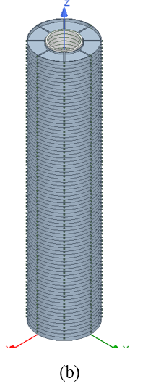
Slot-ring as pickup for SRing
Longitudinal shunt impedance
0.75 m long,
55 cells
0.75 m, 55 cells
Transverse shunt impedance
Pickup transfer impedance
0.75 m, 55 cells
0.75 m, 55 cells

Slide 13
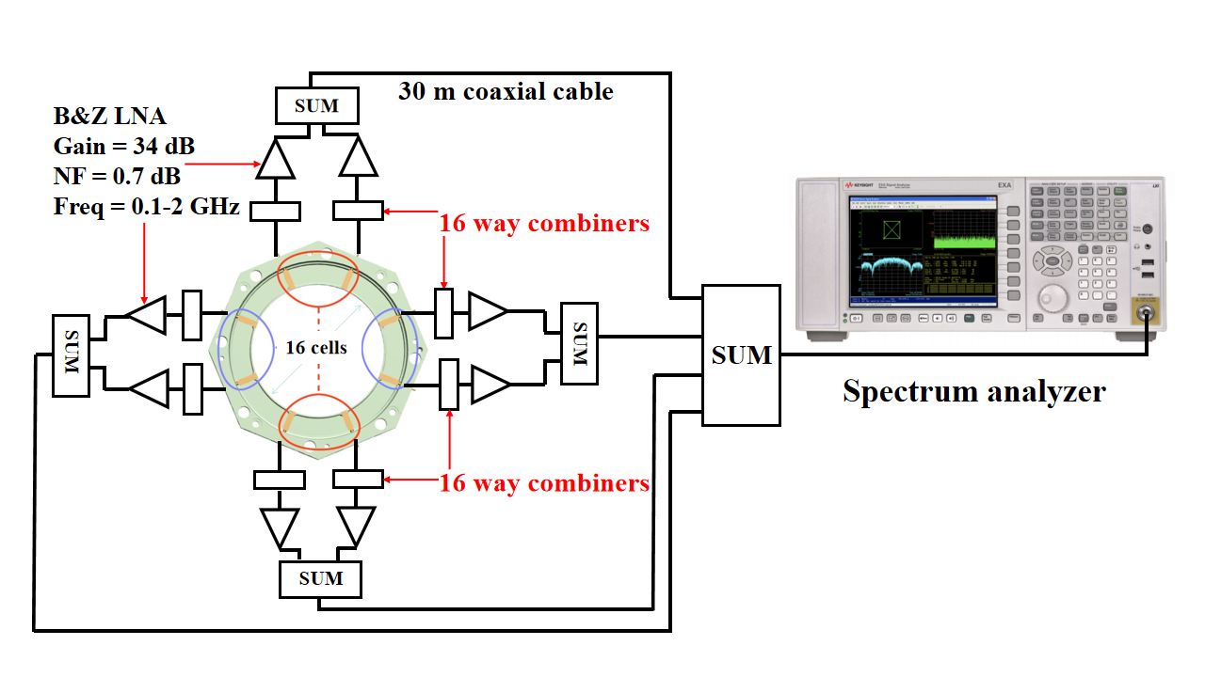
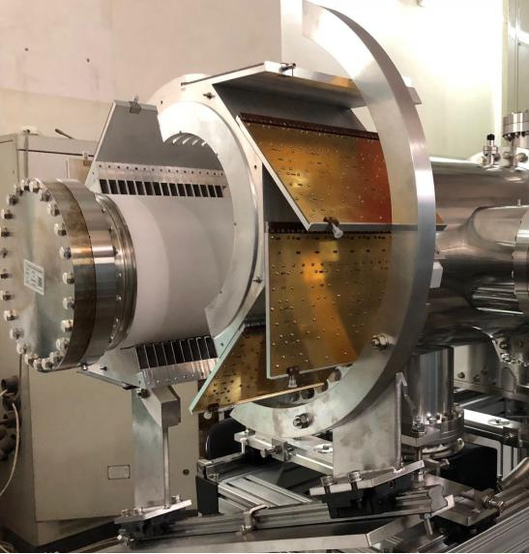
Slot-ring as pickup for SRing
Slot-ring
Combiner
beam test for slot-ring
prototype installed on CSRm
ceramic pipe
β = 0.75
β = 0.63
Guangyu Zhu etal., IEEE Transactions on nuclear science, VOL. 68, NO. 1, 2021

Slide 14
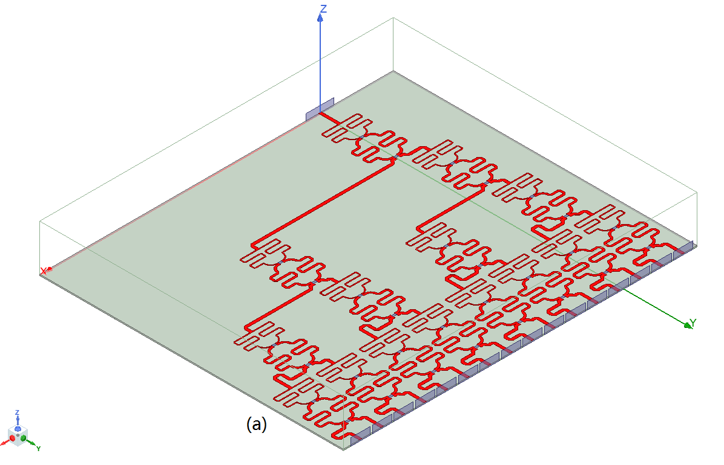
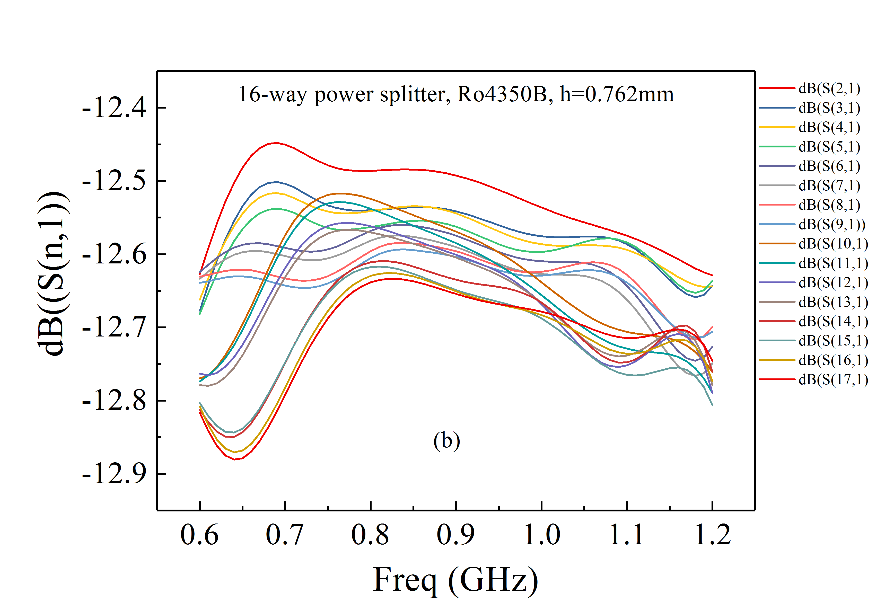
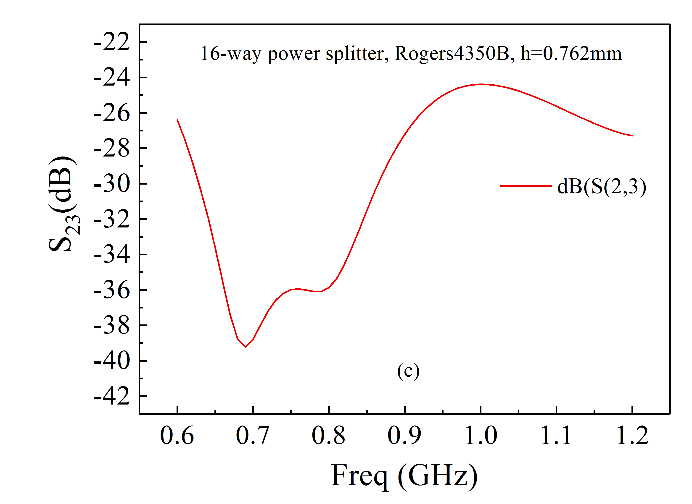
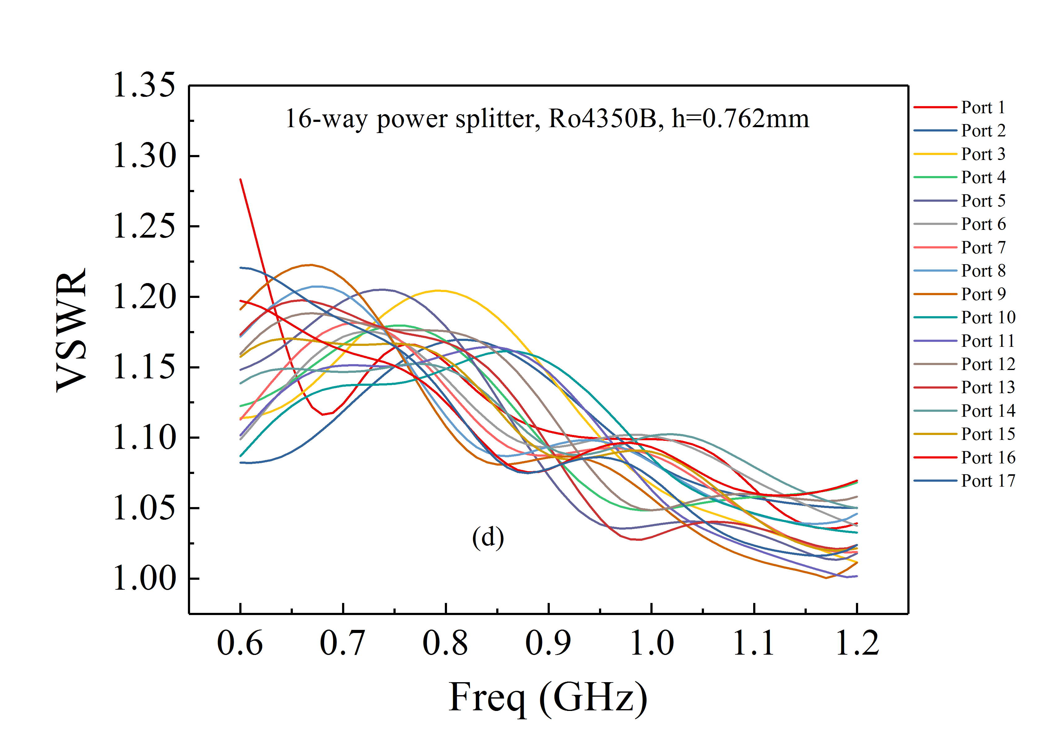
Slot-ring as pickup for SRing- 16 way combiner
Wilkinson 16-way combiner
HFSS simulation
Rogers 4350B
Thickness=0.76 mm
Insertion loss
HFSS model
VSWR
simulation
Isolation simulation

Slide 15
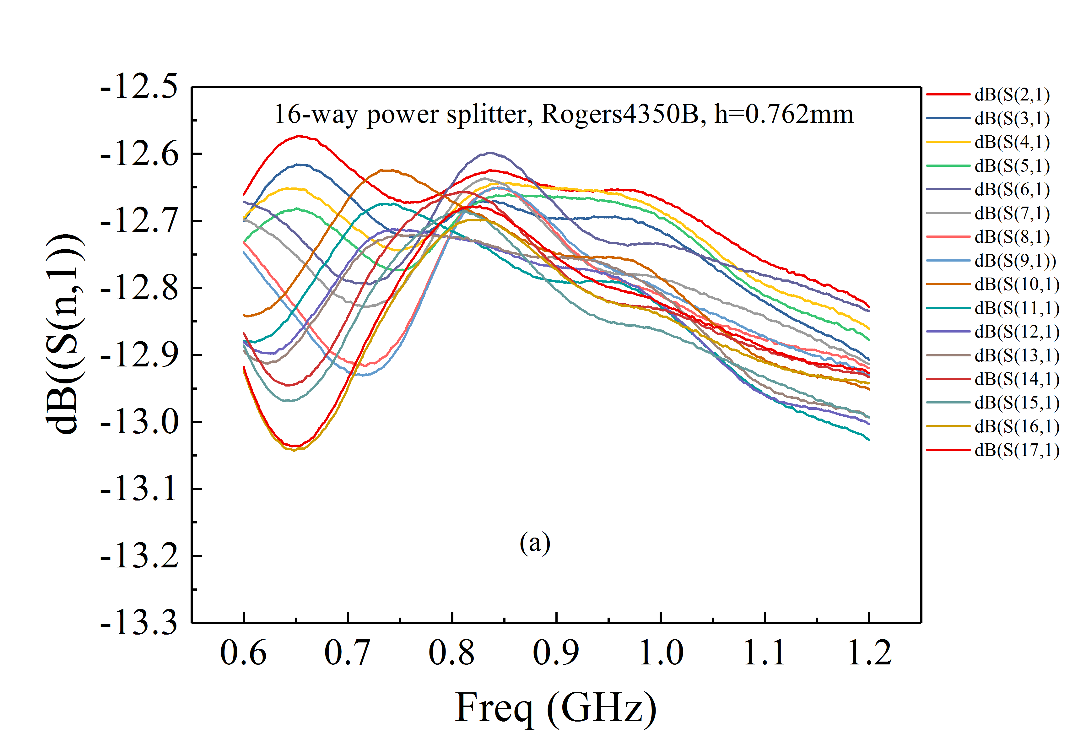
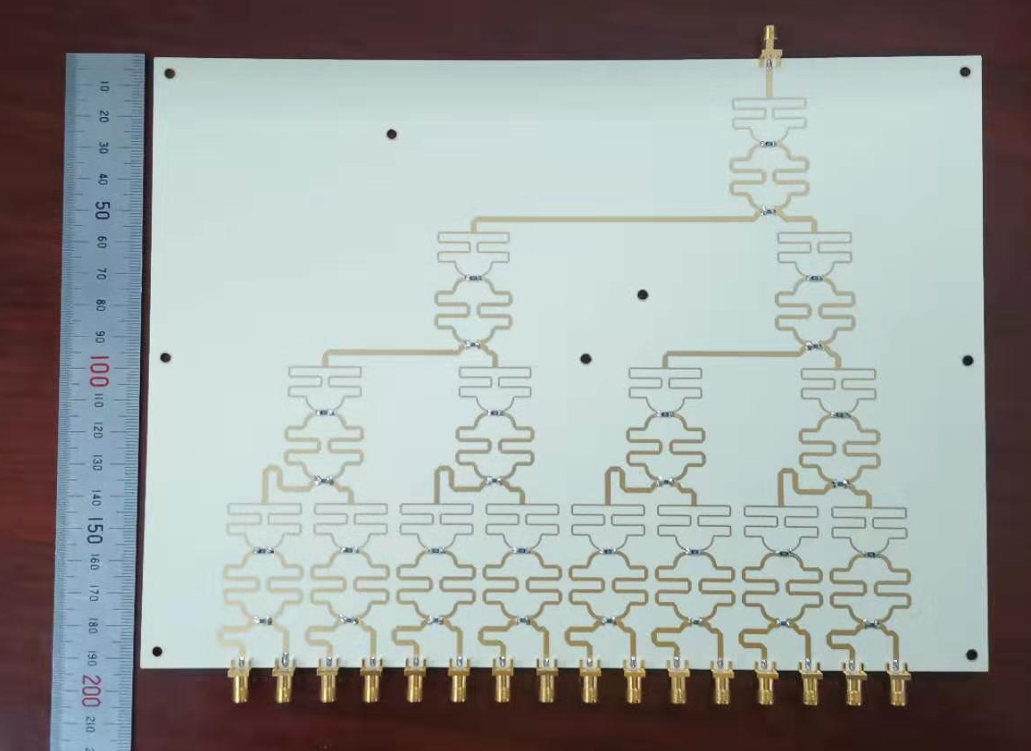
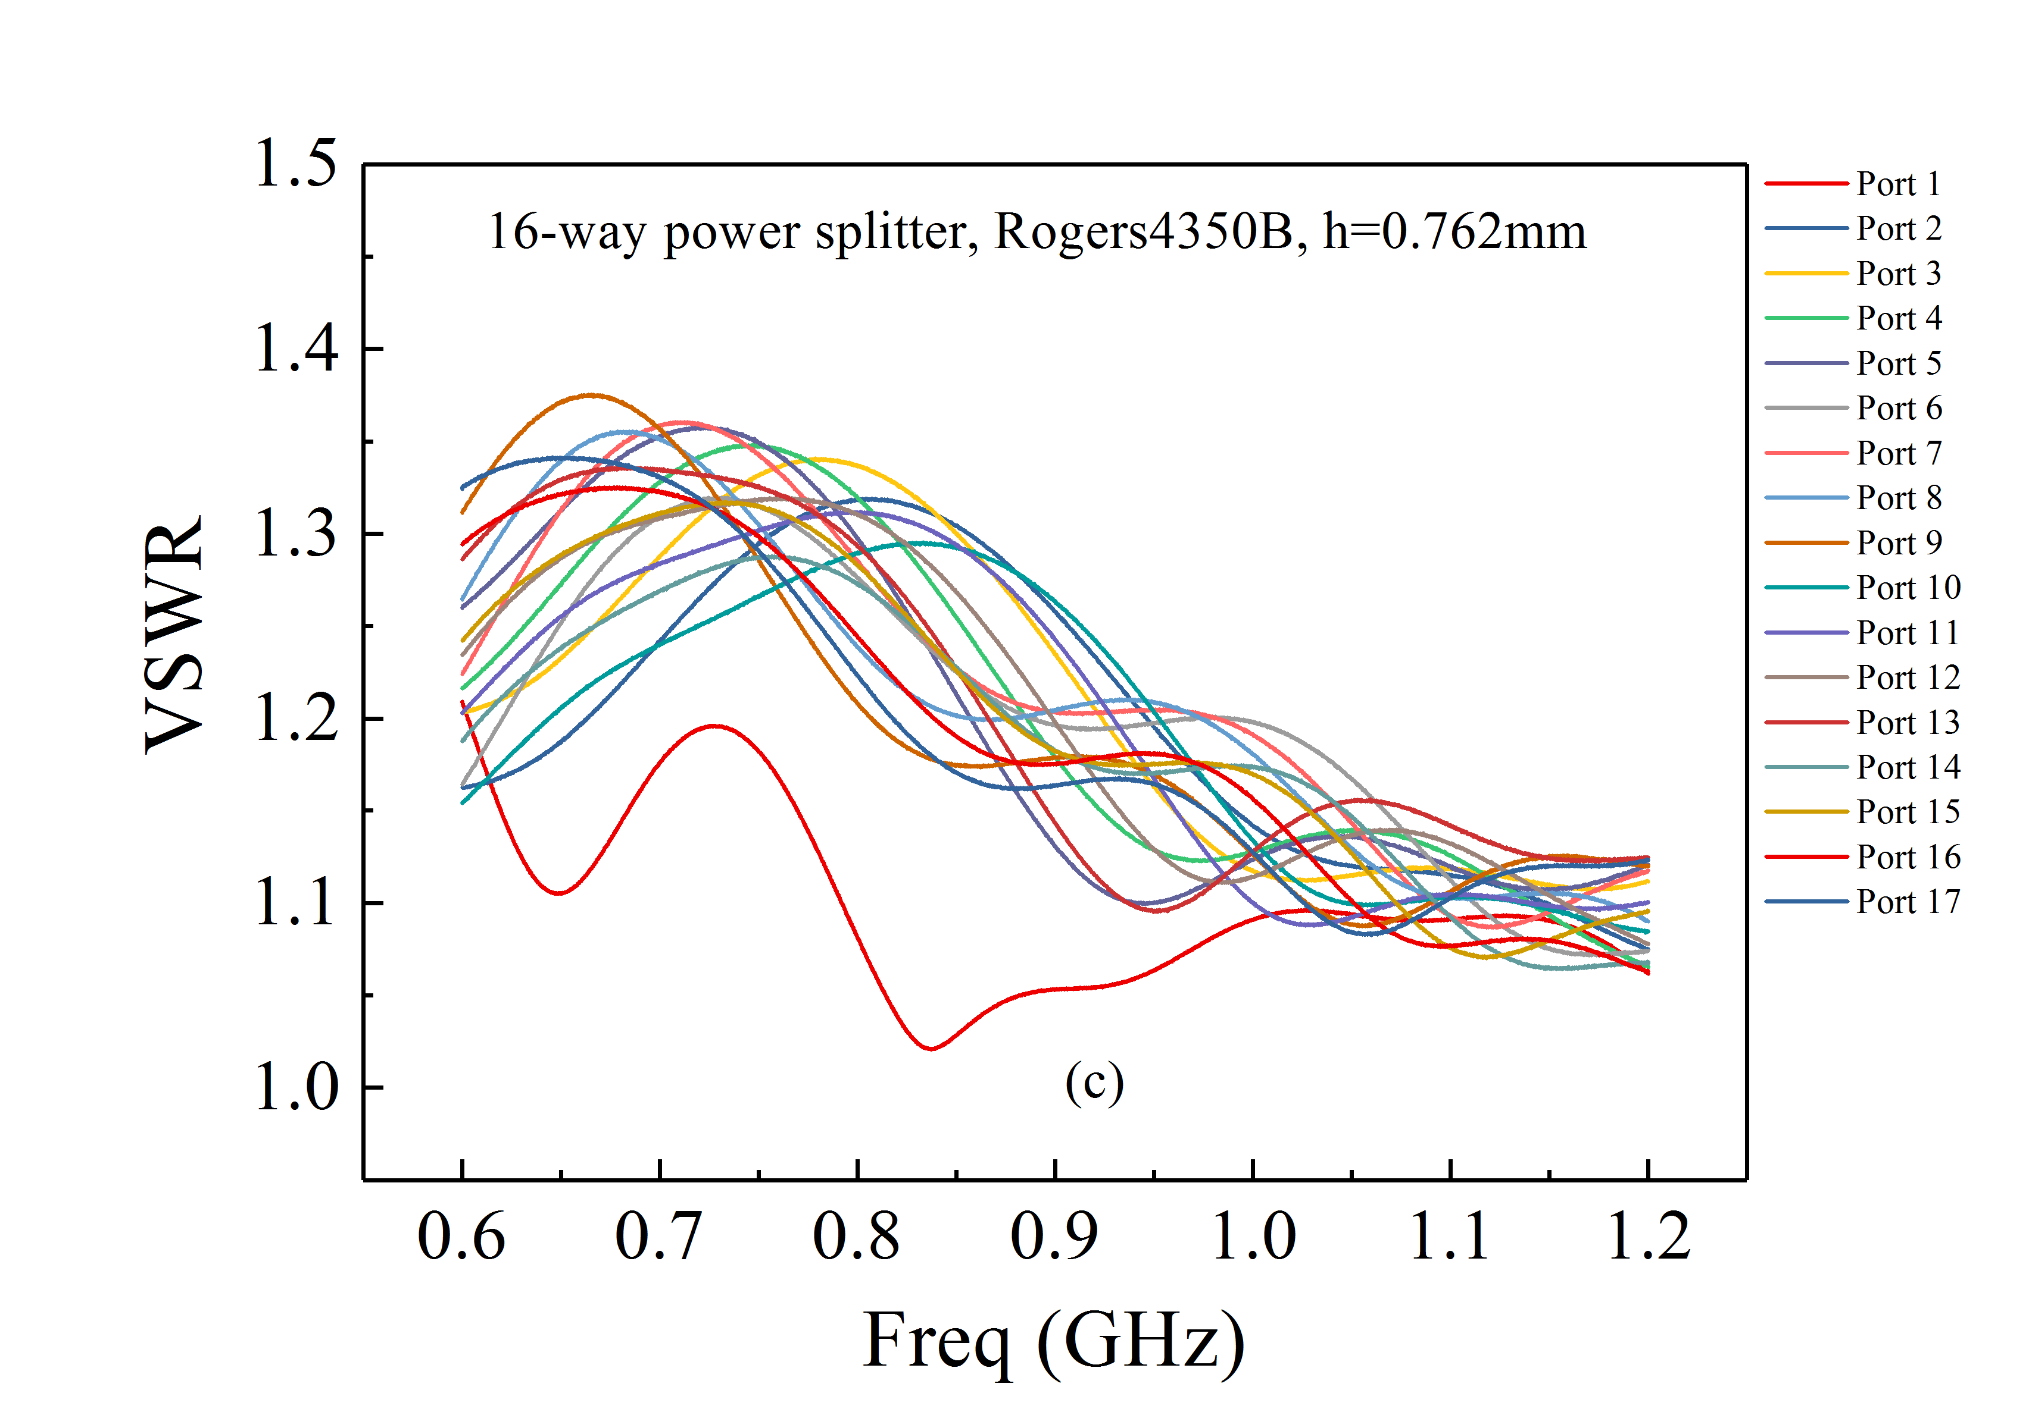
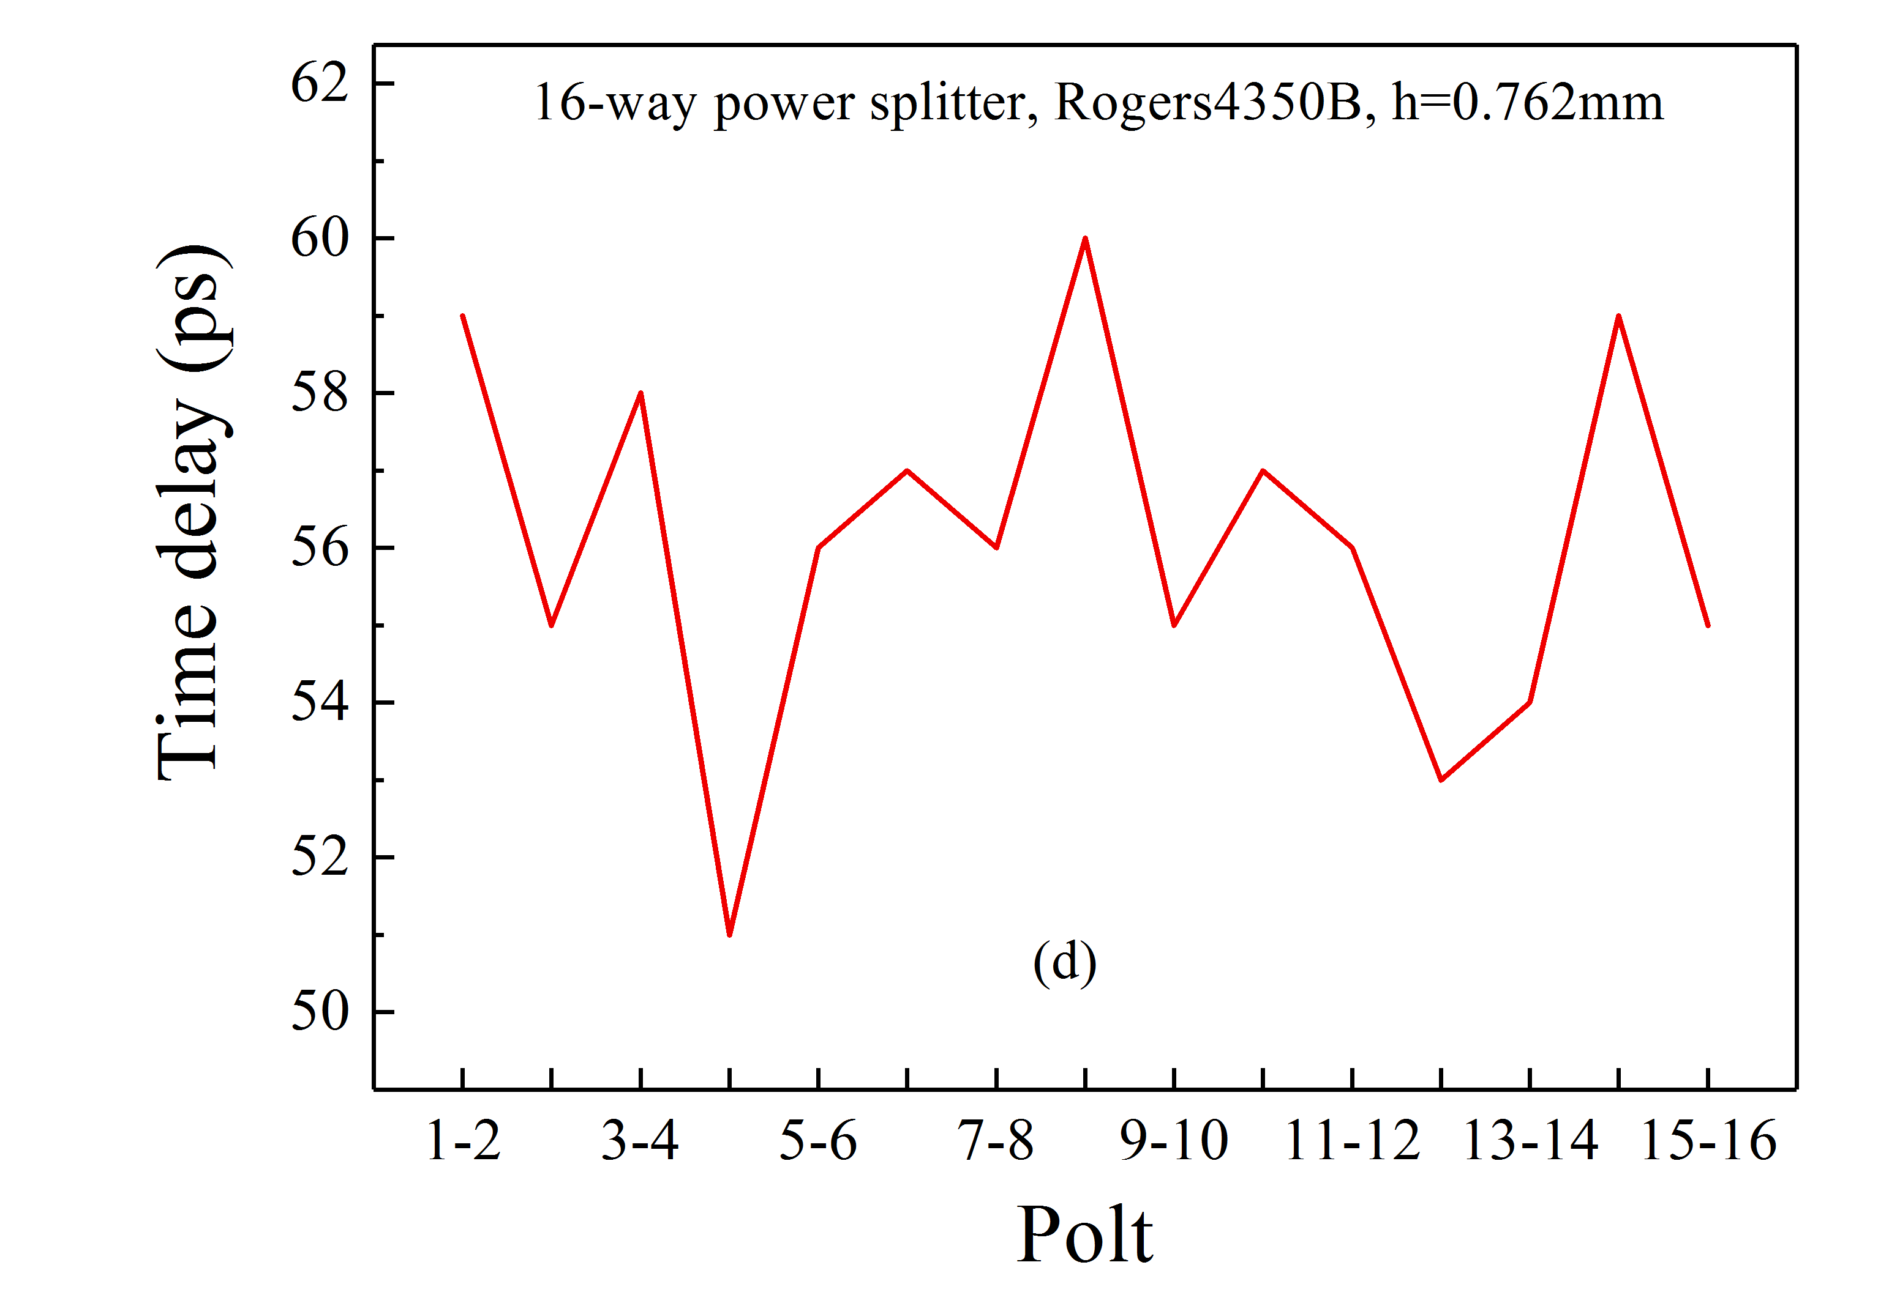
Slot-ring as pickup for SRing-16 way combiner
Insertion loss measurement
16-way combiner prototype
VSWR
measurement
Time delay
measurement

Slide 16
Flatin type as kicker for SRing
3-D diagram with 0.75-m-long rails
Quarter partial HFSS model of Faltin structure
d = 15 mm
d = 12 mm
d = 9 mm
the shunt impedance of the Faltin rail structure is sensitive to the beam velocity beta
When we decrease d, the shunt impedance at a lower frequency improves, however, the peak value of shunt impedance deteriorates at higher frequencies

Slide 17
Flatin type as kicker for SRing
Horizontal pickup
transfer impedance
Horizontal shunt impedance
0.75-m long Faltin structure
Vertical pickup
transfer impedance
Vertical shunt impedance

Slide 18
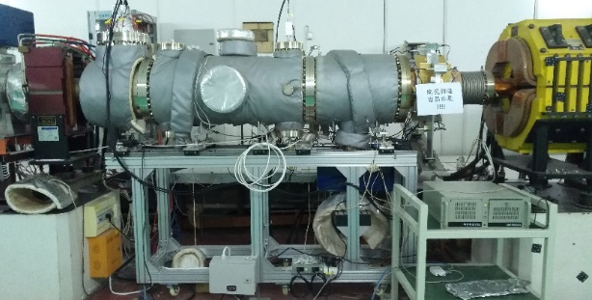
Flatin type as kicker for SRing
Flatin prototype has installed on CSRm for the beam test
β = 0.75
β = 0.63
Guangyu Zhu etal., IEEE Transactions on nuclear science, VOL. 68, NO. 1, 2021

Slide 19
Outlines
Development of stochastic cooling components for HIAF Spectrometer-Ring (High Intensity heavy-ion Accelerator Facility)
  Motivation for stochastic cooling on the SRing requirements by physics
  SRing pickup/kicker optimization and test with beam on CSRm
  Notch filter evaluation for SRing stochastic cooling
  Broadband phase shifter development for stochastic cooling

Slide 20
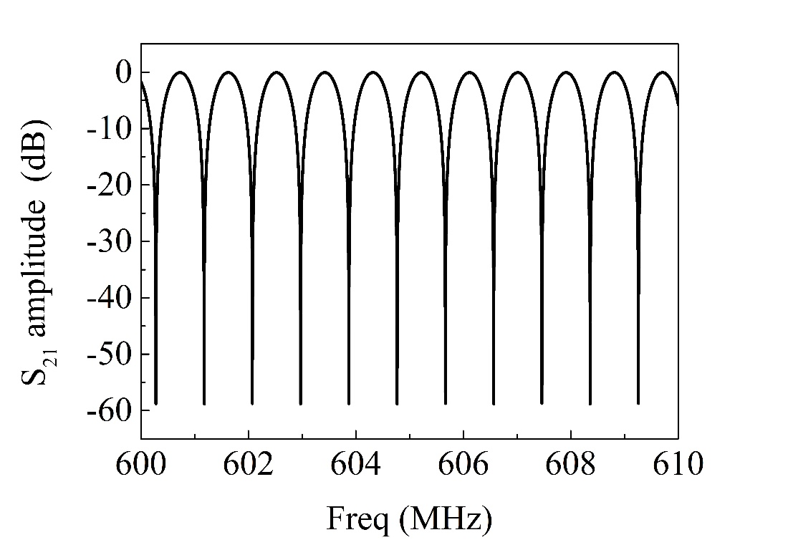
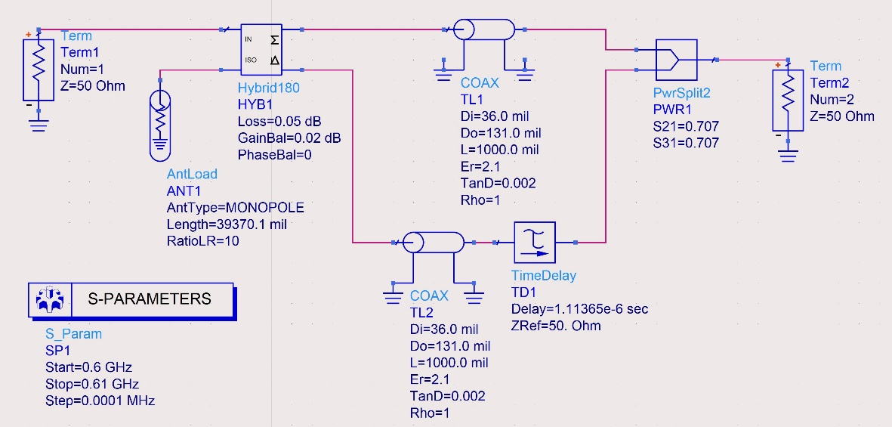
Notch filter for longitudinal cooling
TOF method: is used as a first step to pre-cool
Notch filter method: subsequently used to attain the lower momentum spread
Larger notch depth
Lower frequency drift
compact structure
Schematic drawing of an ideal notch filter
ADS S parameter simulation schematic diagram
Notch depth VS frequency

Slide 21
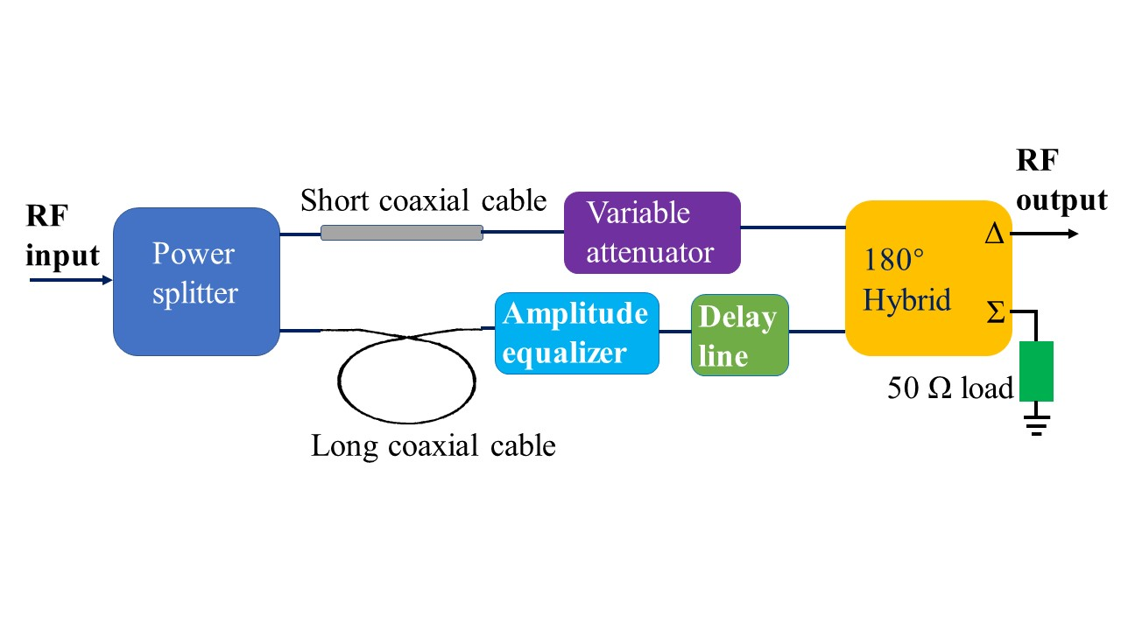
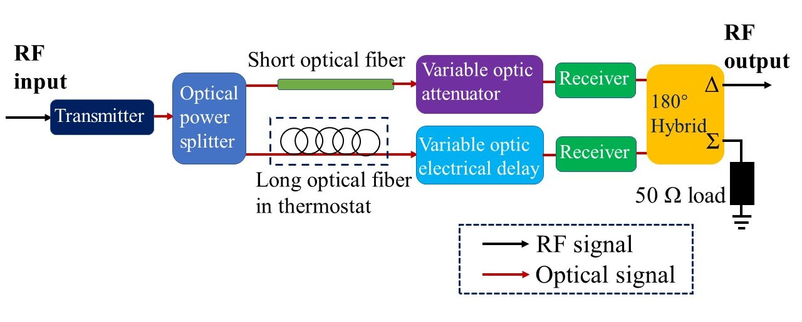
Notch filter for longitudinal cooling
Type Ⅰ: Coaxial notch filter with an amplitude equalizer
Type Ⅱ: Optical notch filter with phase-stabilized optical fiber
Guangyu Zhu etal., Review of Scientific Instruments, 94, 093302 (2023)

Slide 22
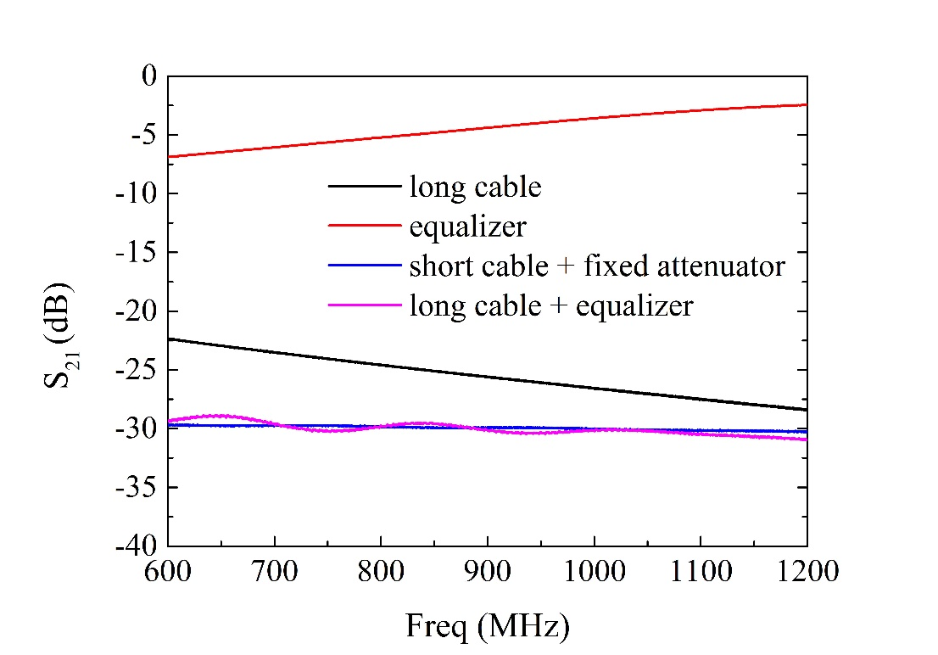
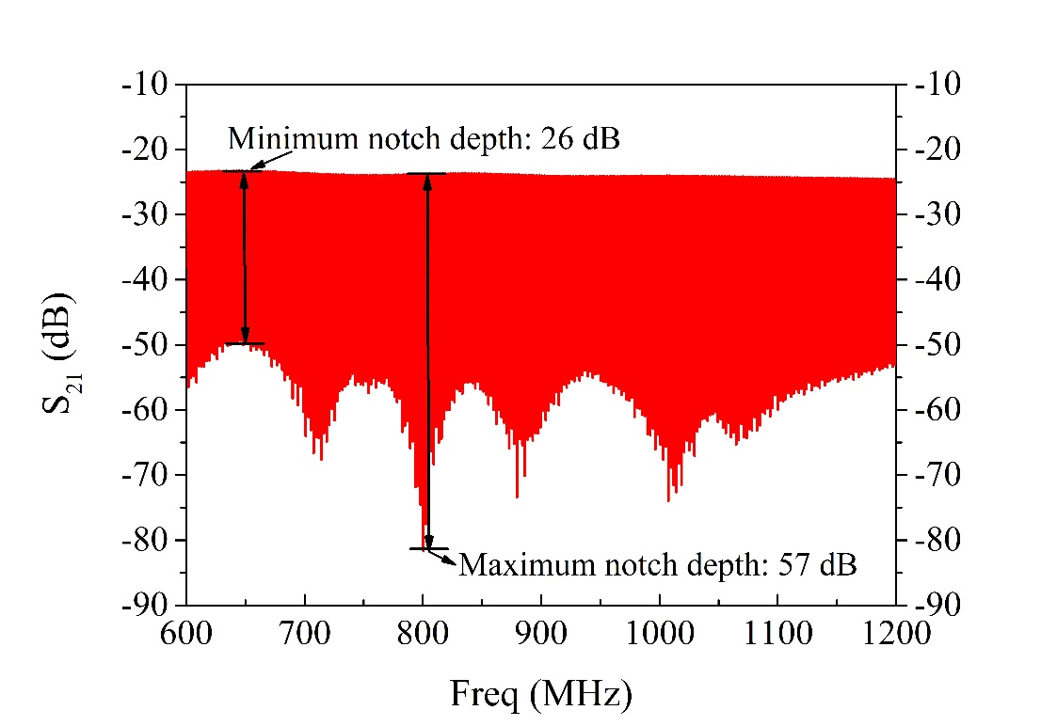
Notch filter for longitudinal cooling
Type Ⅰ: Coaxial notch filter with an amplitude equalizer

Slide 23
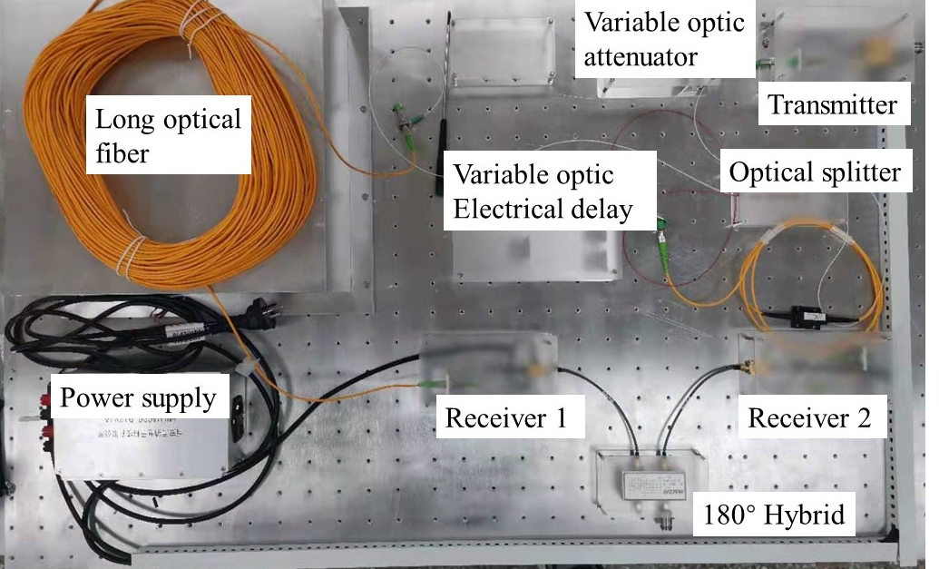
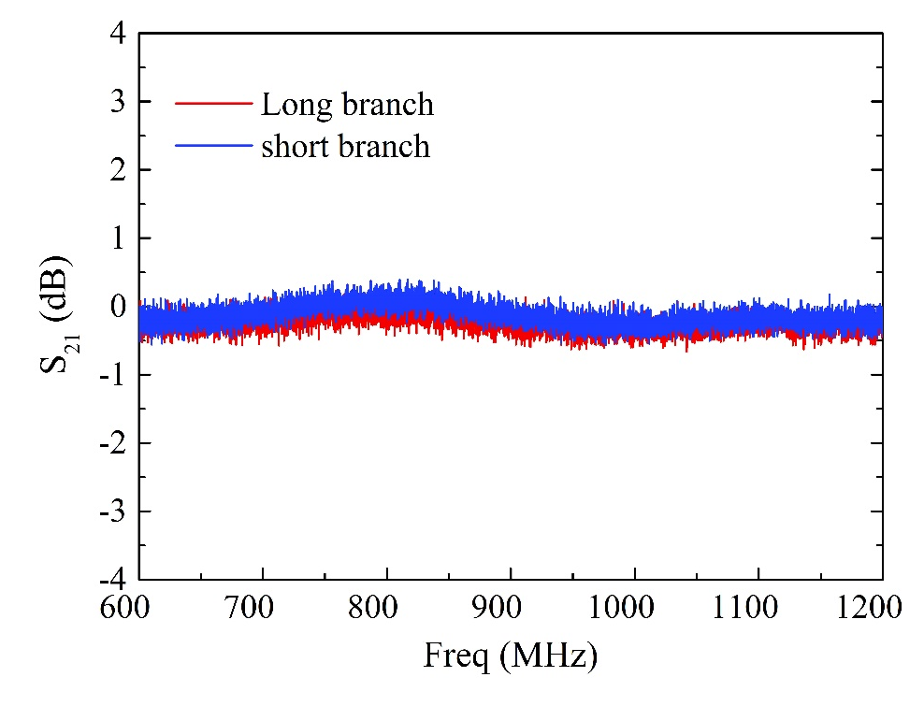
Notch filter for longitudinal cooling
Type Ⅱ: Optical notch filter with phase-stabilized optical fiber

Slide 24
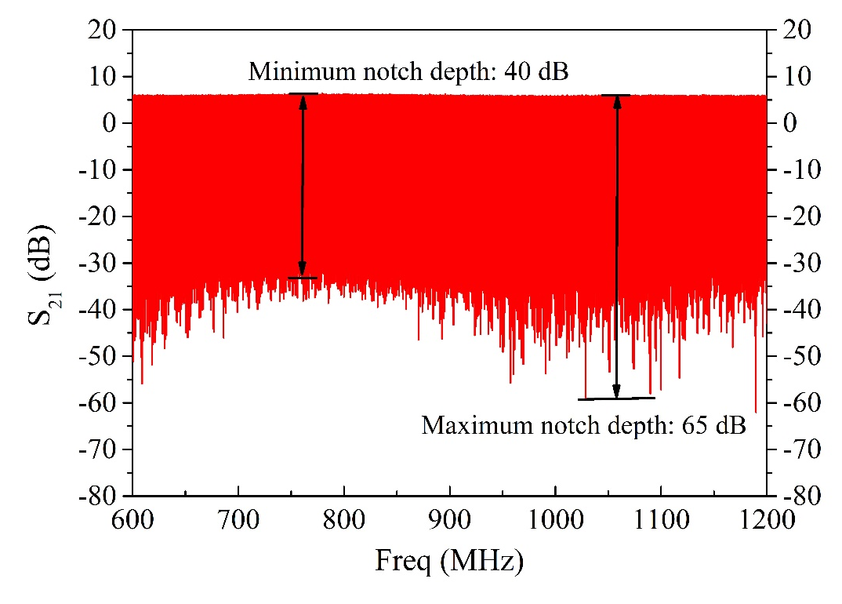
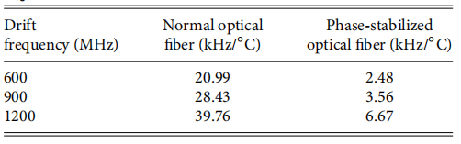
Notch filter for longitudinal cooling
Type Ⅱ: Optical notch filter with phase-stabilized optical fiber
Notch frequency drift of two types of optical fibers including both 223 m normal and phase-stabilized optical fiber in the long branch.
at least a factor of 6 is improved!
COOL’23, Montreux, 09-13 Oct,2023

Slide 25
Comparison of two type notch filters
 | CERN AD Coaxial-type | HIRFL CSRe Coaxial-type | HIAF SRing Coaxial-type | HIAF SRing Optical-type
The minimum notch depth (dB) | 20 | 15 | 26 | 40
The maximum notch depth (dB) | 30 | 35 | 57 | 65
we select the optical notch filter with phase-stabilized optical fiber for the SRing stochastic cooling system with the highest priority
In the next step of this work, the optical fiber notch filter will be installed temporarily on CSRe in the beginning of 2024 to investigate the effect of longitudinal cooling and is planned to be used for experiments with secondary beams

Slide 26
Outlines
Development of stochastic cooling components for HIAF Spectrometer-Ring (High Intensity heavy-ion Accelerator Facility)
  Motivation for stochastic cooling on the SRing requirements by physics
  SRing pickup/kicker optimization and test with beam on CSRm
  Notch filter evaluation for SRing stochastic cooling
  Broadband phase shifter development for stochastic cooling

Slide 27
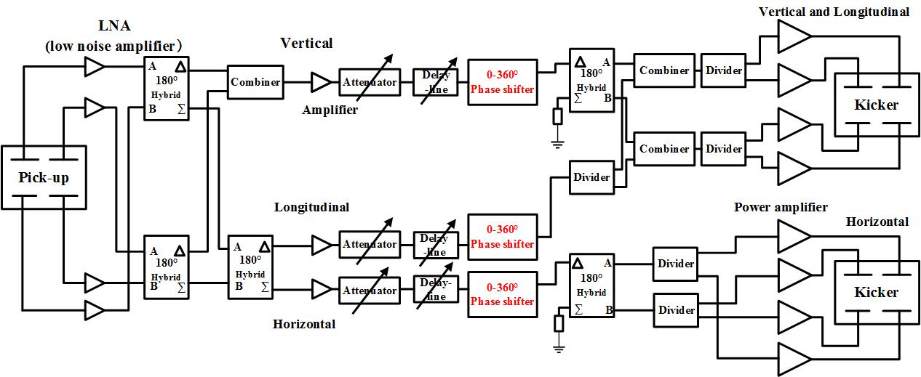
Broadband phase shifter
Broadband phase shifter is one of the critical devices for SRing stochastic cooling system
because it is essential for the correct sign of the momentum correction signal at the kicker

Slide 28
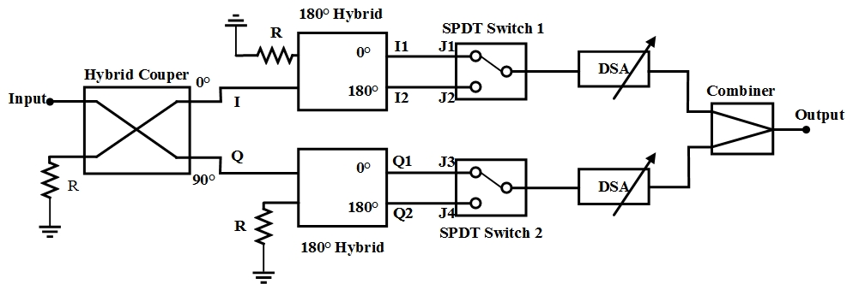
Broadband phase shifter
0.15 - 2 GHz phase shifter consists of:
  a 3 dB 90° Hybrid Coupler
  two 180° Microwave Hybrids
  two program-controlled attenuators (DSA)
  two microwave switches (SPDT)
  combiner
Block diagram of proposed method for the 0°- 360° broadband phase shifter

Slide 29
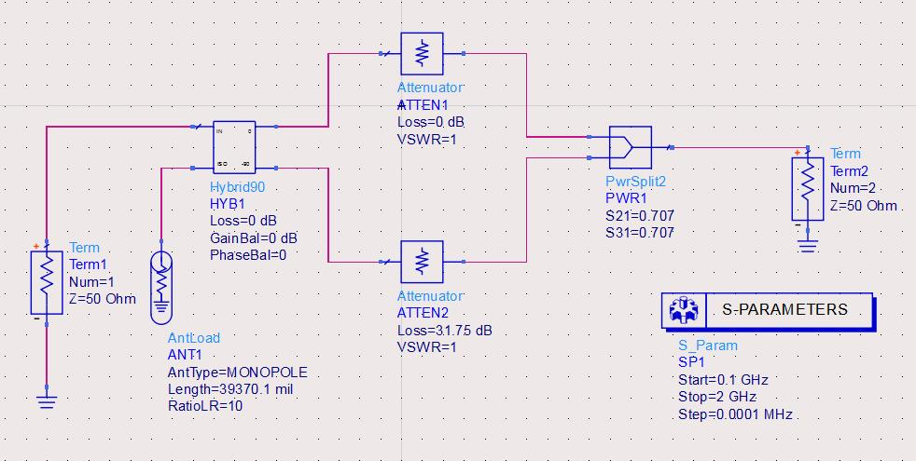
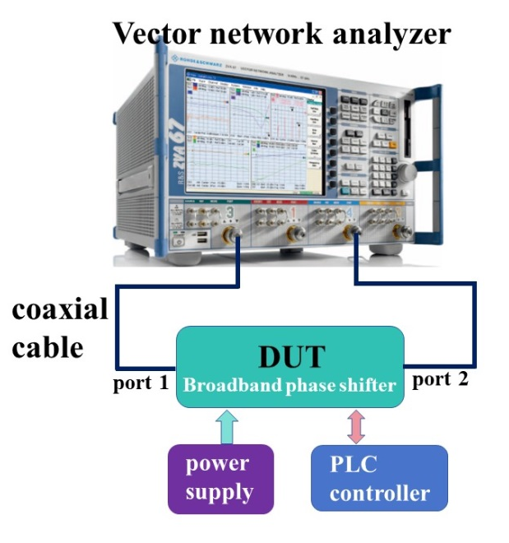
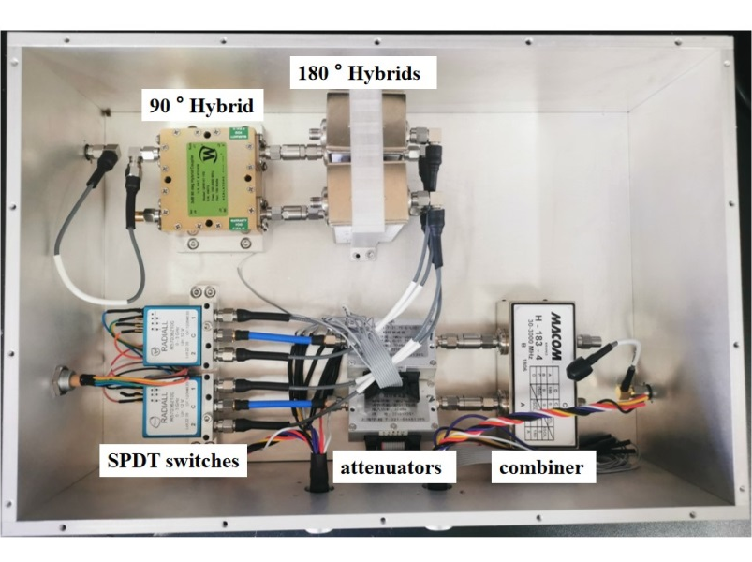
Broadband phase shifter
ADS phase simulation of S₂₁ schematic diagram
Photogragh of the fabricated 0° - 360° phase shifter
phase shifter test block diagram

Slide 30
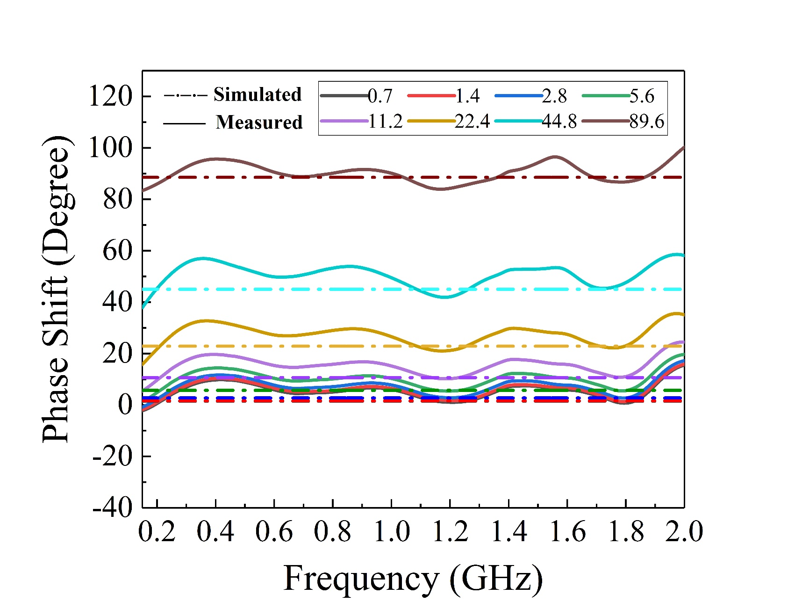
Broadband phase shifter
Measured and simulated main states phase shift of the 9-bit phase shifter

Slide 31
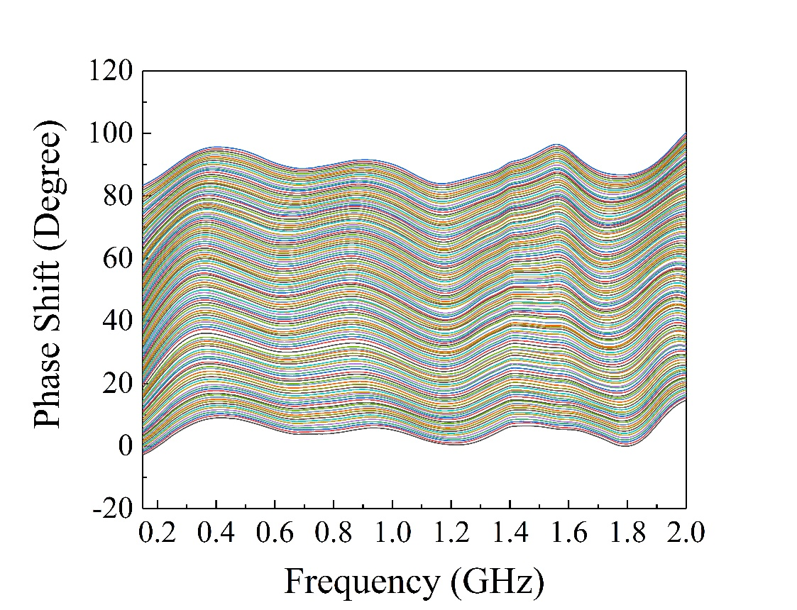
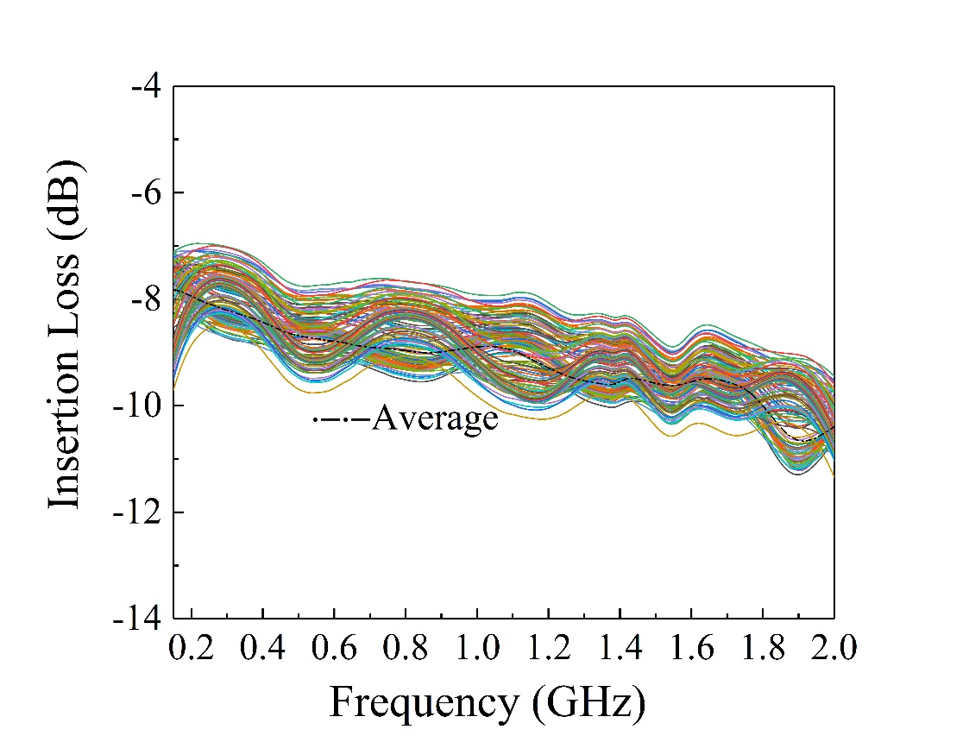
Broadband phase shifter
phase shift
Insertion loss
Measured phase shift and insertion loss of the 9-bit phase shifter with total 128 phase shift states and each phase shift step 0.7°in the range of 0°- 90°

Slide 32
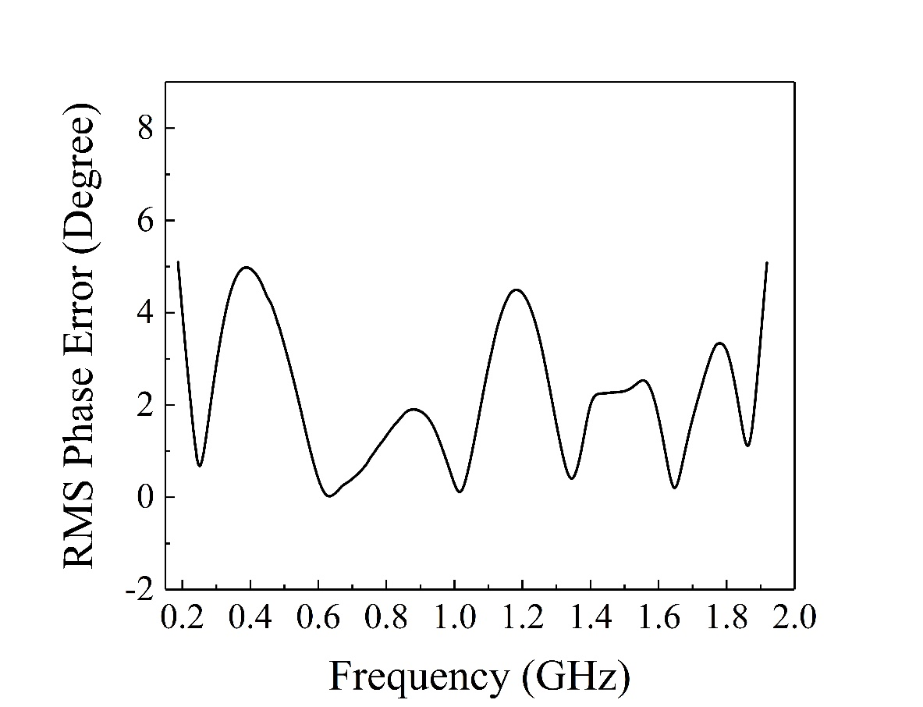
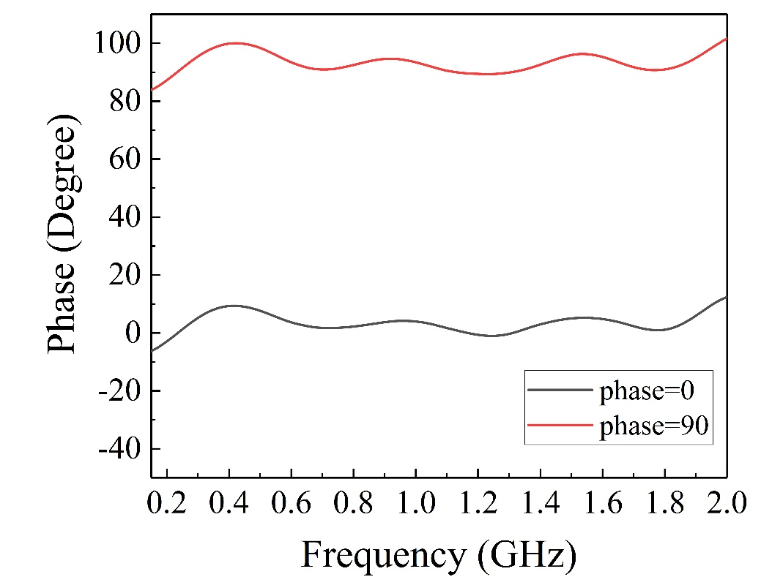
Broadband phase shifter
90°microwave hybrid
From 0.15 GHz to 2 GHz, the RMS phase errors were less than 5°
And the RMS phase error is mainly determined by the phase unbalance of the 90°microwave hybrid
Bandwidth: 0.15 GHz - 2 GHz
Phase shift: 0° - 360°
Insertion loss: 9 dB ± 2 dB
Minimum phase step: 0.7 °
Phase balance:< ± 10°
Phase errors: < 5°
S₁₁: < -15 dB
S₂₂: < -10 dB

Slide 33
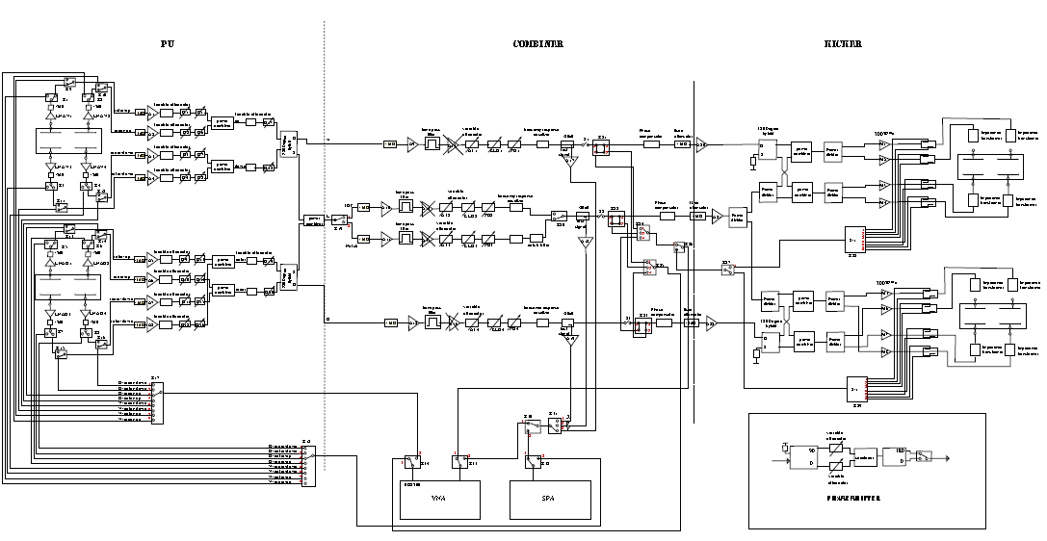
Signal transmission&procession
PU station
Combiner station
Kicker station
Vertical+Longitudinal pick-up
Phase shifter
Power amplifier
V+L kicker
variable attenuator
H+L pick-up
H+L kicker
Diagnostics

Slide 34
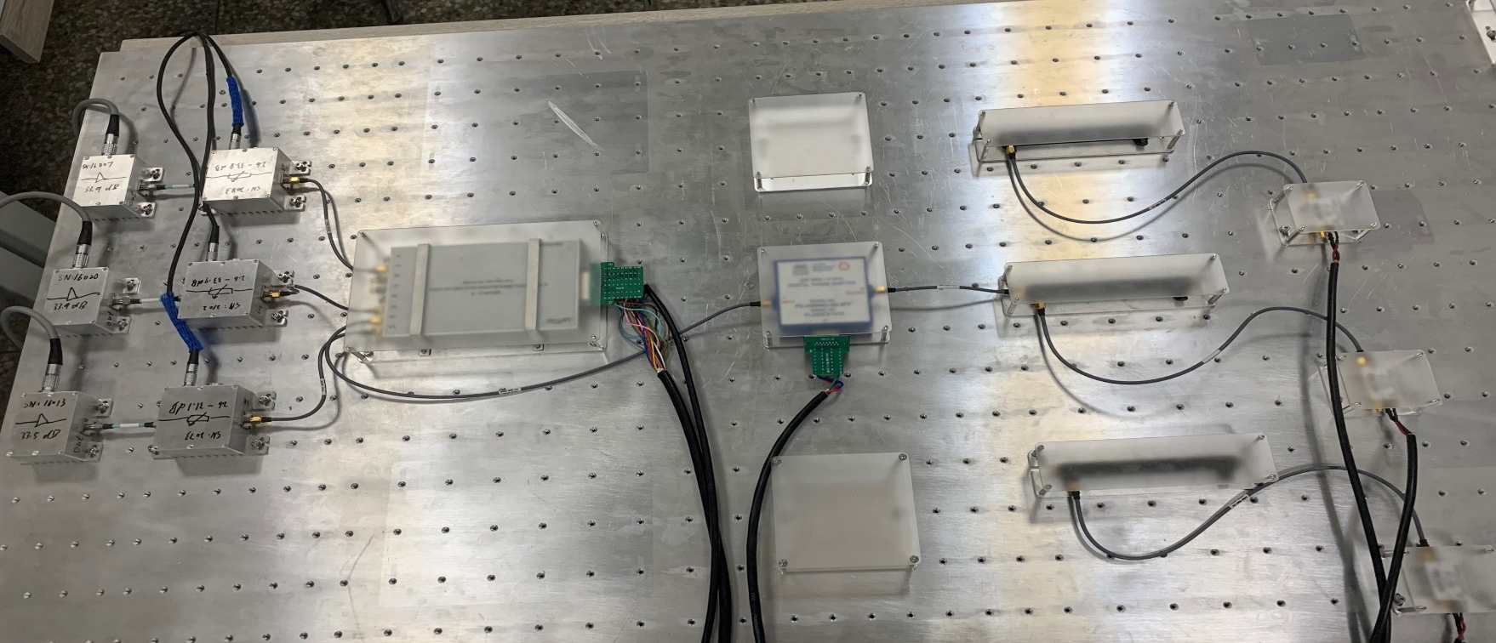
Signal transmission&procession
Partial combiner station hardware
low noise amplifiers
medium
amplifiers
5 ps electrical delay
Phase shifter
attenuators
couplers

Slide 35
Cooling simulation parameters for SRing
Ion 132Sn50+
Kinetic energy 740 MeV/u, 400 MeV/u
Total number of RI 1.0e5, 1.0e8
Initial momentum Δ p/p ±4.0e-3
γ_{t} 3.317
Local γ_{t} 2.568
Bandwidth 0.6-1.2 GHz
Number of slot rings for Pickup 64
Number of slot rings for kicker 128
Number of Faltin pickup (0.75 m) 2
Number of Faltin kicker (0.75 m) 4
Temperature (physical) 300 K
Distance from pickup to kicker 75.25 m
Dispersion at pickup/kicker 0.0 m
Notes:
This is the simulation parameters…..

Slide 36
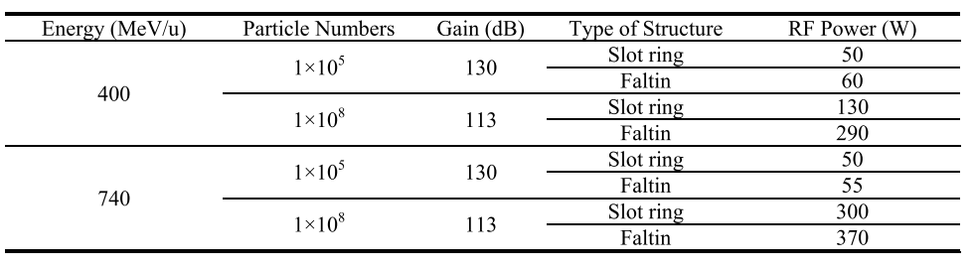
SRing TOF cooling simulation
740 MeV/u, ¹³²Sn⁵⁰⁺ , 0.6-1.2 GHz
400 MeV/u, ¹³²Sn⁵⁰⁺ , 0.6-1.2 GHz
RF power requirement for a ¹³²Sn⁵⁰⁺ beam momentum cooling simulation in the bandwidth 0.6-1.2 GHz

Slide 37
Summary of SRing longitudinal cooling
 | Rare isotope beam 400-740 MeV/u, 1.0e5 ions | Rare isotope beam 400-740 MeV/u, 1.0e8 ions
Before cooling | Δ p/p: ±4.0e-3 εx/ εy: 40 π mm·mrad | Δ p/p: ±4.0e-3 εx/ εy: 40 π mm·mrad
After cooling | Δ p/p: ±2.5e-4 εx/ εy: 5 π mm·mrad | Δ p/p: ±3.0e-4
Total cooling time | 1.0 s | 10 s

Slide 38
Summary
Both a Faltin prototype traveling wave structure and a slot-ring prototype standing wave structure based on a ceramic vacuum chamber are evaluated. We select the slot-ring structure as the pickup and Faltin structure as the kicker of the SRing stochastic cooling system at present.
A coaxial-type notch filter with an amplitude equalizer in the long branch and an optical-type notch filter with phase-stabilized optical fiber are discussed and evaluated. We select the optical notch filter with phase-stabilized optical fiber for the SRing stochastic cooling system with the highest priority.
A 0.15-2 GHz phase shifter with 9-bit phase resolution is built. It can not only be used for both CSRe and SRing stochastic cooling system but also could be used for phased array systems.

Slide 39
Acknowledgements
My acknowledgements to the colleagues who helped us a lot those years for the stochastic cooling:
Fritz Caspers
Rolf Stassen
Lars Thorndahl
Fritz Nolden
……

Slide 40
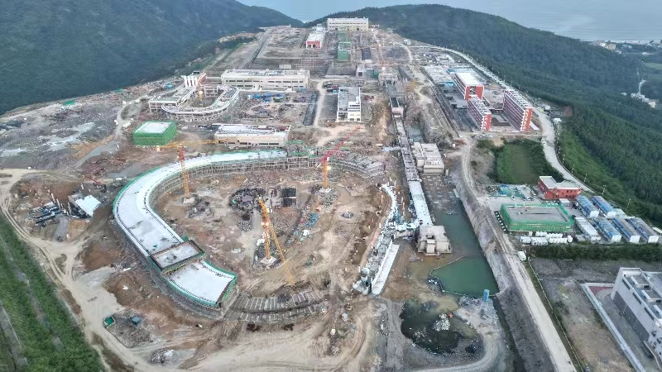
Lastest civil construction for HIAF
2025-Huizhou, HIAF welcome all of you !
2023.09.25

Slide 41
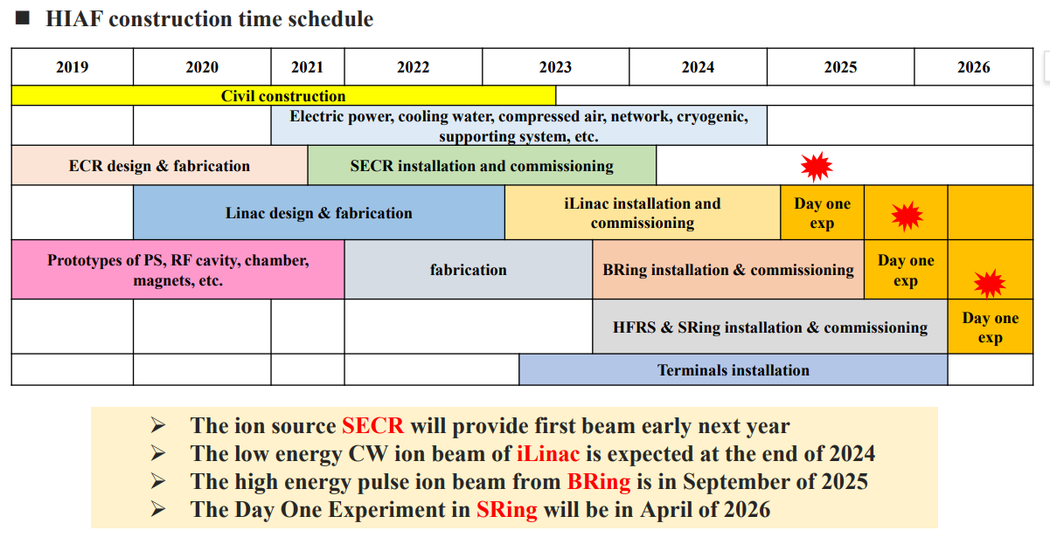
HIAF construction time schedule

Slide 42
Thank you for your attention!
Any comments welcomed!

