Slide 1

A Study of the Wiggler Enhanced Plasma Amplifier for Coherent Electron Cooling
Alexander Zholents, Argonne National Laboratory
Chris Hall, RadiaSoft
COOL 2023 conference, Montreux, Switzerland, October 10, 2023
Notes:
The amplifier plays a significant role in stochastic cooling. However, selection of broadband optical amplifiers is very limited impacting application of optical stochastic cooling. I will show that fast cooling of electrons/positrons can be achieved without the amplifier by a slight modification of a stochastic cooling method.

Slide 2
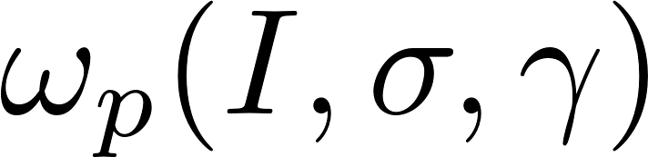
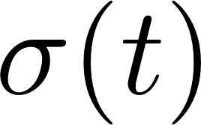
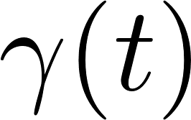
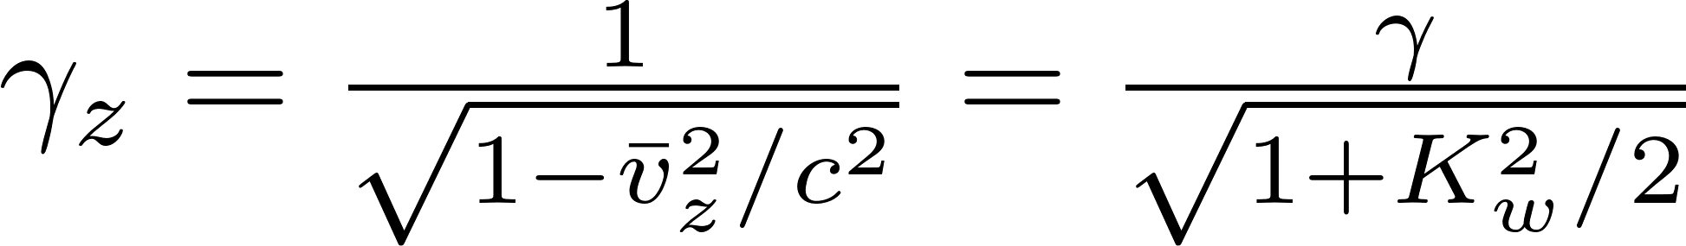
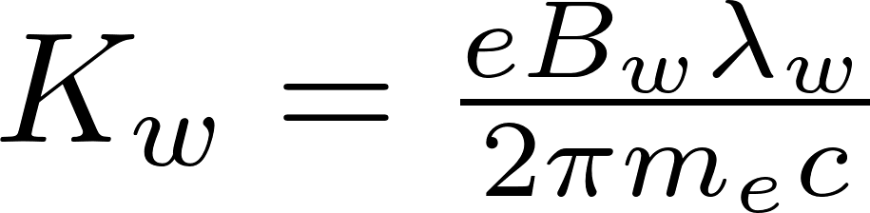
Preamble
The amplifier to be used for Coherent Electron Cooling (CeC)
(V. Litvinenko , Y. Derbenev, Phys. Rev. Lett., 102:114801, 2009)
Plasma Cascade Amplifier (PCA)
Obtain a gain in microbunching by creating a runaway instability of plasma oscillations
(V. Litvinenko et al., Phys. Rev. Accel. Beams 24, 014402, 2021.)
For instability one needs to modulate piecewise
(in a direct analogy to a FODO channel described by Hill’s equation with piecewise periodic coefficients)
Option 1) use
→ Plasma Cascade Amplifier (Litvinenko et al.)
Option 2) use
and
→ Wiggler Enhanced Plasma Amplifier (WEPA, Zholents, Stupakov)
in the wiggler
(G. Stupakov and A. Zholents, 13th Workshop on Beam Cooling and Related Topics, 2021)
Note: WEPA requires separation of ion and electron beams, PCA does not

Slide 3
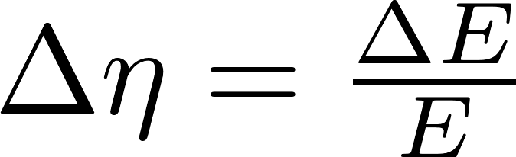
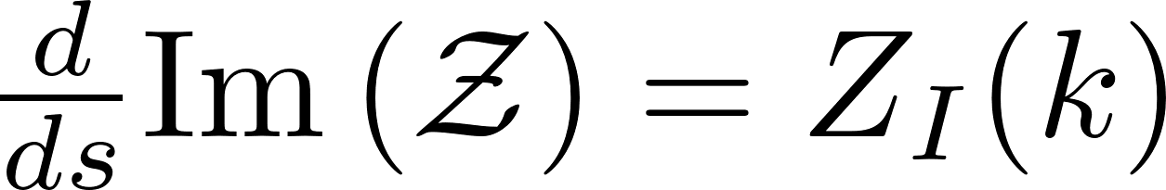
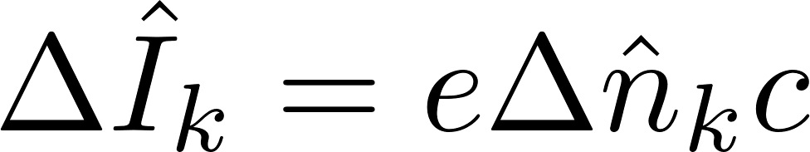
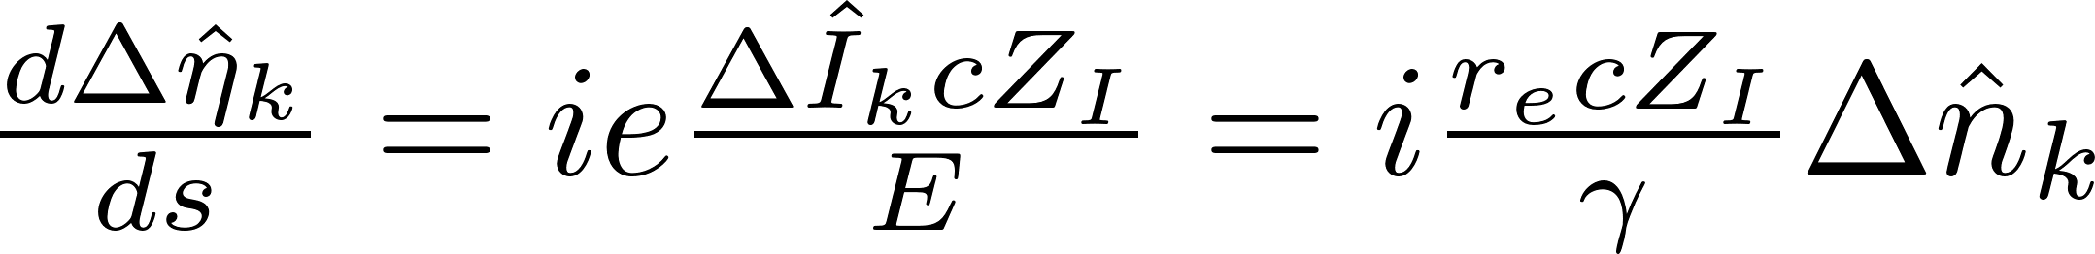
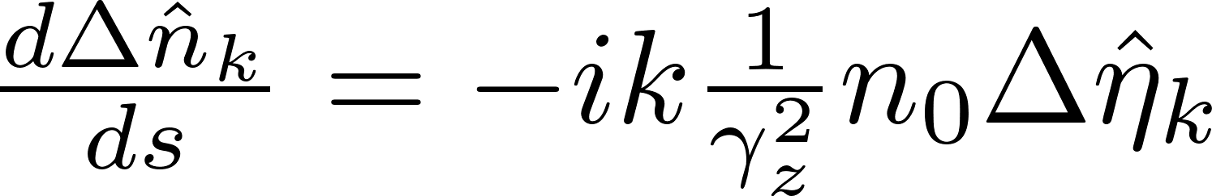
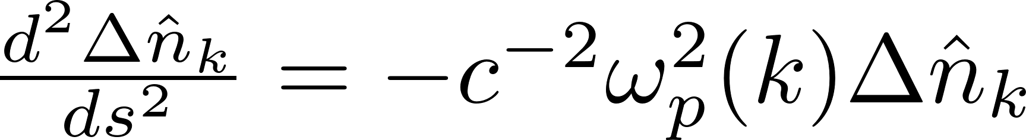
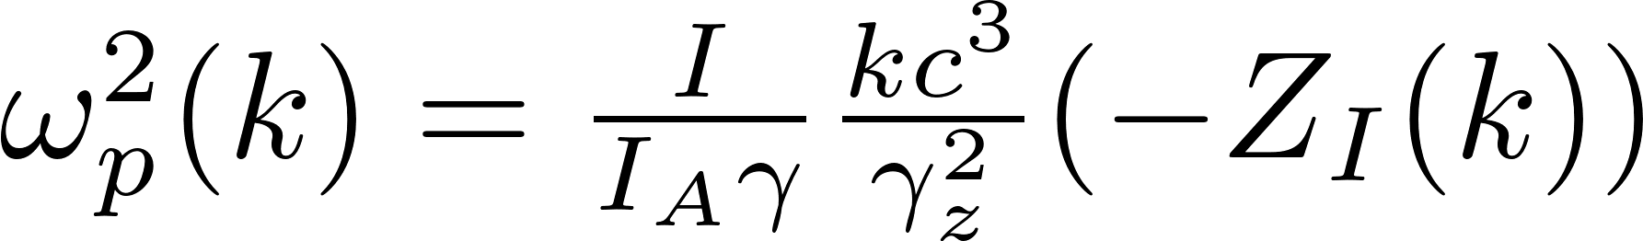
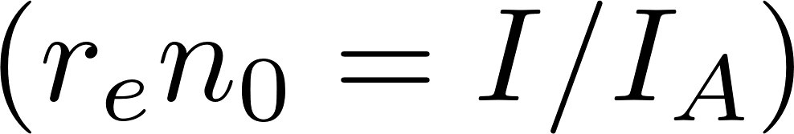
Theory
Fourier transform of a density perturbation
relative energy spread
variables
impedance per unit length
Fourier transform of a peak current
equations
linearized continuity equation for cold plasma in the wiggler
plasma frequency

Slide 4
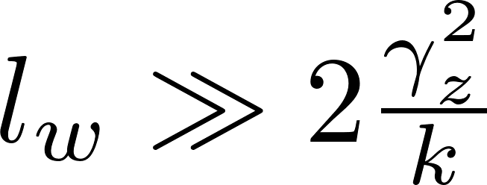
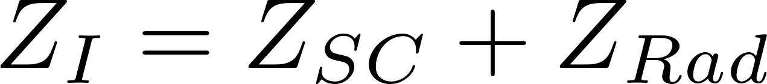
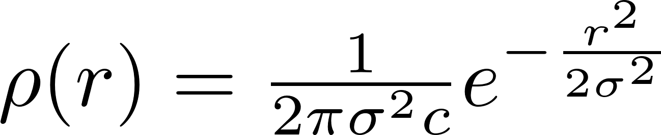
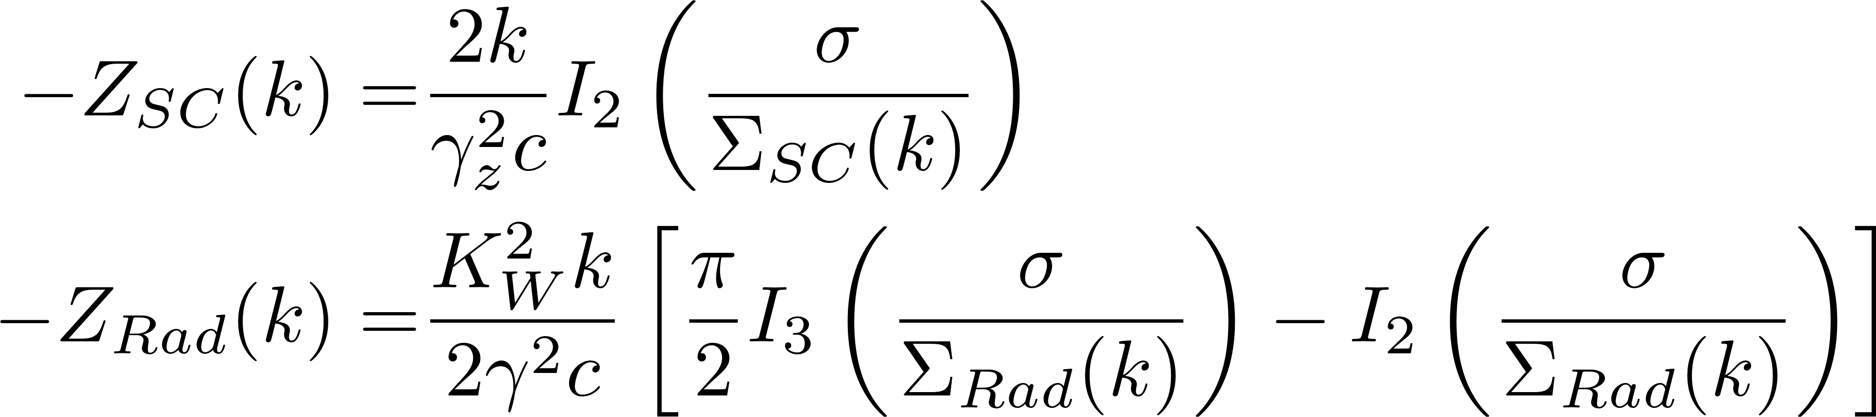
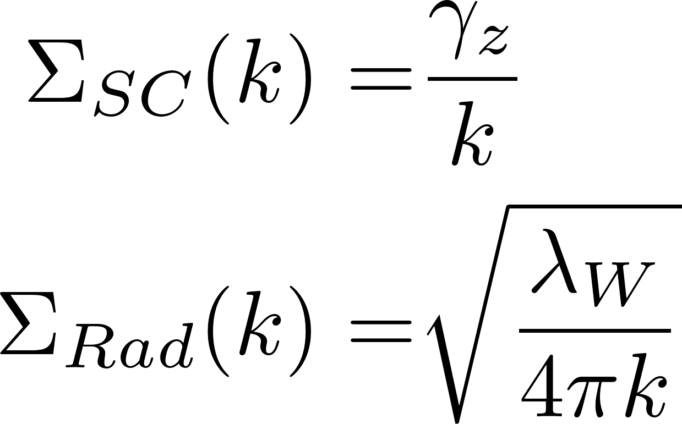
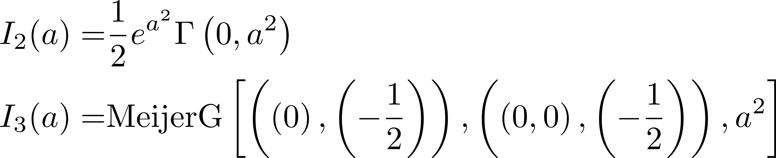
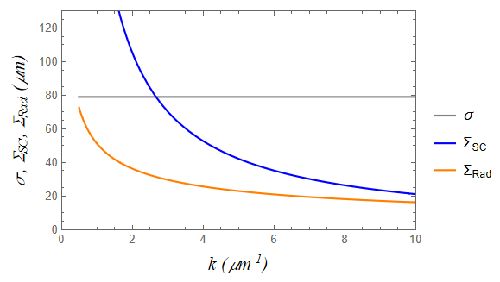
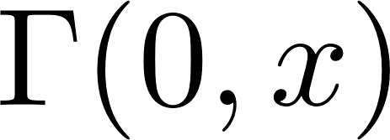
Theory (2)
subsequent analysis is valid when wiggler is longer than a transient length ~ (1 - 8) cm
in the case of the wiggler impedance (G. Geloni et al., NIM A, 2005)
electron distribution in transverse coordinate
is space charge diffraction size
is radiation diffraction size
is incomplete gamma function
is the Meijer G-function

Slide 5
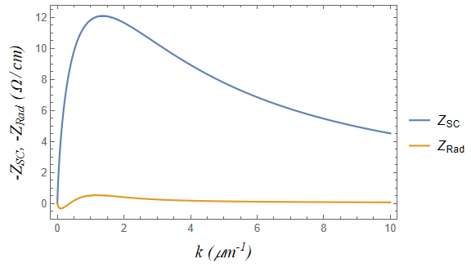
Theory (3)
Impedance as a function of frequency in the case of K_{W}=1.5, beam energy = 157 MeV, and σ = 80 μm

Slide 6
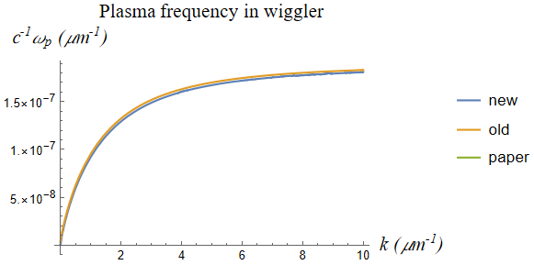
Theory (4)
Plasma frequency in the wiggler calculated using only space charge effects
Calculation approach
presented here
numerical
Curves are plotted with a small vertical offset
Stupakov, Zholents paper
three different calculation approaches agree perfectly

Slide 7

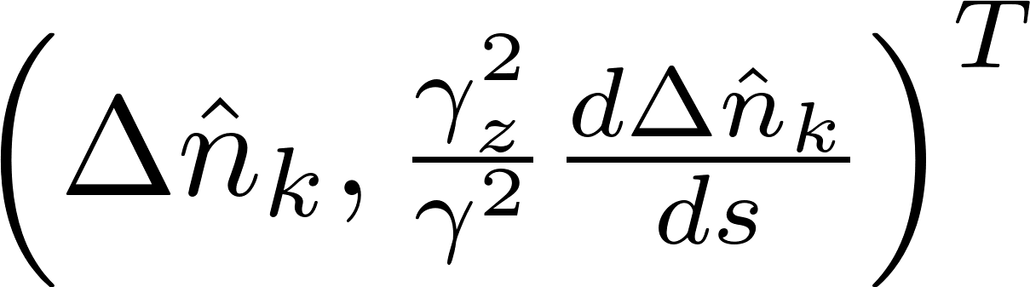
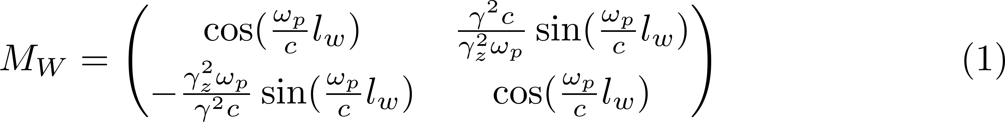
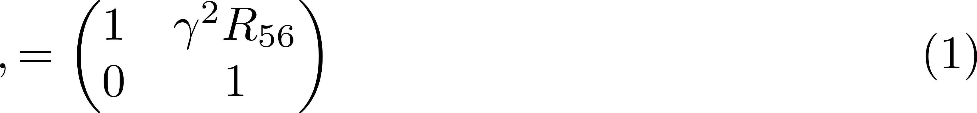
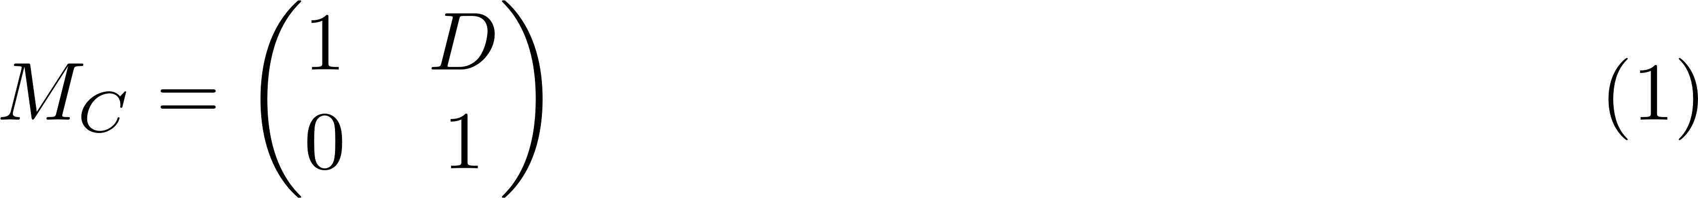

Theory (5)
Amplifier unit
Wiggler of the length
Chicane with R ₅₆
Consider evolution of the vector
Wiggler transport
Chicane transport
Unit transport
has two eigenvalues 𝐺₁ and 𝐺₂. If both |𝐺₁ | = |𝐺₂ | = 1, then the plasma
oscillation in the amplifier is stable and there is no gain in the microbunching.
The plasma oscillation is unstable when either |𝐺₁ | > 1 or |𝐺₂ | > 1

Slide 8
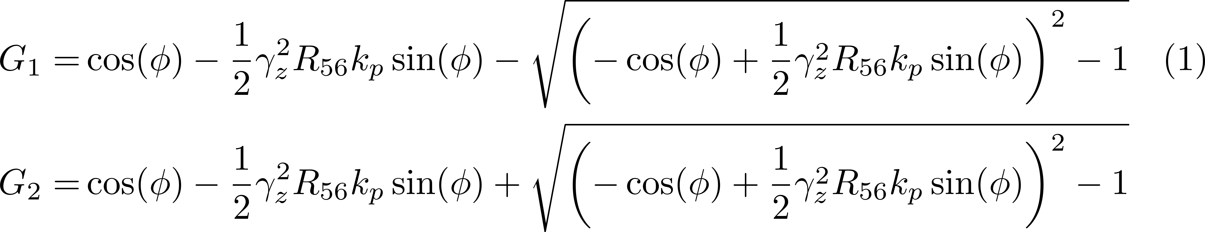
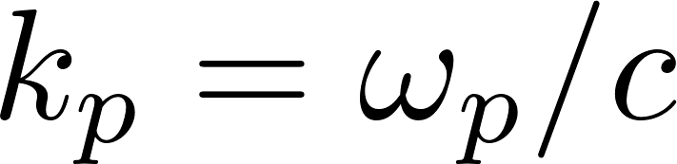
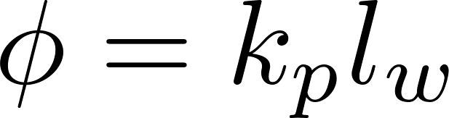

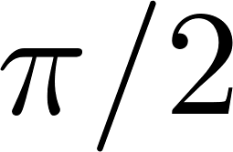
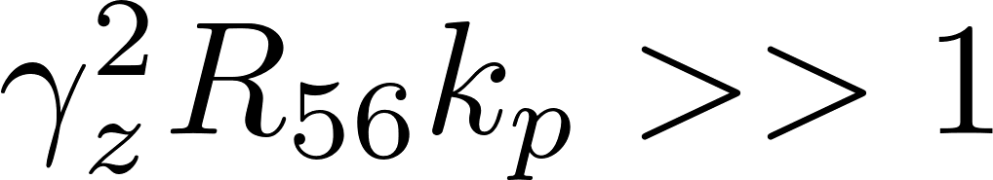
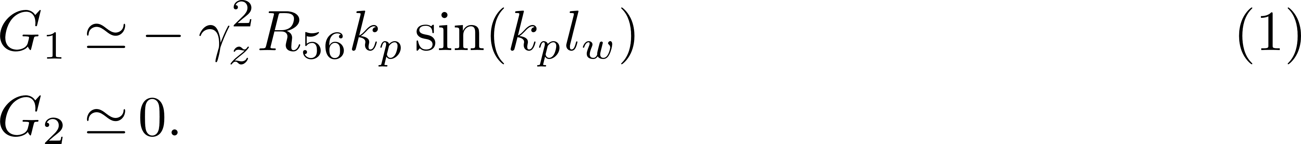
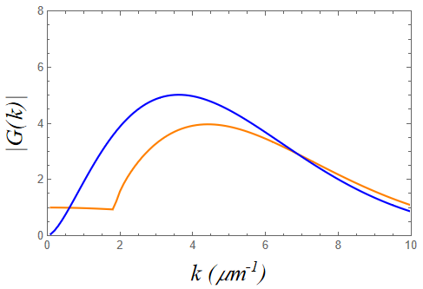
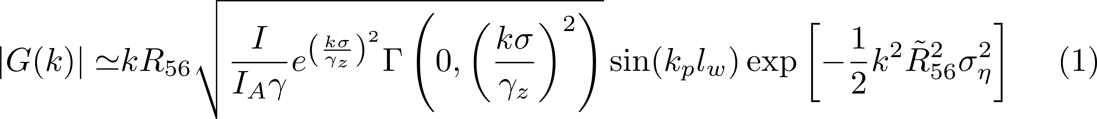
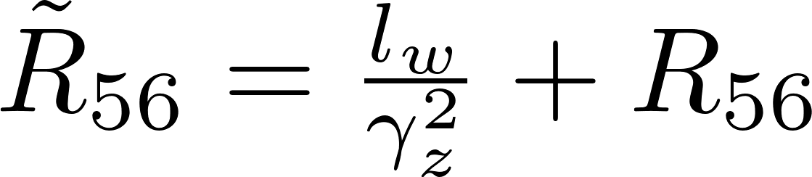
Theory (6)
Eigenvalues
Since it is desirable to have in a neighborhood of and , we write approximate G₁ and G₂
Using only space charge impedance
approximate
Calculated using:
𝛾 = 307, 𝐼 = 100 A,
𝜎 = 72𝜇m, 𝑅56 = 1mm,
drift 𝑙_{𝑤} =3.6 m, σ_{η}=2E-4
exact
debunching
The above formula is valid if using a drift with the length 𝑙_{𝑤} and 𝛾_{𝑧} ≡ 𝛾, in which case it is identical to the gain from the paper:
Stupakov, Baxevanis, Phys. Rev. Acc. and Beams, 2019.

Slide 9
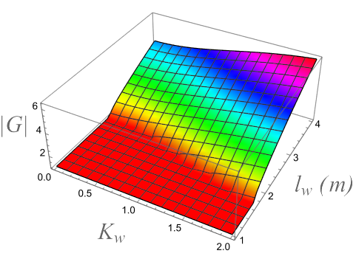
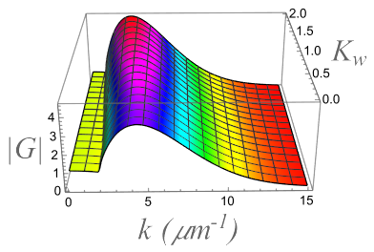
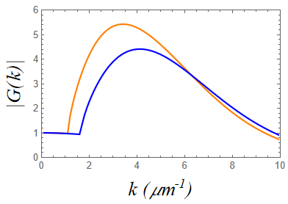
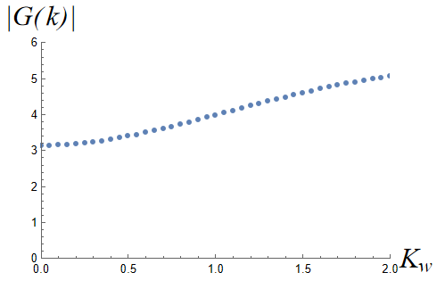
Parametric study of the gain after one amplifier unit
I=100 A
R₅₆=1 mm
k=3 μm⁻¹
I=100 A
𝑙_{𝑤} =3.6 m
R₅₆=1 mm
I=100 A
𝑙_{𝑤} =3.6 m
R₅₆=1 mm
𝑙_{𝑤} =3.6 m
K_{w}=0
K_{w}=1.5

Slide 10
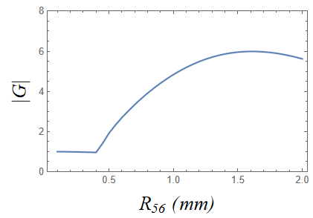
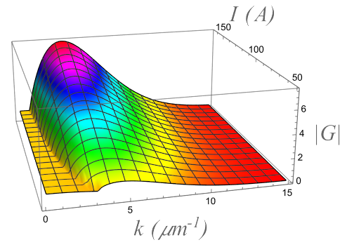
Parametric studies of the gain after one amplifier unit (2)
I=100A
k=3 μm⁻¹

Slide 11
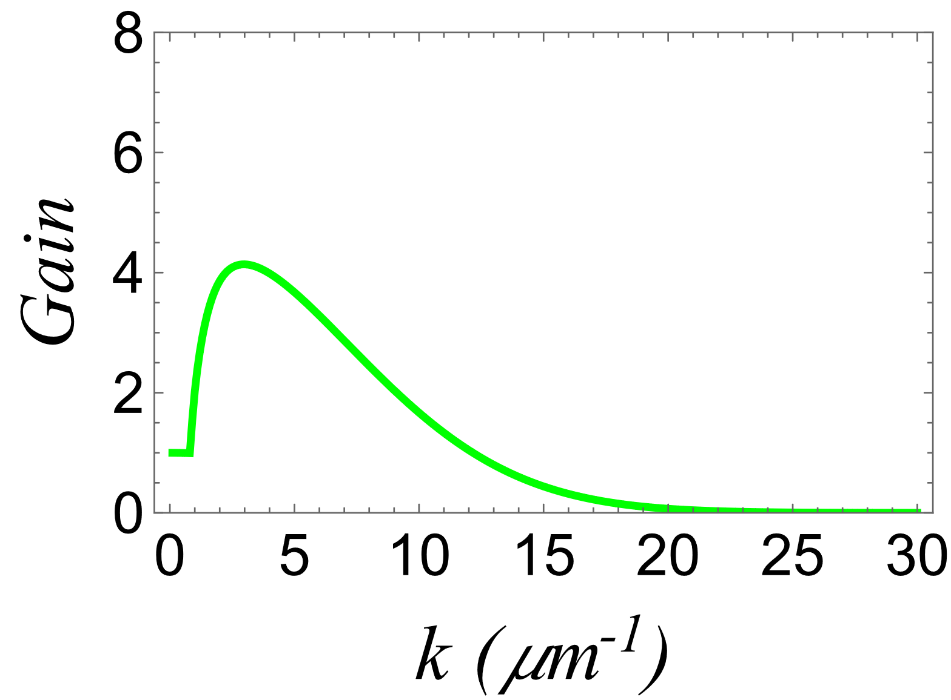
Goal of simulations
SASE FEL resonance
K_{w} = 1.67
To keep SASE FEL resonance outside of the amplifier bandwidth we have to use K_{w}< 1.67 such as k_{SASE} > k

Slide 12
Wiggler-enhanced plasma amplifier was modeled using:
OPAL-FEL for the wiggler sections (code MITHRA was ported to OPAL for that purpose)
Elegant for the chicanes
A. Adelmann et al., OPAL a Versatile Tool for Charged Particle Accelerator Simulations, arXiv:1905.06654, 2019.
A. Fallahi, A. Yahaghi, and F. Kārtner, MITHRA 1.0: A Full-Wave Simulation Tool for Free Electron Lasers, Computer Physics Communications, 228, pp.192-208, 2018.

Slide 13
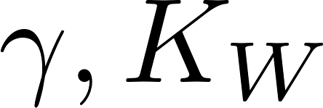
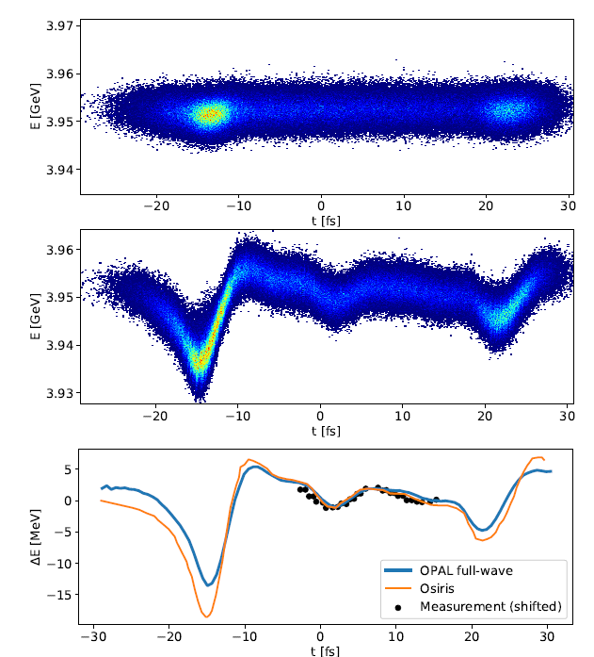
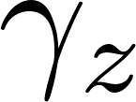
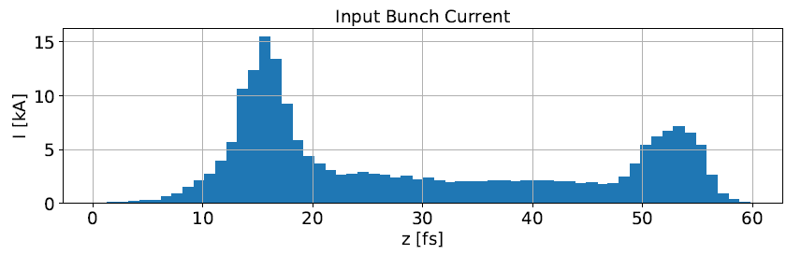
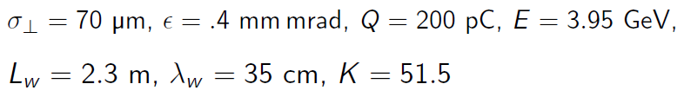
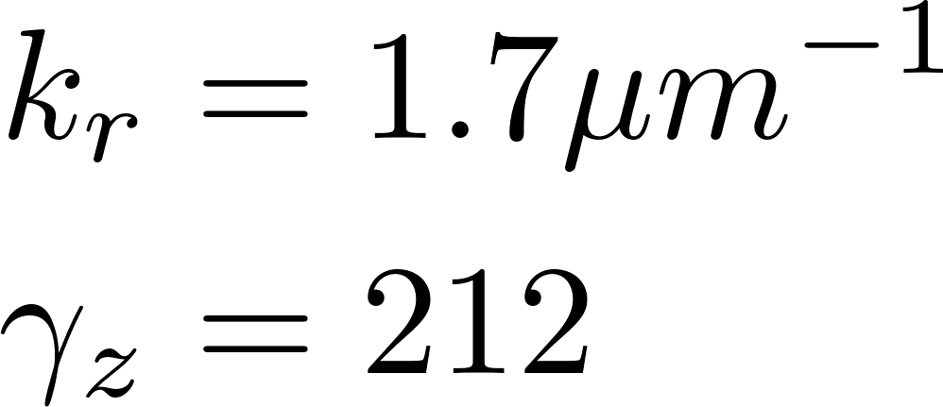
Benchmarking OPAL-FEL with SLAC experiment^{*)}
MacArthur, et al., PRL, 2019
Regime with large
and
Generation of attosecond x-rays at LCLS
Before wiggler
After wiggler
W
Slice central energy
*) Arnau Albà et al., Computer Physics Communications, 2022

Slide 14

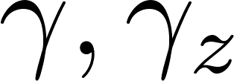



Benchmarking OPAL-FEL with ANL experiment ^{*)}
Regime with large
and small
*) Arnau Albà et al., Computer Physics Communications, 2022
AWA beam energy = 45.4 MeV,
bunch charge = 300 pC, bunch length =0.25 - 0.5 mm
Phase space reconstruction from measurements using magnetic spectrometer and deflecting cavity
Experiment: wiggler-out
Experiment: wiggler-in
1m
e-beam
Section of AWA beamline with APS wiggler
Wiggler period = 8.5 cm, K=10.5, γ_{z} = 11.6,

Slide 15

Lattice of a single amplifier unit used in simulations
wiggler
triplet
two chicanes
Wiggler:
length = 1.2 m
period = 3.3 cm
K = 1.5
B = 0.49 T
Dispersion , η_{x} (m)
Chicane R₅₆ = 1.0 mm
magnet length = 5 cm
magnet field = 0.04 T

Slide 16


Initial electron beam
Core:
Longitudinal phase space
Tails:
Sampling for distribution in z
  Calculate cumulative distribution function
  Numerically invert CDF
  Generate samples from Halton sequence
  Apply inverted CDF
All other distributions are Gaussian

Slide 17
Simulation setup
Define:
grid resolution,
energy resolution<8 keV,
grid domain,
number of macroparticles,
seed modulation amplitude.
Δn must be larger than numerical shot noise, and smaller than ~ 0.2n₀/Gain to avoid gain saturation
Convergence of global beam parameters in many slices in bunch core was used as convergence criteria

Slide 18


Selection of the solver’s grid resolution
Simulation with small grid resolution Δx = Δy= 2.5 μm and Δz = 7.5 nm was used as the reference
Plots show deviations from reference for the beam energy, beam transverse size and emittance.
Color coding:
Δx = Δy=40 μm;
Δx = Δy=10 μm;
Δx = Δy=5 μm
Grid resolution Δx = Δy=10 μm and Δz = 28.6 nm was chosen

Slide 19
Selection of the number of macroparticle
Calculation using 64x10⁶ macroparticles was used as the reference
Solver grid resolution
was used
Plots show deviations from reference for the beam energy, beam transverse size and emittance.
8 x 10⁶ macroparticles was selected

Slide 20




Selection of seed modulation amplitude
Need to avoid harmonic formation
I=165 A
R₅₆=0.5 mm
λm
λm/2
λm/3
λm
Number of wigglers in the amplifier unit
λm/2
λm/3

Slide 21




SASE FEL resonance suppression
After Wiggler 3
After Wiggler 1
(SASE gain=1.53/per wiggler cell)
After chicanes

Slide 22




Simulation results for one amplifier unit in comparison with the theory
I_{peak}=100 A
R₅₆ = 1 mm
σ_{η} = 2.1x10 ⁻⁴
I_{peak}=50 A
Dots – simulations
Solid lines – theory
I_{peak}=165 A
Use drift instead wigglers and OPAL
I_{peak}=165 A
σ_{η}=2.15x10 ⁻⁴
The agreement between simulations and theory is better without wigglers

Slide 23




Simulations in comparison with approximate theory
I_{peak}=50 A
I_{peak}=100 A
Dots – simulations
Solid lines – approximate theory
Use drift instead wigglers and OPAL
I_{peak}=165 A
σ_{η}=2.15x10 ⁻⁴
I_{peak}=165 A
The agreement between simulations and approximate theory is better, but not in the case without wigglers

Slide 24



Simulation results for two amplifier units
I_{peak}=50 A
R₅₆ = 1 mm
σ_{η} = 2.1x10 ⁻⁴
I_{peak}=100 A
I_{peak}=165 A
Dots – simulations
Solid lines – exact theory

Slide 25


Gain versus a number of wigglers in the amplifier unit (2)
I_{peak}=50 A
k=3.76 μm⁻¹
1
2
3
4
5
Wiggler number
I_{peak}=100 A
k=3.76 μm⁻¹
Wiggler number
1
2
3
4
5

Slide 26

Amplifier bandwidth is mostly affected by the energy spread and a little bit by CSR in chicanes
R₅₆ = 1 mm
R₅₆ = 0.5 mm

Slide 27
Credits
Useful discussions with Gennady Stupakov are acknowledged

Slide 28
Conclusion
WEPA is a viable candidate for the CeC amplifier. It offers a competitive gain-bandwidth product and uses smaller real estate comparing to a drift-based microbunching amplifier.
Care was taken to control for nonphysical numerical effects and limitations in the simulation.
Simulations and analytical calculations qualitatively agree but show some important differences.
Similar simulations and calculations performed for the microbunching amplifier with drifts replacing wigglers show better agreement.

Slide 29
Backup slides

Slide 30



Case of a very large wiggler parameter
Total reactive impedance
K_{w} > 7.5 such as k_{SASE} < 0.5 μm⁻¹
λ_{W} = 7.5 cm
K_{w} = 7.5
total
only SC

Slide 31

Chicane CSR Impact on Gain
I_{peak}=165 A
R₅₆ = 1 mm

Slide 32
MITHRA 1.0
Fallahi, Yahaghi, Kärtner, Computer Physics Communications, 2018
Program summary
Program Title: MITHRA
Program Files doi: http://dx.doi.org/10.17632/9f5k4zbtkg.1
Licensing provisions: GNU General Public License 3
Programming language: C++
Nature of problem: Full-wave simulation of the free electron laser radiation is accomplished by the code.
MITHRA transforms the particle positions and momenta to the bunch rest frame using the Lorentz
transformation. Electrons entering the undulator start radiating due to the induced wiggling motion. The
back-effect of the radiation on the bunch results in the modulation of the electron position, which in turn
generates a coherent radiation. This process as the main principle behind the operation of free electron
lasers is simulated using Maxwell equations, electron motion equations and relativity principles.
Solution method: Non-standard Finite Difference Time Domain (NSFDTD) combined with Particle-in-Cell
(PIC) is implemented in the Lorentz-boosted framework to calculate the FEL radiation. Parallelization
is done using both multi-threading (open-MP) and message passing interface (MPI) to maximize the
computation efficiency.

Slide 33
Unlike OPAL’s static solver, which can stretch and rotate the grid as necessary to tightly enclose the bunch at each time step, FDTD requires the grid to be fixed in space because each grid point is updated using its previous values, and thus it needs to enclose the whole domain where there will be EM fields of interest during the simulation. In the case of an undulator this means that the computational domain should have the same length as the undulator, usually within a range Lu=1–100 m, but should also have a grid spacing small enough to resolve the bunch of length σz=0.1–1 mm and the resonance frequency of the radi-ation λr=0.01–100 μm, which represents an order of ∼10⁶–10¹⁰ cells just for the longitudinal axis, extremely large even for the current state-of-the-art HPC clusters.

Slide 34

Simulation Parameters
Number of grid points ~ 90x10⁶

Slide 35

Mitigating impact of finite bunch length
Regenerate tails after each wiggler to mitigate impact of spikes
(simulation domain is much shorter than bunch length)
spikes

Slide 36


Gain versus a number of wigglers in the amplifier unit
I_{peak}=50 A
6 wigglers (approximate)
I_{peak}=50 A
6 wigglers (exact)
3 wigglers

Slide 37



Gain determination using NAFF vs Bunching Factor
bunching factor
Examples using seed modulation = 0.004
Exactly 1 period of data
Bunch core
N - <N>
N - <N>
NAFF:
𝜆 = 1.22 𝜇m
Amplitude / Avg(counts) = 0.003979
Error = -0.5 %
NAFF:
𝜆 = 1.22 𝜇m
Amplitude / Avg(counts) = 0.003999
Error = -0.01 %

Slide 38



