Slide 1
Heavy, Highly-Charged Ions at GSI/FAIR : Deceleration and Cooling
CRYRING@ESR and HITRAP
Frank Herfurth

Slide 2


Ion Storage at GSI/FAIR
HESR
ESR
400 MeV/u
400 MeV/u
UNILAC
SIS
Stripper/Target
CRYRING@ESR
SHIPTRAP
FRS
ESR
see talk by Markus Steck
4 K
HITRAP
4 MeV/u
SHIPTRAP
4 MeV/u … 100 keV/u
HITRAP
CRYRING@ESR
10 MeV/u
see also talk by Claude Krantz
Notes:
1e-11 eV (1e-7K) = BEC, Obere Energie Cosmics 1e20

Slide 3
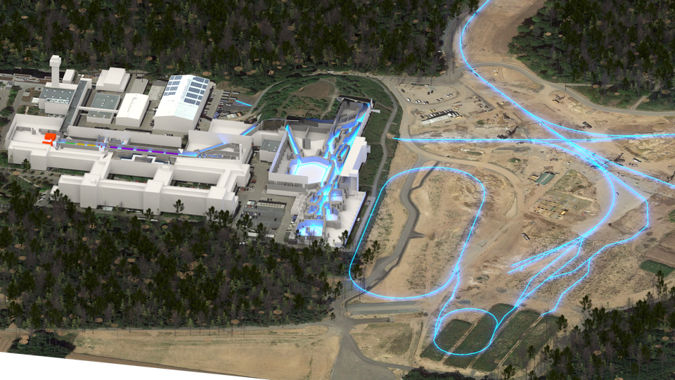



The GSI/FAIR Site
Ionsources
Fragment-
separator
HITRAP
SIS18
SIS100
image created by W. Geithner
CBM
HESR,
PANDA
UNILAC
Super-FRS,
Antiproton
target
ESR
SHIPTRAP
CRYRING@ESR
Collector-Ring
https://www.youtube.com/watch?v=pnvZfVNyUSQ

Slide 4
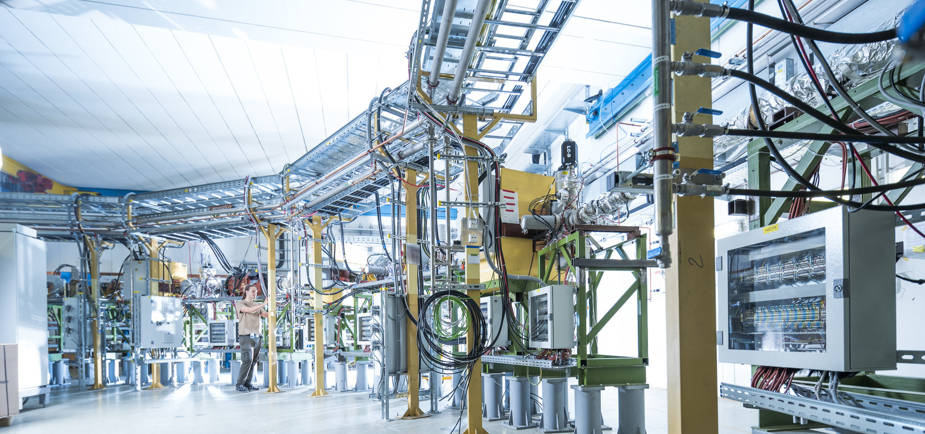
Deceleration and Cooling : CRYRING@ESR and HITRAP
Overview
CRYRING@ESR
  move, reinstallation, parameters
  vacuum conditions
  detection challenges
HITRAP
  facility overview, working principles, challenges
  electron cooling in an ion trap
Summary

Slide 5
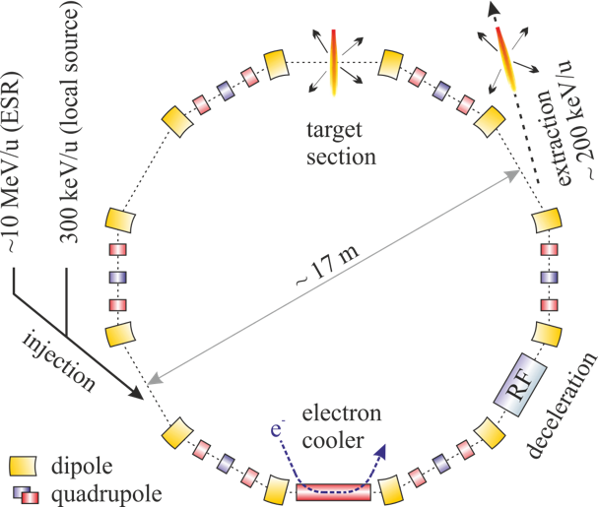
CRYRING@ESR
Max. rigidity 1.44 Tm
  15 MeV/u U⁹²⁺
  96 MeV/u protons
Min. rigidity ~ 0.054 Tm
  Actual limit given by beam life time
UHV … 10⁻¹¹ mbar

Slide 6
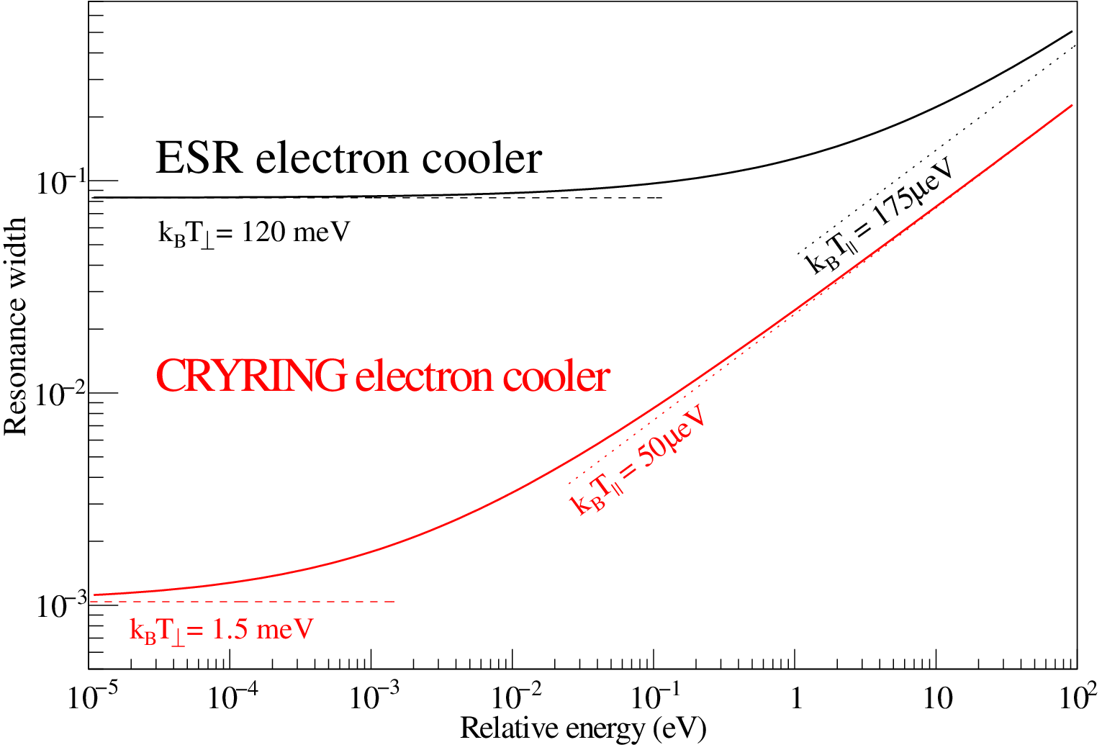
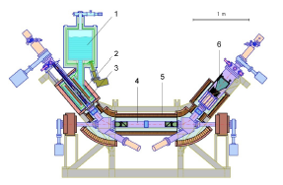
Electron Cooling ESR - CRYRING
C. Brandau priv. comm.

Slide 7
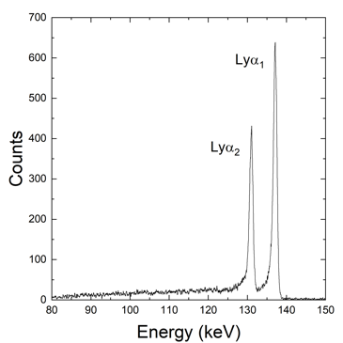
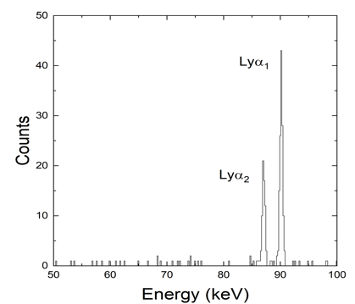




Electron Cooling ESR – CRYRING@ESR
$U^{92+}$+ $e^{−} →U^{91+}+ℏω$
${Pb}^{82+}$+ $e^{−} →{Pb}^{81+}+ℏω$
X-ray spectrum of $U^{91+}$-Ions close to 0° at the ESR.
X-ray spectrum of ${Pb}^{81+}$-Ions at 0° at CRYRING@ESR.
comparison plot: M. Lestinsky; Publication: B. Zhu et al., submitted to PRA, arXiv:2201.06977v1

Slide 8
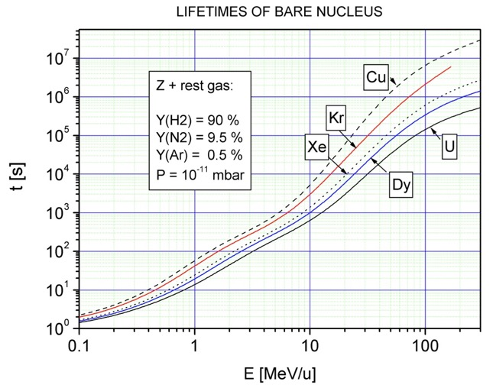
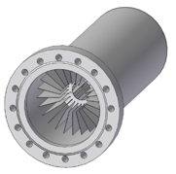
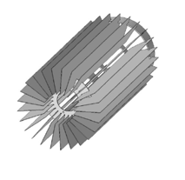
Ultra High Vacuum & Beam Life Time
Ion pumps
  ~ 10 and increasing
Cryopumps .. soon history
NEG pumps
  ~ 50+
15 min
2 min
V. Shevelko, priv. comm.
3 s
0.4 s
0.3
15

Slide 9
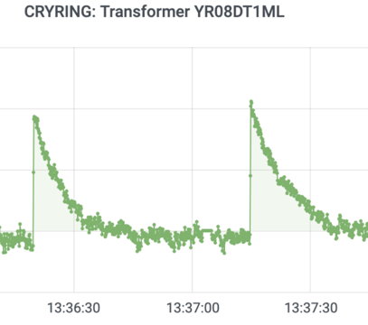

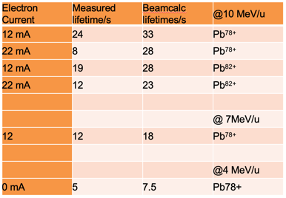
Vacuum Conditions
CRYRING@ESR
Main effort in 2020 went into sections 05 – 08:
addition of new ion getter pumps
NEG coating of some easily accessible parts
pretty good for first experiments
needs improvements for later experiments
U⁹¹⁺ @10 MeV/u
life time about 10s
calculations (M. Lestinsky et al.):
http://web-docs.gsi.de/~lestinsk/beamcalc

Slide 10
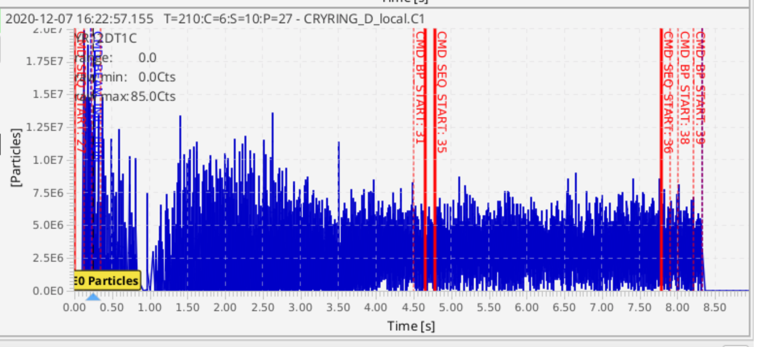
Detection limits
dedicated run in Dec 2020
investigated the lower limit for necessary intensity
Guinee pig D⁺ @5 MeV/u (1⋅10⁷ particles = charges / μA)
  for intensity measurement
    with CCC: 5 nA (5⋅10⁴q)
    bunched beam (ICT, CRYRADIO): 20 nA (2⋅10⁵q)
    DC Trafo: 5 μA (1⋅10⁷q)
  for ring setup
    injection and cooling
      IPM: 300 nA (3⋅10⁶q)
      Bunches on BPM, Schottky, Neutral Particle Counter: 150 nA (1.5⋅10⁶q)
Conclusion: Need at least 1.5⋅10⁶ charges stored to setup a cooled, accelerated beam
Info: typical transfer efficiency of mass separated beam from local source to ring: 20%

Slide 11
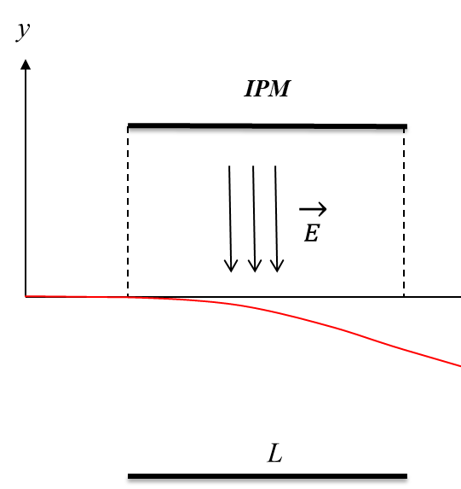
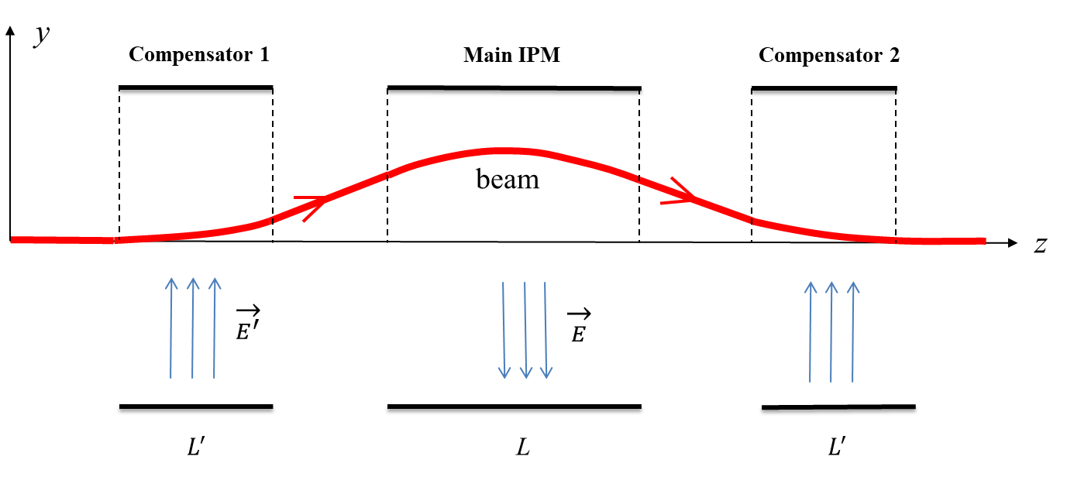
Low Energy IPM
present IPM
low Energy IPM

Slide 12
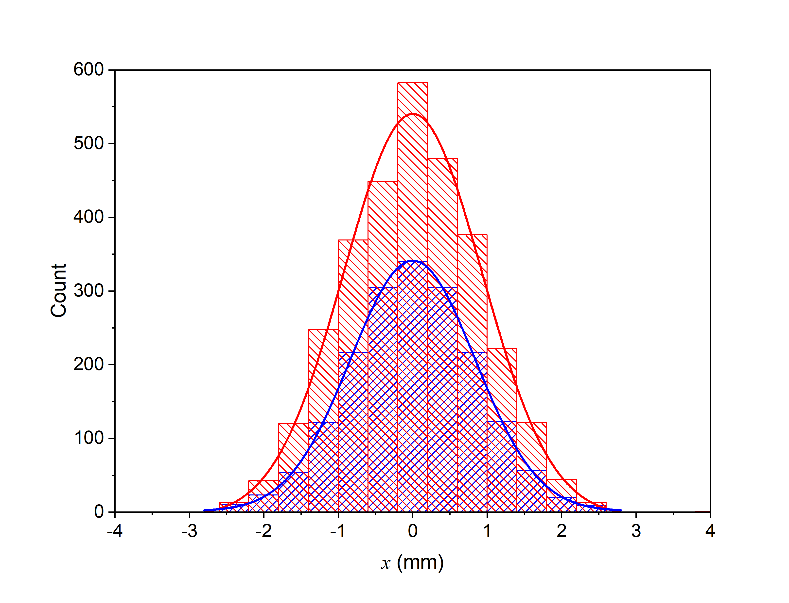
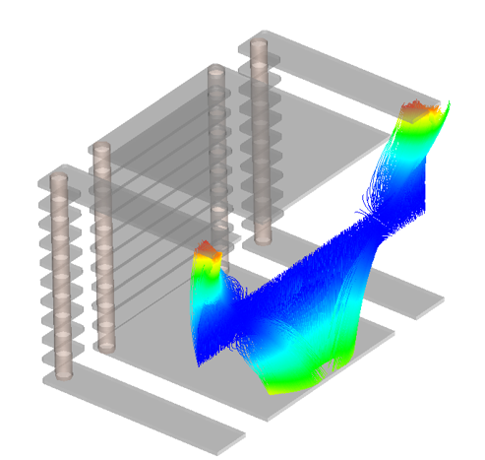
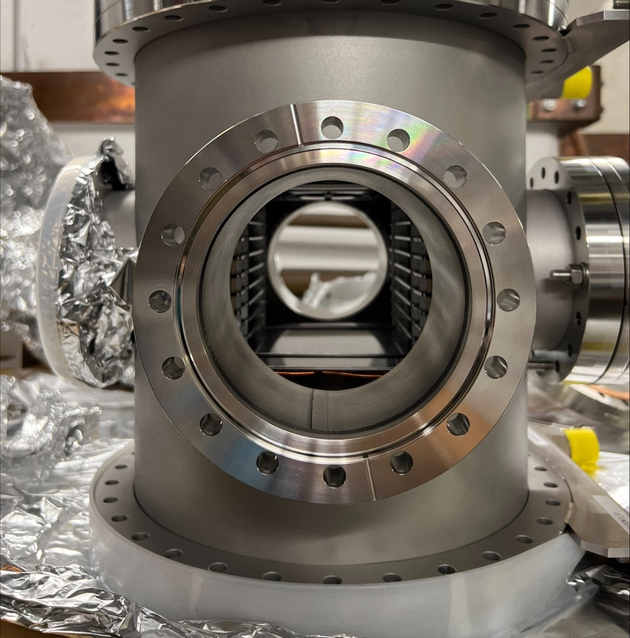
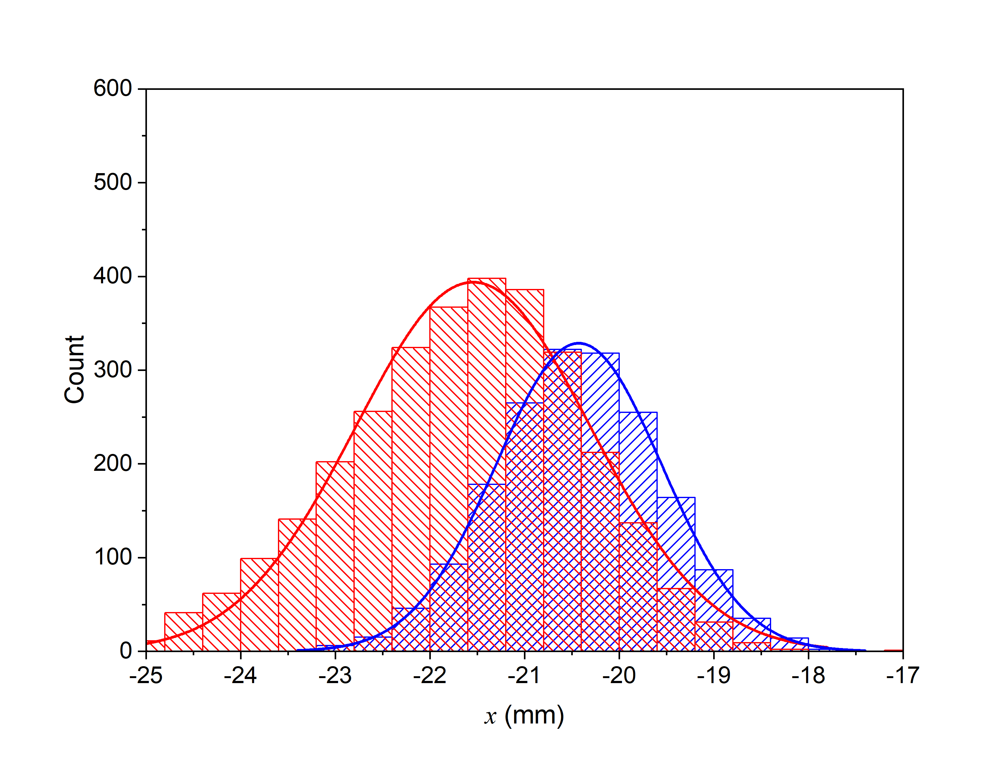
Low Energy IPM
CRYRING@ESR
drop-in replacement for old one (250 mm)!
field distortion causes managable image distortion
central beam:
amplification due to focussing
very small increase of FWHM
off axis beam:
about 10% error in position
FWHM increased up to 150%
main electr. field only
correction field added
Bowen Zhou, Zoran Andelkovic, Rudi Hettinger, Nikita Kotovsky, Andreas Reiter et al.

Slide 13
Deceleration and Cooling : CRYRING@ESR and HITRAP
Overview
CRYRING@ESR
  move and reinstallation, electron cooling
  vacuum conditions
  detection challenges
HITRAP
  facility overview, working principles, some challenges
  electron cooling in an ion trap
Summary

Slide 14

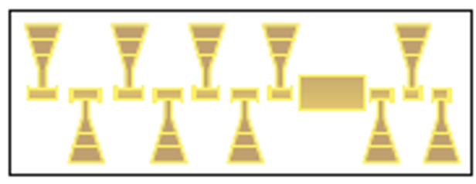
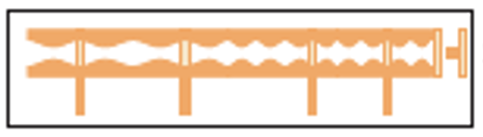

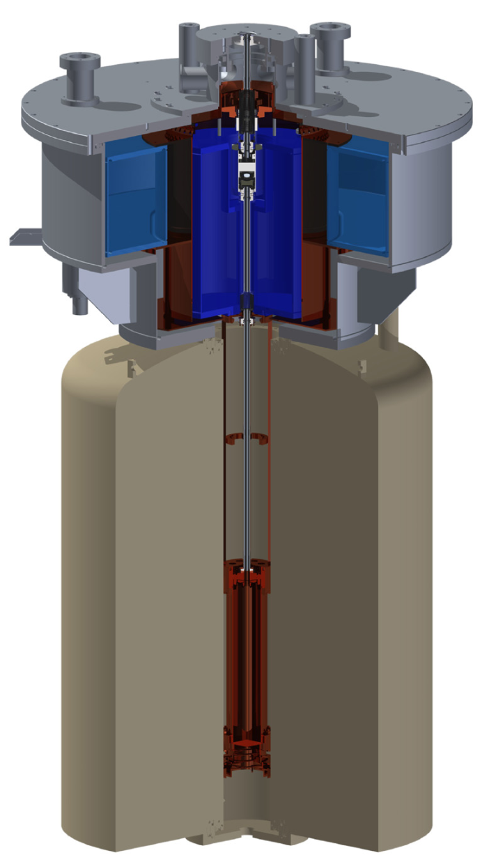
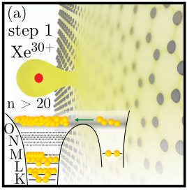
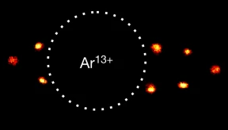
HITRAP facility - overview
EBIT
Experimental stations
Platform
Buncher
IH
RFQ
from ESR
Cooling trap
4MeV/u
500keV/u
6keV/u
~eV/q
~10m
Cave
Optical Clocks with HCI, e.g. Micke, Leopold, King et al., Nature 578 (2020)
g-Factor of Ar¹³⁺, e.g. I. Arapoglou, A. Egl, M. Höcker et al., PRL 122 (2019)
HCI interaction with surfaces, e.g. Wilhelm et al., PRL 119 (2017)

Slide 15
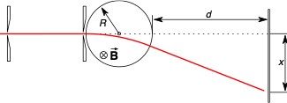
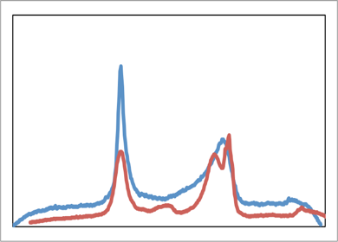
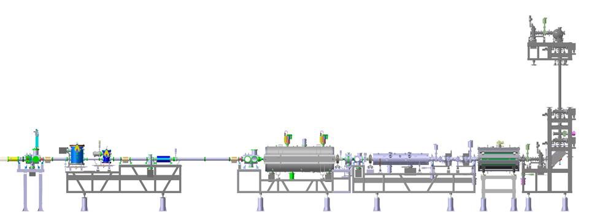
Deceleration from 4 MeV/u to 6 keV/u
Ion beam
primary beam
slit1
slit2
~ 6 keV/u
Magnet 0.5T
screen
4 MeV/u
0.5 MeV/u
6 keV/u
F. Herfurth "The linear decelerator HITRAP"
F. Herfurth "HITRAP Decelerator and Beam Instrumentation"
F. Herfurth "HITRAP Project Status"
F. Herfurth "HITRAP and CRYRING@ESR"

Slide 16
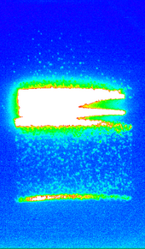
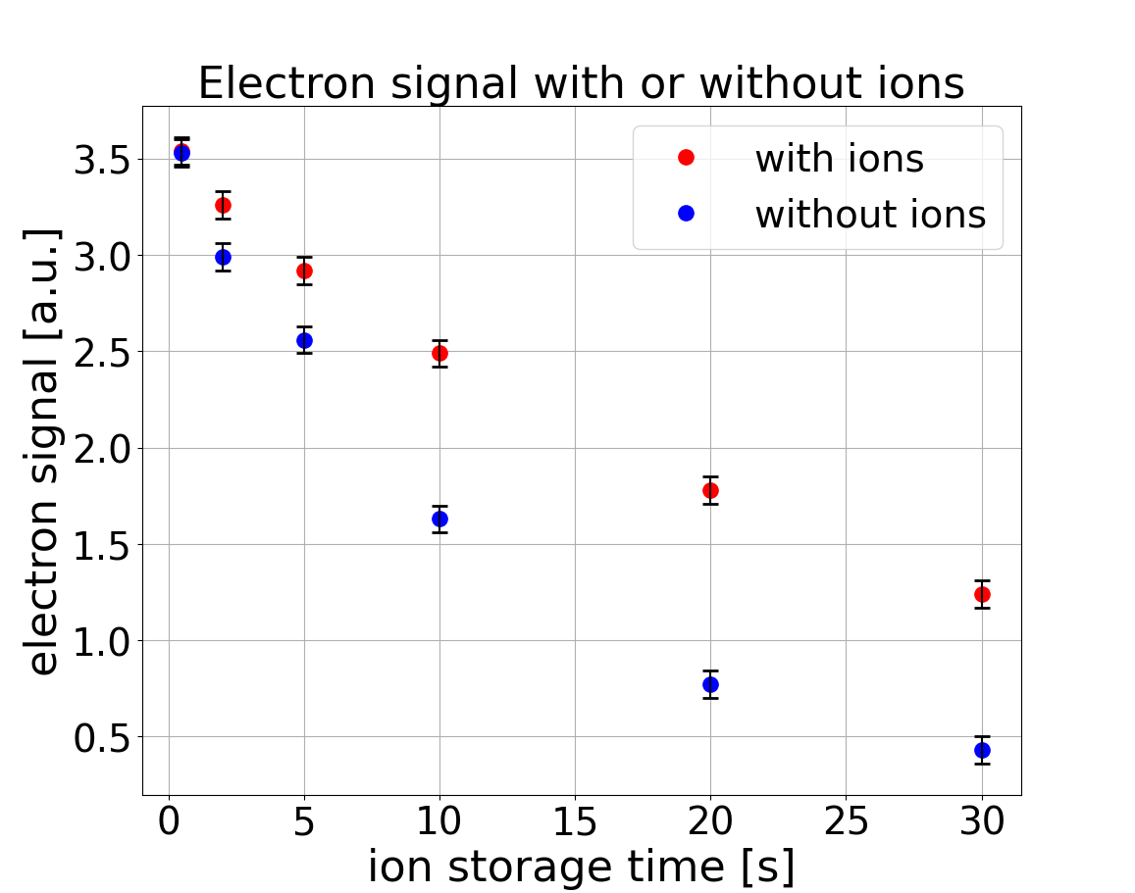
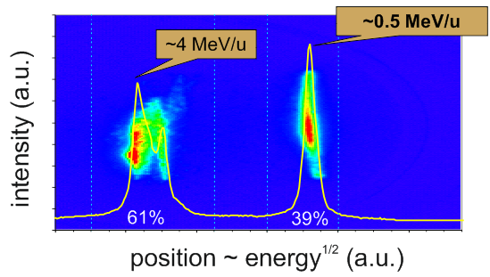
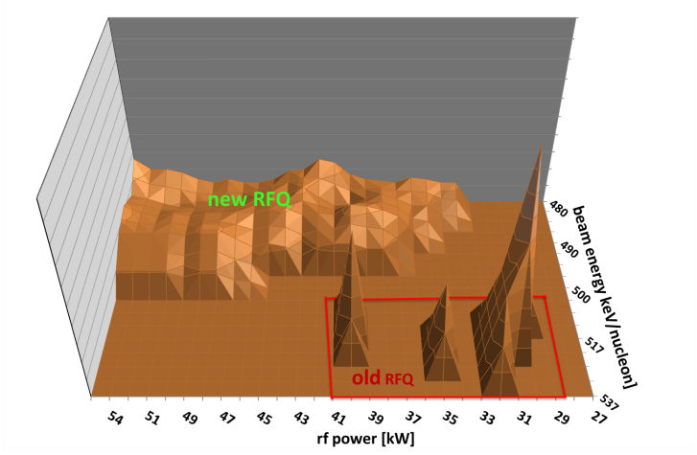
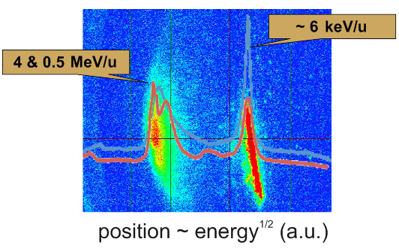
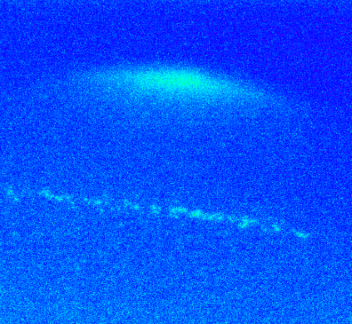
Timeline
16 online beam times (typically 7-10 days)
‚Standby‘
(loc. operation, trap dev.,
control sys. upgrade)
‚Restart‘
2004
2007
2008
2009
2010
2011
2012
2013
2014
…
2018
…
2020
…
2022
2023
…
HCI @
0.5MeV/u
RFQ
rework
HCI @
6keV/u
trap
rework
storage of
ions + electrons
first beam time
after 8 years
to be
continued….
reconstruction
(2013-14)

Slide 17
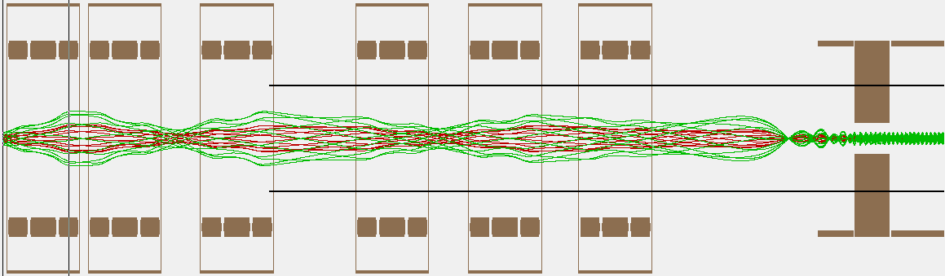
Transfer of decelerated ions
  Ion optical elements + pump barriers needed
  Cooling in the trap (electron cooling) transport towards experiments
18 ± 3 keV/q
10⁻⁷ mbar
linear
Decelerator
3 ± 3 keV/q
10⁻¹³ mbar
Trap

Slide 18
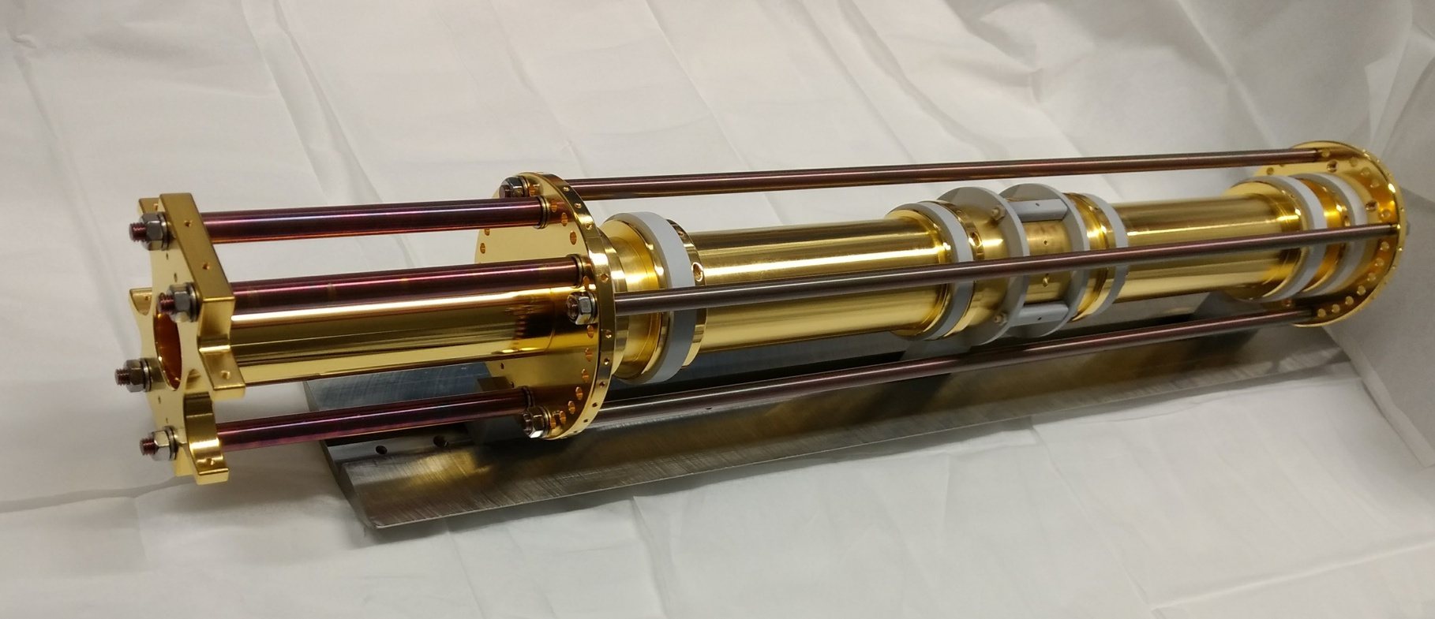
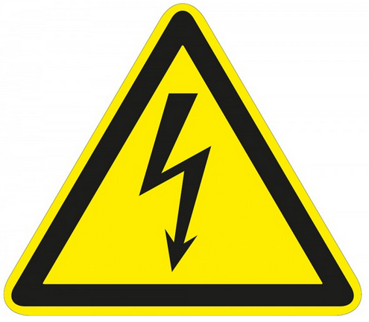

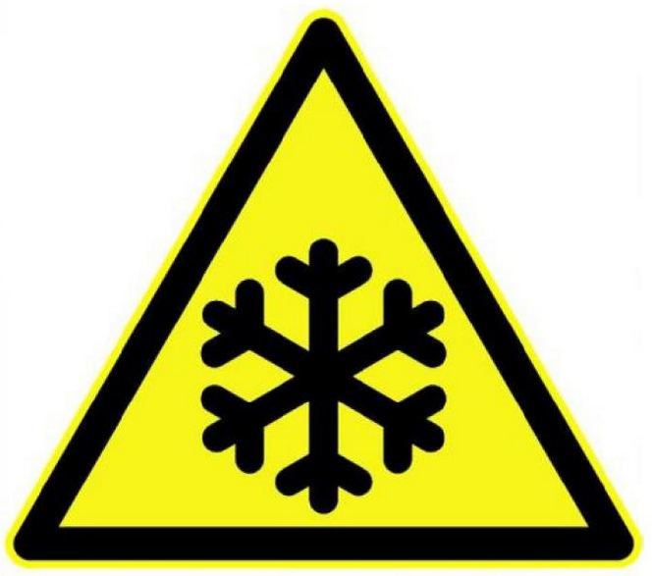
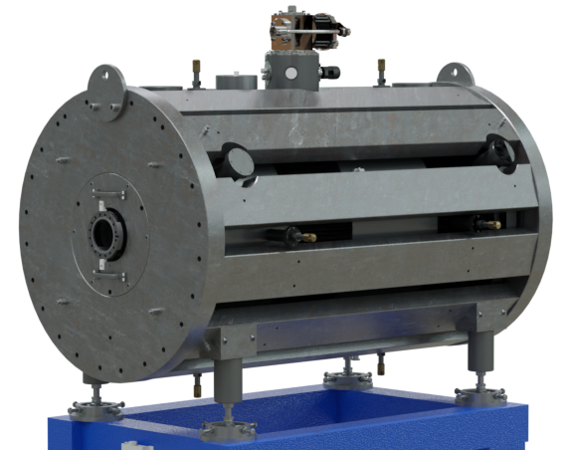
Cooling trap
Penning-Malmberg trap
40cm
~kV
~T
~4K
6 kV
4 keV/q
: Ar-ion
Nested-trap configuration
: electron
Coulomb
interaction
0 V
-400 V
< eV

Slide 19
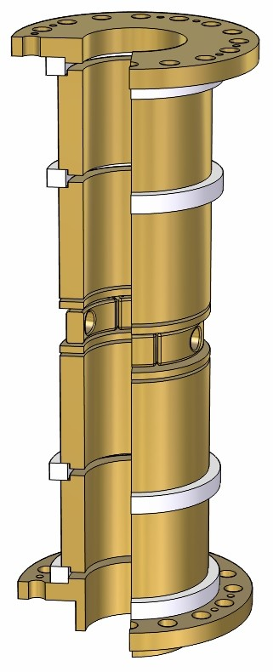
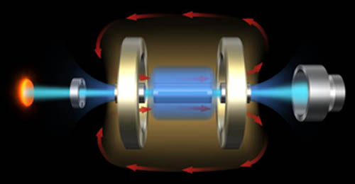
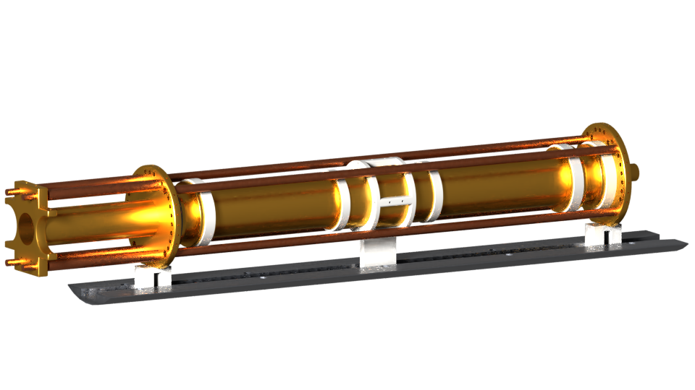
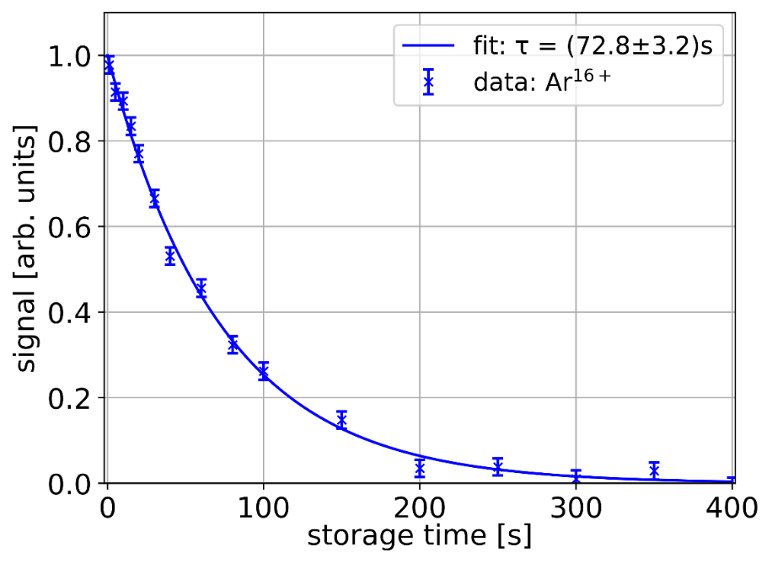
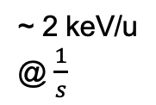
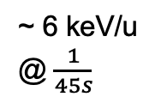

Offline commissioning
EBIT
ESR
SIS
linear decelerator
UNILAC
stripper
~ 6 keV/u
@ $\frac{1}{45s}$
~ 2 keV/u
@ $\frac{1}{s}$
up to 6 T
~40cm
$$\vec{B}$$
4K
capture electrodes
up to 20 kV

Slide 20
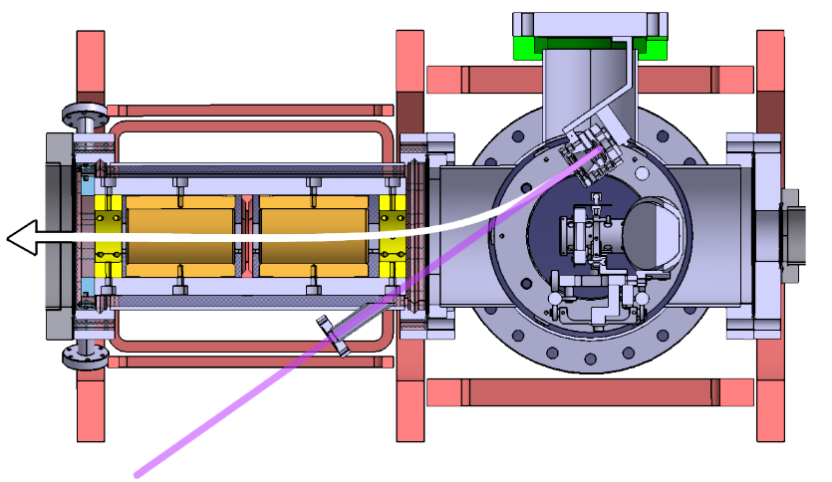
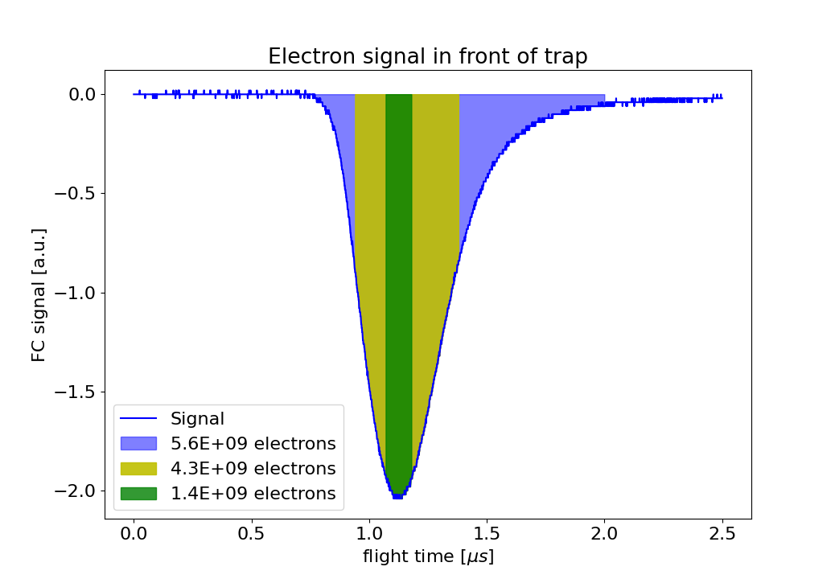
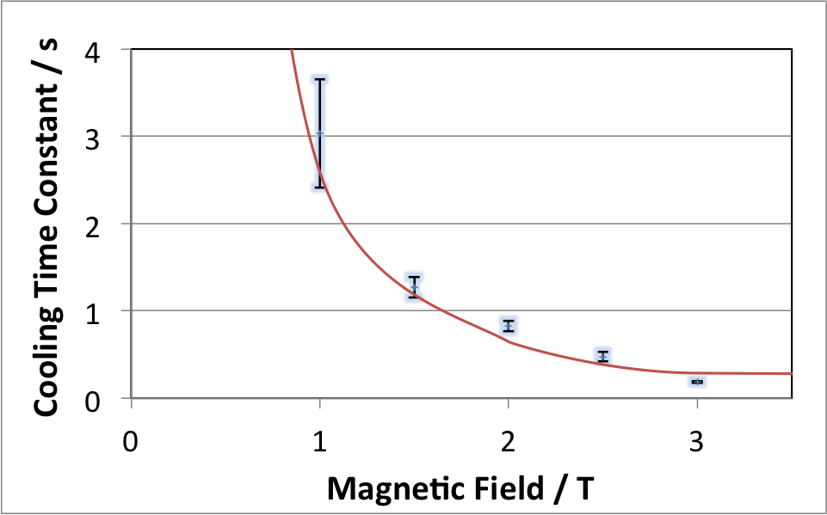

Electron Production
coils
Photo cathode
Claude Krantz. „Intense electron beams from GaAs photocathodes as a tool for molecular and atomic physics“. Diss. Okt. 2009
$Φmax$ = $\frac{N_{e}e }{4πε_{0}l}$ $(2\ln\left(\frac{r_{t}}{r_{s}}\right)+1)$
capture
long endcap
ring
long endcap
~3*10⁹ stored electrons
stacking → >10¹¹ electrons
→ sufficient amount for electron cooling
endcap
endcap
capture
UV light
B. Maas

Slide 21
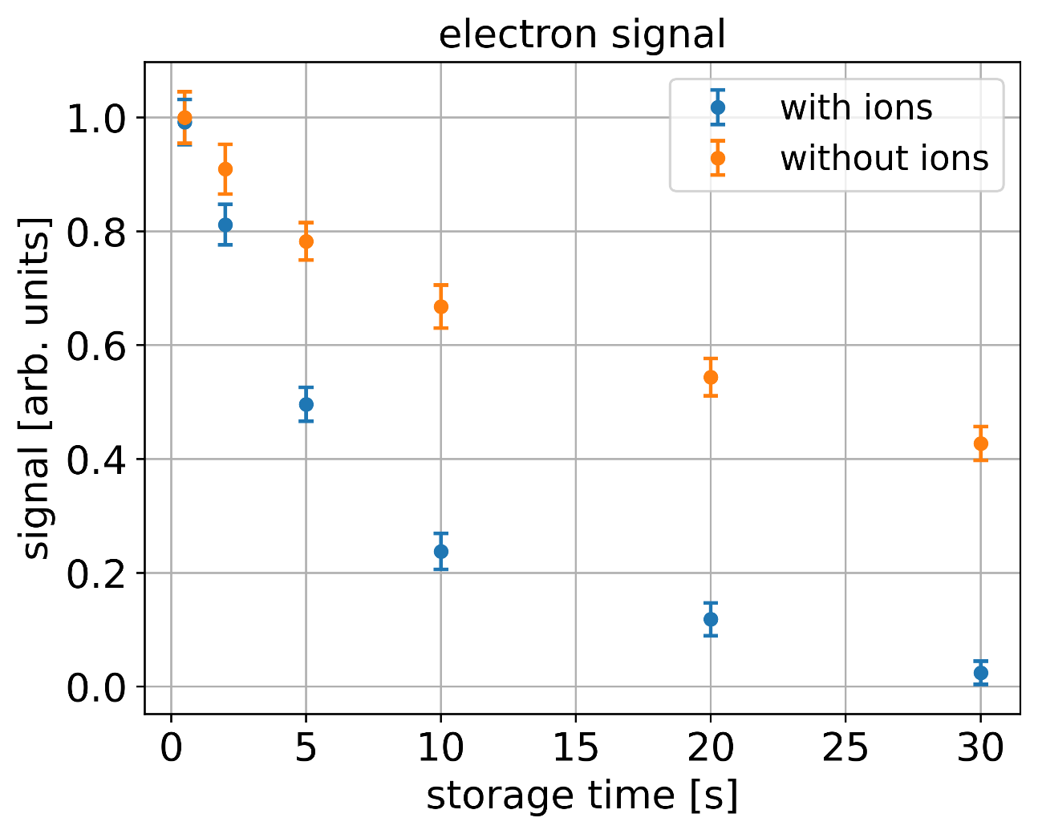
Electron Cooling(?)
6 kV
4 keV/q
: HCI
: electron
Coulomb
interaction
0 V
- 600 V
< eV
Ions effect stored electrons
.. but no detectable effect of electrons on ions
  insufficient overlap between electrons and ions?

Slide 22
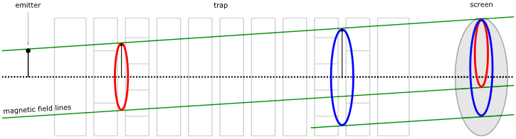
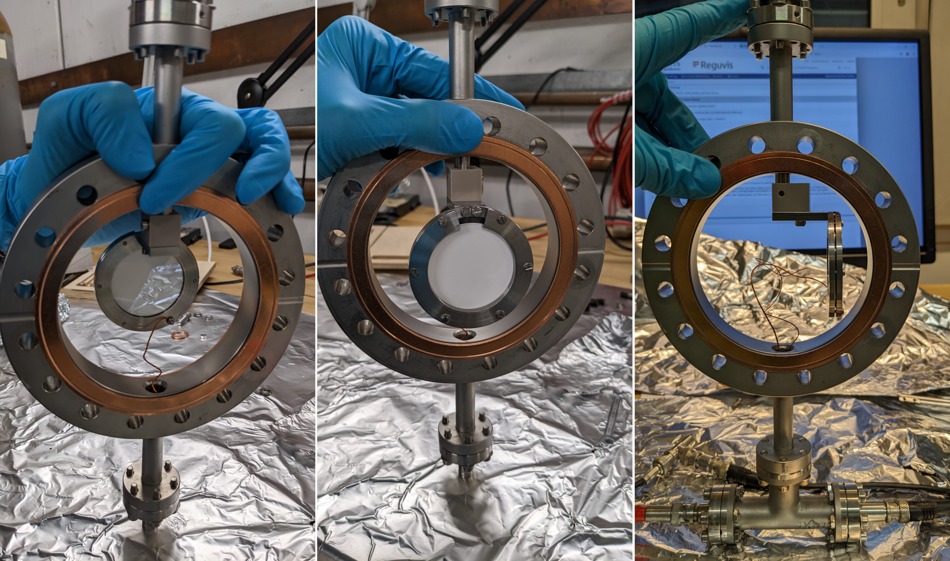

Advanced alignment
22
Circles (Magnetron motion) due to ExB
Different circles @ different trapping locations
  Misalignment between E/B field
New phosphorus screen detector
  2D-map of the spatial distribution
M. Singer et al, "Non-neutral plasma manipulation techniques in development of a high-capacity positron trap", Review of Scientific Instruments 92, 123504 (2021)
42mm
~x5 due to ΔB

Slide 23






Setup alignment
23
Electrons stored at different locations in the trap
  Different circles indicated misalignment between E/B-field
  Mechanical adjustment of the trap compensates for that
42mm
71mm
$r_{ω_{−}}≈14mm$
$$r_{ω_{−}}≈100µm$$

Slide 24



Electron cooling!
Nils Stallkamp
24
signal
ion signal no cooling
ion signal + electron cooling
ion signal + electron cooling + stacking
6 kV
6 kV
4 keV/q
: HCI
4 keV/q
: HCI
: electron
Preliminary
Coulomb
interaction
0 V
0 V
- 600 V
- 600 V
< eV
First electron cooling of highly charged ions!!
Simon Rausch, Max Horst, Nils Stallkamp,
Zoran Andelkovic, Sergiy Trotsenko et al.
t

Slide 25
Deceleration and cooling of heavy, highly-charged ions CRYRING@ESR and HITRAP
CRYRING@ESR
  in operation = delivers cooled beam to Experiments
  Upgrading the electron cooler
    details and much more info : Claude Krantz
  Improving also low intensity and slow beam detection capabilites
  Soon ready for next science run Q4/2023 and Q1 and Q2/2024
HITRAP
  commissioning resumed in 2022
  meanwhile intensive offline work on cooling trap
  electron cooling of highly-charged ions demonstrated (offline)
  will go on-line again in 2024 to get finally heavy, highly-charged ions into the trap

Slide 26

A common effort!
GSI/FAIR
Expert Groups
Construction
External Partners
TU Darmstadt
HIJ Jena
Stockholm University
Krakow University
KVI Groningen
IKF Frankfurt
Facility
Engineering
Mechanical
Design/Integration
Ion Sources
System Design
HITRAP
UNILAC RF
Ring RF
Accelerator Physics
Atomic
Physics
Magnets
SPARC
APPA
collaboration
Accelerator
Operations
Vacuum
Decelerator
Experiments
SPARC Det.
Decelerators
(DEC)
Power Suppl.
Beam Diagns.
Controls
BMBF (Ministry)
„Verbundforschung“
DEC @ GSI
Z. Andelkovic, S. Fedotova, W. Geithner, FH, M. Horst, N. Kotovskiy, D. Racano, S. Rausch, N. Stallkamp, S. Trotsenko, G. Vorobjev, B. Zhou
Transport&Installation
Beam Cooling
Notes:
Nice example of cowork between GSI – FAIR – Research – Accelerator – Collaborations and external Partners

