Slide 1

Towards More Realistic Simulations of the Coherent Electron Cooling Experiment
G. Wang, Y. Jing, V.N. Litvinenko and J. Ma
Brookhaven National Laboratory
COOL’23 workshop, Oct. 8th – Oct. 14th , Montreux, Switzerland

Slide 2
Outline
Introduction
  Coherent electron cooling (CeC)
  Plasma cascade amplifier (PCA)
  CeC experiment at RHIC
Improvements on the simulation of PCA-based CeC
  Limitations of the previous CeC simulations
  Implementing the dependance of the cooling force on the ion’s longitudinal location
  Implementing the dependance of the cooling force on the ion’s transverse location
Our plan for the CeC experiment at RHIC
  Required parameters for demonstrating CeC
  Approaches to achieve the required parameters
Summary

Slide 3
Coherent electron Cooling
Modulator
Amplifier
Kicker
  Part 2. Density modulation is amplified using instability
  Part1. Hadrons create density modulation in co-propagating electron beam
  Part 3. Time-of-flight dependence on the hadron’s energy results in energy correction, i.e. cooling.

Slide 4
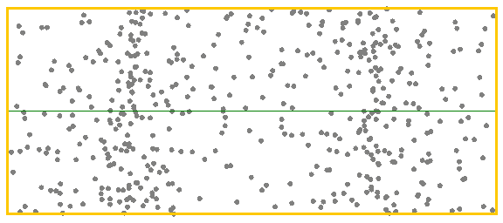
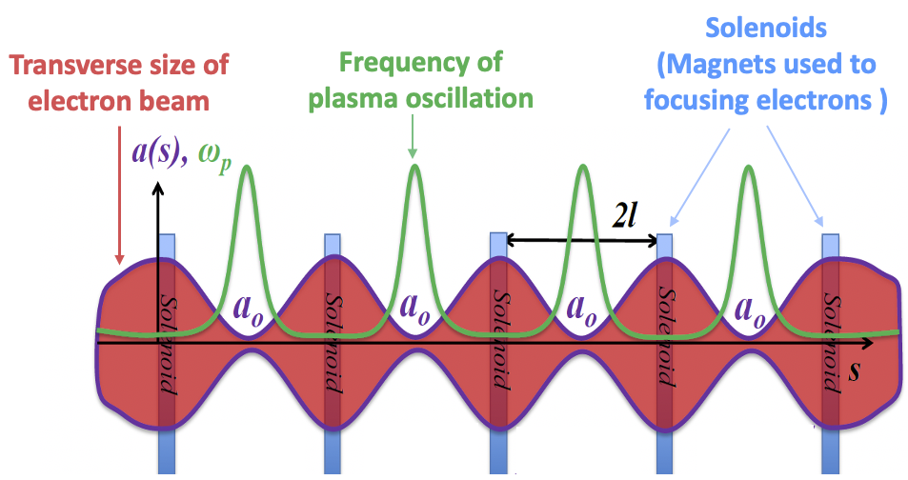


Plasma-Cascade Instability
Longitudinal plasma oscillation with periodically varying plasma frequency
Betatron motion in a FODO cell
Stability condition
$$k_{β}$$
$$k_{sc}$$

Slide 5
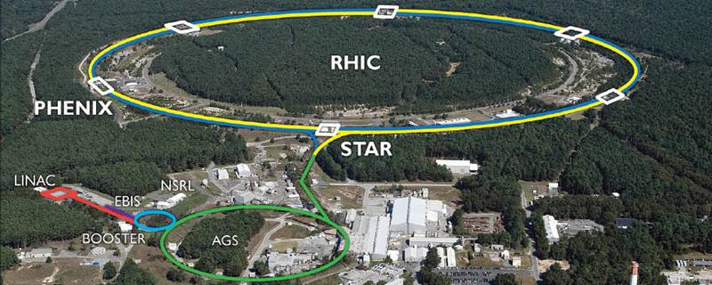
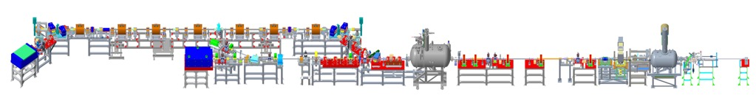
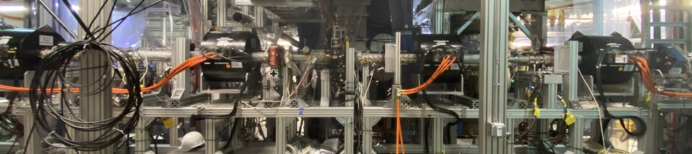
CeC experiment at RHIC
4-cell PCA
Kicker
Modulator
RHIC ion beam
Bunching cavity
Time-resolved diagnostics beamline
13.1 MV SRF linac
Ballistic bunch compression
1.25 MV SRF
photoelectron gun
Parameter
Charge per bunch, nC | 1.5
Peak current, A | 50
Normalized emittance, RMS, μm | 1.5
Beam energy (inj), MeV | 1.75
Final beam energy, MeV | 14.56
Energy spread, RMS | < 2x10⁻⁴
Bunch rep-rate, kHz | 78
Solenoids for Plasma-Cascade Amplifier
7

Slide 6
Overall Structure of CeC Prediction
Ion’s initial condition
x, x’, y, y’, t, E
… … … … … …
… … … … … …
Kicks due to CeC
dx’, dy’, dE
… … … …
… … … …
A. Prediction of the single pass kicks received by an ion in the cooling section
Interpolation
B. Long term prediction for circulating ions
CeC
Ion bunch

Slide 7
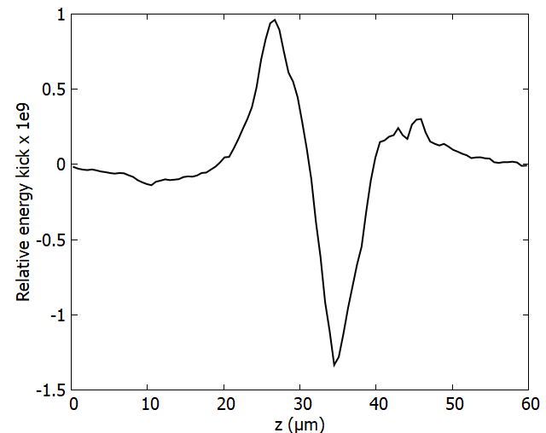
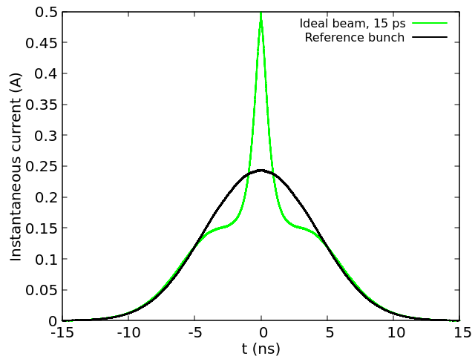
What has been done in the past...
In the past, our preliminary approach for predicting the cooling performance is the following:
Find a set of peak current, emittance and energy spread of the electrons (via 3D SPACE simulation) required to achieve the desired results for cooling (Modulation signal, PCA gain, cooling force)
Peak current: 50A
Norm. emit.: 1.5 μm
RMS ener. spread: 2e-4
Find the proper settings for the electron accelerator (via beam dynamic simulations, IMPACT-T) so that the desired parameters can be achieved (or succeed) over a sufficient range (10ps~15ps) around the bunch center.
Ion bunch profile after 40 minutes of cooling with 15 ps of effective cooling range
Applying the same cooling force from step 1 to all ions within the 10ps~15ps range where the electron beam parameters are equal to or better than the required parameters

Slide 8
Limitations of the previous approach
The previous approach is valid when the electrons' properties, i.e. peak current, emittance, energy spread and TWISS functions, are relatively uniform within the 10ps~15ps range so that the cooling force at the kicker section does not vary significantly within that range.
In addition, the previous simulation for the ions does not include the dependance of the cooling force on the transverse location of the ion. When the electron beam size is equal to or larger than that of the ion beam, this effects should be moderate (~ a factor of 2 from 1-D theoretical estimate).
When the above assumptions are not satisfied, more accurate simulations are needed.

Slide 9
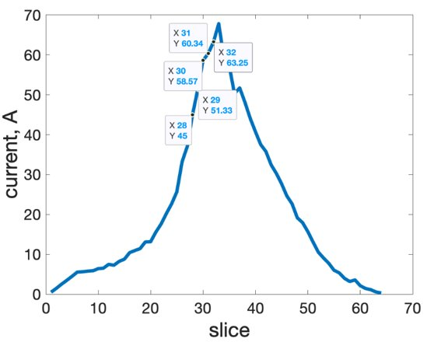
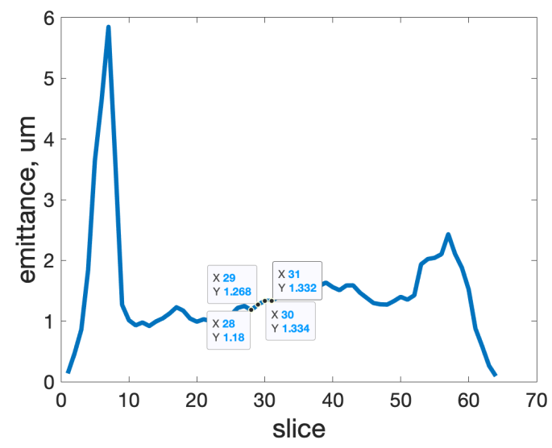
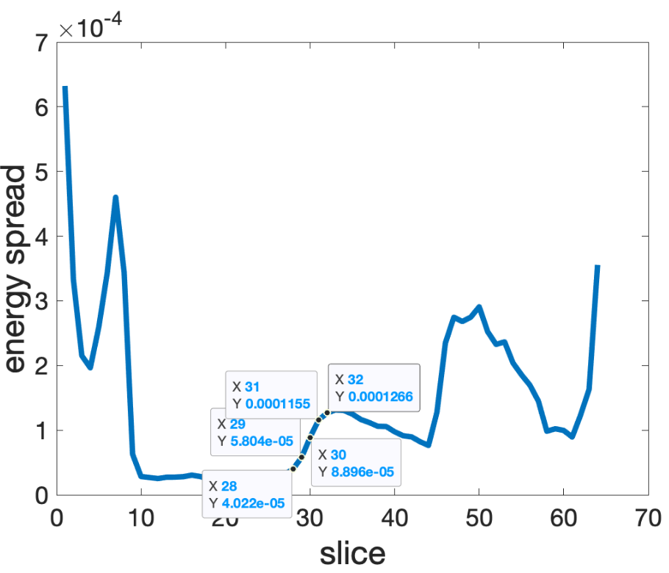
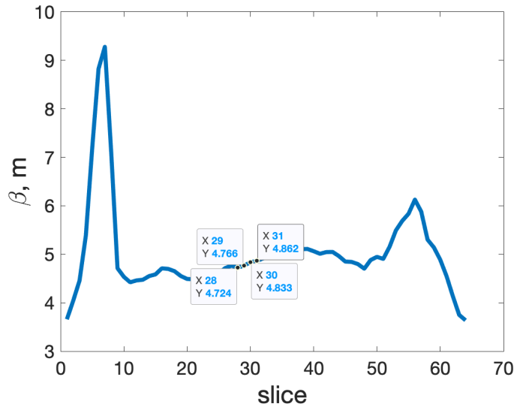
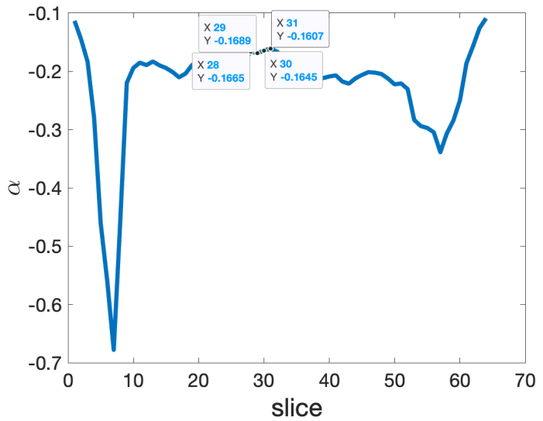
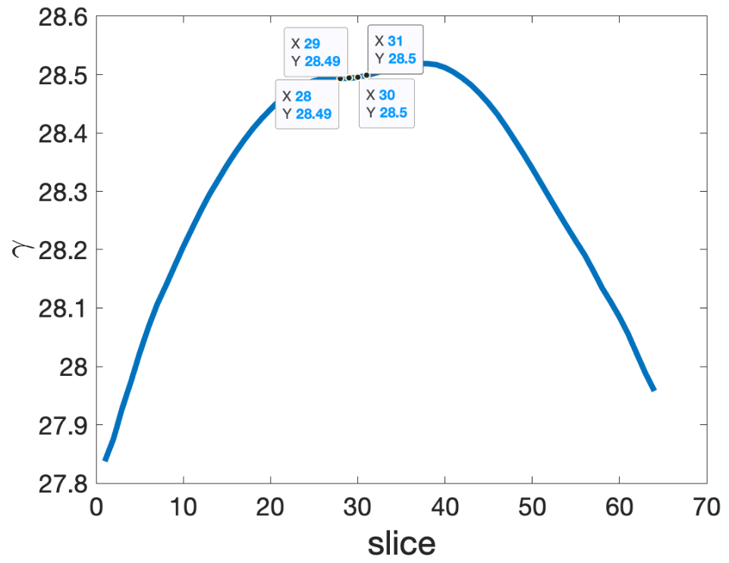
Dependance of the cooling force on the longitudinal position of the ion:
Variation of the electrons' parameters
Courtesy to Y. Jing and J. Ma
~35% variation in the ~10ps range
~10% variation in the ~10ps range
~a factor of 3 variation in the ~10ps range
~3% variation in the ~10ps range
~5% variation in the ~10ps range
~0.035% variation in the ~10ps range

Slide 10
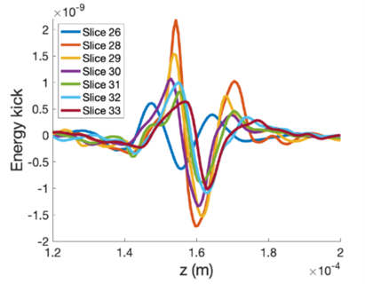
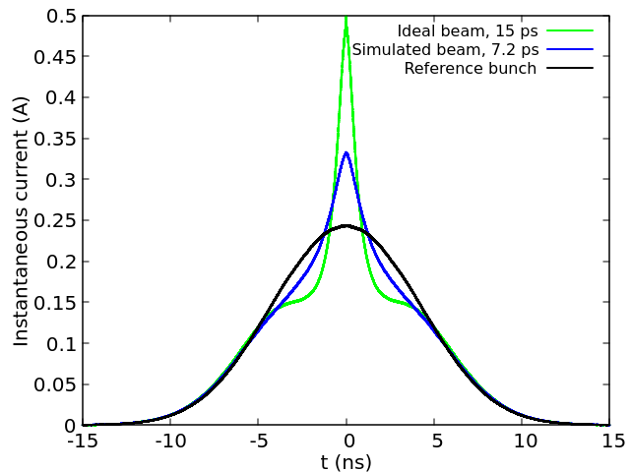
Dependance of the cooling force on the longitudinal position of the ion:
Impact to the cooling performance
Slice 26
Slice 28
Slice 29
Slice 30
Slice 31
Slice 32
Slice 33
Electron bunch
8.4 ps
Courtesy to J. Ma

Slide 11
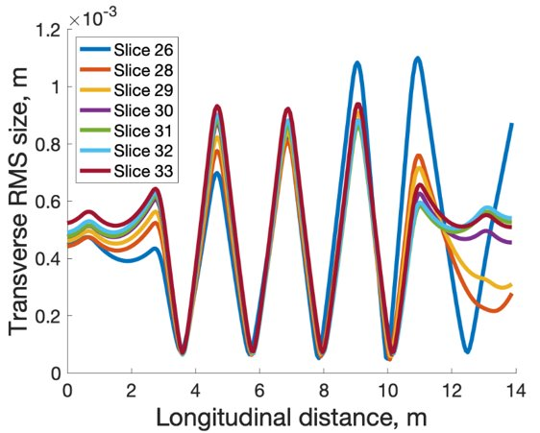
What have we missed...
Slice with the best cooling force at the bunch center is slice #28, which happens to be the slice with minimal transverse size, indicating that we need to take the transverse dependance of the cooling force into account.
Slice #28
Courtesy to J. Ma

Slide 12
Latest SPACE simulation results for e beam size
Courtesy to J. Ma
ion rms beam size
Poor spatial overlapping of the electrons with the ions can reduce the cooling effects.
In order to properly study the effects, one need to obtain the dependance of the cooling energy kick on the transverse offset of the ion.
As a start, we adopted two analytical models of the transverse dependance of the cooling field.

Slide 13
Dependance of cooling force on the transverse location of the ion:
Disc models
The longitudinal electric field can be found by solving the Poisson’s equation for given charge distribution
Gaussian disc
Uniform disc (step function for transverse density)

Slide 14
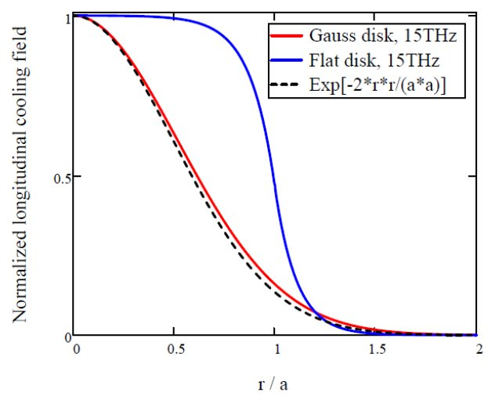
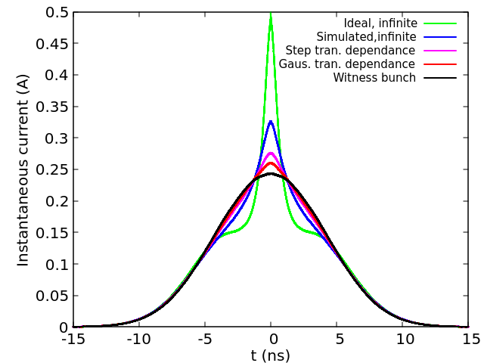
Dependance of cooling force on the transverse location of the ion: Disc models
The transverse dependance of the cooling force can significantly reduce the cooling performance since the ion beam has transverse rms size of 0.8-1 mm and most ions don’t see the electrons.

Slide 15
Updated electron distribution
We started to explore the possibilities to make the electron bunch more uniform by adjusting the laser profile at the cathode. It is still work in progresses.
Current profile at the cooling section
~50% variation in the ~13ps range
Current profile out of the Gun, formed with 4 individual laser pulses.
Courtesy to Y. Jing and J. Ma

Slide 16
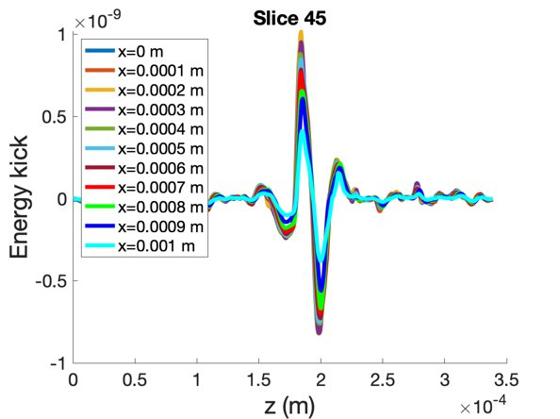
Simulated cooling forces with transverse offsets at the kicker
By introducing the transverse offset to the ion in the kicker section, cooling forces are obtained at 11 transverse locations for each slice.
Courtesy to J. Ma

Slide 17
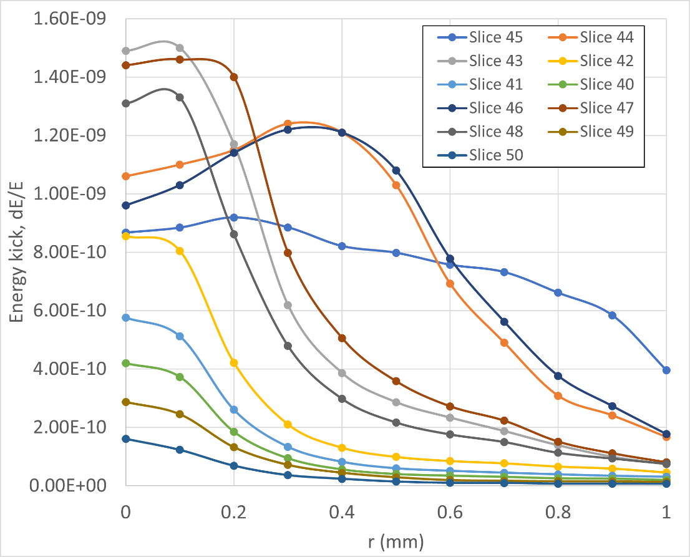
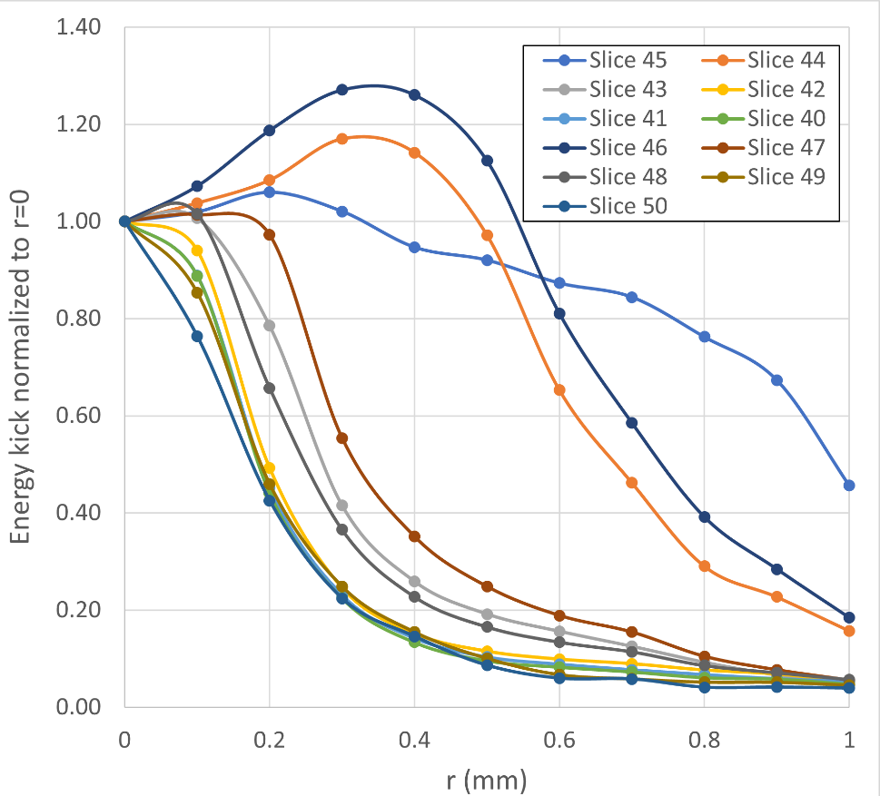
Amplitude of the cooling energy kick
For better visibility of the transverse distribution of the cooling force, we plot the amplitude of the energy kick curve.
Amplitude of the energy kick, i.e.
Normalized amplitude, i.e.

Slide 18
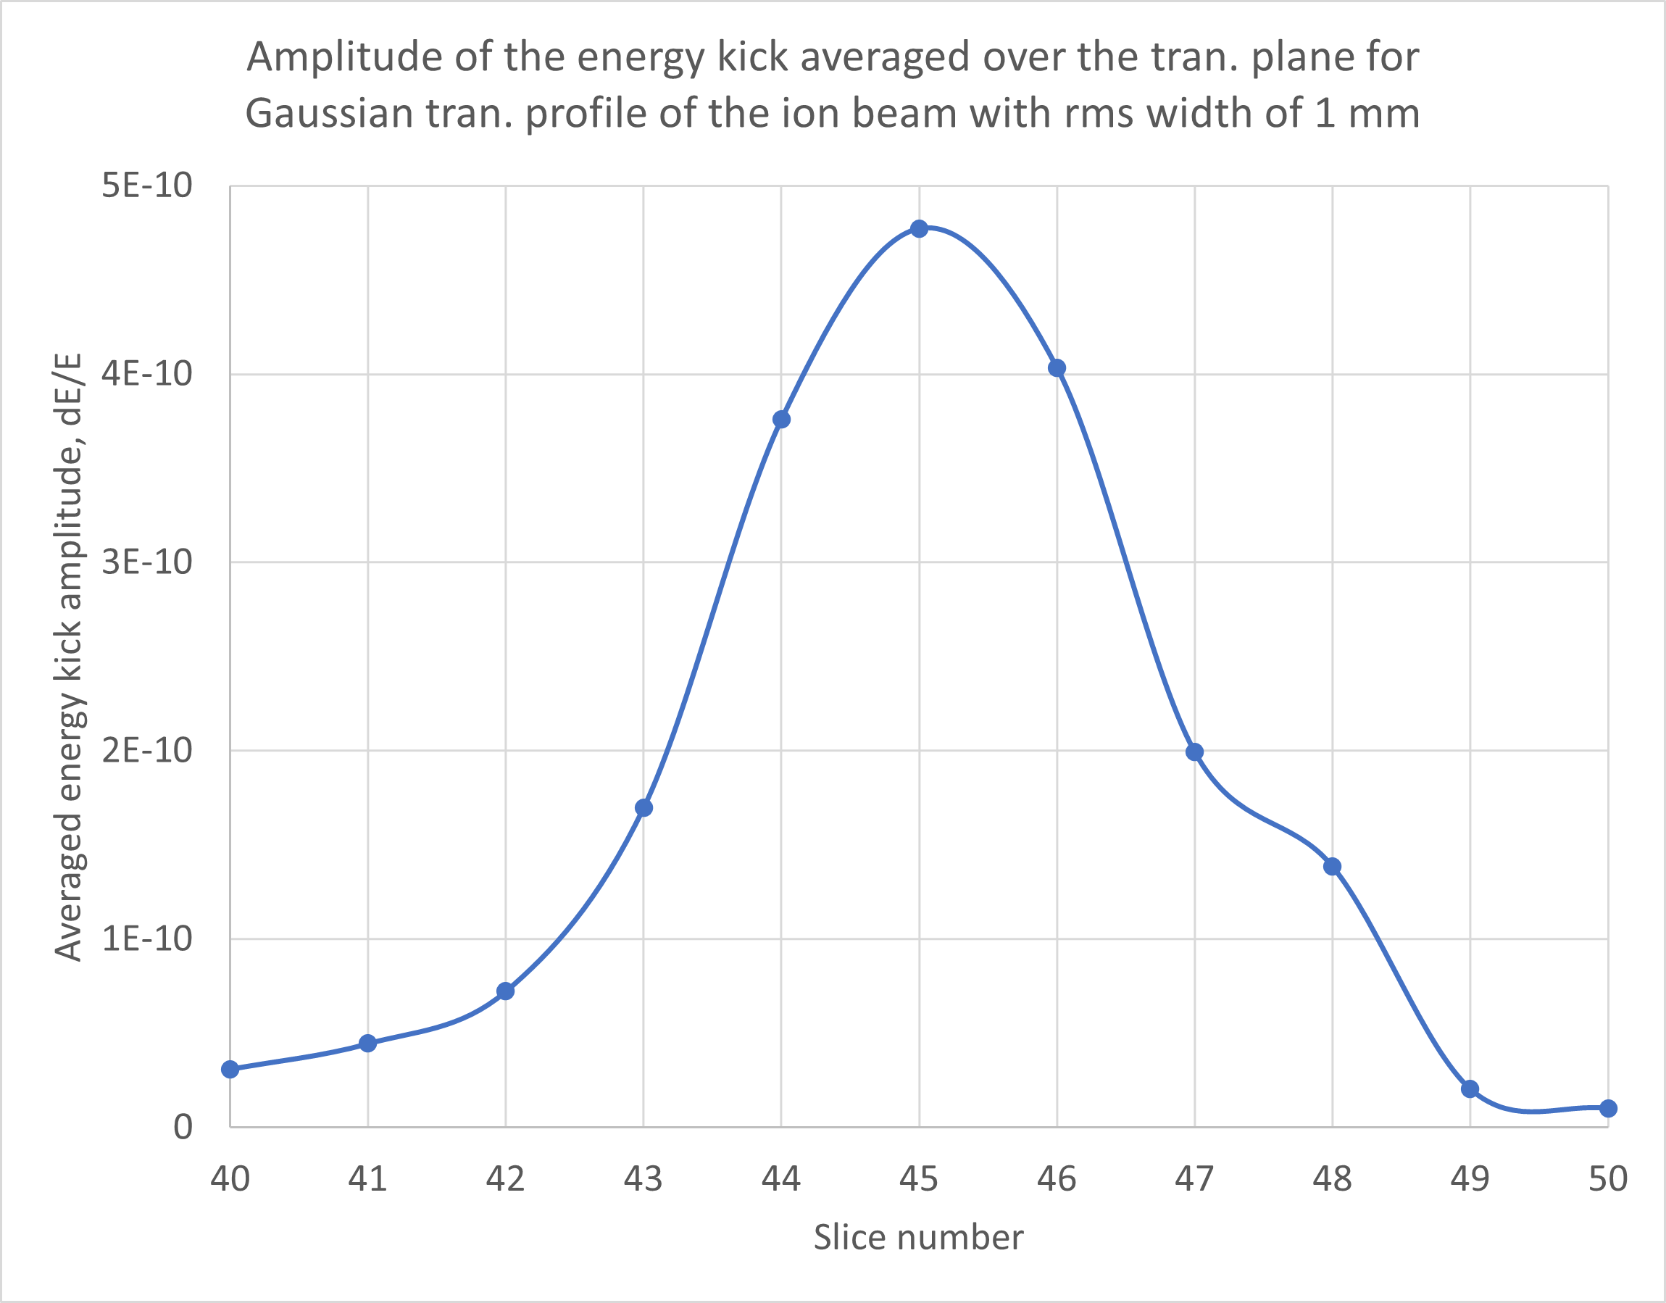
Averaged cooling force over the transverse profile of the ion bunch
The averaged amplitude of the energy kick over the transverse profile of the ion bunch could serve as a reasonable quantity for optimizing cooling force.
Judging from this quantity, the matched slice, i.e. slice #45 has the maximal contribution for cooling the ion bunch
For more accurate evaluation of the cooling performance, the ion tracking code is used.

Slide 19
Implementing the transverse dependance of the cooling force into the ion tracking code
Slice 48
Slice 49
Slice 50
r₁
Electron bunch
Slice 40
Slice 41
Slice 42
Slice 43
Slice 44
Slice 45
Slice 46
Slice 47
r₂
r₃
...
r₁₁
13.2 ps
Courtesy to J. Ma

Slide 20
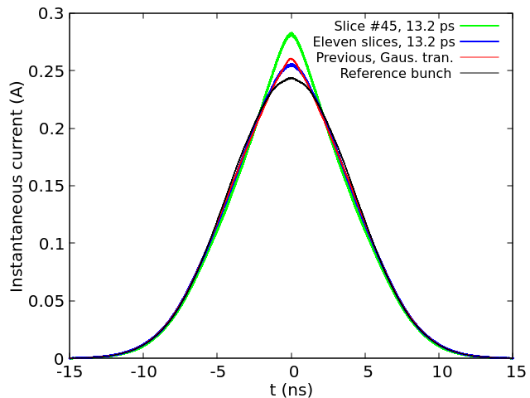
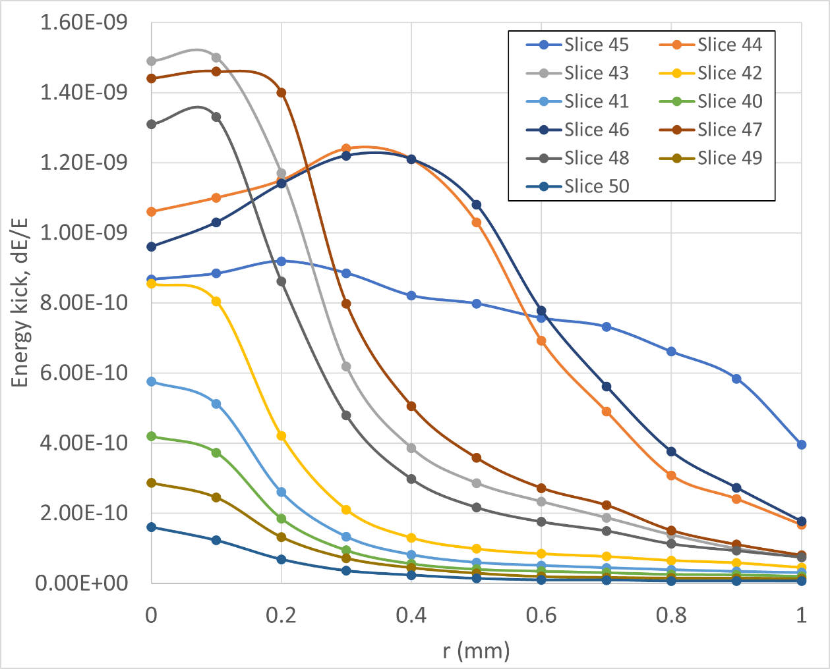
Results from ion tracking with 2D interpolation
Flattop laser profile results in triangular longitudinal charge distribution, which does not lead to better cooling performance compared with the previous set up.
The cooling performance can be improved by a factor of 2~3 if we can make all 11 slices work like slice #45.

Slide 21
Why the cooling performance with updated electron distribution is even worse than the old one with Gaussian transverse profile?
The cooling force at the bunch center gets smaller for the updated distribution;
The cooling force decrease faster with transverse offsets of the ion for most of the slices (8 slices out of 11 slices).
with previous electron distribution
with updated electron distribution

Slide 22
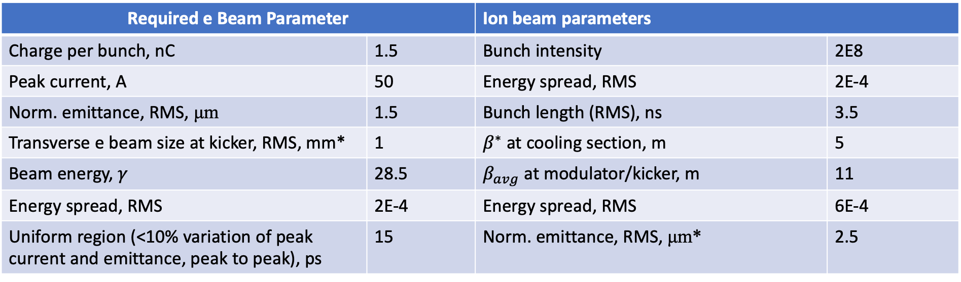
Required parameters for demonstrating CeC
We are currently optimizing the electron accelerator and the cooling section magnets so that the followings can be achieved for the electron bunch:
    Peak-to-peak variation of the instantaneous current stay below 10% over a duration of 15 ps;
    The quality of the electrons with the 15 ps duration should be sufficient to generate cooling energy kick with amplitude of 1.5e-9 at the center of the bunch;
    The transverse RMS size of the cooling force should not be smaller than the RMS size of the ion.
Required e Beam Parameter |  | Ion beam parameters
Charge per bunch, nC | 1.5 | Bunch intensity | 2E8
Peak current, A | 50 | Energy spread, RMS | 2E-4
Norm. emittance, RMS, μm | 1.5 | Bunch length (RMS), ns | 3.5
Transverse e beam size at kicker, RMS, mm* | 1 | $β^{∗}$ at cooling section, m | 5
Beam energy, $γ$ | 28.5 | $β_{avg}$ at modulator/kicker, m | 11
Energy spread, RMS | 2E-4 | Energy spread, RMS | 6E-4
Uniform region (<10% variation of peak current and emittance, peak to peak), ps | 15 | Norm. emittance, RMS, μm* | 2.5
* In case we can reduce ions’ emittance by scraping, the electron beam size should be reduced accordingly.

Slide 23
Our plan
Continue exploring the possibility of generating electrons with more uniform current distribution by adjusting the laser profile at the cathode;
Exploring the possibility to improve the transverse matching of the electron slices in the kicker section by adjusting the betatron phase advances in the electron accelerator and the cooling section (similar to the concept of emittance compensation);
Exploring the possibility of increasing the beta function of the electron beam at the modulator and kicker so that the cooling force does not decrease too fast with the transverse offset of the ion;
Investigating how the cooling performance changes with the emittance of the ion bunch and exploring the possibilities of reduce transverse emittance of the RHIC ion beam by scraping off large amplitude ions (IBS rate will increase.).
Explore possibilities of asymmetric IR2 at the modulator and kicker to optimize cooling performance.
Continue improving tracking code
  Introduce transverse offset of the ion at both the modulator and the kicker section. Obtain cooling wakes for ions with various transverse offset through the cooling section. Investigate how the cooling performance is affected by the transverse offset.

Slide 24
Summary
The previous simulations of the CeC experiment assumes a uniform electron bunch with no significant change of the beam parameters over a 15 ps longitudinal range;
Recently, we improved the simulations of the CeC experiment to include the dependance of the cooling force on the longitudinal and transverse location of the ion in the electron bunch. From the preliminary results of these more accurate simulations, we found that the cooling force strongly depends on the local properties, such as peak current and transverse beam size, of the electrons. The quality of the electron bunch, especially the uniformity of the current profile and transverse matching at the cooling section, as predicted by the beam dynamics simulation appears to be insufficient for achieving the desired cooling performance;
We are currently optimizing the electron accelerator and the cooling section magnets so that the followings can be achieved for the electron bunch:
    Peak-to-peak variation of the instantaneous current stay below 10% over a duration of 15 ps;
    The quality of the electrons with the 15 ps duration should be sufficient to generate cooling energy kick with amplitude of 1.5e-9 at the center of the bunch;
    The transverse RMS size of the cooling force should not be smaller than the RMS size of the ion.
The current simulations only includes 3-D spatial dependance of the cooling force. Dependance on the transverse angle of the ion will be included in the future, which may change the results shown for the cooling performance.

Slide 25
Acknowledgements
We would like to thank A. Fedotov, S. Seletskiy, D. Kayran, I. Pinayev and K. Shinh for many helpful discussions on this topic.

Slide 26
Thank you!

