Slide 1
Design to Achieve Uniform Electron Beam in Coherent Electron Cooling
Yichao Jing, for the CeC PoP team
COOL’23 workshop, 10/12/2023

Slide 2
Outline
Beam dynamics in CeC PoP
  Optimization with space charge and wakefield
  Chromatic aberration and Coherent Synchrotron Radiation effects
Beamline diagnostics and comparison with simulation
Path to achieve uniform beam distribution for compressed beam
Summary

Slide 3
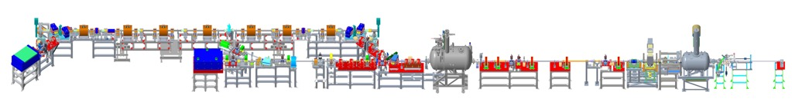

Beam dynamics/requirements in accelerator for CeC X
4-cell PCA
Kicker
Modulator
RHIC ion beam
1.25 MV SRF
photoelectron gun
Bunching cavity
Time-resolved diagnostics beamline
13.1 MV SRF linac
Ballistic bunch compression
Start to end electron beam dynamics simulation from photocathode to the common section
Each element modeled with real geometry with measured fields
Lattice matching design (Common section and/or doglegs)
Collective effects
Space Charge effect (ASTRA/GPT/IMPACT-T/PARMELA)
Chromatic aberration and Coherent Synchrotron Radiation effect (ELEGANT/IMPACT-T/CSRTRACK)
Wakefields (CST/ECHO/ABCI)
High brightness electron beam required by CeC X
peak electron current ( > 50 A), slice Emittance < 1.5 micron, slice Energy spread < 0.02 %
Core of the beam has uniform beam properties (e.g., flat top longitudinal distribution)

Slide 4
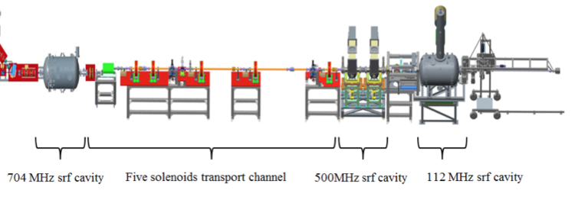
Coherent electron Cooler – Low energy beam transport (LEBT)
For CeC proof of principle (PoP) experiment, space charge effect is dominated in the low energy region.
Different simulation codes were benchmarked to have reasonable agreement in results (will focus on IMPACT-T simulation in this talk).
Various effects (wakefields, vacuum chamber effects etc…) were implemented in codes to study/verify their importance to beam dynamics.
Parameter | Value
Charge per bunch, nC | 1.5
Peak current, A | 50
Normalized emittance (slice), RMS, μm | 1.5
Beam energy, Gamma | 28.5
Beam energy, MeV | 14.56
Energy spread (slice), RMS | < 2x10⁻⁴
Bunch rep-rate (CW), kHz | 78
Beam requirement
  Peak current > 50A by ballistic compression
  Slice Energy spread < 2e-4
  Slice Emittance < 1.5 mm-mrad
Optimization terms
  1+5 solenoids
  Cavities’ phases (gun, buncher, linac)
  Bunching cavity voltages (#1 and #2)
  Adv., beam radius at cathode, laser pulse duration, etc…

Slide 5
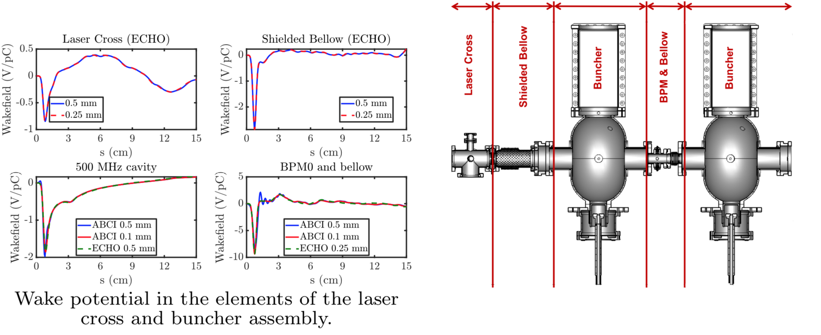
Wakefields in LEBT
© I. Petrushina
10 different types of wakes (cavities, bellows, BPMs, PMs, etc…) from after gun to after linac were simulated in ABCI/ECHO. Cross-checking was performed and calculated wakes were imported into IMPACT-T.
Total longitudinal wakefield < 20 V/pC. For our operation regime (charge 0.6 – 1.5 nC), the resulted effect in beam distribution is small.

Slide 6
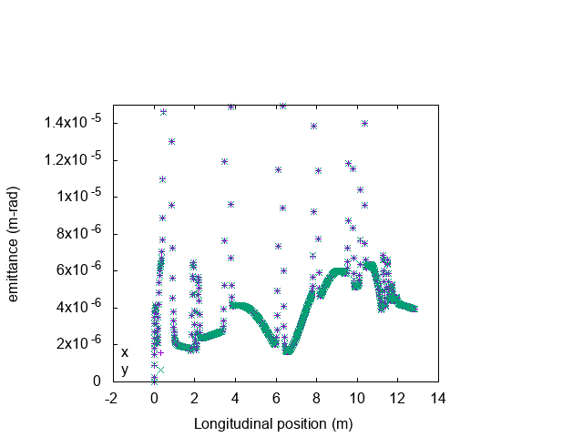
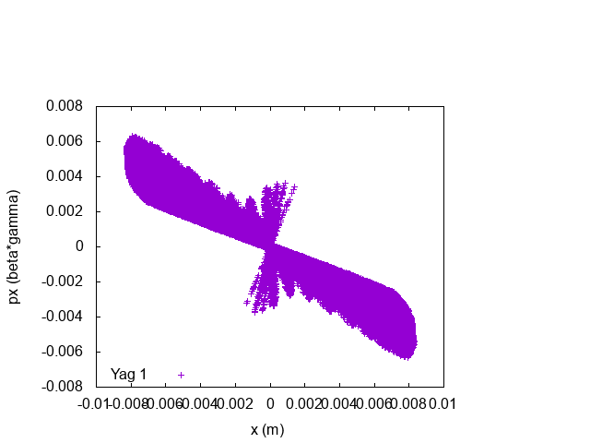
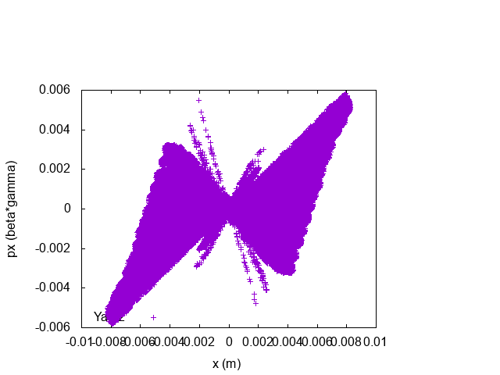
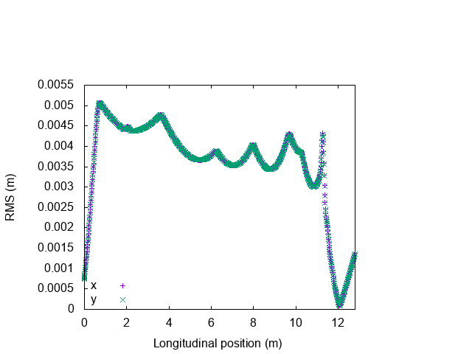
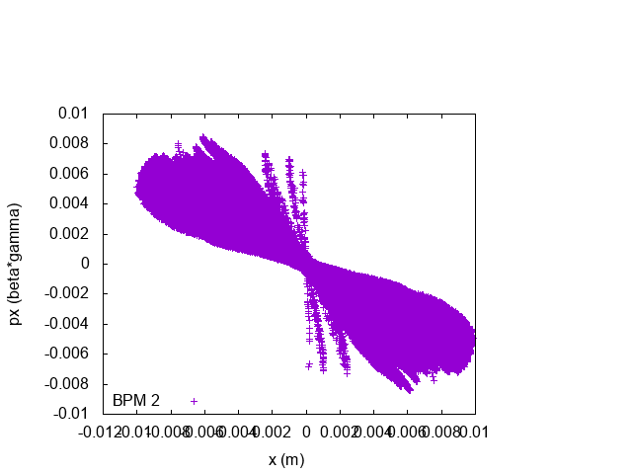
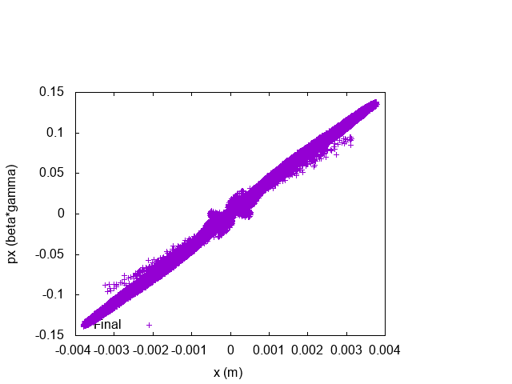
Low Energy Beam Transport Optimization
Yag 1
Yag 2
BPM 2
Final
Emittance compensation by aligning all slices are not only important for reducing projected emittances but also key to make core part of the beam having same/similar TWISS parameters.

Slide 7
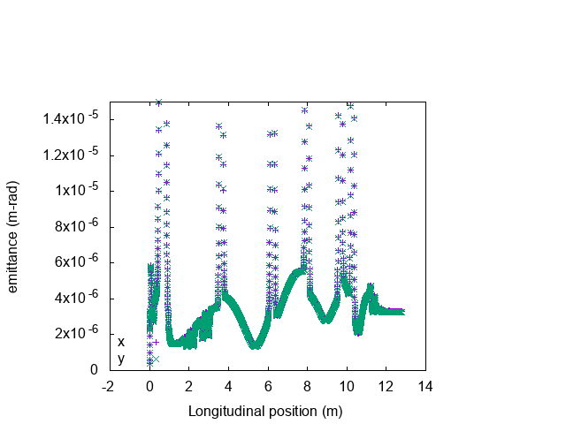
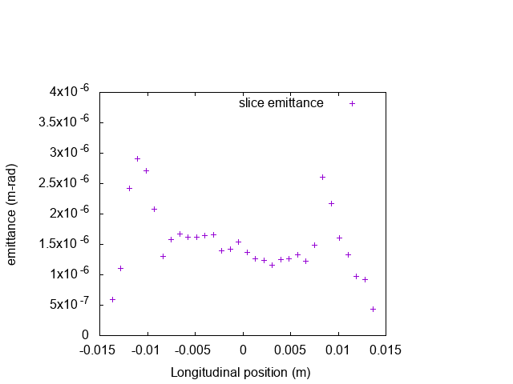
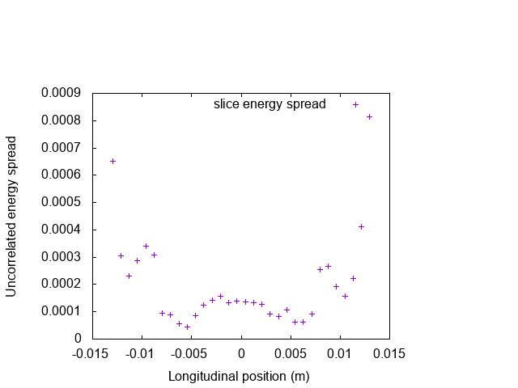
Optimized beam setup for low noise and high gain demonstration
Charge per bunch | 1.5 nC
σ_{s}, FWHM | 380 ps
Beam radius | 1.88 mm
Projected norm. emittance ~ 3.3 um
66.9% of the beam
Core part of the beam’s norm. emittance < 1.5 um, slice energy spread ~ 1e-4, peak current ~ 70 A, this type of beam setup has been used in run 20-21 and in PCA gain demonstration.

Slide 8

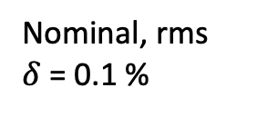
Other effects (CSR, chromatic) are not dominating
Nominal, rms
$δ$ = 0.1 %
Nominal, C = 1.5 nC
C = 10 nC
rms $δ$ = 1 %
CSR and chromatic aberration do not play an important role for our chosen beam parameters thus are not incorporated in routine simulation.

Slide 9
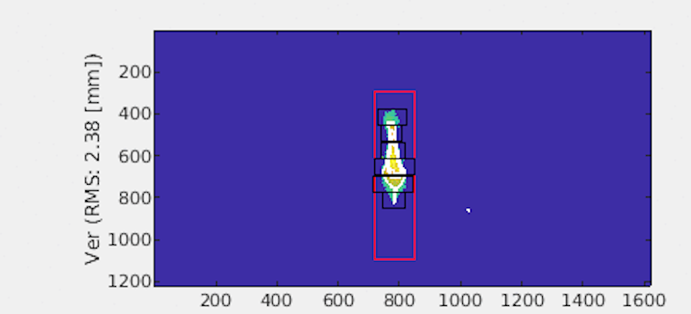
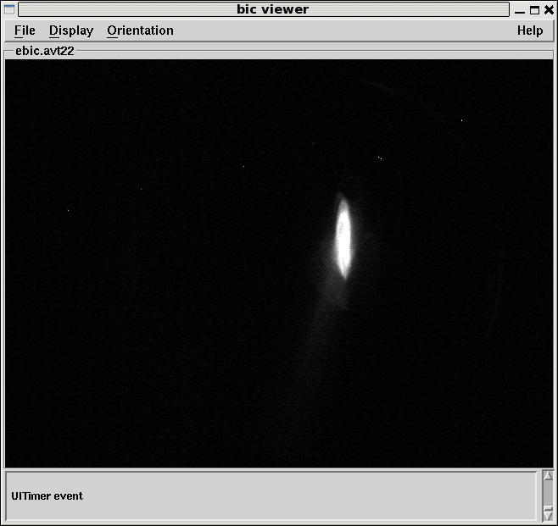
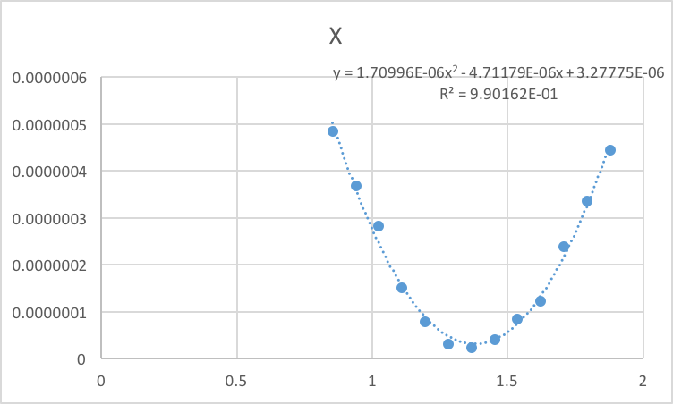
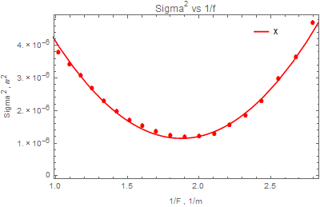
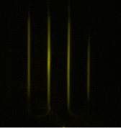
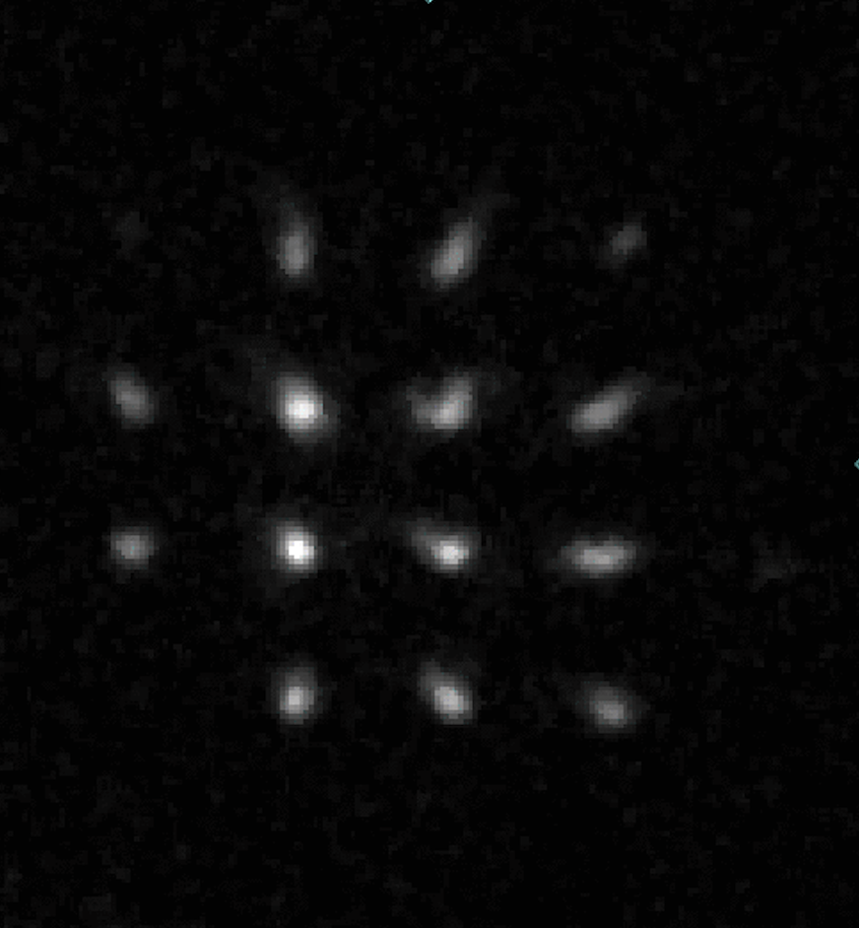
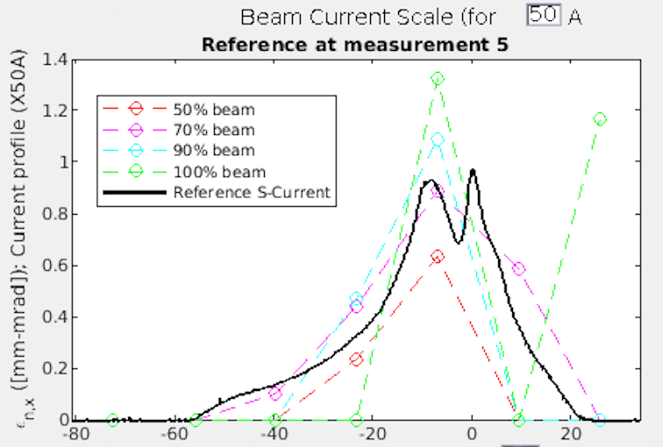
Beam measurements along the CeC beamline
4-cell PCA
Kicker
Modulator
RHIC ion beam
1.25 MV SRF
photoelectron gun
Bunching cavity
Time-resolved diagnostics beamline
13.1 MV SRF linac
Ballistic bunch compression
Beam compressed by ~ 20-40 folds after LEBT, energy spread ~ 0.1%
Quad scan, norm. emittance ~ 3.6 um
Slits/pep-pot, norm. emittance ~ 1-4 um
Sol scan, norm. emittance ~ 0.5 - 1 um
With T-Cav, slice emit. ~ 1-1.4 um, slice energy spread ~ 2e-4
Properties measured by solenoids and slits in good agreements with simulation predicted: proj. emittance ~ 3 - 4 mm- mrad, energy spread ~ 0.1%; slice emit ~ 1– 1.5 um, slice rel. energy spread < 2e-4

Slide 10
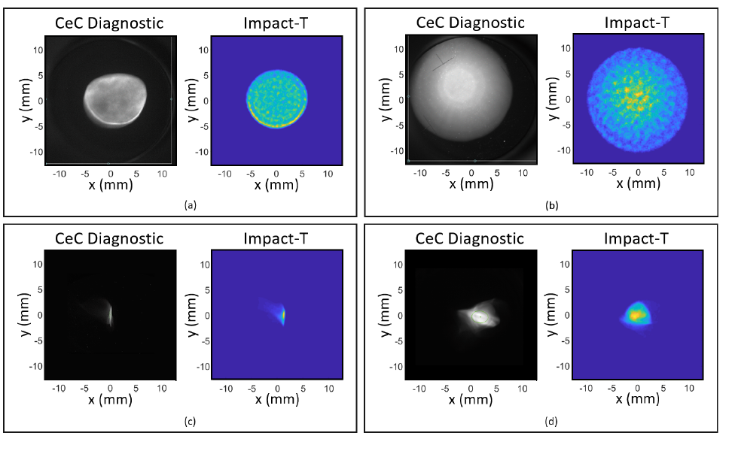
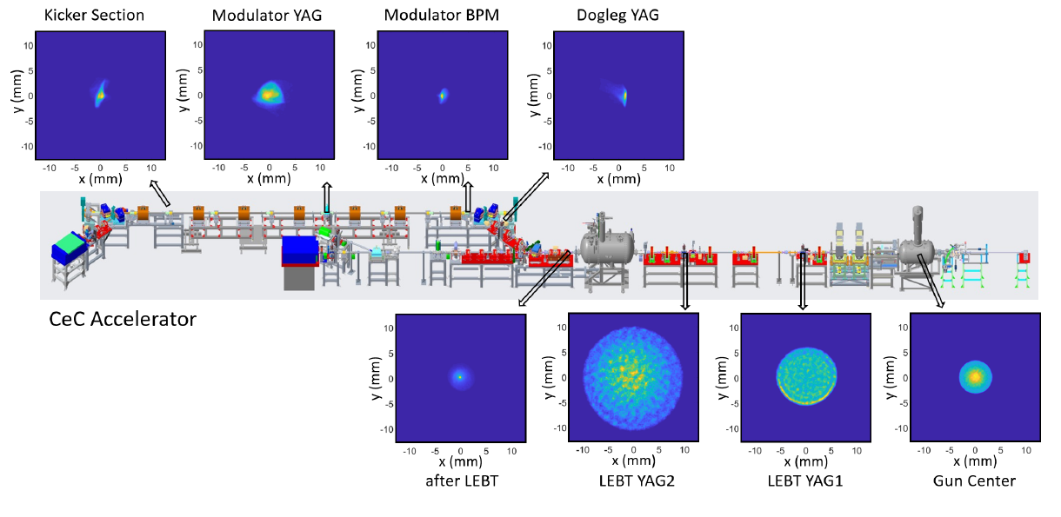
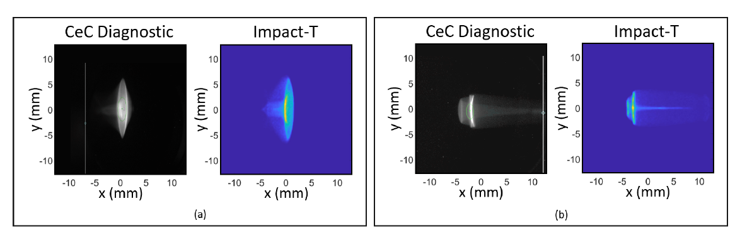
Simulation’s prediction with real beam (with misalignments/field errors)
Our simulation has qualitatively good agreement in predicting the unusual behaviors in the real beam when misalignment/field errors in the beamline are included.
© K. Shih

Slide 11
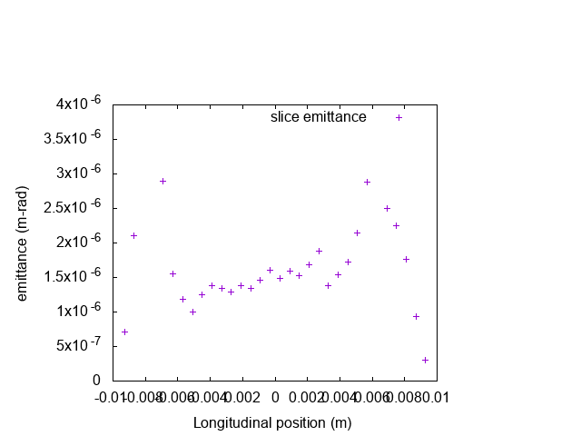
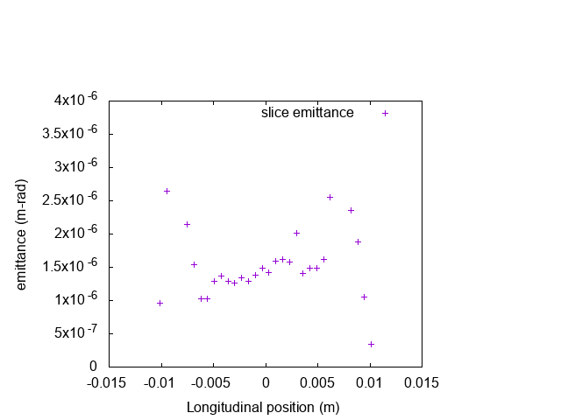
Road to beam with uniform temporal distribution – flat top initial dist. no good
Due to the strong compression and space charge dominated nature, for an initial flat top distribution, final distribution is close to triangular shape.
tail
head
Flat-top with linear chirp (real)
Gaussian
Both Gaussian and semi-flat top distributions cannot produce uniform temporal distribution for compressed beam. Need some innovative laser pattern!

Slide 12
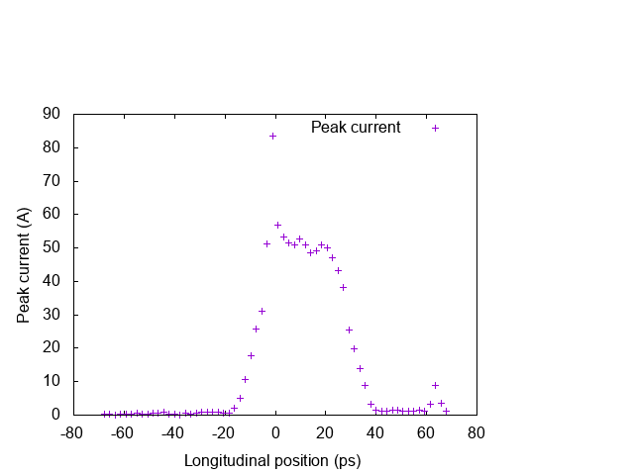
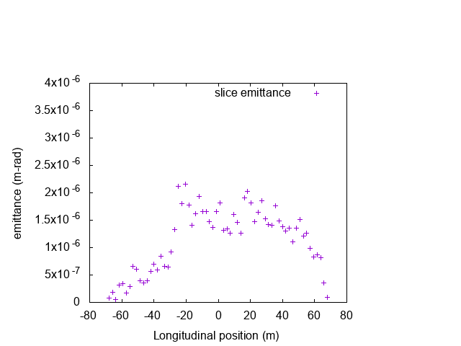
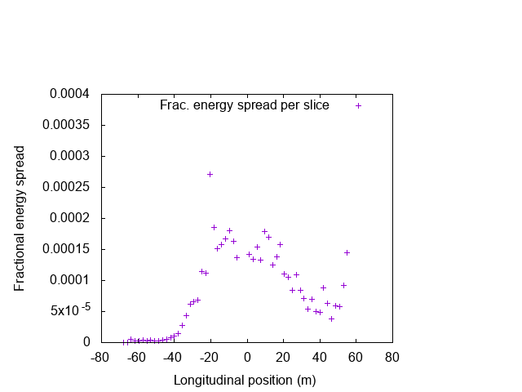
New laser pattern with combinations of Gaussian beamlets
We first start with 3 Gaussian beamlets for uniform final distribution
Laser profile: 3 degrees of freedom
Item | Unit
Side beam center | 180 ps
Beamlets’ r.m.s | 80 ps
Relative intensity center/sides | 0.5
Slice emittances (~1.5 um) and peak current (~ 50 A) are satisfactory. Slice energy spread (for core, > 1.5e-4) is too large due to long initial bunch length and strong compression.

Slide 13
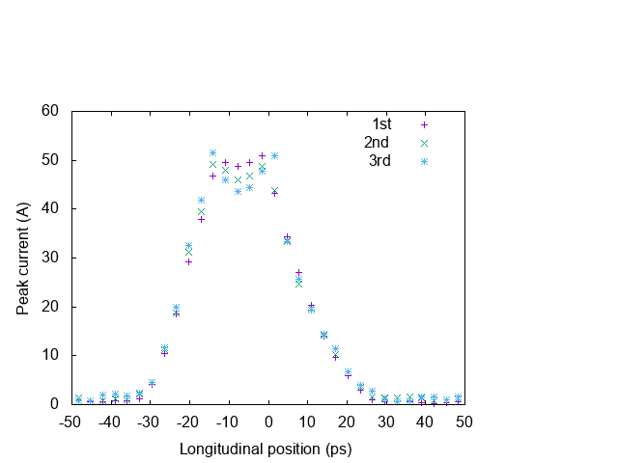
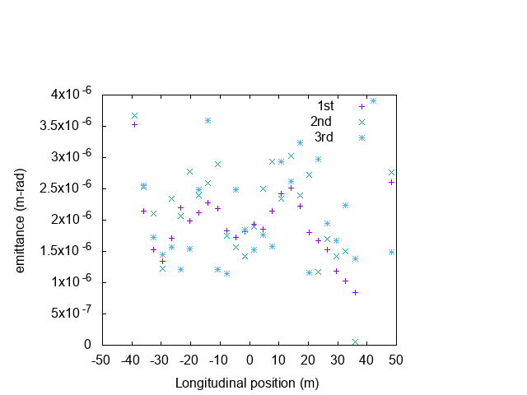
Laser pattern more Gaussian beamlets
We then used 5 Gaussian beamlets and optimized the relative strengths between beamlets
Laser profile: 3 degrees of freedom
1st: (1;0.85;0.7;0.85;1)
2nd: (1;0.75;0.5;0.75;1)
3rd: (1;0.7;0.4;0.7;1)
Initial dip’s height seems to have strong effect on the final current distribution’s uniformity. Slice emittances in the core part are 1.3 – 1.8 um (has relationship with local compression).

Slide 14
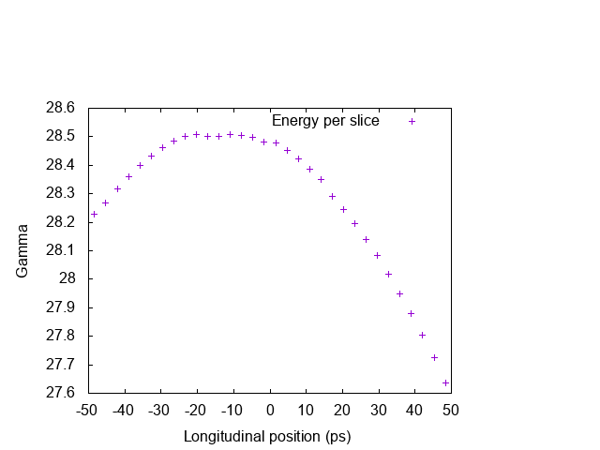
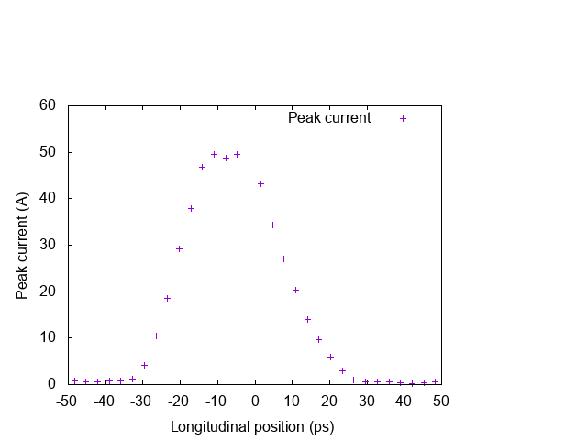
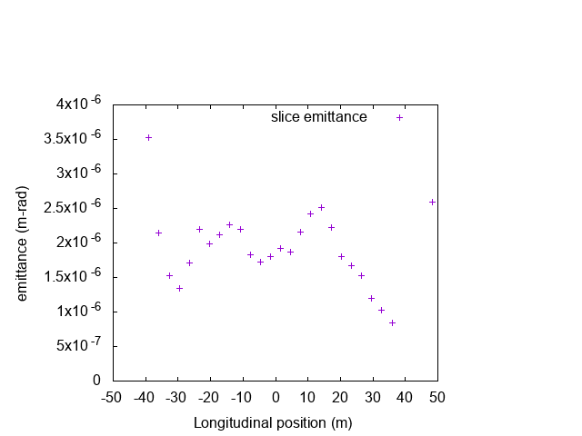
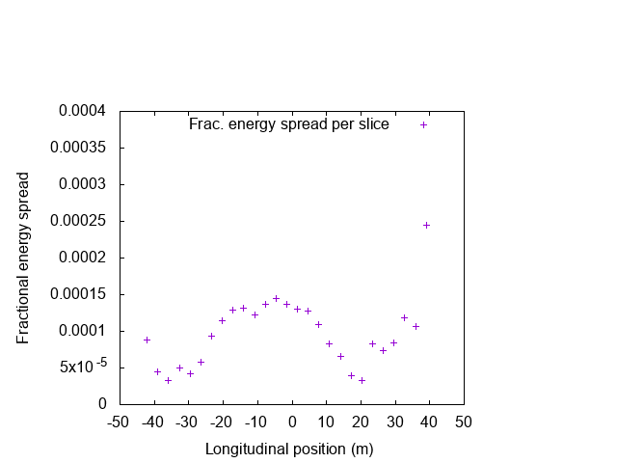
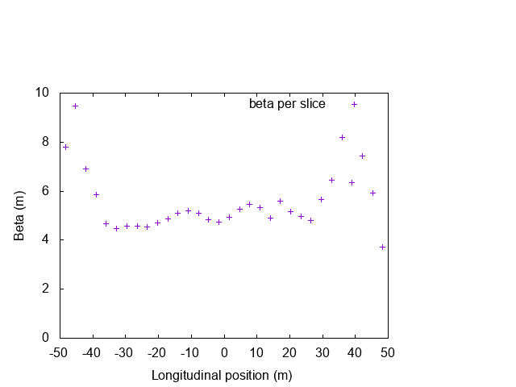
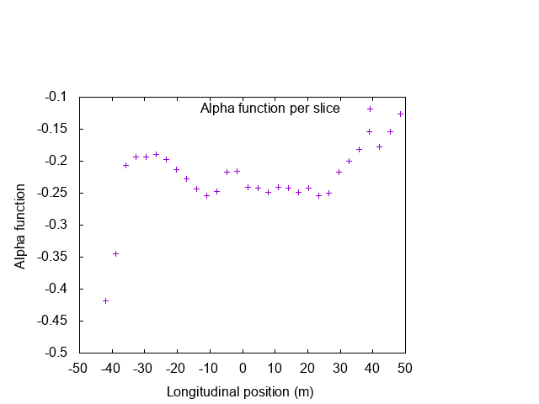
Slice performance for optimized setup (1st)
Laser profile: 3 degrees of freedom

Slide 15
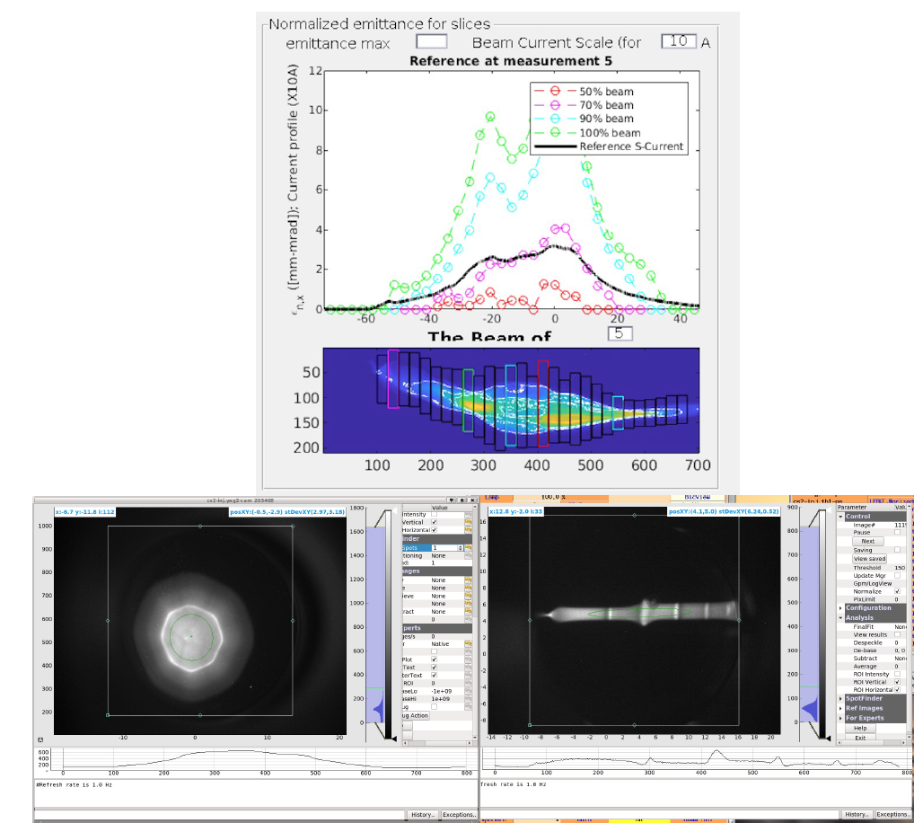
Beam measurements Run 23
Whole beam (with all 5 beamlets) has worse performance than expected.
Measured beam emittances (slice and projected) are significantly larger (2 – 2.5 times) than what we achieved earlier.
Different beamlets seem to have huge uncompensated chromatic effects when time dependent energy variation is introduced (buncher cavity on).
Density/energy modulation along the beam becomes obvious in dispersive region (dogleg) as supposed to be smooth distribution.
Laser profile: 3 degrees of freedom

Slide 16
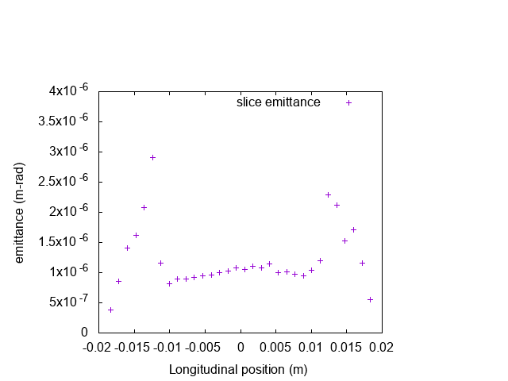
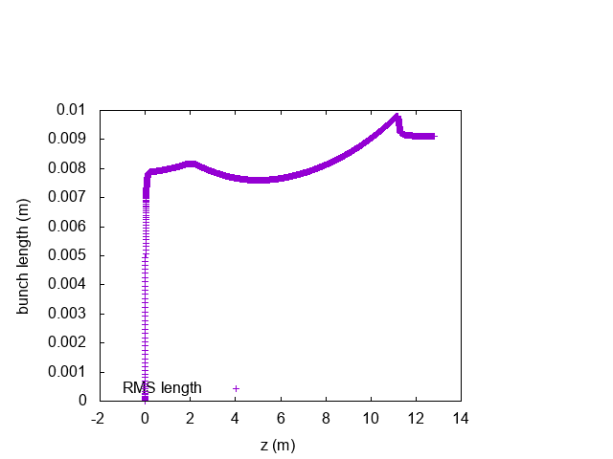
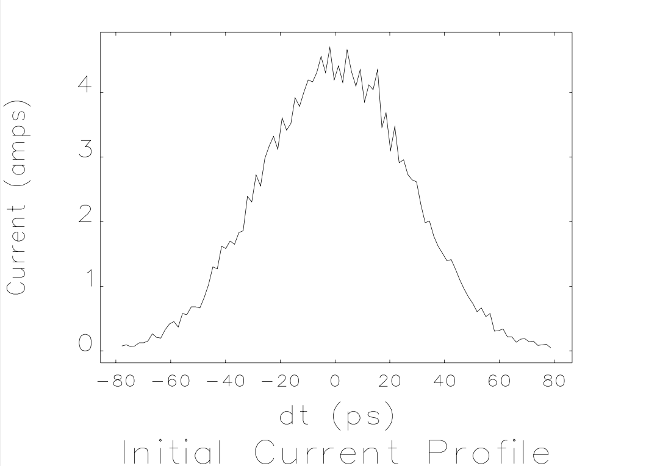
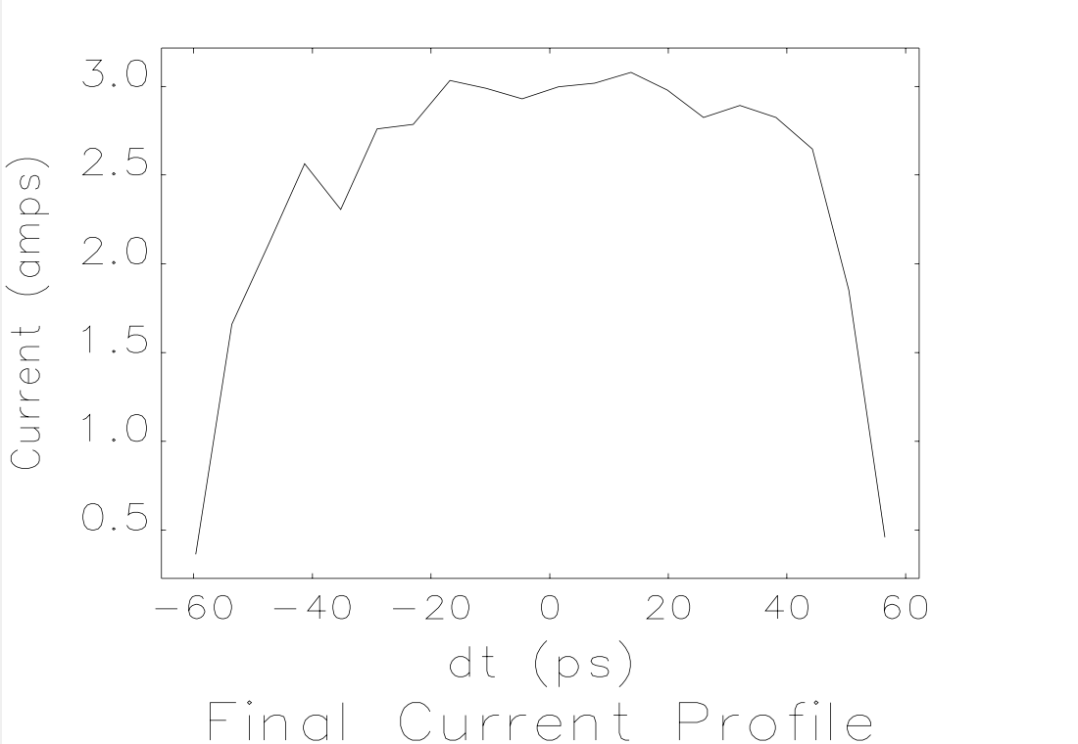
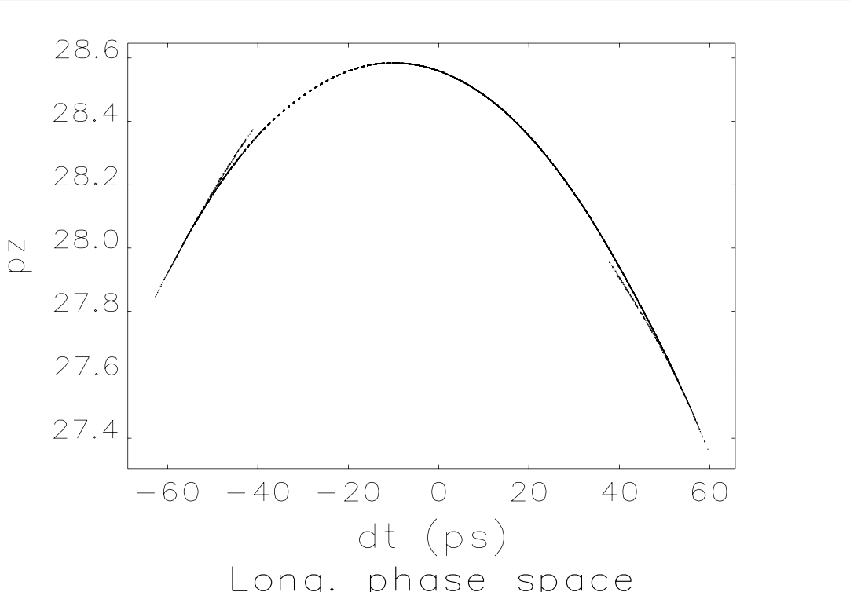
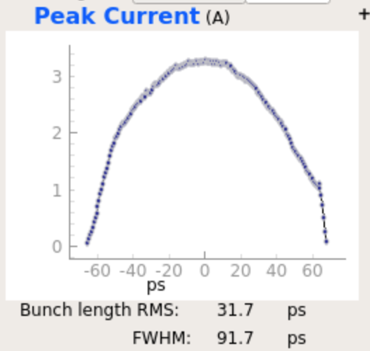
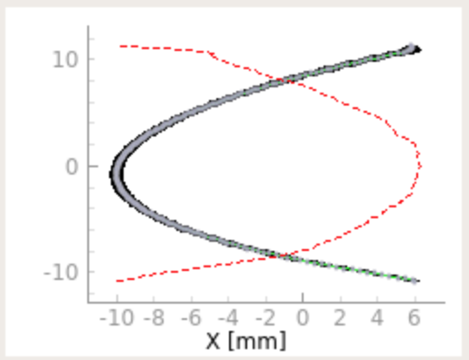
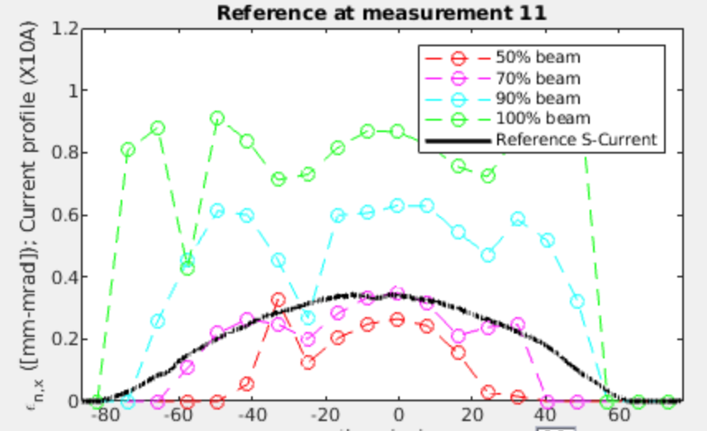
Measurements with individual beamlet
We then switch to single beamlet (by blocking others). Simulation predicts each individual beamlets’ properties (slice emit., peak current, bunch length etc) reasonably well.
Laser profile: 3 degrees of freedom
Simulated (top row) vs
measured (bot row)

Slide 17
Problems found/to solve in the coming Runs
The alignments of 5 beamlets need to be improved (smearing minimized) so that the emittance does not blow up (measured 10 um norm., slice).
When combining 5 beamlets, the relative strength of laser power is not as desired, #1,3,5 have significantly weaker power than #2,4 (fixed).
The beam test was not finished due to early RHIC operation termination (6 weeks earlier than planned) and many interruptions in operation due to high temperature and humidity.
Will put all beamlets together and measure properties when laser tuning is done.
Parameter | Sim. | Exp.
Charge per bunch, nC | 0.3 | 0.3
Bunch length, RMS, ps | 30.8 | 31.7-32.4
Bunch length, FW, ps | 119 | 120-123
Final peak current, A | 3.0 | 3.2-3.4
Normalized emittance (slice), RMS, μm | 1.0 | 0.9-1.0
Beamlets separation, ps | 55 | 54-56
Laser profile: 3 degrees of freedom

Slide 18
Summary
Beam dynamics simulation for CeC PoP experiment provides good guidance in determining beam properties under various operation modes.
New laser pattern was proposed to generate a compressed e- beam to provide uniform final beam distribution. Experiment will be performed to verify the e- beam’s properties.
Optimization in parametric space to achieve lower emittance and/or higher peak current is underway.

Slide 19
Back slides

Slide 20
