Slide 1

Experiments on Electron Cooling and Intense Space-Charge at IOTA
Nilanjan Banerjee, MaryKate Bossard, John Brandt, Young-Kee Kim, Sergei Nagaitsev, Giulio Stancari

Slide 2
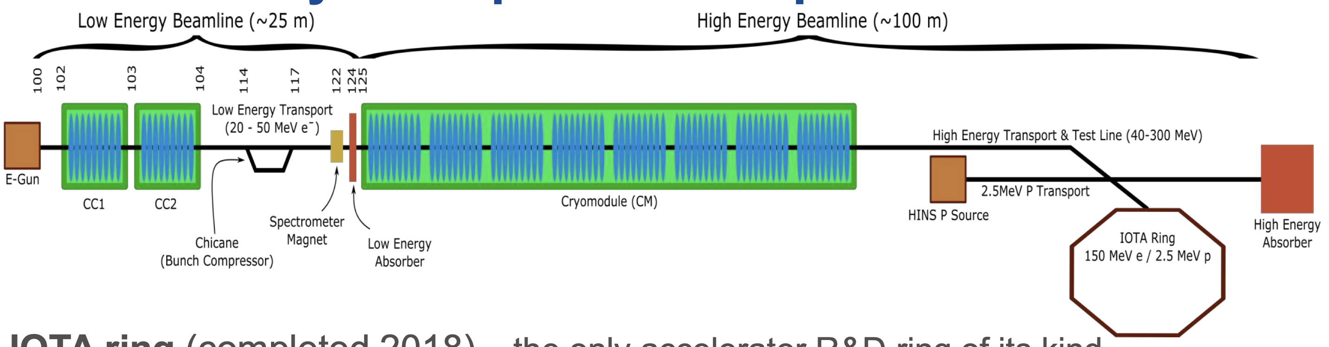
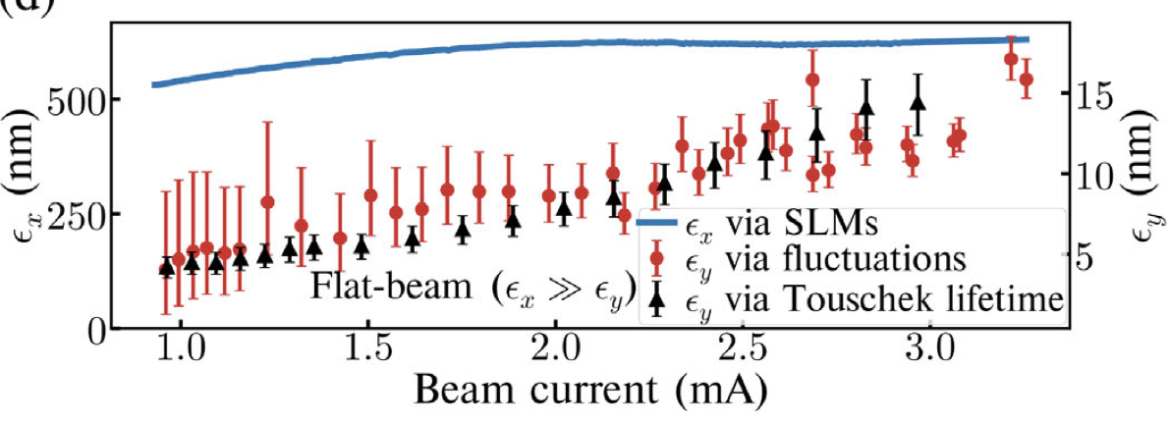
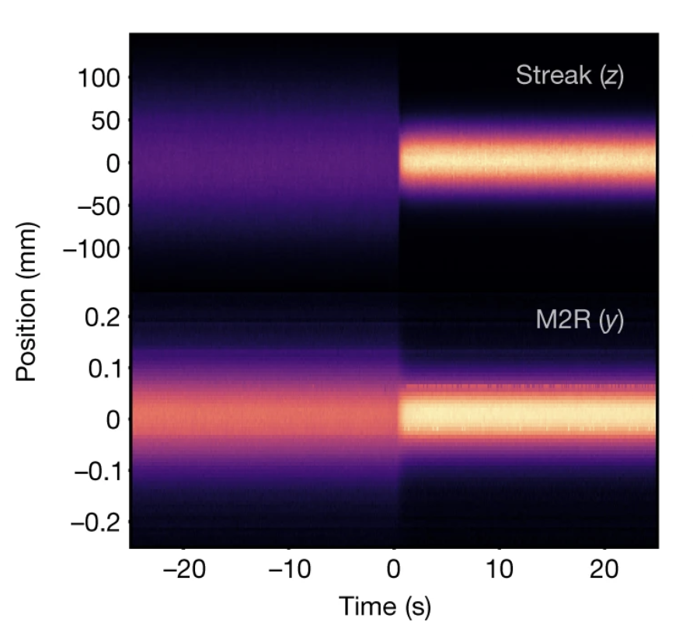
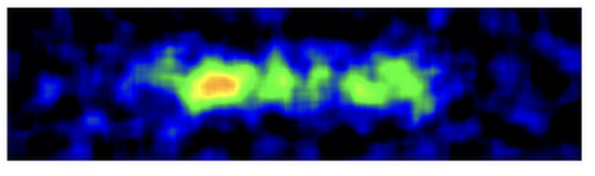
The FAST/IOTA Facility
The Fermilab Accelerator Science and Technology (FAST) facility and the Integrable Optics Test Accelerator are dedicated to beam physics research.
Reached 31.5 MV/m in 2017
Operational with 150 MeV electrons since 2018.
S. Antipov et al, JINST 12 T03002, 2017.
Wide range of research areas: Non-linear integrable optics, optical stochastic cooling, photon generation, single electron dynamics, quantum statistics of undulator radiation, coherent instabilities, electron lens and more!
I. Lobach et al., Phys. Rev. Lett. 126, 134802, 2021.
J. Jarvis, et al., Nature 608, 287–292, 2022.
A. Romanov et al., JINST 16 P12009, 2021.

Slide 3
Overview
Motivation and Conceptual Design
Beam Experiments using Electron Cooling
Hardware Configuration and Status

Slide 4
Motivation and Conceptual Design

Slide 5
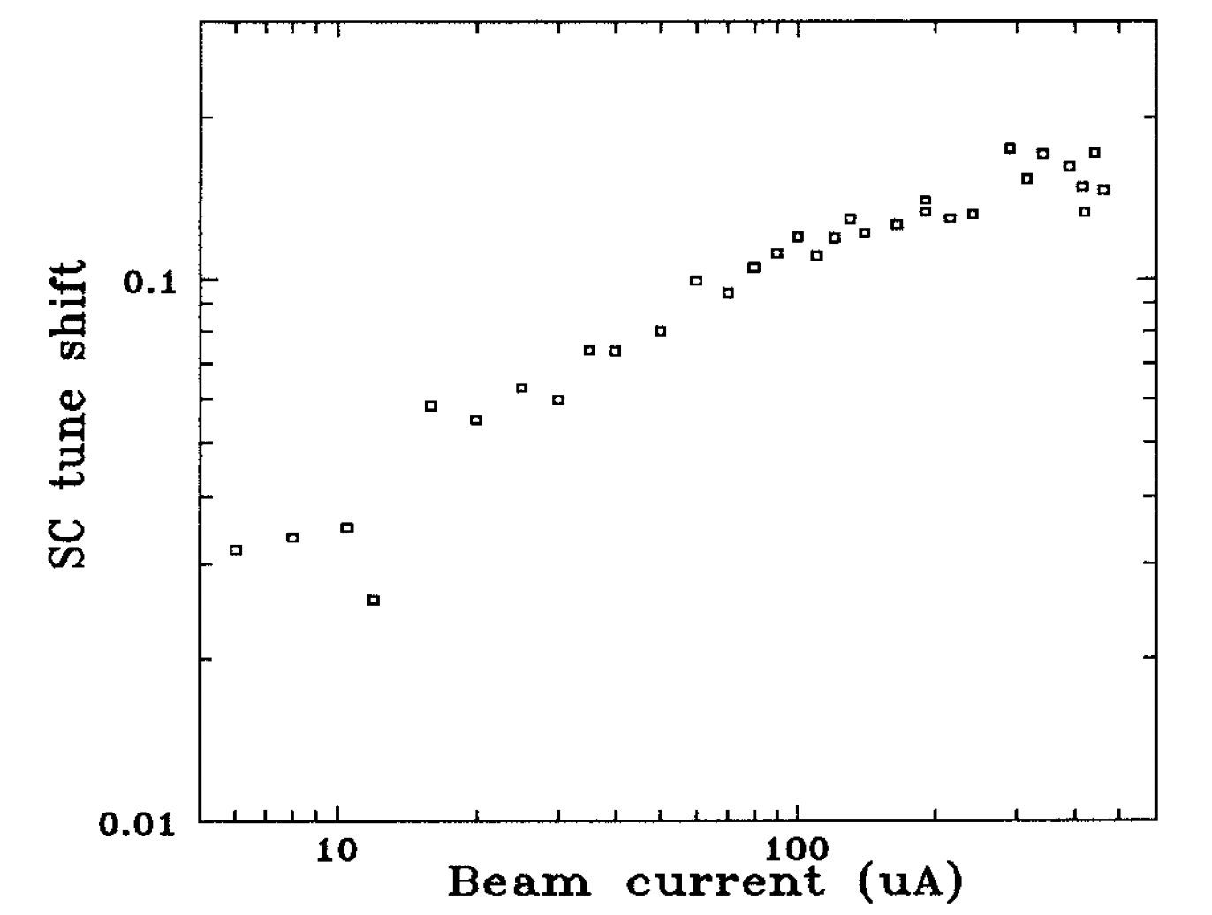
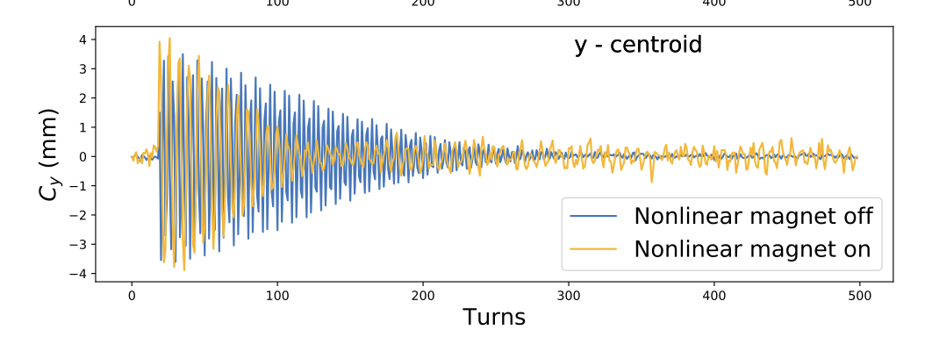

Maximizing Brightness and Intensity
$$Δν<0.1−0.2$$
S. Nagaitsev et al., Proceedings Particle Accelerator Conference, 1995, pp. 2937-2939
Beam density
Four grand challenges of accelerator and beam physics facing the community are:
Beam Quality: Limited by heating due to Intra-Beam Scattering, resonance crossing, etc.
Beam Intensity: Limited by collective effects and particle losses.
Beam Control
Beam Prediction: Limited by error fields and non-linearity of space-charge.
Beam intensity
How to maximize phase-space density of stored beam and minimize beam loss in a ring for given number of turns?
C. C. Hall et al., in Proc. IPAC'19, paper WEPTS070, 2019
J. Blazey et al, Accelerator and Beam Physics Roadmap, DOE Accelerator Beam Physics Roadmap Workshop, 2022
How much tune spread is needed to stabilize stored beam?

Slide 6
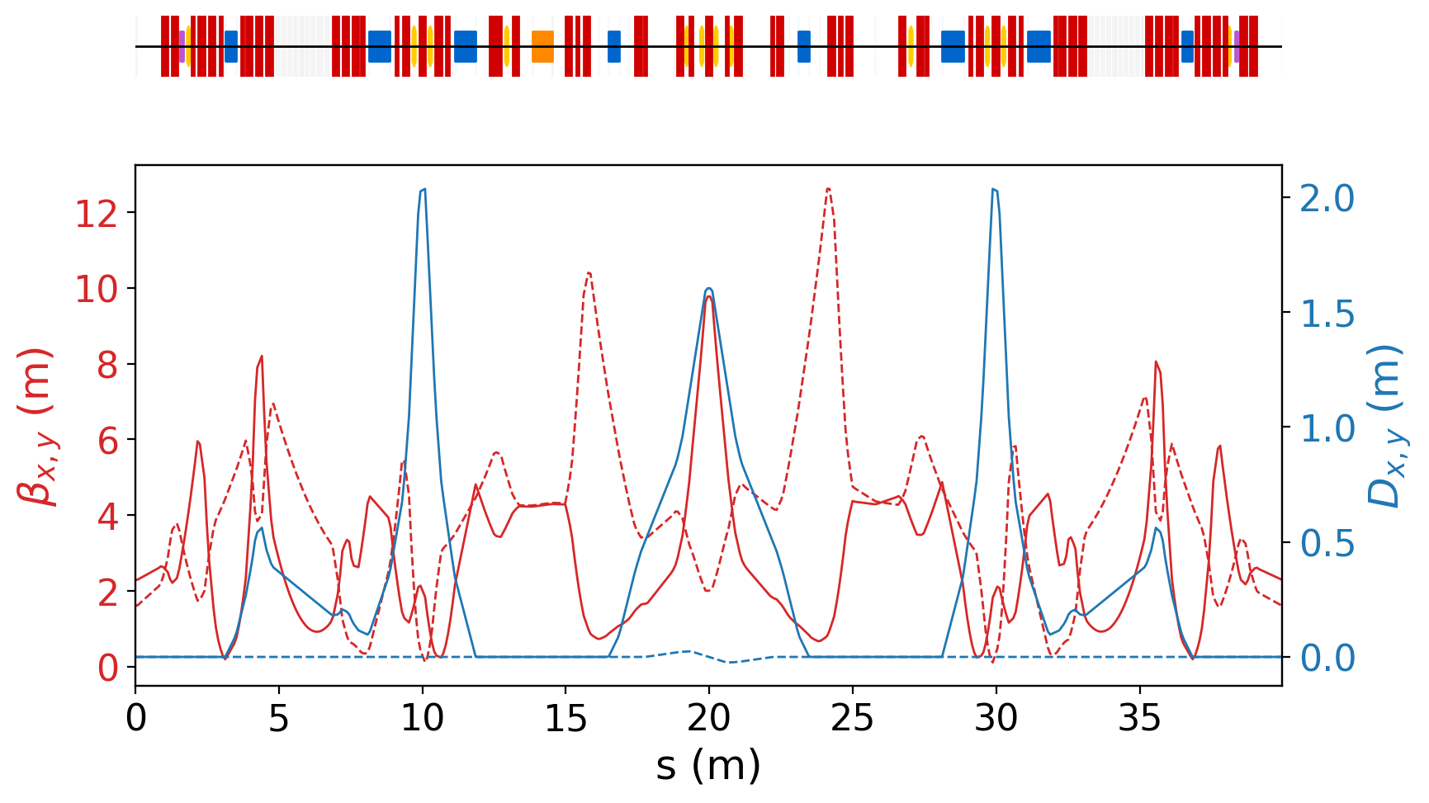

The Proton Program at IOTA
IOTA will be configured to recirculate 2.5 MeV protons up to $\left|Δν_{x,y}\right|\sim 0.5$.
.
Features:
All (skew) quadrupoles and correctors are independently controlled.
Both bunched beam and coasting.
Single turn injection.
Electron lens/cooler with length 0.7 m.
At the Laslett tune shift of 0.5, Intra-Beam Scattering driven transverse emittance growth time-scale is a few seconds. Electron cooler must compensate for heating.
G. Stancari et al, JINST 16 P05002, 2021

Slide 7
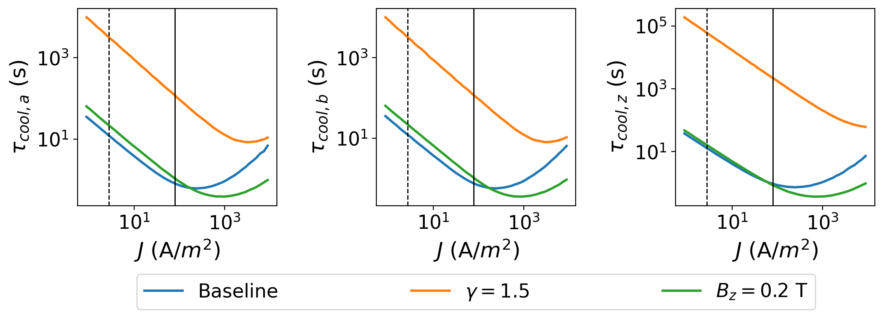
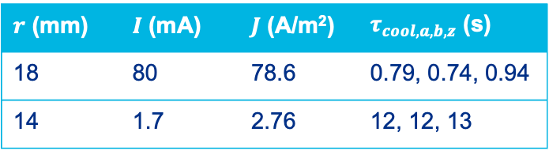
Electron Cooler Design Parameters
Electron beam parameters aim to provide a cooling time of ~ 1 - 10 seconds to control equilibrium emittance at different bunch charges.
We estimated the cooling time using the Parkhomchuk model assuming:
Flat transverse distribution of the electron beam.
Ideal solenoid field.
Matched proton beam.
For the baseline design we chose two electron coolers with an order of magnitude difference in cooling time.
$r$ (mm) | $I$ (mA) | $J$ (A/m²) | $τ_{cool,a,b,z}$ (s)
18 | 80 | 78.6 | 0.79, 0.74, 0.94
14 | 1.7 | 2.76 | 12, 12, 13
M. Bossard et al., in Proc. IPAC'23, pp. 646-649, 2023.

Slide 8
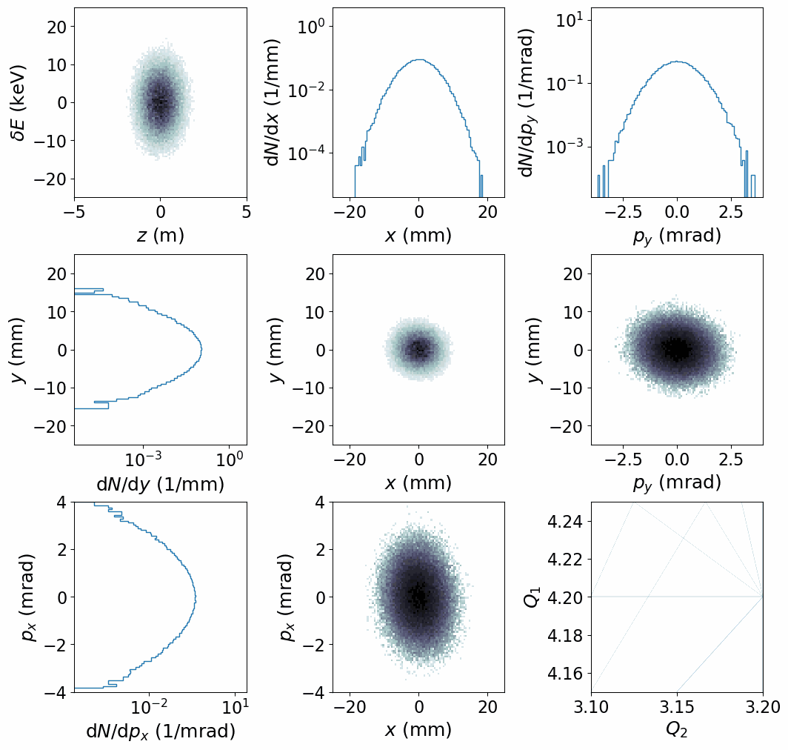
Simulations in PyORBIT with Space-Charge and Cooling
We simulate our experiments using a transverse PIC space-charge model and the Parkhomchuk model of cooling.
Cool the core of the beam.
Can’t cool large amplitude particles.
More beam loss in bunched beam.

Slide 9
Beam Experiments using Electron Cooling

Slide 10
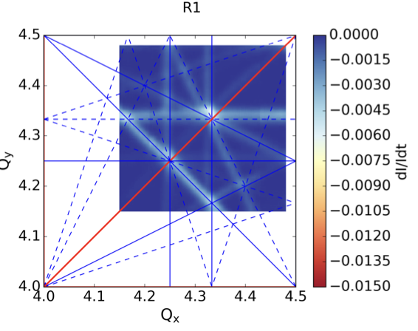
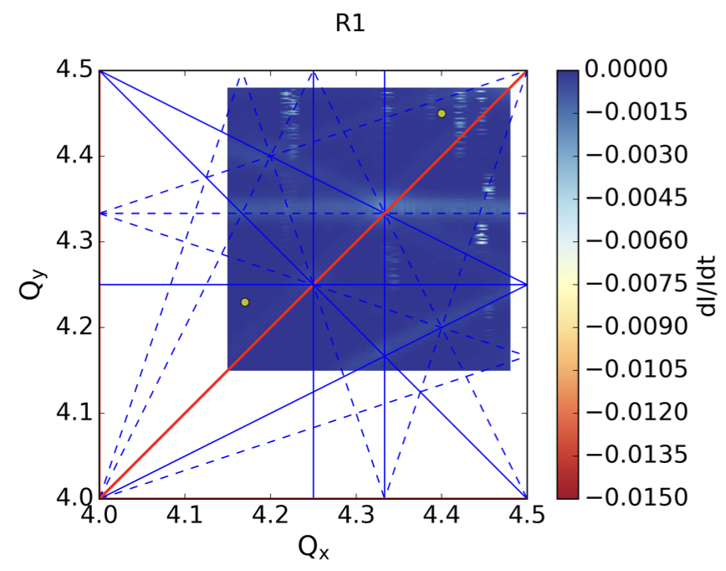
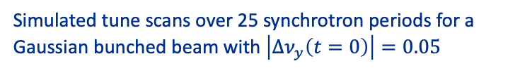
Optimization of the Bare Lattice to Maximize Tune Shift
What is the maximum space-charge tune shift of stored beam we can achieve?
Optimizing the linear lattice configuration, including tunes and transverse coupling.
Compensating for specific resonance driving terms using sextupoles.
Simulated tune scans over 25 synchrotron periods for a Gaussian bunched beam with $\left|Δν_{y}\left(t=0\right)\right|=0.05$
Compensated
F. Asvesta et al., in Proc. IPAC'22, pp. 2056-2059, 2022.

Slide 11
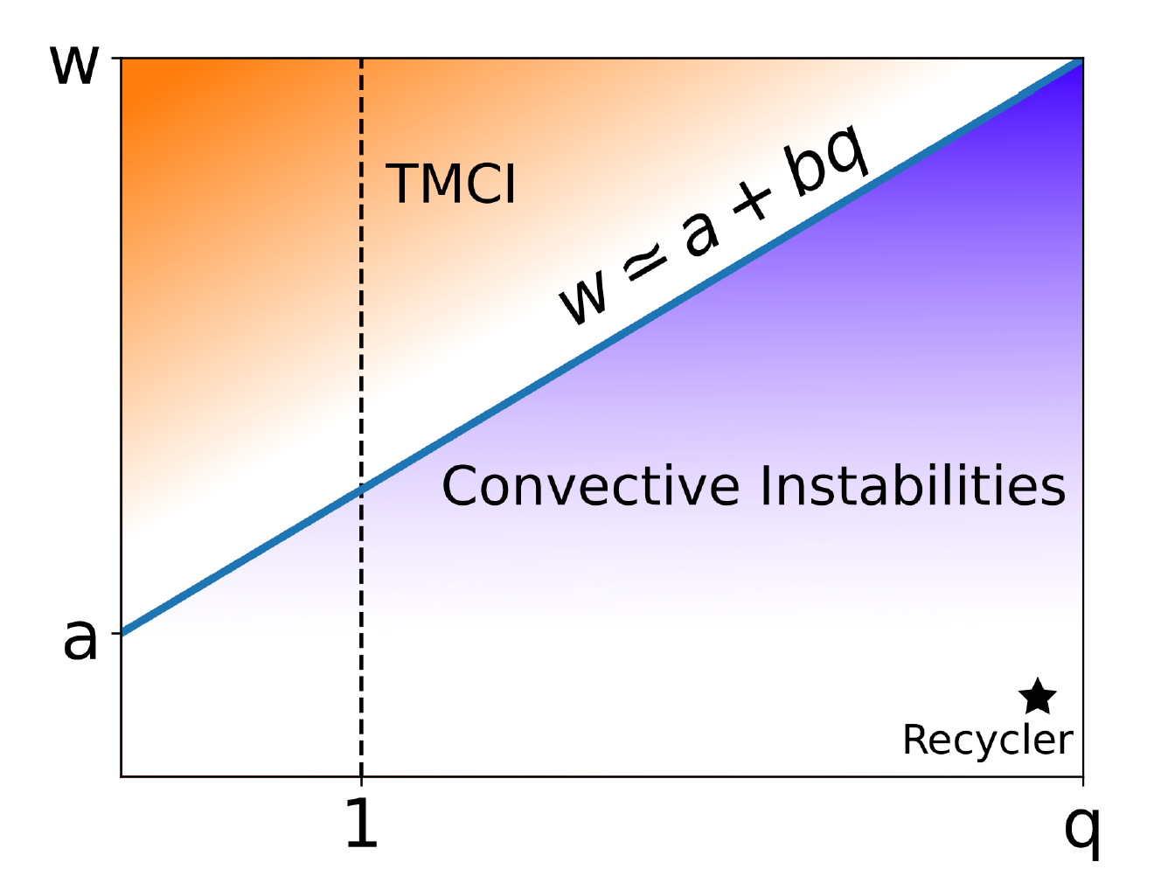
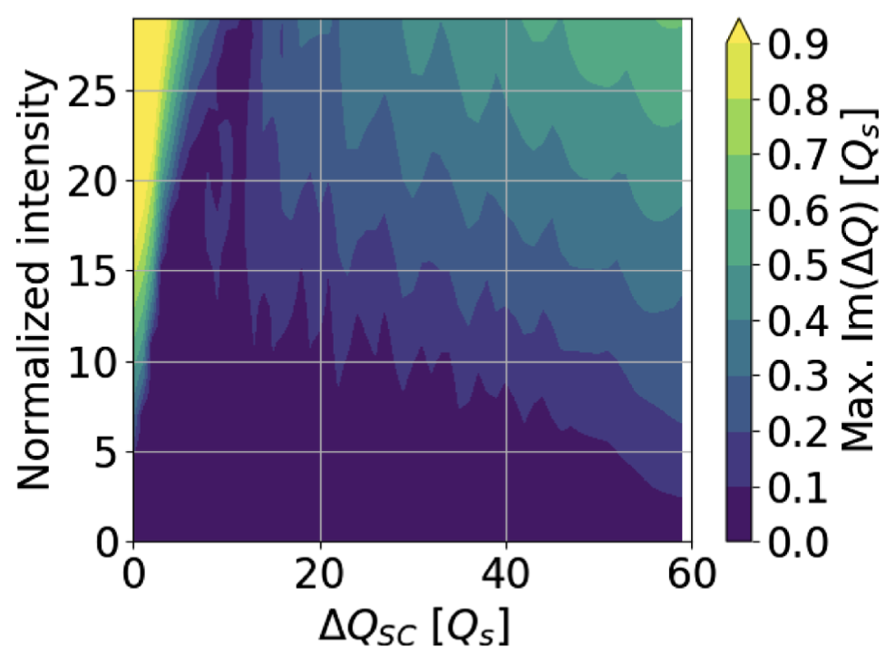
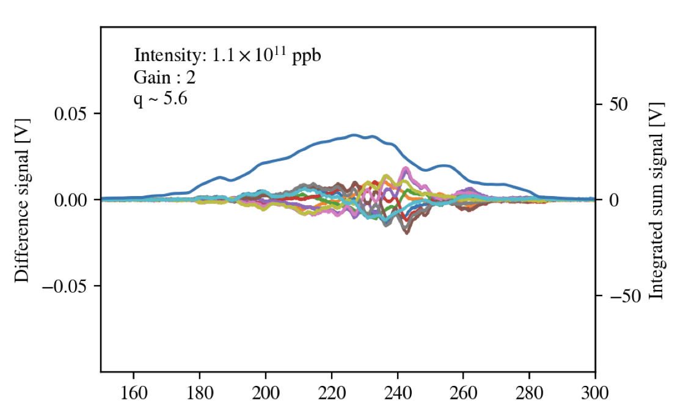
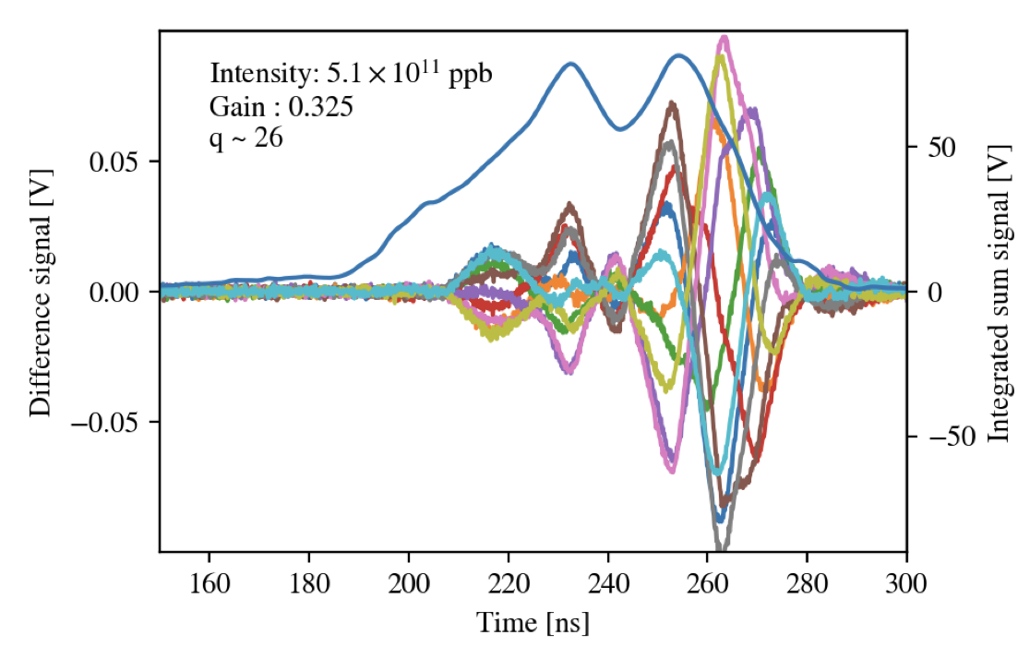
Interplay of Space-Charge and Coherent Instabilities
How are coherent instabilities affected by space-charge? The 2.5 MeV protons at IOTA provide strong space-charge but weak impedance.
Measure instability growth rate and head-tail amplification in the parameter space using:
Controlled wakefields generated using the wake-building feedback system.
Electron cooling to enforce an equilibrium phase-space distribution, independent of bunch charge.
Wakefield
Amplitude (Waker)
ABS
CMM Gaussian
SC Tune Shift (Electron Cooling)
ABS: A. Burov, Phys. Rev. Accel. Beams 22, 034202, 2019.
CMM: X. Buffat et al., Phys. Rev. Accel. Beams 24, 060101, 2021.
R. Ainsworth et al., in Proc. HB'21, pp. 135-139, 2021.
O. Mohsen et al., in Proc. NAPAC'22, pp. 124-127, 2022.
Fermilab Recycler
Time (ns)
Time (ns)

Slide 12
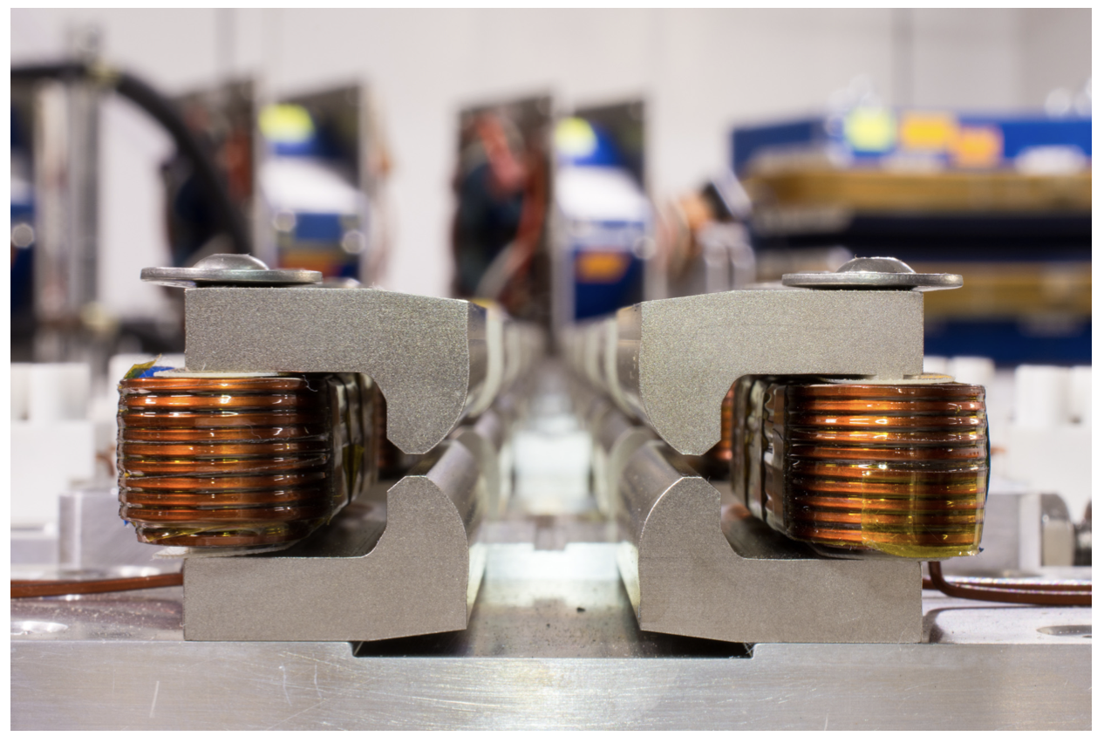
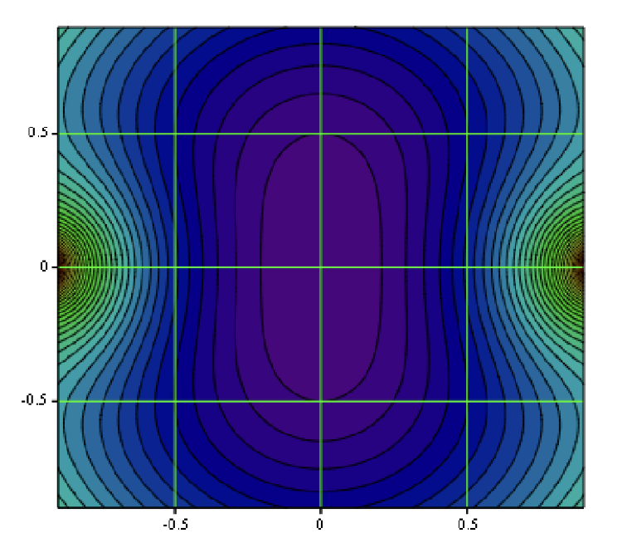
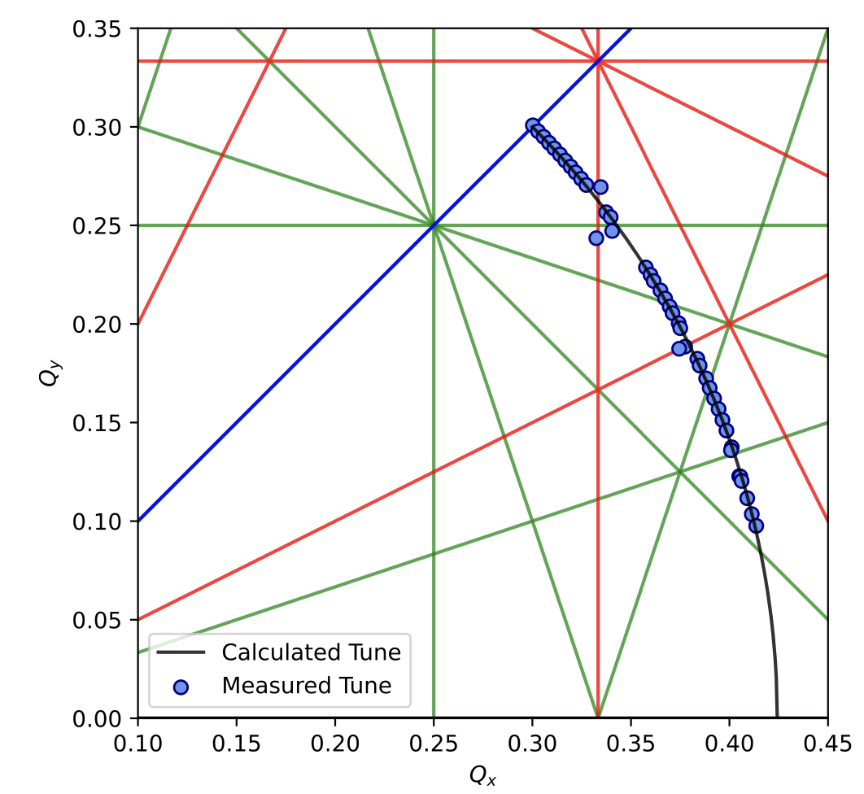
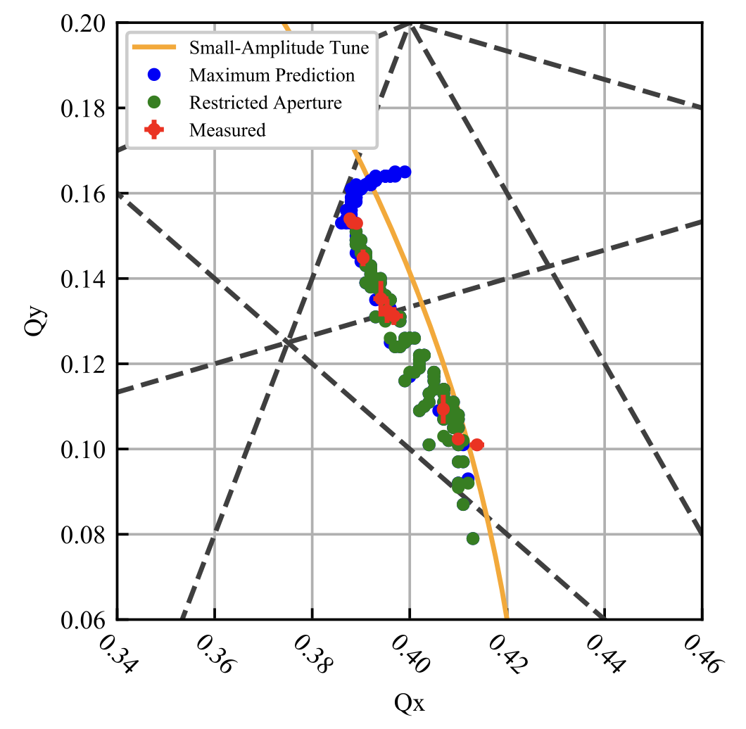
Tunable Landau Damping with Space-Charge
Non-linear Integrable Optics enable large amplitude-dependent tune spreads while keeping single-particle dynamics stable.
Flagship project for the Integrable Optics Test Accelerator!
Electron cooling enables:
Single particle dynamics experiments with pencil beam and low energy spread.
Measurement of minimum tune spread required to mitigate coherent instabilities with space-charge.
V. Danilov and S. Nagaitsev, Phys. Rev. ST Accel. Beams 13, 084002, 2010.
S. Antipov et al, JINST 12 T03002, 2017.
A. Valishev et al., in Proc. IPAC’21, pp. 19-24, 2021.
N. Kuklev et al., in Proc. IPAC'21, pp. 1964-1967, 2021.
J. Wieland et al., in Proc. IPAC'23, pp. 3230-3232, 2023.
S. Szustkowski, PhD Thesis, Northern Illinois University, 2020.

Slide 13
Hardware Configuration and Status

Slide 14
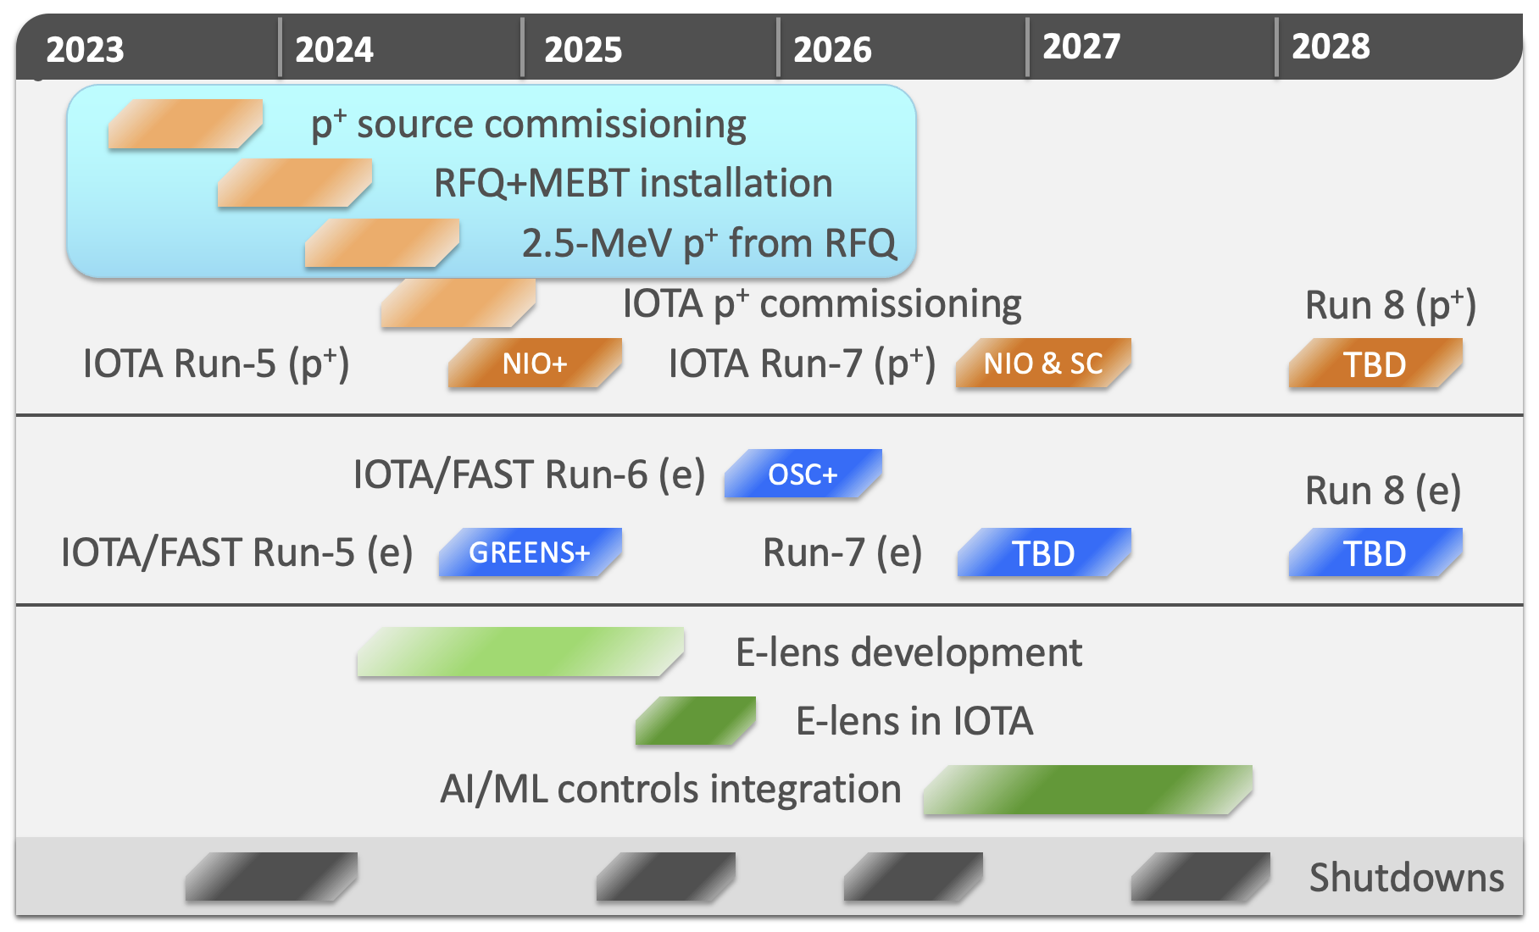
Electron Cooling in 2025
D. Edstrom, IOTA/FAST department meeting, 2023.

Slide 15
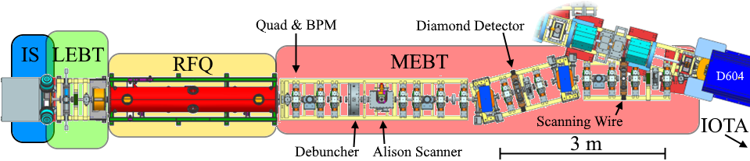
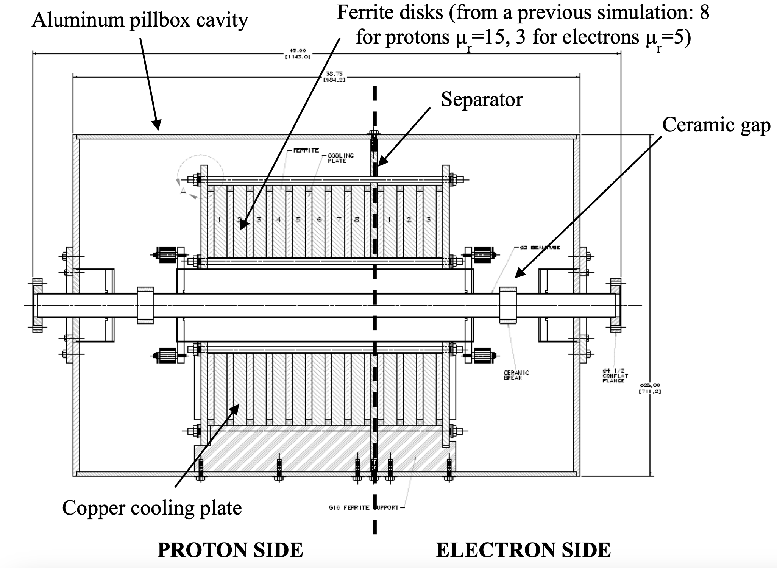
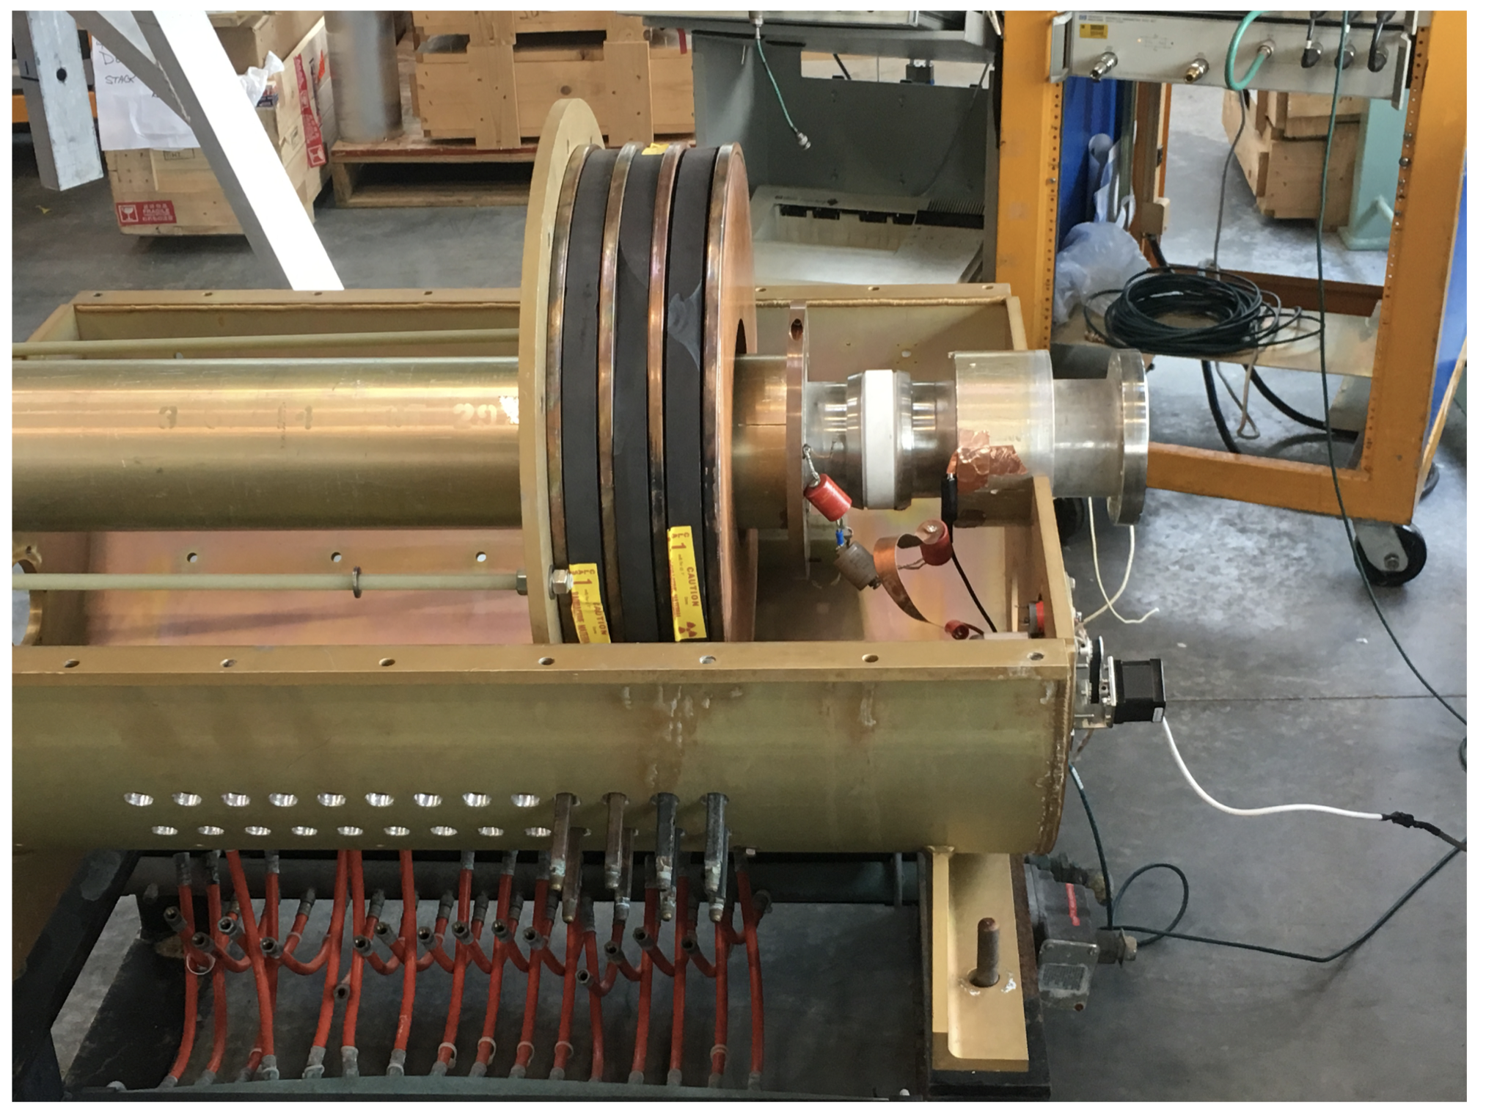
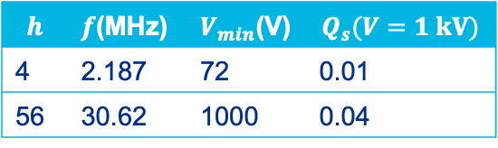
2.5 MeV Proton Injector and IOTA RF Configuration
Injector beamline capable of delivering short pulses of 2.5 MeV protons at 1 Hz.
Broadband normal conducting RF system with two gaps, but only 30 MHz gap installed.
$$h$$ | $f$(MHz) | $V_{min}$(V) | $$Q_{s}(V=1 kV)$$
4 | 2.187 | 72 | 0.01
56 | 30.62 | 1000 | 0.04
E. Prebys, Beams Document 4837-v1, Fermilab, 2015.
G. M. Bruhaug and K. Carlson, in Proc. NAPAC'16, pp. 432-434, 2016.

Slide 16
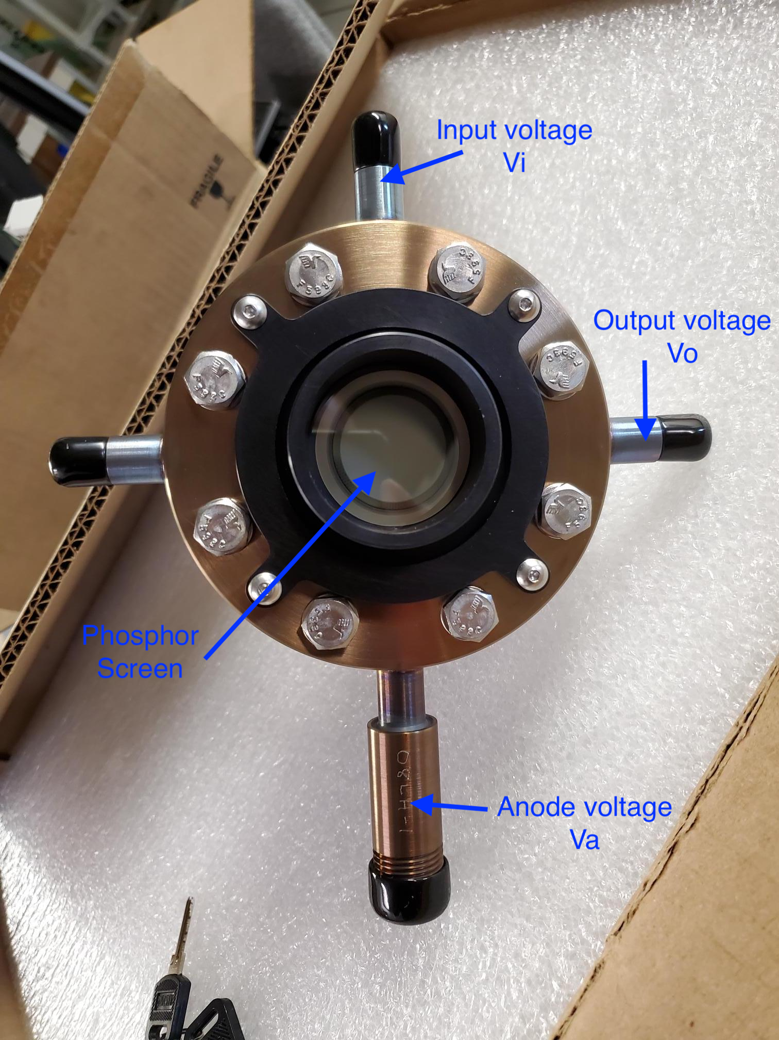
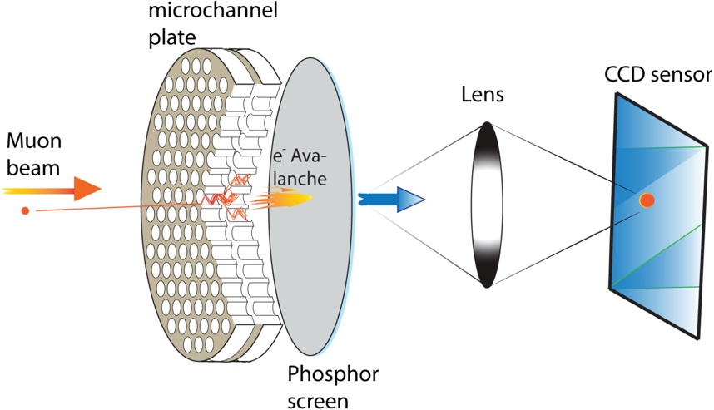
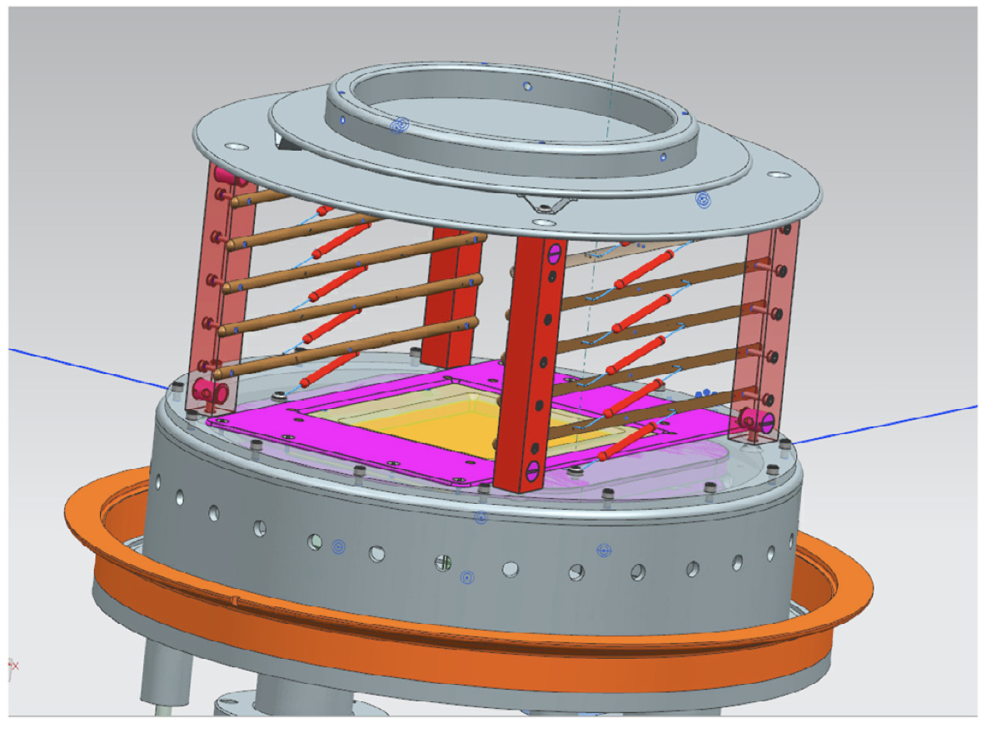
Proton Beam Diagnostics
Injector: Toroid, Scanning wire, Allison scanner
Storage Ring:
DCCT: Measure injection efficiency and beam lifetime.
Beam Position Monitors
  Use LOCO to configure lattice.
  Use turn-by-turn centroid positions of pencil beams to measure single-particle dynamics.
Neutralization monitor
  Measure equilibrium transverse profile with cooling.
Ionization Profile Monitor
  Measure turn-by-turn evolution of transverse profile.
H⁰
H⁰
Bongho Kim et al., NIM A, 899, 22-27, 2018.
V. Shiltsev, NIM A, 986, 164744, 2021.
H. Piekarz et al, Beams Document 9903-v1, Fermilab, 2023.
p⁺

Slide 17
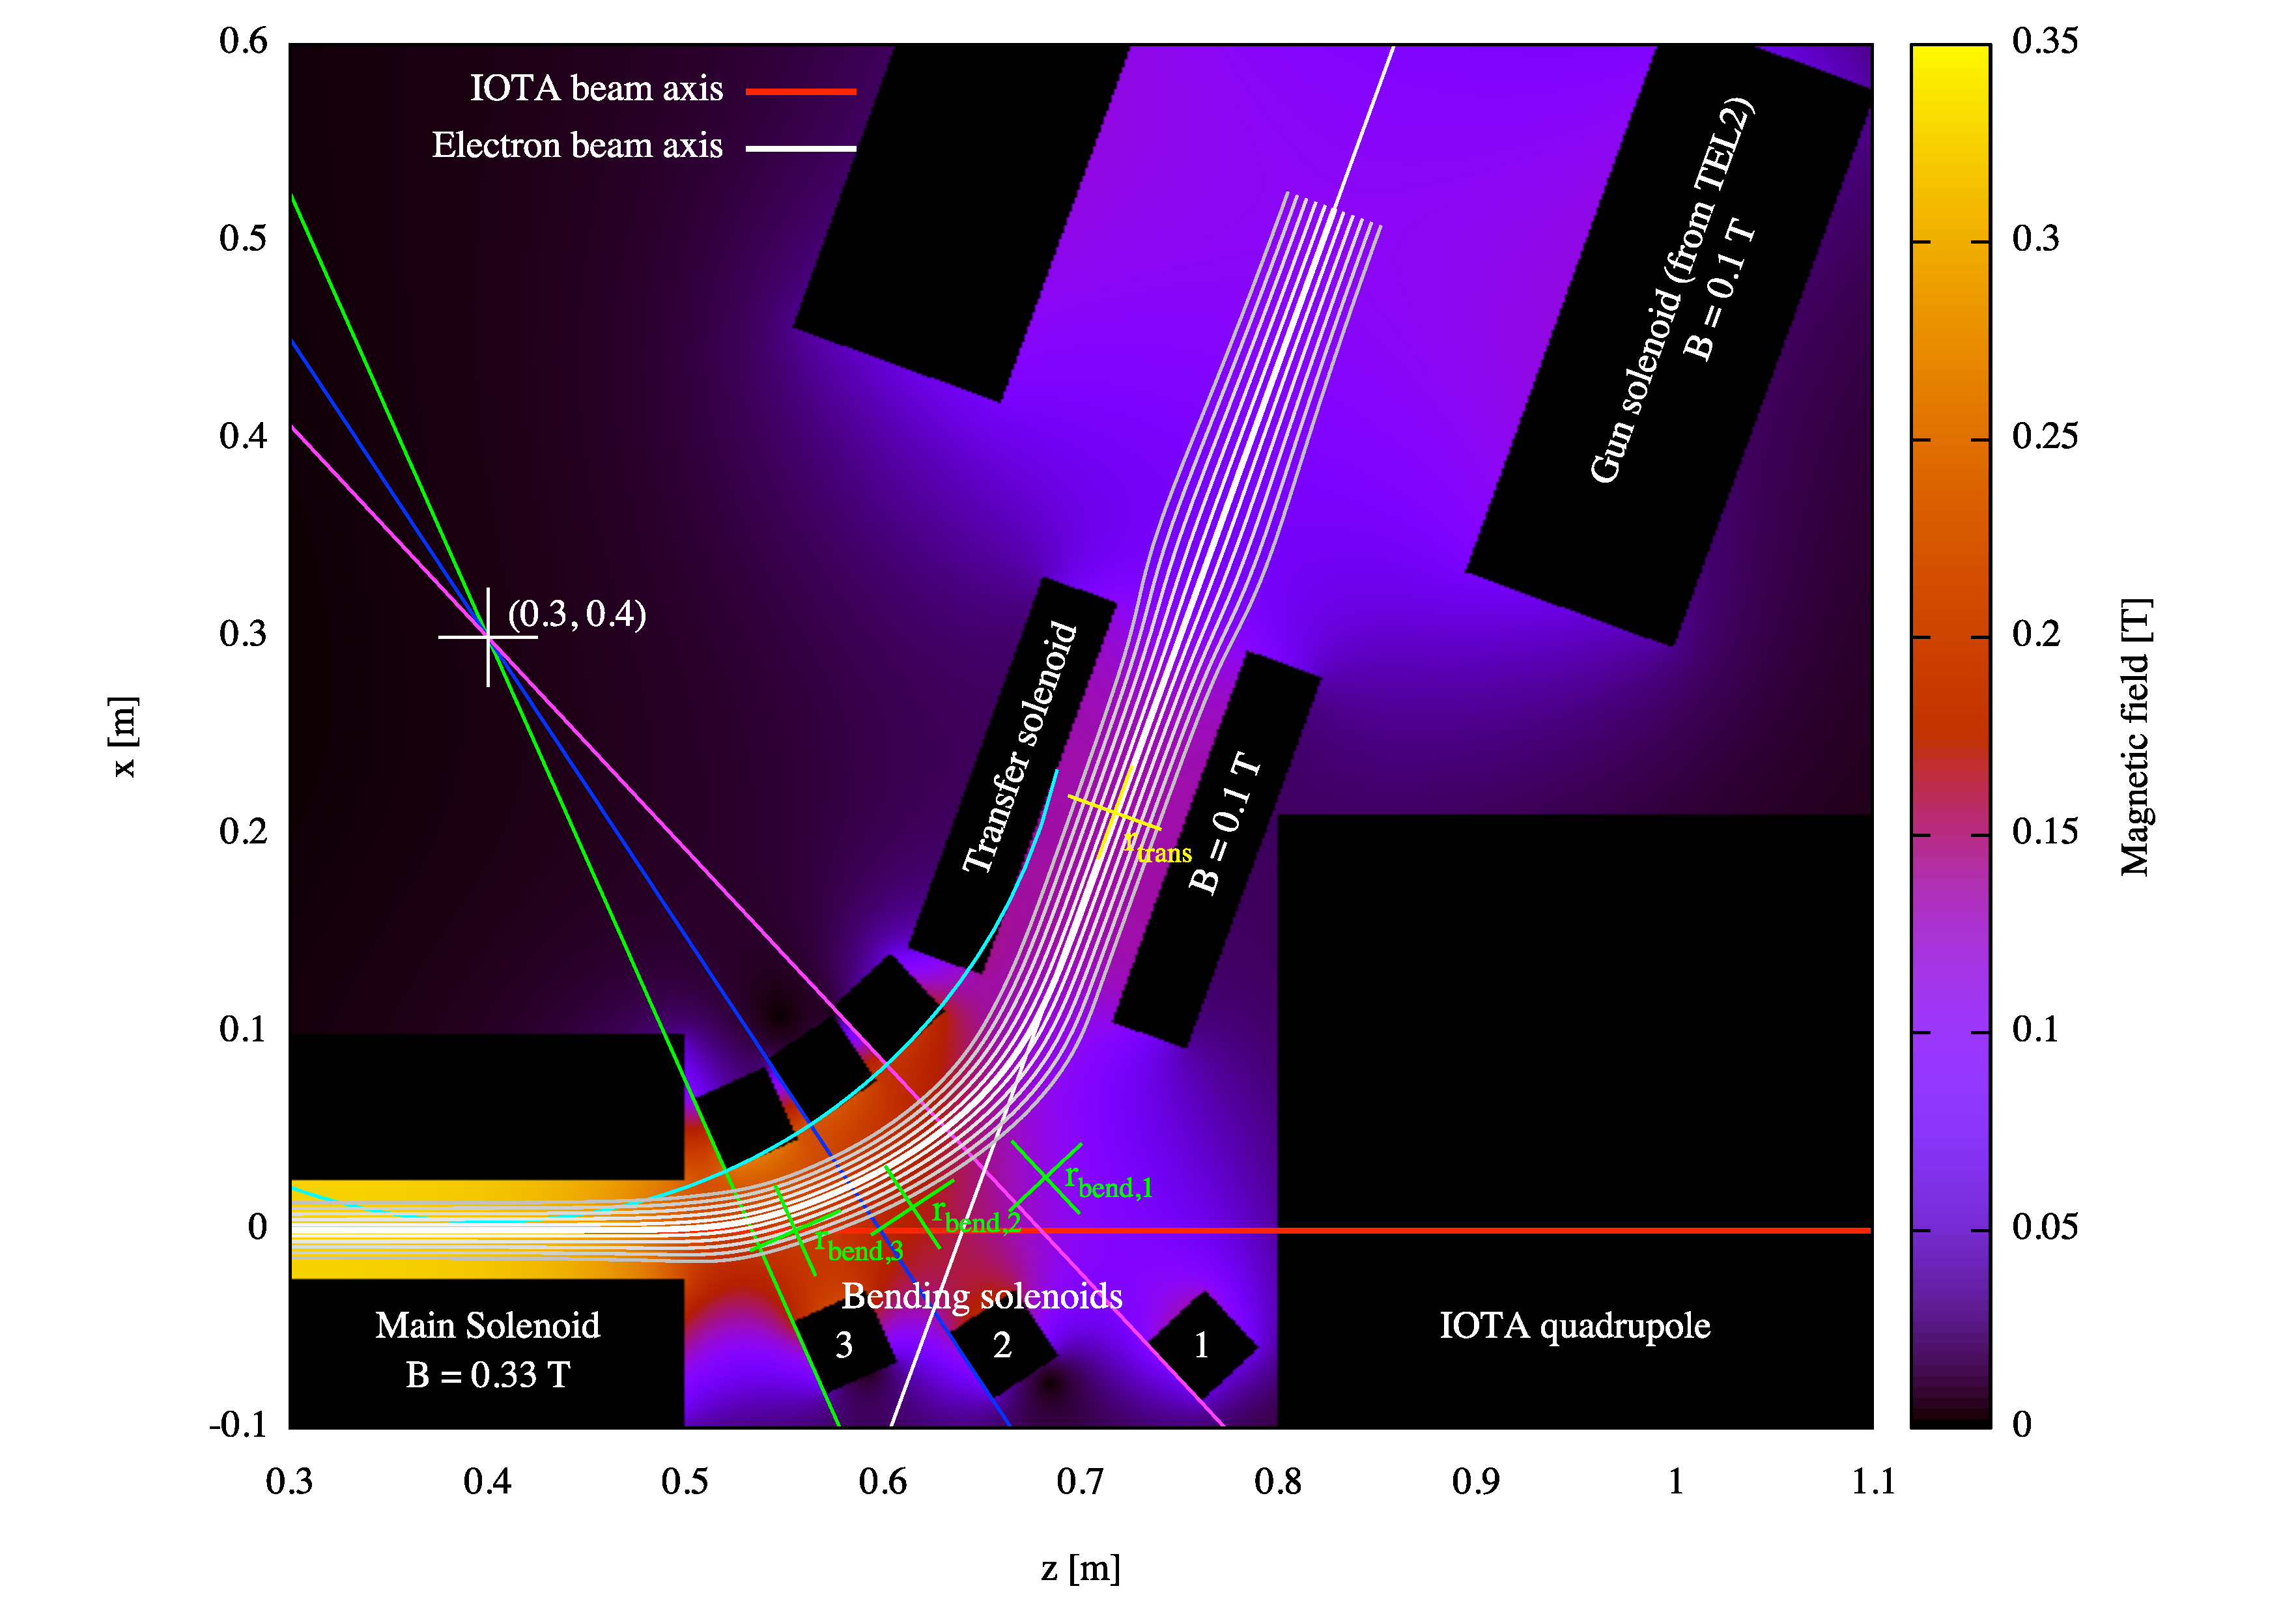
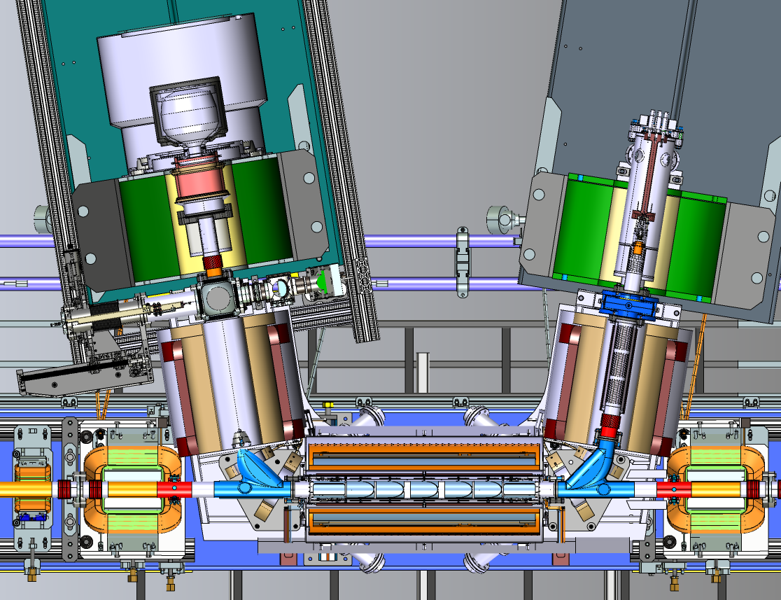
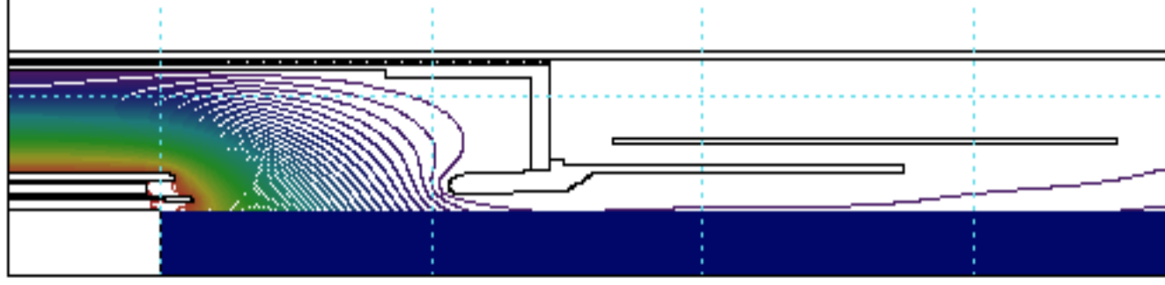
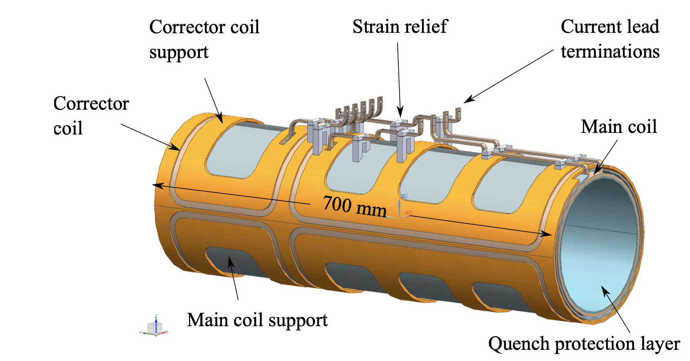
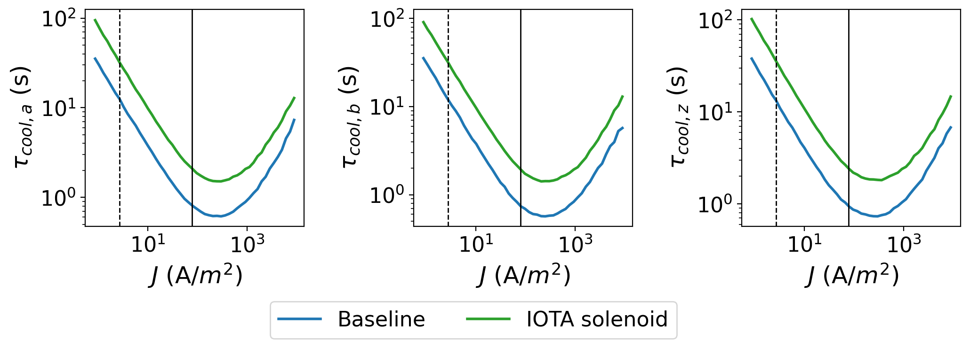

Electron Lens Setup
Conceptual design of all parts exist but engineering design needs to be finalized.
e⁻ source
Anode
Profiler
Dispenser Cathode
e⁻ beam
Flat beam gun
M. Bossard et al., in Proc. IPAC'23, pp. 646-649, 2023.
Electron Tracking
D. Noll and G. Stancari, Technical Memo, Fermilab, 2015. FERMILAB-TM-2598-AD-APC.
~3 times increase in $τ_{cool,a,b,z}$!
Conduction cooled SC solenoid
R.C. Dhuley et al 2021 JINST 16 T03009

Slide 18
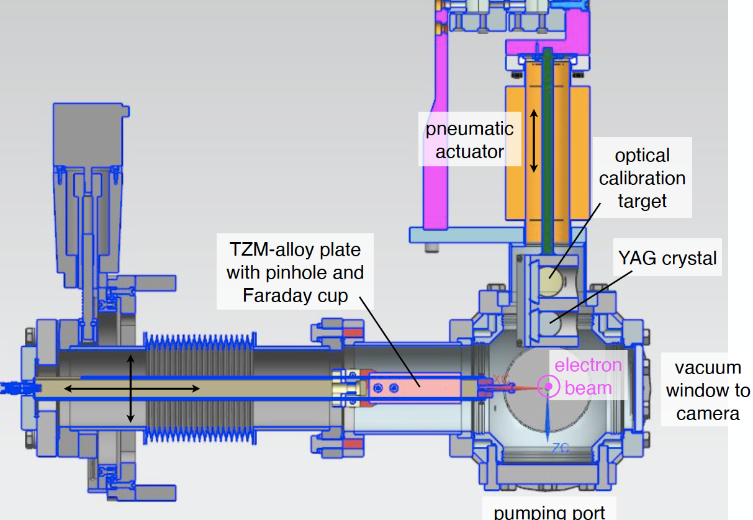
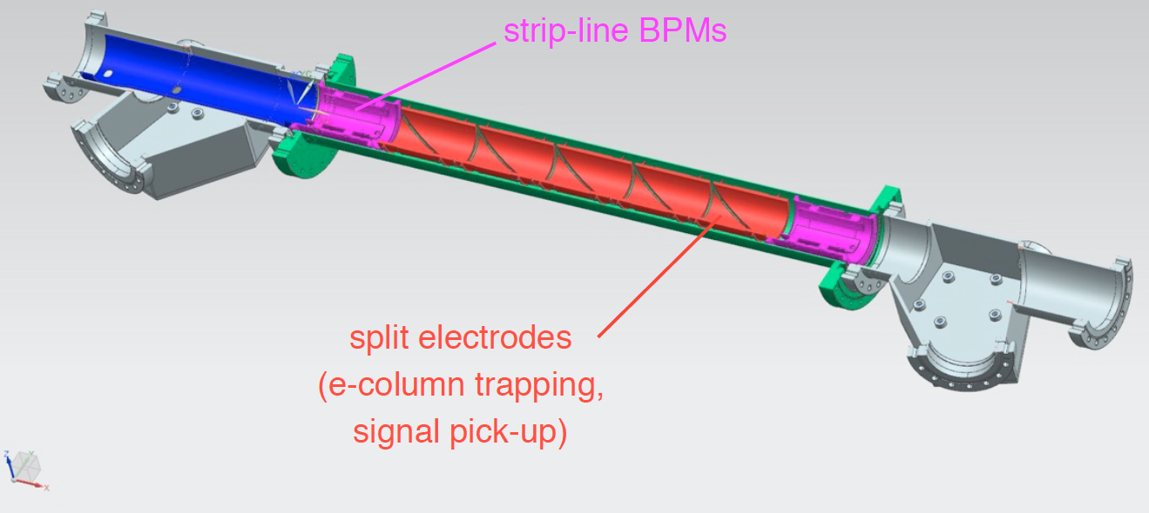
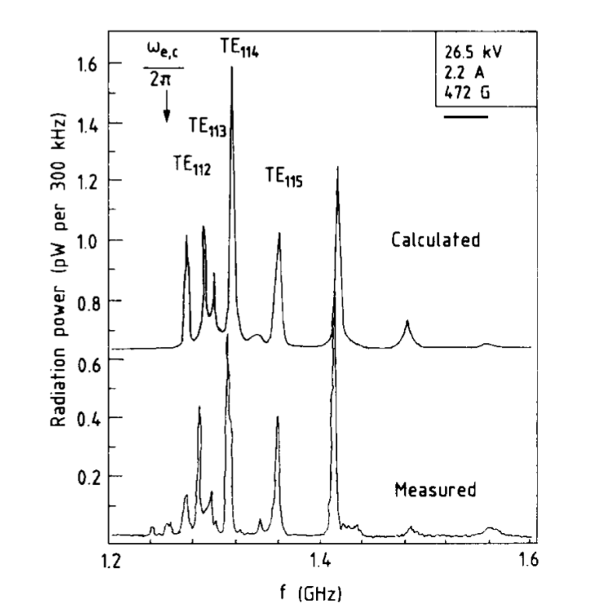
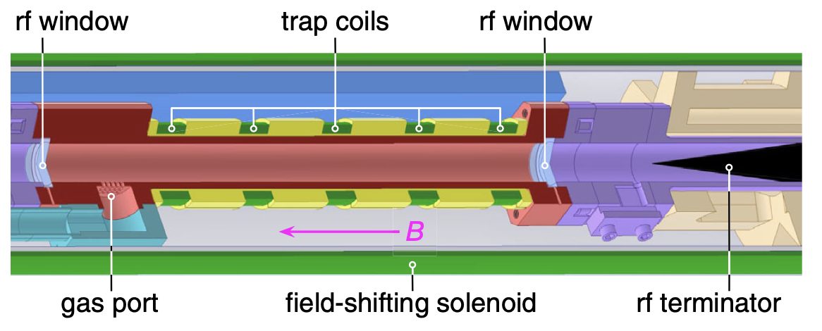
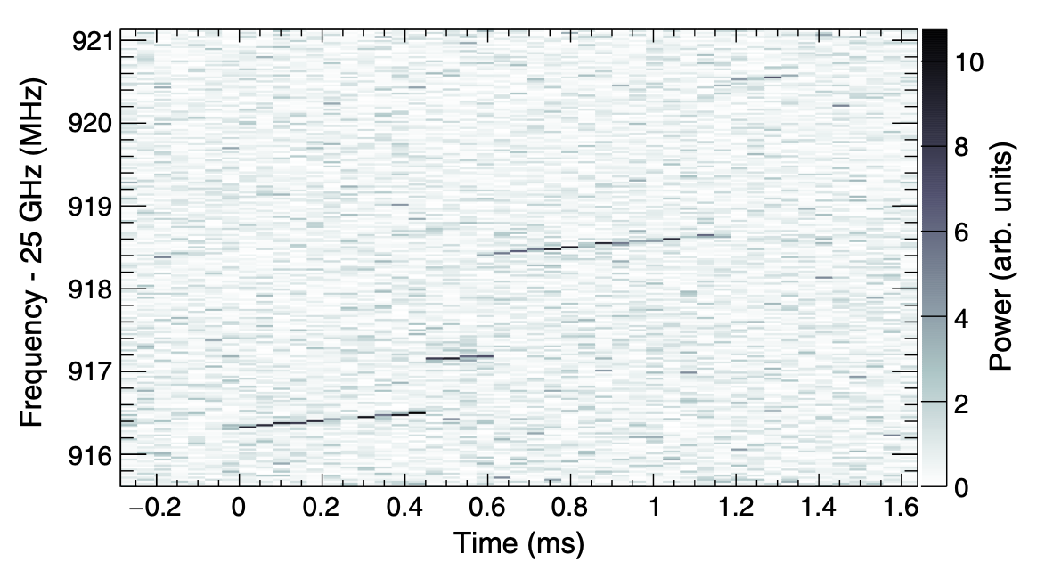

Electron Beam Diagnostics
Toroids: Measure beam current and losses.
Stripline BPMs: Align with the proton beam.
Profile measurement: Measure transverse profile.
Recombination Monitor: Optimize cooling performance.
Cyclotron Emission Monitor: Estimate electron density and temperature.
G. Stancari et al, JINST 16 P05002, 2021
LEAR
Project 8: CRES
A. Ashtari Esfahani et al., Phys. Rev. Lett. 131, 102502, 2023.
D. M. Asner et al., Phys. Rev. Lett. 114, 162501, 2015.
$$f_{c,e}$$
C. Habfast, PhD thesis, Karlsruhe U., KFK-4188, 1987.

Slide 19
Conclusion
The IOTA 2.5 MeV proton program will study extreme beam conditions in future hadron synchrotrons and storage rings.
  Space-charge tune shift approaching -0.5. – Electron cooling to achieve equilibrium.
  Adjustable wakefields of arbitrary shapes and magnitudes. – Wake-building feedback system.
We have proposed a few experiments:
  Maximize tune shift for given turns, emittance growth and loss budget.
  Measure instability growth rate and head-tail amplification as a function of space-charge tune shift and ring impedance.
  Characterize single-particle dynamics of two Non-linear Integrable Optics systems and demonstrate suppression of coherent instability.
First protons in IOTA in summer 2024 and cooling in late 2025.

Slide 20
Acknowledgements
Rob Ainsworth, Alexey Burov, Brandon Cathey, Sergei Kladov, Valeri Lebedev, Aleksandr Romanov, Alexander Valishev and the IOTA/FAST team at Fermilab.
Thank You!

Slide 21
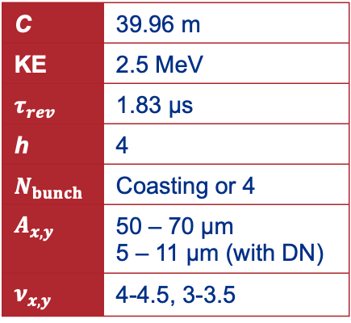
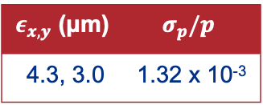
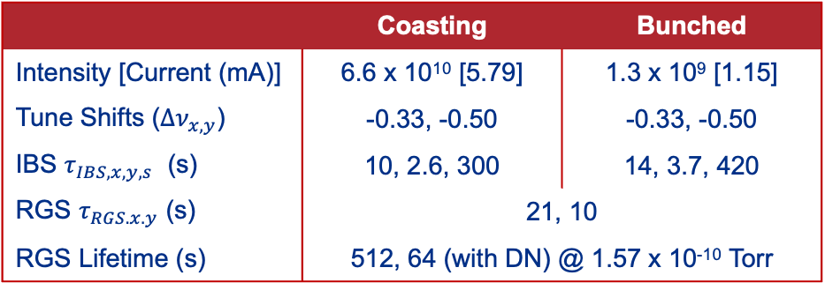
Appendix I: Proton Parameters
Lattice
C | 39.96 m
KE | 2.5 MeV
$$τ_{rev}$$ | 1.83 μs
h | 4
$$N_{bunch}$$ | Coasting or 4
$$A_{x,y}$$ | 50 – 70 μm 5 – 11 μm (with DN)
$$ν_{x,y}$$ | 4-4.5, 3-3.5
IOTA Operation
 | Coasting | Bunched
Intensity [Current (mA)] | 6.6 x 10¹⁰ [5.79] | 1.3 x 10⁹ [1.15]
Tune Shifts ($Δν_{x,y}$) | -0.33, -0.50 | -0.33, -0.50
IBS $τ_{IBS, x,y,s}$ (s) | 10, 2.6, 300 | 14, 3.7, 420
RGS $τ_{RGS.x.y}$ (s) | 21, 10
RGS Lifetime (s) | 512, 64 (with DN) @ 1.57 x 10⁻¹⁰ Torr
Injector
$ε_{x,y}$ (μm) | $$σ_{p}/p$$
4.3, 3.0 | 1.32 x 10⁻³

Slide 22
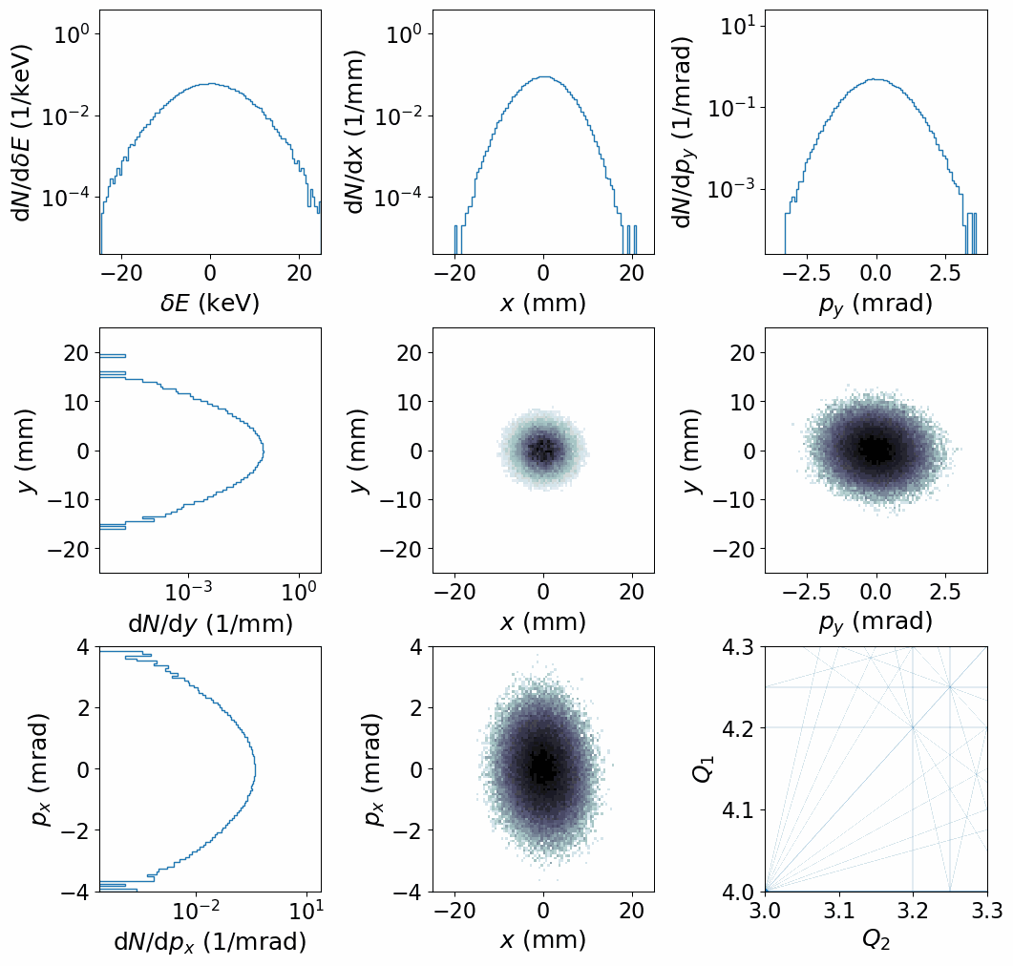
Appendix II: Electron Cooling and SC with Coasting Beam
Compared to the bunched beam simulation:
More uniform cooling in transverse
Less beam loss

