Slide 1
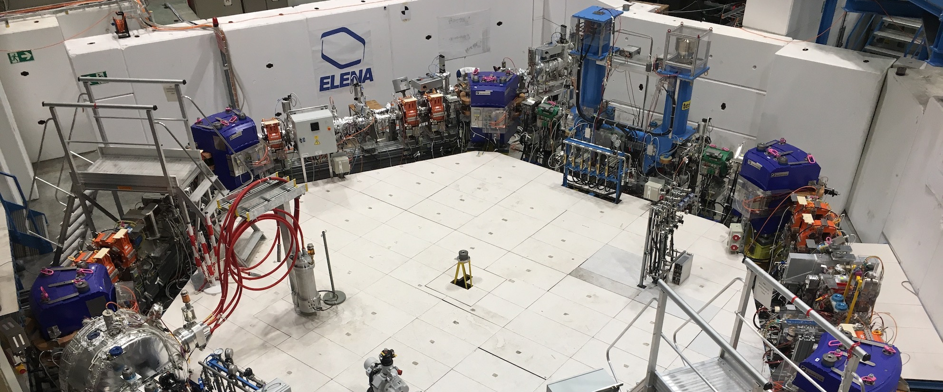
Status of E-cooling at 100 keV in ELENA
COOL2023 Workshop – Montreux – Oct 2023 D. Gamba for the AD/ELENA team
Introduction of the AD/ELENA facility and performance status
Tools and methods available for e-cooling studies in ELENA
Some recent, yet preliminary, results at 100 keV
Notes:
The Extra Low ENergy Antiproton ring (ELENA) ring at CERN was commissioned in 2018 and is in regular production operation from 2021. ELENA uses e-cooling for cooling pbar beams on two plateaus at 653 keV and 100 keV kinetic energy. The first cooling is necessary to allow for efficient deceleration of the 5.3 MeV pbar beam coming from the Antiproton Decelerator (AD), while the second cooling is used to define the quality of the bunches before extraction.
The experience accumulated so far shows that cooling at 653 keV is sufficient to ensure good deceleration efficiency, while cooling at 100 keV might not be sufficient to provide the design transverse beam emittances at extraction.
In this paper we document the present ELENA e-cooling performance at 100 keV, the typical optimisation procedure used during setup, and we investigate possible limitations of the present system.

Slide 2
AD/ELENA – introduction
3
Deceleration and cooling
(3.5 → 0.1 GeV/c)
AEGIS
~2 10¹³ protons (26 GeV) on target
~5 10⁷ antiprotons captured in AD
Deceleration to the lowest energy:
  → 5.3 MeV (AD)
  → 100 keV (ELENA)
Typical pbars extracted per cycle:
  1 bunch ~4 10⁷ (AD)
  4 bunches of ~8 10⁶ pbars (ELENA)
Typical cycle lengths:
  ~100 s (AD)
  ~15 s (ELENA)
Beam cooling:
  Stochastic 3.57 and 2.0 GeV/c
  Electron (AD) 0.3 and 0.1 GeV/c
  Electron (ELENA) 35 and 13.7 MeV/c
Beam Revolution Frequency:
  AD injection: 1.6 MHz; 𝛽_{rel}=0.967
  ELENA ejection: 144 kHz; 𝛽_{rel}=0.015
4
ELENA:
Deceleration and
cooling
( → 13.7 MeV/c)
BASE
GBAR
PUMA
Main purpose is to provide 100 keV pbar beams
to (typically trap-based) experiments!
Kay parameter: INTENSITY (for ~100s rep period)

Slide 3
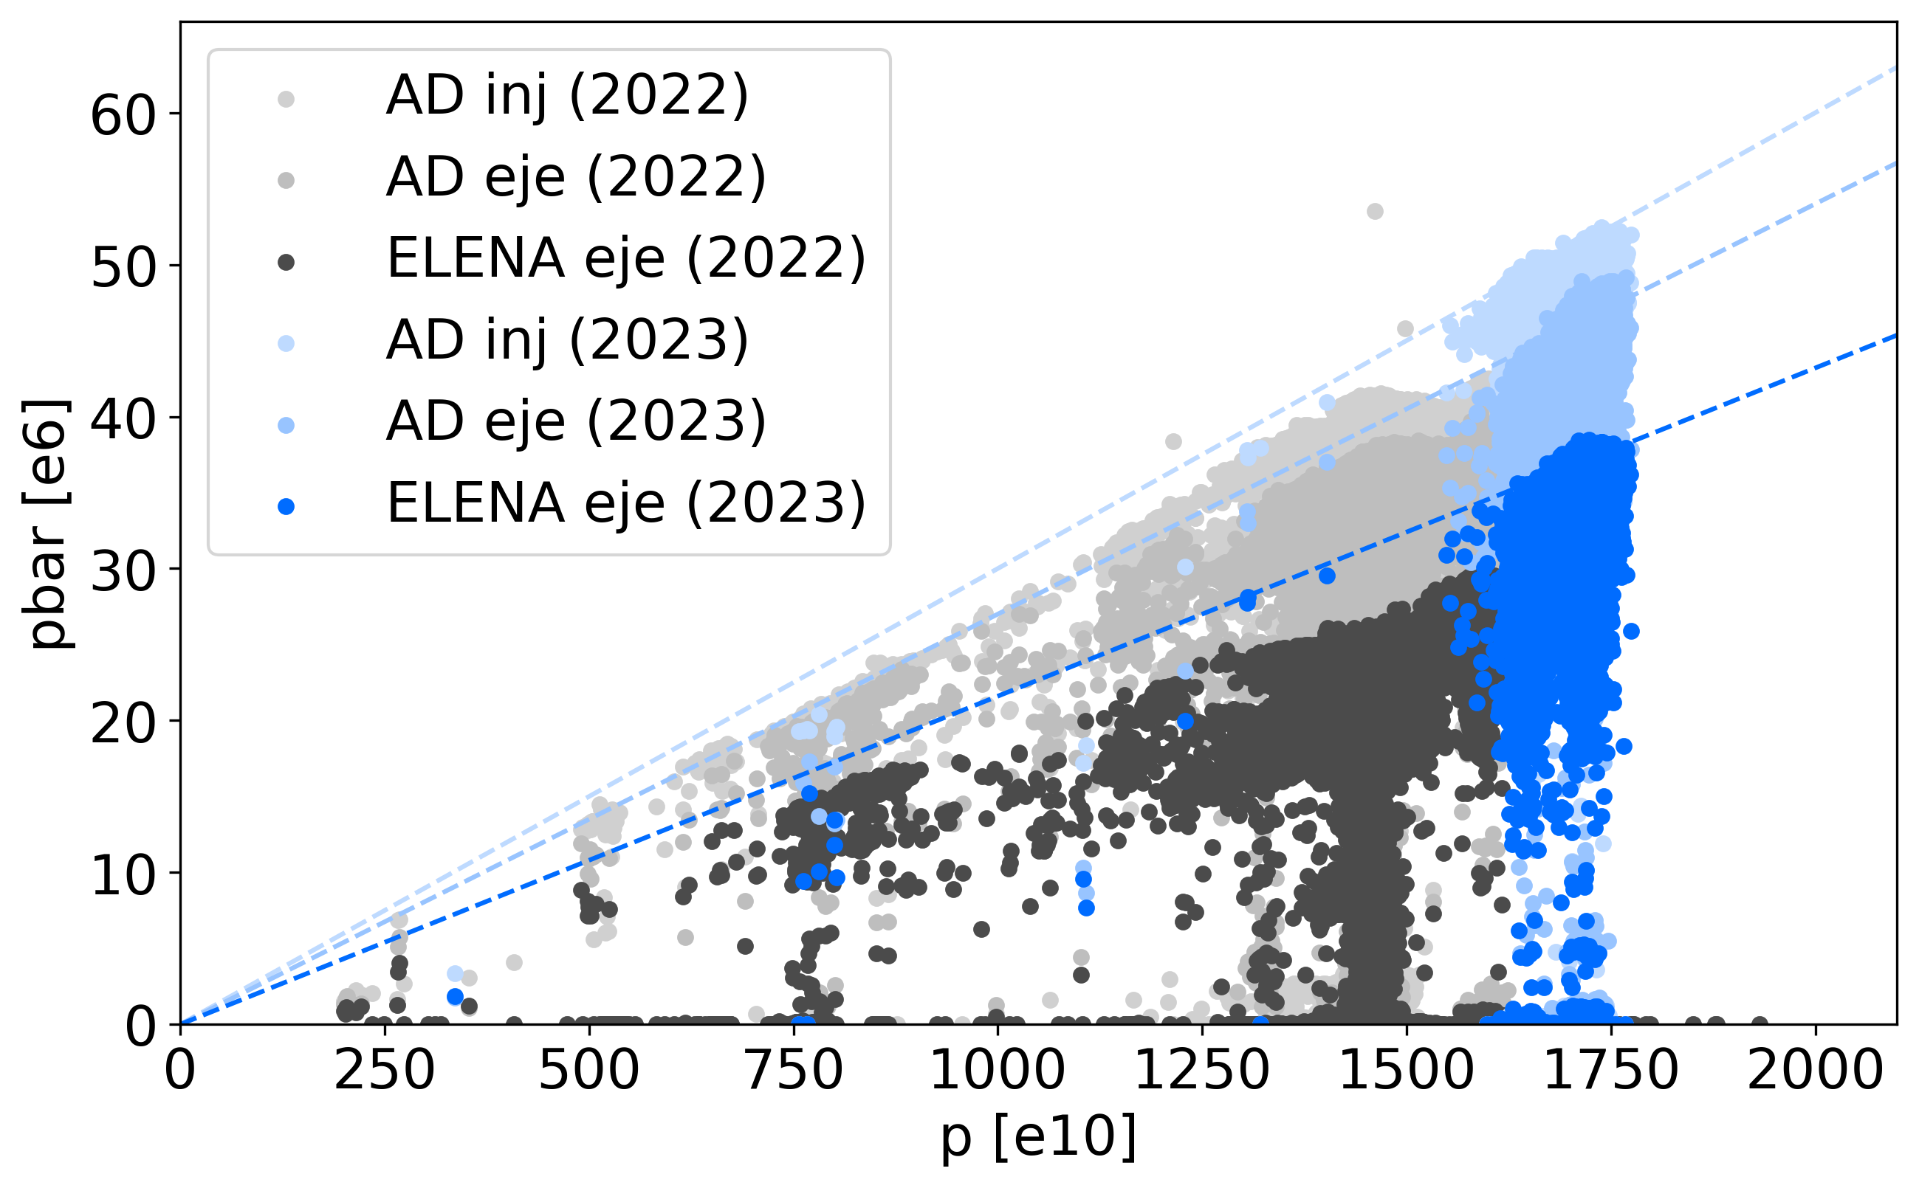
AD/ELENA Overall Performance
Overall performance can be expressed as delivered pbar per proton on target
  Looking at about ~20 days of operation in 2022 and 2023
KPI
3e-6 pbar/p
90% AD transmission
80% ELENA transmission
ELENA Design
Overall: another excellent year for AD/ELENA with performance improvements!
  Still need to work on stability, repetition rate, and transmission…
  More details in L. Joergensen presentation

Slide 4
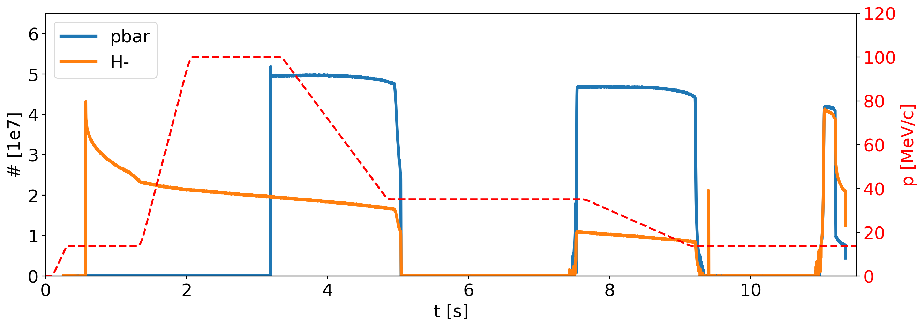
The ELENA cycle
Running with two (magnetically-equal) ~15-second-long pbar/H- cycles
Second H⁻ injection to increase beam intensity @100 keV before extraction
n bunches extracted on demand by users
h=1
h=4
h=4
h=1
E-cooling
E-cooling
E-cooling
We are providing 4 equal bunches to serve 4 experiments in contemporary
Margin of improvement:
  Transmission: today at up to ~20% losses,
  Cycle length: not important if we run in the shadow of AD (baseline), but relevant if we wait for ELENA extraction before restart AD (as today!)
Repetition rate is very slow for any study/setup with pbar
  Good news: No H- lifetime degradation observed with e-cooling! We can use H- for most studies!
  Bad news: H- source reliability questionable, known to be prone to hardware faults…
  Bad news: H- lifetime strongly affected by vacuum levels in the ring (typically 10⁻¹¹ mbar)

Slide 5
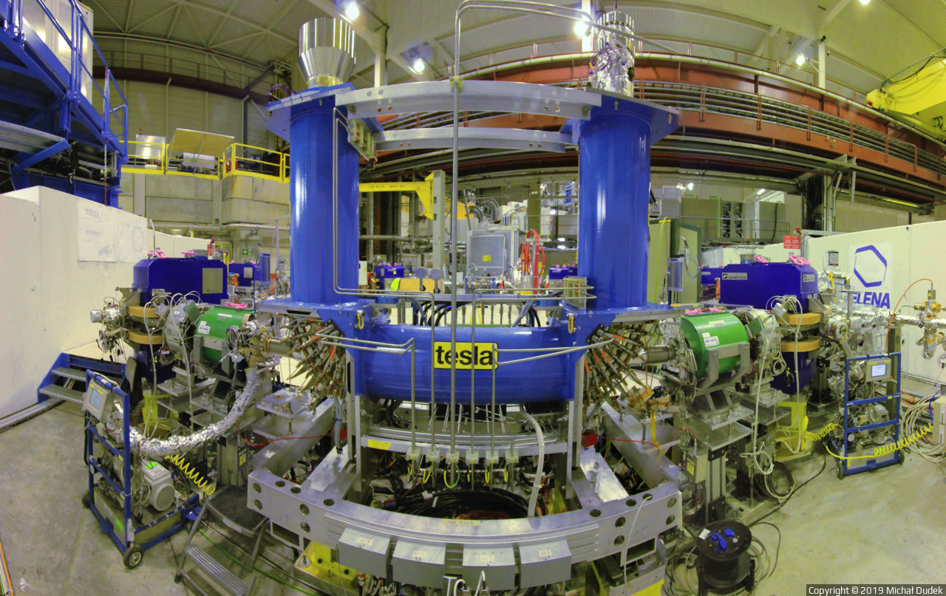
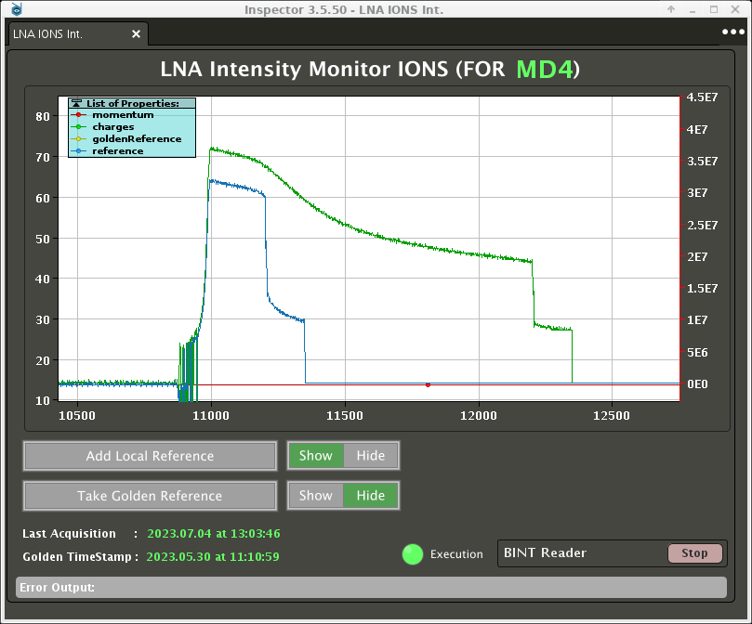
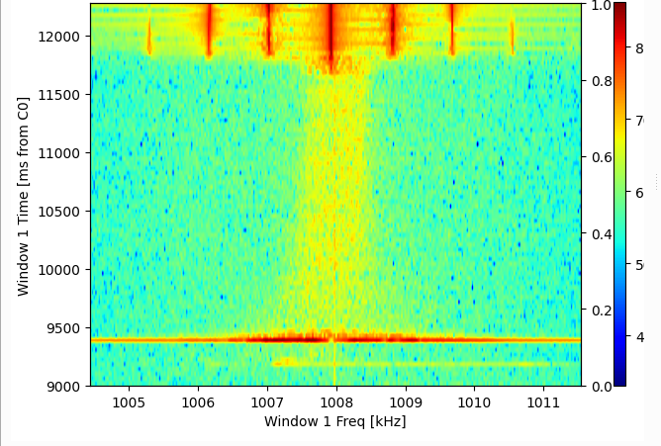
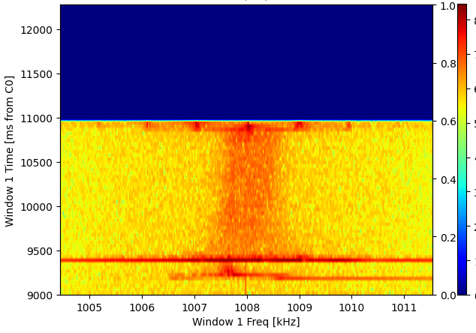
The ELENA e-cooler
Designed by G. Tranquille (see for example IPAC2016, IPAC2018)
In operation since 2018, no major hardware issues observed so far
First measurements and characterisation of cooling already done in 2018 (see J. Hunt thesis)
Here an example of 100 keV H⁻
pbar momentum | 35 MeV/c | 13.7 MeV/c
Electron kinetic energy | 355 eV | 55 eV
Relativistic beta | 0.037 | 0.015
Electron current | ~5 mA | ~1 mA
Cooling length | ~1 m
Ring length | 30.41 m
Gun magnetic field | Up to 1 kG
Drift magnet field | 100 G
Field quality B_{perp}/B_{parallel} | <5e-3
Electron beam radius (drift) | 8 to 25 mm
1e-3 dp/p
2e-3 dp/p

Slide 6
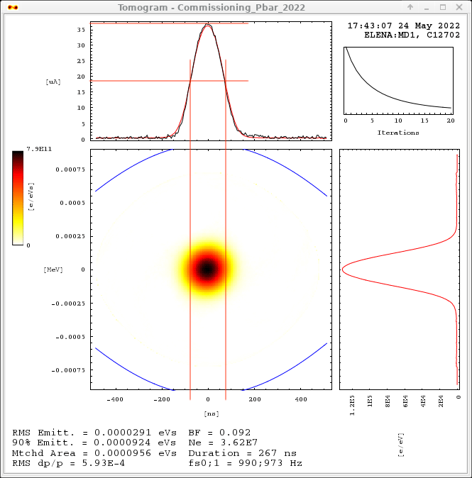
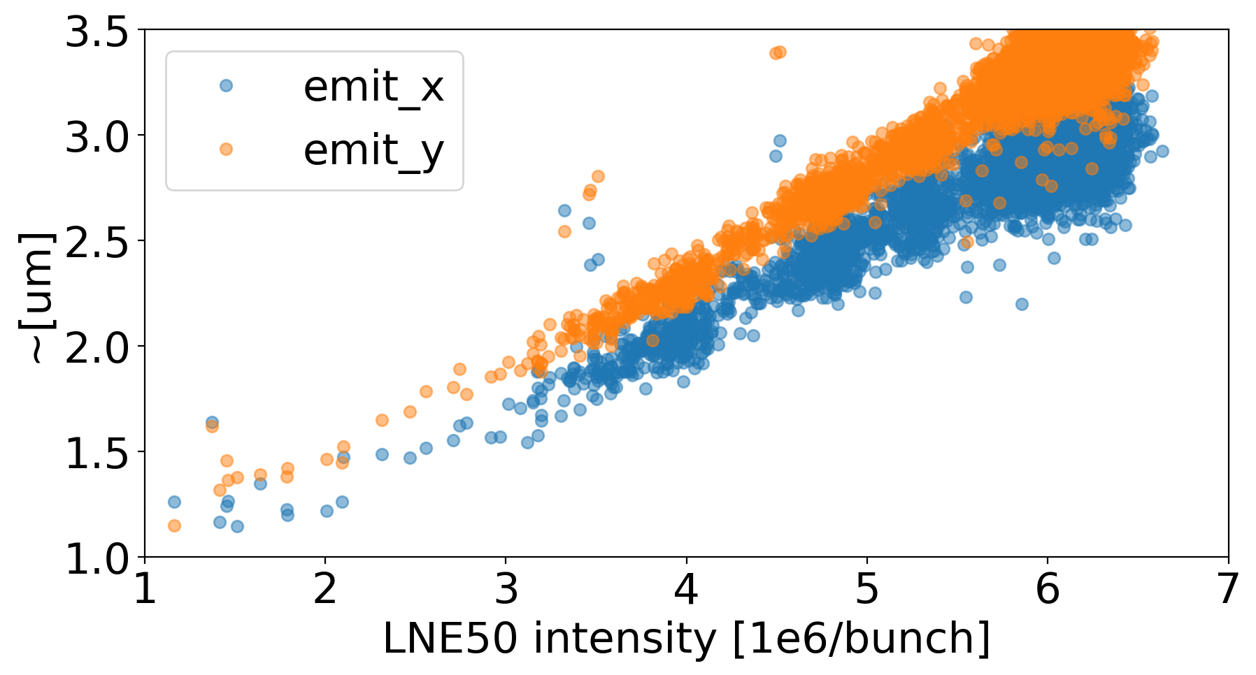
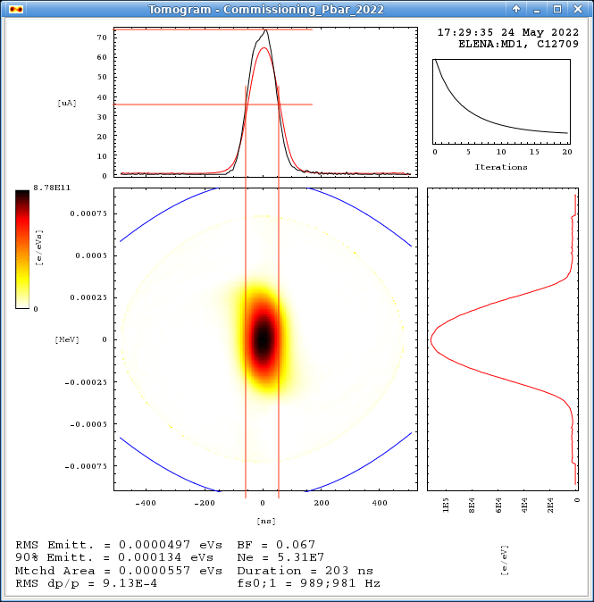
Charactheristics of beams delivered to users
In longitudinal, normally meeting user needs
  Thanks to flexibility provided by bunched beam cooling, and bunch rotation
Transverse emittances too large!
  Design values: ~1 um
  ~linear dependance with beam intensity
Users do not seem to have strong requirements on emittance and/or energy spread…
Still, worth investigating reasons for discrepancy!
Without bunch rotation:
150 ns-long FWHM, 6e-4 RMS dp/p
Not accurate values!
With bunch rotation:
100 ns-long FWHM, 9e-4 RMS dp/p

Slide 7
Investigations Tools and Methods

Slide 8
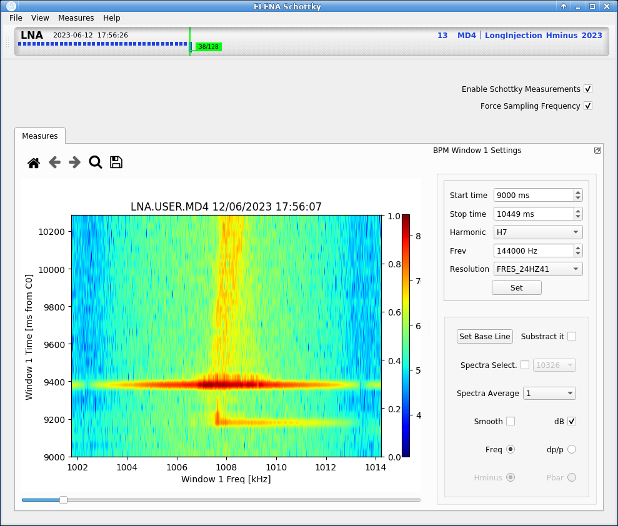
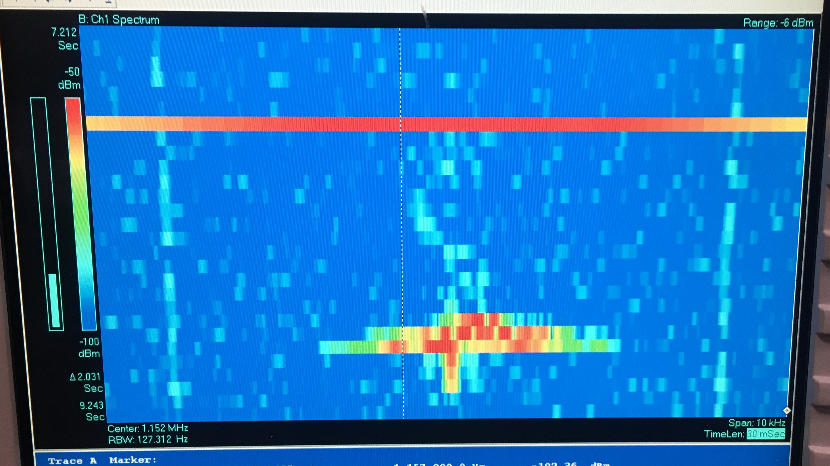
Longitudinal: Schottky using BPMs
Schottky by combining several BPMs
  See O. Marqversen et al. at IBIC2021
  Characterisation of the full system still ongoing, but certainly good enough for
  e- energy adjustments
Too little signal seen using standard spectrum analyzer with a single BPM
  Tests ongoing to see if we can amplify the signal…
In principle, dedicated LPU should give us more SNR than all BPMs,
  so far, never seen any usable Shottky (to my knowledge) using the LPU
  Tests also ongoing to see if we can amplify the signal…
LPU Schottky?

Slide 9
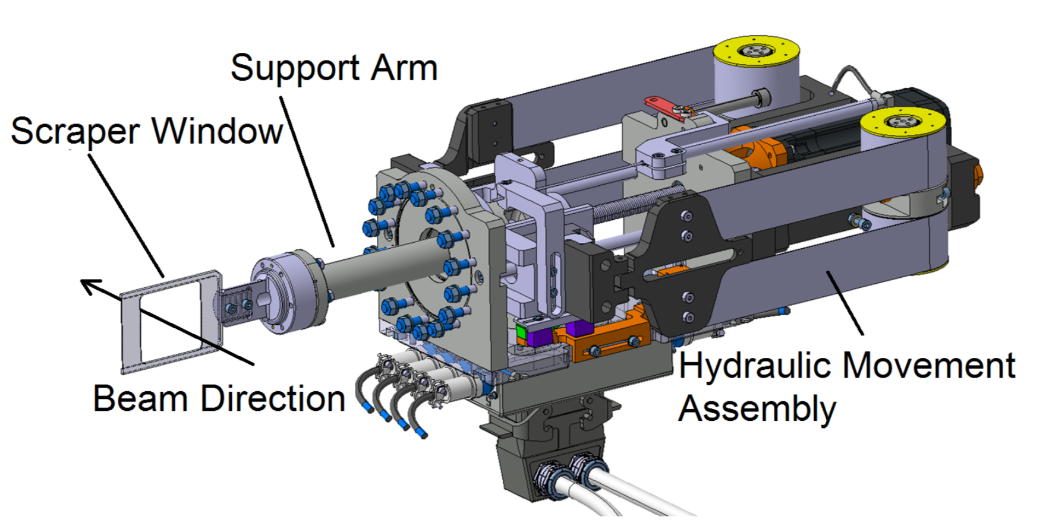
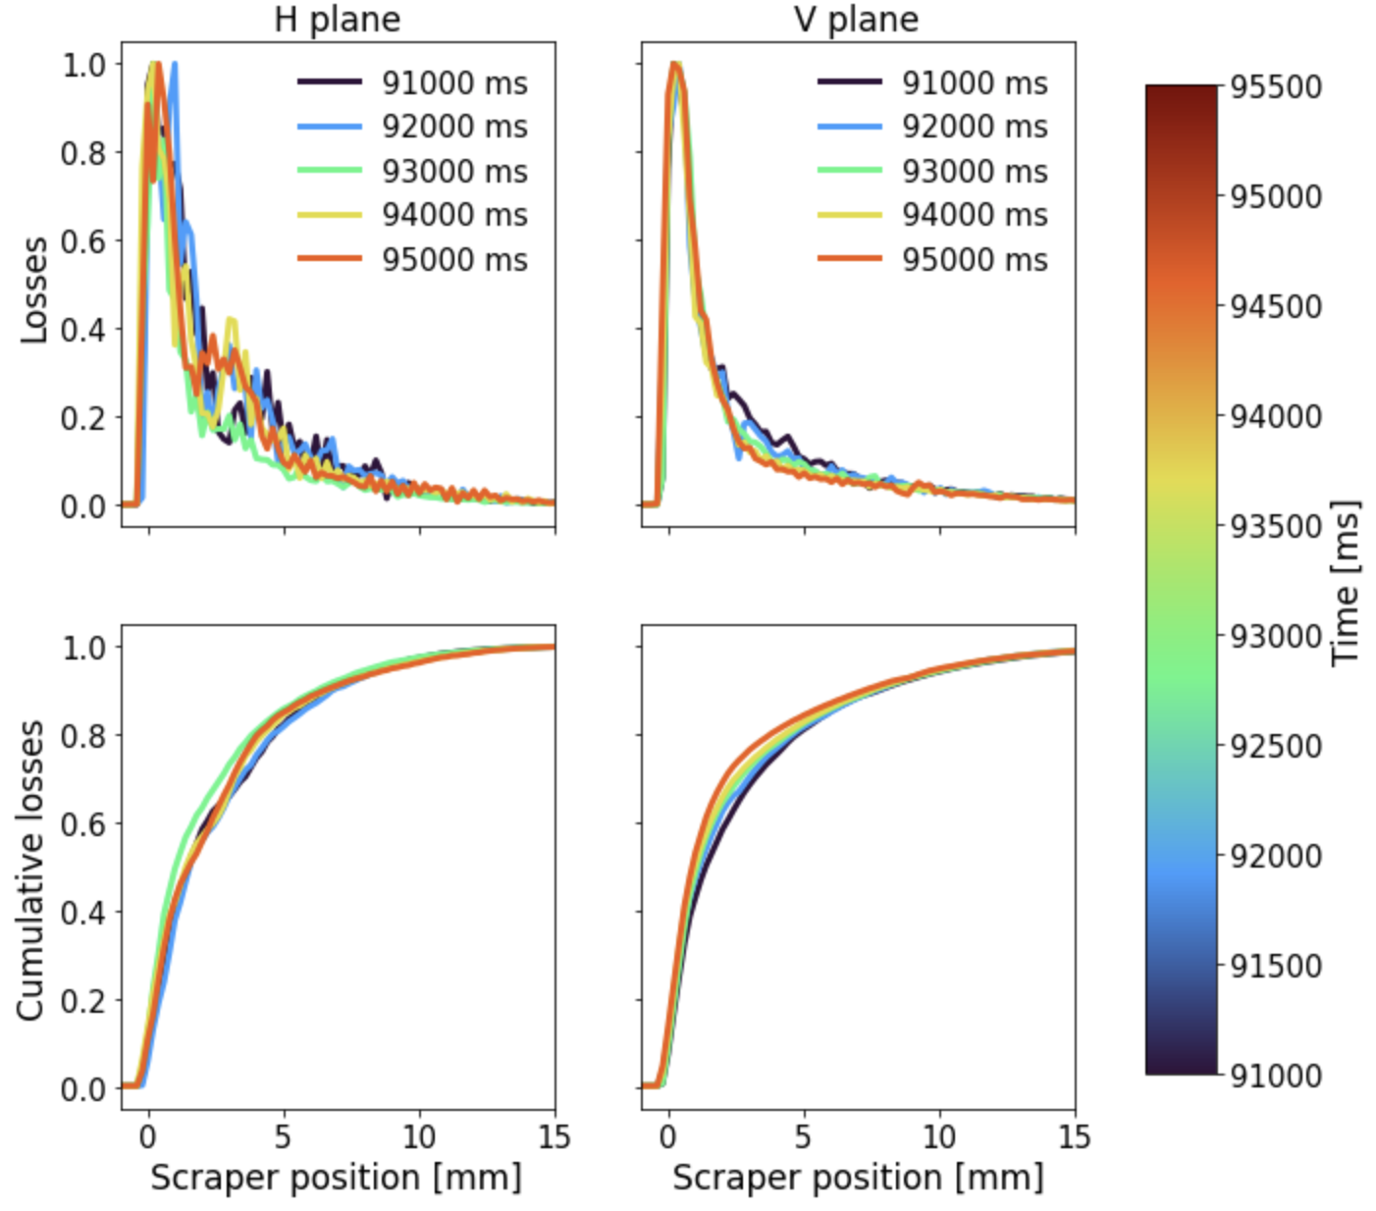
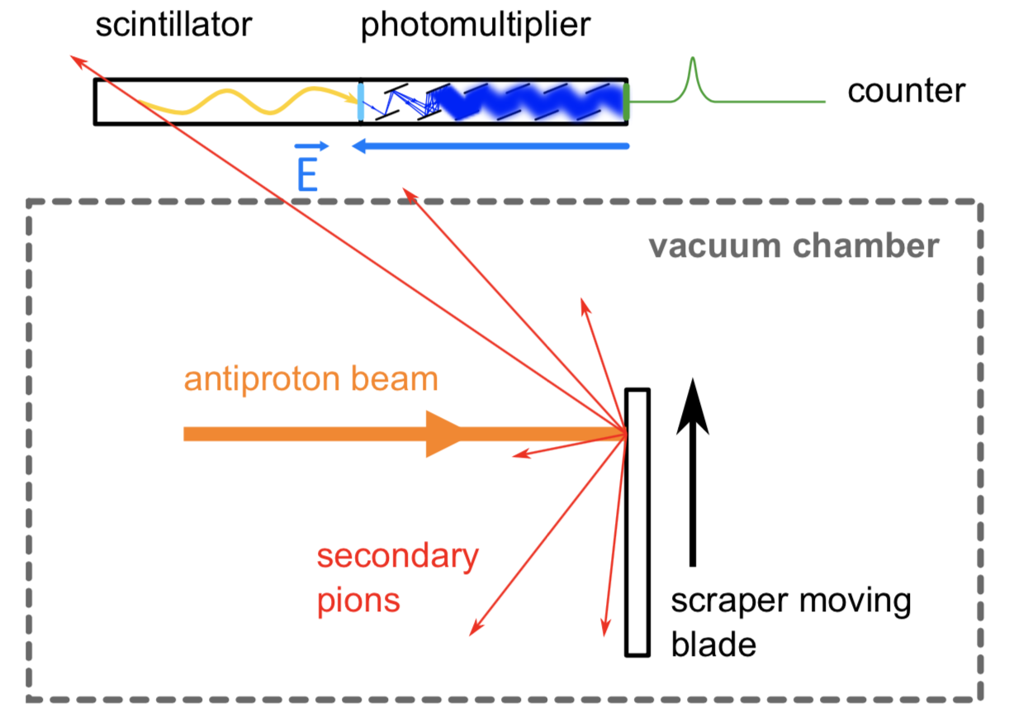
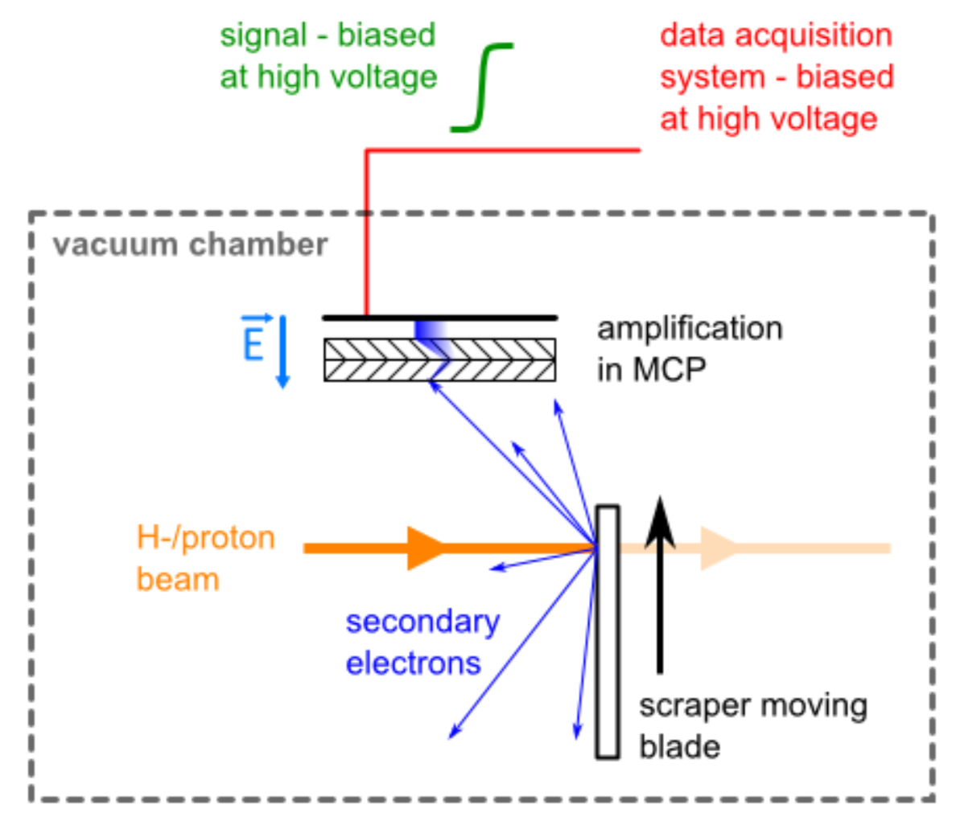
Transverse: Scraper Measurements
Only available system to measure transverse beam profiles
  Similar system (different hardware) for both AD and ELENA
  Destructive measurement: any optimization is a very lengthy process!
Reliability of signal retrieval and interpretation sometimes difficult
  Work ongoing for better data treatment – see G. Russo @ HB2023
  So far, limited time invested on ELENA
    In-vacuum MCPs for H- detection too noisy
Courtesy P. Grandemange (link)
AD 100 MeV/c example - courtesy G. Russo
Notes:
To be looked.

Slide 10
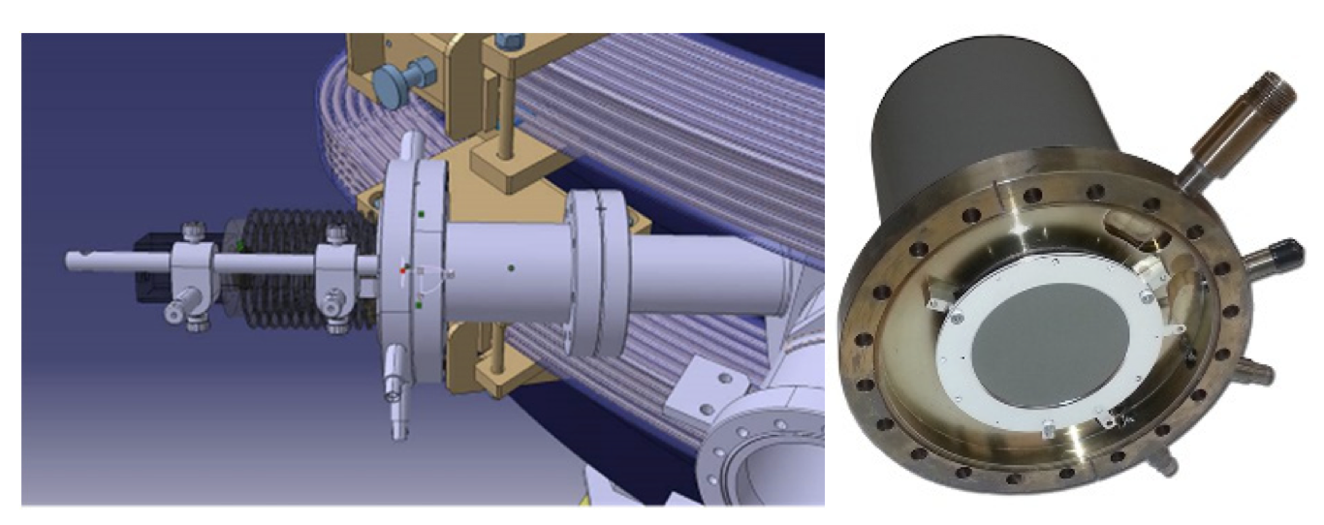
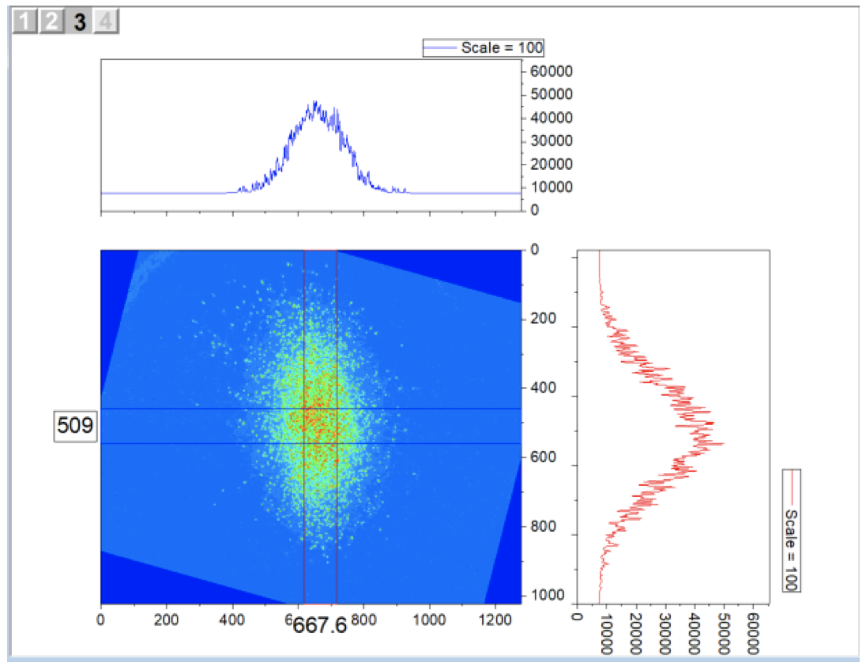
Neutrals Monitor
System installed at the end of e-cooler section in ELENA
Great potential for cooling (but not only!) studies with H⁻
Work ongoing to interpret the measurements obtained so far:
  Source of the signal might not be (only) due to H⁻-e⁻ interaction
  System not yet fully exploited
  See G.Tranquille at COOL23

Slide 11
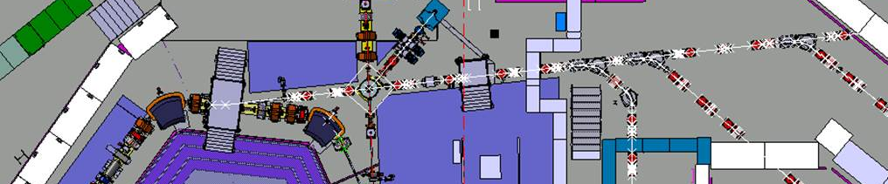
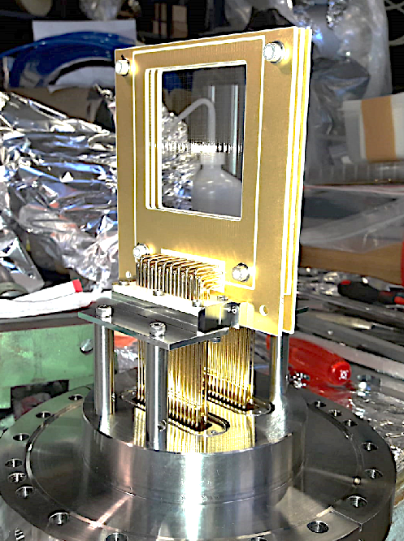
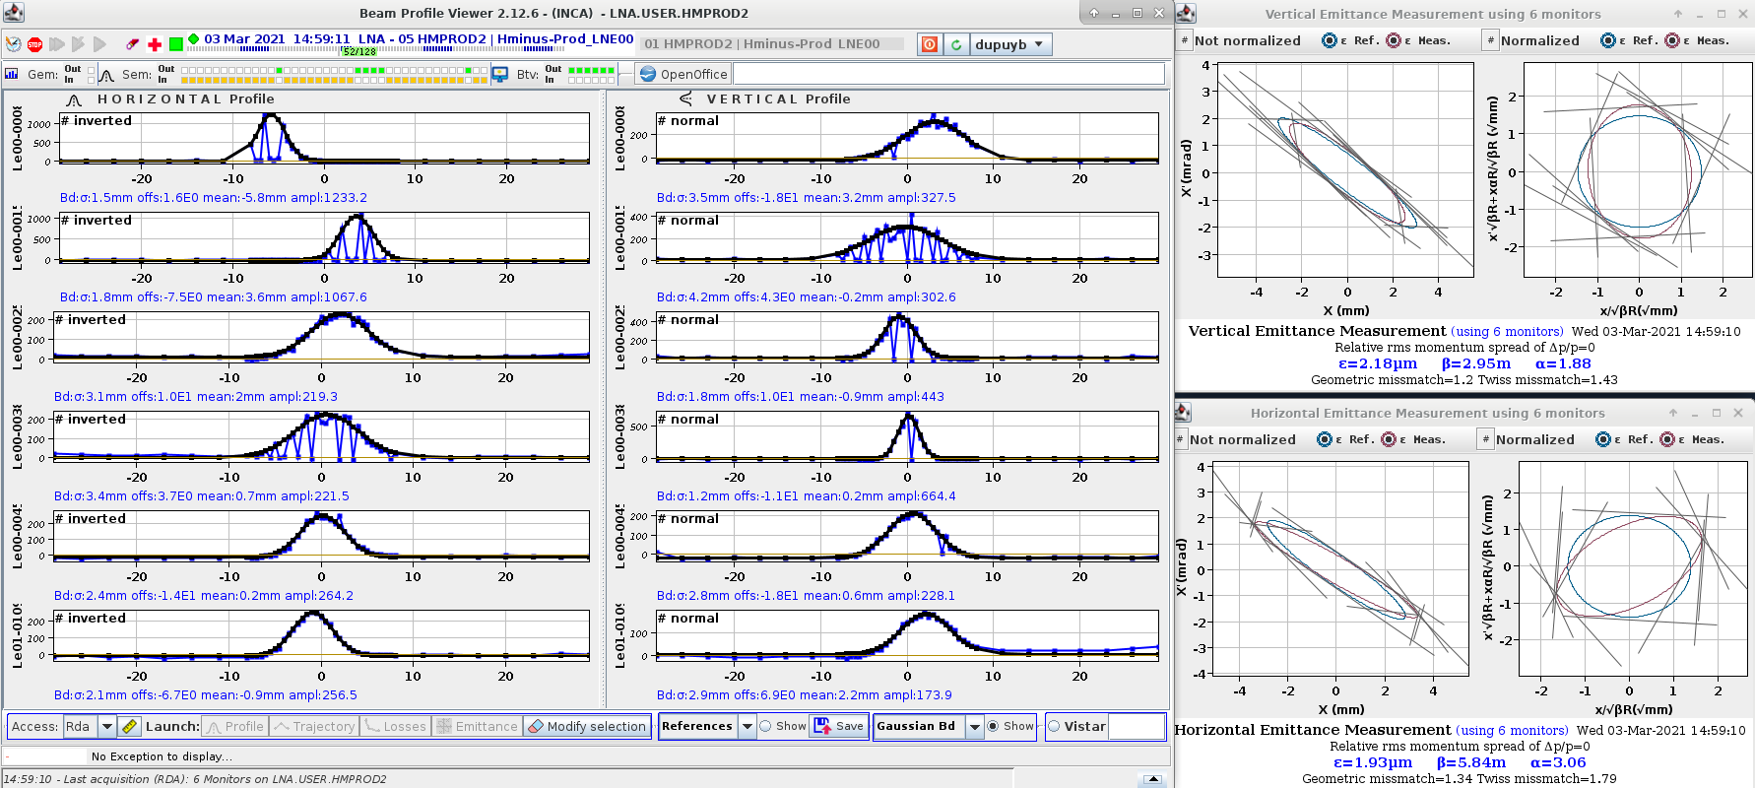
SEM: single shot optics measurement
ELENA transfer lines are equipped with multi-wire profile monitors (SEM)
ELENA
ring
SEM monitors
LNE00 Transfer line
Exemple good beam profile
By combining the information of several SEM one can perform a multi-screen beam Twiss parameter measurement
Extremely useful diagnostic!!
  but loss of intensity as SEM are semi-interceptive device (about 10% beam loss per SEM in the beam)
Often using a single SEM for
e-cooling optimization…

Slide 12
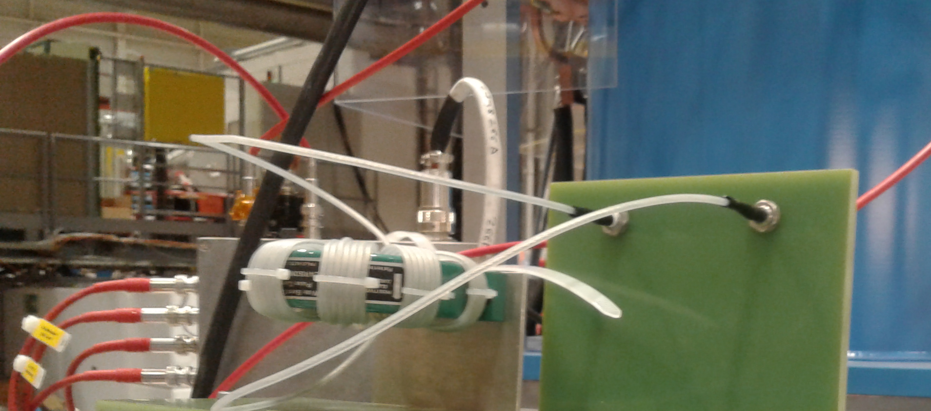
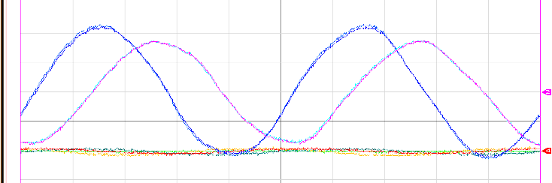
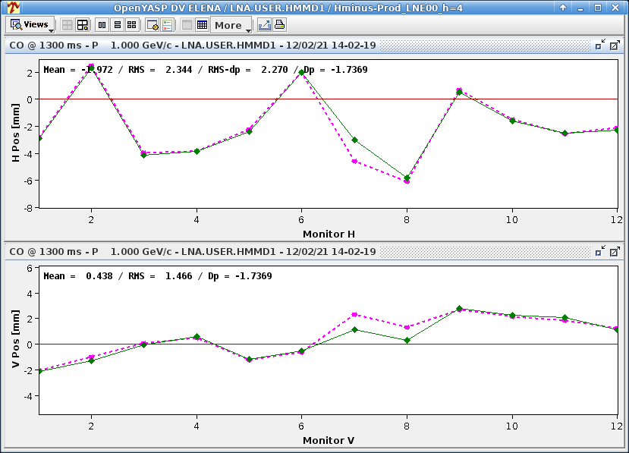
pbar (or H-)/e⁻ orbit matching
All CERN cooler have two BPMs in the cooling drift solenoid that “see” both ions and e⁻ beams.
  One needs to induce an e⁻ beam intensity modulation in order to see a signal with those BPMs
Using BPM acquisition system for both generating e⁻ excitation and signal processing
  it allowed to integrate this new tool with standard orbit correction tools (e.g. YASP steering program widely used at CERN)
  Accuracy on H-(pbar)/e- alignment of the order of 1 mm: enough for first cooling setup!
Pearson transformer used to induce a modulation of grid voltage
Sinusoidal excitation seen on sum BPM signals
400 mV p-to-p
Before correction
H⁻ orbit
After correction
Start of e⁻
e⁻ orbit
H orbit [mm]
H⁻ orbit
e⁻ orbit
Time [ms]
Special thanks to A. Frassier and B. Galante

Slide 13
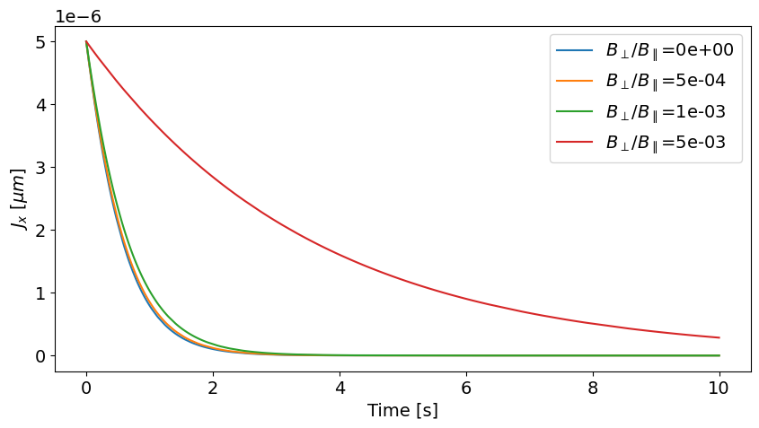
Simulations Tools Development
Trying to overcome limited availability of e-cooling simulation codes:
  Exploring the e-cooling module in RF-Track (see work by A. Boruka @COOL21)
  Implementation of e-cooling module in Xsuite (see work by P. Kruyt @COOL23)
    E.g. study impact of solenoid field straightness on cooling time
Present wp:
1e7 pbars
100 keV
65 ns rms
2 um rms
ELENA magnetic field quality somwhere in this range
Investigate in tools/methods typically used in space-charge-dominated machines (e.g. see F. Asvesta studies in CERN injectors)
  Space-charge induced tune spread at ELENA extraction is right on top of a third order resonance!
Notes:
intensity = 1e7 #particles per bunch
bunchLength_ns = 65 #1 sigma in ns (about 150 ns FWHM)
#bunchLength_m = 1.3 #1 sigma in m
b = 0.0145997520321079 # relativistic beta : if desired energy different than in twiss file
g = 1.0001065934205136 # relativistic gamma : if desired energy different than in twiss file
emittance_x = 2e-6*b*g #rms normalised emittance, in m
emittance_y = 2e-6*b*g #rms normalised emittance, in m
dpp_rms = 5e-4 #RMS Dp/p
Qh = 2.3975 #5.45 #5.39 #6.21 # to estimate detuning and plot
Qv = 1.375 #5.42 #5.37 #6.24 # to estimate detuning and plot
#Qh = 2.28 #5.45 #5.39 #6.21 # to estimate detuning and plot
#Qv = 1.32 #5.42 #5.37 #6.24 # to estimate detuning and plot
Qh = 2.28 #5.45 #5.39 #6.21 # to estimate detuning and plot
Qv = 1.32 #5.42 #5.37 #6.24 # to estimate detuning and plot
twiss_file = 'twiss_files/twiss_ELENA_Henergy'
harmonic = 4

Slide 14
Some Recent (yet preliminary) Results

Slide 15
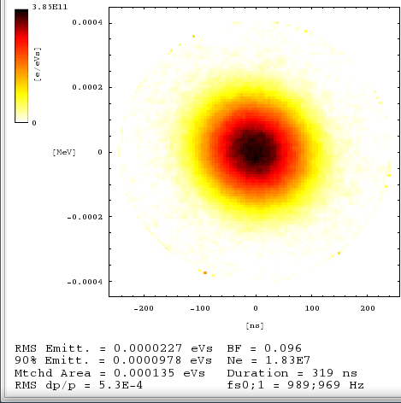
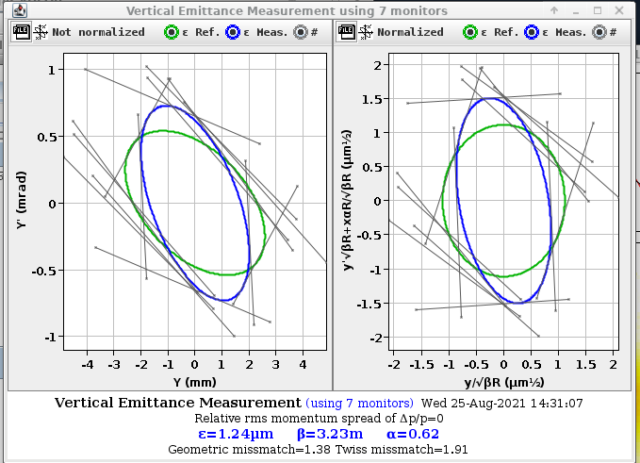
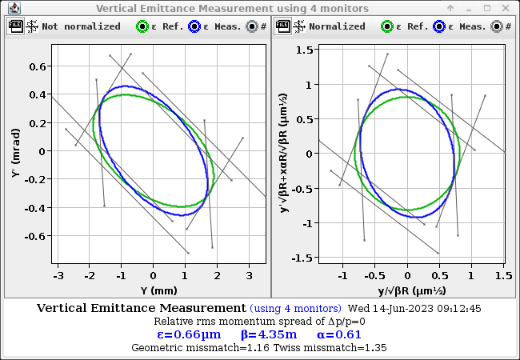
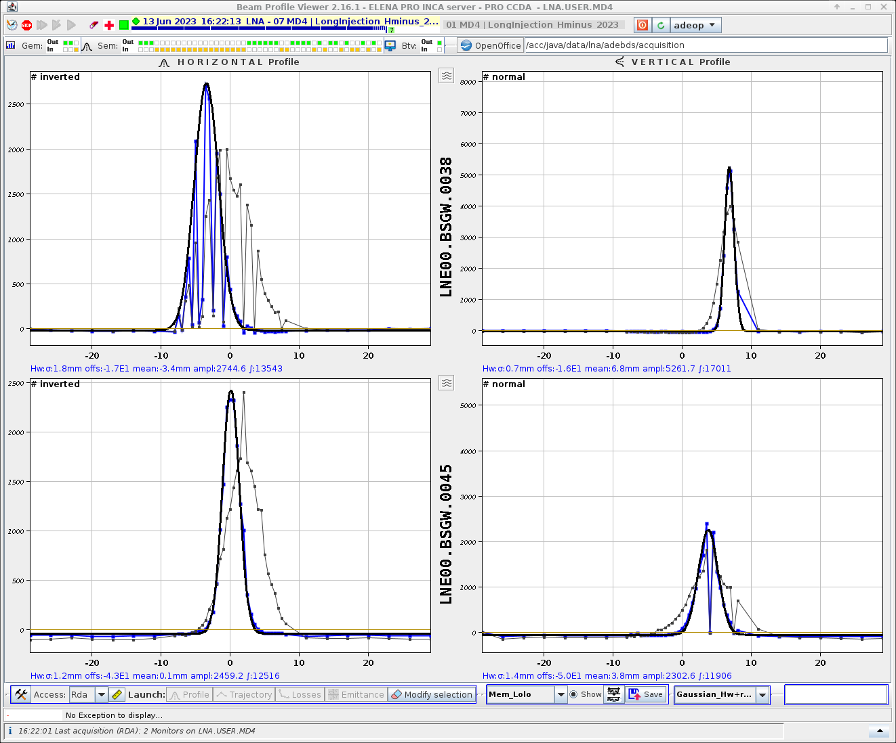
Is space charge our limiting factor?
Possible to obtain smaller emittance (at the expenses of higher longitudinal one) playing with length of bunched beam cooling before extraction in ELENA
Longer bunches:
200 ns-long FWHM, 5e-4 RMS dp/p
Or even smaller emittances if extracting the beam un-bunched!
Un-bunched Beam
𝛔=1.2 mm
Bunched Beam 𝛔=3.3 mm

Slide 16
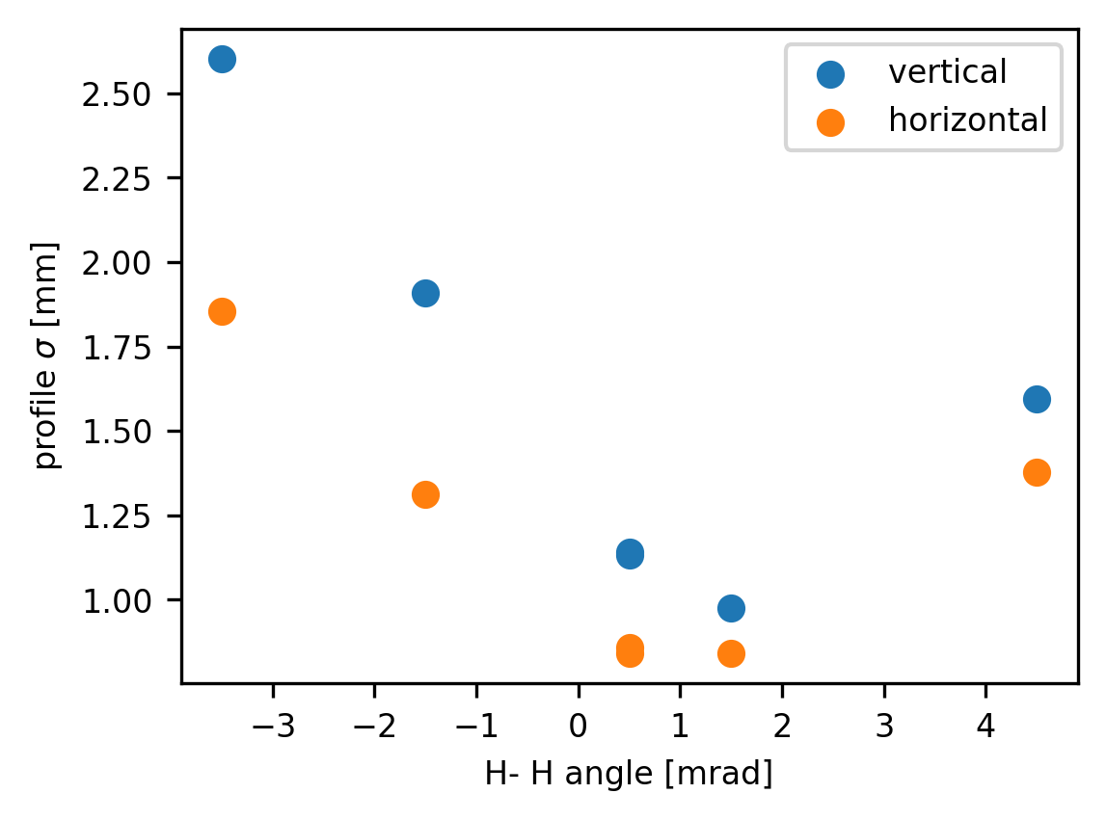
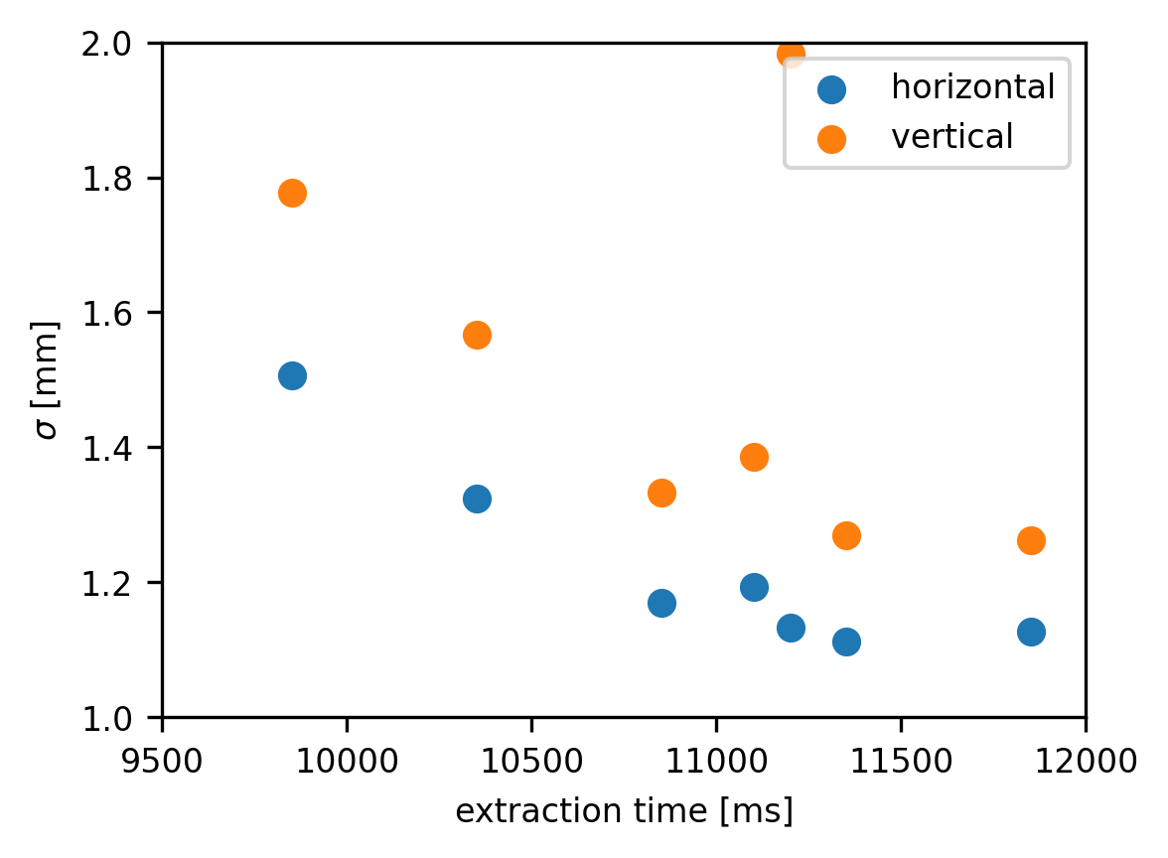
New 100 keV e-cooling Optimisation Procedure
Bunching masks most of e-cooling performance, hence, relying on beam profile measurement of extracted beam in a single SEM:
Remove RF before extraction
  focus on e-cooler performance and not on
  re-bunching/space charge dynamics
  But… we are blind on intensity measurement…
Vary H- (pbar) angle in e-cooler and minimise observed beam size
Extract the beam at different times to see when cooling “stops” begin effective
Beam size minima corresponding to best H-/e-alignment
Transverse cooling seems to saturate after about 1.5 s

Slide 17
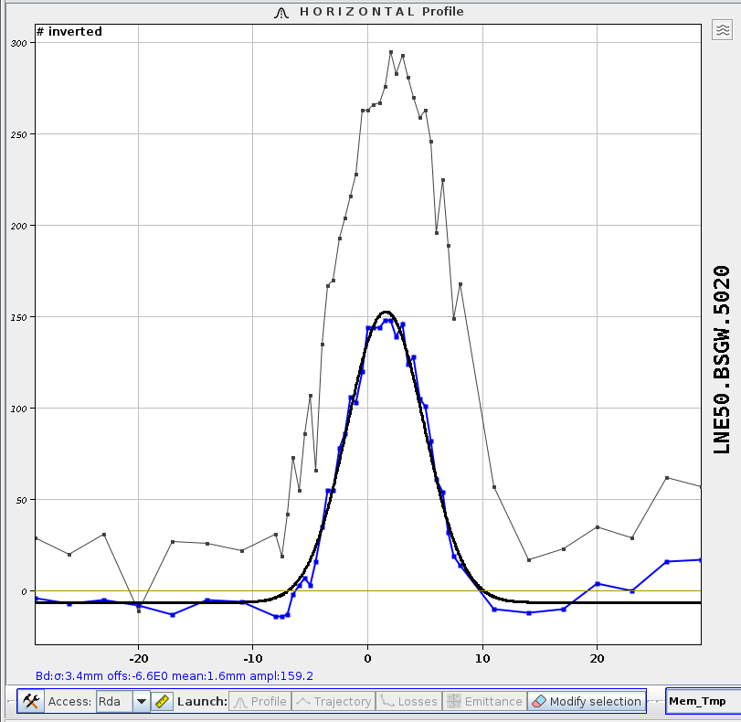
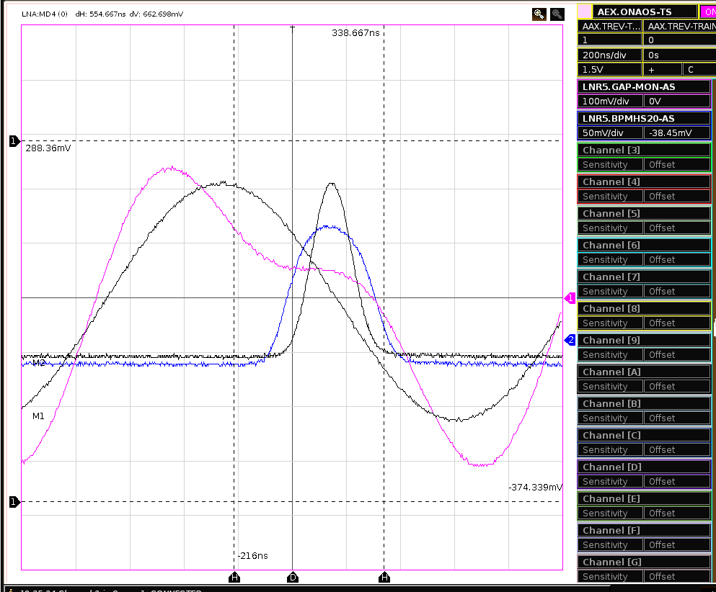
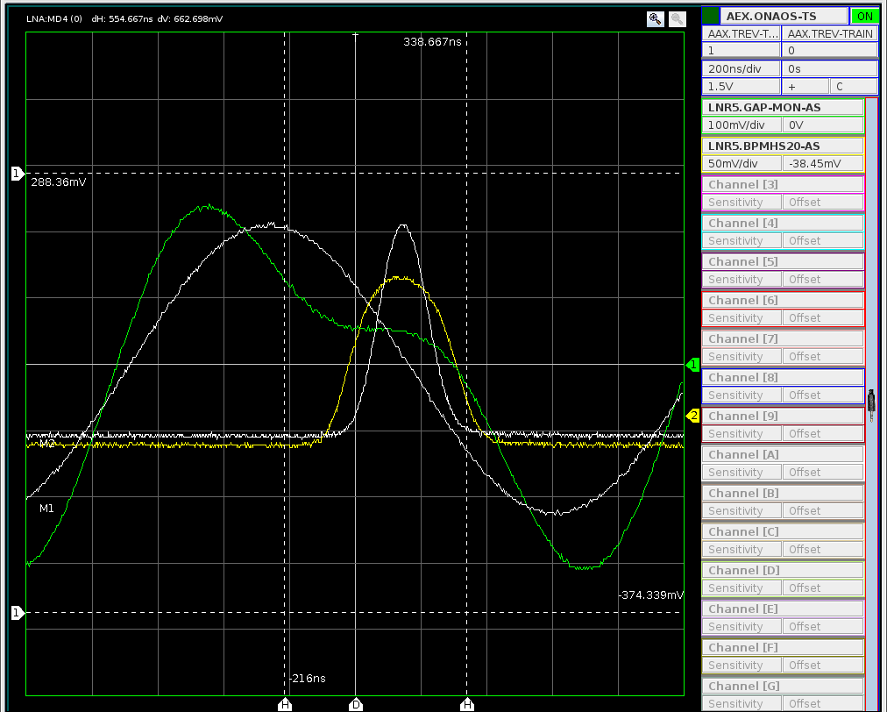
Using double h RF for SC minimisation?
Profiting of flexibility of ELENA RF system with double harmonic
  Possible to reduce beam size (hence emittance), but not-acceptable bunch length (300 ns FWHM) for experiments using drift tubes to stop the beam
Single h
𝛔=5.0 mm
Single h
Double h
𝛔=3.4 mm
Double h

Slide 18
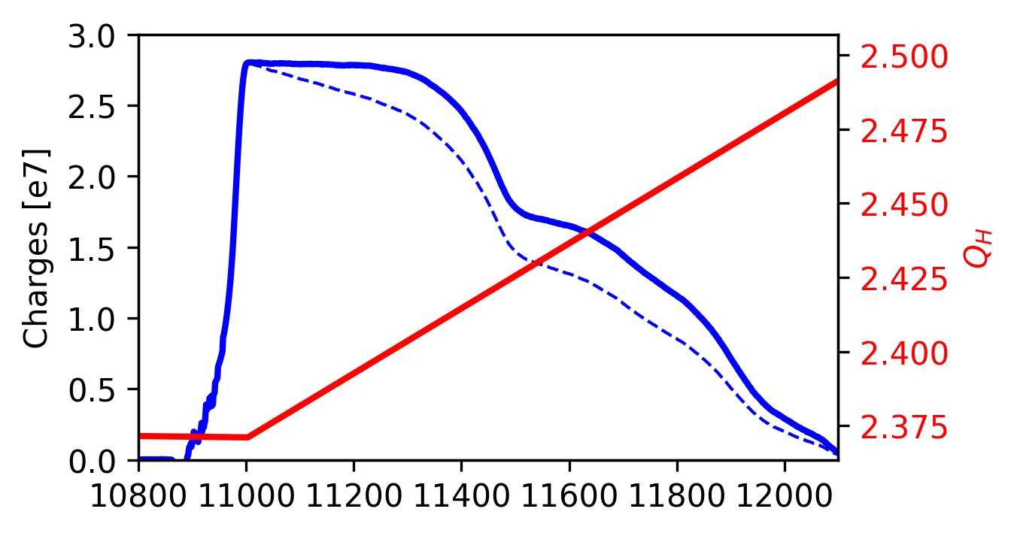
Exploring nearby Working Point
Lifetime-compensated intensity data
Idea of looking at loss rate as a function of working point variation
Inpractical with pbar (too few cycles!)
Using H-, but require lifetime compensation
  One should be careful interpreting the data, as space-charge tune shift varies with time!
We are operating in a narrow region!
Programmed tune
Raw intensity data
bunching
process
Third order resonance
Moving tune along the cycle

Slide 19
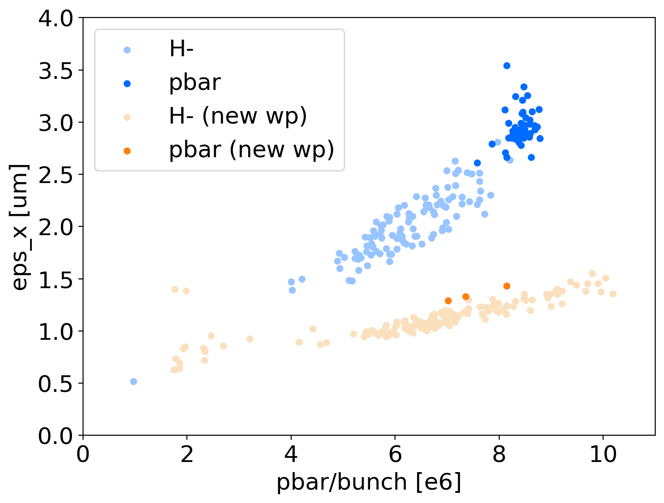
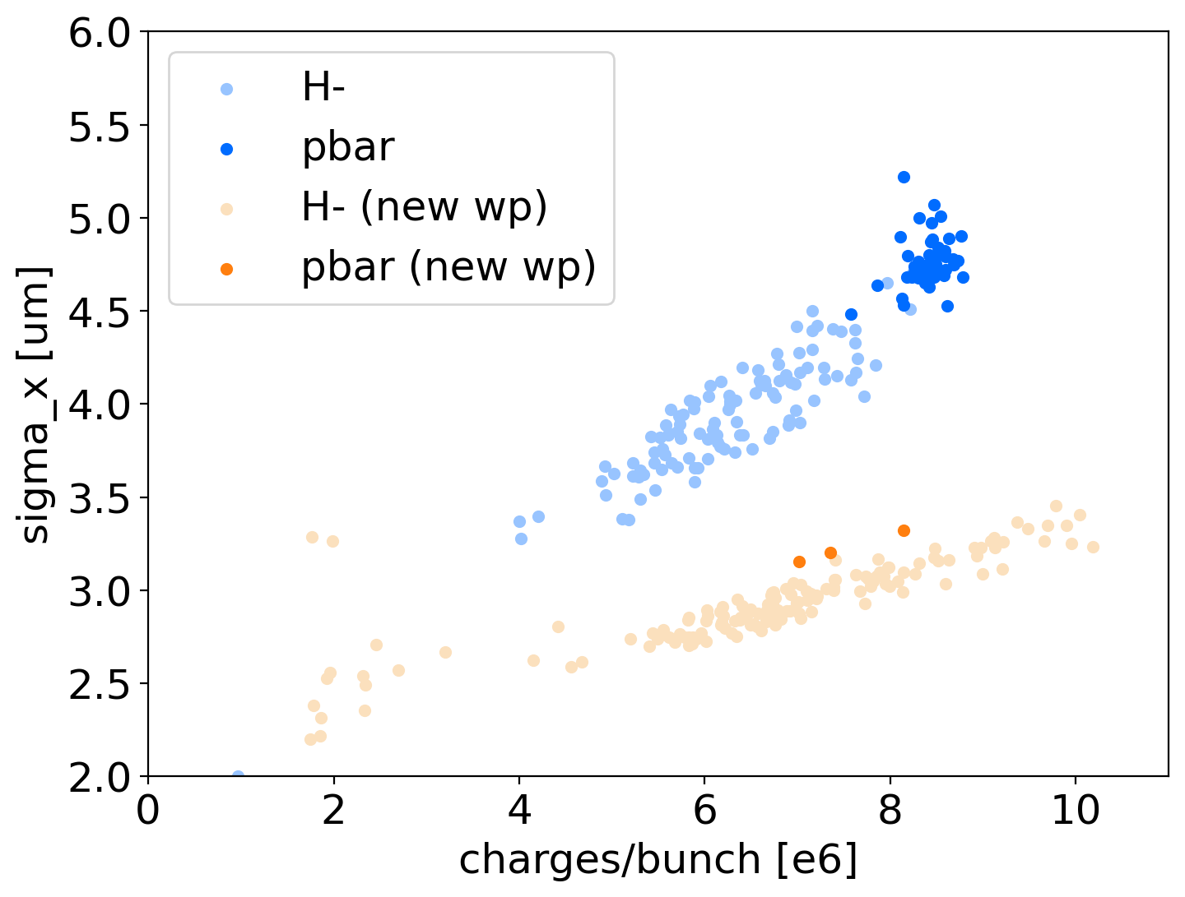
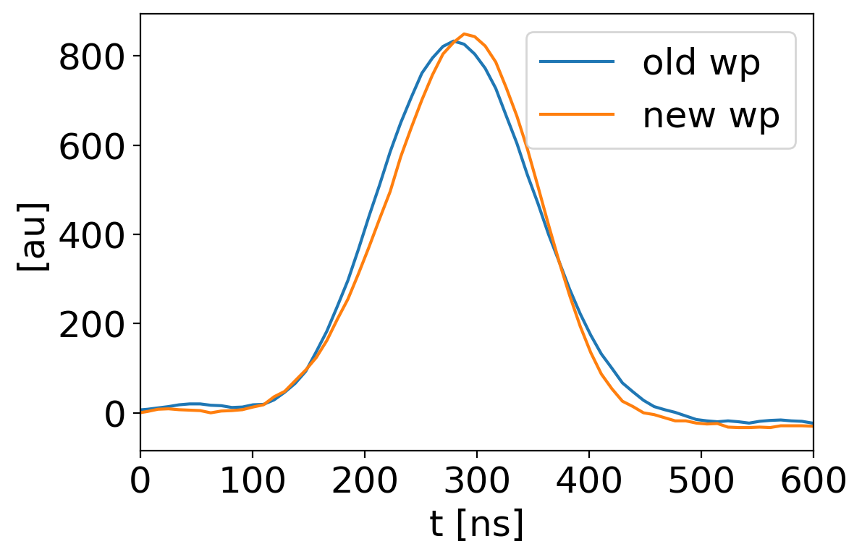
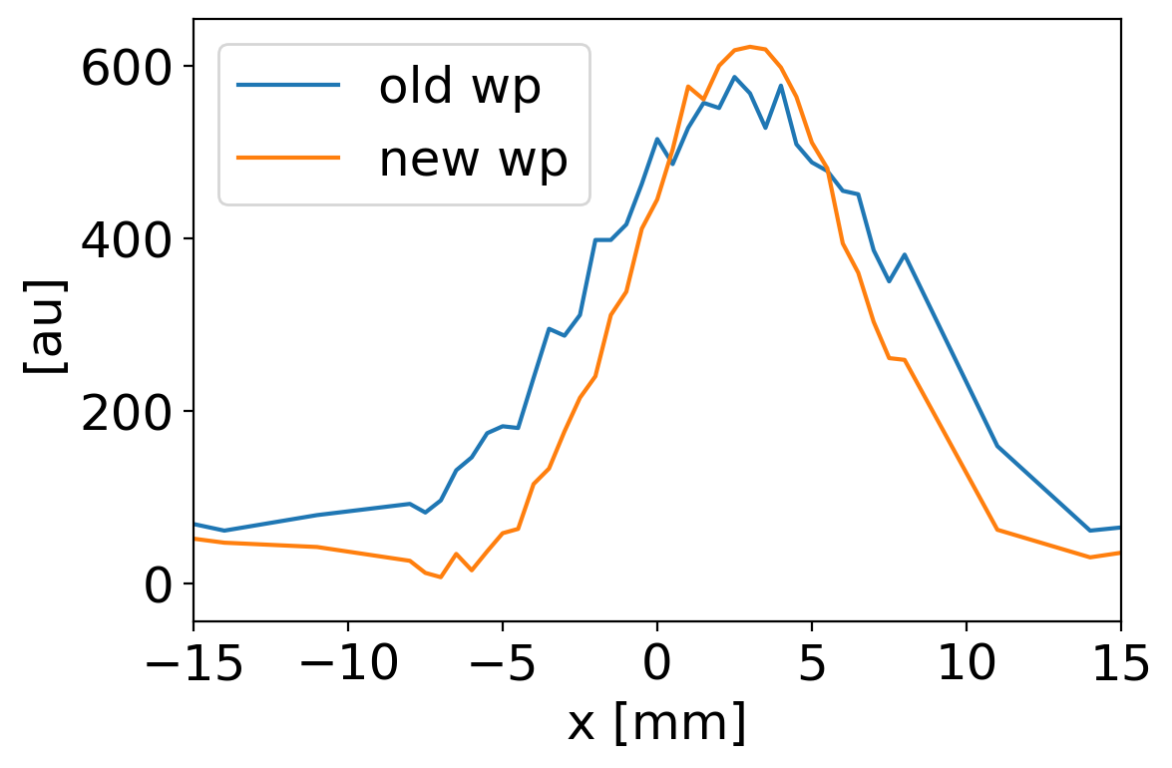
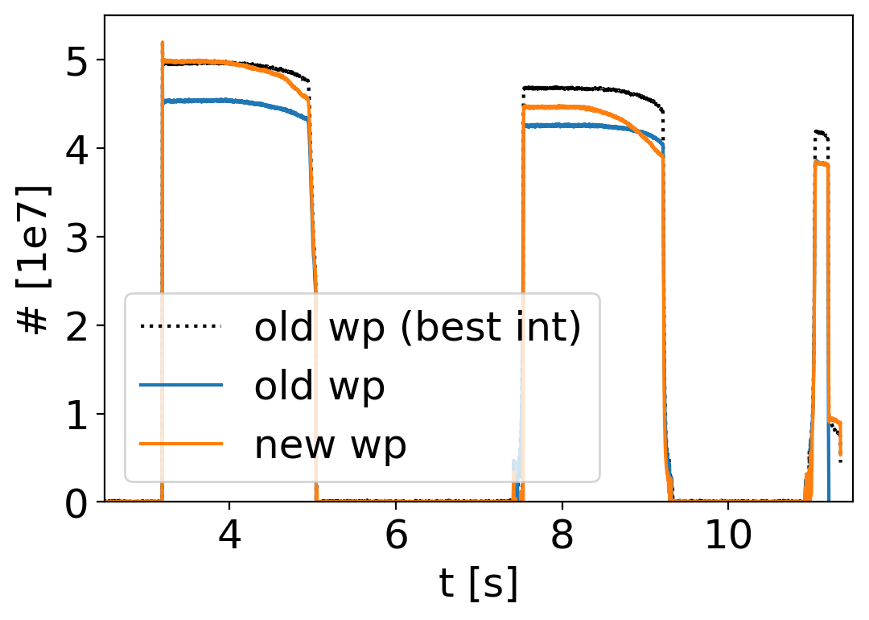
Exploring a New Working Point
Up to 4th order resonance
Moving below third
order resonance
requires to change
whole ELENA cycle…
Tested first with H-
  Advantage of injecting beam already on new working point at 100 keV
  Clear reduction of beam size observed for equivalent bunch length
Promising preliminary results confirmed with pbar (but losses along the cycle)
x2 emittance reduction!

Slide 20
Outlook and Conclusions
ELENA and its e-cooler are performing within expectations
  Delivered beam intensities x2 higher than design!
  Procedures and tools for e-cooling setup and optimisation are in place
    Regularly applied for correcting drifts and recovery from incidents
  Space-charge might be defining beam parameters at extraction
    Short bunch length typically requested/favoured by experiment
    Investigations on different working point show promising results
Ongoing activities:
  Improving understanding of beam instrumentation (scrapers, Schottky,…)
  Improving ring optics understanding/control
  Implementing complete simulation of e-cooling process including
  Space Charge and Intra Beam Scattering effects
    Aim at measuring+simulating impact of magnetic field quality and cooling force on e-cooling performance
Thanks to all the AD/ELENA team and for your attention !

Slide 21
Appendix

Slide 22
User wishes
Based on recent survey sent to all AD/ELENA users
Repetition time and stability:
  ~110s (mainly driven by BASE: shorter cycles can be a problem for them!)
  Ideally requiring back-to-back cycles (optimum for stability and intensity flux).
    If not (as today) we should aim for 5% rep-rate stabilty
Delivered bunch properties:
  >7.5e6 pbars/bunch (driven by AEgIS design)
  Rms emittance <2um. No strong desire for lower (but GBAR, short term)
  Rms dp/p <1e-3. No strong desire for lower
  Trajectory stability <0.1 mm
  100 ns FHWM bunch length
    Today’s 150 ns FWHM without bunch rotation sufficient for most experiments, but GBAR.
  100 keV fixed extraction energy
    But keep open the possibility to explore 50-500 keV (up to 5.3 MeV for ASACUSA1)
Beam availability:
  Present yearly schedule (days of pbar physics) and injectors availability typically good enough
    Both could be improved with equal importance
  4 bunches extracted from ELENA all the time seems to statisfy most use cases
    More dynamic scenarios don’t seem to be interesting

Slide 23
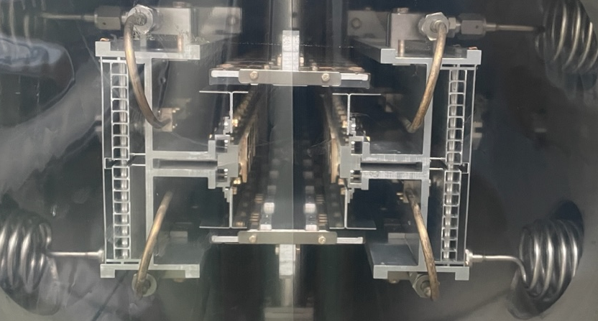
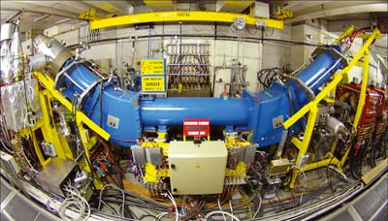
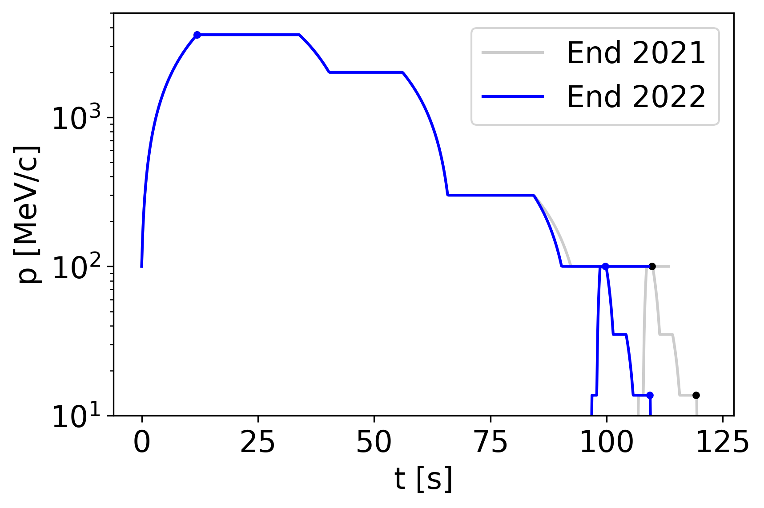
AD/ELENA Cycles
Cycles basically un-changed since after LS2, but some minor shorthening of AD cycle thanks to better control of e-cooling.
Total cycle time dominated by AD cycle: about 2 minutes per shot!
  Very few cycles for machine setup… and studies with pbar
  Likely, possible to use H- directly injected in ELENA for studies
s-cooling
e-cooling

Slide 24
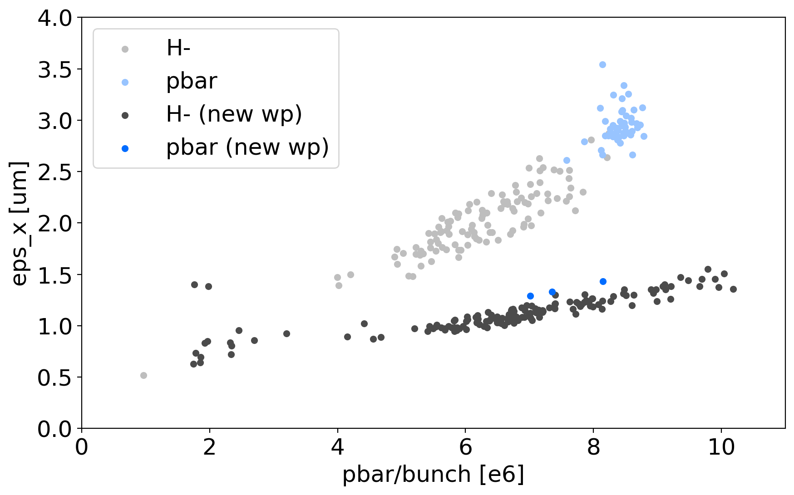
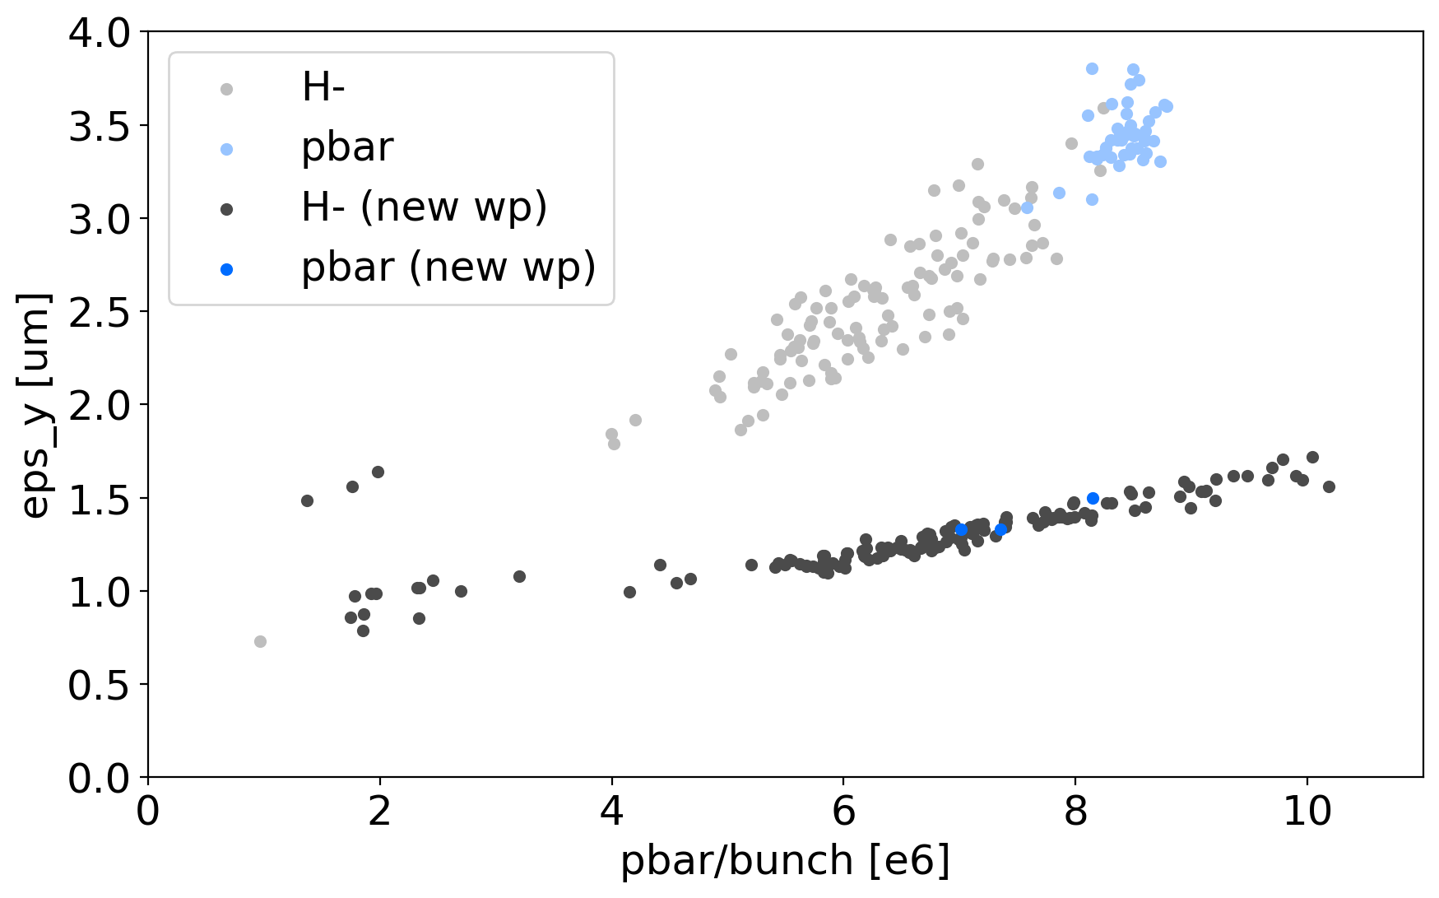
Exploring new working point

Slide 25
First simulations in Xsuite with space–charge and cooling
Only few particles tracked
Frozen model of space charge (assuming bunched beam, 1e7 pbar/bunch)

Slide 26
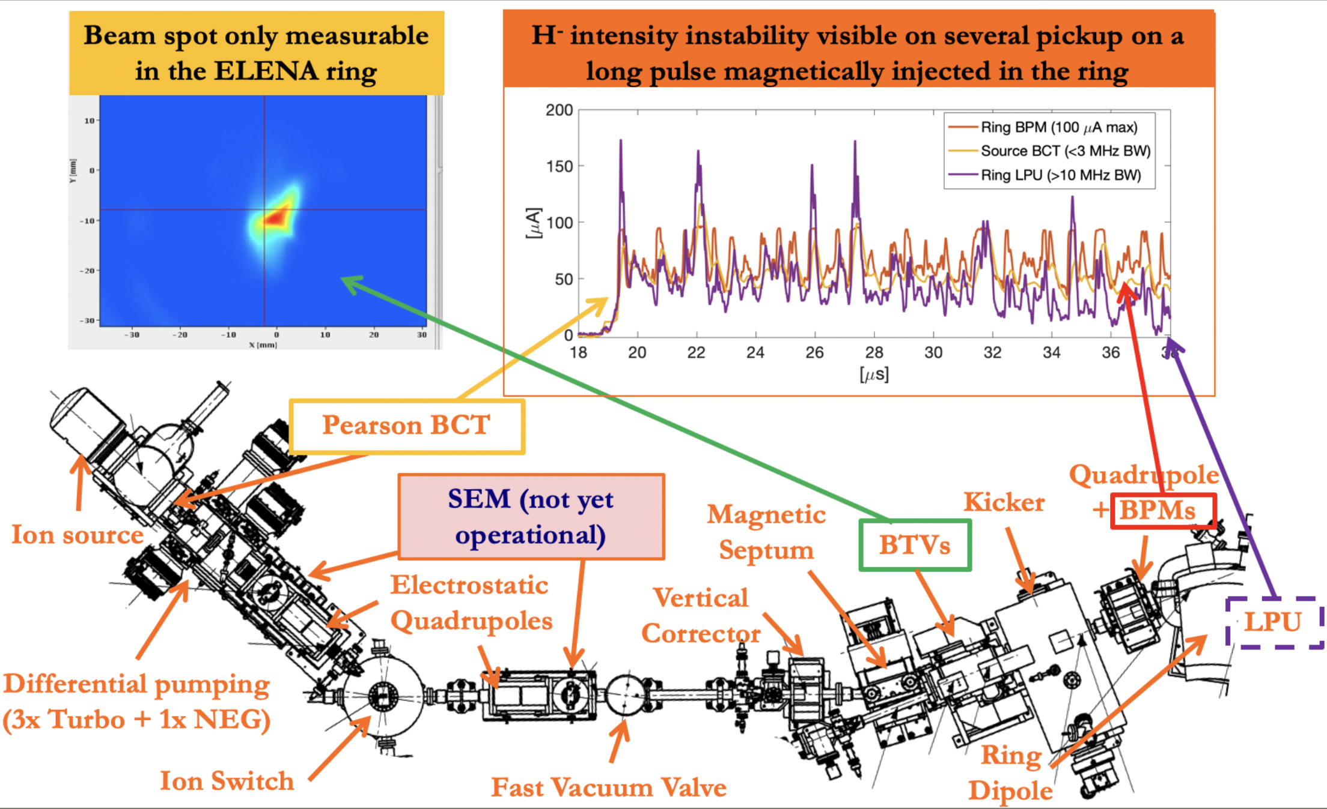
On ELENA Source (2020)

