Slide 1
Dieter Möhl Awards 2023
Awarded since 2013 (COOL’13 in Mürren)
It is awarded in memory of Dieter Möhl, a pioneer in the field of particle beam cooling who passed away very suddenly in 2012.
“Dieter Möhl (1936 — May 24, 2012) was a German accelerator physicist. Möhl worked at CERN and contributed substantially to the antiproton programme, the Initial Cooling Experiment (ICE) and was a member of the team which initiated and designed the Low Energy Antiproton Ring (LEAR). The Dieter Möhl Medal and the Dieter Möhl Award are sponsored by CERN as a memorial to him.”

Slide 2
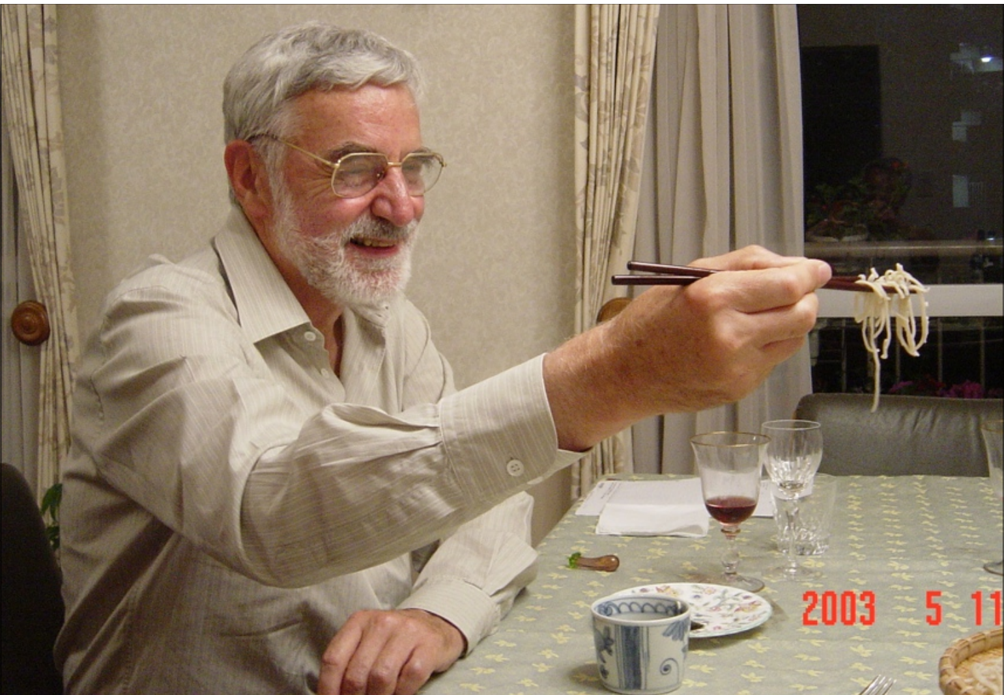

Slide 3
Life-time achievements and/or recent important contributions to the field of beam cooling and their applications.
Young scientists in their early career who have already made significant contributions to the field of beam cooling and their applications.

Slide 4
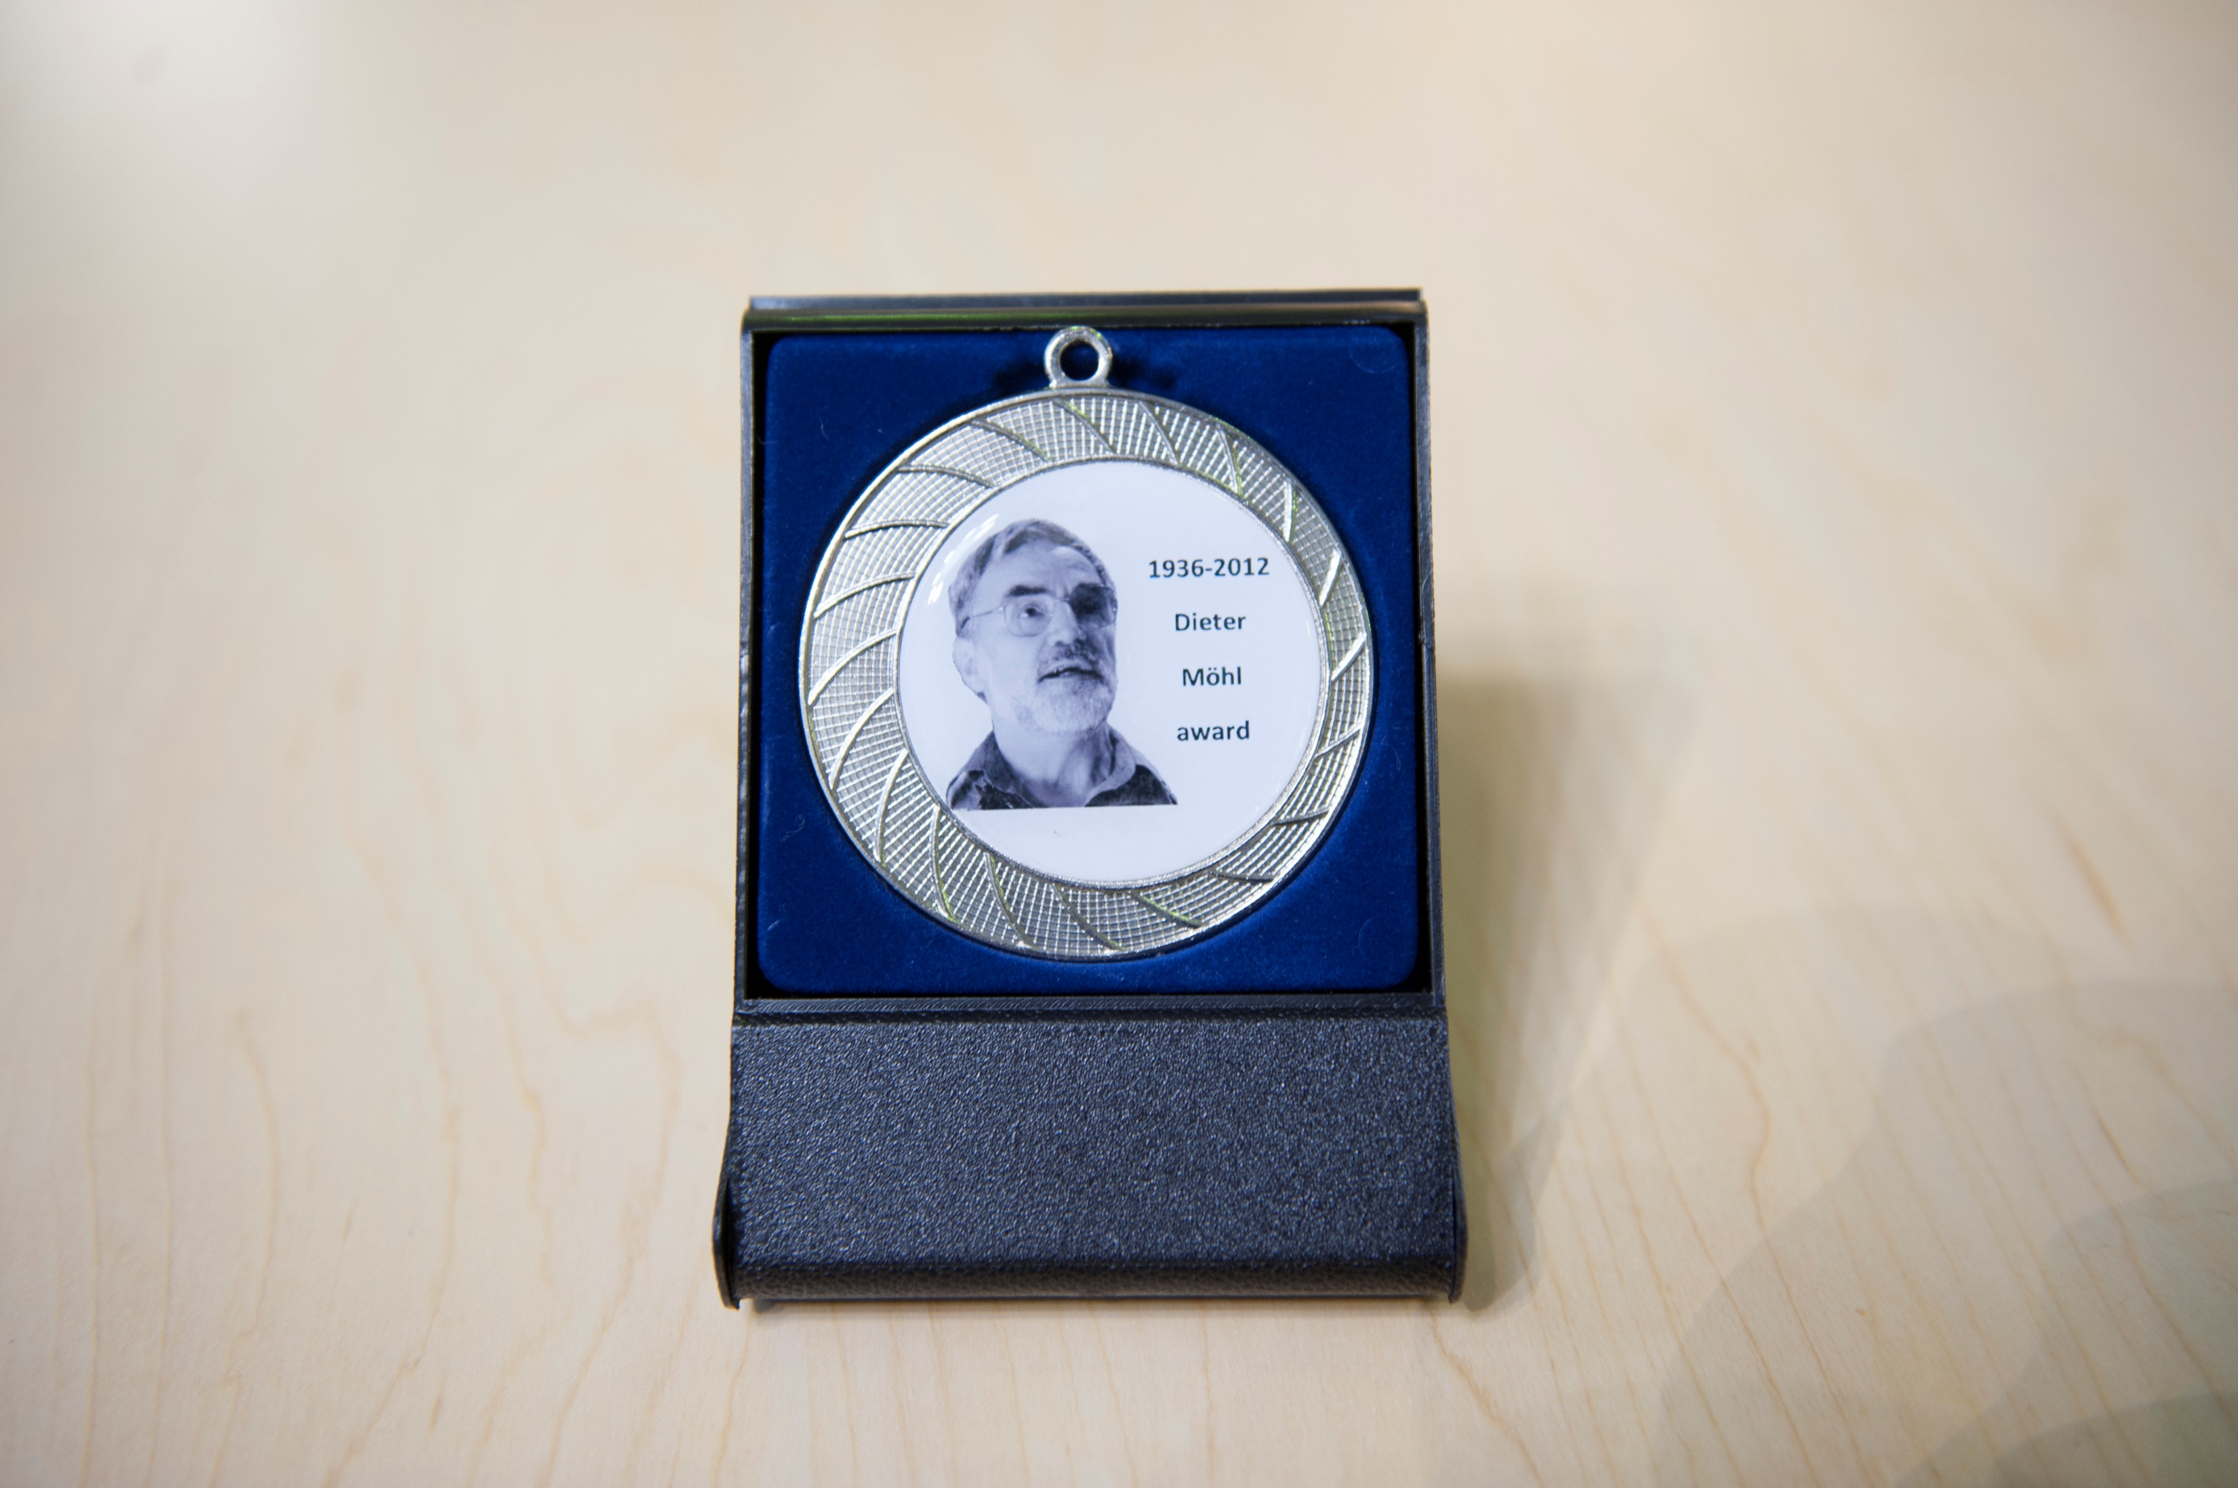

Slide 5
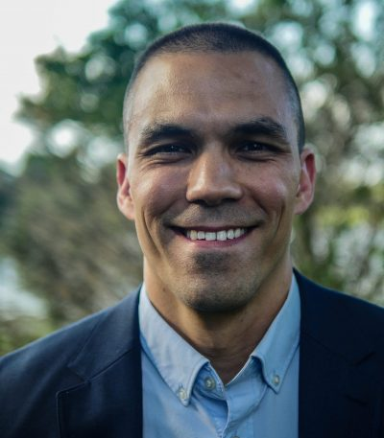

Slide 7
