Slide 1
Collimators & Safety Review
D. Macina (CERN)
CMS-ATLAS Forward Detector Meeting
CERN 12/1/2011

Slide 2
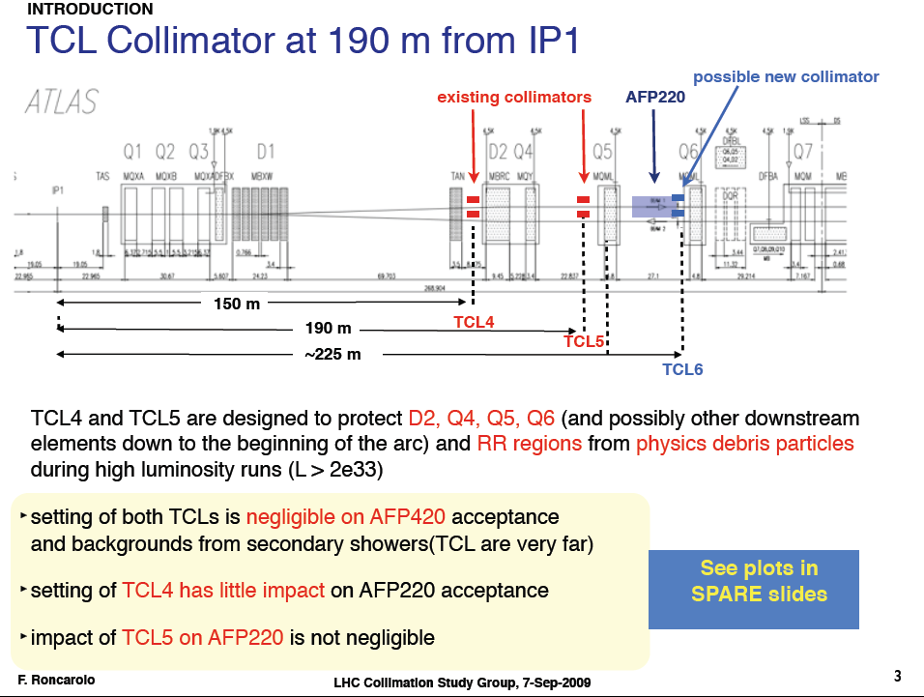
Collimators: proposal from F. Roncarolo

Slide 3
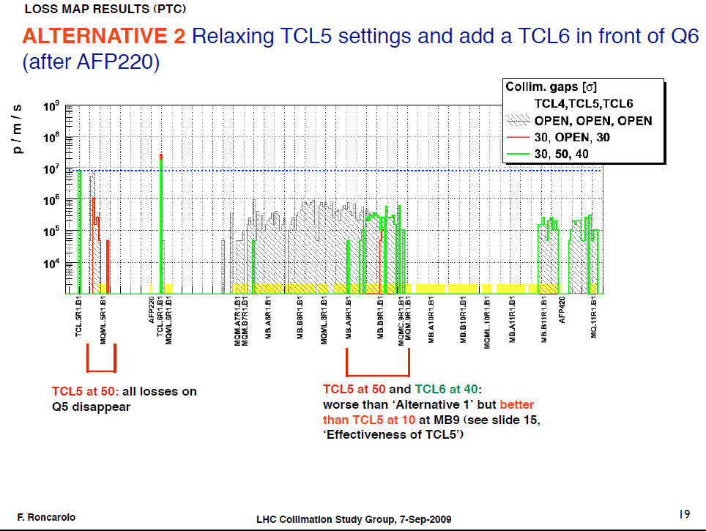
Collimators: proposal from F. Roncarolo

Slide 4
Collimators
Federico’s proposal was presented at the Collimation WG more than 1 year ago:
  Federico’s results look very sound and there is a priori no showstopper to this project of adding another TCL collimator
  However, detailed integration study is missing as well as simulation results with realistic imperfections and a confirmation of the quenching levels
Federico’s study will be published in a note before the end of January (private communication with Federico)

Slide 5
Safety Review
The design of the beam pipe at 220 m (same for the 420 m design) needs to be reviewed by:
  Vacuum group (TE/VSC) since it has to be compatible with all UHV requirements (outgassing, electron cloud, leak tightness, vacuum safety etc)
  Beam physics group (BE/ABP) to make sure that it is compatible with the “impedance budget” defined for the LHC to avoid beam instabilities and to make sure that it will not add aperture restrictions that might generate beam losses
  Machine Protection Panel (MPP) to make sure that the beam pipe operation is safe and all appropriate interlocks are implemented to avoid beam losses or accidents

