Slide 1
Reducing cloud boundaries in DDM Site Services
Fernando H. Barreiro Megino
CERN IT-ES-VOS

Slide 2
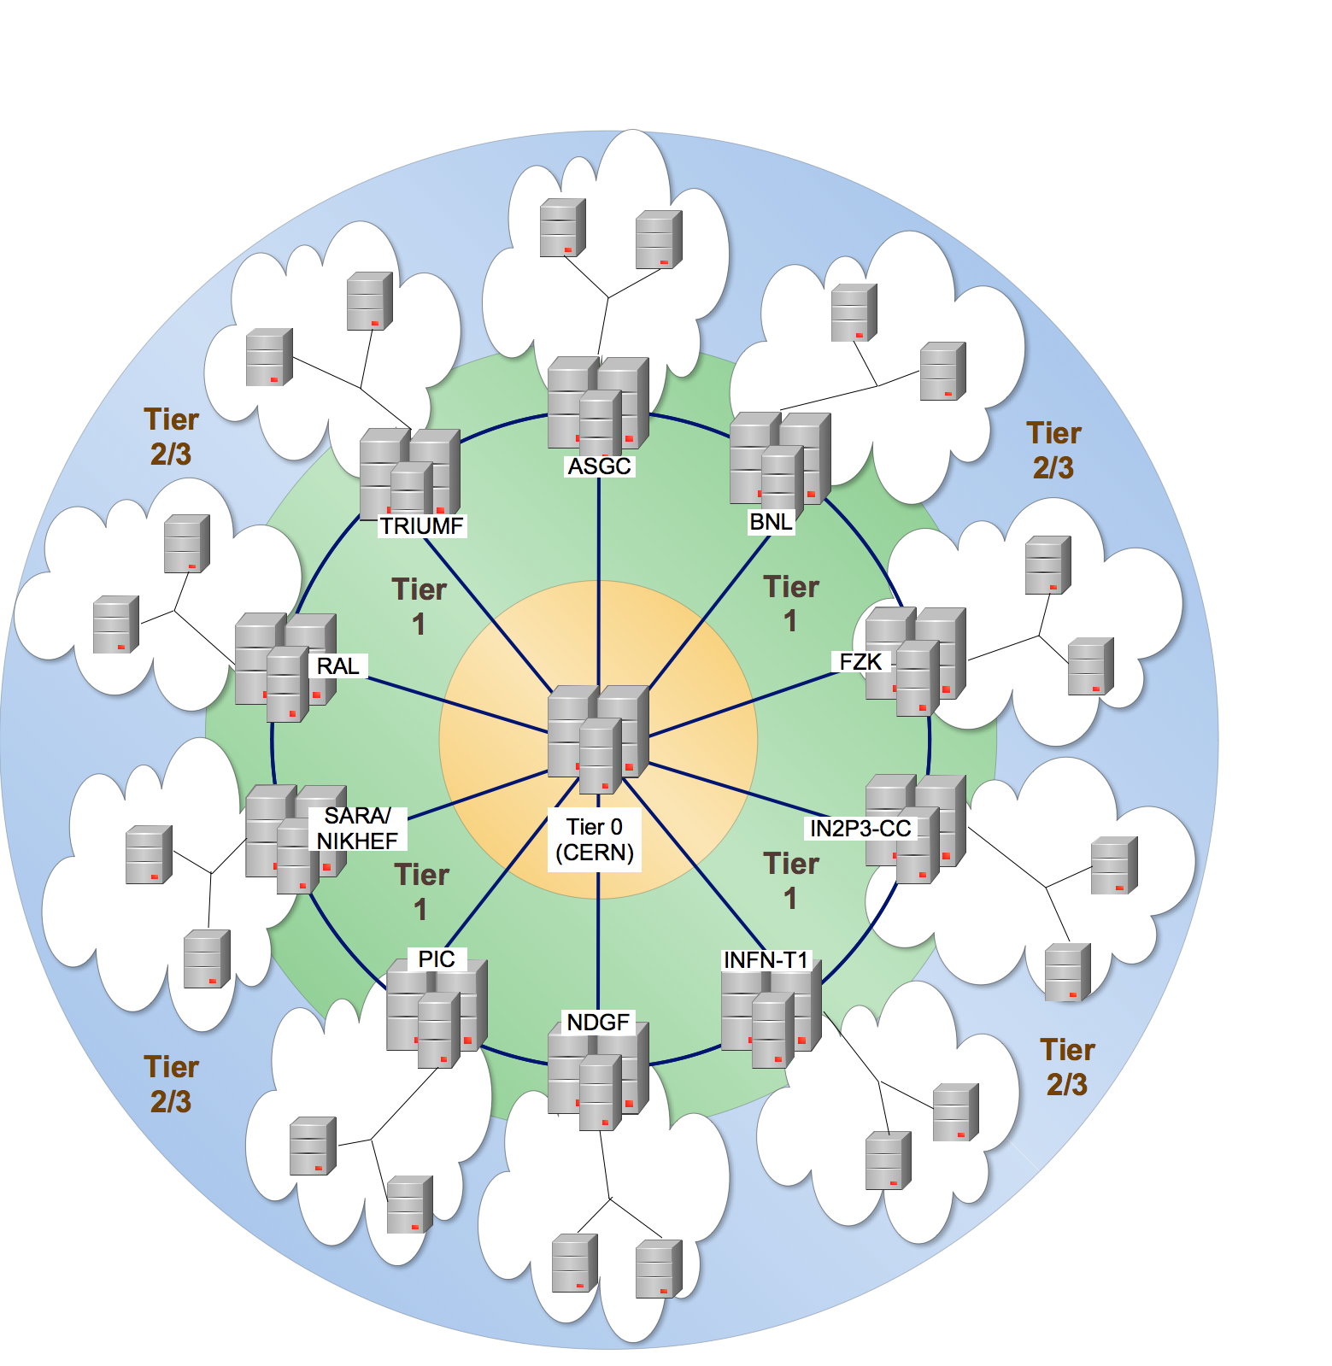
Original data distribution model
Hierarchical tier organization according to network topology which was laid out for data distribution
Possible communications:
    T0-T1
    T1-T1
    Intra-cloud T1-T2
    Intra-cloud T2-T2
Restricted communications:
  Inter-cloud T1-T2
  Inter-cloud T2-T2

Slide 3
Reasons to reduce cloud boundaries
Network bandwith has significantly increased since Computing Model was first published
Some ADC components are currently restricted by these boundaries
  Inflexible PD2P on one cloud
  Consolidation of User Analysis output
  MonteCarlo production must confine one task to one cloud
This talk will focus on the work that has been carried out in DDM to enable cross-cloud transfers
  Source and path optimization in data transfers
  Tools for link commissioning: The Sonar and the FTS statistics monitor
  Operational validation process

Slide 4
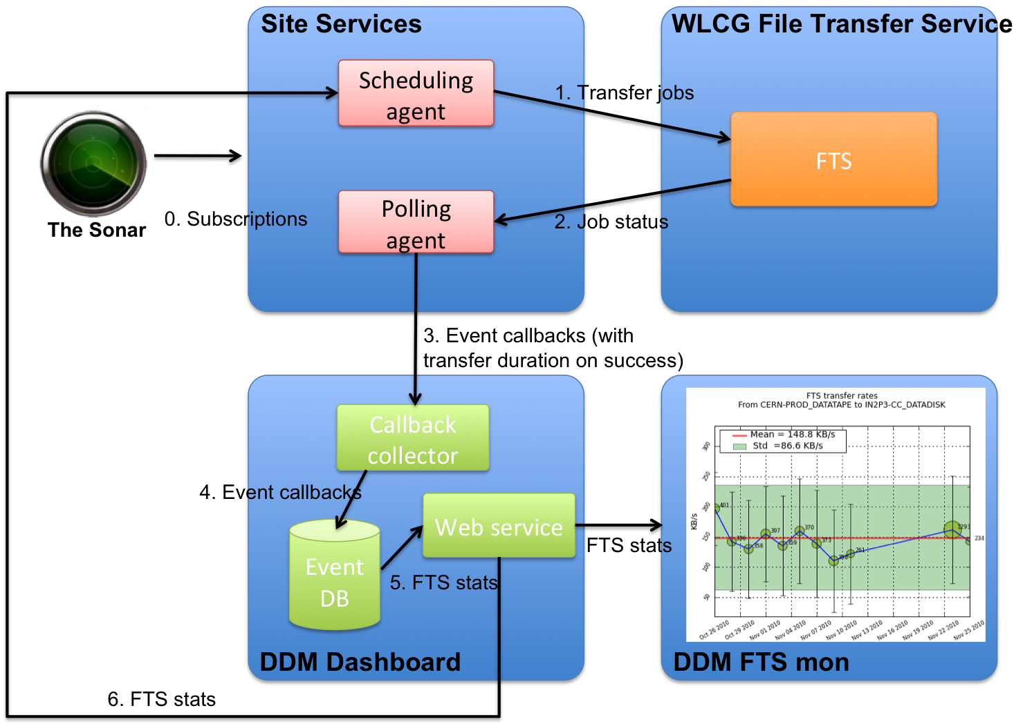
Machinery in place
Purpose: Generate transfer statistics for monitoring and for feedback to the system

Slide 5
About the FTS Statistics
FTS durations include SRM negotiation time
  Transfer of small files will be dominated by SRM overhead
  Transfer of big files will be dominated by actual transfer
➔Definition of three file-size types
  Small files: 0 – 100MB
  Medium files: 100MB – 1GB
  Large files: 1GB - ∞
FTS statistics are generated by the Dashboard
  Aggregating 10 minute bins
  Separating by file-size types
Available via simple API

Slide 6
Optimized source selection
Site Services file buffers
FTS transfer queues
Definitions
Small file: 0 – 100 MB
Medium file: 100MB – 1GB
Large file: 1GB - ∞
Source 1
Source 2
Destination
Source 3
If multiple sources are available for a file, estimate the waiting and service time of each buffer
  Considering files of each type (S,M,L) in buffers
  Using channel statistics of last 2 week
  Penalizing channels without statistics
The model is a simple approach but can be elaborated on in the future
No FTS stats means channel failed or was not tested in weekly tests

Slide 7
Cross-cloud transfers
Tier2
Tier1
Tier1’
Tier2’
  FTS STAR-Channel transfer
  Multihop
Cloud1
Cloud2
Originally cross-cloud subscriptions were submitted by DaTRI doing a multi-hop
Now Site Services are taking care of it
  Since mid February on Italian cloud
  Since mid March on all clouds
Estimate transfer time of direct transfer and multi-hop and choose most convenient one
If no statistics available for direct link, SS will transfer by default via multi-hop
  Probability can be tuned to be more permissive with direct transfers
Multi-hop child subscriptions are left on T1_SCRATCHDISKs with expiration date of 15 days

Slide 8
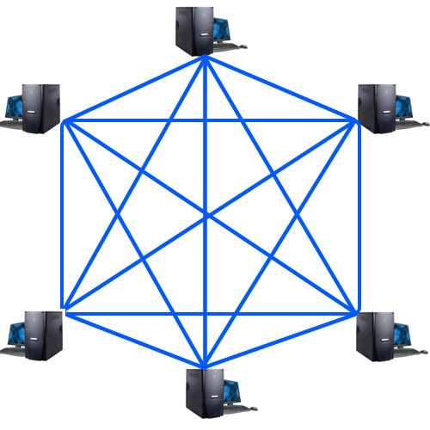
Sonar tests
Weekly file transfers between all ATLAS sites
Provide recent transfer statistics for the complete Grid mesh
  Excepting few small sites that have asked to be excluded
  O(10.000) links
Tests consist of 15 FTS transfers
  1 dataset with 5 small files: 20 MB each
  1 dataset with 5 medium files: 200 MB each
  1 dataset with 5 large files: 2 GB each
Workflow
  Each site owns the 3 datasets (site in name)
  Dataset is pre-placed and stored permanently on custodial site
  Destination replica is copied and deleted each week
Transfers submitted gradually during the whole week
Stopped&cleaned after 5 days

Slide 9
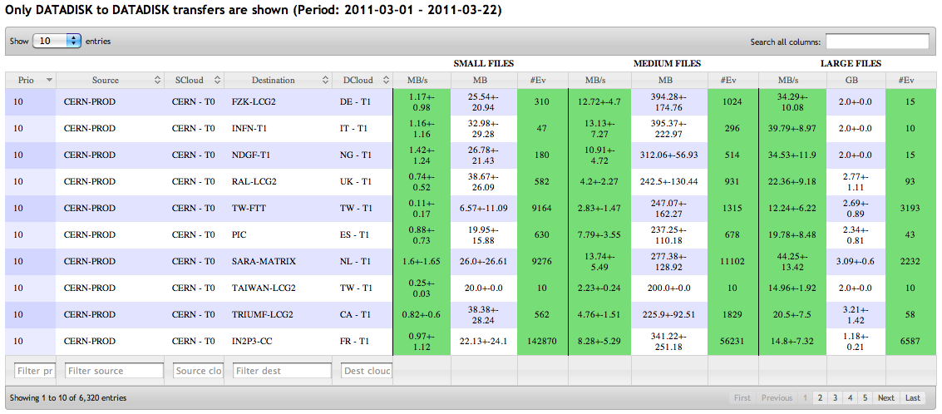
Sonar monitoring
http://bourricot.cern.ch/dq2/ftsmon/sonar_view/cached/
Technologies: Django, jQuery, DataTables
DESTINATION | Tier3 | 0 | 0 | 0 | 0
 |  |  | Cloud 3 | Cloud 1
 | Tier2 | 4 | 4 | 2 | 0
 |  | Close 7
 |  |  | Close 7 | Close 5
 |  |  | Cloud 8 | Cloud 6
 | Tier1 | 10 | 9 | 4 | 0
 |  |  |  | Close 7
 |  |  |  |  | Cloud 3
 |  |  |  | Cloud 8
 | Tier0 | 9 | 9 | 4 | 0
 |  |  |  | Close 7
 |  | Tier0 | Tier1 | Tier2 | Tier3
 |  | SOURCE
 | Avg(Byterate)+StD(Byterate)
SMALL | <0.05MB/s | <0.1MB/s | ≥0.1MB/s
MEDIUM | <1MB/s | <2MB/s | ≥2MB/s
LARGE | <10MB/s | <15MB/s | ≥15MB/s
 | Number of files transferred
SMALL | ≤3 | 4 | ≥5
MEDIUM | ≤2 | 3 | ≥4
LARGE | ≤1 | 2 | ≥3

Slide 10
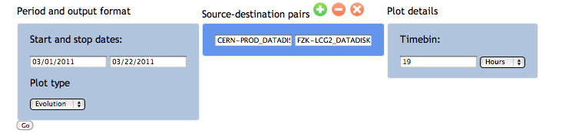
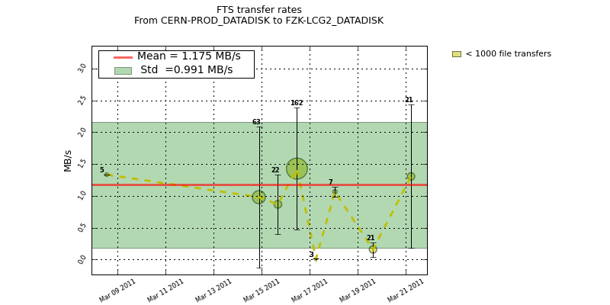
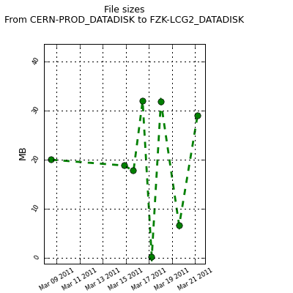
Channel history
http://bourricot.cern.ch/dq2/ftsmon/
Technologies: Django, Matplotlib, jQuery

Slide 11
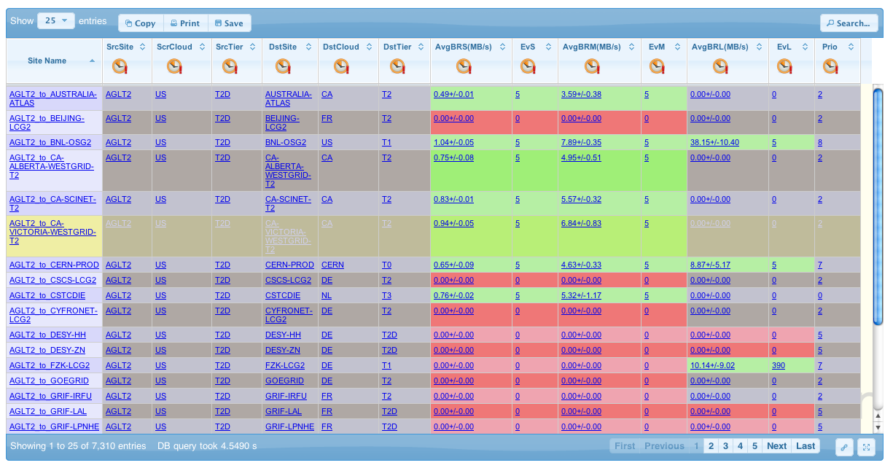
Sonar view in the Site Status Board
http://dashb-atlas-ssb.cern.ch/dashboard/request.py/siteview?view=Sonar
Michal Maciej and Pablo Saiz are working on implementing an improved Sonar table
  Fix shortcomings in actual Sonar Table
  Historic view of the table
  Combine metrics with other information (e.g. downtime information)

Slide 12
Commissioning work
Monitoring of the links: Check Sonar test results
  Responsibility of AMOD, shifters and cloud squads
Create the “T2Ds” category: Directly connected T2s
  T1s and T2Ds are topologically close in Tiers of ATLAS
  Reduce cloud boundaries in a controlled fashion
  Initial selection: 22 T2s in 6 clouds
  Selection based on
    Storage and network capabilities
    Commitment and reliability
  FTS service providers were asked to create 2 new channels to connect T2Ds to all T1s
    Foreign T2Ds to local T1
    Foreign T1s to local T2Ds
  Monitor T1-T2D links (priority 7) actively to verify they don’t degrade

Slide 13
Multi-hopping to T2Ds
Tier2
Tier1
Tier1’
Tier2’
Cloud1
Cloud2
Tier2D
Tier1
Tier1’
Tier2(D)’
  FTS STAR-Channel transfer
  Multihop
Cloud1
Cloud2
Tier2
Tier1
Tier1’
Tier2D’
Cloud1
Cloud2
Site Service multi-hop already adapted to new T2D category
Skip one hop (usually on the T2D cloud)
  Reduce intermediate left-overs
  Improve subscription times

Slide 14
Other news about Site Services
ActiveMQ integration
  Site Services send many different callbacks to the DDM Dashboard:
    Dataset content
    File events (Transferring, copied, registered, failed…)
    Subscription events (Queued, completed, canceled, broken…)
    And, on request, a subset to analysis tools (e.g. PanDA)
  Site Services are ready to publish callbacks to ActiveMQ
    Feature implemented and validated in testbed
    Not activated in production instances yet
  Message queues will allow to send once and listen by all interested parties

Slide 15
Other news about Site Services (2)
Reduced source selection policies in order to reduce the load on TAPE sites
FTS overwrite option is being used now
  Avoids generating infamous __DQ2-<timestamp> files
  MWT2_UC and on Functional Test machine
DDM is being very unlucky with the hardware lately
  SS spare machine is being rotated frequently because of disk problems
  However SS migrations to spare take 5 minutes now

Slide 16
Credits
Simone Campana
David Tuckett
Andrii Thykonov
Stephane Jezequel
I. Ueda
Vincent Garonne
Martin Barisits

