Slide 1
WP7: Gaseous Detectors
Silvia Dalla Tore (INFN-Trieste), Burkhard Schmidt (CERN)
WP7 Session at the 2nd Annual Meeting, April 25, 2023

Slide 2
Overview
Task 7.1: Coordination and Communication (S. Dalla Torre, BS)
Task 7.2: RPC sector 3 tasks
                - 7.2.1: Multi-gap RPCs (MRPCs) for fast timing (C. Williams)
                - 7.2.2: Shower development in SDHCAL (Mary-Cruz Fouz)
                - 7.2.3: Eco-friendly gas mixtures for RPCs (B. Mandelli, D. Piccolo)
                Task 7.3: MPGD sector, Technology and engineering 2 tasks
                - 7.3.1: Development of resistive electrodes for MPGDs (P. Verwilligen)
                - 7.3.2: Industrial engineering of high-rate μ-RWELLs (G. Bencivenni)
                Task 7.4: Large volume gaseous detectors 2 tasks
                - 7.4.1: A 4-channel electronic board for cluster counting (F. Grancagnolo)
                - 7.4.2: High pressure gas TPC for neutrino physics (A. Deisting)
Task 7.5: PID sector 1 task
- Photon detectors for hadron particle identification at high momenta
(S. Dalla Torre)
2

Slide 3
Partners
Strong collaboration with industry (yellow boxes)
Wide and solid links also outside Europe
Bi-lateral agreements with non-European partners have been signed last year
3

Slide 4
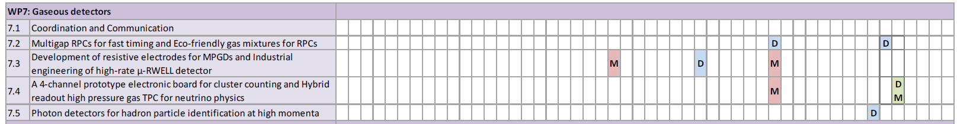
MILESTONES & DELIVERABLES
The first milestone of WP7 has been successfully achieved!
4

Slide 5
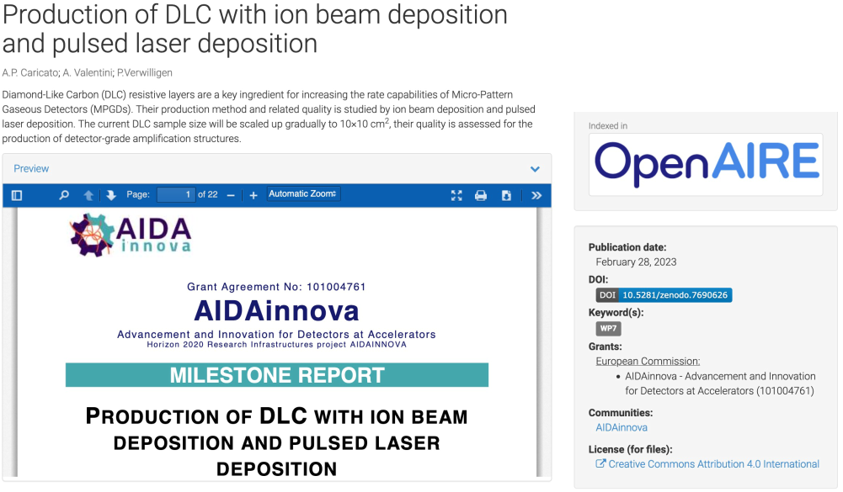
Milestone Report Task 7.3.1
Report delivered on time in month 23 (February 2023)
22 pages – 15 figures – Introduction to various PVD techniques for DLC
5

Slide 6
MILESTONES & DELIVERABLES
We have a couple of Deliverables and Milestones coming up.
I do hope that the presenters address the plans and progress towards the achievement of these milestones and deliverables.
We have allocated 15min for each talk, plus 5min discussion
4

