Slide 1


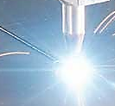

At the tip of an intense laser beam: operando monitoring of laser processing in manufacturing
Troy R Allen, Tristan G Fleming , and James M Fraser
Department of Physics, Engineering Physics & Astronomy
Queen’s University
Kingston ON Canada

Slide 2
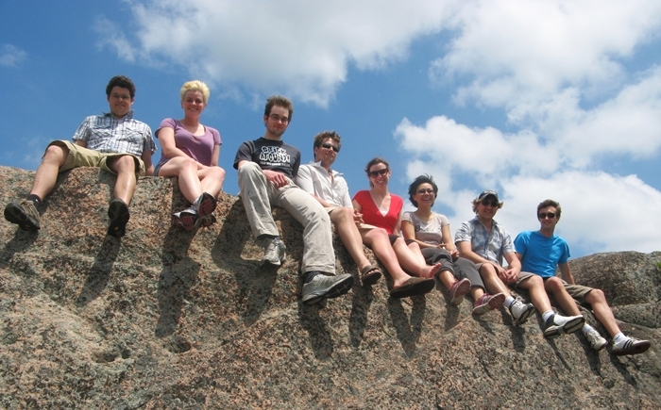
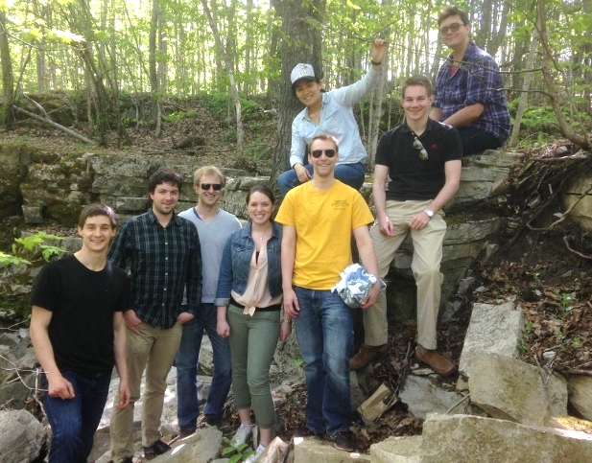
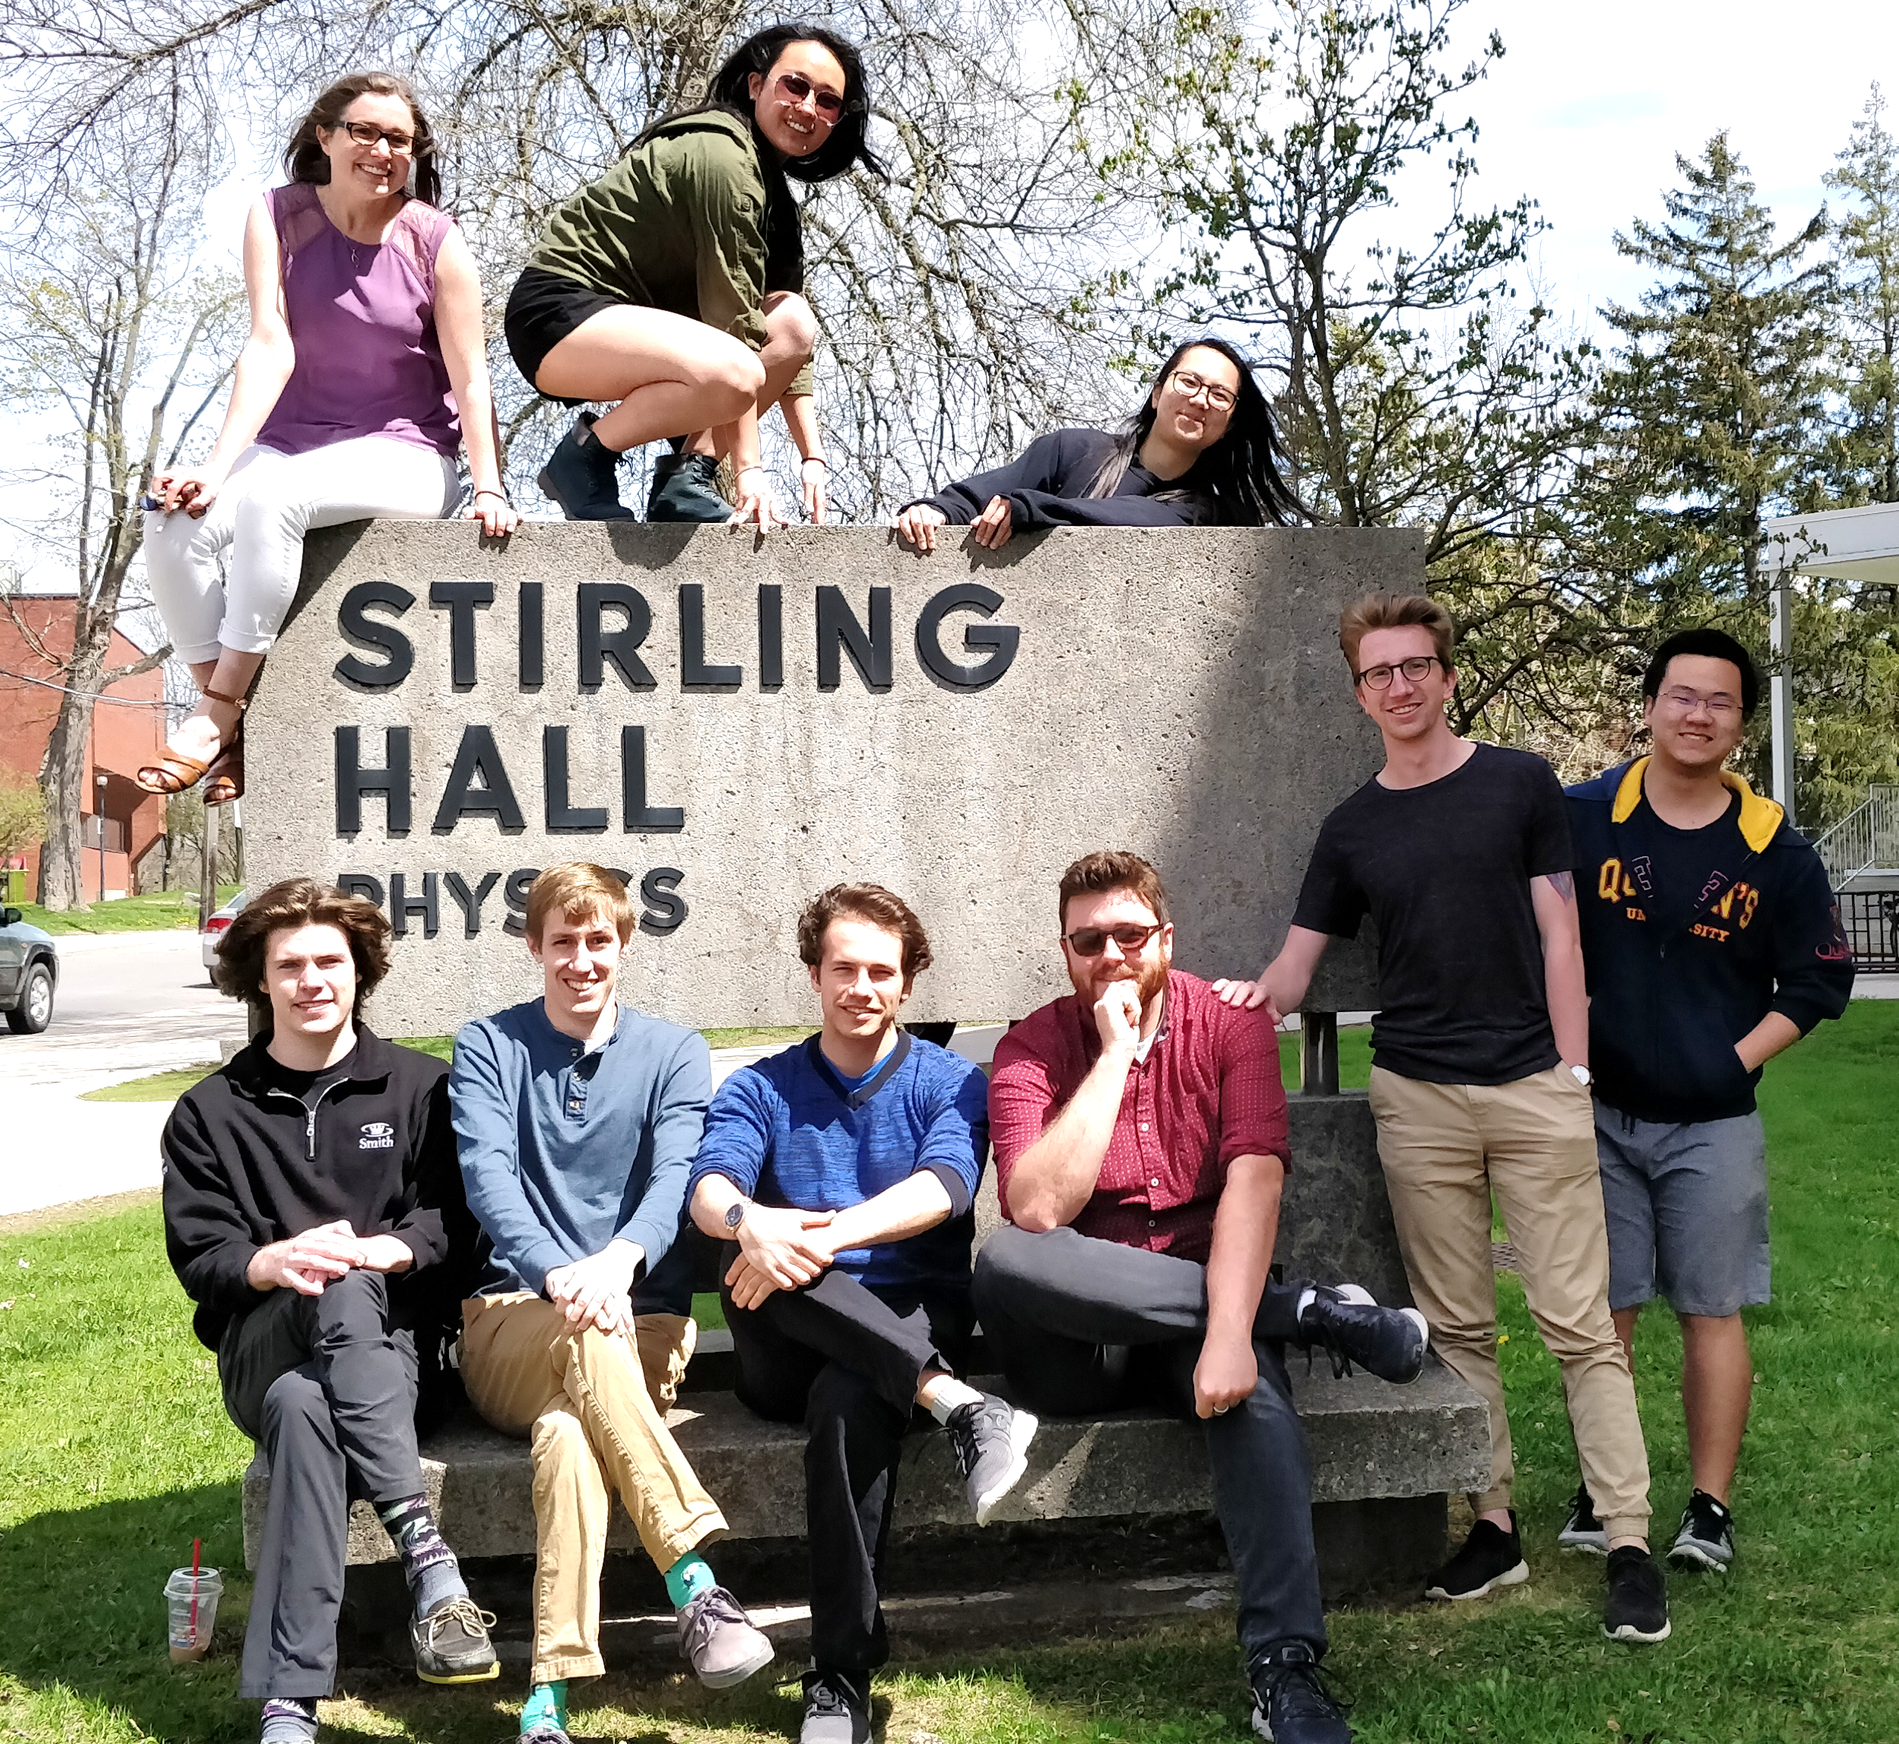






Acknowledgements
2012
2015
2018
2019

Slide 3
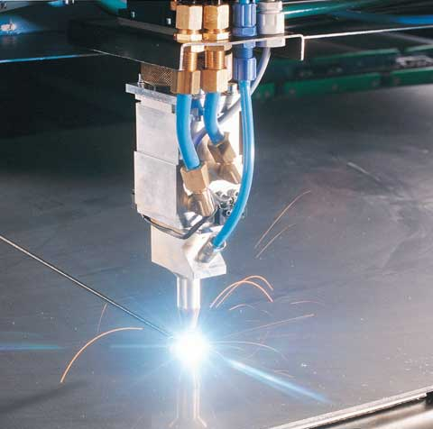
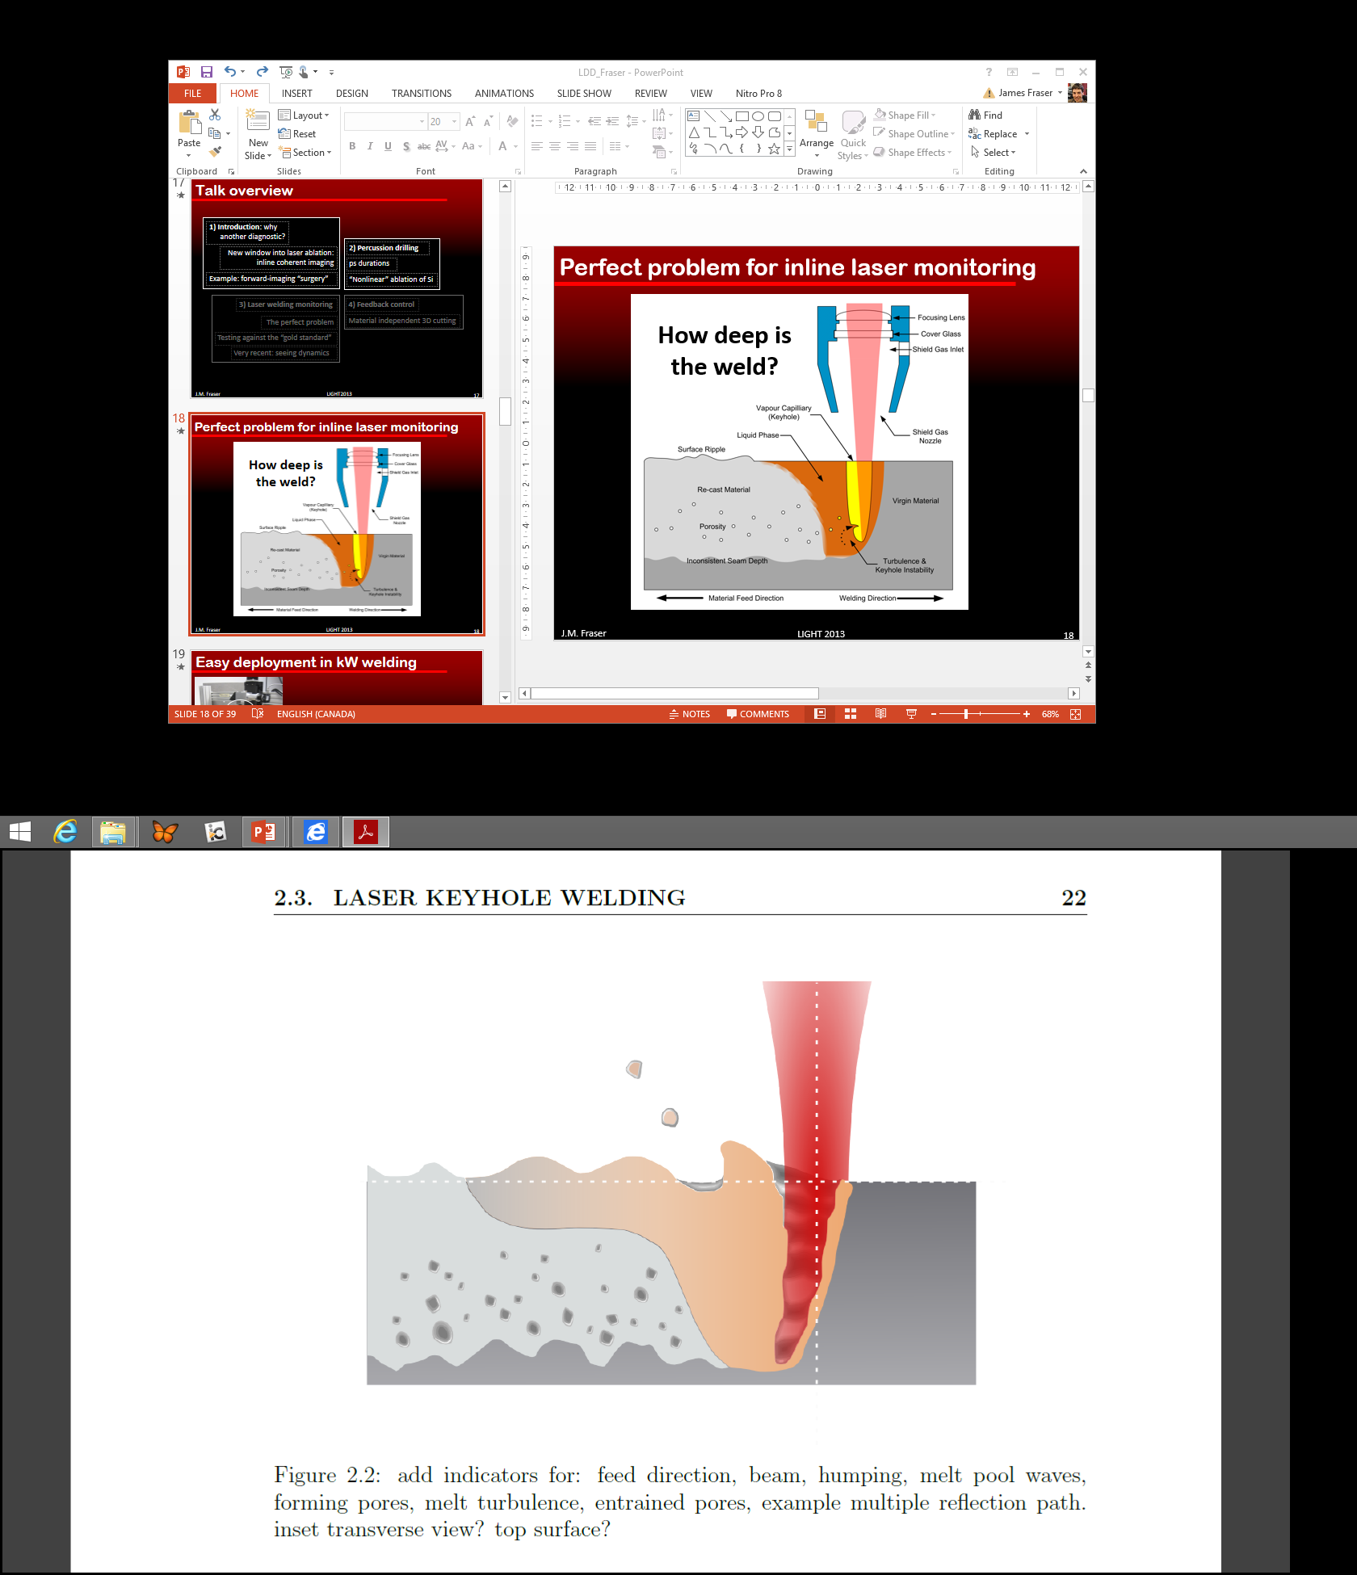
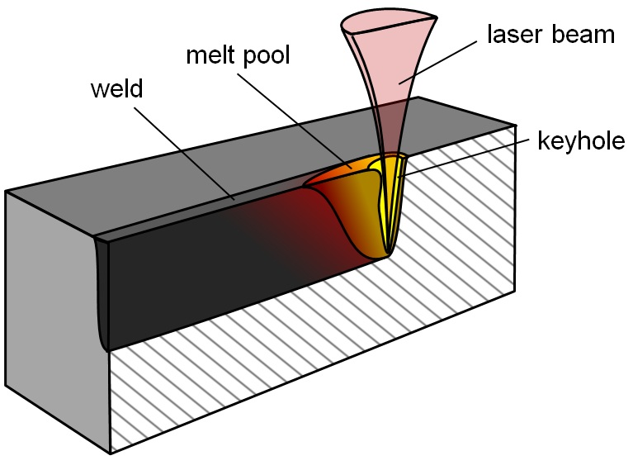
Grounded in a problem
How deep is the laser weld?
Image: www.wausaubusinessdirectory.com
Image: ionix.fi
Image: Galbraith, Queen’s

Slide 4

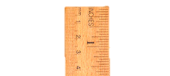
Grounded in a problem
A lot of welds in your electric car…
How deep is the laser weld?
Need a measuring stick!
IPG Photonics Inc.
Image: Galbraith, Queen’s

Slide 5
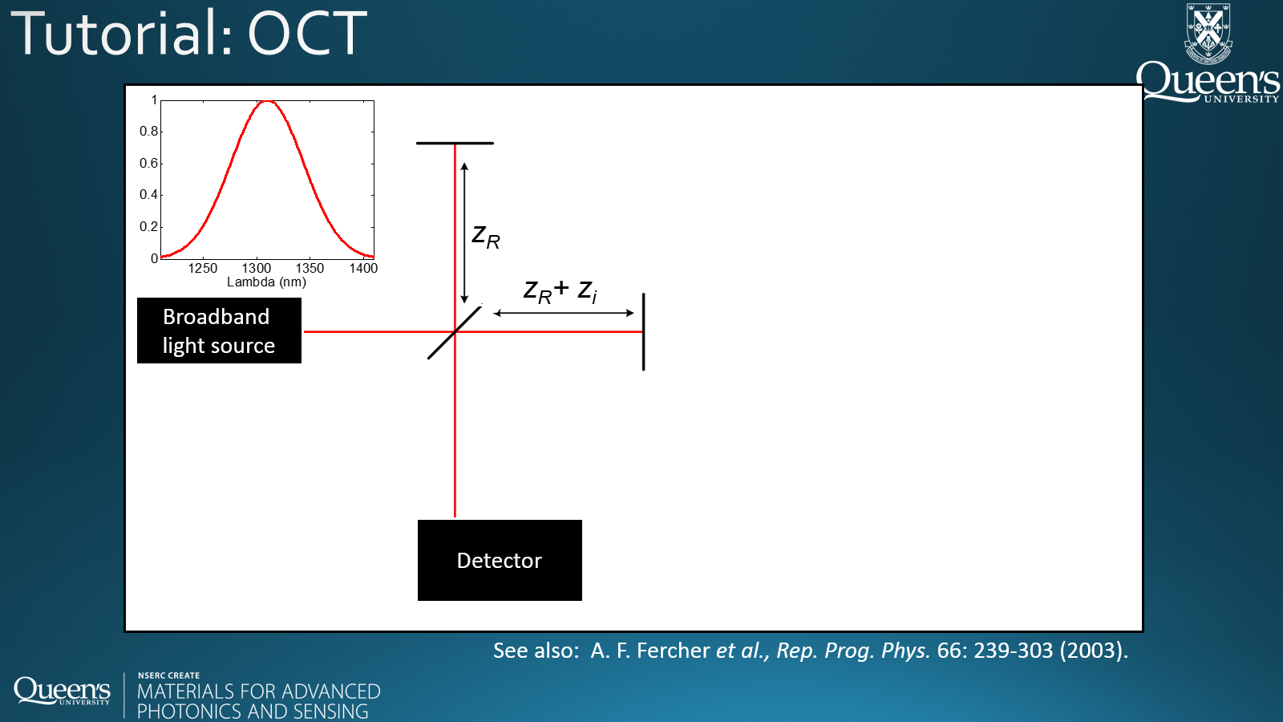

Our approach: optical measuring stick
Inline coherent imaging (ICI)
Fourier-domain broadband interferometry.
Similar to optical coherence tomography
Spectrometer
$$I\left(k\right)=A(k)\left(\frac{I_{ref}}{2}+\frac{I_{i}}{2}+\sqrt{I_{ref}I_{i}}cos⁡\left(nz_{i}k\right)\right)$$

Slide 6
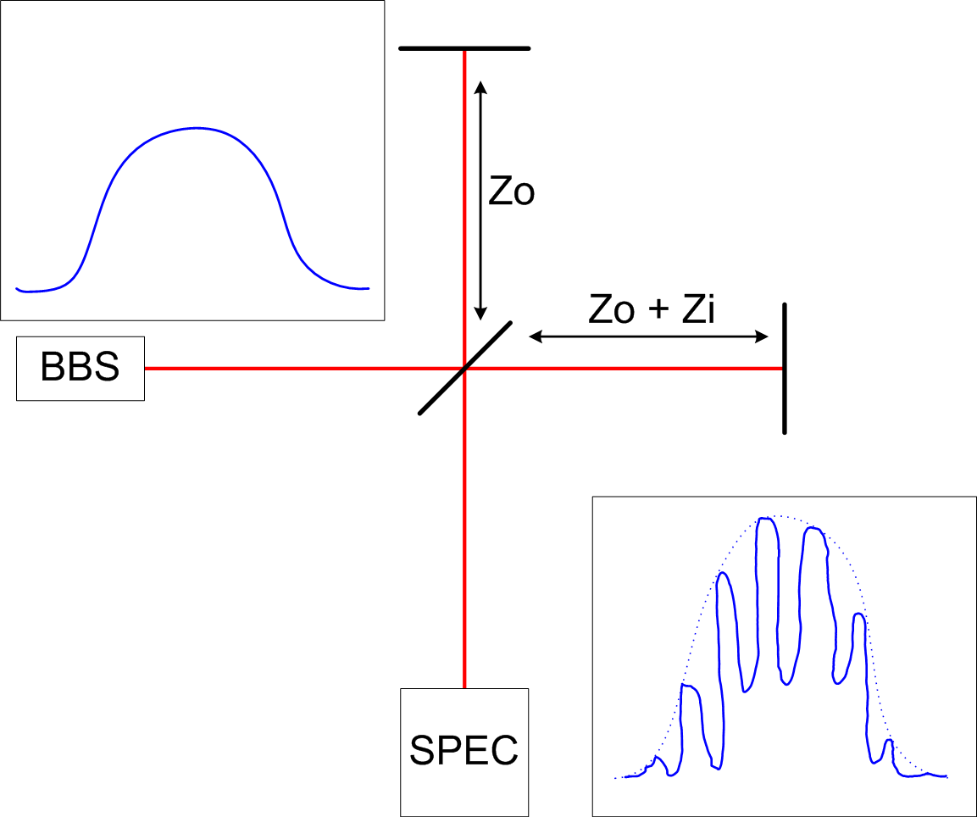
Tutorial: OCT
z_{R}
z_{R}+ z_{i}
z₀
Broadband
light source
Fringe separation:
Image as fast as your
Spectro: .. array camera can go!
Swept-source: .. light source can scan!
Spectrometer /
detector
See also: A. F. Fercher et al., Rep. Prog. Phys. 66: 239-303 (2003).

Slide 7
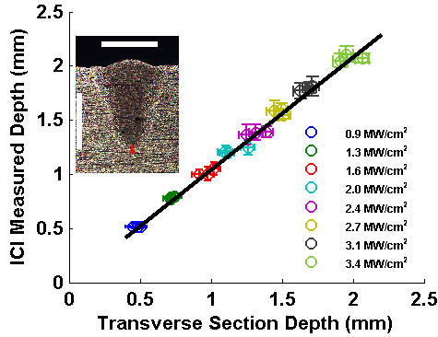
ICI integrates into any laser head
Verification with destructive cross-sectioning
mild steel, 40 mm/s scan speed, argon cover gas
P. Webster et al., Optics Letters 39: 6217-6220 (2014).

Slide 8
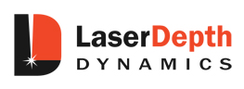
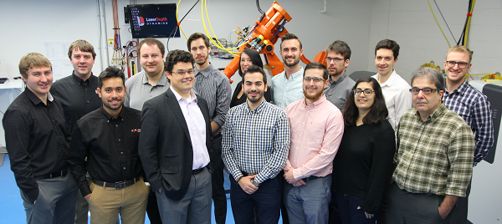
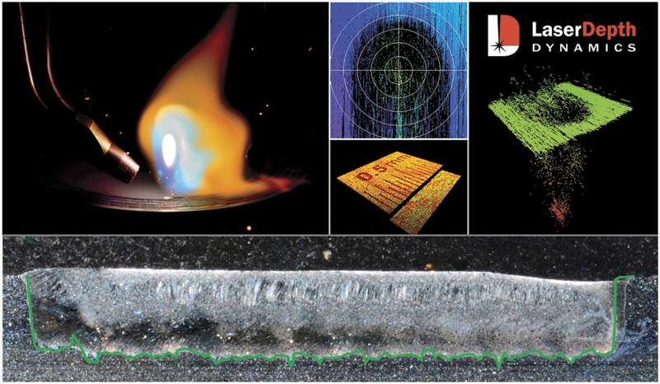
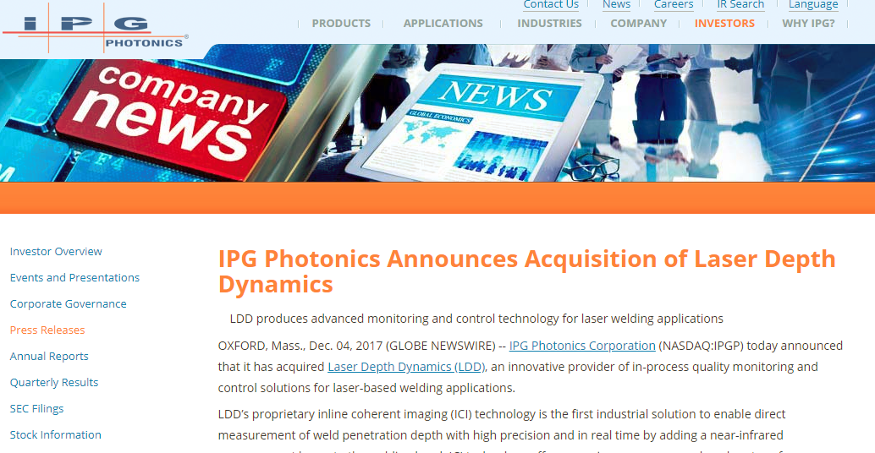
Aiming for impact: spin-off company
Dec 4, 2017
Notes:
3475 square m.
Almost 40, 000 square foot building.

Slide 9
But there is more: access to dynamics
Laser
316L SS

Slide 10
Access to dynamics
Laser
6061 Al
Laser
316L SS
Is it just noise?

Slide 11
Very recent: compare ICI to gold standard
Lead: Tristan Fleming. In collaboration with Peter Lee, UCL
Synchrotron: Advanced Photon Source, Argonne National Laboratory

Slide 12
80% within 14 micron
Aluminum 6061
872 W CW @1070 nm
scan speed 150 mm/s
Fleming et al., under review
Notes:
aluminum 6061 bead-on-plate welding using the APS LPBF

Slide 13
But why does laser processing work so well?
Laser
1070 nm
316L SS
Reflectance 60-70%

Slide 14
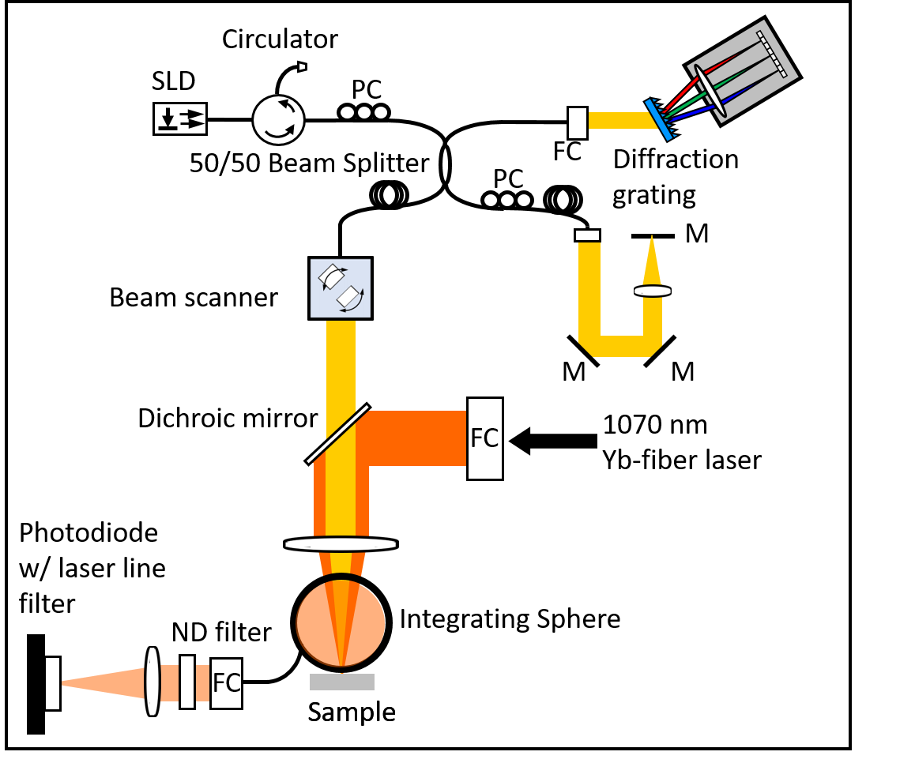
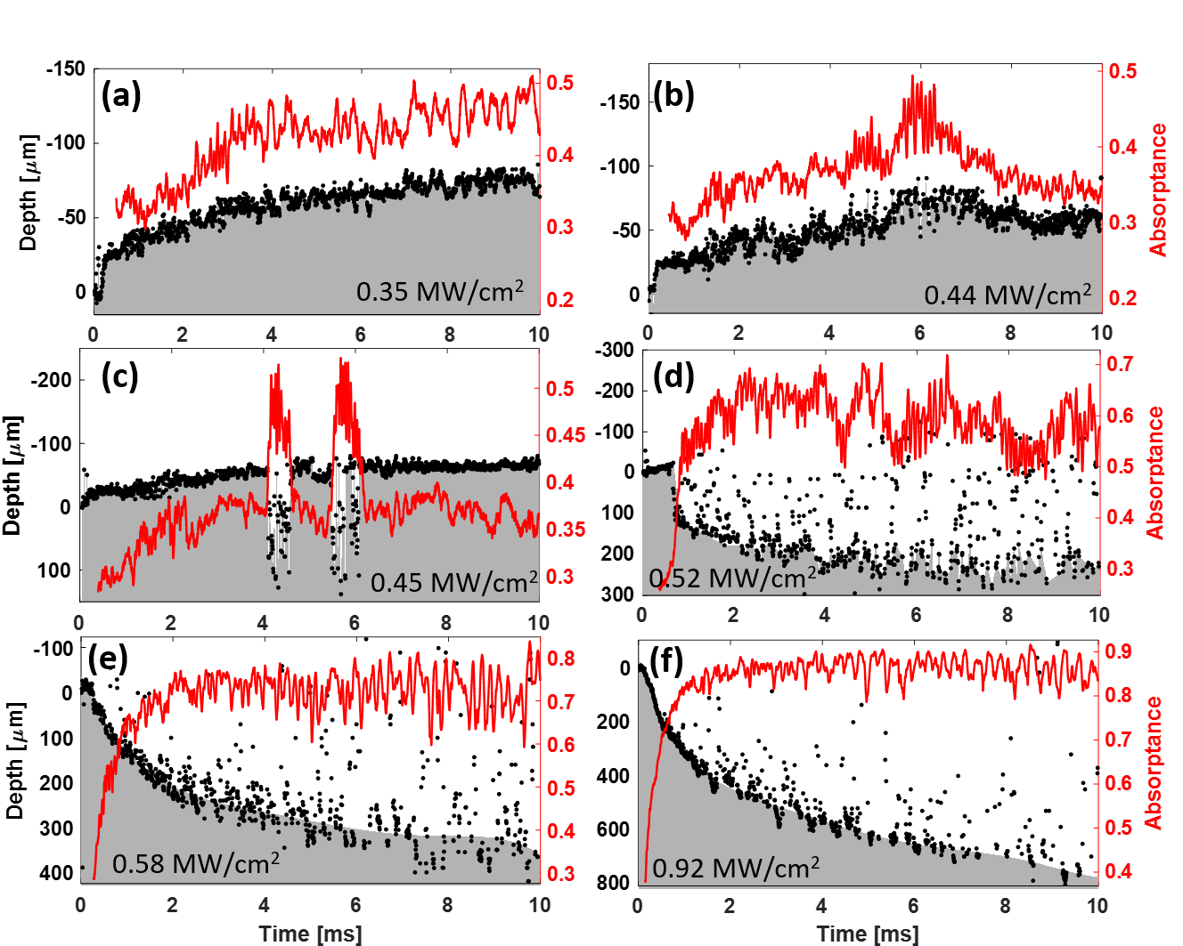
Measure depth and absorption simultaneously
with Wenkang Huang, Wenda Tan [Utah], Jack Tanner, Brian Simonds [NIST]
Allen et al, Physical Review Applied 13, 064070 (2020)

Slide 15
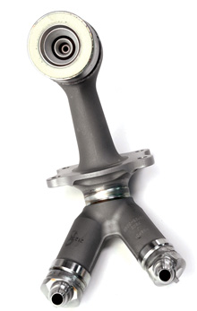
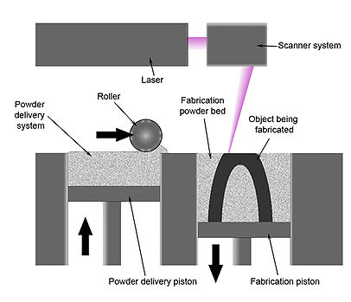
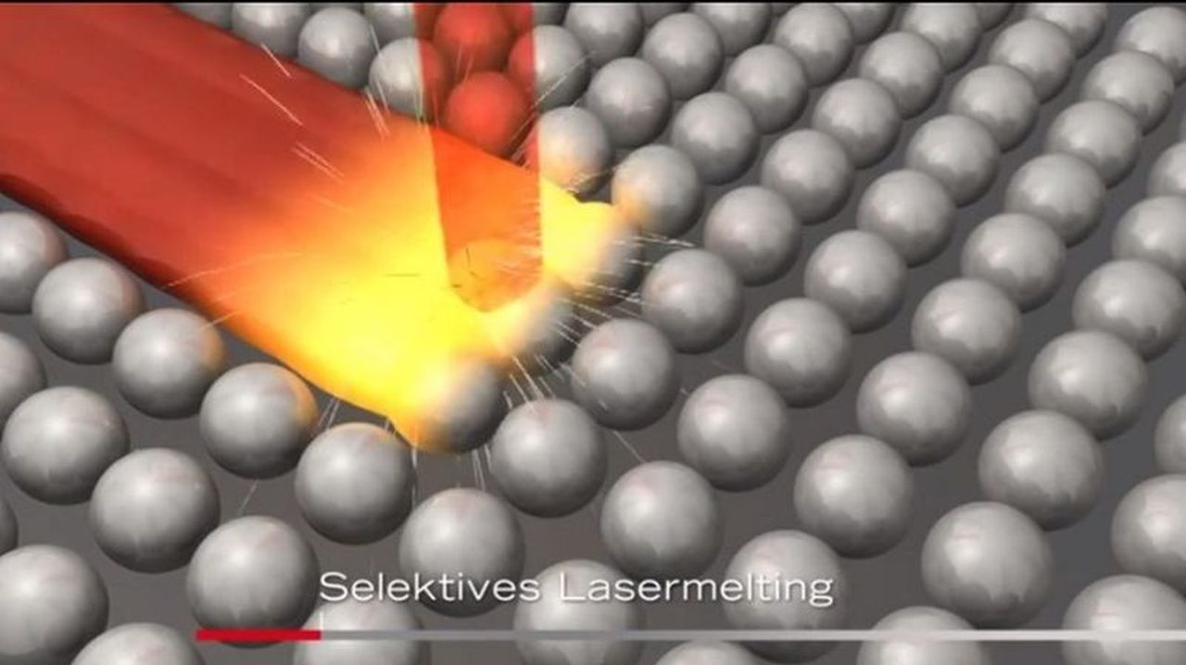
New paradigm in manufacturing?
GE fuel nozzle
Additive manufacturing
Image: wikipedia
Image: klsmartin group

Slide 16
Image during processing: operando monitoring
virgin powder
melt
solid
denudation
Kanko, Sibley, and Fraser, J. Mat. Proc. (2016)

Slide 17
Capture the full story: pre and post melt
Powder layer
After melting
Denudation
Tristan Fleming et al., Additive Manufacturing 32, 100978 (2020)

Slide 18
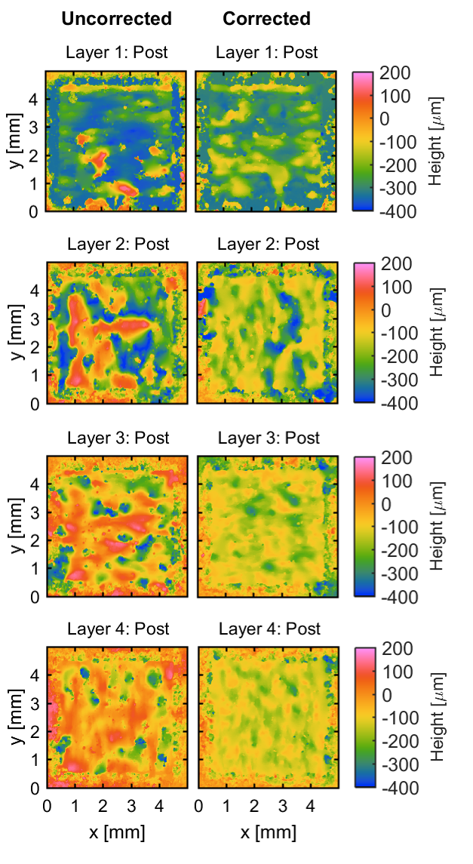
Beyond QA: feedback control
Ablate protrusions and fill in holes
Tristan Fleming et al., Additive Manufacturing 32, 100978 (2020)

Slide 19
Summary
Optical measuring stick
Starts from a problem
Improve our understanding of the process
Feedback control

Slide 20
References
Tristan G Fleming et al. “In situ correlative observation of humping-induced cracking in directed energy deposition of nickel-based superalloys,” Additive Manufacturing 71: 103579 (2023)
Troy R. Allen et al. “Simultaneous high-speed keyhole depth and absorptance measurements in laser spot welding of dissimilar metals,” Elsevier Procedia CIRP 111: 5-9 (2022).
TJH Krause et al. “Self-witnessing coherent imaging for artifact removal and noise filtering,” Optics and Lasers in Engineering 151: 106936 (2022).
Troy R. Allen et al. “Simultaneous in operando monitoring of keyhole depth and absorptance in laser processing of AISI 316 stainless steel at 200 kHz,” Elsevier Procedia CIRP 94: 419–424 (2020)
Troy R. Allen et al. “Energy-coupling mechanisms revealed through simultaneous keyhole depth and absorptance measurements during laser-metal processing,” Physical Review Applied 13: 064070 (2020).
Tristan G. Fleming et al. “Tracking and controlling the morphology evolution of 3D powder-bed fusion in situ using inline coherent imaging,” Additive Manufacturing 32: 100978 (2020).
Faleh Altal et al. “Dual-channel inline coherent imaging,” Applied Optics 58: 1614-1620 (2019)
Jordan A. Kanko et al. "In situ morphology-based defect detection of selective laser melting through inline coherent imaging," Journal of Materials Processing Technology 231: 488-500 (2016)
Chenman Yin et al. "Automated 3D bone ablation with 1,070 nm ytterbium‐doped fiber laser enabled by inline coherent imaging," Lasers in Surgery and Medicine 48: 288–298 (2016).
Yang Ji et al. “Real-time depth monitoring and control of laser machining through scanning beam delivery system,” Journal of Physics D: Applied Physics 48:155301 (2015).
P.J.L. Webster et al. “Automatic laser welding and milling with in situ inline coherent imaging,” Optics Letters 39: 6217-6220 (2014).
Jared Blecher et al. “Real-time monitoring of laser beam welding keyhole depth by laser interferometry,” Science and Technology of Welding and Joining 19: 560 - 564 (2014).
Karen X.Z. Yu et al. “Deep nonlinear ablation of silicon with a quasi-continuous wave fiber laser at 1070 nm,” Optics Letters 38: 1799-1801 (2013).
B.Y.C. Leung et al. “Real-time guidance of thermal and ultrashort pulsed laser ablation in hard tissue using inline coherent imaging,” Lasers in Surgery and Medicine 44: 249–256 (2012).
P.J.L. Webster et al. “Automatic real-time guidance of laser machining with inline coherent imaging,” Journal of Laser Applications 23: 022001 (2011).
P.J.L. Webster et al. “In situ high-speed coherent imaging of morphology changes during laser micromachining,” Optics Letters 35: 646-648 (2010).
P.J.L. Webster et al. “High speed in situ depth profiling of ultrafast micromachining,” Optics Express 15: 14967-14972 (2007).

Slide 21
Other work slides

Slide 22
Spot welds: steel vs aluminum
316 Stainless Steel
6061 Aluminum
Laser
Laser
316 SS
Immediate keyhole formation
Rapid initial keyhole growth
Depth appears as diagonal streaks
6061 Al
Delayed keyhole formation
Sporadic keyhole growth with temporary pauses

Slide 23
Steel + Aluminum: completely different
316 Stainless Steel on 6061 Aluminum
0.92 MW/cm²
Laser
In SS
SS
Slow, stable keyhole growth
Completely unlike Al or SS
Al
Immediate keyhole formation
Rapid initial keyhole growth
In Al

Slide 24
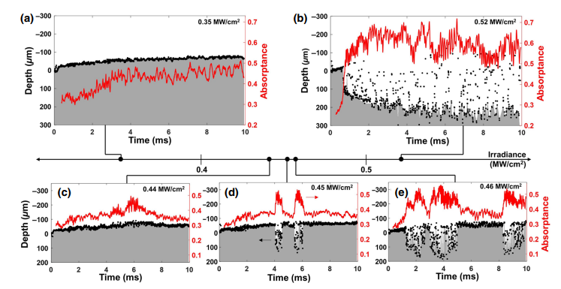
Zone of particular relevance to additive manufacturing
Allen et al, Physical Review Applied 13, 064070 (2020)

Slide 25

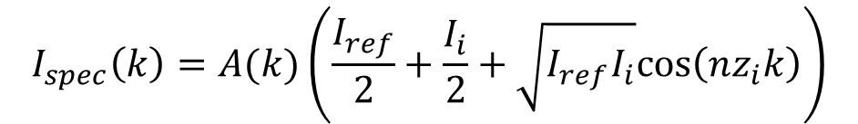
Other work: increase S:N through balanced detection
$$I_{spec}\left(k\right)=A(k)\left(\frac{I_{ref}}{2}+\frac{I_{i}}{2}+\sqrt{I_{ref}I_{i}}cos⁡\left(nz_{i}k\right)\right)$$
$$I_{back}\left(k\right)=A(k)\left(\frac{I_{ref}}{2}+\frac{I_{i}}{2}−\sqrt{I_{ref}I_{i}}cos⁡\left(nz_{i}k\right)\right)$$
z_{R}
z_{R}+ z_{i}
z₀
Broadband
light source
Faleh Altal, Troy R. Allen, Stephen G. L. Nestor, Tristan G. Fleming, and James M. Fraser, Applied Optics 58: 1614-1620 (2019)
Spectrometer /
detector

