Slide 1

Using random perturbation experiments to constrain feedback in biomolecular networks
Seshu Iyengar (seshu.iyengar@mail.utoronto.ca)
University of Toronto Mississauga
Department of Chemistry and Physical Sciences
https://www.hilfinger.group

Slide 2
How do molecules in cells interact?
Hit something, see how molecular levels respond
Problem: drugs may have effectively “random” effect
Notes:
The big ticket question: how do molecules in cells interact.
Physicist attitude, kick the system in many different ways and see how it reacts.
But biological networks are large, sparsely characterized: so from our perspective kicks are ‘random’ in that they may hit many different things, different strengths.

Slide 3
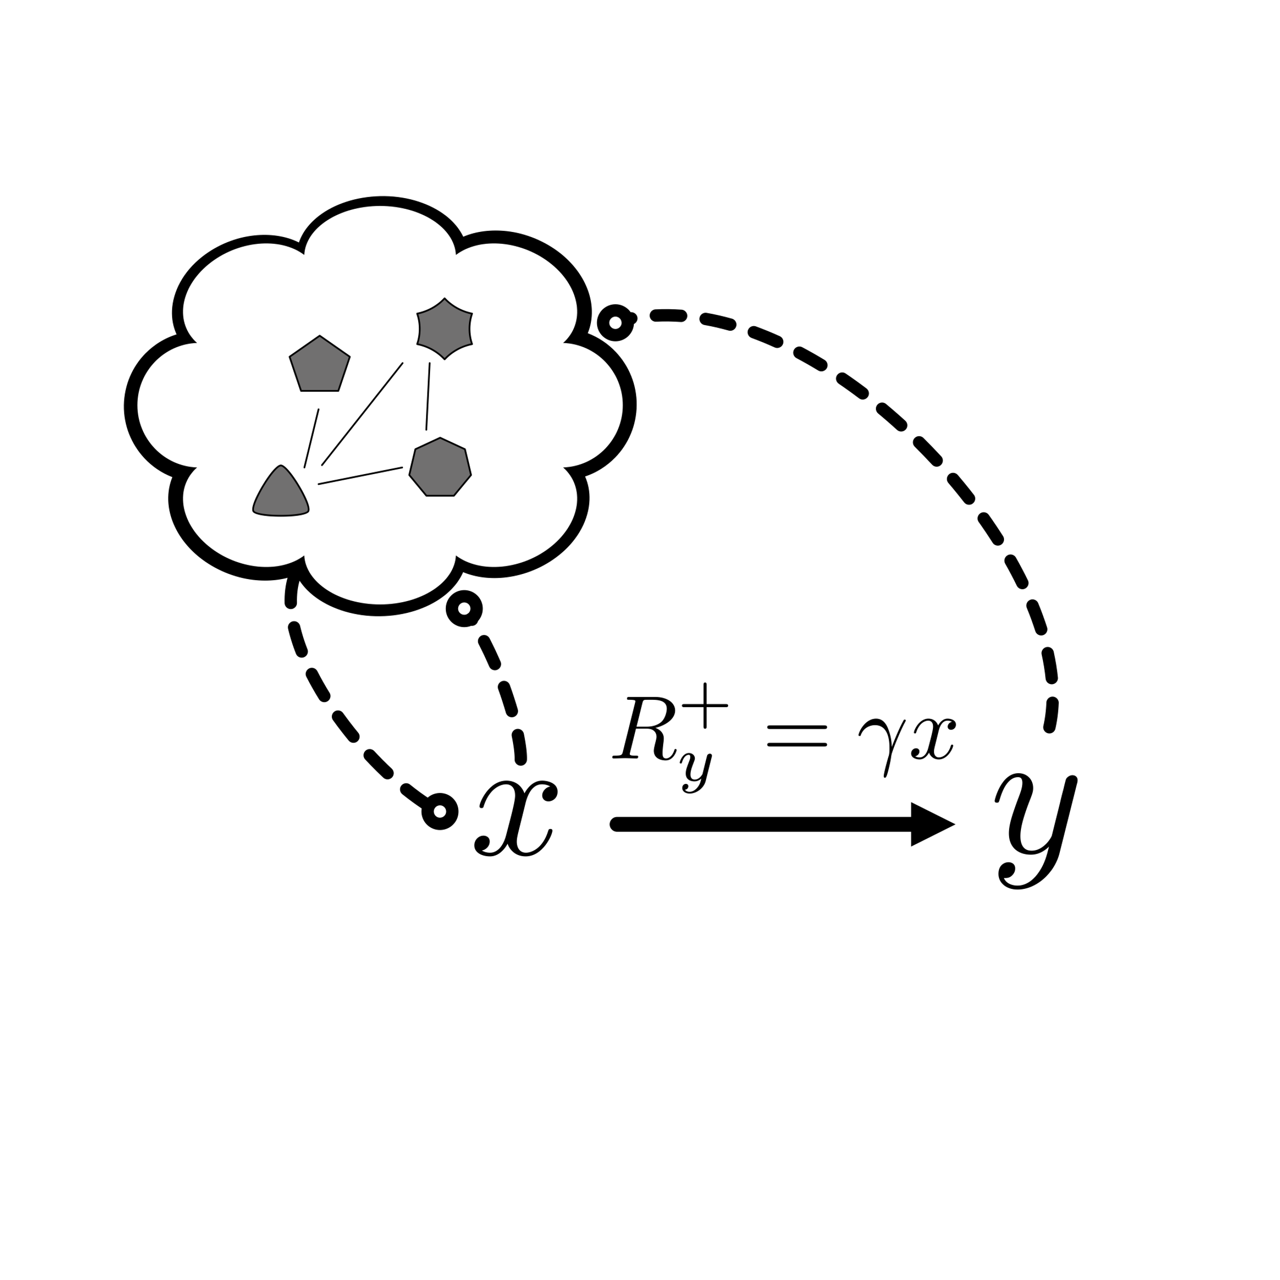
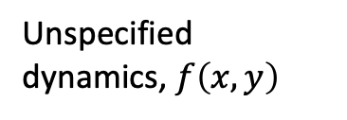
Class of models: systems that contain a linear production rate
Unspecified dynamics, $f\left(x,y\right)$
Notes:
To study whether random perturbations can tell us about system information, studied a simpler class of models where there was a molecule produced at a rate linear to another molecule, with all other molecules and interactions unspecified. On this sketch these are represented by the arrow and cloud respectively, and this system can be represented by these equations that give you the molecular levels as a function of the parameters (implicitly). The unspecified dynamics are ‘summarised’ by this function f(x,y).

Slide 4
Can we infer the sensitivity of this system to feedback via perturbation responses?
Sign of sensitivity defines positive or negative feedback
Notes:
And the question is ultimately can we understand what the nature of these dashed lines connecting the molecules to the cloud are? Numerically, we’re interested in the sensitivity of the function f(x,y) to each of the molecules, measured by the log-log derivative. However in biology it’s often enough to know the sign of that derivative: whether there’s positive, negative, or no feedback from the molecule to the system as a whole.

Slide 5

Yes with linear response analysis! But perturbations can only hit one target
$$λf(x,y)$$
True even if size of perturbations is unknown
Kholodenko., et al. PNAS 99.20 (2002)
Notes:
It is known how to solve for those sensitivities through perturbation response data, by assuming the system responds linearly to perturbations. In this class of models there are two effective targets: hitting the parameter lambda through the cloud and hitting the arrow through the parameter gamma. And if a drug perturbation only hits one parameter, then techniques like modular response analysis can be used to solve for the sensitivities and the sign of feedback from y and x.

Slide 6
These methods do not account for drugs hitting both targets
Notes:
But these methods have some gaps. One big one is they do not account for perturbations that hit both targets simultaneously, whether a drug has the same effect on the parameters or different effects.

Slide 7
Methods do not study correlations in response to set of perturbations
Notes:
Furthermore as seen in experiment before, we are interested in whether correlations in value of x and y across a range of these perturbations contains information about feedback in the system

Slide 8
Let alone correlations to set of unknown perturbations
Can we develop a linear analysis of ‘random’ perturbations?
Notes:
But in general it may not be possible for experimentalist to even know what any given drug actually targeted, making this distribution effectively random. Can we use a linear theory to study feedback under these conditions?

Slide 9
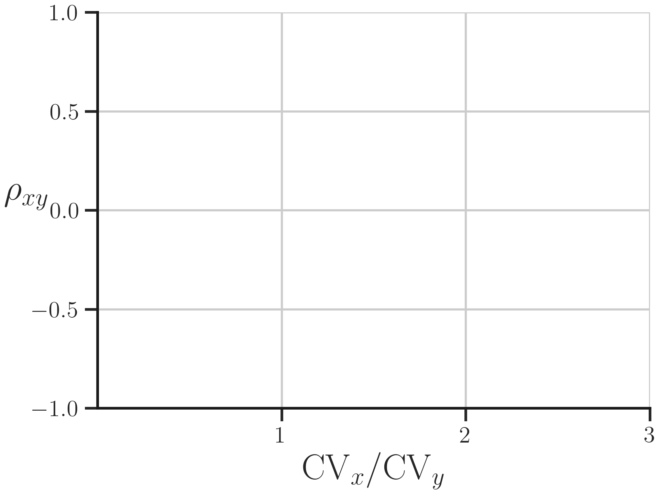
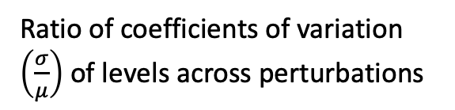
Linear analysis of random perturbation experiments yields constraints on feedback sensitivities
Correlation between levels across random perturbations
Ratio of coefficients of variation $\left(\frac{σ}{μ}\right)$ of levels across perturbations
Notes:
Answer: yes! Inspired by stochastic analysis, we looked to see whether correlations across perturbations between x and y were related to the ratio of the coefficients of variation of the two molecules. The CV is a measure of normalized ‘fluctuations’ in response, the standard deviation of the levels across perturbations divided by their average. These quantities can be measured by taking a system of interest, measuring the levels of molecules after different perturbations, and calculating the relevant summary statistics on that data.

Slide 10
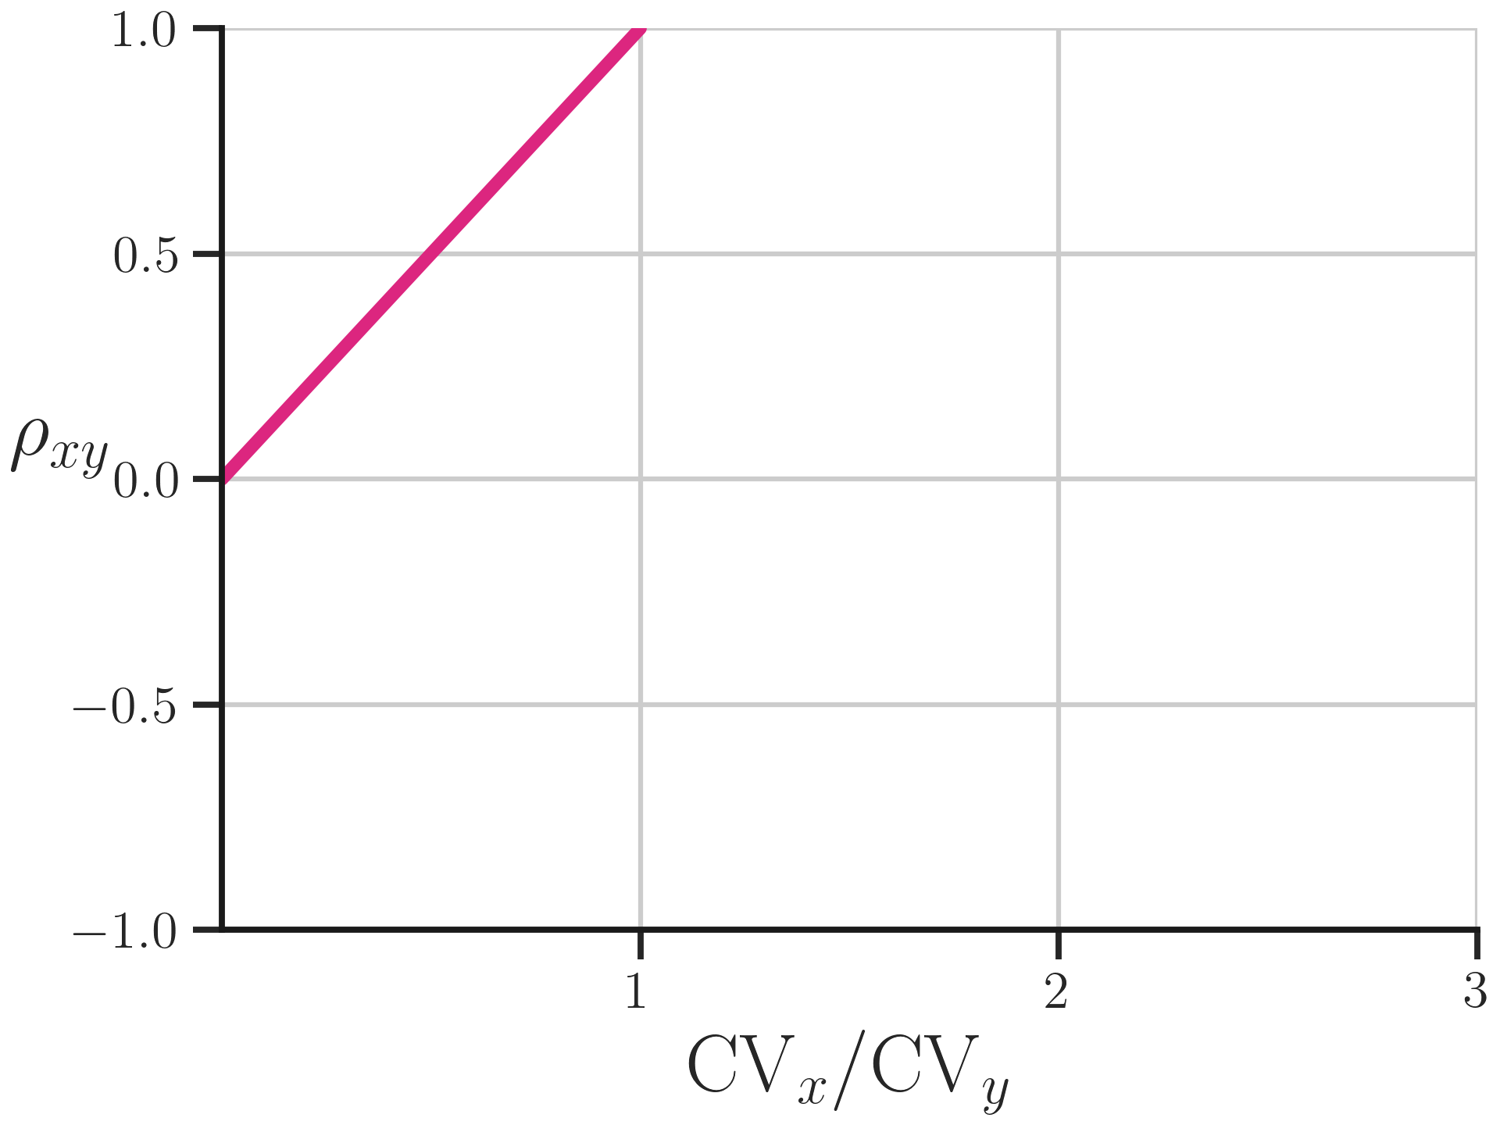
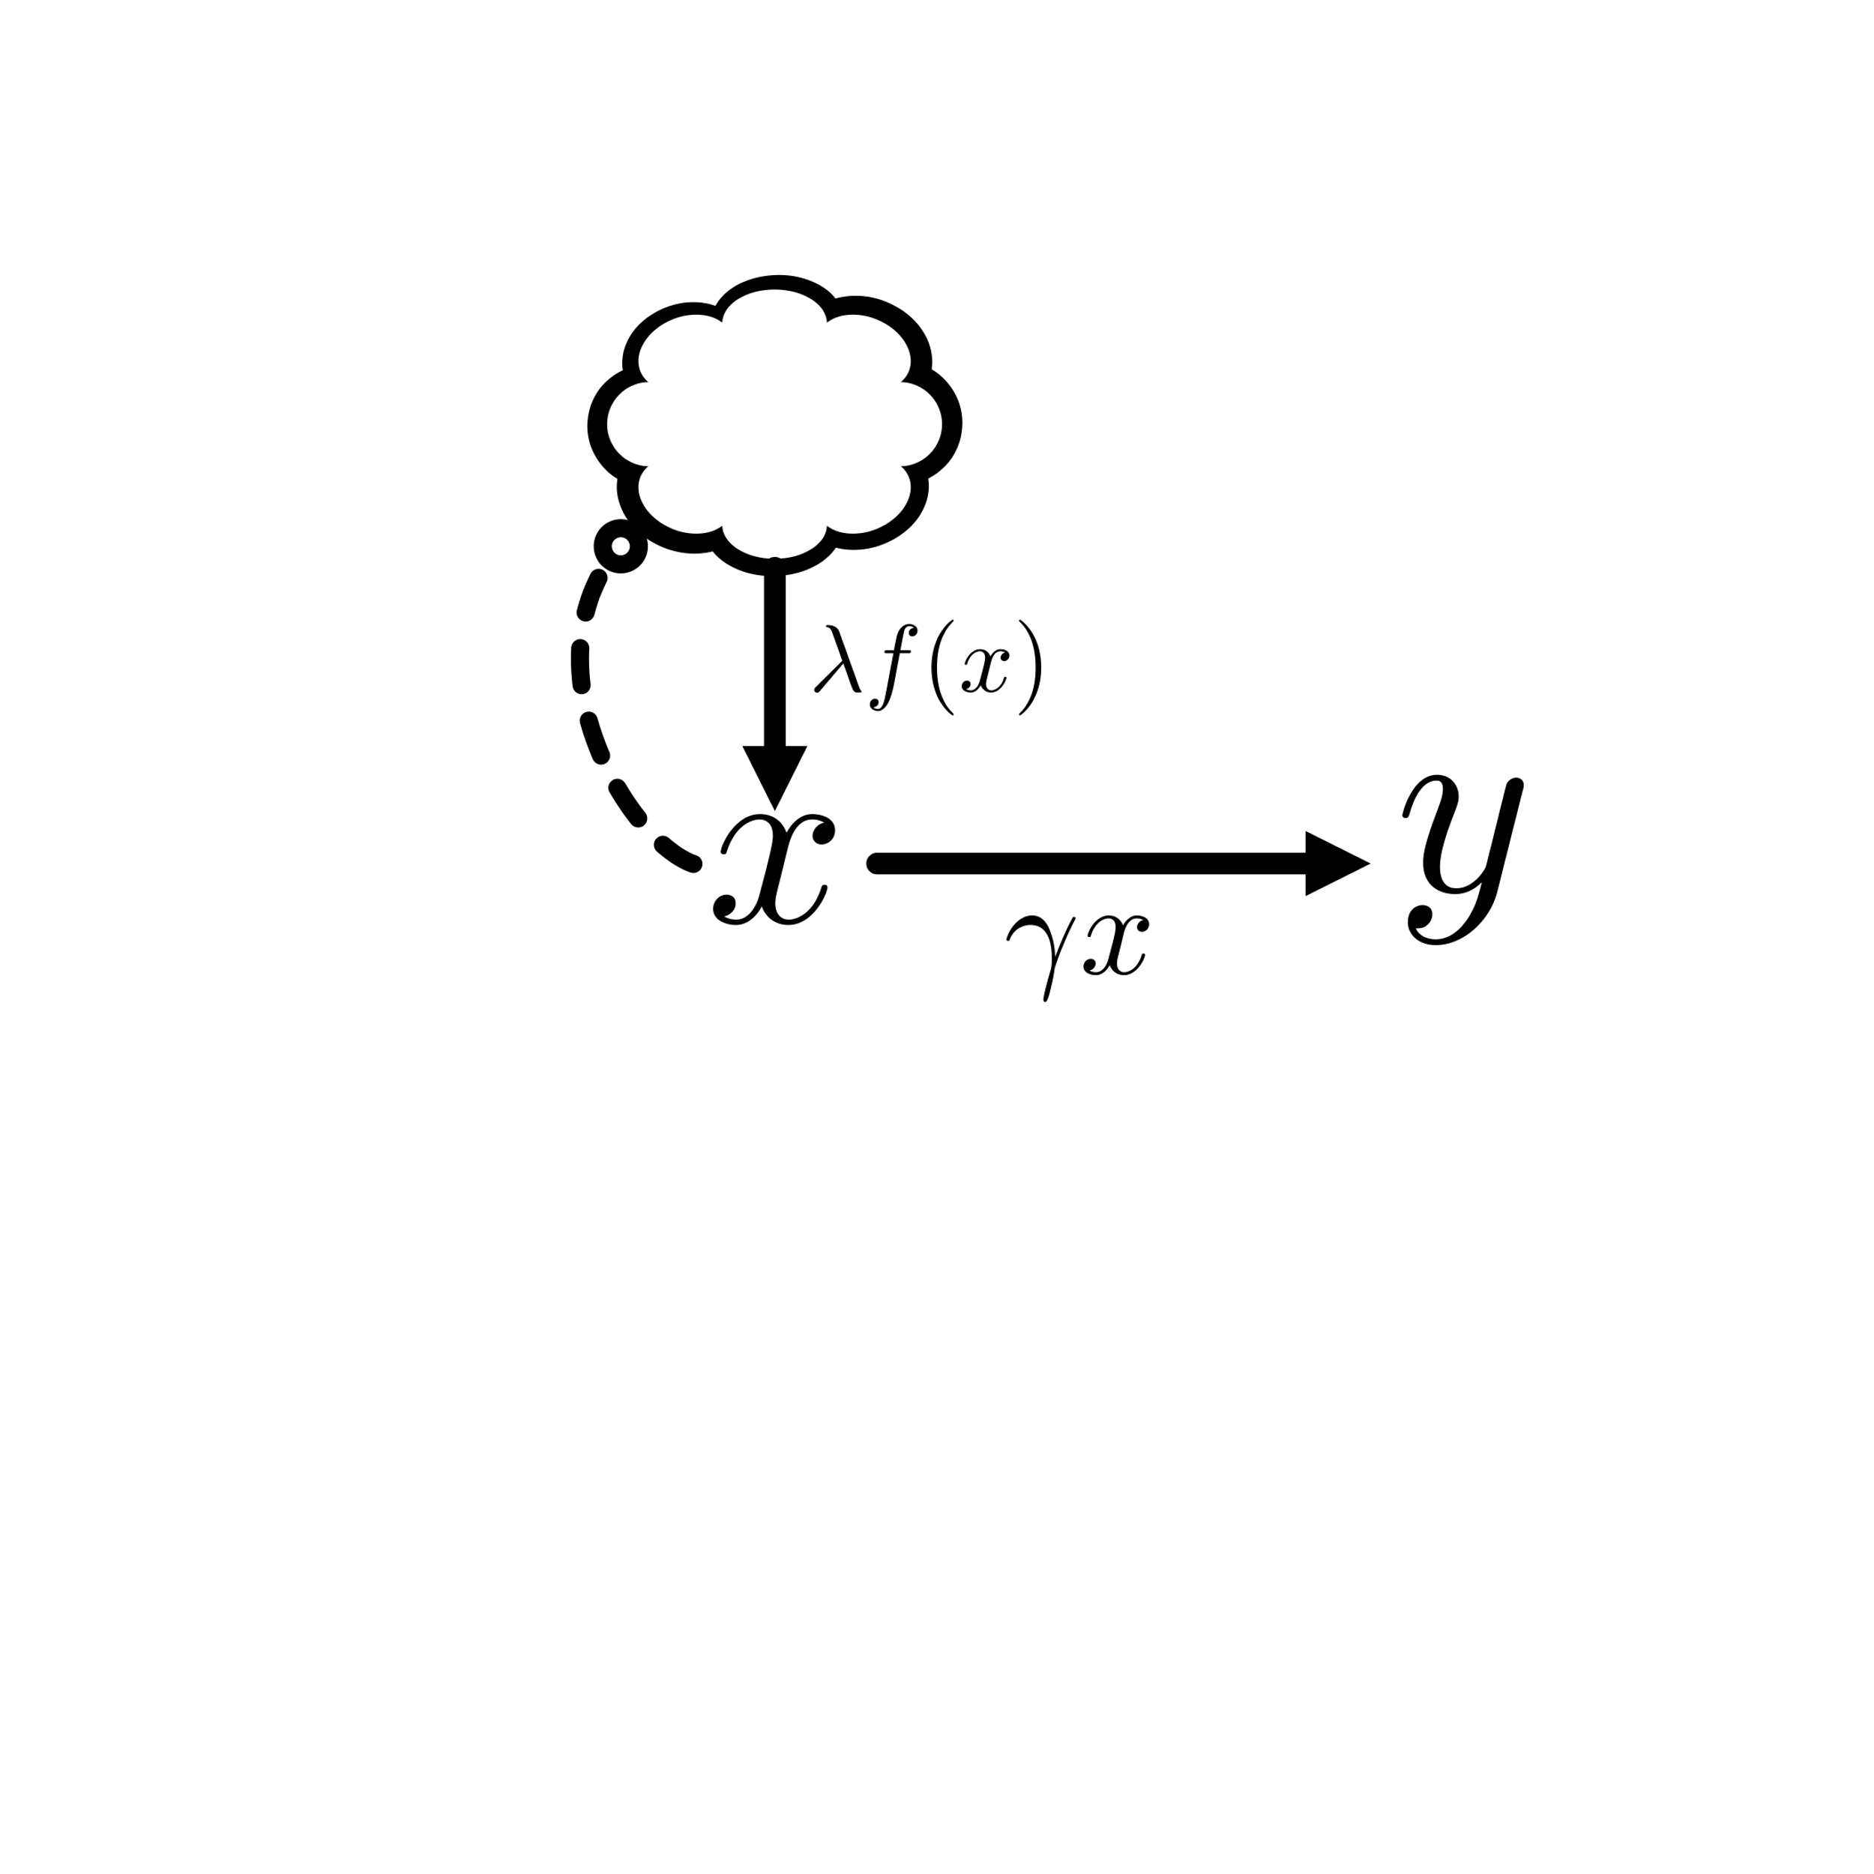

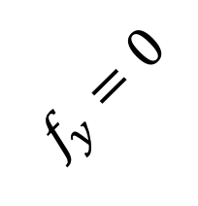
Position on plot determines sign of $f_{y}$
$$f_{y}=0$$
Notes:
And two constraints, one for each sensitivity, emerge. The first is a constraint based on the line where correlations equal the CV of x divided by the CV of y. If a system’s response to random perturbation is on this line, that system has no feedback from y to the cloud!

Slide 11
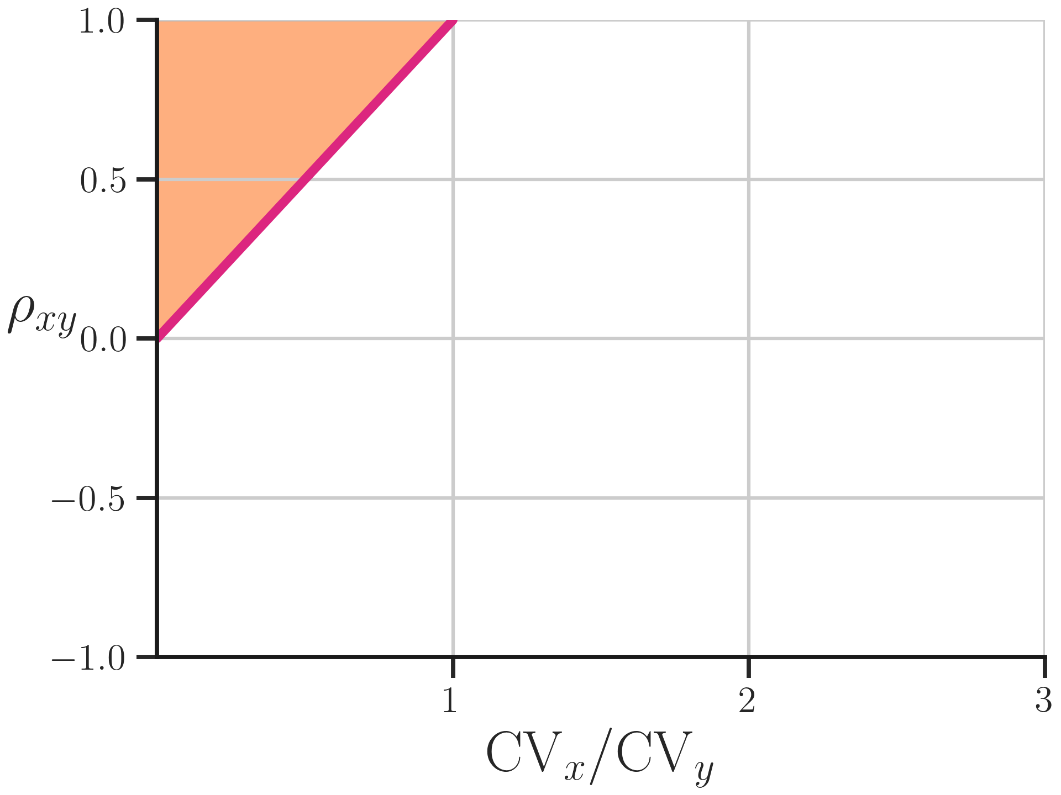


Position on plot determines sign of $f_{y}$
$$f_{y}>0$$
$$f_{y}=0$$
Notes:
If a system’s response however was observed above this line, that means that the y-feedback is greater than 0 and therefore positively feeding back into x.

Slide 12
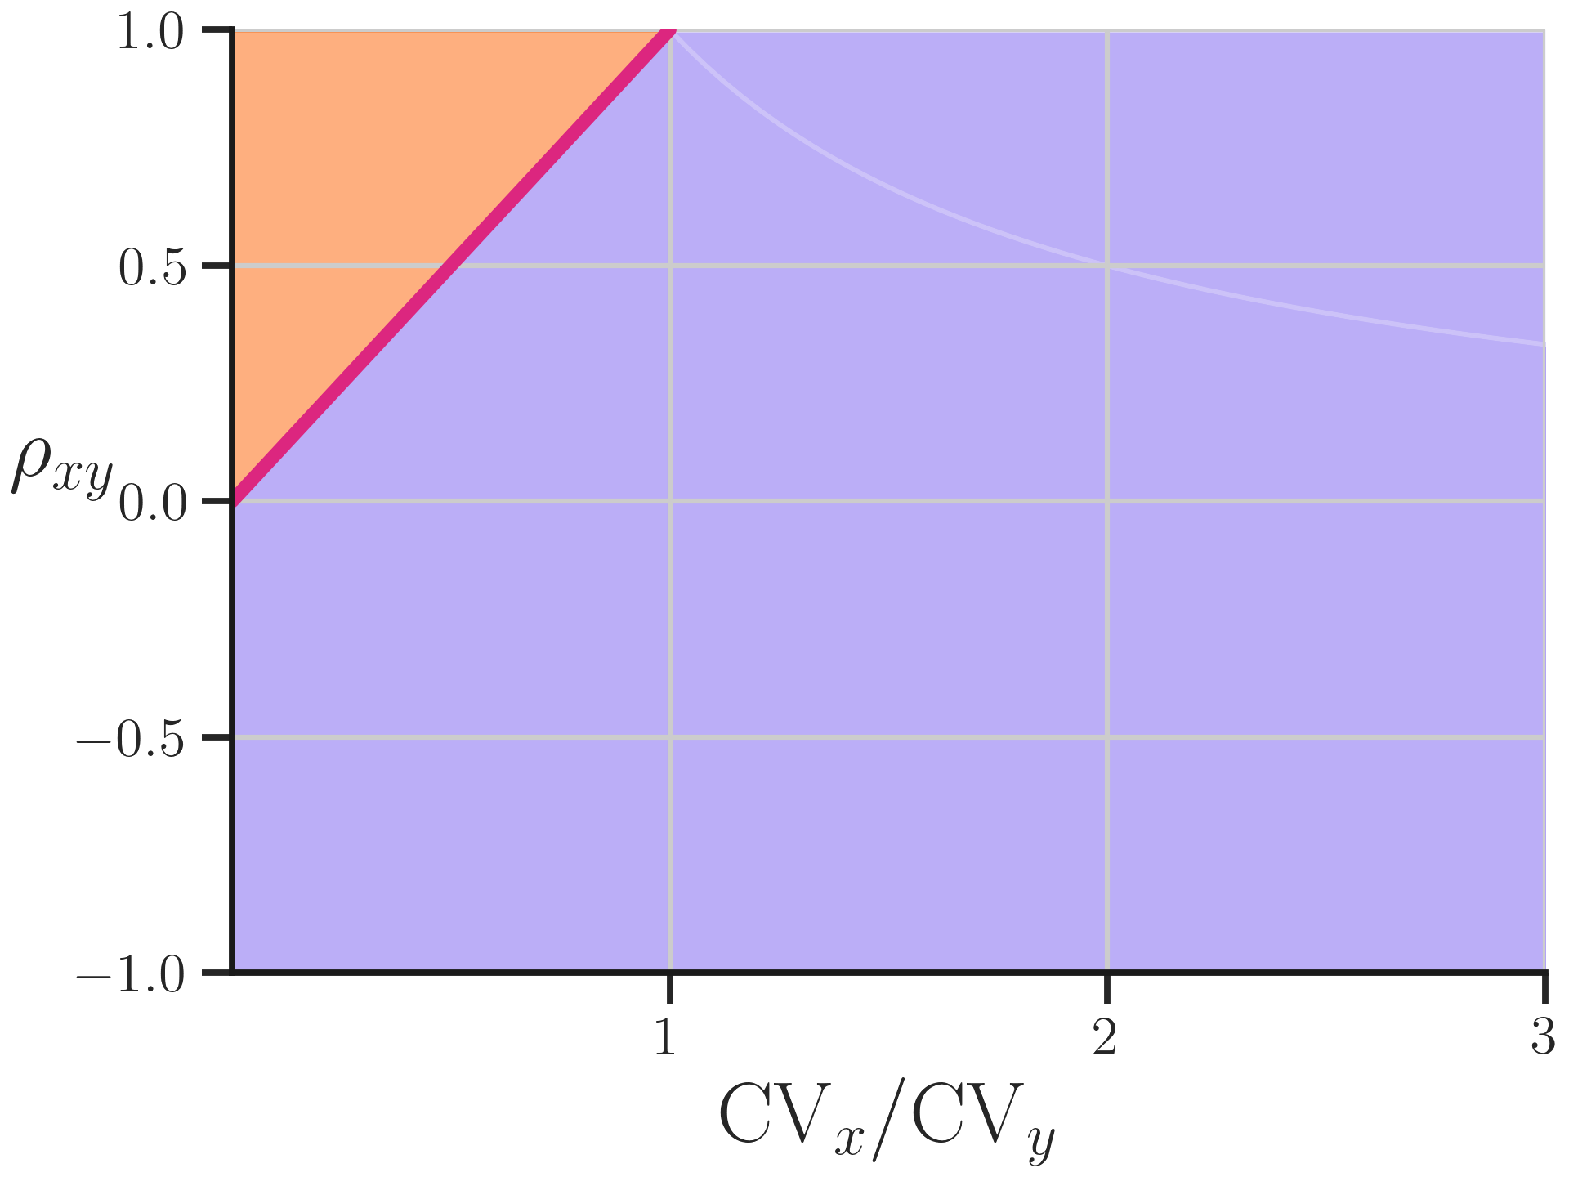

Position on plot determines sign of $f_{y}$
$$f_{y}>0$$
$$f_{y}=0$$
$$f_{y}<0$$
Notes:
And anywhere below the line the feedback from y to x must by negative, meaning y inhibits the production rate of x and forms a negative feedback loop

Slide 13
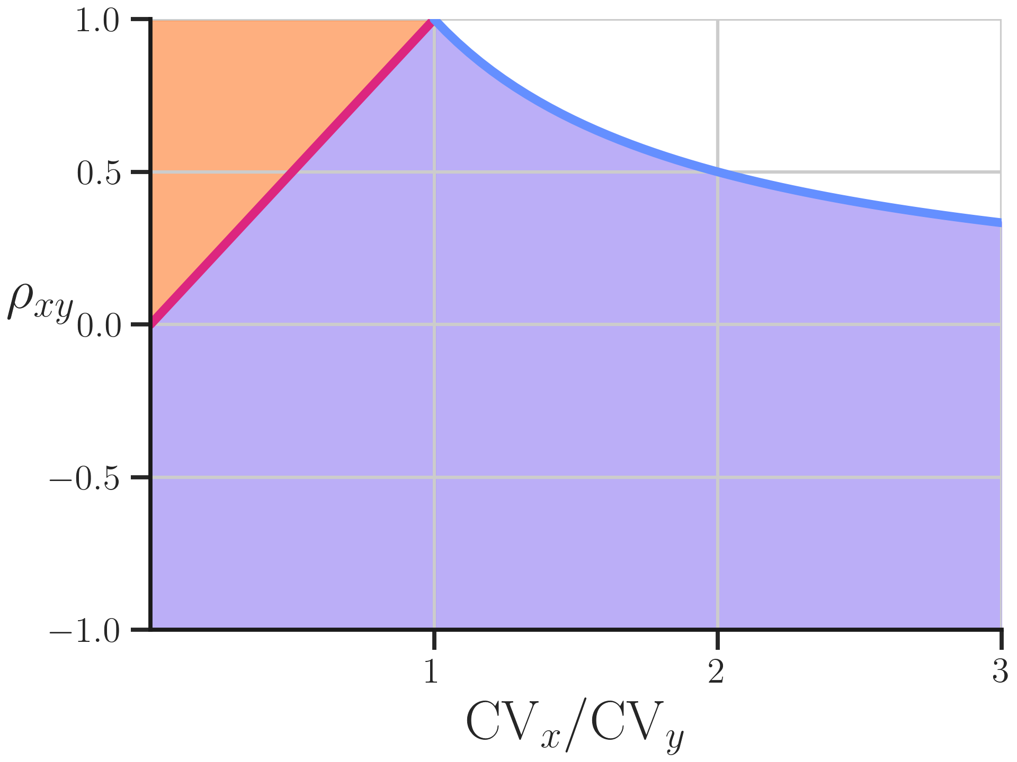
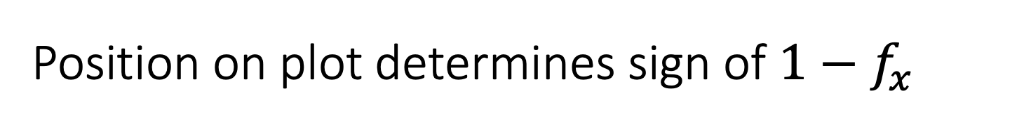
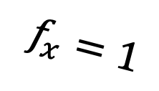
Position on plot determines sign of $1−f_{x}$
$$f_{y}>0$$
$$f_{x}=1$$
$$f_{y}=0$$
$$f_{y}<0$$
Notes:
There is a second constraint for the feedback from x into its own production based on the line where the correlations is equal to the reciprocal of this ratio. However instead of the sign of the feedback itself, it is the sign of 1 – that sensitivity. This means the sketches won’t be as easy to represent, so I’ll skip them. However this constraint further divides the negative y feedback region. First if f_x is exactly 1 a system must fall on this line.

Slide 14

Position on plot determines sign of $1−f_{x}$
$$f_{y}>0$$
$$f_{x}=1$$
$$f_{y}=0$$
$$f_{y}<0$$
$$f_{x}<1$$
Notes:
And all regions below it: which includes the red line and orange area, have f_x less than 1

Slide 15
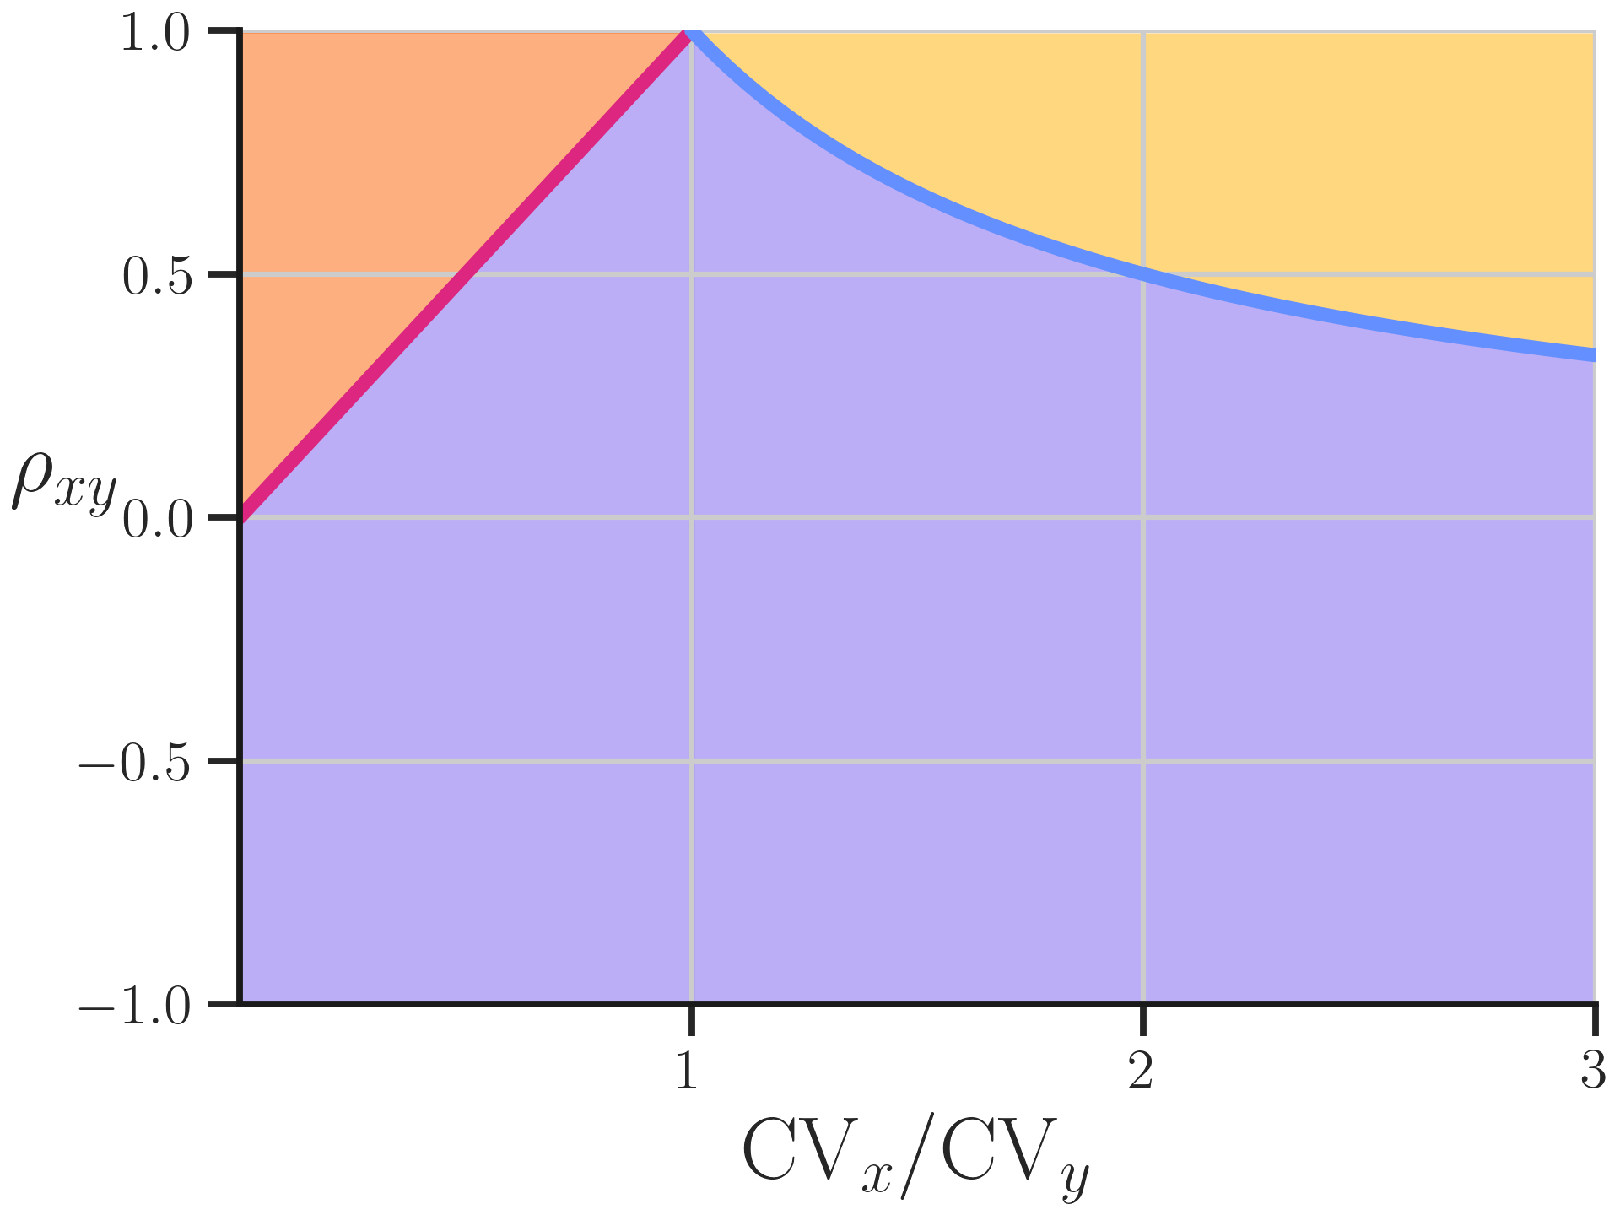
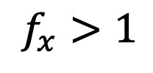
Position on plot determines sign of $1−f_{x}$
$$f_{y}>0$$
$$f_{x}>1$$
$$f_{x}=1$$
$$f_{y}=0$$
$$f_{y}<0$$
$$f_{x}<1$$
Notes:
And any system with f_x greater than 1 will fall above the blue constraint line. This means correlations and coefficients of variation identify a phase diagram for the response of these systems to random perturbations

Slide 16
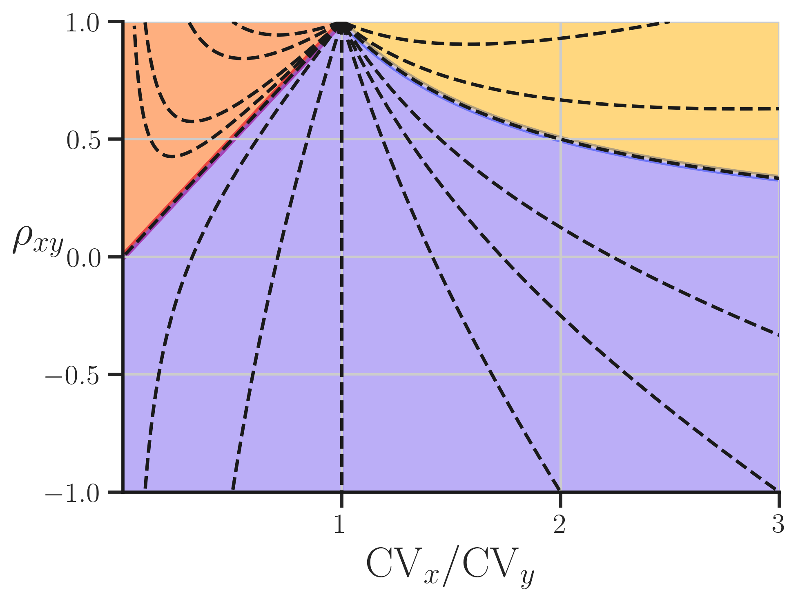
Systems land on curves based on relative feedback sensitivities
Curves shared by systems with same
Notes:
These regions are actually formed by ‘iso-feedback lines’. That is, systems fall on one of these curves, alongside any other system with the same value for their ratio of relative sensitivities.

Slide 17
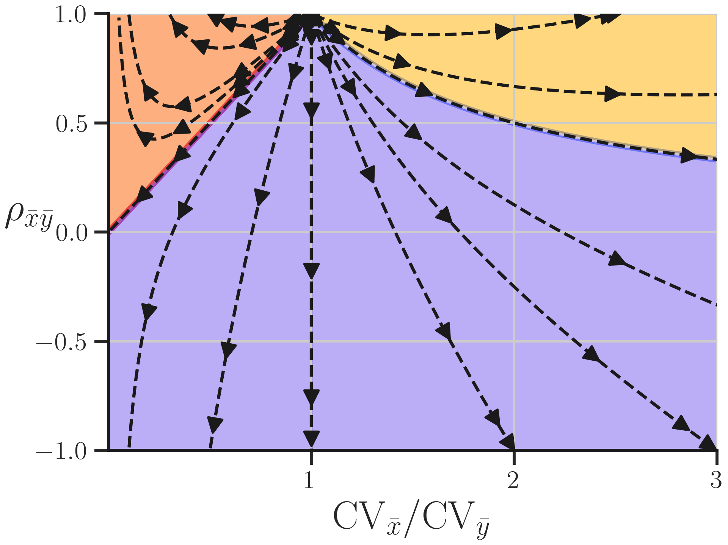
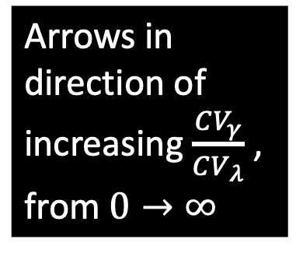
Position on ‘iso-feedback curves’ is from relative variation in parameters
Arrows in direction of increasing $\frac{CV_{γ}}{CV_{λ}}$ , from $0→∞$
Notes:
Where a system lands on the curve is determined by the perturbation distribution: namely how much variation the perturbation distribution induces in the arrow (gamma) versus the cloud (lambda). When only lambda is hit the curves start at 1,1, and go to their final point if only gamma is hit.

Slide 18
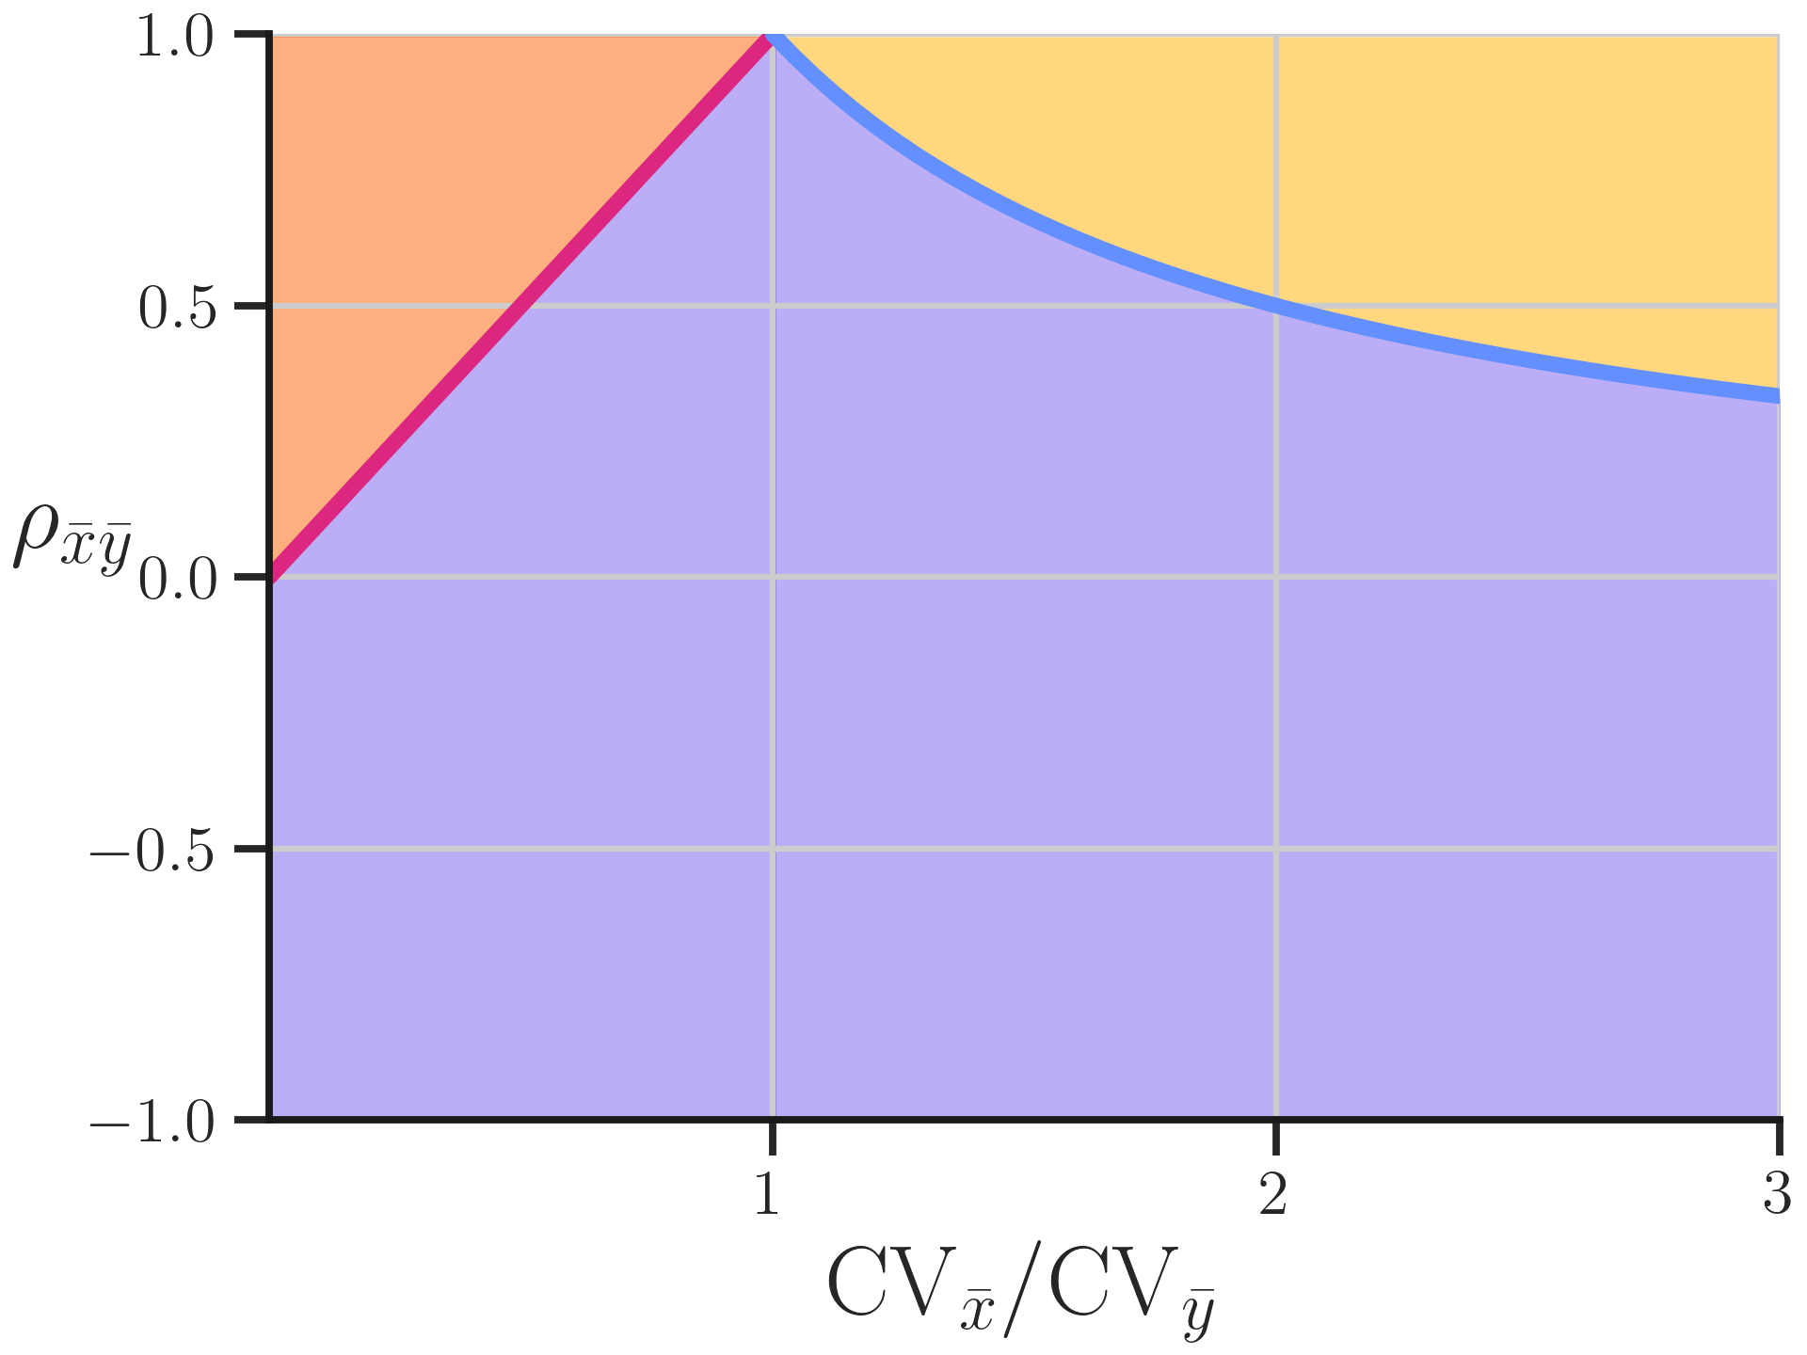
The fine print:
Bounds assume perturbations have uncorrelated effects on parameters
Notes:
But there is always, ALWAYS a catch. In addition to the assumptions needed to make linear approximations valid, these results only work under the assumption that you do not use a set of perturbations that has a correlated effect on lambda or gamma. Like in this example, where anti correlations in parameters make your system "look" like it has negative feedback

Slide 19
Finite perturbation effects:
Real biological systems are non-linear
Notes:
Now let’s take a look at the approximations underlying linear theory. Linear theory assumes you can take an equation like this, and solve for its change under perturbation to first order in its derivatives. But crudely, there is an error term associated with this process for any dx or dy that is finite, and not infinitesimal.

Slide 20
Finite perturbation effects:
Real biological systems are non-linear AND stochastic
Notes:
Biological systems actually get hit by a double whammy. Not only are the systems non-linear, but the very equation we linearise actually comes from a statement about the average rates, leading to equations like this. But to even cast this in a form we can use linear response in, we have to LINEARISE the averaging operation and bring it into the function in the first place.

Slide 21
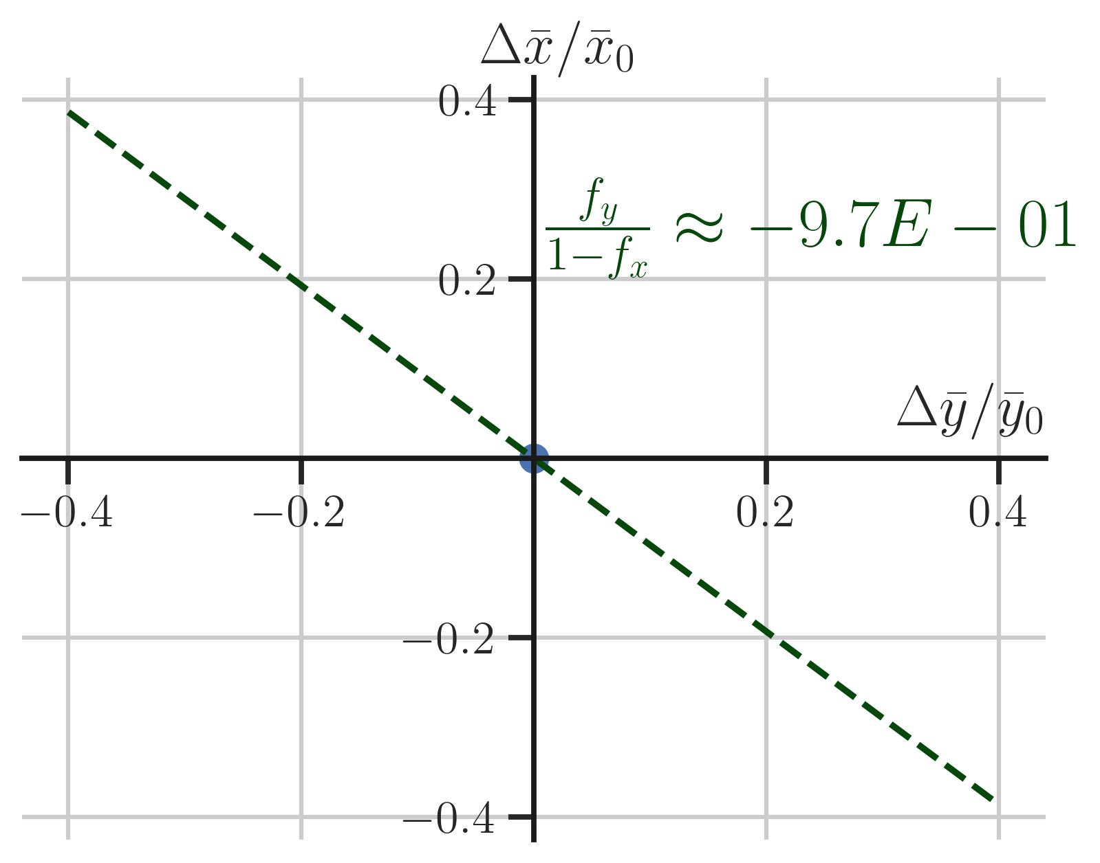

Real biological systems deviate under finite perturbations to $γ$
Notes:
Here’s some simulated data from an example system. I calculated the feedback sensitivity of the example, and plotted the line linear response theory would expect the molecular levels to fall on under perturbations to gamma.

Slide 22
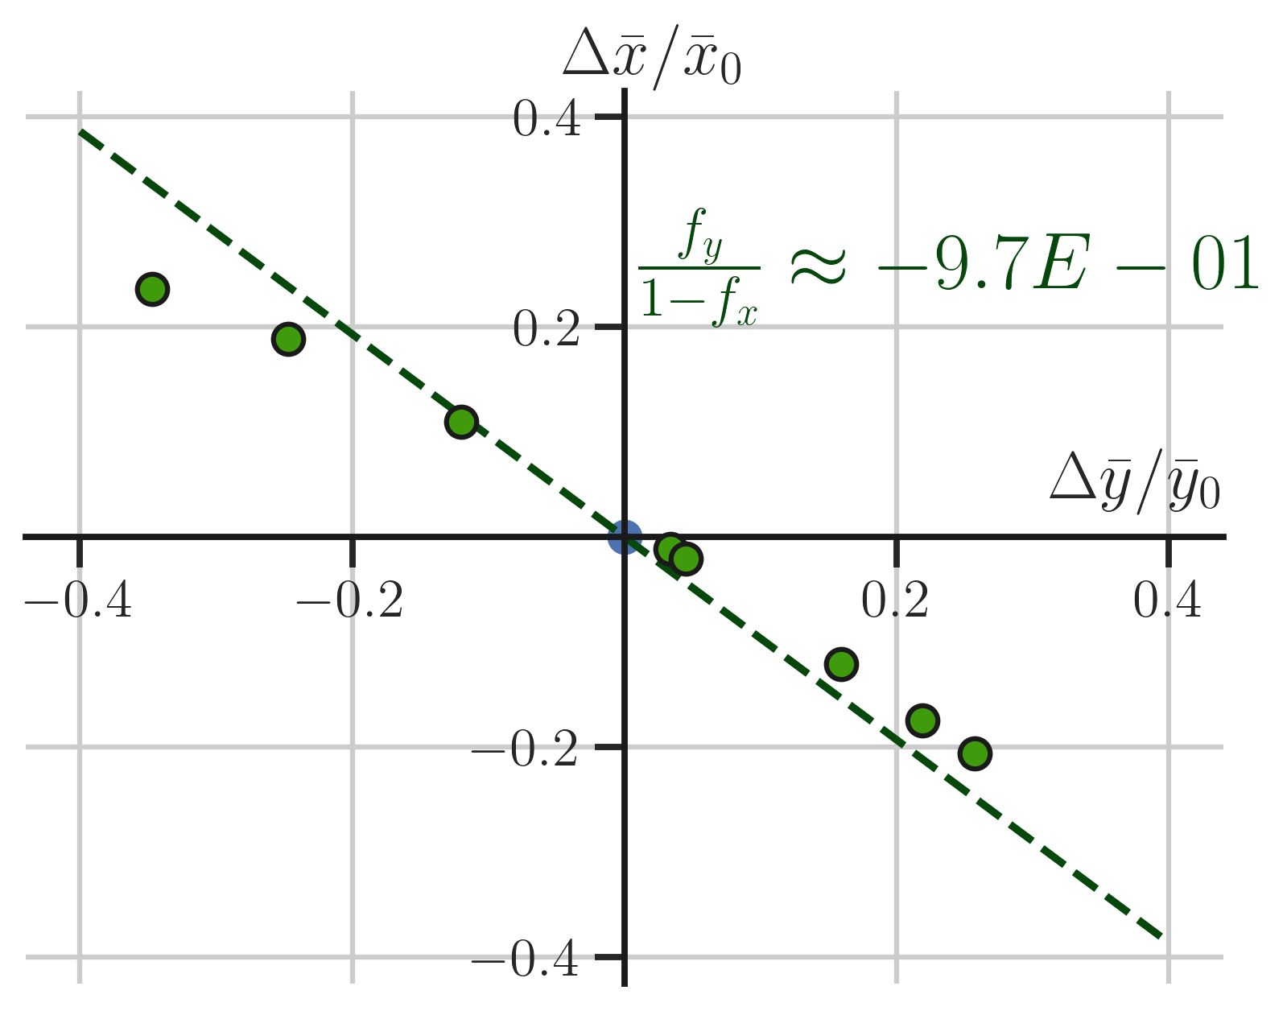
Real biological systems deviate under finite perturbations to $γ$
Do random perturbation constraints work?
Notes:
Here are dots from actual finite perturbations to the parameter gamma, which as you can see clearly do not follow this line (or any straight line), especially as the size of perturbations increases. So given this fact, do the constraints shown above work?

Slide 23
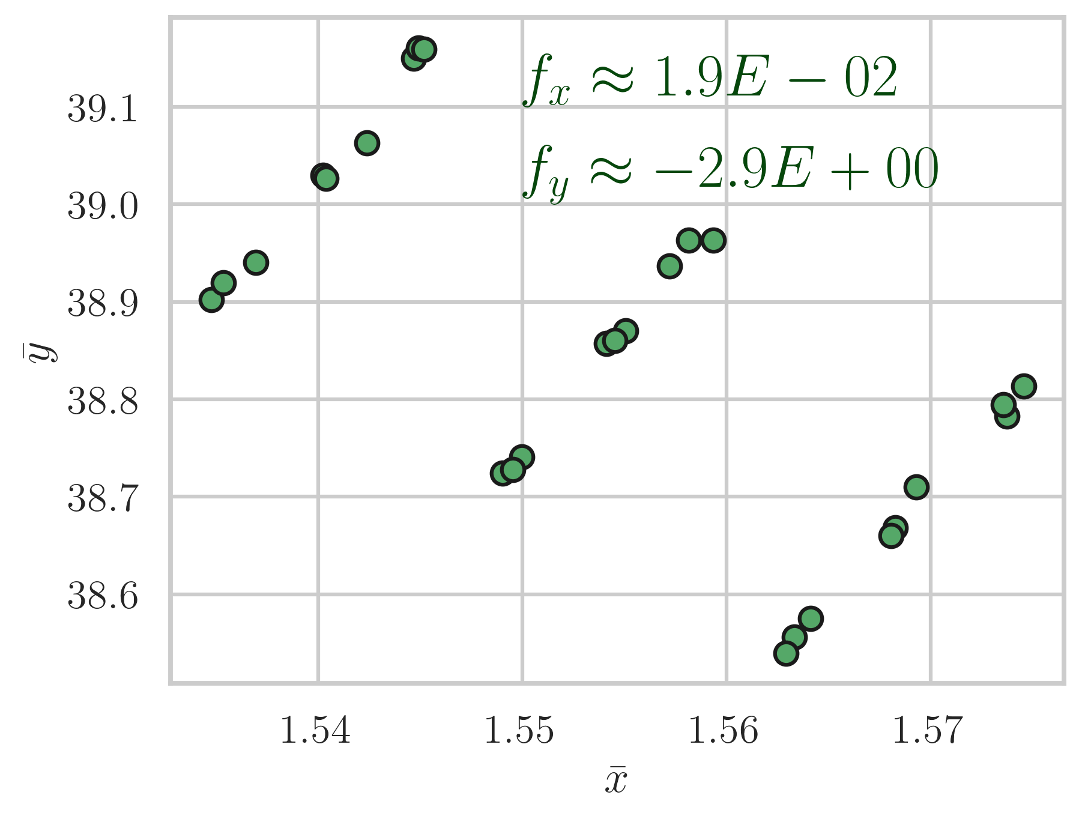
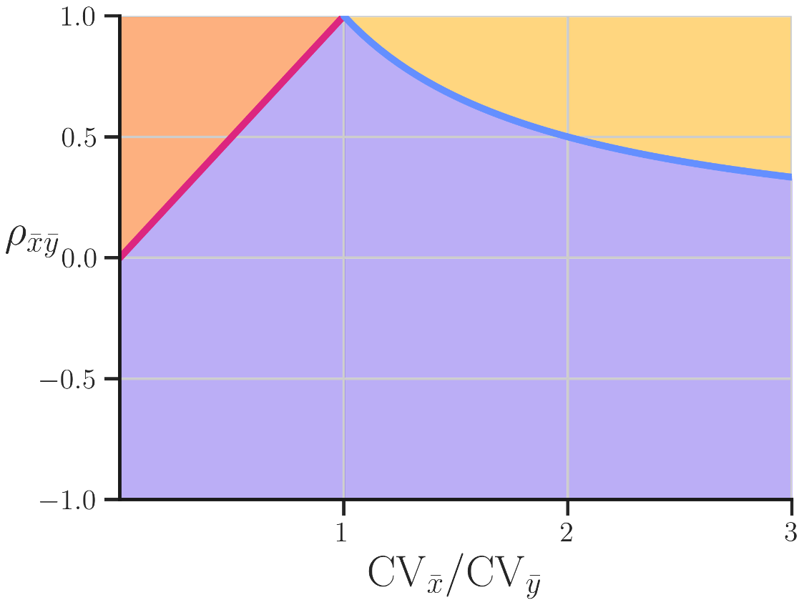
Stochastic simulations calculate exact values for observables and feedback under finite perturbation
Mismatch of dot colour and background colour => inferred sensitivity category “incorrect”
Notes:
We can test this by doing simulated perturbation experiments with uncorrelated parameter changes for different systems, using simulation to predict what the feedback category should be and calculate what the observed correlations and CVs are, from datasets like those on the left. Then we can compare the simulated feedback sensitivities and those you’d infer from the simulated value of correlations and CVs to see if these systems break the predicted relationship. In this example, they agree.

Slide 24
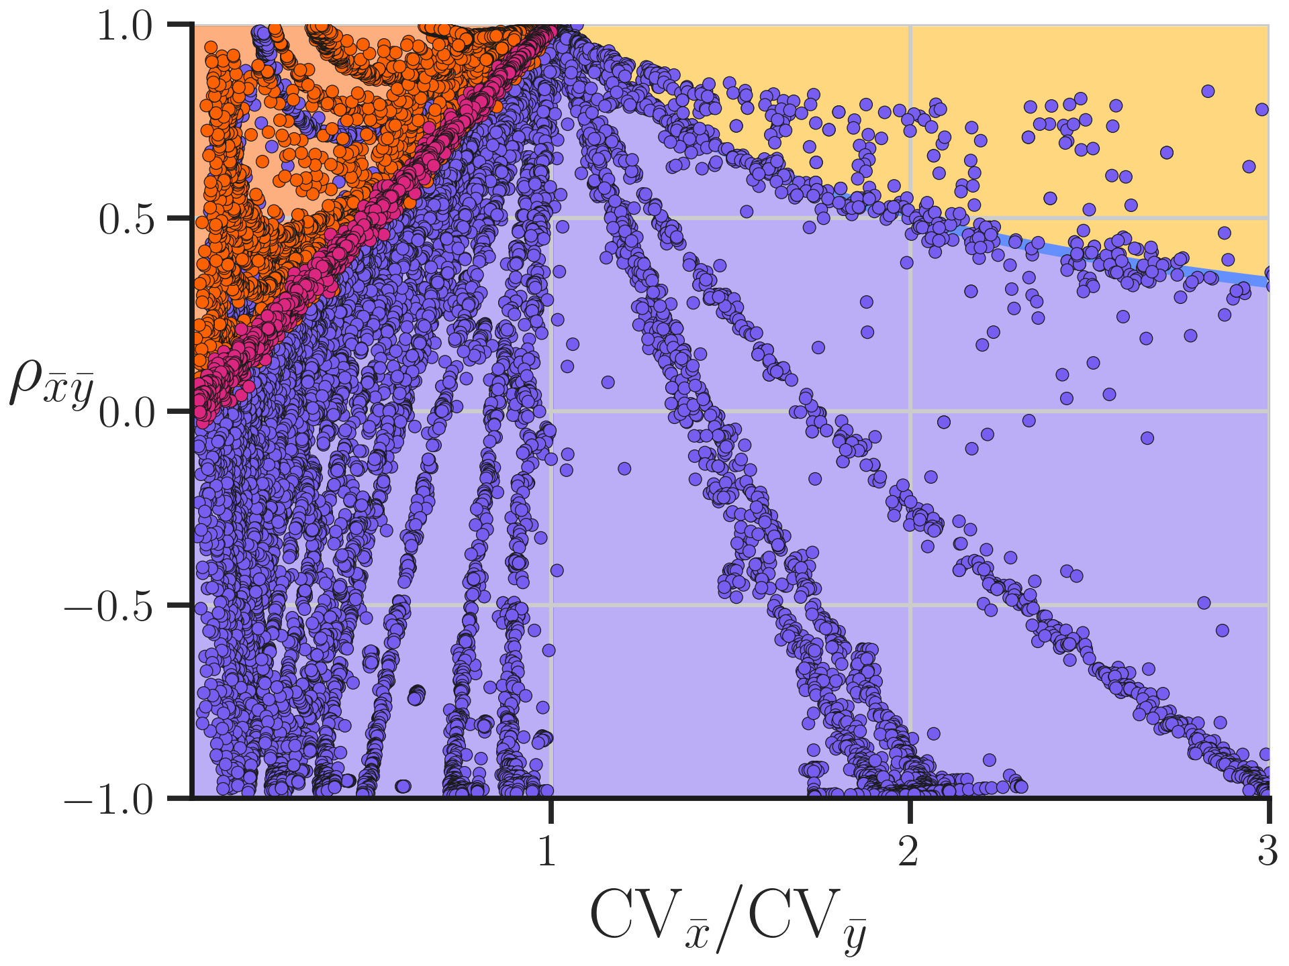
Most sampled systems obeyed predicted constraints under finite perturbation
Parameters perturbed by 1-97%
Notes:
Doing this at a large range of finite perturbations, for 5400 unique systems and many unique parameter variations we see that many (and the vast majority of sampled) systems do in fact obey constraints. However some violators are visible almost immediately.

Slide 25
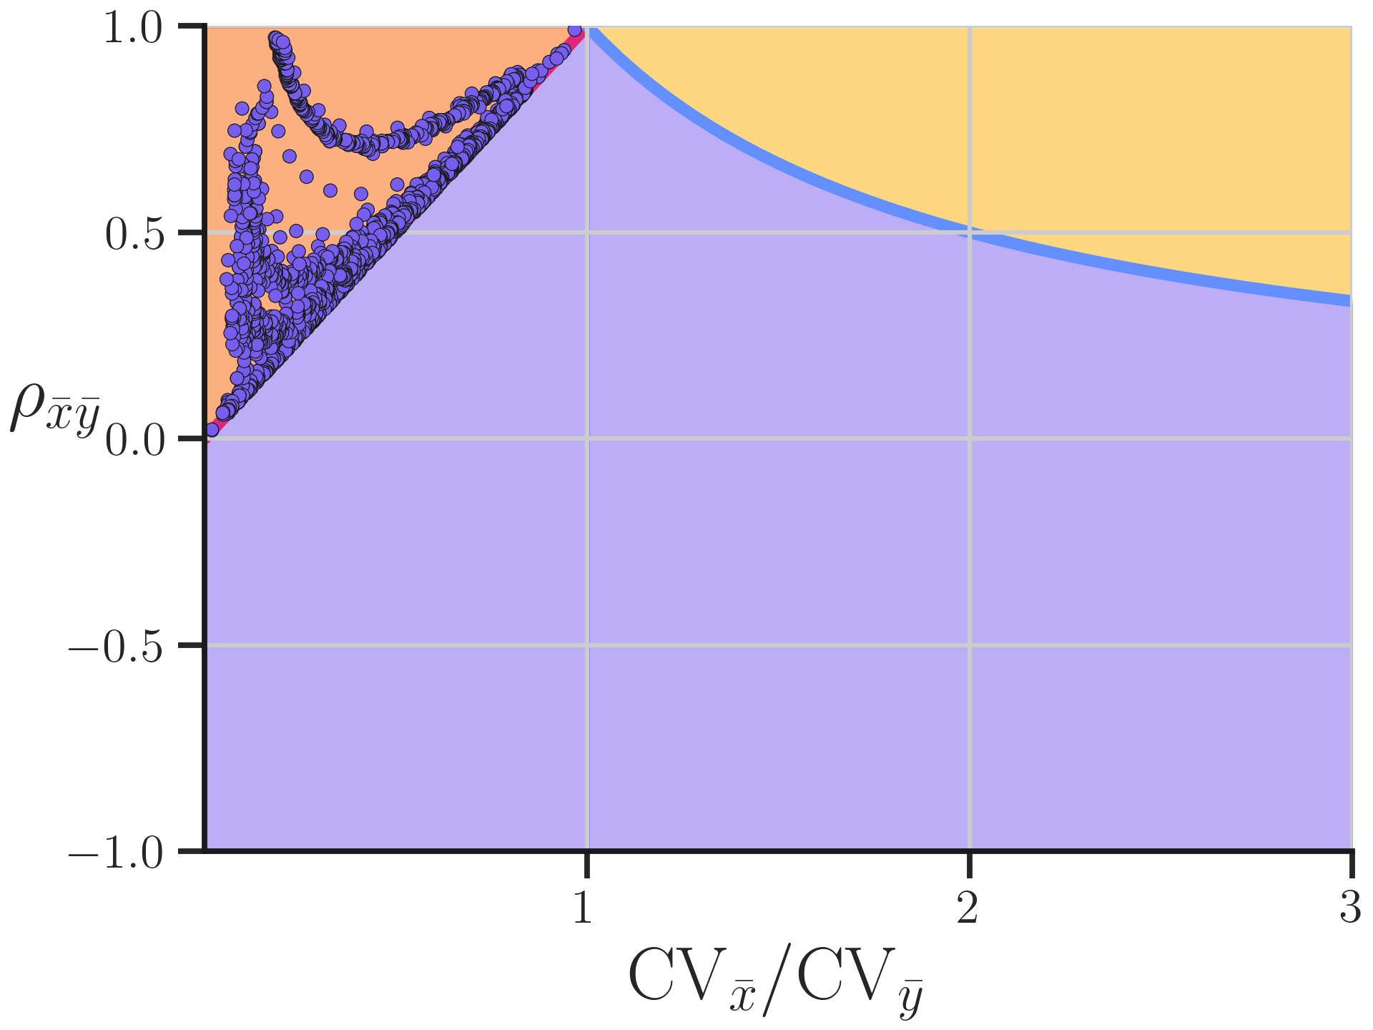

Some systems with $f_{y}<0$ behave like positive feedback systems
Curves look like positive feedback systems
Notes:
Let’s look at the two major groups of violating points found, larger than estimated error. Here we can see that a set of negative feedback system violates the f_y constraint by showing up above the rho = CVx/Cvy line. These systems furthermore appear to follow curves predicted for positive feedback systems under linear theory. This shows some nonlinear, stochastic systems have behaviour completely unpredicted in linear analysis.

Slide 26
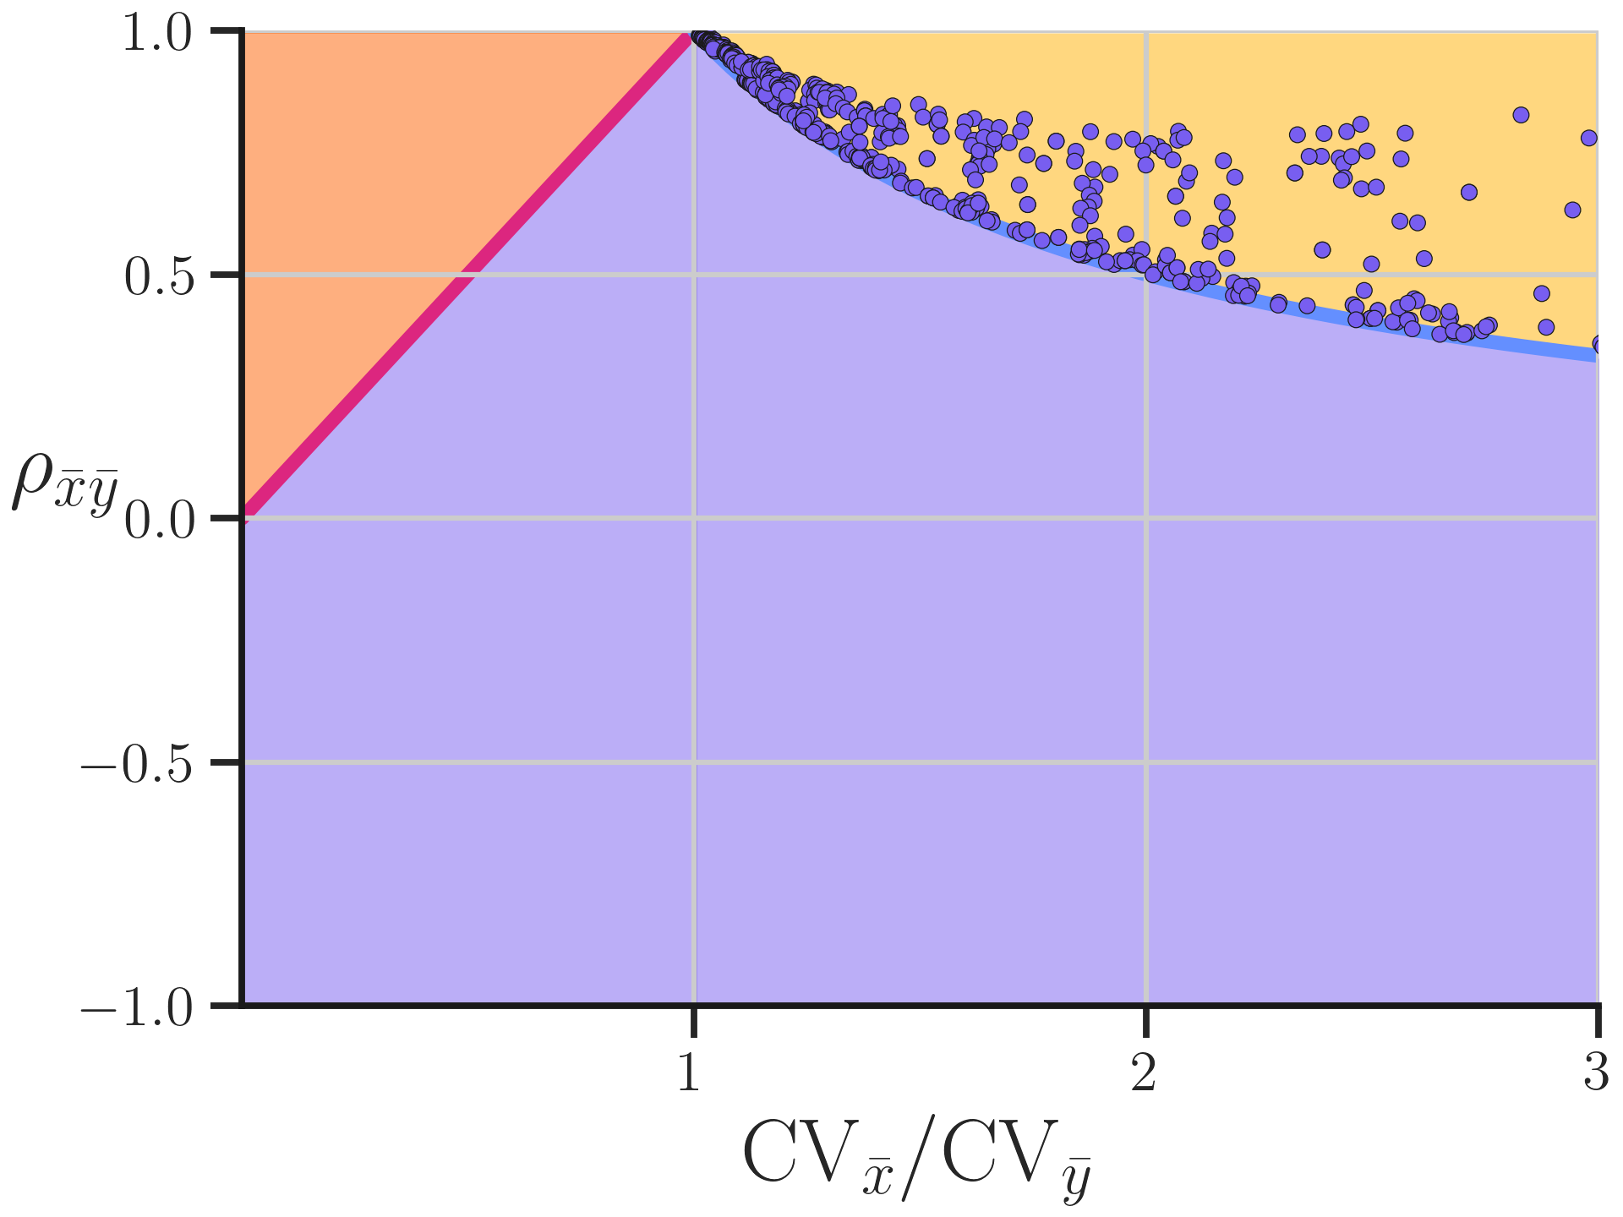
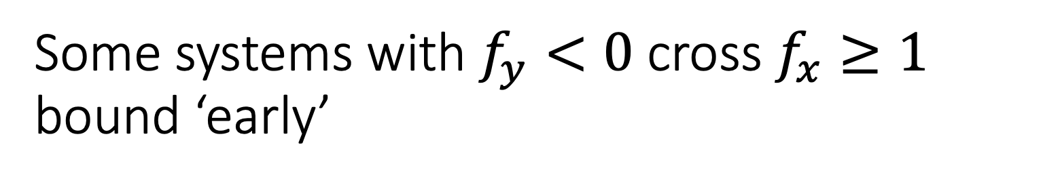
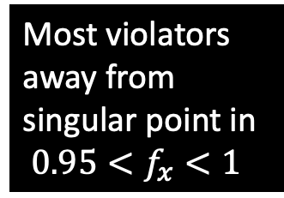
Some systems with $f_{y}<0$ cross $f_{x}≥1$ bound ‘early’
Most violators away from singular point in
${0.95<f}_{x}<1$
Notes:
Additionally, we found some systems that had f_x less than 1 appear above and on the constraint line for that sensitivity. These systems all had f_x approaching 1. This suggests that non-linear systems may be able to cross this bound at lower sensitivities than predicted by linear theory. Taken together, these show how finite perturbation effects must be considered when interpreting linear response data.

Slide 27
Additional problem: what if sampling from ‘correlation-free’ perturbations
Statistically independent population
Sample
Notes:
There’s an additional problem that is of practical importance for experimentalists. What if you have access to samples of a perturbation set that is truly statistically independent, but you can only sample a finite part of it?

Slide 28
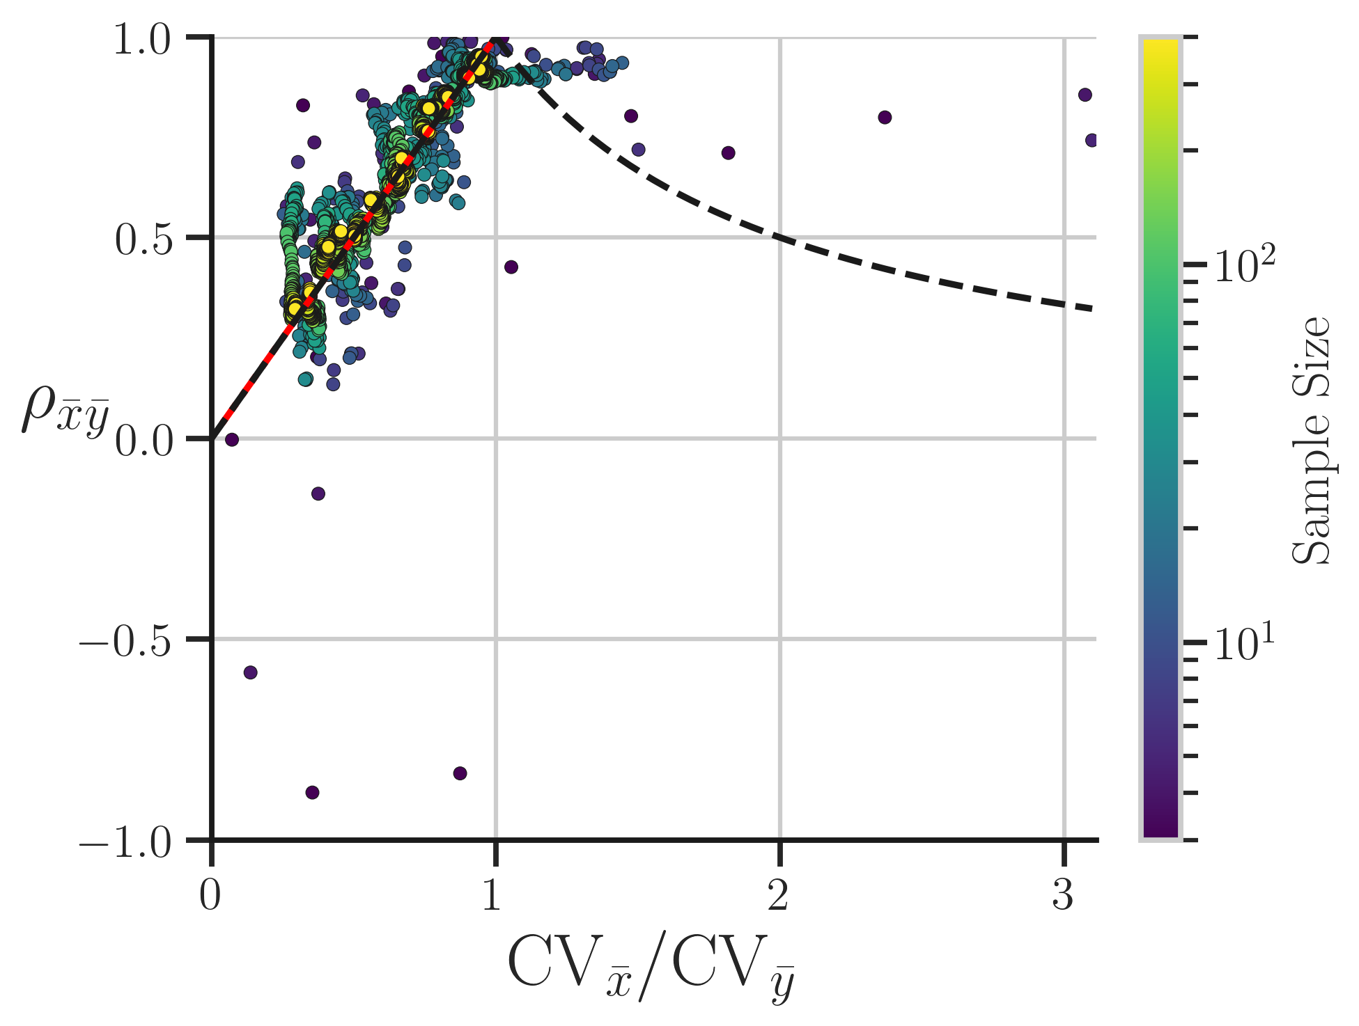
Finite sampling causes deviation from constraints due to sample perturbation correlations
No feedback:
finite perturbation size not responsible!
At 400, close to numerical error estimate
At 3, dots everywhere
Notes:
We can illustrate this effect by looking at systems with no feedback whatsoever: the value of f is a constant. In this example system, no finite perturbation effects exist at all and points have to land on the rho equals CVx/Cvy constraint for any magnitude of perturbation. When perturbation distributions are formed of 3 samples from an independent population, we see that the location of the system on the pplots really can be anywhere. In contrast, by the time the sample size is on the order of 400 the agreement with the constraint is fairly good, and similar to what was observed as numerical error in the statistically independent case.

Slide 29
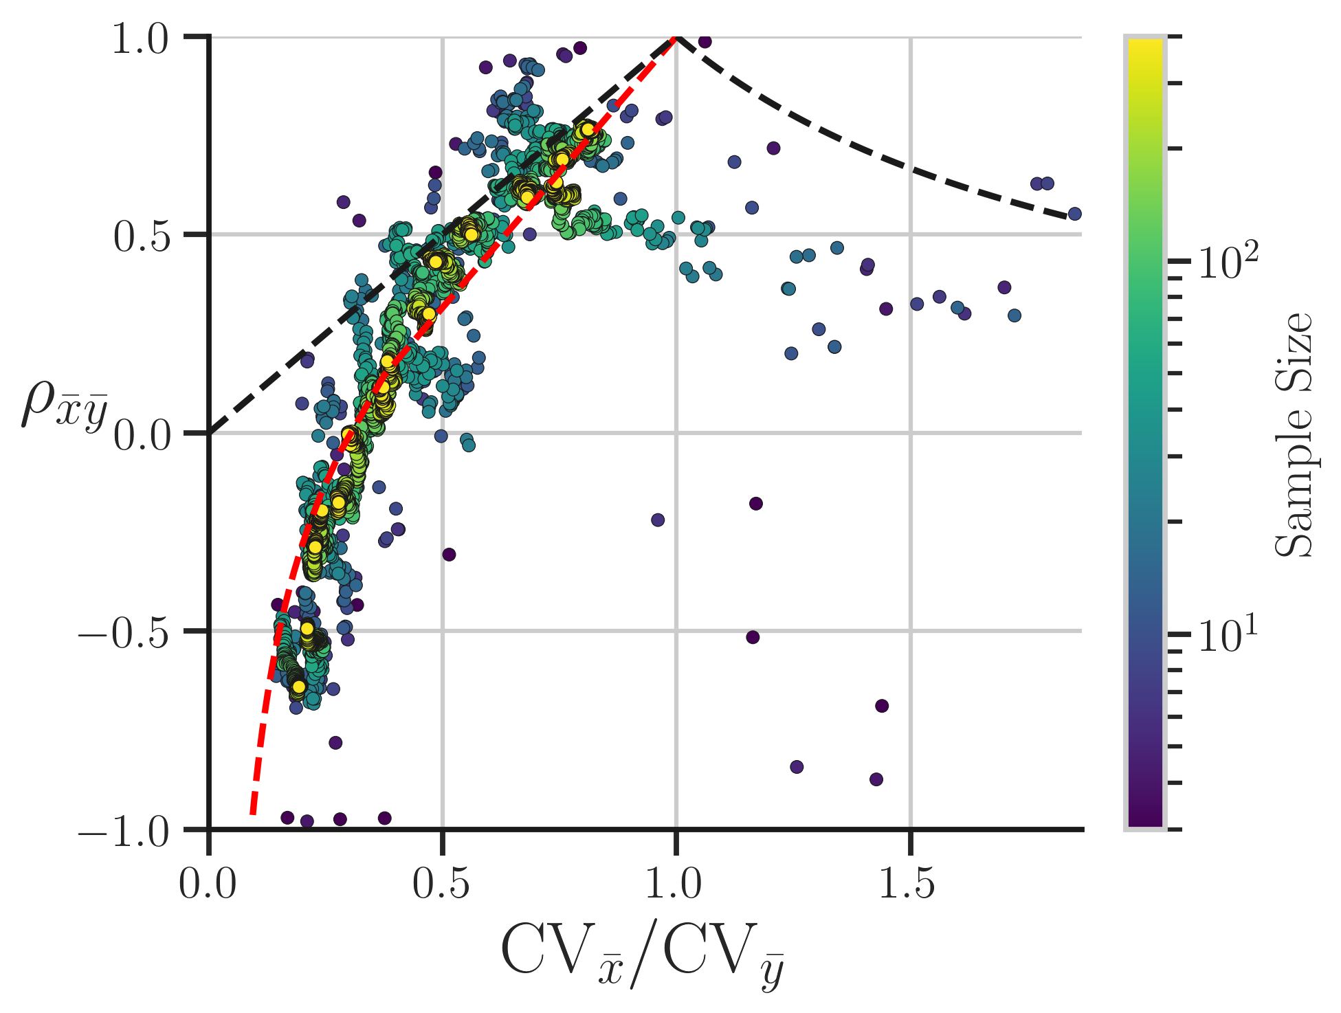
Systems with feedback show similar reliance on sample size
Finite perturbation effects will contribute divergence
Notes:
Knowing this in the linear system case is important, because it gives us an idea of what is needed in systems with feedback. Like the previous case we see that for low sample sizes points really can show up anywhere. And while the agreement with the predicted curve in red improves for the green and yellow dots, we know that due to finite perturbation effects some deviation from the curve is expected anyway. So these estimates argue the use of large sample sizes in random perturbation studies to use linear response theory.

Slide 30
This work (and a lot of Physics) in one sentence
Linear analysis works, except when it doesn’t
Predicting feedback via random perturbation is possible, but can fail:
Finite perturbation effects for non-linear AND stochastic systems
Finite sampling effects if experiment is subsample of a correlation free set
Notes:
So to summarise, this work joins a large and noble body of physics literature that declares:
Linear analysis works… except when it doesn’t.
We show that predicting feedback via random perturbations is possible, but can fail deue to finite perturbation effects for non-linear, stochastic systems and finite sampling effects that generate correlations from the experimental conditions. But linear analysis is a powerful tool, so fleshing out and quantifying these failures so we can operate within safe bounds for it is very valuable.

Slide 31
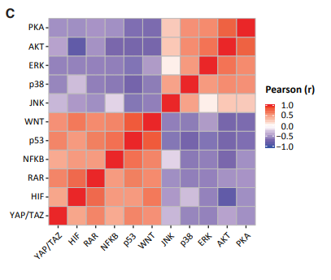
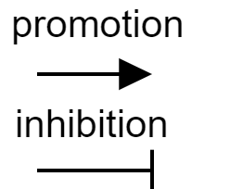
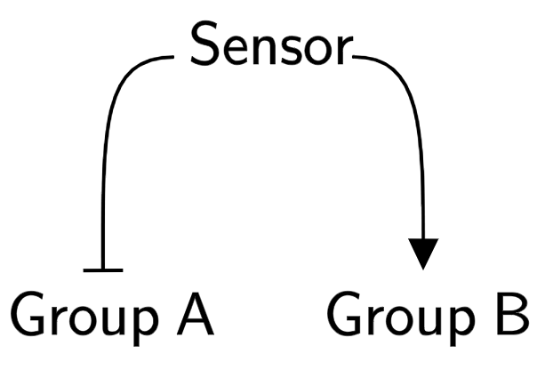
Large scale ‘random’ perturbation experiments are a reality: Physics can play role in modelling
Correlations of pathway activity changes in response to 122 drugs
“Naïve” model of data
Kaufman, Tom, et al. Nature Communications 13.1 (2022).
Notes:
A collaborating group measured the perturbation response of 12 common signaling pathways in cancer cells to over 100 different drug perturbations, and found interesting pattern of correlations across the very distinct and effectively random perturbation set. Instead of 12 ‘independent’ responses system essentially had 1: two groups of proteins emerged where within groups proteins had same response, and the groups had opposite responses to perturbation. This leads to a naïve model of the data where a common sensor is controlling the groups in an opposite matter, but can we offer physical grounding for this?

Slide 32
Lands and Treaty acknowledgement
Research performed on treaty lands of the Mississaugas of the Credit; ancestral lands of the Anishinabek, Huron-Wendat, Haudenosaunee, and Chippewa peoples; and on the lands of the Wolastoqey Nation.
Research funding is produced by value extraction from these lands—often in systemic violation of the treaties which give us settlers the right to use it

Slide 33


Acknowledgements
Thank you to:
Hilfinger Group:
Dr. Ran Kafri
Dr. Tom Kaufman
Dr. Ravid Straussman
Dr. Andreas Hilfinger
Jacob Daum
Euan Joly-Smith
Brayden Kell
Raymond Fan
Funding Sources:
C. David Naylor Fellowship,
Walter C. Sumner Memorial Fellowship
National Sciences and Engineering Research Council of Canada (NSERC)
Ontario Graduate Scholarship

Slide 34
Appendix

Slide 35
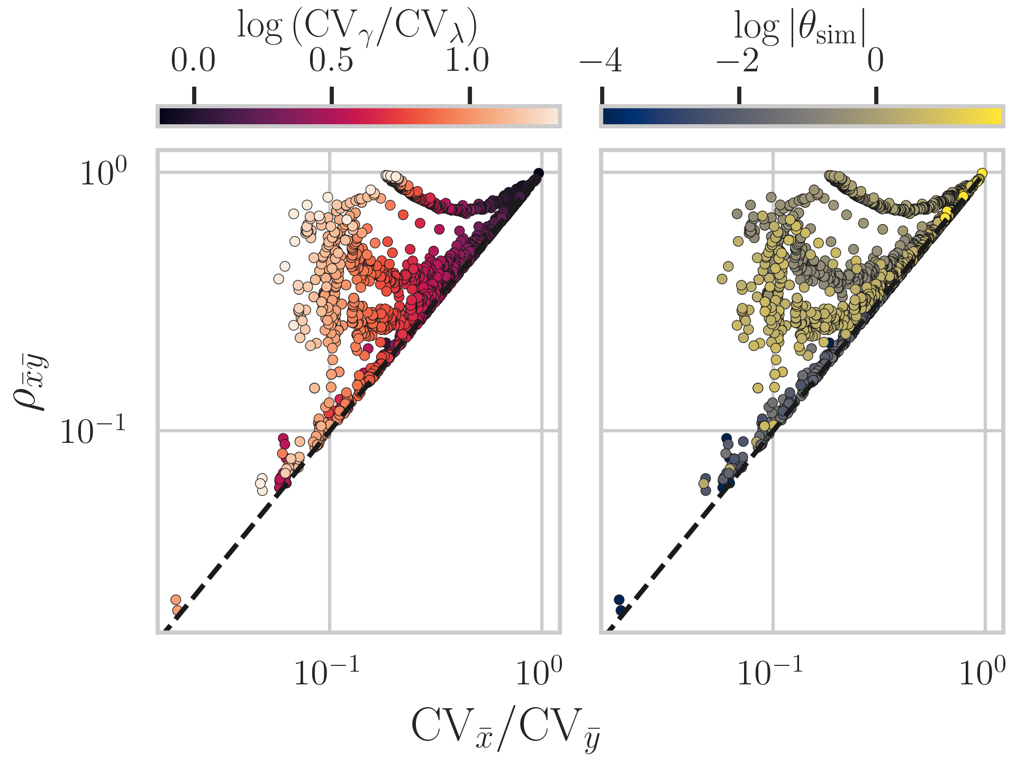
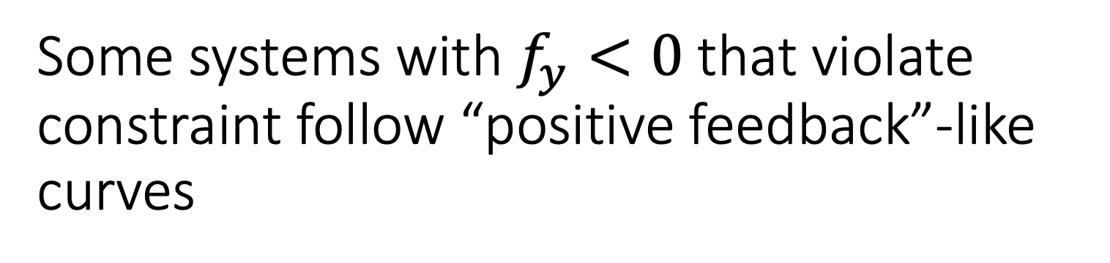
Some systems with $f_{y}<0$ that violate constraint follow “positive feedback”-like curves
Notes:
In contrast, looking at some negative fy violators we see that they trace curves with increasing CVg/CVl that look like positive feedback curves. This suggests that they show how non linear systems can have very ‘unpredictable’ effects under finite perturbation

Slide 36
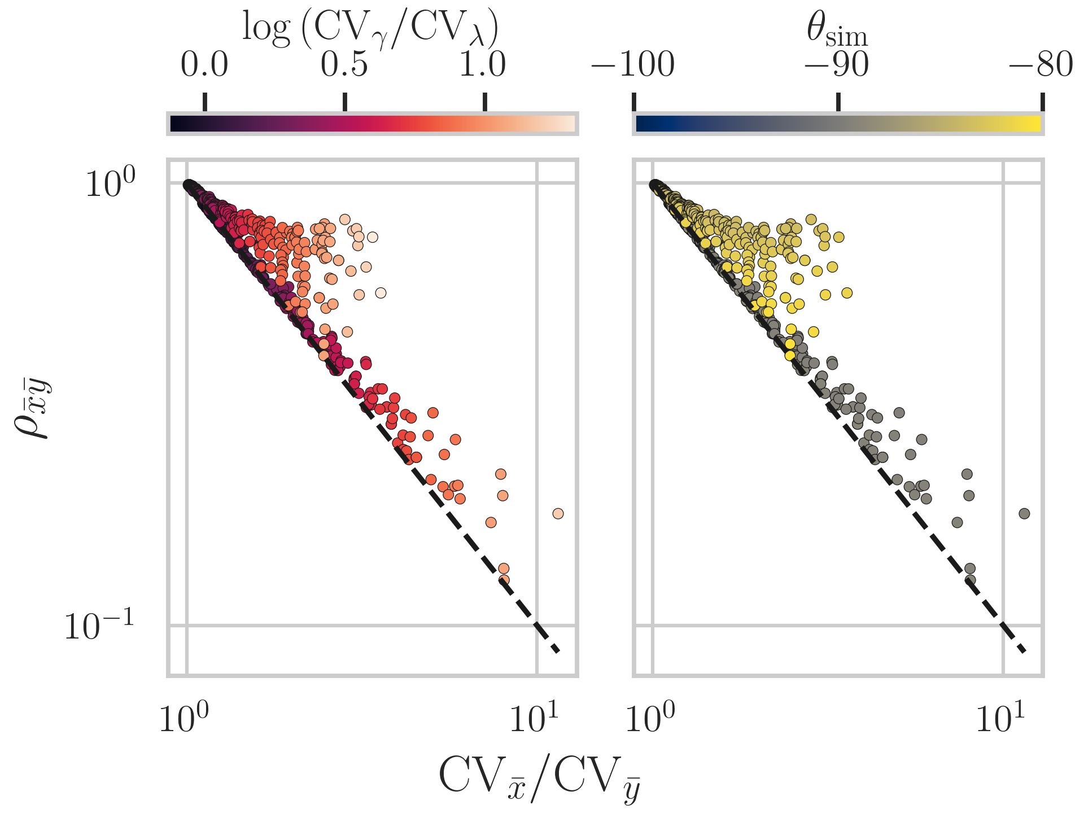
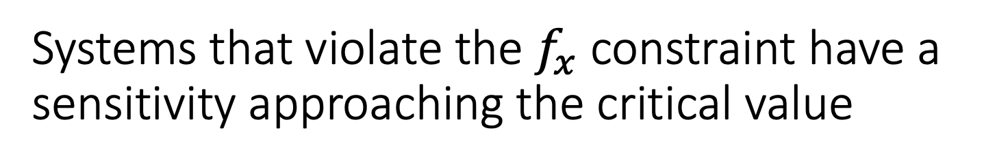
Systems that violate the $f_{x}$ constraint have a sensitivity approaching the critical value
Notes:
The other constraint also had violations: namely systems on it should have theta of 90 but systems with theta from 80-89 degrees sat on or above the line, following curves predicted in that region. Again shows nonlinear stochastic systems breaking a constraint ‘early.

Slide 37
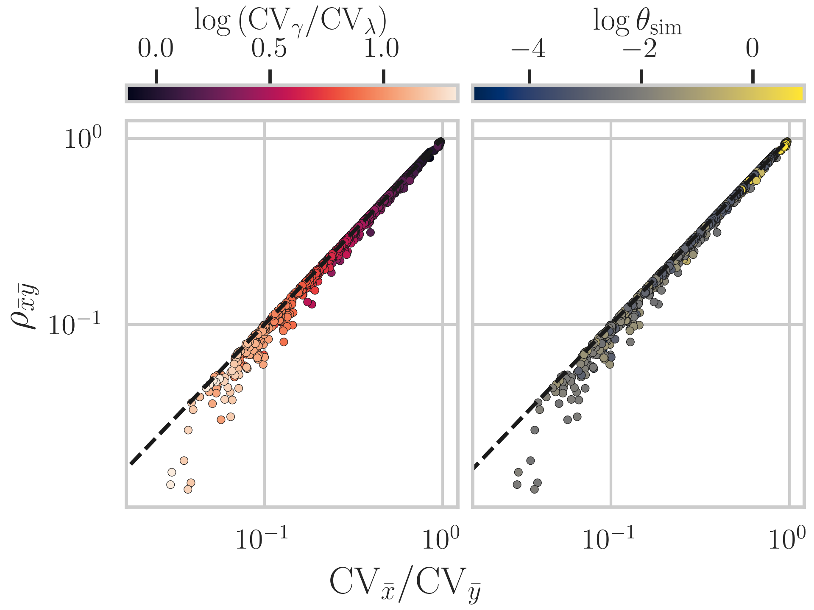
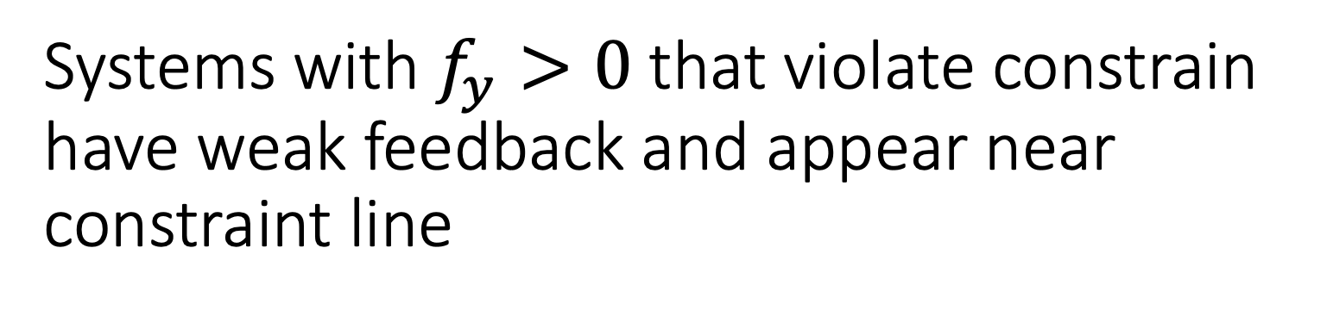
Systems with $f_{y}>0$ that violate constrain have weak feedback and appear near constraint line
Notes:
Looking at violators specifically: the positive fy systems came from systems where feedback was very small: this suggests numerical error+small non linear deviations cause a slight reduction in correlation

Slide 38
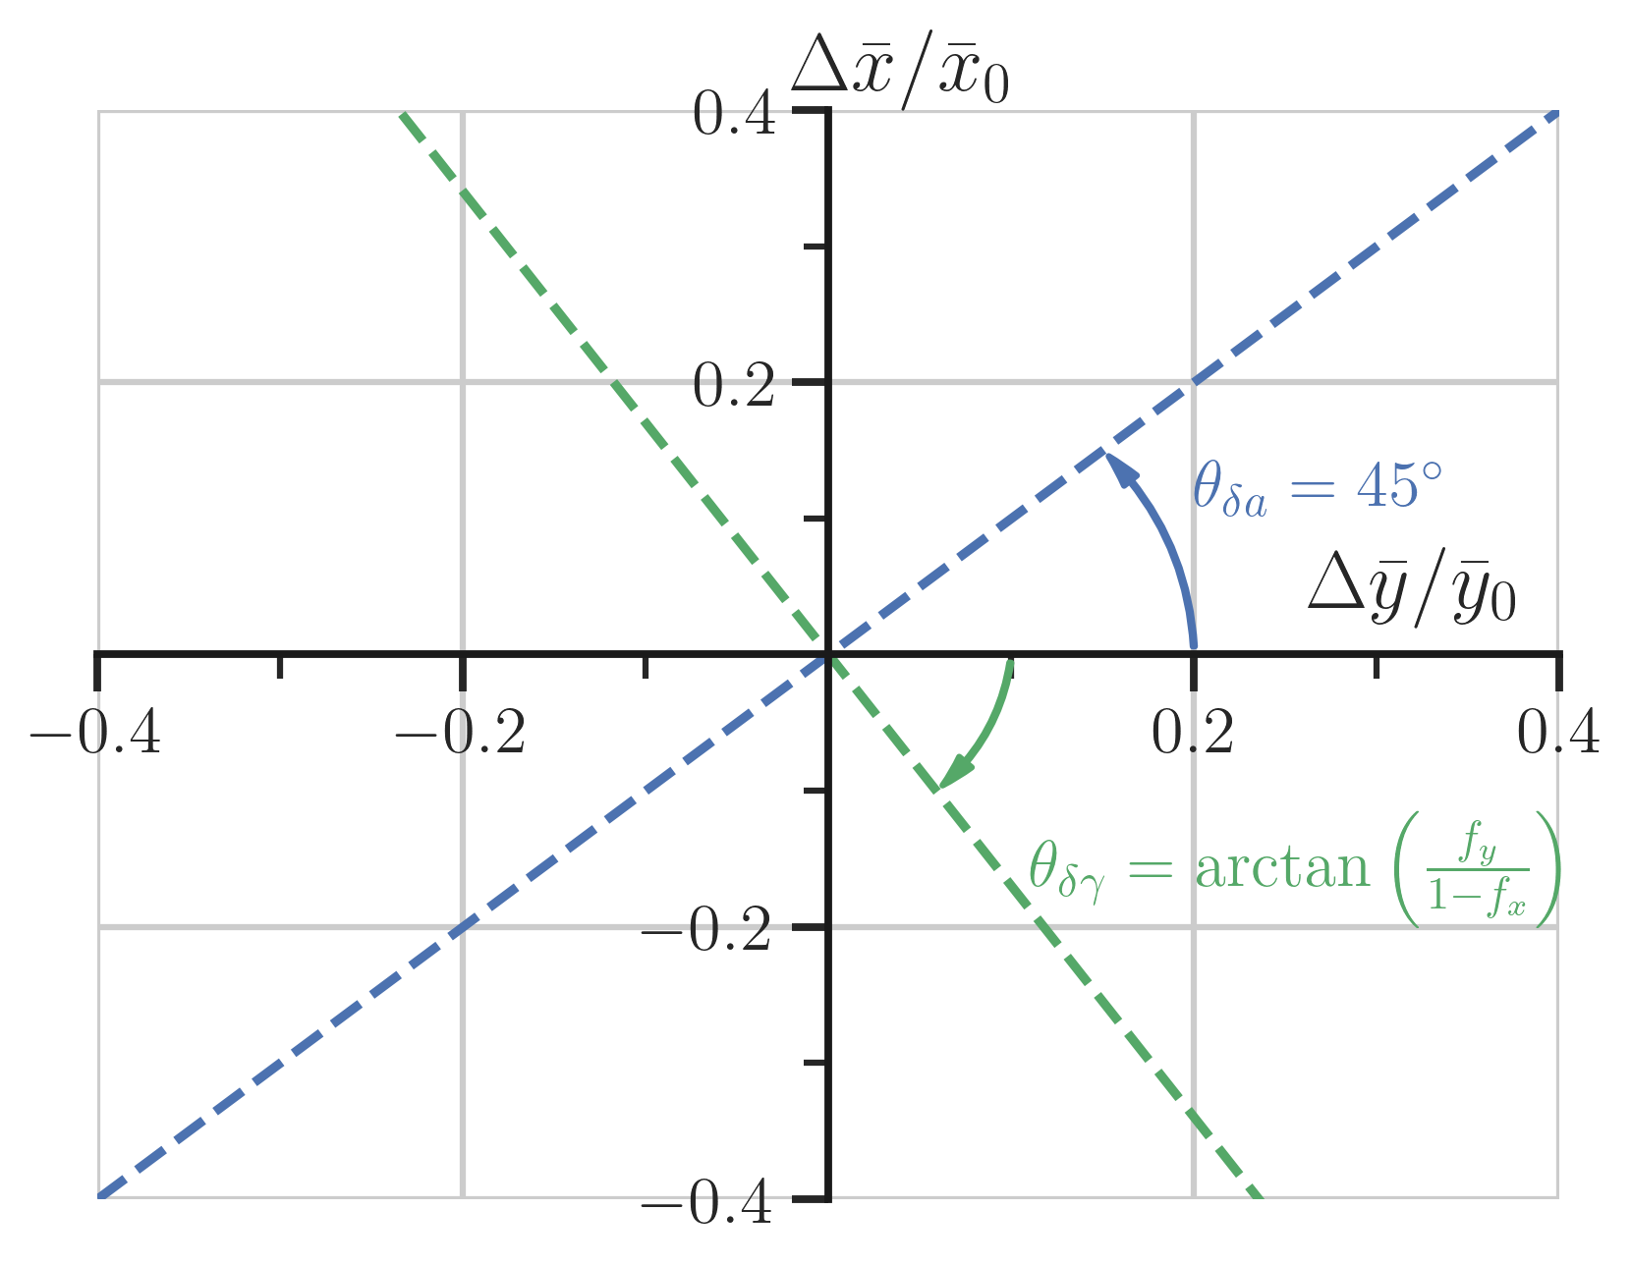
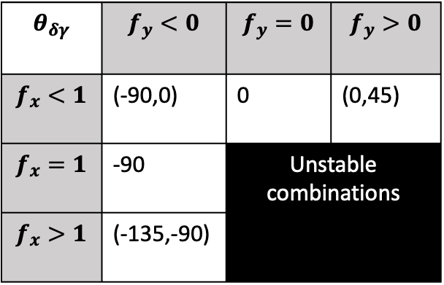
Hit one parameter: “linear response” constrains feedback
Feedback “sensitivity”
$$θ_{δγ}$$ | $$f_{y}<0$$ | $$f_{y}=0$$ | $$f_{y}>0$$
$$f_{x}<1$$ | (-90,0) | 0 | (0,45)
$$f_{x}=1$$ | -90 | Unstable combinations
$$f_{x}>1$$ | (-135,-90)
How to account for ‘random’ perturbations?
Notes:
Namely we can identify the sensitivity of the x dynamics to feedback in x and y respectively. By using a linear expansion you can show that perturbations to lambda will all land on the blue line of this fold-change plot, and perturbations to gamma will land on the green one. And the angle that green line sits at actually determines one of five stable combinations of feedback sensitivities: in fact every angle is associated to a specifc ratio of the sensitivities.
But only works if perturbations hit just one of the two parameters: what if a set of perturbations is ‘random’, and potentially includes cases where both hit?

Slide 39
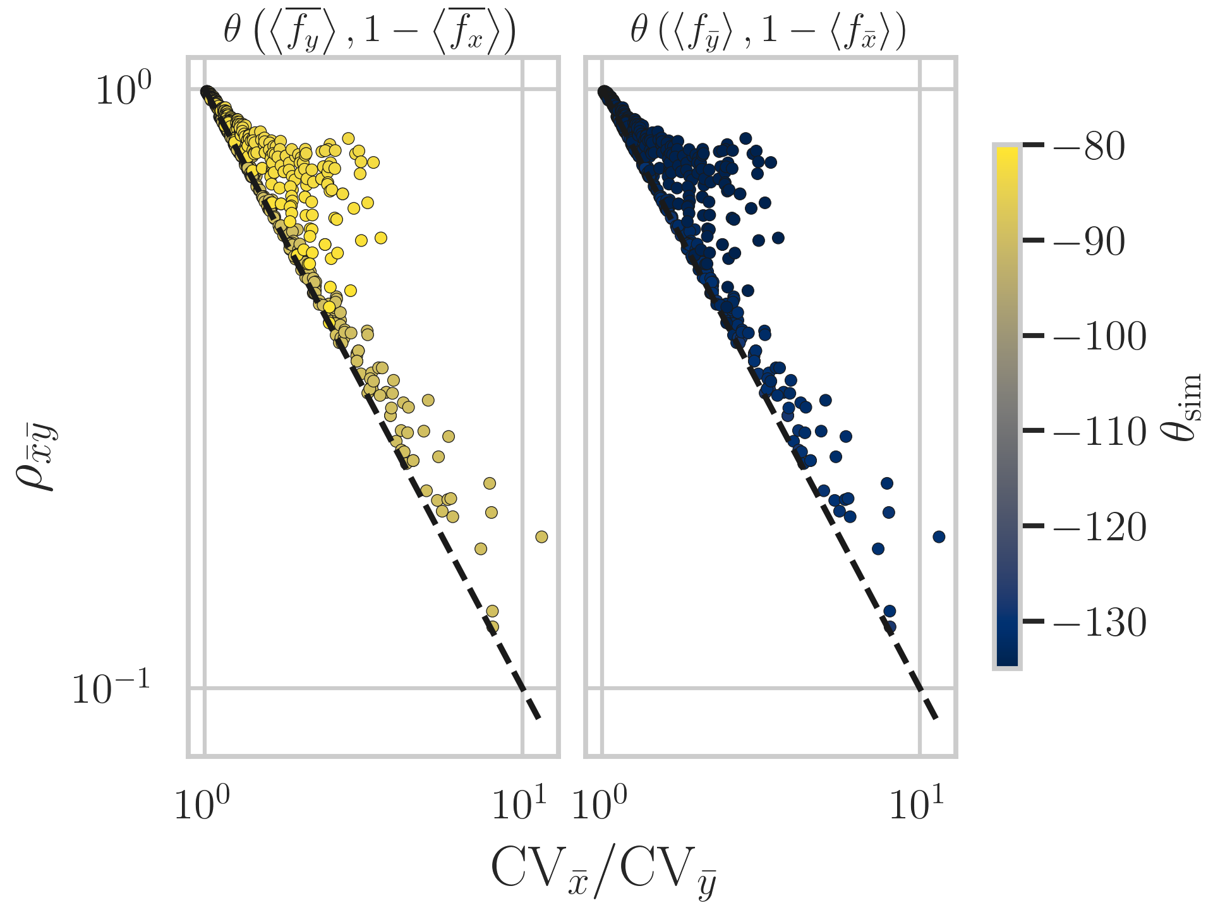
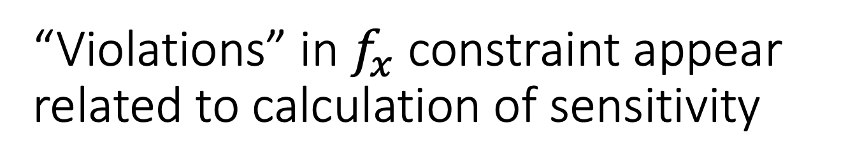
“Violations” in $f_{x}$ constraint appear related to calculation of sensitivity

Slide 40
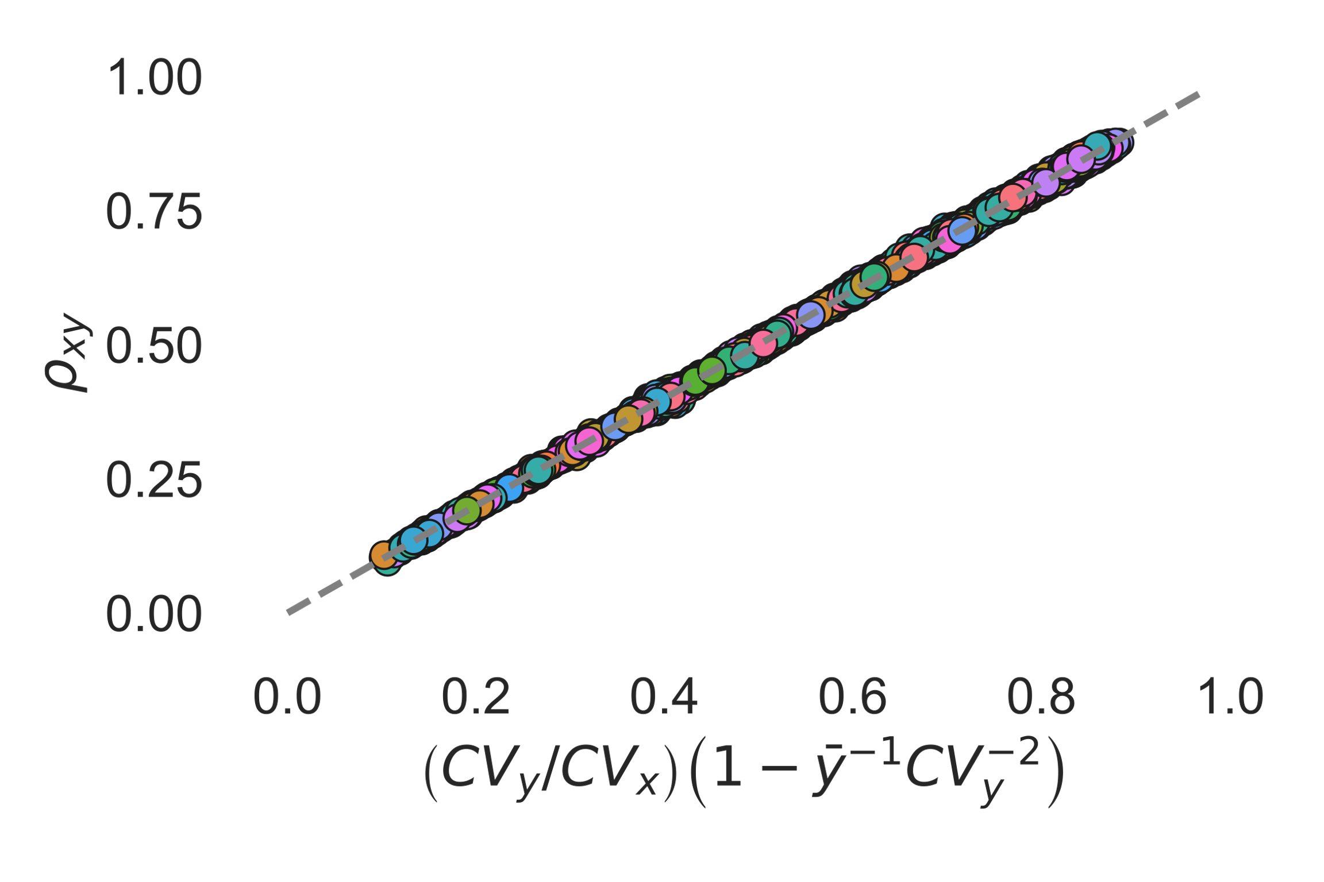
Incompletely specified stochastic systems still obey certain constraints on their correlation
Model: Stochastic Gene Expression
If a measurement lands here, system inconsistent with this class of model!
Hilfinger, Andreas, et al. Cell Systems 2.4 (2016).
Notes:
In practical terms, this means that if you were to measure the stochastic correlation of mRNA and protein, alongside the relevant coefficients of variation and average levels, you could ‘check’ whether the data was consistent with a model of translation that featured linear translation rates. For example, the added orange dot could not be generated by the sketched class of models, providing us information on the physical interactions in the cell.

Slide 41
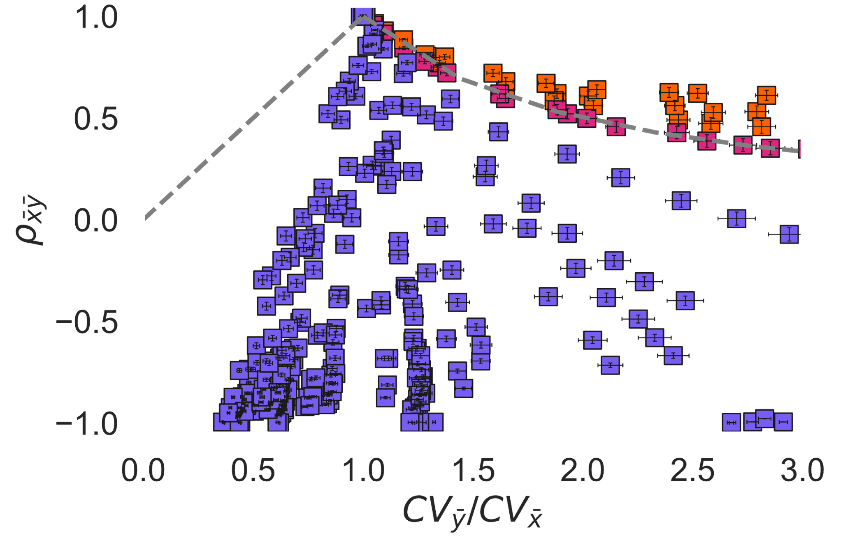
Perturbation response correlations are linked to variation of molecular averages by physical model of system
Verify consistency with linear translation
Infer feedback assuming linear translation model
Notes:
So the overall message I’d like to leave you with is that perturbation response correlations are linked to the variation of molecular averages under that perturbation: and that link is related to the physical interactions in the system. One aspect that emerges is the sometimes overlooked point that the responses to perturbation and the stochastic behaviour of the system are not identical in biological systems. This can be seen in the plot of the stochastic constraint and the perturbation constraint here. This information being different is useful for much more than just an academic curiosity: as my colleague Euan will shortly discuss, they can tell you completely different things. However they can be synergistic.

Slide 42

Perturbation response correlations are linked to variation of molecular averages by physical model of system
Verify consistency with linear translation
Infer feedback assuming linear translation model
Notes:
If you measured stochastic mRNA and protein levels in the unperturbed system and calculated the relevant statistics, you can use that information to verify consistency with a linear translation model by seeing if it falls on the plotted line, like the green dot here does.

Slide 43
Perturbation response correlations are linked to variation of molecular averages by physical model of system
Verify consistency with linear translation
Infer feedback assuming linear translation model
Notes:
Then, by performing a perturbation experiment you can now infer the type of feedback the protein has on its mRNA, even without specifying the ‘how’ or ‘what’ modulates that feedback. And so, for example, our green dot is consistent with a system that has linear translation and positive feedback from protein to mRNA

Slide 44
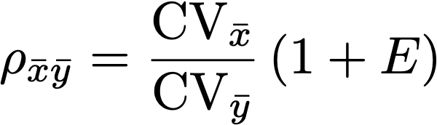
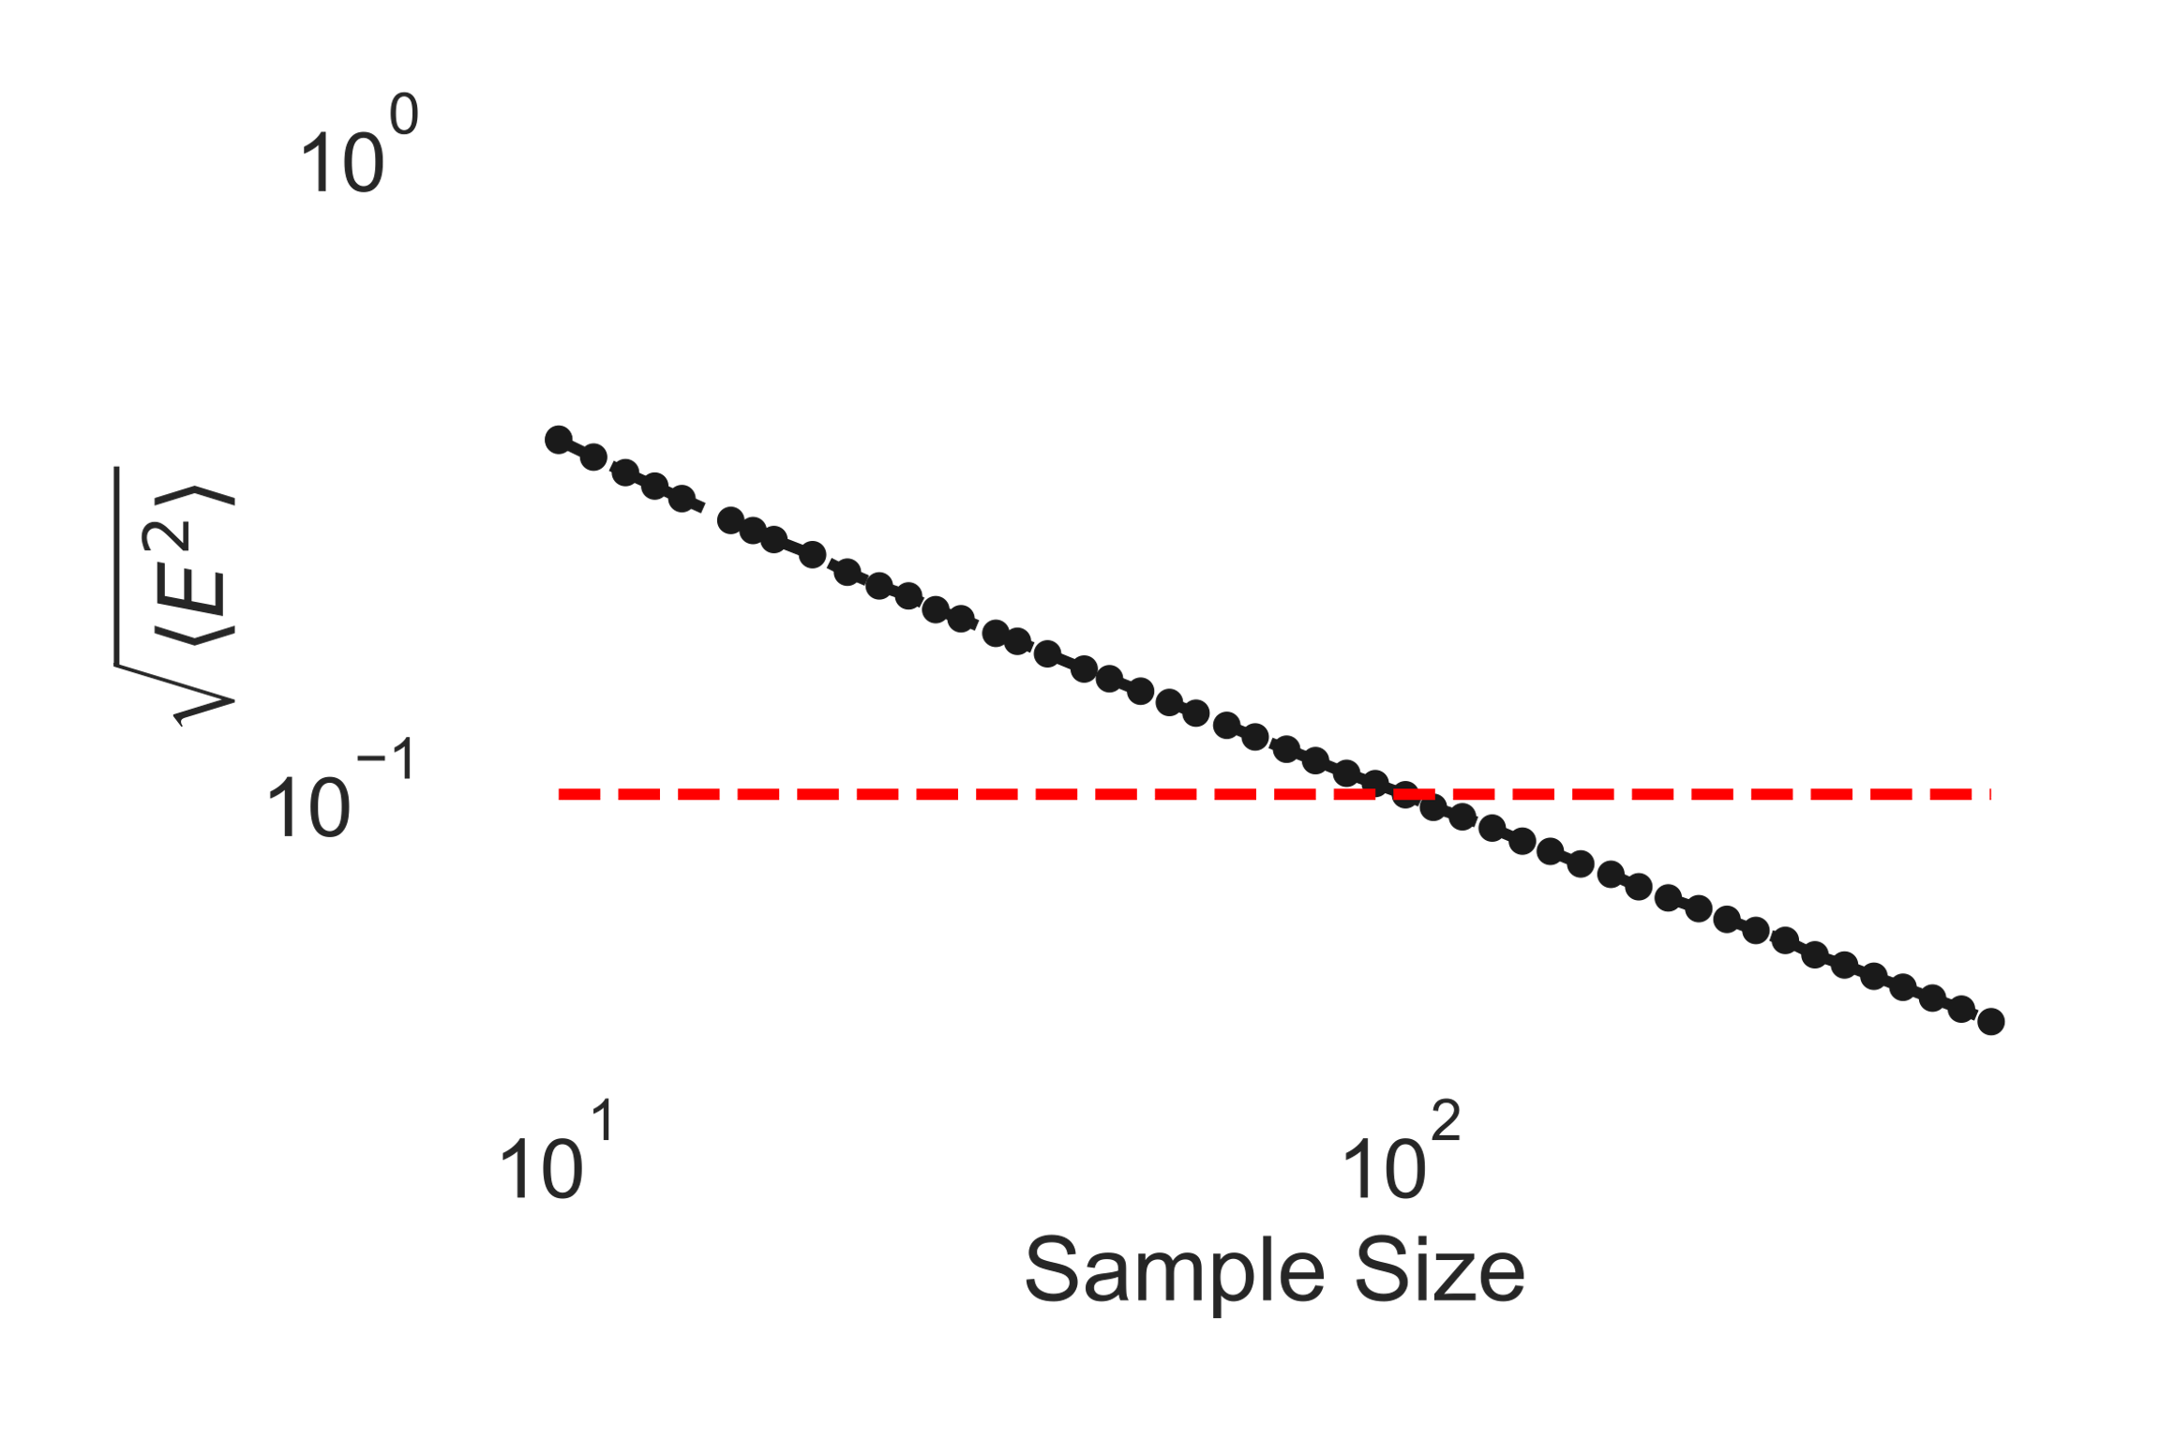
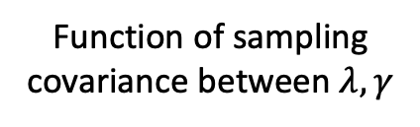
Reducing ‘error’ below 10% requires ~100 samples
Function of sampling covariance between $λ,γ$
Notes:
We can use numerically calculated examples to get some idea of how much sample covariance matters. First, we can separate the contribution to the measured correlation from the sample covariances into an ‘error’ term depending on them. Then, we can see what the root-mean-square value of this term is for a perturbation distribution of choice. On this plot, I use the example where a and b are drawn from identical uniform distributions with support on 0.8 and 1.2. For each sample size, I draw 10000 replicates and calculate the rms value. In this case, the error term hits 10% more or less at 100 exactly. In other cases the exact value might be higher or lower depending on the characteristics of each distribution. However the crucial point is that many, many might be samples needed for reasonable sounding perturbations: much more than the classic n=30 guess. This supports the case for large-scale perturbation studies like the prior mentioned signalome , as they may have the needed scale to overcome error due to sampling covariance and use the predicted bounds.

Slide 45
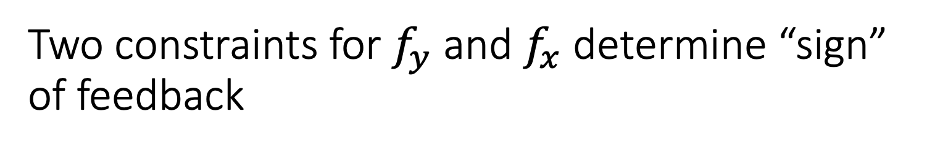
Two constraints for $f_{y}$ and $f_{x}$ determine “sign” of feedback
Notes:
Specifically, they form two constraints. First is when the correlation is equal to the CV ratio.
Points above positive feedback
On line no y feedback
Below line negative y feedback
Similarly, for x feedback a constraint exists for when the correlation is the reciprocal.
Above is greater than 1
On is equal
Below is less.

Slide 46
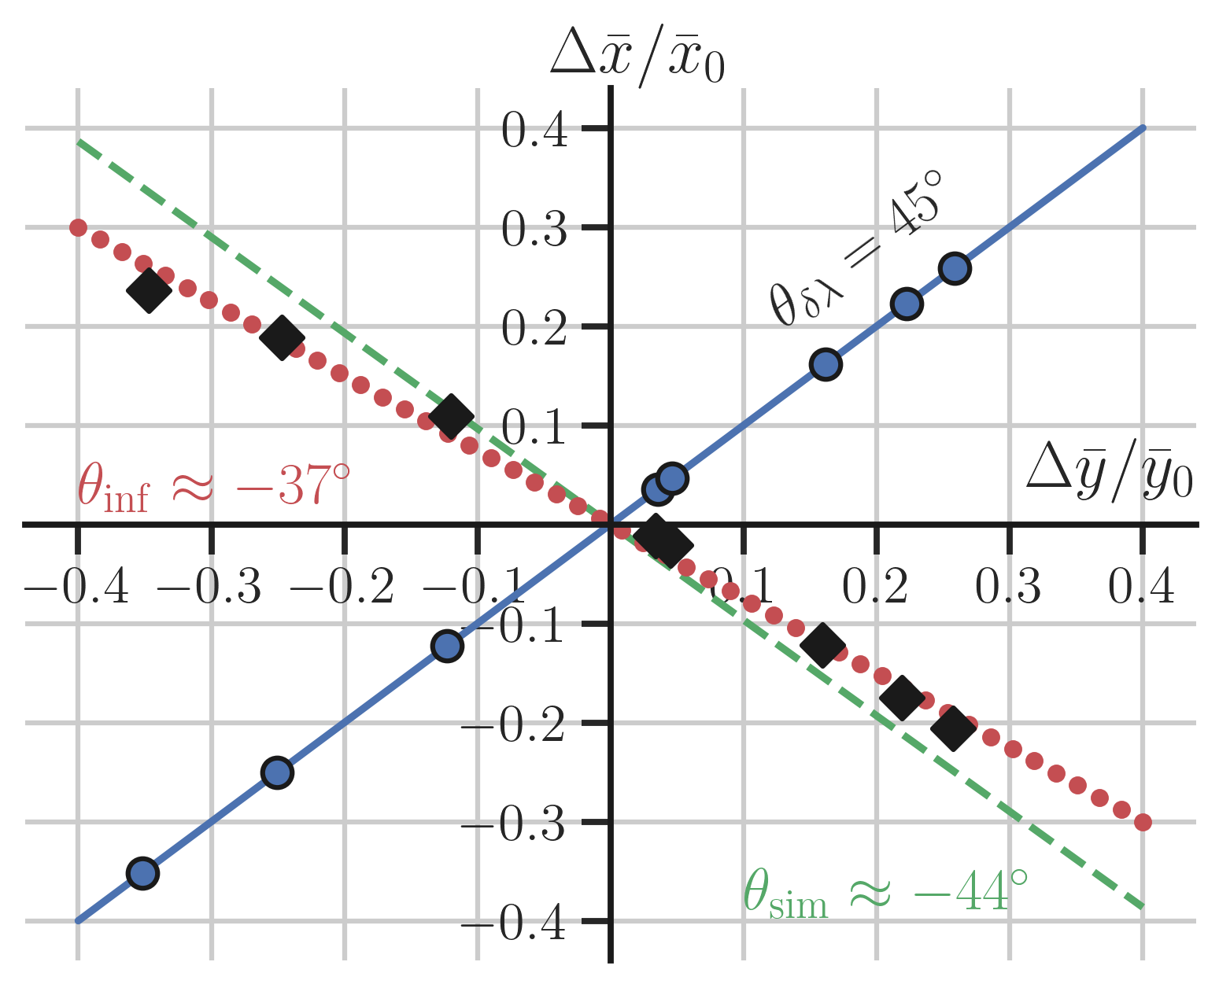

Non-linear, stochastic systems deviate for finite perturbations to $γ$
Notes:
But first assumption a problem: under finite perturbation non linear stochastic systems deviate from prediction. Here markers show results of perturbations to a simulated system. While lambda perts exact, the black diamonds (which ar egamma perts don’t land on the green line, which is where they should based on simulated feedback strength. If you fit a red line, you’d get a slightly different value for strength than simulated (here category same)

Slide 47


Systems land on curves based on relative feedback sensitivities
All curves start at $\left(1,1\right)$
Curves shared by systems with same
End at CV ratio equal to
With a correlation of
Notes:
Under these conditions, systems actually land on
Curves defined by the ratio of the sensitivities
All system curves start at the point (1,1), and end at a CV ratio defined by their relative sensitivity strength, with a correlation determined by the signs of the two sensitivities.

