Slide 1
The future of optical quantum information :
Farther, Better, Slower, Stronger
Deny Hamel
CAP Congress 2023
QSTATE Symposium

Slide 2
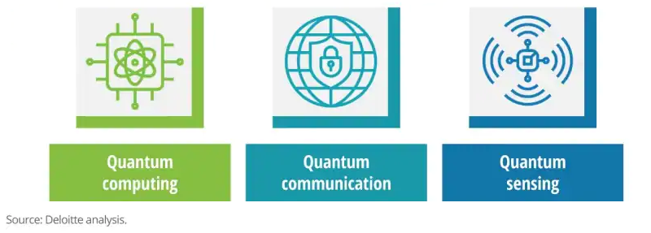

Slide 3
What makes photons good?
Fast
Don’t interact much
Can be sent very far
Easy to create

Slide 5
What makes photons good?
What makes photons bad?
Fast
Don’t interact much
Can be sent very far
Easy to create
Fast
Don’t interact much
Can’t be sent very far
Not so easy to create

Slide 6
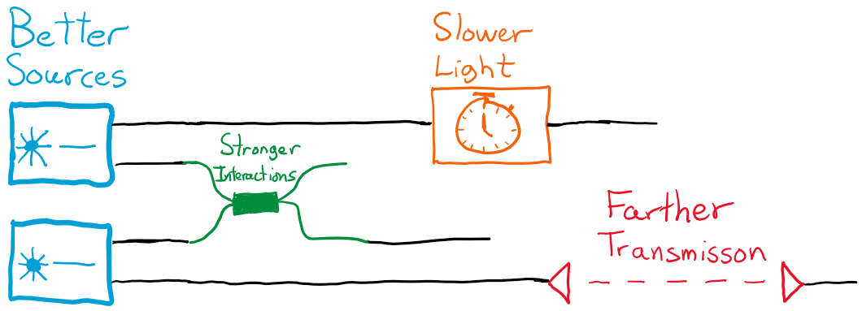
We want photons to go:
Farther, Better, Slower, Stronger

Slide 7

Better sources
On demand Heralded Probabilistic Post-selected
1
2
3
4+

Slide 8

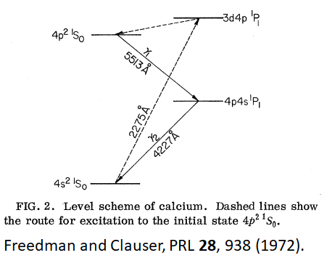
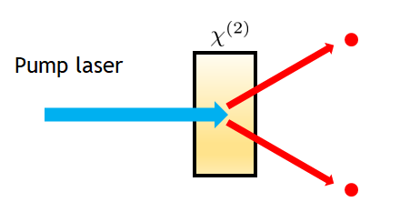
Better sources
On demand Heralded Probabilistic Post-selected
1
2
3
4+

Slide 9
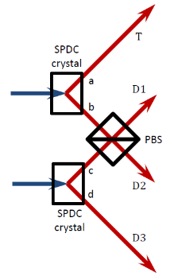
Better sources
On demand Heralded Probabilistic Post-selected
1
2
3
4+
N/A

Slide 10
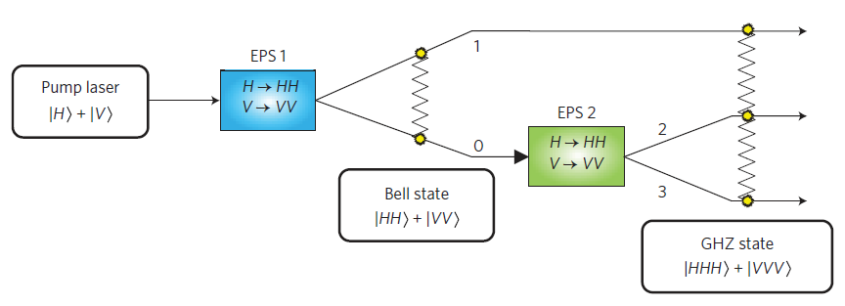
Better sources
On demand Heralded Probabilistic Post-selected
1
2
3
4
N/A
Hamel et al. Nat. Photonics 8, 801 (2014).

Slide 11
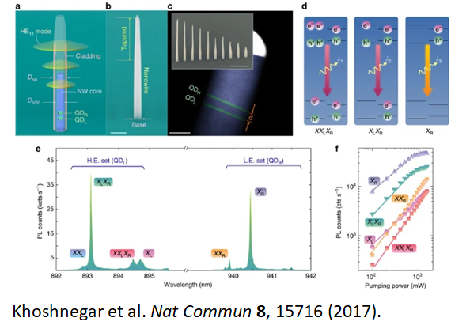
Better sources
On demand Heralded Probabilistic Post-selected
1
2
3
4+
N/A

Slide 12
Better sources
On demand Heralded Probabilistic Post-selected
1
2
3
4+
N/A
Notes:
Higher brightness
Better fidelity
More indistinguishable

Slide 13
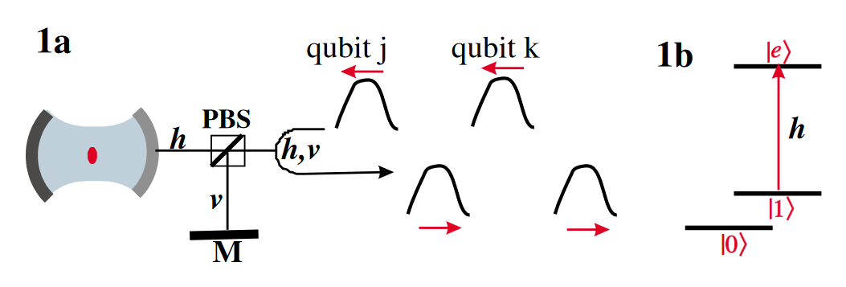
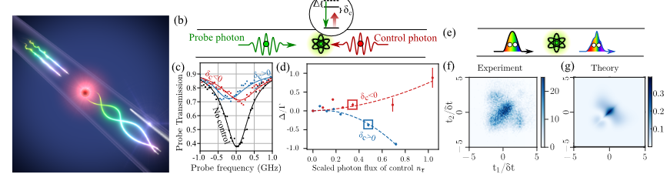
Stronger interactions
Duan and Kimble, PRL 92, 12, (2004).
Le Jannic et al. Dynamical photon–photon interaction mediated by a quantum emitter. Nat. Physics 18, 1191 (2022).
Notes:
Promising results from the field of waveguide quantum electro dynamics.

Slide 14
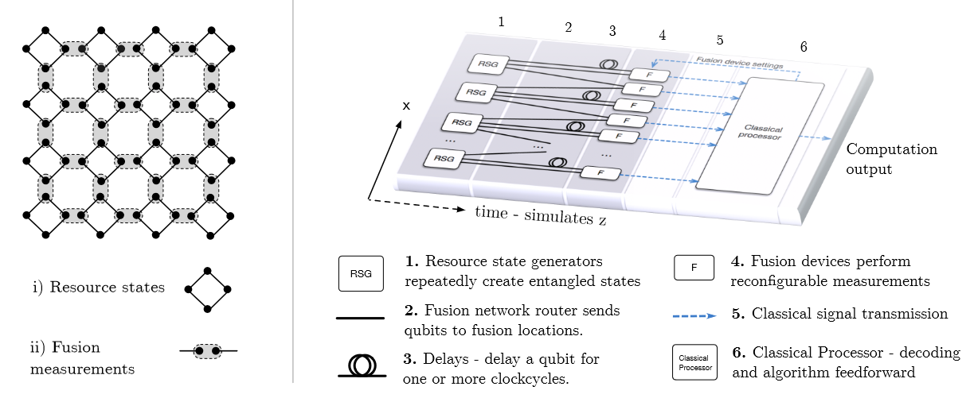
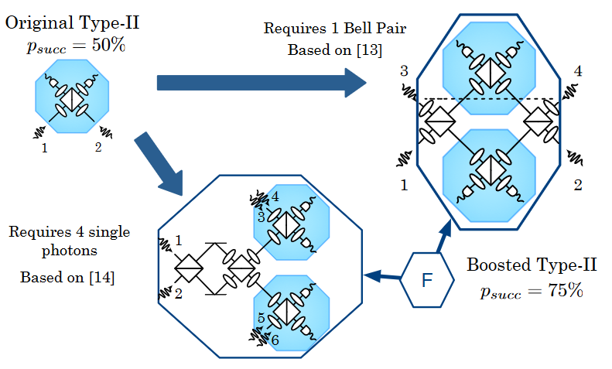
Stronger interactions : cluster state quantum computation
Gimeno-Segovia et al, PRL 115, 020502 (2015)
Bartolucci et al. Nat. Communications 14, 912 (2023)
Notes:
Psi-Quantum’s approach : fusion gates to turn several copies of a small resource state into a large cluster state.

Slide 15
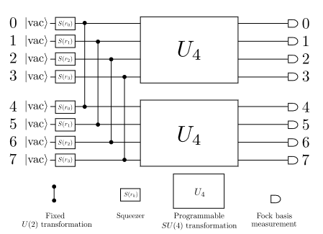
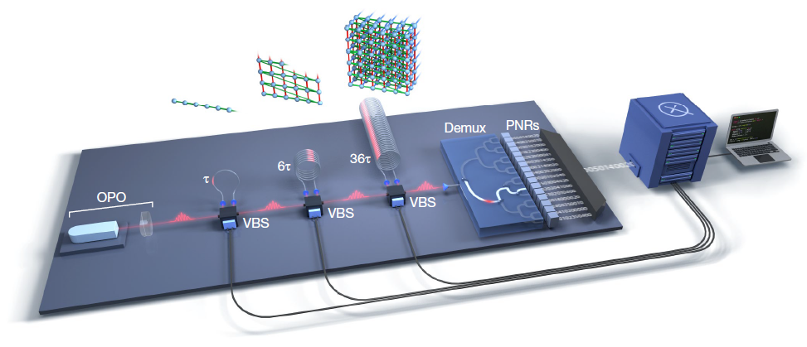
Stronger interactions : switch the paradigm
Arrazola et al. Nature 591, 54 (2021).
Madsen et al. Nature 606, 7912 (2012).
Notes:
Xanadu’s approach : avoid the need for interactions between single photons by using Gaussian states.

Slide 16

Slower photons : Quantum memories
Control
mechanism
Input photon
Output photon

Slide 17
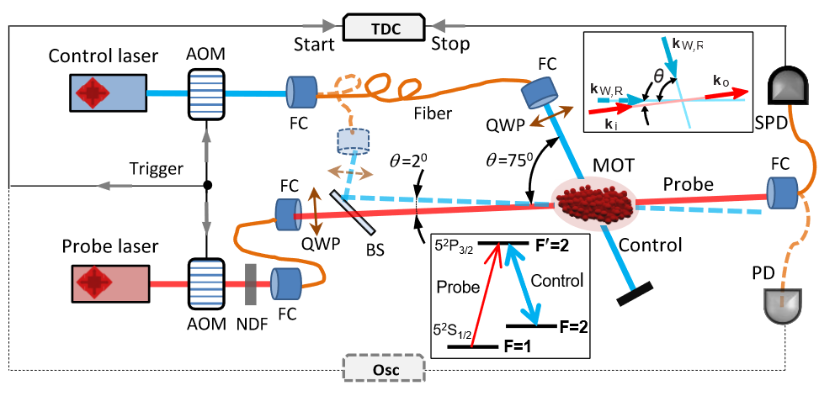
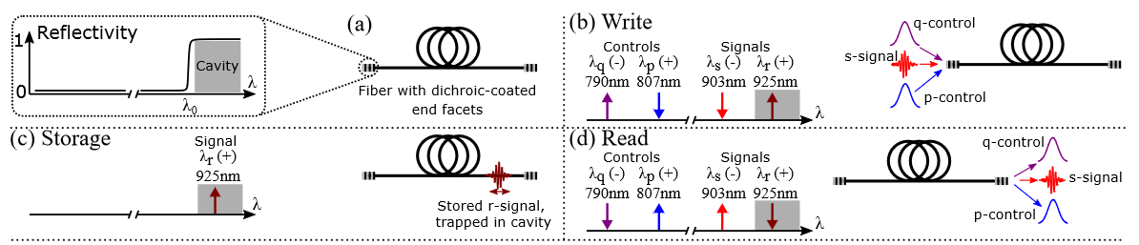
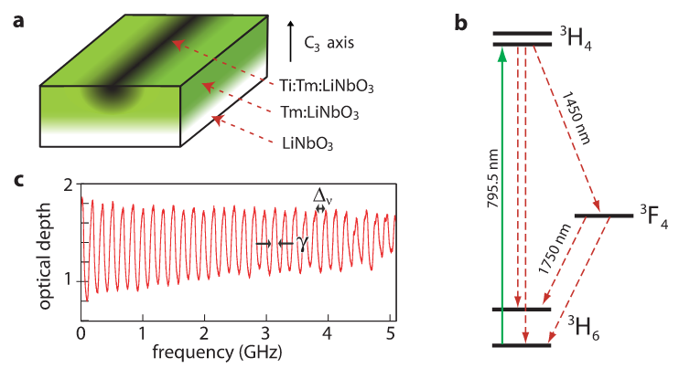
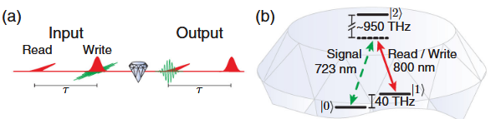
Slower photons : Quantum memories
Atomic vapors
Cavities
Bustard et al. PRL 128, 120501 (2022).
Saglamyurek et al., PRR 1, 022004(R) (2019).
Rare-earth doped solids
Diamond color centers
D. England et al. PRL 114, 053602 (2015).
Saglamyurek et al. PRL 108, 083602 (2012).
Notes:
Challenges are to get:
- longer storage times
- high bandwidths
- good retrieval rates.

Slide 18
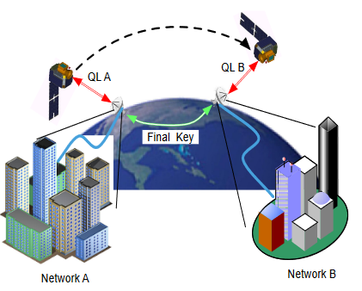
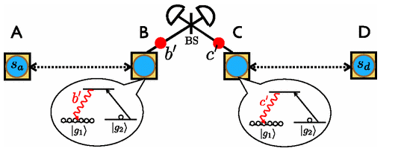
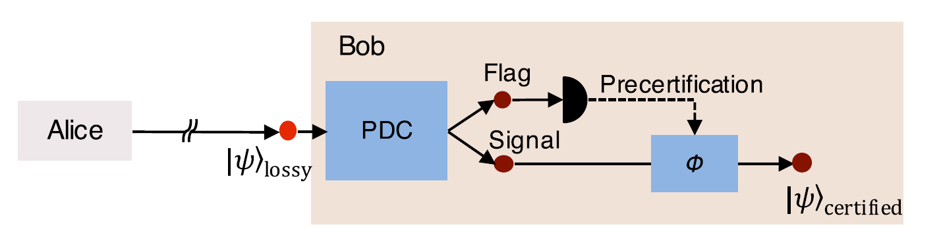
Farther transmission
Satelites
Quantum repeaters
Sangouard et al. Rev. Mod. Phys. 83, 33 (2011).
Photon precertification
Jennewein et al. In Advances in photonics of quantum computing, memory, and communication VII, vol. 8997, pp. 21-27. SPIE, 2014.
Meyer-Scott et al. PRL 116, 070501 (2016)

Slide 19

The future of optical quantum information

