Slide 1

Beamline for Schools 2022
A Physics Competition for
High-school Students
Margherita Boselli
Teacher and Student Forum,
September 27, 2022

Slide 2



Competition Overview
2014
2018
2021
  Goal: bringing young people from all over the world close to the fundamental research in particle physics. Learning by doing.
In 2022 the competition came back to CERN but the collaboration with DESY, started in 2018, continues.
DESY hosts an extra winning team
​
27/09/2022
M. Boselli | BL4S

Slide 3
Competition Overview
304 proposals from
Teams representing
71 countries!
Number of Proposal
Edition
27/09/2022
M. Boselli | BL4S
3

Slide 4


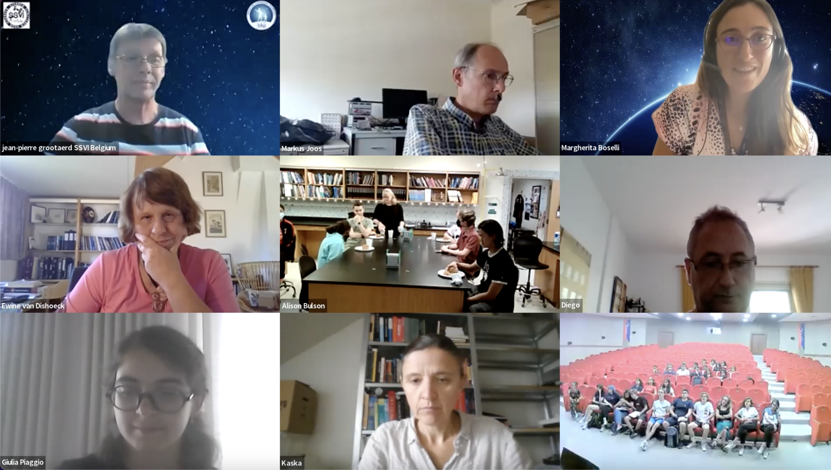
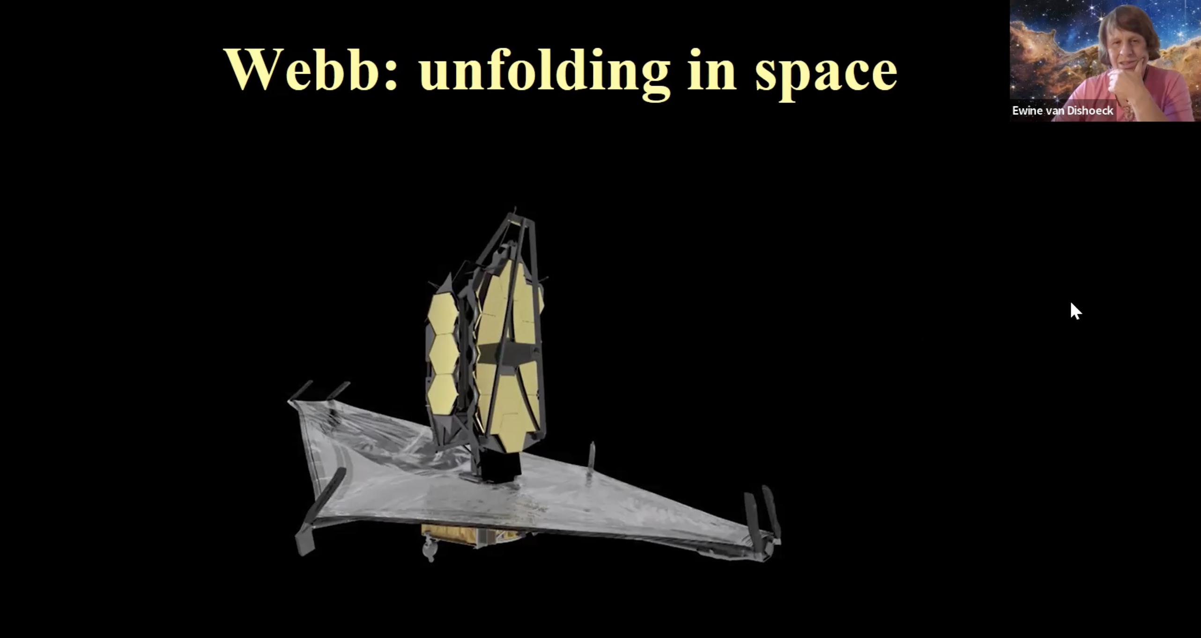
An opportunity for all the participants
2123 students took part in the competition (59% m, 41% f) but only a tiny fraction will come to CERN. Providing constant support and extra-curricular opportunities to most of them is crucial!
We organized 9 online events (almost one per month) including: a meeting between perspective participants and former winners), Virtual Visits of CERN facilities, a Q&A session on the Higgs Discovery (July 4) with Prof. Philip Clark and Dr. Frederik VAN DER VEKEN and a seminar on the James Webb Telescope given by Prof. Ewine Fleur van Dishoeck from the Leiden Observatory.
27/09/2022
M. Boselli | BL4S

Slide 5
Winners
3 winning teams, 2 hosted at CERN and 1 at DESY
21 team have been shortlisted and one got a prize for the best video, they will receive t-shirts, BL4S USB keys, DIY particle detectors.
6 teams got an award for the best outreach proposal, news in 2022!
The teams were invited to suggest an outreach activity to share with their communities what they learnt through the participation in BL4S.
Have a look!
27/09/2022
M. Boselli | BL4S

Slide 6
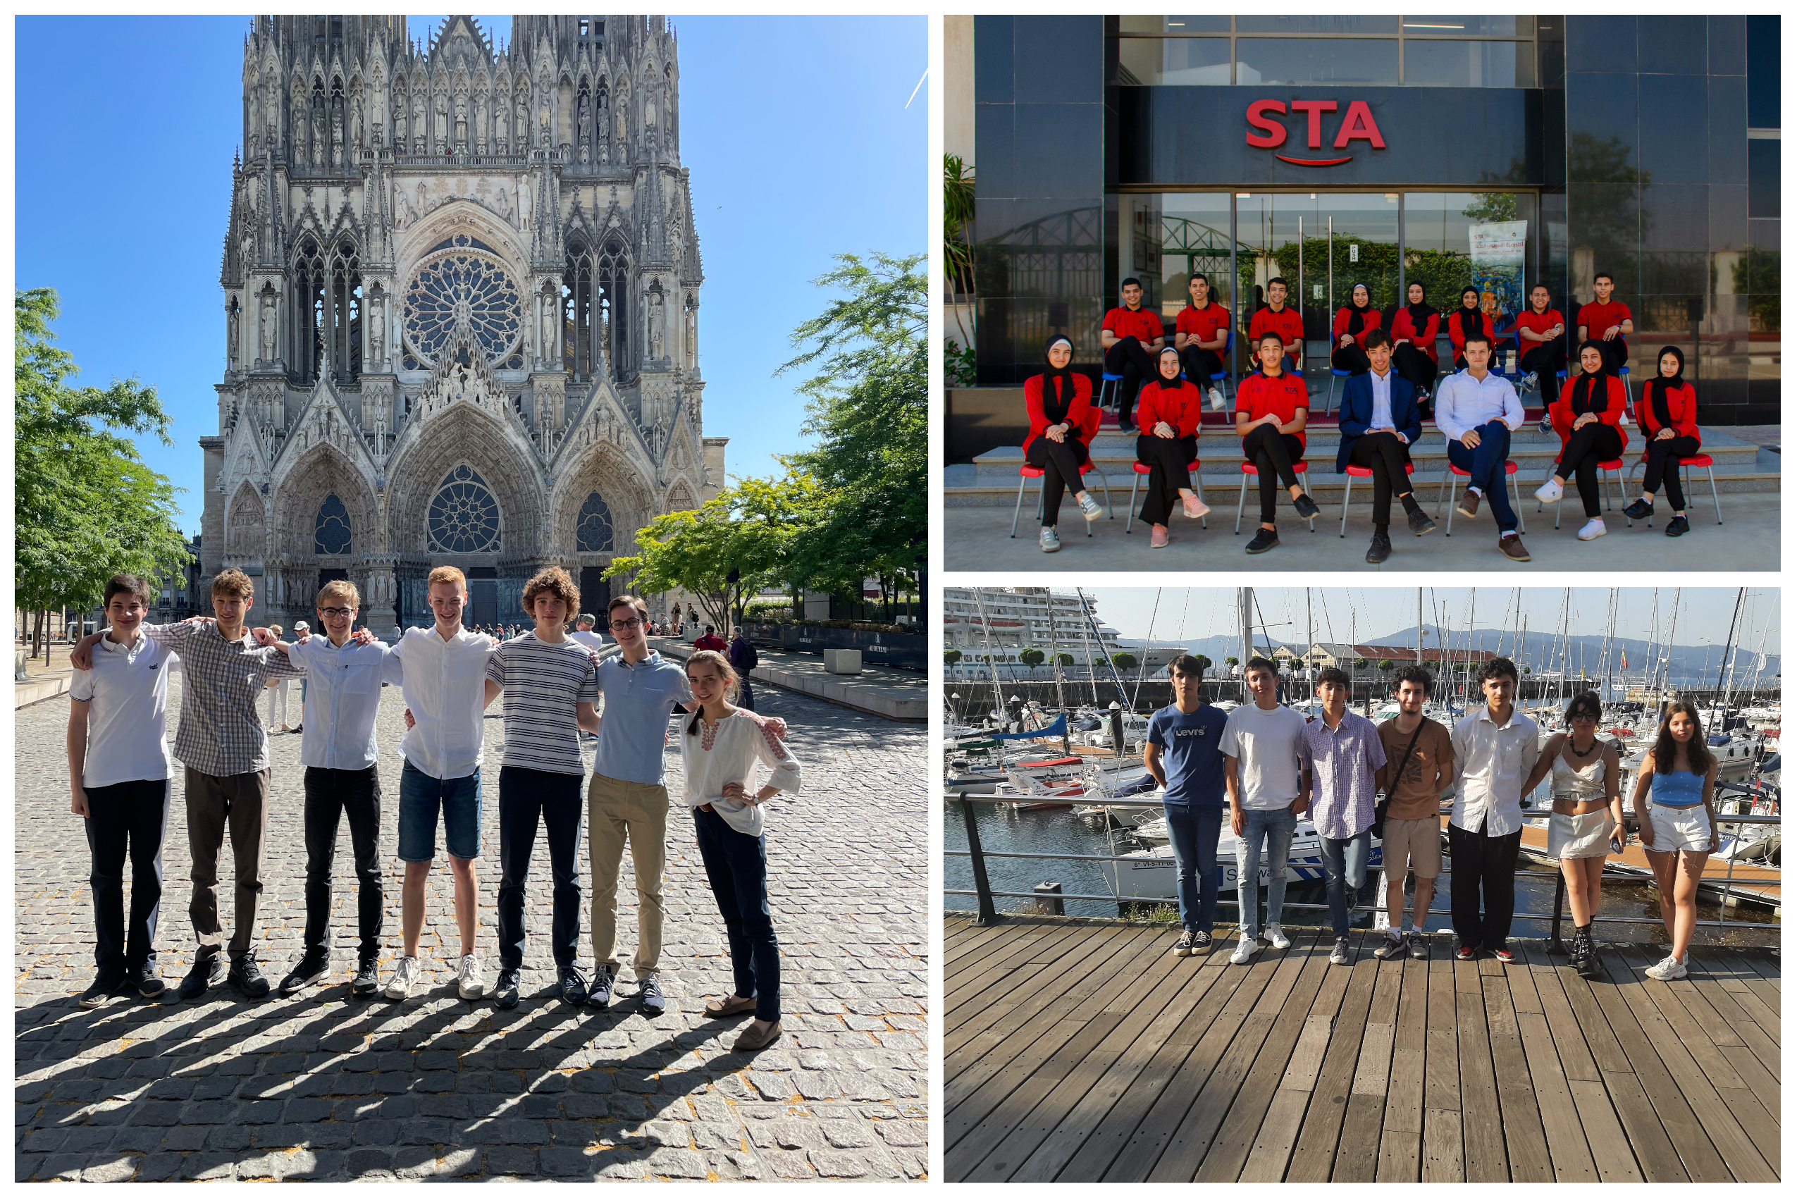
27/09/2022
M. Boselli | BL4S

Slide 7
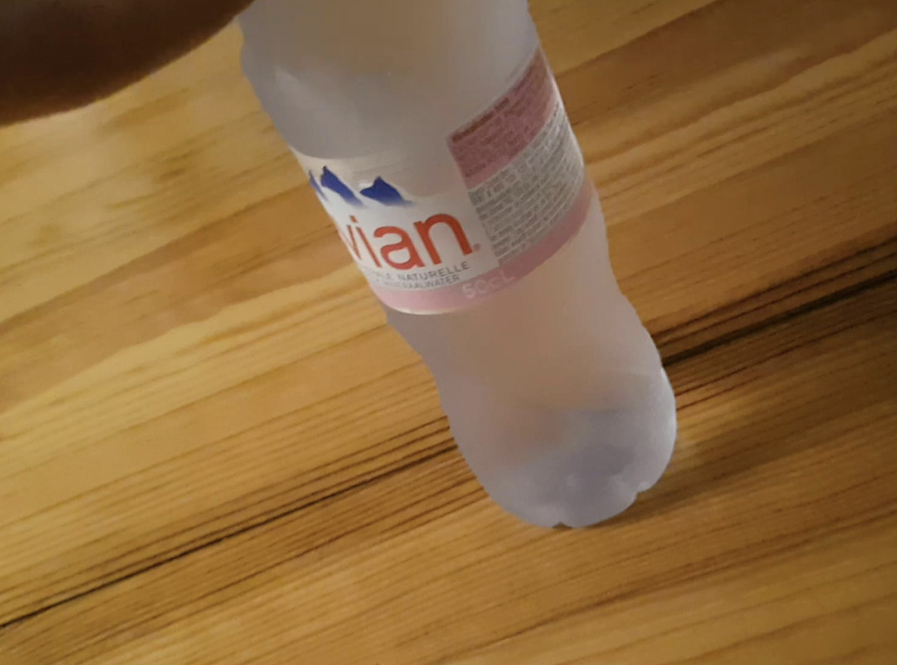
Supercooling Team
Ecole du Sacré Coeur, Reims, France.
Goal: Using water in the supercooling phase to detect particles.
27/09/2022
M. Boselli | BL4S

Slide 8
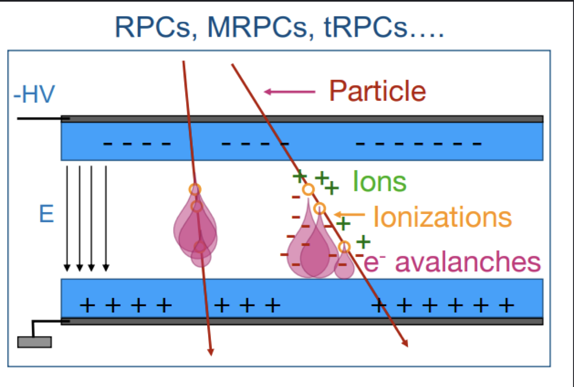
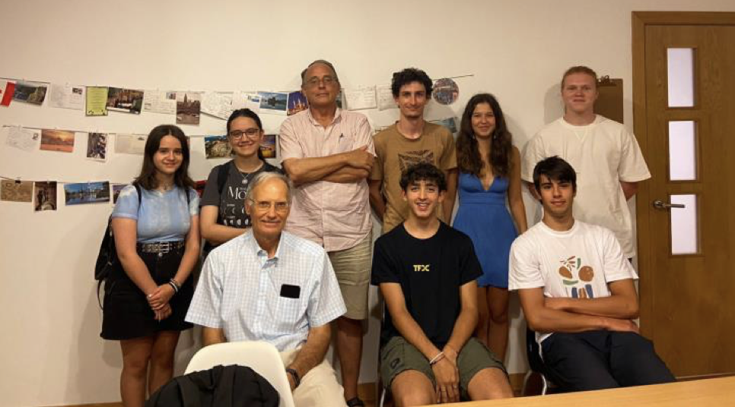
Fermi Team
Club de Fisica Enrico Fermi, Vigo, Spain
Goal: Correlate the mass of particles with the charge deposited in MRPCs (Multi-resistive Plate Chambers).
27/09/2022
M. Boselli | BL4S

Slide 9
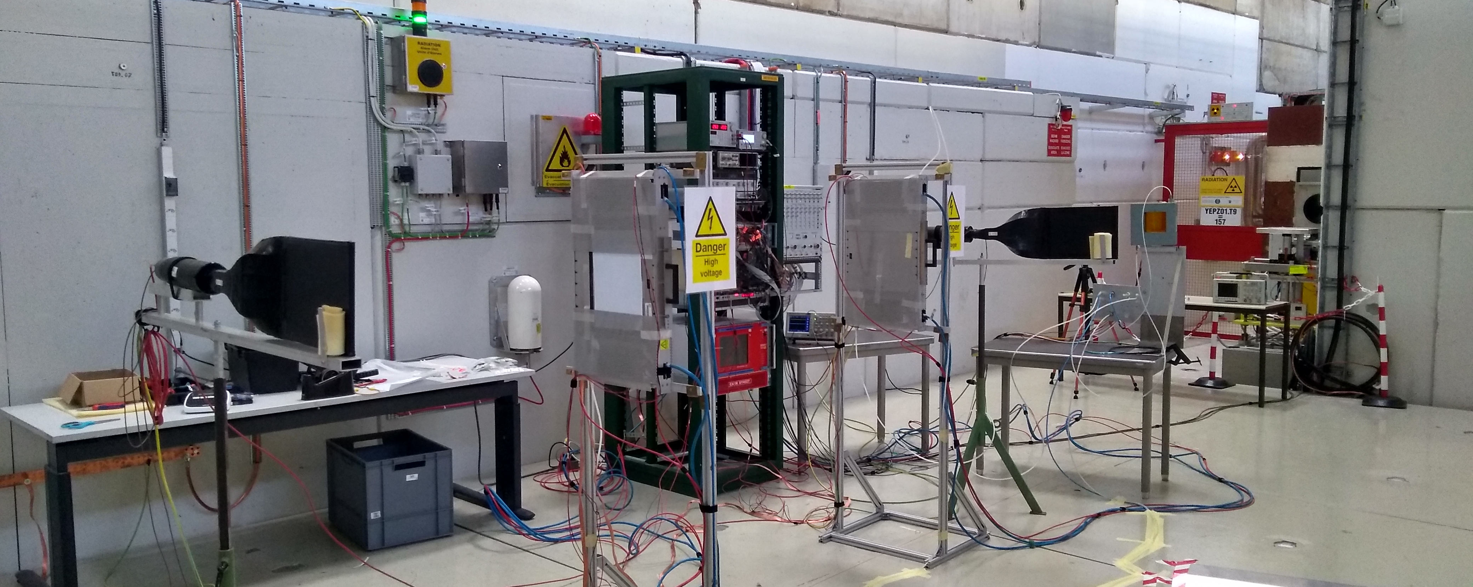
Fermi Team
ElSewedy Technology Academy, Cairo, Egypt
Goal: Study the efficiency of MRPCs (Multi-resistive Plate Chambers) using environmentally friendly (low GWP) gas mixtures.
27/09/2022
M. Boselli | BL4S

Slide 10
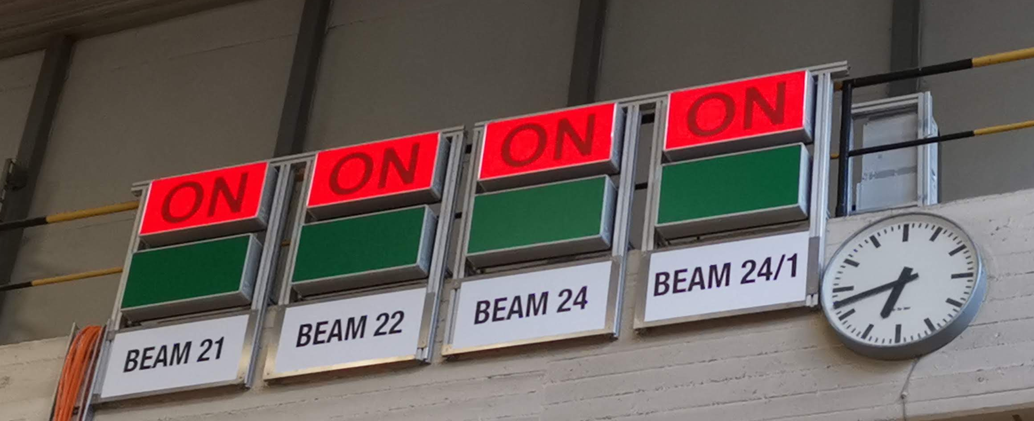
Beamtime at CERN and DESY
Between Wednesday September 21 and October 4 the teams are at CERN and DESY
VIP day – hybrid
Cultural Exchange
Experiments
27/09/2022
M. Boselli | BL4S

Slide 11
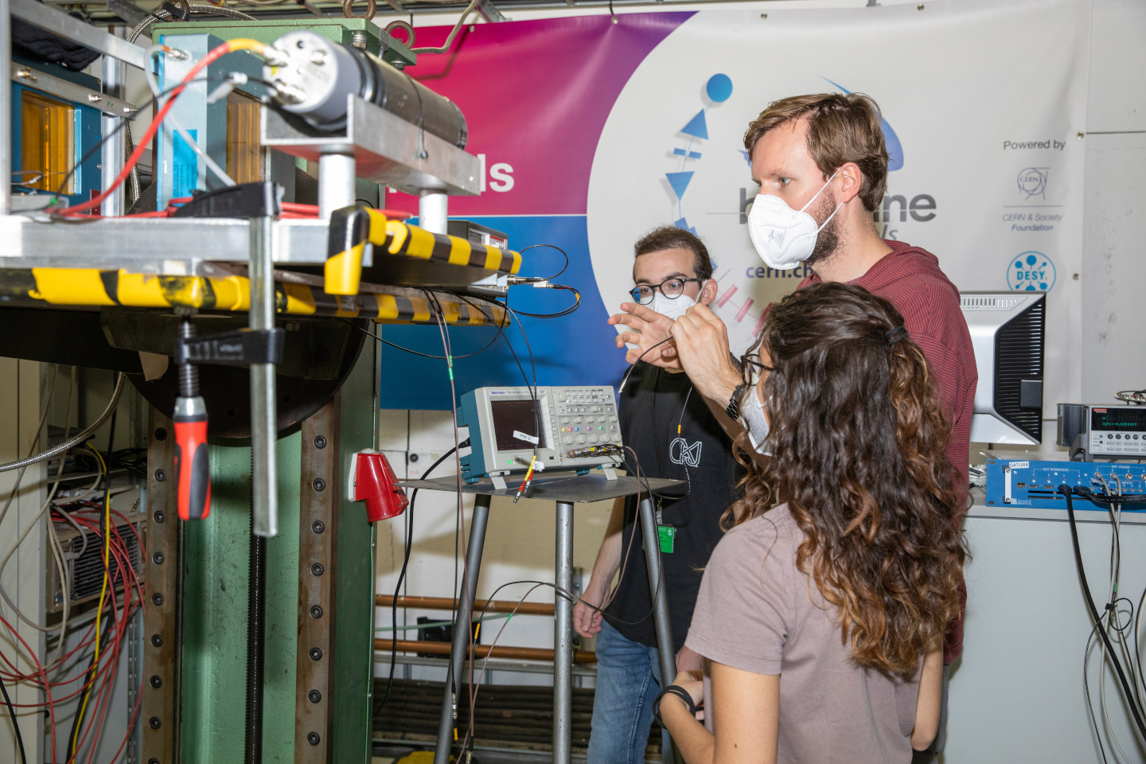
Next Edition
We will open the registration to Bl4S 2023 soon!
The format should be the same: two teams at CERN and one at DESY.
Don’t hesitate to share the information:
cern.ch/bl4s
27/09/2022
M. Boselli | BL4S

Slide 12


To conclude:
HSSIP finished in 2022
Italy - Spring 2022
Serbia - Spring 2022
margherita.boselli@cern.ch
bl4s.team@cern.ch
Thanks a lot for your support!

