Slide 1


Students’ Types of Interest in Physics
Sarah Zoechling
Martin Hopf | University of Vienna, AT
Julia Woithe and Sascha Schmeling | CERN, Geneva, CH
sarah.zoechling@cern.ch
Notes:
Hello everyone, Thank you very much for the nice introduction. My name is Sarah and I am a PhD student in Physics Education Research at the University of Vienna. I am working at CERN, the European Laboratory for Particle Physics. And as you can already tell from the title of my talk today, in my PhD project, I did a study about students’ types of interest in physics.

Slide 2
Most students can be categorised into one single type of interest in physics
Notes:
And by the end of this talk you will know the surprising result of this study. That is, in contrast to previous findings and to our hypotheses most students can actually be categorised into one single type of interest in physics.

Slide 3
Theoretical and Empirical Background
Notes:
So let’s start with the theoretical and empirical background of my research.

Slide 4


Interest in Physics
Interest
“… most studies report a positive effect of context-based science education
on students’ interest …”
(Habig et al., 2018)
CONTEXT
Notes:
An object of interest is characterized by its interestingness, as I have illustrated.
When it comes to physics as object of interest, most studies report a positive effect of context-based education on students’ interest. For example, it has been found that human medicine is a very interesting context for most of the student, when teaching physics. KLICK
Therefore, context can be considered as the key to interest in physics.

Slide 5

Types of Interest in Physics
The IPN study describes 2 types of interest
(Sievers, 1999; Rost, Sievers, Häußler, Hoffmann, & Langeheine, 1999)
Generally and highly interested
Highly interested in relation to nature and humans, applications, and relevance for society
Physik!!!
Physics? Only in the right contexts!
Notes:
One important past empirical research is an interest study that was conducted in the 80s by the German IPN institute. The IPN study is the study that is commonly referred to when talking about students’ types of interest in physics. The IPN study distinguishes between 3 types of interest. KLICK
The first type describes students that are generally and highly interested in physics – from learning activites set in a purely scientific context to the relevance for society as context. KLICK
The second type describes students that are highly interested in physics set in contexts that emphasise the relation to nature and humans, applications and the relevance for society. KLICK
The third type describes students whose interest profiles are similar to Type 1 or Type 2 depending on the content area. KLICK
Type 3 is either like type 1 or type 2 depending on the content area. This means that there are basically only 2 types of interest. KLICK
To remember these types better: type 1 students love physics set in all contexts. KLICK
And type 2 students are only interested in physics set in the right contexts.
These two types of interest also cover the interest categories revealed by other past empirical studies, such as the European HOPE study and the international PISA studies.

Slide 6
Research Gap
Previous studies did not …
describe how interesting different contexts are relative to each other within the students’ different types of interest.
include modern physics content areas, such as particle physics.
Notes:
However, previous studies did not describe how interesting different contexts are relative to each other within the students’ different types of interest.
Moreover, they did not include modern physics content areas, such as particle physics.

Slide 7
Research Interest and Design
Notes:
And these research gaps lead us to the research interest and design of my PhD project.

Slide 8
Research Interest
RQ: Into which different types of interest in physics can German-speaking students aged 14 to 16 years be categorised, while comparing classical and modern physics content areas
(namely mechanics and particle physics)?
Notes:
Our research question is: Into which different types of interest in physics can German-speaking students aged 14 to 16 years be categorised, while comparing classical and modern physics content areas (namely mechanics and particle physics)? KLICK
And the corresponding hypotheses are: that the interest types (1, 2, 3) are valid for today’s students and for classical as well as modern physics content areas. Moreover we hypothesise that, within each type of interest, different contexts are more or less interesting relative to each other. For example, for type 1 students, medical contexts are more interesting than technical contexts.

Slide 9
Research Design
Online questionnaire in German language to assess
Interest in Mechanics
from IPN study (Häußler, Lehrke, & Hoffmann, 1998)
Interest in Particle Physics
modelled on IPN study (Zoechling, Hopf, Woithe, & Schmeling, 2022)
Notes:
To answer this research question, we conduct a new study about students’ types of interest.
For data collection, we used an online questionnaire in German language which consists of two parts:
To assess students’ interest in the content area mechanics, we use the corresponding measurement instrument from the IPN study.
To assess students’ interest in the content area particle physics, we have develeoped a new measurement instrument modelled on the IPN study.
In the questionnaire the students are first presented with an introduction text to the content area. Then the students are presented with the measurement instrument about their interest in this content area.

Slide 10
Questionnaire
Mechanics
How interested are you in doing the following?
 | My interest in it is ...
 | very high | high | medium | low | very low
Getting insight into the artificial organs (e.g., heart as blood pump) and joints used in medicine today | ○ | ○ | ○ | ○ | ○
Notes:
Let’s take mechanics now as an example.
So after the mechanics introduction text the students are asked : «How interested are you in doing the following?» . And one examplar item for assessing interest in mechanics is «Getting insight into the artificial organs (e.g., heart as blood pump) and joints used in medicine today». This exemplar item is set in a medical context.
The students express their interest on a 5-category rating scale ranging from ‘very high’ to ‘very low’.

Slide 11
Questionnaire
Particle Physics
How interested are you in doing the following?
 | My interest in it is ...
 | very high | high | medium | low | very low
Getting insight into the workflow in a medical diagnostic centre | ○ | ○ | ○ | ○ | ○
Notes:
For comparison, the item to assess interest in particle physics that is set in a medical context is «Getting insight into the workflow in a medical diagnostic centre».

Slide 12
Research Design
Cross-cohort study: German-speaking students aged
14-16 years (May - September 2021)
Sample size: 1214 students
Different German-speaking countries represented
Austria (N=798), Germany (N=233), and Switzerland (N=183)
Both sexes equally represented
Girls (N=595), boys (N=529), prefer not to say (N=90)
Analysis method: Mixed Rasch rating scale model
Notes:
Using this questionnaire, we conducted a cross-cohort study with German-speaking students aged 14-16 years from May to September 2021.
The sample size was more than 1200 students
Different German-speaking countries were represented and
Both sexes were equally represented
The collected data was analysed using the mixed Rasch rating scale model.

Slide 13
Results
Notes:
And now I am very happy to share some results with you!

Slide 14
Results
Mechanics
100% of the students have similar interests regardless of their degree of interest!
Notes:
For the content area mechanics, we found that 100% of the sample, that is, the Groups 1_{M} and 2_{M}, have a similar interest profile.
This means that for both groups the relative interestingness of the different contexts is the same. For example, for both groups medical contexts are more interesting than technical contexts.

Slide 15
Results
Mechanics
Particle Physics
100% of the students have similar interests regardless of their degree of interest!
79% of the students have similar interests regardless of their degree of interest!
21% of the students have similar interests and are highly interested in Particle Physics!
Notes:
For the content area particle physics, we found that 79% of the sample, that is, the Groups 1_{PP} and 2_{PP}, have a similar interest profile. Again this means that for both groups the relative interestingness of the different contexts is the same. For example, for both groups medical contexts are more interesting than technical contexts. This is also in line with our results for mechanics!
KLICK
Moreover, for particle physics, we found that 21% of the sample, that is Group 3_{PP}, have a different interest profile and these students are highly interested in Particle Physics! When looking at their interest profile we see that for them purely scientific contexts are more interesting than technical and medical contexts.

Slide 16
Discussion and Implications for Practice
Notes:
Now I will sum up and discuss our results and draw possible implications for practice.

Slide 17
Discussion
Physics? Only in the right contexts!
Mechanics
Particle Physics
100% of the students have similar interests regardless of their degree of interest!
79% of the students have similar interests regardless of their degree of interest!
21% of the students have similar interests and are highly interested in Particle Physics!
Physik!!!
Notes:
We argue that for mechanics and for particle physics, both groups 1 and 2 describe one single type of interest. In particular, the type of students that is only interested in physics set in the right contexts. KLICK
And we argue that, for particle physics, the group 3 describes the type of students that loves particle physics. With our measurement instrument this physics lover – type of students could only be found for the content area particle physics. Therefore we might also call them the particle physics lovers!!!

Slide 18
Discussion
Physics? Only in the right contexts!
Mechanics
Particle Physics
100% of the students have similar interests regardless of their degree of interest!
79% of the students have similar interests regardless of their degree of interest!
21% of the students have similar interests and are highly interested in Particle Physics!
Physik!!!
Notes:
So let’s focus on most students, that is, the students that are only interested in physics when set in the right context.
The interest profiles of these students can be described with one conceptualisation of interest in physics. This means that we can describe with one conceptualisation of interest which contexts are more or less interesting for most students.

Slide 19
Conceptualisation of Interest in Physics
Physics? Only in the right contexts!
Number of contexts
Even fewer students are additionally interested in contexts related to
(1) science, e.g., “elementary particles”
(2) technology, e.g., “garage”
Number of students
Fewer students are additionally interested in
everyday life contexts:
specific examples, e.g., “digital camera”
Most students are only interested in contexts related to
(1) one’s own body, e.g., “artificial joints (medicine)”
(2) socio-scientific issues, e.g., “smuggled arms”
(3) existential questions of humankind, e.g., “big bang theory”
Notes:
Just a reminder: This conceptualisation of interest in physics is valid for the type of students that is only interested in physics set in the right context. KLICK
The horizontal axis represents the number of students. KLICK
The vertical axis represents the number of contexts. KLICK
We see that most students are interested in few contexts. In particular, most students are only interested in contexts related to
(1) one’s own body, for example, “artificial joints in medicine”
(2) socio-scientific issues, for example, “smuggled arms”, and
(3) existential questions of humankind, for example, “the big bang theory” KLICK
Fewer students are additionally interested in everyday life contexts: especially in specific examples, e.g., “digital camera”
KLICK
Even fewer students are additionally interested in contexts related to
(1) science, e.g., “which elementary particles” and
(2) technology, e.g., “garage”

Slide 20
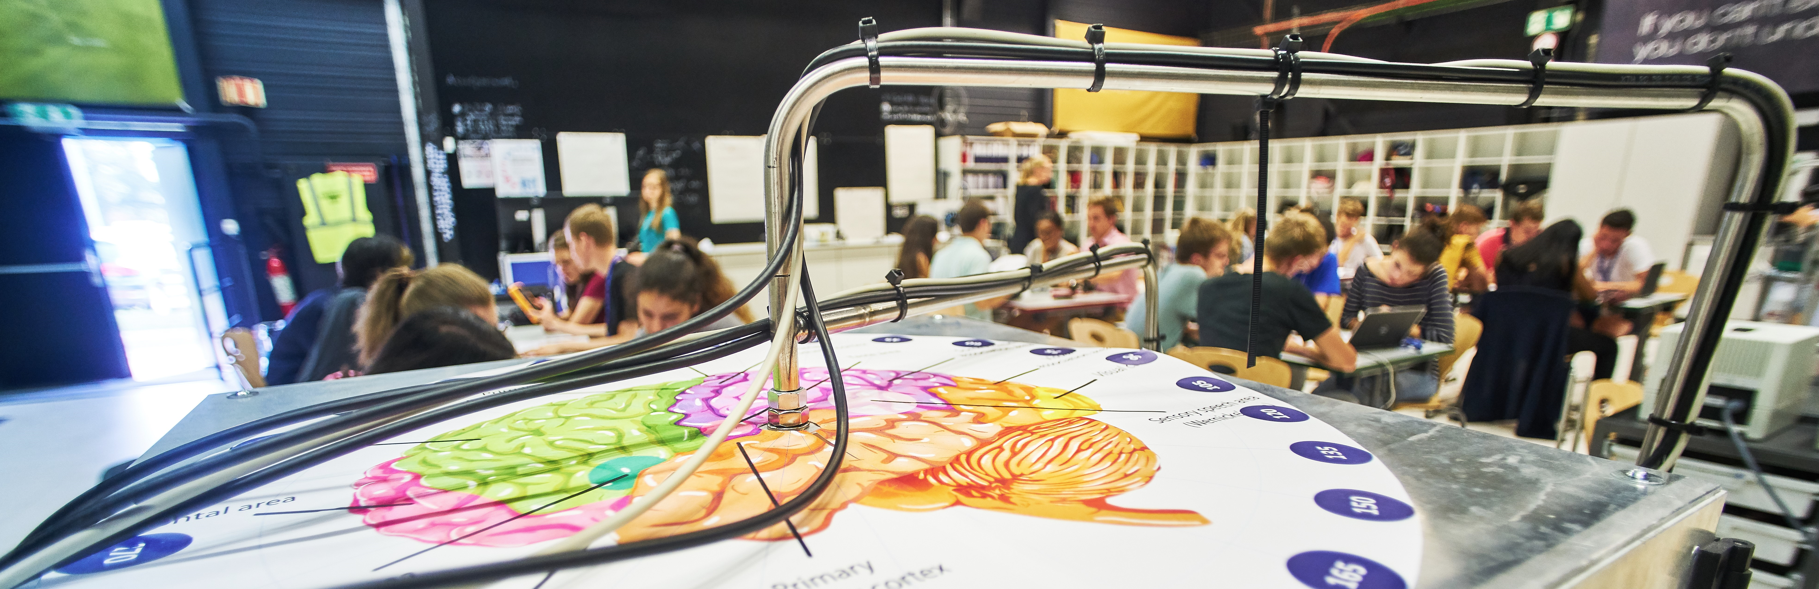
Implications for Practice
Educators trying to address the students’ interest can match the design of their learning activities with
the conceptualisation of interest.
Notes:
Knowing and understanding this conceptualisation of interest is important for educators trying to increase their students’ interests. In particular, they can match the design of their learning activities with this conceptualisation of interest.

Slide 21
Most students can be categorised into one single type of interest in physics
Notes:
So we can conclude that most students can indeed be categorised into one single type of interest in physics. And that we can even describe the interest profile of this type of interest using one conceptualisation of interest.
PAUSE

Slide 22
Thank you very much for your attention!
Looking forward to your comments and questions!
Sarah Zoechling | sarah.zoechling@cern.ch
Notes:
Thank you very much for your attention! And I am Looking forward to your comments and questions!

Slide 23
References
Drechsel, B., Carstensen, C., & Prenzel, M. (2011). The Role of Content and Context in PISA Interest Scales: A study of the embedded interest items in the PISA 2006 science assessment. International Journal of Science Education, 33(1), 73–95. https://doi.org/10.1080/09500693.2010.518646
Habig, S., Blankenburg, J., van Vorst, H., Fechner, S., Parchmann, I., & Sumfleth, E. (2018). Context characteristics and their effects on students’ situational interest in chemistry. International Journal of Science Education, 40(10), 1154-1175. https://doi.org/10.1080/09500693.2018.1470349
Häußler, P., Lehrke, M., & Hoffmann, L. (1998). Die IPN-Interessenstudie Physik. Kiel: IPN.
Krapp, A. (2002). Structural and dynamic aspects of interest development: theoretical considerations from an ontogenetic perspective. Learning and Instruction, 12, 409. https://doi.org/10.1016/S0959-4752(01)00011-1
Levrini, O., De Ambrosis, A., Hemmer, S., Laherto, A., Malgieri, M., Pantano, O., & Tasquier, G. (2017). Understanding first-year students’ curiosity and interest about physics—Lessons learned from the HOPE project. European Journal of Physics, 38(2), 025701. https://doi.org/10.1088/1361-6404/38/2/025701
Rost, J., Sievers, K., Häußler, P., Hoffmann, L., & Langeheine, R. (1999). Struktur und Veränderung des Interesses an Physik bei Schülern der 6. bis 10. Klassenstufe. Zeitschrift für Entwicklungspsychologie und pädagogische Psychologie, 31(1), 18-31. https://doi.org/10.1026//0049-8637.31.1.18
Sievers, K. (1999). Struktur und Veränderung von Physikinteressen bei Jugendlichen. (Doctoral thesis). Universität Kiel, Kiel.
Zoechling, S., Hopf, M., Woithe, J., Schmeling, S. (2022). Students’ interest in particle physics: Conceptualisation, instrument development, and evaluation using Rasch theory and analysis. International Journal of Science Education. https://doi.org/10.1080/09500693.2022.2122897
Student group photo created by lookstudio - www.freepik.com

Slide 24
Back-up Slides
Notes:
My talk will give you an overview of my PhD project.
Firstly, I will introduce you to the empirical background.
Then, I will explain my research interest in more detail.
Thirdly, I will talk about the research design.
And next, I will present first results of my study.
Finally, we will have time for a discussion and I’d be glad to answer any questions.

Slide 25
Results
Students’ Interest in Mechanics
Model of two latent groups describes the data the best
Group 1_{M}: 49% of the sample
Group 2_{M}: 51% of the sample
Different mean interest (Group 1_{M} > Group 2_{M})
Similar interest profiles
Notes:
Let’s start with students’ interest in mechanics. KLICK
We found that a model of two latent groups describes the data the best. So for mechanics Group 1 consists of 49% of the sample and group 2 of 51%. The index M stands for Mechanics. And please note that when I talk about a group here, I do not mean an interest type.
These two groups have different mean interest. In particular, group 1 has a higher mean interest than group 2.
And both groups have similar interest profiles. So what do I mean with interest profile?
******
Mean interest:
Group 1: 49% of students: 0.69
Group 2: 51% of students: 0.02

Slide 26
Mechanics Interest Profiles
more interesting
_{M}
_{M}
NOTE: For each group, the
item parameter means are normalised to 0 in Rasch analysis.
Notes:
Here you can see the mechanics interest profiles of group 1 and 2.
The x axis shows the 11 items .
The y axis shows the item parameter for each item, that ist, how interesting each item is. Higher item parameter means that an item is more interesting! NOTE that for each group, the item parameter means are normalised to 0 in Rasch analysis.
The dark blue dots represent the item parameters for group 1, and the light blue dots for group 2.
The line between the data points has no meaning but it helps to see the pattern. And this pattern tells us how interesting different items are relative to each other within a group.
We call this pattern the interest profile.
And as you can see the mechanics interest profiles of group 1 and group 2 are similar.

Slide 27
Results
Students’ Interest in Particle Physics
Model of three latent groups describes the data the best
Group 1_{PP}: 45% of the sample
Group 2_{PP}: 34% of the sample
Group 3_{PP}: 21% of the sample
Different mean interest: (Group 3_{PP} > Group 1_{PP} > Group 2_{PP})
Notes:
Now let’s have a look into particle physics. KLICK
We found that a model of three latent groups describes the data the best. Group 1 consists of 45% of the sample, group 2 of 34%, and group 3 of 21%. The index PP stands for Paricle Physics. And again, please note that when I talk about a group here, I do not mean an interest type.
These three groups have different mean interest. In particular, group 3 has a higher mean interest than 1 which has a higher mean interest than group 2.

Slide 28
Particle Physics Interest Profiles
more interesting
_{PP}
_{PP}
_{PP}
NOTE: For each group, the
item parameter means are normalised to 0 in Rasch analysis.
Notes:
Here you can see the particle physics interest profiles. Again the dark blue dots represent the item parameters for group 1, and the light blue dots represent the item parameters for group 2. Higher item parameter means that an item is more interesting!
As you can see the particle physics interest profiles of group 1 and group 2 are also similar.
However, the orange dots represent the item parameters for group 3. And this item profile is different than for group 1 and 2. KLICK Let’s have a look into item 7 as an example. You already know item 7 as it is the one in which particle physics is set in a medical context. We observe that item 7 is less interesting relative to the other items within group 3. And this is not the case, actually even the opposite, for group 1 and 2.

Slide 29
Results
Students’ Interest in Particle Physics
Interest profiles of Group 1_{PP} and 2_{PP} are similar!
(79% of the sample)
Different interest profile of Group 3_{PP}, which has the
highest mean interest in particle physics!
(21% of the sample)
Notes:
So we have seen that the interest profiles of group 1 and group 2 are similar. And groups 1 and 2 together cover 79% of the sample.
In comparison, group 3, that, is 21% of the sample, has a different interest profile. And we have also seen that group 3 has the highest mean interest in particle physics.

Slide 30
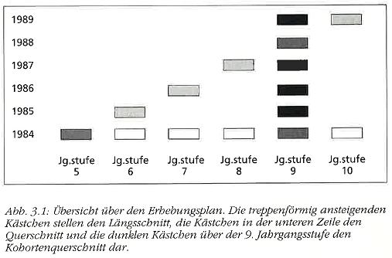
IPN Interest Study
  Germany
  Cross-sectional and longitudinal study
  Longitudinal: 51 classes participated annually (1984 – 1989, 5th - 10th grade)
  Cross-sectional: 24 classes each participated once (1984, 5th - 10th grade)
  Cohort: 24 classes (9th grade) participated once (1984 – 1989)
(Häußler, Lehrke, & Hoffmann, 1998)
Notes:
(Hoffmann et al., 1998)
+wie viele schüler/jahr/region/alter

Slide 31
Examplary Item Categories
Item category
Exemplary item
Learning
more about the function
Learning
more about how a particle accelerator works
principle of technical devices
Learning
more about qualitative
Learning more about
which interaction binds together the
physics
elementary particles in the nucleus space
Constructing
technical devices
Building
a particle detector out of
daily life objects

Slide 32

Analysis of the Main Study
Mixed Rasch Analysis:
  Latent class analysis: latent, “qualitative” person variable, according to which persons are sorted into groups
      Type of interest
  Rasch analysis: individual quantitative parameter within each class
      Degree of interest
X Y Z
X
Notes:
At the moment I am analysing the collected data of the pilot study.
Here, I use a very specific but useful method called Mixed-Rasch model:
This approach consists of 2 steps:
Firstly, latent class analysis is conducted. The result is a latent, qualitative person variable, according to which persons are sorted into distinct classes. => In my study, this qualitative variable reflects the type of interest of a student.
KLICK As you can see, the sampling population of students is divided into 3 interest types X, Y, and Z
Then, Rasch analysis is conducted. Here, the result is an individual quantitative parameter within each class. => In my study, this quantitative parameter reflects the degree of interest of a student.
KLICK As you can see, all 3 interest types X, Y, and Z consist of students with both, high and low interest.
I am analysing my data using a specific software „WINMIRA“ (an acronym standing for Windows and mixed rasch analysis) as well as the open source software „R“.
(Häußler, Hoffman, Langeheine, Rost, & Sievers, 1998)

Slide 33
Research Interest
RQ: To what extent is physics-related self-concept a better clustering variable than gender for distinguishing between different types of interest in mechanics and in particle physics?
Hypothesis: When using self-concept instead of gender as clustering variable, the interest types are described better.

Slide 34
Research Design
Linear regression analysis for the Mechanics and
Particle Physics groups using different student characteristics
Dependent Variable: Interest (Rasch person parameter)
Independent Variables:
Interest group assignment (factor)
Sex (factor)
Physics-related self-concept (Rasch person parameter)
Self-reported experience in school (Rasch person parameter)

Slide 35
Results of Linear Regression Analysis
Students’ Interest in Mechanics
 |  | Group 1 | Group 2
Mean interest |  | 0.69 | 0.02
Mean self-reported experience in school |  | -0.27 | -0.24
Mean self-concept |  | -0.35 | -0.73
Sex | female (Count, %) | 323 (52.8%) | 272 (45.2%)
 | male (Count, %) | 255 (41.7%) | 274 (45.5%)
 | no-answer (Count, %) | 34 (5.6%) | 56 (9.3%)

Slide 36
Results of Linear Regression Analysis
Students’ Interest in Mechanics
Variable | Model 1 | Model 2 | Model 3 | Model 4
Self-concept | 0.12*** (0.02) | 0.11*** (0.03) | 0.14*** (0.01) | x
Mechanics Class Assignment (Factor) | -0.64*** (0.05) | -0.54*** (0.07) | -0.61*** (0.05) | -0.83*** (0.07)
Sex (Factor) | x | Significant: 1&2 (females and males): 0.17* (0.07) | x | Not significant
Self-reported experience | Not significant | Not significant | x | x
Interaction | Significant: Class 1&2 INT SRE: 0.14** (0.02) Class 1&2 INT SRE INT SC: 0.06** (0.02) | Significant: Class 1&2 INT SRE: 0.15* (0.07) Class 1&2 INT sex 1&2 (females and males): 0.21* (0.10) SE INT SRE INT sex 2&3 (males and no-answer): -0.19* (0.09) | N | Significant: Class 1&2 INT sex 1&2 (females and males): 0.33 (0.11)**
Adjusted R² values | 0.31*** | 0.31*** | 0.26*** | 0.13***
Summary | M2 group & SC & SRE | M2 group & SC & SRE & sex | SC & M2 group | Sex & M2 group
Notes:
Focus on the R2 values the higher the better (ranging from 0 to 1)
The 3 best models and Model with students’ sex in comparison

Slide 37
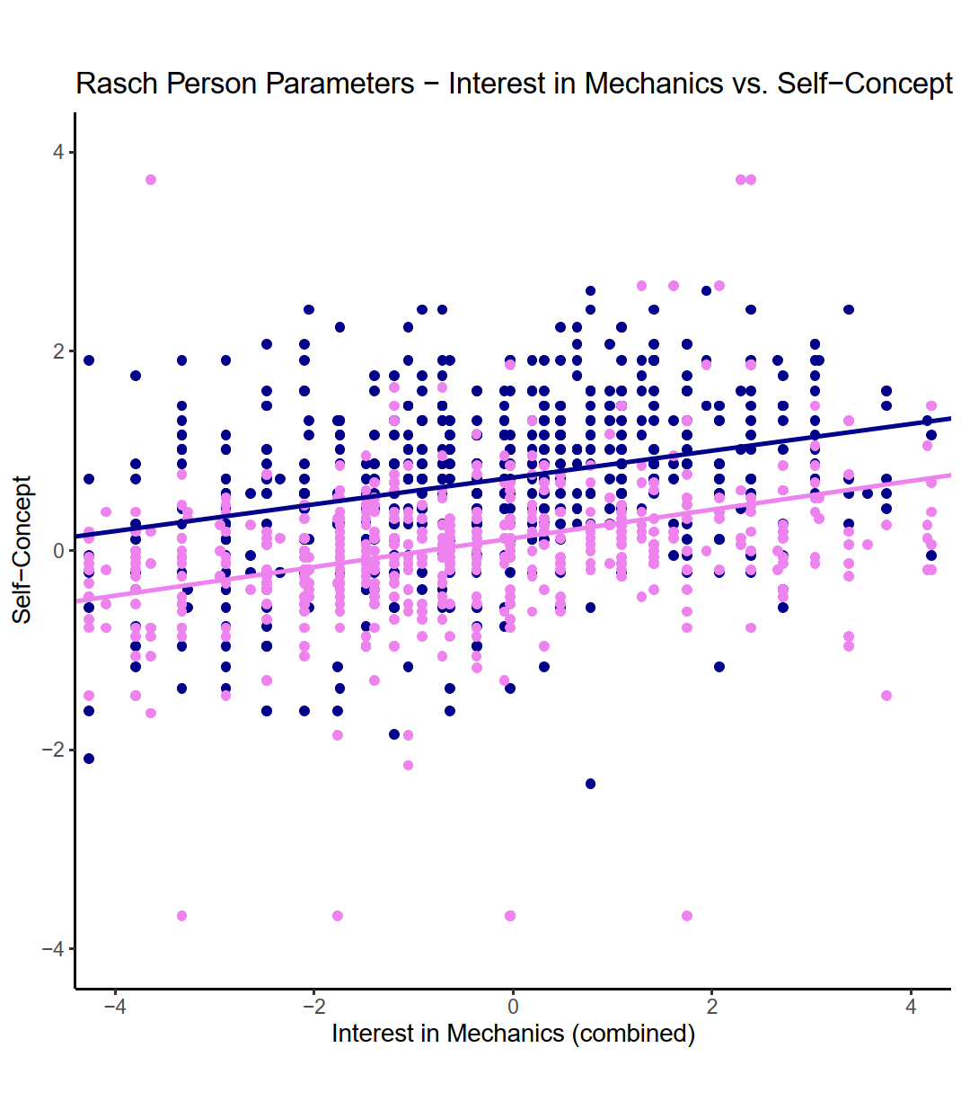
Results of Linear Regression Analysis
Students’ Self-Concept and Interest in Mechanics
Variable | Model 3
Self-concept | 0.14*** (0.01)
Mechanics Class Assignment (Factor) | -0.61*** (0.05)
Sex (Factor) | x
Self-reported experience | x
Interaction | N
R² values (adjusted) | 0.26***
Summary | SC & M2 group
Group 1: 49%
Group 2: 51%
Notes:
The 3 best models and Model with students’ sex in comparison

Slide 38
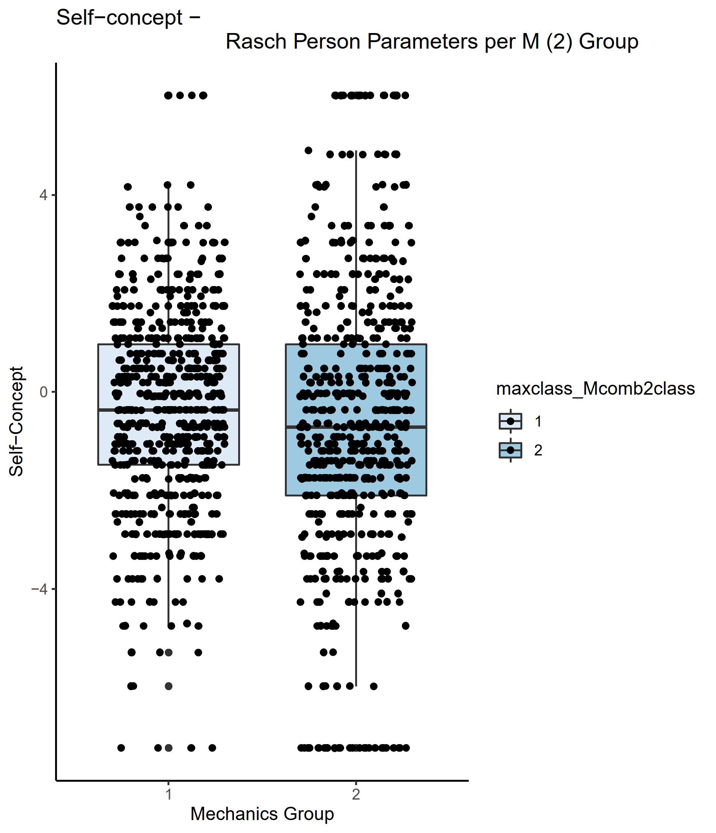
Results of Linear Regression Analysis
Students’ Self-Concept and Interest in Mechanics
Variable | Model 3
Self-concept | 0.14*** (0.01)
Mechanics Class Assignment (Factor) | -0.61*** (0.05)
Sex (Factor) | x
Self-reported experience | x
Interaction | N
R² values (adjusted) | 0.26***
Summary | SC & M2 group
Notes:
The 3 best models and Model with students’ sex in comparison

Slide 39
Discussion of Linear Regression Analysis
Students’ Interest in Mechanics
Dependent Variable: Mechanics interest (Rasch person parameter)
Independent Variables:
Interest group assignment (factor) ✓
➔ Not surprising because interest is scaled per group
Sex (factor) ✗
➔ Evidence for hypothesis
Physics-related self-concept (Rasch person parameter) ✓
➔ Evidence for hypothesis
Self-reported experience in school (Rasch person parameter) ~
➔ Significant in interaction with group, and group and self-concept
Notes:
The 3 best models and Model with students’ sex in comparison

Slide 40
Discussion of Linear Regression Analysis
Students’ Interest in Mechanics
Mechanics interest is best described with a
linear regression model comprising
Interest group assignment,
Physics-related self-concept, and
Self-reported experience in school
Self-reported experience may be omitted
Notes:
The 3 best models and Model with students’ sex in comparison

Slide 41
Research Interest
RQ: To what extent is physics-related self-concept a better clustering variable than gender for distinguishing between different types of interest in mechanics and in particle physics?
Hypothesis: When using self-concept instead of gender as clustering variable, the interest types are described better.
➔ YES: for types of interest in mechanics

Slide 42
Results of Linear Regression Analysis
Students’ Interest in Particle Physics
 |  | Group 1 | Group 2 | Group 3
Mean interest |  | 0.62 | -0.37 | 1.86
Mean self-reported experience in school |  | 0.36 | -0.36 | 1.02
Mean self-concept |  | -0.60 | -1.38 | 0.89
Sex | female (Count, %) | 324 (57.0%) | 202 (51.9%) | 69 (26.8%)
 | male (Count, %) | 213 (37.5%) | 145 (37.3%) | 171 (66.5%)
 | no-answer (Count, %) | 31 (5.5%) | 42 (10.8%) | 17 (6.6%)
Notes:
The 3 best models and Model with students’ sex in comparison

Slide 43
Results of Linear Regression Analysis
Students’ Interest in Particle Physics
Variable | Model a | Model b | Model c | Model d
Self-concept | x | 0.04*** (0.01) | x | x
Mechanics Class Assignment (Factor) | 1&2: --0.21*** (0.02) 1&3: 0.44*** (0.03) 2&3: 0.65*** (0.03) | x | x | x
Sex (Factor) | x | x | Significant: 1&2 (females and males): 0.12*** (0.03) | x
Self-reported experience | 1.45**8 (0.02) | 1.14*** (0.01) | 1.13*** (0.02) | 1.18*** (0.01)
Interaction | Significant: 1&2 INT SRE: -0.73*** (0.02) 1&3 INT SRE: -0.17*** (0.03) 2&3 INT SRE: -0.57*** (0.02) | Significant: 0.03*** (0.00) | Significant: Sex 1&2 (females and males) INT SRE: 0.11*** (0.03) Sex 1&3 (females and no-answer) INT SRE: -0.11** (0.04) Sex 2&3 (males and no-answer) INT SRE: -0.22*** (0.04) | x
Adjusted R² values | 0.95*** | 0.88*** | 0.87*** | 0.87***
Summary | PP group & SRE | SC & SRE | Sex & SRE | SRE

Slide 44
Results of Linear Regression Analysis
Students’ Interest in Particle Physics
Dependent Variable: Particle Physics interest (Rasch person parameter)
Independent Variables:
Interest group assignment (factor) ✓
Sex (factor) ~
Physics-related self-concept (Rasch person parameter) ~
Self-reported experience in school (Rasch person parameter) ✓
Notes:
The 3 best models and Model with students’ sex in comparison

Slide 45
Discussion of Linear Regression Analysis
Students’ Interest in Particle Physics
Dependent Variable: Particle Physics interest (Rasch person parameter)
Independent Variables:
Interest group assignment (factor) ✓
➔ Not surprising because interest is scaled per group
Sex (factor) ~
➔ Difference between females and males in group 3
Physics-related self-concept (Rasch person parameter) ~
➔ No evidence for hypothesis
Self-reported experience in school (Rasch person parameter) ✓
➔ Surprising
Notes:
The 3 best models and Model with students’ sex in comparison

Slide 46
Results of Linear Regression Analysis
Students’ Interest in Particle Physics
Variable | Model e | Model f
Self-concept | 0.19*** (0.02) | x
Mechanics Class Assignment (Factor) | 1&2: -0.96*** (0.07) 1&3: 0.90*** (0.08) 2&3: 1.85*** (0.09) | 1&2: -0.97*** (0.09) 1&3: 0.89*** (0.14) 2&3: 2.33*** (0.12)
Sex (Factor) | x | Not significant
Self-reported experience | x | x
Interaction | Significant: SC INT 1&2: -0.08** (0.03) SC INT 2&3: -0.14*** (0.03) | Significant: Class 1&3 INT sex 1&2 (females and males): 0.43* (0.18)
Adjusted R² values | 0.46*** | 0.36***
Summary | PP group & SC | PP group & sex
Notes:
Model without SRE

Slide 47
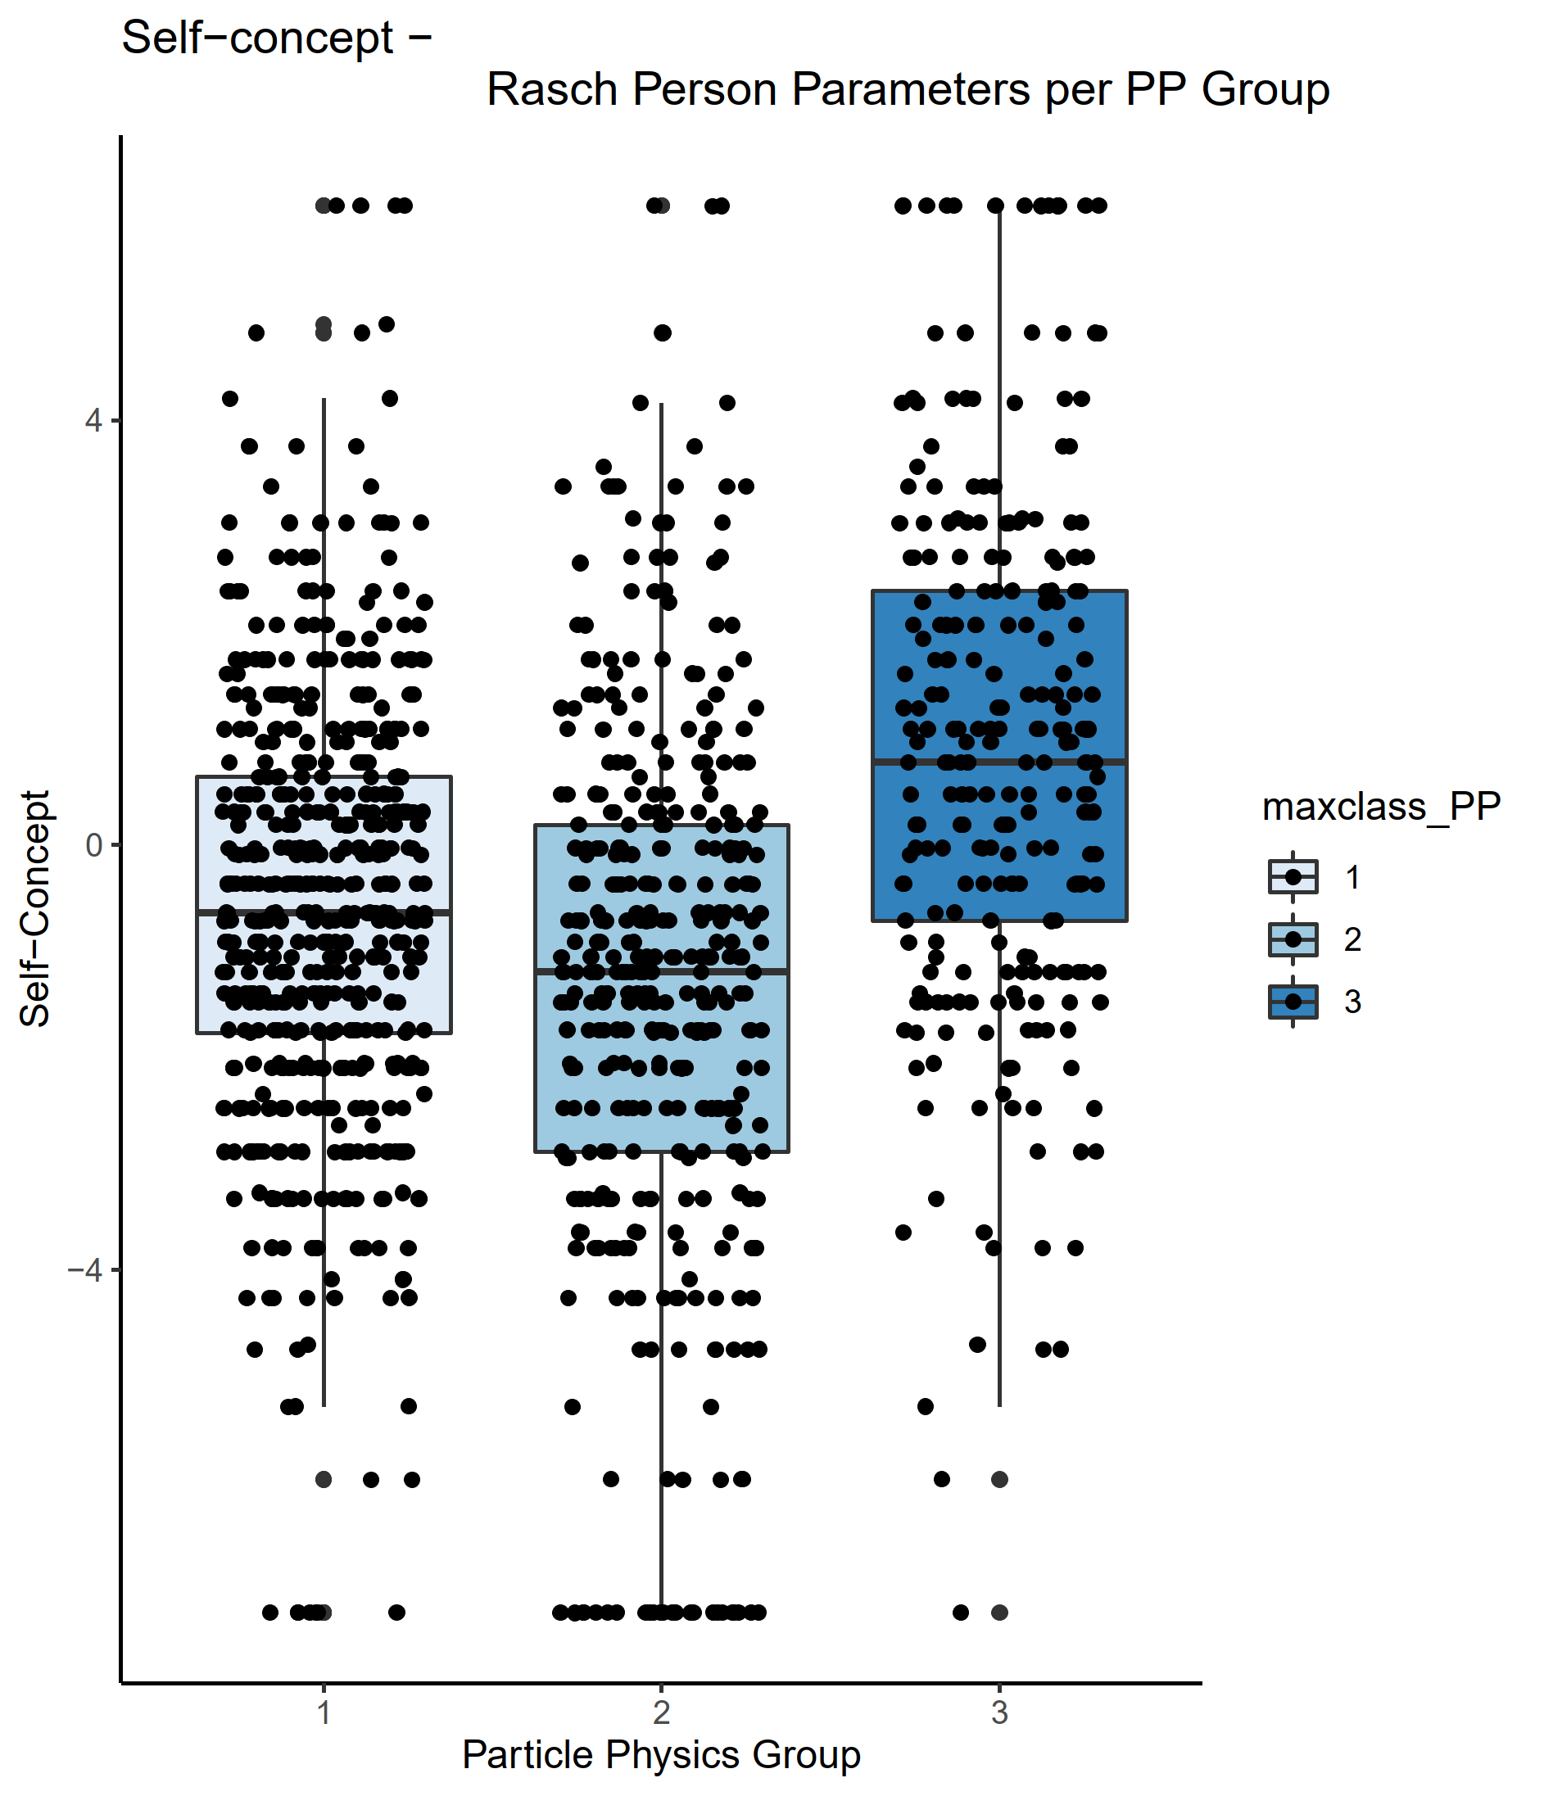
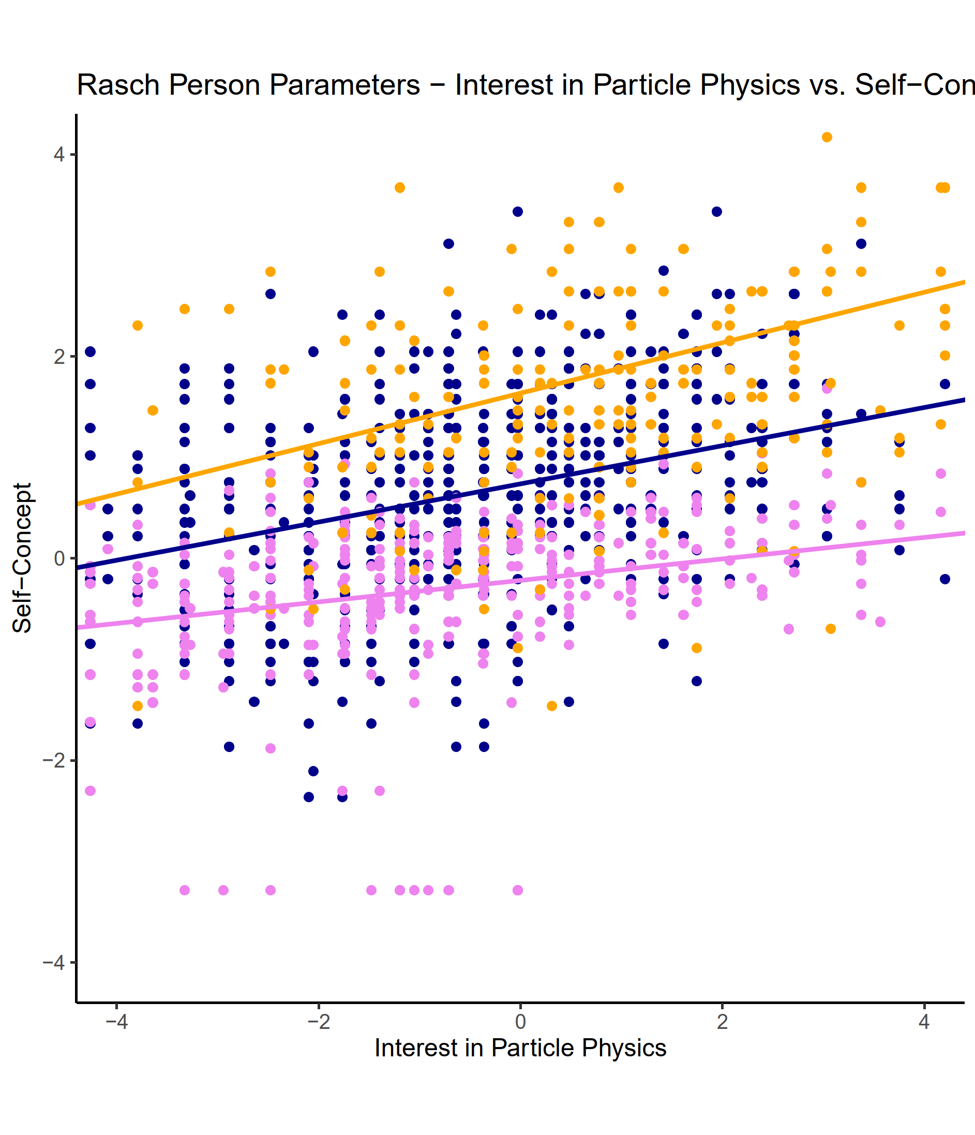
Self-Concept and Interest
Students’ Interest in Particle Physics
Group 1: 45%
Group 2: 34%
Group 3: 21%
Notes:
The 3 best models and Model with students’ sex in comparison

Slide 48
Research Interest
RQ: To what extent is physics-related self-concept a better clustering variable than gender for distinguishing between different types of interest in mechanics and in particle physics?
Hypothesis: When using self-concept instead of gender as clustering variable, the interest types are described better.
➔ YES: for types of interest in particle physics
➔ BUT: surprising importance of the self-reported experience

Slide 49
Research Interest
RQ: Which physics content area is overall more interesting, Particle Physics or Mechanics?
Hypothesis: Particle Physics is more interesting for high-school students than Mechanics.

Slide 50
Research Design
Combined analysis of Mechanics and Particle Physics items
Analysis method:
Mixed Rasch rating scale model
Based on 22 Items
Notes:
Using this questionnaire, we conducted a cross-cohort study with German-speaking students aged 14-16 years from May to September 2021.
The sample size was more than 1200 students
Different German-speaking countries were represented and
Both sexes were equally represented
The collected data was analysed using the mixed Rasch rating scale model.

Slide 51
Interest Profiles
more interesting
Mechanics
Particle Physics
45% 31% 24%

Slide 52
Combined Rasch Analysis
 | Rasch Analysis based on | Mean Item Parameters
 |  | Group 1 | Group 2 | Group 3 | Mean
Mechanics | 22 items | 0 | 0.1 | -0.3 | -0.1
Particle Physics | 22 items | 0 | -0.1 | 0.3 | 0.1
M+PP | 22 items | 0 | 0 | 0 | 0
Notes:
Different mean item parameters for the different groups
Group 1: M and PP same mean item parameters
Group 2: M higher mean item parameter than PP
Group 3: M lower mean item parameter than PP
PP higher mean item parameter than M

Slide 53
Results of Combined Analysis
Students’ Interest in Mechanics and Particle Physics
Different mean item parameters for the different groups
Group 1: M and PP same mean item parameters
Group 2: M higher mean item parameter than PP
Group 3: M lower mean item parameter than PP
PP higher mean item parameter than M

Slide 54
Discussion
Interestingness of Mechanics and Particle Physics
Overall, Particle Physics items were more interesting than Mechanics items
Group 3 (24% of the sample): relatively highly interesting Particle Physics items
Group 1 and 2 (76% of the sample): Mechanics items are similarly or slightly more interesting

Slide 55
Discussion
Students’ Interest in Mechanics and Particle Physics
Group 1 is more interested than Group 2
Group 3 has the highest interest
Combined analysis:
24% of the sample
Separate analysis for Particle Physics:
21% of the sample

Slide 56
Research Interest
RQ: Which physics content area is overall more interesting, Particle Physics or Mechanics?
Hypothesis: Particle Physics is more interesting for high-school students than Mechanics.
➔ YES: for group 3 students, that is, the highly interested students
➔ NO: for group 1 and 2 students (76% of the sample)
Notes:
But the interestingness of particle physics items is so high for the group 3 students that it overshadows group 1 and group 2.

Slide 57
Reminder: Group 3
Students’ Interest in Particle Physics
 |  | Group 1 | Group 2 | Group 3
Mean interest |  | 0.62 | -0.37 | 1.86
Mean self-reported experience in school |  | 0.36 | -0.36 | 1.02
Mean self-concept |  | -0.60 | -1.38 | 0.89
Sex | female (Count, %) | 324 (57.0%) | 202 (51.9%) | 69 (26.8%)
 | male (Count, %) | 213 (37.5%) | 145 (37.3%) | 171 (66.5%)
 | no-answer (Count, %) | 31 (5.5%) | 42 (10.8%) | 17 (6.6%)
Notes:
The 3 best models and Model with students’ sex in comparison

