Slide 1



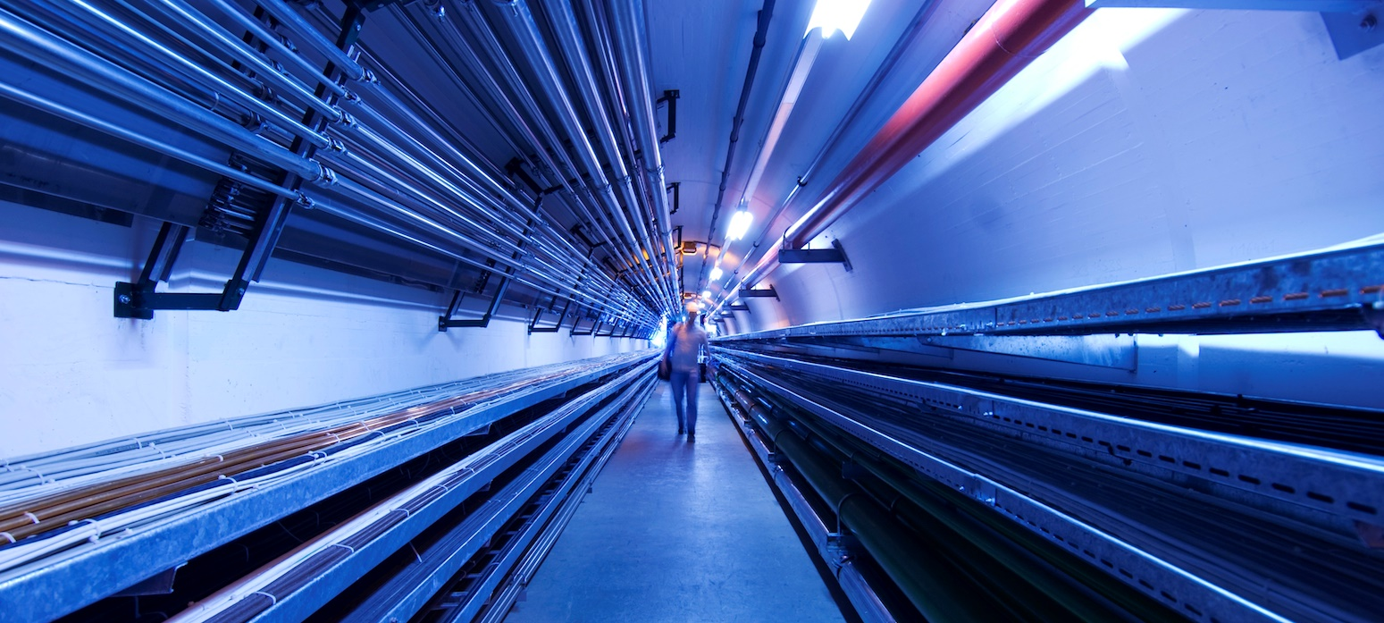
Geoprofiler: Geological and Radiological Analysis Tool for Muon Collider Positioning
Progress Update and Muon Tunnel Placement
G.Lacerda, Y. Robert, N. Guilhaudin
22/08/2022

Slide 2
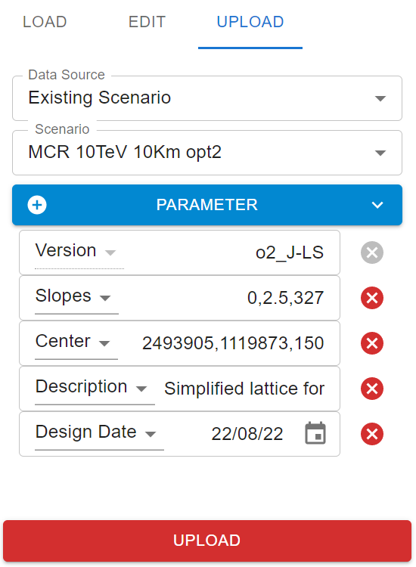
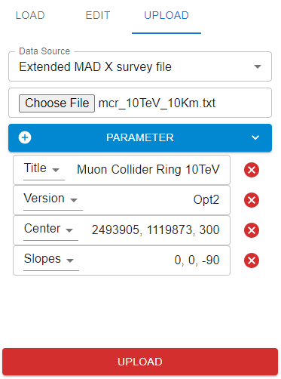
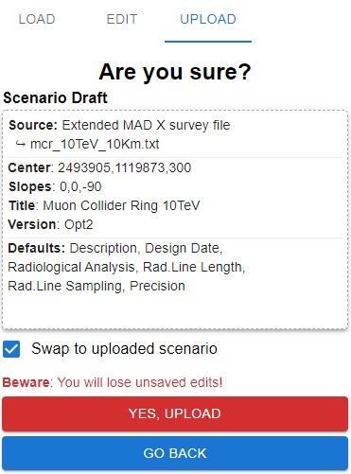
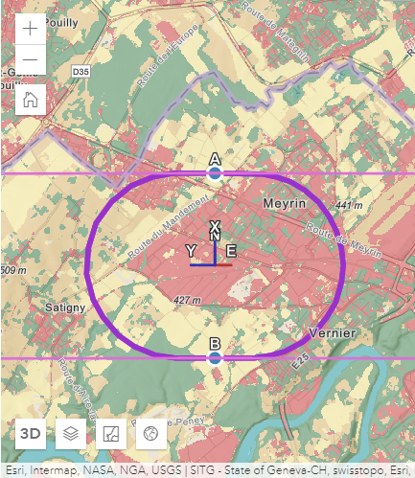
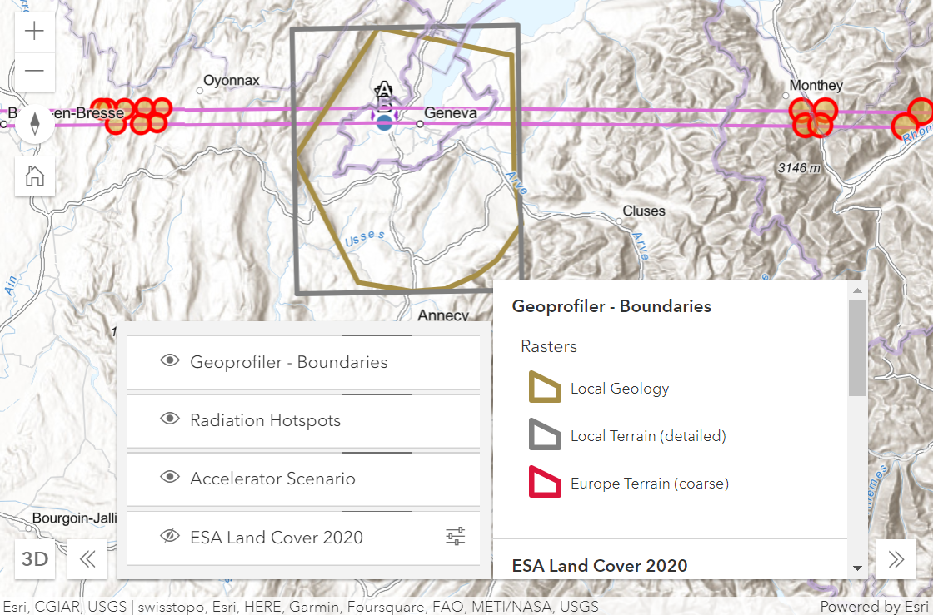
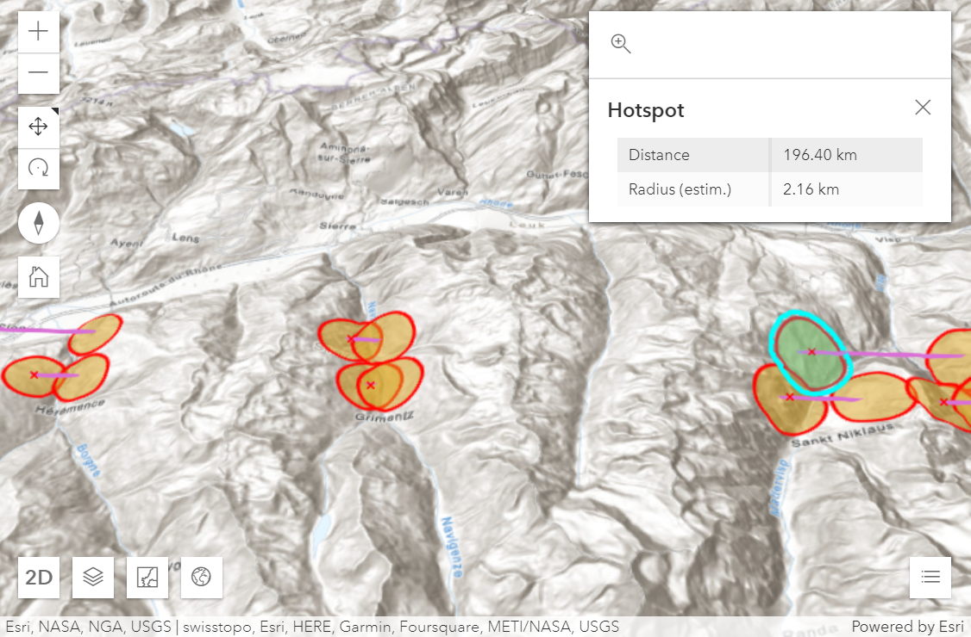
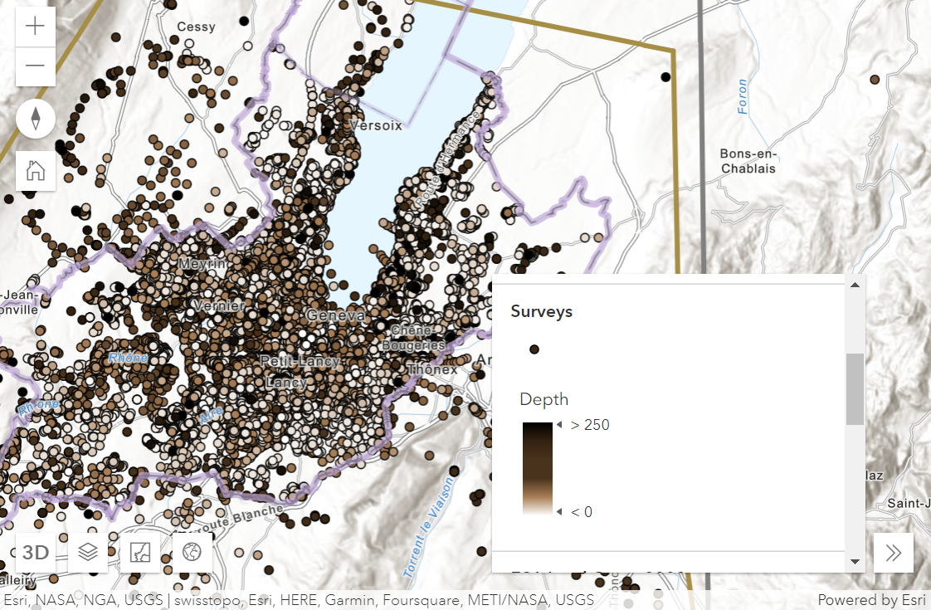
Geoprofiler Progress
  MADX File / Scenario Edit upload
  Interface improvements
    Represent data boundaries
    More accurate 3D terrain
    Improved hotspot visualization (prototype)
  Geodesy and tunnel placement improvements
    Eliminate LHC calculated similarity bias
    Earth curvature correction
    Minimize conversions and inaccuracies
    Coherent conventions for both Swiss coordinate and MADX based data
  Service restructuring and performance study
    Cleaner geology and DTM service structure
    Data publishing changes for performance
    Optimizations in data fetching and calculations
  Bug fixing and data / code clean-up
    Update to UNIGE Geology
Current Work
  Include FCC / UNIGE data
  Documentation – code, Jira, others…

Slide 3
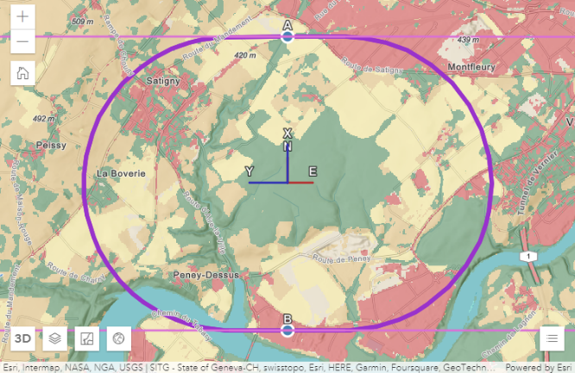
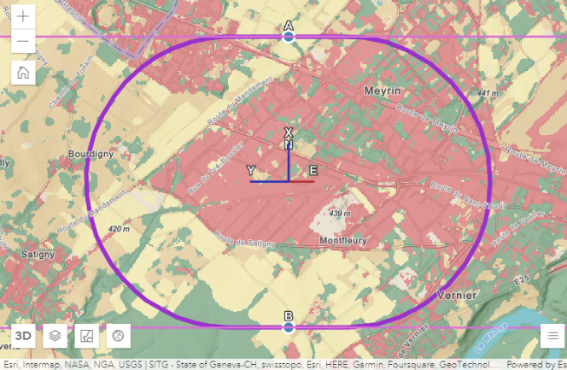
Muon Tunnel Placement
  Starting point
  10TeV Muon collider ring (10Km circumference) - lattice provided by Kyriakos.
    3TeV, 4Km case should be much easier to place:
      The radiation lines will be closer, less area to cover. Same for geology.
      Less radiation intensity means less restrictions regarding populated areas.
  2 candidate positions proposed earlier:
Placement Option 1
Placement Option 2

Slide 4

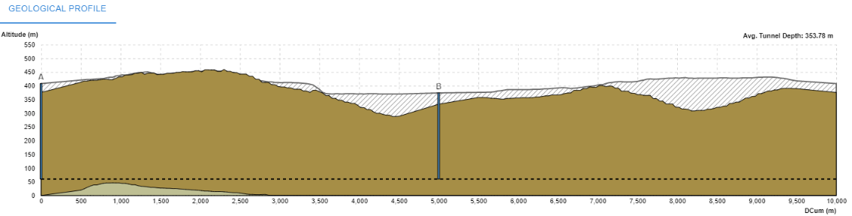
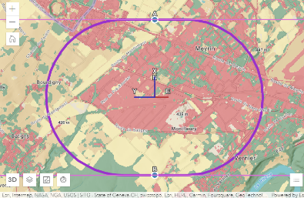
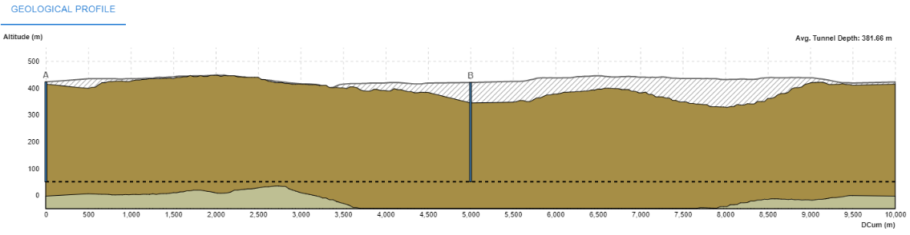
Muon Tunnel Placement
Goals:
Only molasse along tunnel
Non-populated areas along tunnel, especially surface sites
  Geology, Shafts
  2 candidate positions proposed earlier:
Center Altitude: 60-355mASL
Average Depth: 135-350m
Shaft Depth: 120-350m / 95-315m
Shaft B in populated and river area
Placement Option 1
Center Altitude: 50-320mASL
Average Depth: 110-380m
Shaft Depth: 100-370m
Placement Option 2
Shape implies:
1% Slope Y → ~18 m Depth delta
1% Slope X → ~13 m Depth delta

Slide 5
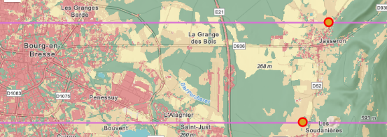




Muon Tunnel Placement
Observations
Radiation lines along Y so matching slope is most decisive.
Depth’s effect increases with slope.
Slope along X mostly for asymmetry adjustments.
Usually, the more distant the hotspot, the higher the relative inclination of the line and the surface; and the “cleaner” the exit.
Better radiation optimizing workflow?
Starting from a position:
Find 2 non-populated areas in line
Find matching azimuth
Fiddle with slope Y and depth to find clean exit
Fiddle with slope X to distance from populated areas if asymmetric
  Radiation Hotspots
  2 candidate positions proposed earlier:
Similar positions - Similar problems
Bourg en Bresse
Saint Maurice, Sion, Niedergrächen…
Placement Option 1
Placement Option 2
Placement Option 2 – 320 mASL
Placement Option 2 – 50 mASL
Better places for exit in these positions and azimuths

Slide 6
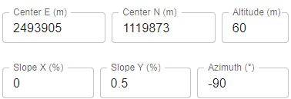
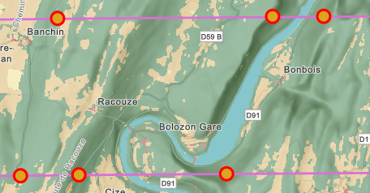

Muon Tunnel Placement
  Radiation Hotspots
Better places for exit in these positions and azimuths
Option 2 adjustment example
Parameters:
~60-100m altitude
~0.5 Y slope
X Slope increase → raise line clearance near Simandre-Sur-Suran and Varzo
Problem: effect of beam divergence?
Line clearance from surface cannot be judged well for the moment and this azimuth crosses a lot of populated areas!
Option 1 with slight azimuth delta and similar parameters can reach same areas
Similar case for 3TeV 4Km scenario

Slide 7
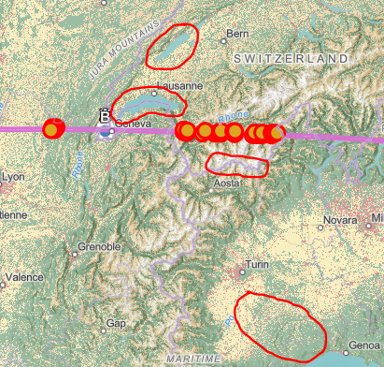
Muon Tunnel Placement
  Radiation Hotspots
Starting from a position:
Find 2 non-populated areas in line
Find matching azimuth
Fiddle with slope Y and depth to find clean exit
Fiddle with slope X to distance from populated areas if asymmetric
Better azimuth ideas
Lake Geneva and Neuchâtel ?
Cevennes and crop lands on the other side
Towards Alps stretch ?
Good distance
Near no populations in the mountains
Disperse populations on other side (Jura)
Towards Italian crop lands and sea ?
  Good distance
Disperse populations on both sides

Slide 8
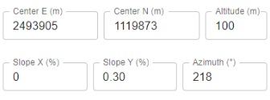


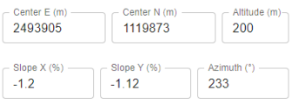
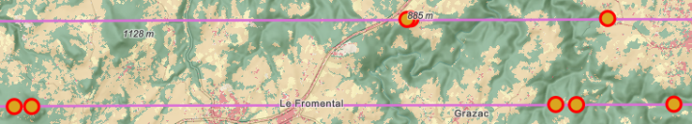
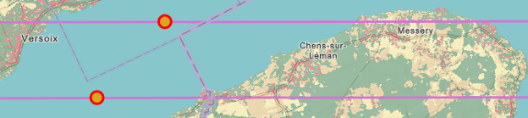
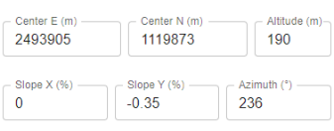
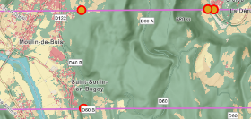

Muon Tunnel Placement
  Radiation Hotspots
In all cases the lakes are too close!
Cannot get a clean exit in the lakes
Low angle and height on far side (Neuchâtel and Lausanne).
Clearance analysis is crucial.
Cevennes is too far and terrain is low until then
Better azimuth ideas
Lake Geneva and Neuchâtel ?
Cevennes and crop lands on the other side of lakes
Neuchâtel
  Exits west in lightly populated areas in Jura
Geneva - Versoix
  Exits west in lightly populated areas near Le Puy-en-Velay
Geneva – Thonon Les Bains
  Exits west in Jura close to populated areas

Slide 9
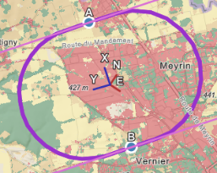
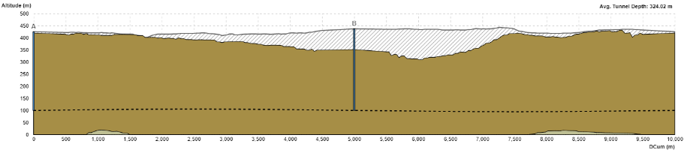
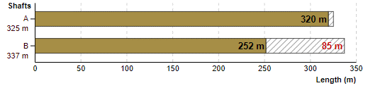
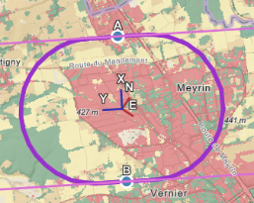
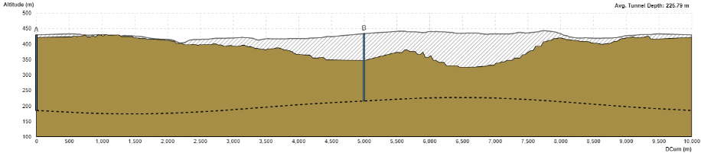
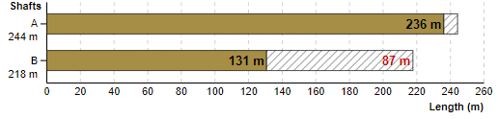
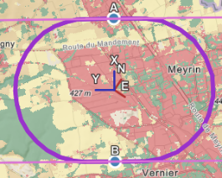
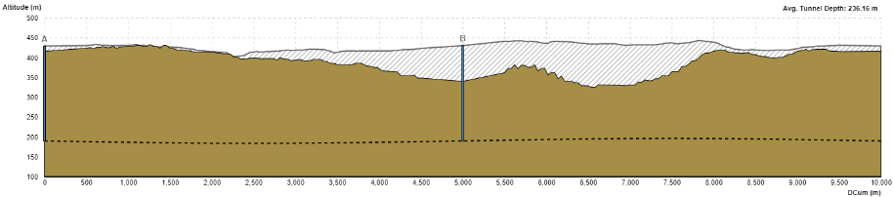
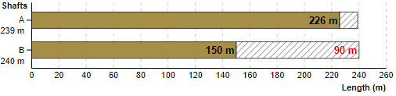
Muon Tunnel Placement
  Geology and Shafts
Neuchâtel parametrization is much deeper and flat. Maybe a shallower but more tilted solution can be found.
In Geneva parametrizations Point A is within Meyrin Site.
Better azimuth ideas
Lake Geneva and Neuchâtel ?
Cevennes and crop lands on the other side of lakes
Neuchâtel
Geneva - Versoix
Geneva – Thonon Les Bains

Slide 10
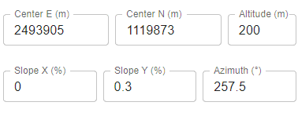
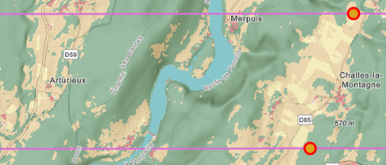
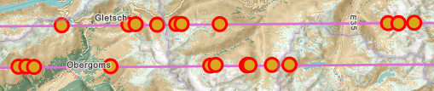
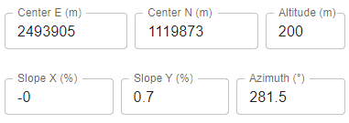
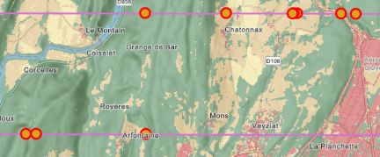
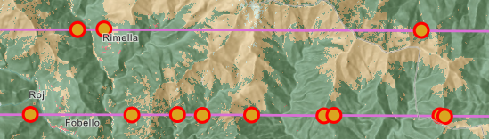
Muon Tunnel Placement
  Radiation Hotspots
Better azimuth ideas
Towards Alps stretch ?
Good distance
Near no populations in the mountains
Disperse populations on other side (Jura)
Bernese Alps
  Angle on jura side exit not great but low impact
  Villages crossed are on deep valleys, good clearance
Alps – Monte Rosagletscher
  Seemed like a good opportunity for a shallow, flat parametrization but its tricky due to Oyonnax and Martigny

Slide 11
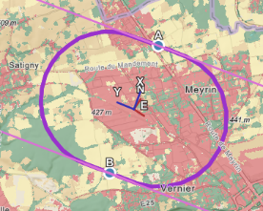
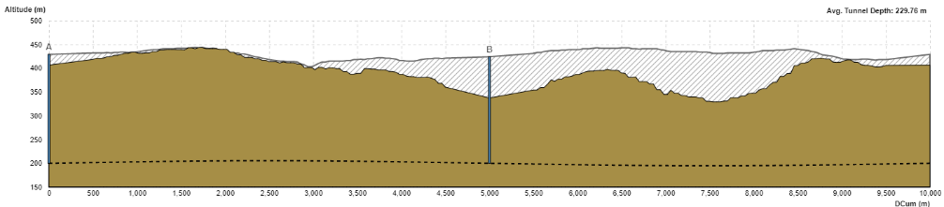
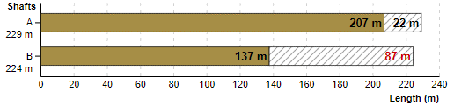
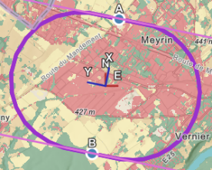
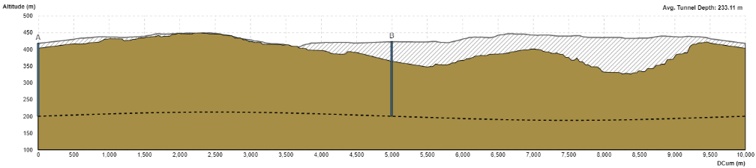
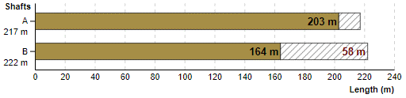
Muon Tunnel Placement
  Radiation Hotspots
Better azimuth ideas
Towards Alps stretch ?
Good distance
Near no populations in the mountains
Disperse populations on other side (Jura)
Bernese Alps
Alps – Monte Rosagletscher
  Point A is in populated area

Slide 12
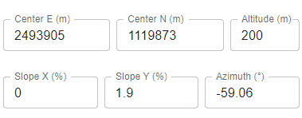
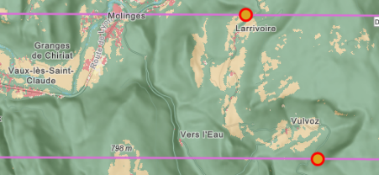
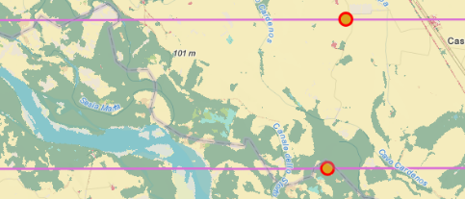
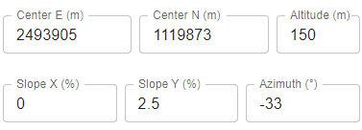
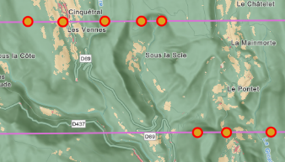
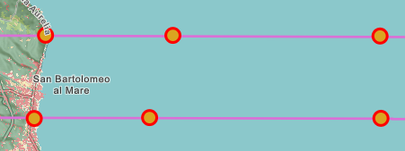


Muon Tunnel Placement
  Radiation Hotspots
Better azimuth ideas
Towards Italian crop lands and sea ?
  Good distance
Disperse populations on both sides
Apennines
Clean exits in low population areas
Plenty of room to optimize
More depth / tilt to reach Apennines where there is less population
Ligurian Sea
  Like above, reaching sea requires bigger tilts and depths
  Clean exits in zones of near no population
Data Issue

Slide 13






Muon Tunnel Placement
  Radiation Hotspots
Better azimuth ideas
Towards Italian crop lands and sea ?
  Good distance
Disperse populations on both sides
Apennines
Point A is in populated area
Ligurian Sea

Slide 14
Muon Tunnel Placement
  Some Conclusions
Shallow, flat parametrizations seem difficult to find due to radiation
Considering bigger depths and tilts, the Alps or North of Italy show promise
Increase clearance by:
- capitalizing on mountains (increase distance and / or sharp drop)
- capitalizing on distant flat ground (earth curvature)
However Jura may receive higher doses due to proximity and its surroundings are well populated
Given tight scenarios, beam divergence and clearance analysis is key
Other placements may bring clearer paths to the mountains or sea / lakes
  View these parametrizations (also in 3D!)
  and explore alternatives
  in Geoprofiler
  https://test-geoprofiler.web.cern.ch

Slide 15
Radiological Analysis Feature Ideas
Hotspot dose intensity encoding
  Add surface draped point symbol
  Distance from origin → point size
    Issue: Common symbology uses screen units
    and update on map resolution is not reliable, see the current prototype.
    Work-around: 3D volumetric Symbols / CIM Symbols
  Size of origin segment → point colour hue
  Terrain classification → point colour value
Radiation line information encoding
  Height from surface → line colour hue
    Issue: Gradient symbology is not available
    Work-around: Point markers in sampling points instead
  No hotspots found → line colour shade
Radiation line geological profile
  Display line and traversed geology and hydrogeology
  Exact values for altitude, height, depth, geology and hydrogeology layers along the line
  Display terrain and surface models, with classification data
Draw in map the full intersection of the ring’s plane with the surface
  Encode radiation dose parameters in the resulting polygon
Improve hotspot calculation performance and accuracy
Work to develop:
  Surface analysis
    Selecting data of interest and approved sources
  Geoprofiler radiation model
    Accounting for arcs, divergence, and other parameters.
  Refined radiation dose model
    Interfacing between models and other integrations

Slide 16

Questions?

Slide 17
Thank you
for your atention!

