Slide 1
Debrief CineGlobe 2022

Slide 2

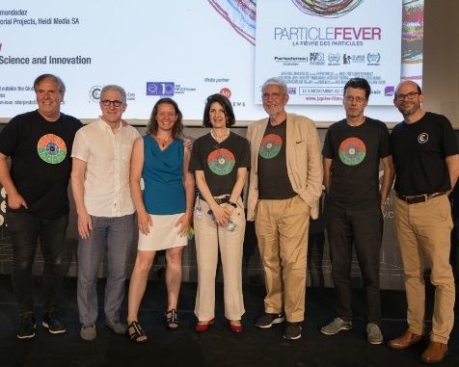
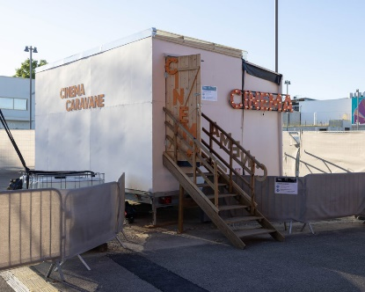
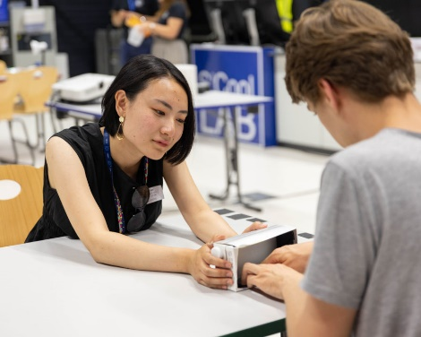
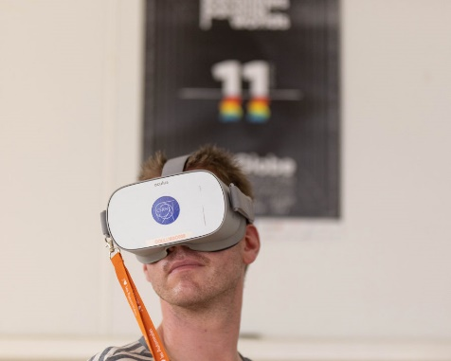
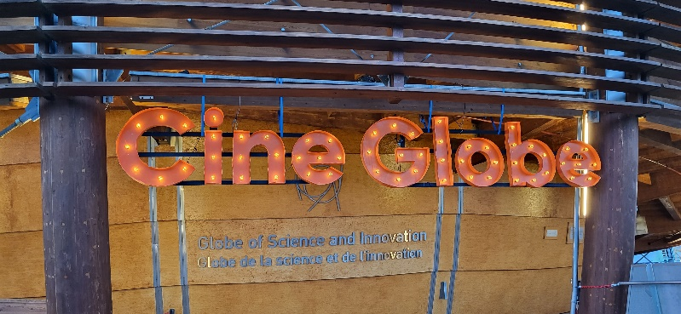
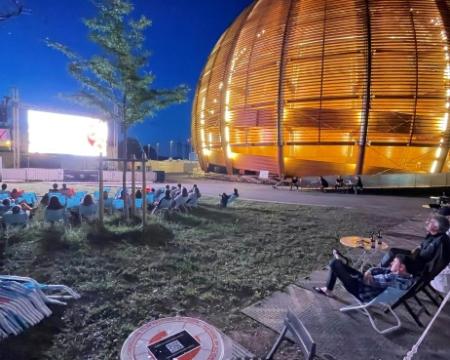
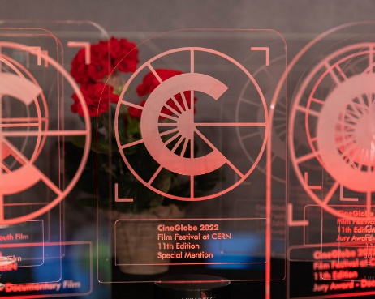
CineGlobe 2022
11th edition
29 June – 3 July 2022
In person (2 evenings webcasted)
Free of charge
Open to the local general public including children
Bilingual

Slide 3
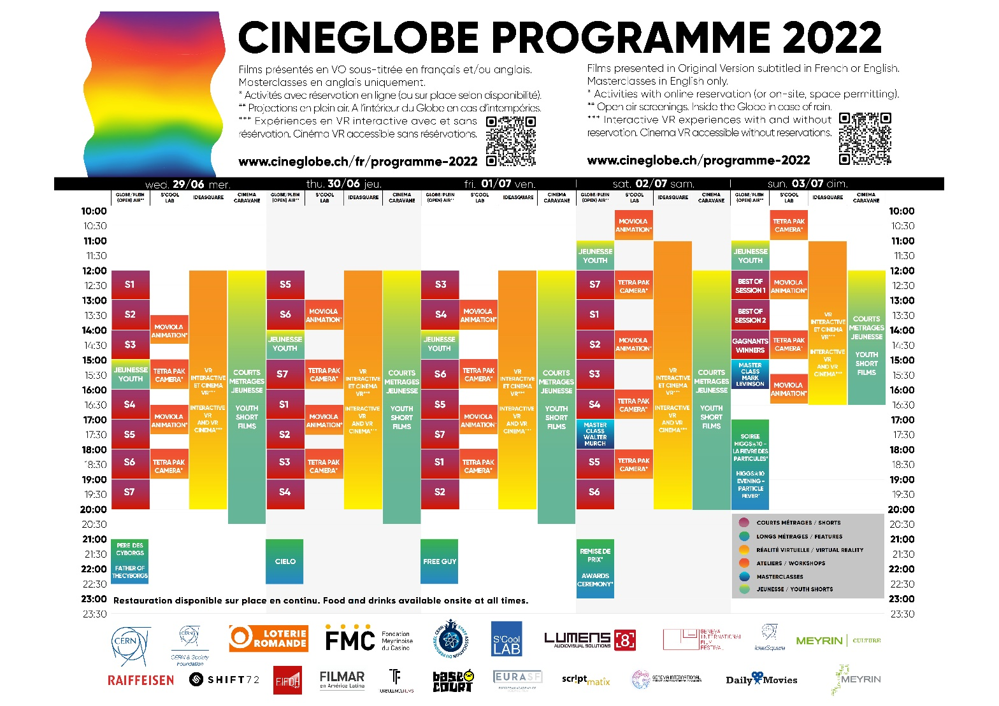
CineGlobe 2022
52 short films in competition
2 Masterclasses
Interactive VR
VR Cinema
21 workshops
Cinema Caravan
5 evening events

Slide 4
Attendance over the 5 days
Date | Workshops | VR | Outdoor daytime | Outdoor evening | Globe evening | Masterclass | Webcast |  | Total per day
29-Jun-22 | 31 | 70 | 30 | 39 | / | / | / |  | 170
30-Jun-22 | 43 | 70 | 30 | 11 | 67 | / | / |  | 221
1-Jul-22 | 16 | 70 | 30 | 118 | / | / | / |  | 234
2-Jul-22 | 61 | 70 | 50 | / | 76 | 64 | / |  | 321
3-Jul-22 | 57 | 70 | 50 | 35 | 190 | 40 | 53 |  | 495
Total | 208 | 350 | 190 | 203 | 333 | 104 |  | Grand total | 1388

Slide 5
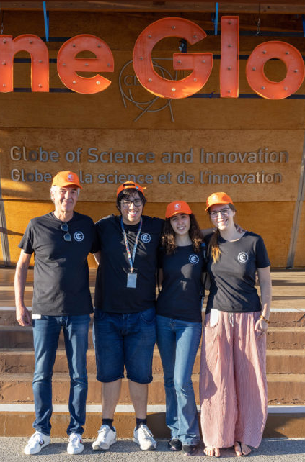
Volunteers over the 5 days
Week days (Wed – Fri.)
  15 shifts / day
  67 hours / day
Week-end (Sat. – Sun.)
  20 shifts / day
  105 hours / day
→ 25 volunteers doing 85 shifts for a total of 411 hours

Slide 6
IR-ECO-VI involvement
16 team meetings as of January 2022
8 site meetings: location, logistics, suppliers etc. as of January 2022
4 training sessions for volunteers
Creation and management of 29 indico events
Overtime: 198 hours
  155 : hours compensated (Mélissa, Loraine, Gilles, Philippe)
  8 hours paid (Valentin)
  35 hours offered (François)
… on top of CineGlobe team efforts

Slide 7
Budget
(source : CET as of 18 August 2022)
  Budget code 30404 – External revenue funding
  Budget code 30405 – CERN funding
Description | Supplier | Amount
AV infrastructure | Lumens 8 | 14997.97
Impressions (signalétique etc) | CERN Print Shop | 206.61
 |  | 15206.58
Description | Supplier | Amount
T-Shirts + Caps Volunteers | AVR 360 | 2370.00
Tents | Party Partner SA | 6864.50
AV infrastructure | Lumens 8 | 5000.03
Hotel | CERN hostel | 4717.50
Guards | Protectas | 3511.94
Cleaning | SCE | 216.06
Webcast support | Serco | 384.00
 |  | 24299.48
  Still to be charged
Description | Supplier | Expected
HSE inspection | Lumens 8 | 800.00
Meals for volunteers | Novae | 2490.00
Thank you drink | Novae | 400.00
Water for guests, volunteers | Novae | 50.00
 |  | 3740.00
  Total cost 43246.06
  CERN funds 15000.00
  External funds 28246.06 (10k from 2021)

Slide 8
What worked well
Volunteers management – moved to IR-ECO-VI since 2021
  Releases CineGlobe from extra work, experience from IR-ECO-VI
Content
  Short films and long features were attractive
Awards ceremony, feature evenings and masterclasses
VR activities
  worked well due to the absence of public… and thanks to many volunteers needed (nearly more than the visitors themselves)
Foodtruck
  NOVAE provided great service despite low attendance

Slide 9
What needs to be improved (1/2)
Attendance…
  S’Cool LAB workshops were very poorly attended
  Often more volunteers than participants during daytime
Programme and content late arrival and last minute changes - reported for years
  school offers, description of VR activities, graphic identity, popcorn etc. - impacts logistics preparation
Unfinished programme content
  All playlists had to be redone by Globe technical team; wrong format of main feature discovered last minute etc.
Distribution of responsibilities – reported for years
  CineGlobe interferes often with logistics questions while festival content is not ready

Slide 10
What needs to be improved (2/2)
CineGlobe team changes last minute
  Communication officer, unexperienced with CERN, introduced to the project 1 month before
Lack of communication / promotion of the event
  IR shared many potential channels (FB, cultural agendas etc.), few of which were used
  CERN promotion consisted of posters, flyers and internal communication articles – did not reach the goal
Filmmakers’ experience
  Uninformed filmmakers showing up at CERN, no plan, no proper welcome
  A responsible person should be named by CineGlobe or responsibility should be moved to IR
Project management and planning
  Too many “misunderstandings”, needed to minute everything in the end

Slide 11
Next edition
June 2023 and previous months to be avoided at all costs
  Incompatible with Science Gateway preparation and inauguration
2nd Semester 2023 not an option
  Science Gateway first semester with public
  2021 late summer edition has shown limitations of this format (many absences when decisions are made)
  Sparks! will take place in November and require much resources as it will be the first full size edition
Duration should be reduced – requested for years
  We have moved from 10 days to 5
  3 days seems more appropriate
  Extension to be re-considered once a large audience has been acquired
We request the postponing to 2024

