Slide 1
Status of DCM – 2nd November 2022
Y. Leclercq, F. Crisci, Y. Coutron, S. Donche, S. Spathopoulos, D. Foresy, E. Rigutto, J. Romanet on behalf of WP3
WP3 meeting 02/11/2022

Slide 2
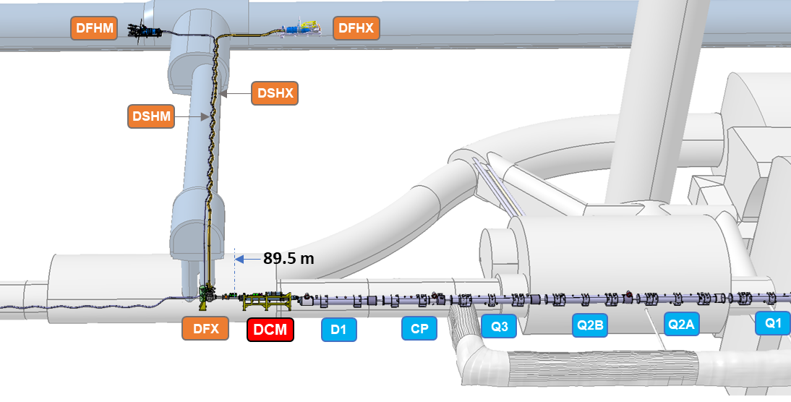
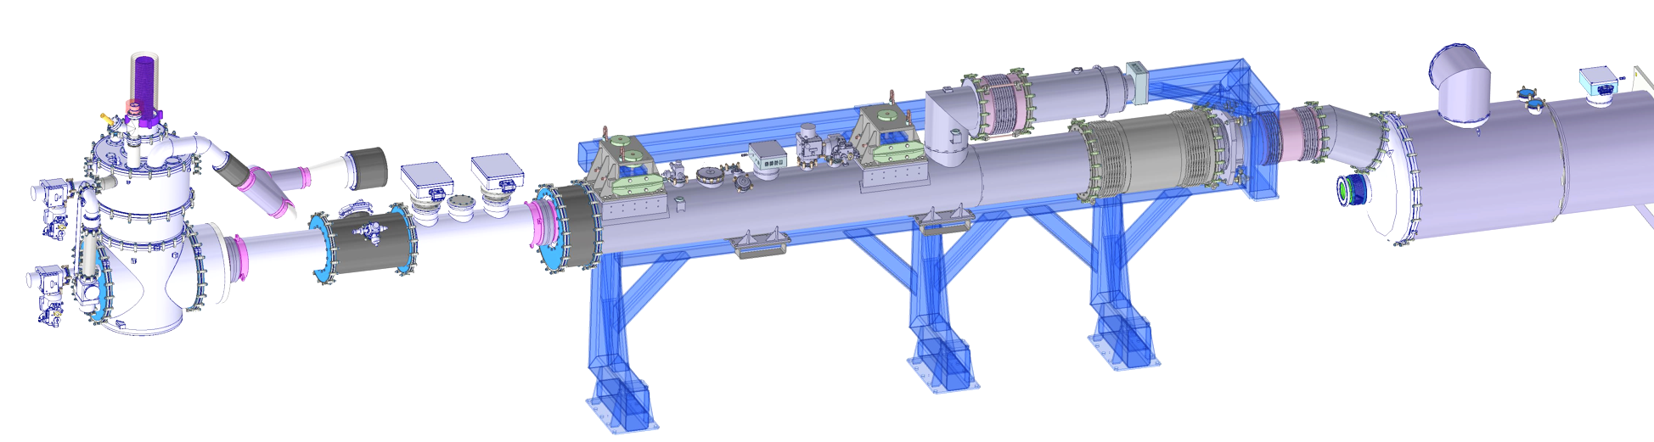
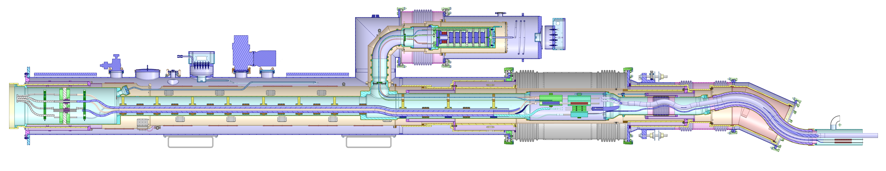
DCM Key Functions
Electrical continuity between CP-IT*
Diodes : host & ensure operating conditions
CP-IT interconnect : host & ensure operating conditions
Hydraulic barrier (ʎ-Plate) : CP & IT cryogenic volumes
Vacuum barrier : CP & IT insulation volumes
Interface
  for vacuum services (gauges, pumps)
  for safety relief devices
  for instrumentation (for diodes, interco., cryo)
* Cold Powering (CP) / Inner Triplets (IT)
1
2
3
4
5
6
DFX
DCM
D1
2
6
1
3
5
4

Slide 3
DCM Project Overview
Design & Qualification
One symmetric design for 1+4 units
DMC & λ-Plate reviews follow-ups #2 in June 2022
Procurement
Pre-series/series in progress
Assembly in SMI2
Pre-series Assembly start = BB availability + 3 months
Series : Assembly in series in SMI2
Installation studies in STRING/LHC tunnel starting
DCM availability = Assembly start + 6 months
2021 |  |  |  | 2022 |  |  |  | 2023 |  |  |  | 2024 |  |  |  | 2025 |  |  |  | 2026
Q1 | Q2 | Q3 | Q4 | Q1 | Q2 | Q3 | Q4 | Q1 | Q2 | Q3 | Q4 | 1 | 2 | 3 | 4 | 1 | 2 | 3 | 4 | 1 | 2 | 3 | 4
DCM EDR
DCM EDR follow-up
DCM EDR follow-up 2
T0 = NbTi BB availability
Pre-series Available for STRING installation for T0 = January 2023
ʎPlate EDR
ʎPlate EDR follow-up
ʎPlate EDR follow-up 2
Procurement
Plugs
Manuf.
Pre-series
Assembly
Preparation
Assembly & QC
Installed in STRING
Design & Qualification
Phase ✔
P
Procurement
Installation
in LHC tunnel
Assembly & QC
1
2
3
4
Series
Storage in Flex

Slide 4
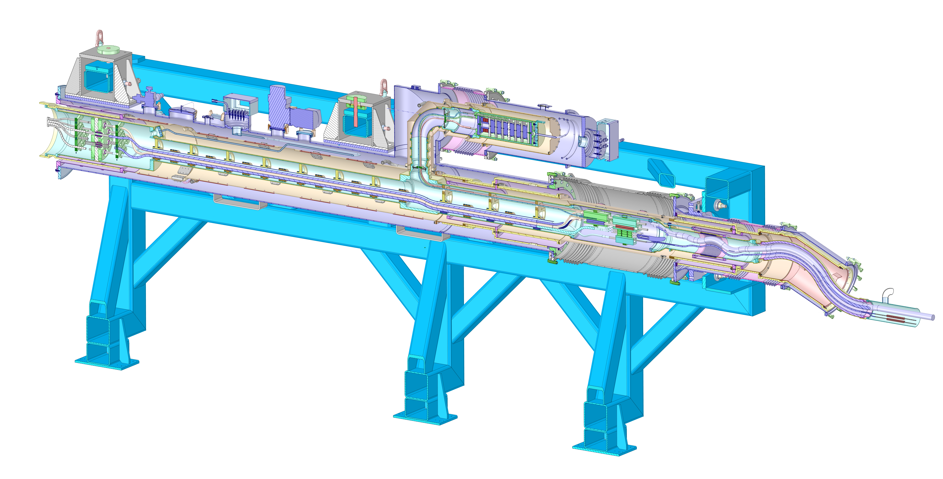
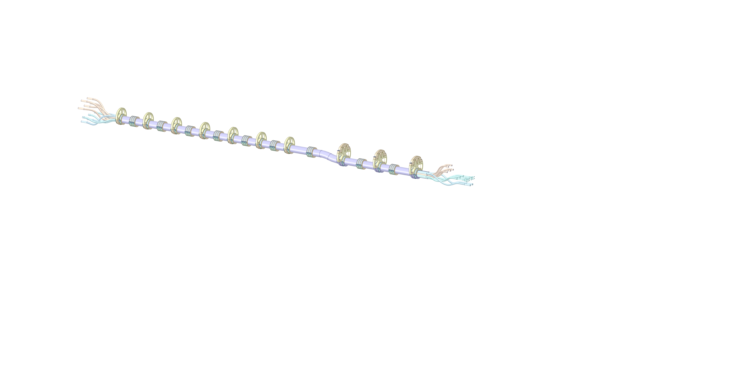
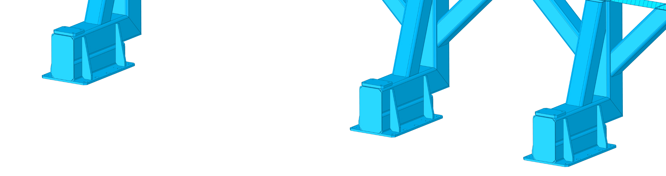
DCM Overview
Adjustment &
support systems
Cu-Cu Splices
DFX
Side
NbTi Busbars
Services
Cu Busbars
Diodes Stack
Diodes IFS
Cu-NbTi splices
NbTi-NbTi splices
Lambda Plate
D1 Side
Helium Vessel
Thermal Shield
Vacuum Vessel
D1 splices
Frame
4

Slide 5
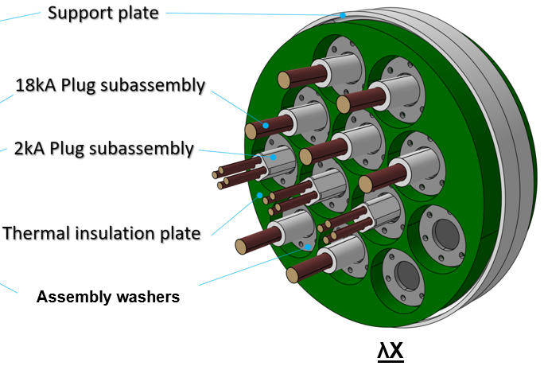
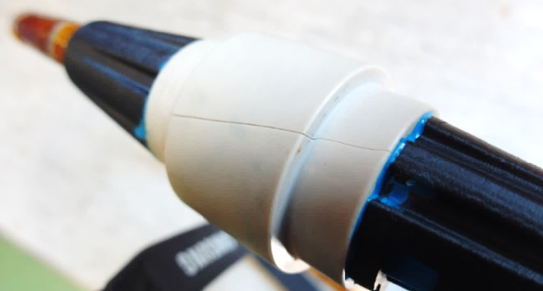
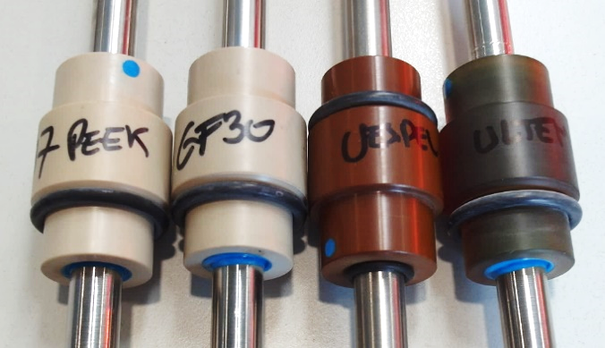
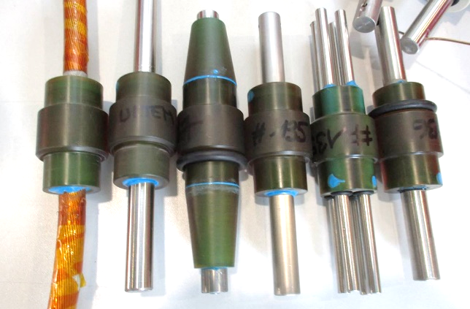
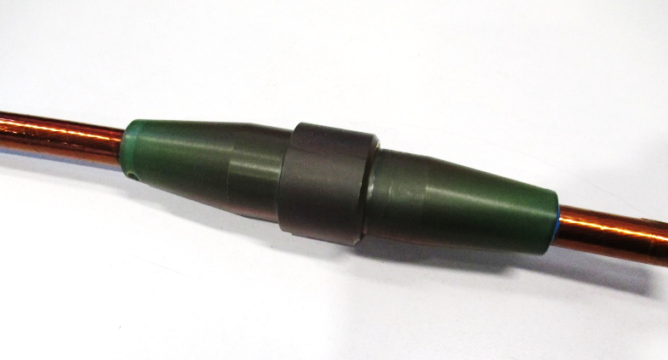
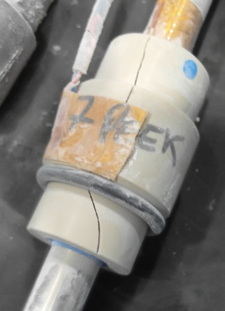
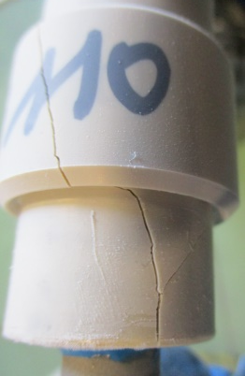
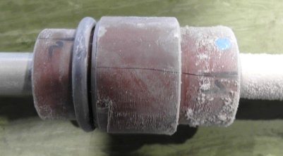
Design & qualification phase : λ-Plate
Follow-up Eng. Review #2 in Jun.22
➔ Validation of “Electrical Insulator” material replacement
DCM-DFX Lambda Plate illustration
Q2-2021: Unexpected rupture of PEEK plug during QC
➔ Q2-2022: Intense test campaign to quantify the margin of PEEK wrt thermal contractions & test various materials
Intense qualification campaign with ULTEM1000 :
Thermal cycles 300K-77K
Leak test at 77 K
200 x Quench simulations on knife edge at 77 K
June 2022 :
Convincing qualification campaign
+ LHC experience
➔ Decision to replace PEEK by ULTEM
PEEK & VESPEL presented limited margins during (violent) thermal cycling to 77K

Slide 6
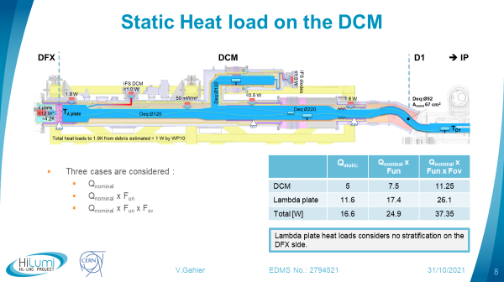
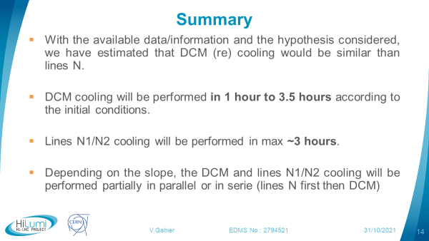
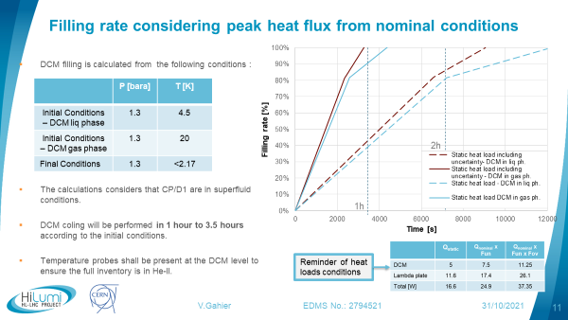
Design & qualification phase : DCM
Follow-up Eng. Review #2 in Jun.22 ➔ Study Quench recuperation time in DCM wrt IT magnets
WP9 performed a preliminary analysis on the IT system (EDMS 2794521)
  Order of magnitudes :
  Preliminary conclusions
    DCM diodes & IT N-lines will reach superfluid phase for similar durations (up to 3 hours) in parallel or in series depending on slope directions
➔ no design change to be implemented wrt quench recuperation time
Preliminary estimations HL-LHC IT
(without DCM & Line N ≈ 39 MJ)
≈ 9h
LHC IT (≈ 2 MJ)
≈ 6h
LHC arc magnets (≈ 40 MJ)
≈ 14h
Indications of
Quench recuperation times
Courtesy WP9 – V.Gahier

Slide 7
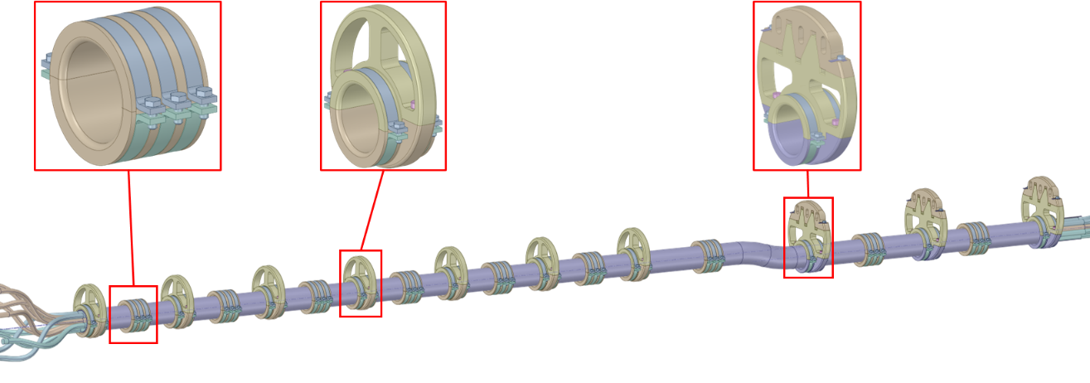

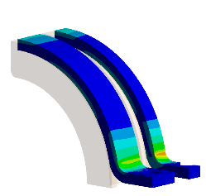
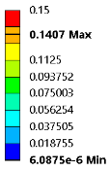
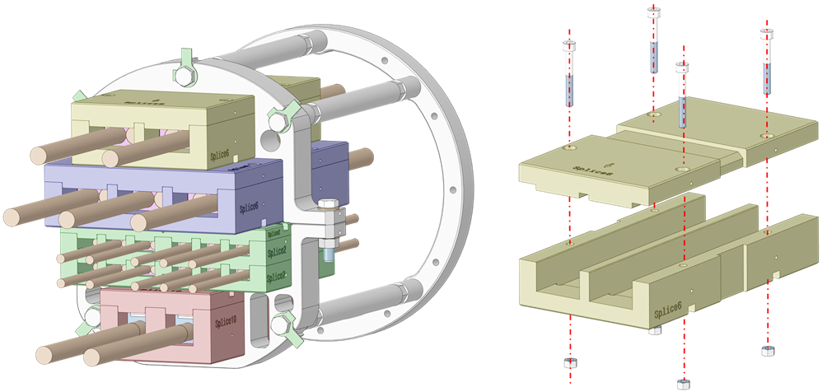
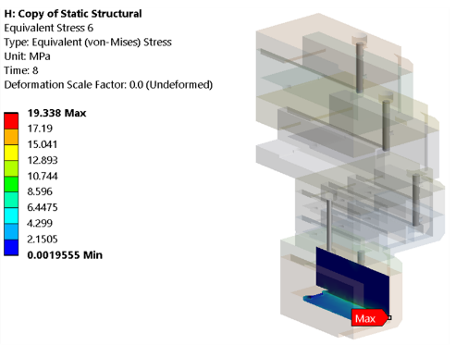
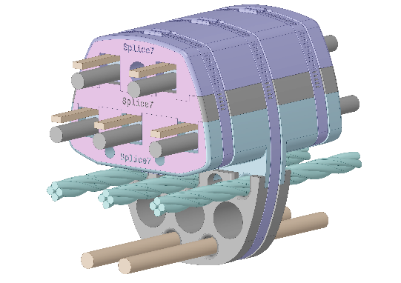
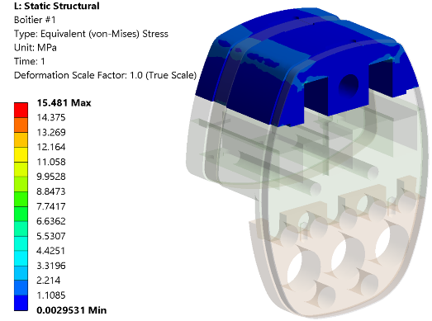
Design & qualification phase : Status
 |  |  | Status
1 | NbTi Plugs x 10 | Specifications.: Functional EDMS 2507629 Technical EDMS 2692793 | D: ✔ Q: final cable pending
2 | Vacuum Vessel | Drawing folder : EDMS 2649183 | ✔
3 | Helium Vessel | Drawing folder : EDMS 2664287 | ✔
4 | Thermal Shield | Drawing folders : EDMS 2688803 EDMS 2691309 | ✔
5 | Instrumentation | Cryo : LHCLSQRG0001 Elec : EDMS 24118222 | ✔
6 | MLI | ST1158927 | ✔
7 | Cu busbars | ST1158927 | ✔
8 | Diodes stack | Status : indico1161569 | ✔
9 | IFS flange | EDMS 2385591 | ✔
10 | Cable guides | In collaboration with LMF | 80%
11 | Splices support | In collaboration with LMF | 80%
12 | Support Frame | STRING : LHCLDQD_0367 LHC tunnel | ✔ Due by mid-2023
Qualification of handling and bending radius to be validated with final cable
DCM cables’ routing supports, final design phase
DCM splices boxes’ structural analysis EDMS 2773790
In collaboration with LMF section
In collaboration with LMF section

Slide 8
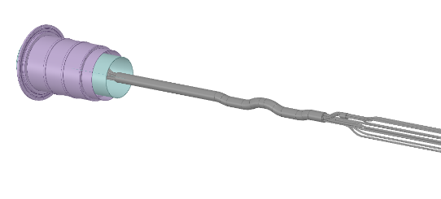
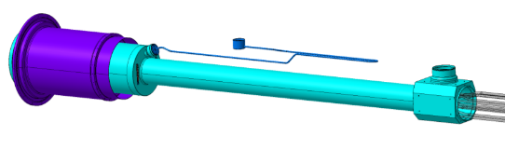
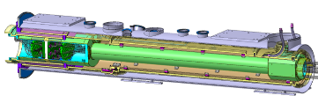
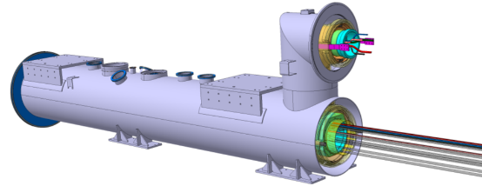
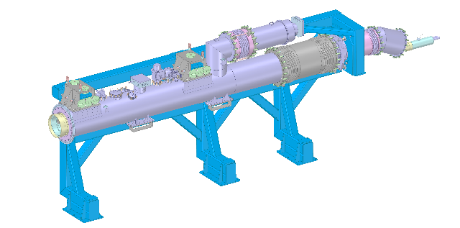
DCM structure & Assembly Sequence
Procurement
Assembly
In surface (SMI2)
Installation in Tunnel (String)
NbTi cables
Plug
Vacuum Vessel
Helium Vessel
Thermal Shield
Cable guides
Instr. Hardware
MLI
Cu busbars
Diodes stack
IFS flange
Ancillaries
Support frame
Splices Support

Slide 9
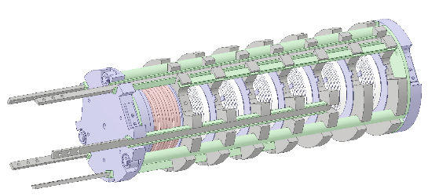
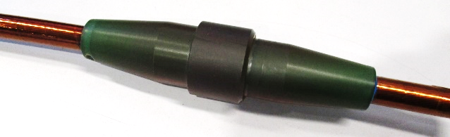
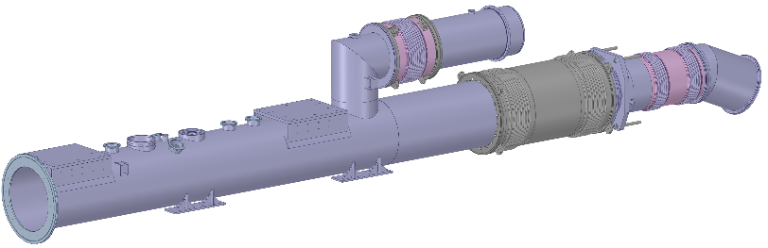
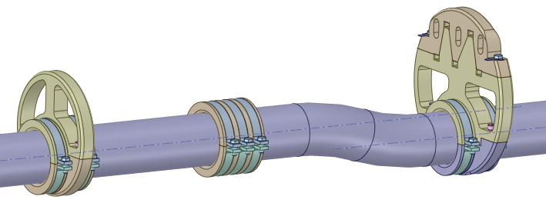
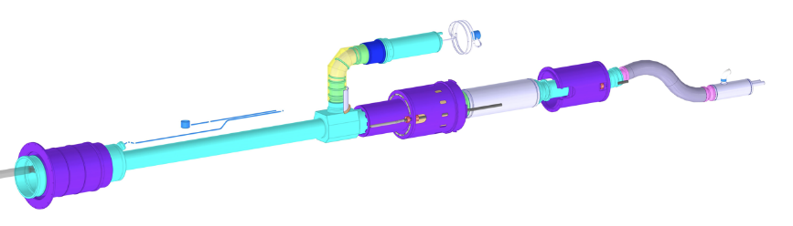
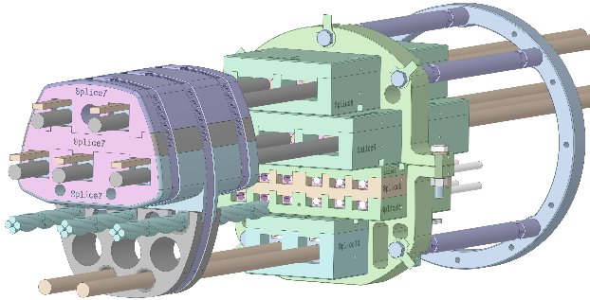
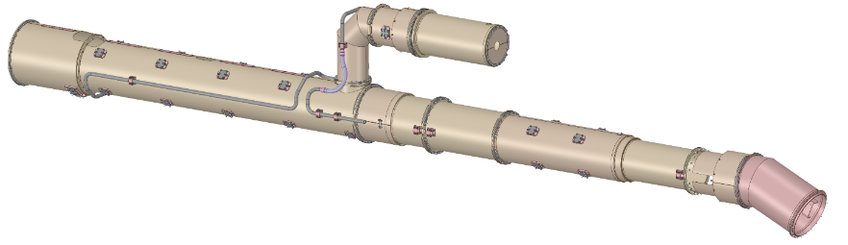
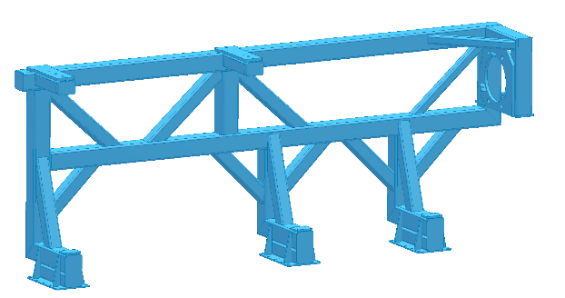
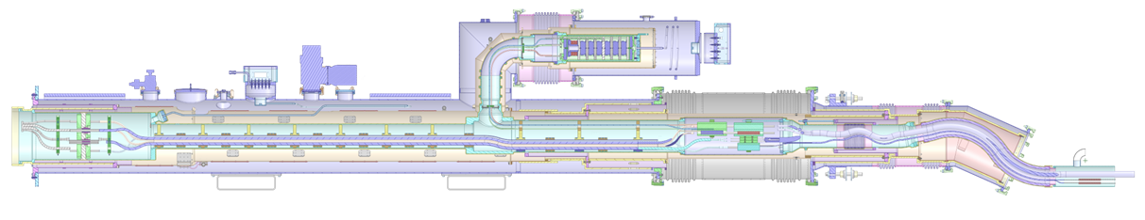
Pre-series : procurement
N | Component | Source | Status
1 | NbTi Plugs x 10 NbTi busbars Manufacturing & QC | TE-MSC sub-contract TE-MSC-CMI |  
2 | Vacuum Vessel | EN-MME workshop | 90% 12.22
3 | Helium Vessel | EN-MME workshop | 80% 01.23
4 | Thermal Shield | EN-MME sub-contract | ✔
5 | Instrumentation | CERNOX : TE-CRG Wires : TE-MSC | ✔ 
6 | MLI | RUAG | ✔
7 | Cu busbars | CERN store | 01.23
8 | Diodes stack | TE-MPE | ✔
9 | IFS flange x2 | TE-MSC & TE-MPE | ✔
10 | Cable guides | TE-MSC-LMF | 01.23
11 | Splices support | TE-MSC-LMF | Q2.2023
12 | Support Frame | EN-MME sub-contract | 05.23
1
8
10
2
3
11
4
12
2
8
9
7
5
1
10
11
3
6
4

Slide 10
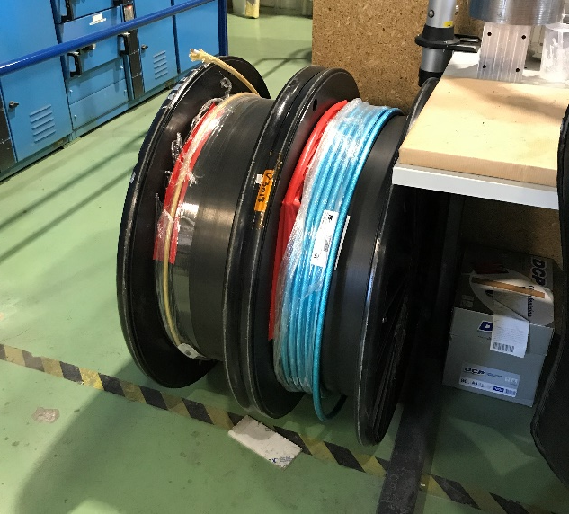
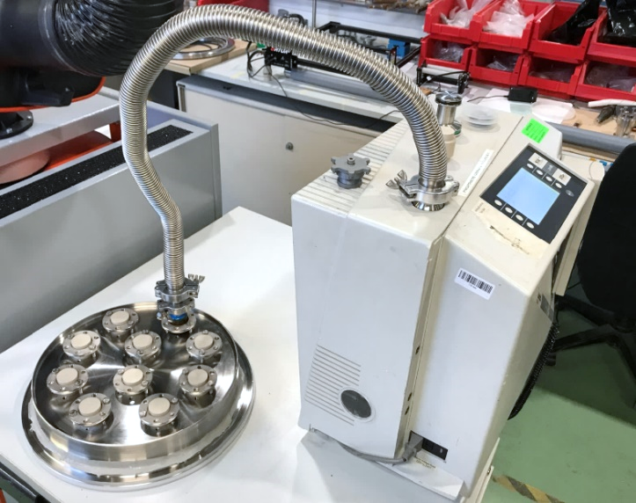
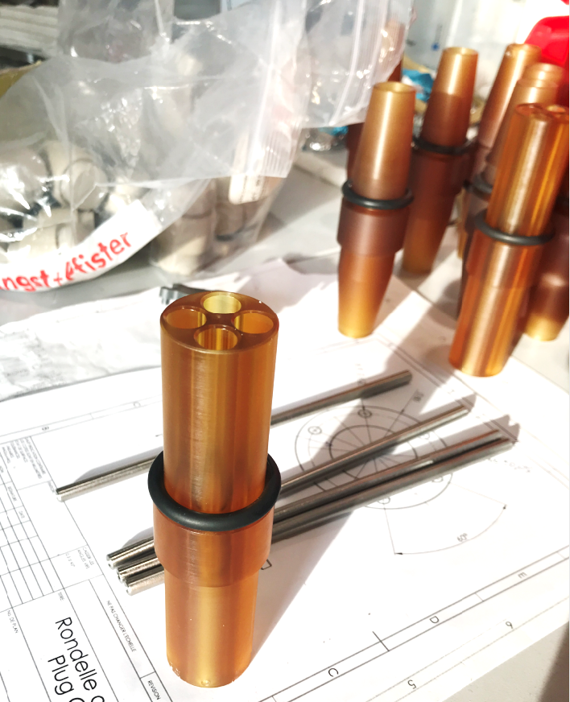
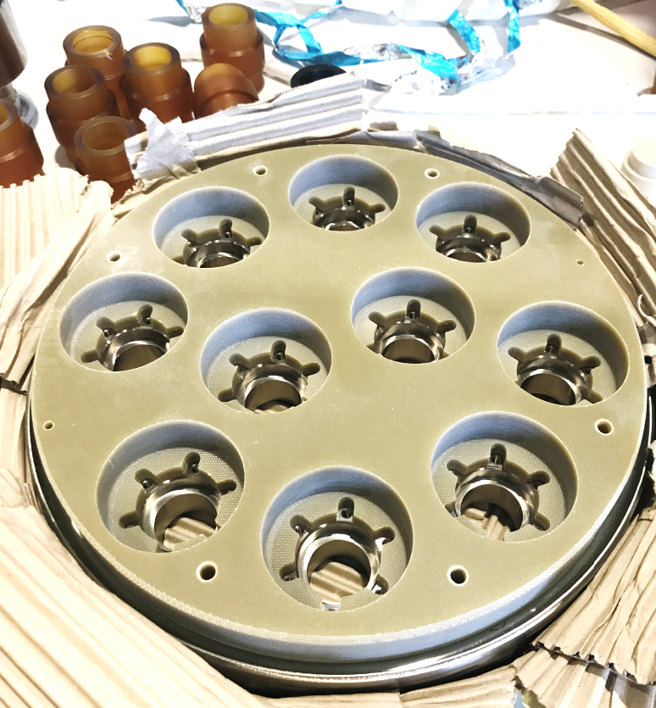
Pre-series : procurement
NbTi BB samples in SMI2
Lambda Plate plug interfaces leak testing
 |  | Source | Status
1 | NbTi Plugs x 10 NbTi busbars Manufacturing & QC | TE-MSC sub-contract TE-MSC-CMI |  
NbTi busbars
  Demonstrators delivered in Q3-2022
  Ok wrt plug production, rigid for routing
  ➔ Waiting for delivery of more flexible version
Lambda Plate components
  Ultem parts machined
  Thermal insulating plates received
  Plugs/SS plate leak tight interfaces being leak tested
ULTEM machined parts
Thermal insulation plates

Slide 11
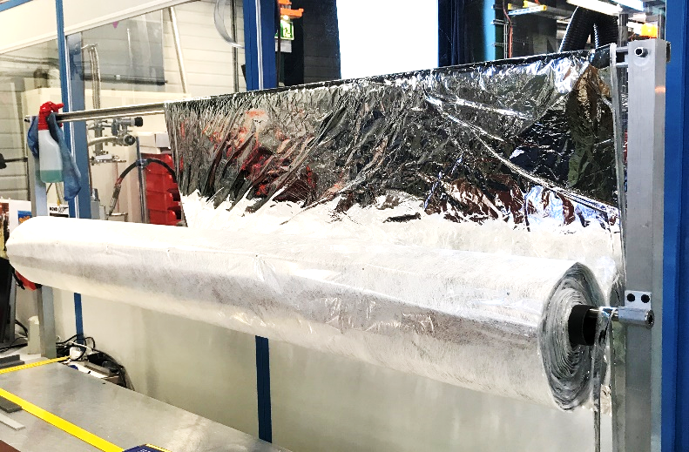
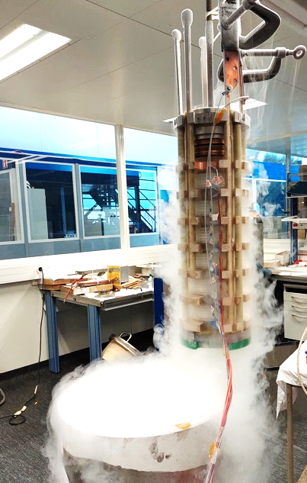
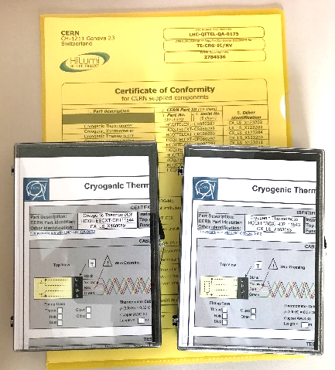
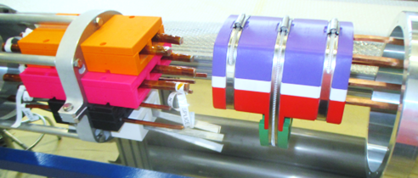
Pre-series : procurement
 |  | Source | Status
4 | Thermal Shield Tech. Spec. EDMS 2681854 | EN-MME sub-contract | ✔
5 | Instrumentation | CERNOX : TE-CRG Wires : TE-MSC | ✔ 03.23
6 | MLI | RUAG | ✔
7 | Cu busbars | CERN store | 12.22
8 | Diodes stack | TE-MPE | ✔
9 | IFS flange x2 | TE-MSC & TE-MPE | ✔
10 | Cable guides | TE-MSC-LMF | 01.23
11 | Splices support | TE-MSC-LMF | Q2.2023
12 | Support Frame | EN-MME sub-contract | 05.23
MLI for DCM pre-series
CERNOX for DCM pre-series
Instrumentation Wires
  Delays due to CERN internal process
  May require to borrow some from CRN group stocks
Cable guides : Final design in progress
  Need : T0 + 4 months
Splices support : Final design in progress
  Need for STRING : DCM/D1 interconnection Q4-2023
Support frame specific for STRING
  6 months from drawings release (within days)
  Needed in Q4-2023 after BB pulling through IT magnets
Diodes stack for DCM pre-series
Thermal Shield
Mock-up splices stack (courtesy TE-MSC-LMF)

Slide 12
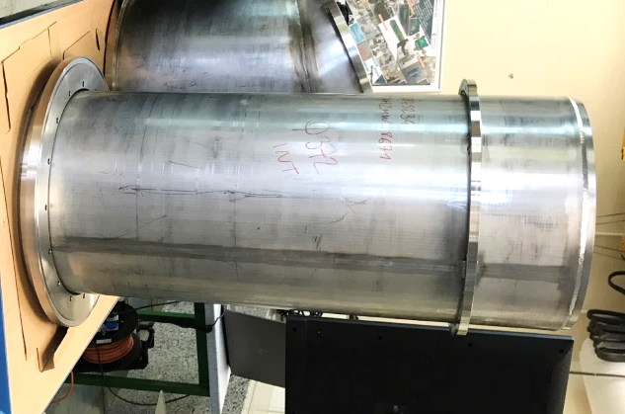
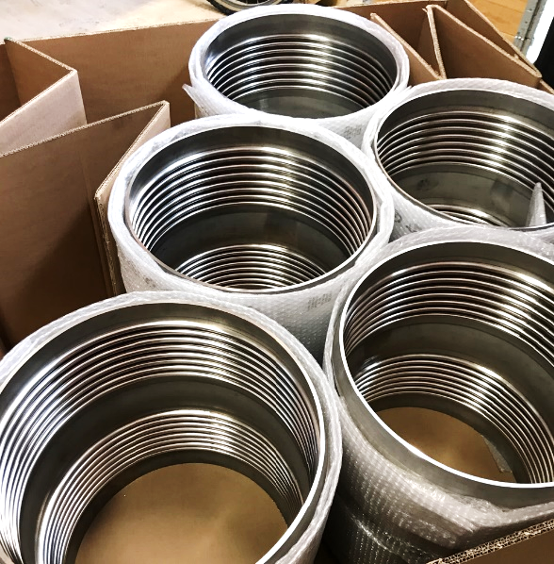
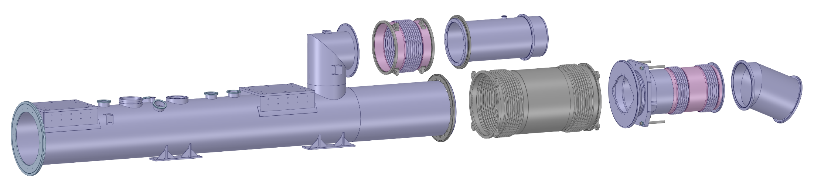
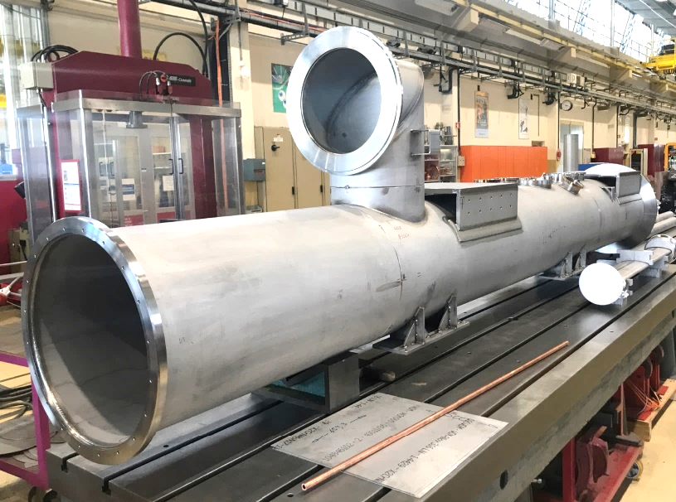


Pre-series : procurement
 |  | Source | Status
2 | Vacuum Vessel Tech. Spec. EDMS 2515149 | EN-MME workshop (bellows sub-contracted) | 90%
Vacuum Vessels
  Forming & welding completed - QC in progress
  Pre-series available by EOY 2022
Vacuum Vessel Bellows
  Sub-contracted through EN-MME
  1st delivered set presents non-conformities ➔ action in place
  Available in due time by EOY 2022
Manufacturing | ✔
Metrology | ✔
Leak test | 
Manufacturing | ✔
Metrology | ✔
Leak test | 
Manufacturing | ✔
Metrology | ✔
Leak test | 
Manufacturing | ✔
Metrology | ✔
Leak test | 

Slide 13










Pre-series : procurement
Manufacturing | ✔
Metrology | 
Leak test | 
Manufacturing | 
Metrology | 
Leak test | 
 |  | Source | Status
3 | Helium Vessel Tech. Spec. EDMS 2519812 | EN-MME workshop (bellows sub-contracted) | 60%
Manufacturing | 
Metrology | 
Leak test | 
Manufacturing | ✔
Metrology | ✔
Leak test | 
Manufacturing | 60%
Metrology | 
Leak test | 
Manufacturing | ✔
Metrology | ✔
Leak test | 
Manufacturing | 50%
Metrology | 
Leak test | 
Manufacturing | ✔
Metrology | ✔
Leak test | 
Manufacturing | ✔
Metrology | ✔
Leak test | 

Slide 14





























Pre-series : Assembly
Assembly start = Availability of NbTi BB + 3 months
Strategy
  Where : in SMI2 ✔
  Who : TE-MSC-CMI technicians with EN-MME support for welding activity ✔
Preparation work
  Assembly procedure 
  Assembly tooling 
  Welding book (in collaboration with EN-MME) 
  QC testing procedures being finalized 
Main body assembly sequence
Extract of welding book in collaboration with MME

Slide 15

Pre-series : Installation in STRING
Sequence : DCM & frame installed in Q4-2023 after
  Busbars routing through Q1 to D1
  Cold Powering installation
Contribution to WP16 – EDMS 2188576 (Eng. Check)
Interconnection by TE-MSC – EDMS 2755342 (In work)
DSHX
Courtesy A.Kosmicki, WP16
DFX
DCM
D1

Slide 16

Series : procurement
 |  | Source | Status / Delivery
1 | NbTi Plugs x 10 NbTi busbars Manufacturing & QC | TE-MSC sub-contract TE-MSC-CMI |  
2 | Vacuum Vessel | Raw material : procured through EN-MME Sub-contract - EN-MME DO-33445 | 100% @ CERN ✔ Contract signed ✔ 2023 : Mar. x1 - Q3/Q4 x3
3 | Helium Vessel | Raw material : procured through EN-MME Manufacturing : Sub-contract & EN-MME workshop | 100% Ordered ✔ Waiting for raw material Delivery Q1-Q4 2023
4 | Thermal Shield | EN-MME sub-contract for pre-series + series | 100% manufactured ✔ Delivery : 12.2022
5 | Instrumentation | CERNOX : TE-CRG Wires : TE-MSC | ✔ 
6 | MLI | RUAG | 
7 | Cu busbars | CERN store | Q1-2023
8 | Diodes stack | TE-MPE | Diodes : ✔ Delivery series : 2023-2024
9 | IFS flange x2 | TE-MSC & TE-MPE | 
10 | Cable guides | TE-MSC-LMF | Q2-2023
11 | Splices support | TE-MSC-LMF | Q4-2023
12 | Support Frame | EN-MME sub-contract | 2024 
CERNOX for DCM (not diodes) 100% supplied

Slide 17
Series : Assembly preparation
Assembly in series in SMI2
DCM series availability
  #1 : Q2-2024
  #2 : Q4-2024
  #3 : Q1-2025
  #4 : Q2-2025
Storage in Flex building

Slide 18

Series : Installation in LHC tunnel
Installation in LHC tunnel from 2026
After installation of IT magnets (BB routing from Q1 to D1) & Cold powering installation

Slide 19

Summary
DCM pre-series assembly starts 3 months after NbTi cables delivery (duration for plug production)
Procurement
  Well advanced for pre-series
  In progress and well within schedule for series long lead items
Preparation of pre-series assembly in progress
DCM pre-series available for STRING installation in Q4-2023 assuming NbTi cables are available by EOY 2022

