Slide 1
The FiDeL model for the MCBXF orbit corrector for HL-LHC
Agnieszka Chmielińska, Lucio Fiscarelli, Ezio Todesco
WP3 Meeting, 02.11.2022

Slide 2
Part 1: Introduction
Keywords: FiDeL, MCBXF

Slide 3
The FiDeL Model
The Field Description of the LHC (FiDeL) is the magnetic field prediction system that provides a model of the transfer function of magnetic circuits installed in the machine in order to retrieve the current level given the required field
→ indispensable for LHC operation.
The model is based on a physical decomposition of effects that contribute to the total ﬁeld in the aperture of the magnet.
The model uses several levels of approximations, starting from a linear dependance on the current (ideal magnet) and adding correction terms (depending on the magnet type and function) to describe nonlinear effects.
The prediction of the field is based on static (current, ramp-direction dependent) and dynamic (time, ramp-rate dependent) components.

Slide 4


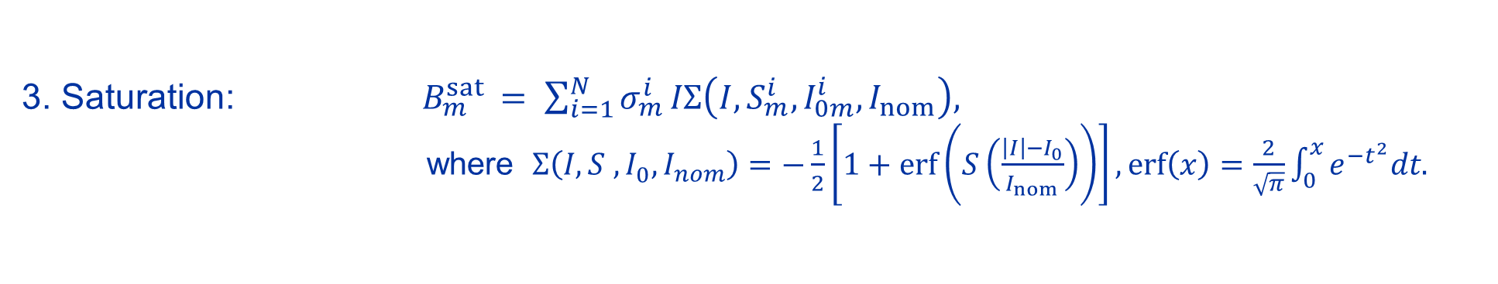
Static components: Parametrization
1. Geometric: $B_{m}^{geo }= γ_{m}^{ }I.$
2. DC Magnetization: $B_{m}^{mag }= μ_{m}^{ }\left|I\right|{\left(\frac{I_{inj }}{\left|I\right|}\right)}^{2−p_{m}}{\left(\frac{I_{c }−\left|I\right|}{I_{c }−I_{inj }}\right)}^{q_{m}}$ ${\left(\frac{{T_{c0 }}^{1.7}−{T_{ }}^{1.7}}{{T_{c0 }}^{1.7}−{T_{meas }}^{1.7}}\right)}^{h_{m}}.$
3. Saturation: $B_{m}^{sat }= \sum_{i=1}^{N}{σ_{m}^{i}}IΣ\left(I, S_{m}^{i},I_{0m}^{i},I_{nom}\right),$
where$Σ\left(I, S_{ }^{ },I_{0}^{ },I_{nom}\right)=−\frac{1}{2}\left[1+\operatorname{erf}\left(S\left(\frac{\left|I\right|−I_{0}}{I_{nom}}\right)\right)\right], \operatorname{erf}\left(x\right)=\frac{2}{\sqrt{π}}\int_{0}^{x}{e^{−t^{2}}dt.}$
4. Residual
Magnetization:
$B_{m}^{res }= ρ_{m}^{ }\left|I\right|{\left(\frac{I_{inj}}{\left|I\right|}\right)}^{r_{m}}$.
More information:
FiDeL Website, https://lhc-div-mms.web.cern.ch/tests/MAG/Fidel/
$$m_{ }^{ }−multipole order$$
  The fitting parameters are implemented in the LHC control system.

Slide 5
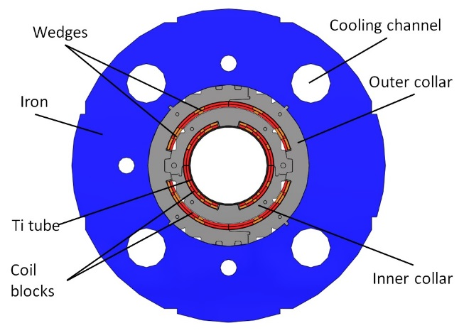
MCBXF B / A
Parameter | Value (B / A)
Aperture (mm) | 150
Magnetic length (m) | 1.2 / 2.2
Int. field (Tm) | 2.5 / 4.5
Current inner (A) | 1580 / 1584
Current outer (A) | 1430 / 1402
This presentation will focus on the MCBXFB version of the magnet for which magnetic measurements are already available.
  Inner coil provides vertical field (main field B1, normal).
  Outer coil provides horizontal field (main field A1, skew).
  For MCBXF, the development of FiDeL model is particularly challenging and involves
  non-standard approach → the first ideas and results will be discussed in this talk.

Slide 6
Part 2: Identifying the problem

Slide 7
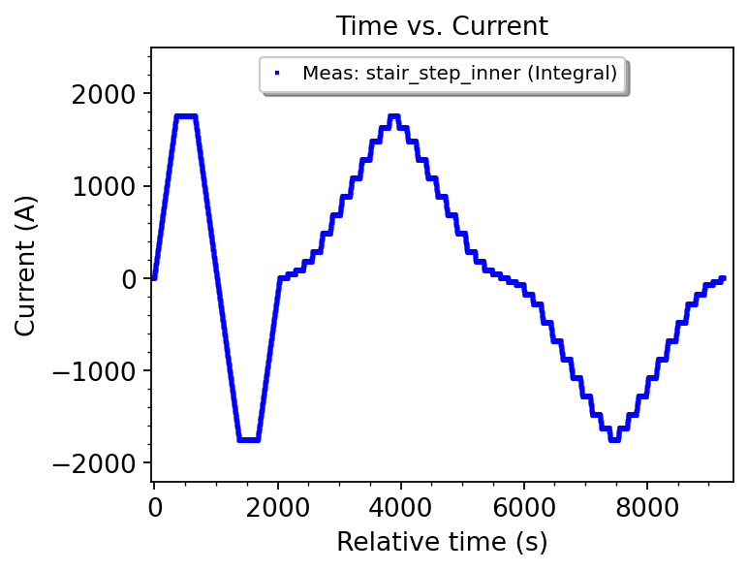
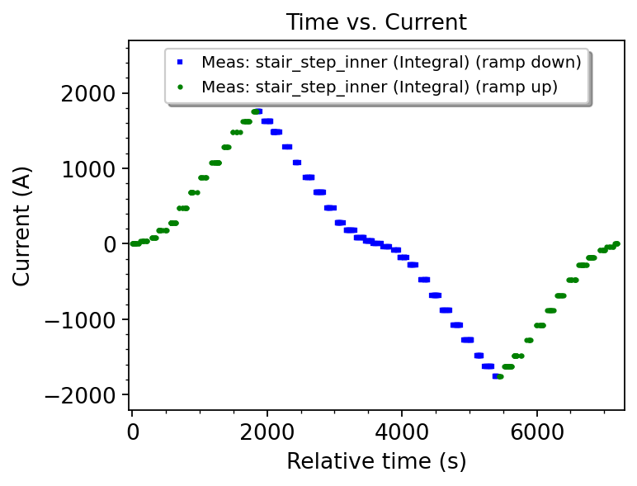
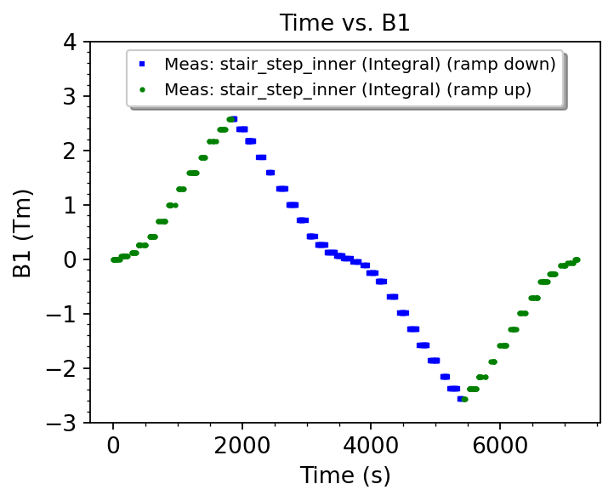
Analysis of the magnetitic measurements for standard reference cycle: Inner aperture (B1)
  The magnet is pre-cycled up to nominal current (±1755 A) followed by a stair-step profile.
  The magnetic field is measured with high accuracy (better than 10⁻⁴) at plateaus.
  The analysis is performed for the data points measured at plateaus after filtering.

Slide 8
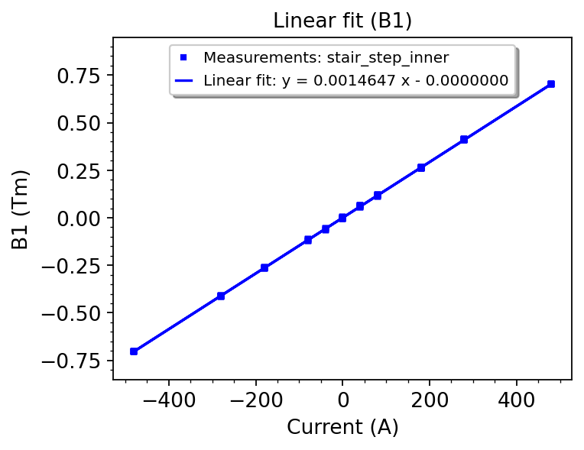
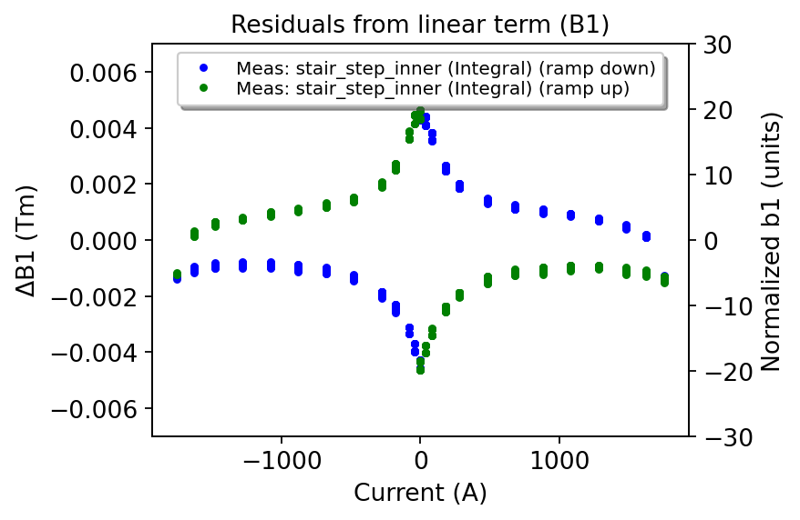
Geometric term and residuals (B1)
  The geometric term is computed for datapoints within the linear range (below saturation).
  A non-linearity is observed in the residuals from the linear term, normalized to the nominal field of 2.5 Tm.
  The saturation at high field is below 6 units.
  The maximum error from linear term is ±20 units mainly due to magnetization at low field.

Slide 9
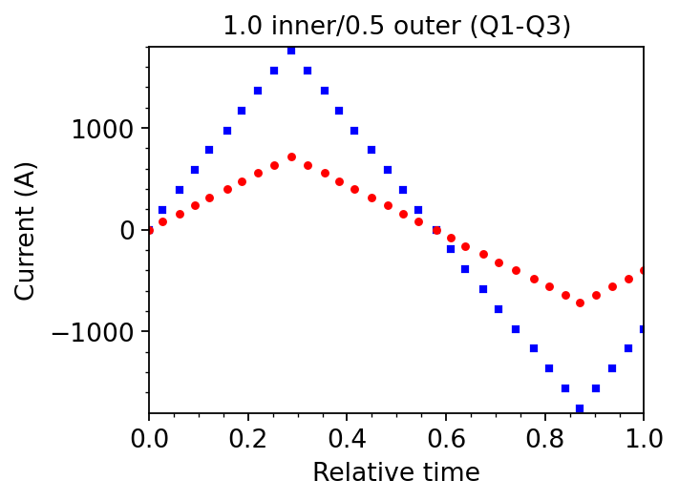
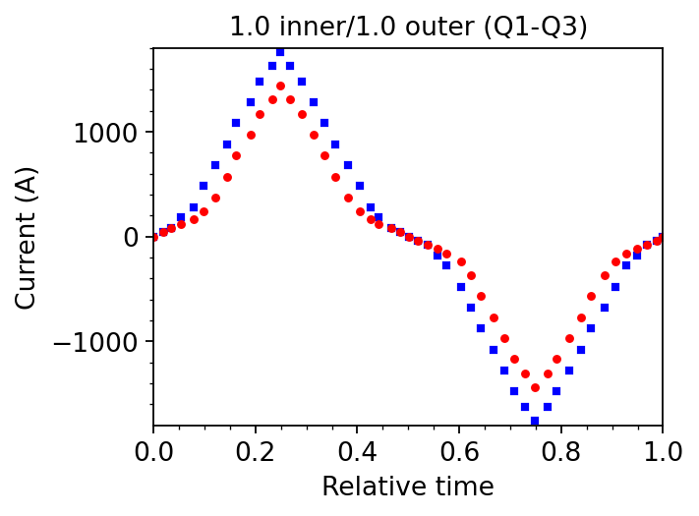
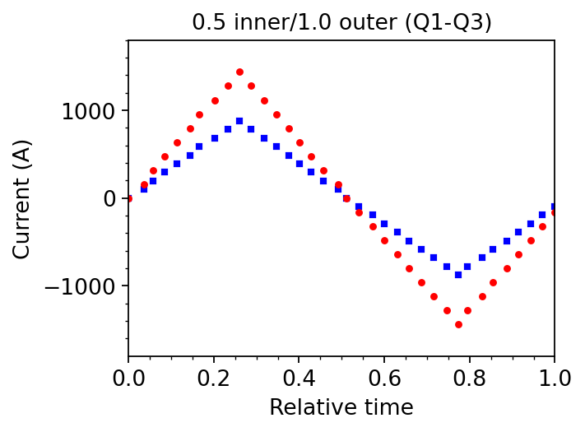
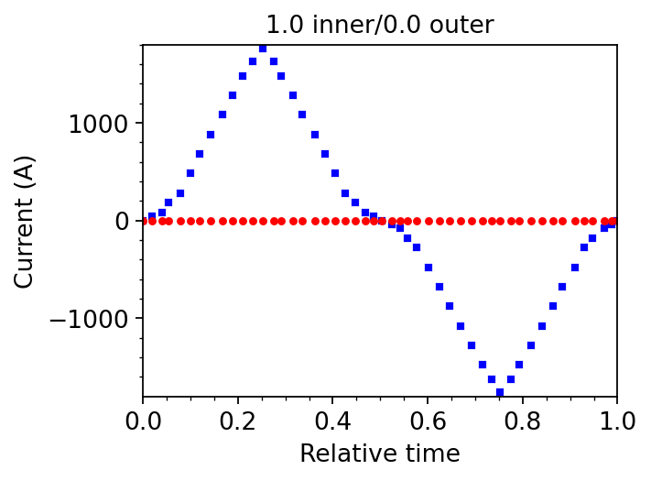
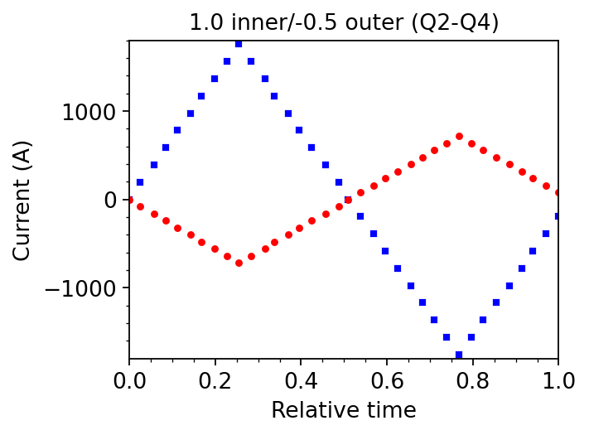
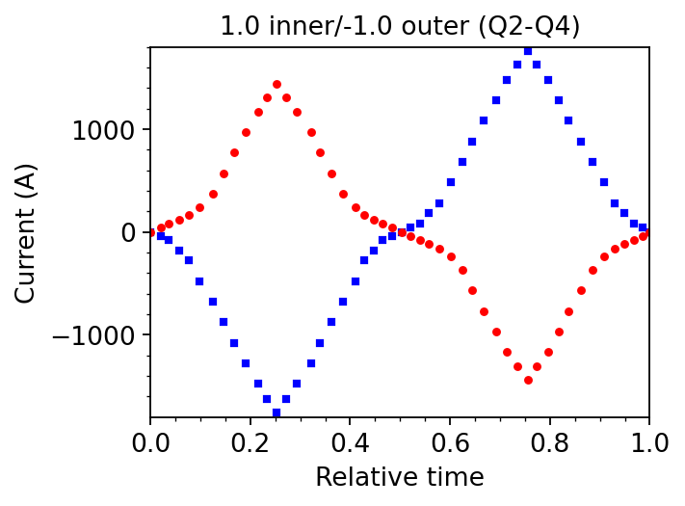
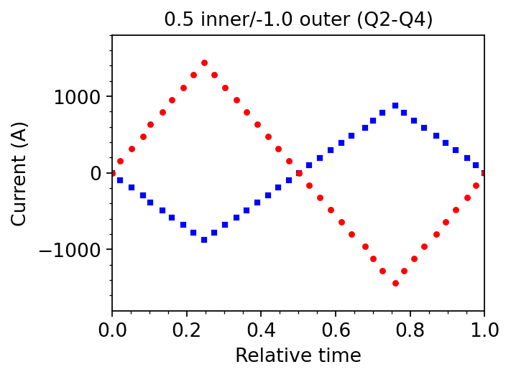
What is the relative error from the linear term if also the outer aperture is powered?
Examples of analyzed
powering schemes:

Slide 10
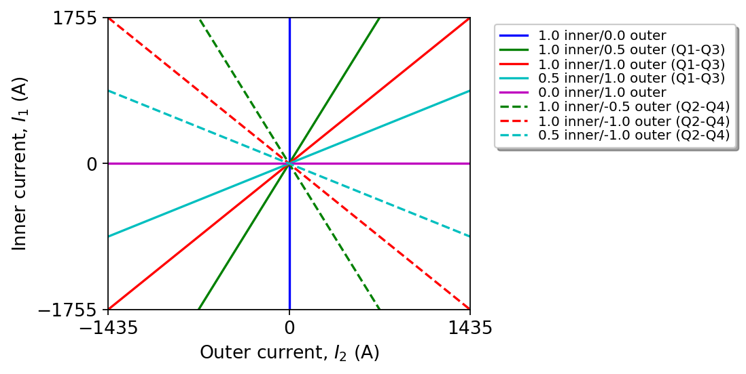
What is the relative error from the linear term if also the outer aperture is powered?

Slide 11
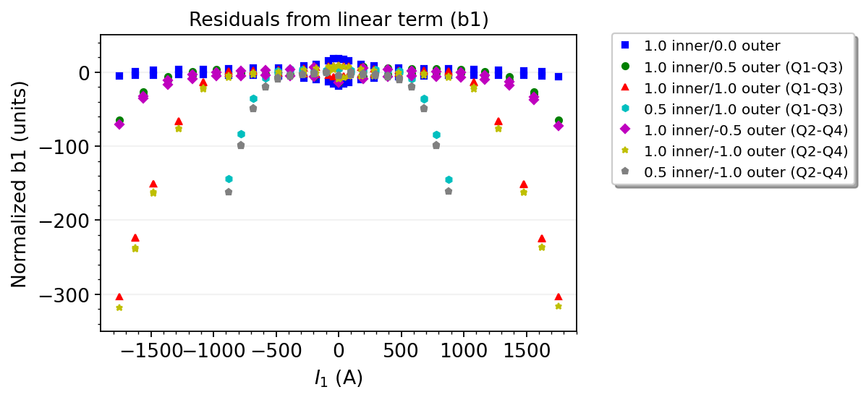
Relative error from the linear term (B1)
  Saturation behavior poses unique implications for the FiDeL model of nested orbit correctors…
  The results are similar for cycles of the same polarity (Q1-Q3) and cycles of inverse polarity (Q2-Q4):
  maximum difference is 20 units for both coils powered at nominal current.
  The saturation at high field increases as a function of current in the inner & outer coil (up to 320 units).

Slide 12
Challenges
A standard approach of using a single fit for the main/skew field is not applicable
if high accuracy is demanded.
Using several fits with different saturation terms for specific cycles involves high level of complexity. Moreover, it can be done for a subset of powering combinations, and it would not be accurate for other operating schemes.
Expressing the variation of saturation as a function of current in both inner and outer coils seems to be a prerequisite for developing a model in which the saturation function changes continuously and monotonically.
Proposed idea and objectives:
→ Explore the possibility of modelling angular dependence of saturation.
→ Provide a new model with low complexity.

Slide 13
Part 3: Proposed model & initial results

Slide 14
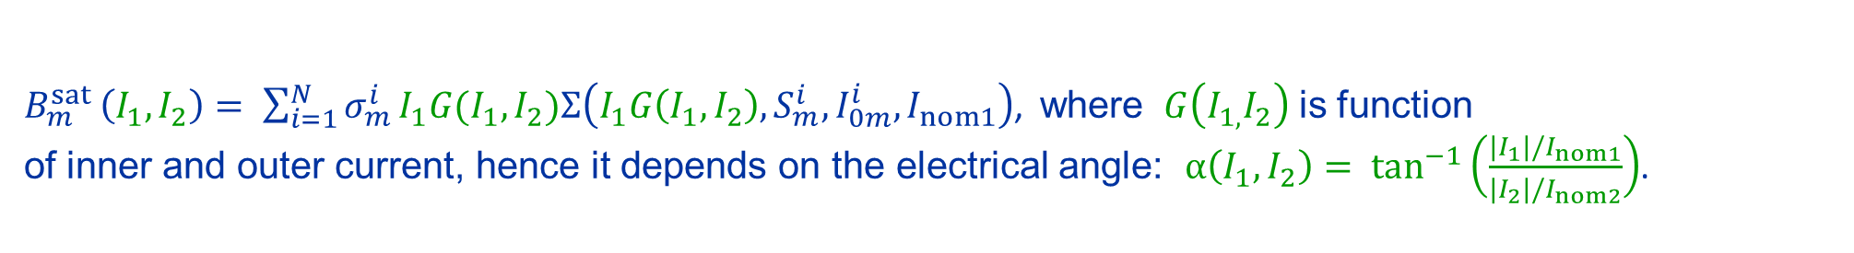
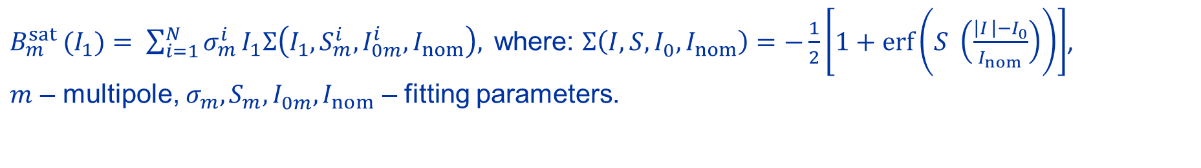
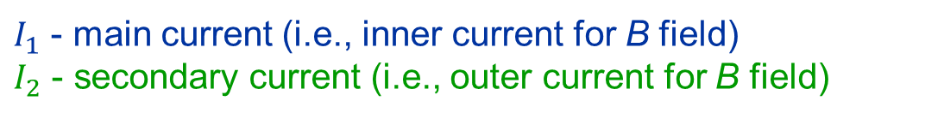
New model with angular dependence of saturation
Original definition:
$B_{m}^{sat }(I_{1})= \sum_{i=1}^{N}{σ_{m}^{i}}I_{1}Σ\left(I_{1}, S_{m}^{i},I_{0m}^{i},I_{nom}\right),$ where: $Σ\left(I, S,I_{0}^{ },I_{nom}\right)=−\frac{1}{2}\left[1+\operatorname{erf}\left(S_{ }^{ }\left(\frac{\left|I_{ }\right|−I_{0}^{ }}{I_{nom}}\right)\right)\right]$,
$m$ – multipole, ${σ_{m}^{ },S}_{m}^{ },I_{0m}^{ },I_{nom}$ – fitting parameters.
Proposal:
$$B_{m}^{sat }\left(I_{1}\right) ↦ B_{m}^{sat }(I_{1},I_{2})$$
$I_{1}$ - main current (i.e., inner current for B field)
$I_{2}$ - secondary current (i.e., outer current for B field)
New definition:
$B_{m}^{sat }\left(I_{1},I_{2}\right)= \sum_{i=1}^{N}{σ_{m}^{i}}I_{1}G(I_{1},I_{2})Σ\left(I_{1}G\left(I_{1},I_{2}\right), S_{m}^{i},I_{0m}^{i},I_{nom1}\right)$, where $G\left(I_{1,}I_{2}\right)$ is function
of inner and outer current, hence it depends on the electrical angle: $α\left(I_{1},I_{2}\right)= \tan_{ }^{−1}\left(\frac{|I_{1}|/I_{nom1}}{{|I}_{2}|/I_{nom2}}\right)$.
  Question: How to find $G\left(I_{1,}I_{2}\right)$?

Slide 15
B1 / A1

Slide 16
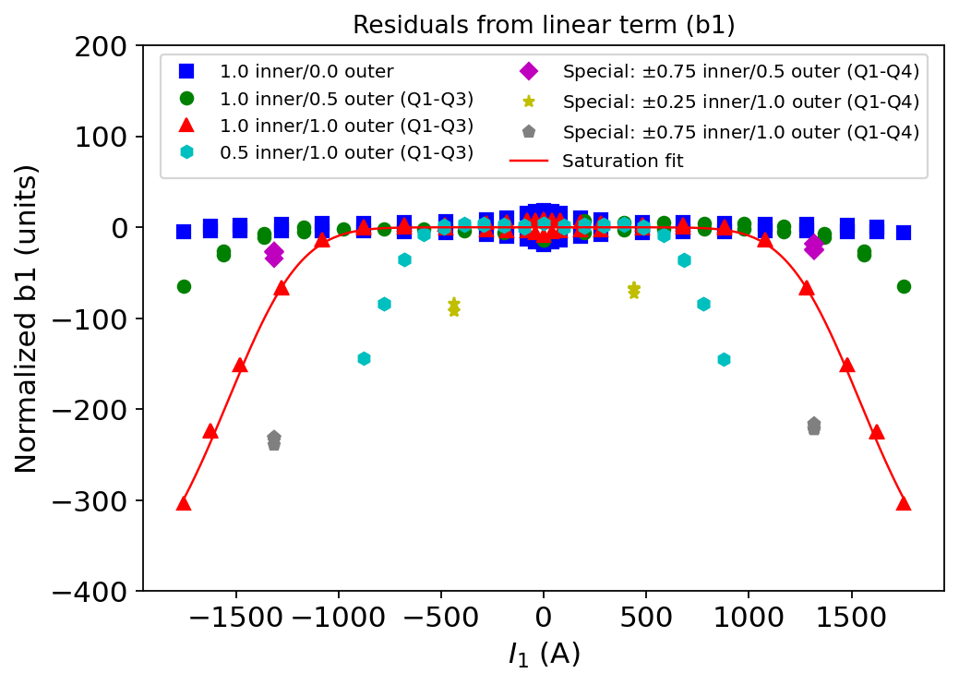
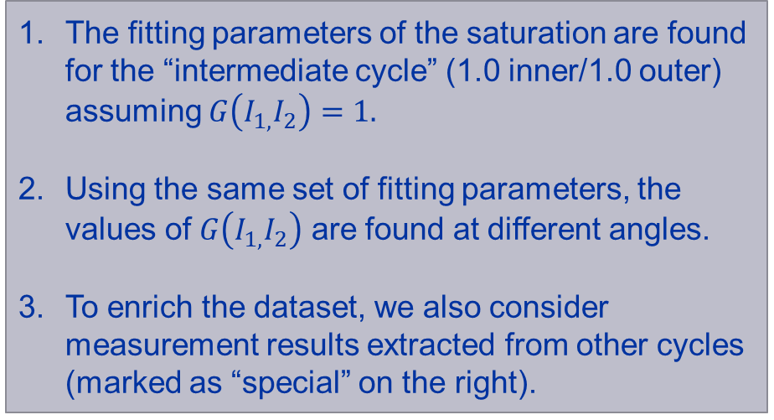

How to find $G\left(I_{1,}I_{2}\right)$?
The fitting parameters of the saturation are found for the “intermediate cycle” (1.0 inner/1.0 outer) assuming $G\left(I_{1,}I_{2}\right)=1.$
Using the same set of fitting parameters, the values of $G\left(I_{1,}I_{2}\right)$ are found at different angles.
To enrich the dataset, we also consider measurement results extracted from other cycles (marked as “special” on the right).

Slide 17
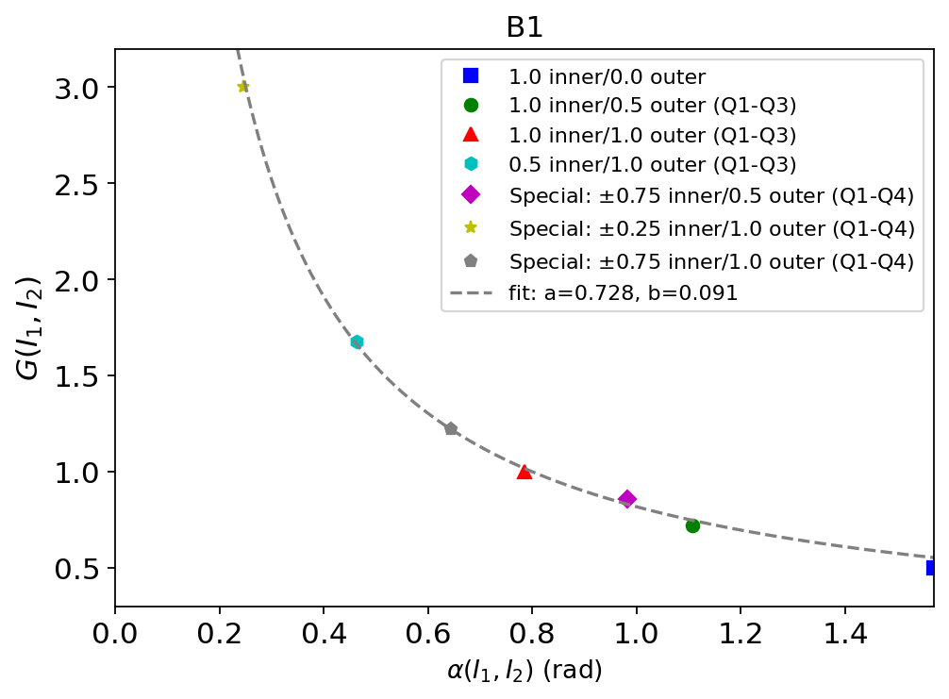
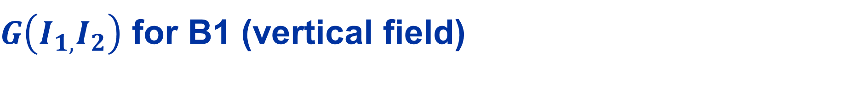


$G\left(I_{1,}I_{2}\right)$ for B1 (vertical field)
  $$G\left(I_{1,}I_{2}\right)=\frac{a}{α\left(I_{1},I_{2}\right)}+b$$
Definition:
with $a=\text{0.}\text{728 }$and $b=\text{0.0}\text{91}$.
  The function $G\left(I_{1,}I_{2}\right)$ together with the fitting parameters is determined from the experimental data.

Slide 18

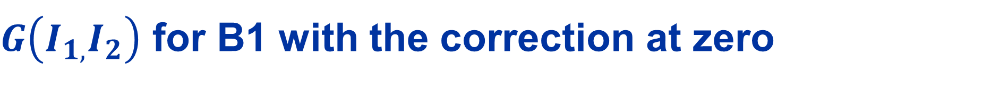


$G\left(I_{1,}I_{2}\right)$ for B1 with the correction at zero
Definition:
  $$G\left(I_{1,}I_{2}\right)=\frac{a}{α\left(I_{1},I_{2}\right)+∆}+b$$
with$a=\text{0}\text{.739 }$and $b=\text{0.0}\text{86}$.
  $G\left(I_{1,}I_{2}\right)$ includes correction $∆=0.001$ to ensure that $B_{m}^{sat }\left(I_{1}=0,I_{2}\right)=0$, since $G\left(I_{1}=0,I_{2}\right)=const.$

Slide 19
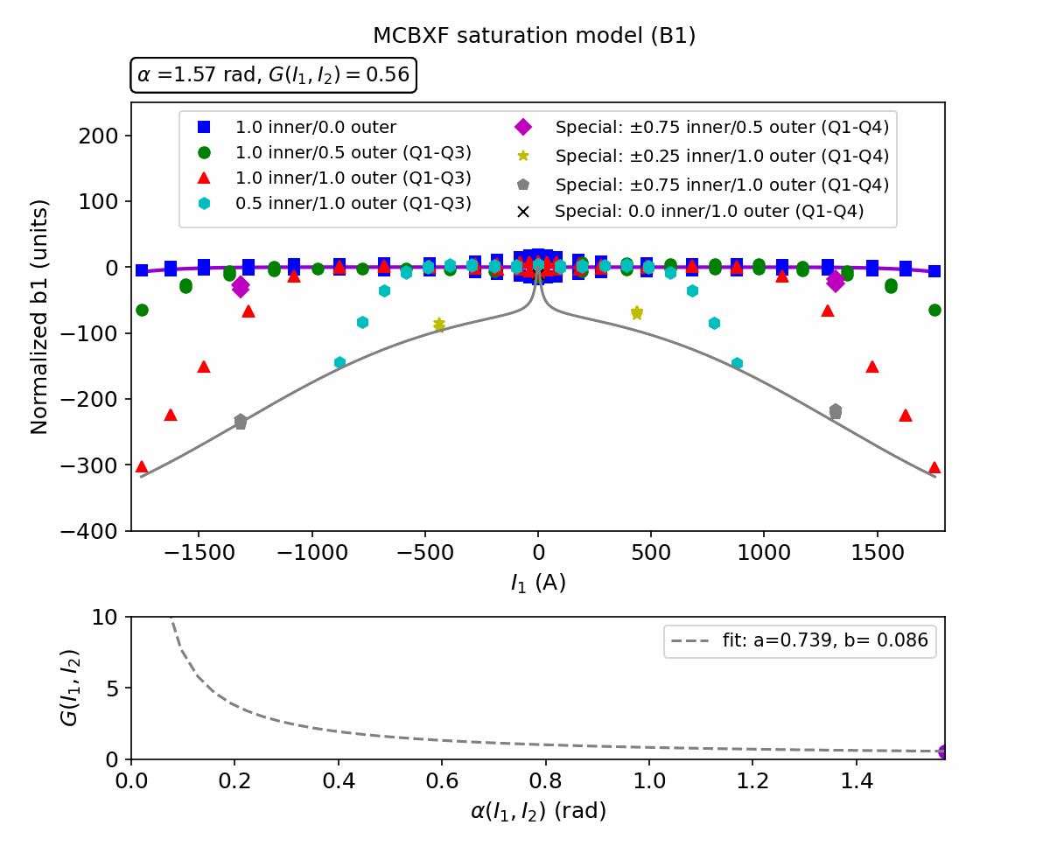
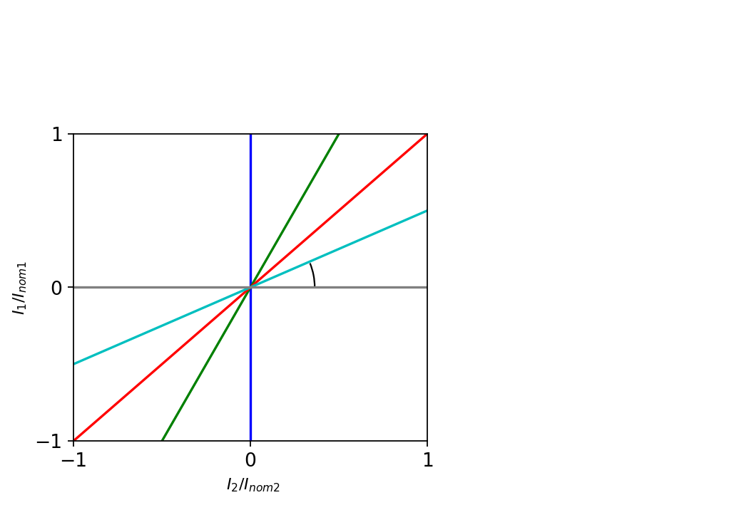

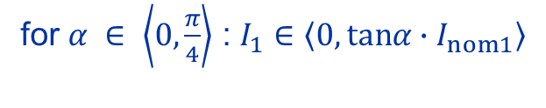


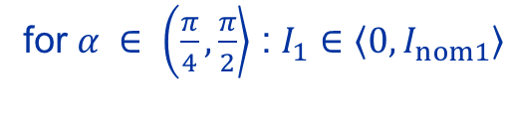
Saturation model (B1)
Working domain:
for $α ∈ \left\langle 0, \frac{π}{4}\right\rangle$ : $I_{1}∈\left\langle 0,tanα∙I_{nom1}\right\rangle$
for $α ∈ \left(\frac{π}{4}\right., \left.\frac{π}{2}\right\rangle$ : $I_{1}∈\left\langle 0,I_{nom1}\right\rangle$
$$α$$
Boundary line
$$tanα= \frac{I_{1}/I_{nom1}}{I_{2}/I_{nom2}}$$
Boundary line:
$B_{m}^{sat }\left(I_{1},I_{2}=I_{nom2}\right)$ (normalized)

Slide 20
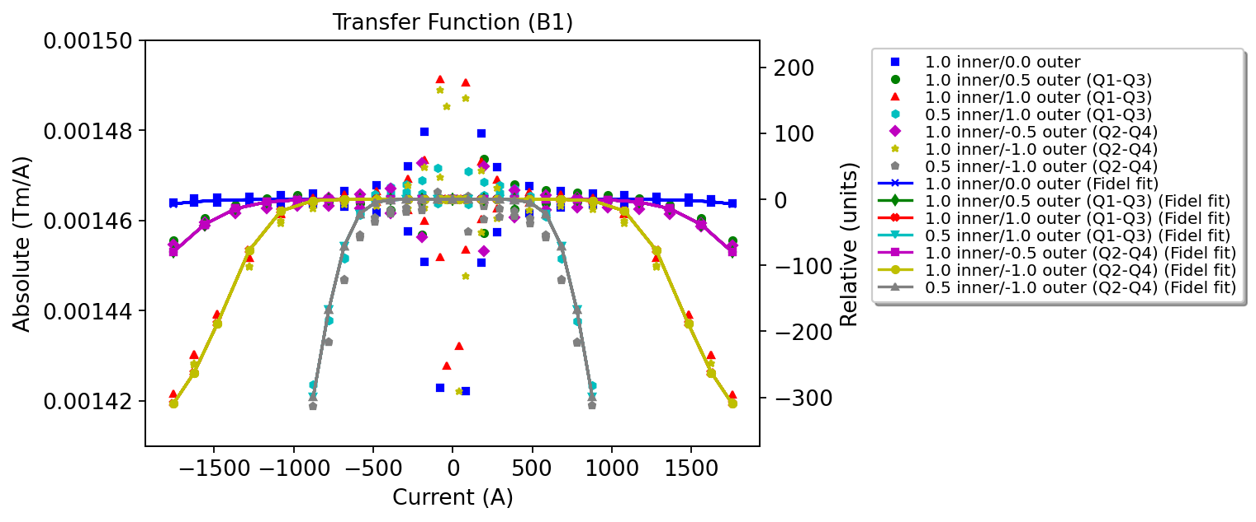
Transfer function (B1)

Slide 21
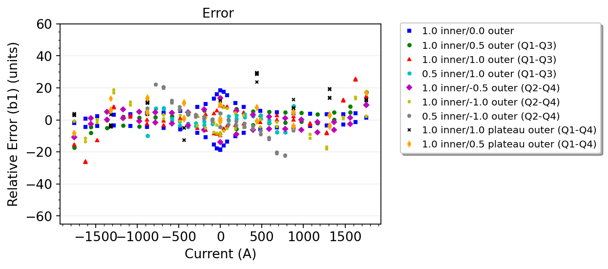
Fitting parameters & relative error (B1)
Component | Parameter | 1.0 inner/ 0.0 outer
Geometric | y | 0.0014647
Saturation | sigma1 | 0.0000485
Saturation | I01 | 1445
Saturation | S1 | 4.7
 | a | 0.739
 | b | 0.060
Constant parameters
Iinj | Ic | Tc0 | T | Tmeas | Inom1 | Inom2
117 | 15000 | 9.5 | 4.5 | 1.9 | 1755 | 1435
  The proposed model is accurate within ±30 units in the entire operating range.

Slide 22
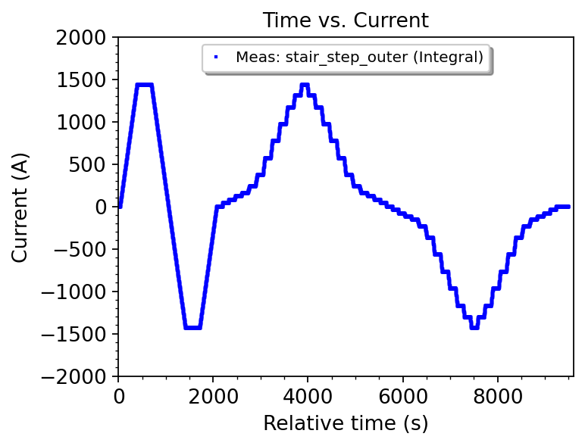
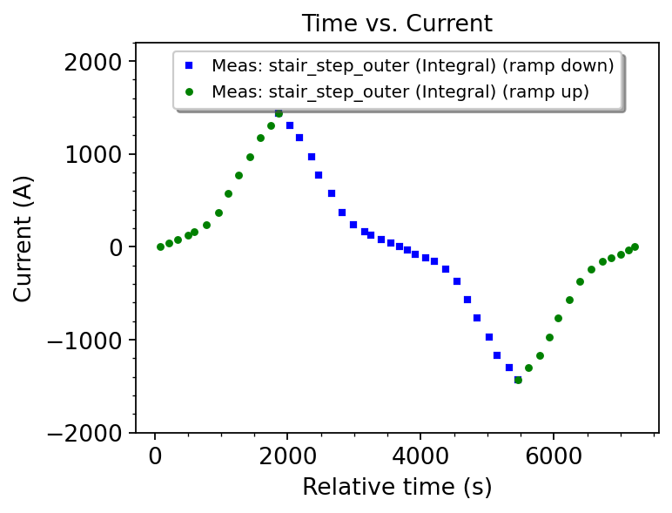
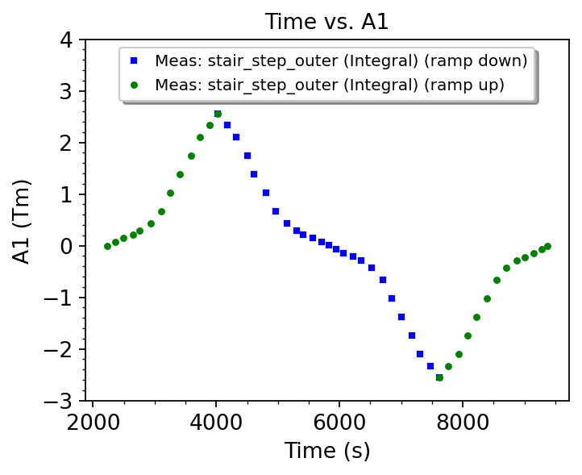
Standard reference cycle: Outer aperture (A1)
  The magnet is pre-cycled up to the nominal current (±1435 A) followed by a stair-step profile.
  The magnetic field is measured with high accuracy (better than 10⁻⁴) at plateaus.
  The analysis is performed for the data points measured at plateaus after filtering and averaging.

Slide 23
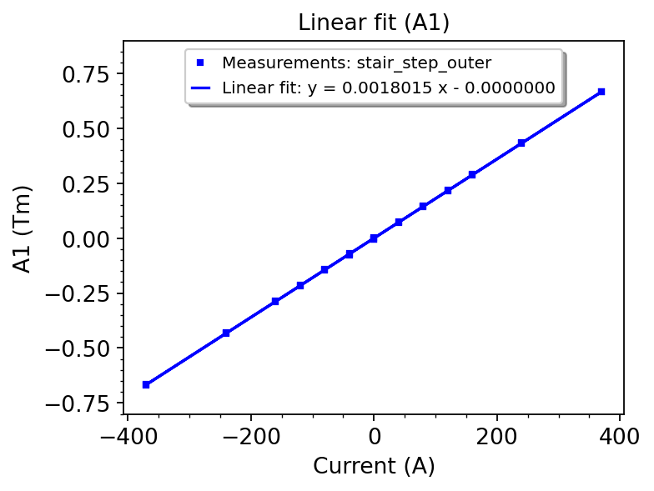
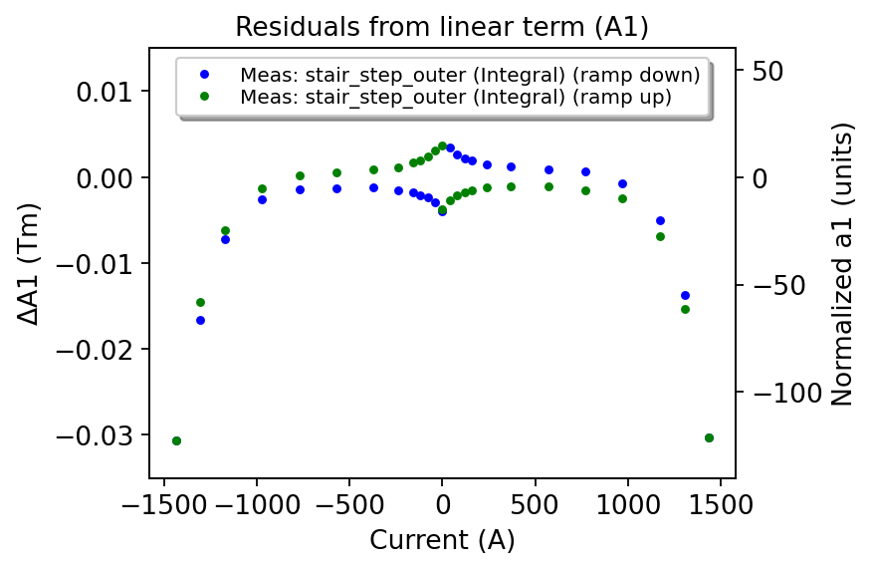
Standard reference cycle: Outer aperture (A1)
  The geometric term is computed for datapoints within the linear range (below saturation).
  A non-linearity is observed in the residuals from the linear term, normalized to the nominal field of 2.5 Tm.
  The magnetization at low field is within ±20 units (same as for the inner coil).
  The saturation at high field is 130 units (stronger in comparison to the inner coil).

Slide 24
What is the relative error from the linear term if also the inner aperture is powered?

Slide 25
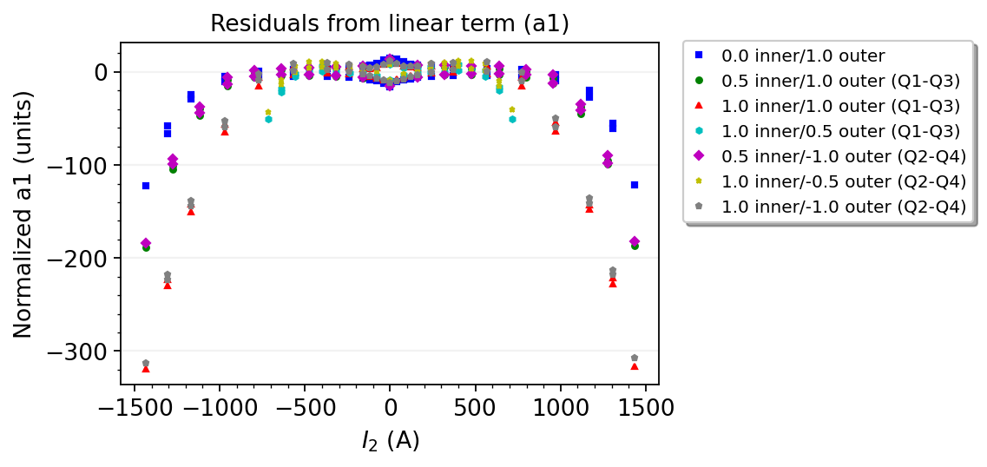
Error from the linear term (A1)
  The magnetization at low field is within ±20 units.
  The saturation at high field increases as a function of current in the inner & outer coil (up to 320 units).
  For a standard cycle, the saturation for A1 is much stronger than for B1.
  The results are similar for cycles of the same polarity (Q1-Q3) and of the inverse polarity (Q2-Q4): maximum difference is 10 units for both coils powered at nominal current.

Slide 26
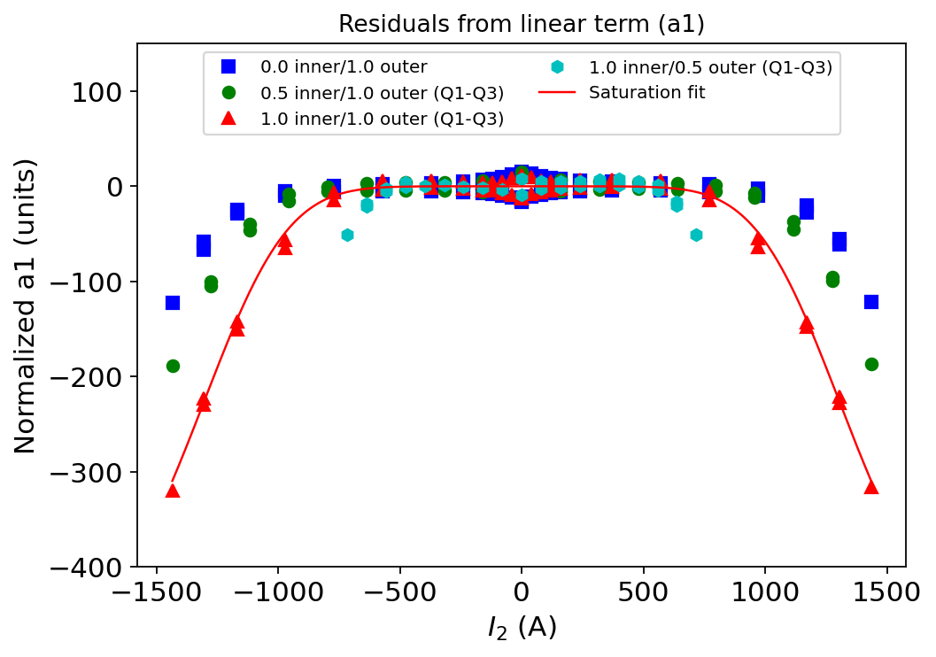
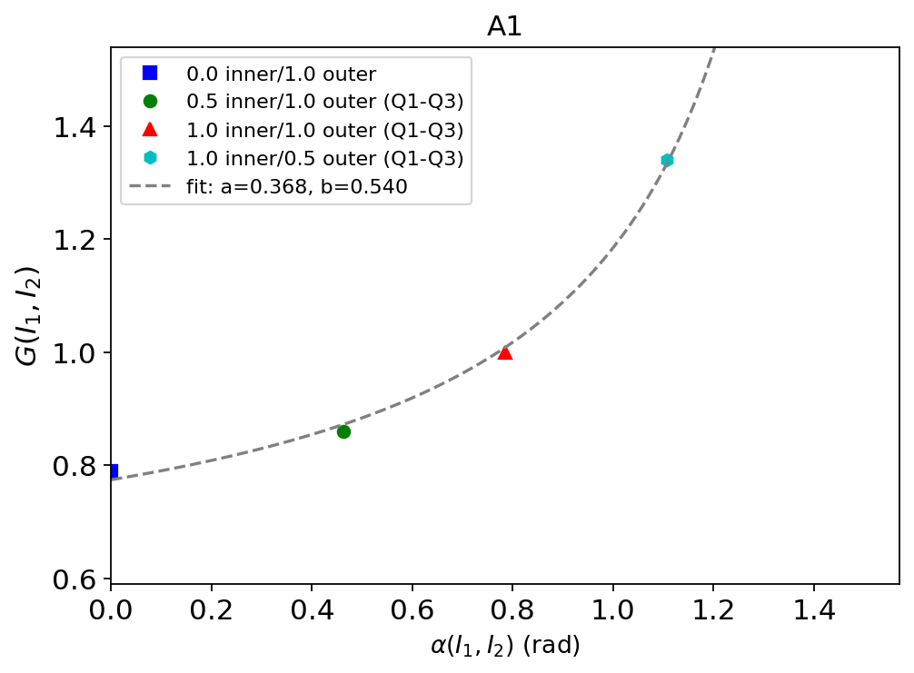
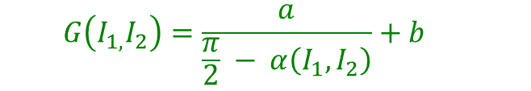
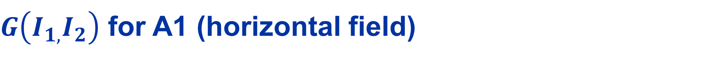

$G\left(I_{1,}I_{2}\right)$ for A1 (horizontal field)
Definition:
  $$G\left(I_{1,}I_{2}\right)=\frac{a}{\frac{π}{2} − α\left(I_{1},I_{2}\right)}+b$$
with $a=\text{0.}\text{368 }$and $b=\text{0.}\text{540}$.

Slide 27
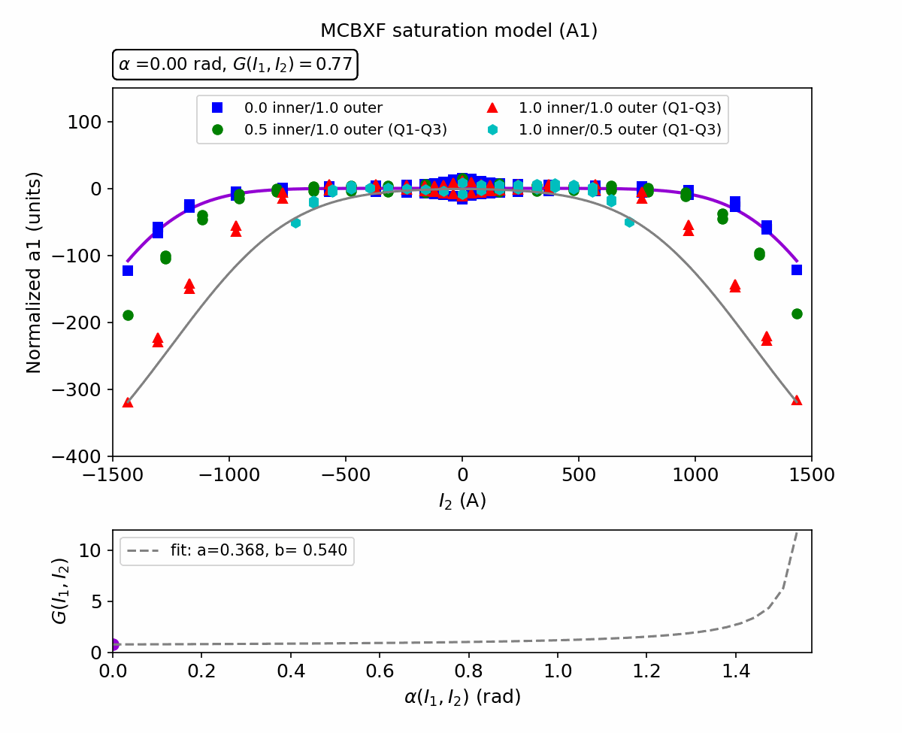
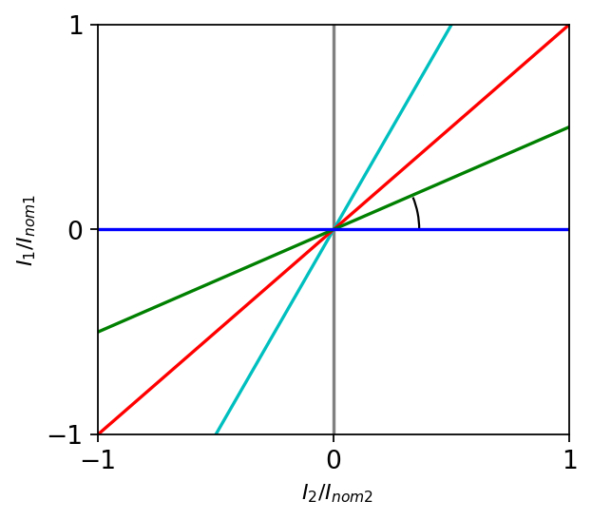




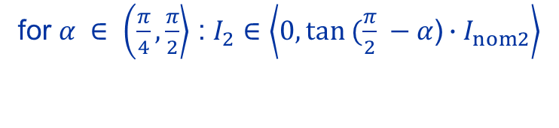
Saturation model (A1)
Working domain:
for $α ∈ \left\langle 0, \frac{π}{4}\right\rangle$ : $I_{2}∈\left\langle 0,I_{nom2}\right\rangle$
for $α ∈ \left(\frac{π}{4}\right., \left.\frac{π}{2}\right\rangle$ : $I_{2}∈\left\langle 0,tan (\frac{π}{2} −α\text{)}∙I_{nom2}\right\rangle$
$$α$$
$$tan(\frac{π}{2}−α)= \frac{I_{2}/I_{nom2}}{I_{1}/I_{nom1}}$$
Boundary line:
$B_{m}^{sat }\left(I_{1}{=I}_{nom1},I_{2}\right)$ (normalized)

Slide 28
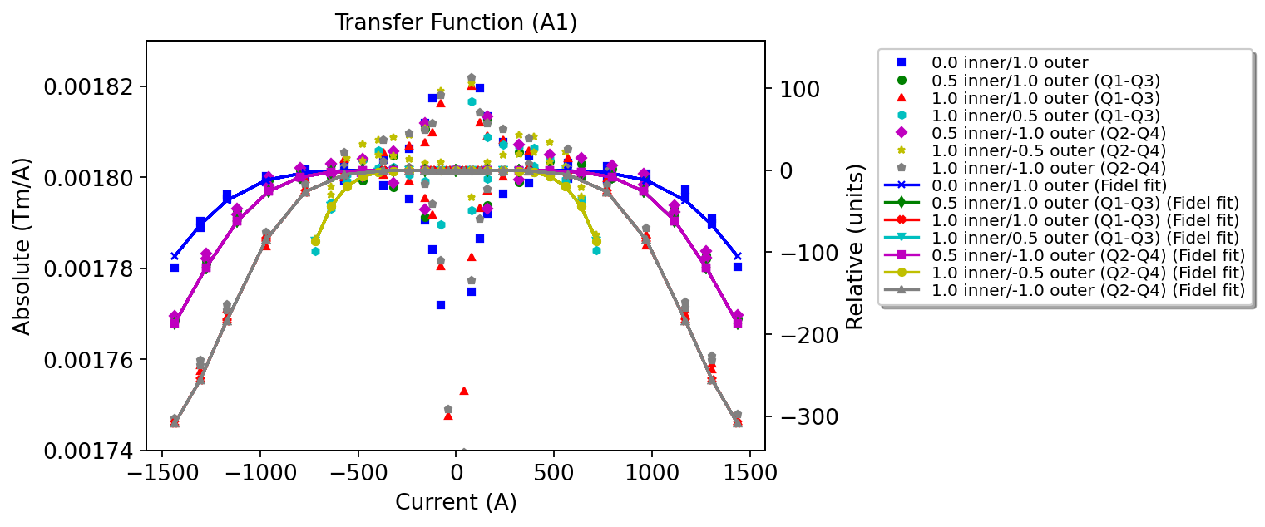
Transfer function (A1)

Slide 29
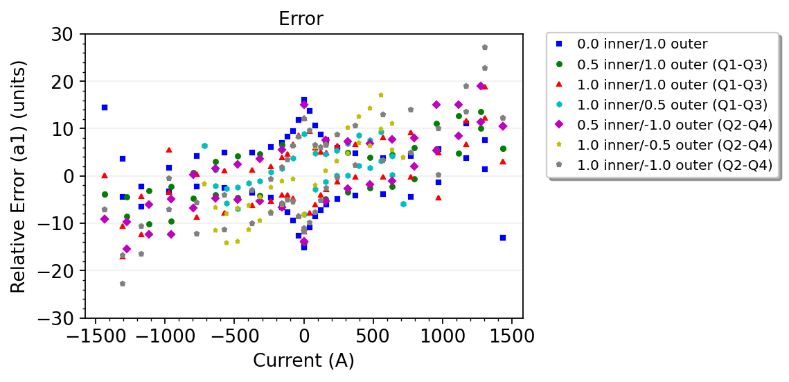
Fitting parameters & relative error (A1)
Component | Parameter | 1.0 inner/ 0.0 outer
Geometric | y | 0.0018015
Saturation | sigma1 | 0.0000665
Saturation | I01 | 1200
Saturation | S1 | 3.9
 | a | 0.368
 | b | 0.540
Constant parameters
Iinj | Ic | Tc0 | T | Tmeas | Inom1 | Inom2
95 | 15000 | 9.5 | 4.5 | 1.9 | 1435 | 1755
  The fit is accurate within ±28 units in the entire operating range.

Slide 30
B3 / A3

Slide 31
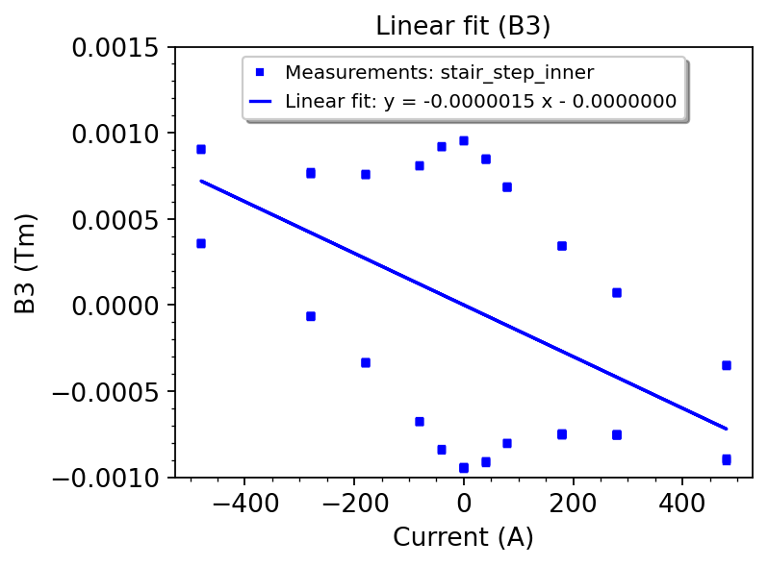
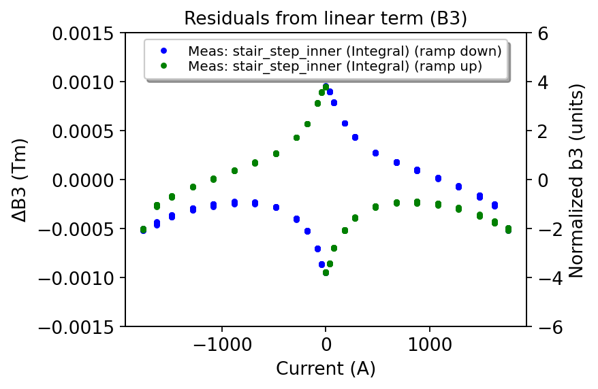
Standard reference cycle: inner aperture (B3)
  The geometric term is computed for datapoints within the linear range (below saturation).
  A non-linearity is observed in the residuals from the linear term, normalized to the nominal field of -2.5 Tm.
  The saturation at high field is below 2 units.
  The maximum error from liner term is ±4 units due to magnetization at low field.

Slide 32
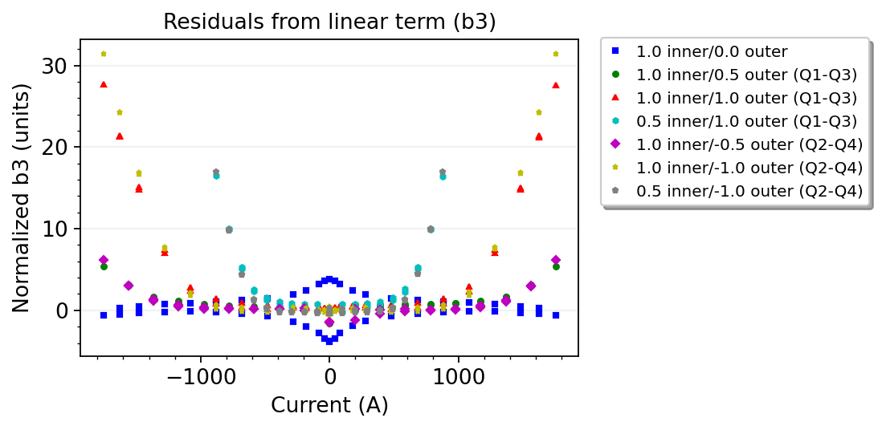
Error from the linear term (B3)
  At high field, the saturation increases as a function of current in the outer aperture (up to 32 units).
  At low field, the magnetization is within ±4 units with the maximum error for a standard reference cycle.
  For cycles of the same polarity (Q1-Q3), the relative error is similar as for cycles of inverse polarity
  (Q2-Q4): the difference in saturation is up to 4 units when both coils are powered at nominal current.

Slide 33
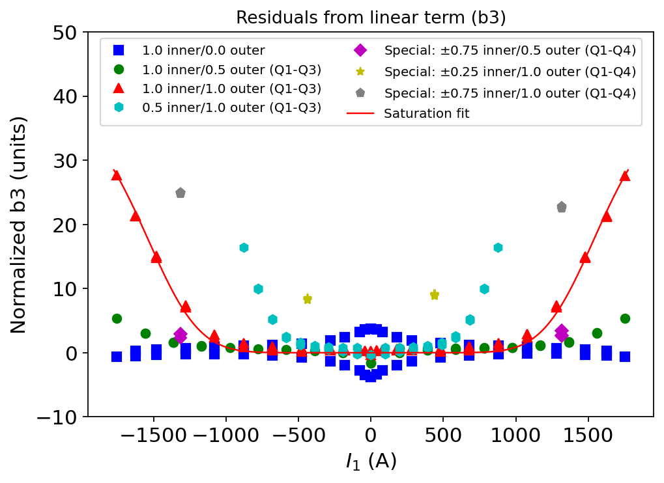

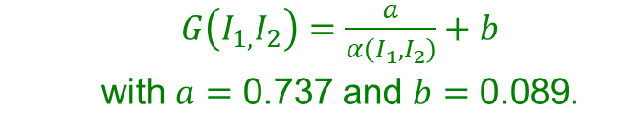
Angular dependence of saturation (B3)
  $G\left(I_{1,}I_{2}\right)=\frac{a}{α\left(I_{1},I_{2}\right)}+b$
  with $a=\text{0.7}\text{37 }$and $b=\text{0.}\text{089}$.
    The fitting parameters are very similar as for B1.

Slide 34

Saturation model (B3)
Working domain is the same as for B1 (slide 14).

Slide 35

Fitting parameters & relative error (B3)
Component | Parameter | 1.0 inner/ 0.0 outer
Geometric | y | -0.0000015
Saturation | sigma1 | -0.0000045
Saturation | I01 | 1445
Saturation | S1 | 4.7
 | a | 0.737
 | b | 0.089
Constant parameters
Iinj | Ic | Tc0 | T | Tmeas | Inom1 | Inom2
117 | 15000 | 9.5 | 4.5 | 1.9 | 1755 | 1435
  The fit is accurate within ±3 units at high field (±4 units at low field, ±8 units at $I_{1}=0,I_{2}=I_{nom2}$).
  The accuracy of the model for very small angles and at maximum outer current can be improved down to ±4 units (determined by magnetization) by adding correction factor $∆$ in $G\left(I_{1,}I_{2}\right)$ (same as for B1).

Slide 36


Standard reference cycle: Outer aperture (A3)
  The geometric term is computed for datapoints within the linear range (below saturation).
  A non-linearity is observed in the residuals from the linear term, normalized to the nominal field of 2.5 Tm.
  The saturation at high field is below 6.5 units.
  The magnetization at low field is ±3 units.

Slide 37

Error from the linear term (A3)
  At high field, the saturation increases as a function of current in the outer aperture (up to 27 units).
  At low field, the magnetization is within ±3 units with the maximum error for the reference cycle.

Slide 38



Angular dependence of saturation (A3)
  $G\left(I_{1,}I_{2}\right)=\frac{a}{\frac{π}{2} − α\left(I_{1},I_{2}\right)}+b$
  with $a=\text{0.}\text{43 }$and $b=\text{0.}\text{38}$.

Slide 39

Saturation model (A3)
Working domain is the same as for A1 (slide 21).

Slide 40

Fitting parameters & relative error (A3)
Component | Parameter | 1.0 inner/ 0.0 outer
Geometric | y | 0.0000016
Saturation | sigma1 | 0.0000052
Saturation | I01 | 1023
Saturation | S1 | 3.7
 | a | 0.43
 | b | 0.38
Constant parameters
Iinj | Ic | Tc0 | T | Tmeas | Inom1 | Inom2
95 | 15000 | 9.5 | 4.5 | 1.9 | 1435 | 1755
  The fit is accurate within ±4 units in the entire operating range.

Slide 41
Part 4: Summary

Slide 42
Conclusions
The analysis of the experimental data shows saturation is the strongest contribution to the nonlinear effects, and it cannot be modelled in the standard way as the resulting error is expected to be detrimental to machine performance (approx. ±320 units for B1/A1 and ±30 units for B3/A3).
To use the MCBXF magnet in operation, a dedicated FiDeL model must be developed.
A modified saturation component has been proposed to model the angular dependence of saturation.
The proposed approach involves a low level of complexity: 2 new parameters for each multipole.

Slide 43
Conclusions
The relative error from the proposed model for analyzed multipoles is:
Multipole | Maximum error [units]
B1 | ±30
A1 | ±28
B3 | ±4
A3 | ±4

Slide 45
Spare slides

Slide 46





Saturation model (B1) without correction factor $∆$
Boundary line
  At $I_{1}=0$, $I_{2}=I_{nom2}$, the saturation is non-zero due to the finite limit of the saturation function.
  The model can be improved by adding correction factor $∆.$

Slide 47

Fitting parameters end relative error (B1)
Component | Parameter | 1.0 inner/ 0.0 outer
Geometric | y | 0.0014647
Saturation | sigma1 | 0.0000485
Saturation | I01 | 1445
Saturation | S1 | 4.7
 | a | 0.728
 | b | 0.091
Constant parameters
Iinj | Ic | Tc0 | T | Tmeas | Inom1 | Inom2
117 | 15000 | 9.5 | 4.5 | 1.9 | 1755 | 1435
-13-(-65)=52
Very good agreement
  The fit is accurate within ±30 units in most of the operating range, except for very small angles and at the maximum outer current (see black marker).

Slide 48
PyMagAnalysis
Filtering:
- time,
- current,
- ramp-rate.
Clustering:
- mean value,
- std. deviation,
- difference.
FiDeL Model
Modelling fit
Analyzer
Data input
Multipole inputs:
- ROXIE input,
- Measurement input,
- FiDeL input.
Advanced analysis:
- current vs. time,
- multipole vs. time,
- multipole vs. current,
- linear fit,
- residuals vs. current,
- and many more…
Plotter
Presenting results:
- custom labels,
- zoom,
- plot types,
- and many more…
ROXIE files
FiDeL reports (EDMS)
Magnetic
Measurement DB
Design of the experiments

Slide 49





Example: LHC Main Dipoles
Geometric
DC Magnetization
Saturation
+
+
Residual Magnetization
Total field
+
-=

