Slide 1
Revised estimates of cooling the WP3 magnets: numerical assessment of the temperature distribution due to dose-generated power deposition
Patricia Borges de Sousa, Rob van Weelderen
WP3 meeting, 2nd November 2022

Slide 2
Framework
In the context of HL-LHC, a robust multi-region CFD numerical toolkit for the modelling of heat transfer in complex cryogenic system geometries involving He II has been developed
Initial work aimed to provide thermal design requirements early enough in the MQXF design phase such that they could be implemented in the mechanical design
The work presented here is a continuation of previous studies, implementing updated MQXF geometry and dose maps (April 2022) as well as a fully upgraded numerical toolkit
Heavily built on the work of H. Allain, G. Bozza, F. Aabid, and especially Kirtana Puthran

Slide 3
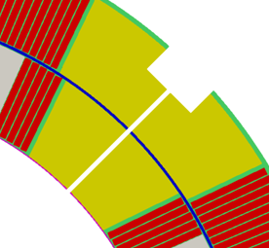
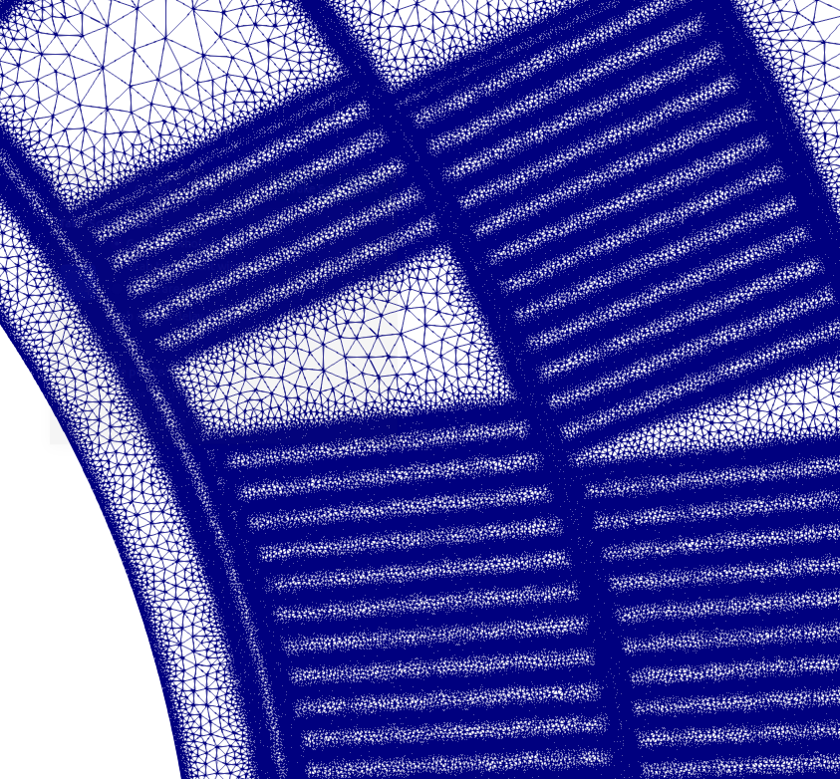
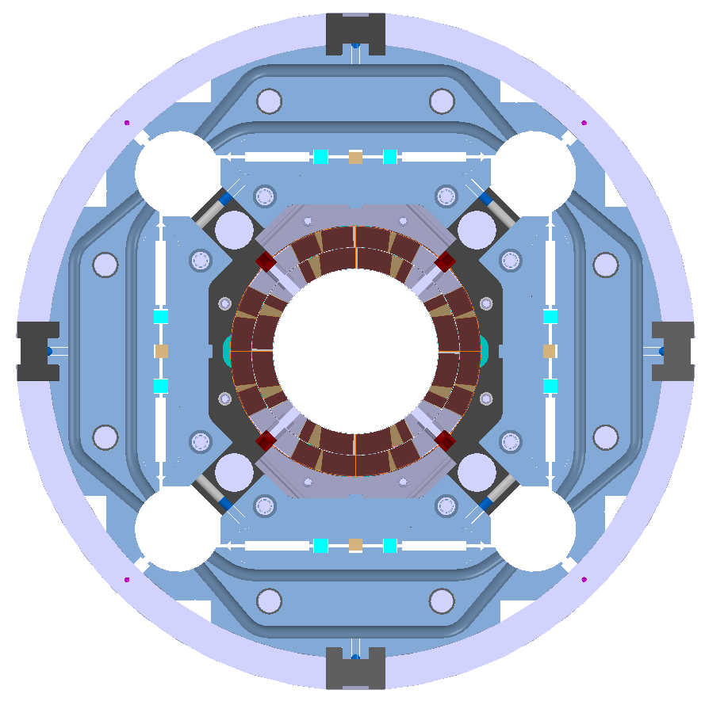
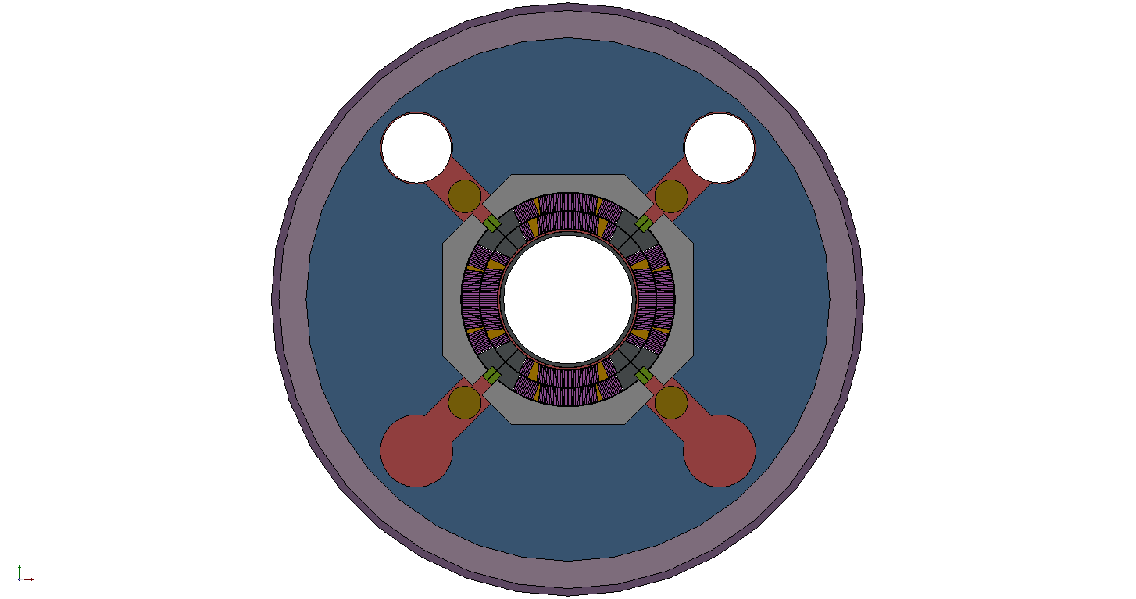
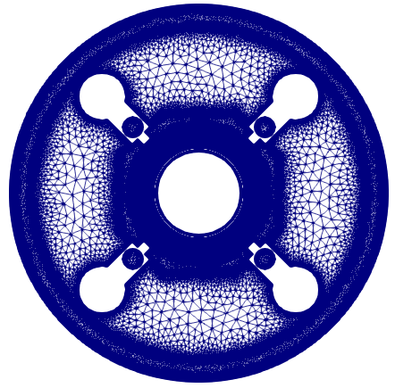
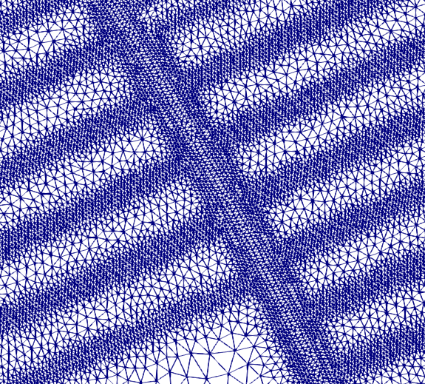
Geometry MQXF coil + cold mass (I)
Geometry created with dimensions in warm (300 K) conditions
Coil described in detail, simplifications mainly on iron yoke (bladder structure omitted), main He pathways included
He II heat extraction passages in Titanium pole/G10 keys (Ø8 mm hole every 50 mm) converted to 1 mm slit in 2D geometry
Mesh composed of 3.5M cells, prisms; coil pack refined → especial refinement on thin insulation layers
MQXF v7 + cold mass
(ST0703448)
Simplified geometry for simulation (coded in Python and Salome)
Resulting 2D meshed geometry (coded in Python and Salome)

Slide 4
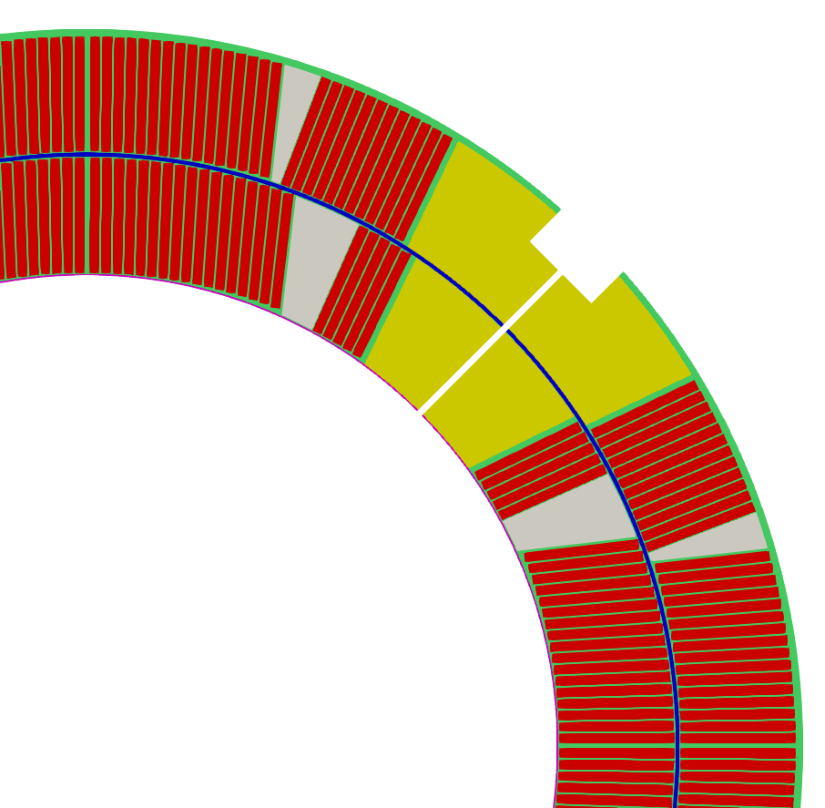
Geometry MQXF coil + cold mass (II)
Outer + ground
insulation
Outer vessel
Inter-cable insulation
Al shell
Titanium pole
(w/ He slit shown)
G10 keys
Coil wedge
Cold bore
Interlayer insulation
Inner insulation
Axial rods
Iron yoke
Nb₃Sn cables
Al collar

Slide 5
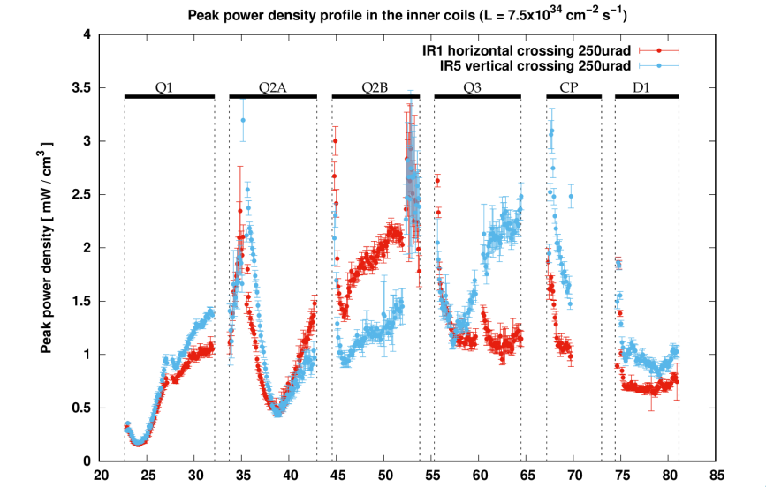
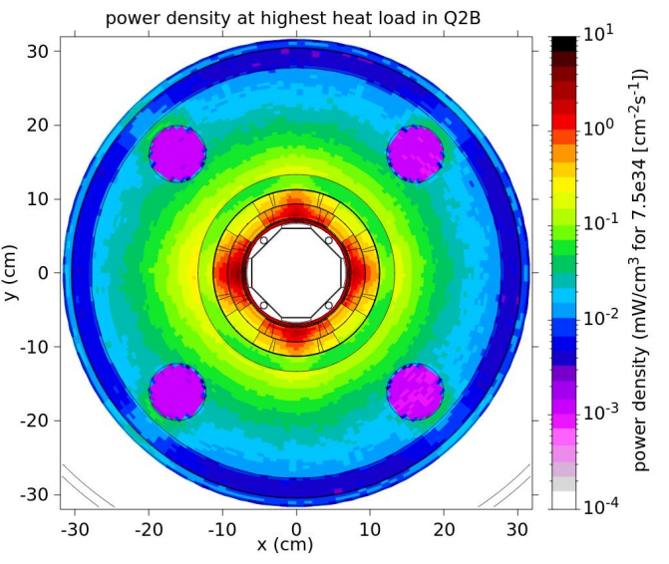
Input for heat deposition from dose calculations (I)
For each magnet/cold mass, the cross-section that corresponds to the highest dose (and consequently heat load) is selected
12 cross-sections selected (Q1/2/3 A and B, vertical and horizontal crossings)
Distance from interaction point [m]
Source: Review of estimates of energy deposition, M. Sabate-Gilarte

Slide 6
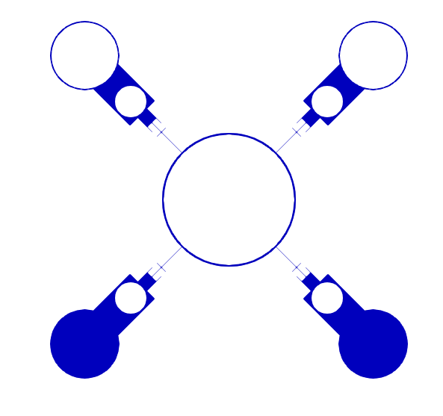
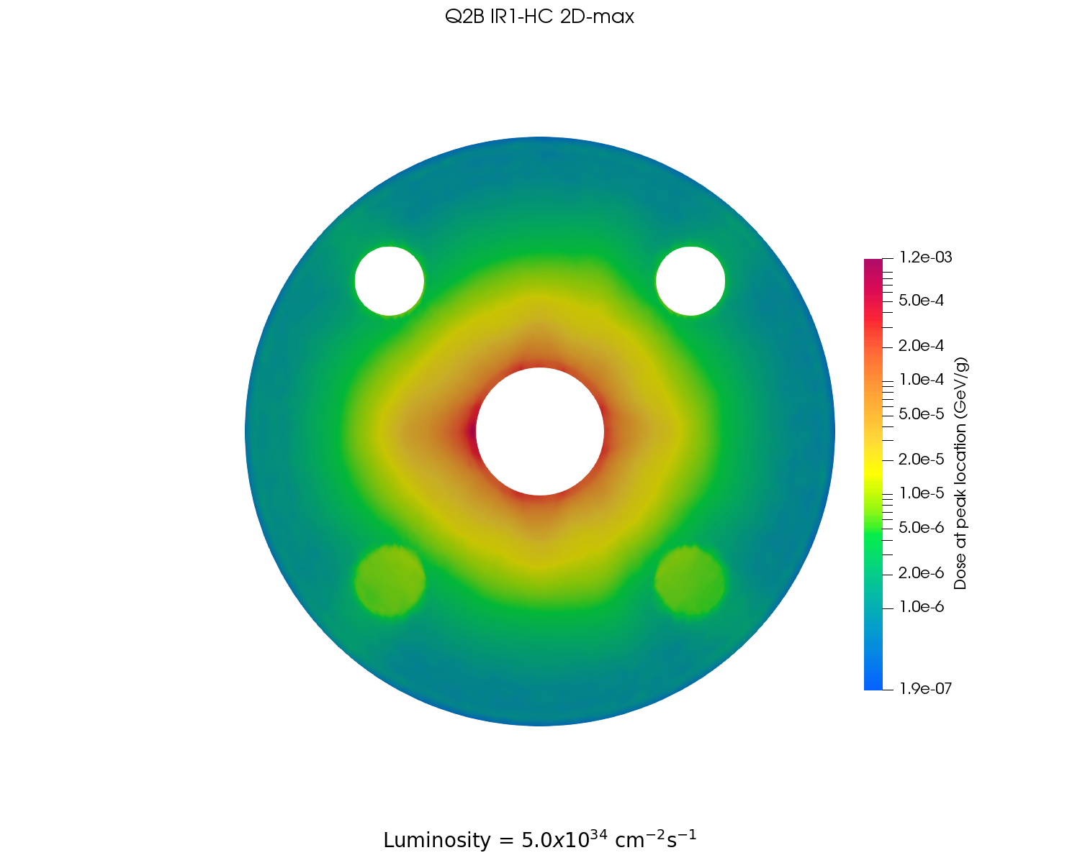
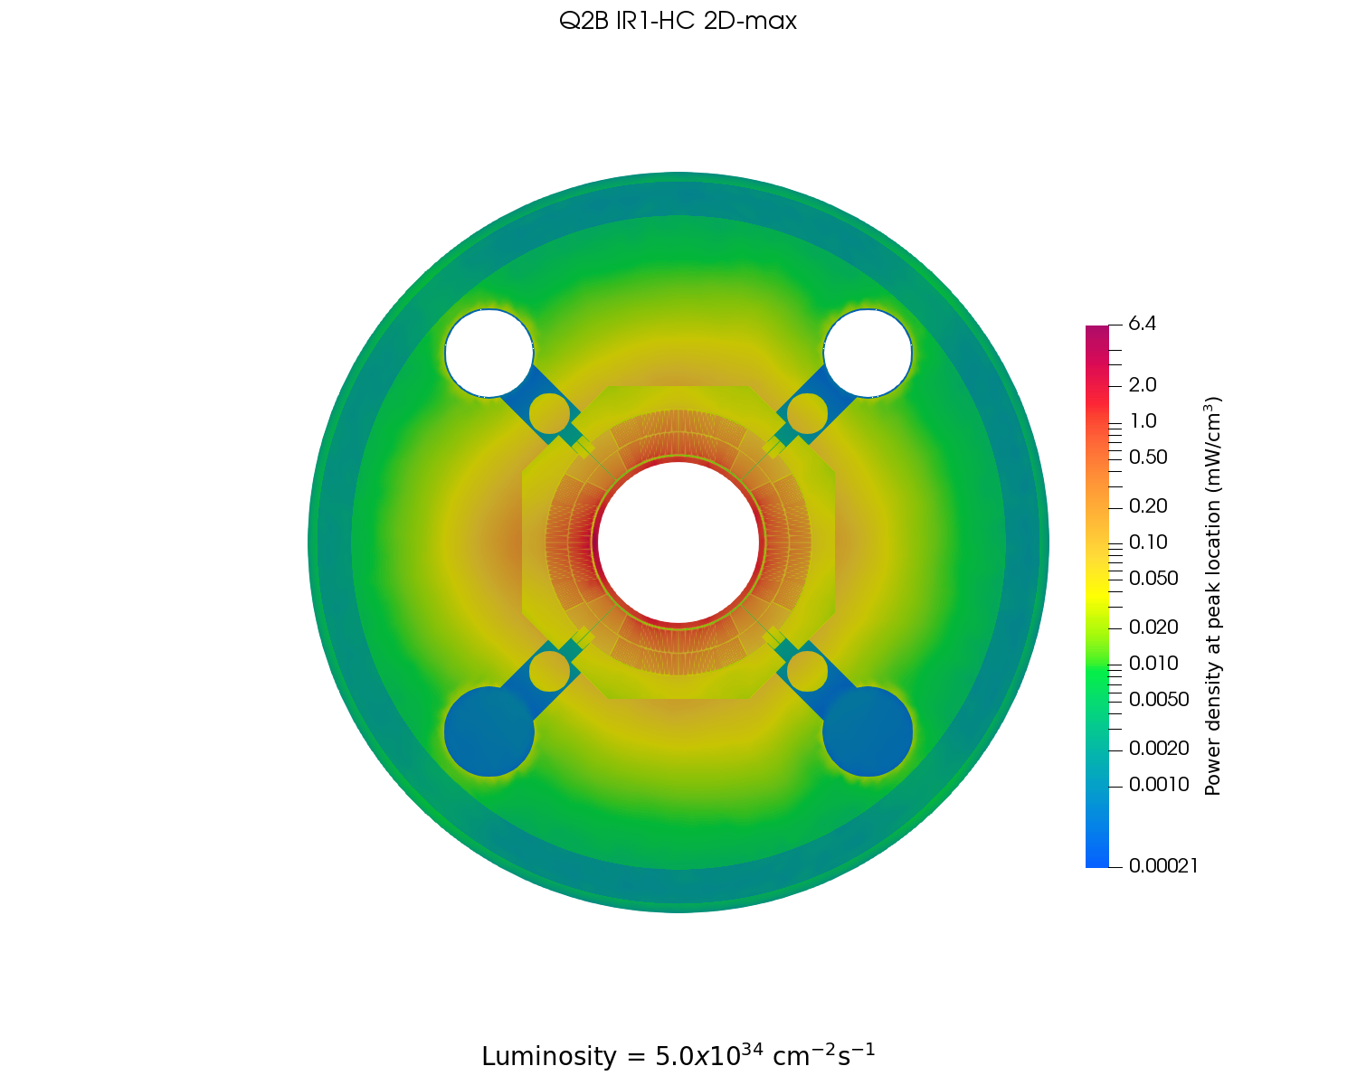
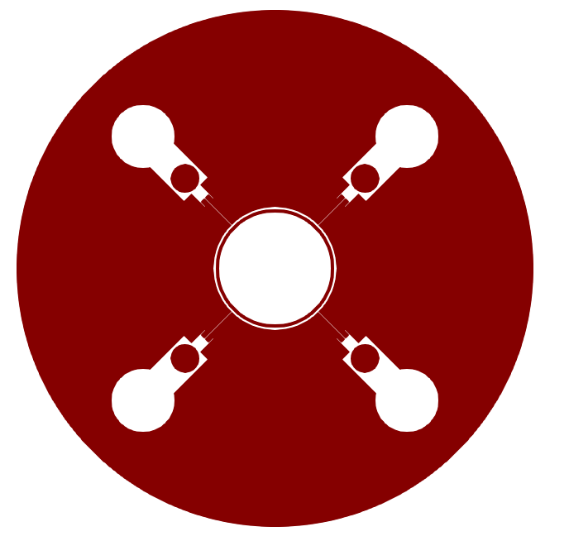
Input for heat deposition provided dose calculations (II)
For each magnet/cold mass, the dose at peak location for nominal luminosity (7 TeV, 5.0x10³⁴ cm⁻²s⁻¹) provided by FLUKA is mapped onto the mesh
Mapped dose is converted to 2D power density (mW/cm³) map at the peak (maximum) location according to each component’s density
Mesh is split into two regions, a He II region and a solid region. The solid region is composed of many different zones each with their own material properties
Q2B IR1-HC – dose @ peak loc.
Q2B IR1-HC – power dep. @ peak loc.
He II region (connected passages via poles)
Solid region (17 parts)
Luminosity 5.0x10³⁴ cm⁻²s⁻¹ Cold bore included

Slide 7
He II region and (composite) solid region
Mesh is split into two regions: a He II region and a solid region
The solid region is composed of many different zones each with their own temperature-dependent material properties
NB2: 8 mm holes every 50 mm converted to
1 mm slit in 2D
NB1: annular space 1.2 mm
NB3: cold bore insulation thickness of 510 µm
Helium region
Connected passageways via Titanium poles/keys
Solid region
16 areas with different properties

Slide 8

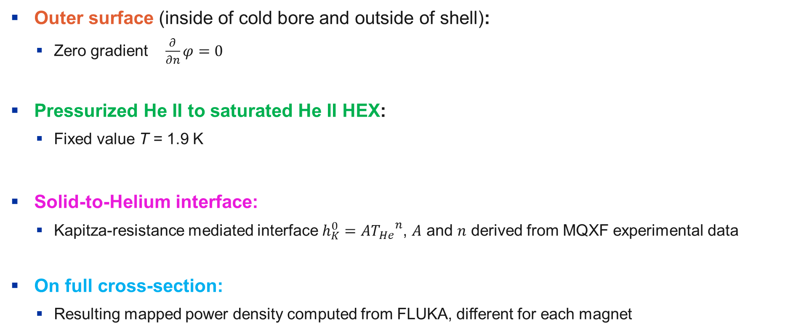
Boundary conditions for calculations
Outer surface (inside of cold bore and outside of shell):
  Zero gradient $\frac{∂}{∂n}φ=0$
Pressurized He II to saturated He II HEX:
  Fixed value T = 1.9 K
Solid-to-Helium interface:
  Kapitza-resistance mediated interface $h_{K}^{0}=A{T_{He}}^{n}$, $A$ and $n$ derived from MQXF experimental data
On full cross-section:
  Resulting mapped power density computed from FLUKA, different for each magnet

Slide 9
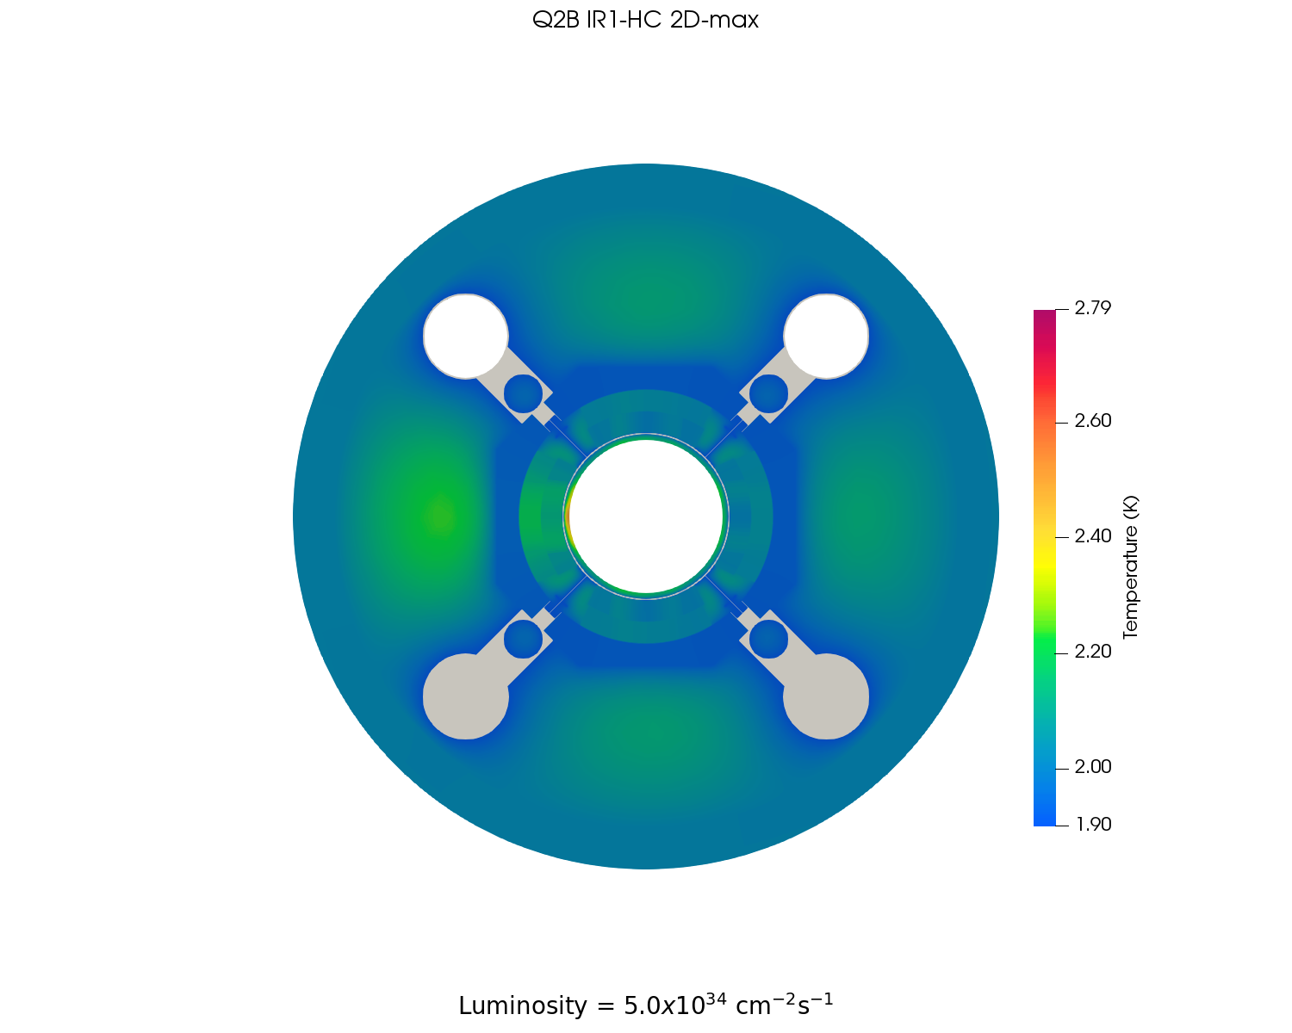
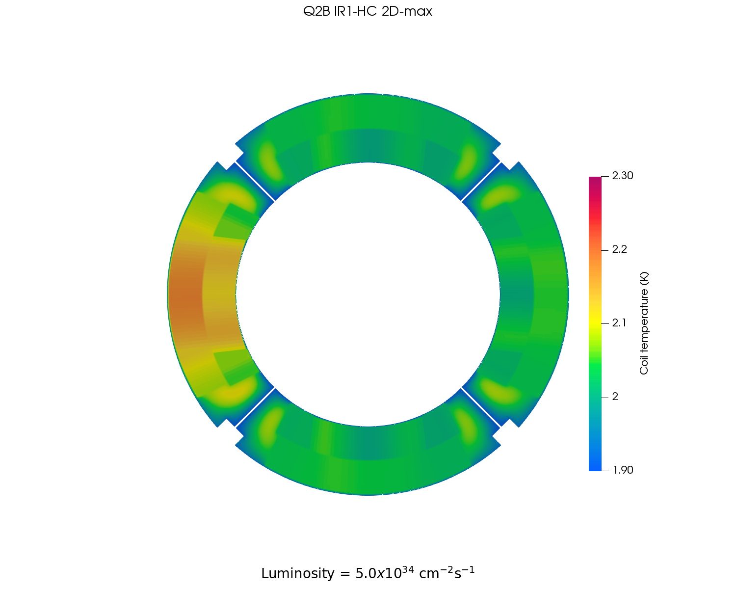
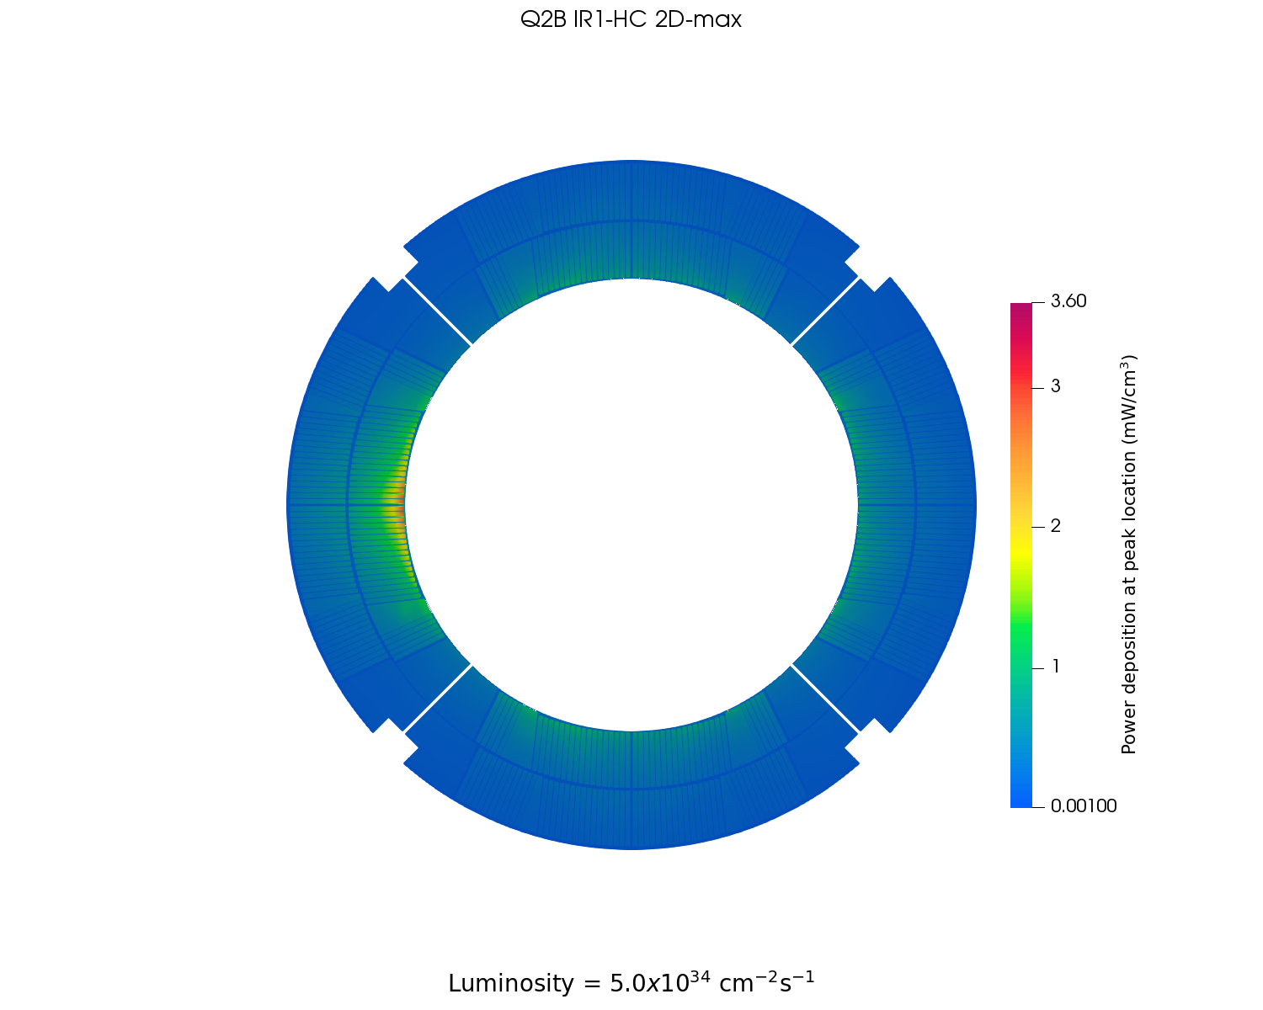
Results: example Q2B IR1-HC @ nominal luminosity
Dose at peak location
Temperature distribution at peak location
Power deposition at peak location
Power deposition at peak location (coil detail)
Temp. distribution at peak location (coil detail)
Max T in cold bore
Maximum coil temperature 2.2 K
NB: Cold bore included, dose for luminosity = 5.0x10³⁴ cm⁻²s⁻¹

Slide 10
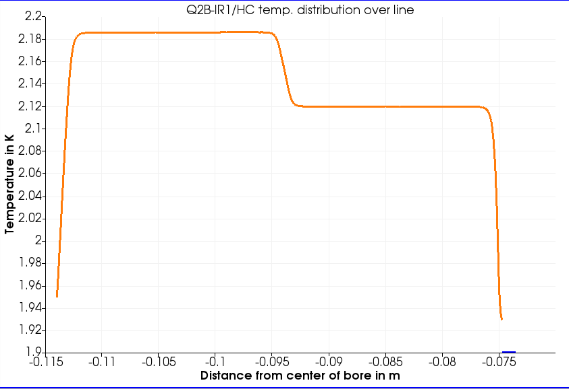
Results: example Q2B IR1-HC @ nominal luminosity
Temp. distribution at peak location (coil detail)
outer coil layer
inner coil layer
interlayer insulation
inner insulation
outer + ground insulation
He II
Kapitza resistance

Slide 11
Results: example Q2B IR1-HC @ nominal luminosity
Temp. distribution at peak location (coil detail)
For the described geometry, boundary conditions and considering the peak power deposition generated by a luminosity of 5x10³⁴ cm⁻²s⁻¹ for each of the 12 magnet cross-sections, we find:
Max. T in the coil = 2.3 K
Max. T in cold mass = 2.8 K (on cold bore)
He II T gradient O(100 µK)
T gradient dominated by inner insulation, interlayer insulation and Kapitza
Max T in cold bore

Slide 12
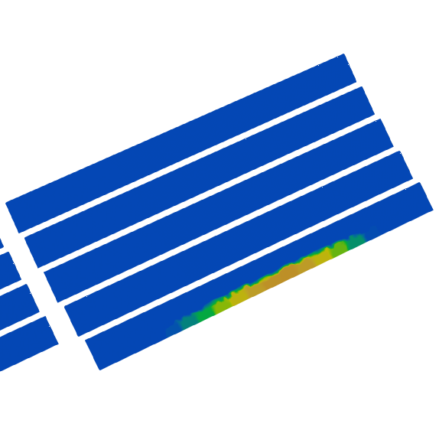
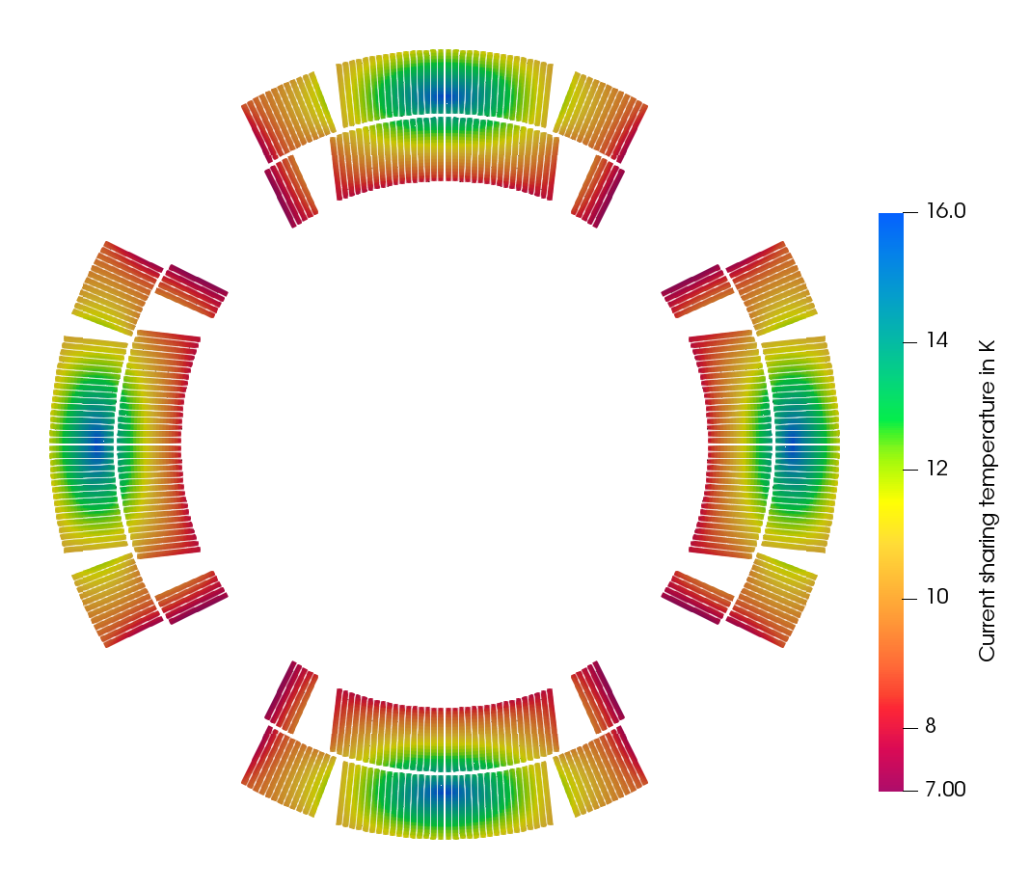
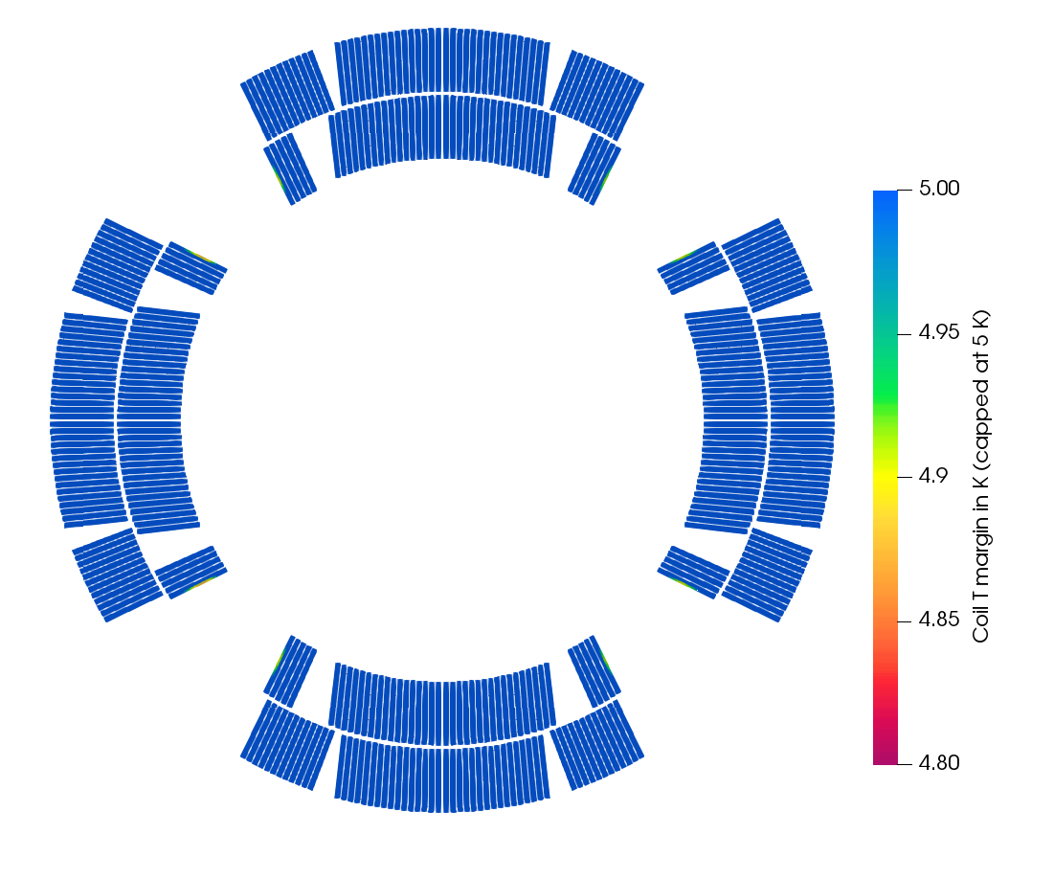
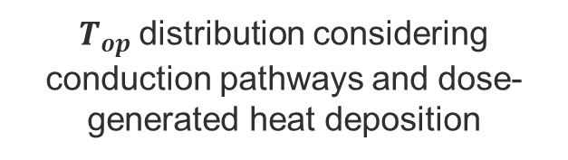

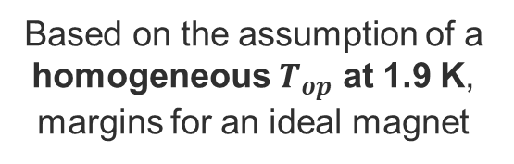
Resulting temperature margin for MQXF magnets
Based on the assumption of a homogeneous $T_{op}$ at 1.9 K, margins for an ideal magnet
$T_{op}$distribution considering conduction pathways and dose-generated heat deposition
Min T margin = 4.88 K
Current sharing temp.
MQXF @ $J_{op}$, $B_{op}$, $T_{op}$
Temperature profile
Q2B IR1-HC @ nom. lum.
Temperature margin
Q2B IR1-HC @ nom. lum.
(scale truncated at 5 K!)
NB: Cold bore included, dose for luminosity = 5.0x10³⁴ cm⁻²s⁻¹

Slide 13
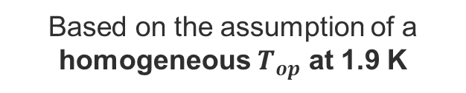
Resulting temperature margin for MQXF magnets
Min T margin = 4.88 K
Based on the assumption of a homogeneous $T_{op}$ at 1.9 K
For the described geometry, boundary conditions and considering the peak power deposition generated by a luminosity of 5x10³⁴ cm⁻²s⁻¹ for each of the 12 magnet cross-sections, we find:
Min. T margin in the coil = 4.78 K
Invariably located on the 8 turn(s) closest to the pole
The rest of the coil pack for each magnet cross-section has a temperature margin higher than 5 K
Current sharing temp.
MQXF @ $J_{op}$, $B_{op}$, $T_{op}$
Temperature margin
Q2B IR1-HC @ nom. lum.
(scale truncated at 5 K!)

Slide 14
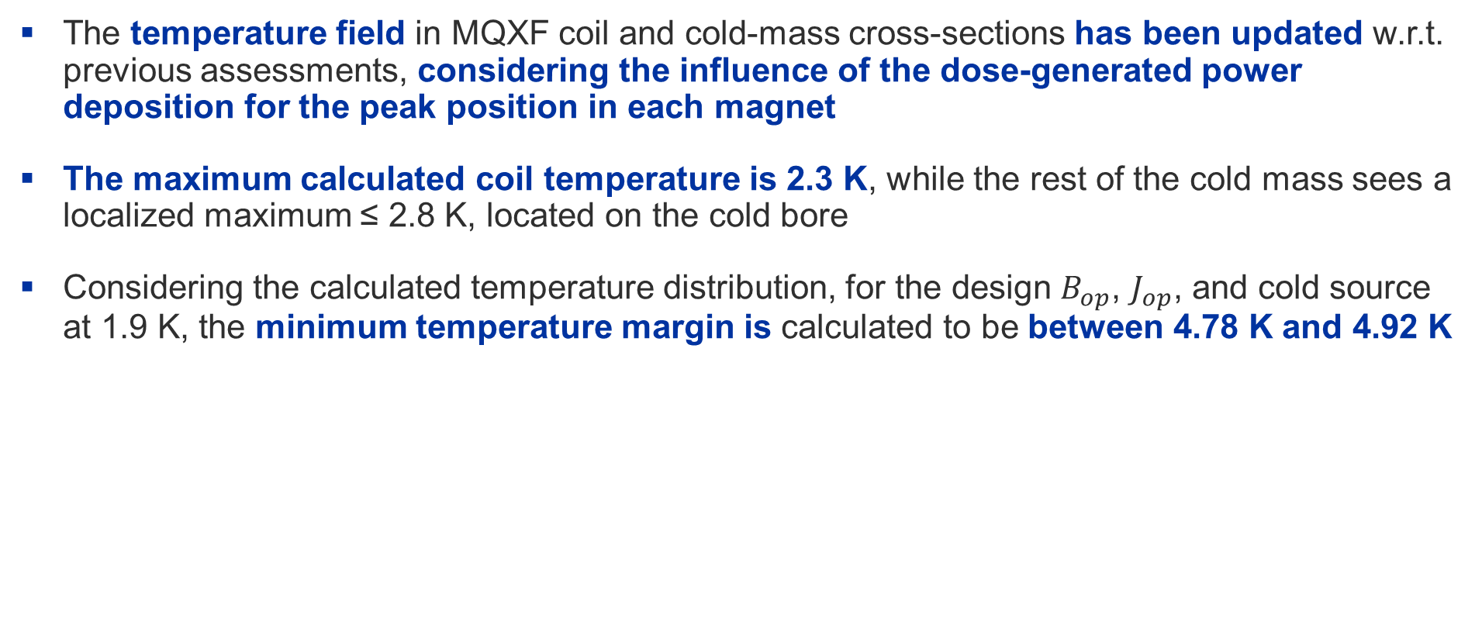
Summary
The temperature field in MQXF coil and cold-mass cross-sections has been updated w.r.t. previous assessments, considering the influence of the dose-generated power deposition for the peak position in each magnet
The maximum calculated coil temperature is 2.3 K, while the rest of the cold mass sees a localized maximum ≤ 2.8 K, located on the cold bore
Considering the calculated temperature distribution, for the design $B_{op}$, $J_{op}$, and cold source at 1.9 K, the minimum temperature margin is calculated to be between 4.78 K and 4.92 K
MQXF cross-sections at peak dose, 7 TeV, 5.0x10³⁴ cm⁻²s⁻¹,1.9 K cold source
 | On coil pack | On cold mass
Maximum power density | 3.6 mW/cm³ | 6.4 mW/cm³
Maximum temperature | 2.30 K | 2.79 K
Minimum temp. margin | 4.78 K | N/A

Slide 15
Thank you for your attention!

Slide 16
(Other) changes w.r.t. initial simulations
Mesh: 3.5M cells vs. 300k cells
  Previous simulations were run with coarser meshes; this was necessary since the geometry was divided into many (hundreds) of regions, resulting in very long computation time
  Mesh is now divided into only two regions (solid and helium), and solid regions are divided into zones with different material properties, much less expensive computationally, allows for finer mesh
Material properties: literature vs. measured data
  Previous simulations needed to rely on literature data for both bulk material and interface properties
  Thermal properties of impregnation of inner and inter layers have been experimentally measured for both 11T and MQXF coil samples, inner-layer-to-He Kapitza resistance is also derived experimentally
Power deposition mapping: finer conversion from dose → power
  Previously, FLUKA data was provided as power deposition at peak location (mW/cm³)
  Now the dose (in GeV/g) was provided, allowing for a much finer calculation of power deposition according to each zone’s density
Cold bore included
  The highest dose is deposited onto the cold bore, heat load that also needs to be extracted via the annular He space.
Inner quench heaters
  Previous simulations had quench heaters on the inner layer, present results no longer consider it

Slide 17
Results at peak location for IR1/HC
Luminosity = 5.0 x 10³⁴ cm⁻²s⁻¹
Energy = 7 TeV
Dose map cold mass in GeV/cm³
Power deposition cold mass in mW/cm³
Power deposition (coil detail) in mW/cm³
Temperature profile cold mass in K
Temperature profile (coil detail) in K

Slide 18
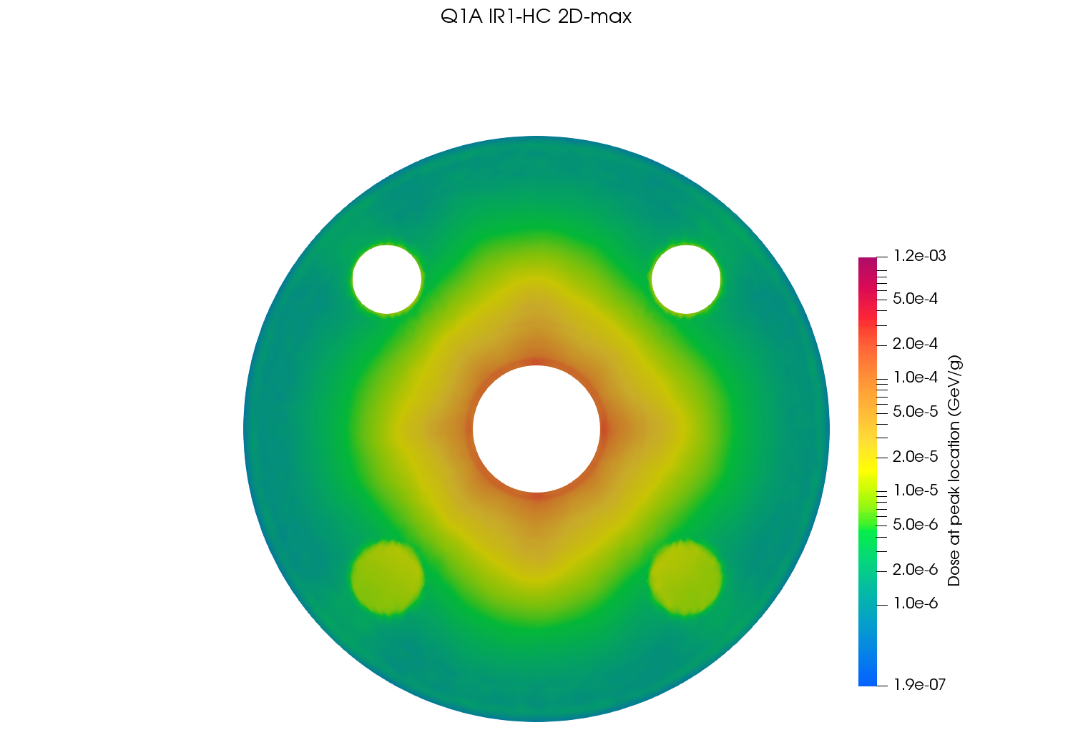

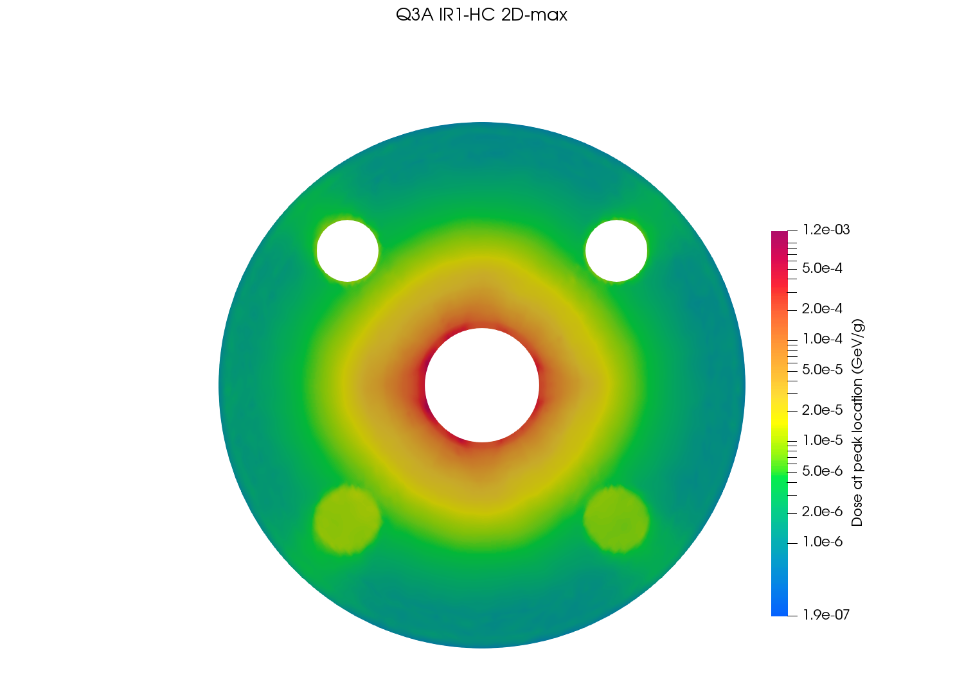
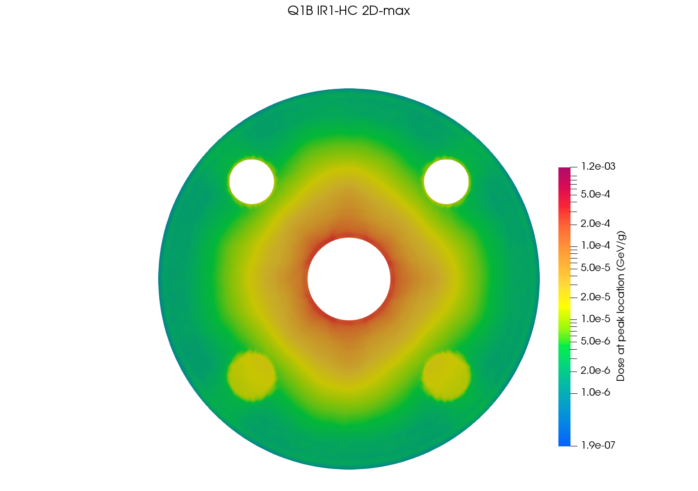
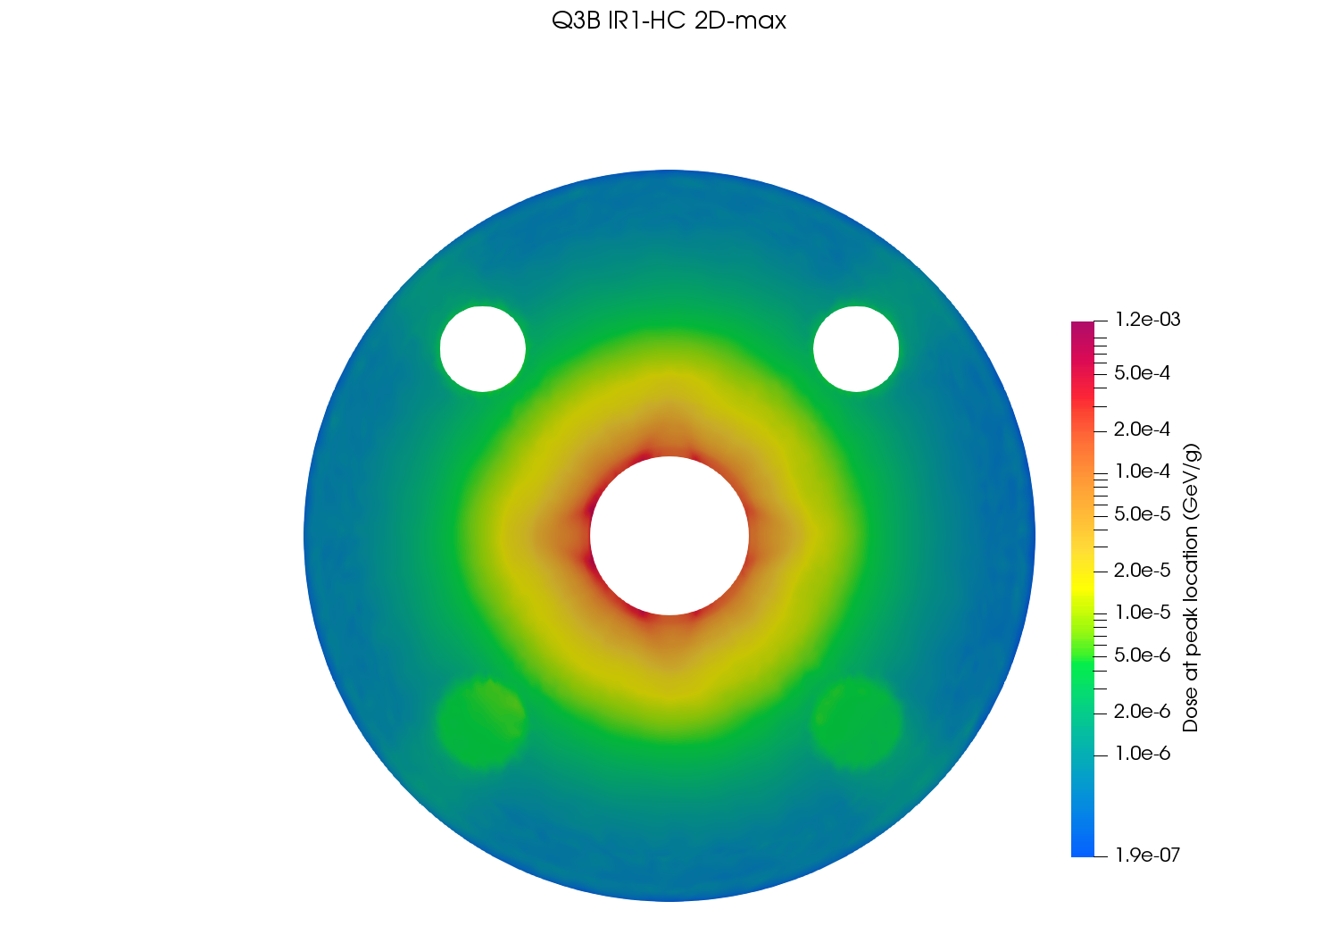
Dose maps at peak location – IR1/HC

Slide 19
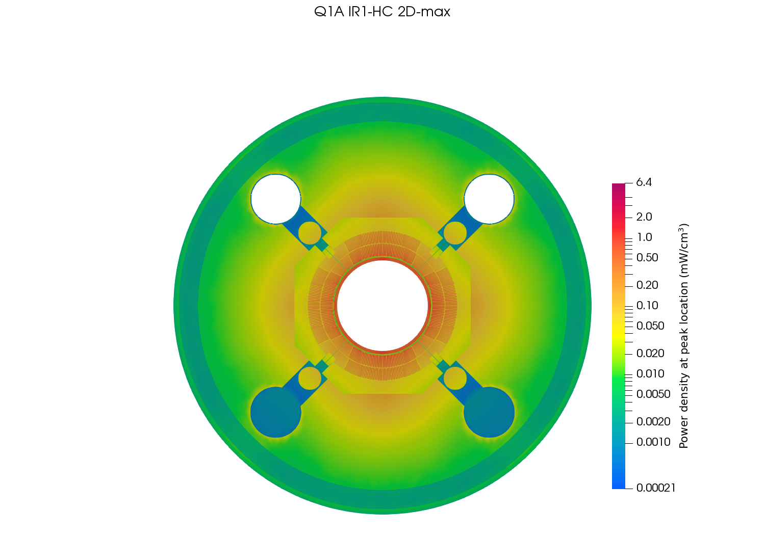
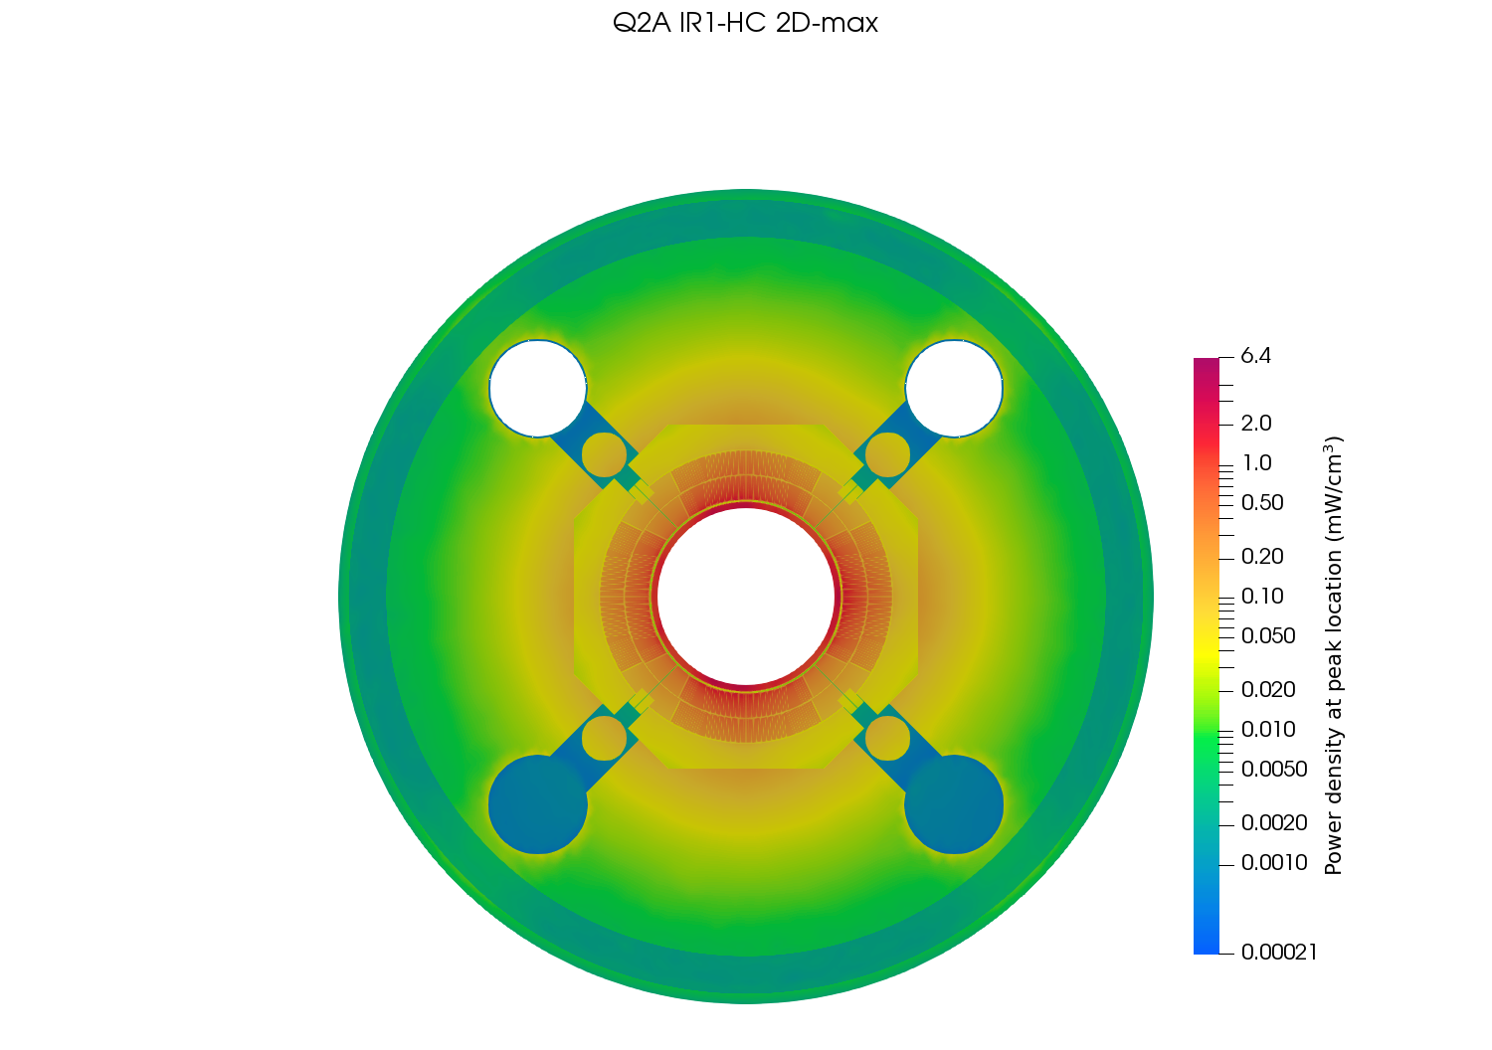
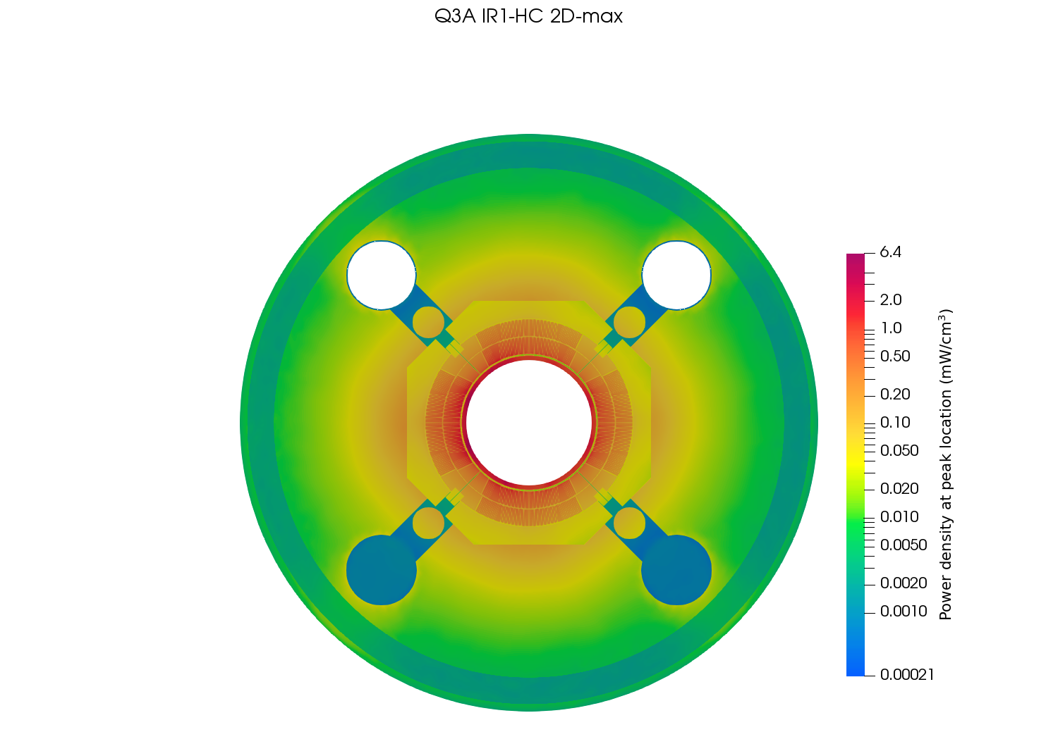
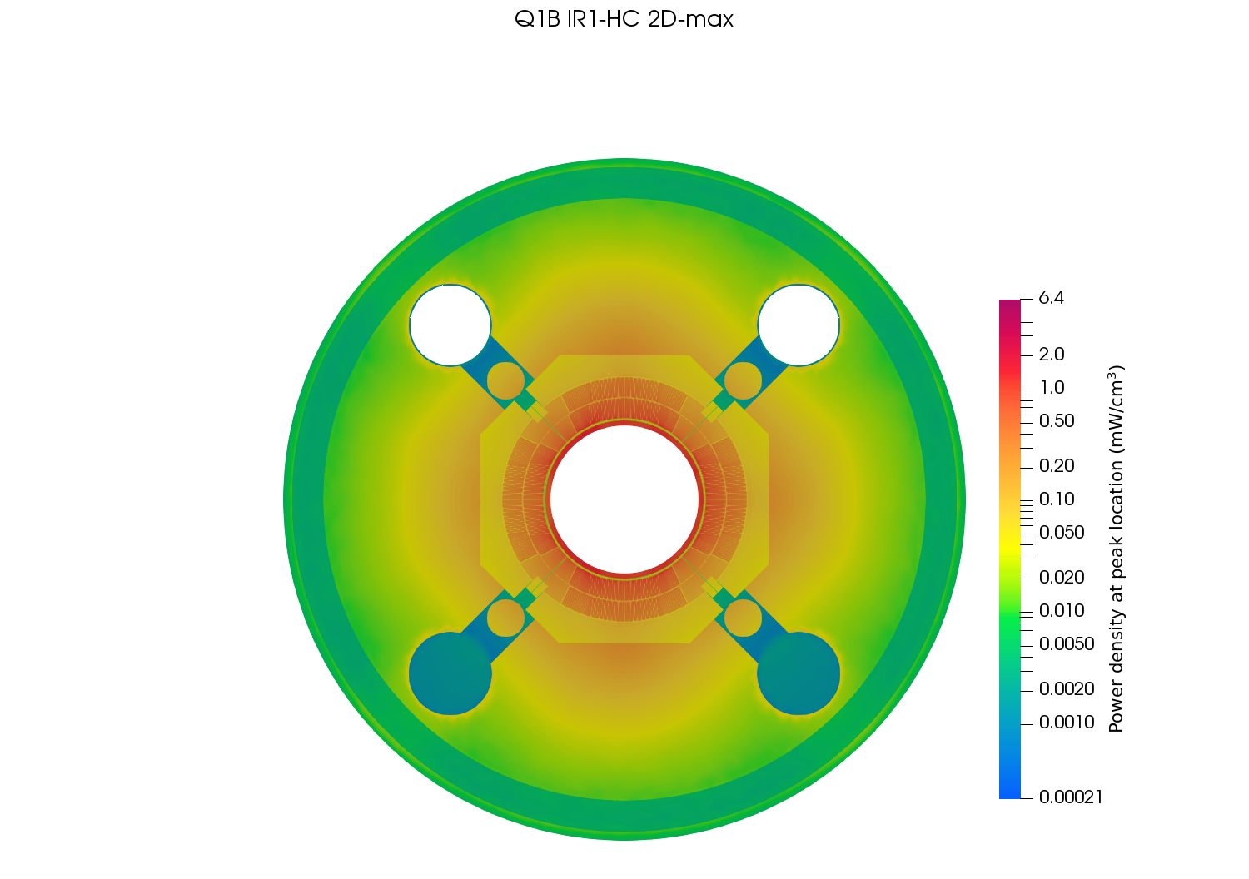
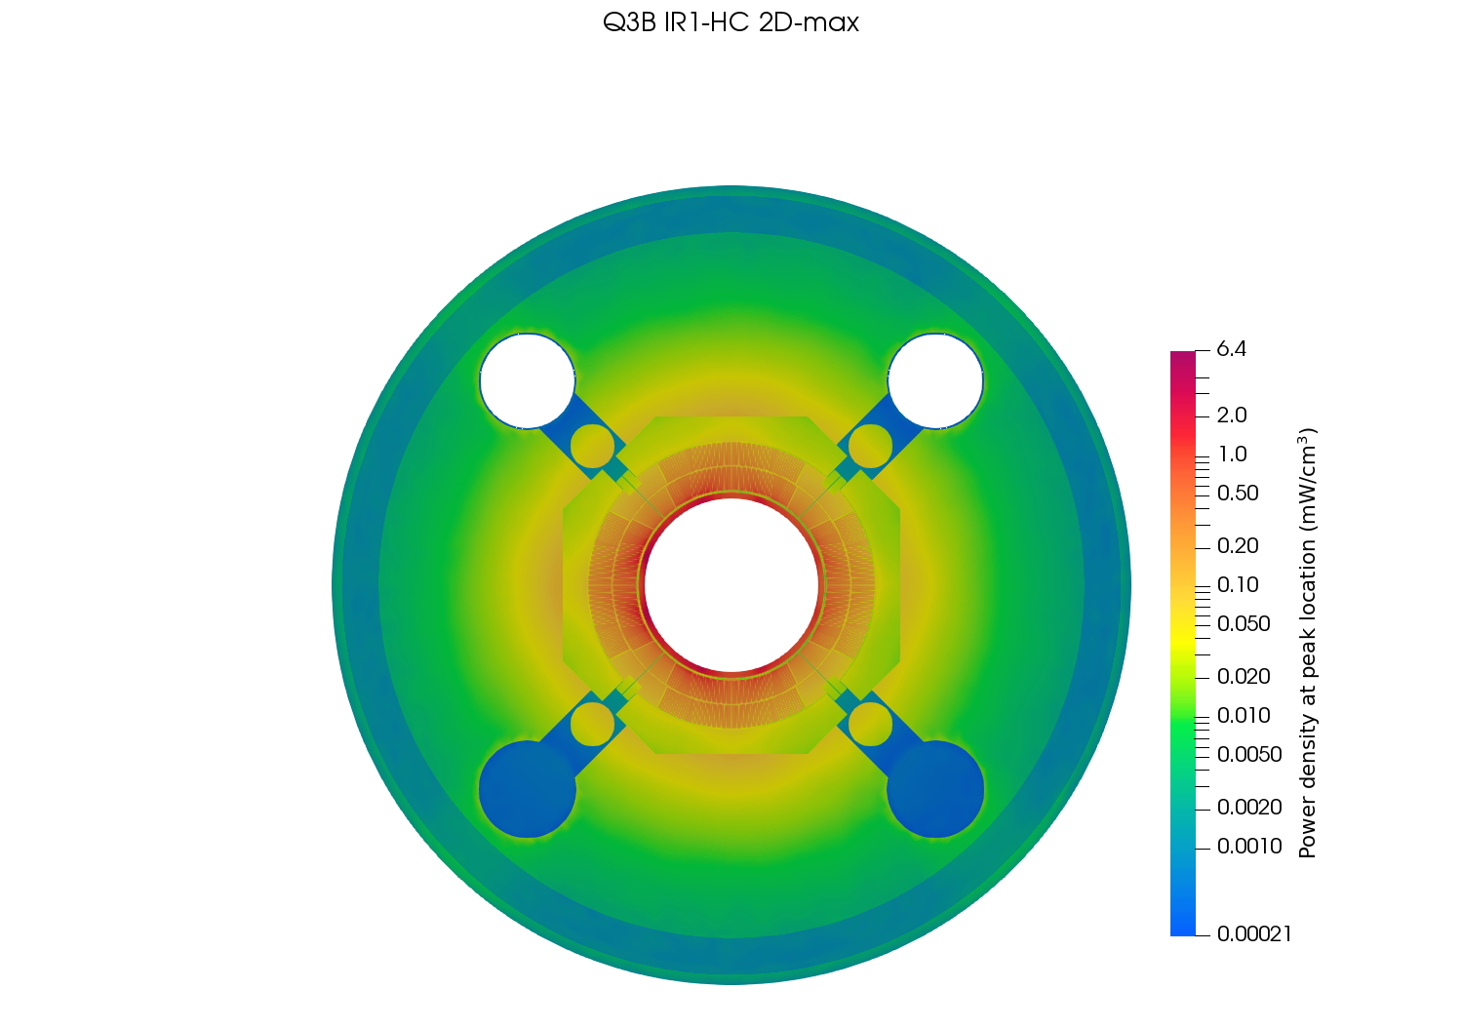
Power deposition at peak location – IR1/HC

Slide 20
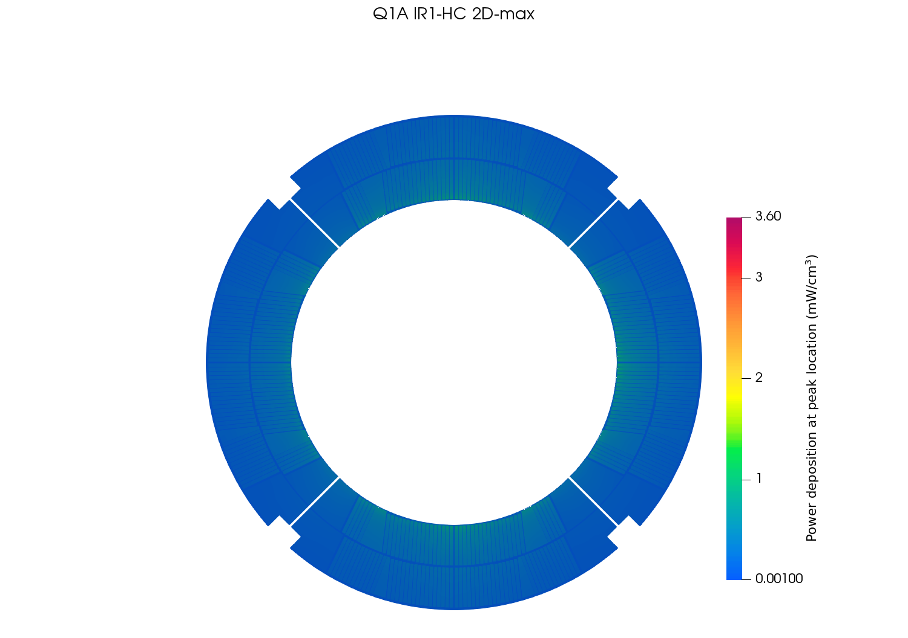
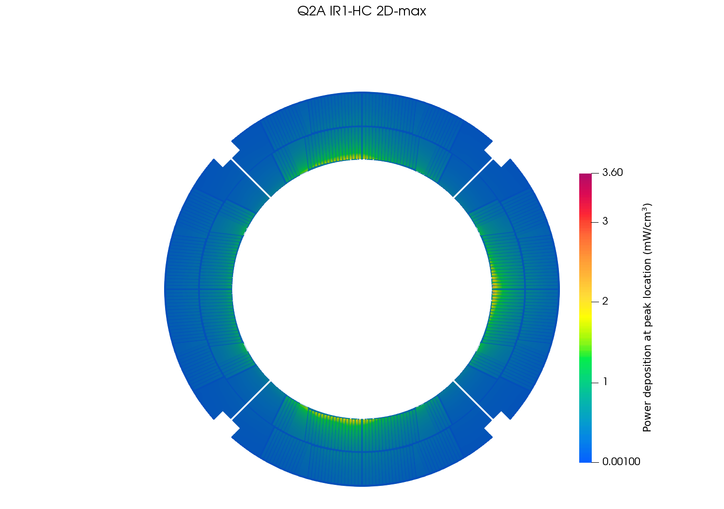

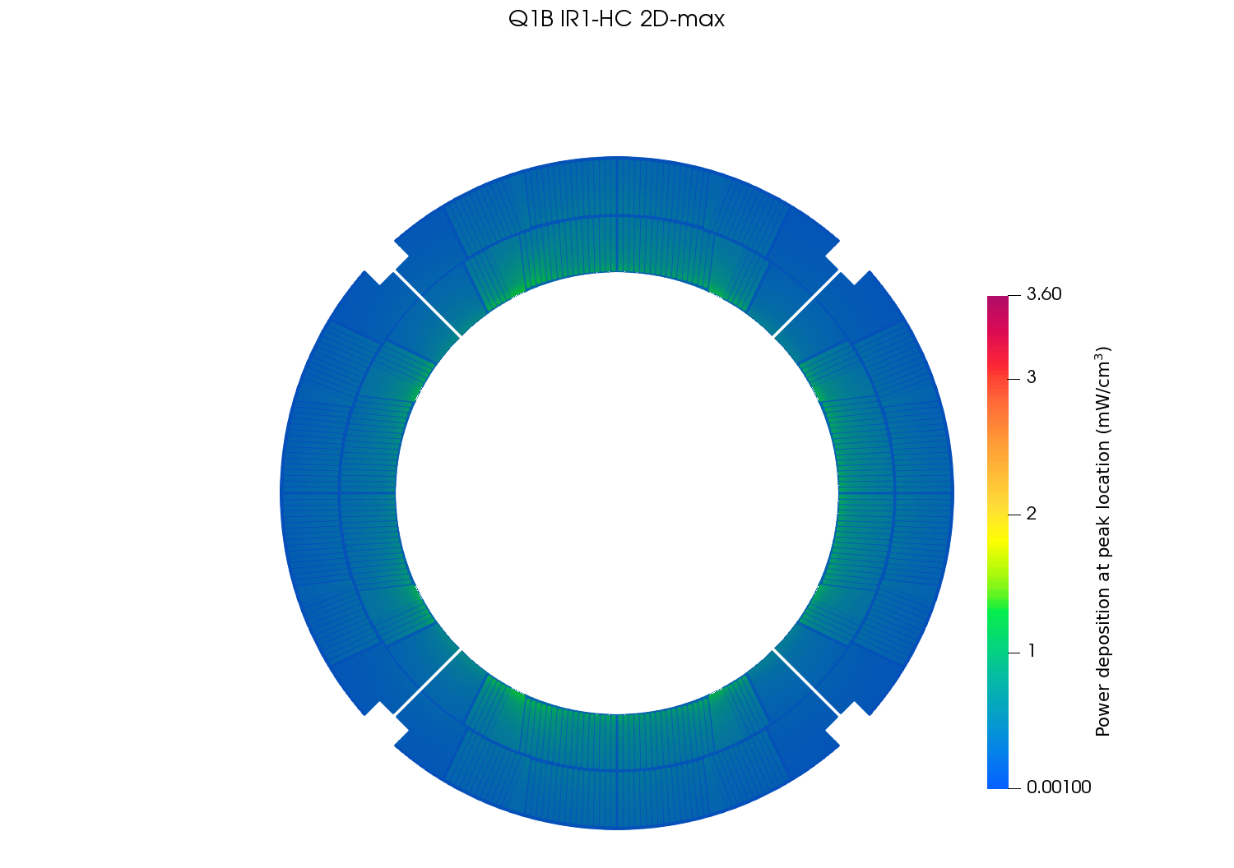
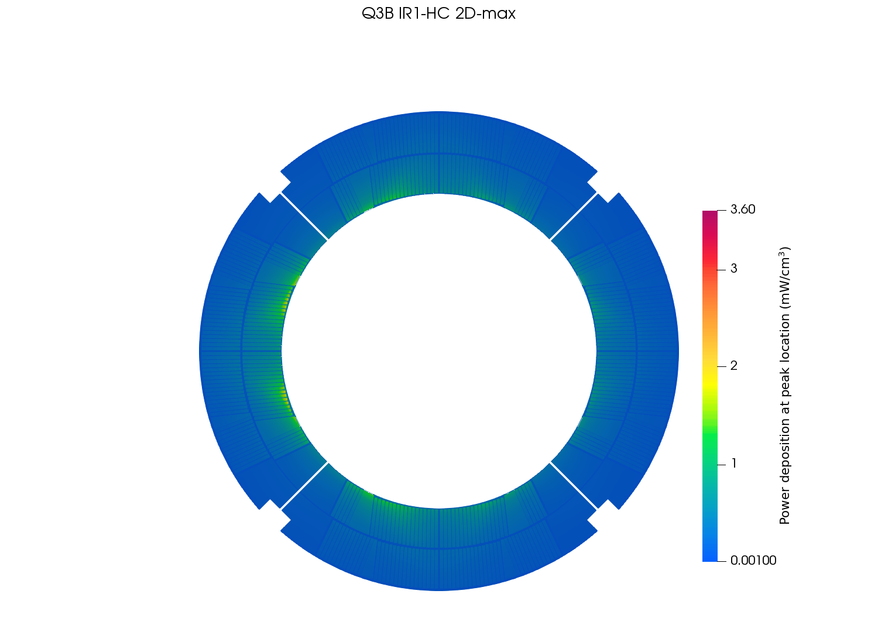
Power deposition at peak location (coil) – IR1/HC

Slide 21
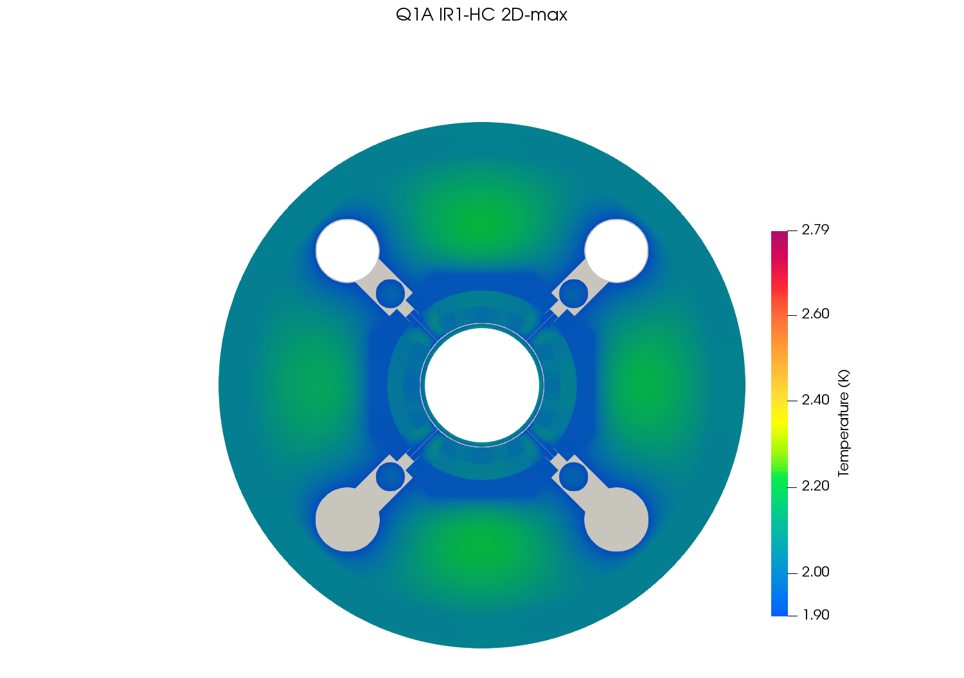

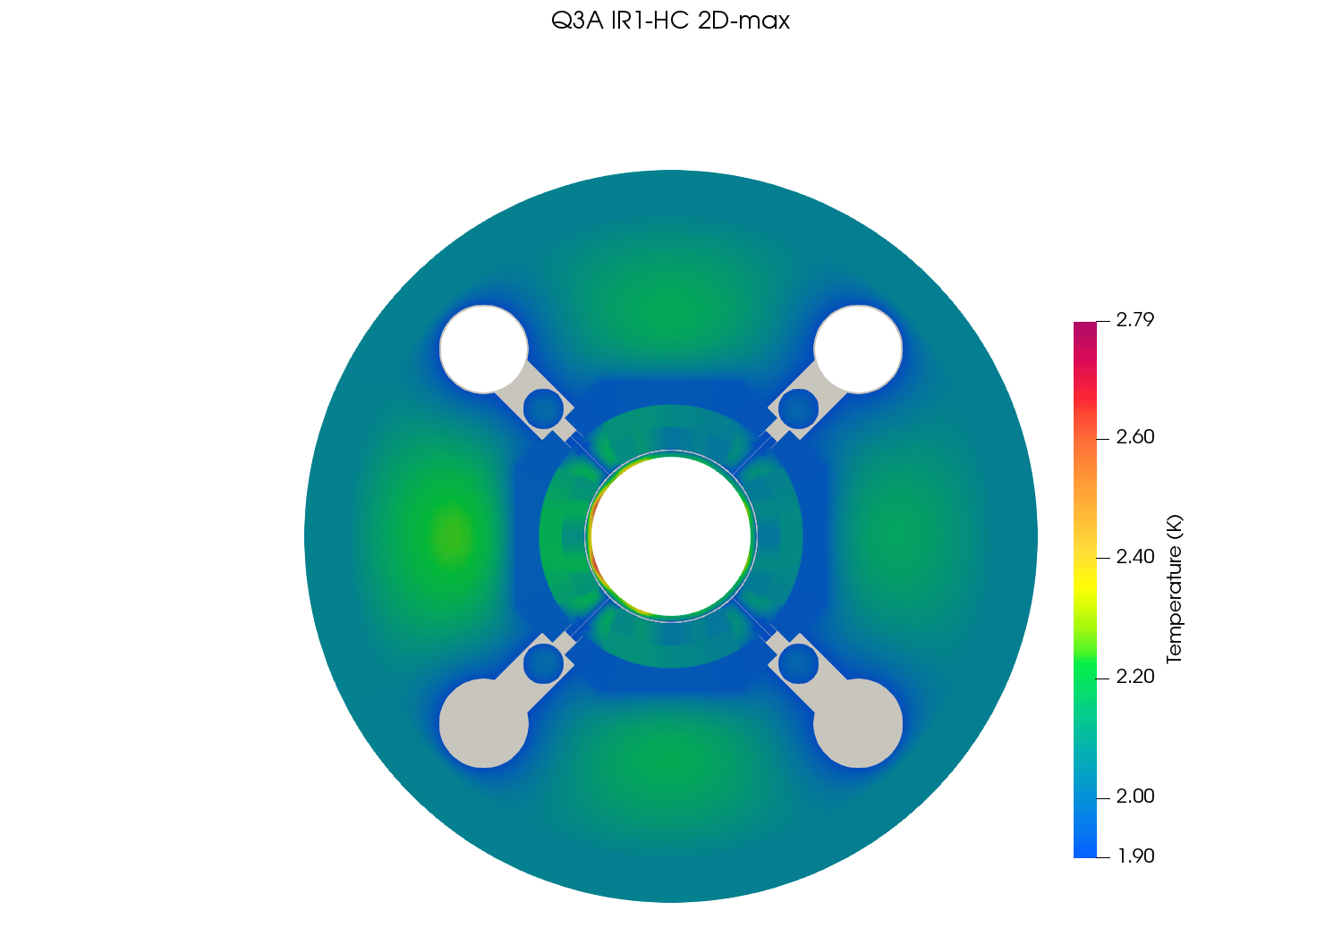
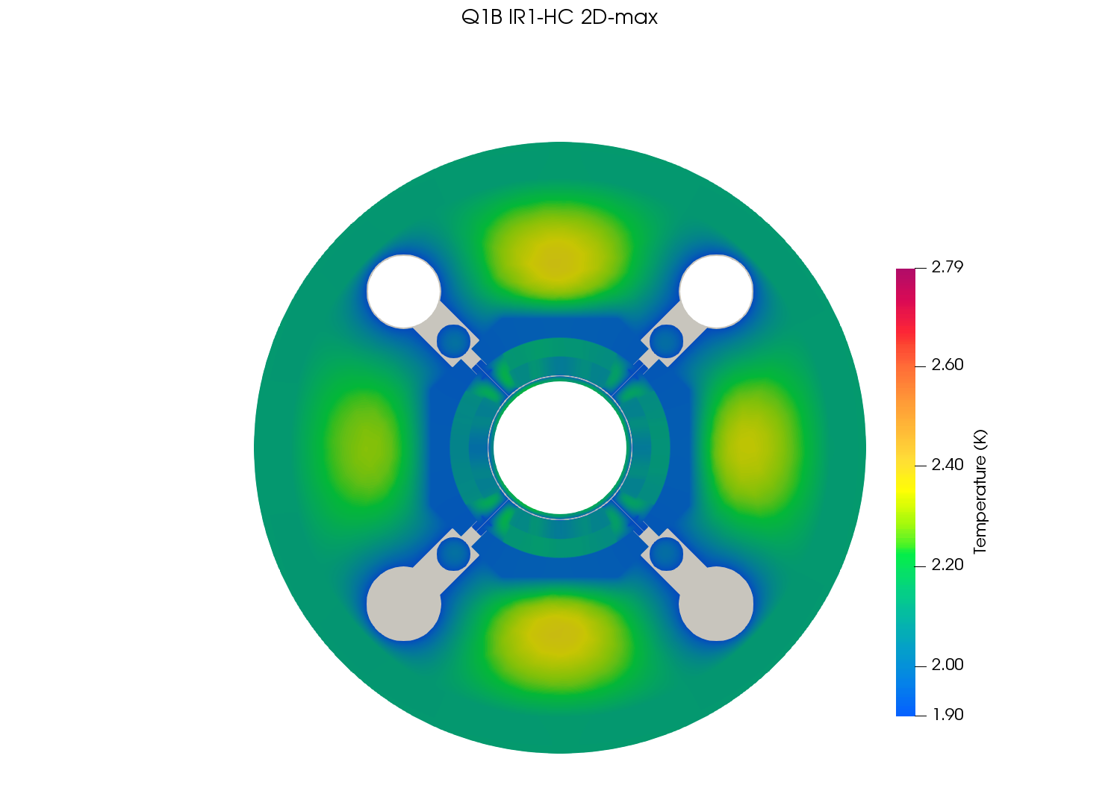
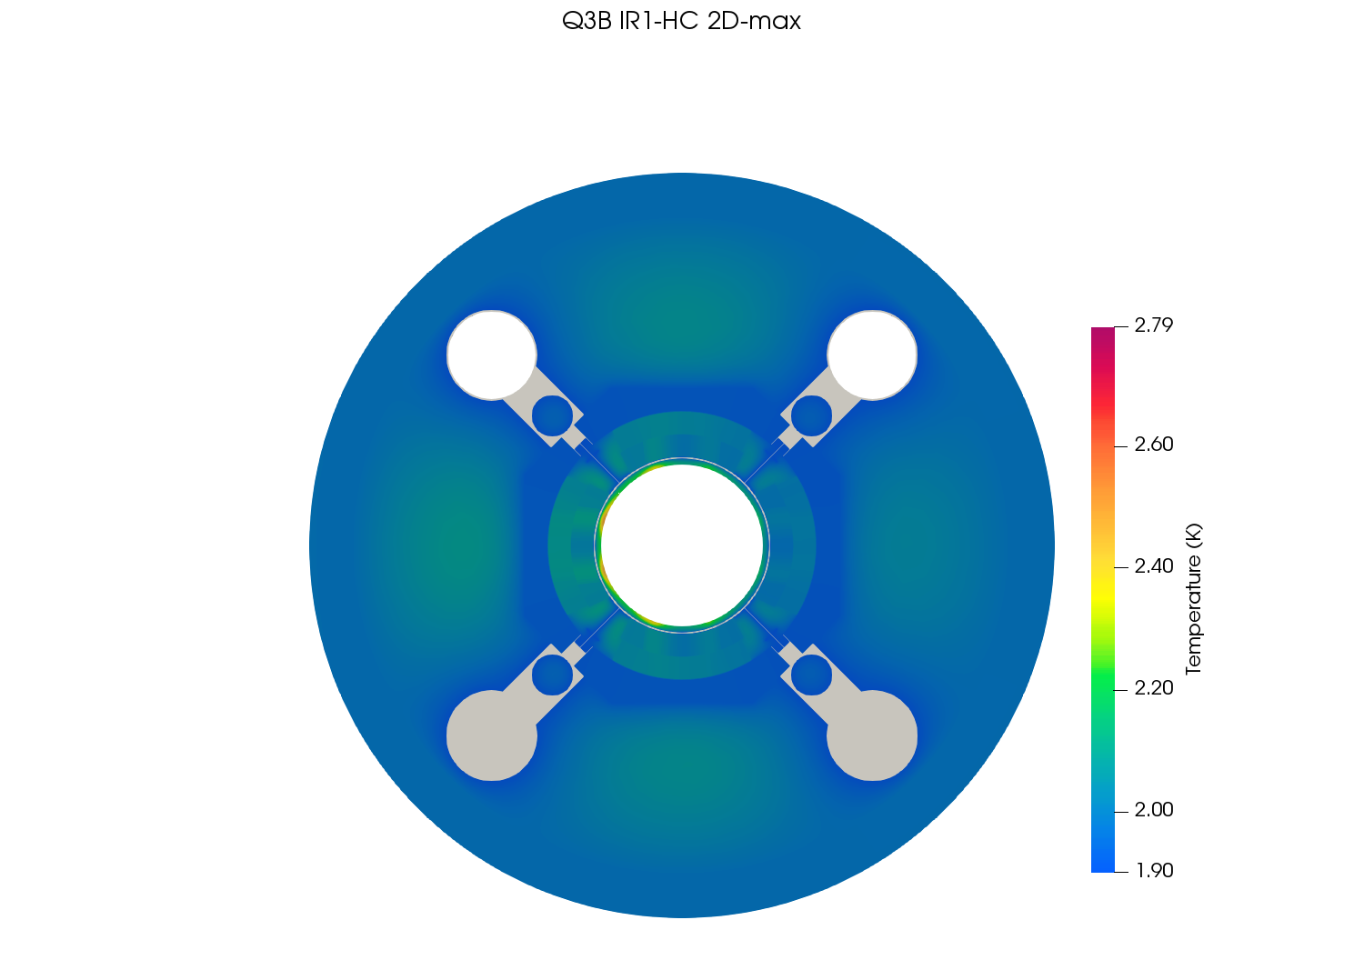
Temperature profile at peak location – IR1/HC

Slide 22
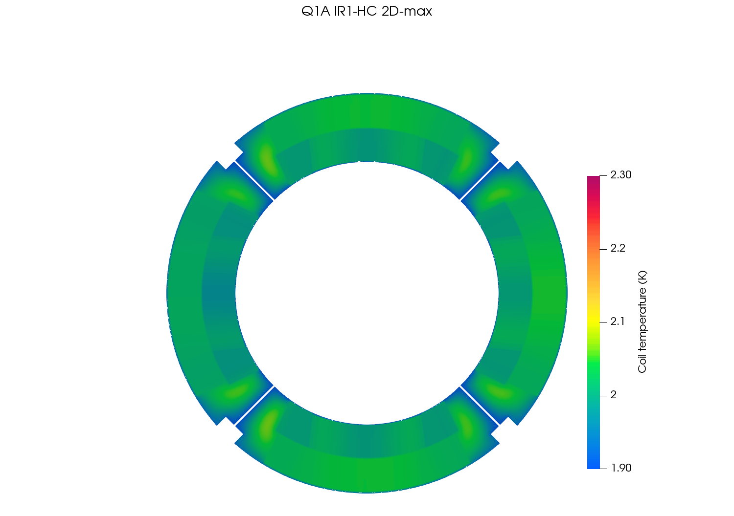
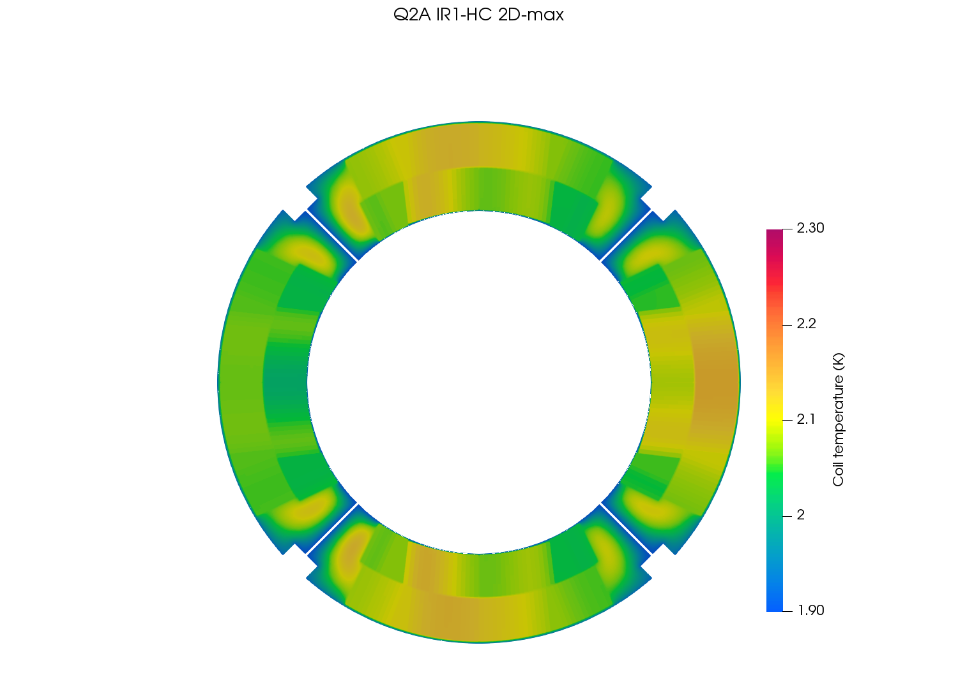
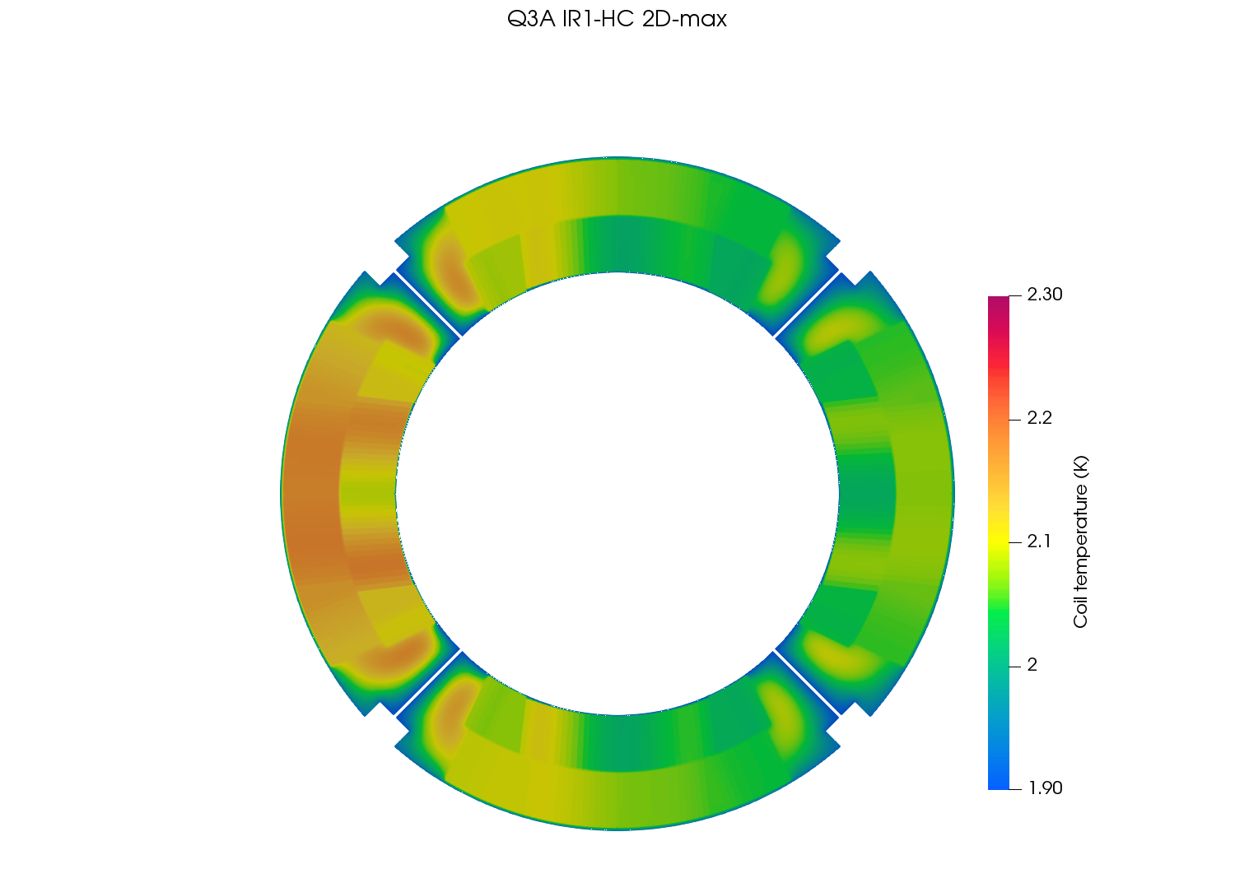
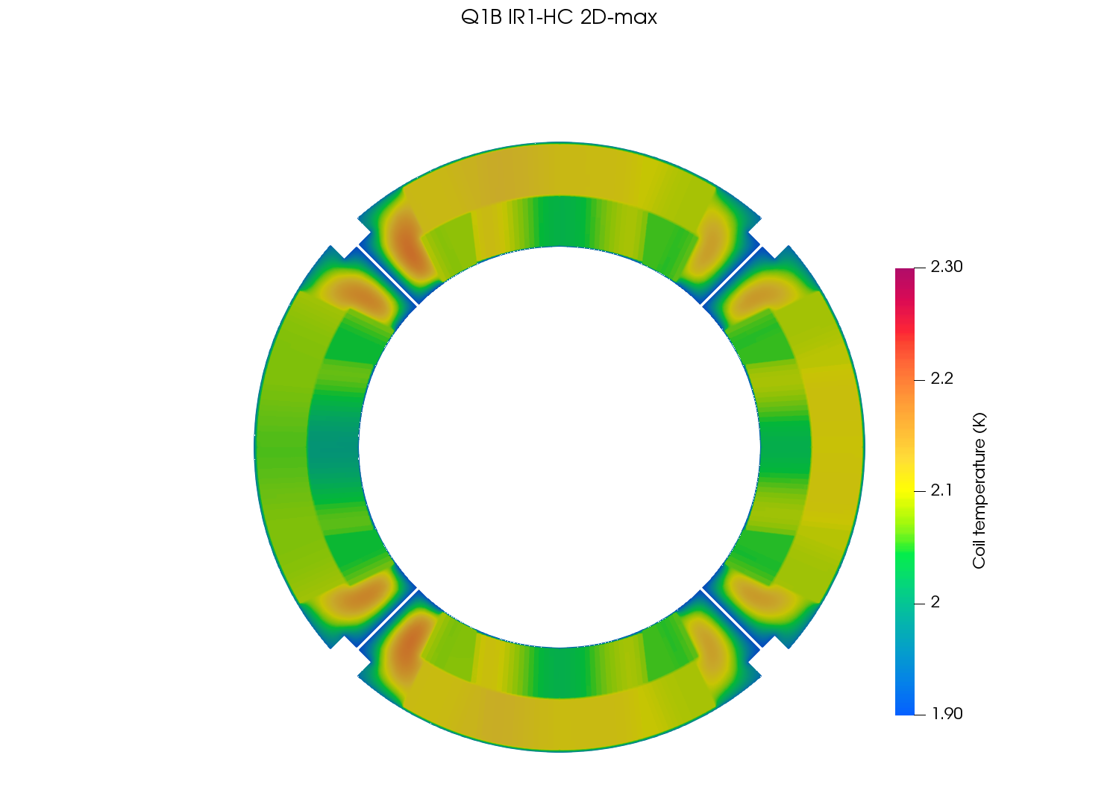
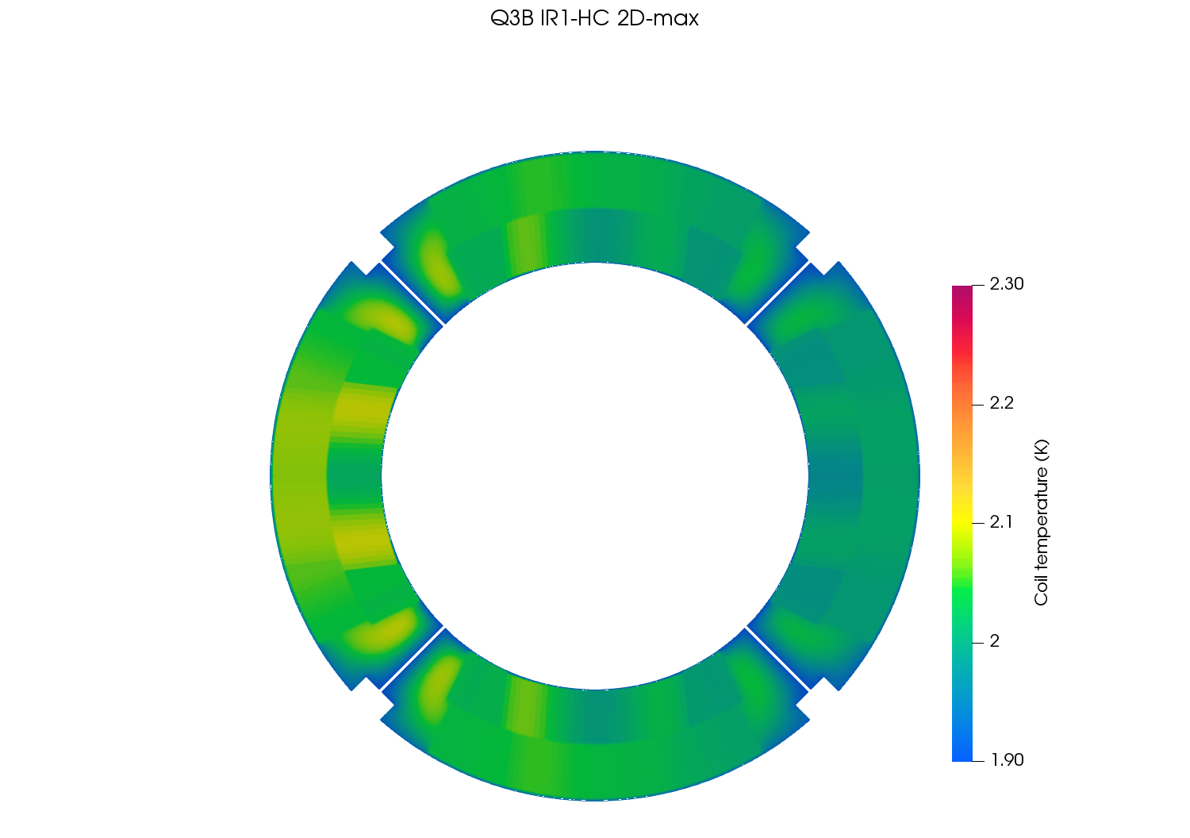
Temperature profile at peak location (coil) – IR1/HC

Slide 23
Results at peak location for IR5/VC
Luminosity = 5.0 x 10³⁴ cm⁻²s⁻¹
Energy = 7 TeV
Dose map cold mass in GeV/cm³
Power deposition cold mass in mW/cm³
Power deposition (coil detail) in mW/cm³
Temperature profile cold mass in K
Temperature profile (coil detail) in K

Slide 24
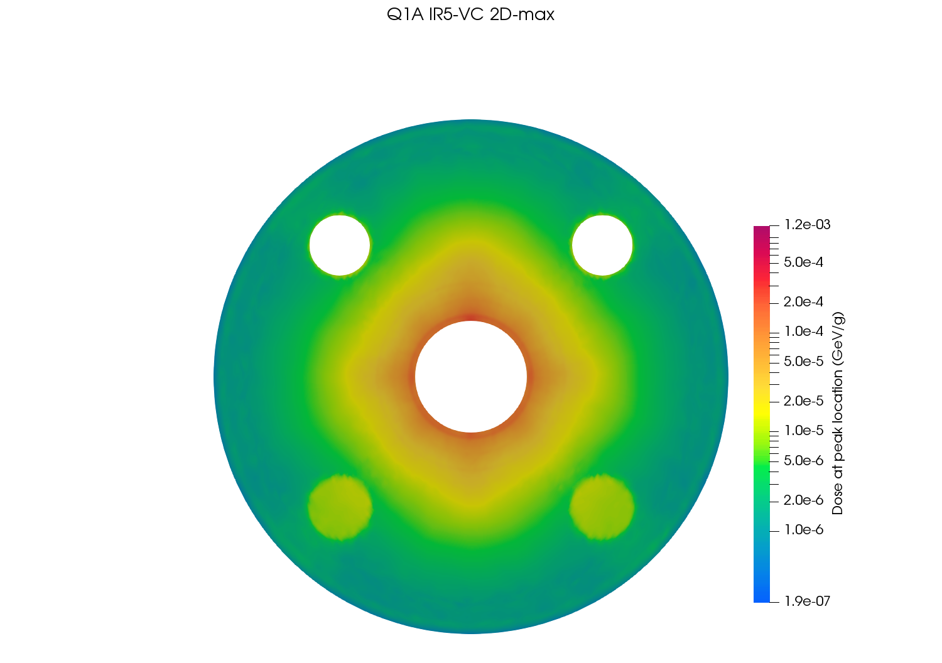
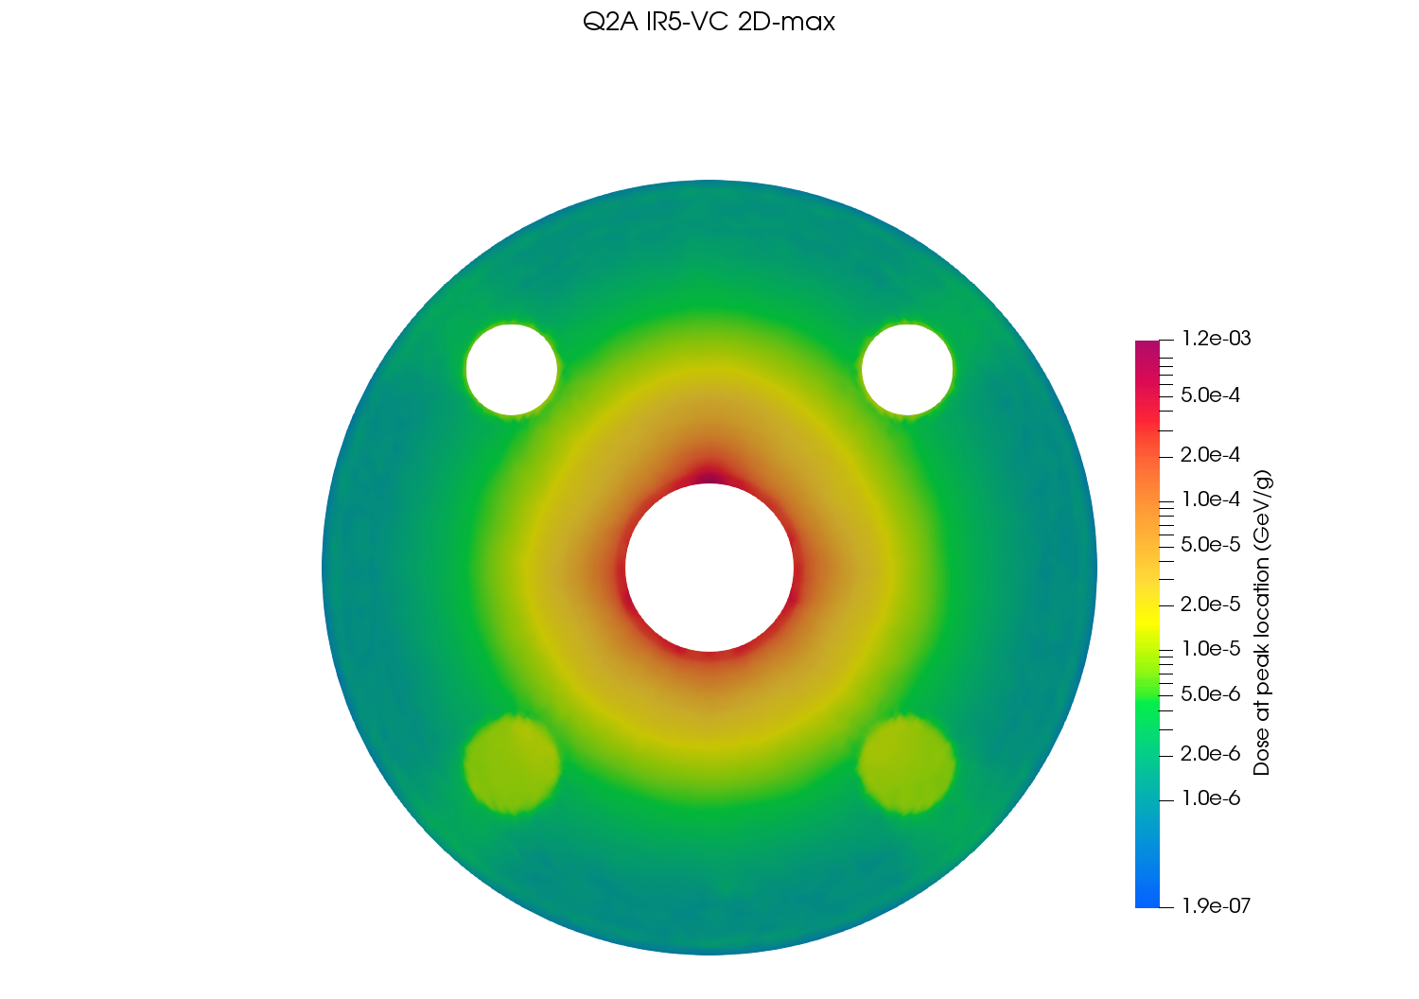
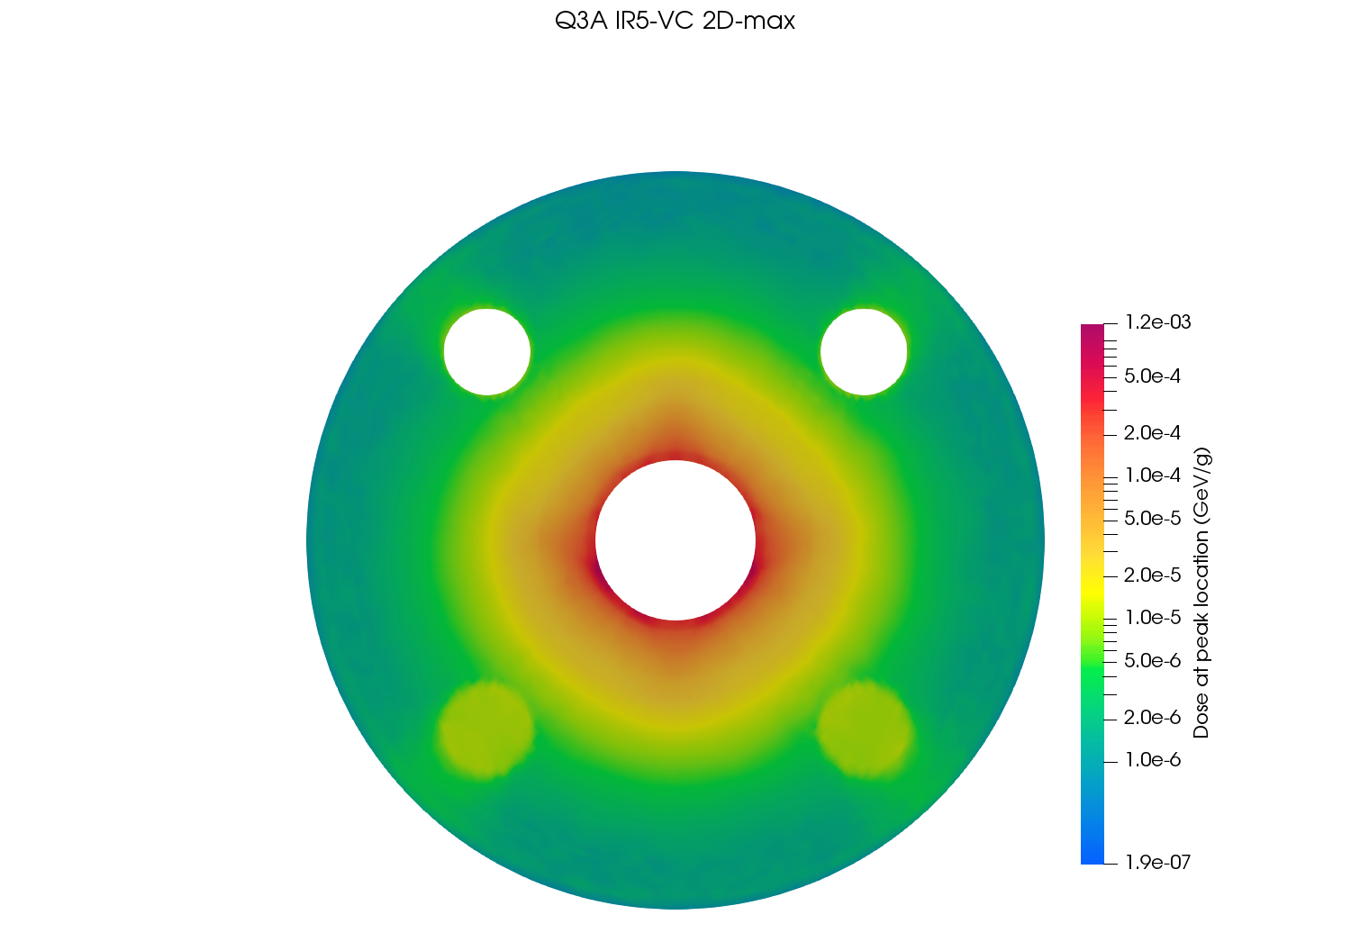



Dose maps at peak location – IR5/VC

Slide 25






Power deposition at peak location – IR5/VC

Slide 26






Power deposition at peak location (coil) – IR5/VC

Slide 27






Temperature profile at peak location – IR5/VC

Slide 28






Temperature profile at peak location (coil) – IR5/VC

