Slide 1
B-FREE Project
A New Long-Term Disposal Pathway for Radioactive Waste Clearance in Switzerland
P. G. Pisano
PGP Consulting
HSE Unit Seminar
06.10.2022
EDMS 2782271

Slide 2
Outline
Radioactive Waste Management at CERN
The B-FREE Project
Lessons Learned

Slide 3
Radioactive Waste Management at CERN

Slide 4
Radioactive waste management at CERN - Context
Between 400 and 1000 m³/y of radioactive waste produced at CERN by the operation, dismantling and upgrade of experimental facilities.
Specific processing, storage, and disposal strategies for different waste classes (e.g. TFA, FMA, ect.) and families (e.g. metallic waste, cables, ISOLDE targets, etc.).
Disposal of radioactive waste distributed between France and Switzerland based on the Tripartite Agreement.
Waste classes | Description | Stored volume, m³ (31.12.2021) | Disposal options
CL | Below Swiss legal limits | 1604 | Conventional disp. in CH
TFA | Very low-level activity | 3881 | Surface repositories in FR
FMA-VC | Low to medium activity – short half lives | 325 | Surface repositories in FR
FA-MA | Low to medium activity | 15 | Surface repositories in FR Deep geological repositories in CH
Total | - | 5825

Slide 5
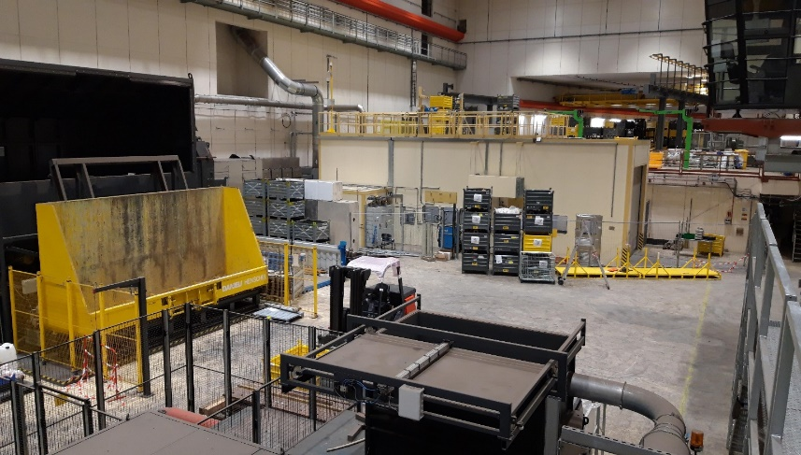
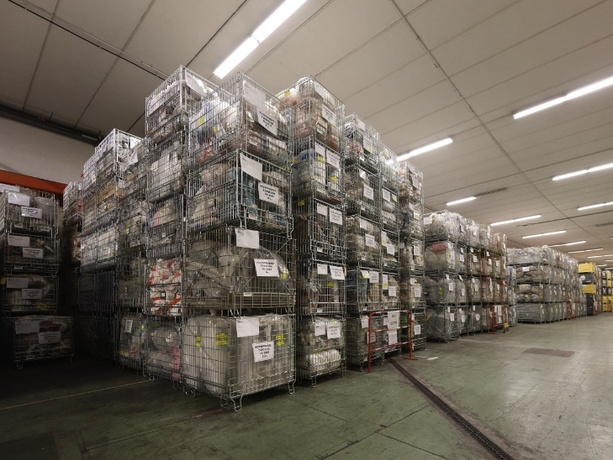


Radioactive waste management at CERN - Overview
Technological waste, metallic waste, cables, ISOLDE targets, etc.
Production, sorting, (dismantling)
CADRA*
RWTCS**
Processing
Interim storage
Disposal
* CADRA: Critères d’Acceptation des Déchets Radioactifs
Volume reduction, packaging, radiological characterization, etc.
** RWTCS = Radioactive Waste Treatment & Storage Center

Slide 6
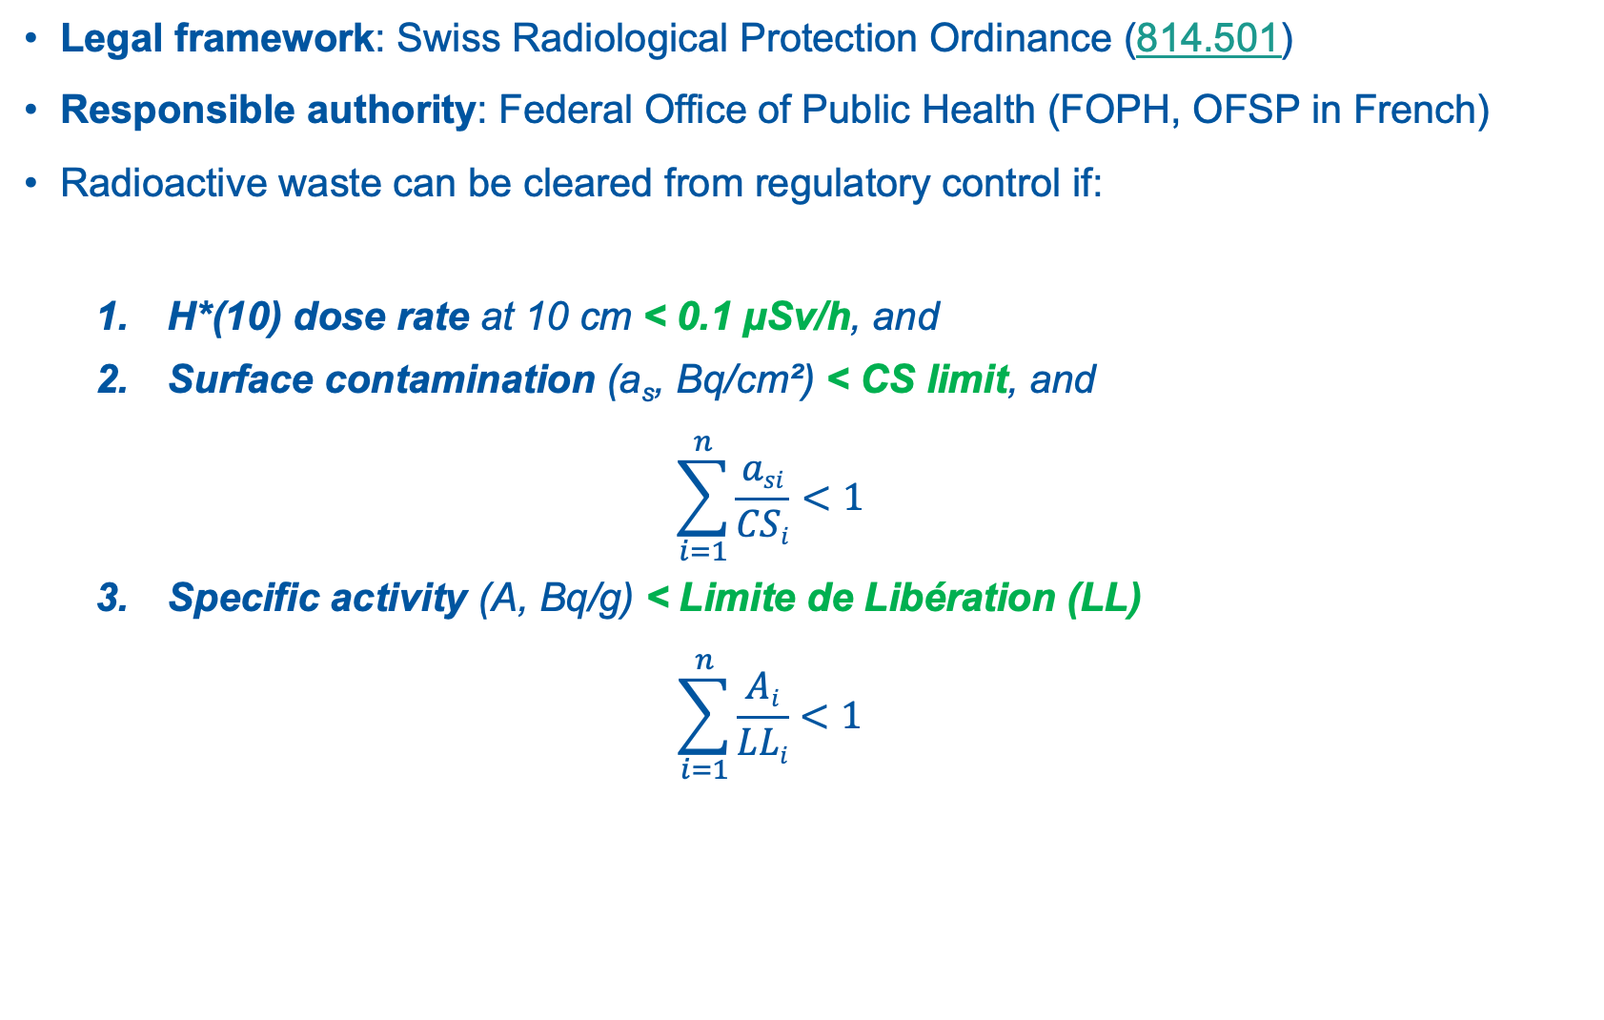
Radioactive waste clearance
Legal framework: Swiss Radiological Protection Ordinance (814.501)
Responsible authority: Federal Office of Public Health (FOPH, OFSP in French)
Radioactive waste can be cleared from regulatory control if:
  H*(10) dose rate at 10 cm < 0.1 μSv/h, and
  Surface contamination (a_{s}, Bq/cm²) < CS limit, and
  $$\sum_{i=1}^{n}{\frac{asi}{CSi}<1}$$
  Specific activity (A, Bq/g) < Limite de Libération (LL)
  $$\sum_{i=1}^{n}{\frac{Ai}{LLi}<1}$$

Slide 7
The B-FREE Project

Slide 8
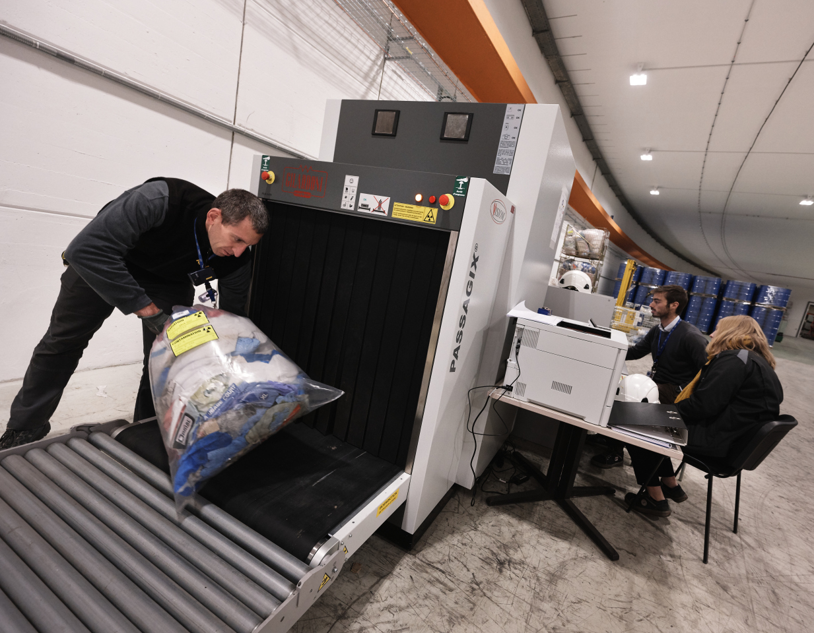
B-FREE Background and Context
Technological waste is comprised of gloves, overshoes, masks, wipes, etc., used during maintenance interventions and operations of CERN facilities.
The waste is contaminated by radioactive dust (e.g. concrete) or metallic particulate.
Up to ~150 m³/y of technological waste can be produced during long shutdown periods.
Since 2020, the BEEP* process ensures the disposal of TFA technological waste towards France.
* BEEP = Burnable wastE Elimination Project
Processing of technological waste at CERN.

Slide 9
B-FREE Project Rationale and Objectives
Beep waste for FREE-release project
RATIONALE
Experience and operational knowledge suggest a large fraction of conventional technological waste.
Technological waste was automatically processed as TFA – no classification sorting.
Suboptimal use of CERN resources and unnecessary occupation of TFA repository in France.
OBJECTIVES
Develop the radiological characterization methodology.
Develop the processing, QA and validation plans.
Obtain from OFSP a long-term authorization for clearance.
Execute a pilot campaign targeting 30 m³.

Slide 10


B-FREE Process Overview
Incineration facility
Corrected non-conformities
BEEP-BG or BEEP-ABG
(TFA)
DR & Contam.check
X-ray scan
RADOS
DR & Contam. measur.
Interim Storage
Buffer
10% volume
Quality control
(γ-spec)
Processing unit = 0.7 m³ grid box

Slide 11
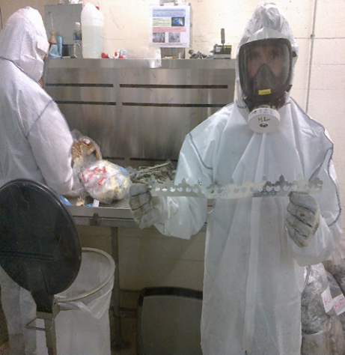
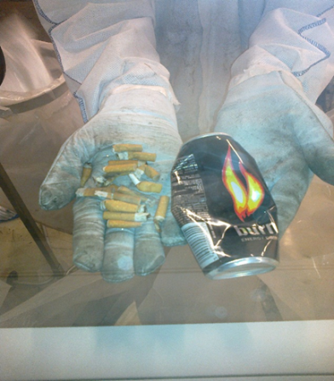
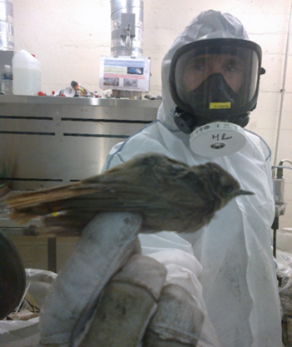
B-FREE Special SURPRISES
Pictures taken in 2014 (LS1) [EDMS 1463650].

Slide 12
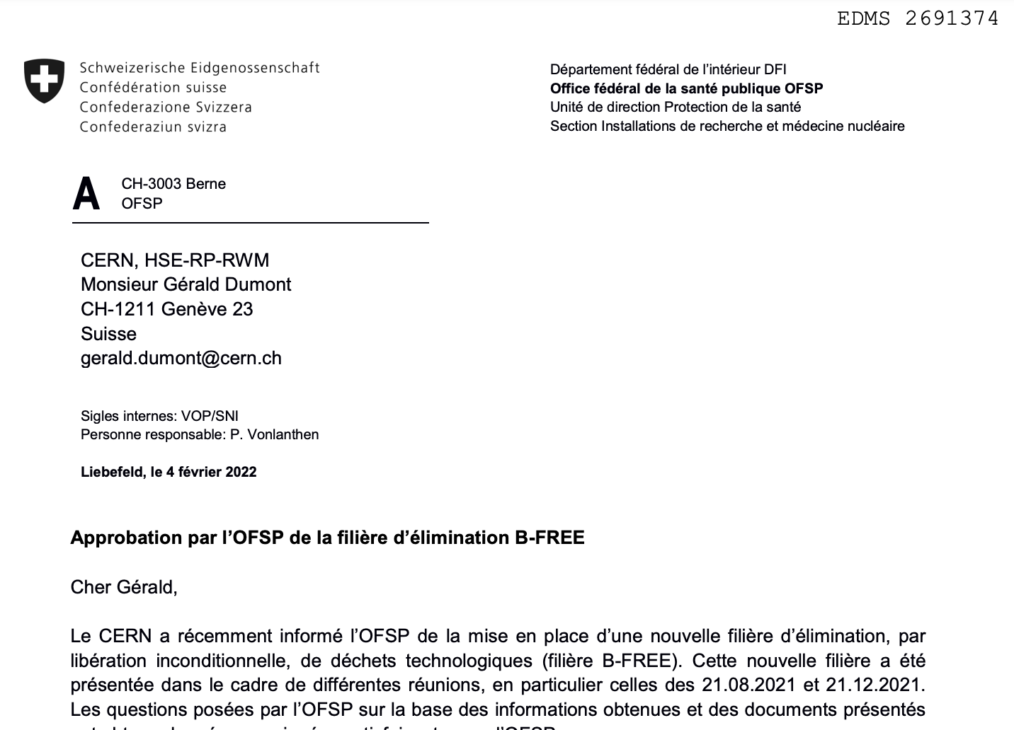
B-FREE Outcome
The OFSP long-term authorization to clear technological waste from regulatory control.
A first batch of 30 m³ disposed of as conventional waste.
Consolidation of best practices and collaboration within the HSE-RP Group.
Experience and lessons learned paving the road to future projects → clearance pathways for “all” waste families.

Slide 13
Lessons learned

Slide 14

Lessons Learned - Communication
Managing a project is 80% communication, 20% supporting the project team members → the project manager is not (necessarily) a subject-matter expert.
Regular, short project team meetings (e.g., 30’ every 2 weeks) are paramount and should not be skipped (don’t be lazy!).
Zoom meetings are less demanding and easier to manage → higher attendance.
Communication → discussion → progress.

Slide 15
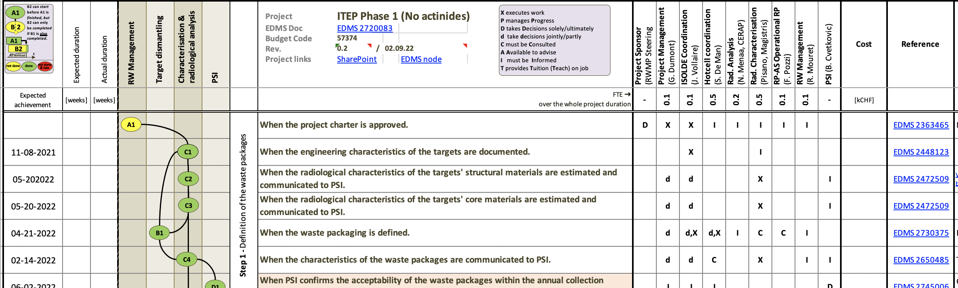
Lessons Learned – Project management tools
Overwhelming number of project management tools → hard to chose the right one.
Milestone plan: milestones, timeline, dependencies, responsibilities, costs on one page!
Written documents (prj. proposals, milestone plans, etc.) provide guidance for problem analysis.

Slide 16
Thank you for your attention

