Slide 2
Electronic Traveller (eMIP)
A transparent tool for production monitoring
Matthias Bonora
TE-MSC-TM
On behalf of MSC-QA team
Olivier Housiaux, Rosario Principe, Kevin Monneron
Support of EN-IM team

Slide 3
Outline
What is a MIP
Motivation and objectives
Implementation
Building an eMIP
Future plans and features

Slide 4
What is a MIP
Reference document to ensure that manufacturing was properly done
Lists manufacturing steps, inspection steps, and versions of procedures/drawings used for production
Implemented at CERN for HL-LHC project
From nuclear industry (complex, reliable)
What is a MIP

Slide 5
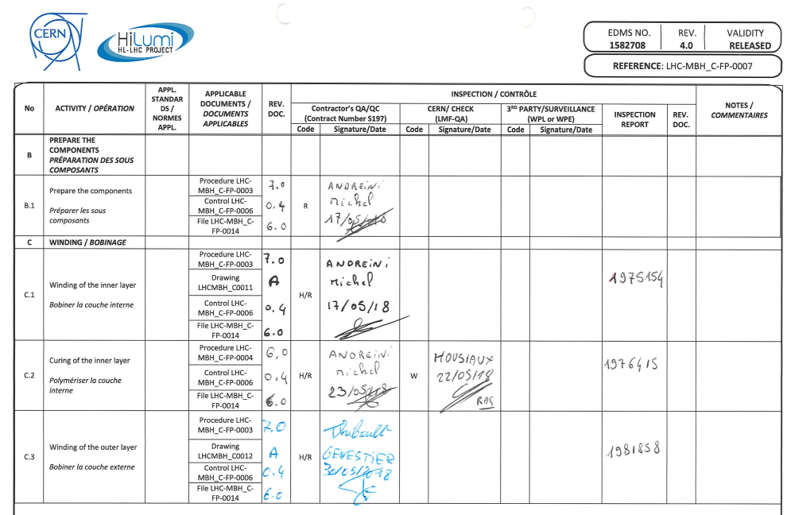
MIP Example
Description of the operation
Validation
3rd party
(if any)
Additional Comments
Documentation traceability
CERN Controls
Reports
© Olivier Housiaux
What is a MIP

Slide 6
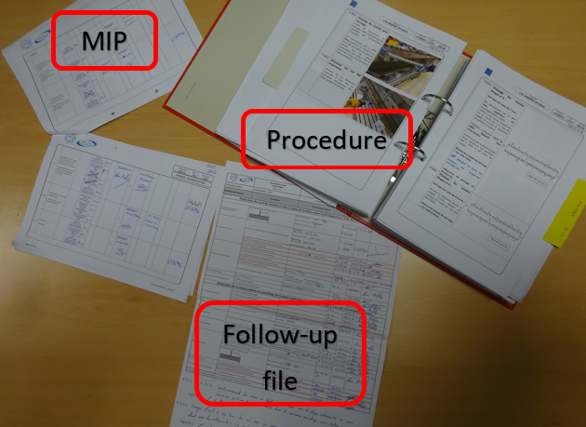
MIP in field
Follows the production
“Travels” with the assembly
© Olivier Housiaux
What is a MIP

Slide 7
Motivation for electronic MIP
Paperless CERN
  Traceability, security, accessibility
  GL + TE-MSC-QA initiative
Propagation of changes
  Direct access to latest version of procedure, drawings and follow-up file
  Automatic data recording
  Notifications
Data analysis
  KPIs, summaries, as needed
→ Introducing the eMIP
Motivation / Objectives

Slide 8
Objectives - Technical
Robust
Simple in administration
Flexible and secure
Adaptable to requirements from production & management.
Using CERN infrastructure (EAM, EDMS)
  Support from EAM team
Generic
  Avoid customization for each eMIP
  benefit for other teams
Motivation / Objectives

Slide 9
Objectives - User
Access to documentation during production
  procedures, drawings, checklists, manuals, standards
Access to documentation as used during assembly (back engineering)
Digitally signing of performed steps
Integrated checklists
Motivation / Objectives

Slide 10
Objectives - Management
Real-time access to current state of production
Traceability of responsibilities with signatures
Notification on milestone steps
Summary reports, KPIs
Motivation / Objectives

Slide 11
Implementation - eMIP
EAM/EDMS/MTF
Checklists
MIP Overview
Statistics
Signing
Notifications
Reports
A collection of reports, tools and features
A recipe for creating Workorders, Taskplans and Checklists
Implementation

Slide 12
eMIP Technologies Used
EAM/MTF
  Production steps and checklists
  EAMLight as user interface in field
Pentaho
  Report generation
EDMS
  Storing and referencing documents
No custom software (within TE-MSC)
EN-IM team support
Implementation

Slide 13
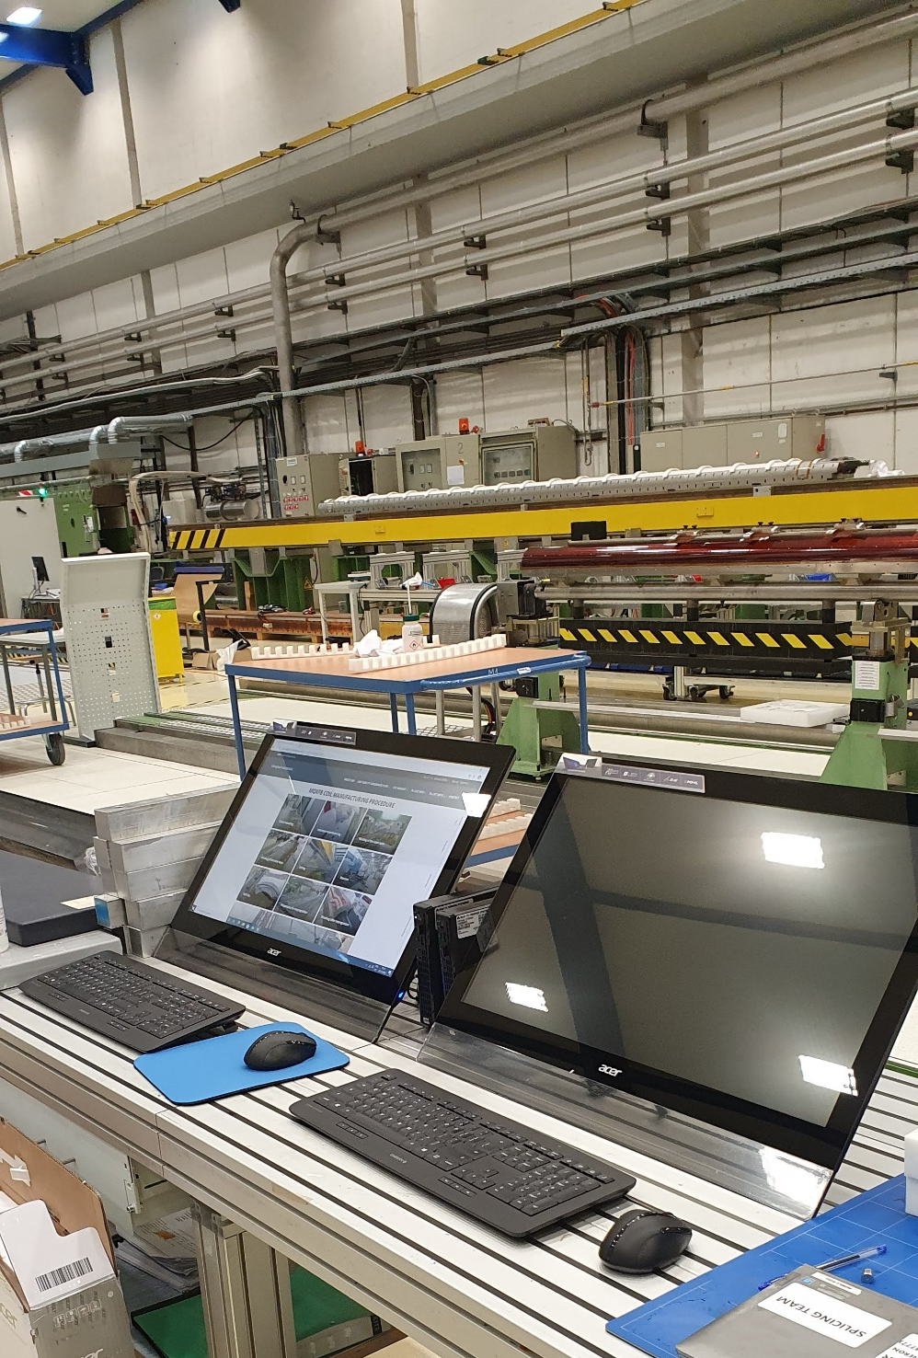
eMIP Hardware
Dedicated hardware station
  Computer, touchscreen,
  barcode scanner
Or Tablet / Phone
  EAMLight mobile support
Implementation

Slide 14
First Step – Prototyping (2021)
Technical concept and prototyping
  Test stations for hardware
Implementation of all features
  Holding points, blocking points,
  E-signing,
  Custom reports
  Notifications
Implementation

Slide 15
Prototyping – Lessons Learned
Too much hardcoding and customization
  Not robust, hard to administer, hard to change, hard to maintain
Be aware of complexity
  Hard to track errors and permission problems
Blocking points are dangerous
  Stops work on eMIP until issue is resolved
  Use procedural holding points instead of technical ones
Better simple and working than complex and breaking
Need to keep everyone involved
Implementation

Slide 16
New Version – “Production”
Take what worked from prototype, discard what failed
Incrementally build up features
Keep reusability in mind
  generic over customization
  New ideas take time to generalize and validate
Implementation

Slide 17
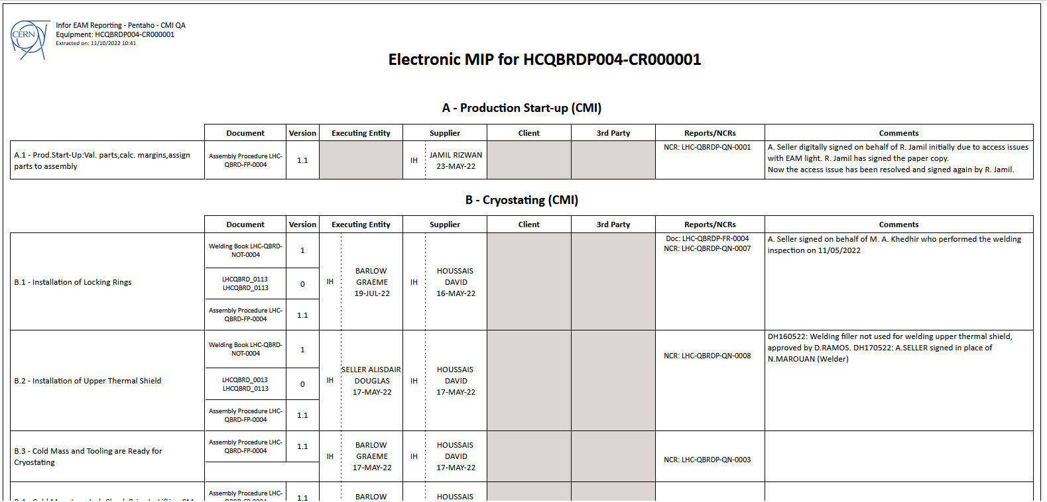
The eMIP Provides
Production step
Reports
Comments
Procedures
Signatures
Implementation

Slide 18
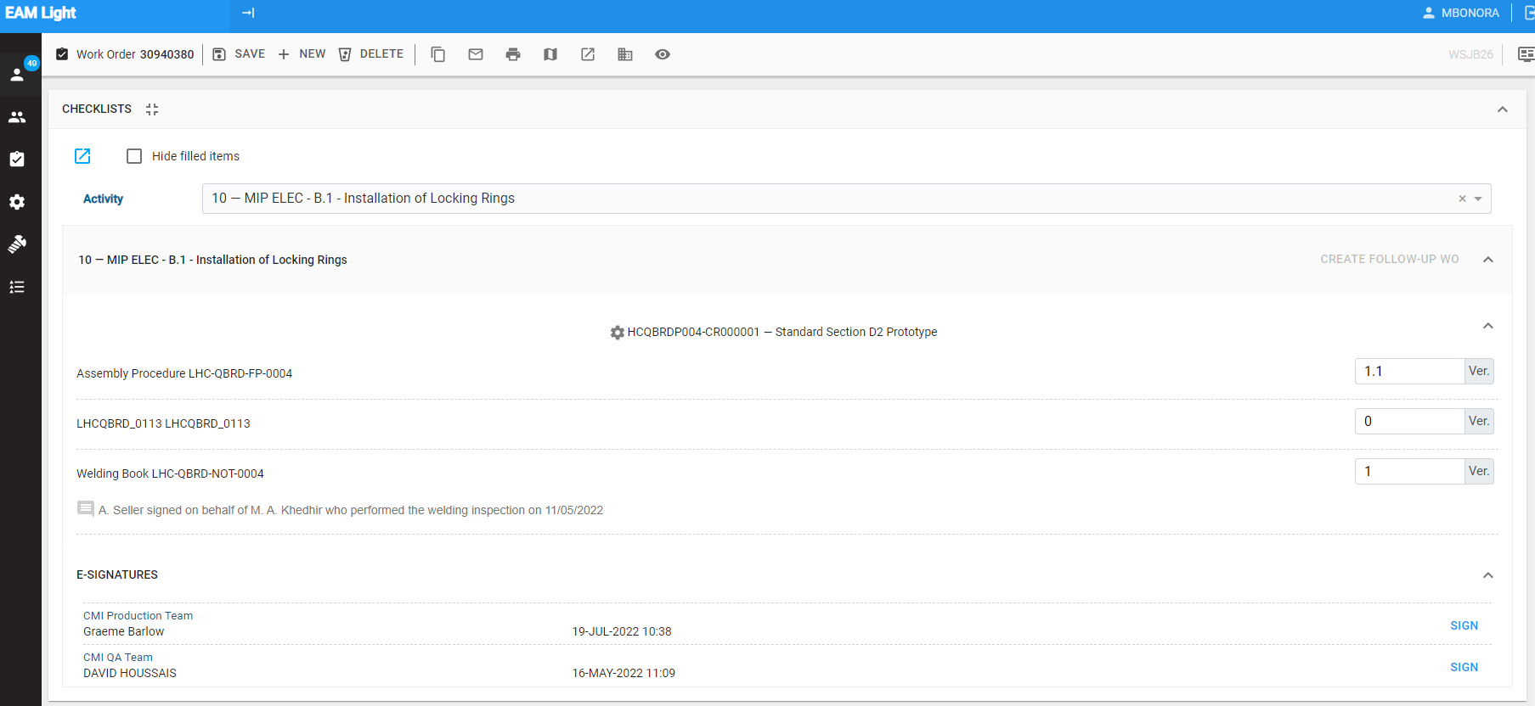
The eMIP Provides
Direct link to step in EAMLight
Implementation

Slide 19
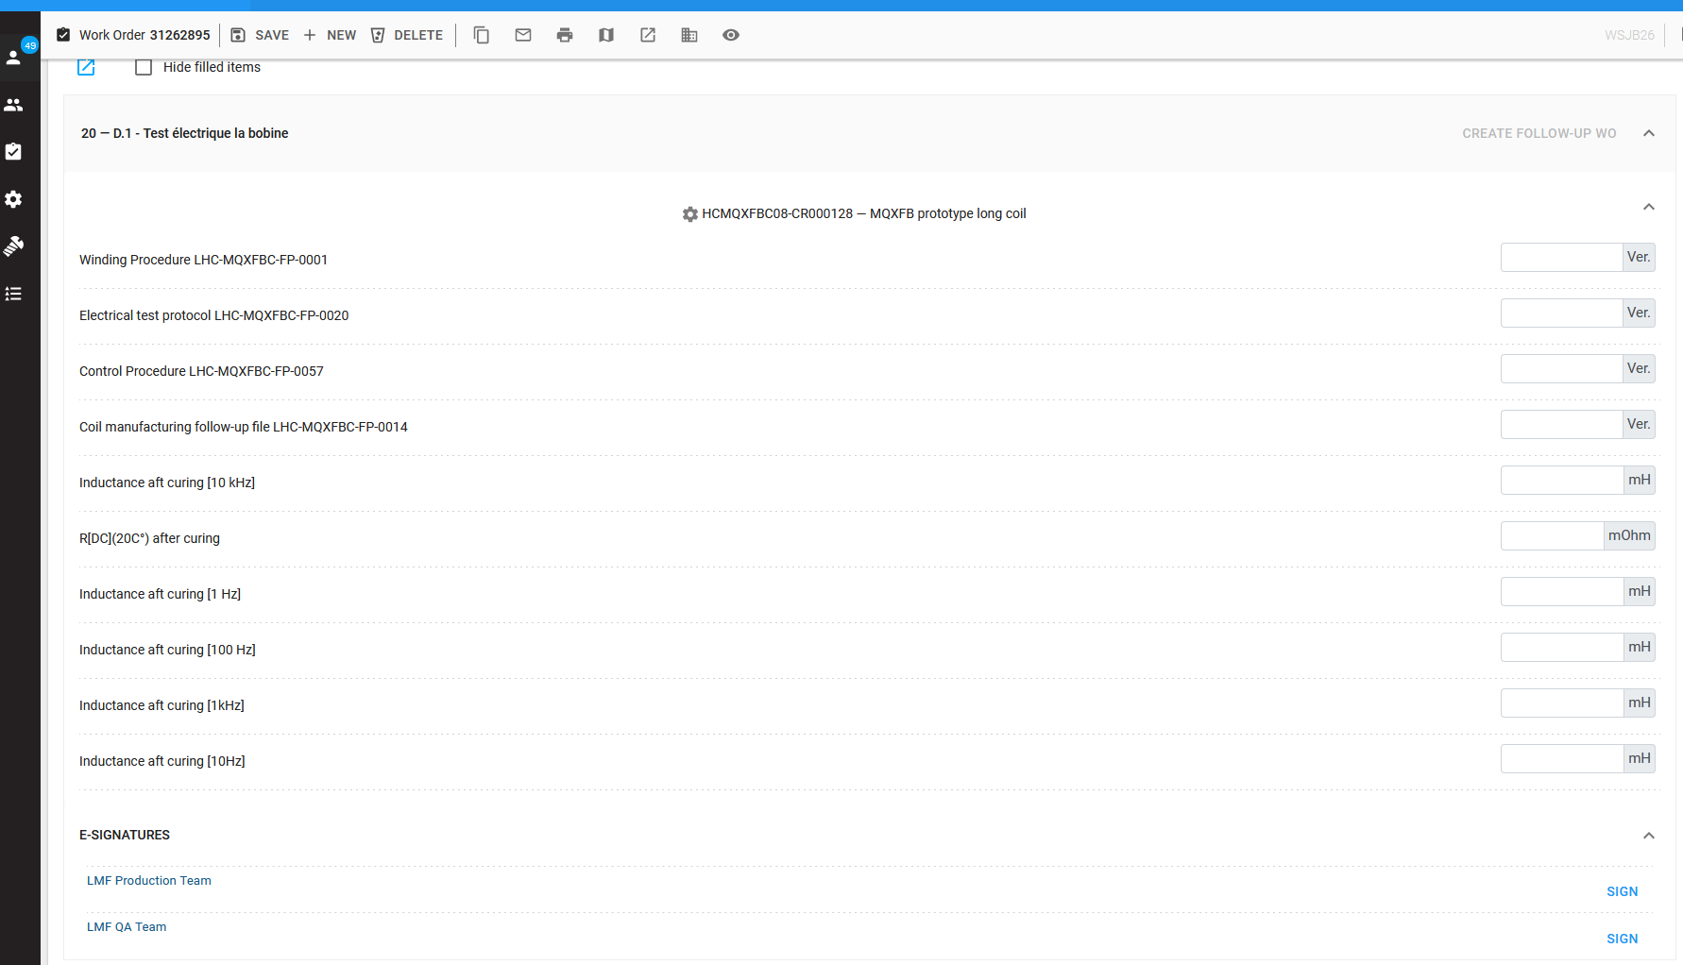
The eMIP Provides
Checklists
Implementation

Slide 20
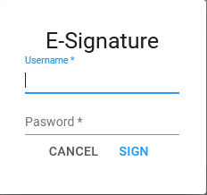
The eMIP Provides
Digital signatures
Implementation

Slide 21
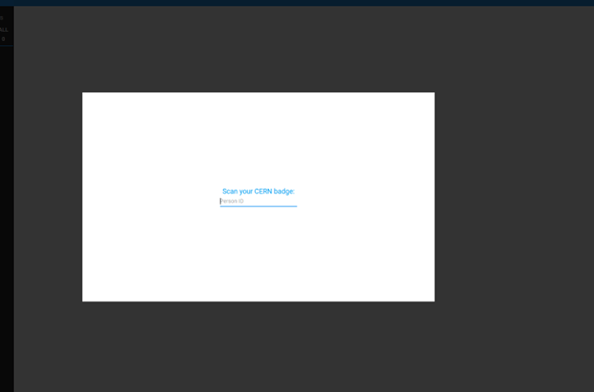
The eMIP Provides
Kiosk mode, login via badge scan
Implementation

Slide 22
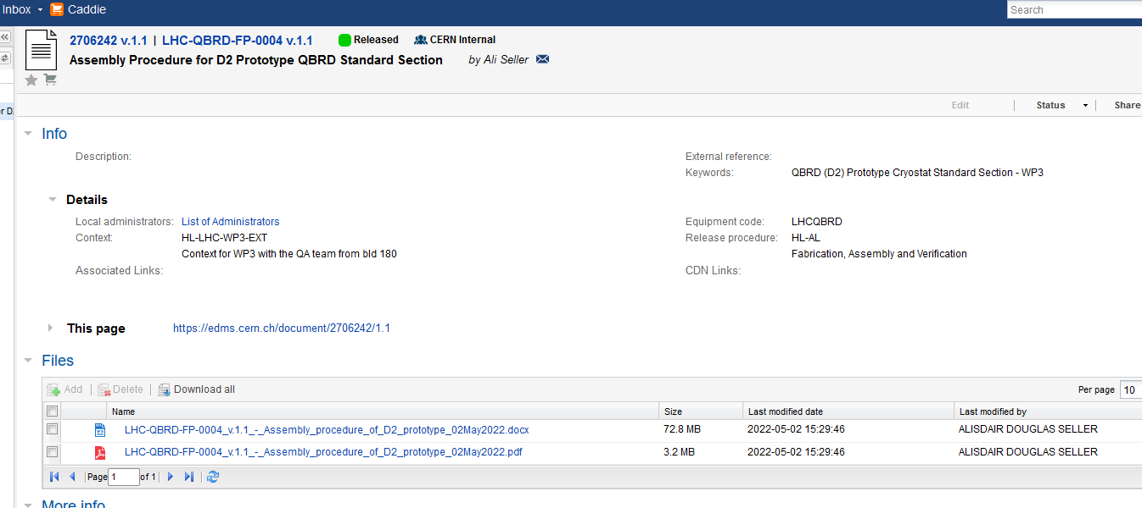
The eMIP Provides
Direct link to procedure

Slide 23
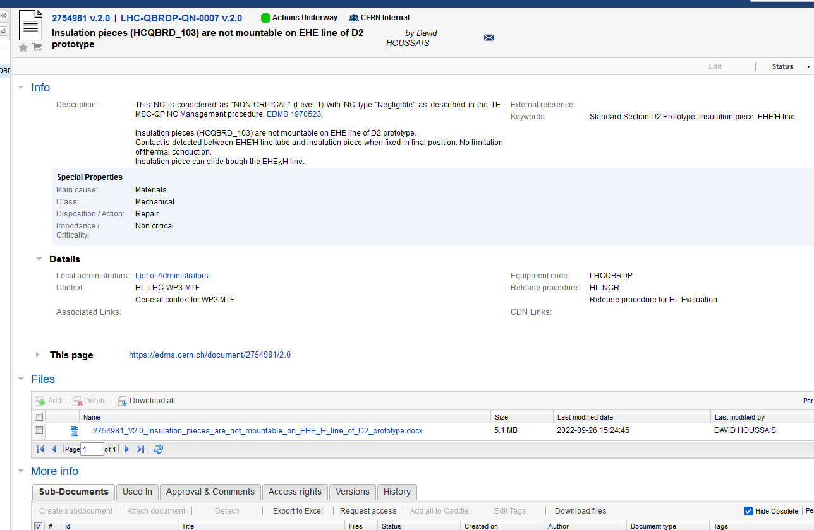
The eMIP Provides
Direct link to NCR/Reports
Implementation

Slide 24
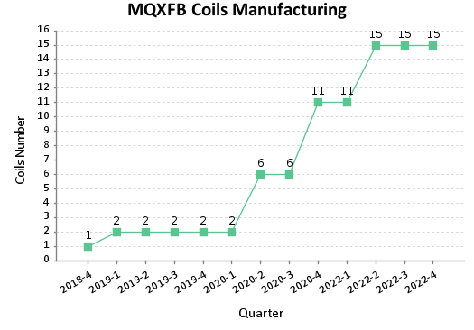
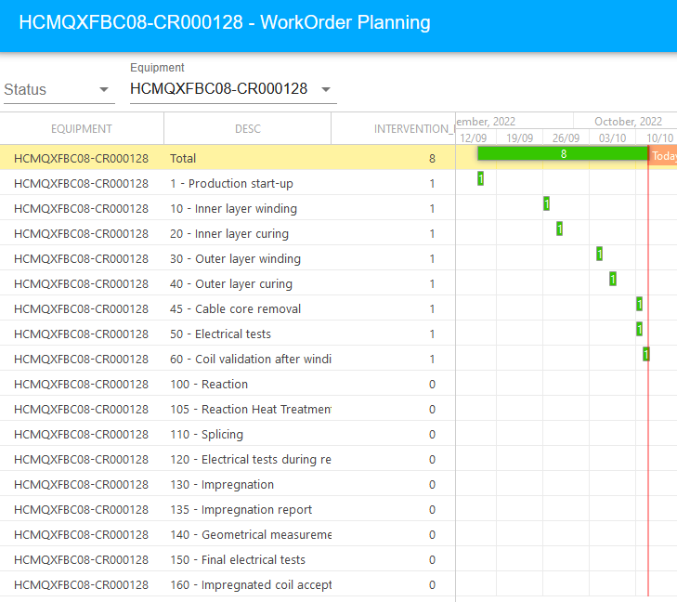
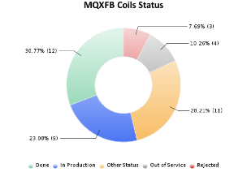
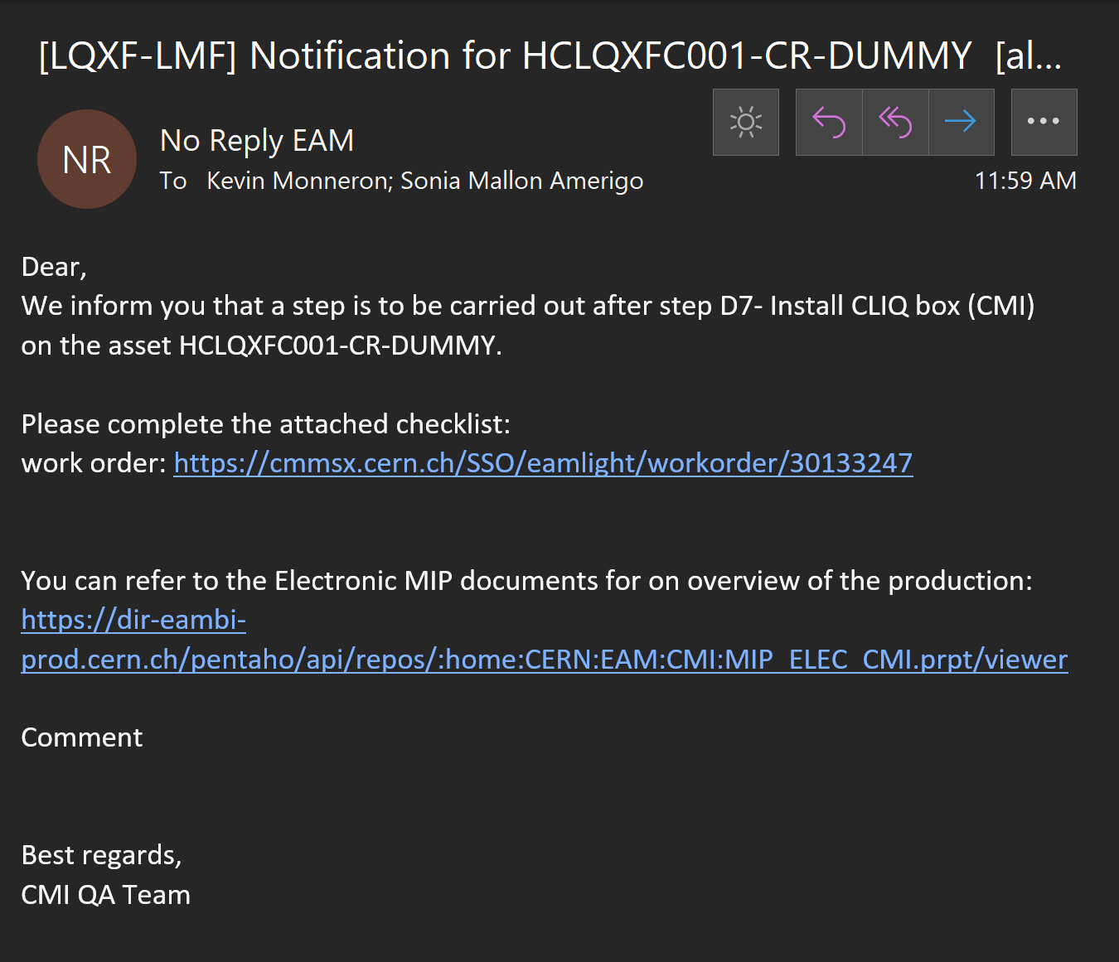
The eMIP Provides
Reports and KPI
Summaries
Notifications
Implementation

Slide 25
How To Build a new eMIP
Involved EAM components
Access rights
Procedure and tools
Building an eMIP

Slide 26
How To Build a new eMIP
Starting point: approved MIP (EDMS) + procedures, drawings
Equipment + Item in EDMS
Building an eMIP

Slide 27
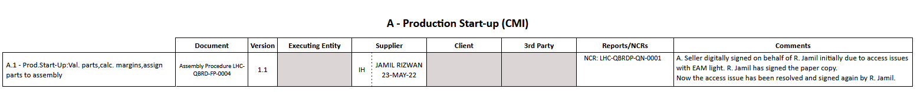
How To Build a new eMIP
Standard Workorders
    Workorder templates
    Equal to MTF
    step
Building an eMIP

Slide 28
How To Build a new eMIP
Taskplans
    Activity templates
    Signing rights (groups)
    Notifications
    Workorder logic
Building an eMIP

Slide 29
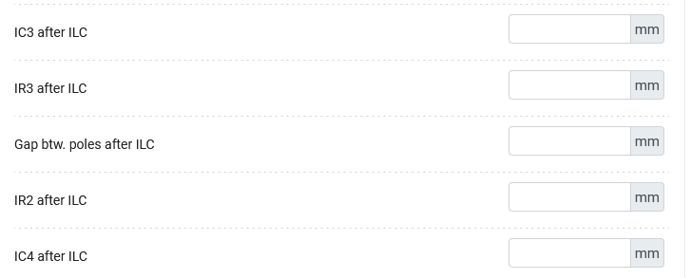
How To Build a new eMIP
Checklists
    Procedures
    Input fields
    Link to custom fields
      MTF equipment data
Building an eMIP

Slide 30
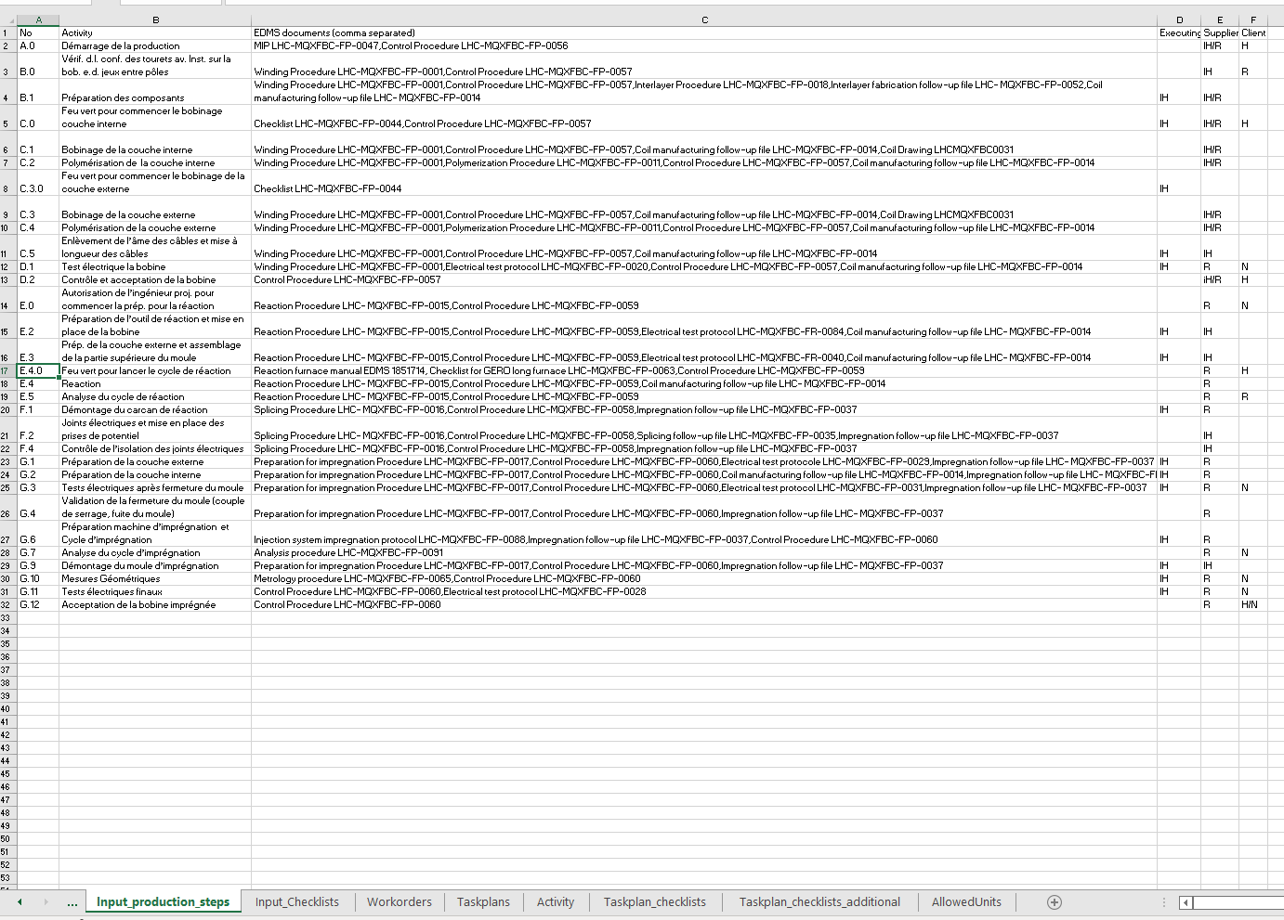
eMIP Creation in Practice
Fill out Excel Sheet
  Defaults
  Steps
  Checklists
Generated import tables
Few manual adjustments
Checked by link person
CERN Upload Utility
Assign workflow in Equipment Generator
Building an eMIP

Slide 31
In Case of Changes
Modify Standard WO/Taskplans
Existing eMIP not touched
Only future Assets affected
Changes in already created eMIP possible
  Only affects specific eMIP
Direct modification of structure
  -> Made by link person
Procedure/Document Update transparent (over EDMS version)
Access rights for signing transparent (not bound to eMIP directly)
Building an eMIP

Slide 32
User Access Control
Signing Rights linked to groups
  M-CMI-P -> Production team of CMI
  Linked to e-group
Badge access linked to e-groups
Building an eMIP

Slide 33
Current State
Current implementation in use for assemblies (D2 proto cryostat, Q2b cryostat, MQXFB coils and Magnets)
Tested viability of different scenarios
  Creating new eMIP from MIP template
  modifying prototype eMIP to production eMIP
  Adapting already created assets to eMIP
Slowly adding features bit by bit in production
  Quick reaction in case of problems
  Clear source of new problems
Plans and features

Slide 34
Outlook
Simplify inputs
  Interface for creating new eMIP
  Input for notifications and recipients
Extend automatic reports
  Automatic generation on specific events
  Summary reports
Open for everyone
  Same structure easily adapted to other processes
  Mutual benefit of EN-IM developments
  Central place for overview/statistics/information (EAM)
Plans and features

Slide 35
Outlook – Operation
eMIP managed by QA teams
  Creation of new eMIP
  Asset generation
  Managing of access rights
Link person
  For issues and new features
  Final check of eMIPs (structure, new features, improvements)
  Coordination with EN-IM team
  Collection and feasibility check of required features
Plans and features

Slide 36
Thanks
Promoted by group (TE-MSC GL) and TE-MSC QA team (pushing initiative)
CMI and LMF production teams for their patience, help and inputs
EN-IM team for their quick response and effective help to adopt solutions

