Slide 1
Plasma colliders: efficiency
What is needed, where are we, where do we have to go?
Erik Adli
Department of Physics, University of Oslo, Norway
Erik.Adli@fys.uio.no
ALEGRO 2023, DESY. Germany, Mar 23, 2023

Slide 2
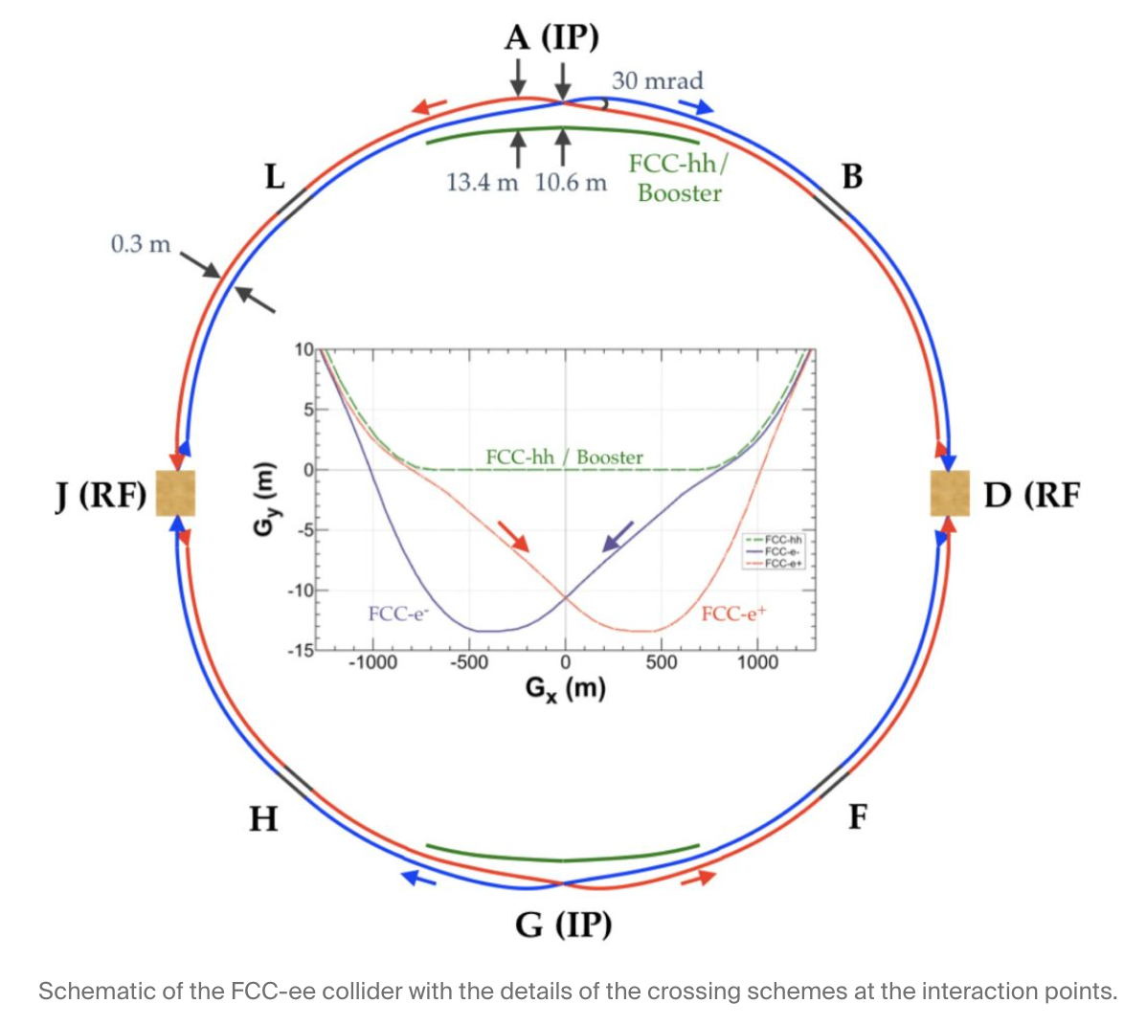
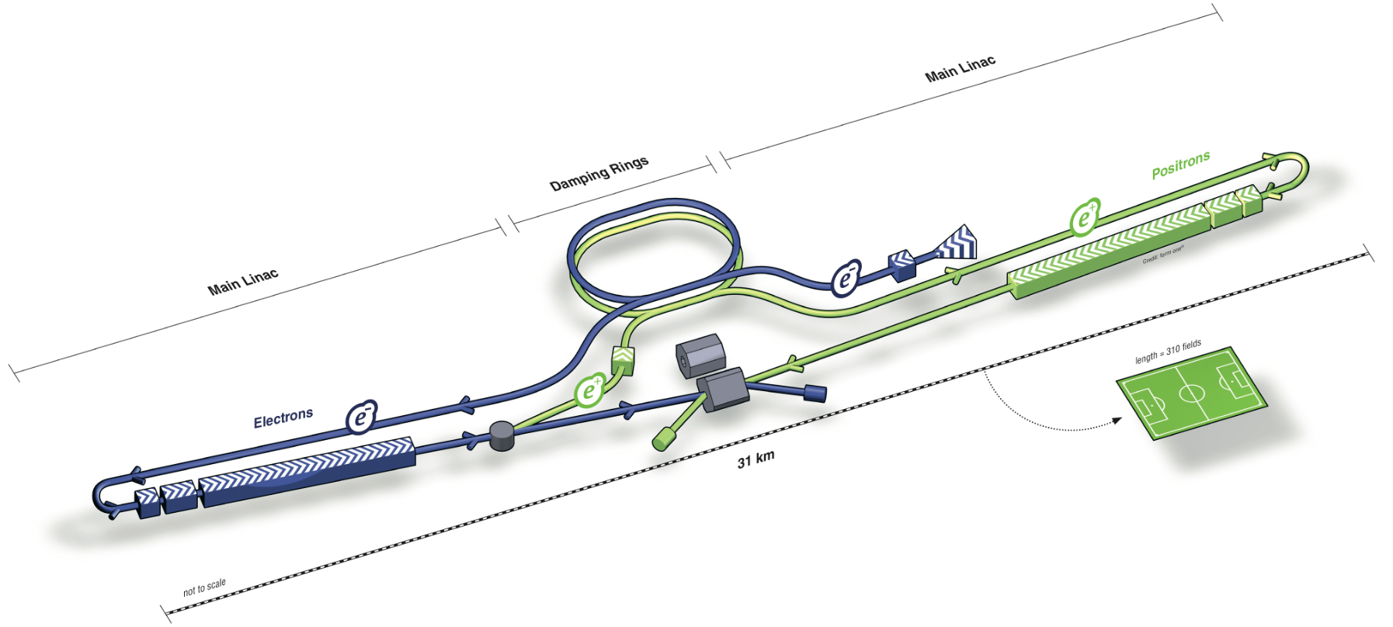
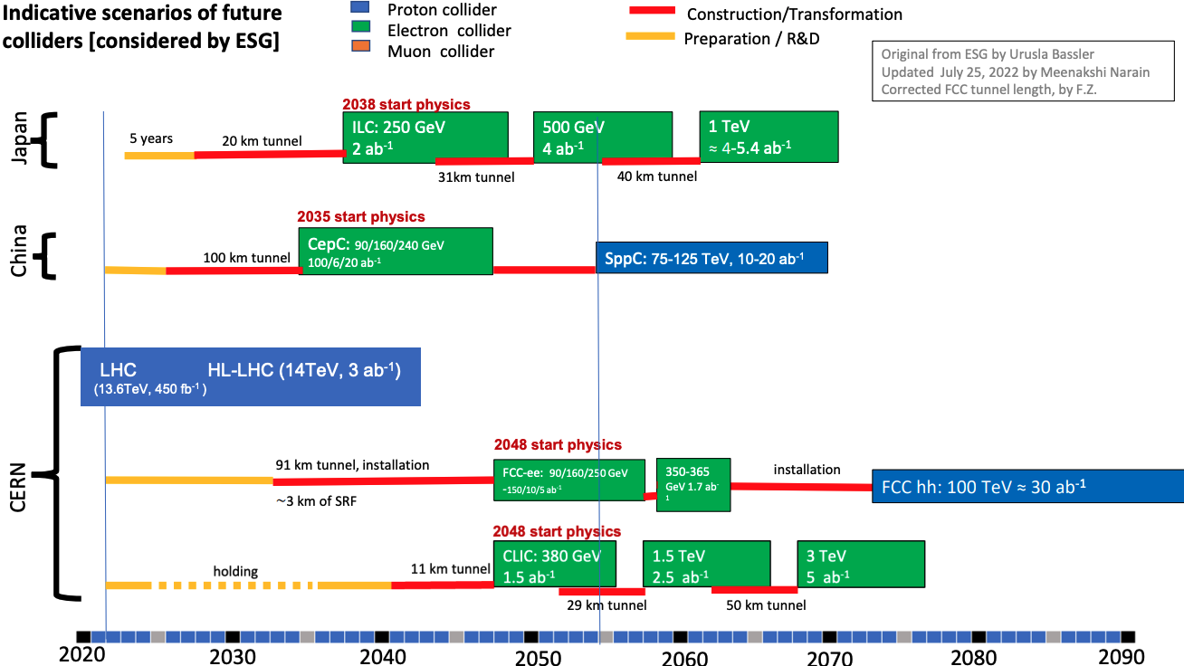
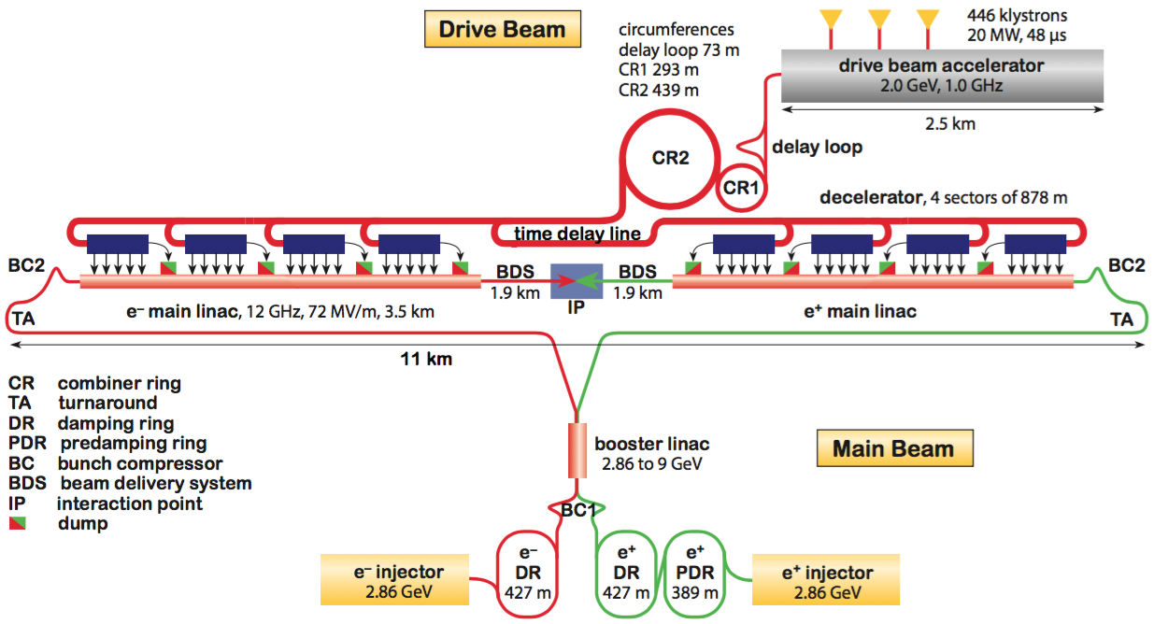
Despite a rich physics program, the current global funding climate makes the realization of the below TeV-scale linear colliders challenging. Can we provide not only more compact, but more power efficient colliders?

Slide 3
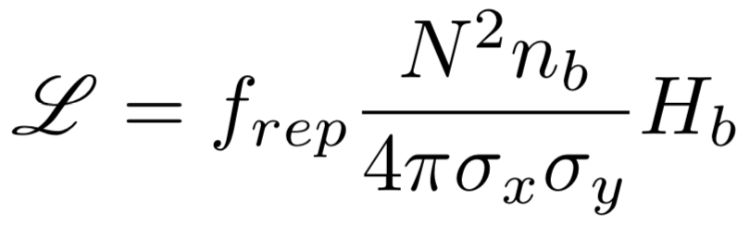
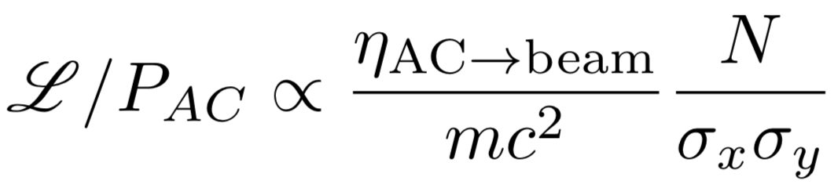
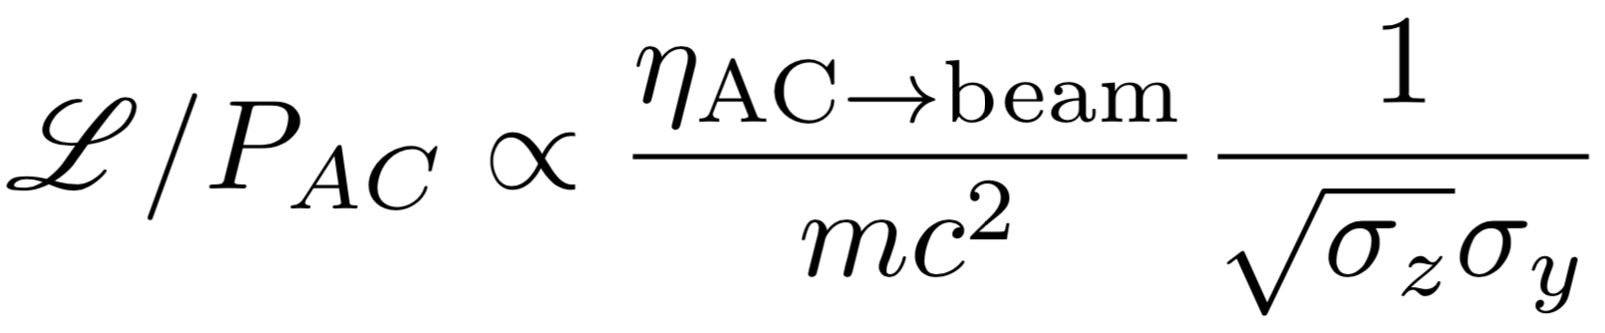
To be attractive, proposed plasma colliders should have significant improvement with respect to the existing projects (ILC, CLIC).
General formula:
Rewrite in terms of power :
Possibilities for improvement for a PWFA-LC?
footprint (cost)
vertical emittance?
vertical focusing function?
wall-plug-to-beam efficiency?
Short bunches, but lower limit from beam-beam must be checked (not shown in scaling)?
Keep luminosity target!
  A collider that costs one O.M less than CLIC/ILC but gives several O.M. less luminosity would likely have limited interest.
Taking into account beam strahlung :
σ_{y}² = β_{y} ε_{y}

Slide 4
Reference project: CLIC
I use CLIC as a reference project for comparison:
Beam-driven two-beam acceleration scheme, many similarities to PWFA
Detailed CDR exist, with consistent parameters, all aspects studied
I know it well, wrote chapters for the CLIC CDR

Slide 5
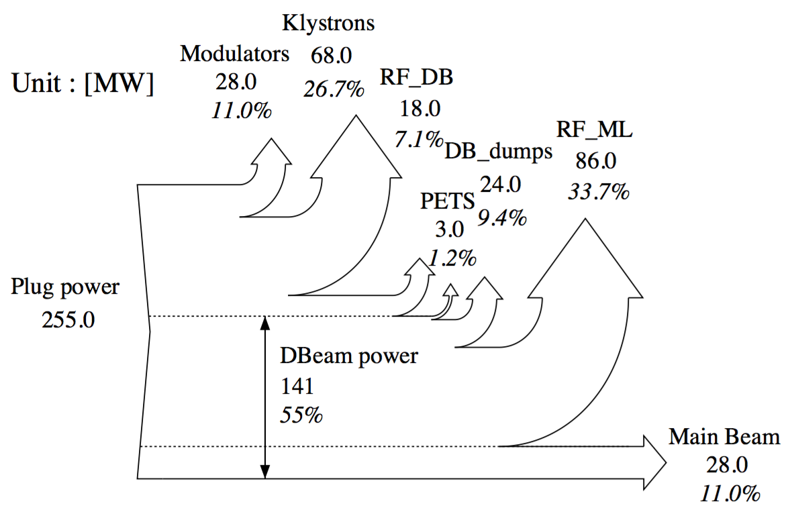
CLIC parameters (3 TeV cm)
gradient 100 MV/m
L = 10
L = 10³⁴ /cm²/s
ε∗_{n,y} = 20 nm
σ∗_{y} = 1 nm
σ∗_{z} = 44 um
N = 600 pC/e
n_{b} = 312 @ 2 GHz
f_{rep} = 50 Hz
Efficiencies:
AC to DB : 141/255 = 55%
DB to rf wake : (28+86)/141 = 81%
Rf wake to MB : 28/141 = 25%
-> DB to MB = 28/141 = 20%
-> AC to MB = 28/255 = 11%
Power flow chart: from CLIC CDR (2012)
Notes:
Aux. systems power not shown
Current efficency numbers improved with respect to CDR
CLIC
After the two-beam module
Before the two-beam module
DB
dump
100%
20%
19.1%
ACC wall
and dump
61%
WB
DB

Slide 6
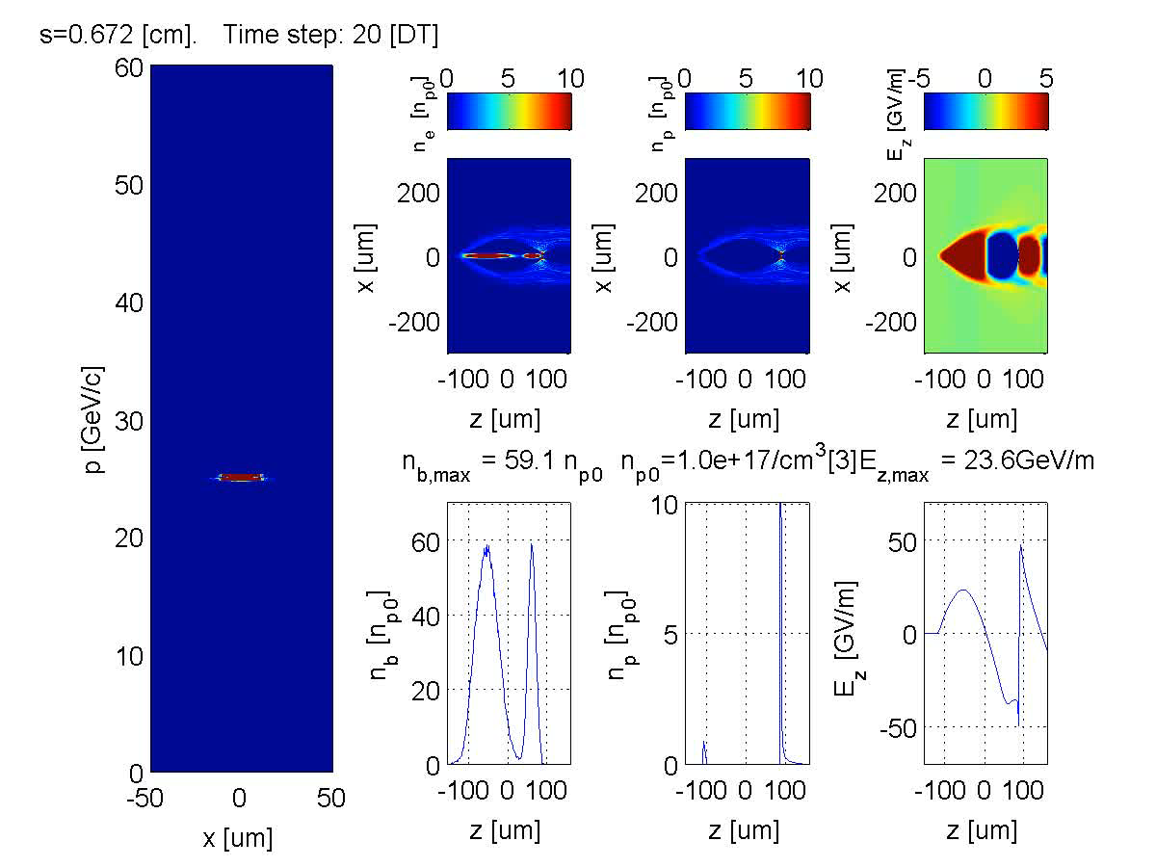
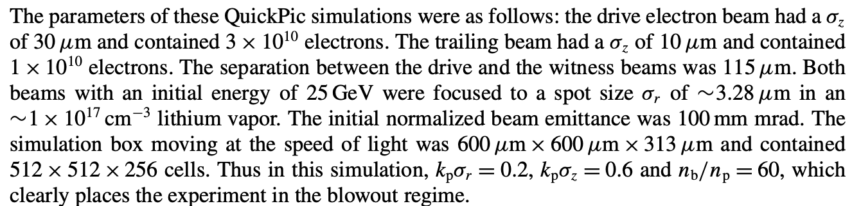
DB-to-wake and wake-to-MB efficiency :
DB to WB efficiency: 50%
Not optimized for efficiency.
Gaussian bunches
with 100 um emittance.

Slide 7
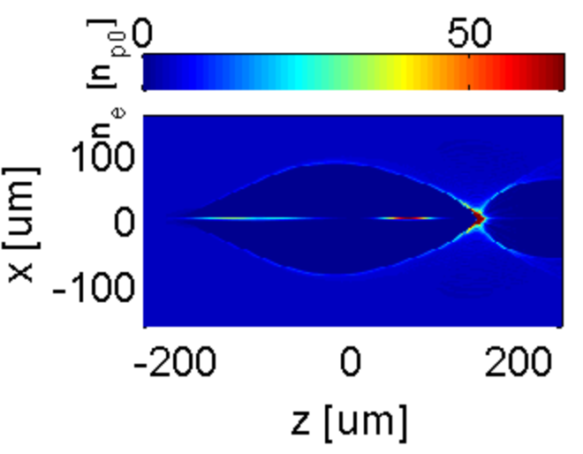
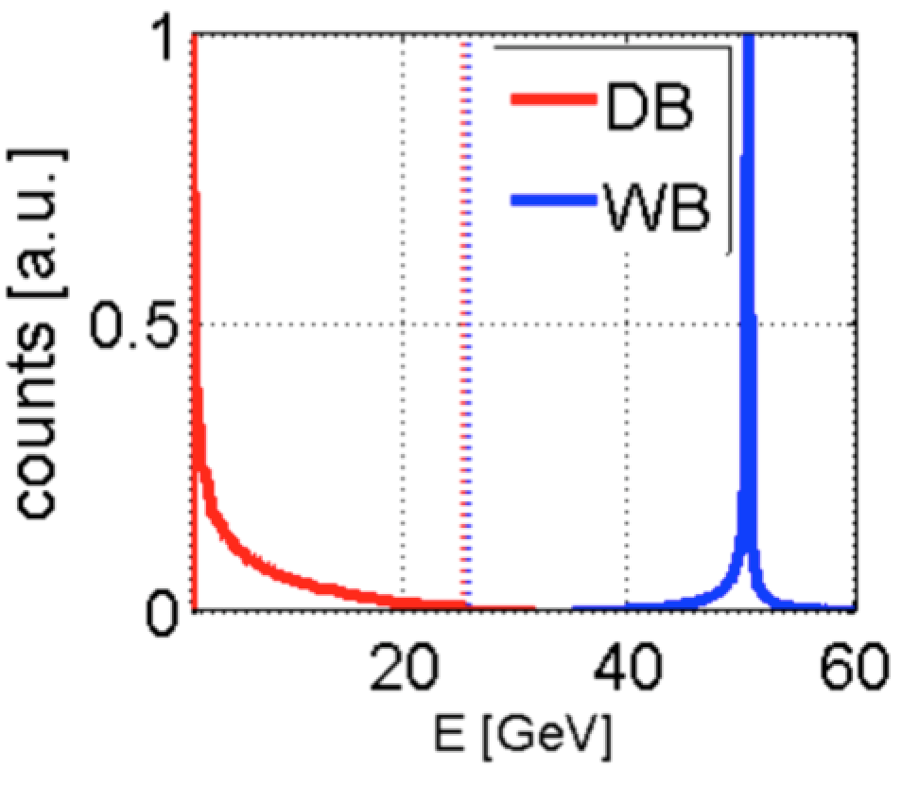
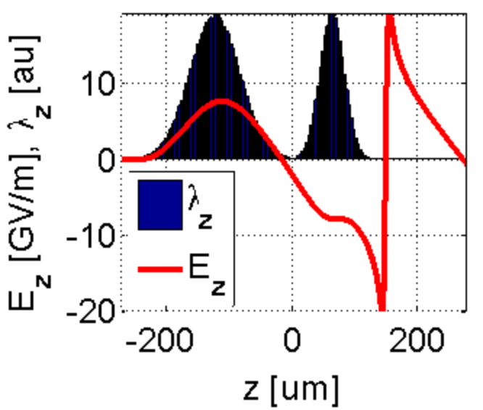
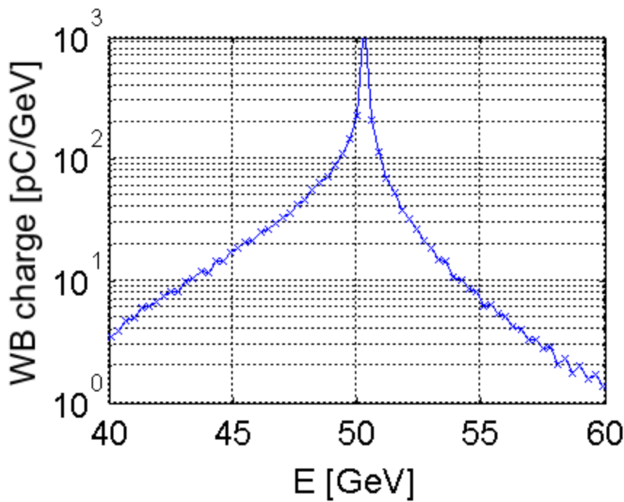
a)
b)
Basis for Snowmass 2013 study:
Final energy spectrum
after one stage :
DB
WB
Bunches travel towards the left
Initial
energy
c)
d)
I_{peak} =
9.6 kA
E_{dec}=7.6 GV/m
E_{acc}=7.6 GV/m
Sharply peaked WB spectrum.
67% of the charge is within
+/- 2% of the peak energy.

Slide 8
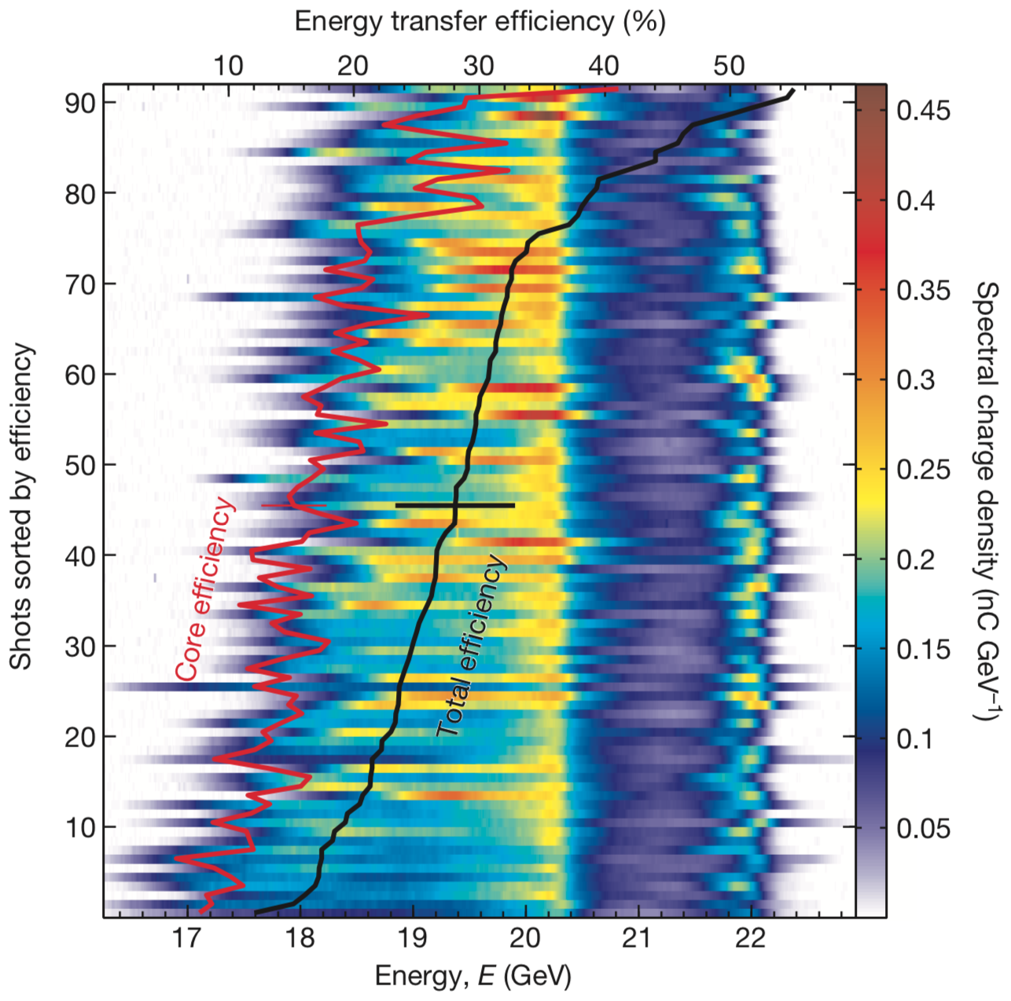
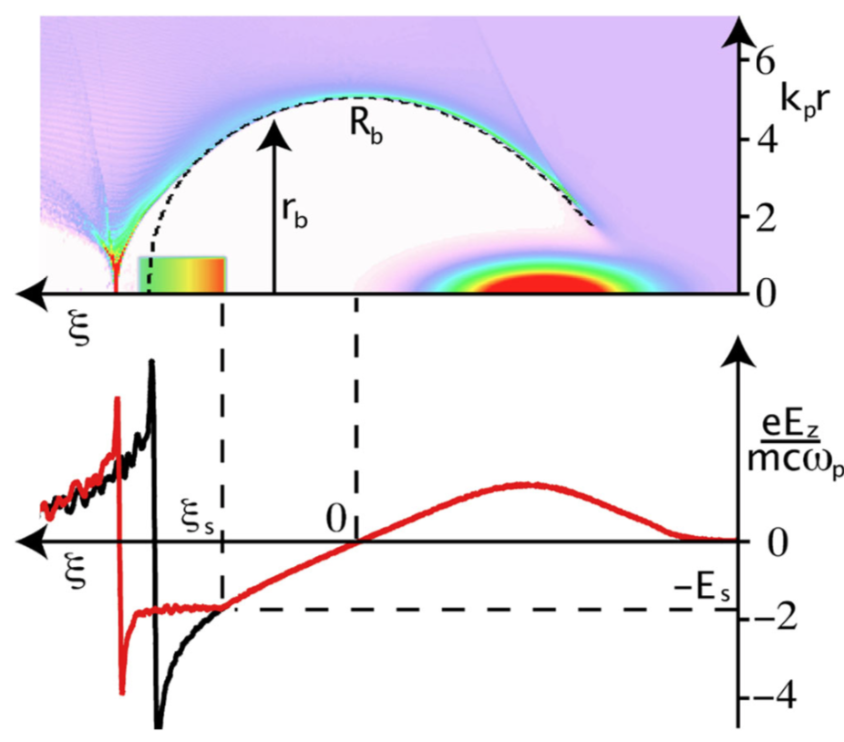
Opportunity: efficiency
Experimental status
(FACET):
wake to MB > 30%
From the 2013 “Snowmass” PWFA-LC concept
(E. Adli, J. P. Delahaye et al.)
CLIC
After the two-beam module
Before the two-beam module
DB
dump
100%
20%
19.1%
ACC wall
and dump
61%
WB
DB
CLIC CDR
PWFA-LC
After the plasma interaction
M. Litos, Nature 515, 92 (2014)
Before the plasma interaction
DB
dump
DB-to-wake x wake-to-MB = 0.77 x 0.65 = 0.50
100%
50%
23%
PLASMA
27%
Possibly increased
by shaping the WB
WB
DB
Possibly increased by shaping the DB
E. Adli et al., snowmasss 2013
Can PWFA beat RF colliders on efficiency?
Improved efficiency will reduce operation cost
M. Tzoufras, PRL 101, 145002 (2008
DB-to-MB of 90% according to theory
and PIC simulations.

Slide 9
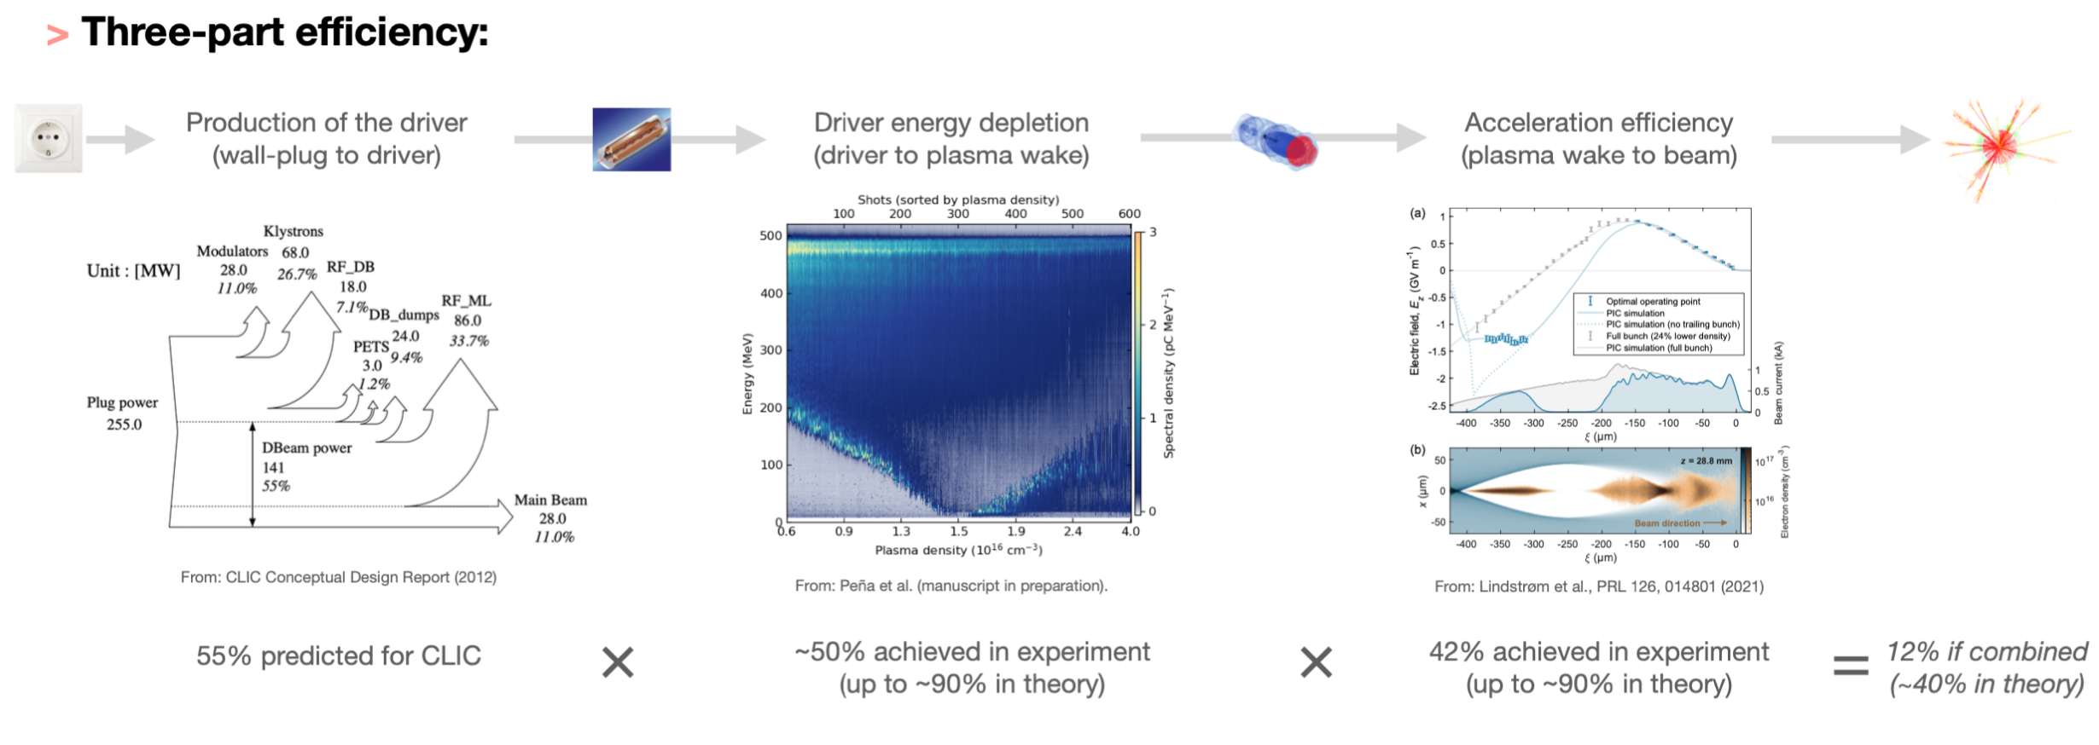
PWFA: recent result from DESY
PWFA
one-stage,
simulation:
PWFA
one-stage,
experiement:
AC to DB : (n/a)
DB to plasma wake : 90%
Plasma wake to MB : 90%
-> DB to MB = 80%
-> AC to MB : (n/a)
AC to DB : 141/255 = 55%
DB to rf wake : (28+86)/141 = 81%
Rf wake to MB : 28/141 = 25%
-> DB to MB = 28/141 = 20%
-> AC to MB : 28/255 = 11%
AC to DB : (n/a)
DB to plasma wake : 50%
Plasma wake to MB : 42%
-> DB to MB = 21%
-> AC to MB : (n/a)
CLIC:

Slide 10
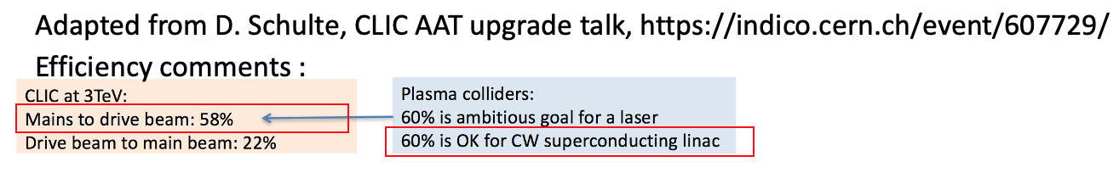
Efficiency: are we done?
1) Production of driver: we can safely assume about 50-60% . Will anyway be similar for beam-driven RF and beam-driven plasma.
2 + 3) DB to MB: experimentally we have already shown efficenct as good CLIC – for a single stage.

Slide 11
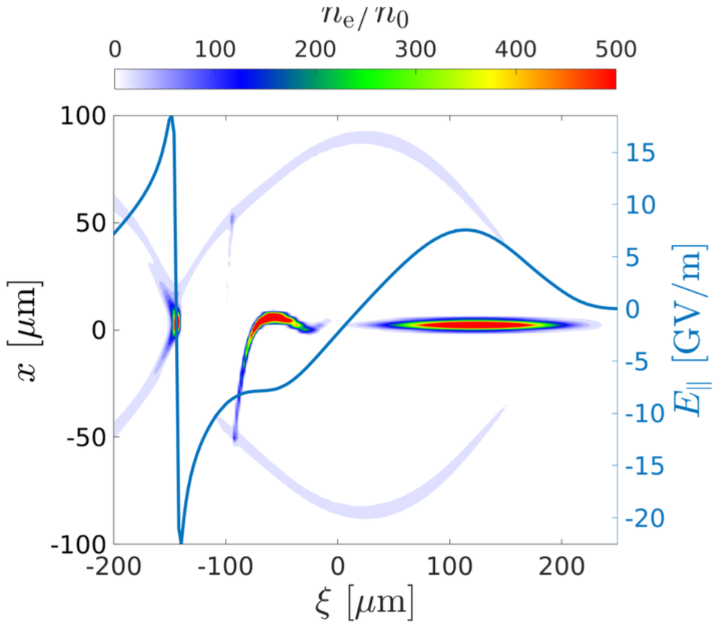
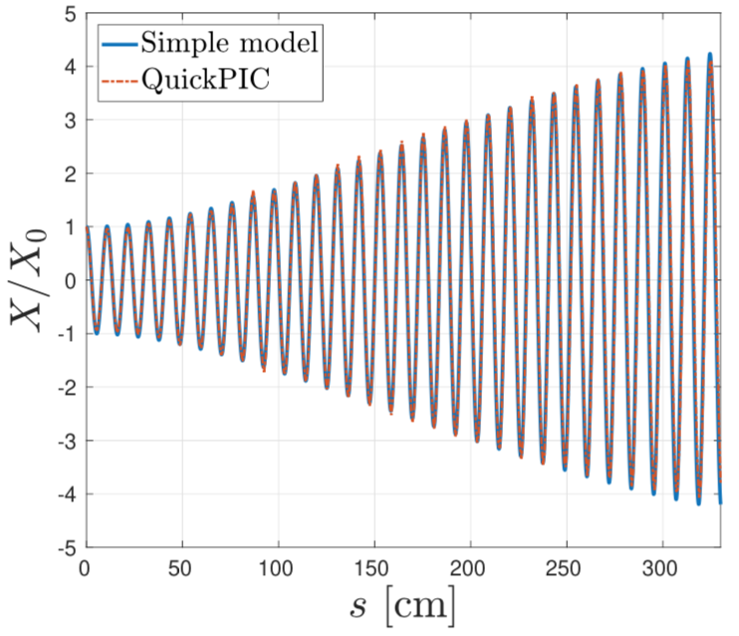
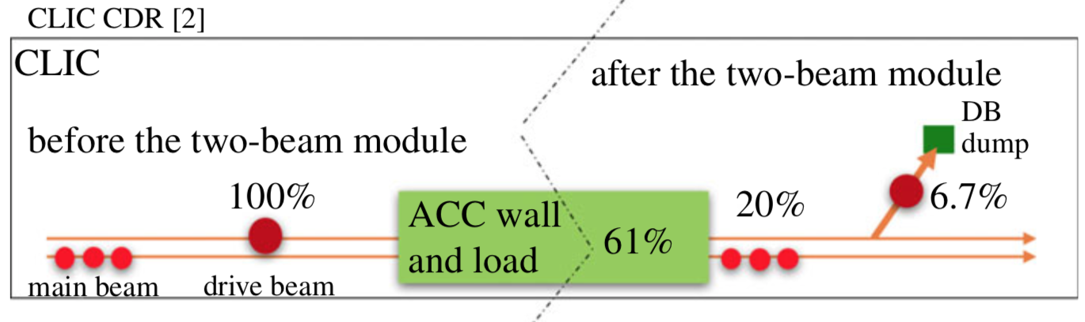
Transverse instabilities: RF colliders vs plasma colliders
Focus lately: witness beam intra-beam wake :
Why are the linear community scrutinizing the main beam single bunch wake?
The single-bunch wake decides how much charge can be loaded into CLIC.
CLIC:
Limit for transverse single bunch wake: 100 kV/pC/m/m
Goal attained by spreading pulse charge into multi-bunch trains. Limits the CLIC wake to RF efficiency to ∼25%.
Current plasma collider concepts: single bunch acceleration
- disadvantageous with respect to the CLIC multi-bunch scheme
Still an open questions:
- sufficient mitigation of the instability for efficient PWFA single bunch acceleration?
- further studies, including and benchmarking with PIC simulations and experiment needed

Slide 12
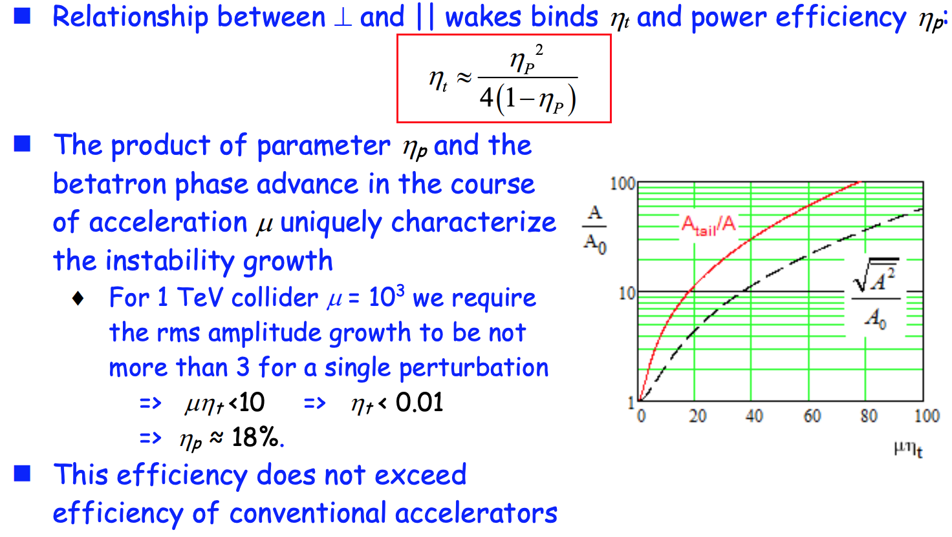
To investigate a single stage is not sufficient
Neither in simulation nor experiment.
From Valeri Lebedev, Fermilab

Slide 13
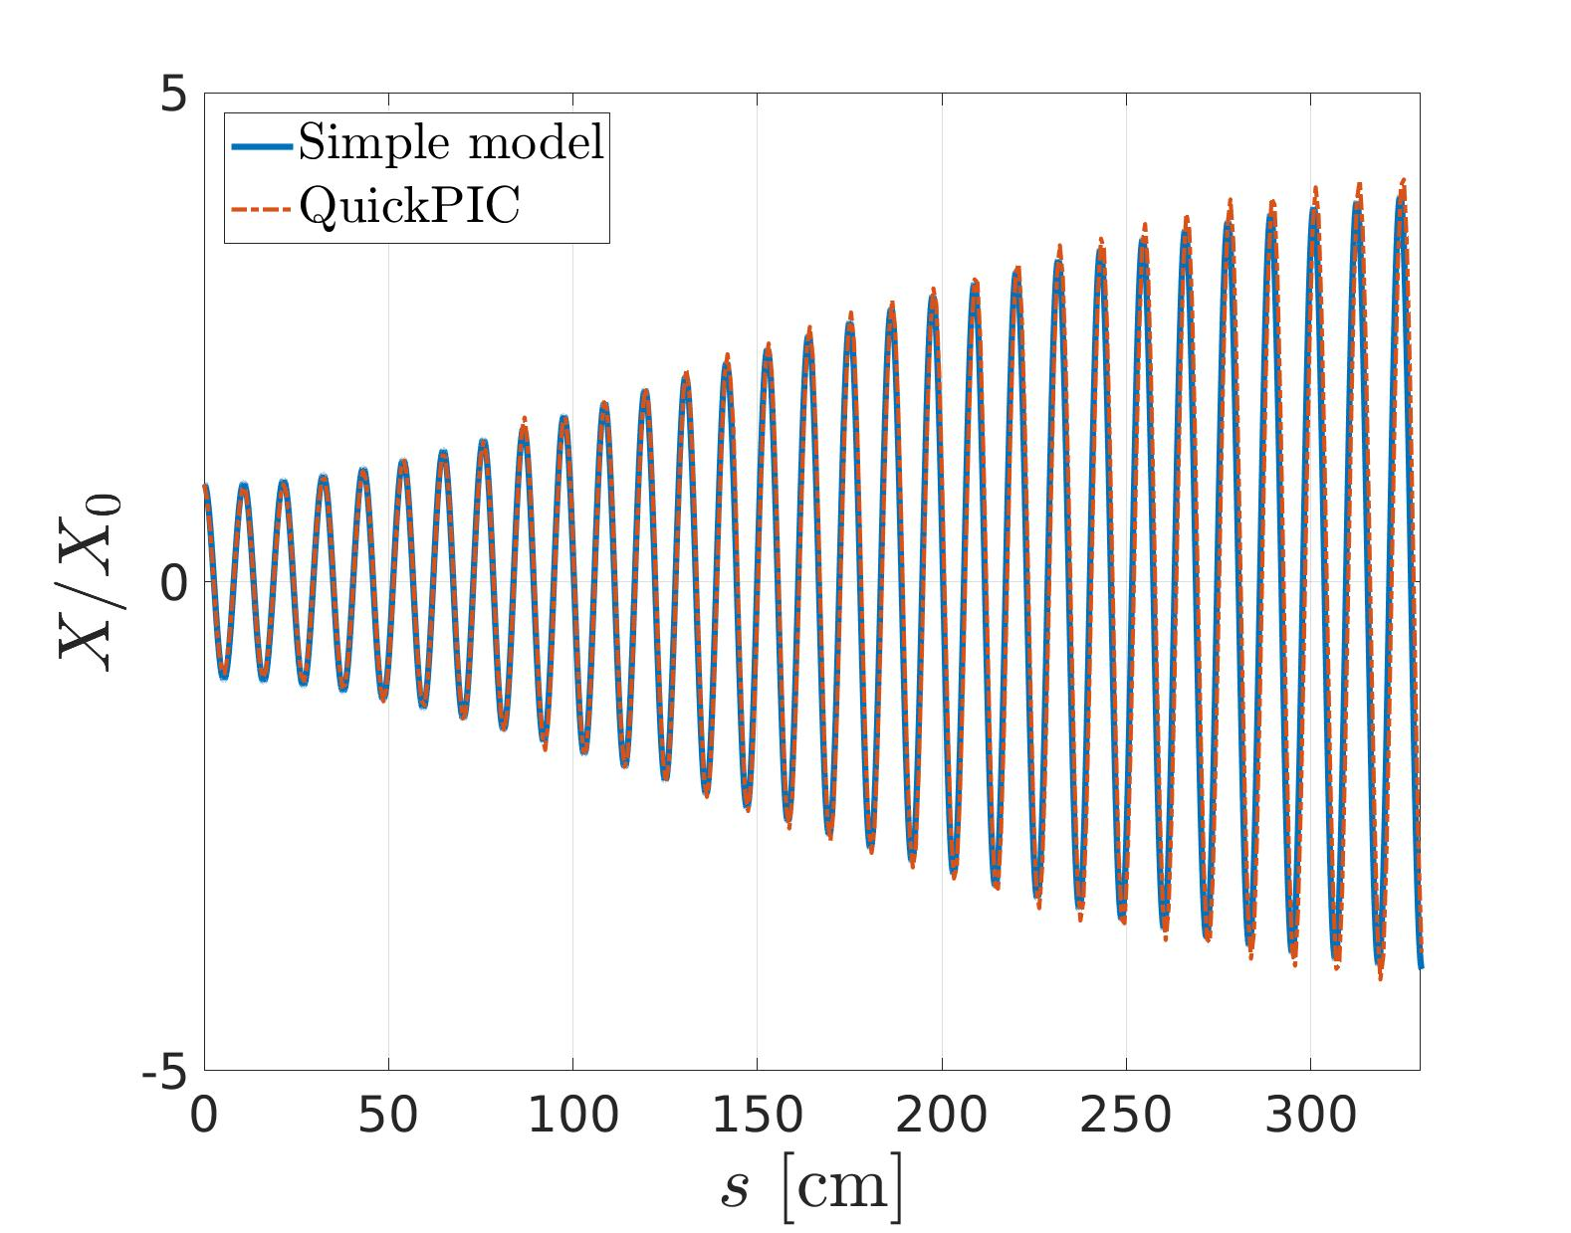
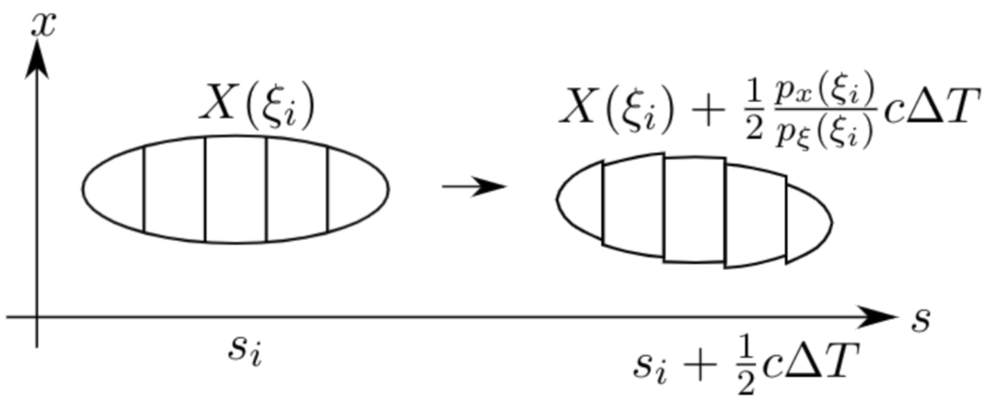


Transverse wakefunctions:
E- blow out regime: can be studied with with simplified models
Fermilab / Gennady Stupakov:
  $W_{⊥}\left(ξ^{′}−ξ,α\right)=\frac{2}{πε_{0}}\frac{ξ^{′}−ξ}{{\left(r_{b}\left(ξ^{′}\right)+αk_{p}^{−1}\right)}^{4}}Θ\left(ξ^{′}−ξ\right)$
  $a= r_{b}\left(ξ^{′}\right)+αk_{p}^{−1}$ represents an effective structure iris.
  The electromagnetic fields penetrate into the plasma at depths $∼k_{p}^{−1}$ a numerical coefficient on the order of one.
G. Stupakov
We have benchmarked the wake function model, combined with simplified quasi-static tracking.
$2σ_{z}$ behind center
B. Chen, D. Schulte and E. Adli, B 2020 J. Phys.: Conf. Ser. 1596 012057

Slide 14
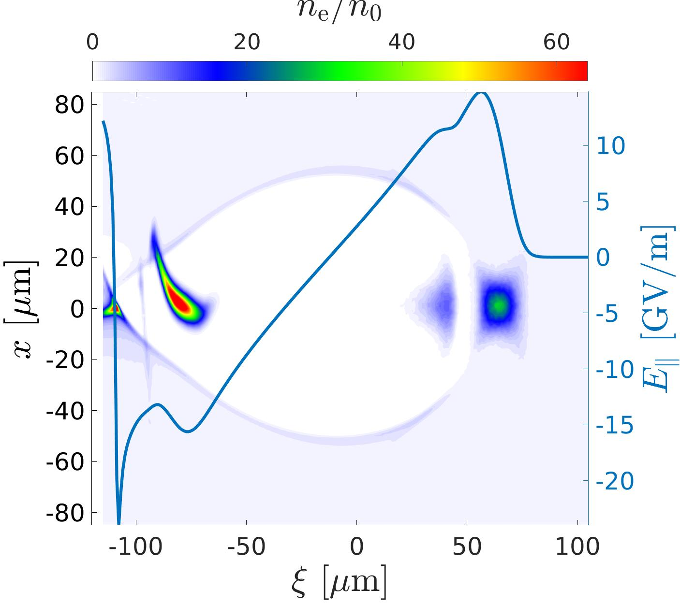
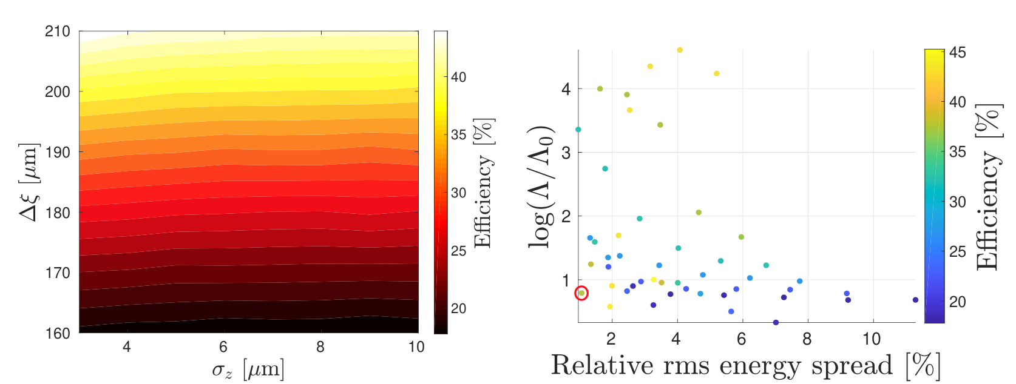
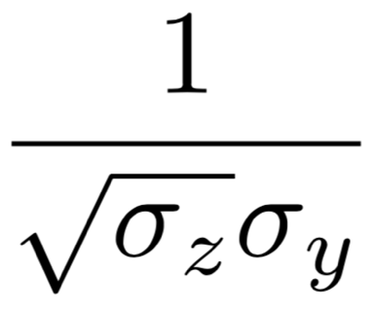
Optimizing taking instability-efficiency into account: bunch length, charge, damping
Performed by one timestep QuickPIC simulations
(negligible computer time), plus tracking with simplified model. 1000s of working points can be in a matter of days.
Working point with acceptable instability and higher luminosity, with respect to Snowmass study.
Bunch length of 5.5 μm (Snowmass: 20 μm)
Amplification of action of a factor 6 (Snowmass: very large)
Energy spread of 1.1% (Snowmass: 12 %)
Efficiency of about 37.5 (Snowmass: 50 %)
luminosity increase about 1.5
Validity of lum. scaling?
Validity of model?
B. Chen, D. Schulte and E. Adli, B 2020 J. Phys.: Conf. Ser. 1596 012057

Slide 15
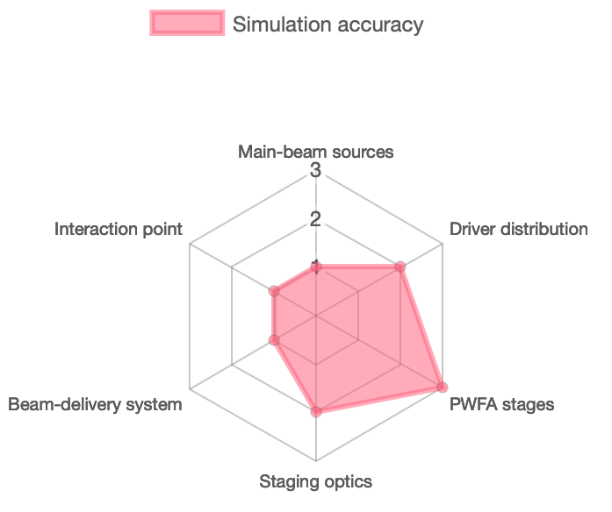

Next steps: integrate into our local Oslo framework
Inter-
stage
Interfacing
using
OpenPMD
Source
Stage
BDS
IP
Basic
(Gaussian)
Basic
(energy gain)
Basic
(apply R56)
Basic
(demagnify)
Basic
(geometric luminosity)
Measured 6D
phase space
1D nonlinear
wakefields++
Transfer
matrices
Transfer
matrices
GUINEA-PIG
ASTRA
PIC (HiPACE++,
WarpX, etc.)
ELEGANT
ELEGANT
PIC? (OSIRIS)
Dr. Carl A. Lindstrøm | 24 March 2023 | ALEGRO workshop
Page
For the efficiency studies: levels of increasing model accuracy:
No transverse instability modelled (negligible CPU time)
Fixed amplitude change per cell (negligibe CPU time)
Wake function + Sliced beam model, as in B. B. Chen et al (seconds)
Quasi-static PIC code (minutes, hous +)
Using the Oslo framework, we aim to fully answer the relevance/implications of the Fermilab instability-efficiency relation, for beam-driven e⁻ linacs. And get realistic numbers for e- PWFA efficiency.
In additon, eventually, experimental verification is needed (work in collaboration with SLAC)

Slide 16
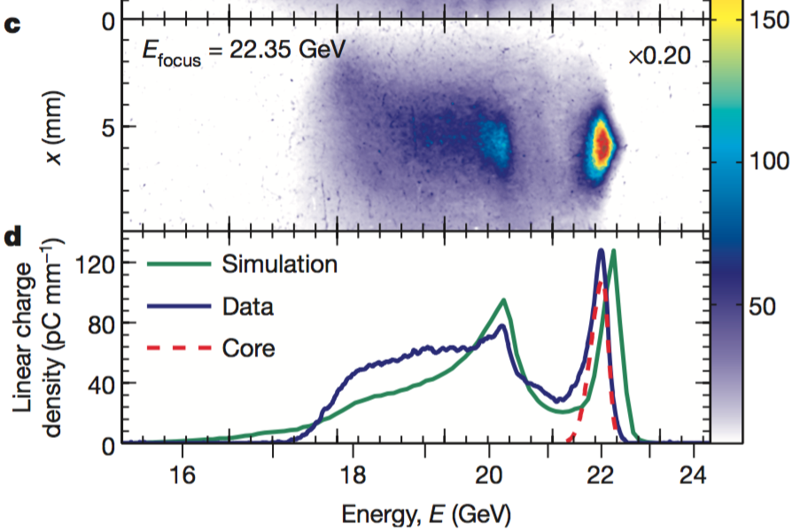
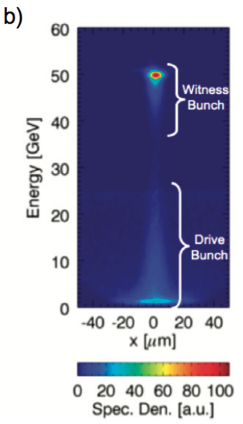
What to take into account for a pre-CDR
Slide from E. Adli, CLIC Novel Accelerator Methods (2017)
Although experimental progress is impressive, the technology may be far from its ultimate performance. What should a design study take into account when considering feasibility? One example from beam-driven two-bunch PWFA :
Simulation :
Two-bunch acceleration, almost full DB depletion, 50% DB to MB efficiency single stage, emittance preservation at um level, energy spread at %-level. M. Hogan et al., 2010 New J. Phys. 12 055030 (2010).
Ultimate performance? :
90% efficiency?
Experiment :
two-bunch acceleration, 30 wake to DB efficiency. M. Litos et al., Nature 515, 92–95 (2014)
Oslo opinion, for the pre-CDR:
We could and should base ourself on what is possible in simulation today, as long as the assumptions are consistent with technologically feasible plasma drivers and plasma targets.
It will already hard enough to show a good performance
The pre-CDR will suggest further technological developments

Slide 17
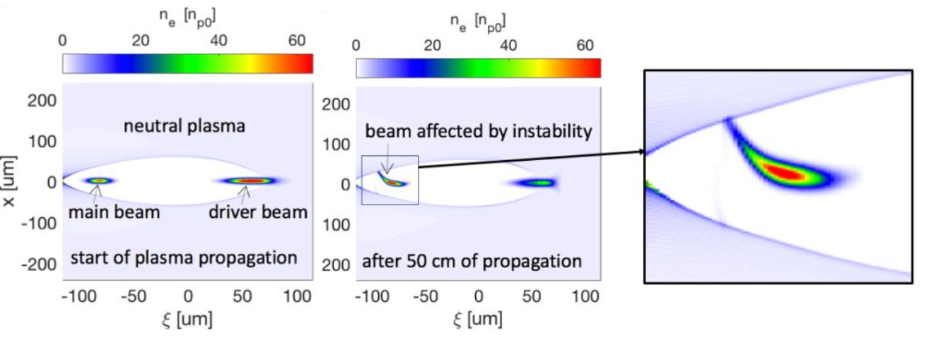
Experimental challenges – experiments are single stage
Also a challenge for CLIC/ILC :
can we build CLIC/ILC relying on numerical models? Answer seems to be yes.
a go ahead for building a plasma collider would likewise not only require experiment progress, but to develop and build up confidence in our simulations and models

Slide 18
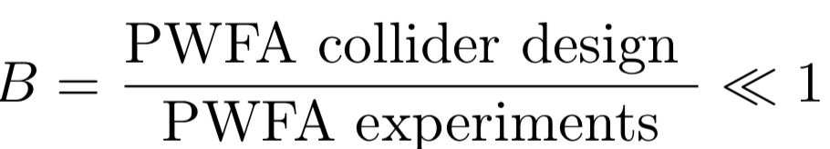
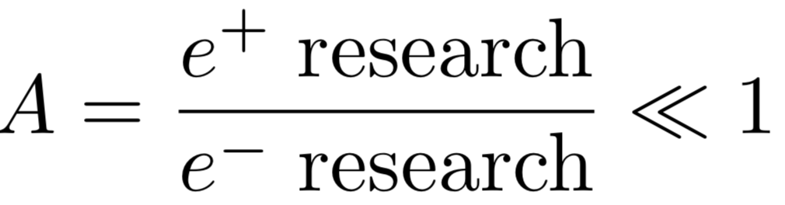
Interaction PWFA-LC study and PWFA research
(S. Corde)
(E. Adli)
This part is underrepresented in the NAT community.
"Top downapproach"
Collider design, based on current knowledge (including simulation/theory), fulfilling physics requirements.
The better PWFA-LC concept exists,
the better the experimental studies
can be guided.
gives input to
updates/
inspires
Technology development and experiments to address the critical issues
New ideas can arise from “free
experimentation”, and inspire
new PWFA-LC concepts
Development not necessary driven by linear collider requirements
"Bottom up approach" – see what comes out of technology
Slide from E. Adli, CLIC Novel Accelerator Methods (2017)

Slide 19
Extra

Slide 20
Transverse tolerances
Independent of instabilities, the very strong focusing of the plasma leads to tight tolerances.
Drive beam center defines center of the focusing
Strong focusing fields gives offset witness beam a kick
Centre of cell
Centre of drive beam
Main beam trajectory
Example PWFA:
2% luminosity loss budget leads to required jitter stability of 1.4 nm
Could use phase advance of 2nπ
Or much larger beta-function (lower plasma density) at ends of cells
Important to understand tolerances correctly
R&D programme essential on transverse alignment and stabilisation
From CLIC WG on Novel Accelerator Technologies,
D. Schulte (CERN), 2018, https://indico.cern.ch/event/607729/

Slide 21
Ideal interaction PWFA-LC study and PWFA research
This part is underrepresented in the NAT community.
"Top downapproach"
Collider design, based on current knowledge (including simulation/theory), fulfilling physics requirements.
The better PWFA-LC concept exists,
the better the experimental studies
can be guided.
gives input to
updates/
inspires
Technology development and experiments to address the critical issues
New ideas can arise from “free
experimentation”, and inspire
new PWFA-LC concepts
Development not necessary driven by linear collider requirements
"Bottom up approach" – see what comes out of technology

Slide 22
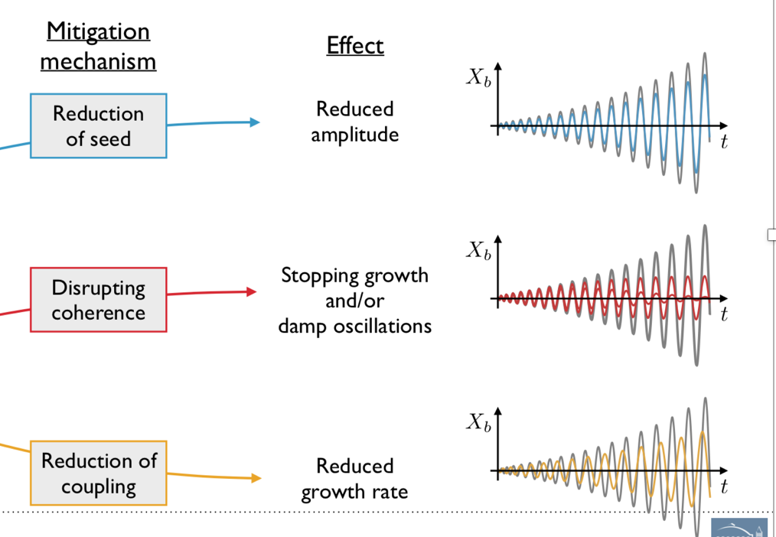
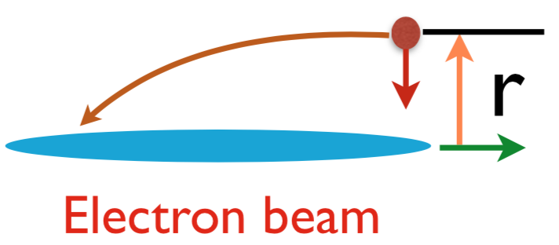
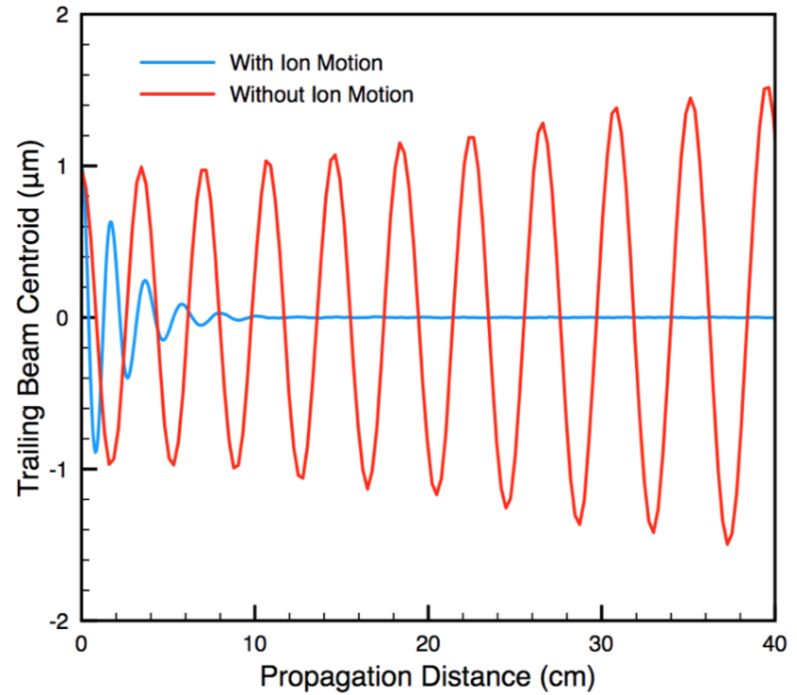
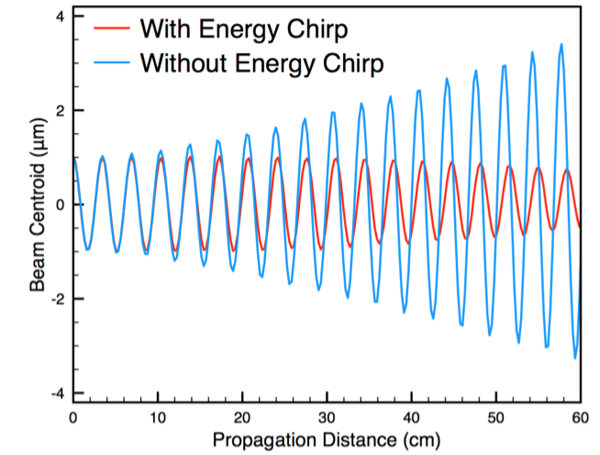
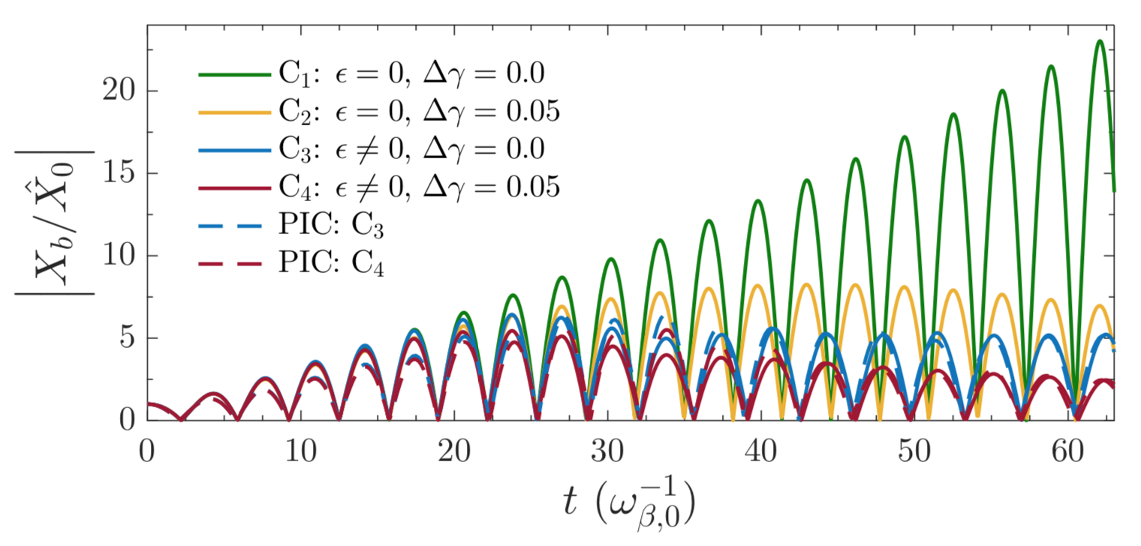
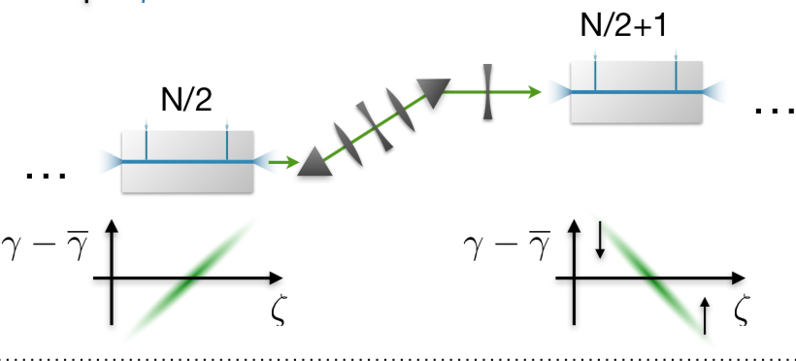
Instabilities, mitigation
T. Mehrling, ALEGRO
Relativist regime
C. Huang et al. PRL
99, 255001 (2007) (UCLA)
(but this mitigation already included in wake model on previous page?)
Ion motion: surprising and interesting results from Weiming An
Strong focusing:
Feature of the blow out regime.
Energy gain and energy spread
Mitigation of seed :
depending on length of ramp : expect factors of few reduction in amplitude.
Growth rate still the same.
W. An (FACET-II parameters, 10% energy spread)
T. Merhling (PRL)
Ideas for mitigation exists.
Lacking: systematic studies of emittance growth through many stages, to verify that suppression is sufficient.
Clever ideas for high energy spread:
T. Mehrling
C.A. Lindstrøm
- can they be realized in practice in a short, emittance preserving interstage?

Slide 23
Transverse Tolerance
Tolerances
Adapted from D. Schulte, https://indico.cern.ch/event/607729/
Drive beam center defines center of the focusing
Strong focusing fields gives offset witness beam a kick
Centre of cell
Centre of drive beam
Main beam trajectory
Example PWFA:
2% luminosity loss budget leads to required jitter stability of 1.4 nm
Could use phase advance of 2nπ
Or much larger beta-function (lower plasma density) at ends of cells
Important to understand tolerances correctly
R&D programme essential on transverse alignment and stabilisation

