Slide 1



Positron arm development strategy
Gianluca Sarri
g.sarri@qub.ac.uk
School of Mathematics and Physics, The Queen’s University of Belfast
Severin Diederichs
severin.diederichs@desy.de
DESY
ALEGRO Workshop 2023
23.03.2023

Slide 2
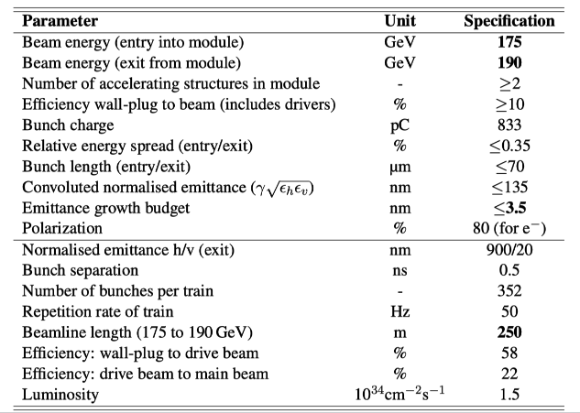

Extremely challenging parameters have been asked for…
Working package: Positron Beam Performance Reach of Advanced Technologies (Simulation Results - Comparisons)
Plasma-based positron acceleration with
Ultra-low emittance
Low energy spread
High charge
High efficiency
Report on high-energy case study due by June 2025

Slide 3
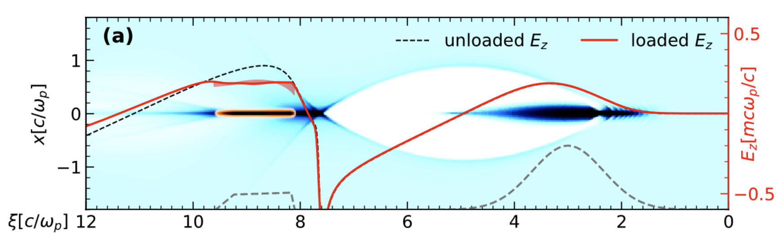
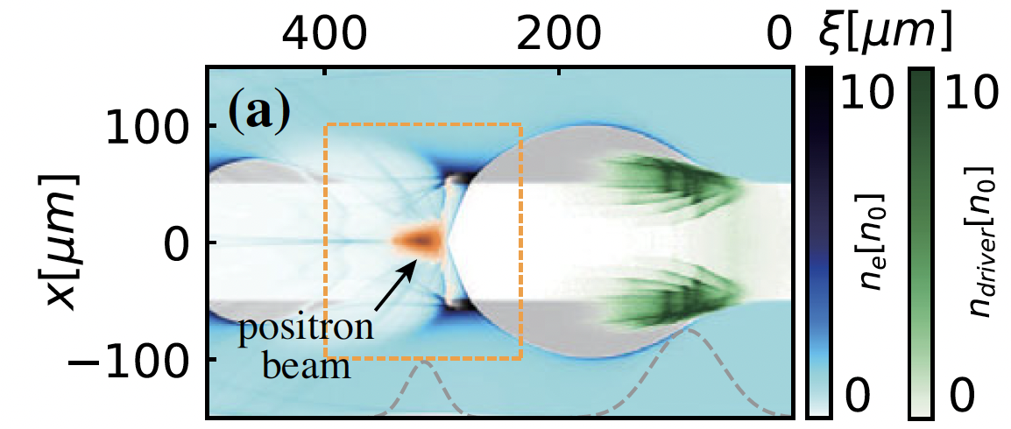
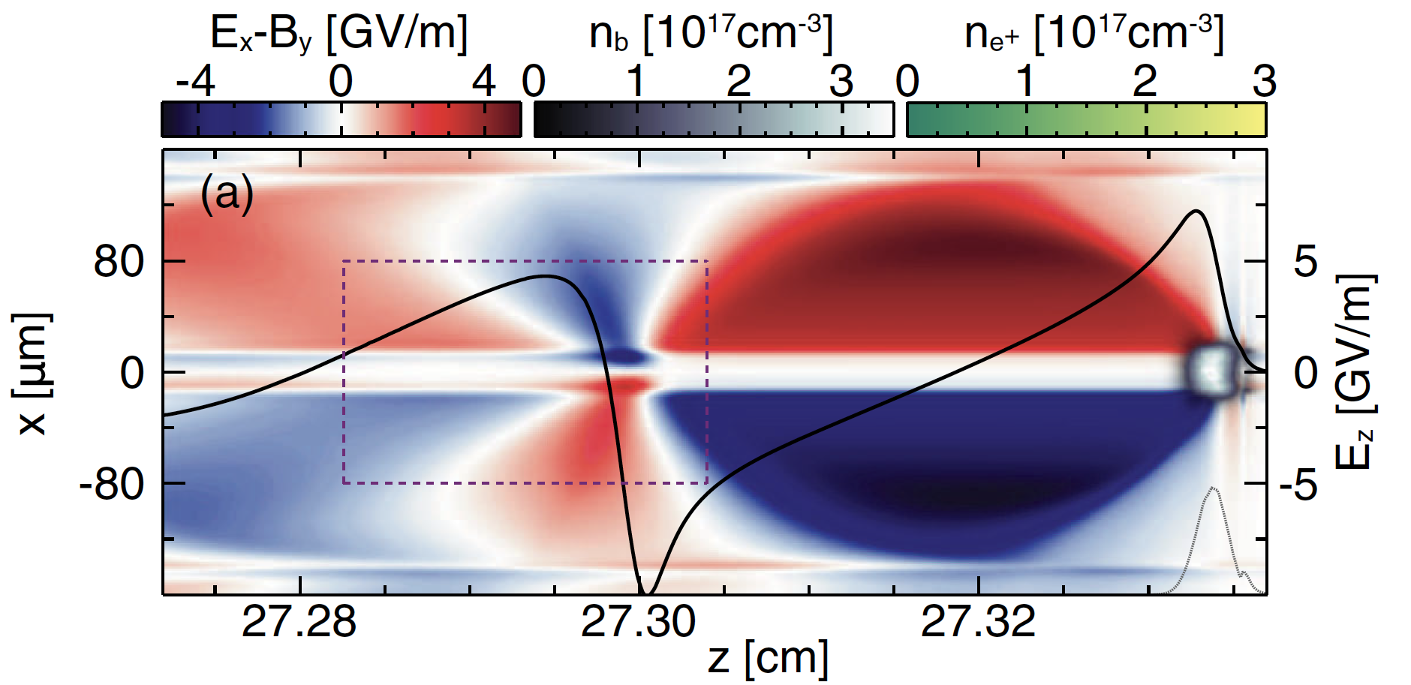
Promising advances for plasma-based positron acceleration
Many new concepts have evolved!
Overview talk today at 16:30
Demonstrating that in principle
Low-emittance, low-energy-spread, high-charge, high-efficiency positron acceleration is possible…

Slide 4
Promising advances for plasma-based positron acceleration
Many new concepts have evolved!
Overview talk today at 16:30
Demonstrating that in principle
Low-emittance, low-energy-spread, high-charge, high-efficiency positron acceleration is possible…
… but so far not with collider-relevant beam emittances
We need to upgrade our simulation codes (mesh-refinement)

Slide 5
Game plan: Optimize each scheme properly, compare apples to apples!
vs
50 µm emittance, 490 pC charge vs 0.5 µm emittance, 50 pC charge
We need a self-consistent collider parameter set

Slide 6
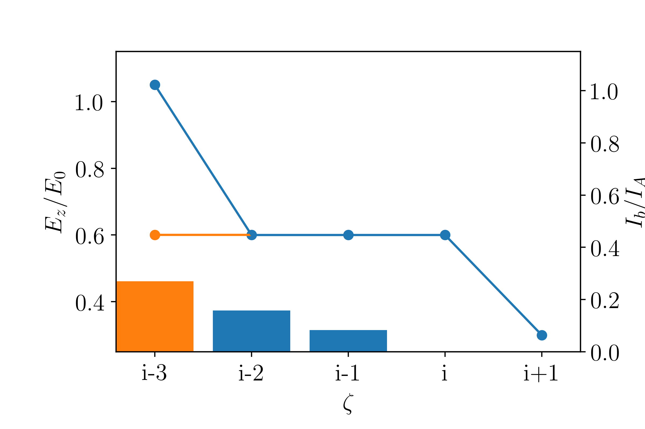
Game plan: Optimize each scheme properly, compare apples to apples!
vs
50 µm emittance, 490 pC charge vs 0.5 µm emittance, 50 pC charge
We need a self-consistent collider parameter set
Each scheme must
Be optimized for efficiency
Use the same emittance witness beam
Optimally load the wake using beam loading algorithms
Demonstrate resilience against jitters
SALAME

Slide 7
Game plan: Optimize each scheme properly, compare apples to apples!
vs
50 µm emittance, 490 pC charge vs 0.5 µm emittance, 50 pC charge
We need a self-consistent collider parameter set
Each scheme must
Be optimized for efficiency
Use the same emittance witness beam
Optimally load the wake using beam loading algorithms
Demonstrate resilience against jitters
Need to decide on best positron
acceleration scheme for HEP!

Slide 8
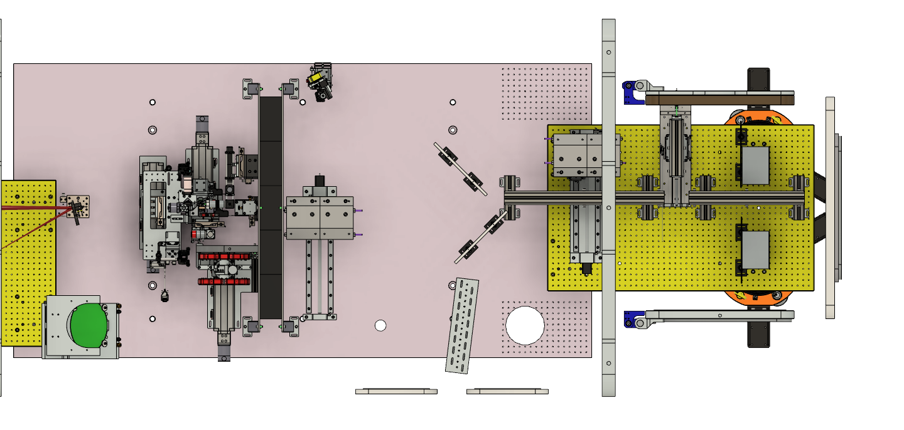
Real progress only possible via experiments
All previous PWFA positrons experiments have been conducted at SLAC
Laser-based positron sources are available for testing purposes
Recent results at Astra-Gemini, CLF
Obtained positron beam properties
Energy: 500 MeV
Bandwidth: ΔE/E ~ 5%
Charge: 0.2 pC
Norm. Emit.: 18 μm
Duration: < 50 fs
M. Streeter et al. arXiv:2205.13850
energy
selection
detector
wakefield
accelerator
second
dipole
first
dipole
positrons
electrons
converter
1 m

Slide 9
Real progress only possible via experiments
Obtained positron beam properties
Energy: 500 MeV
Bandwidth: ΔE/E ~ 5%
Charge: 0.2 pC
Norm. Emit.: 18 μm
Duration: < 50 fs
All previous PWFA positrons experiments have been conducted at SLAC
Laser-based positron sources are available for testing purposes
Recent results at Astra-Gemini, CLF
Simulations indicate that a PW-scale laser could achieve positron beams with
GeV-level energy, > pC charge, few percent energy spread, normalized emittance of few microns
M. Streeter et al. arXiv:2205.13850
G. Sarri et al., PPCF 64, 044001 (2022)

Slide 10

New facilities are planned
European Plasma Research Accelerator with eXcellence in Applications
Extreme Photonics Application Centre (expected in 2025)
These sources could enable the testing of positron acceleration schemes
Note: some require beam loading to work!

Slide 11
Answer to questions
1.4 Positron arm:
What is the state-of-the-art in positron generation, capture, acceleration in plasmas?
Need a detailed numerical study to determine the best positron acceleration scheme for HEP
Fulfilling the deliverable for the 2025 milestone has highest priority
What are the key challenges to build a plasma based positron linac that can be demonstrated in the next 5-10 years?
Will depend on the scheme, but experimental facilities are urgently needed for all of them
What are the challenges in using a conventional linac based systems for positrons?
See Brian Foster’s talk today at 17:00

Slide 12


Slide 13
Spin and polarisation in plasma-based accelerators
Kristjan Põder
Deutsches Elektronen-Synchrotron DESY, Germany

Slide 14
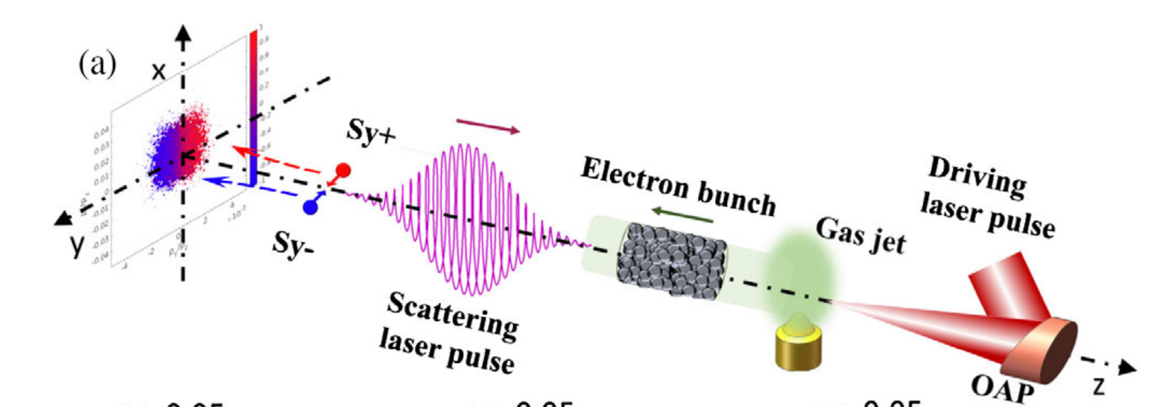
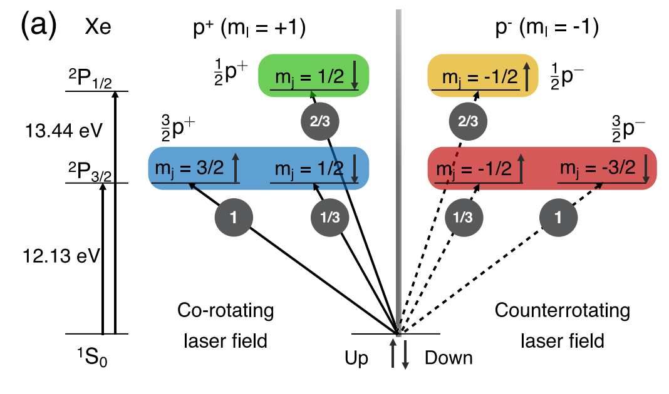
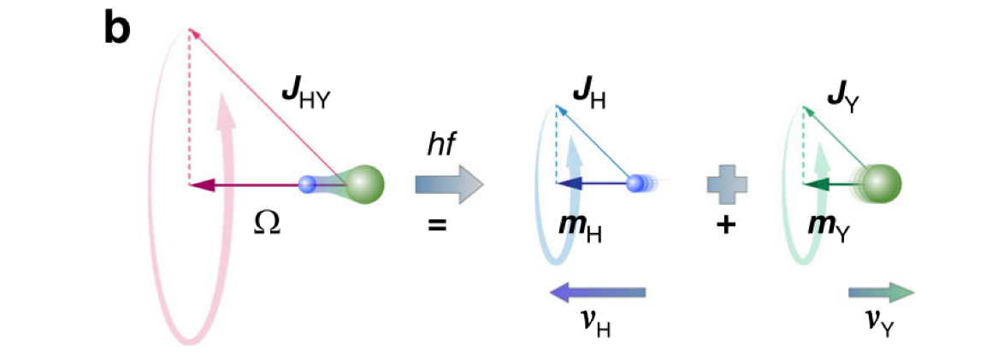
Many advanced concepts for generating polarised electrons
What are potential concepts?
Spin-filter ⁽¹⁾
  Drifting electrons polarised via spin-exchange with Rb vapour
“Stern-Gerlach” beam splitter ⁽²⁾
  Coherent scattering via Kapitza-Dirac effect of low energy electrons
Lasers
  Spin-dependent radiation reaction of relativistic electron beams ⁽³⁾
  Sokolov-Ternov in colliding laser fields ⁽⁴⁾
  Breit-Wheeler by pol. 𝛾 and asymmetric laser ⁽⁵⁾
Plasma-based methods
  Selective multi-photon ionisation ⁽⁶⁾
  Pre-polarised plasma sources ⁽⁷⁻¹⁰⁾
(1) Dellweg & Müller, PRL 118 070403 (2017)
(2) Batelaan et al, PRL 82 pp4216 (1999)
(3) Li et al, PRL 122 154801 (2019)
(4) Del Srobo et al, PRA 96 043407 (2017)
(5) Xue et al, Fundam. res. 2 pp539 (2022)
(6) Nie et al, PRL 126 054801 (2021)
(7) Rakitzis et al, Science 300 1936 (2003)
(8) Wen et al, PRL 122 214801 (2019)
(9) Wu et al, PRE 100 043202, (2019)
(10) Wu et al, New J. Phys. 21 073052 (2019)

Slide 15
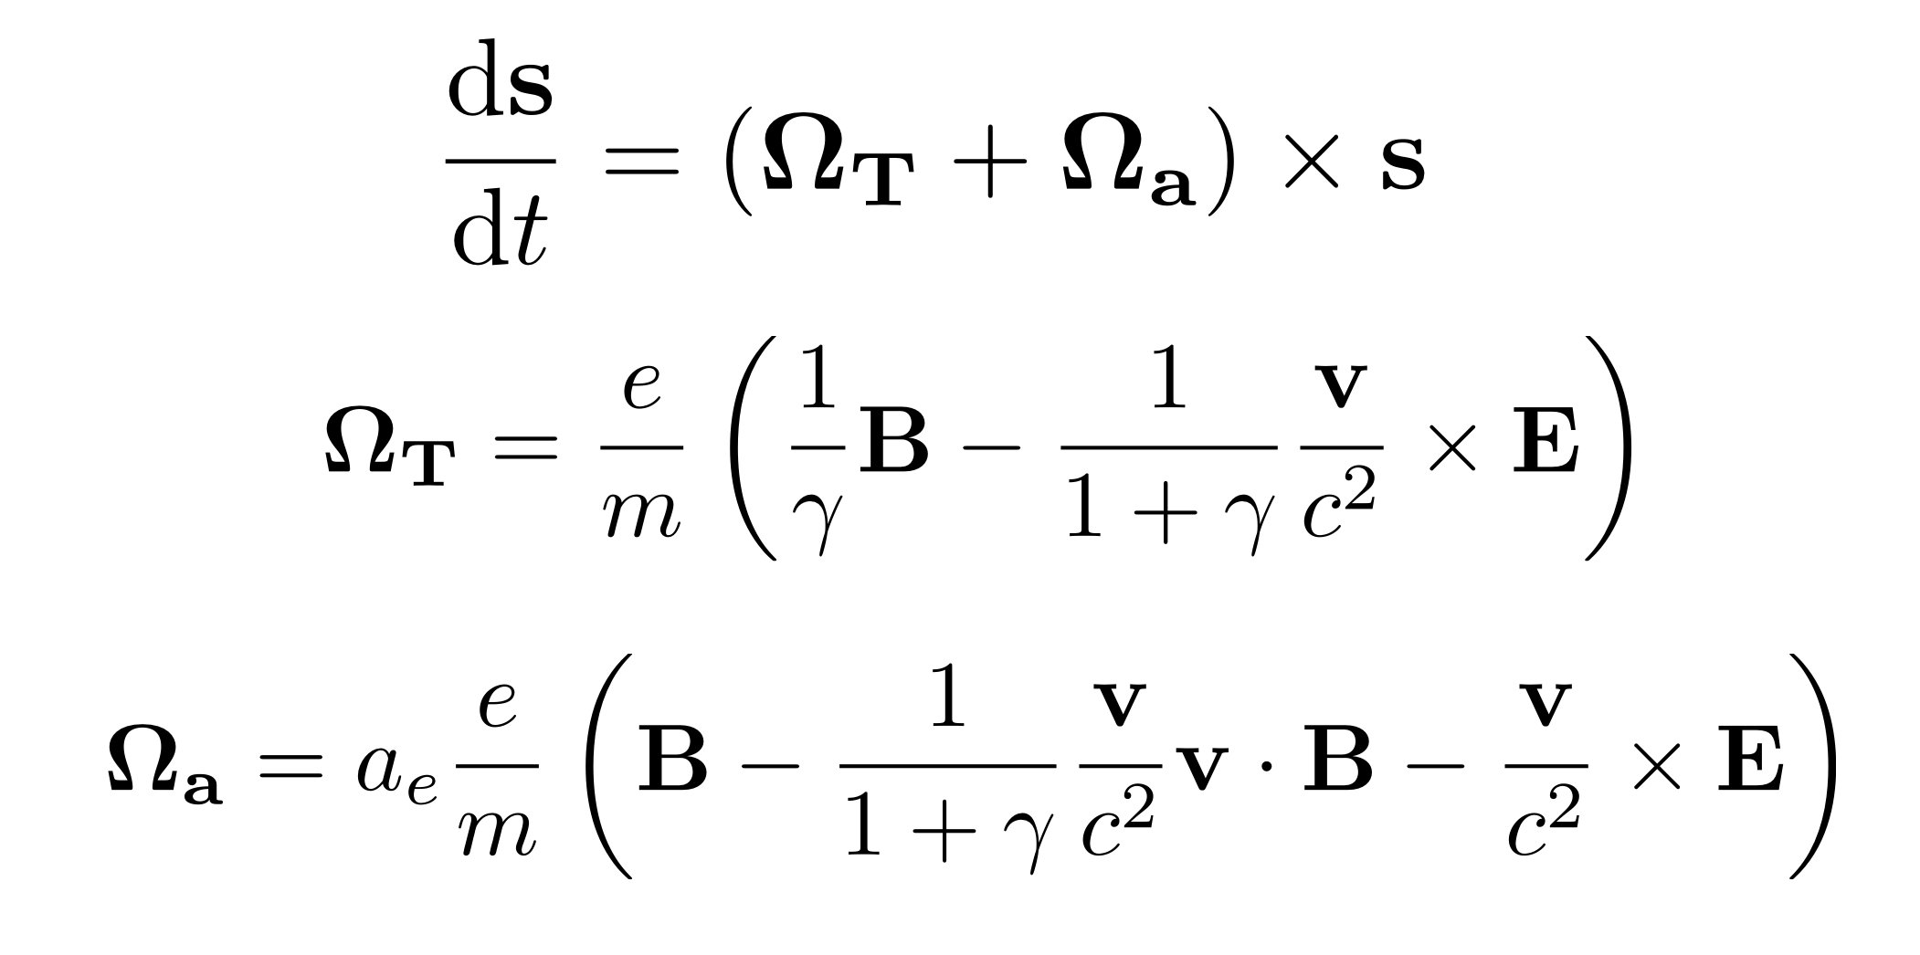
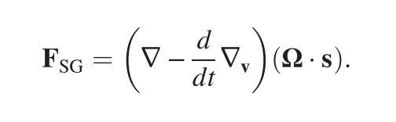
Simulation tools
What is the state of the art of simulation tools and do we need more?
Thomas-Bergmann-Michel-Telegdi
A few PIC codes have now spin-tracking (TBMT) enabled
  E.g. FBPIC, OSIRIS, VLPL, EPOCH, …
FBPIC enables very high throughput parameter scans
For very high energies, may need to also look at the Sokolov-Ternov effect or Stern-Gerlach force ⁽¹¹⁾
  S-T timescales in plasma fields O(us)
  S-G depends on field gradients
  These not yet implemented in any PIC
Detailed simulations of polarisation preservation in long stages needed ⁽¹²⁾
Stern-Gerlach
(11) Thomas et al, PRAB 23 064401 (2020)
(12) Vieira et al, PRSTAB 14 071303 (2011)

Slide 16
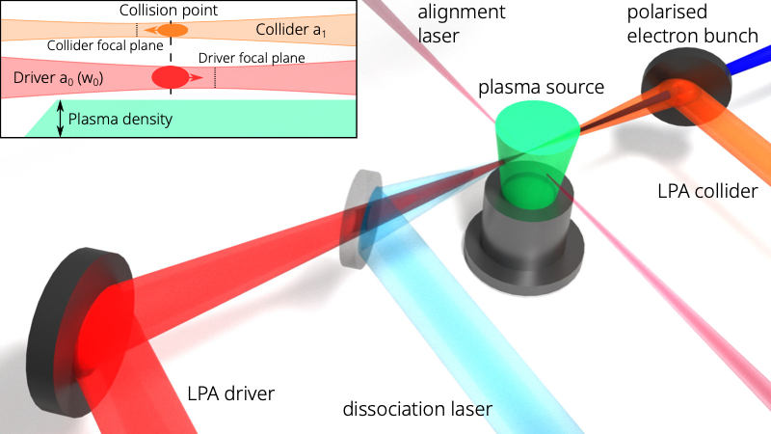
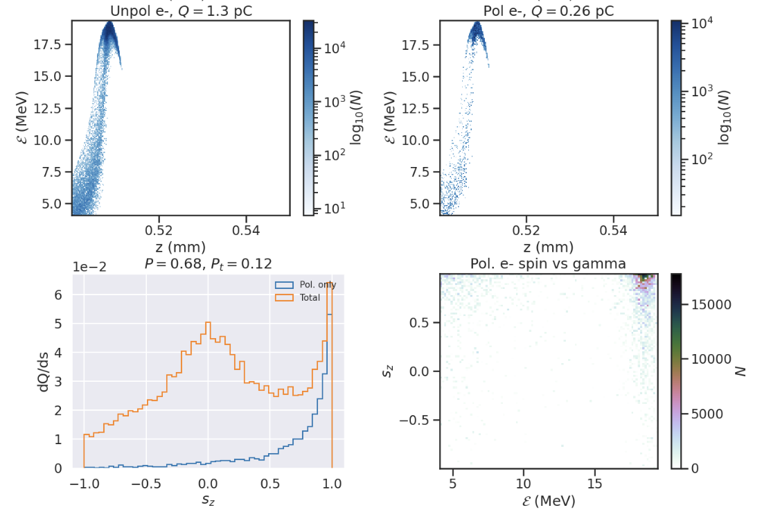
Proof-of-principle experiment feasible in 3 years
Are there proof-of-principle experiments that can be proposed?
LEAP project at DESY studies polarised LPA
  Developed custom electron polarimeter ⁽¹³⁾
  Developed novel polarised injection scheme ^{(14,15)}
  Working on pre-polarising a plasma source
  Existing infrastructure able to accommodate a polarized LPA viz pre-polarised plasma source
1 post-doc + 1 PhD would allow exp. demo of P~10% polarization from HCl by end of 2025
Would also allow work on future P->100% concepts
(13) Popp et al, SPIN2021, JPS Conf. Proc. 37, 021104 (2022)
(14) Gong et al, to be submitted
(15) Bohlen et al, to be submitted

