Slide 1

ALL ABOUT THE FILLING FACTOR
Ezio Todesco
European Organization for Nuclear Research (CERN)
Technology Department
Magnets, superconductors and cryostat group

Slide 2

All about Eve (J. Mankiewicz, 1950, 20th Century Fox)

Slide 3
CONTENTS
Introducing the filling factor
The dependence on the quadrupole spacing
The dependence on the cell phase advance
Out of the box: combined functions

Slide 4
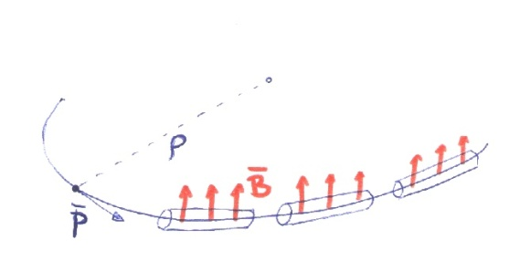


ENERGY VERSUS FIELD AND LENGTH
In a circular collider, one has the well-known relation between field, curvature radius and momentum
In ultra-relativistic regime pc>>mc²
LHC at 7 TeV: 8.3 T and 2800 m curvature radius
How to get more energy?
Longer accelerators (brute force)
Higher fields (the technological path)

Slide 5
ENERGY VERSUS FIELD AND LENGTH
The cost of the infrastructures is related to the length of the tunnel
Dipoles (that bend the protons) occupy a (large) fraction of the expensive tunnel
A collider has a fraction of the tunnel dedicated to straight parts (LSS, long straight sections, it is 7 km in the LHC)
The rest of the tunnel (the curved one, it is 20 km in the LHC) is taken by the arcs

Slide 6
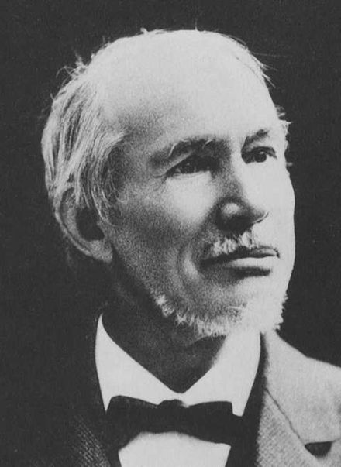
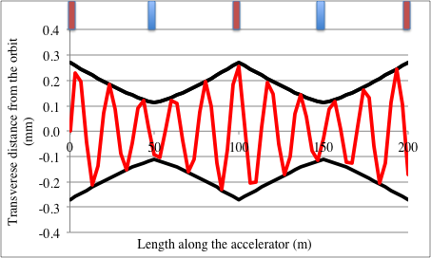
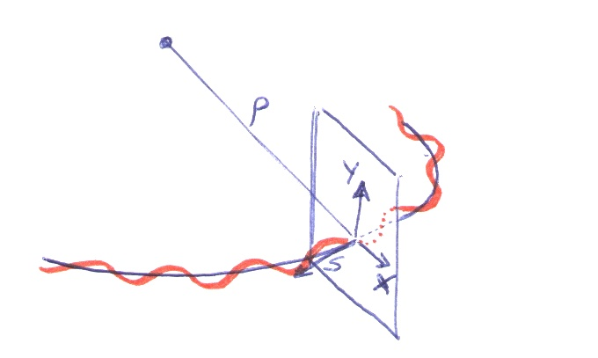
A CLOSER LOOK TO FILLING FACTOR
The arc is made by a sequence of identical units, called cells, providing the linear stability via quadrupoles – main parameter is the quadrupole spacing L
Particles are making oscillations as pendulum around the reference orbit, but with amplitude and frequency that depend on the coordinate along the machine (Hill equations)
Cell length
L
Qf
Qd
Qf
Qd
Qf
G. W. Hill, American
3 March 1838 – 16 April 1914

Slide 7
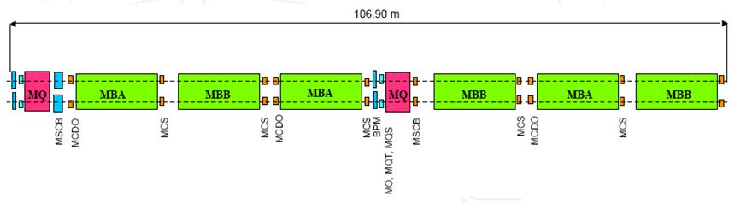
A CLOSER LOOK TO FILLING FACTOR
Filling factor is the ratio between the arc part covered by dipoles and the total length of the arc
Distribution of the 107 m cell length in the LHC
Dipole magnetic length: 14.3 m
Quadrupole magnetic length: 3.15 m
14.3×6= 85.8 m (80%) covered by the magnetic length of the arc dipoles
3.10×2= 6.2 (6%) covered by the magnetic length of the quadrupoles
The rest (14%) covered by coil heads, correctors, interconnections
The LHC cell (see LHC design report, page 39, Fig. 3.5)

Slide 8
FILLING FACTOR IN FCC-hh
FCC-hh baseline
91.2 km total length
14.24 km of straight sections
77.0 km of arcs
Cell length: 215 m (twice the LHC)
Dipole magnetic length: 14.2 m
Filling factor: 14.2×12/215= 79% slightly lower than in the LHC
Quadrupole magnetic length: 7.06 m (in Nb₃Sn)

Slide 9
CONTENTS
Introducing the filling factor
The dependence on the quadrupole spacing
The dependence on the cell phase advance
Out of the box: combined functions

Slide 10
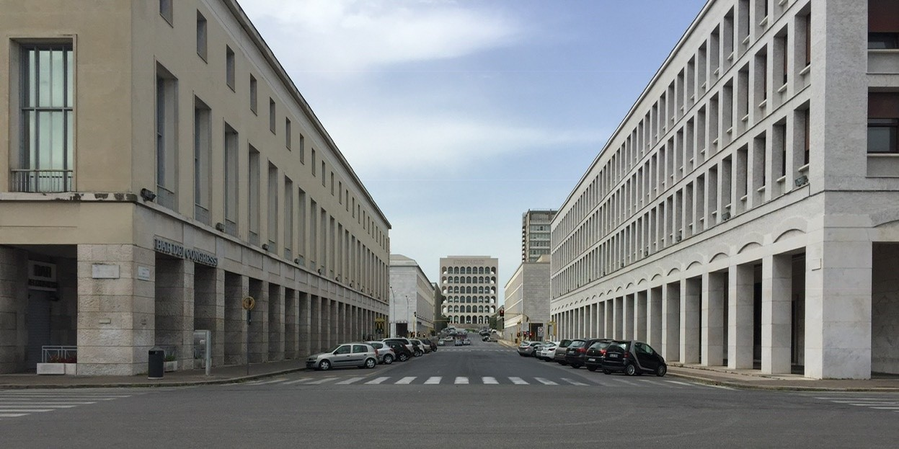
ROME, APRIL 2016

Slide 11
WHAT IF …
If in the LHC lay-out we had 85% rather than 80% filling factor, with the same 8.1 T dipole field we use today for 6.8 TeV, (and with (85-80)/80*1232=77 more dipoles) we could achieve 85/80×6.8 = 7.2 TeV (a bit more energy)
Or, as another example, we could run at 6.8 TeV powering the dipoles below 11.0 kA (much less training)
Therefore one should pose the question: are we doing everything to optimize the filling factor for future high energy colliders?
(talk given in Rome, FCC week 2016) “Field quality, correctors and filling factor in the arcs”

Slide 12
APERTURE REQUIREMENTS
The aperture (diameter) needed in an arc magnet (dipole or quadrupole) is given by
A constant accounting φ₀ for the cold bore,
beam screen, shielding, tolerances …
A part proportional to the beam size σ (the spread of a Gaussian distribution of the transverse beam) times n (the number of sigma we
take, usually more than 15)
Example: LHC beam size (injection) is σ=1.2 mm (see next slide), we have 56 mm aperture diameter, ∼15 mm for φ₀ and 40 mm for the beam i.e. >15 σ
Note that initially magnet aperture in LHC was 50 mm and was later enlarged to 56 mm for fears on field quality
Magnet
Cold bore
Beam
(one sigma)
Beam screen

Slide 13
SIZE OF THE BEAM: MAIN DEPENDENCES
Size of the beam is given by
There are 3 relevant dependences:
ε: emittance [m] invariant along the ring, invariant from ring to ring
This is a property of the injectors!
γ_{r} Beam energy: the larger the energy, the smaller the beam
β is the beta function [m], its square root giving the envelope of the beam along the ring (the sequence of magnets define the beta functions – what is also called beam optics)
LHC: ε_{n} =3.75 10⁻⁶ m rad
Beta is 170 m (see next slides)
High field E=7 TeV, γ=7460, σ=0.29 mm
Injection E=450 GeV, γ=480, σ=1.2 mm

Slide 14
BETA FUNCTION DEPENDENCE
Having fixed the injection energy and the emittance of the beam coming from the injectors, the only other parameter that affects aperture requirementsis is the beta function
The beta function is propotional to the quadrupole spacing
For the type of optics we use today in the LHC (90° phase advance)
where L is the quadrupole spacing
LHC: L=53.5, β∼180 m
L

Slide 15
BETA FUNCTION DEPENDENCE
What happens if we double the spacing between the quadrupoles ?
We get rid of one quadrupole out of two (less cost)
We increase the filling factor by 3% (more energy)
We double the beta function →we increase by 40% the beam size → and we probably need larger aperture (more cost)
But there is another effect …
Cell length 2L

Slide 16
GRADIENT DEPENDENCE
The integrated gradient is inverse proportional to the quadrupole spacing L – twice cell length, half gradient!
For the type of optics we use today in the LHC (90° phase advance), the quadrupole gradient is given by
LHC:
This is realized via ∼3.15 m long quadrupoles giving ∼200 T/m gradient
Double cell length → quadrupole magnetic length from 3.15 m to 1.6 m
In an LHC with double quadrupole spacing, we would half the number of quadrupoles, and we would be able to increase the filling factor by 3% (from the removed quadrupole) plus 1.5% (from the shorter quadrupole), i.e. from the 80% towards 85%
FCC-hh is considering today quadrupole spacing of 107 m – even larger values should be explored

Slide 17
CONTENTS
Introduction
The dependence on the cell length
The dependence on the phase advance
Out of the box: combined functions

Slide 18

MILANO, FEBRUARY 2015

Slide 19
DEPENDENCE ON PHASE ADVANCE
The 90° phase advance used in the LHC is not the most effective phase advance from the point of view of beam size (beta function) versus quadrupole gradient
It has the big advantage of providing max amplitude in H/V direction in the focusing/defocusing quadrupoles
Equations for beta function and quadrupole gradient with the dependence on phase advance ψ_{L} and are
Where ψ_{L} is the phase advance
If we take ψ_{L} =π/3 we obtain

Slide 20
DEPENDENCE ON PHASE ADVANCE
Let us compare the 60° and the 90° phase advance
The maximum beta function is similar:
90° phase advance 60° phase advance
But the force of the quadrupole is 30% lower in the 60° case
90° phase advance 60° phase advance

Slide 21
DEPENDENCE ON PHASE ADVANCE
Example: in the LHC, if we had 60° phase advance, we could have reduced the quadrupole length by 30%, i.e. about 1 m per quadrupole, 2% larger filling factor would have given 2% larger energy
Today we could operate at 6.95 TeV with the same number of quenches needed to operate at 6.8 TeV
Obviously one should have filled the reduced space of the quadrupole (1 m per quadrupole) with 33 cm longer dipoles
Example: in the FCC-hh, quadrupole is 7 m long, with 60° phase advance we could free 2.3 m each 107 m, also in this case 2.2% larger filling factor
We could have lowered the dipole field from 16.0 T to 15.7 T
A LHC MD (machine development) has been proposed to study the implications of a 60° phase advance optics – first one done in 2022
60° phase advance optics has been also studied for possible energy upgrades of LHC and HE-LHC Y. Nosochkov, et al. « Optimized arc optics for HE-LHC », IPAC (2018) (J. Keintzel, et al., Phys. Rev. STAB 23 (2020) 101602)

Slide 22
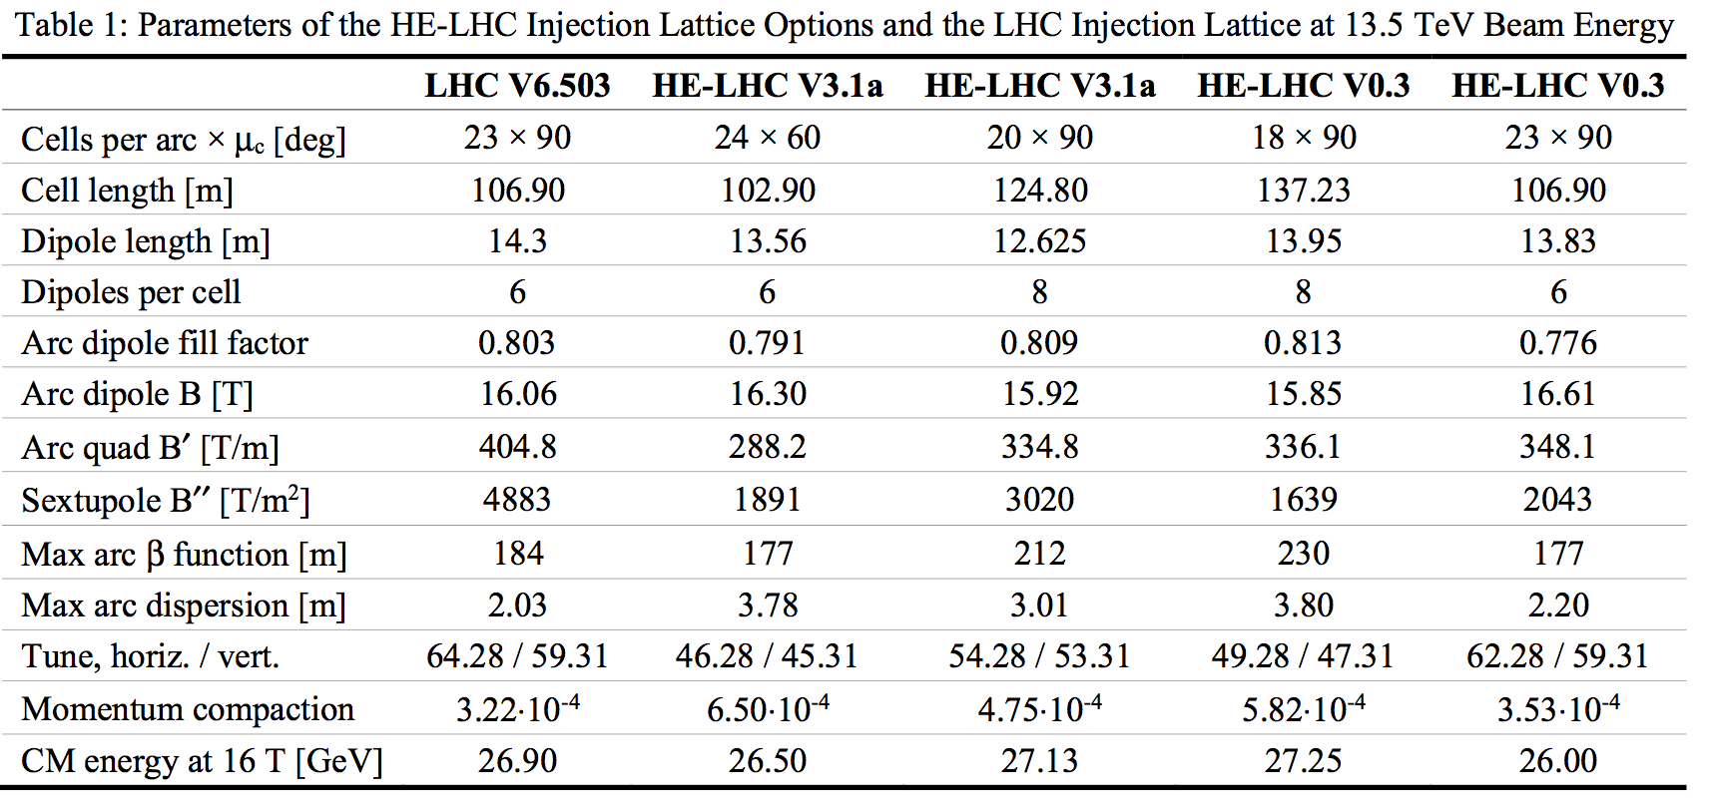
HOW THE LAYOUT CAN AFFECT REQUIREMENTS ON MAGNETIC FIELD
Y. Nosochkov, et al. « Optimized arc optics for HE-LHC », IPAC (2018)

Slide 23
CONTENTS
Introduction
The dependence on the cell length
The dependence on the phase advance
Out of the box: combined functions

Slide 24

MOSCOW, MAY 2018

Slide 25
A ROUGH ESTIMATE
First proposal of combined function by A. Devred in 2018
Let us imagine spreading the integrated gradient of the LHC quadrupole over the cell
220 T/m spread from 3.1 m to 14.3×3=42.9 m makes 220*3.1/42.9 = 16 T/m
A gradient of 16 T/m gives 16×0.017 = 0.27 T at reference radius
To be compared to 8.3 T ; 0.27/8.3= 330 units of quadrupole: we would need to inject in the dipole design systematic quadrupole component of 300 units

Slide 26
A ROUGH ESTIMATE
Let us imagine spreading the integrated gradient of the LHC quadrupole over the cell
What would be the additional peak field ? 16 × 0.028 × 1.15= 0.5 T
What is the balance ?
Dipole field should be lowered by 0.5/8.3=6% to keep the same margin
But we can recover a space of 2×3.25 m (full lenght of quadrupole) every 107 m – this is 8% more
Therefore, not only we get rid of the quadrupoles, but probably we also gain a few percent in energy

Slide 27
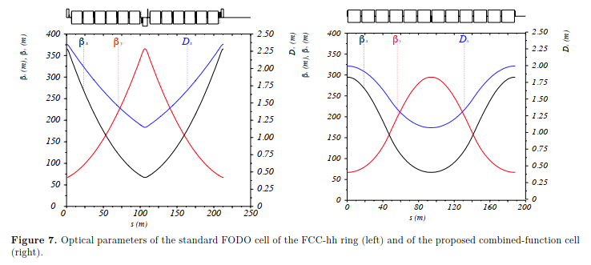
A MORE REFINED ESTIMATE
Let us consider a cell completely covered by combined function dipoles of length L and alternating positive and negative gradient
Computations show that for a 90° phase advance, gradient is
M. Giovannozzi, E. Todesco, Europ. Phys. Jou. Plus 137 (2022)
Therefore for the LHC one obtains 22 T/m,
not far from the 16 T/m of the previous example
The beta function is 20% smaller (therefore L can be increased by 20%)
Therefore to have a comparison with same beam size, quadrupole need is 14 T/m

Slide 28
A TENTTIVE BALANCE FOR COMBINED FUNCTION
What we gain ?
We do not need building the quadrupoles (however, they are less than 10% the total cost of the magnet system)
What we lose?
Spreading the component of the quadrupole in the dipoles, we have to lower the dipole field (to keep the same loadline margin) – this depends on how long is the cell
So it appears to be less effective than simply increasing the cell length
However, the option can recover further space (one interconnection) and increase the modularity if we totally remove the SSS and we place all correctors (orbit, tuning quadrupoles, …) in the dipole cold mass

Slide 29
A TENTATIVE LATTICE FOR COMBINED FUNCTION
A totally modular cell lay-out would involve having 14-m-long dipoles coupled with short (order of 0.7 m) correctors, of five different types
Orbit correctors
Tuning quadrupoles
Skew quadrupoles
Chromatic sextupole correctors
Landau octupoles
Landau Oct/
Skew Quad
Sextupole
Family A
Tuning
Quadrupole
Orbit H
corrector
Sextupole
Family B
Tuning
Quadrupole
Orbit V
corrector
…
Focusing dipole
Focusing dipole
Focusing dipole
Focusing dipole
Defocusing dipole
Defocusing dipole
Defocusing dipole
Defocusing dipole

Slide 30
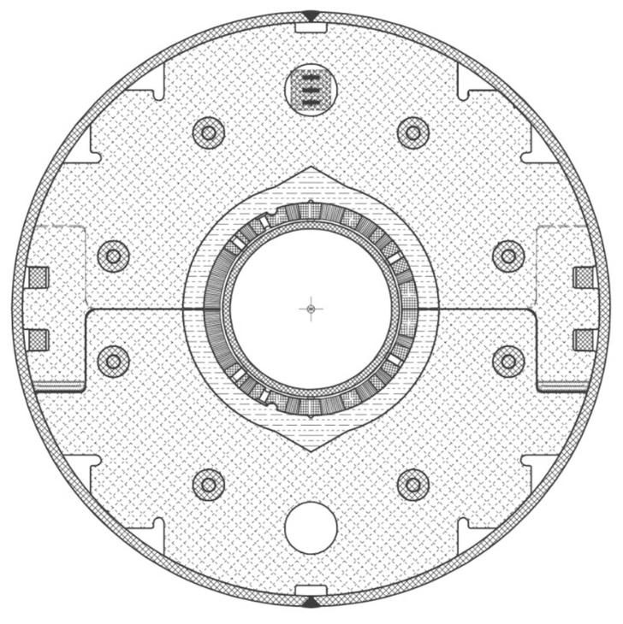
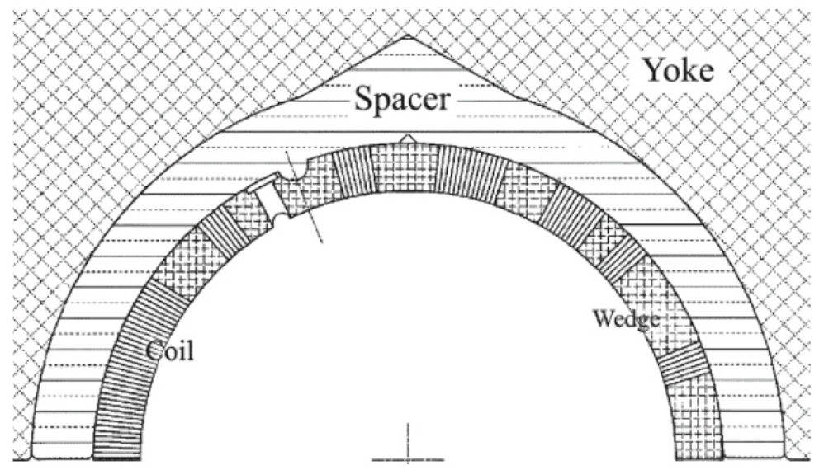
A COMBINED FUNCTION DIPOLE
Combined function dipoles have been build in the past
In particular, KEK transfer line for J-PARC had a combined function dipole – with dipole and quadrupole components of the same order
Here we would need a dipole having order of 200 units of quadrupole, so the quadrupole would be a second order
Cross-section of J-PARC combined function magnets
(T. Nakamoto, et al.)

Slide 31
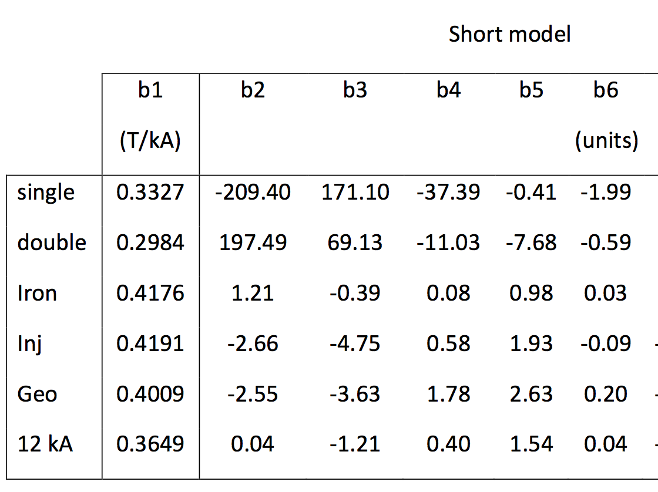
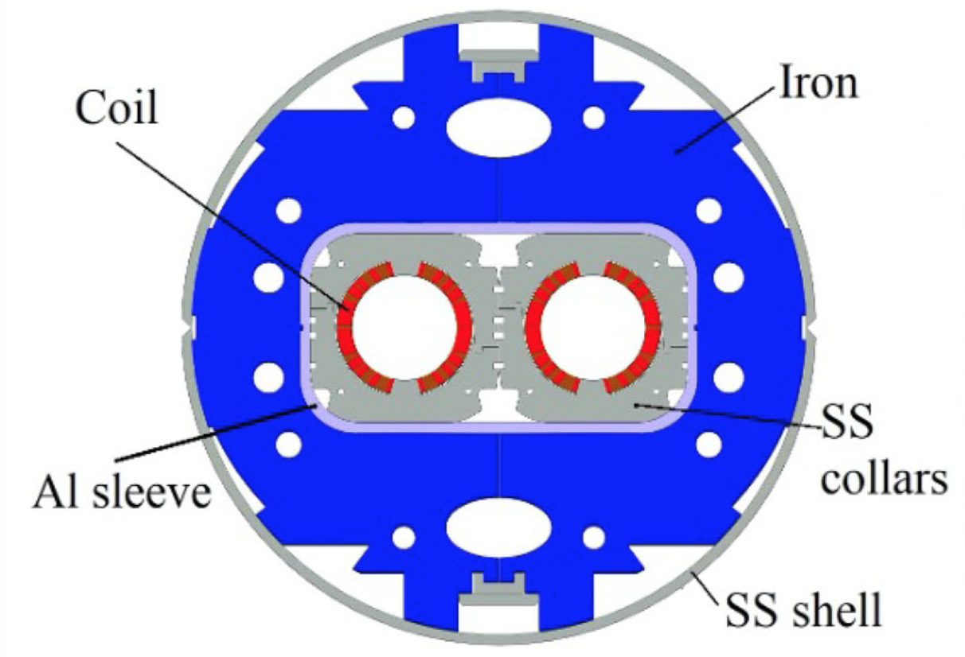
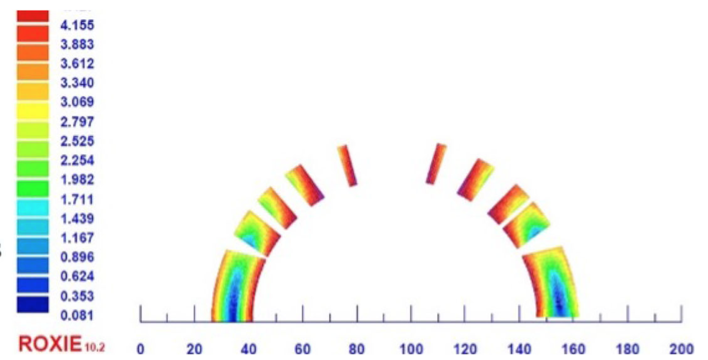
A COMBINED FUNCTION DIPOLE
Combined function dipoles have been build in the past
HL-LHC dipole D2 has a asymmetric coil with a 200 units b₂ to compensate the cross-talk due to the other aperture
This case shows that a slightly (~1 mm) asymmetric coil can be mastered
Cross-section of HL-LHC D2
(S. Farinon, P. Fabbricatore, et al.)

Slide 32
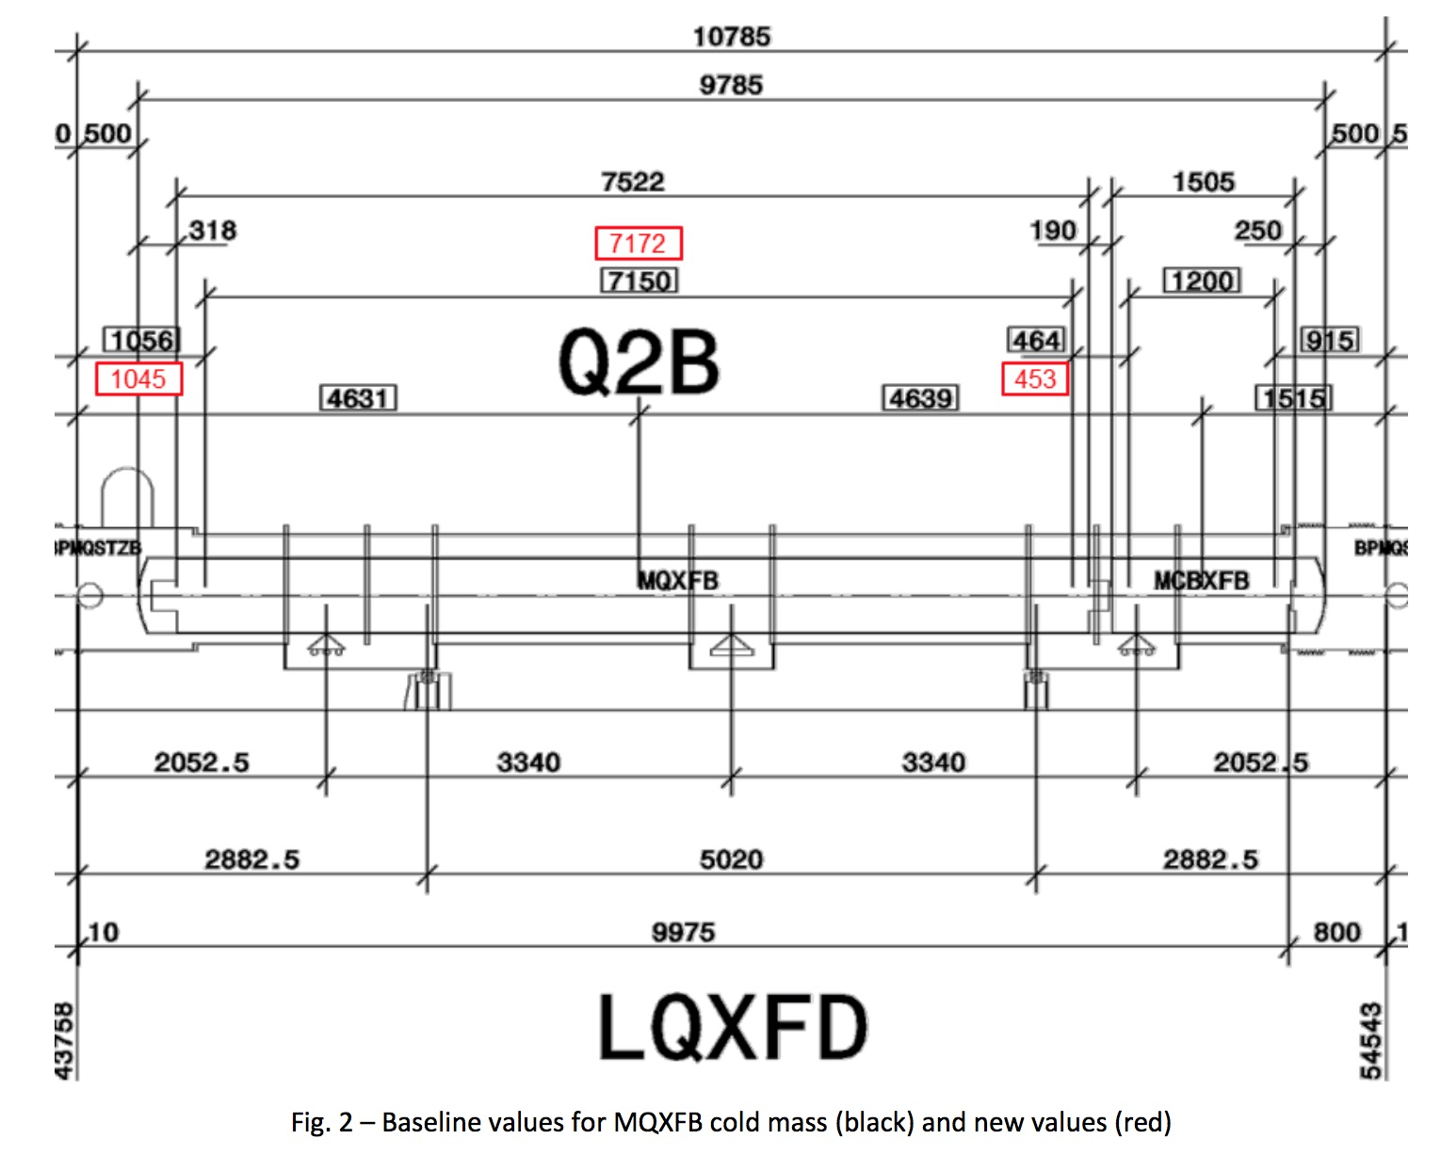
WHERE ARE WE IN HL-LHC WITH FILLING FACTOR ?
HL-LHC lattice has Nb3Sn magnets coupled with short correctors (Q2 cold mass)
Q2 magnetic length | 7150
MCBXF magnetic length | 1200
Total length cold mass | 10785
Filling ratio | 66%

Slide 33
WHERE ARE WE IN HL-LHC WITH FILLING FACTOR ?
HL-LHC lattice has Nb₃Sn magnets coupled with short correctors (Q2 cold mass)
Extrapolation to a main bending for HE-LHC or FCC
Further optimization is possible of interconnection length, distance between magnets, …
Ends should also be shorter since the aperture of HL-LHC is three times larger
 | (mm)
Q2 magnetic length | 7150
MCBXF magnetic length | 1200
Total length cold mass | 10785
Filling ratio | 66%
 | (mm) | (mm)
MB magnetic length | 13150 | + 6000
Corrector magnetic length | 700 | -500
Total length cold mass | 16285 | +5500
Filling ratio | 81%

Slide 34
CONCLUSIONS
The filling factor in the LHC (fraction of arcs covered by bending force of the dipole) is 80%
This design parameter could be increased to 85% and above
90% appears to me as a hard upper limit
How? Exploration of much longer cells
Longer cells do not only need less quadrupoles, but also less strong
How? Exploration of 60° optics
It reduces the requirement on quadrupole gradient by 30%
How? Spreading the quadrupole in the dipole (combined function cell)
One gets rid of the quadrupoles, and can still gain few % more

