Slide 1
Ongoing Design Effort for SoM as Basis for Caribou 2.0
Mathieu Benoit
September 1st 2022

Slide 2
Outline
The FETBv2 DAQ System
  Hardware
  Firmware
  Software (using Go )

Slide 3
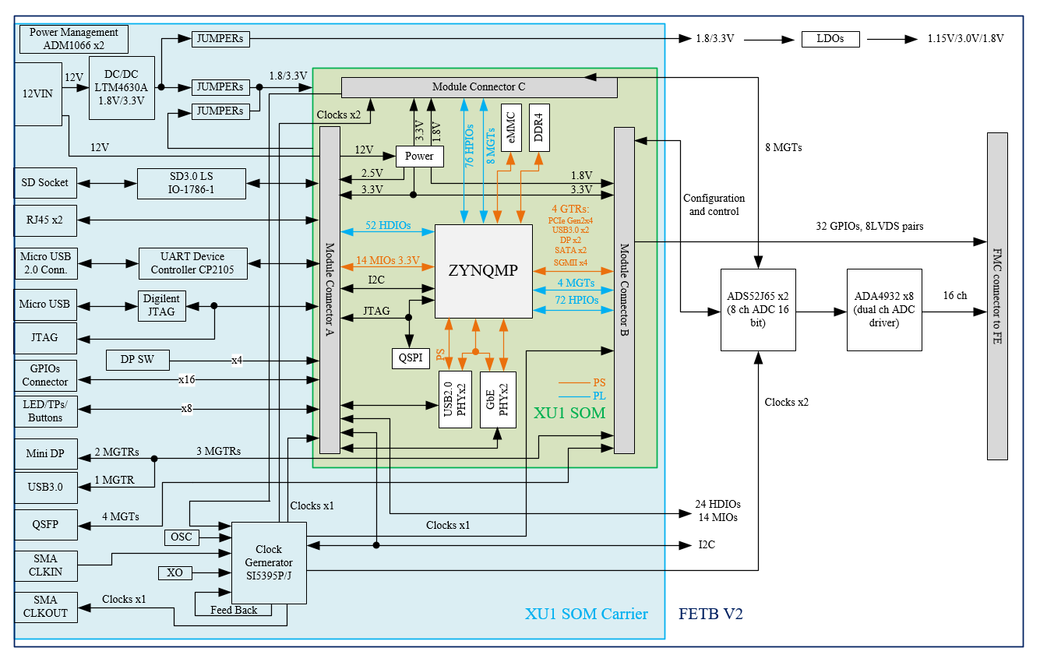
FETBv2 block diagram
Design based on XU1 SOM
Has JTAG, USB (host), SFP+, RJ45 and miniDP
Has 2 power management chips to handle power up sequence and monitor all power rails
Uses the same ADA4932 dual channel ADC drivers with FETB
Has updated ADC (ADS52J65) by TI that provides superior performance

Slide 4
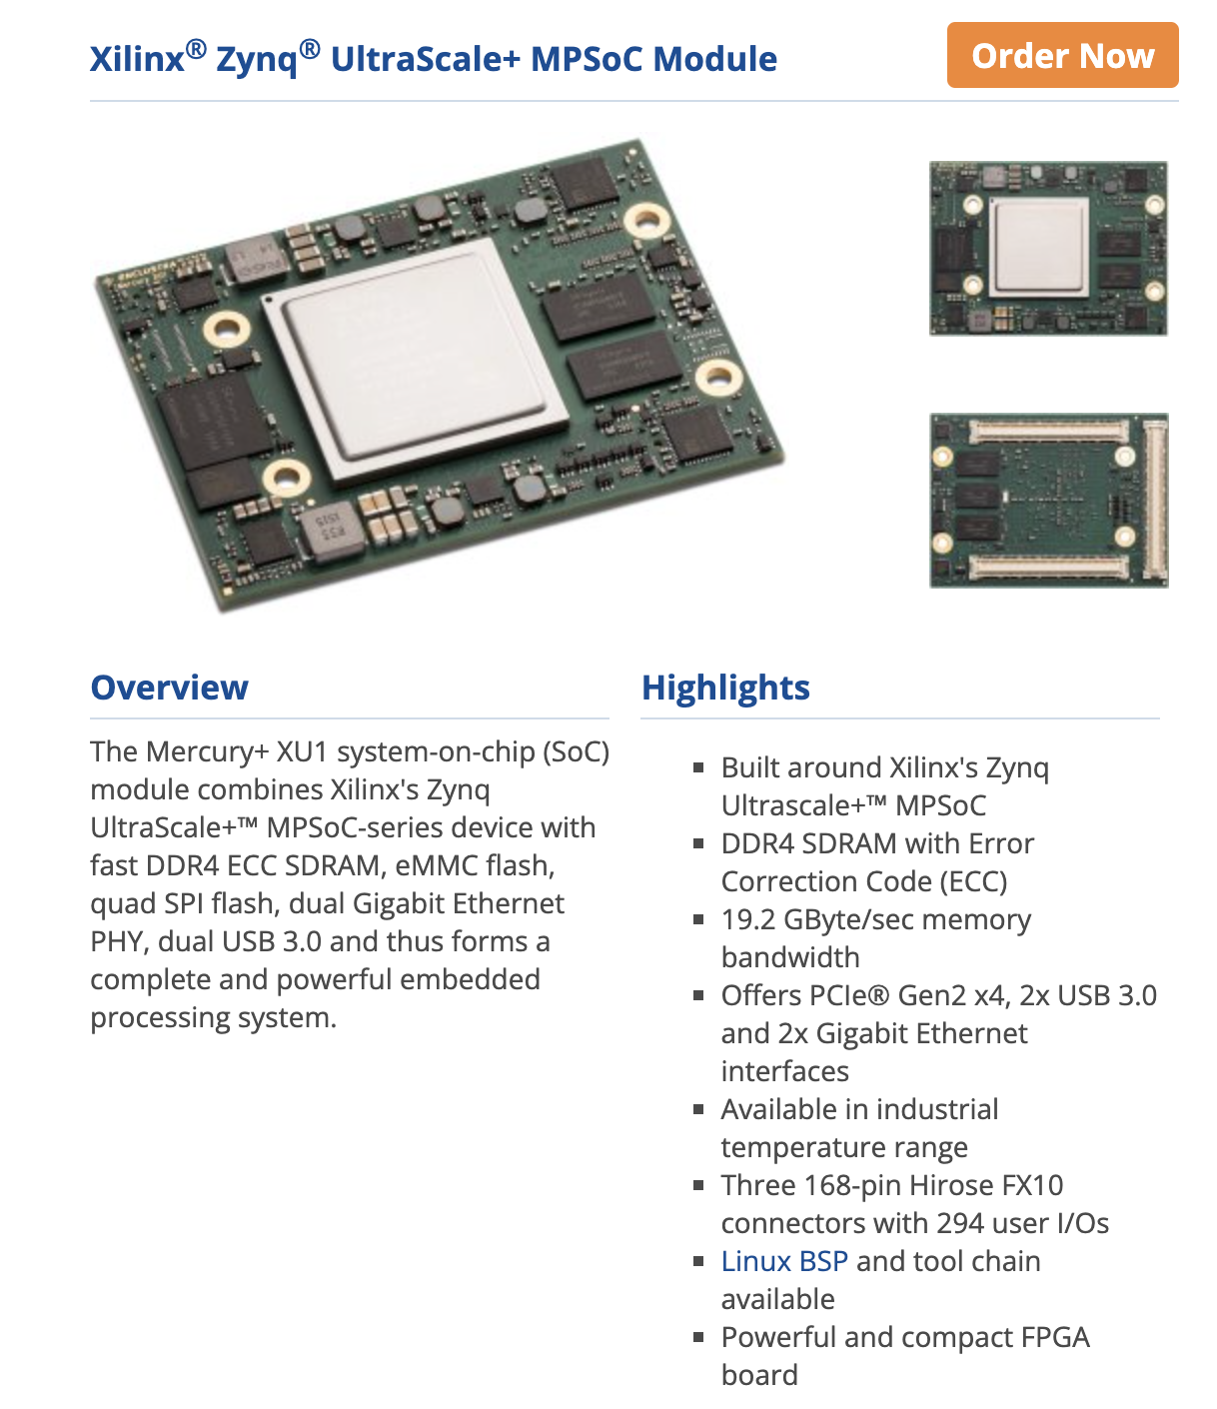
The Enclustra XU1 SOM
Modules available on digikey, it seems : https://www.digikey.com/short/v5qztpd3

Slide 5
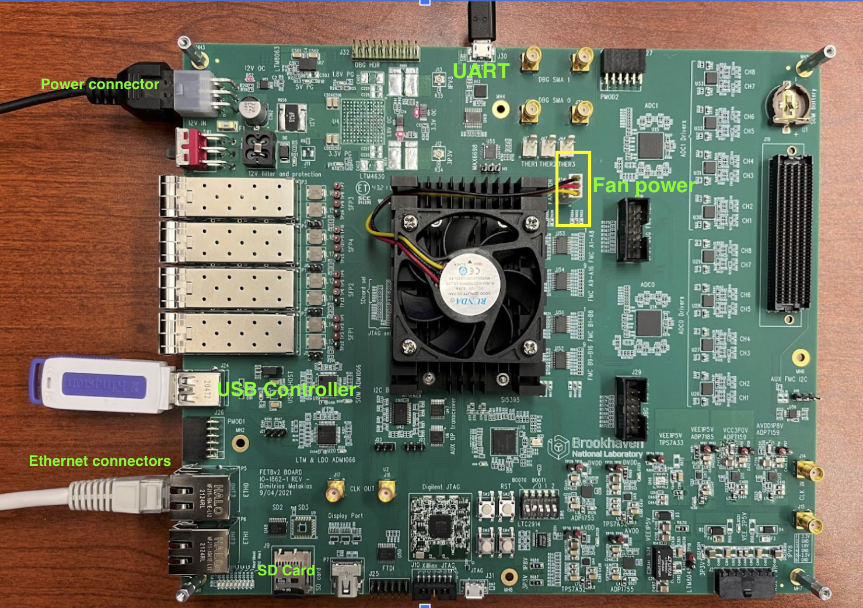
The FETBv2 Board

Slide 6
ADC, ADS52J65
ADS52J65 is a new device from TI that has very impressive noise performance
It offers improved resolution of 16bits, the ENOB (effective number of bits) is 13bits vs ~12 bits for other devices
INL, SNR and power consumption are similar to our previous ADC
Noise level is just 70uV RMS for this ADC according to TI, which will improve some of the low noise measurements significantly
125MSps vs 65MSps (not critical, but interesting feature to have)
Multi channel ADCs with high sampling rates have a very high total throughput:
  8ch x 40 MSps x 16bits = 5.12 Gbps
  Most ADCs use multiple LVDS pairs to output the data
However, ADS52J65 uses the JESD204B interface to output data at up to 12Gbps using 8b10b encoding
  This will significantly reduce the IO requirements of the FPGA, simplify the layout and leads to much smaller packages for the ADC
  Firmware must be developed to read-out the ADC data (Hongbin has already done a similar project in the past)
  Latency of the ADC / system does not affect our test
Supports fractional decimation and advanced FIR filter that can be configured

Slide 7
The FETBv2 OS
We build the OS for FETBv2 with Xilinx petalinux-tools (2020.2).
Layer on top of Yocto to simplify some of the process
Take care of tools installation, go support, deploy scripts for startup etc..
https://github.com/mathieubenoit/FETB2_15EG_OS

Slide 8
The FETBv2 Firmware
JESD Interface for ADC with readout at full throughput
  Synchronization between ADCs
  Common clocking via Si5345 Chip
ADC decoding and data sorting
ADC Data stream to AXI-Stream
  Achieve bandwidth of ~1.4GB/s to RAM -> 2xADC @ 40MHz
Pulser IP with AXI-programmable MMCM for phase scan with 0.01º resolution.

Slide 9
SW in Go

Slide 10

Goals of Go
Provide a simple language in terms of syntax
  Syntax similar to python, C, Java
Provide an easy method to deal with modern multi-processor architecture to maximize its usage
  The language provides mechanism to simply handle concurrency and parallelism issues
Provide the speed of a compiled language, and the feeling and ease of use (libraries etc.) of a compiled language
  Large set of standard libraries covering the needs of a modern software
Provide ease of deployment via the use of static linking

Slide 11
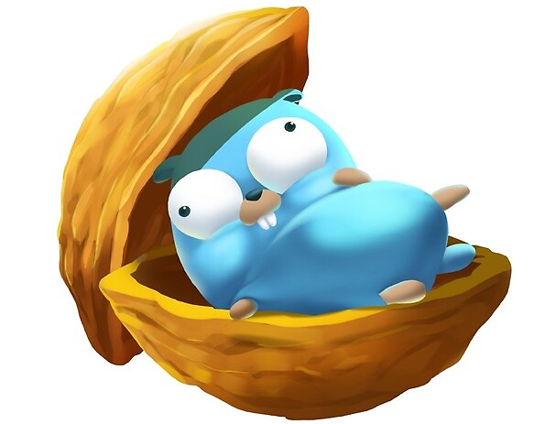
Go language in a nutshell
The go language is an object-oriented language, but not in the common sense
  No classes, inheritance, polymorphism
  Types can be attributed methods
  Object-Oriented concept via Interfaces
  Functions are objects
The language is strongly typed
  Conversion between types always explicit
The language is not sensitive to indentation

Slide 12

The go environment
The go compiler can be downloaded and installed for any platform and architecture from www.golang.org
The compiler comes with all the tools required to develop in the go langage : Compiler, formatter, linter, code checker, profiler , tracer, tester, coverage and version control integration
  It is recommended to use an IDE such as Visual code to make most use of the tools
The go language is statically linked, so the executable produced are standalone and contain all the code needed to run
The compiler can produce executable for any platform that run the go compiler (for example Linux ARM64)

Slide 13
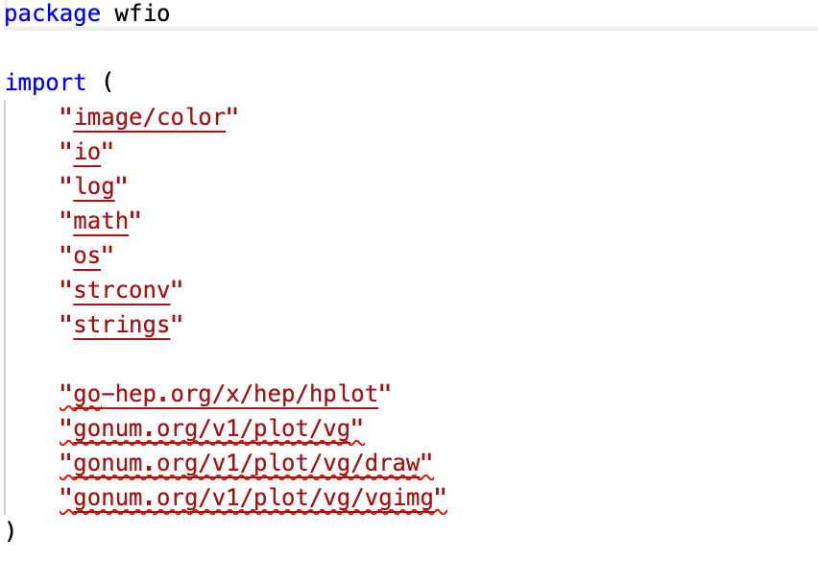

Go libraries
The go standard library provides a wide array of tools to produce quickly modern code, not usually available in standard lib in other languages :
  Stats, math functions, logging and error handling
  http, tcp server client handling
  Cipher, cryptography etc …
  File readers and writer (JSON,YAML,HDF etc…)
  Image handling etc..
Libraries can be used simply by adding their URL to the code, the go compiler will fetch and compile them for you
Standard libs
Additional libs

Slide 14
Example : DAQ
Data Generator
DCS Generator
In this example, we show how to use buffered channel to maximize the throughput of the system by using all threads to average waveform and write them to disk (in ROOT format!)
In a second step, we show how a few line of code can change this application into a heterogenous client server application
Averager
Waveform Writer
DCS Writer

Slide 15
Example : DAQ
Data Generator
DCS Generator
In this example, we show how to use buffered channel to maximize the throughput of the system by using all threads to average waveform and write them to disk (in ROOT format!)
In a second step, we show how a few line of code can change this application into a heterogenous client server application, using cross-compilation features of the go compiler
Averager
Client
arm64
Struct via TCP
Server
X86_64
Waveform Writer
DCS Writer

Slide 16
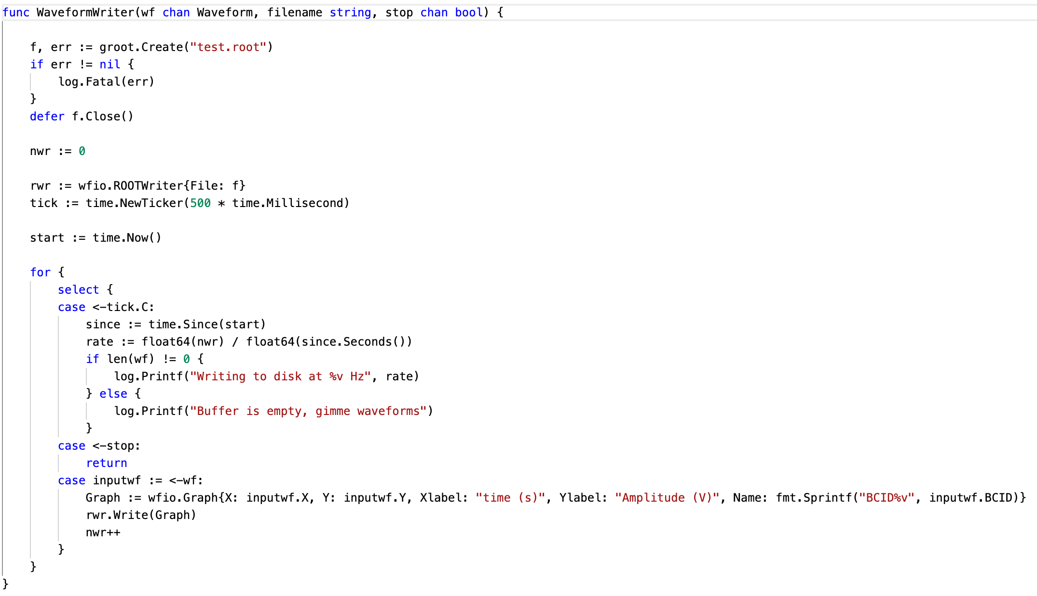
Writing to ROOT file

Slide 17
FETBv2 DCS Monitoring
DCS Consist of measurements from two sources :
Internal to FETB2 (read via I2C)
  INA228, MAX Temperature chip (including 3 external NTC for ALFE2, etc.)
  Power and Voltages from INA228
External (Read via SCPI over Ethernet)
  Keysight power supplies
The DCS runs in the FETB2 and act as an HTTP server that display the live results of measurements
A log of all event is stored in a ROOT Tree/File

Slide 18
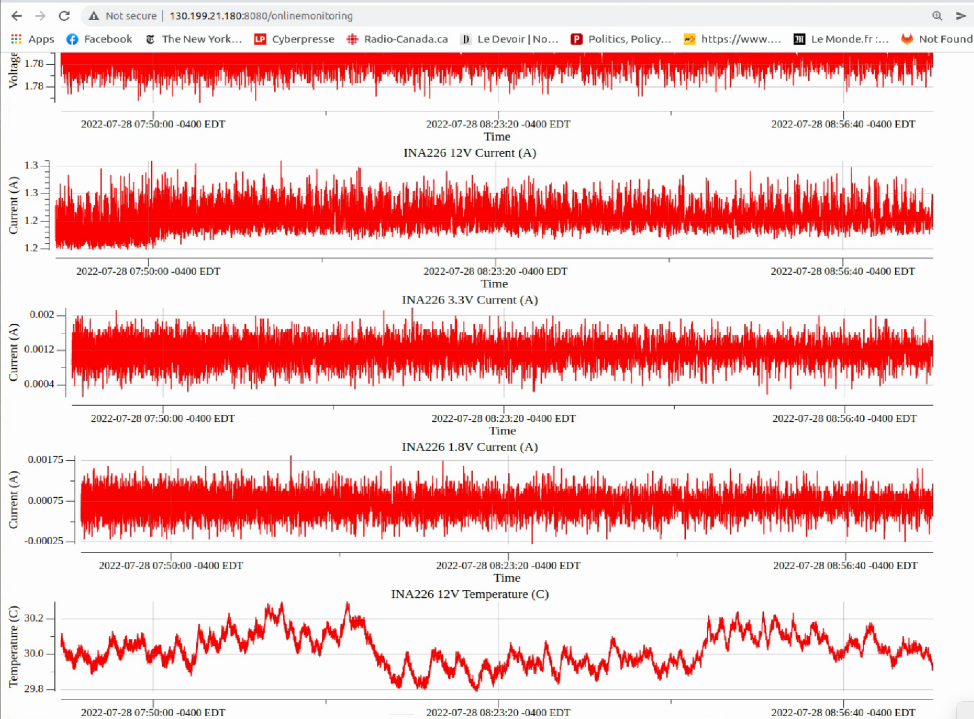
DCS

Slide 19
FETB2 Software
Functionalities of the SW implemented via tools
Noise Scan
Linearity Scan
Peaking Time Scan
Baseline Scan
etc.
The underlying libraries allow the scripting of the main board functionalities
Pulser controller
DAQ Controller (steer data acquisition)
MMCM Controller
Slow Control Register controller
The various controllers are integrated into a top controller exposing the required function to manipulate the FETB2 State : FETB2 Controller

Slide 20
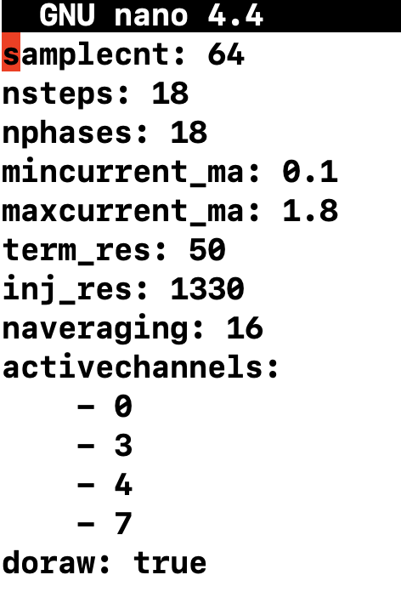
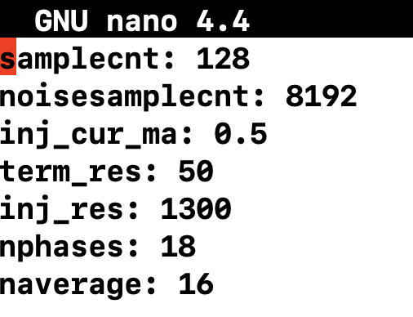
Scans
Each type of scan are based on a common template in 4 steps :
Initialization of the FETB2 controller
Scanning step : Acquisition of the required data
Analysis step : Perform analysis of acquired data
Writing Results : Write results and raw data to a ROOT file
The parameters of each scans are described in a YAML file that can easily be edited to change scan parameters
Linearity Scan
Noise Scan

Slide 21
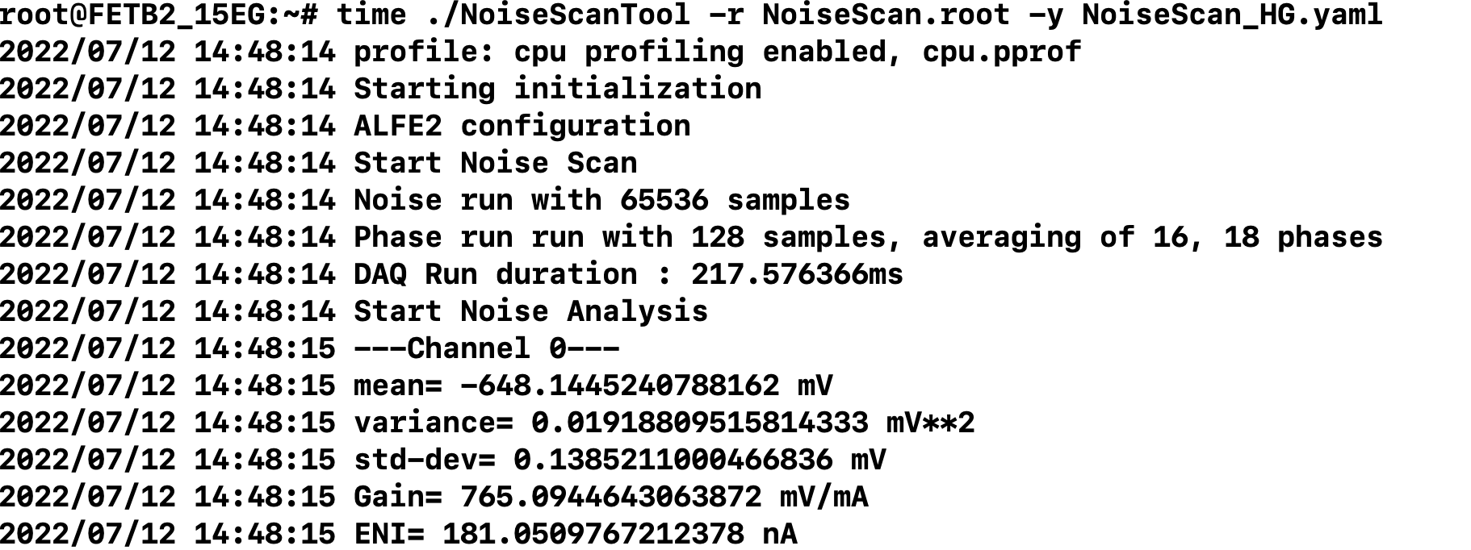
Noise Scan
Perform a baseline measurement with a large amount of sample (ie: 65536)
Perform a pulse injection and measure pulse using a delay scan
Extract gain from delay scan, noise and baseline from noise waveform
Compute ENI, FFT
Write raw data, FFT(optional),Analysis results to ROOT file, CSV
Execution time (18 phases, 16 averaging, 65536 samples) 1.7s
  500ms for analysis
  970ms to write data to disk
  800ms for optional FFT

Slide 22
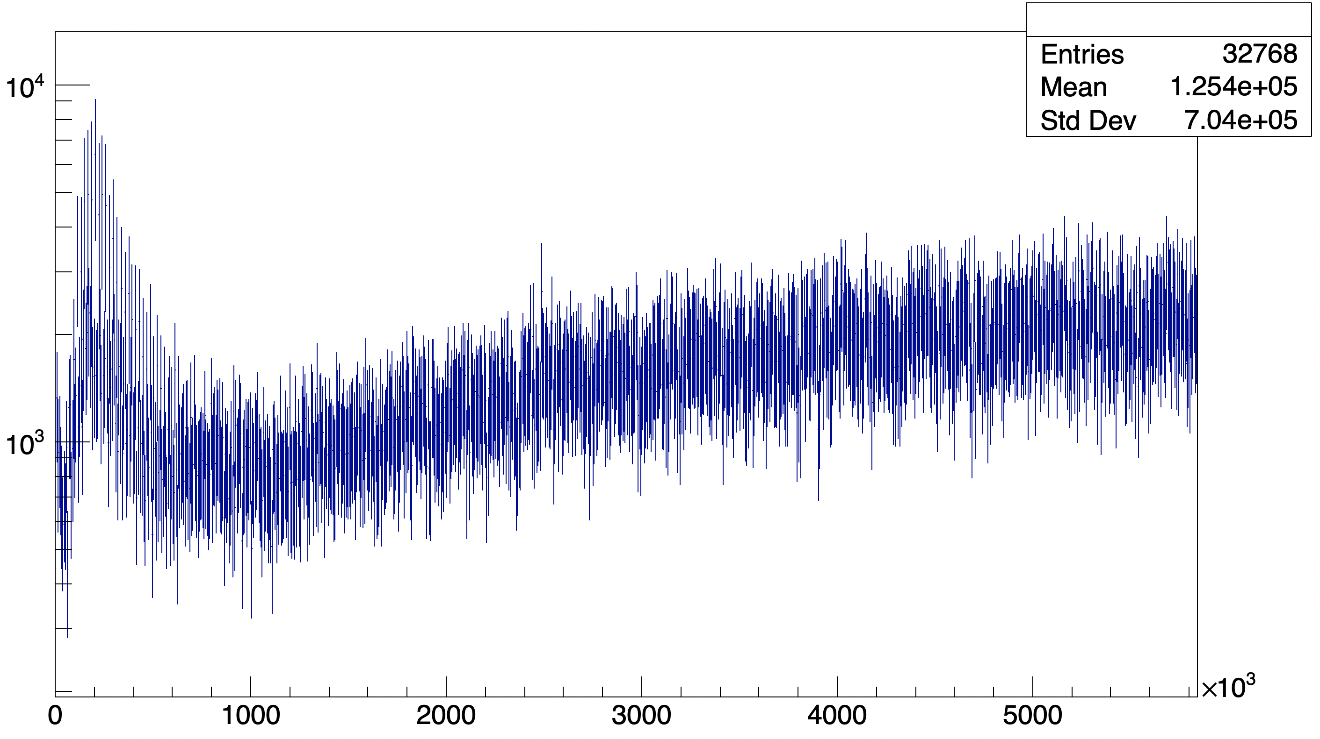
FFT

Slide 23
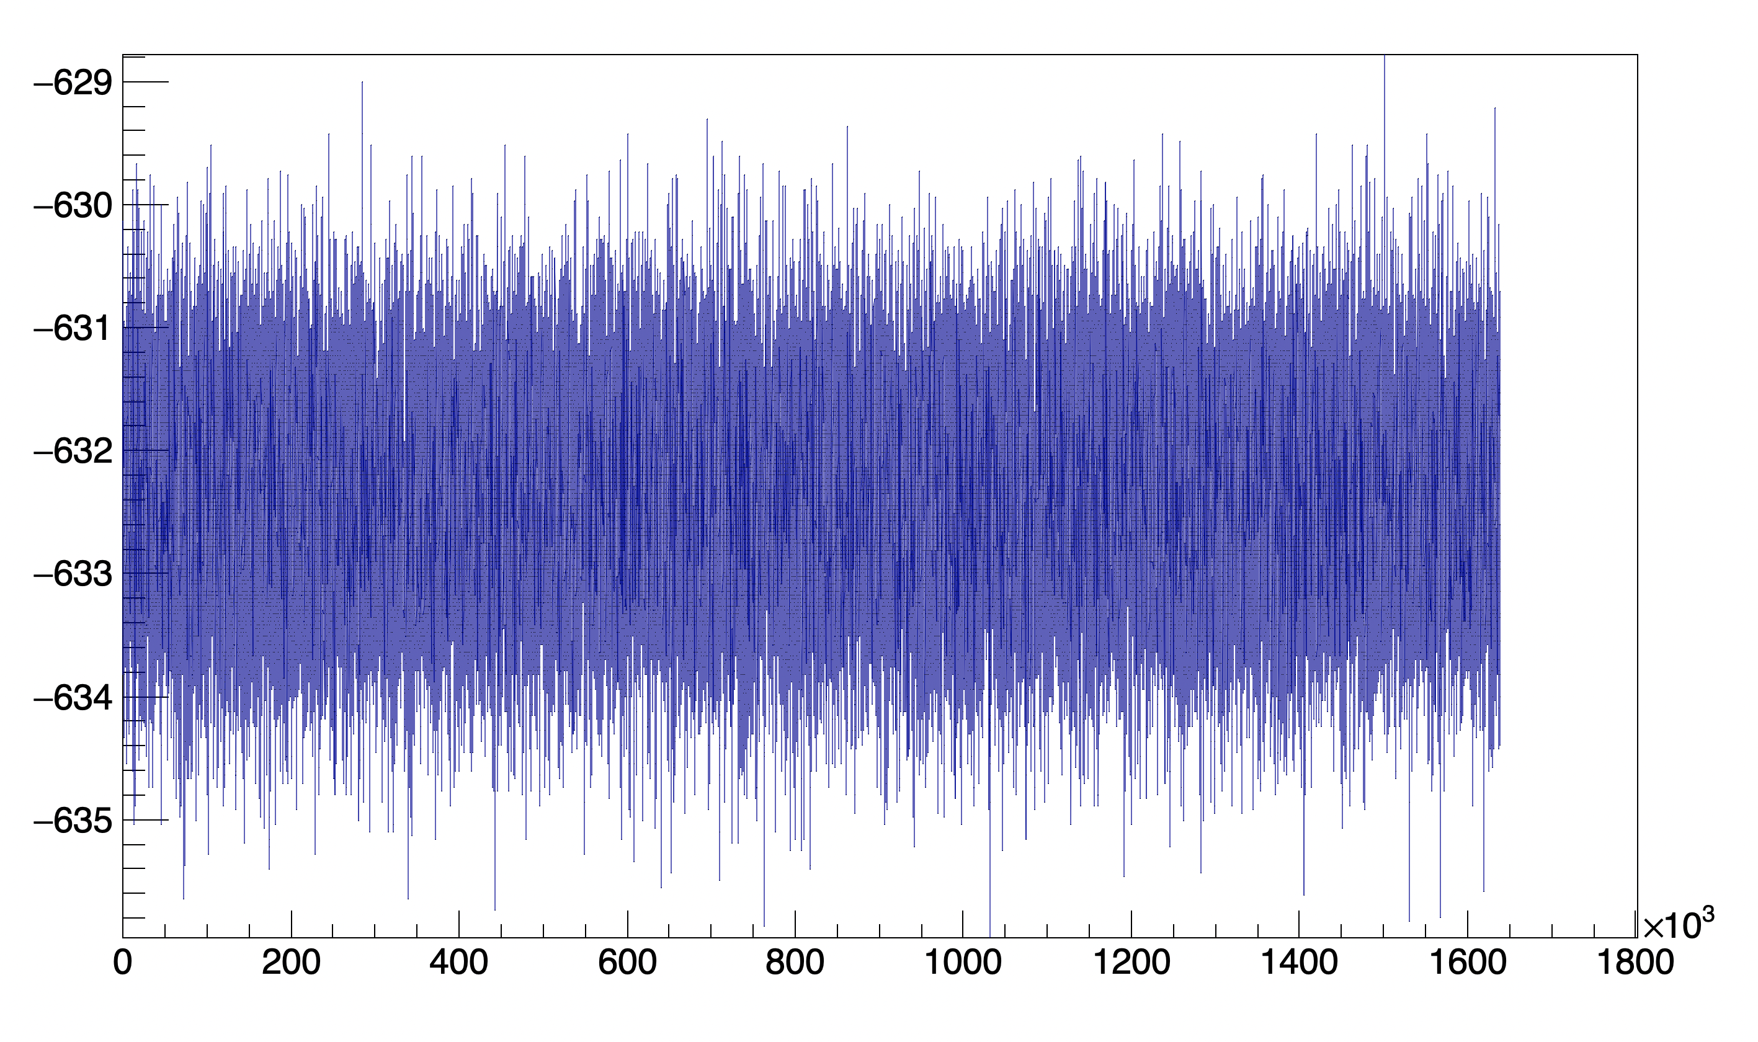
Noise

Slide 24
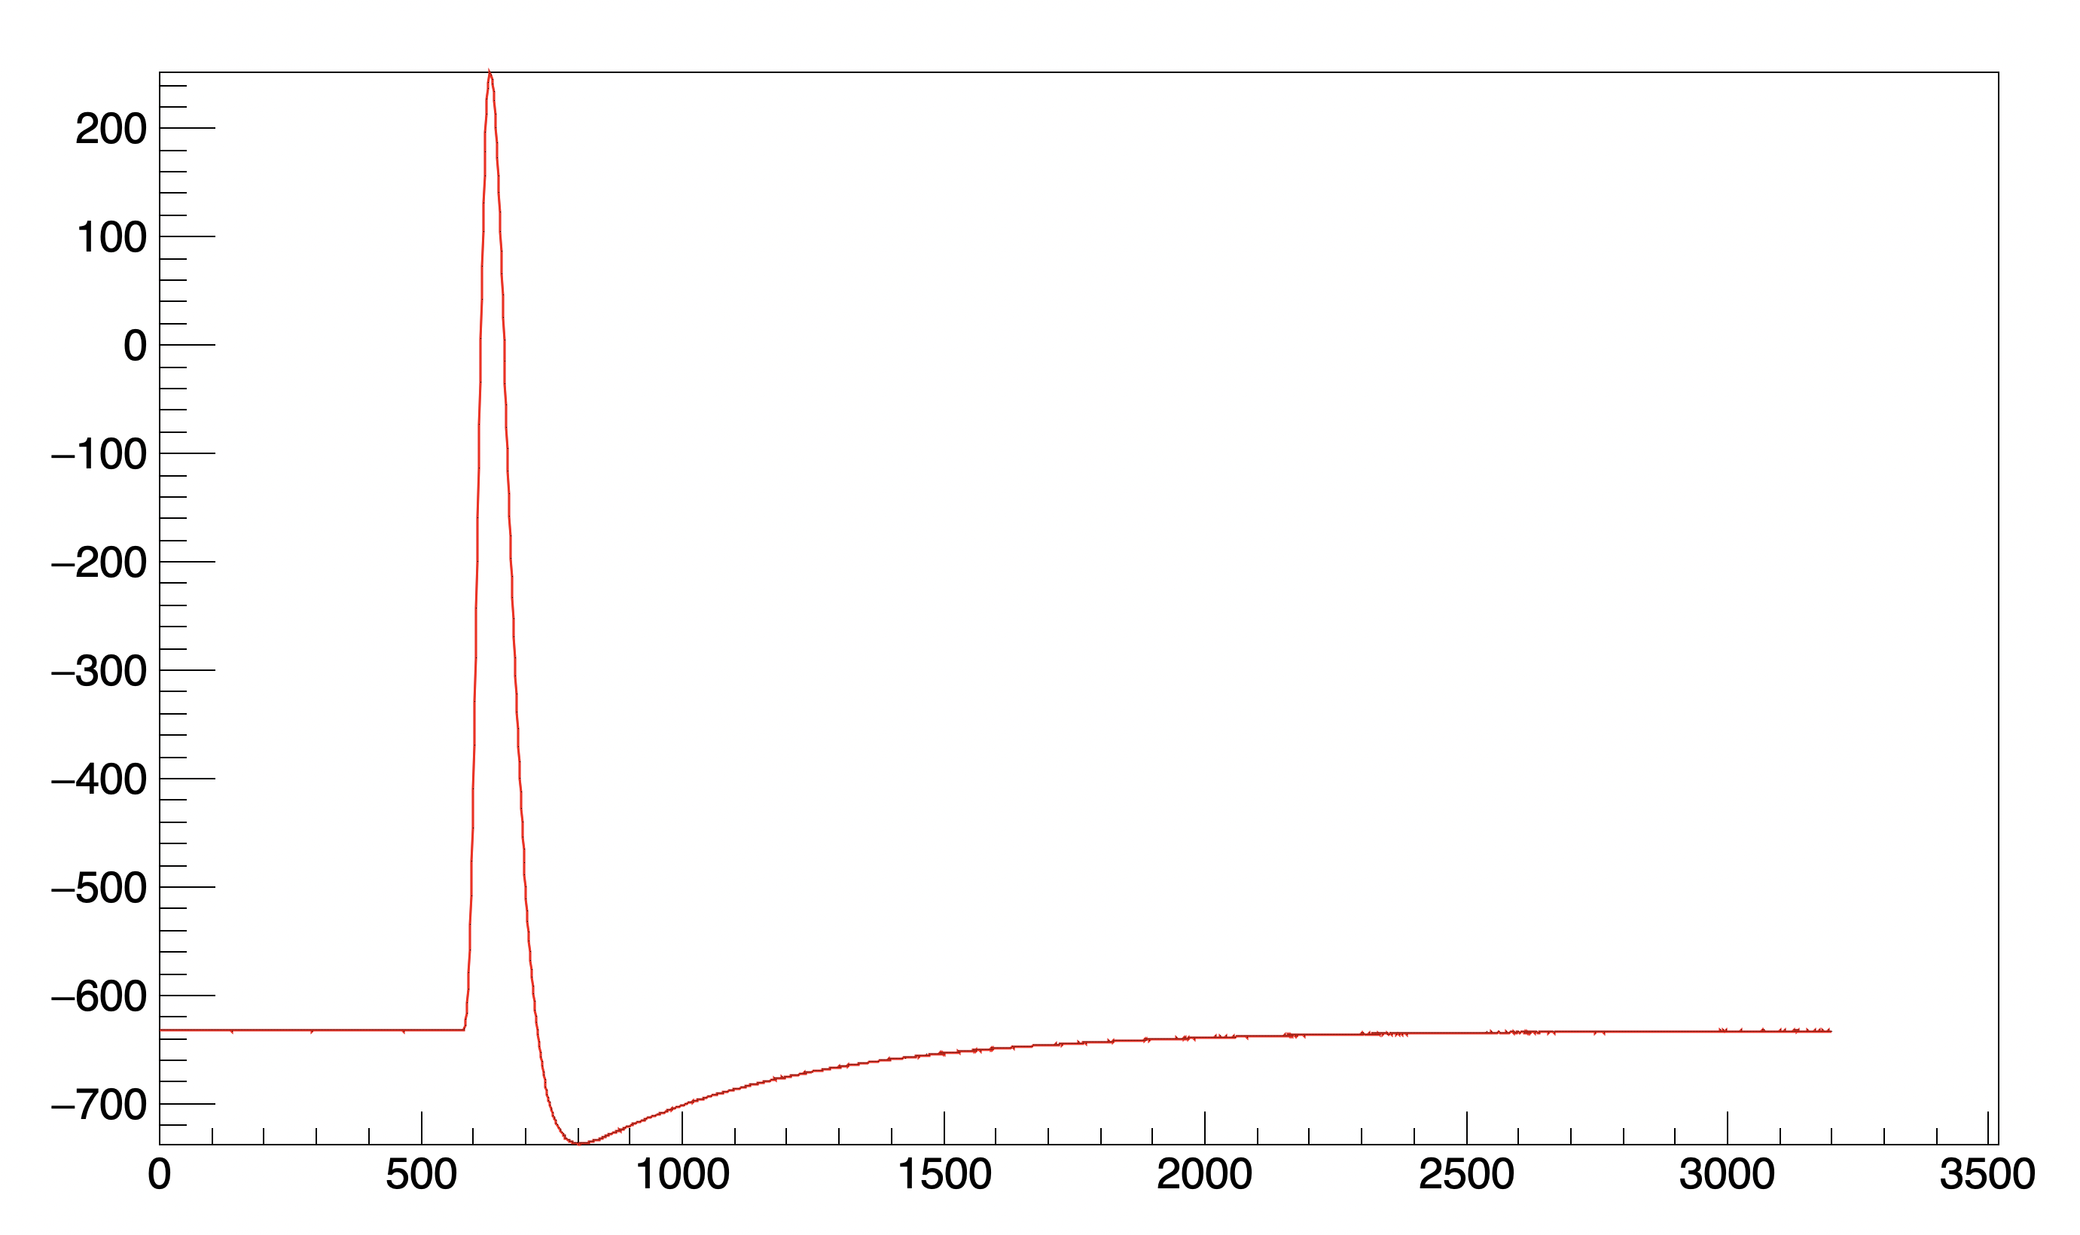
Pulse

Slide 25
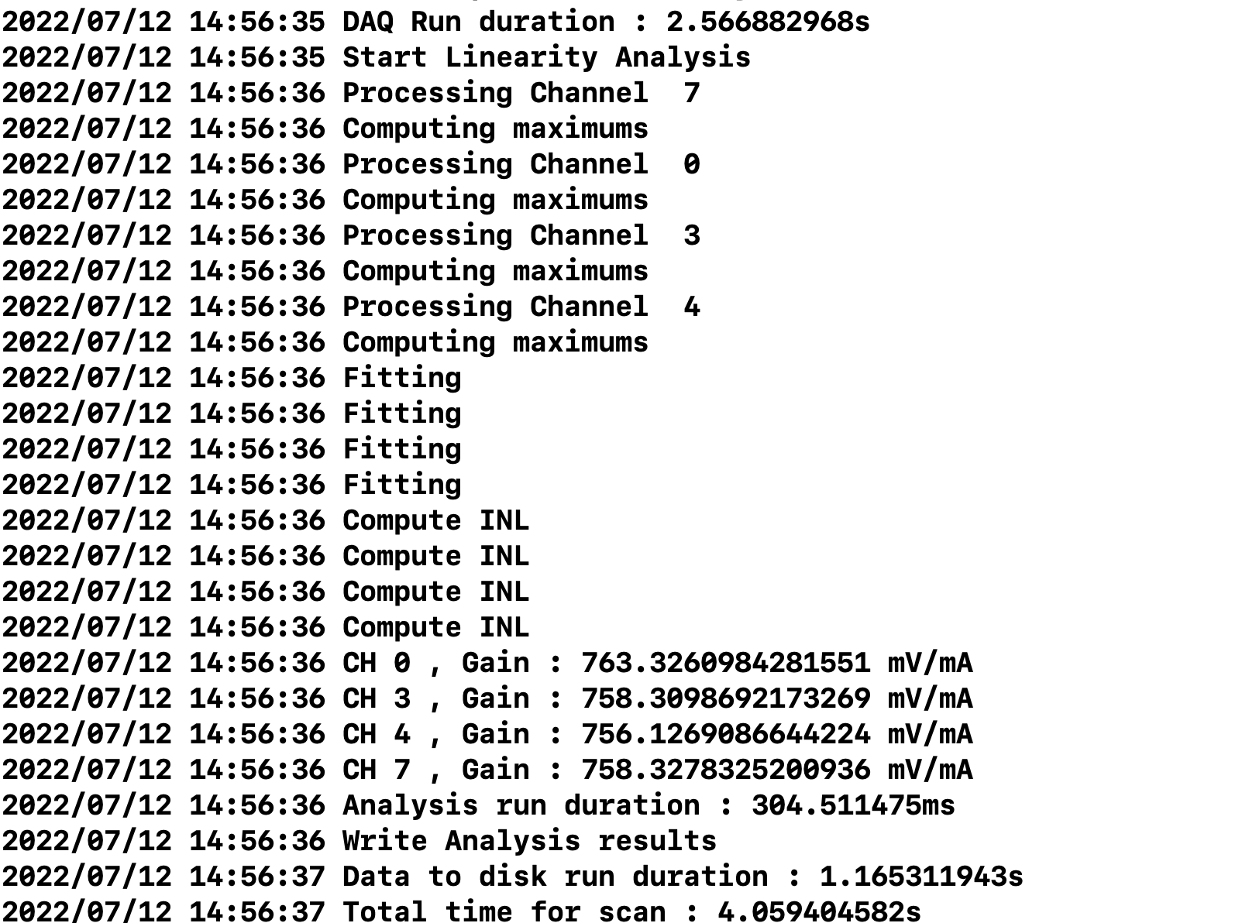
Linearity Scan
Perform a pulse injection and measure pulse using a delay scan for each injection in the range
Extract pulse baseline and amplitude, do linearity fit and extract INL
Write raw data.Analysis results to ROOT file, CSV
Execution time (18 phases, 16 averaging, 18 steps) 4s
  2.5s data acquisition
  300ms analysis
  1.15s to write all data to disk

Slide 26
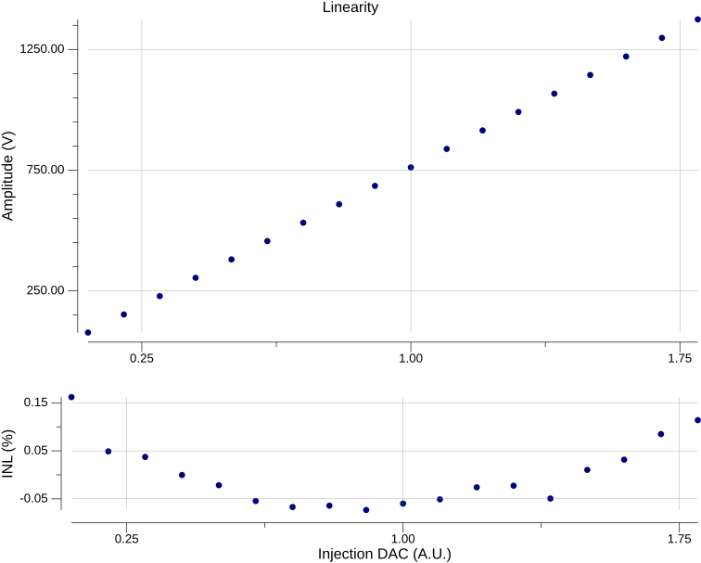

Slide 27
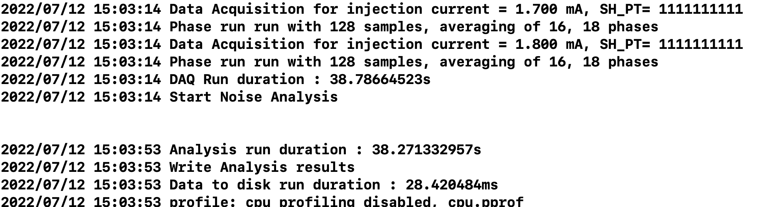
Peaking Time Scan
Perform a pulse injection and measure pulse using a delay scan for each injection in the range , for each register value in range
Extract pulse baseline and amplitude and peaking time
Write raw data.Analysis results to ROOT file, CSV
Execution time (18 phases, 16 averaging, 18 steps, 10 DAC values ) 76s

Slide 28
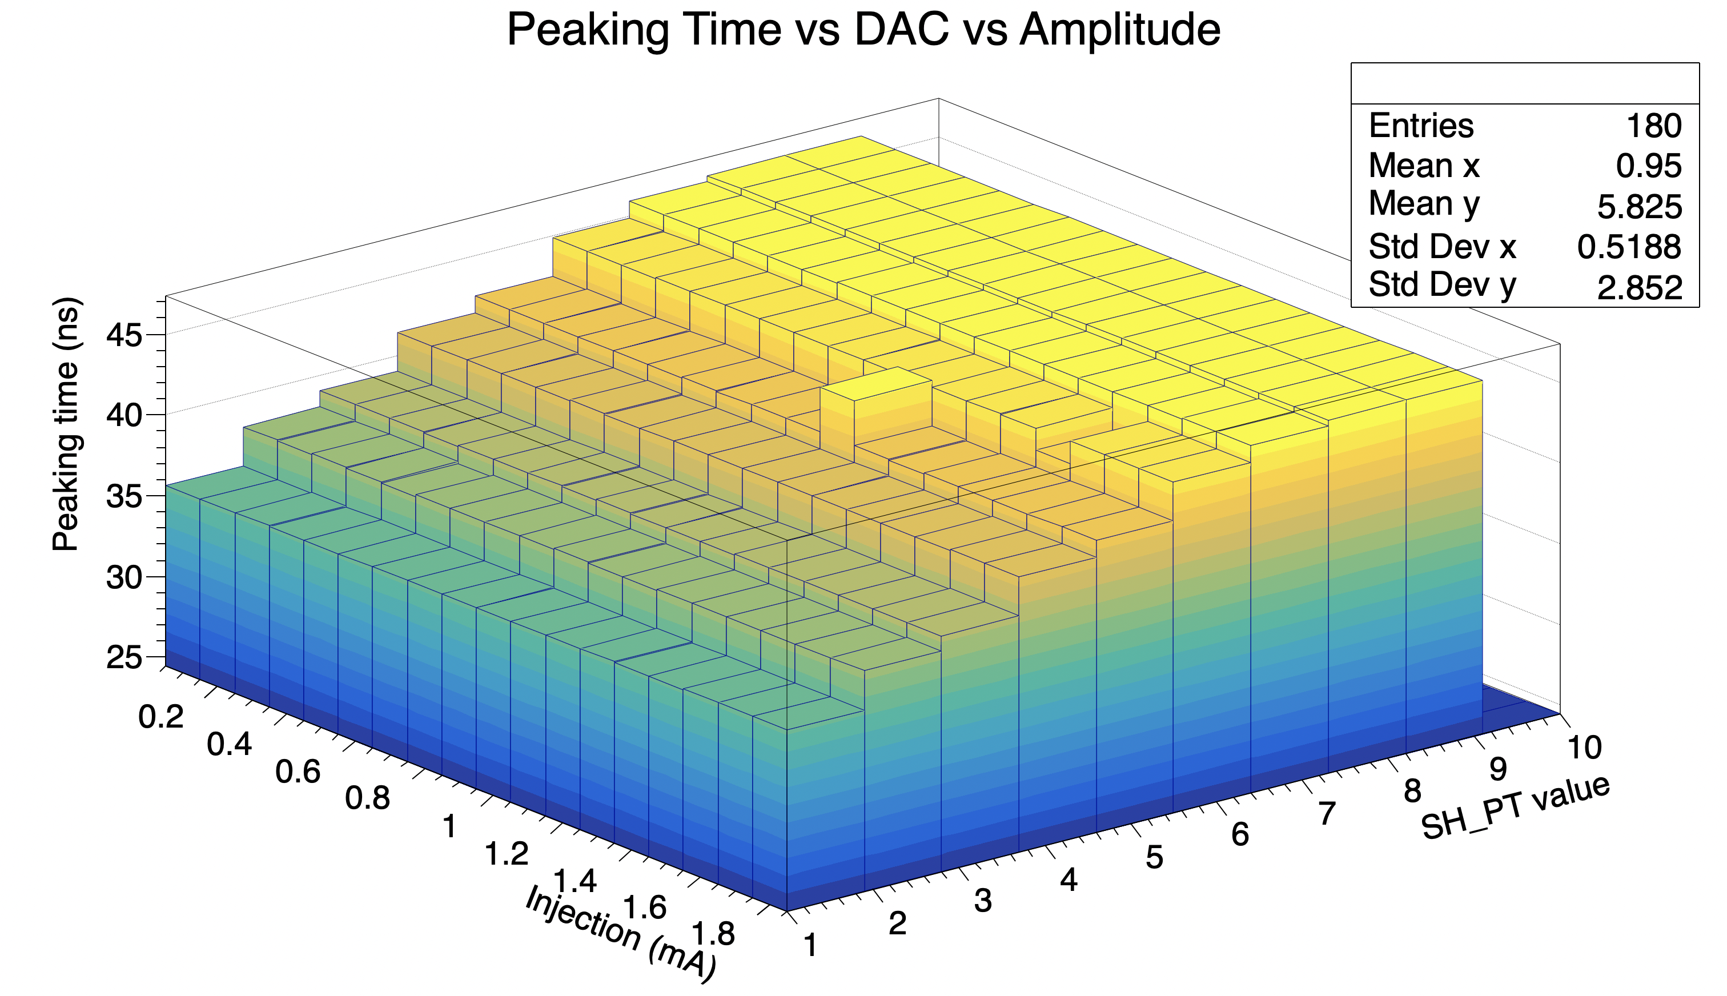

Slide 29

Ressources to learn Go
Basic, interactive online introduction :
https://tour.golang.org/welcome/1
Interesting video that go a bit more in depth :
https://research.swtch.com/gotour
https://vimeo.com/53221560
https://www.youtube.com/watch?v=f6kdp27TYZs
Installing go : https://golang.org/doc/install

Slide 30
Code examples
Various simple wrappers for interfaces such as I2C, SPI, AXI, SCPI memory access, etc.
  https://gitlab.cern.ch/bnl-omega-go
Small tool to configure Si5345
  https://gitlab.cern.ch/bnl-omega-go/si5345tool
Small tool for INA228
  https://gitlab.cern.ch/bnl-omega-go/ina228tool

Slide 31
Outlook
We are proposing to use the current FETBv2 Design as the base for the Caribou 2.0
  The SOM part of schematic+layout can stay the same, is already validated
  Carleton University working on schematics for caribou side, will combine to FETb2 SOM side
Using petalinux-tools for OS generation is probably an improvement on current situation
We can provide ADC IP if we want to integrate it in the Caribou v2.0
Go tools can be used for many applications in the Caribou, in addition to Peary.

Slide 32
backup

Slide 33

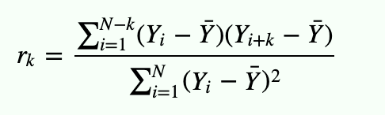
Autocorrelation
In the autocorrelation formula, there is a nested loop that can take a lot of computing time for long waveform.
To make use of all CPU on a machine, we launch a goroutine for each coefficient k, sent the result via a channel, and gather the result to communicate to the writer .
Notice , no mention of mutex, semaphore etc… Here, channel are used to handle concurrency. The Data handle the thread synchronization, instead of thread handling data synchronization in usual languages
https://gitlab.cern.ch/BNL-ATLAS/larphase2/analysistools/gowfanalysis/-/tree/master/autocorrelation

Slide 34

Interfaces
Using the Reader and Writer interfaces, we can implement many different reader and writer, as long as they expect the same bytes in input or output, this way we implement :
TXT reader, get waveform from txt file
Random reader, get random generated signal
Sine Reader, generate a sine signal
CSV reader, read a CSV using standard library
TXT file writer
CSV writer (using standard library)
Cipher writer (encrypting data ! )
PlotWriter , sending data to a plot in PNG

Slide 35
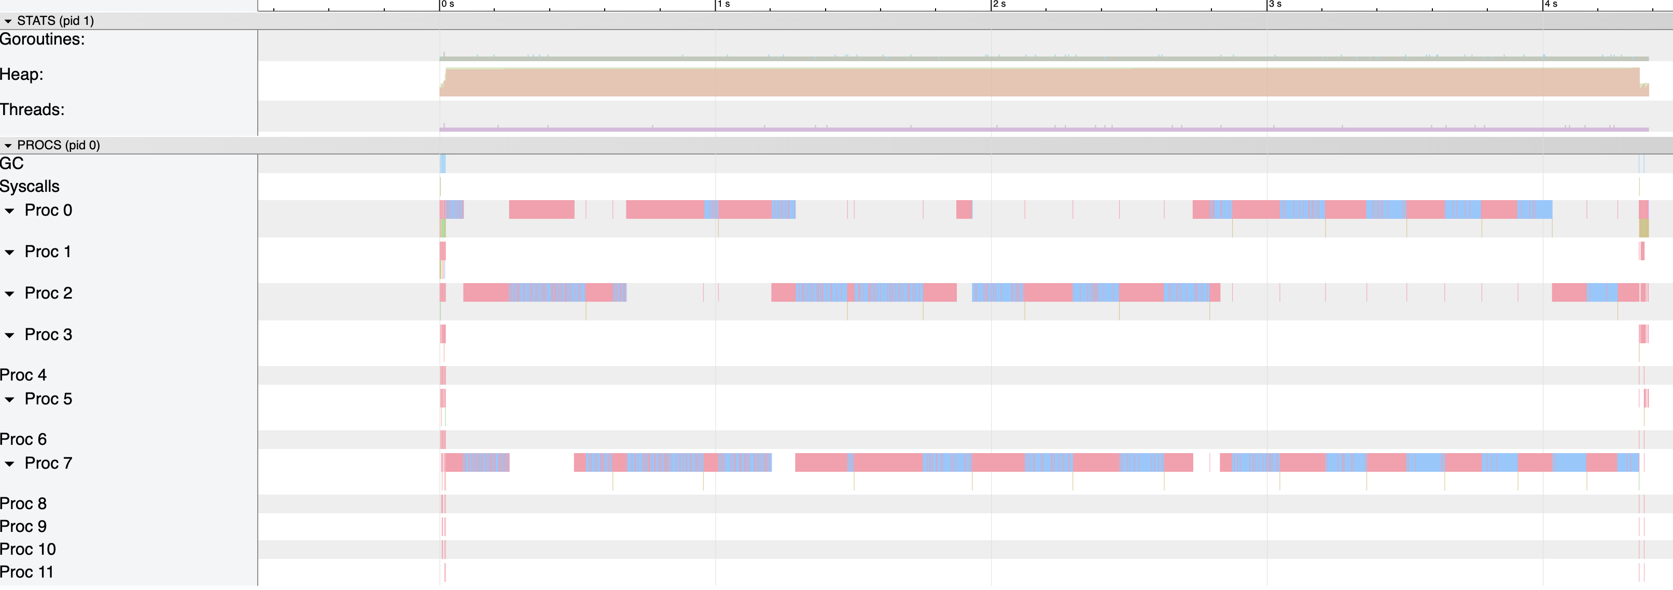
Trace in single thread mode

Slide 36
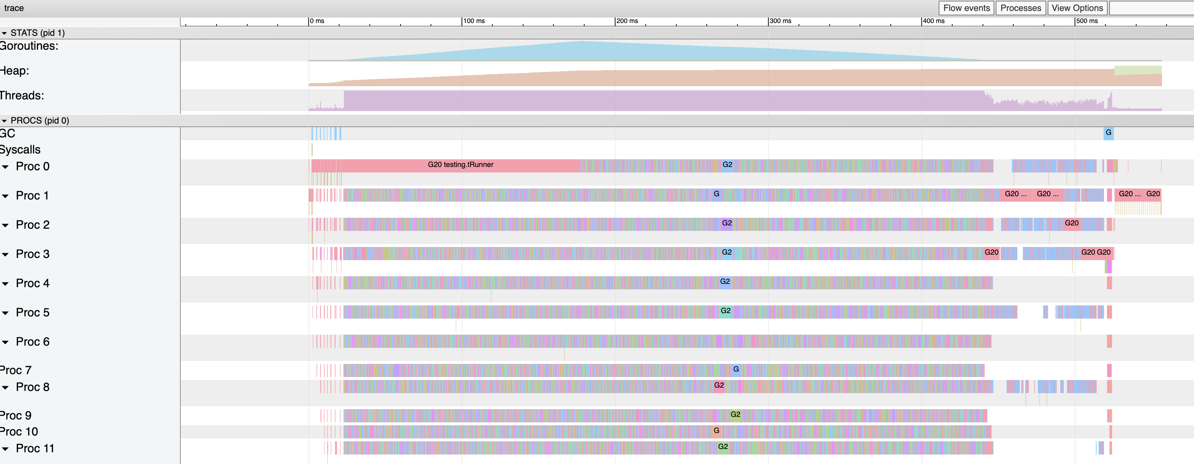
Trace in multithreaded mode

Slide 37
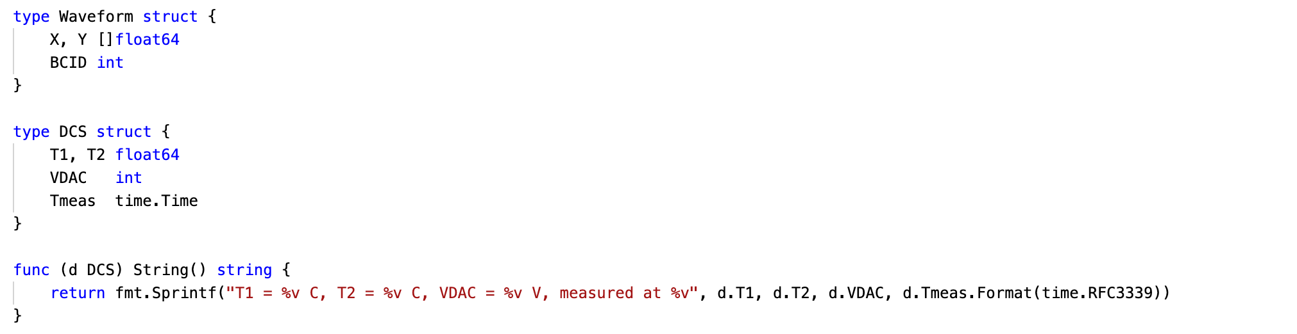
Data struct for IO

Slide 38
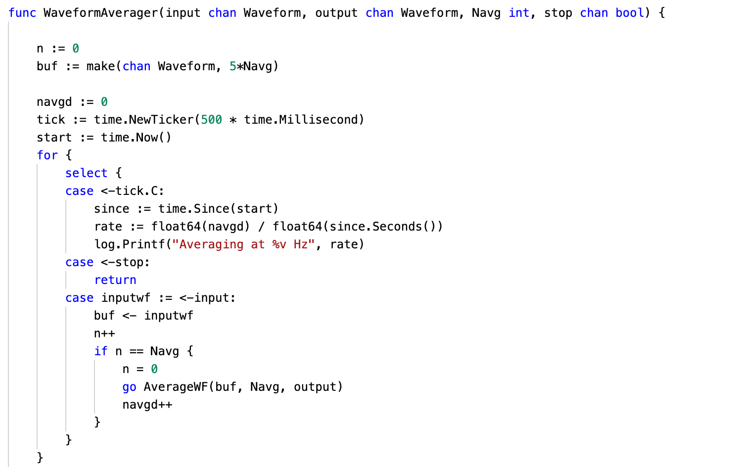
Averaging on all CPU efficiently
Tick generate an event on a channel tick.C every 500 ms
Display rate every 500ms
If we have put enough waveform in the buffer, launch an Average goroutine to digest it

Slide 39
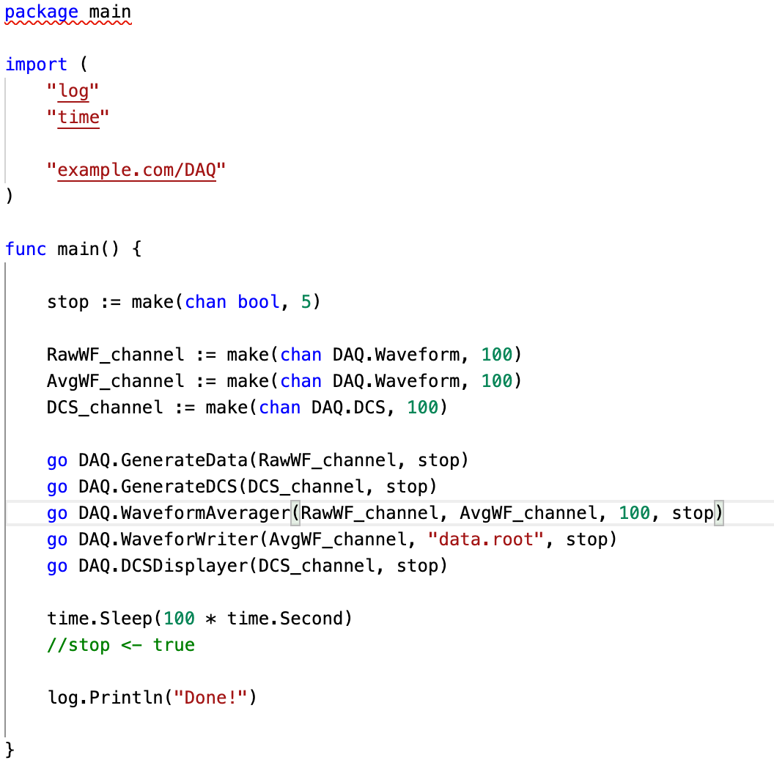
Assembling the code
Channels with buffers with depth 100
Go routines for each steps

Slide 40
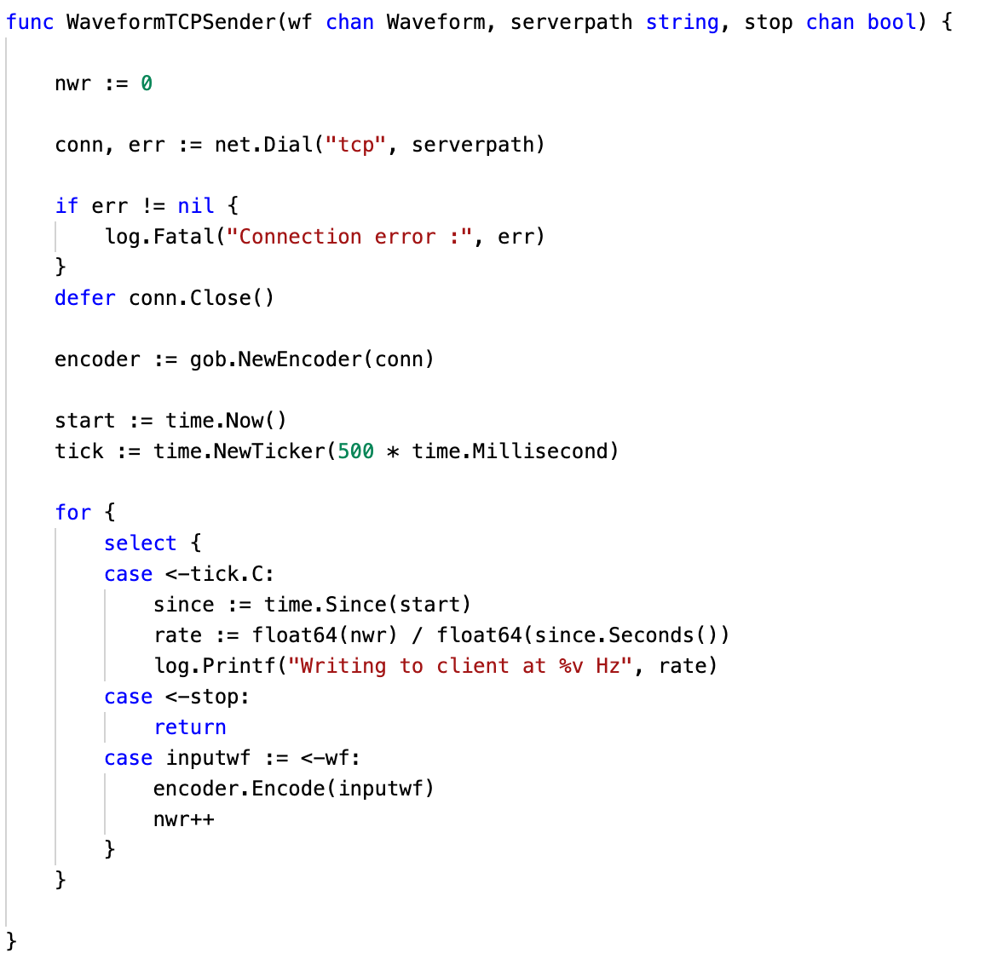
Sending struct over network

Slide 41
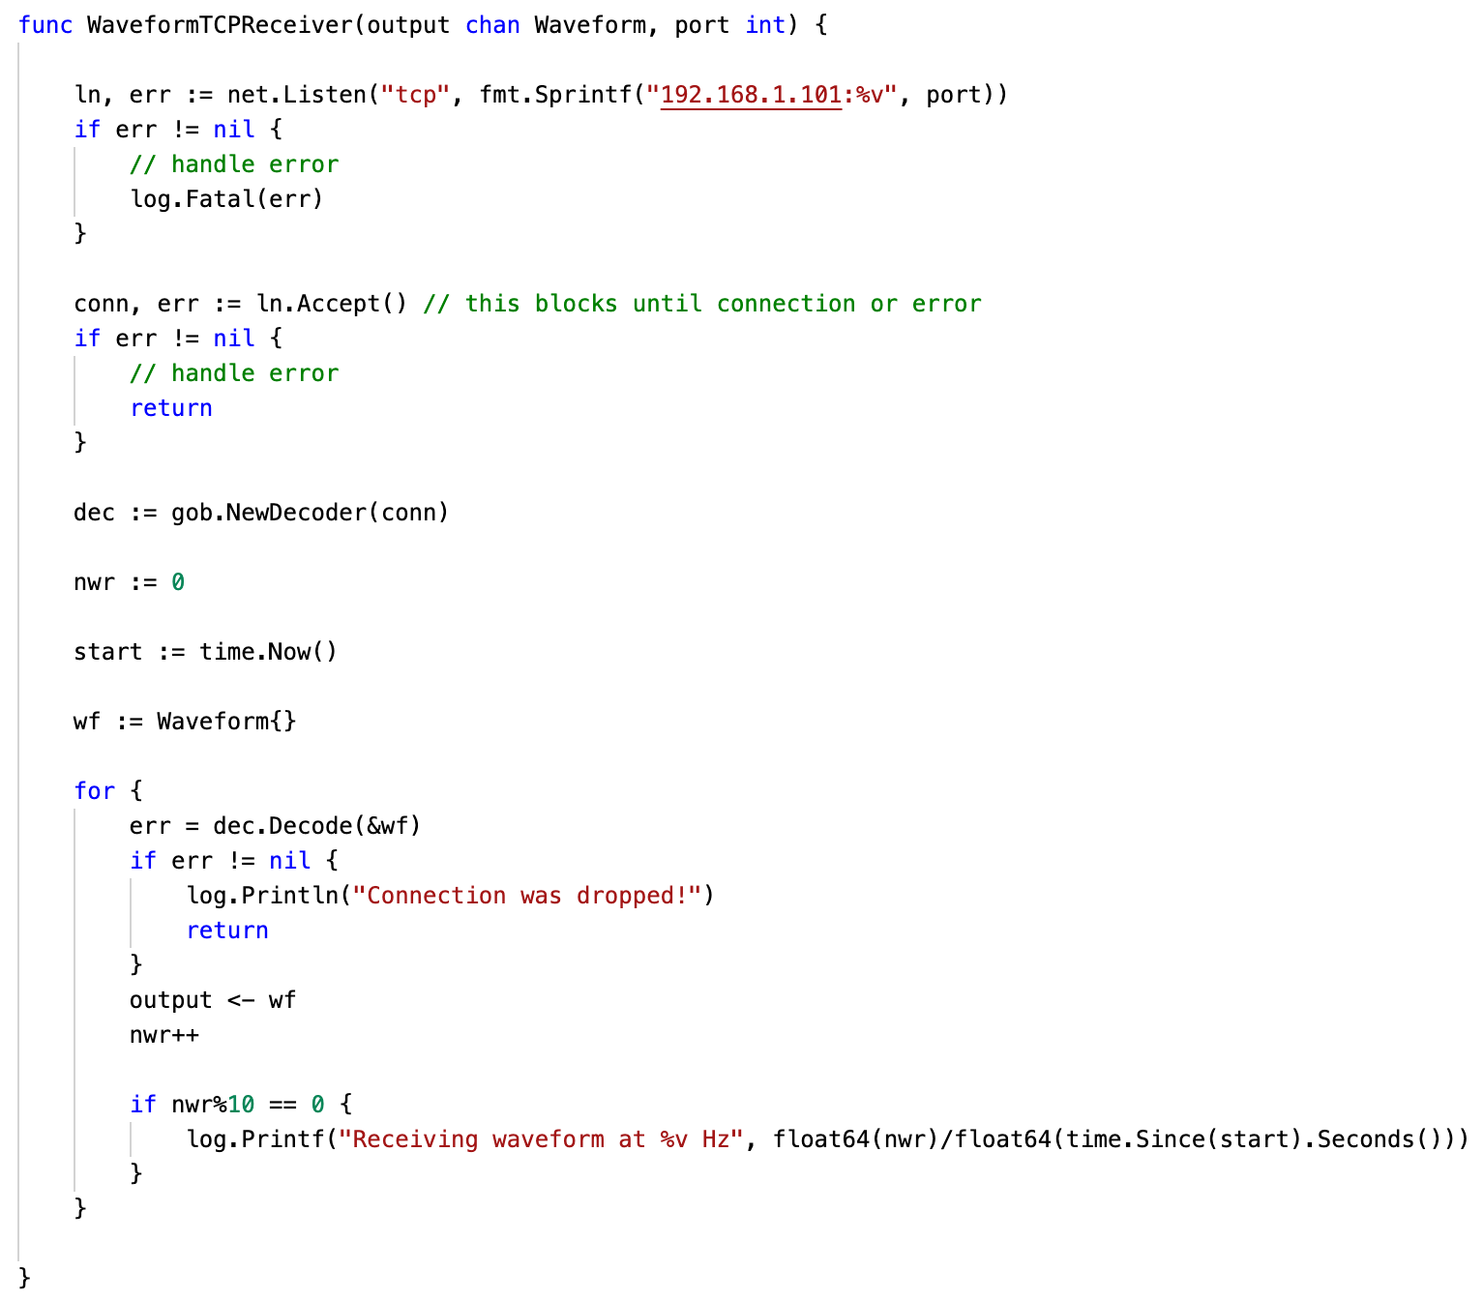
Receiving struct over network

Slide 42
Writing to ROOT file

Slide 43

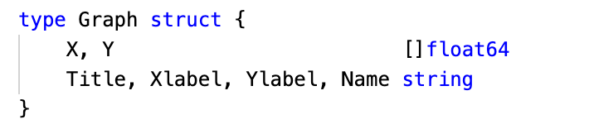
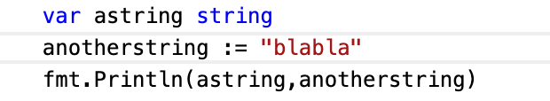
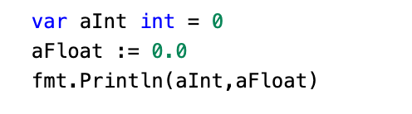
Go concepts type and variables
Basic types are similar to other languages :
  int, float, bool, string, byte (uint8), rune (uint32), complex
Composite types are also provided
  Struct, slice (array), map, channel, error
Types always have a default value
  0 for int, 0.0 for float, nil for composite objects like error
Variable can be instantiated explicitly or implicitly

Slide 44

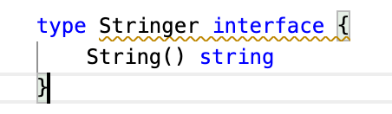
Types interface and functions
In go, any types can be attributed functions, some special functions, called Interfaces, define specific type of behavior for your type , for example the Stringer Interface :
In go, any type that implement the function String() that return a string, implements the stringer interface , which is itself a special kind of type.
Interfaces are an extremely simple, yet extremely powerful concept in go

Slide 45
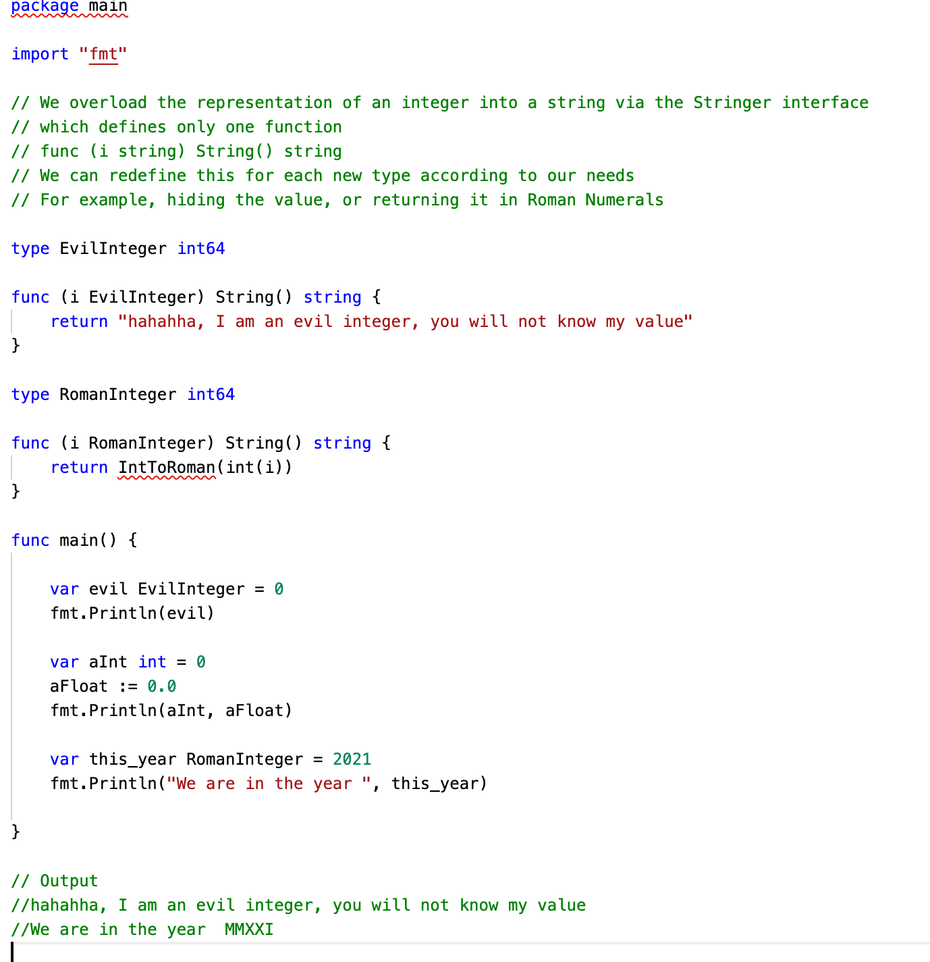

Example
Here fmt.Println expect interfaces

Slide 46

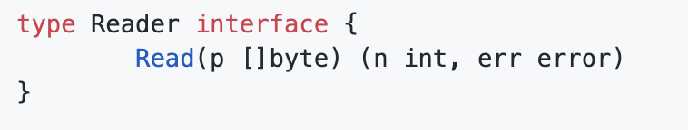
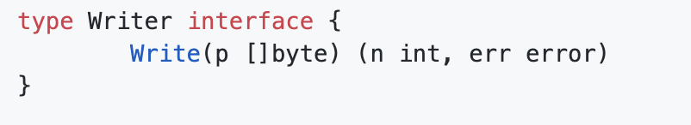
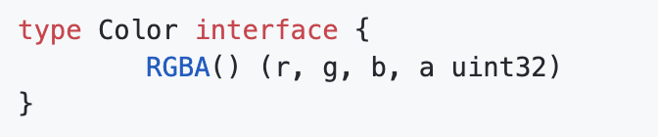
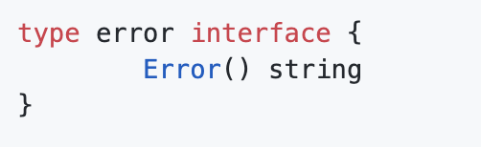
Other common interfaces
Something that read n bytes into p
Something that write p
Something that has a color
A type of error that occured
https://gist.github.com/asukakenji/ac8a05644a2e98f1d5ea8c299541fce9

Slide 47
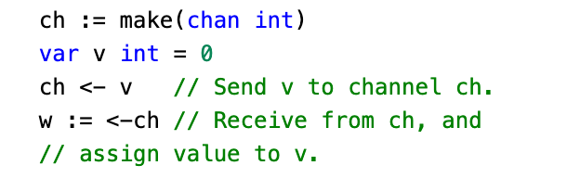
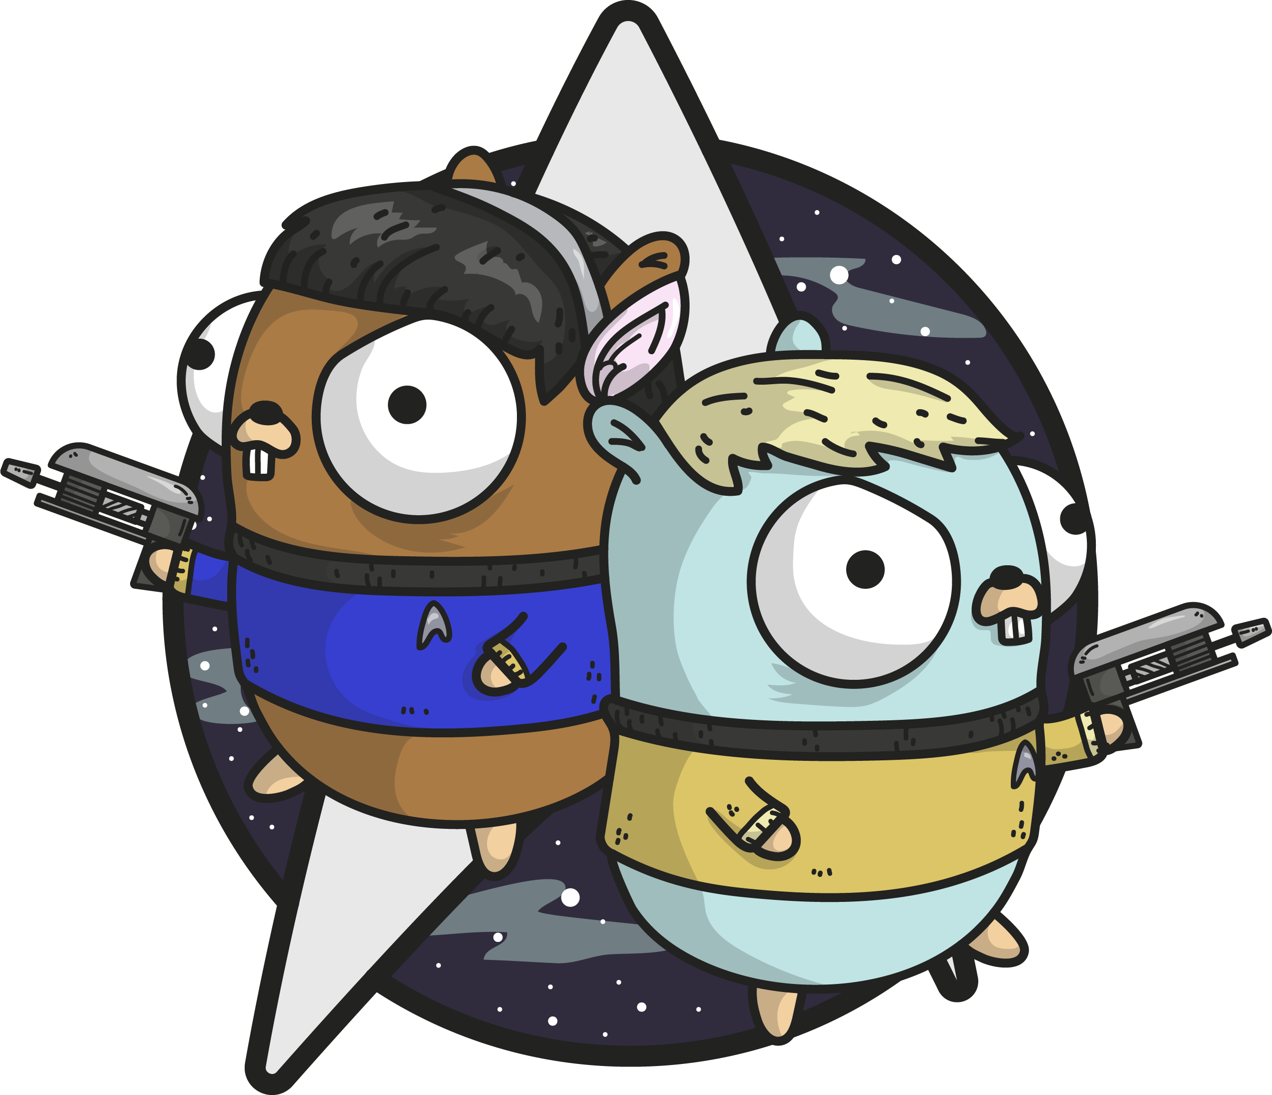
Channels
Channels are a typed conduit through which you can send and receive values with the channel operator, <-
Reading from a channel is a blocking operation, the process will stop until data is available on the channel
Channels can be passed to functions, and returned by them

Slide 48
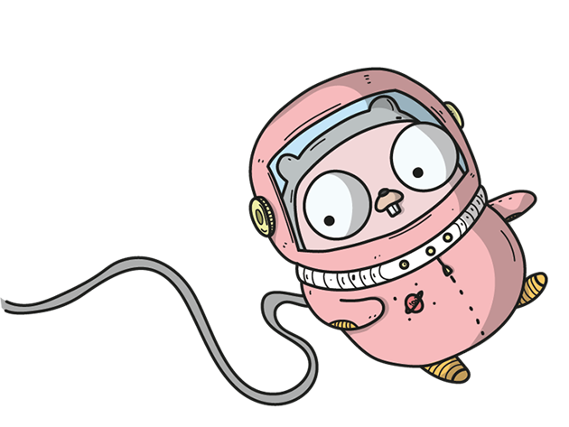
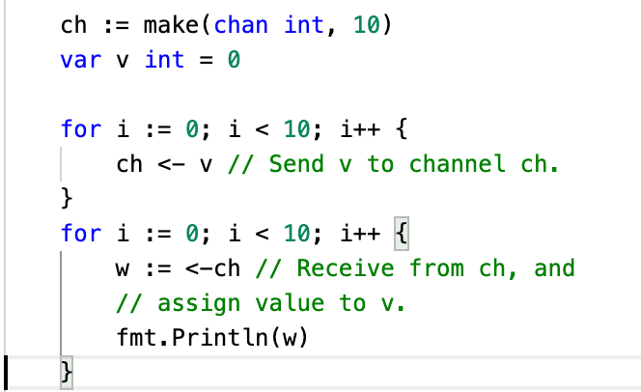
Channels
Channels can also be buffered :
Channels are a key concept to implement concurrency and parallelism in go

Slide 49
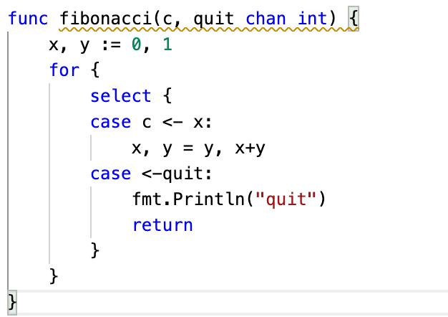

Select statements
A select statement is used to have the current process wait for communication operation from channels :
The process wait until of of the channel send data, if multiple have data, the execution is random

Slide 50

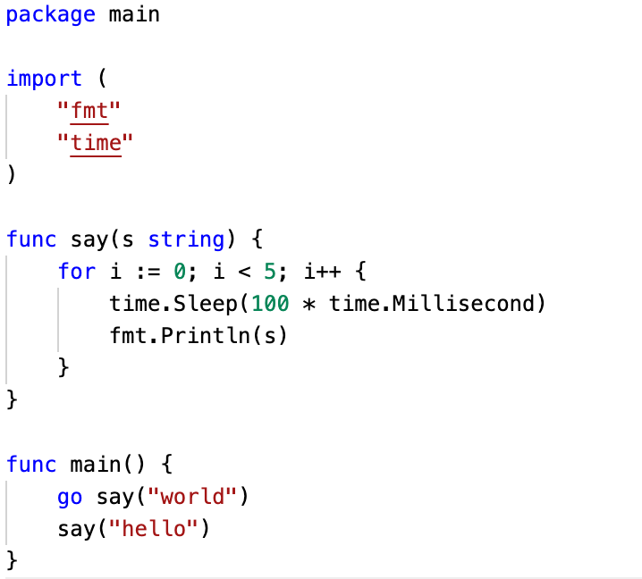
Goroutines
The final building block of golang are goroutines. A Goroutine is a light-weight thread that is managed by go at runtime

